Slide 1
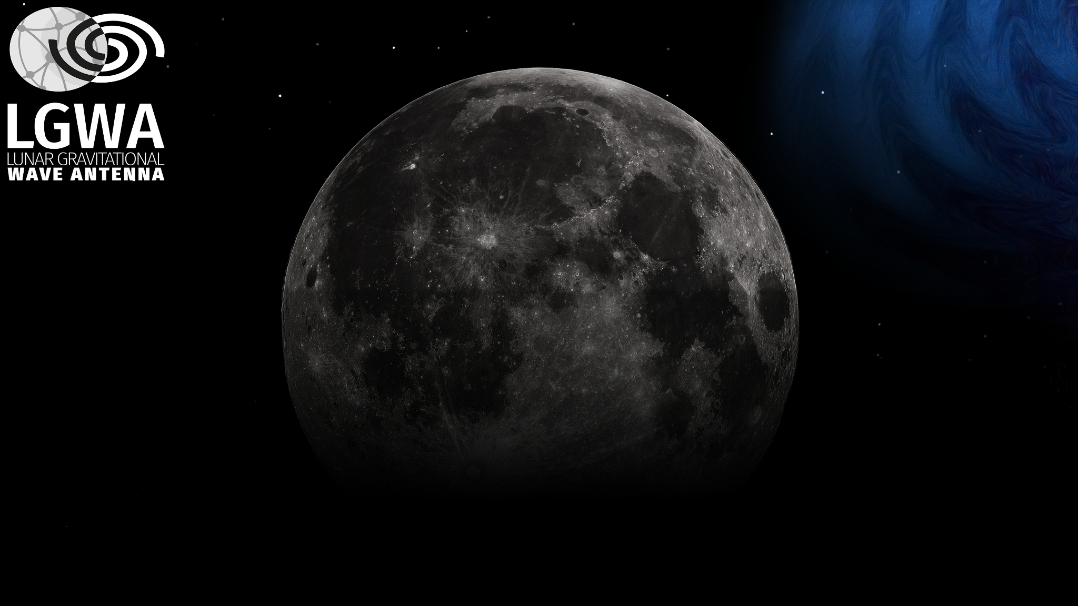
Status of the Project
Jan Harms
Gran Sasso Science Institute
INFN - LNGS

Slide 2
What has happened since San Benedetto?
Signing of an agreement between ASI and GSSI, and formation of Italian Consortium with Uni Camerino, INAF, INFN, INGV
(LGWA preparatory studies 2025 – 2027)
Definition of key deliverables on the development of analysis pipelines, calibration, simulation,…
Inclusion of the science ground segment in the project planning
Several key publications on LGWA (payload, science case, lunar GW response, seismic background mitigation, GW data analysis)
Minor (<10%) growth in the number of collaboration members
2nd Sino-European meeting on lunar GW detection in Dunhuang

Slide 3
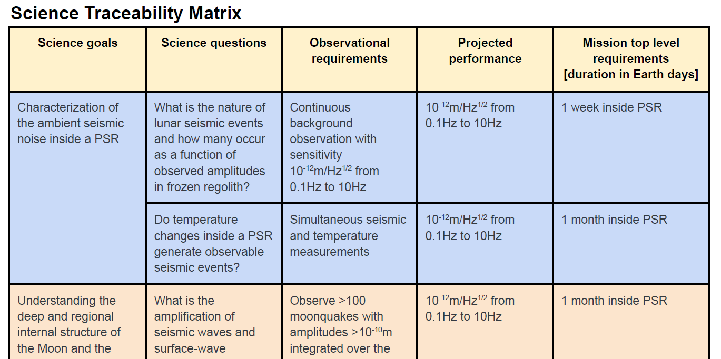
Submissions on Behalf of the LGWA Collaboration
LGWA Soundcheck submitted to NASA’s Lunar Science and Technology Payloads for Expanded Lunar Landing Opportunities - RFI
LGWA Soundcheck submitted to ESA’s Lunar Science Building Blocks: An Announcement of Opportunity for Scientific Instruments for Moon Exploration
Discussion on STM on Thursday

Slide 4
Deliverables 2030
We set ourselves a deadline for Soundcheck analysis pipeline and calibration procedures together with a list of deliverables.
WG1 (GW + MM)
WG2 (lunar + site)
Autonomous and multiband GW signal calibration pipelines
Mock Soundcheck data
Search pipelines for low-high mass CBCs (WD/WD + IMBBH)
Data analysis and GW Multiband analysis pipelines with Soundcheck and terrestrial detectors (including pre-alerting pipelines)
Synthetic catalogs from simulations, population analyses, event occurrence rates, and emission modeling.
Multimessenger analysis pipelines
Ground Segment
Numerical model (mesh generation, seismic forward modelling, geological model, regolith model, scattering regime modelling)
Geodynamic model
Evaluation of seismic noise
Evaluation of best array layout
Simulation of thermal deformations and thermal seismic events
Tidally induced ground tilt
Assessment of impact of human activity
Landing site regolith modelling, seismometer ground coupling, analog experiment, array testing

Slide 5

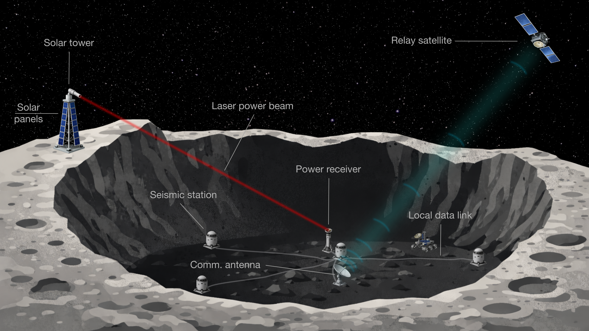
New: Outreach and Communications Team
Coordinator: Ferdinando Patat (ESO)
Magazine articles
Wikipedia article
Presentations to public and audiences outside the field
Outreach and presentation material
Communication

Slide 6
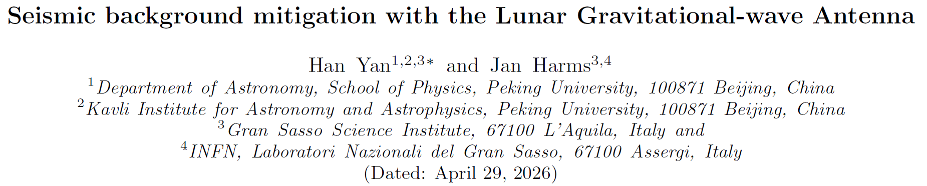
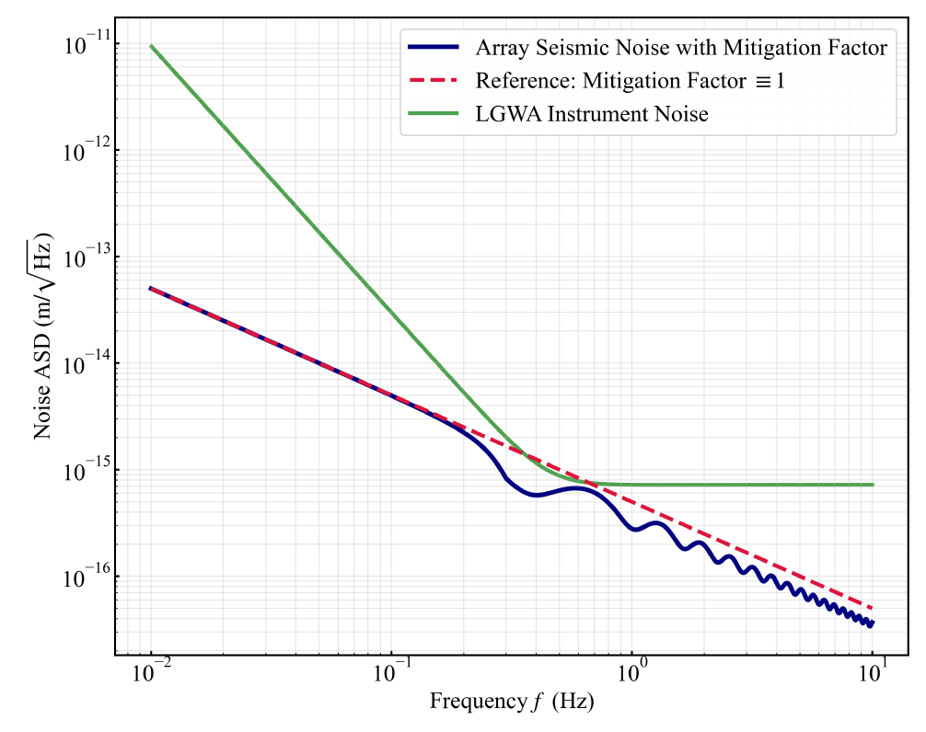
A first study of the seismic background reduction through optimal array processing is under review
Considering two stations, the average mitigation of an isotropic seismic background was calculated.
Up to a factor 2.3 reduction can be achieved on average depending on frequency and distance between the two stations.
Case study: only two seismic stations

Slide 7
GW Science and Data Analysis
Modeling of extragalactic DWD populations and their detectability
(see talk by Giovanni Benetti)
GW231123: a multiband case study
(see talk by Francesco Iacovelli)
Black hole merger rates for LISA and LGWA
(Jasbir Singh)
Calibration of the Lunar Response and Gravitational-Wave Tomography of the Moon
(see talk by Han Yan)
Motion effects on parameter estimation with LGWA
(Jacopo Tissino)

Slide 8
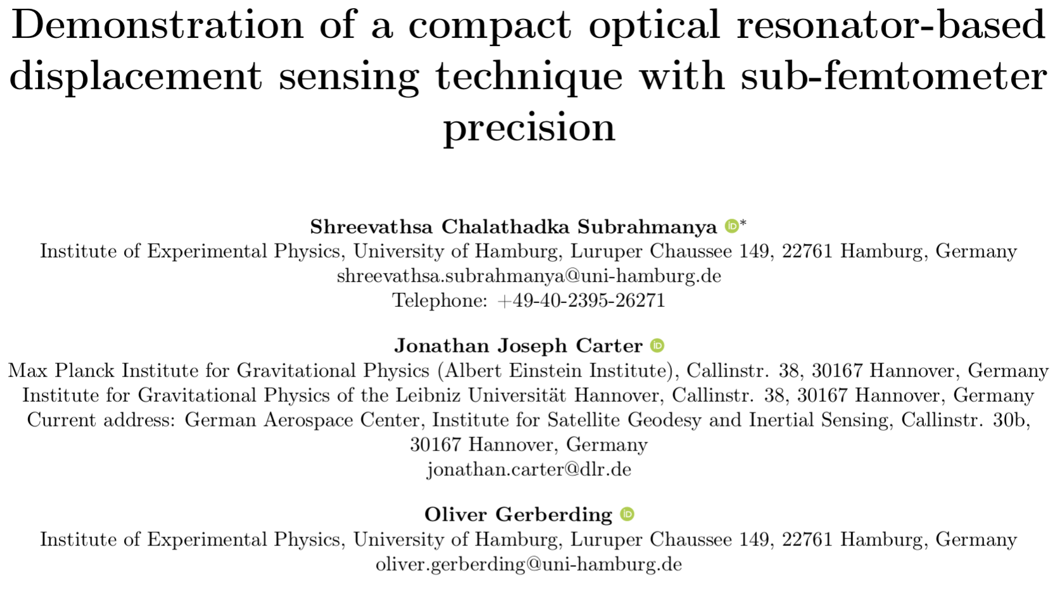
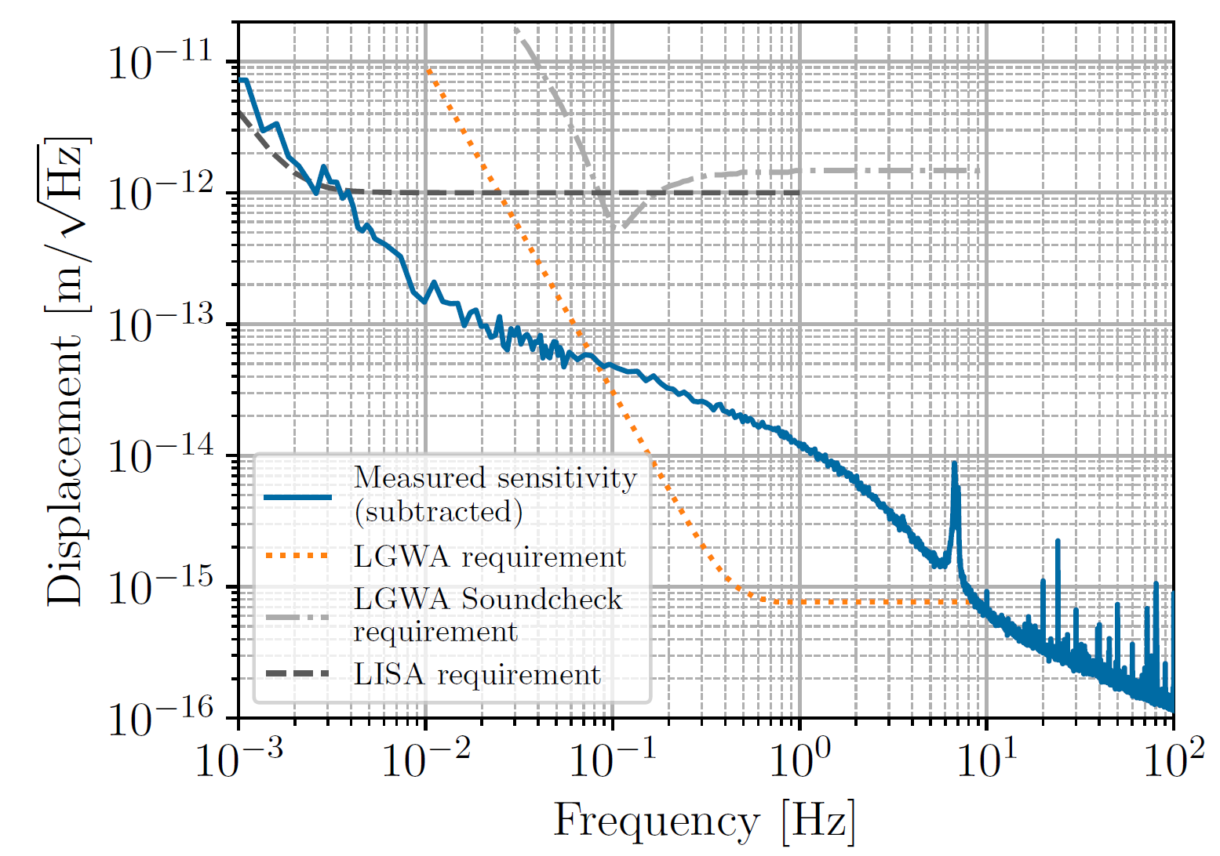
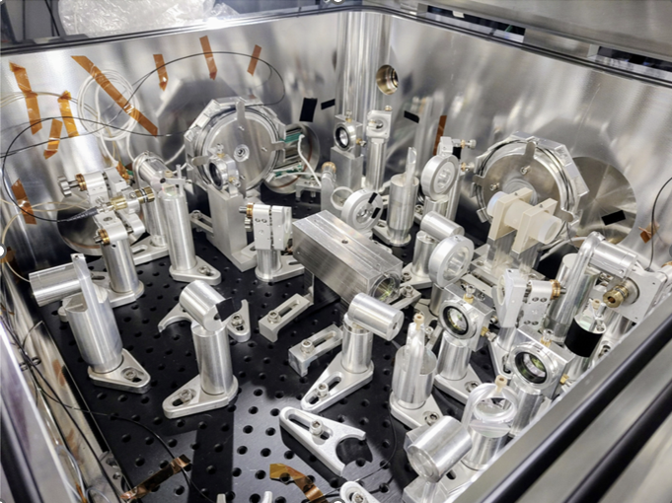
Quantum-limited Sensing
Compact laser interferometer (heterodyne cavity tracking): University of Hamburg

Slide 9
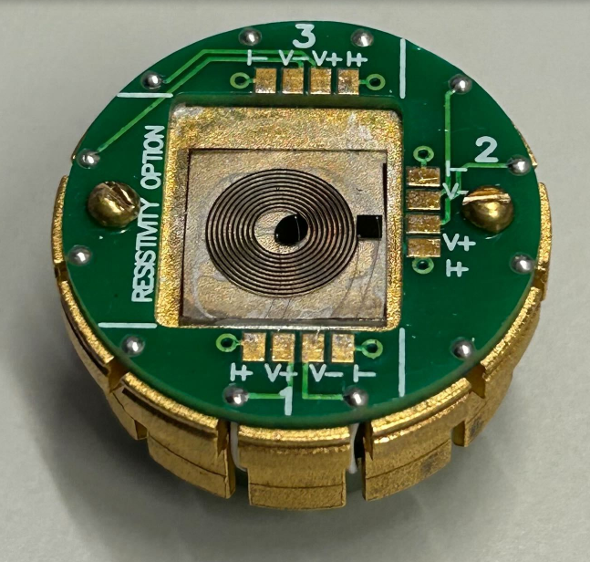
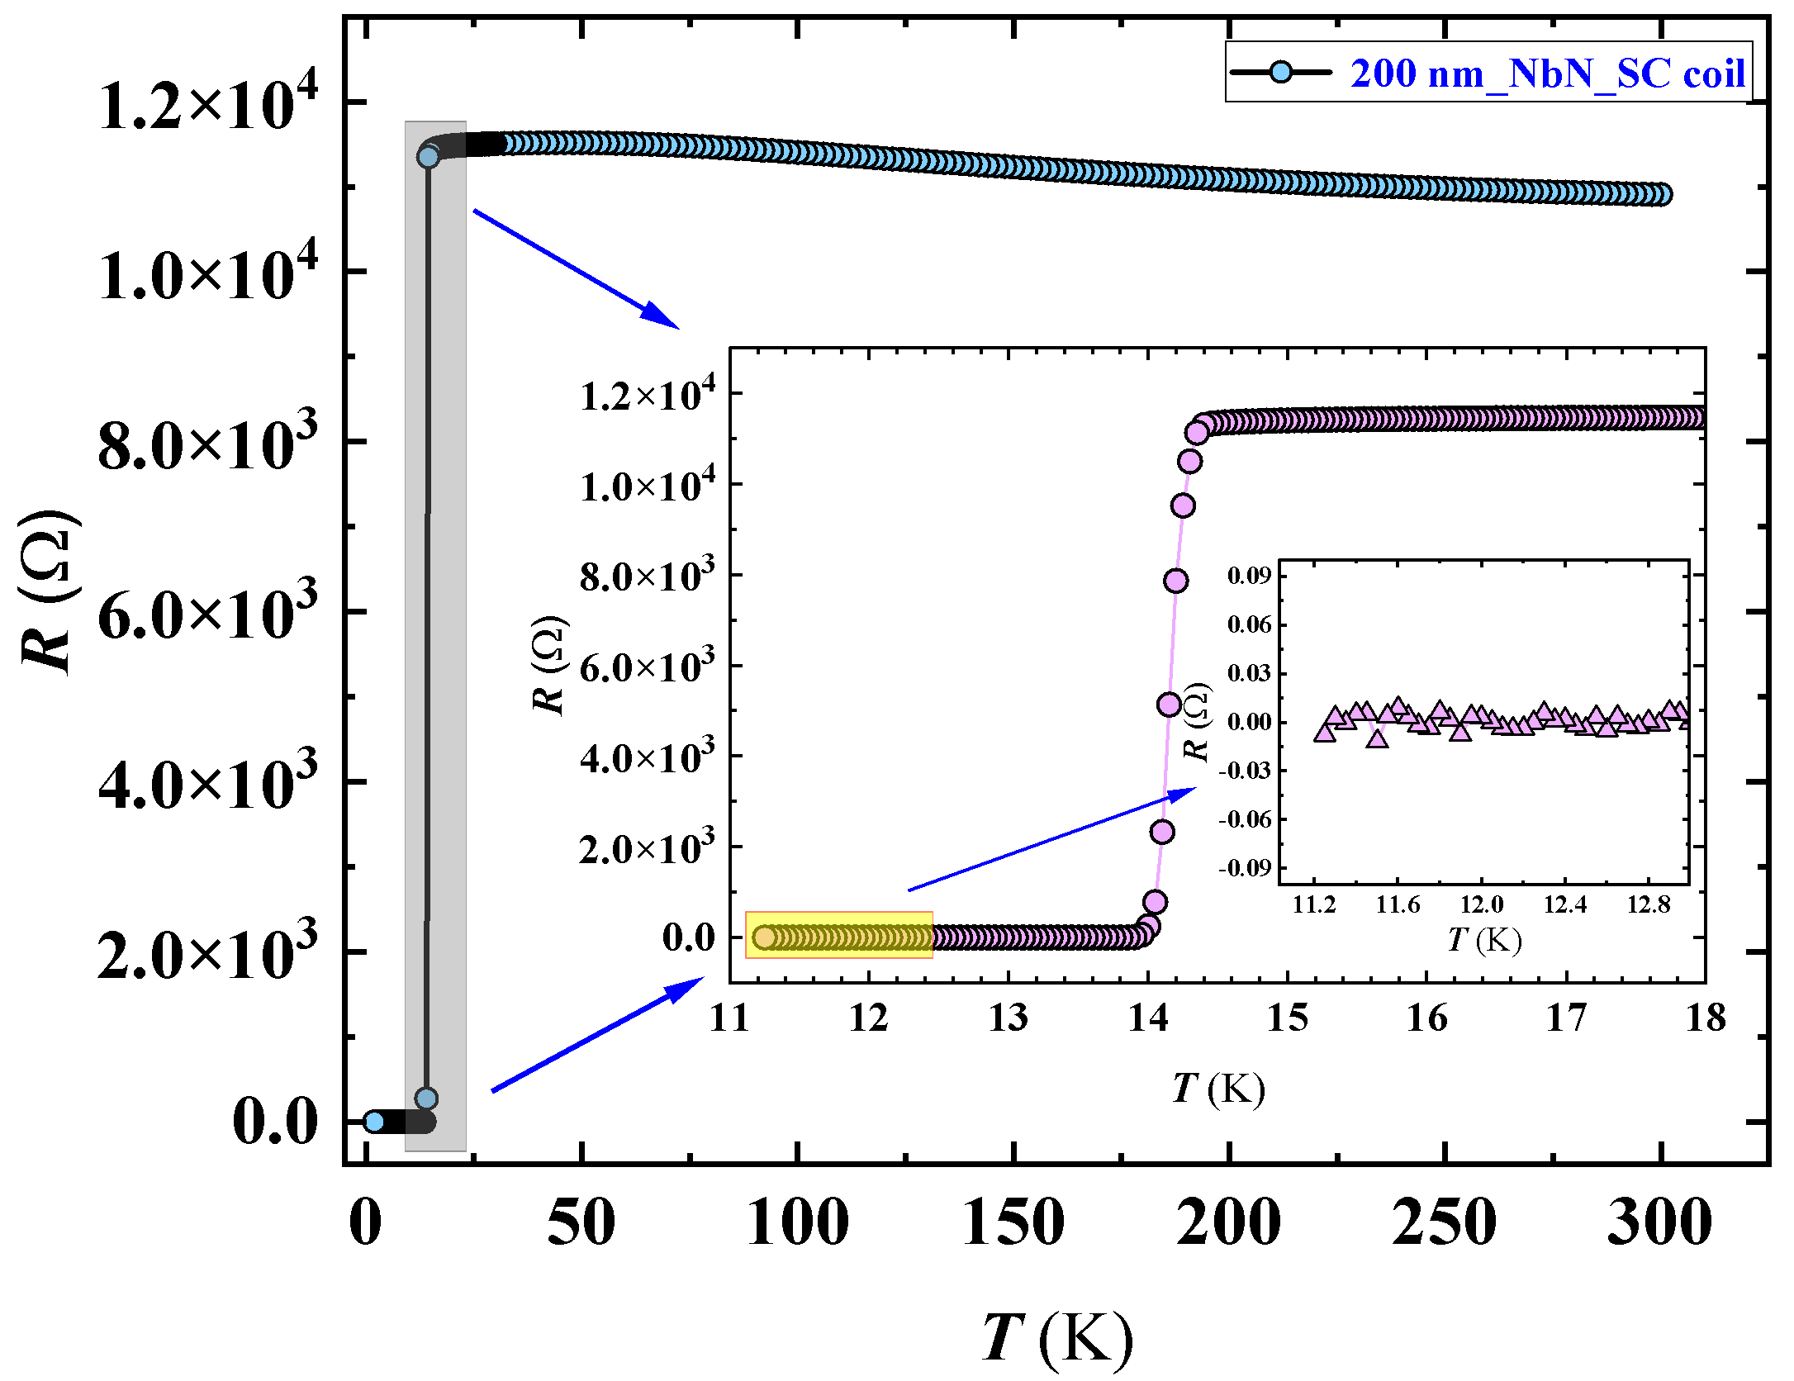
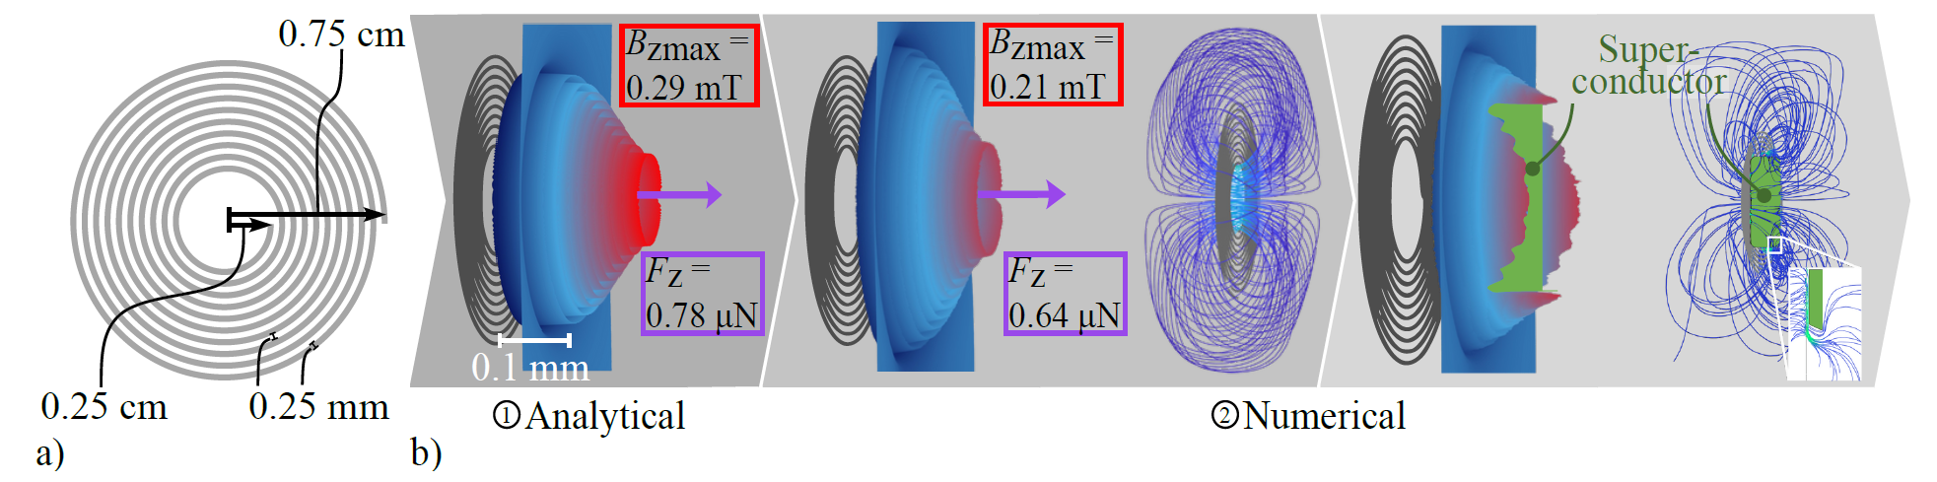
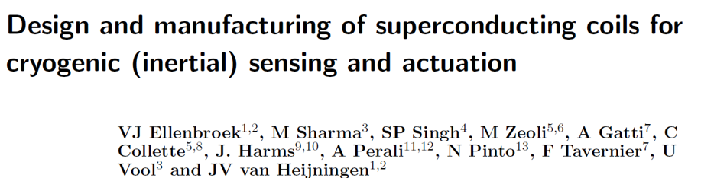
Superconducting Actuators
Superconducting coils:
Uni Camerino, MPG CPFS, NPL New Delhi, VU Amsterdam
Goal: >60K superconducting actuator coils
Update on Wednesday
Update on Wednesday
Sharma et al

Slide 10
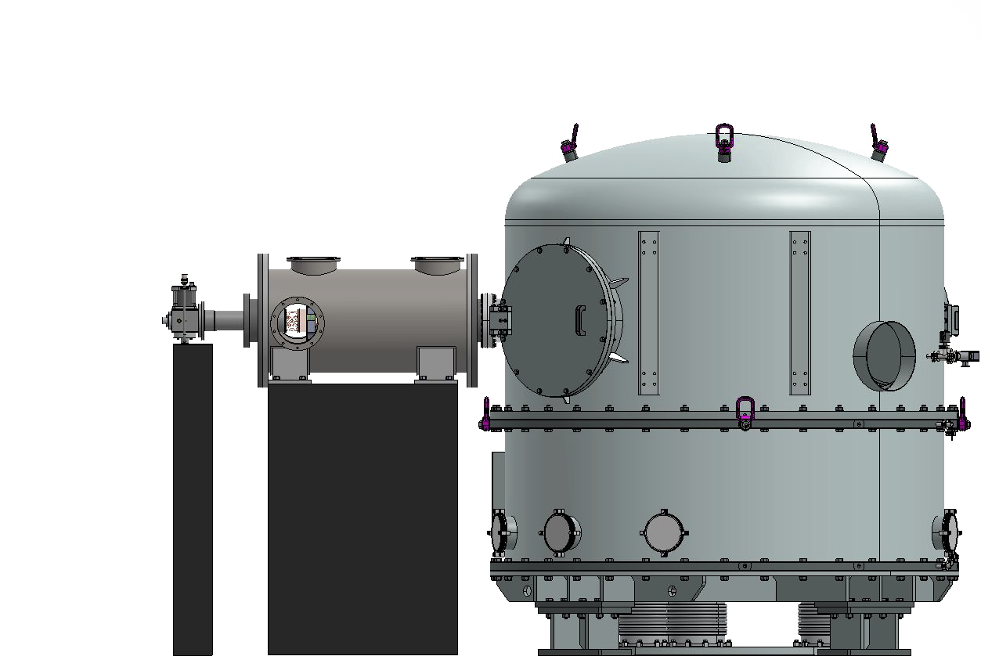
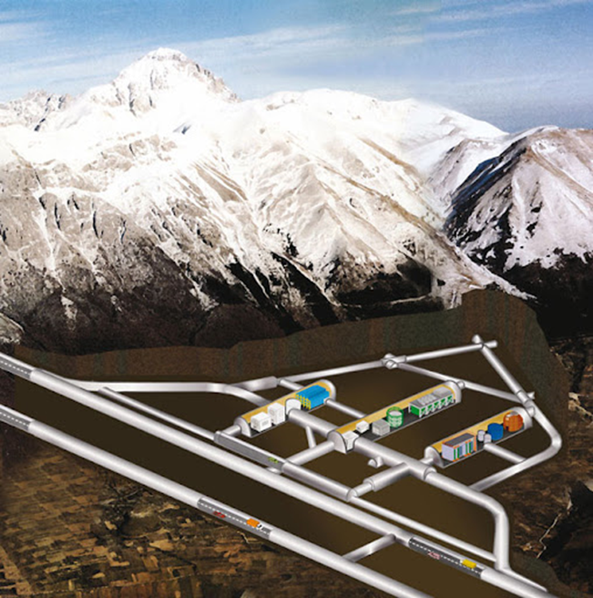

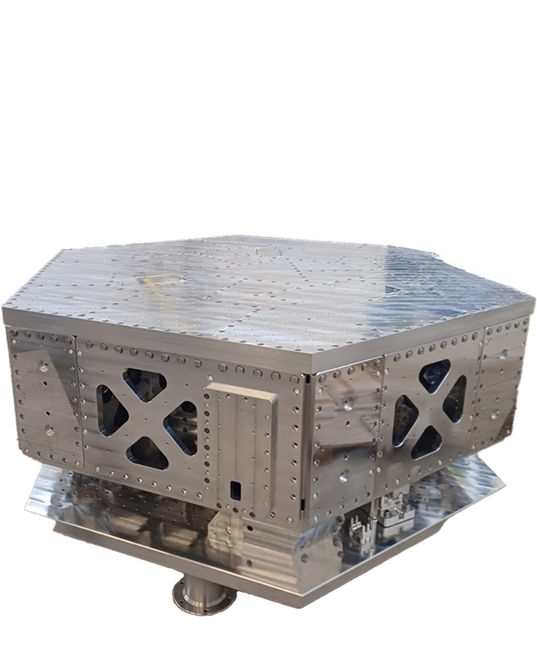
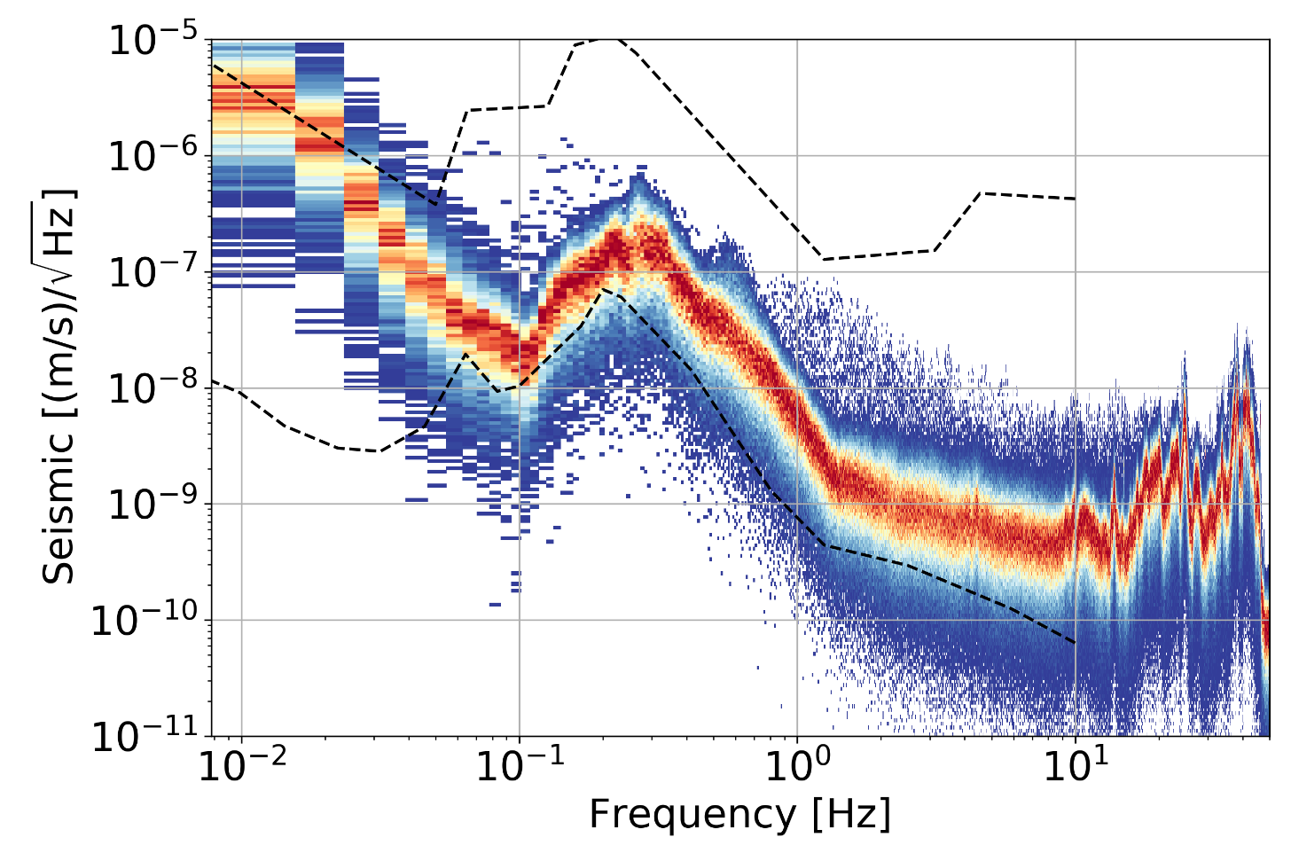
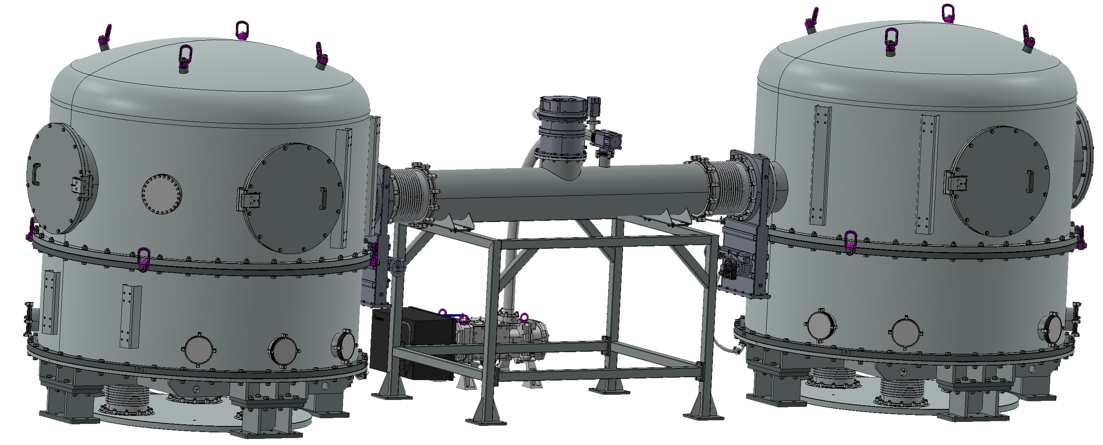
LGWA Test Facility
GEMINI site is 1.4km underground
The Moon Emulator provides a 40K and seismically stabilized environment for LGWA payload tests.
Tests at the surface planned to start in 2027.
Moon Emulator
Seismic spectrum at LNGS
GEMINI
See talk on Wednesday

Slide 11
Conceivable Timeline
Soundcheck deployment
LGWA deployment
ASI funding
LGWA technologies at TRL6
Chang’e 7
LISA mission
Extended lifetime
Farside Seismic Suite
Einstein Telescope / Cosmic Explorer
LGWA technology development
LGWA payload
LGWA data
Soundcheck payload
Soundcheck data
Time
2025
2027
2029
2031
2033
2035
2037
2039
2041
2043
2045

