Slide 1
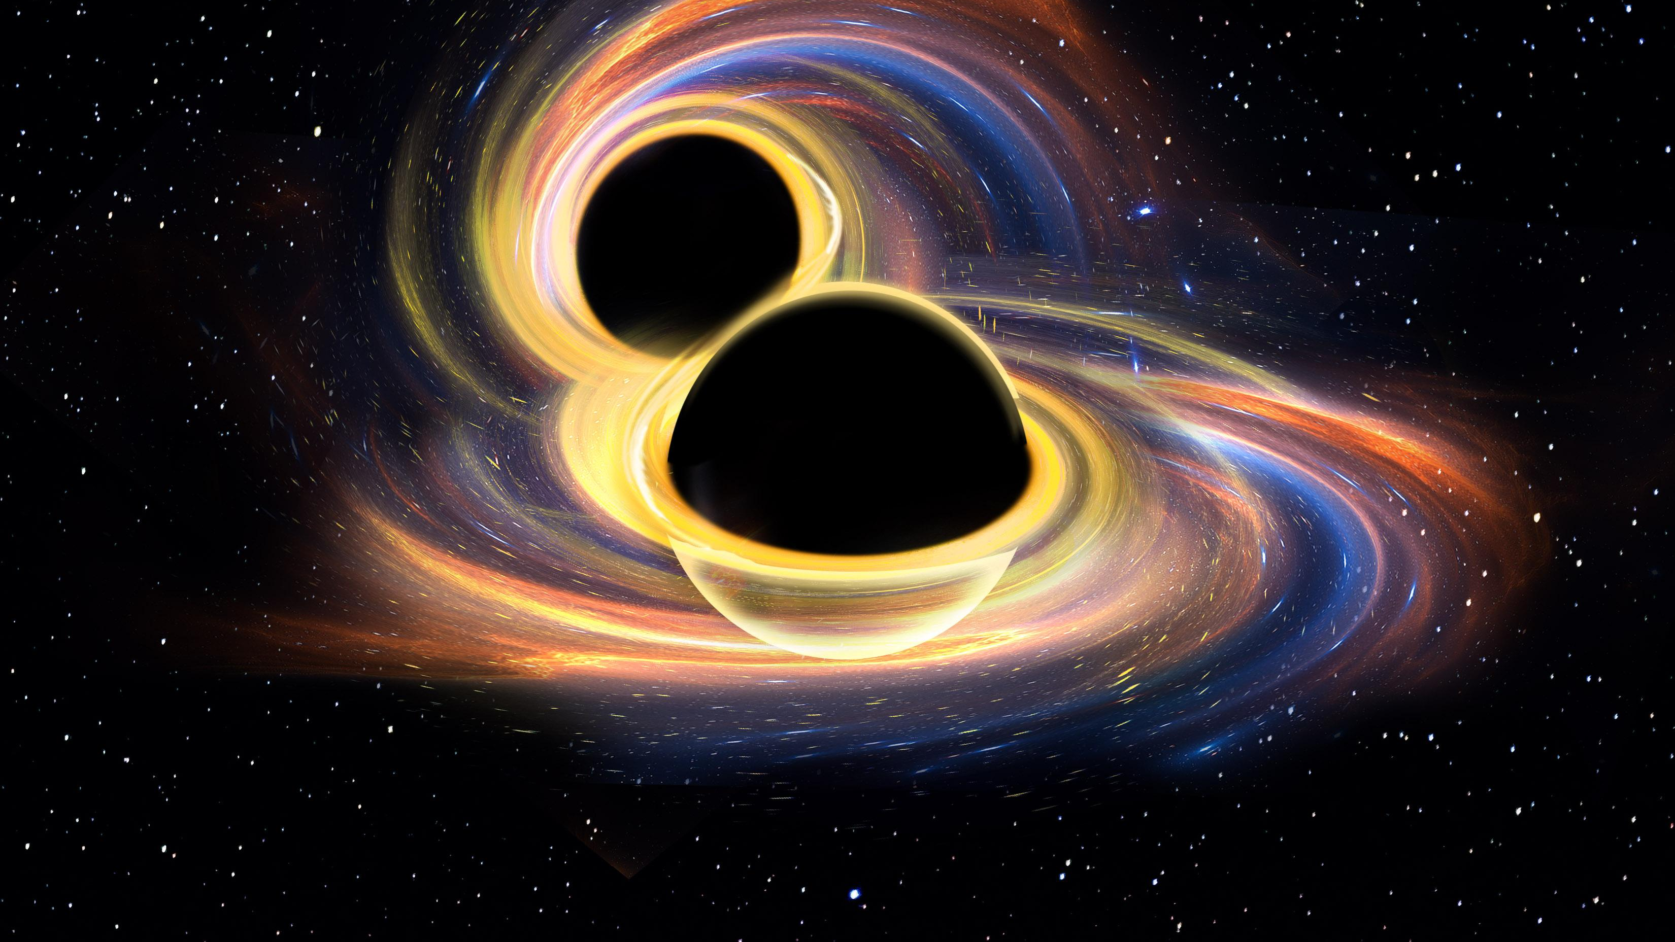



More Than a Sidekick:
Secondary Black Holes in Hierarchical Mergers
_______________________________________________
Cristiano Ugolini – Postdoc@GSSI

Slide 2
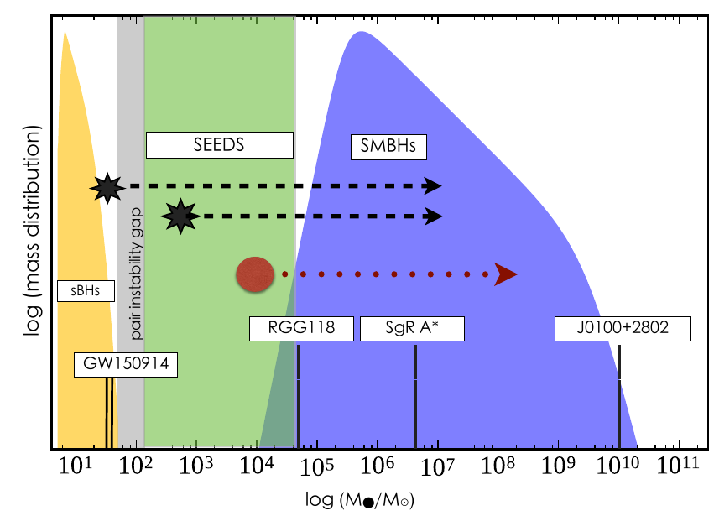
Why do we care about IMBHs?
Missing
Link (?)
Barack+18

Slide 3
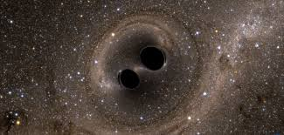

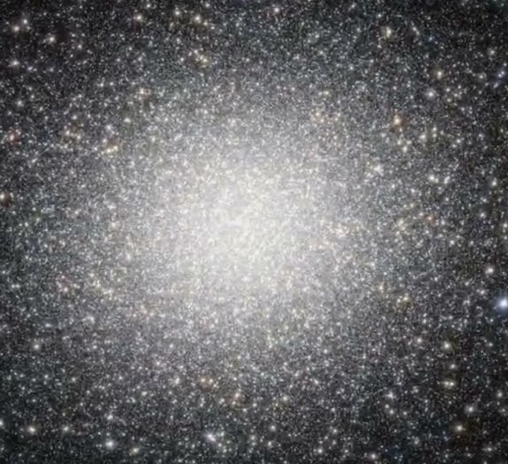
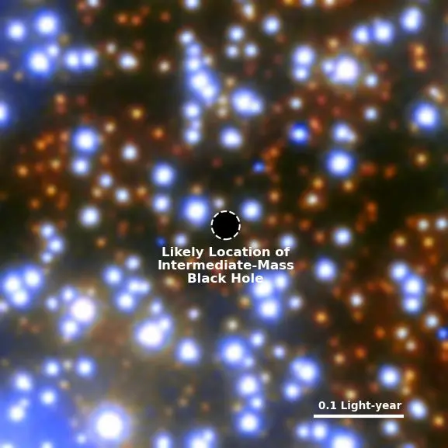
Why do we care about IMBHs?
GW
(e.g. LVK+21)
Dwarf
(e.g. Reines&Volonteri15
Chilingarian+18)
Missing
Link (?)
Barack+18
Globular Clusters
(e.g. VanderMarel+10, Noyola+10,
Lanzoni+13, Lutzgendorf+13,
Kiziltan+17,Perera+17, Lin+18,
Abbate+19,Tiengo+21,Haberle24)

Slide 4
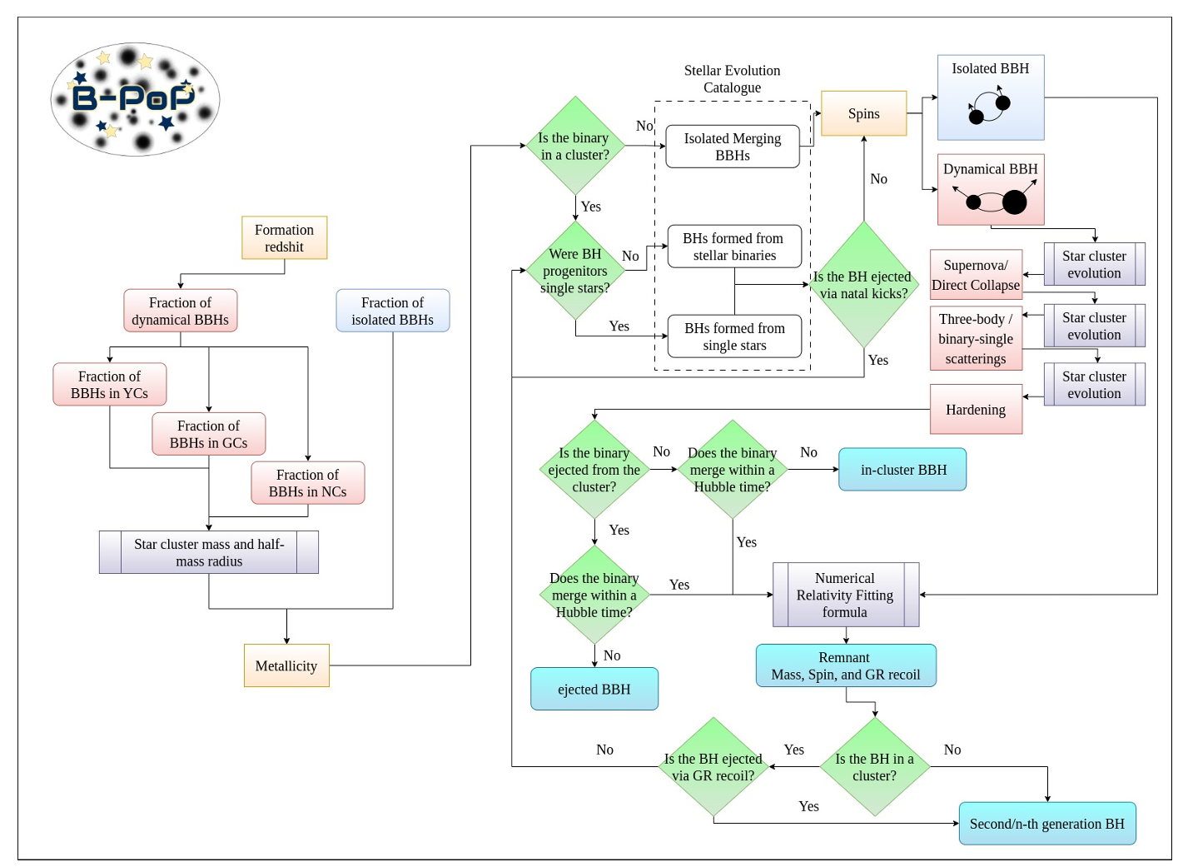

Our approach
Semi-analytical code, modelling BBHs evolution and pairing with the evolution of the host cluster
AS & Beneacquista 2018, AS+2020, 2023, 2026., Paiella+ 2025, 2026, CU+ in prep.
New routine for multiple merger chains.
Evolution of the BH sub-population (see Antonini & Rasio 2016)
Retention fraction of hierarchical BHs
Interaction rate hierarchical BHs vs stellar BHs

Slide 5
Our approach
Semi-analytical code, modelling BBHs evolution and pairing with the evolution of the host cluster
AS & Beneacquista 2018, AS+2020, 2023, 2026., Paiella+ 2025, 2026, CU+ in prep.
New routine for multiple merger chains.
Evolution of the BH sub-population (see Antonini & Rasio 2016)
Retention fraction of hierarchical BHs
Interaction rate hierarchical BHs vs stellar BHs

Slide 6
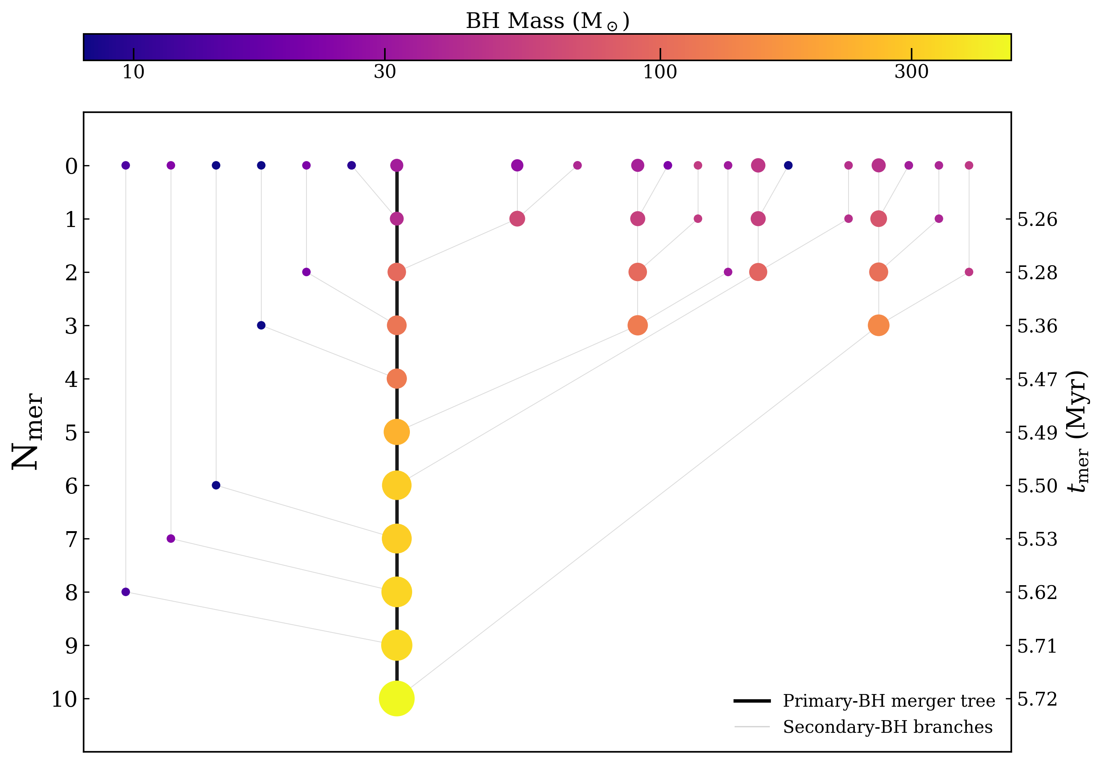
A typical merger chain
Ugolini+ in prep.

Slide 7
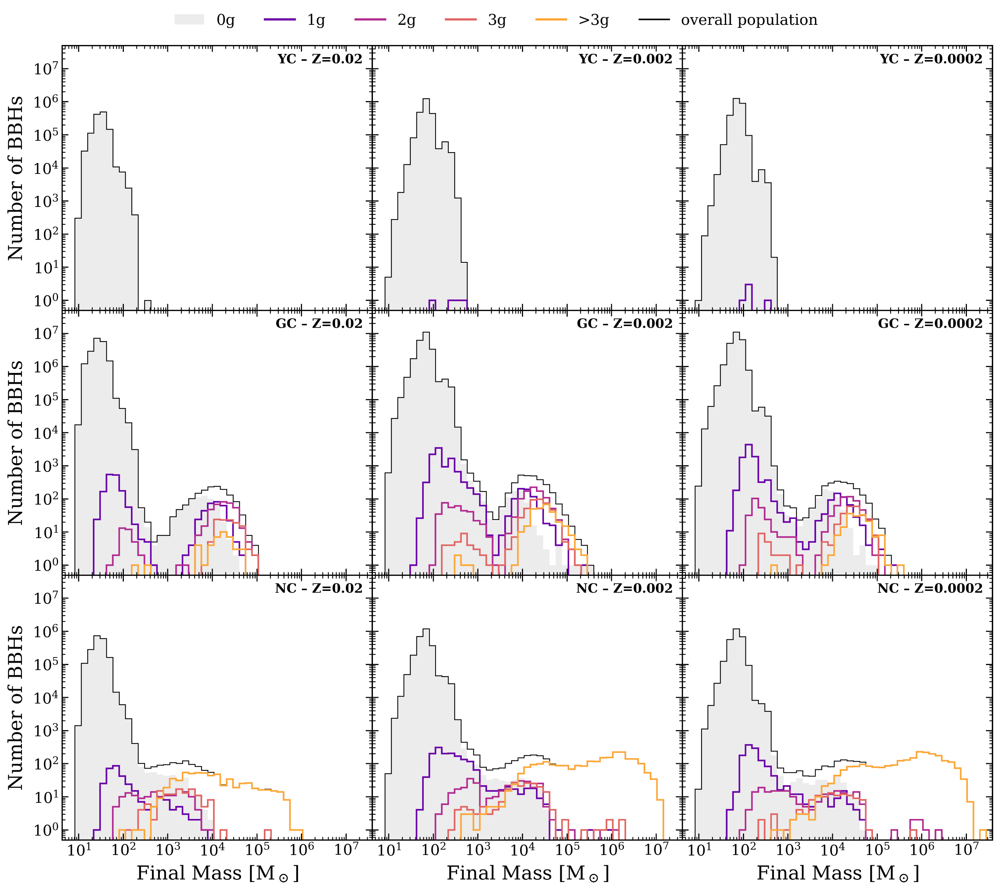
How often hierarchical BHs appear?
Young clusters: rarely grow beyond 1 merger chain
Globular & Nuclear: retain more hierarchical BHs
Massive BHs: encounter ≥1 non-stellar secondary during growth
High metallicity hampers BH growth → lighter reservoir, stronger kicks
Ugolini+ in prep.

Slide 8
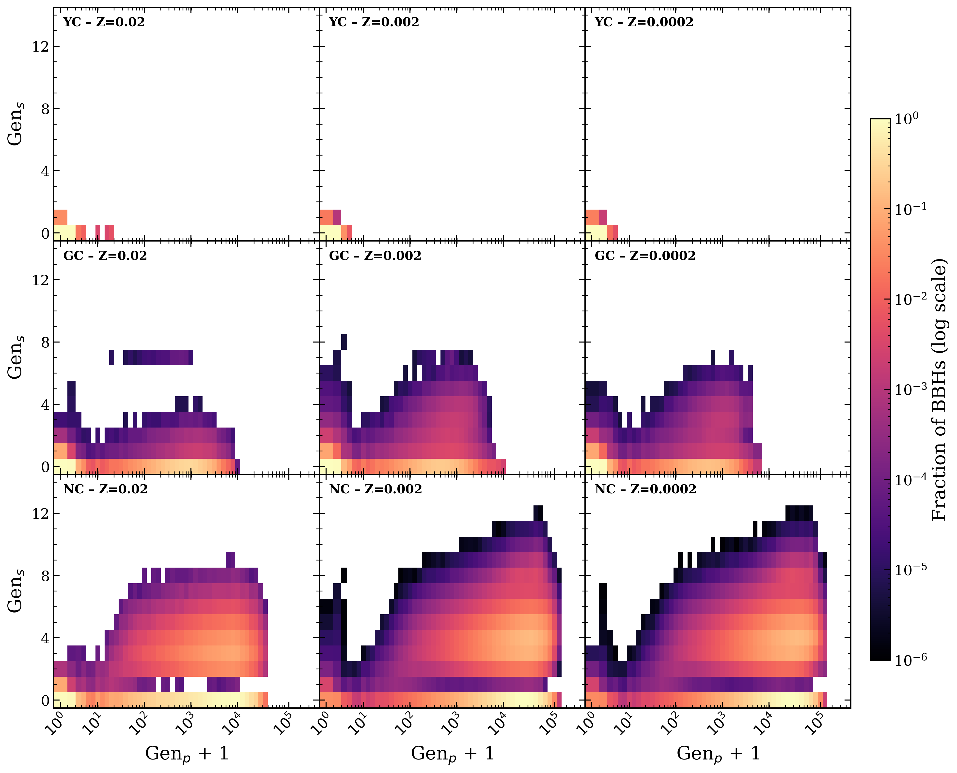
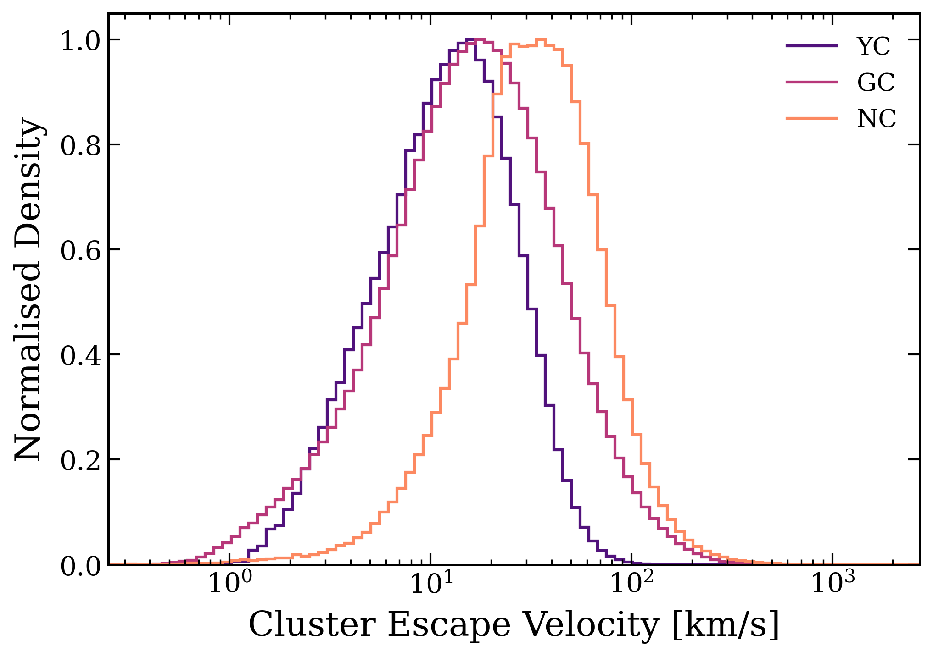
How often hierarchical BHs appear?
Young clusters: rarely grow beyond 1 merger chain
Globular & Nuclear: higher generation pairing
Maximum generation: dominated by escape velocity of the environment
Ugolini+ in prep.

Slide 9
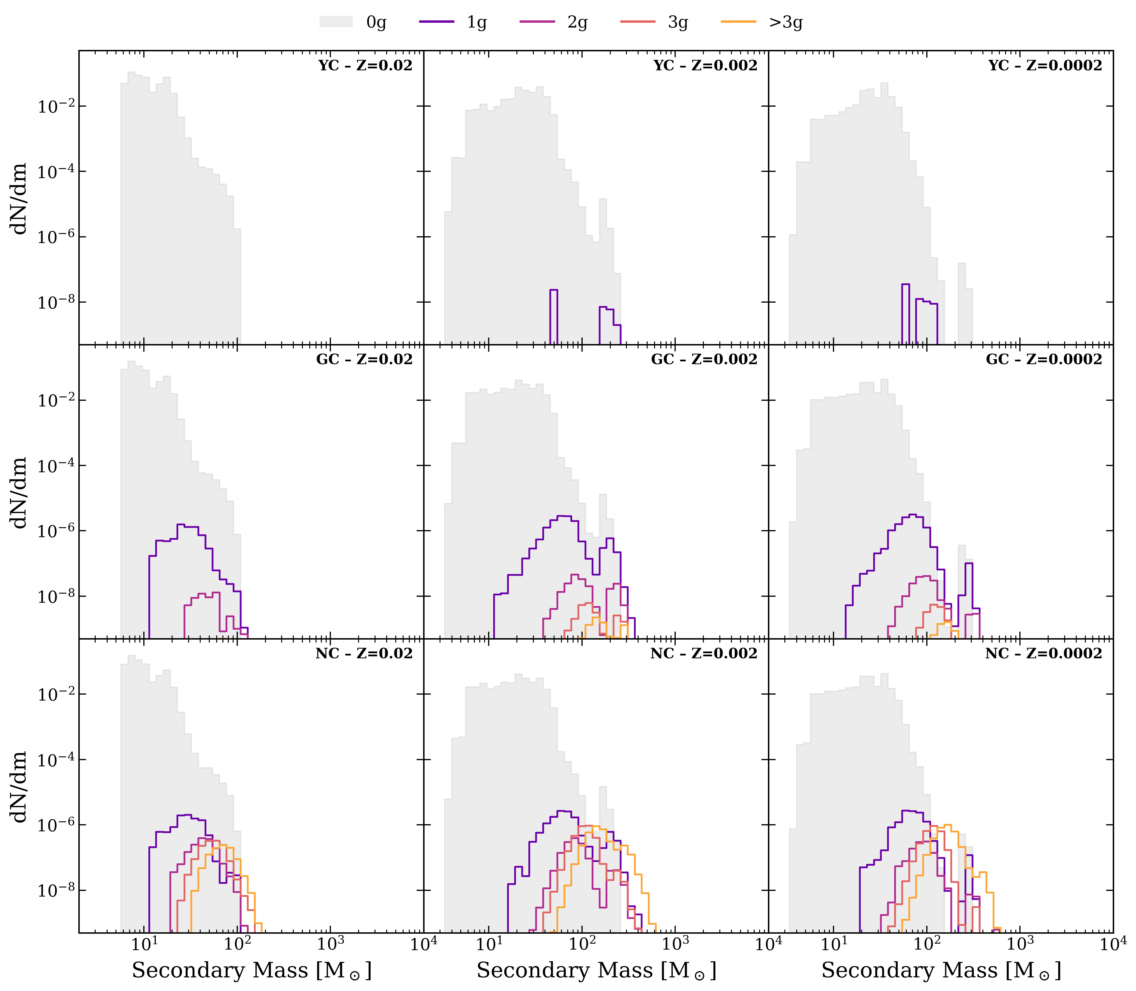
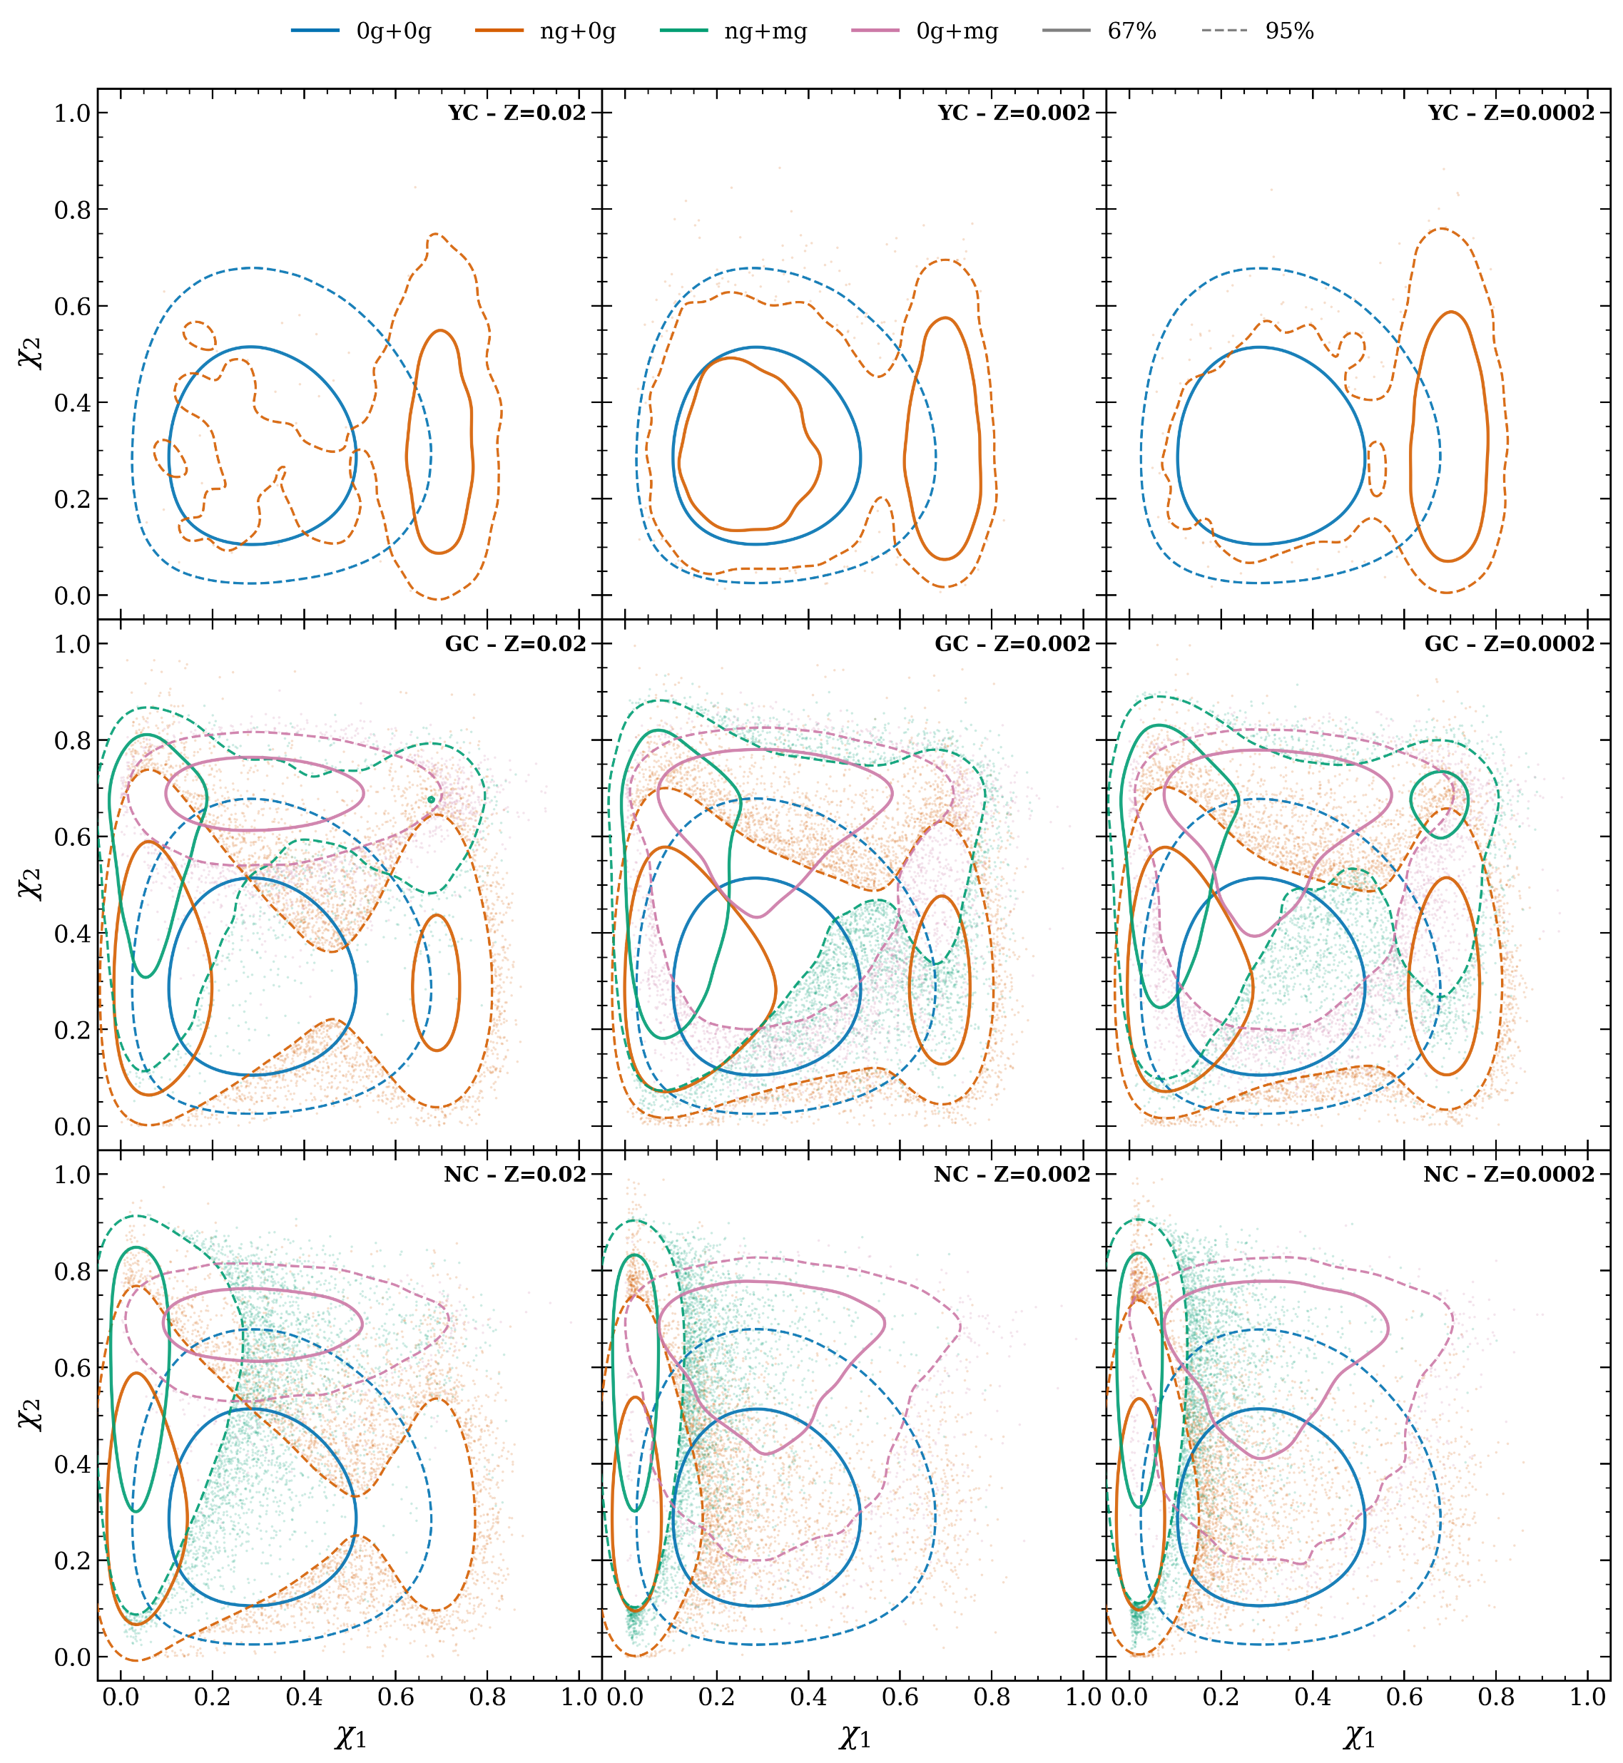
Masses and spins of hierarchical secondaries
Ugolini+ in prep.
Ugolini+ in prep.
Ugolini+ in prep.

Slide 10
Masses and spins of hierarchical secondaries
Ugolini+ in prep.
Ugolini+ in prep.
Hierarchical secondaries are overall more massive than stellar BHs
They are negligible amount over the total population of BBH mergers
Their total number and upper mass is strongly coupled with the environment properties

Slide 11
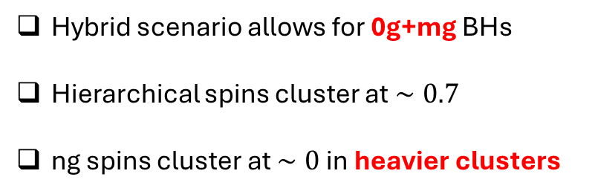
Masses and spins of hierarchical secondaries
Ugolini+ in prep.
Hybrid scenario allows for 0g+mg BHs
Hierarchical spins cluster at $∼0.7$
ng spins cluster at $∼0$ in heavier clusters

Slide 12
Masses and spins of hierarchical secondaries
Ugolini+ in prep.
Hybrid scenario allows for 0g+mg BHs
Hierarchical spins cluster at $∼0.7$
ng spins cluster at $∼0$ in heavier clusters

Slide 13
Can we disentangle stellar and hierarchical secondaries?
Ugolini+ in prep.
Ugolini+ in prep.
Ugolini+ in prep.
Ugolini+ in prep.

Slide 14
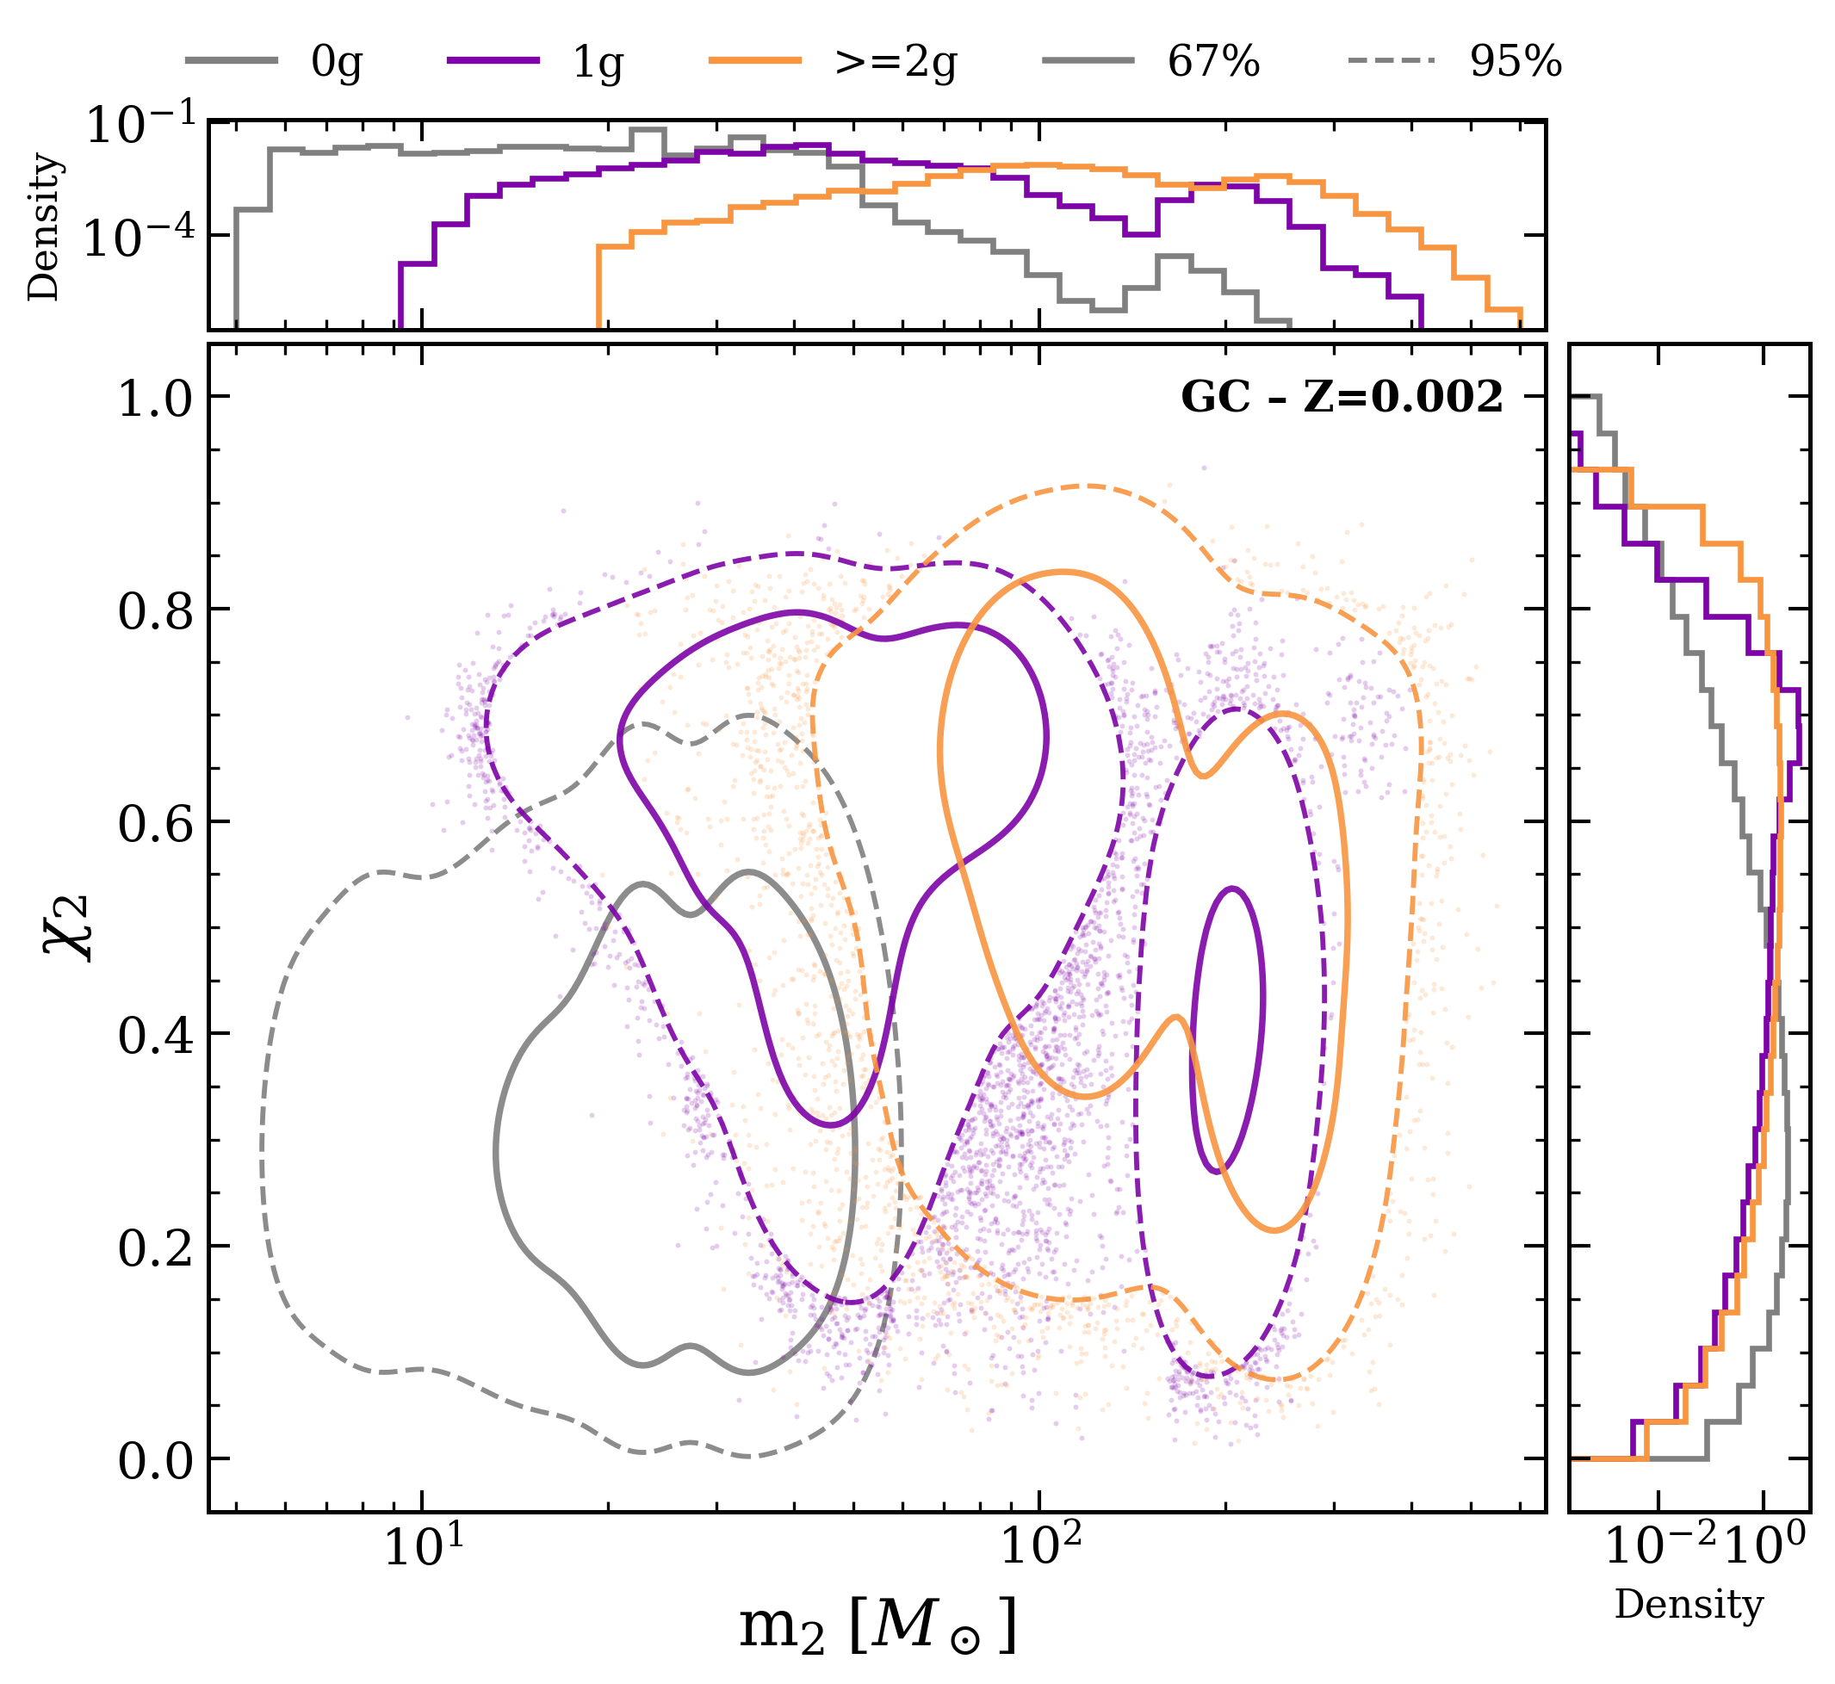
Can we disentangle stellar and hierarchical secondaries?
Ugolini+ in prep.

Slide 15
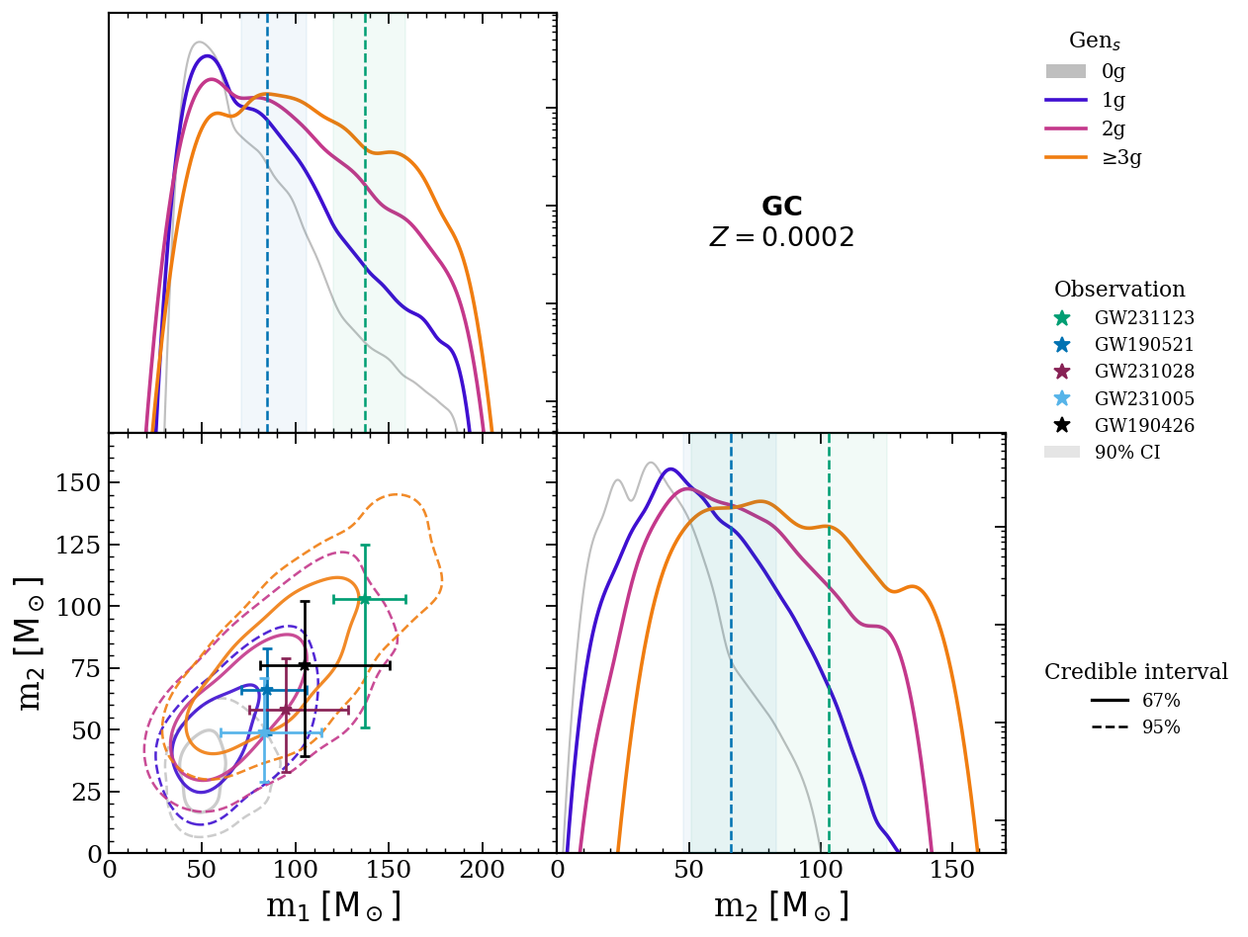
Have we seen hierarchical binary?
Ugolini+ in prep.
m₂ compatible with a secondary that underwent ≥2 (1) mergers for GW231123 (GW190521)

Slide 16
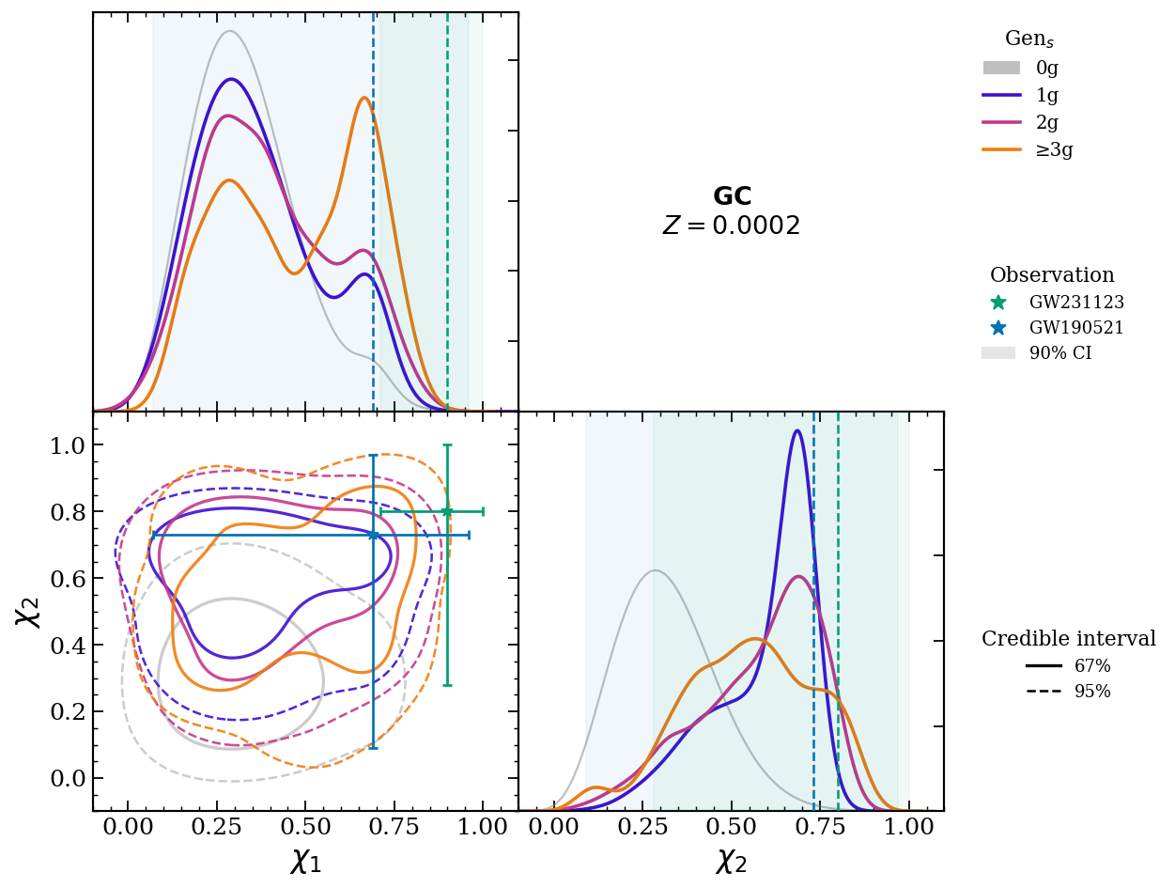
Have we seen hierarchical binary?
Ugolini+ in prep.
Ugolini+ in prep.
Ugolini+ in prep.
m₂ compatible with a secondary that underwent ≥2 (1) mergers for GW231123 (GW190521)
Spins of primary & secondary point to GW mergers

Slide 17
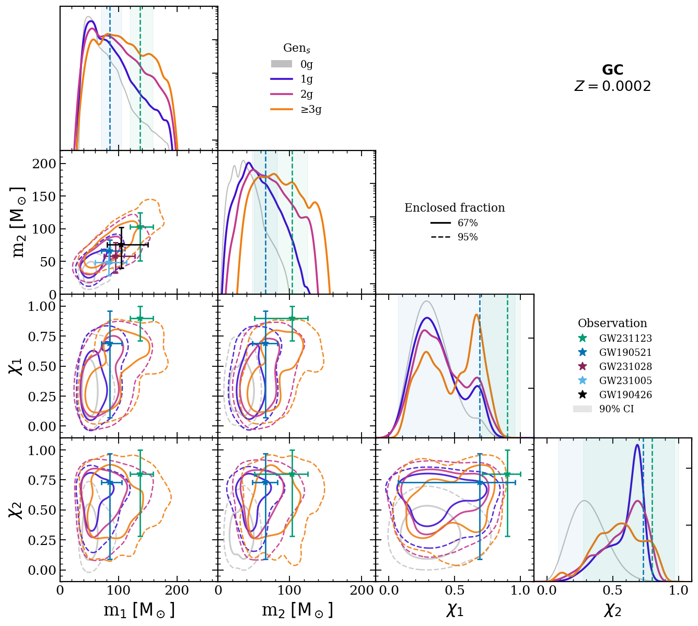
Conclusions
Semi-analytical framework for multiple merger chains in dense star clusters
Hierarchical BHs grow in globular & nuclear clusters; metallicity suppresses growth
Fundamental for IMBH binaries: distinctive mass & spin signatures in GW events
Ugolini+ in prep.
Let’s have a chat!
cristiano.ugolini@gssi.it
Ugolini+ in prep.

Slide 18
BACKUP SLIDES

Slide 19
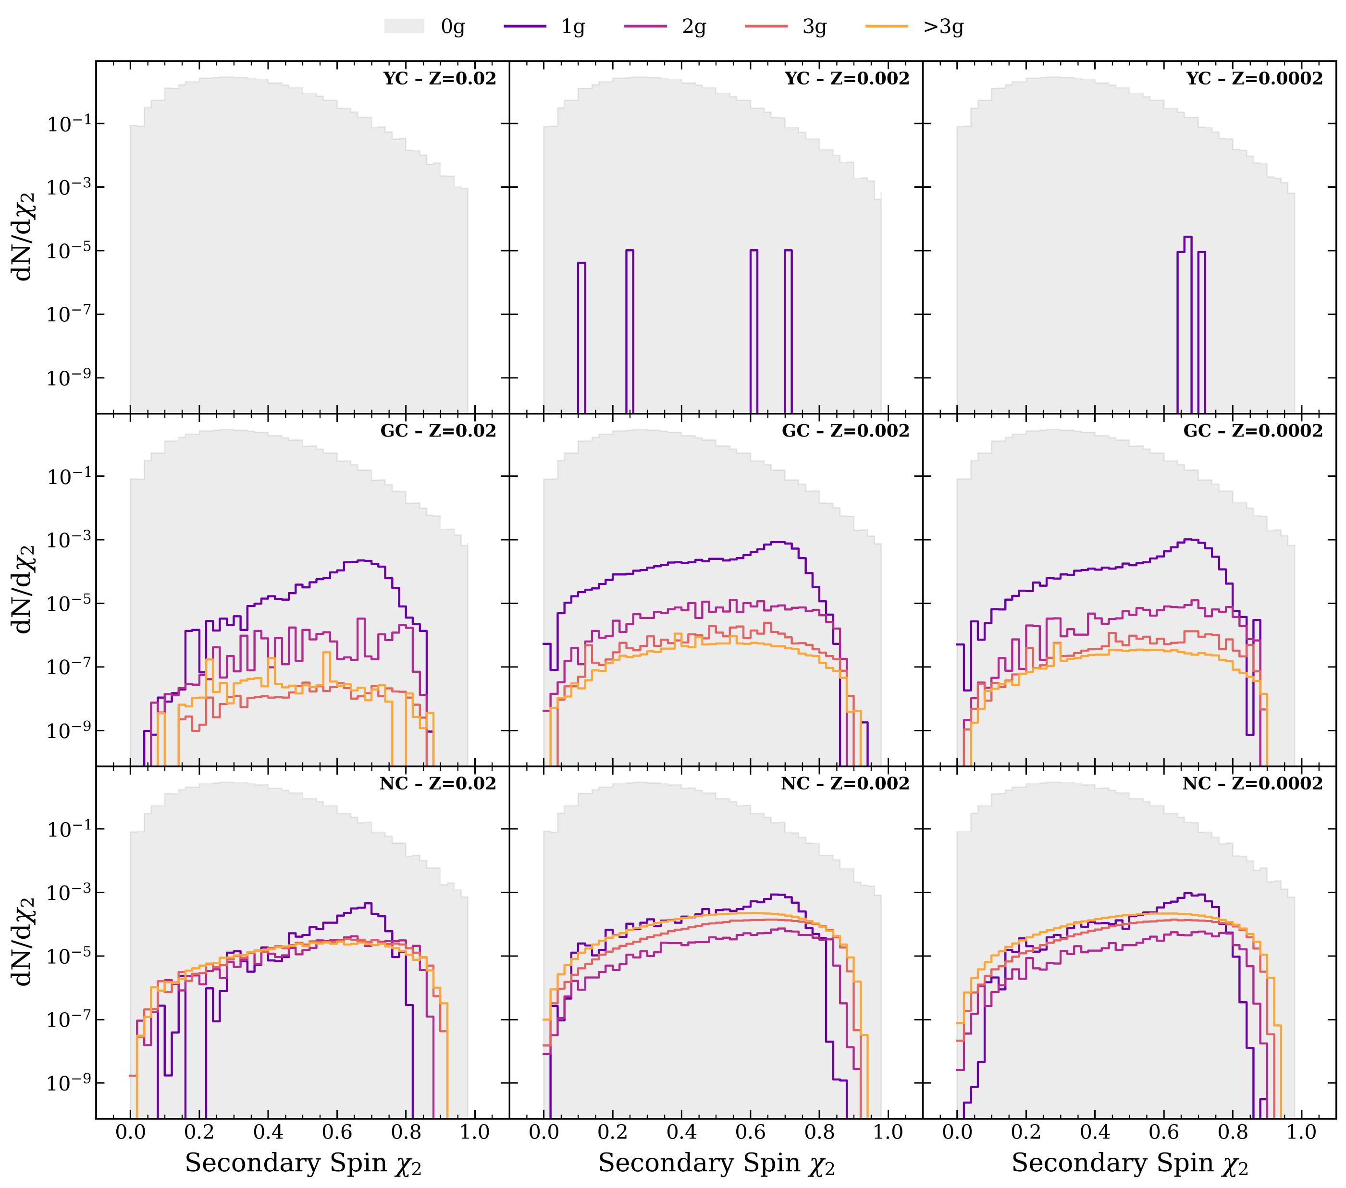
Ugolini+ in prep.

Slide 20
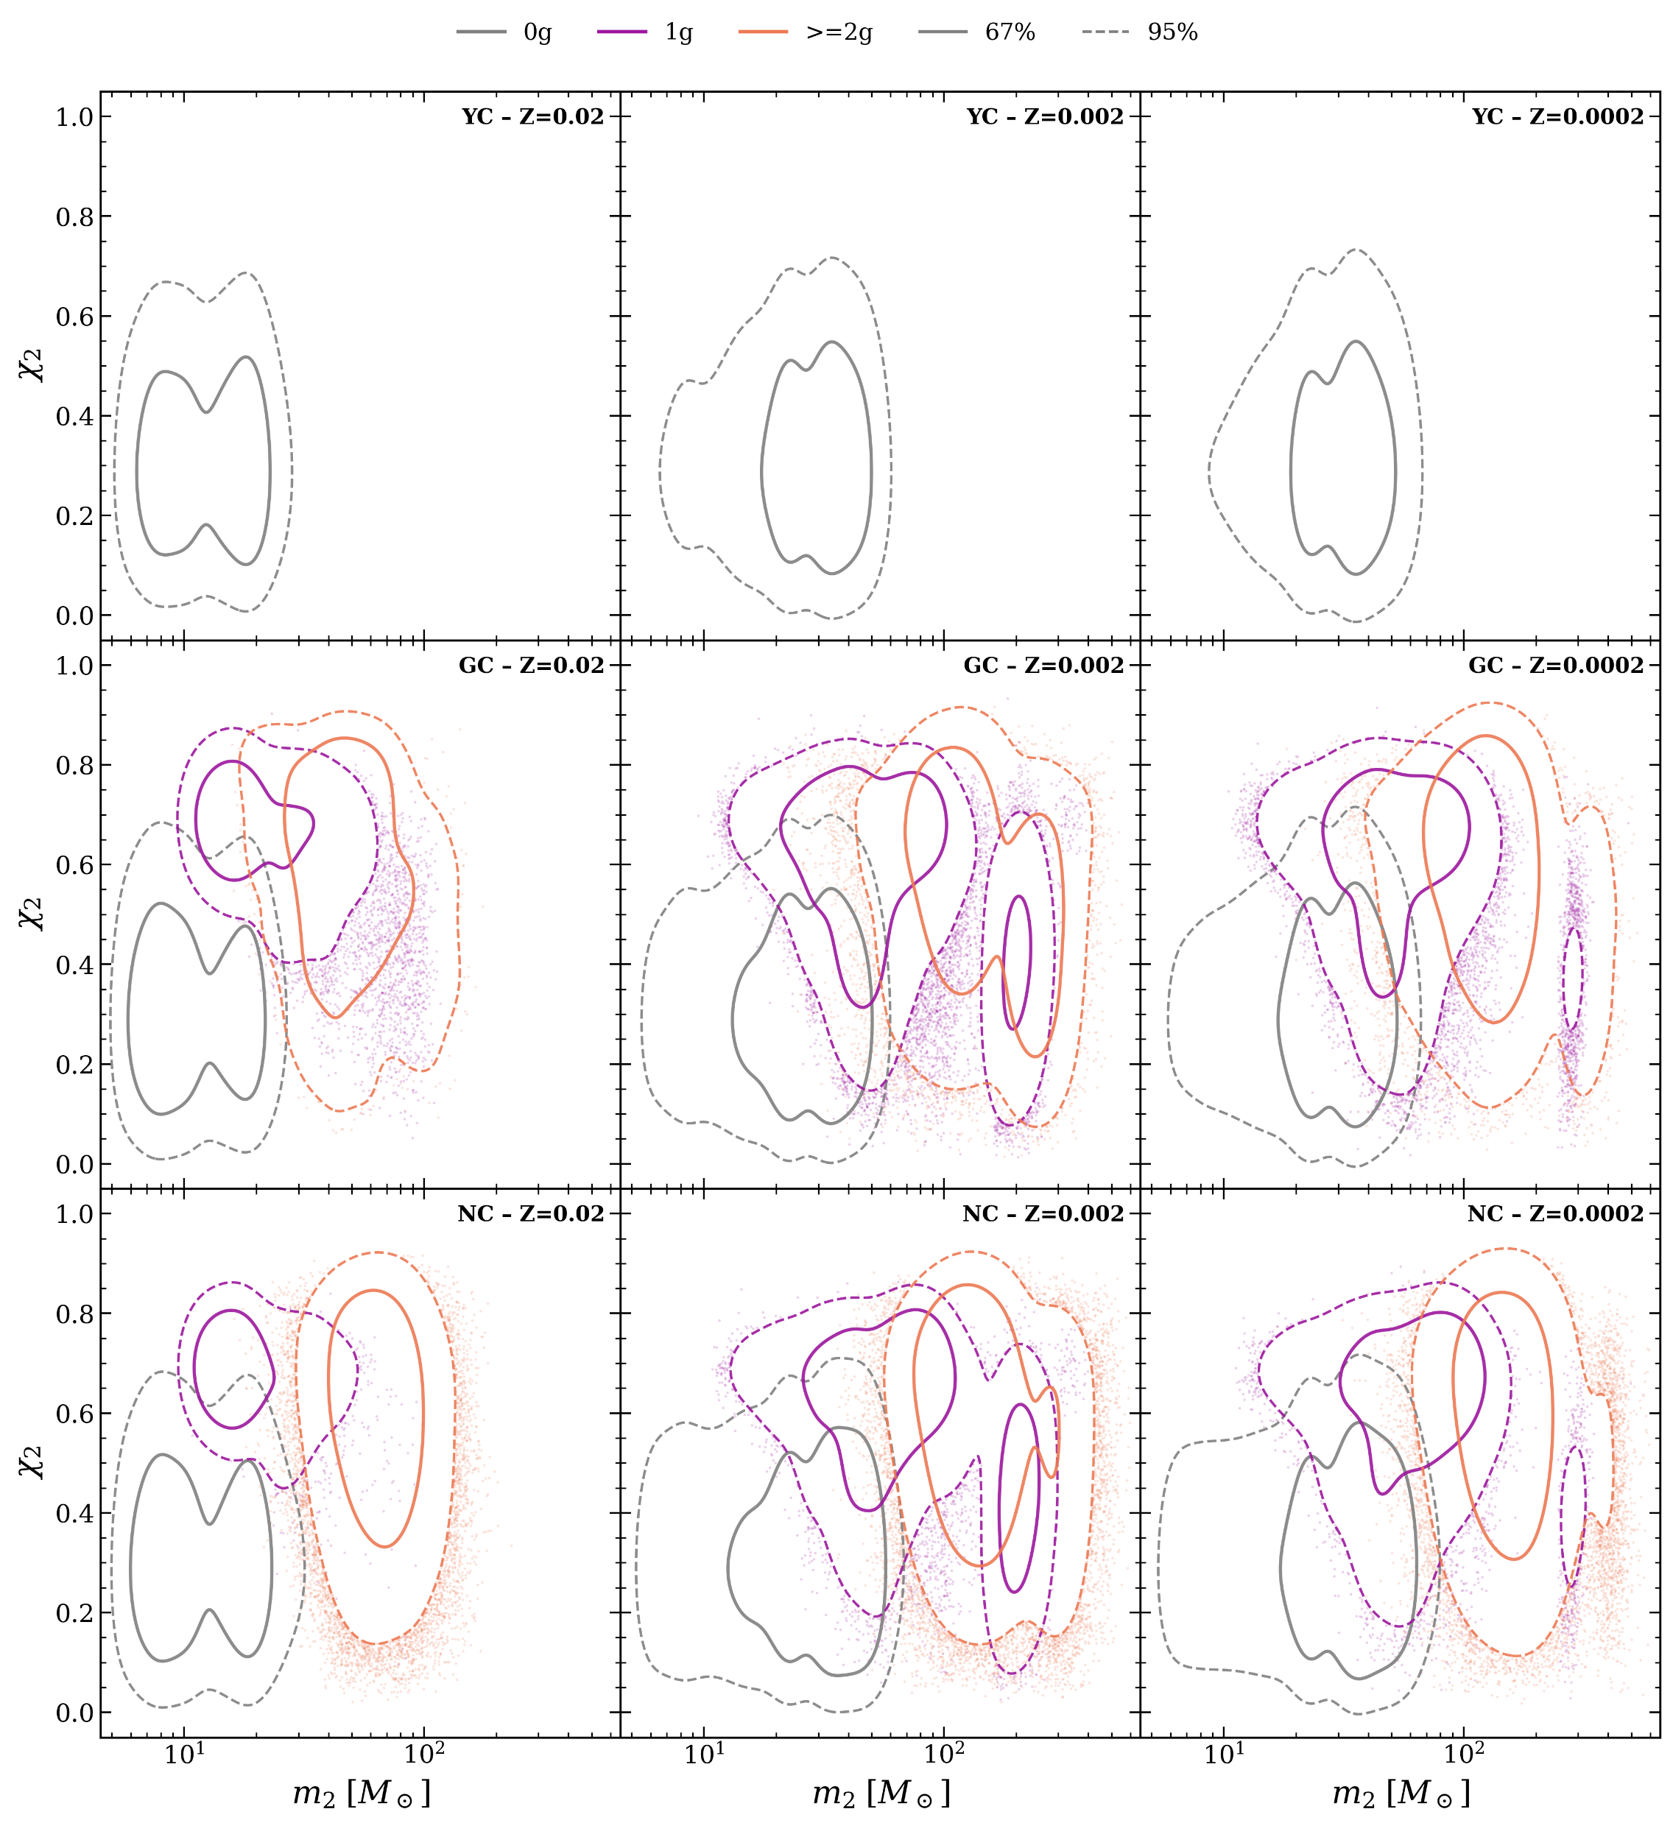
Ugolini+ in prep.

Slide 21
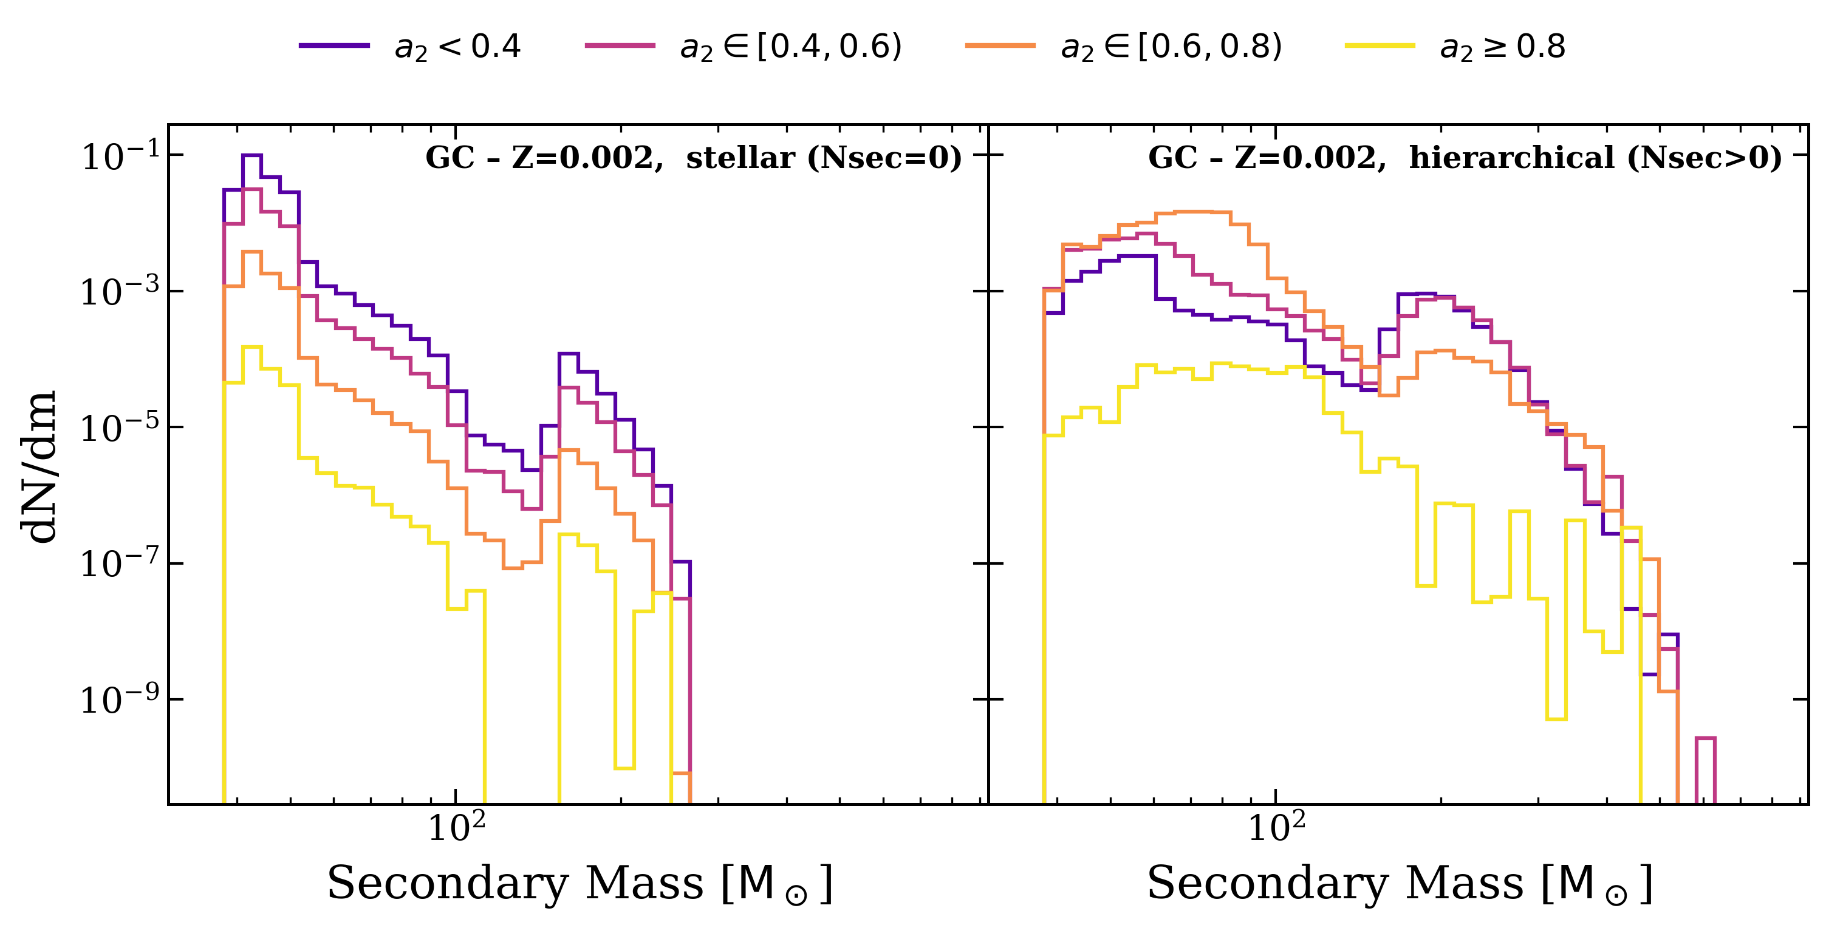
Ugolini+ in prep.

Slide 22
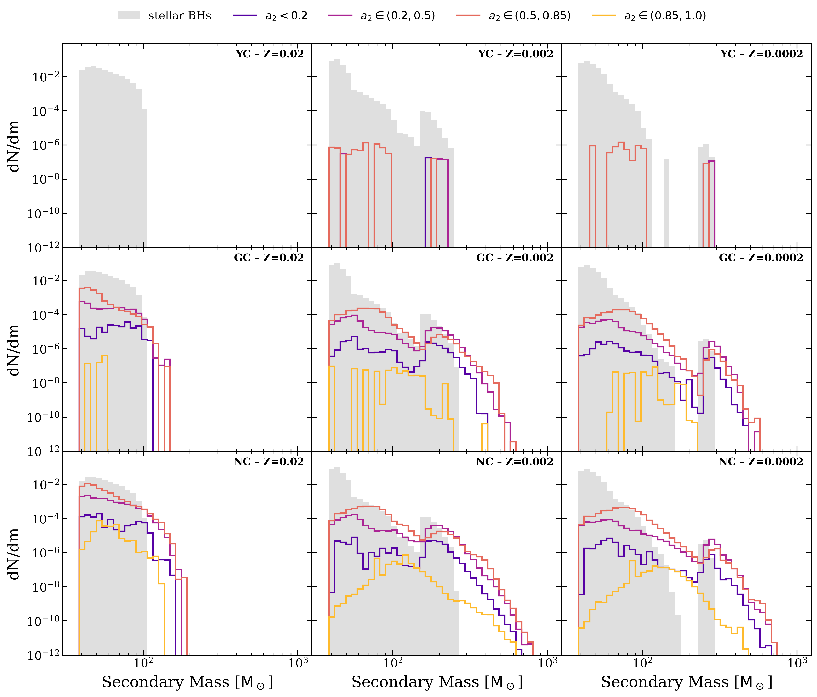
Ugolini+ in prep.

Slide 23
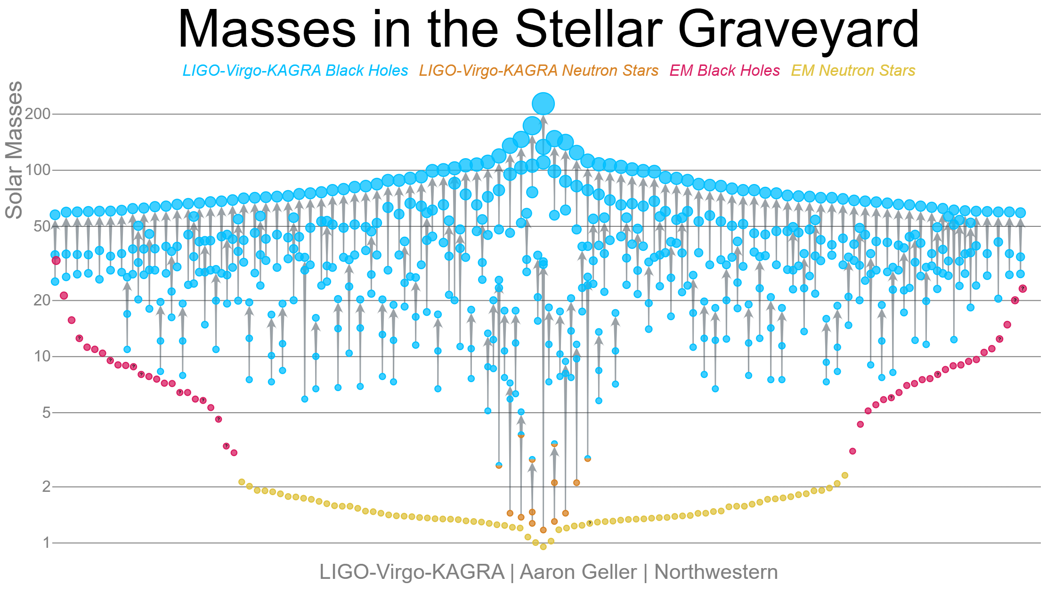

Slide 24
Neutron Stars

Slide 25
Stellar BH
Neutron Stars

Slide 26
Intermediate mass BH
Stellar BH
Neutron Stars

