Slide 1
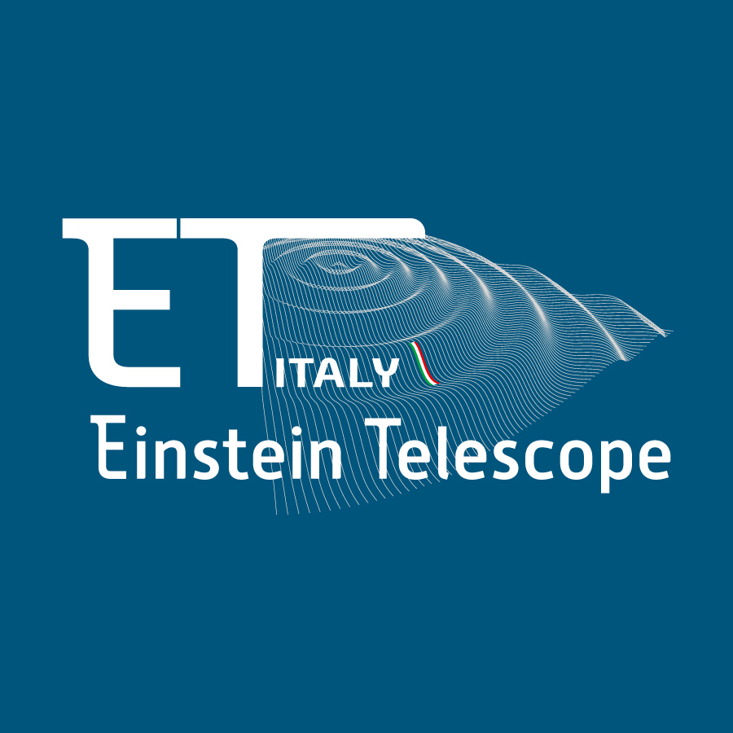

Newtonian Noise Mitigation for Einstein Telescope
Candidate: Mohamed Samy Abdelmotteleb Elzokm
Supervisor: Professor/ Jan Harms
First year Activity Report
16/10/2025

Slide 2
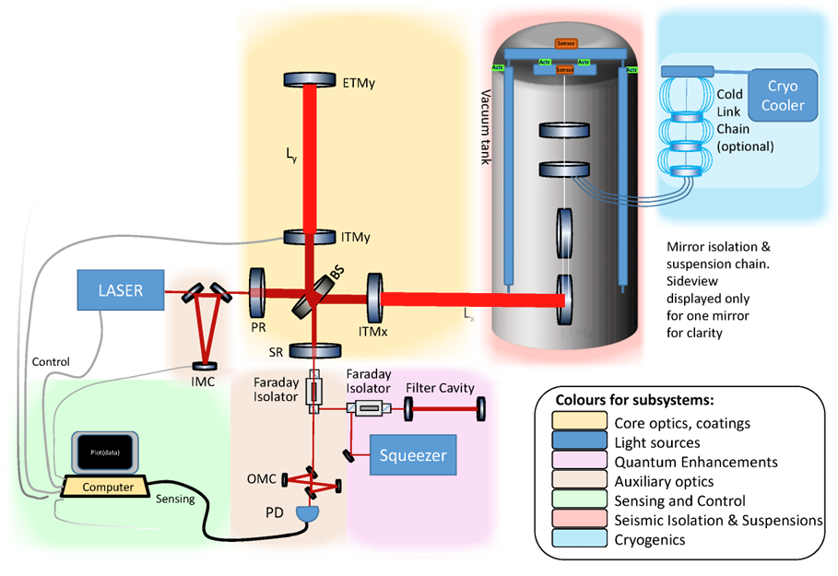
Overview
Introduction
Theoretical Background
Previous Studies (Andrić & Harms 2020, Harms 2019)
Theoretical Development
Numerical Framework and Validation
Current Work: Rayleigh Waves
Courses and Training
Future Work and Outlook
Summary
Fig 1: Schematic representation of an interferometric GW detector (ET)

Slide 3
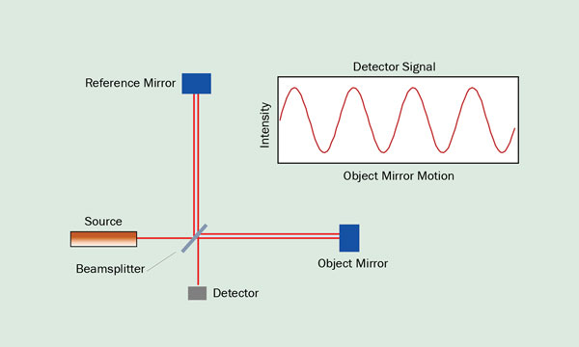
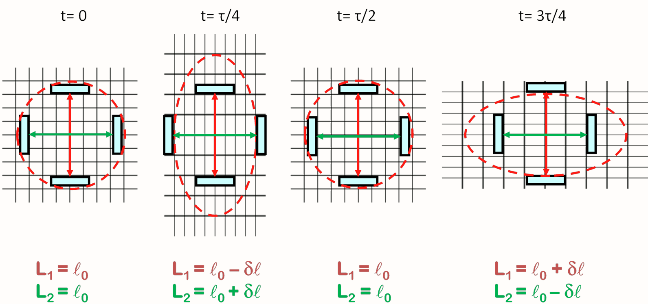
Gravitational Wave Detector
Fig 3: The effect of GWs on the distance between objects. While the mirrors
Remain locally at rest the metric gets changed by the GW. The figure shows
The effect of sinusoidal GW.
Fig 3: Basic working principle of GW detectors using
Michelson interferometer

Slide 4
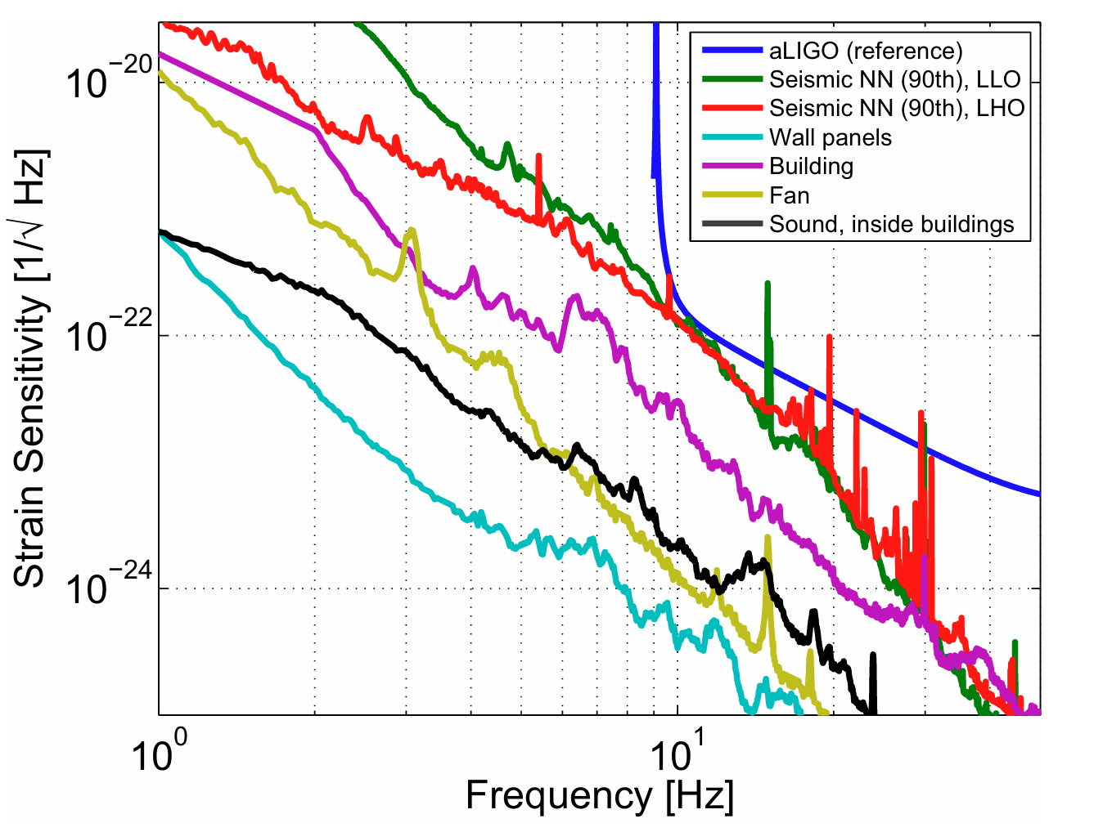
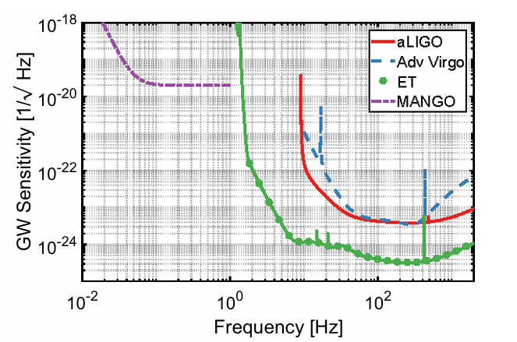
Einstein Telescope
Sensitivity limit
Newtonian Noise (NN) as a key limitation: seismic and atmospheric origins.
Main mitigation strategy: coherent noise cancellation using Wiener filter.
Your project goal: Modeling and mitigation of seismic NN for ET.
Fig 4: Newtonian noise budget for the LIGO sites
Fig 4: Sensitivity goal for the low-frequency detectors

Slide 5
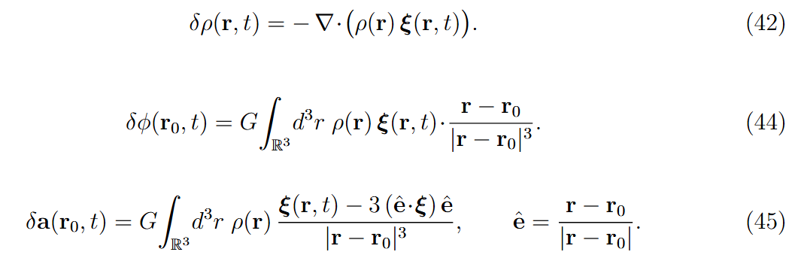
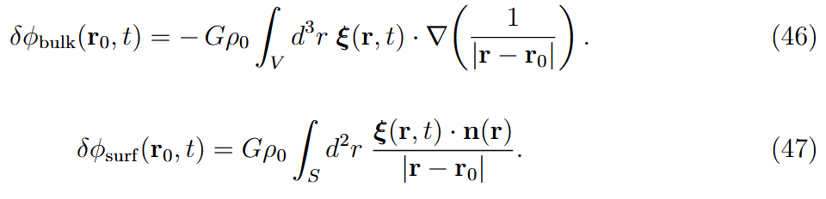
Theoretical Background
How seismic motion causes gravity fluctuations.
Volume (body-wave) and surface (Rayleigh-wave) contributions.

Slide 6
Previous Studies and Motivation
Tomislav Andrić & Jan Harms (2020): Modeling of Rayleigh-wave NN at the Sardinia site using Specfem3D.
Their study focused on surface-induced gravity perturbations and topography effects.
Goal: generalizes the concept to a 3-D isotropic framework — to include both body and surface waves consistently.

Slide 7



Theoretical Development
Extended Harms (2019) analytical model to a general 3-D isotropic formulation.
Unified treatment of P, S, and mixed P–S waves.
(1)
(2)
For anisotropic conditions, put inside the integral

Slide 8
Numerical Framework and Validation
Fully Python-based framework developed
Inputs: displacement cross correlations from Specfem3D simulations.
Key features:
  Reads and processes 3-D seismic correlation data.
  Builds gravity kernel tensor and performs voxel summation.
Validation strategy:
  Tested using analytical models for P, S, and mixed P–S waves.
  Excellent agreement: residuals < 10 %.
  Framework ready for Specfem3D outputs.

Slide 9
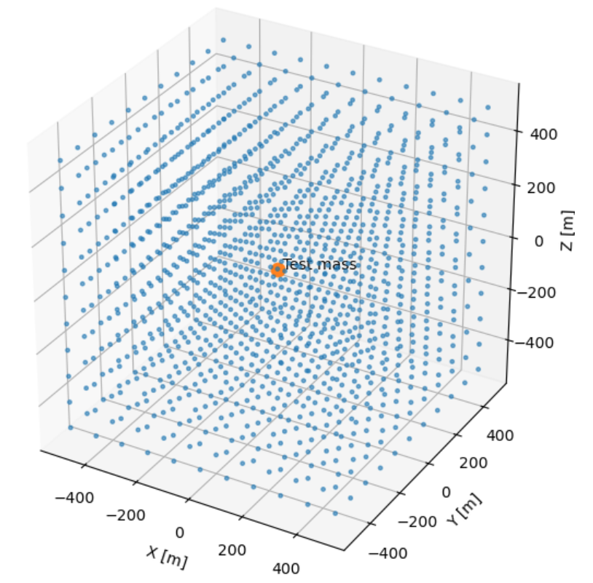


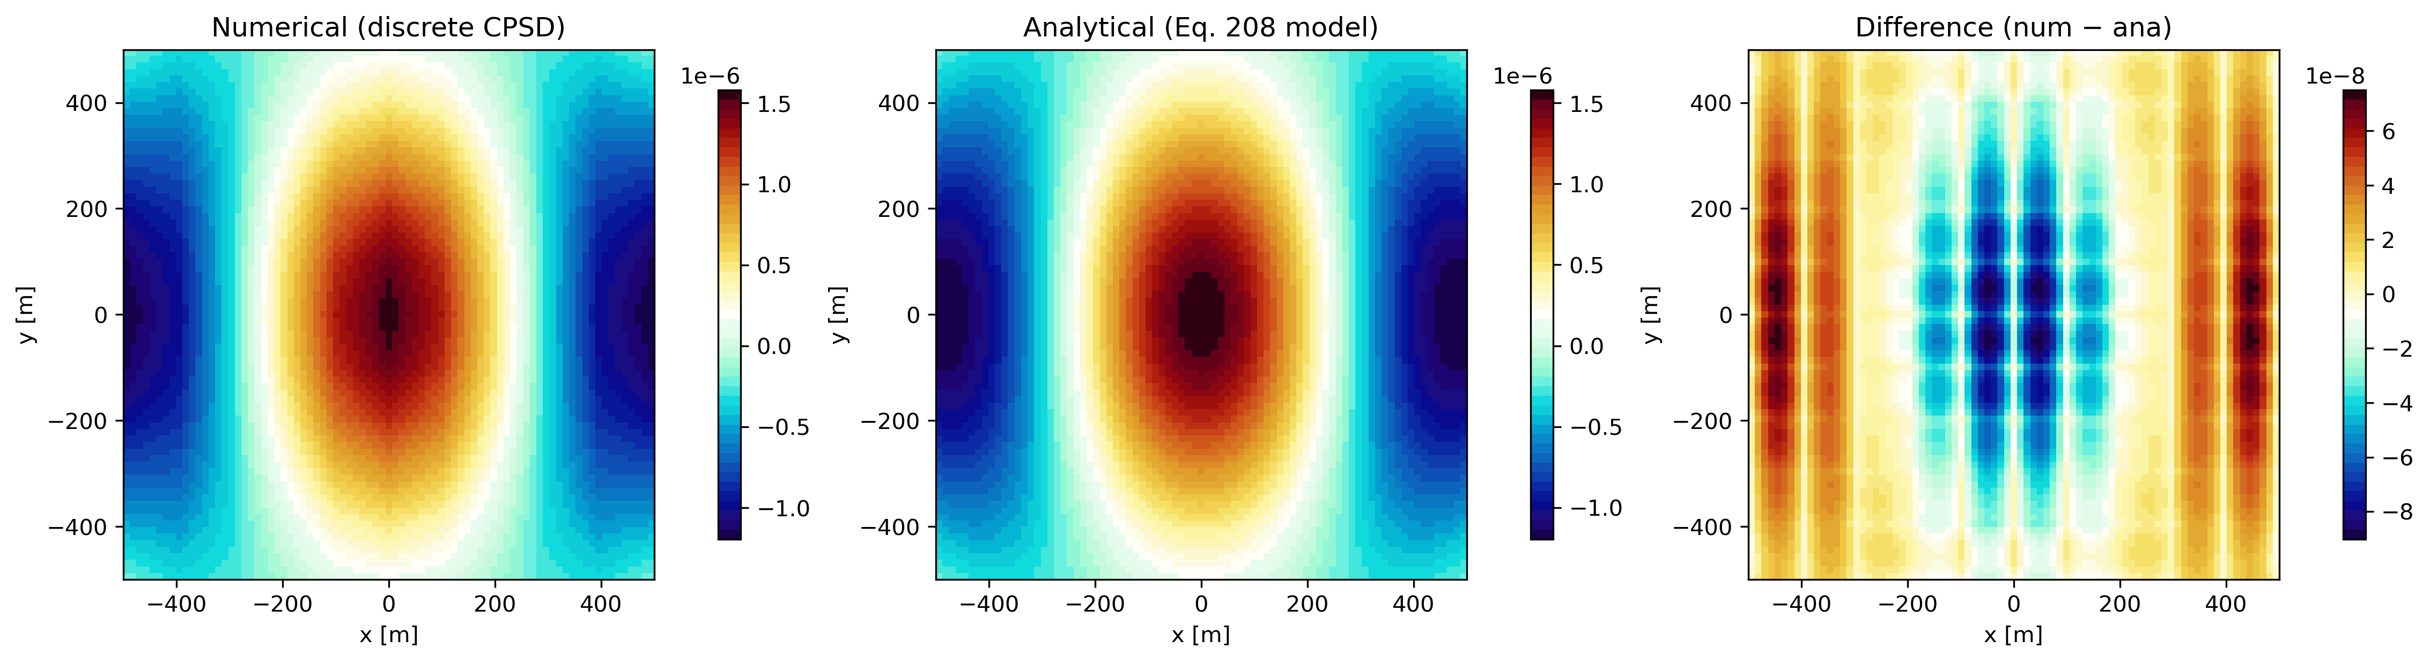
Numerical Framework and Validation
(1)
(2)
(3)
Grid 11x11x11 stations, dx = 100 m

Slide 10



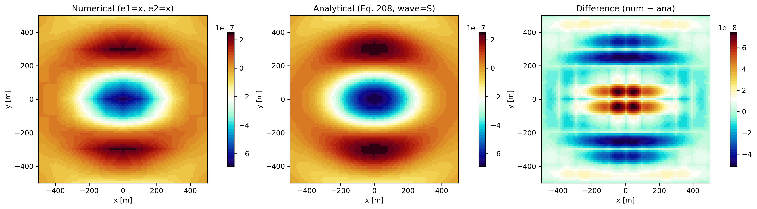
Numerical Framework and Validation
(1)
(2)
(3)

Slide 11

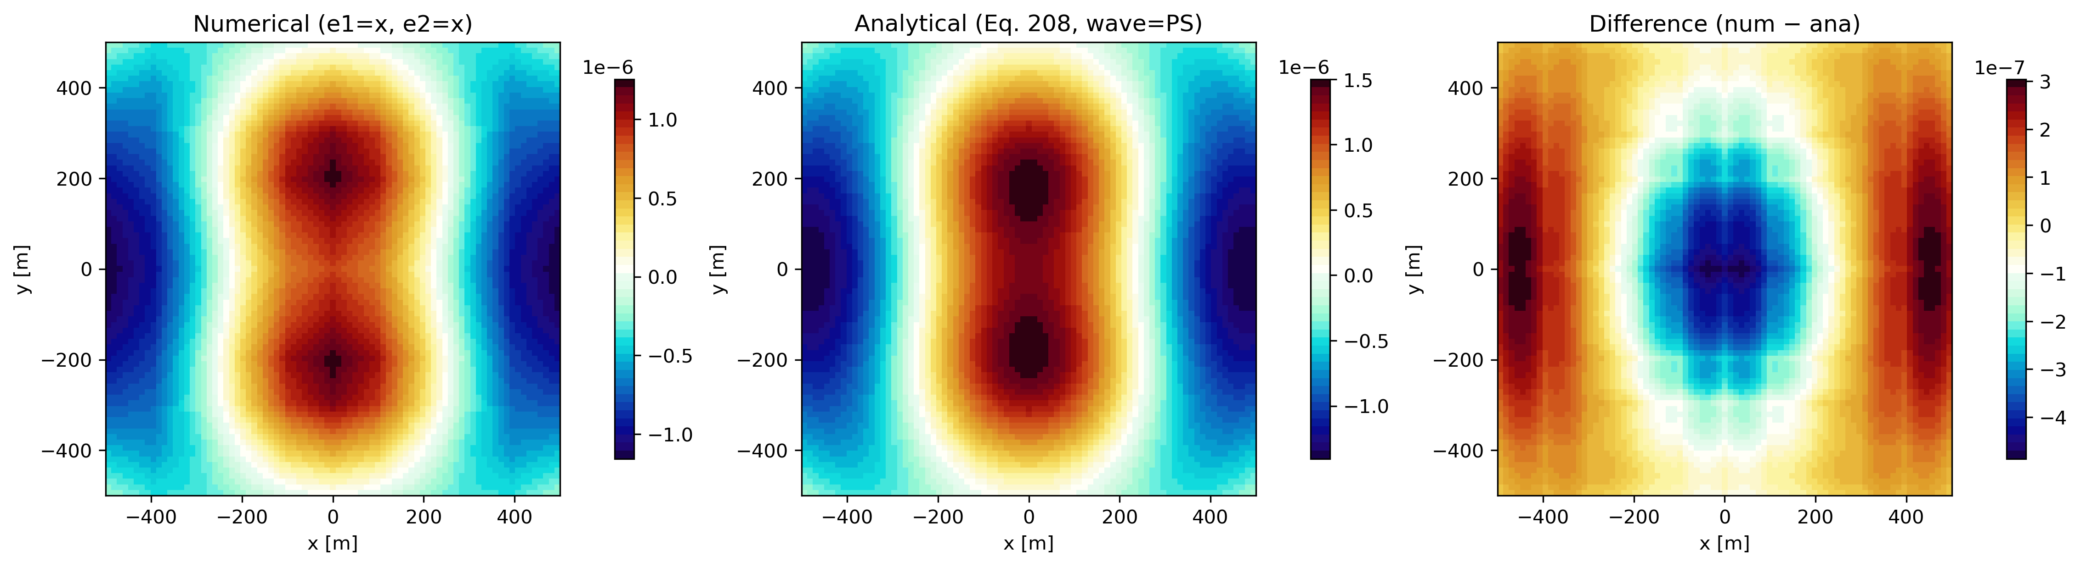
Numerical Framework and Validation
(1)
(2)
P = 0.6

Slide 12
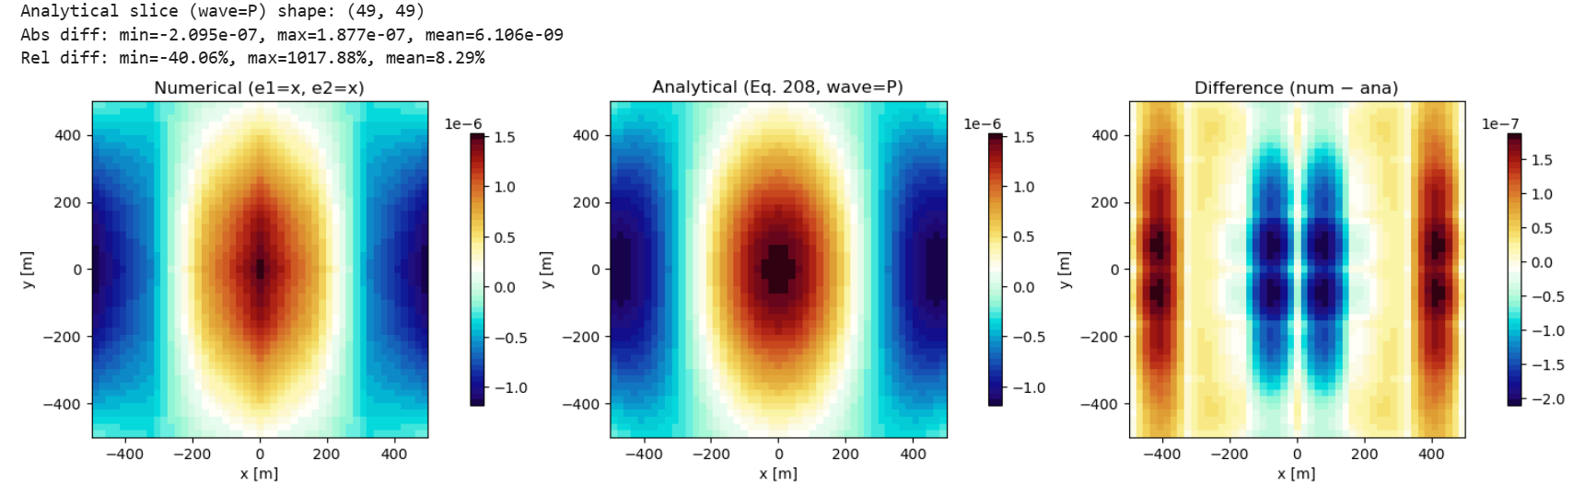
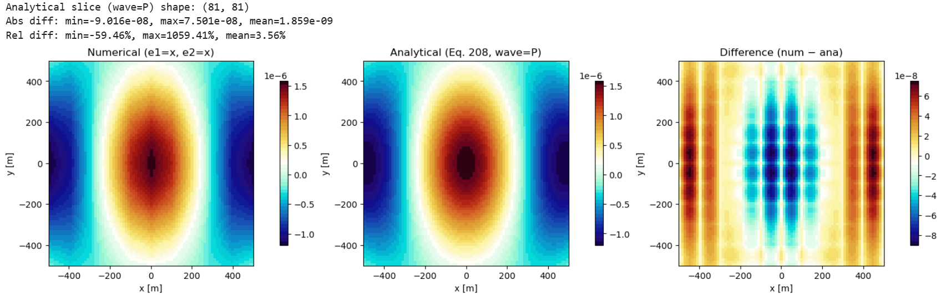
Numerical Framework and Validation
If N = 7 dx = dy = dz = 166.67 m, n = 343 stations, dv = 4629630 m^3
If N = 11 dx = dy = dz = 100 m, n = 1331 stations, dv = 1000000 m^3

Slide 13
Current Work: Surface Term and Rayleigh Waves
Implementing surface integration and testing analytical consistency.
Will combine with body-wave term for full NN modeling.
This step is key to generalizing to all wave types and realistic site conditions.

Slide 14
Next Steps and Outlook
Run Specfem3D simulations for ET site (Sardinia).
Use simulation outputs to calculate full NN correlations (P + S + Rayleigh).
Apply Wiener filtering for coherent noise cancellation.
Optimize seismometer array placement.
Long-term: extend to other NN sources (e.g., atmospheric).

Slide 15
Coursework and Training
Courses completed:
Project Management — A
Introduction to Nuclear and Particle Physics — A
Front-End Electronics and DAQ Systems for Radiation Detection — A
Radiation Detection Techniques — A
Orbit Determination — A
Space Policy and Governance — C+
Cosmic Radiation and Radiation Hardness Assessment — A+
Training and Schools:
ISAPP School on the Theory and Detection of Gravitational Waves
(Vienna, July 2025)
– Covered gravitational-wave theory, detectors, multimessenger astronomy, and quantum sensing.

Slide 16
Summary
Completed:
Coursework and ISAPP school.
3-D NN formulation (body waves).
Python implementation validated against analytical models.
Ongoing:
Integrating and testing surface (Rayleigh) term.
Next:
Apply Wiener filtering and optimize array design for ET.

