Slide 1





2025-10-20
Next Generation Collaborative Design - Frequency-dependent Squeezing
FDS Lessons Learnt: LIGO
Begüm Kabagöz, Vicky Xu, MIT FDS Team, LIGO FDS Team, LIGO Instrument Team

Slide 2
Outline
Optical System Overview
Control System Overview
FC Design and Real Life
FC and Arm Power
FC Backscatter
Squeezing and Thermal Effects
Smaller Problems
Alignment on HAM7 table very stable
Alignment from HAM7 → HAM5 stable, except big shifts happened twice

Slide 3
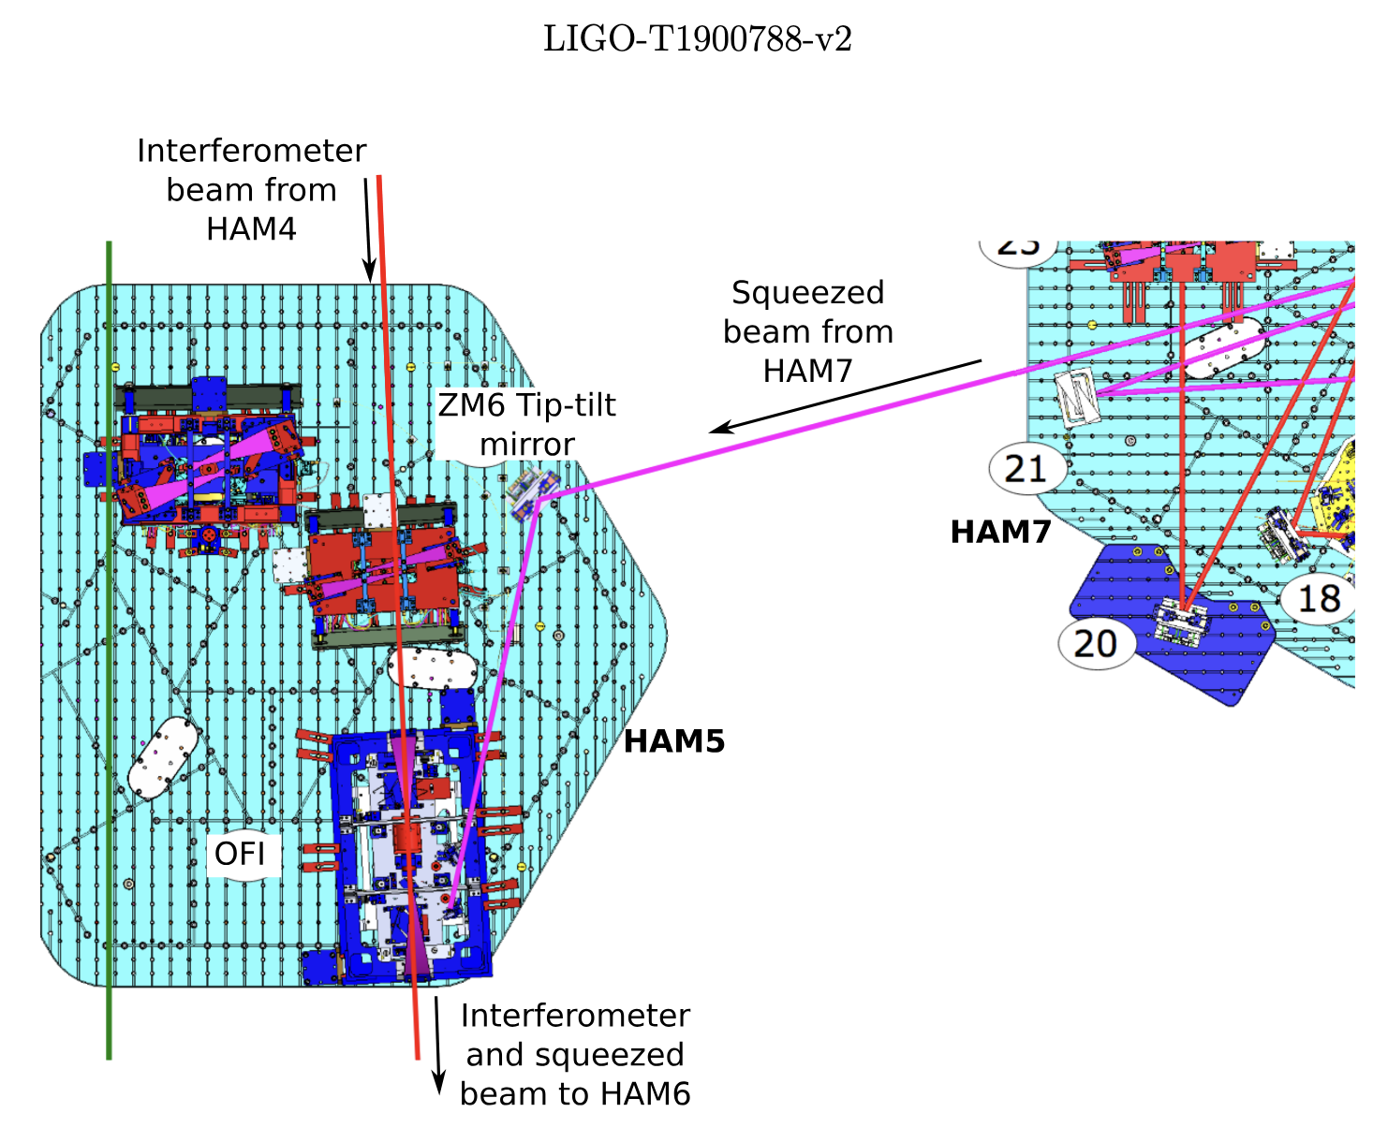
Optical System Overview – HAM7 & HAM5
FC2
ZM2 R₂(V)
Freq. dep. phase rotator
q Controller
FC1 R=1m
to ZM6 OFI SRM OMC
ZM5 R₅(V)
Alignment q Controller
Alignment on HAM7 table very stable
Alignment from HAM7 → HAM5 stable, except big shifts happened twice: LLO76905, LLO68097
ZM4 R₄(V)
q Controller Alignment
VOPO
SQZ Generator
ZM1
ZM3
Squeezer + Filter Cavity
LIGO DCC G2502387

Slide 4
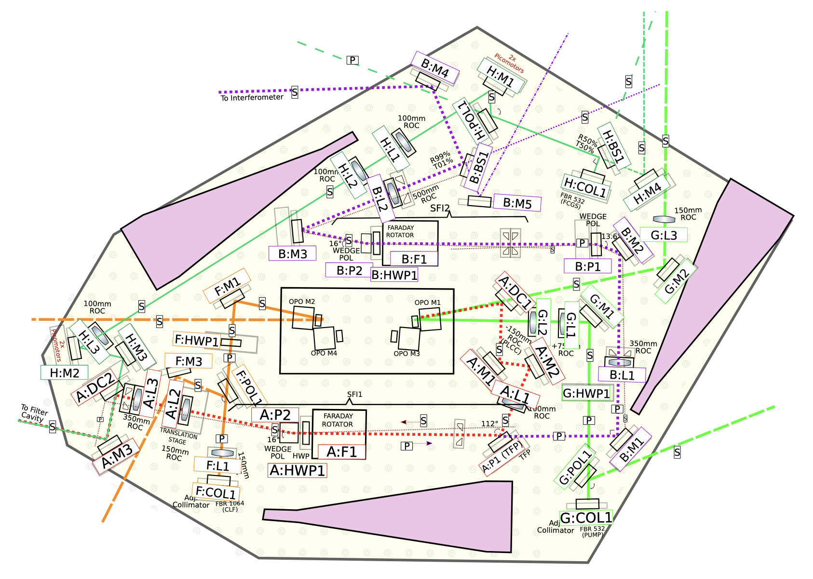
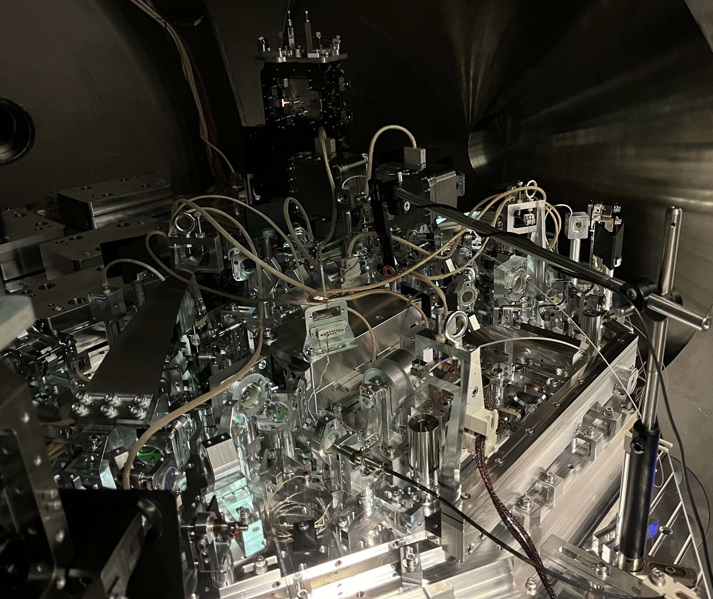
Optical System Overview – Vacuum Injection Platform
﻿﻿T1900649 FDS final optical layout
LIGO DCC G2502387
LLO62811
5 total passes through Faraday Isolators
1% loss if well aligned (LLO62852)
Tight space on on the platform, easy to clip the beam.
5 - 8.5 dB injection loss plausible

Slide 5
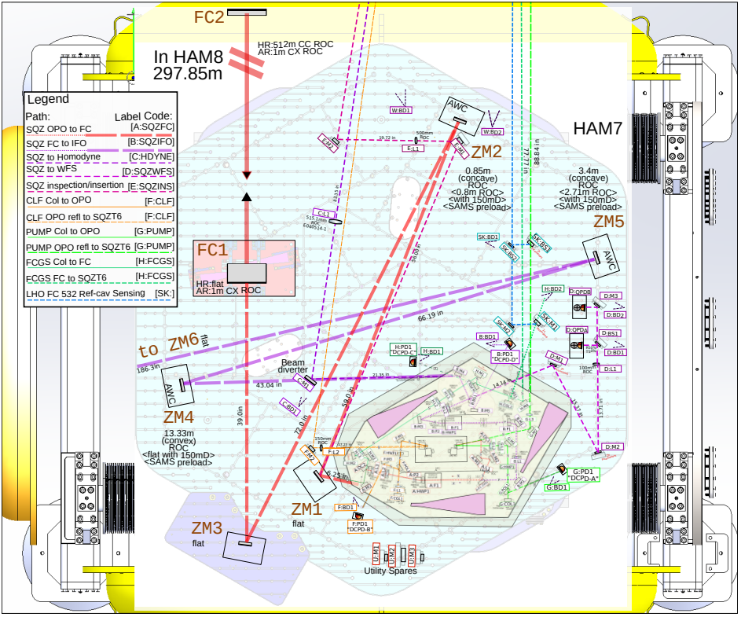
Optical System Overview – HAM7 & HAM5
﻿﻿T1900649 FDS final optical layout
LIGO DCC G2502387

Slide 6
Optical System Overview – Full IFO
To IFO
Free-space path to detection table
Source Table
Detection Table
Fibers from source table for green OPO pump, green FC, IR auxiliary beams CLF&RLF

Slide 7
Control System Overview
ADF Loop
W. Jia, A+ O4 Squeezing Layout G2301114
LIGO DCC G2502387

Slide 8
Control System Overview
LIGO DCC G2502387
Squeezer Laser – Main Laser
Frequency Lock (SQZ TTFSS)
FC Lock with Green
(feedback to Green frequency & to FC length)
Pre-Mode Cleaner Lock (SQZ PMC)
Detune FC until Resonant Locking Field (RLF) near resonance
Frequent FC Green lock loss
Green-IR frequency noise
Sensitive to GR alignment
SHG Cavity Lock (SQZ SHG)
SQZ TTFSS second path error signal CLF-IFO beat at OMC trans (LO Loop)
OPO Lock with Green Pump Beam (Green + IR co-resonance)
Switch the FC length control from Green error signal to IR error signal (beat between RLF and CLF @105 kHz)
Coherent Locking Field (CLF) Phase Lock to OPO (CLF2f Loop)
Activate FC IR alignment loops
OPO Green & CLF Intensity Stabilization ON
Switch the SQZ phase control from CLF2f to Audio Diagnostic Field
Notes:
During hand-off stage, error signal uses half of ADCs range. Easy to rail with high ground motion.

Slide 9
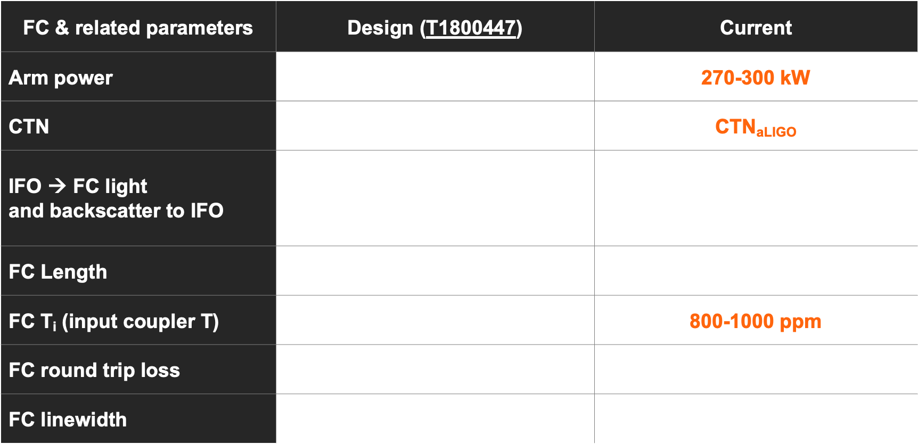
FC parameters design vs current
FC & related parameters | Design (T1800447) | Current
Arm power | 750-800 kW | 270-300 kW
CTN | 0.5 x CTN_{aLIGO} | CTN_{aLIGO}
IFO → FC light and backscatter to IFO | 50 pW (DC readout) 90 dB isolation 20 dB below DARM | <20 dB below DARM @ 10 Hz ~10 dB below DARM 100-300 Hz
FC Length | 300 m | ~300 m
FC T_{i} (input coupler T) | 1100-1200 ppm | 800-1000 ppm
FC round trip loss | 60 ppm | 40-100 ppm
FC linewidth | 2$π$ * 45 Hz | 74 Hz
LIGO DCC G2502387
Notes:
OFI thruput 99.3 % alog 55716
Fc cavity length noise req
deltaL/L = deltaf/f
<1.5 urad

Slide 10
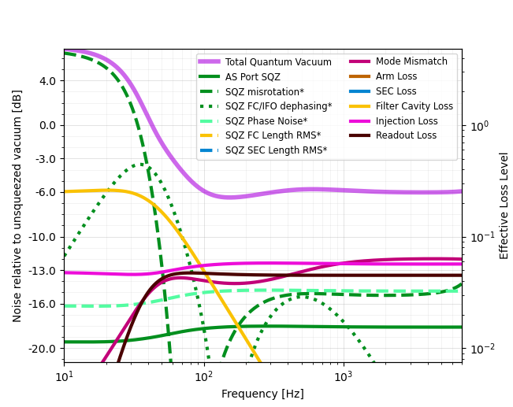
Squeezing at P_{arm} =280 kW suffers misrotation
LIGO DCC G2502387
GWINC SuperQK branch
Using math from L. McCuller, et al. Phys. Rev. D 104, 062006 (2021)
T2500310 - A+/O5 strain curve projections
T2500348 – A+/O5 quantum noise projections
Misrotation <50 Hz
Pointed out also in W. Jia et al. Science 385,1318(2024)
begum@mit.edu

Slide 11
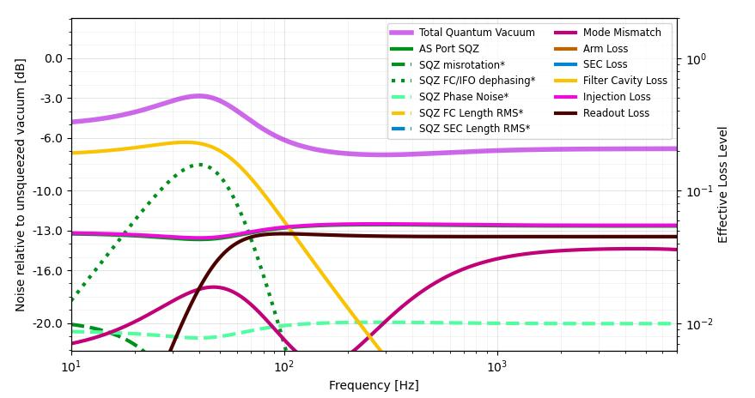
FC parameters are more suitable for squeezing with P_{arm} =550 kW
LIGO DCC G2502387
FC-IFO dephasing becomes limiting
Related to Ti, Lrt, injected squeezing
begum@mit.edu
T2500310 - A+/O5 strain curve projections, T2500348 – A+/O5 quantum noise projections

Slide 12
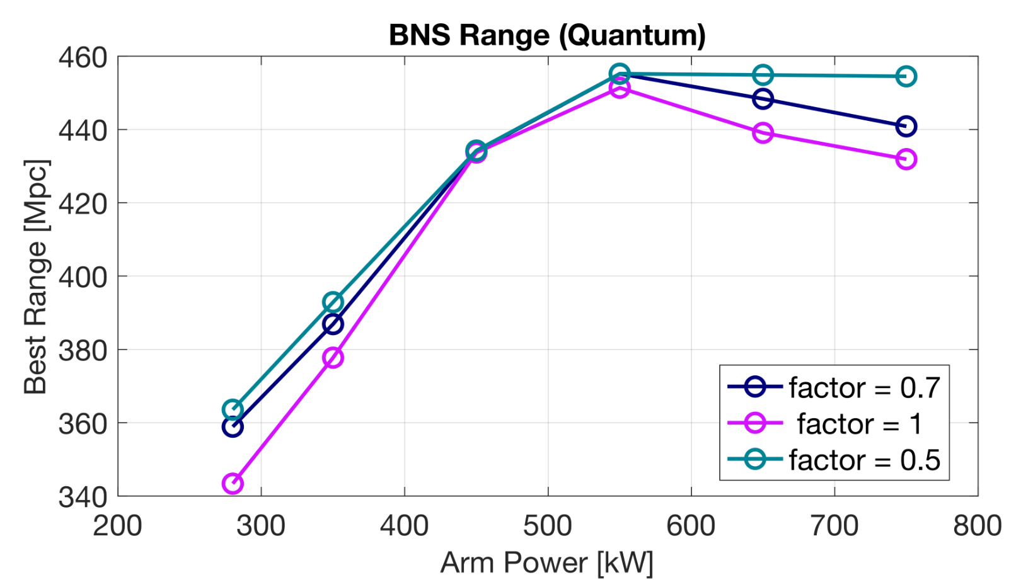
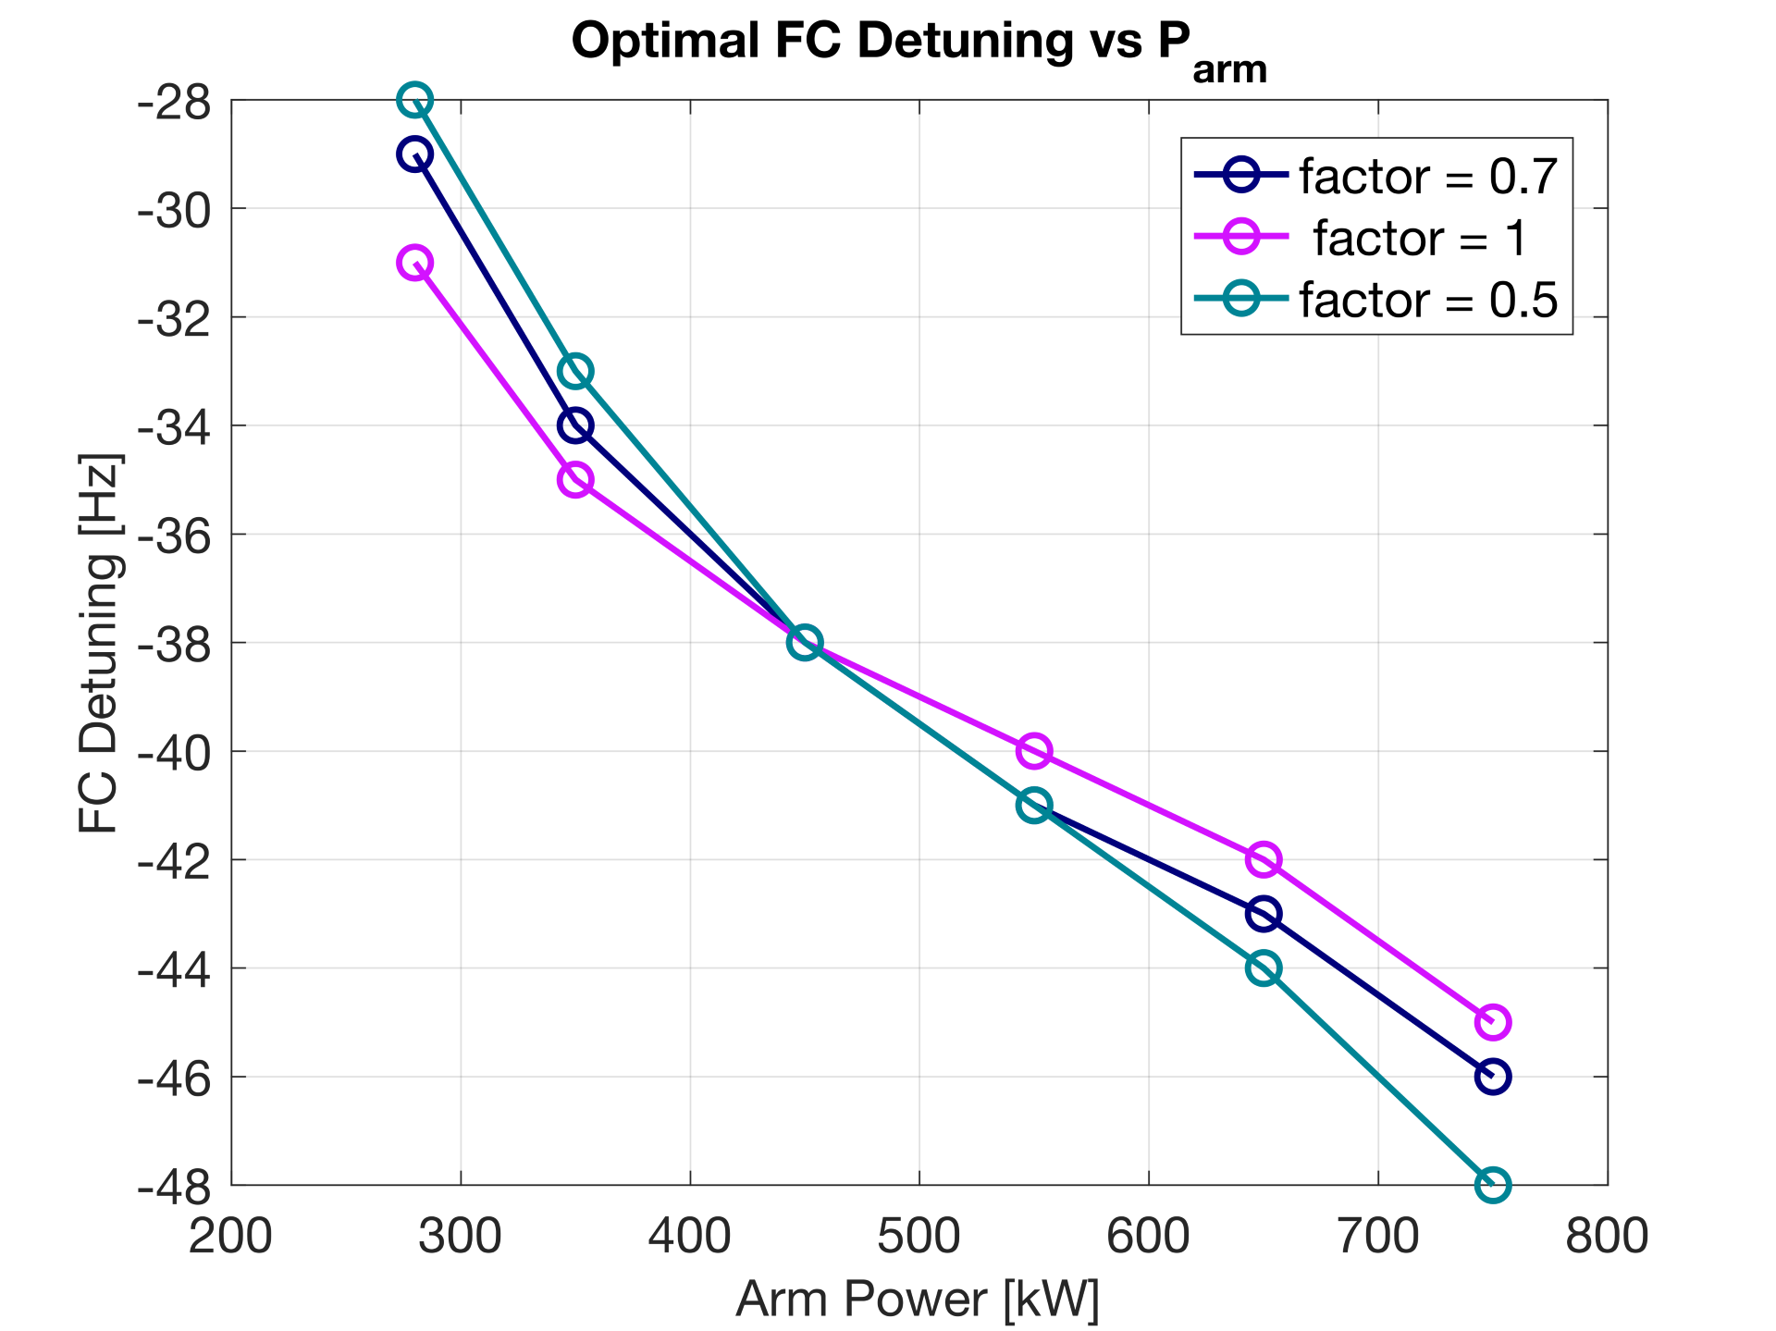
Squeezing with higher P_{arm} highly dependent on CTN
LIGO DCC G2502387
BNS range calculated for Quantum Noise.
Parameters optimized for each arm power and CTN. CTN defined as factor * aLIGO CTN
aLIGO CTN (Gras, G200088)
T1800447 - FDS Design Reqs evaluates this too.
begum@mit.edu
T2500310 - A+/O5 strain curve projections, T2500348 – A+/O5 quantum noise projections

Slide 13
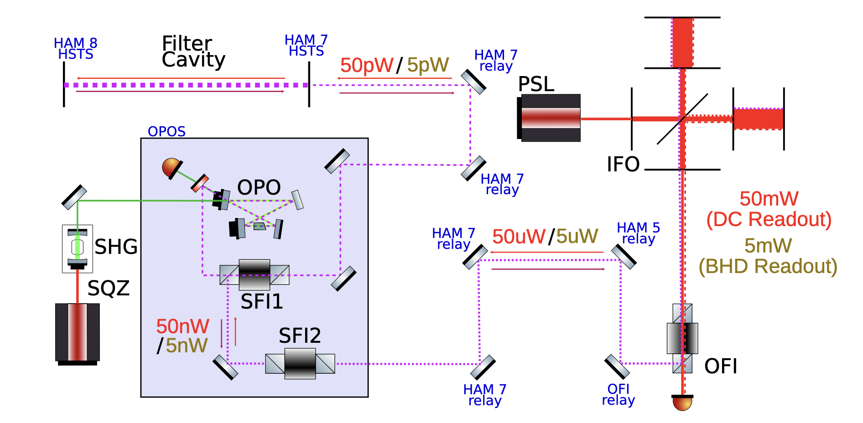
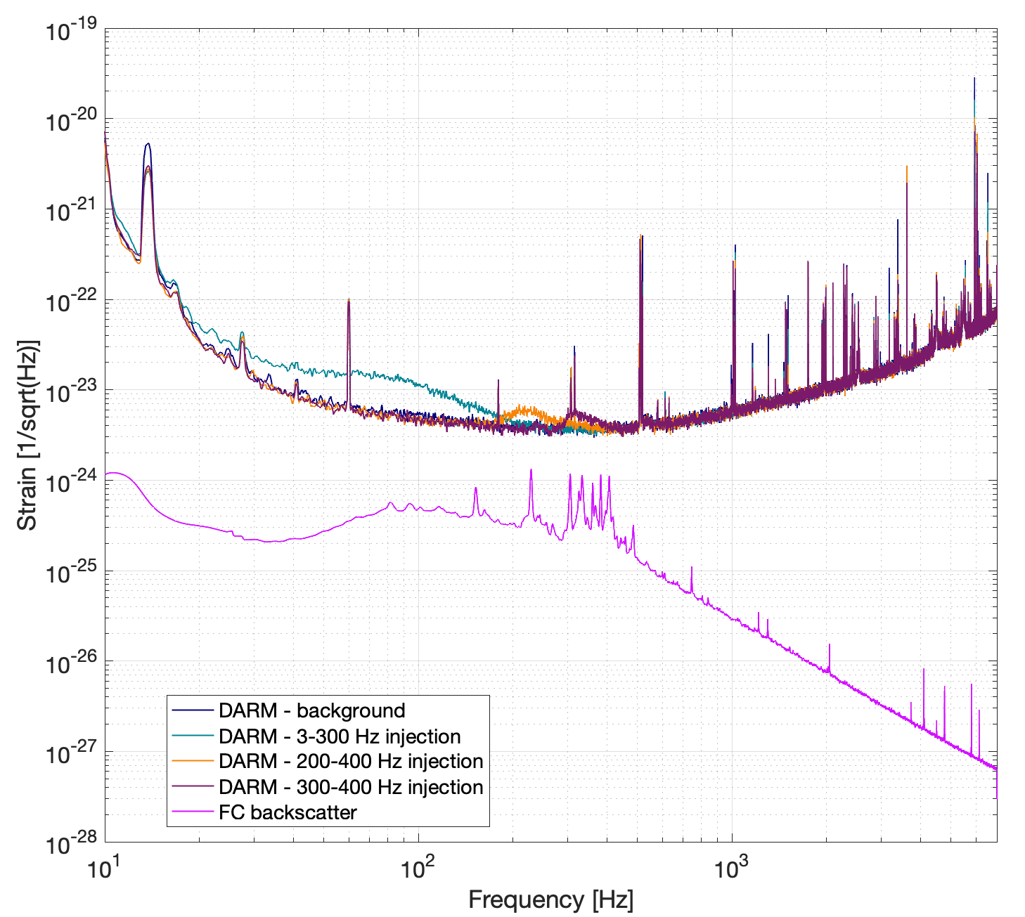
FC backscatter with 2 SQZ Faraday Isolators (+ OFI)
LLO 72088
T1800447 - FDS Design Requirements
FC backscatter is isolated enough with 2 SFIs.
Potential issues with backscatter at LHO86836, upstream of SFI2
Peaks come from sensing, but don’t show up on DARM during injections. Need additional work on this projection.
LIGO DCC G2502387
Notes:
FC linewidth requirement is tied to the pondermotive squeezing we want to pre-compensate for. So this of course means, we either need a very long FC or very high finesse.
High finesse means more stringent requirements on IFO backscatter from FC. FC backscatter noise depends on the fc length noise ofc. And BHD vs DC readout has a difference.
The design is estimated to have <20 dB below darm. Highly alignment dependent and temp needs optimizing.
Lower finesse means we can live with higher Tin & rtloss
FC IR finesse :500kHz/75 Hz ~6700
FC GR finesse:

Slide 14
SQZ and IFO Thermalization
During IFO thermalization (assuming TCS works as intended):
X – Y arm mode mismatch changes (technical noise)
Squeezing angle rotates (we fix with ADF servo, LLO75568, LLO75807)
Squeezer – IFO mode mismatch changes
Signal Extraction Cavity detuning changes
IFO – SEC – Output Mode Cleaner mismatch changes
K. Kuns and D. Brown, P2500132: “Squeezed state degradations due to mode mismatch and thermal aberrations in gravitational wave detectors”
LIGO DCC G2502387
begum@mit.edu
Notes:
ADF: Audio diagnostic field

Slide 15
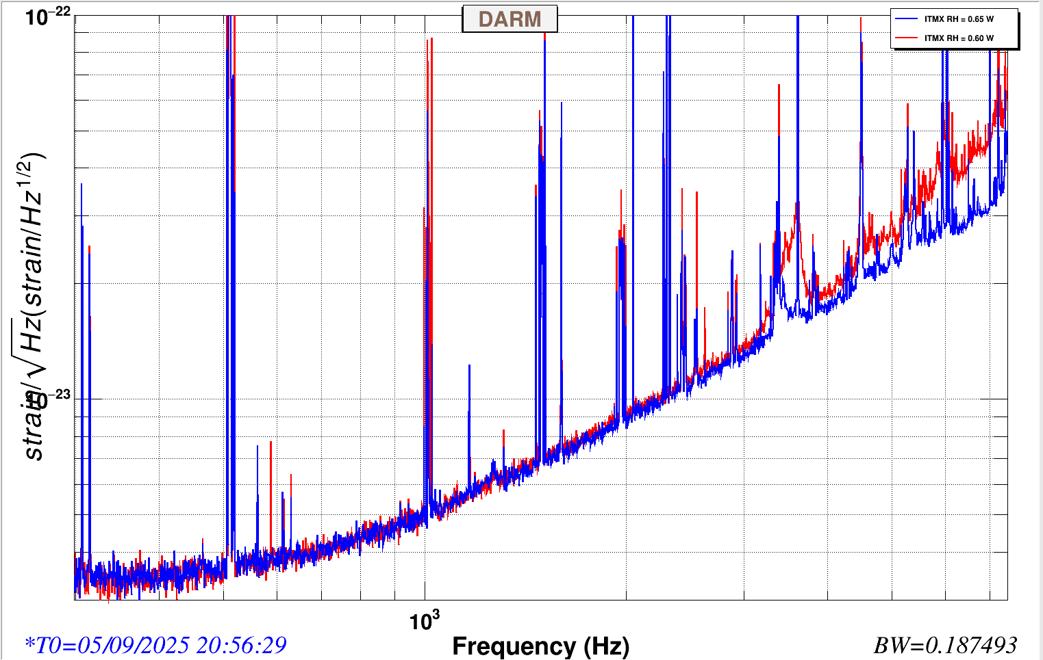
High freq. noise affects measurable squeezing
Arm mode mismatch to each other
Input jitter coupling to dark port
Measurable squeezing level degradation at 2 kHz
Ultimately, we can look at other bands for squeezing level diagnostics. More importantly: technical noise trumps shot noise.
LLO78418
V. Frolov
LIGO DCC G2502387

Slide 16
SQZ and the Static Thermal State of IFO
Thermal state of the test masses affects IFO beam, AND SQZ-IFO mode matching.
We scan SQZ beam parameter using PSAMs when needed. LLO72594: discussion on PSAM scans for power levels. LLO75184: ring heater related scan.
PSAM curvature control is coupled to PSAM alignment. Srivastava et al. Opt. Express 30, 10491 (2022) talks about the tilt in phase front.
Mode matching scan becomes very time consuming.
LHO Power down decision G2301151 (low freq. noise + lock stability)
We need better sensing and control over thermal state of the test masses.
SQZ beam can be used as a probe for IFO beam in full lock, if we have wavefront sensing for SQZ beam.
LIGO DCC G2502387
Notes:
ADF: Audio diagnostic field

Slide 17
Squeezing needs robust Thermal Control
May 8-9: Computer outage & Power glitch
PS
ABW
PS
Xtal move
ABW
PS
CO2 alignment shift
CO2 down
Jul 2: Beckhoff restart
Jul 9: Power glitch
High power experiments
CO2 misaligned on CP
recovery
PS: PSAM scan
ABW: Auto beam walk
LIGO DCC G2502387

Slide 18
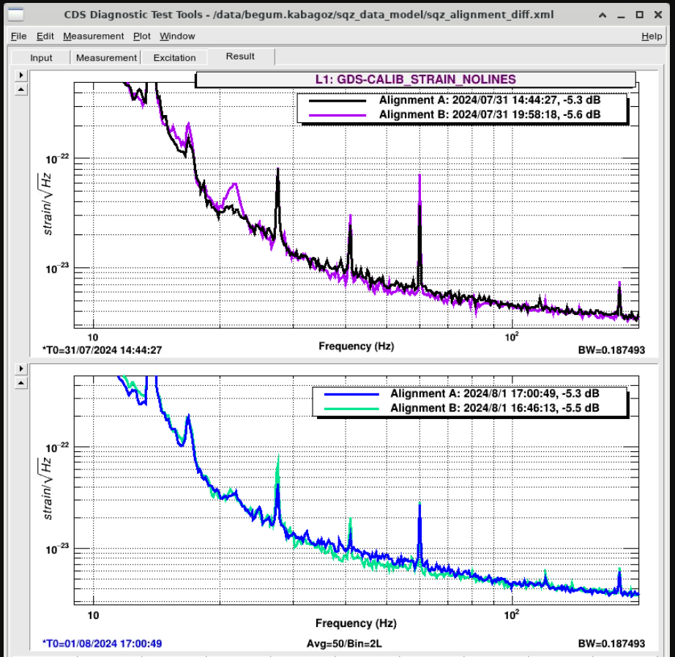
Misalignment can degrade low frequency noise too
LIGO DCC G2502387
Inferred change, LLO72729
SQZ-IFO mismatch | 5 %, 1 rad | 1 %, 0.4 rad
 | Alignment A |  | Alignment B
Right now we have no working SQZ-IFO alignment servo. Error signal (AS42) offset changes.
We align SQZ-IFO when needed, using ZM4/6 beam walking.
18
Notes:
Few percent mismatch. This can easily happen due to misalignment and/or mismatch. We already have indications that misalignment can add to lf noise.

Slide 19
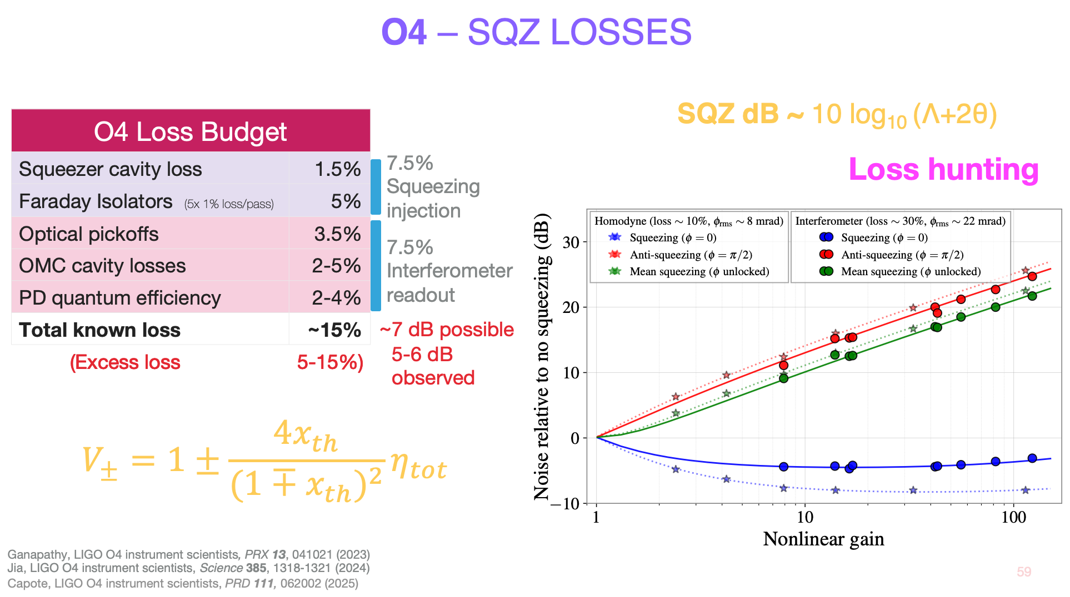
Mode matching losses in SQZ Loss Budget
Credit: V. Xu
Mode matching is a big part of total loss.
Mode matching phases can destructively/constructively interfere <400 Hz.
We have to think of squeezer with the rest of the IFO.
Phase noise 20-30 mrad
L. McCuller, et al. Phys. Rev. D 104, 062006 (2021)
LIGO DCC G2502387
19

Slide 20
Small(er) Problems that need solving
OPO crystal degradation
We move crystal position ~every 10 months, to a new spot. We will need new crystals soon.
After crystal move, rapid degradation
To keep same nonlinear gain, we increase green power to OPO cavity.
Input power to pump fiber increases, risky.
(Solved issue: must adjust crystal temperature (auto: LLO77278) and sqz phase angle changes (ADF servo).)
Green power level issues
LHO SHG output power variations cause FC green locking threshold issues
Polarization rotation through the pump fiber causes increase in input power to the pump fiber, risky.
FC green-IR frequency noise
Filter cavity commissioning without IFO beam was problematic. May be due to fiber delivery.
Fiber phase noise cancellation schemes?
Making alternative locking paths available would be nice. (e.g. FC Green error →TTFSS)
FC bounce modes ring up with proportional gain on length control servo
LIGO DCC G2502387
20

Slide 21
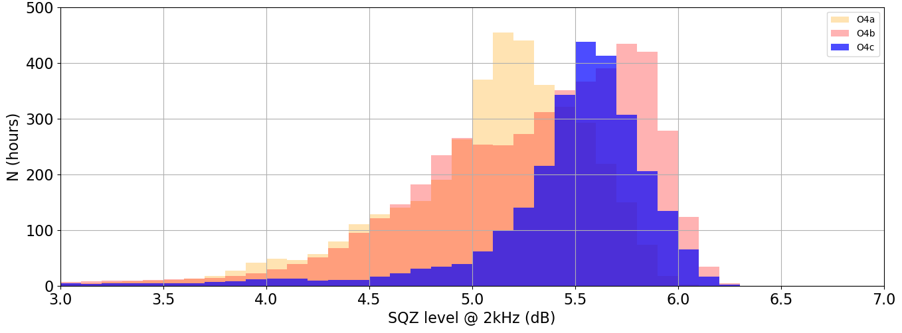
O4 FDS Performance at LLO
Squeezing Level: May 24th 2023 - Aug 31st 2025
O4a: First run with FDS. Starts strong at ~-5.8 dB, degrades over time to ~-5 dB.
O4b: Starts at ~-5.8 dB, degrades with TCS events, recovered to ~-6 dB, maintained there. Large spread in the histogram. Big progress in understanding the behavior and how to improve.
O4c: ~-6 dB before the break, ~-5.5 dB after. Operated with lower input power, higher absorption in the arms. Thermal state changes and test mass beam spot moves mean many cycles of mode matching and alignment optimization needed. Excellent uptime performance, robust control achieved, small variance in histogram.
Figure credit: A. Mulavey, also used in G2501943
Uptime = FDS time/Observing time*100
O4a (2023/05/24 – 2024/01/16): 99.4%
O4b (2024/04/10 – 2025/01/28): 95.3%
O4c (2025/01/28 – 2025/03/11): 100%
LIGO DCC G2502387

Slide 22
Conclusion
Many FC locking failures due to GR-IR frequency noise
Optimal FC parameters are arm power dependent and CTN dependent
Squeezing is highly dependent on thermal state
Squeezer misalignment can can couple noise to DARM<100 Hz
We have to think about the squeezer in the context of the full system
BHD – SQZ interaction is unknown right now
Alignment on HAM7 table very stable
Alignment from HAM7 → HAM5 stable, except big shifts happened twice
LIGO DCC G2502387
Dr. Begüm Kabagöz, MIT Kavli Institute, LIGO Labs

Slide 24
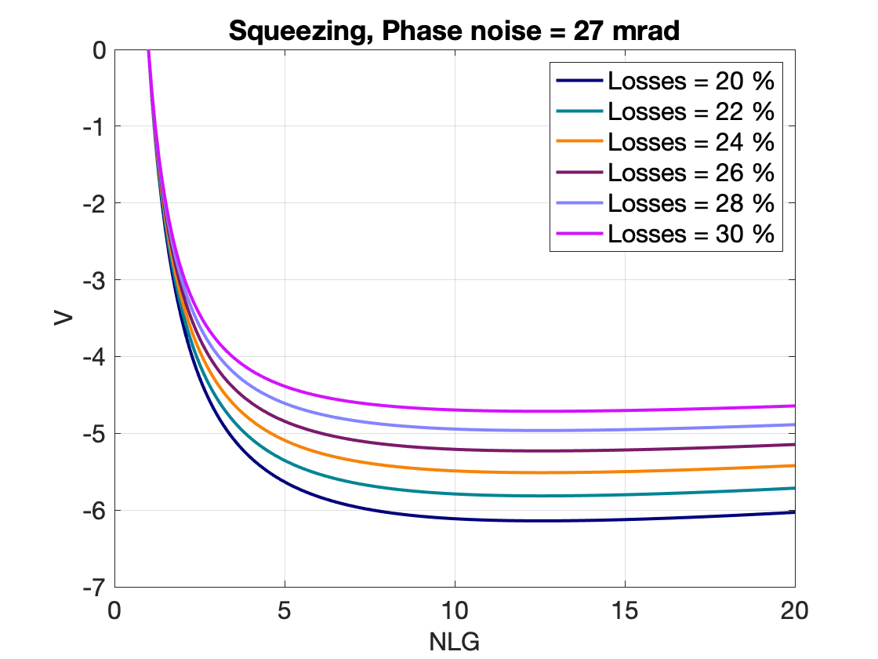
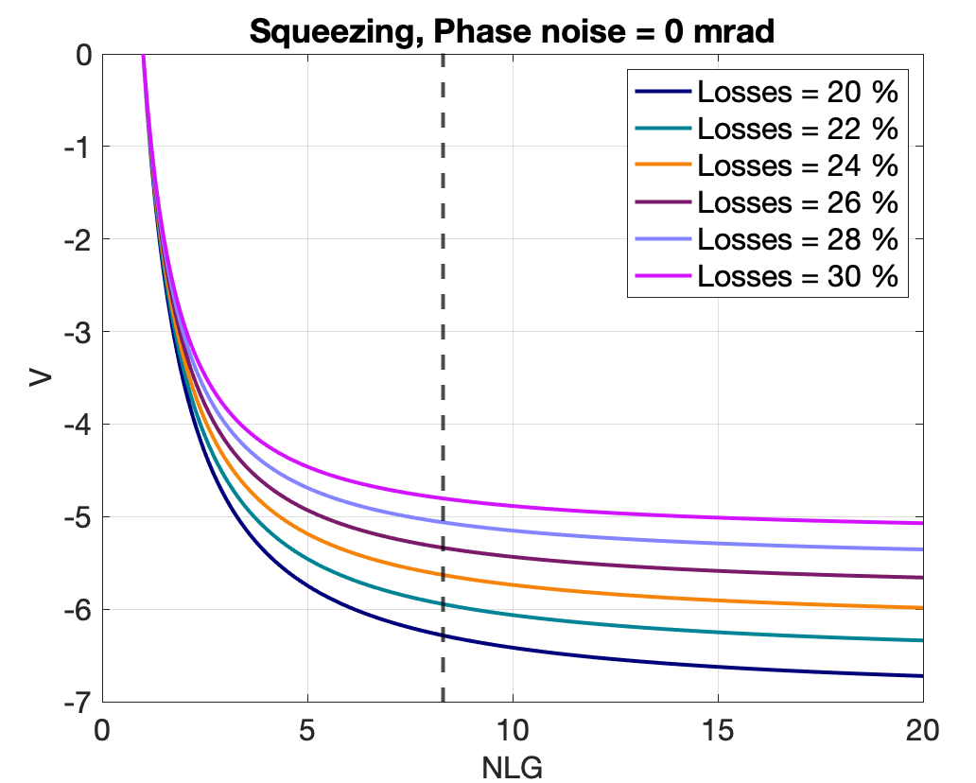

Loss, Phase noise and Squeezing Level
NLG determines the generated squeezing. Loss and phase noise compromise the attainable squeezing level.
$$V_{real} [dB] = 10 ∗ log10 (V_{real}/V_{shot})$$
$$V_{real} = V(φ) ∗\cos^{2}{θ_{rms}} + V(φ+π/2) ∗\sin^{2}{θ_{rms} }$$
$$V\left(φ\right)=\cos^{2}{φ} ∗ \left(1−\frac{4ηx}{{\left(1+x\right)}^{2}}\right) +\sin^{2}{φ}∗ \left(1+{\frac{4ηx}{{\left(1−x\right)}^{2}}}^{ }\right)$$
$$η = 1−loss$$
$x = 1− {\left(\sqrt{nlg}\right)}^{−1}=\sqrt{P/P_{threshold}}$ : normalized NL interaction strength
Estimates: 23% losses, 10 mrad phase noise, 19 NLG
LLO alog 73225 73188
E. Oelker, et al. Optica 3, 682-685 (2016)
begum@mit.edu
Dr. Begüm Kabagöz, MIT Kavli Institute, LIGO Labs

