Slide 1
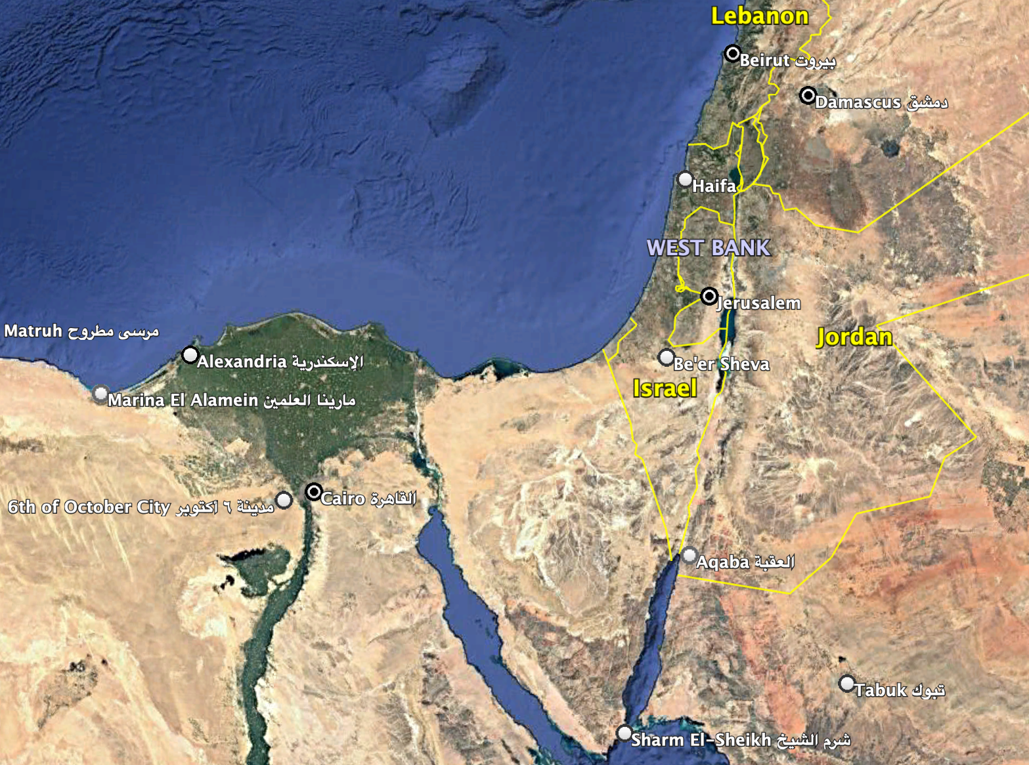
Muon Radiography
in The Holy Land™
City of David- Wadi Hilweh
Daniel Levin³
Yan Benhamou¹
Erez Etzion¹
Yiftah Silver^{1,2}
Gilad Mizrachi¹
Igor Zolkin¹
¹ Tel Aviv University
² Rafael Systems
³ University of Michigan
In collaboration with
Yuval Gadot⁴
Oded Lipschits⁴
Yiftah Sahlev⁵
⁴Department of Archaeology & Ancient Near Eastern Cultures, Tel-Aviv University
⁵Israel Antiquities Authority

Slide 2
Radiography enables search for subterranean features in sites of antiquity
sites = tels, city ramparts, burial sites, edifices: pyramids, necropolis
features = voids, chambers, water conduits, cisterns
Inexpensive - requires less time, $, manpower than excavation
Compliments traditional excavation
Non-invasive ➔ for use in sensitive or inaccessible environments

Slide 3
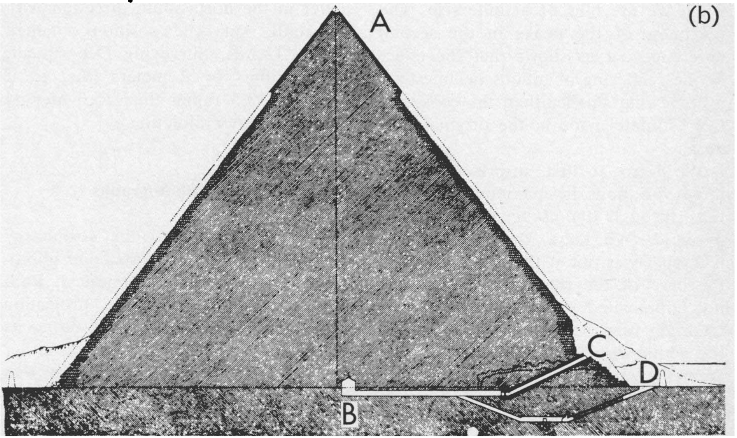
Muon Radiography/Tomography
New South Wales, Australia
E. P. George ➔ Measurement of rock overburden of a tunnel
Technology: Geiger counter. No imaging!
Egypt: 2nd Pyramid of Chephren
L. Alvarez “Search for Hidden Chambers in the Pyramids,”
Science 167, 832 (1970)
Technology: Spark chamber
1989 Laquila, Italy MACRO experiment
Radiographic evaluation of the rock overburden was a common feature of analyses
2011 The Mu-Ray Project: Imaging of Vesuvius
Image volcanic summit from the side.
Technology: hodoscope using extruded plastic scintillators. (adopted from D0)
2023 “Precise characterization of a corridor-shaped structure in Khufu’s Pyramid by observation of cosmic-ray muons”
Nature Comm, March 2023
200 m

Slide 4
Muon Radiography/Tomography
“Hidden chamber discovery in the underground Hellenistic necropolis of Neapolis by muography”, Nature April 2023
“Precise characterization of a corridor-shaped structure in Khufu’s Pyramid by observation of cosmic-ray muons”
Nature Comm, March 2023
Current: University of Virginia (E. C. Dukes) Deploy detector pairs at varying locations over two years for 3D imaging.
plus many applications in mining, reactor evaluation, cargo inspection, defense (tunnel searches) etc.
Our interest is in archaeological sites in Israel

Slide 5
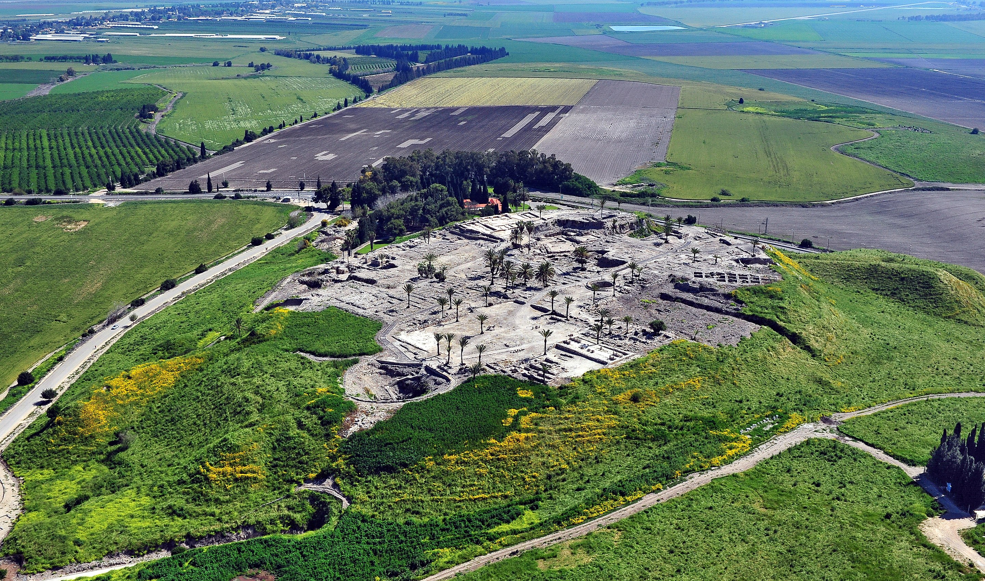
Archaeological tels contain strata of successive civilizations
תל חצור
Tel Hazor
Ancient Canaanite to Israeli city-state
Water systems

Slide 6
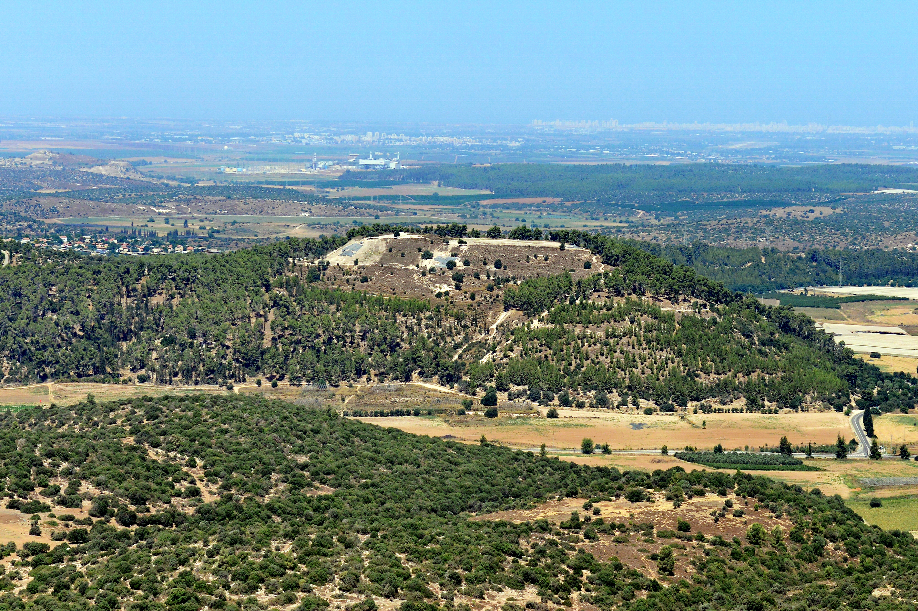
Archaeological tels contain strata of successive civilizations
תל עזקה
Tel Azeka
Early bronze to byzantine
David v Goliath
Water systems
Hideouts (Bar Kokhba revolt)
April, 2025 a three-year-old Israeli toddler stumbled upon a 3,800 year old Canaanite seal near Tel Azeka

Slide 7
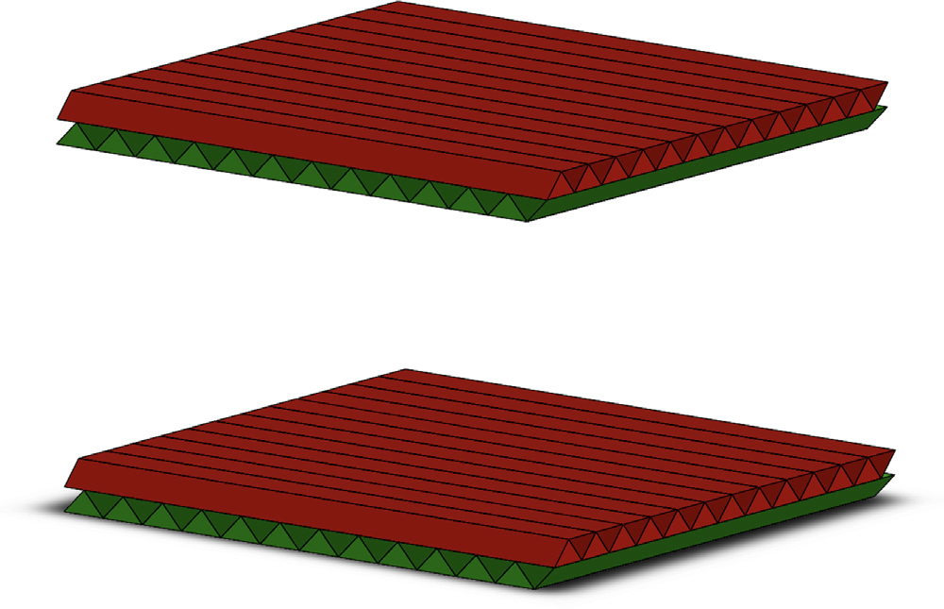
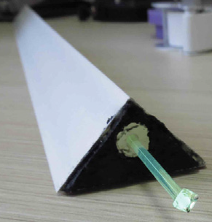
Detector Technology: Extruded Plastic Scintillator
from the FNAL Extrusion Facility
polystyrene + 1% PPO + 0.03% POPOP with TiO₂ coating
40 cm
4 planes ( 2X & 2Y) interleaved triangular scintillator bars
23 triangular bars/layer x 3.2 x 1.7 cm²
40 cm
wavelength shifting fiber (Saint-Gobain BCF-91A)
3.2 cm

Slide 8
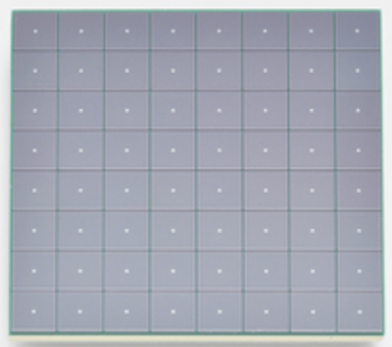
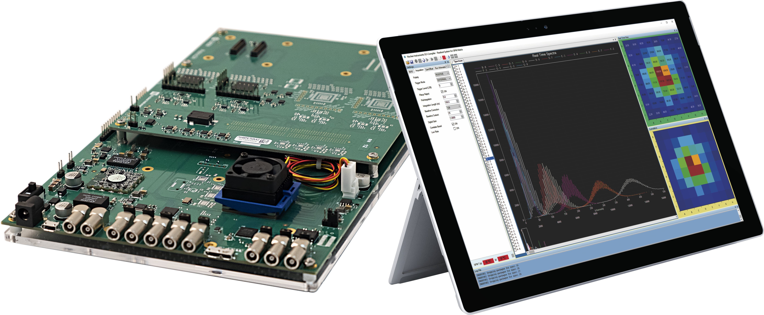
Readout & DAQ
DAQ: CAEN’s DT5550W platform
== > 4 x 32 channels Citiroc ASICs
Each ASIC is self-triggering
Xilinx XC7K160T FPGA reads out the ASICs and ADCs
3 mm
Fibers coupled to Hamamatsu S13361-3050 8x8 SiPM array

Slide 9
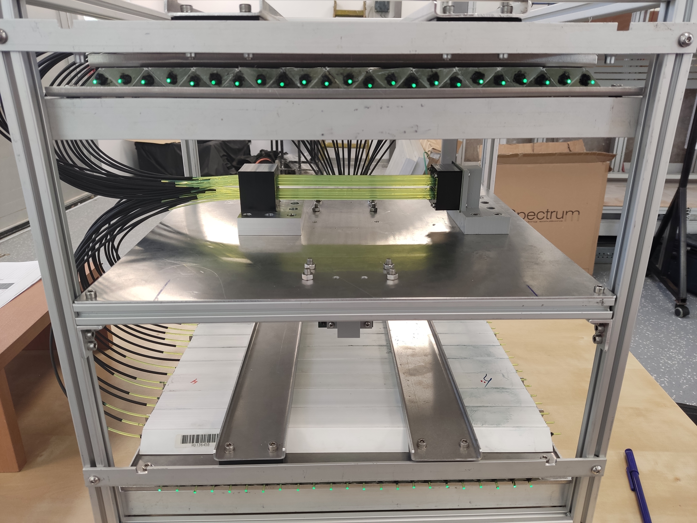
Assembled detector in Tel Aviv University Lab

Slide 10
Muon Tracking
∆X
Hit position: charge weighted avg:
X_{avg} = (Q_{i}*X_{i} +Q_{i+1} * X_{i+1})/(Q_{i}+Q_{i+1})
tan𝛉 = ∆x/∆Z
Angular resolution measured: 𝛅𝛉 < ~ 10 mrad
∆Z = 40 cm

Slide 11
Detector Staging in
The City of David / Wadi Hilweh
City of David regarded as Jerusalem 1.0 ==> established by King David 1000 BCE
Objective: search for signs of passages to Gihon Spring, the city’s water source
All ancient cities needed a water supply and fortified,
secret ways to get to there in case of emergency or war*
* Prof. Oded Lipschits, director of Ancient Israel Studies at the Tel Aviv University

Slide 12
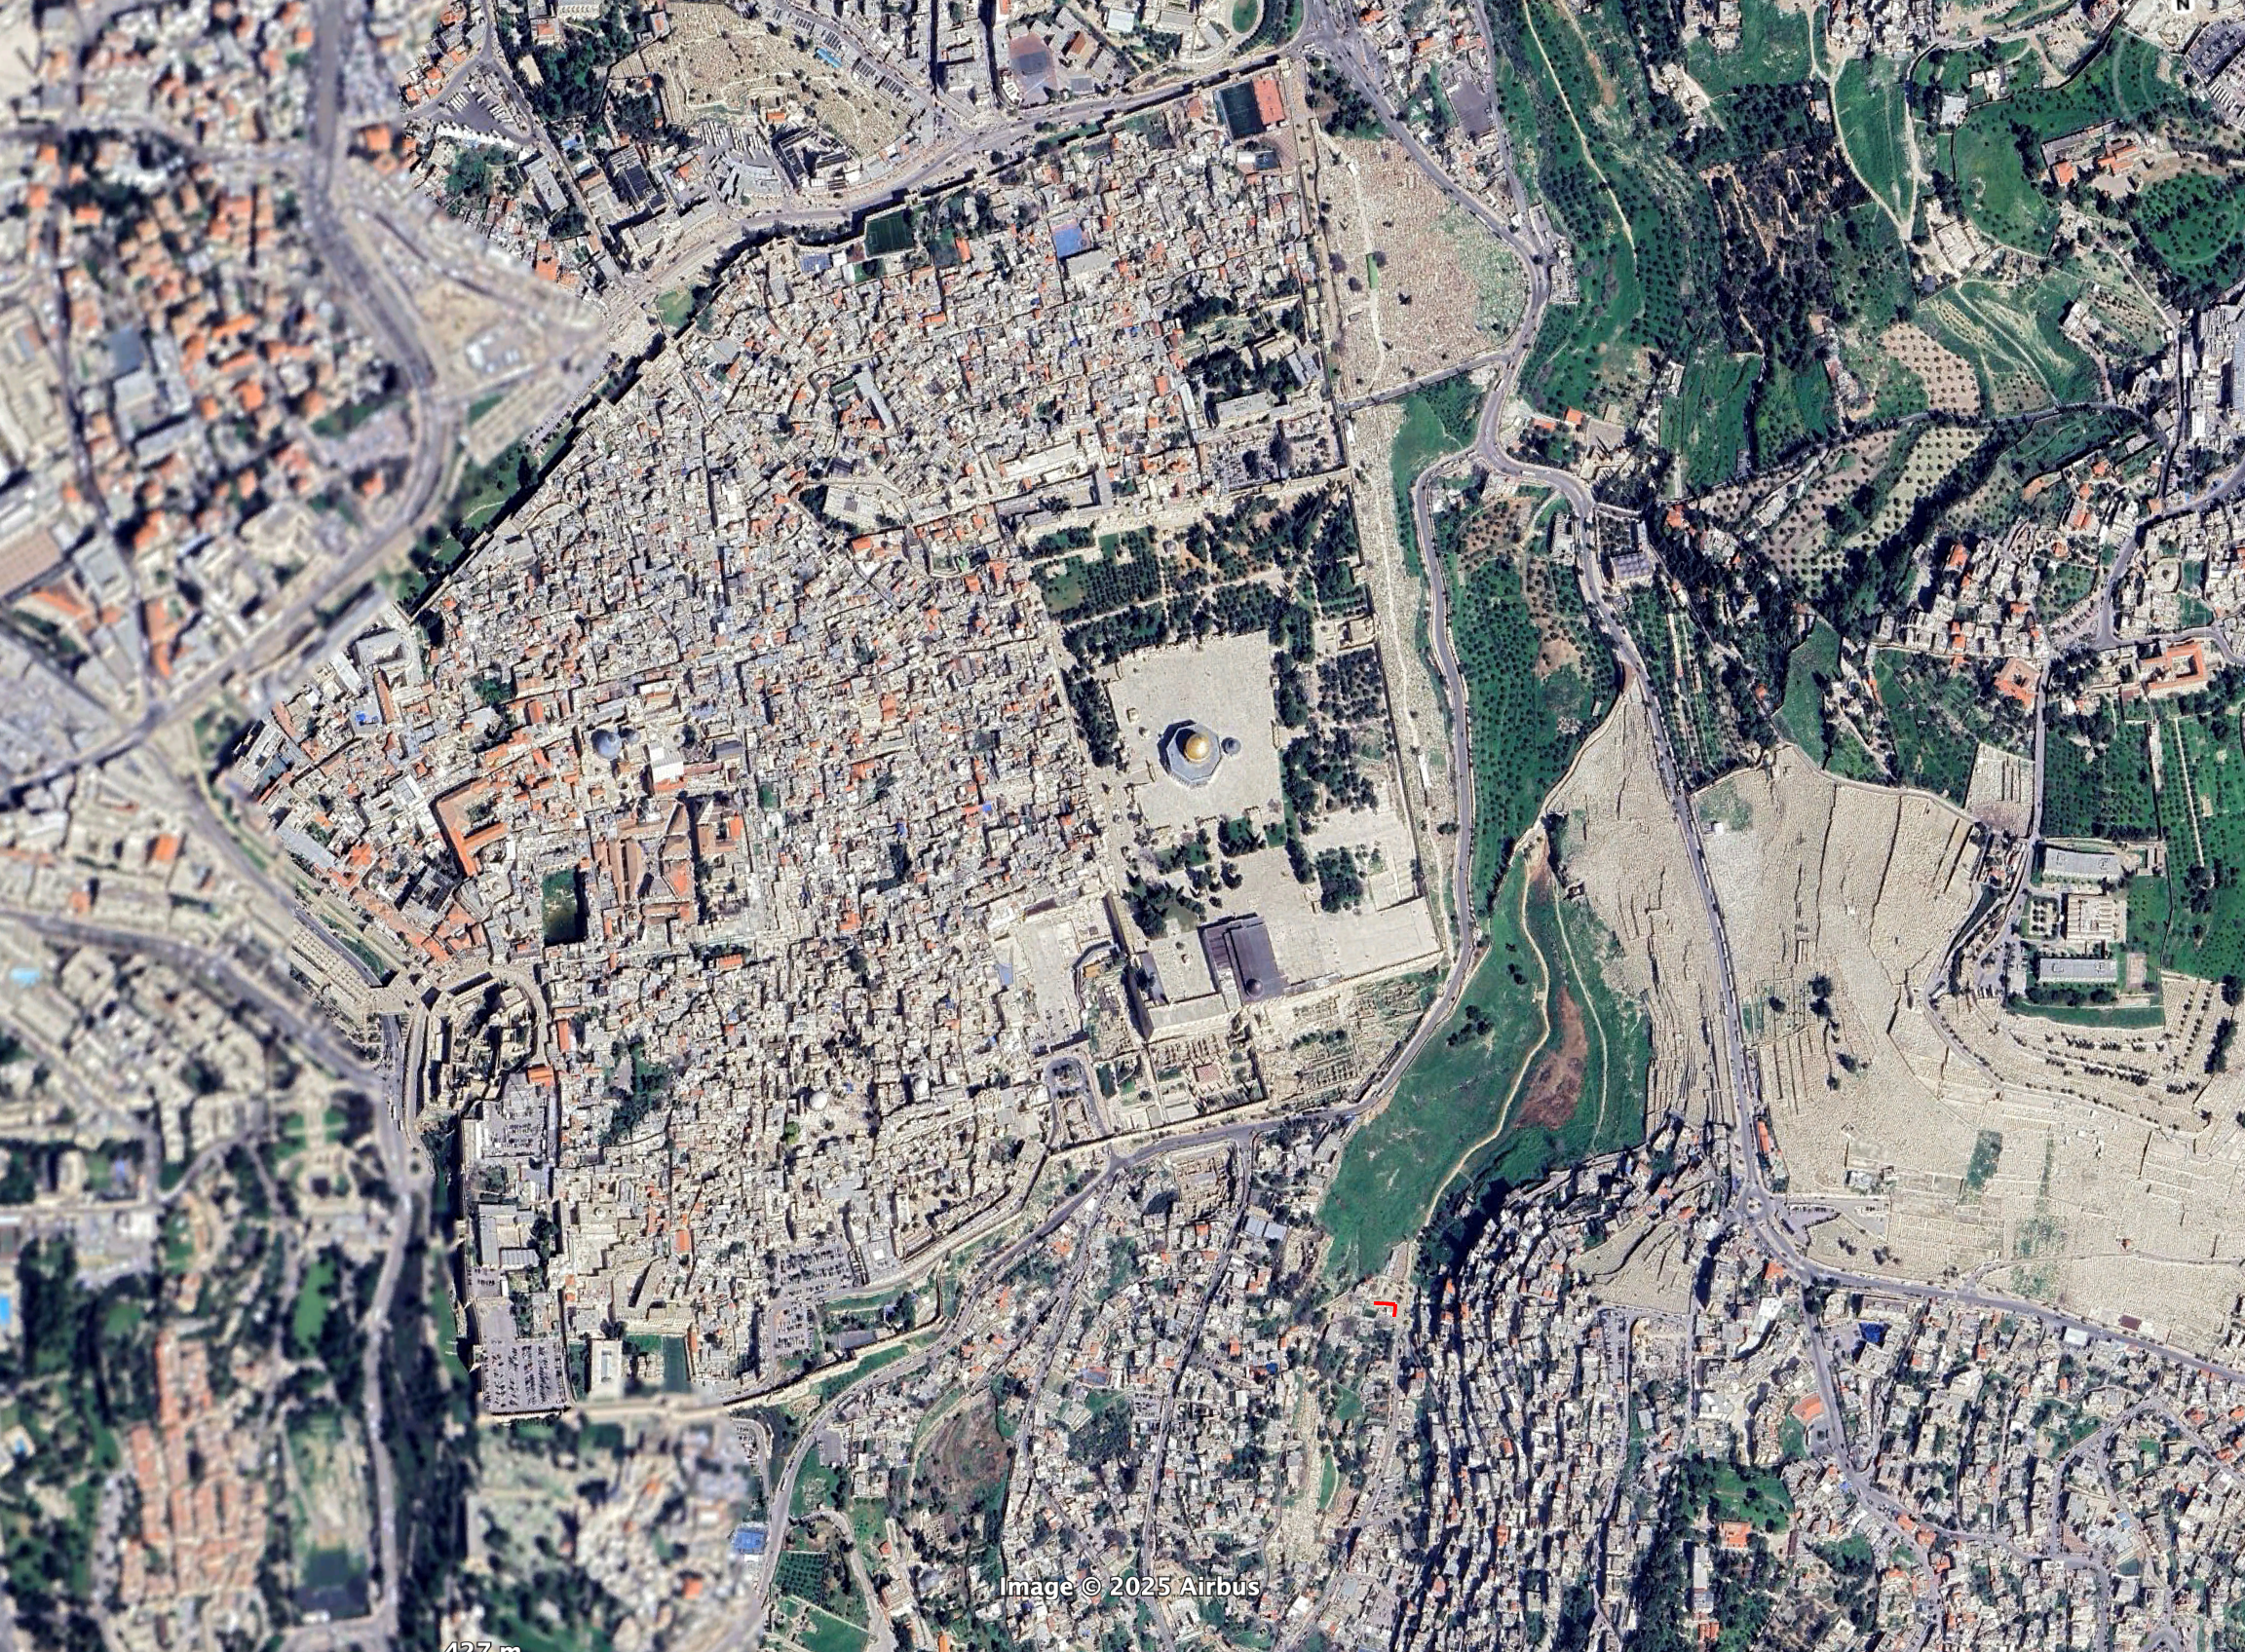
via Dolorosa
Holy Sepulcher
Gethsemane
Dome of the Rock
Western Wall
Al Aqsa Mosque
Muon Detector
nachal qidron
Kidron

Slide 13
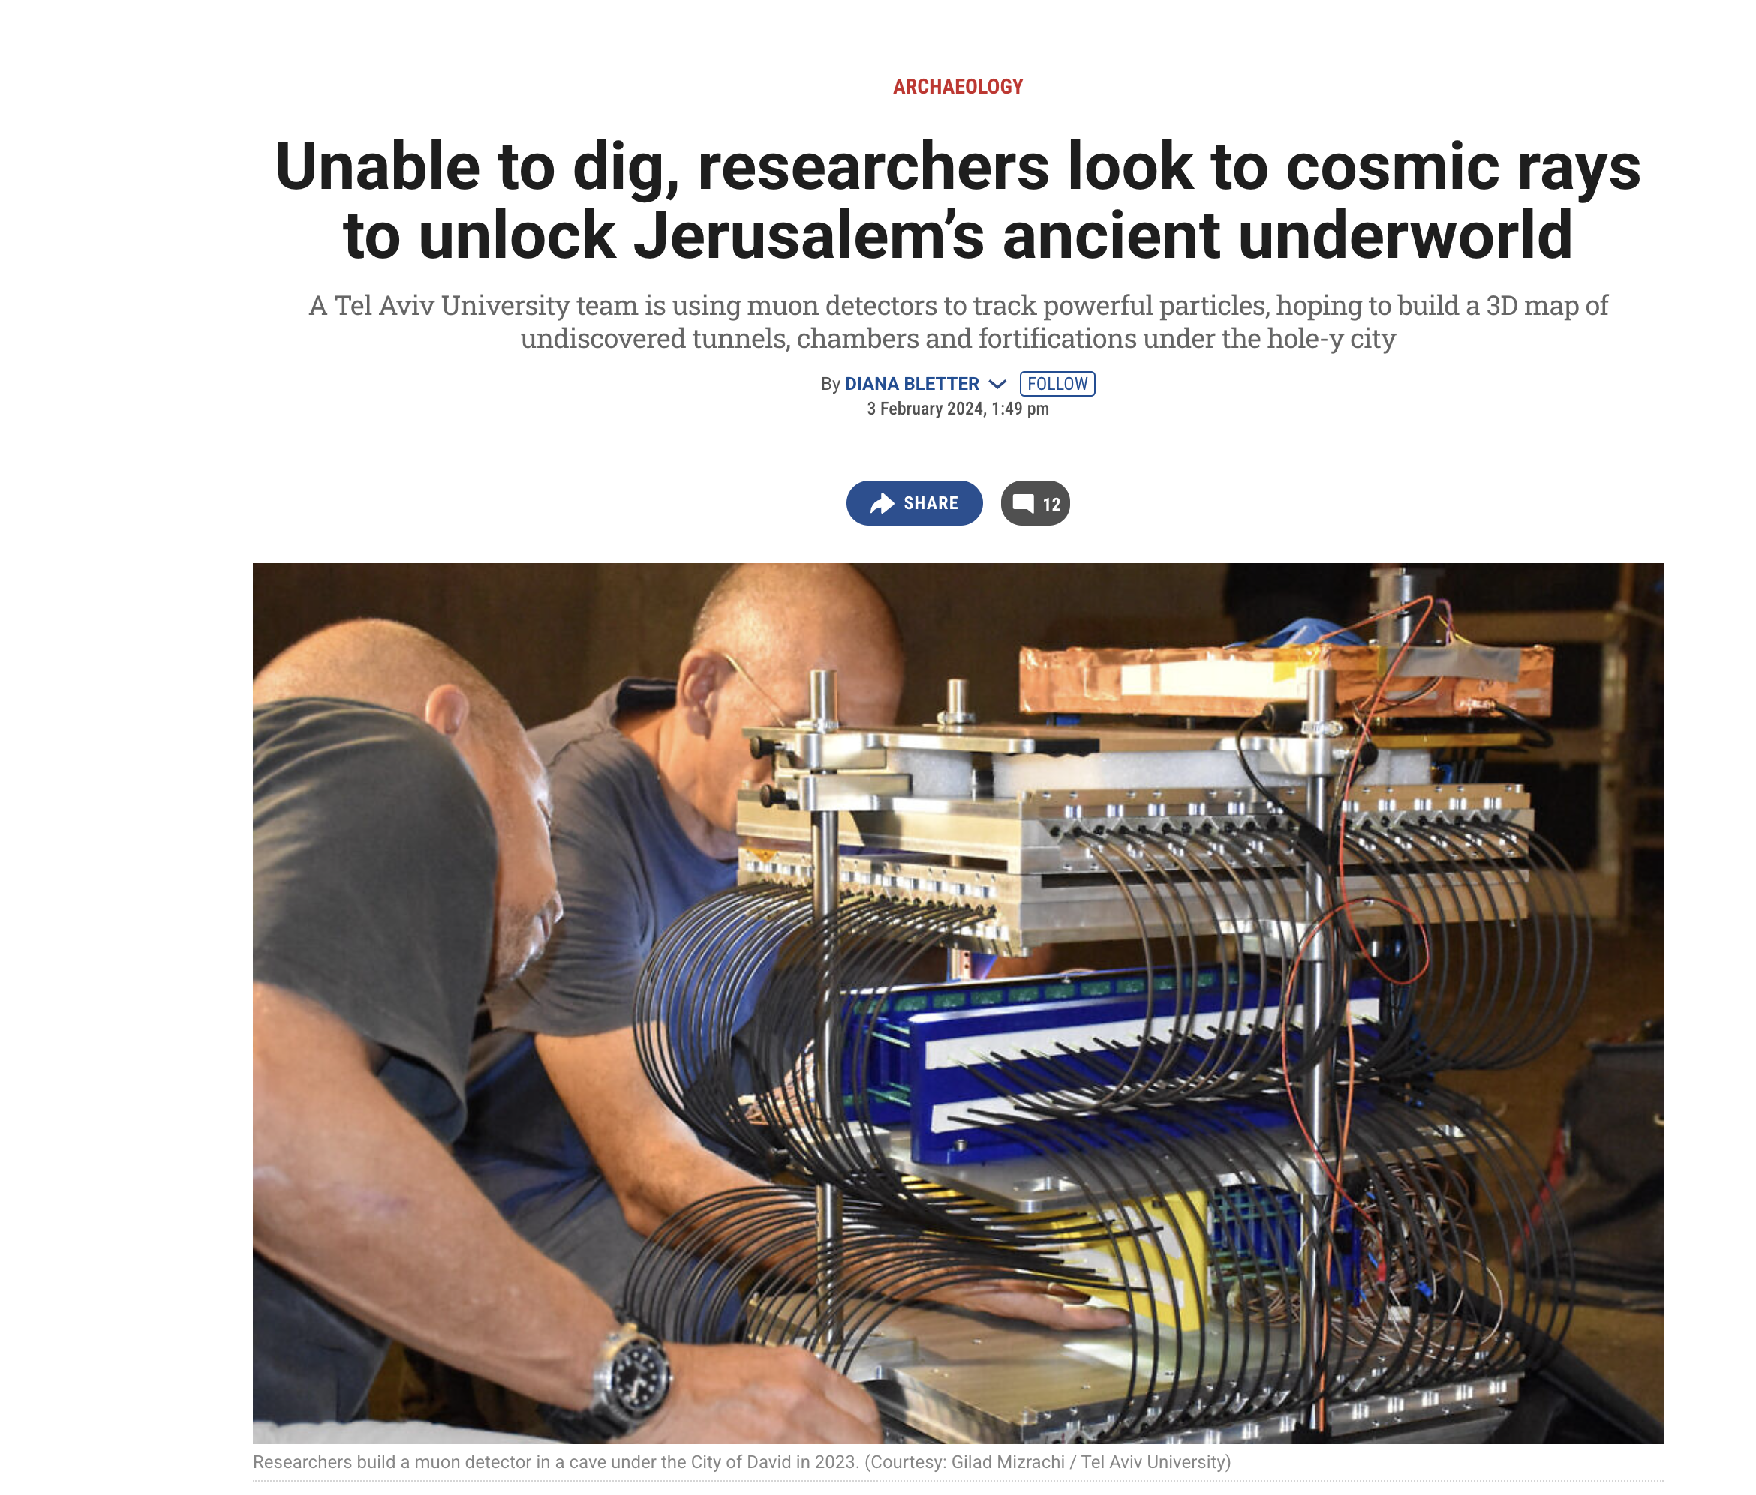

Slide 14
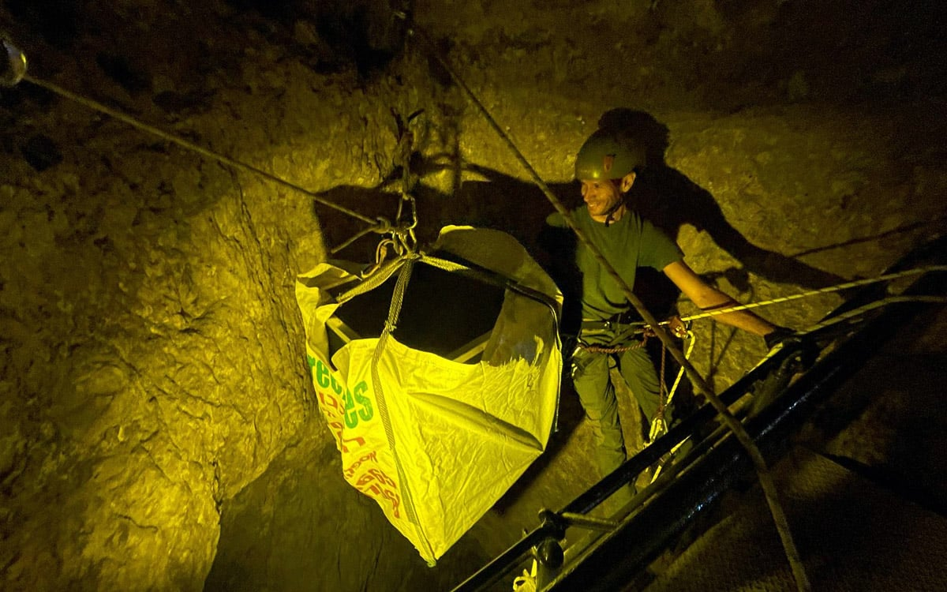
Attempting to install at Warren’s Shaft
10th century BCE access to the Gihon Spring

Slide 15
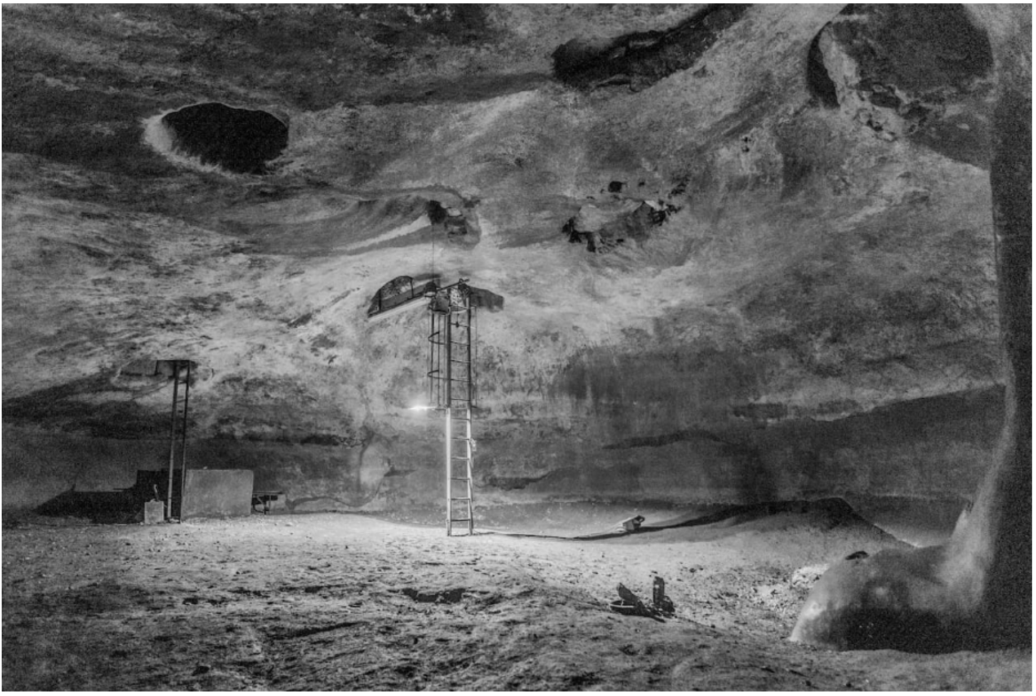
First operational test: Placement in “Jeremiah’s” Cistern
arxiv 2504.03078

Slide 16
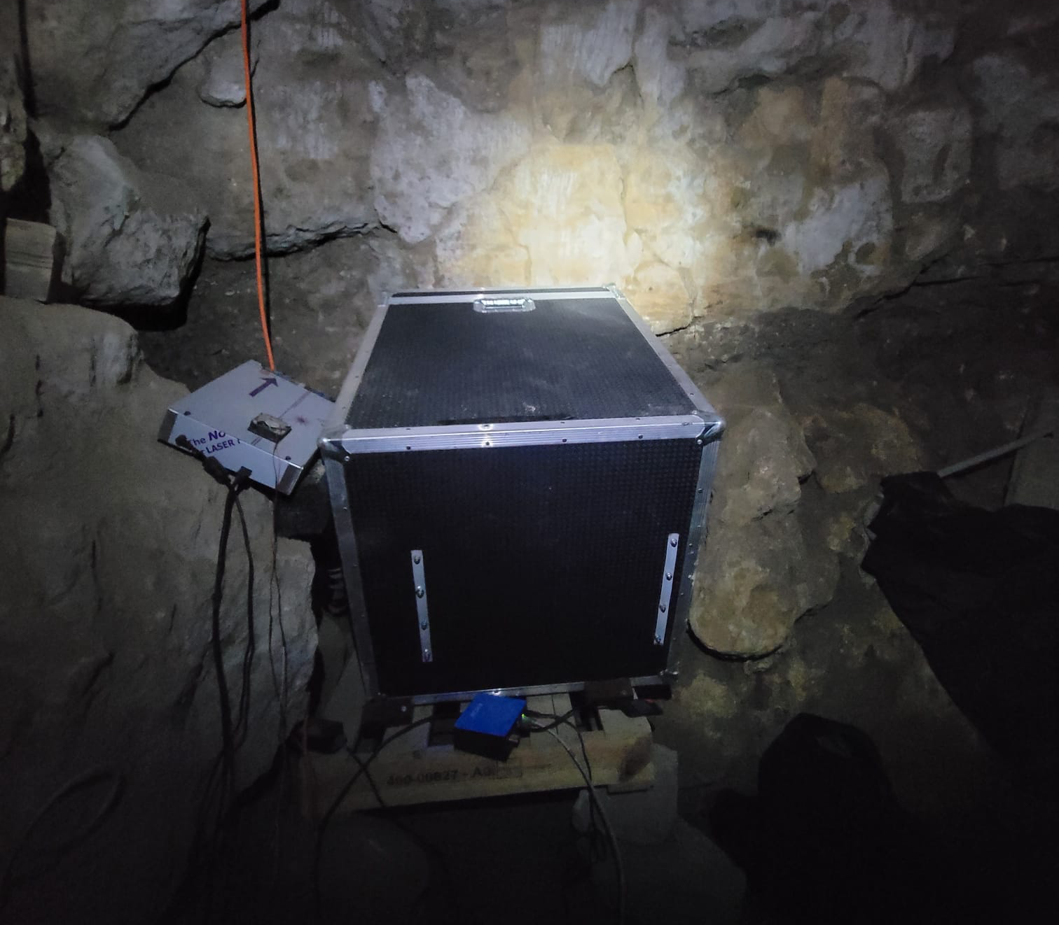
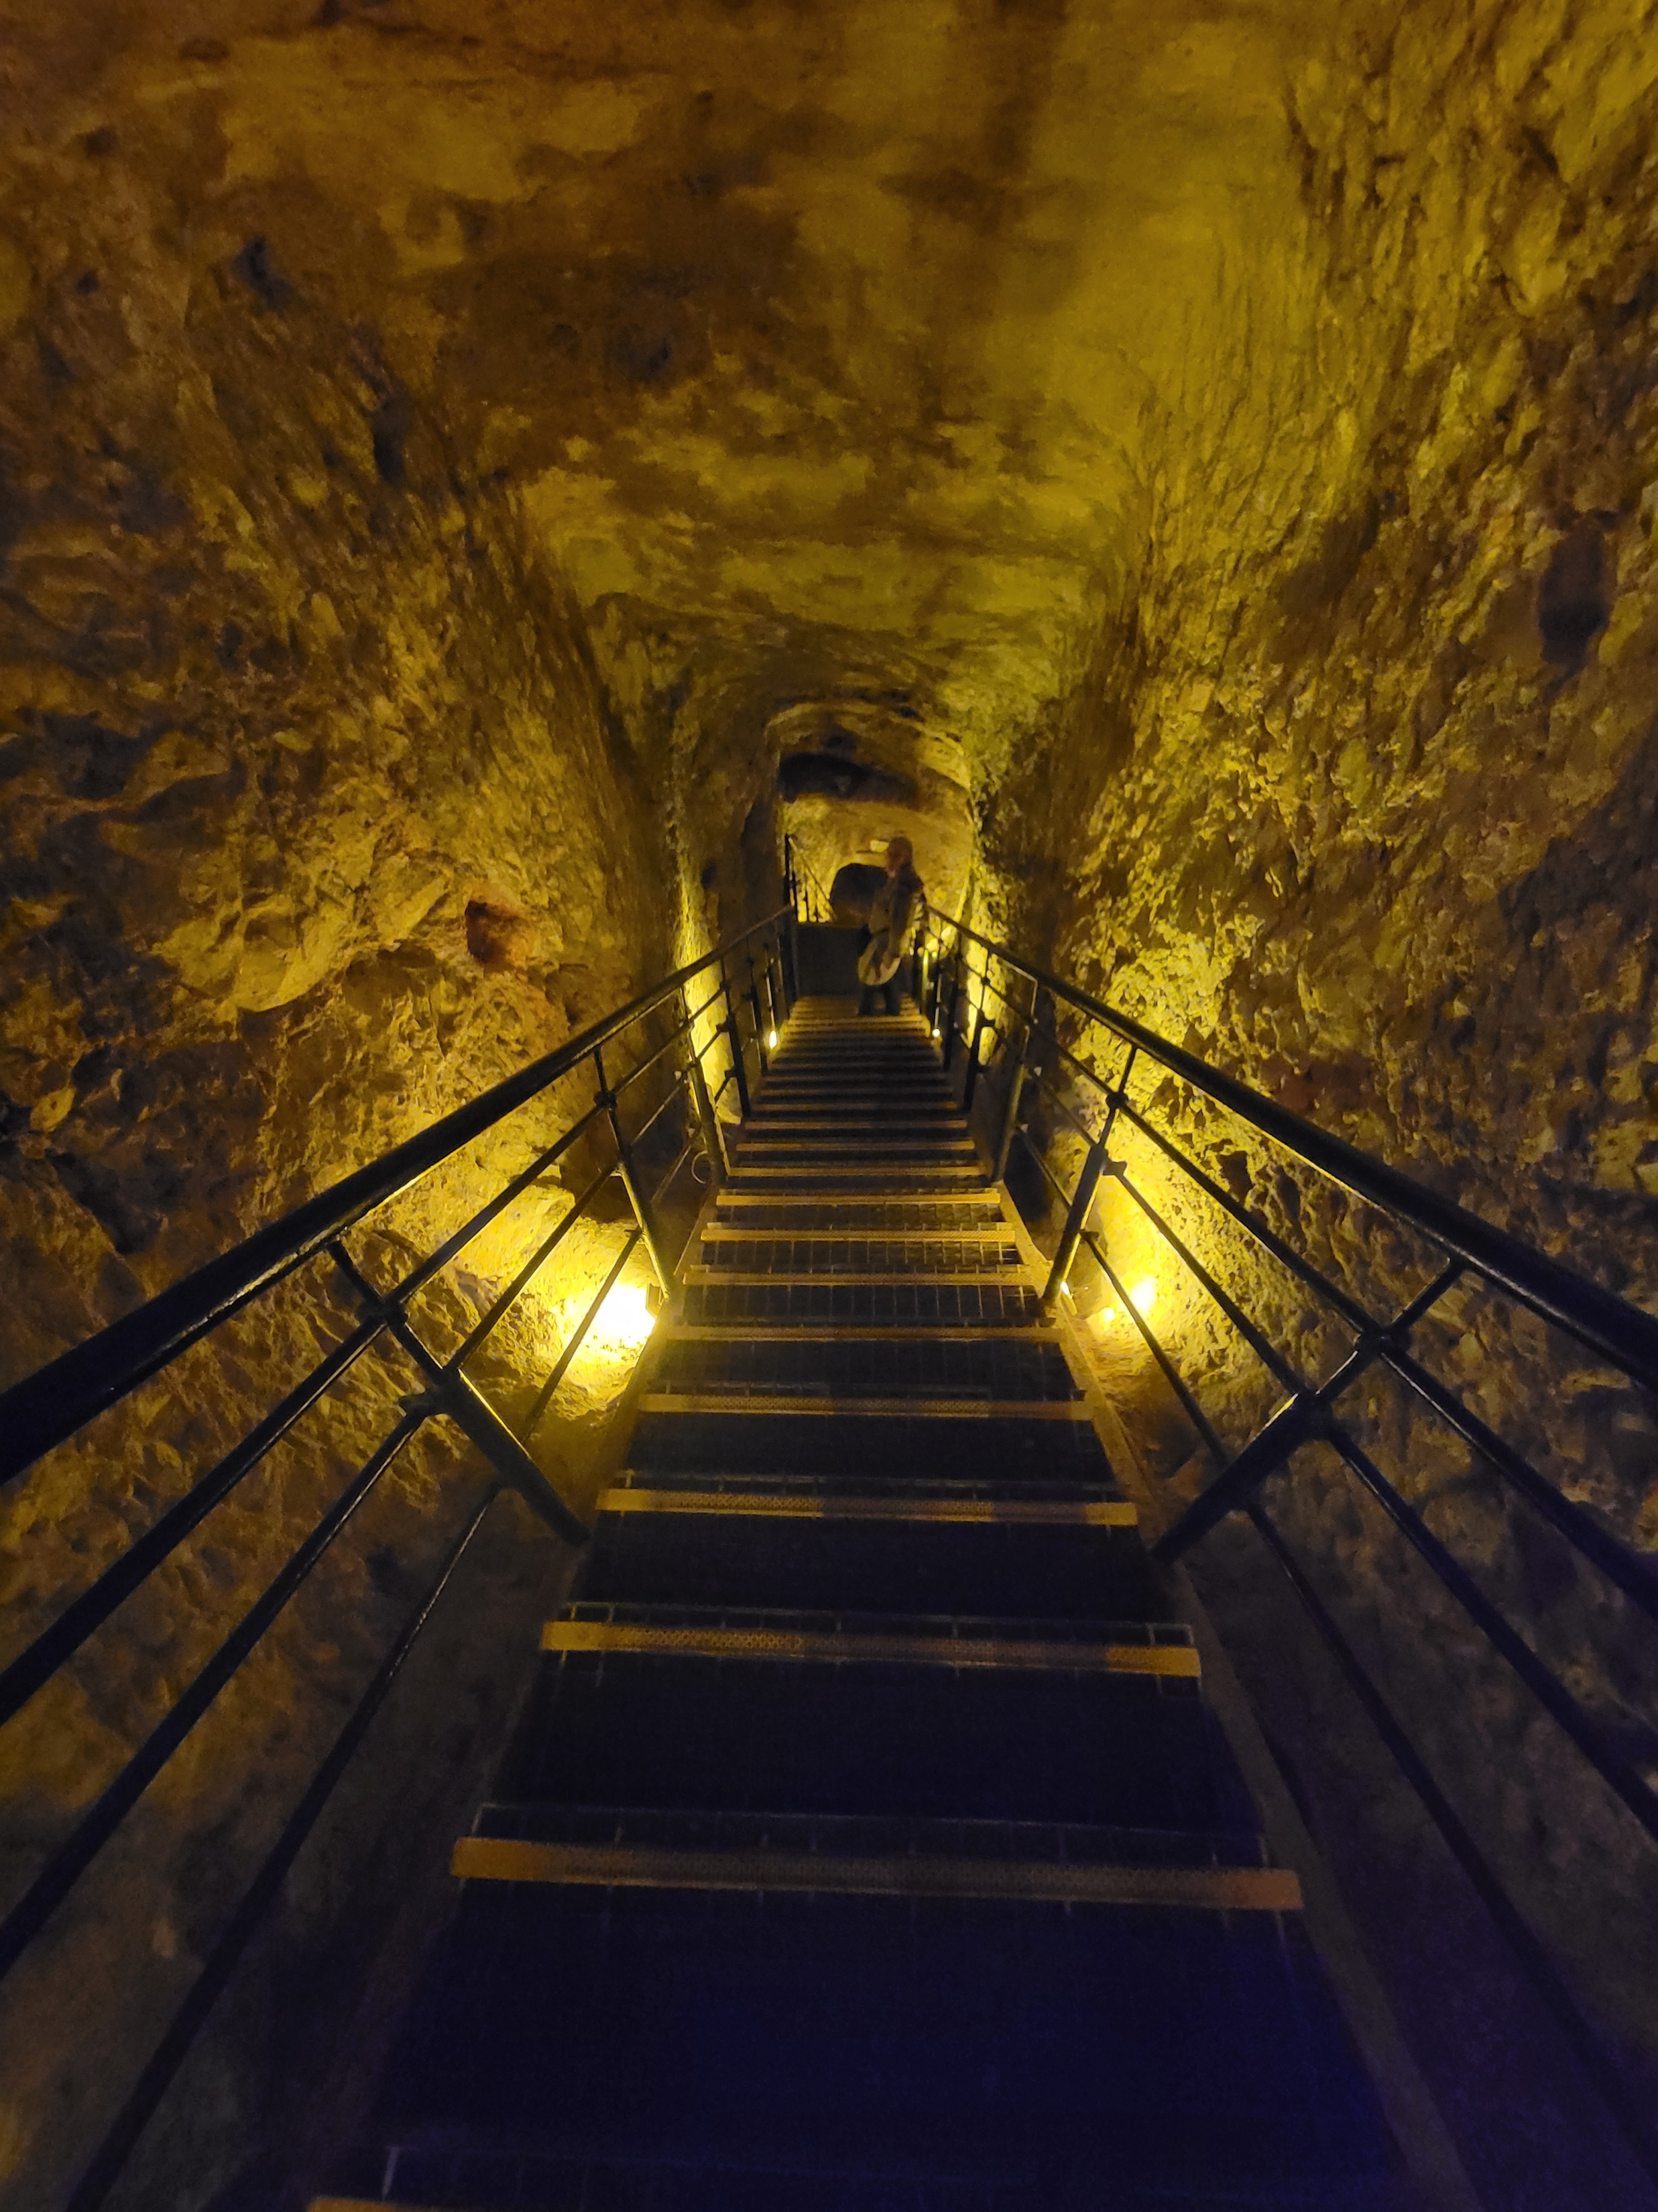
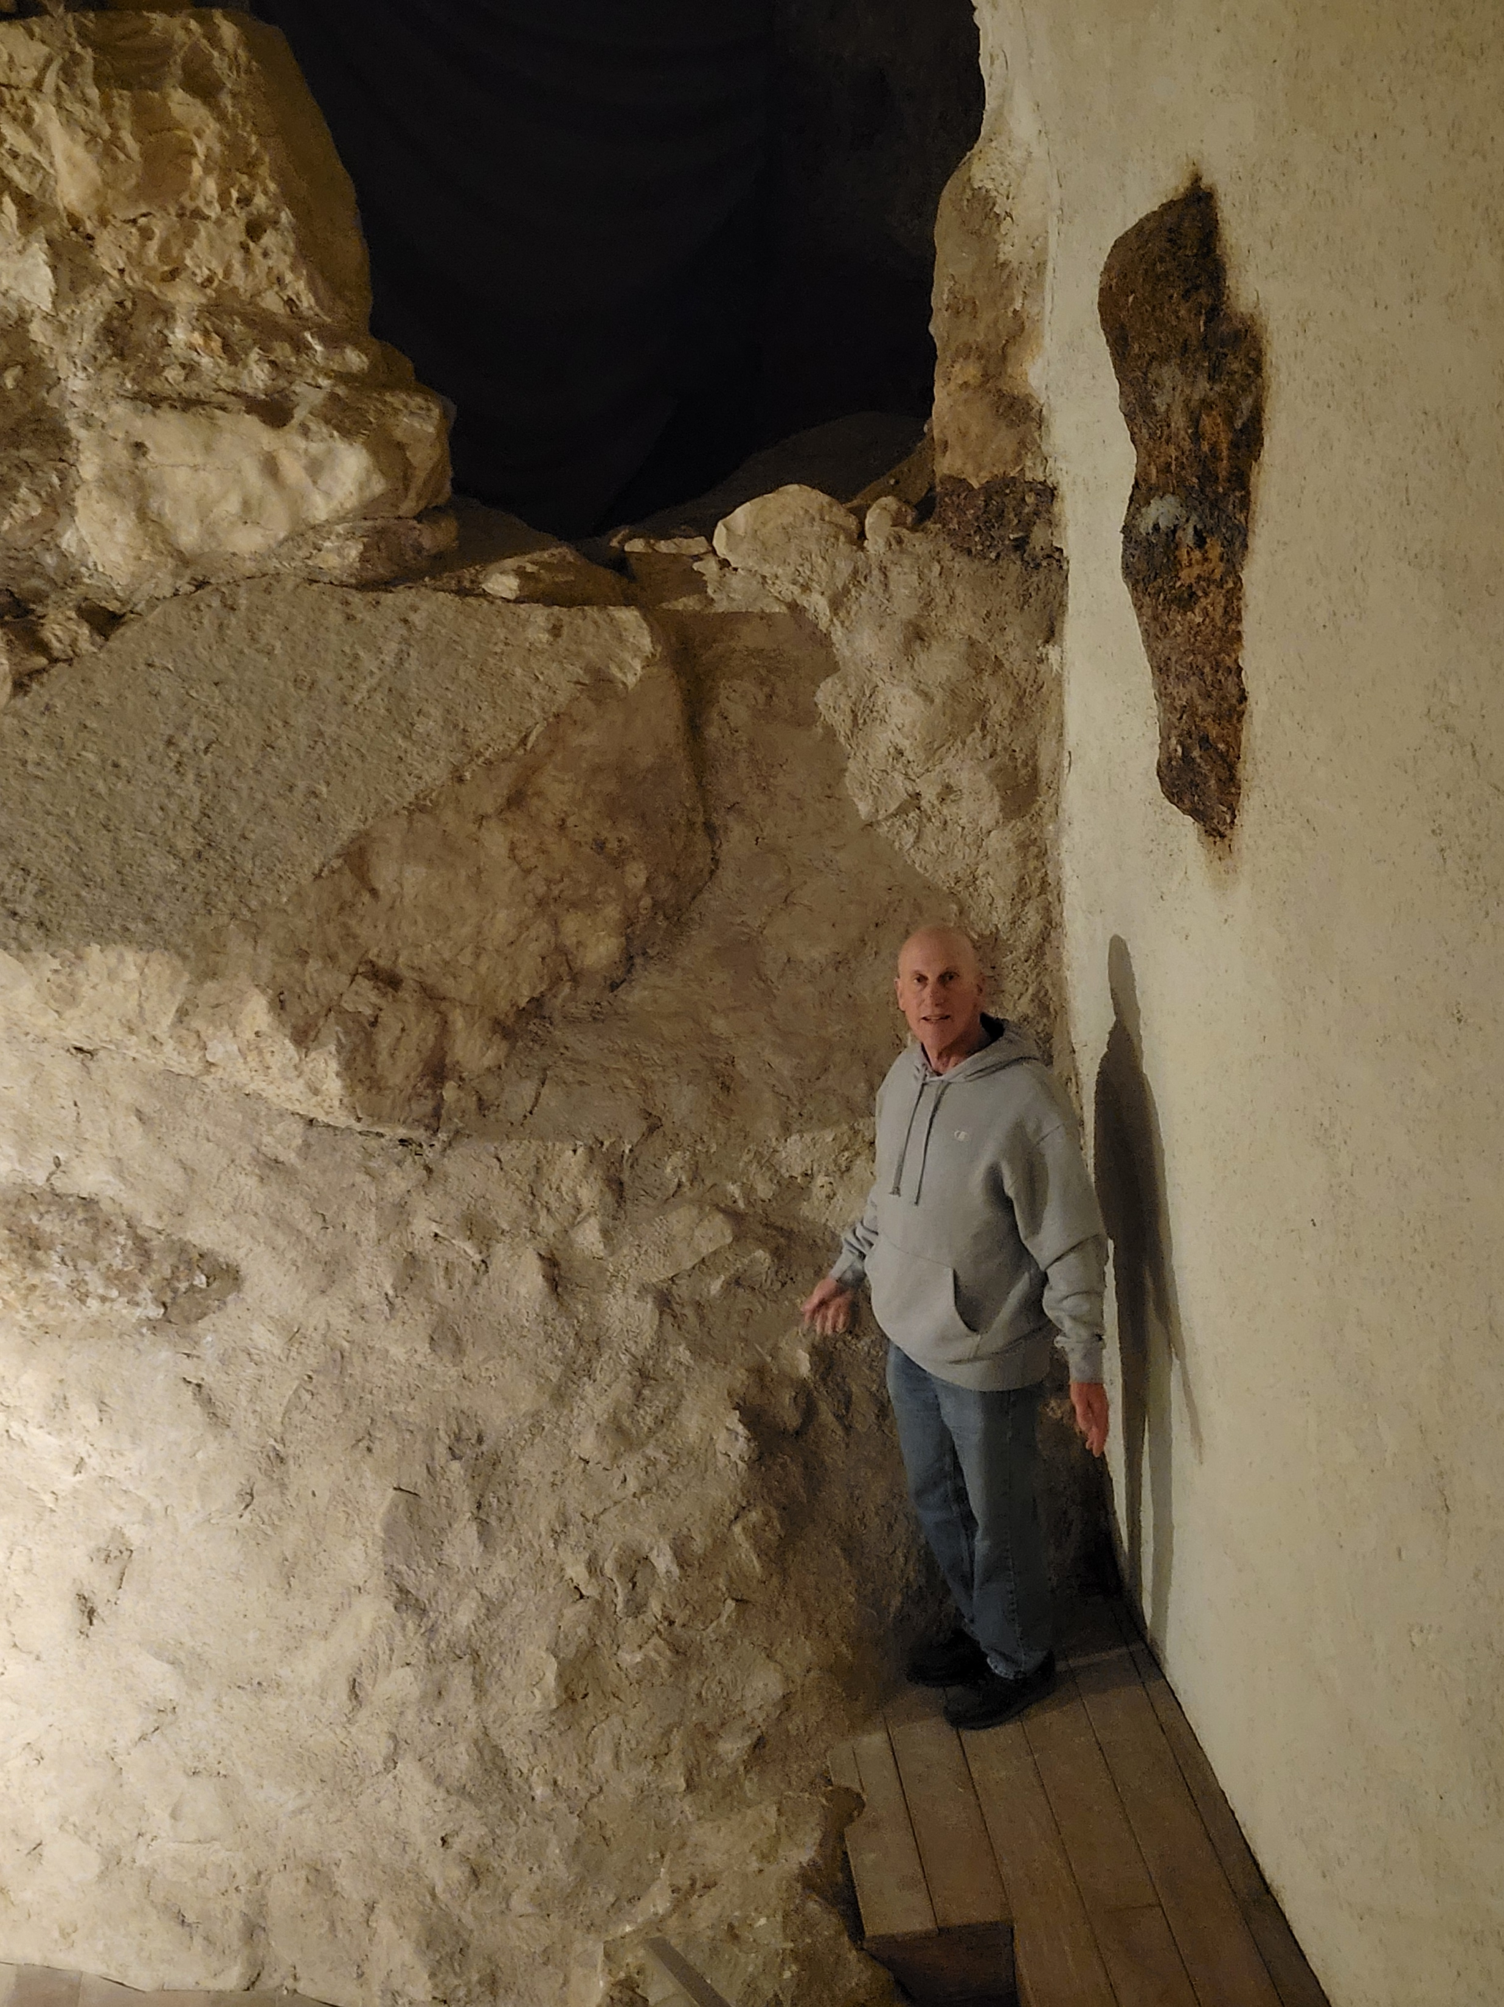
Down a steep stairs past
Warren’s Shaft
Placed inside a cave

Slide 17
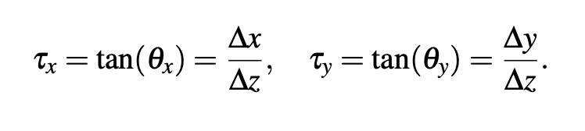
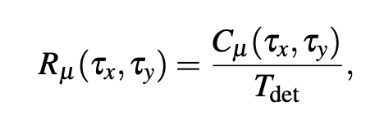
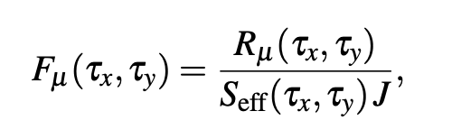
Measurement method
define angular bins:
Extract the count rate R_{u} per angular bin
Generate the “expected“ angular count rate distribution in GEANT4 ==> look for anomalies
or
3) Normalize to the acceptance to get the muon flux F_{u}
& extract the eff overburden from rate vs depth relation

Slide 18
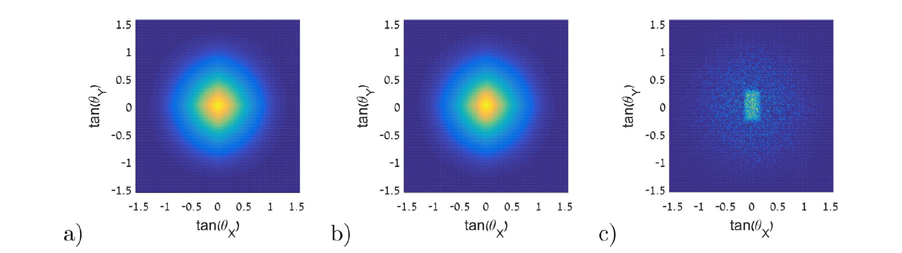
Simulated example of void detection
-
=
2 x 1 x 1 m air void 4 m above the detector.
The surrounding volume is rock.

Slide 19
Modeling in GEANT4 Basic elements
Detector (idealized – fully efficiency, resolution)
Muon generator ➔ Ecomug.h
“EcoMug: An Efficient COsmic MUon Generator for cosmic-ray muon applications”
NIM A Volume 1014, 21 October 2021. D. Pagano, G. Bonomi, A. Donzella, A. Zenoni, G. Zumerle, N. Zurlo
Terrain:
➔ topographic arrays created using GoogleEarth Pro, ArcGIS Pro, VisualizeGPS
➔ represented in GEANT4 as a lego construction with 2 x 2 m grid

Slide 20
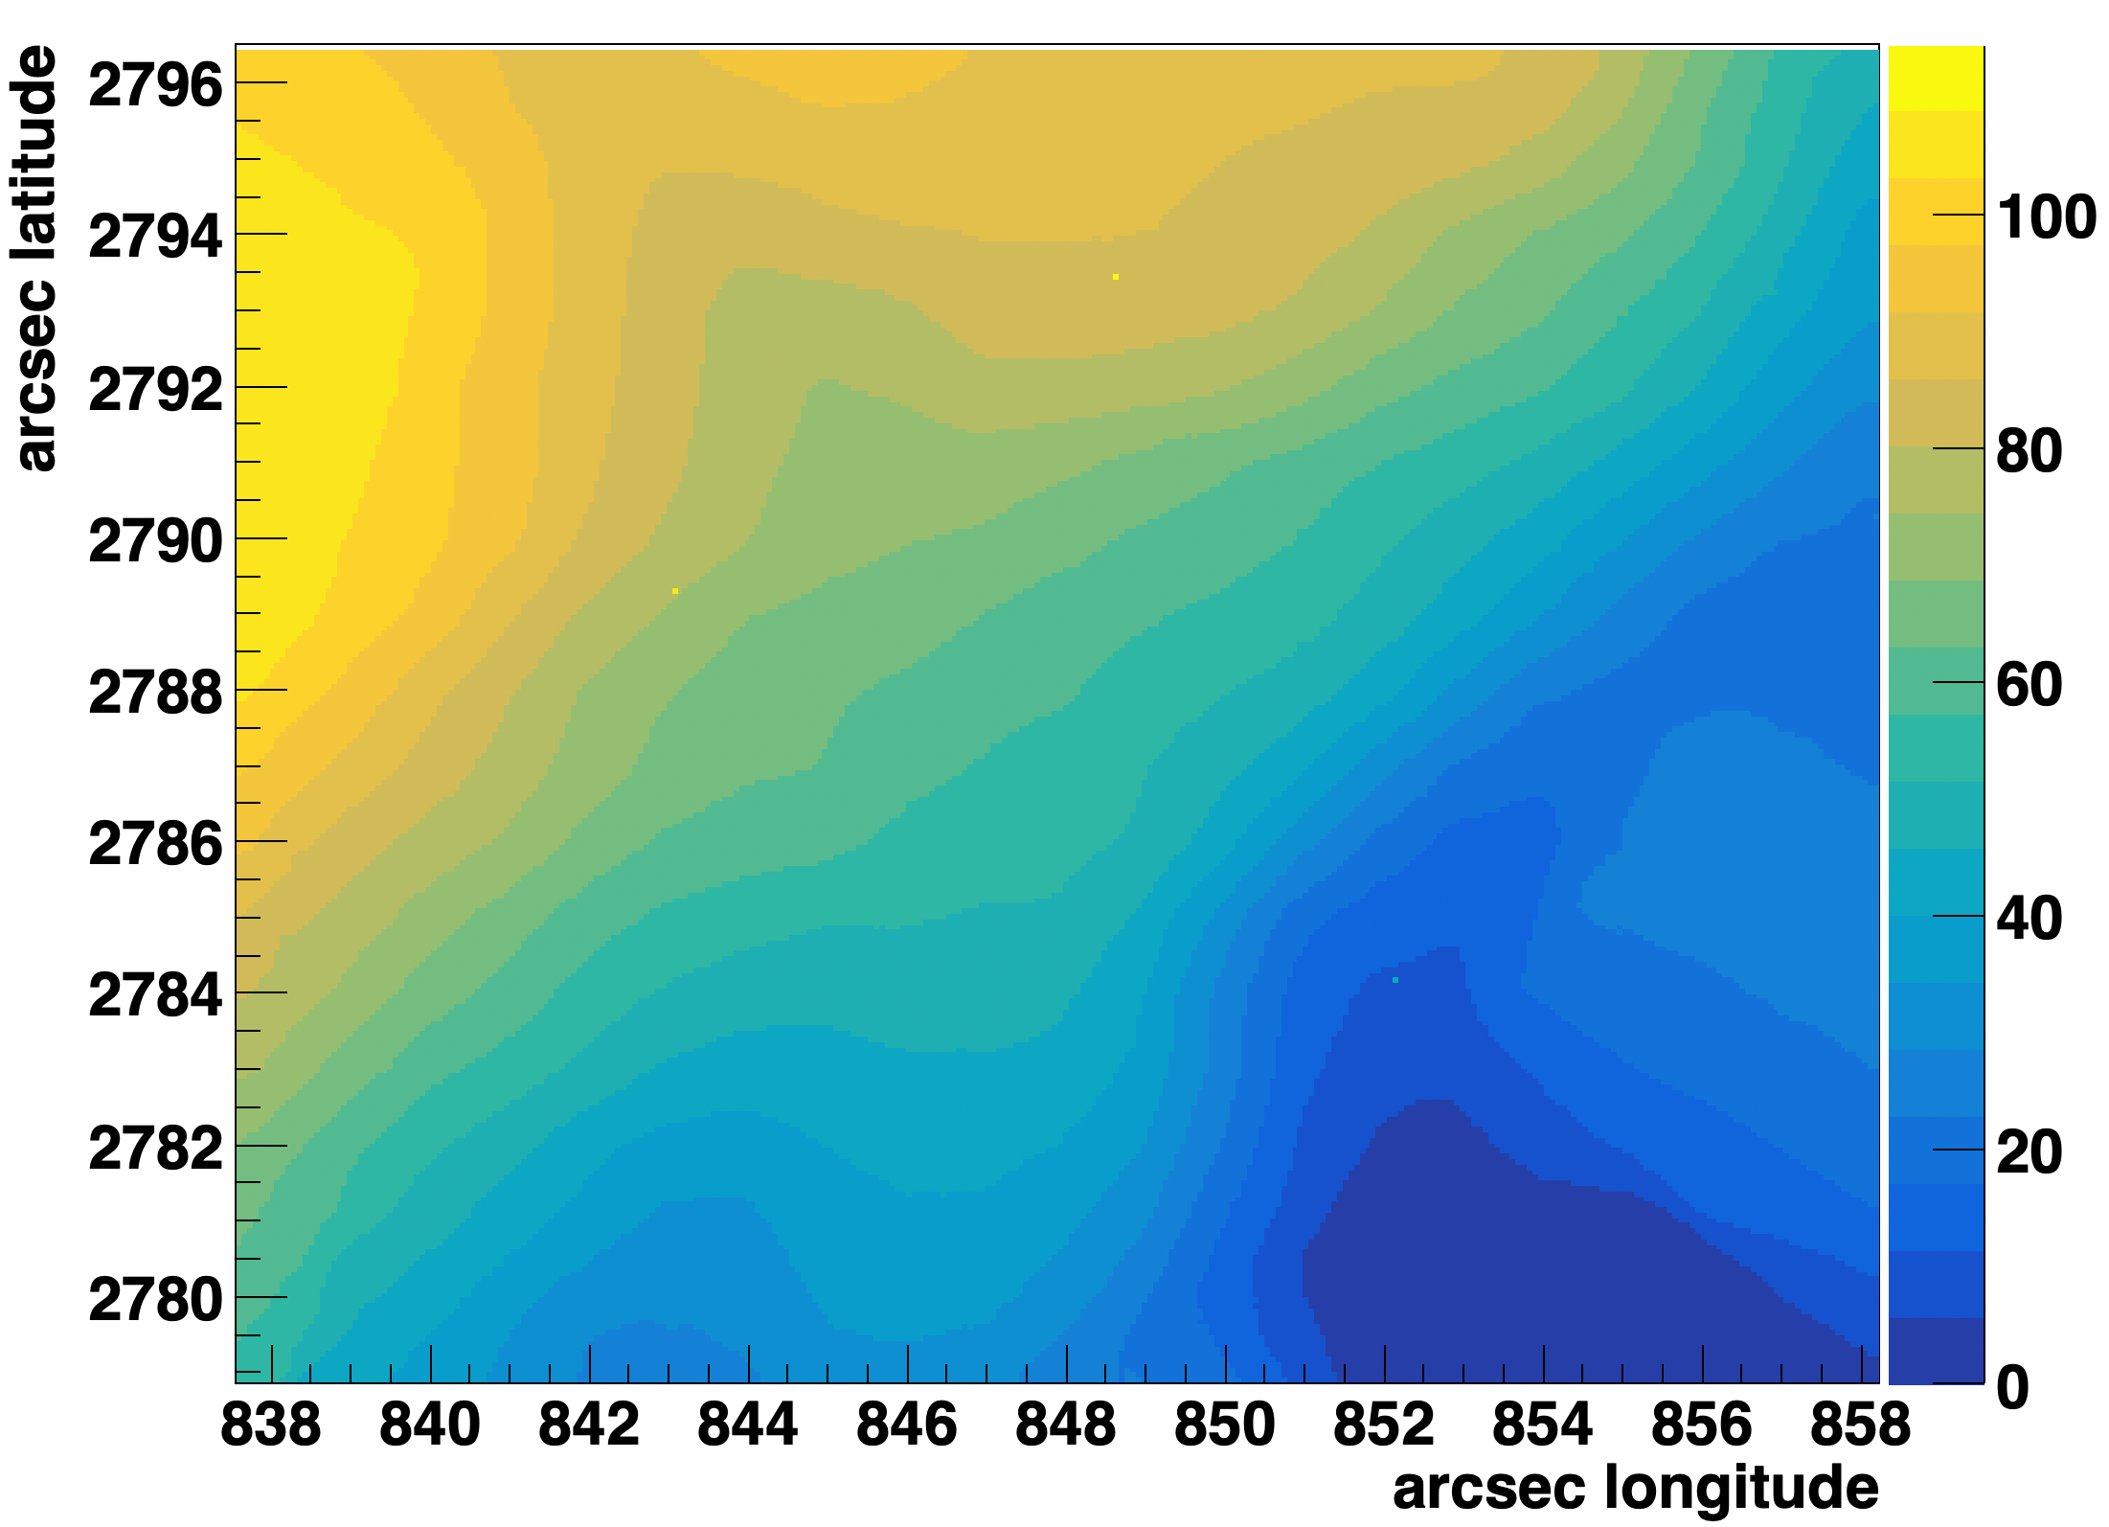
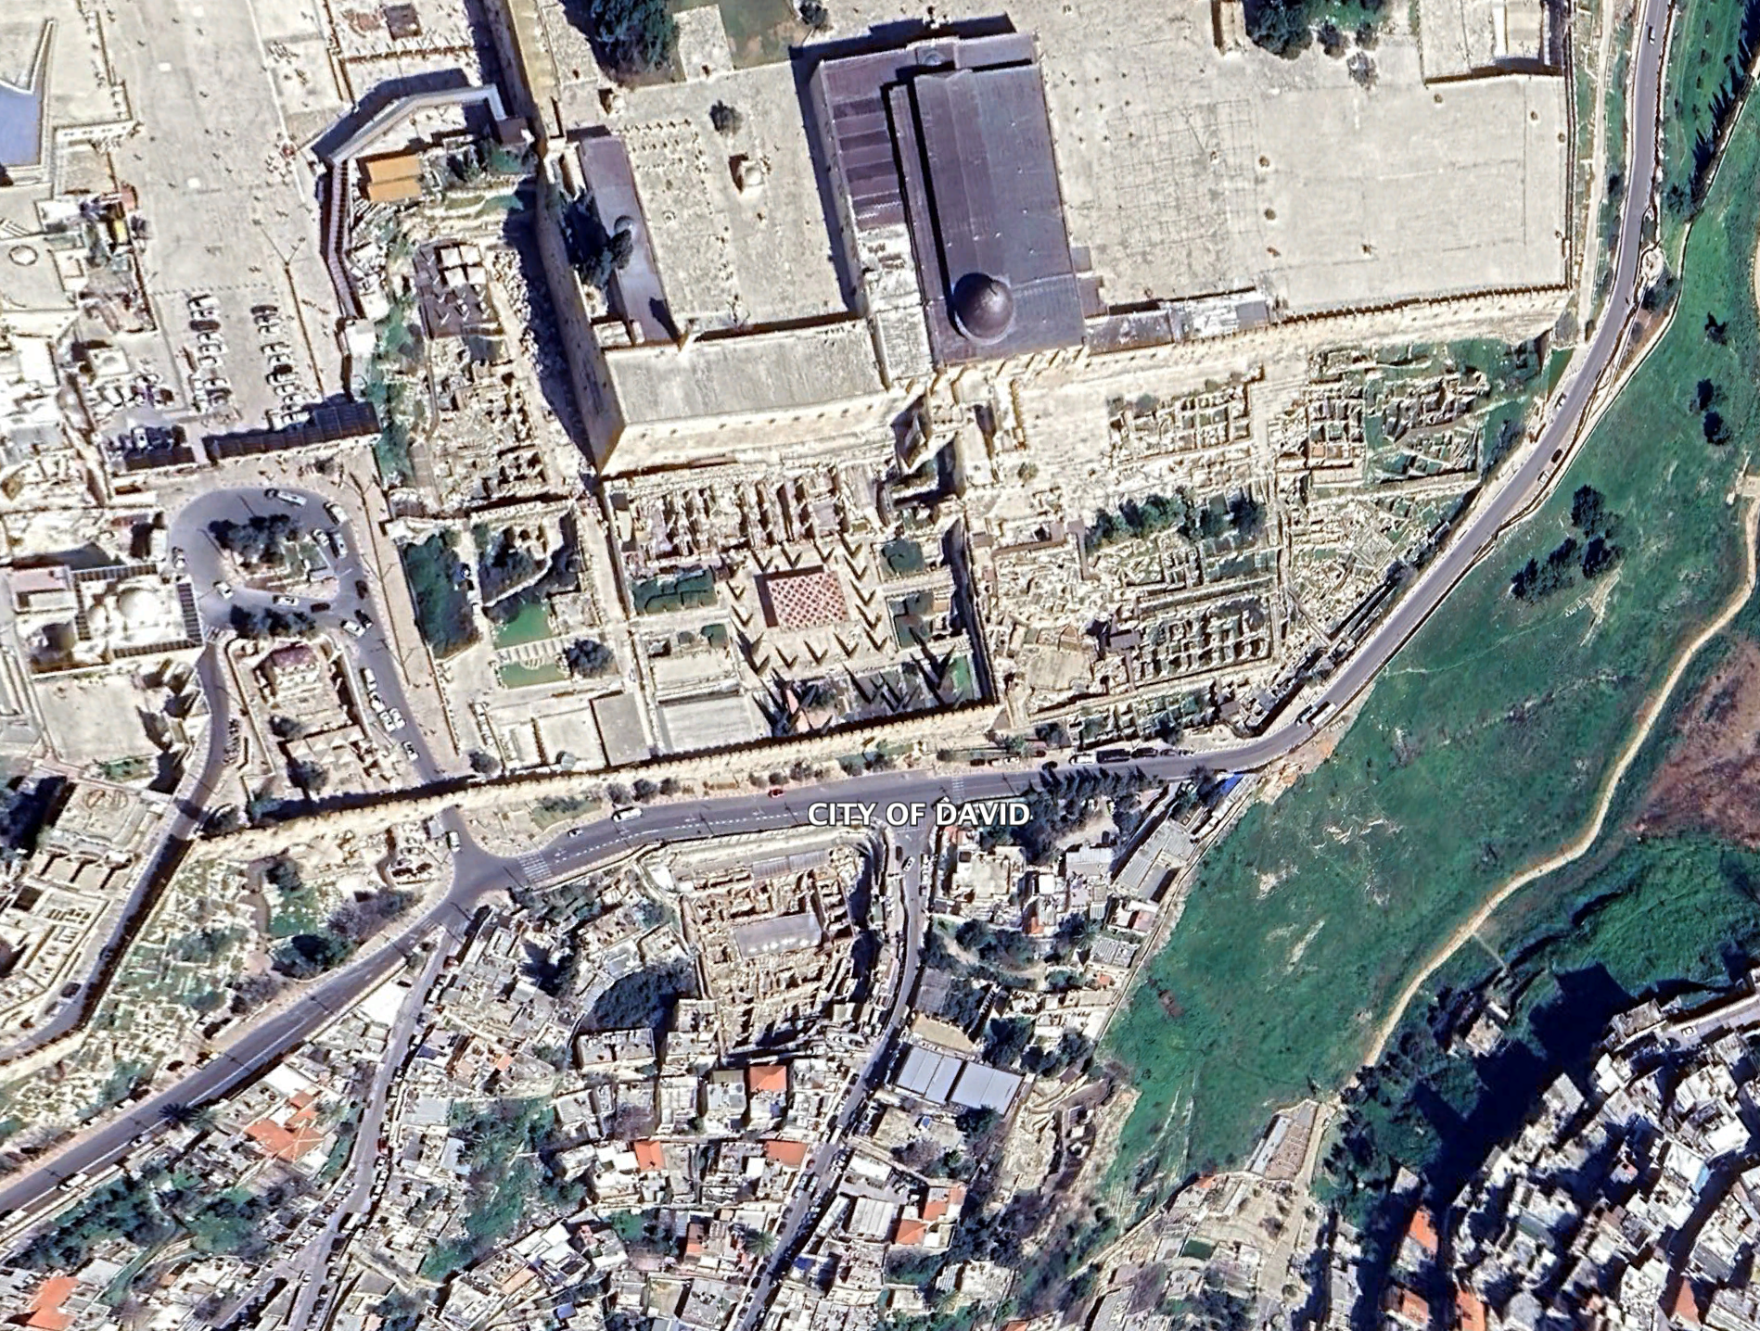
Building a GEANT4 Model
include terrain of Jerualem’s Old City: Temple Mount, Al Aqsa, the Western Wall
Al Aqsa
Dung Gate
Givati excavation
detector

Slide 21
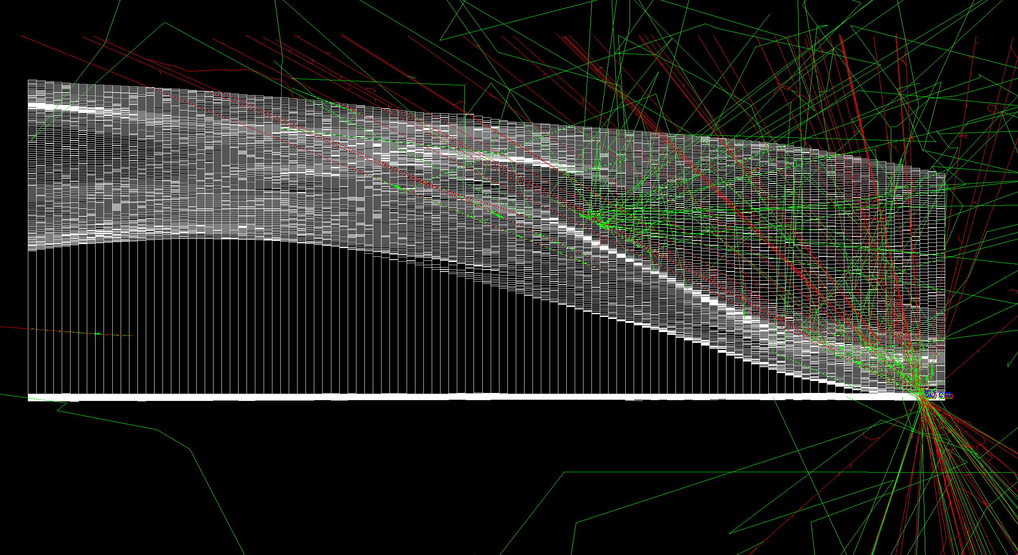
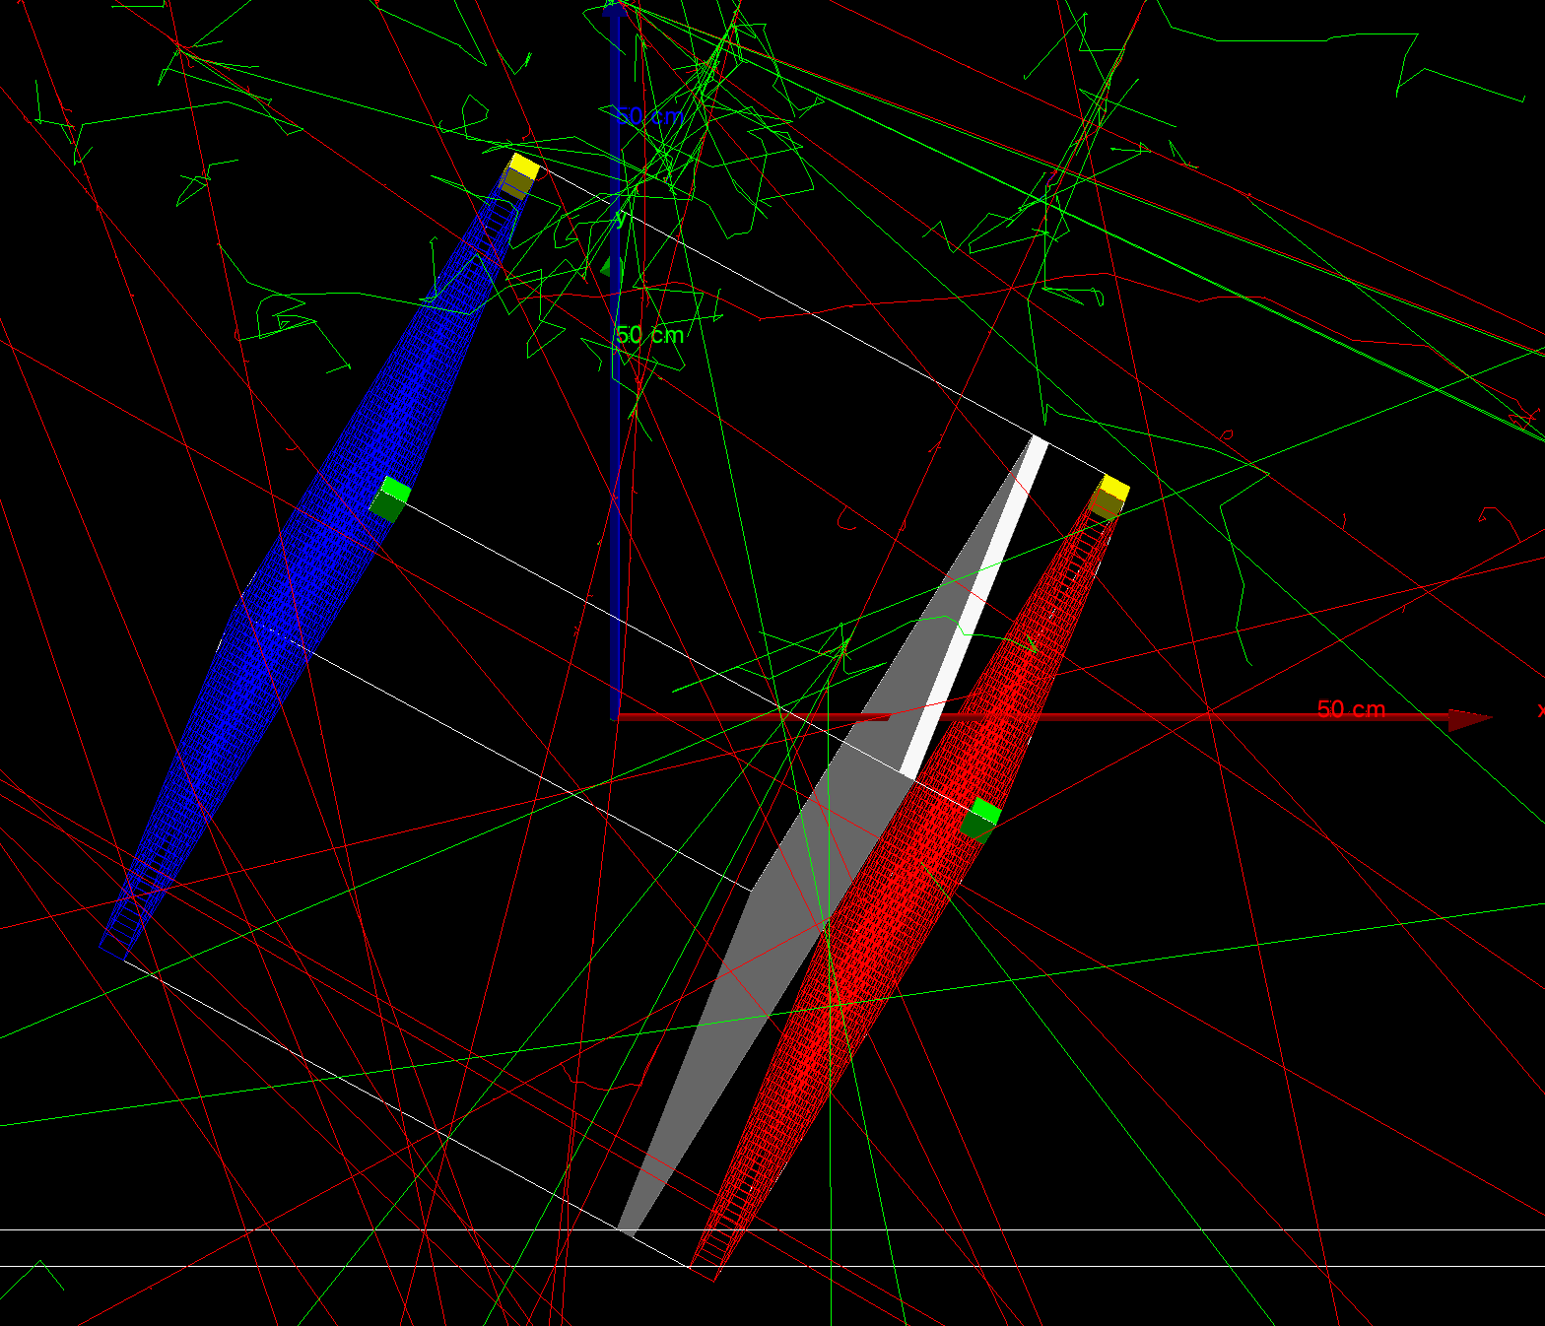
GEANT4

Slide 22
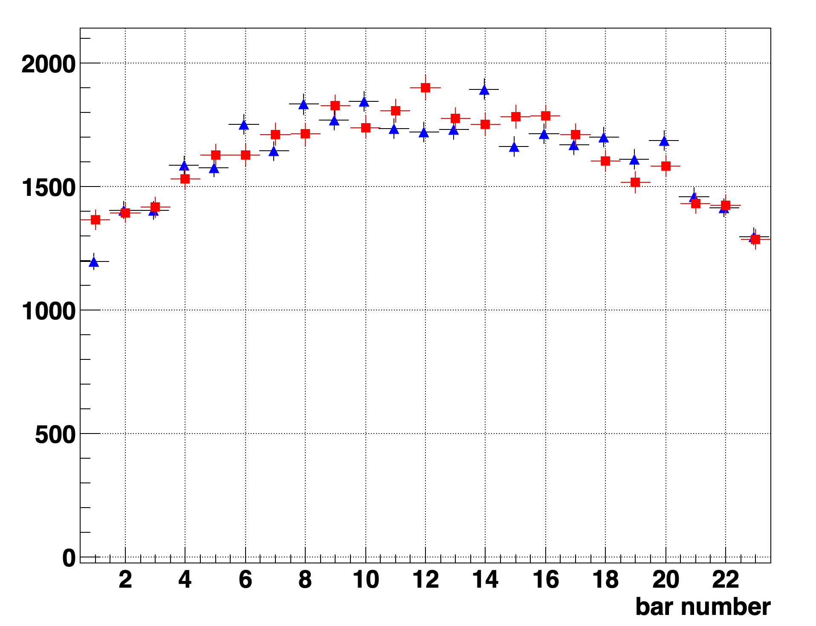
Open Sky Hit Distribution
Detector #1 in Tel Aviv Lab
▲Detector Data
◼︎GEANT4

Slide 23
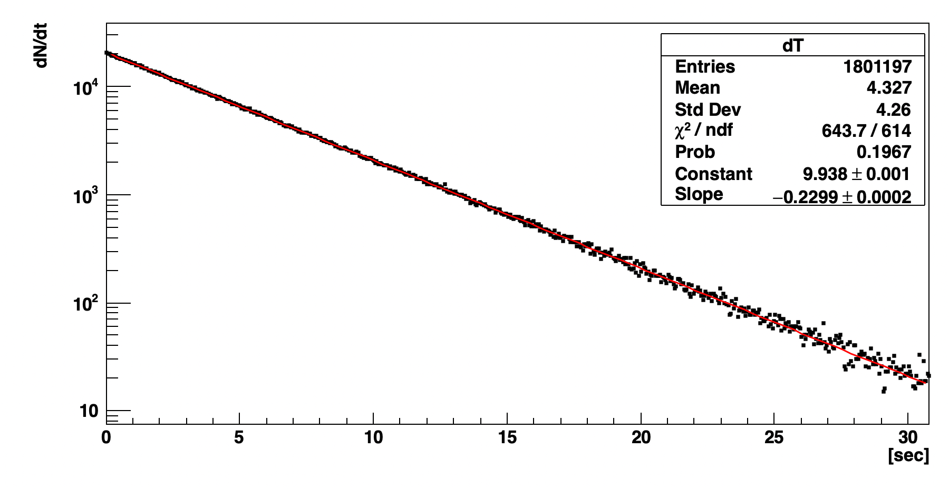
Preliminary Site Data
Time between events
Slope give rate ➔ 0.23 Hz

Slide 24
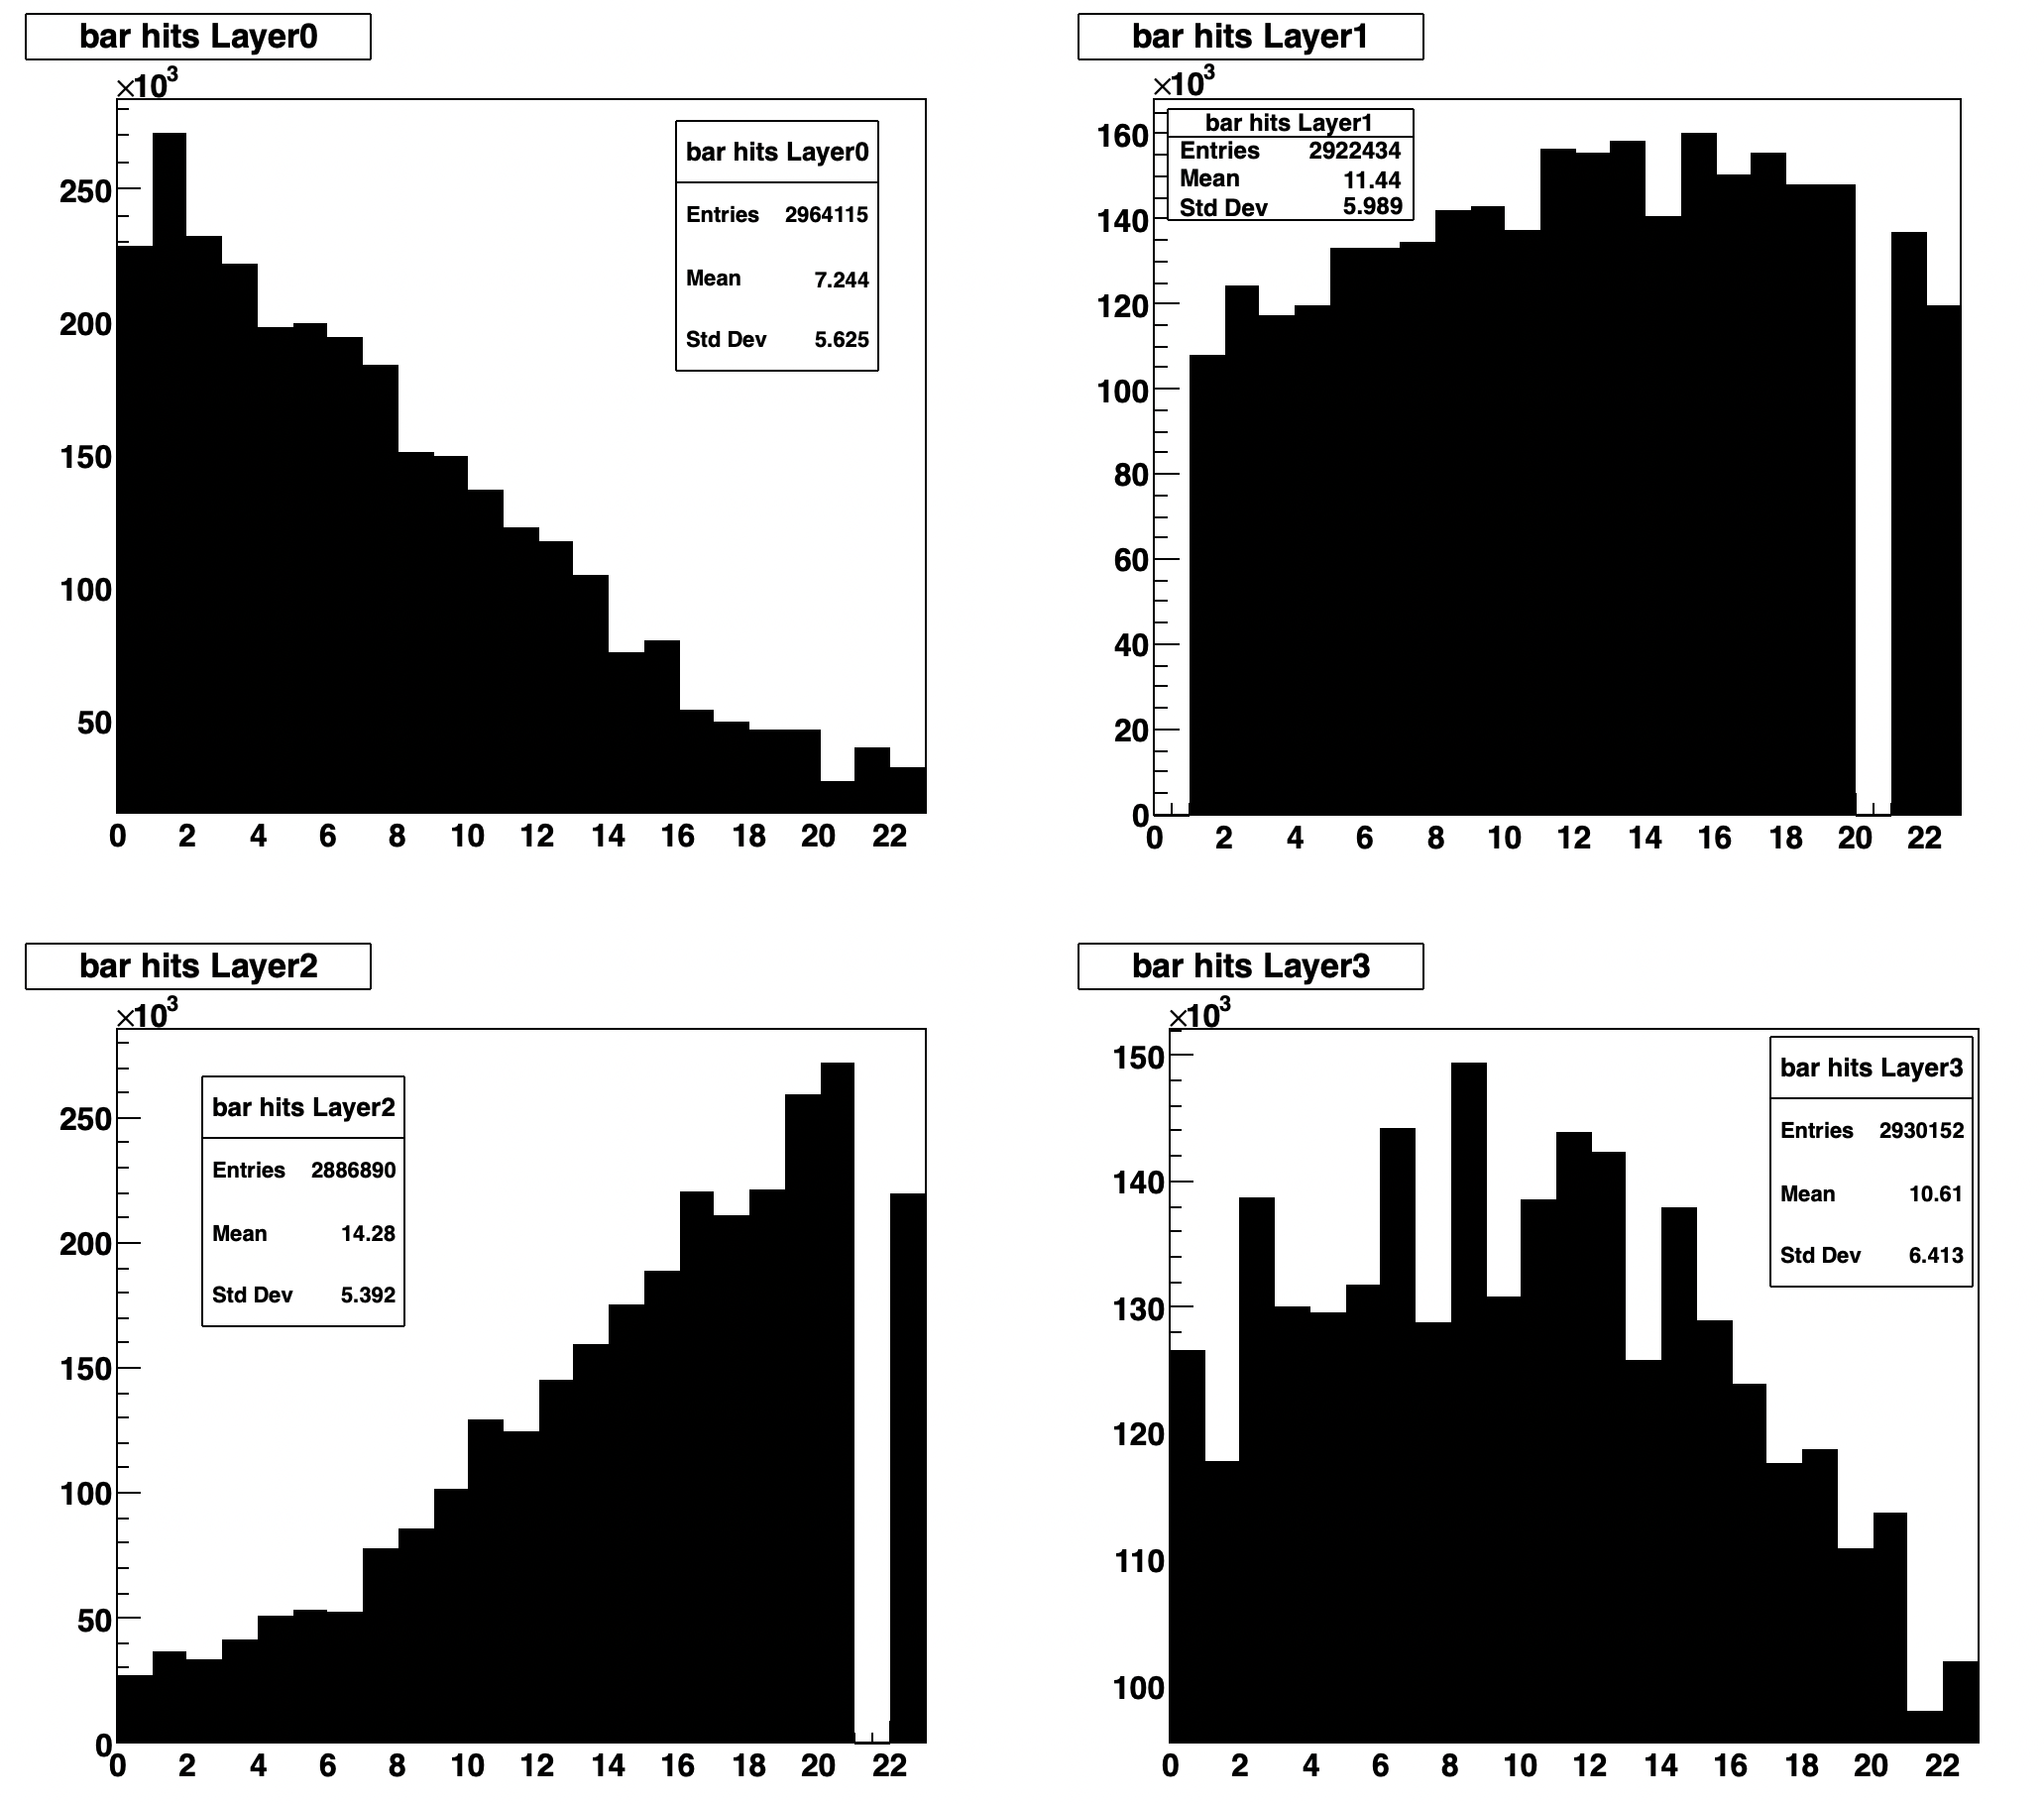
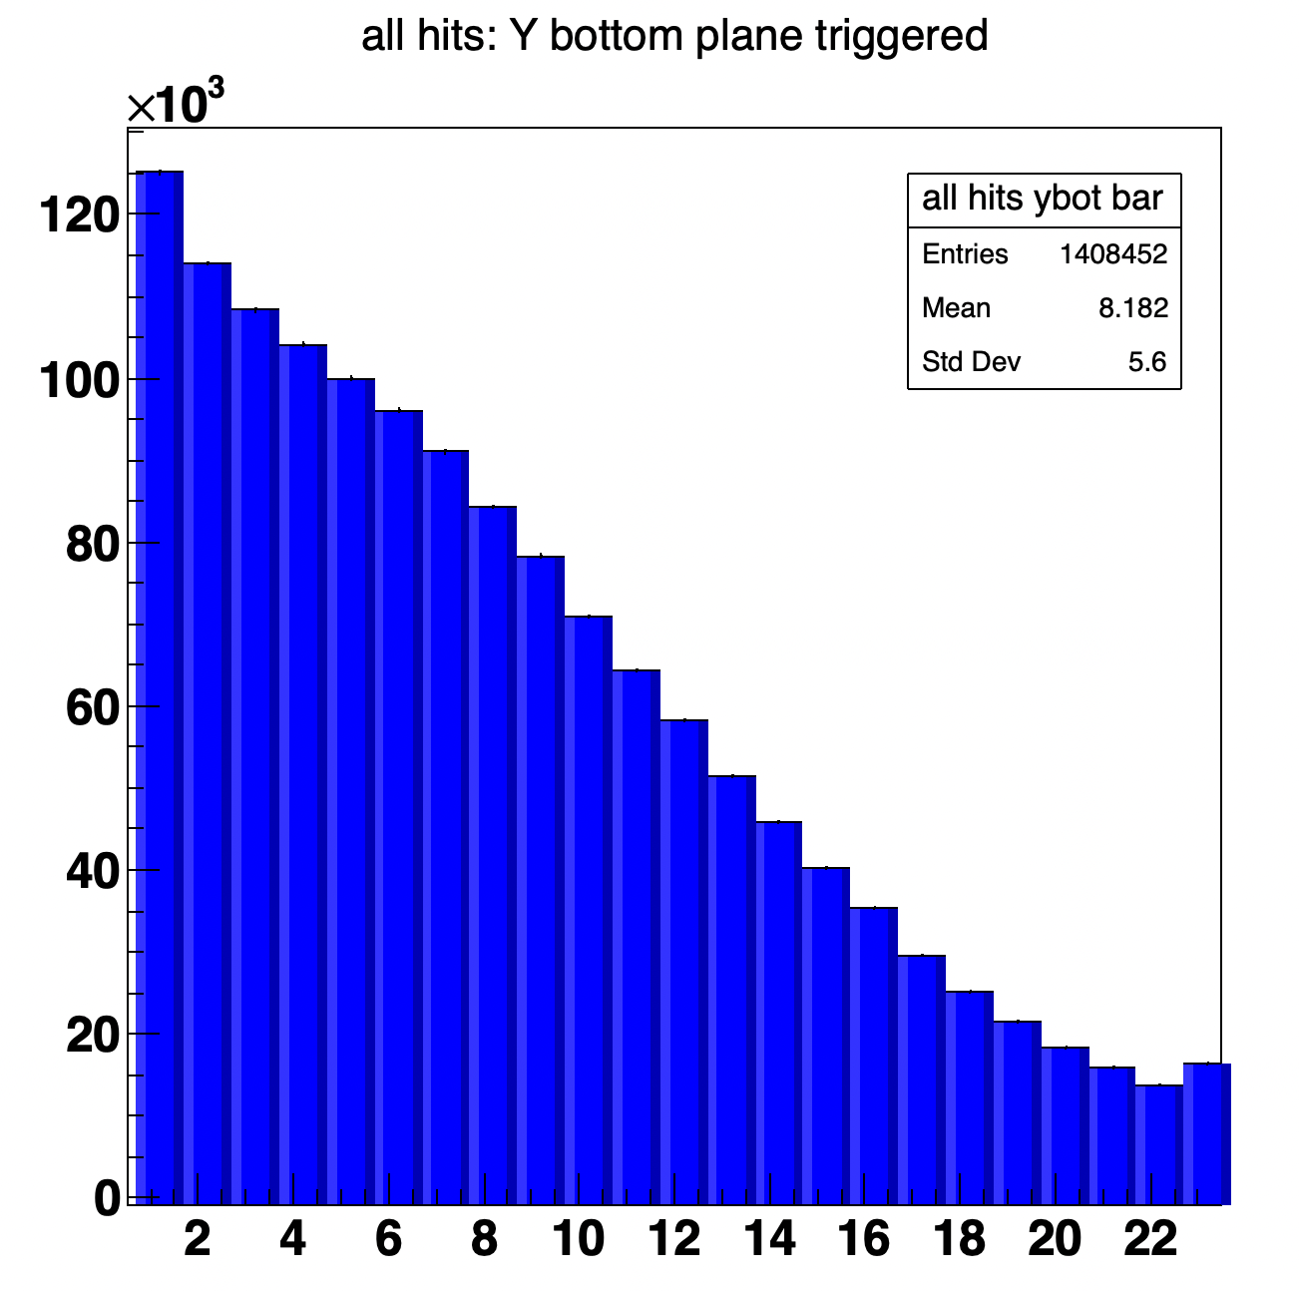
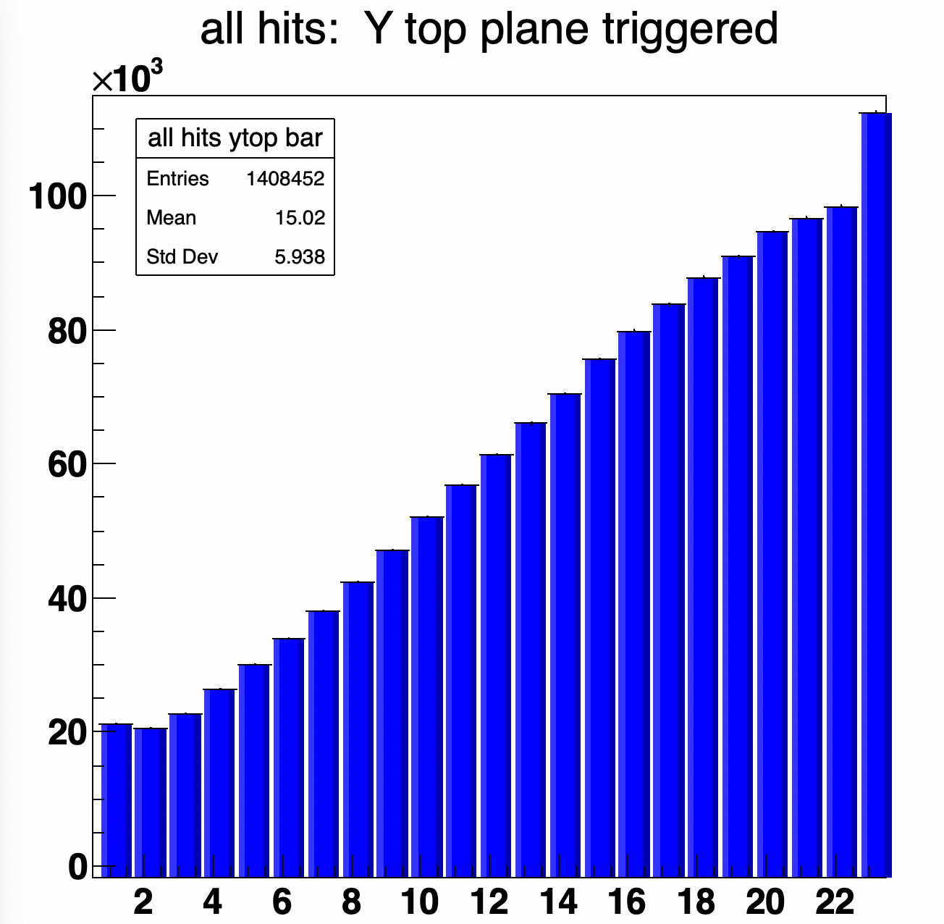
Preliminary Site Data vs MC
Detector #2 in Jerusalem Cave
Early data quality are “good”
Cave environment features:
Dirty – soil, dust, rock debris
High humidity
Rocky platform
Low BW connection
Low security
Difficult access
Some channels required repairs
Gain required optimization
Detector in
City of David
Detector in
City of David
GEANT4
GEANT4

Slide 25
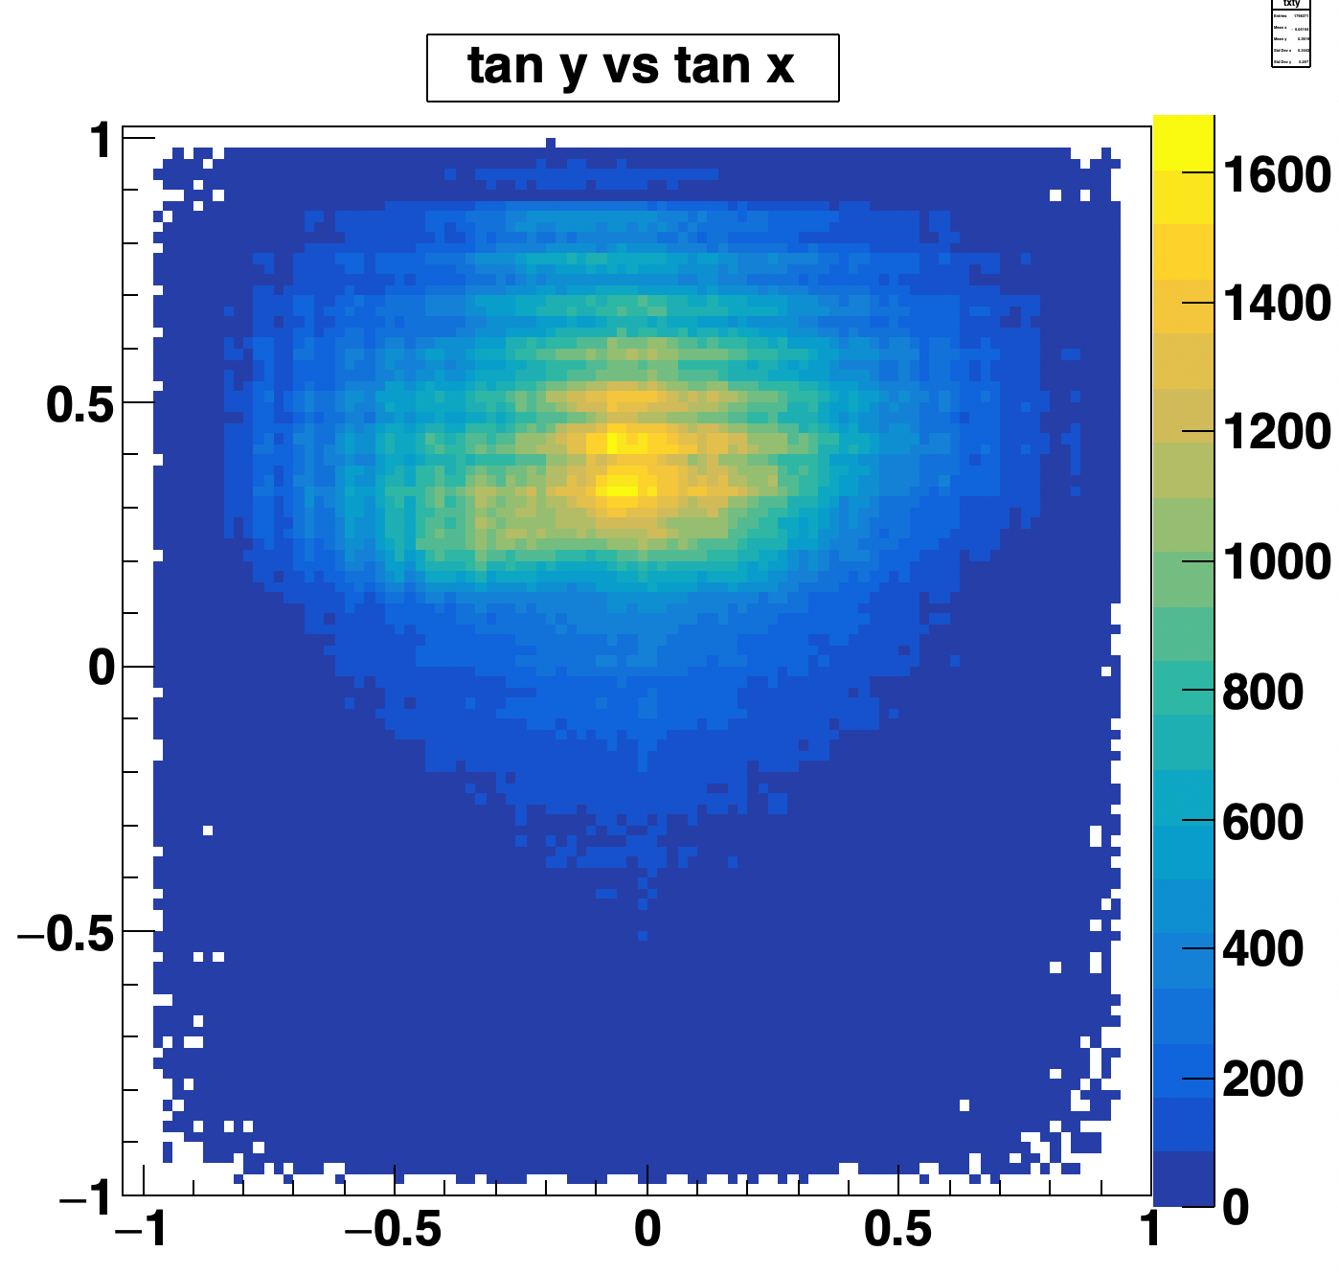
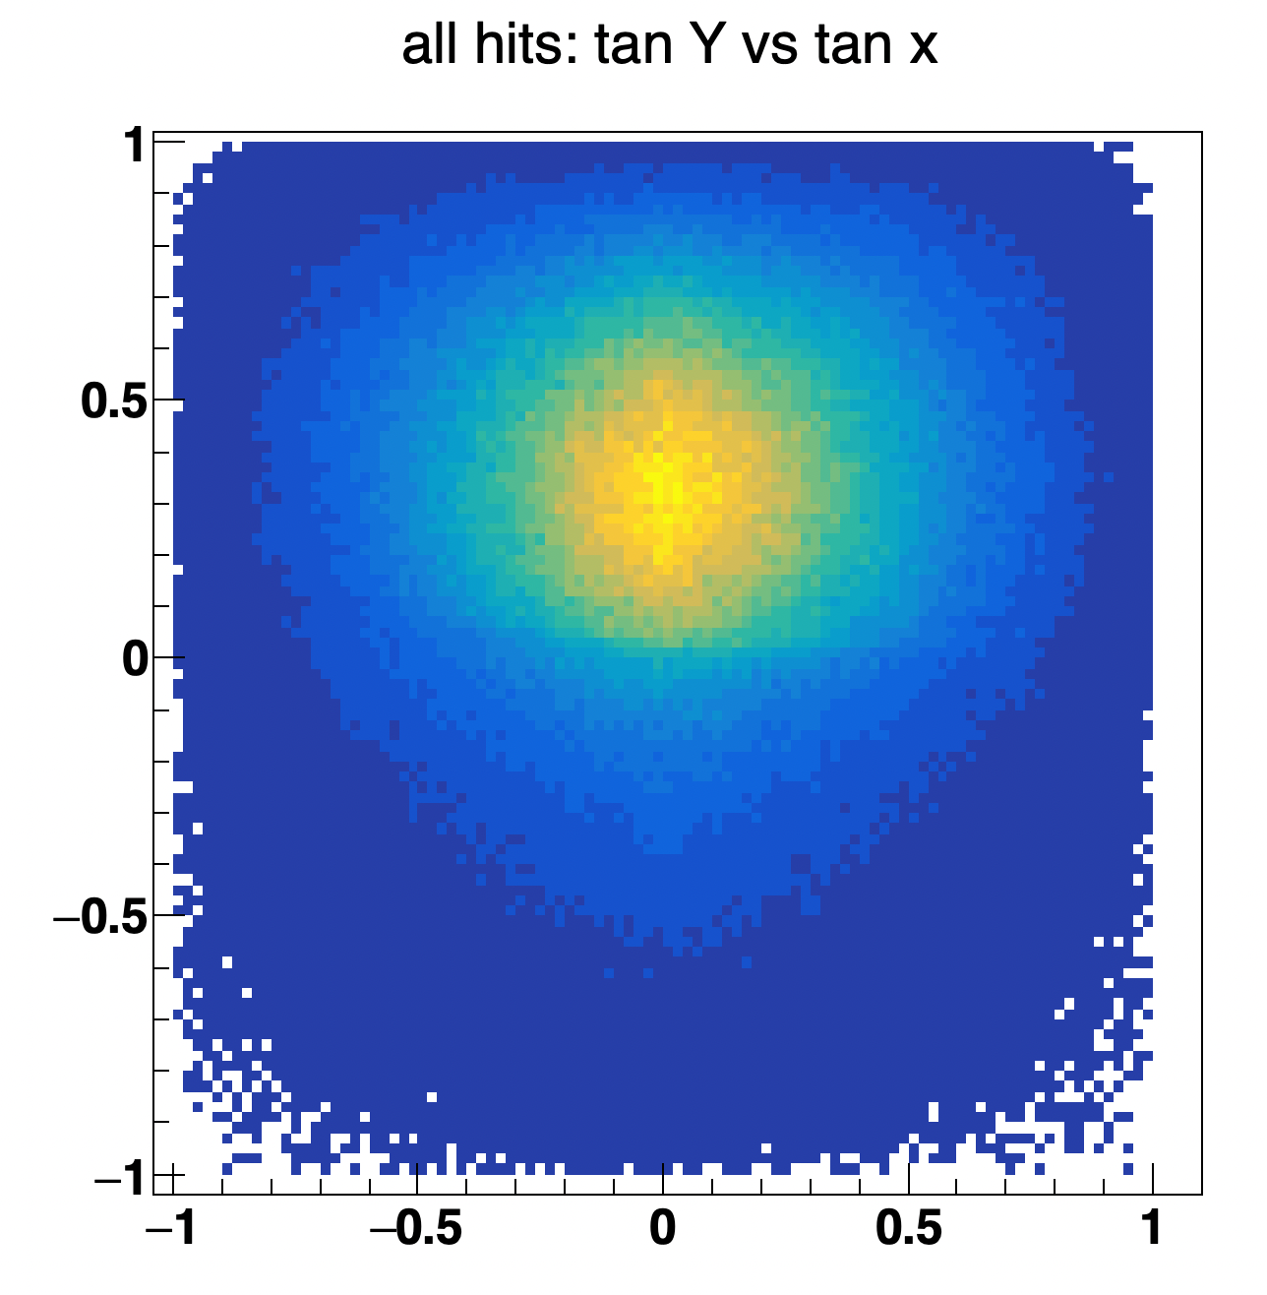
Preliminary Site Data vs MC
Data
GEANT4

Slide 26
Summary & Next steps
Pilot detector installed and operational.
New detector deployment in Jerusalem in Sept.
A new major grant proposal underway with Archaeological, Physics & AI
Identification of sites with archeological potential & detector accessibility
eg: tel Azeka has network of known tunnels for calibration and unknown conduits
Deployment of multiple detectors with intersecting / overlapping FoV
May use boreholes for subterranean placement
Use NN pattern recognition to achieve true 3D tomography

Slide 27
backup

Slide 28
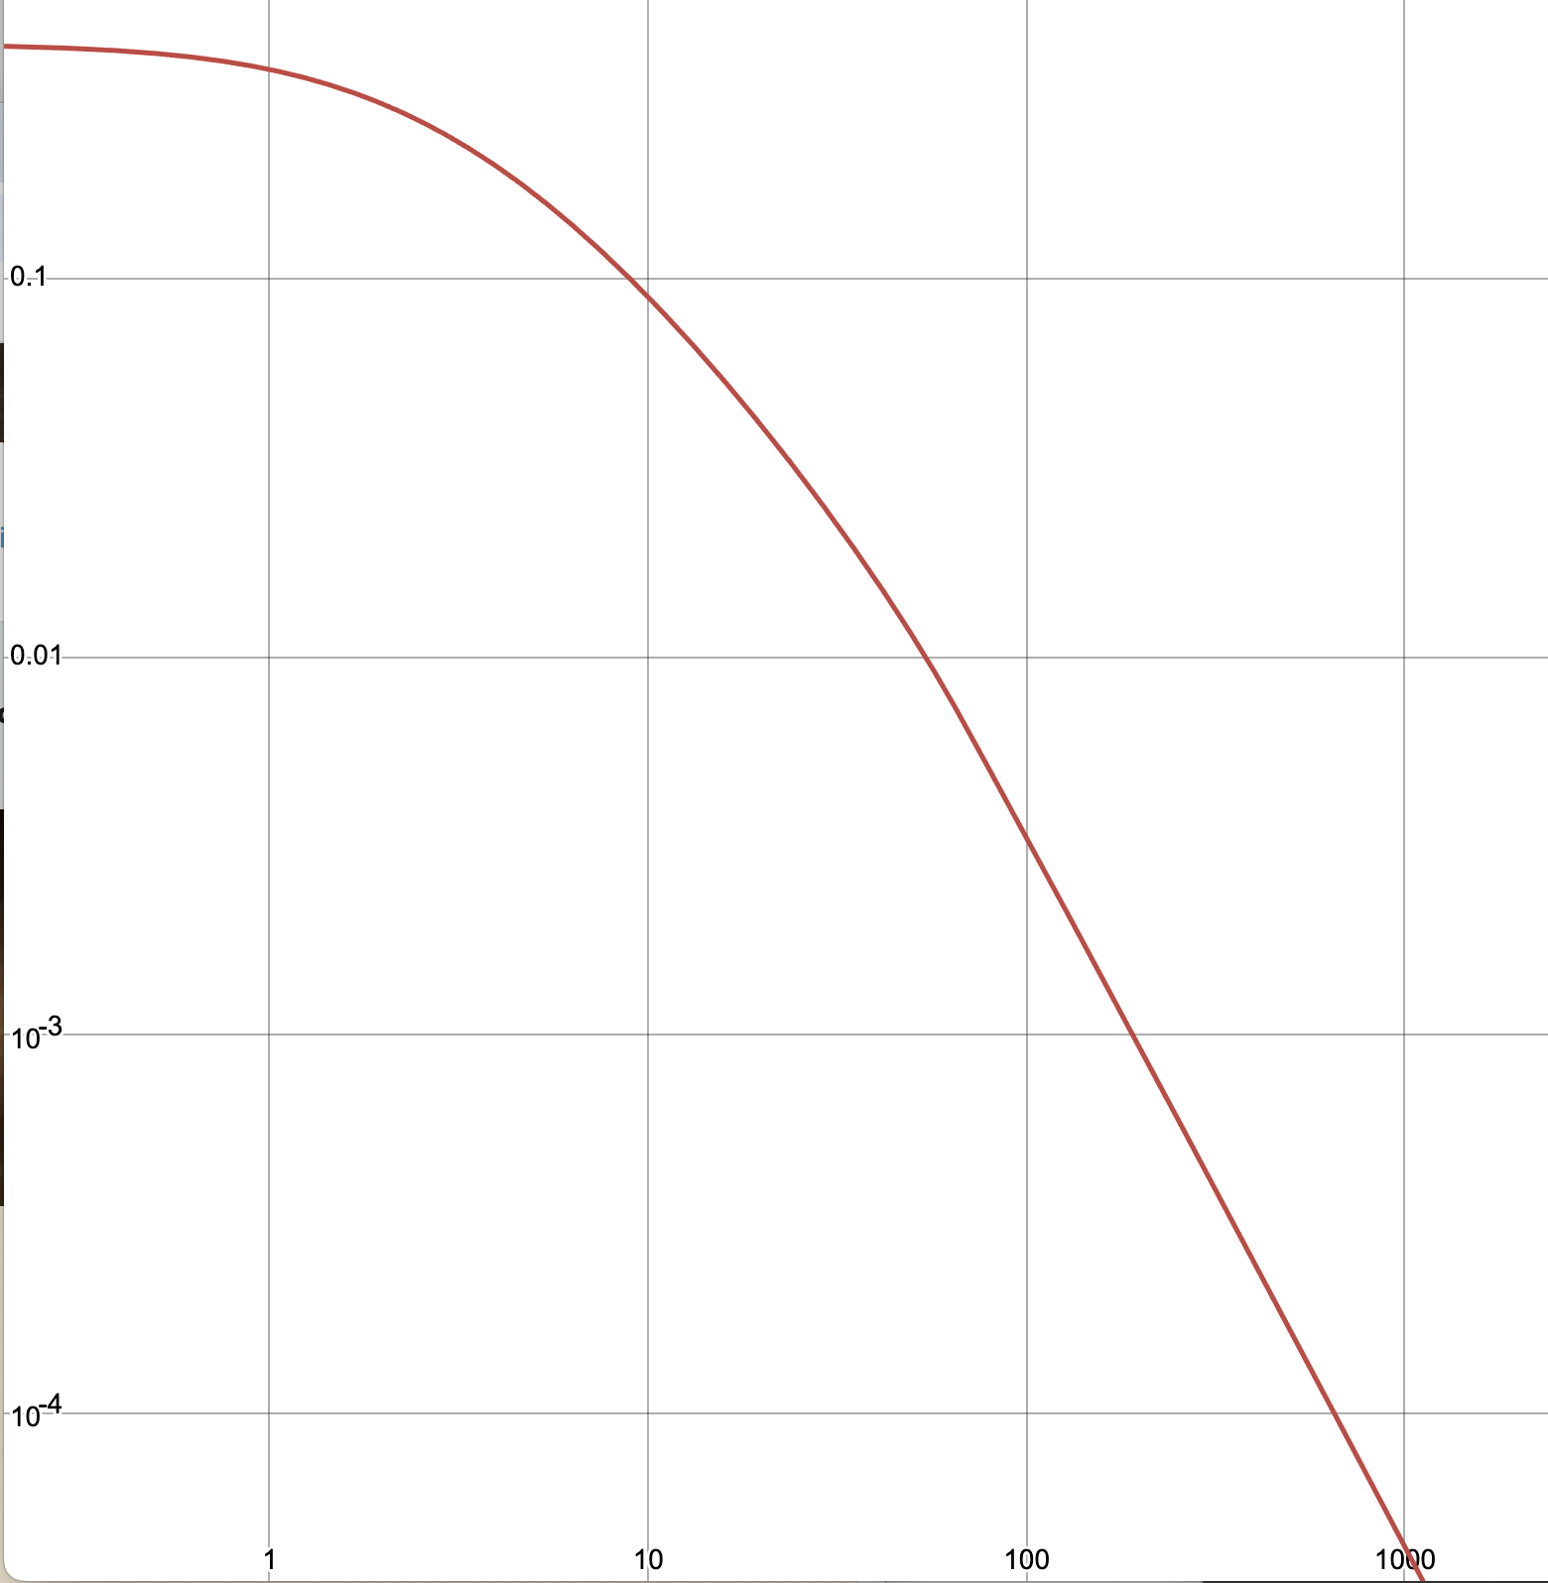
What is sensitivity at Silwan site?
Integrate dN/dE E > E_{min} E_{min} depends on zenith angle, path thru rock
Hz
1.0
0.1
0.01
0.001
0.0001
Integrated track rate for Detector #2 in Jerusalem
rock at 26⁰
at 20⁰
at 12⁰
0.1 1.0 10 100 1000 GeV

Slide 29
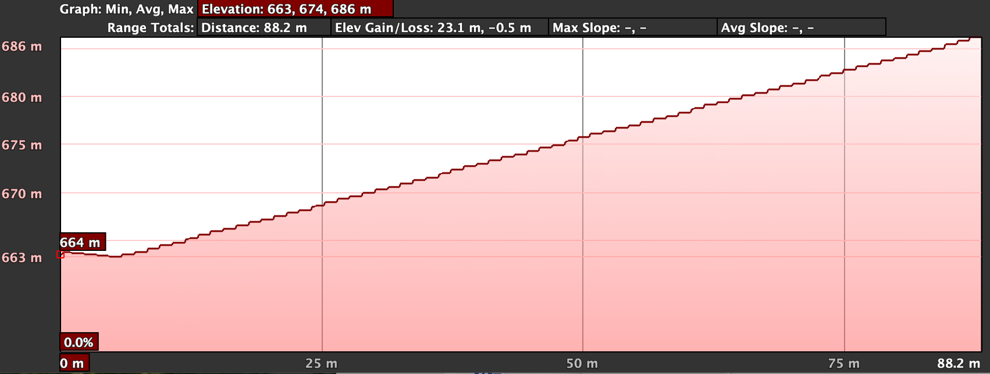
Elevation profile at detector location
20⁰ elev
max rate at 46⁰ elev
Detector normal: 26⁰ elev

Slide 30
Total detector rate at 26⁰ = 0.23 Hz
Example rates assume:
uniform density calcite rock (2.7 g/cm³)
acceptance is independent of energy, orientation
90% hit efficiency ➔ 64% track efficiency
Test feature = 3 x 3 x 3 m³
1 month data
Elev Angle | distance [m] | E_{min} [GeV] | track rate [Hz] | Tracks/month full acceptance | tracks thru test feature | Differential
46 | 8 | 4.6 | 0.25 | 648K | 550K -- 980K | 300K
26 | 20 | 10.8 | 0.11 | 285K | 5K –6K | 1000
20 | 50 | 27 | 0.037 | 96K | 700 | 70

Slide 31
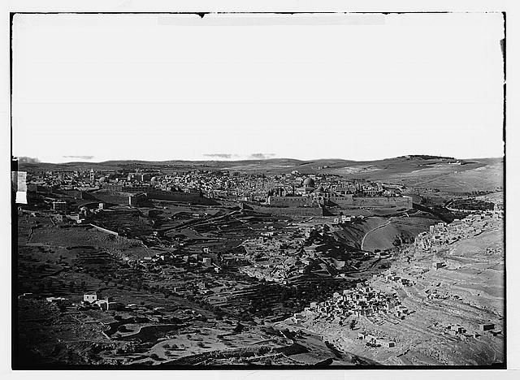
Dome of the Rock
Al Aqsa Mosque
Muon Detector Kidron
Matson (G. Eric and Edith) Photograph Collection
Library of Congress: LC-DIG-matpc-05871
(Date unknown, but consistent with late 19th century)

