Slide 1
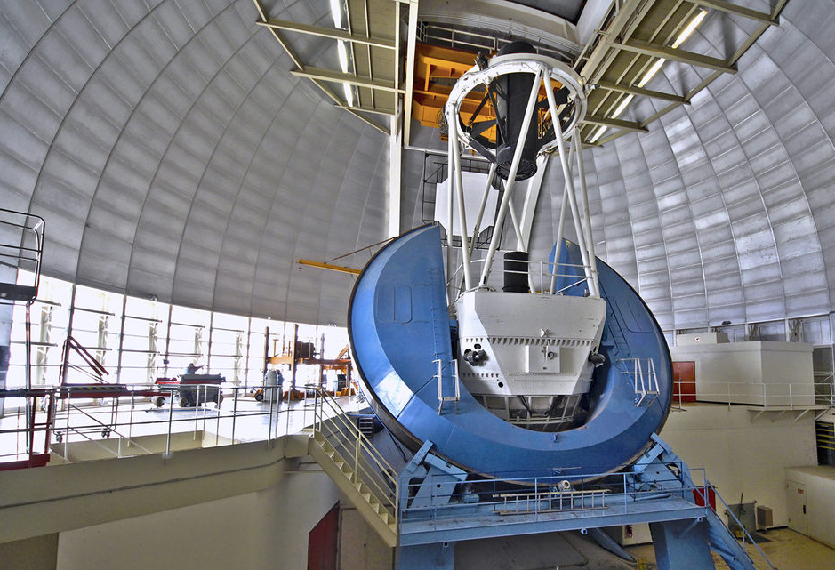
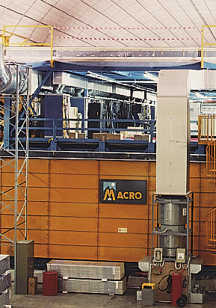
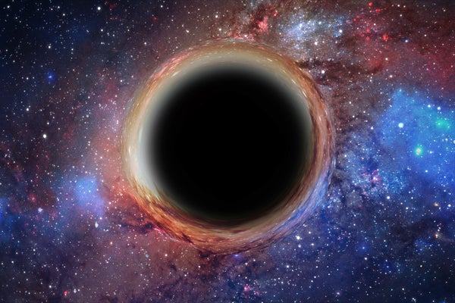
Flattening the Universe: a Scientific Journey from Monopoles to Dark Energy
Gregory Tarlé
University of Michigan
The MACRO experiment and its legacy: more than three decades of astroparticle and neutrino physics
June 28, 2025

Slide 2
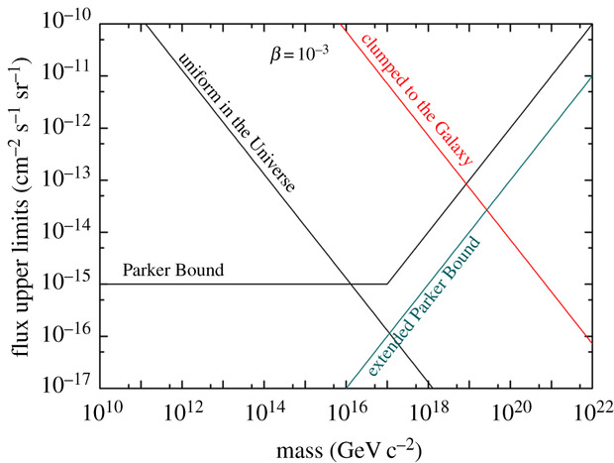
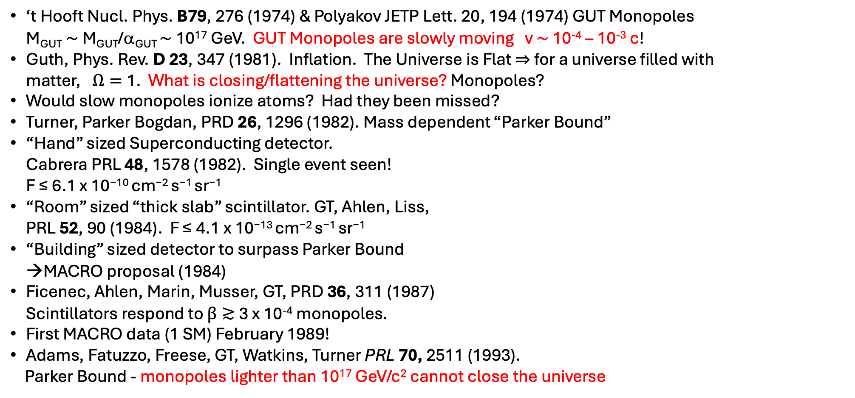
Events to Inspire a Young Monopole Hunter
‘t Hooft Nucl. Phys. B79, 276 (1974) & Polyakov JETP Lett. 20, 194 (1974) GUT Monopoles M_{GUT}$\sim$ M_{GUT}/α_{GUT} $\sim$ 10¹⁷ GeV. GUT Monopoles are slowly moving v $\sim$ 10⁻⁴ – 10⁻³ c!
Guth, Phys. Rev. D 23, 347 (1981). Inflation. The Universe is Flat $⇒$ for a universe filled with matter,$Ω=$1. What is closing/flattening the universe? Monopoles?
Would slow monopoles ionize atoms? Had they been missed?
Turner, Parker Bogdan, PRD 26, 1296 (1982). Mass dependent “Parker Bound”
“Hand” sized Superconducting detector. Cabrera PRL 48, 1578 (1982). Single event seen! F ≤ 6.1 x 10⁻¹⁰ cm⁻² s⁻¹ sr⁻¹
“Room” sized “thick slab” scintillator. GT, Ahlen, Liss, PRL 52, 90 (1984). F ≤ 4.1 x 10⁻¹³ cm⁻² s⁻¹ sr⁻¹
“Building” sized detector to surpass Parker Bound →MACRO proposal (1984)
Ficenec, Ahlen, Marin, Musser, GT, PRD 36, 311 (1987) Scintillators respond to $β≳$3 x 10⁻⁴ monopoles.
First MACRO data (1 SM) February 1989!
Adams, Fatuzzo, Freese, GT, Watkins, Turner PRL 70, 2511 (1993).
Parker Bound - monopoles lighter than 10¹⁷ GeV/c² cannot close the universe
“hand” sized detectors
“room” sized detectors
“building” sized detectors
Figure: Patrizii, Sahnoun, Togo 2019

Slide 3

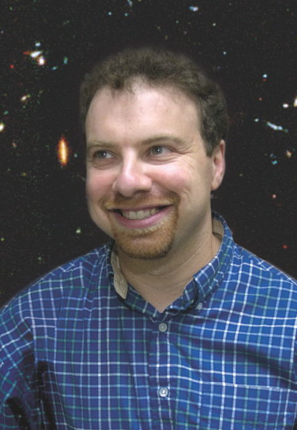
A Revolution in Cosmology!
In 1998 the Supernova Cosmology Project and the High-z Supernova team used Type Ia supernovae as “standard candles” to construct a Hubble diagram out to z = 1. Contrary to expectations, both found that the expansion of the universe is accelerating!
The “stuff” responsible for this acceleration was given the name “Dark Energy” by Michael Turner.
In 2011 Saul Perlmutter, Brian Schmidt and Adam Reiss were awarded the Nobel Prize in Physics for discovering the accelerating universe

Slide 4
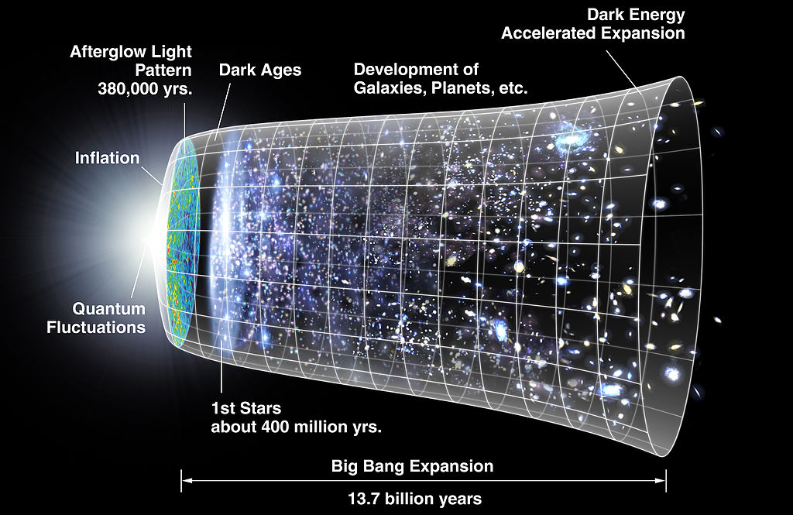
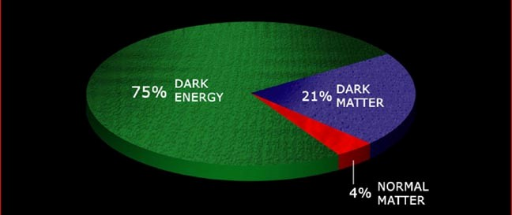
75 ± 2% Dark Energy
25 ± 3% Matter
0.5% Bright Stars
Matter (25%):
20% Dark Matter
4.4% Baryons
0.3% νs
We do not understand 96% of the universe!
Graphic: WMAP

Slide 5
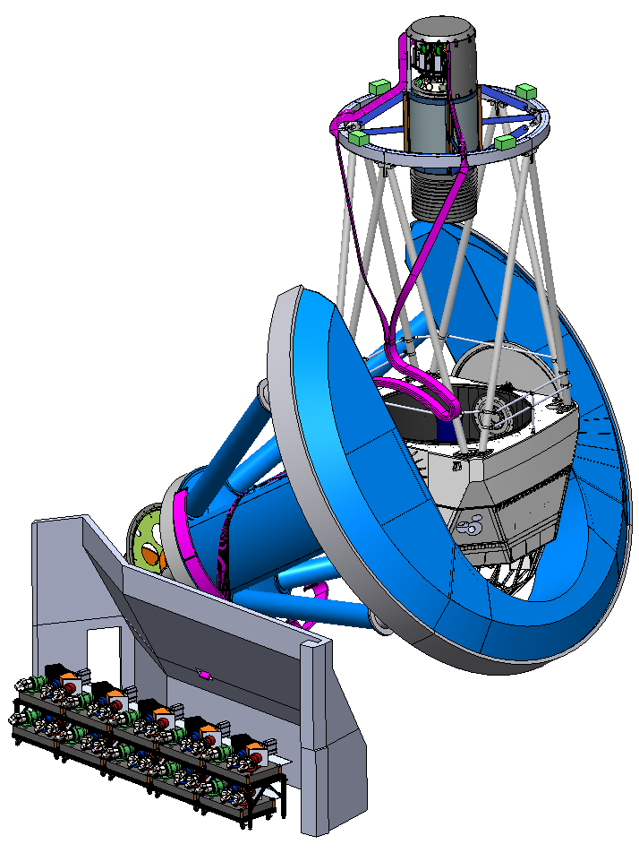
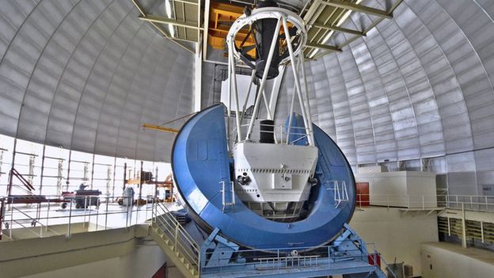
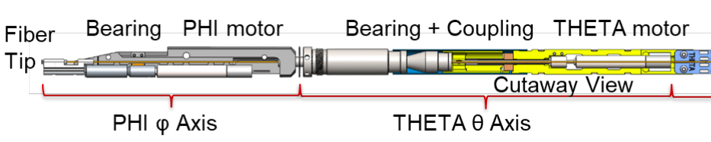
The Dark Energy Spectroscopic Instrument (DESI)
First DETF Stage IV experiment on the sky (more to come)
Nominal 5-year Survey (2021-2026). 35 M galaxy redshifts. Extensions, DESI-2 likely
Baryon Acoustic Oscillations (BAO) and Redshift Space Distortions (RSD)
DESI was designed to answer the question: Is Dark Energy evolving? Spoiler alert: the answer is YES!
Cosmic Cartography: DESI has made the largest 3D map of the universe to date. (16 M galaxy redshifts).
DR2 (3 YR) papers released to arXiv March 2025. Fun reading!
Focal Plane Assembly w/5000 fiber positioner robots, 10 guide-focus assemblies
6-lens wide-field Corrector on Hexapod
49 meter, 5000 fiber run
DESI on the Mayall Telescope at Kitt Peak, AZ
Mayall 4 m Telescope
Fiber View Camera
Ten thermally-controlled 3-band, 500 channel optical- NIR Spectrographs 360-980 nm
Fiber positioner robots

Slide 6
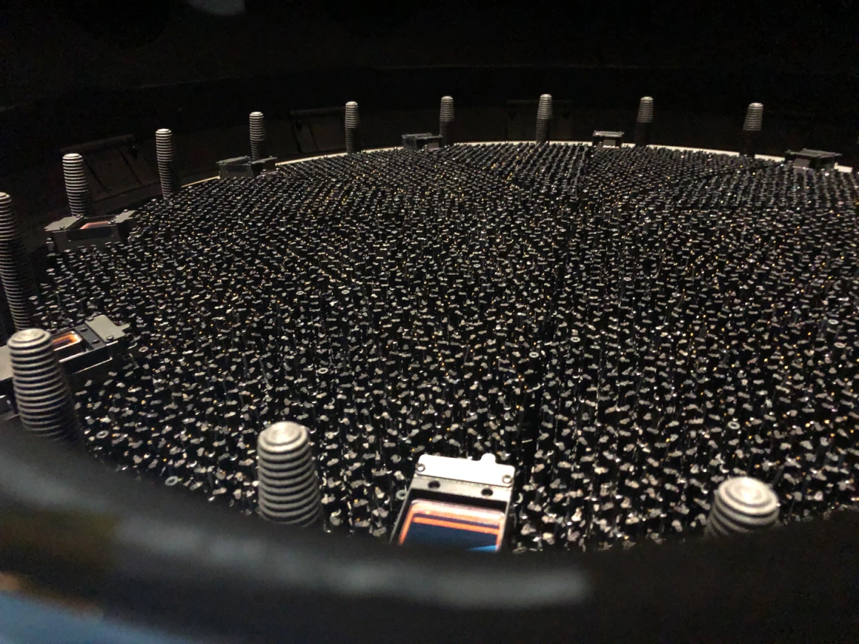
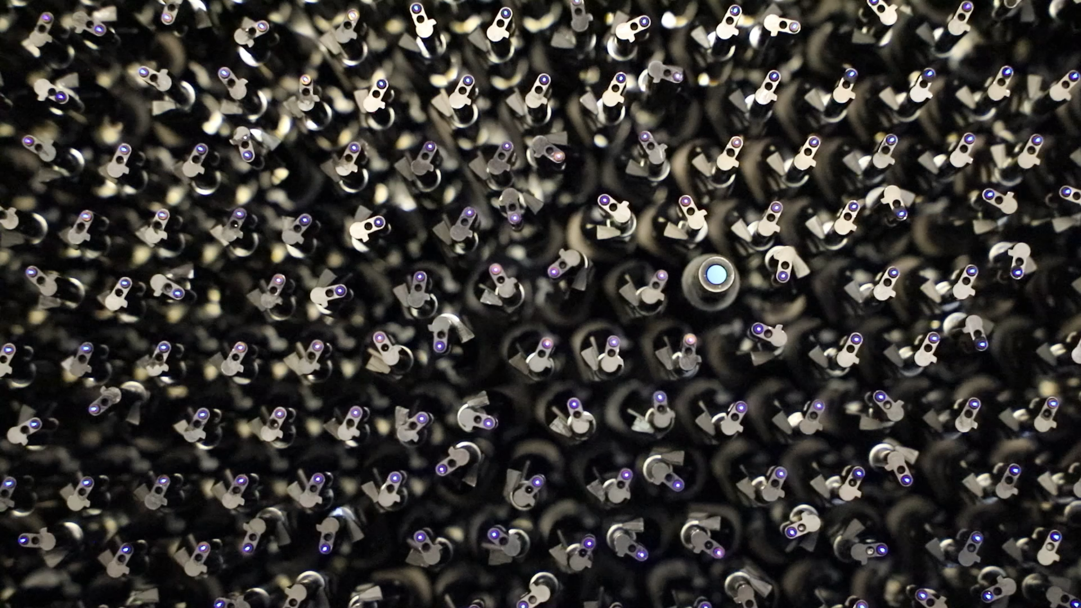
DESI Fiber Positioner Robots
5000 positioner robots, center galaxies from legacy survey on 108 μm fiber to an accuracy of a few μm, with new tile every ~15 minutes.

Slide 7
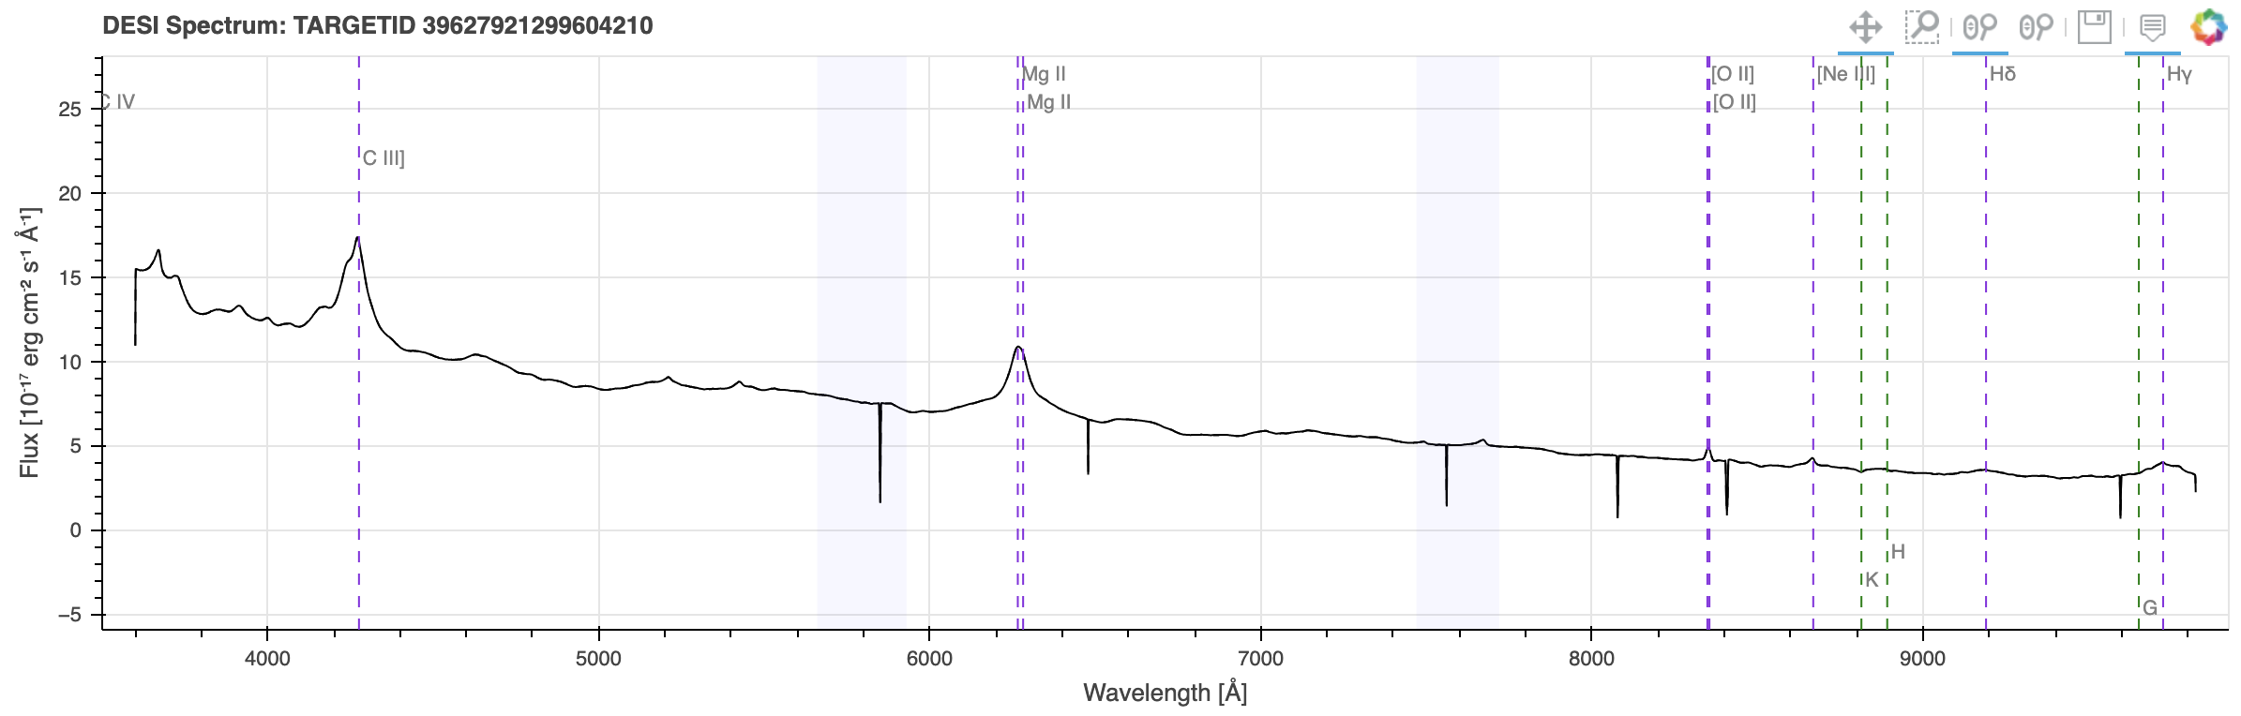
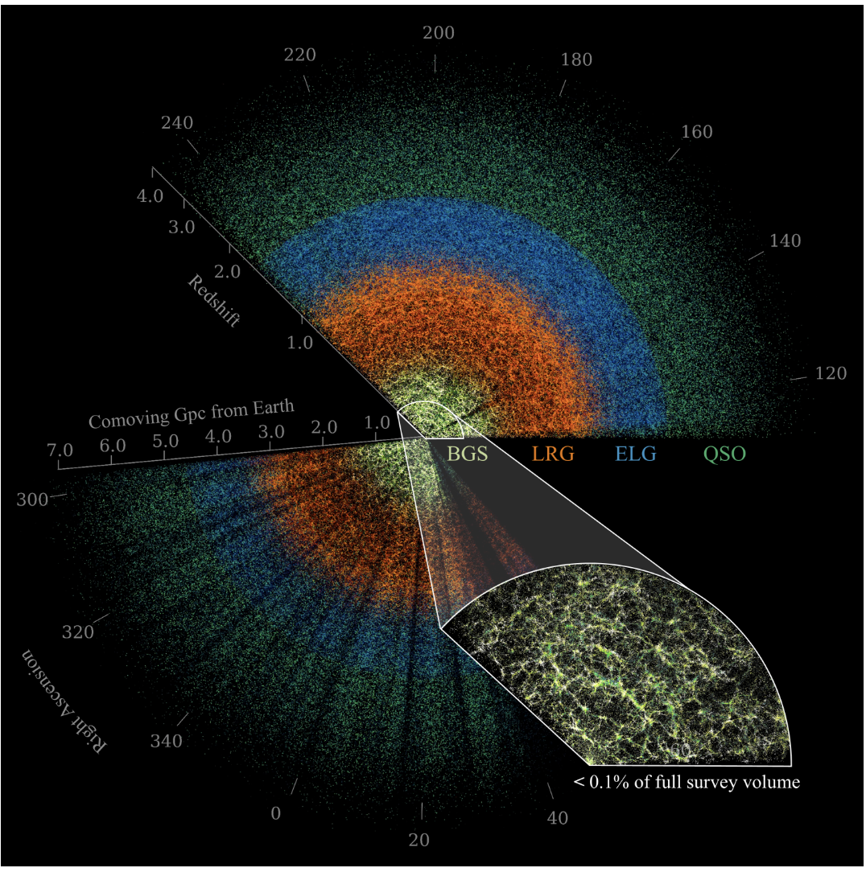
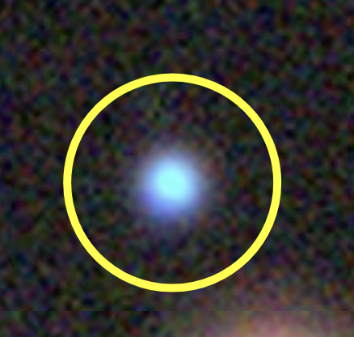
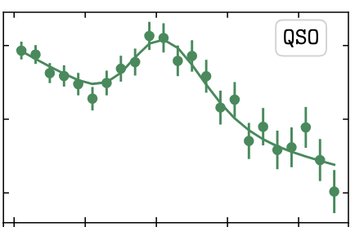

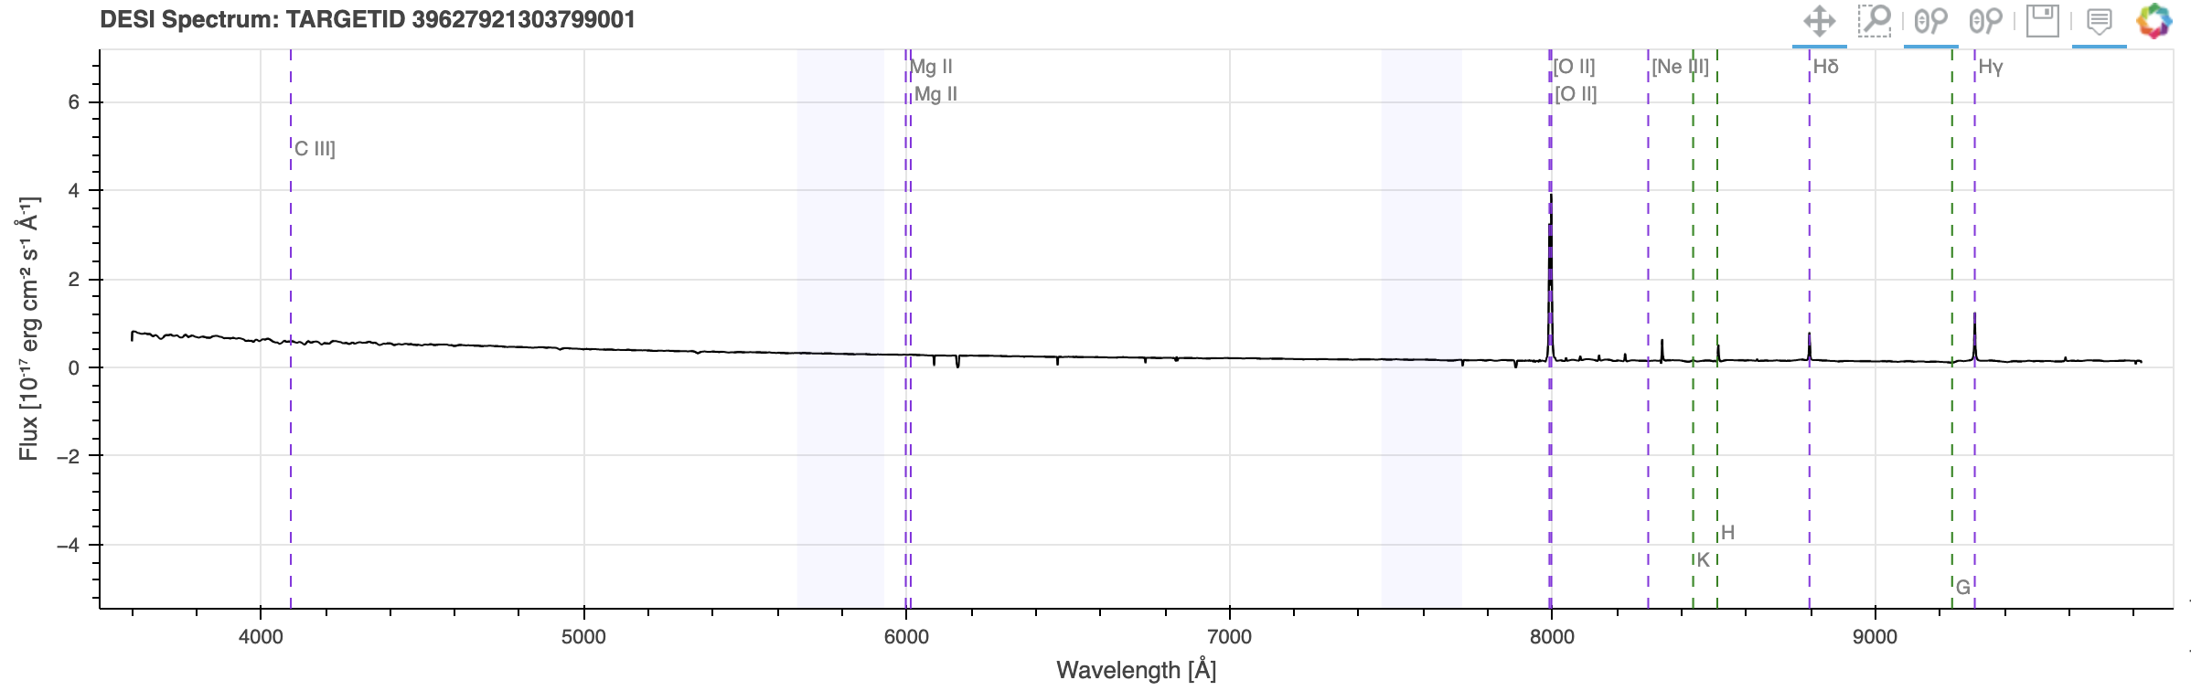
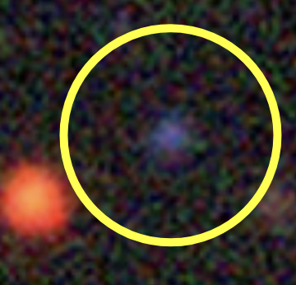
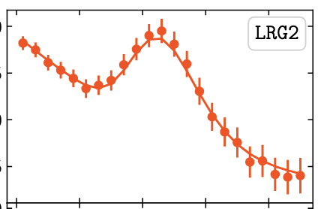
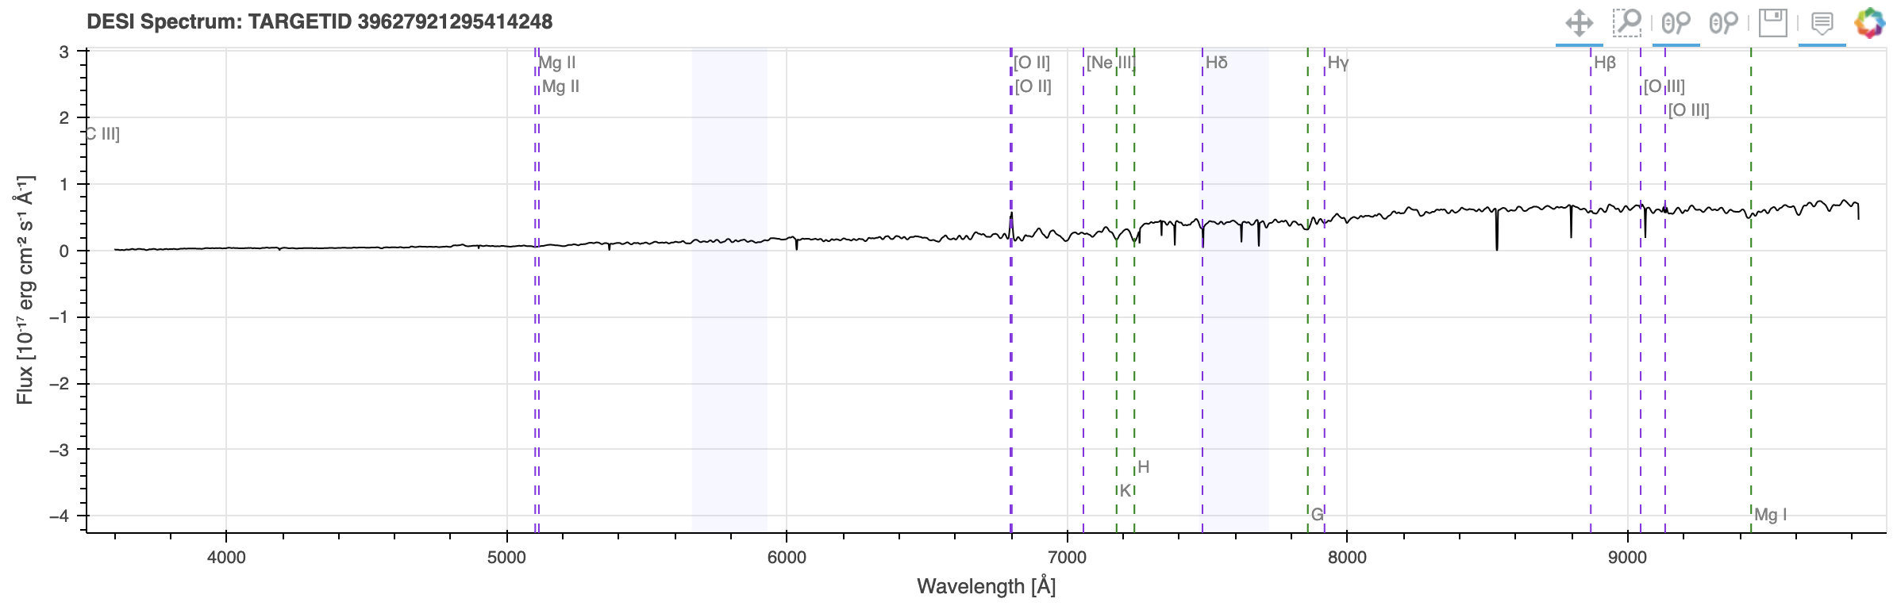
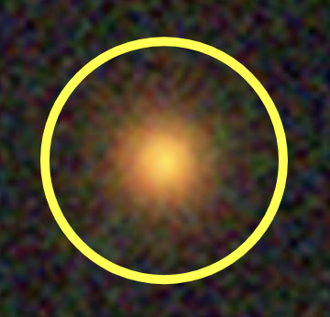
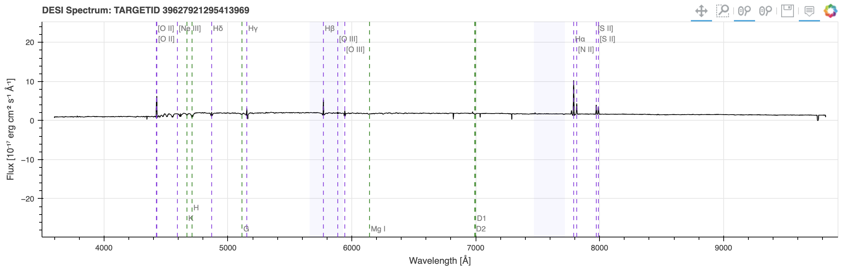
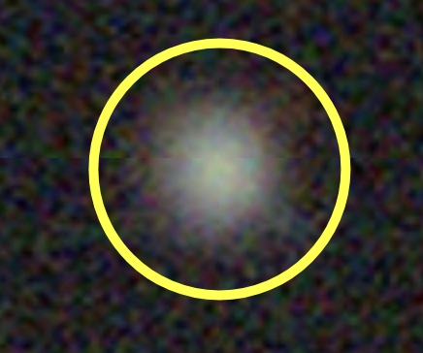
DESI Spectra
Legacy Survey DR9
DESI fiber
Quasar
(QSO)
BAO fit
(DR2)
z = 1.24
D_{M}/r_{d} ~ 30
Mg⁻ doublet:
MgII
5 p elec.,
l =1, s = ½
J=1/2, 3/2
₂P^{3/2}
₂P^{1/2} → ₂S^{1/2}
l=0, s=1/2, j =1/2
[OII]
D_{M} ~ 4.5 Gpc
Emission Line
Galaxy (ELG)
z = 1.14
D_{M} ~ 2.5 Gpc
O⁻ doublet:
[OII]
D_{M}/r_{d} ~ 17
3 p electrons
l =2, s=1/2,
j =3/2, 5/2
₂D^{3/2}
₂D^{5/2} → ₄S^{3/2}
→
BAO scale
l=0, s=3/2, j=3/2
z = 0.82
DESI tracers (+Lyα)
Luminous Red
Galaxy (LRG)
[OII]
z = 0.19
14M tracers
Medium-resolution redshift
Robust distance scale
Bright Galaxy
(BGS)
BAO scale
[OII]
Hα
Balmer
3 → 2
Image: DESI, M. Abdul Karim et al., 2503.14745

Slide 8
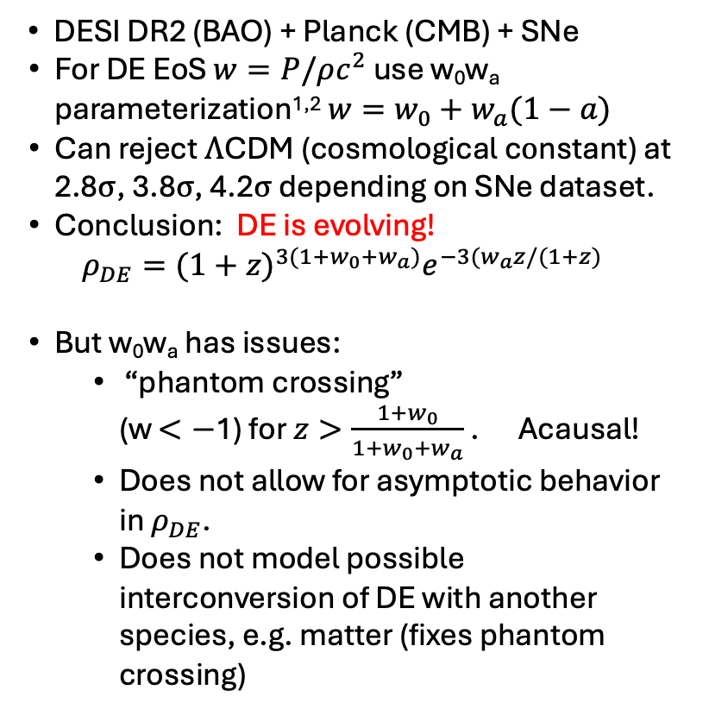

DESI DR2 + CMB + DESY5 w₀w_{a} Rejects $Λ\text{CDM} \text{at}\text{ 4.2}σ$
DESI DR2 (BAO) + Planck (CMB) + SNe
For DE EoS $w=P/ρc^{2}$ use w₀w_{a} parameterization^{1,2} $w=w_{0}+w_{a}(1−a)$
Can reject $Λ\text{CDM}\text{ (}\text{cosmological} \text{c}o\text{nstant}\text{) }\text{at}\text{ 2.8}σ$, $\text{3.8}σ$, $\text{4.2}σ$ depending on SNe dataset.
Conclusion: DE is evolving!
$$ρ_{DE}={(1+z)}^{3(1+w_{0}+w_{a})}e^{−3(w_{a}z/(1+z)}$$
But w₀w_{a} has issues:
    “phantom crossing” (w $<−$1) for $z>\frac{1+w_{0}}{1+w_{0}+w_{a}}$ . Acausal!
    Does not allow for asymptotic behavior in $ρ_{DE}$.
    Does not model possible interconversion of DE with another species, e.g. matter (fixes phantom crossing)
ΛCDM ($w_{0}$ = -1, $w_{a}=0)$
2.8 σ
3.8 σ
4.2 σ
No SNe
DESI DR2
DESI, M. Abdul Karim et al., arXiv 2503.14738v2
¹M. Chevallier and D. Polarski, Int. J. Mod. Phys. D 10, 213 (2001).
²E. V. Linder, Phys. Rev. Lett. 90, 091301 (2003).

Slide 9

A Crazy Idea for the Origin of Dark Energy
For the last 27 years, the conventional wisdom among theorists was that DE arises from quantum fluctuations in the vacuum and that it is a property of space, a cosmological constant $(Λ$CDM).
Problems: Coincidence problem (why now?) New Cosmological constant problem (why $ρ_{DE}\sim$ $ρ_{M}$?)
Given these and that DESI has found that DE is evolving, is it time to explore some new ideas?
In the very early universe, we underwent a period of exponential expansion presumably driven by some sort of vacuum energy $→$ Inflation
Whatever the cause, it stopped. Inflationary vacuum energy turned into the matter of our universe.
Now, in the late universe, exponential accelerated expansion is happening again (Dark Energy).
Question: Where do such extreme conditions exist today?
Answer: At the center of a collapsing black hole (BH). Like little Big Bangs played in reverse.
Is it possible that BHs are the source of dark energy? We forget that the naïve “paper” BH solutions (Schwarzschild, Kerr) are NOT the actual objects that inhabit our universe. They do not match boundary conditions in the expanding Robertson-Walker universe in which we live, contain unphysical singularities, and have absolute, static horizons (incompatible with a dynamic universe).
Non-singular BHs (with P = -$ρ)$ have a long history starting with Gliner (1966), Sakharov, Bardeen, Dymnikova… The have dynamical mass and radius and mimic Schwarzschild or Kerr on the outside for t $≪$ t_{Hubble} and unlike Schwarzschild or Kerr, are coupled to the external cosmology.
Could Cosmologically Coupled Black Holes (CCBH) be the origin of our late time dark energy?
Experimental signatures : BH mass growth, DE tracking star formation, evolving comoving $ρ_{DE}$, $ρ_{M}$.

Slide 10
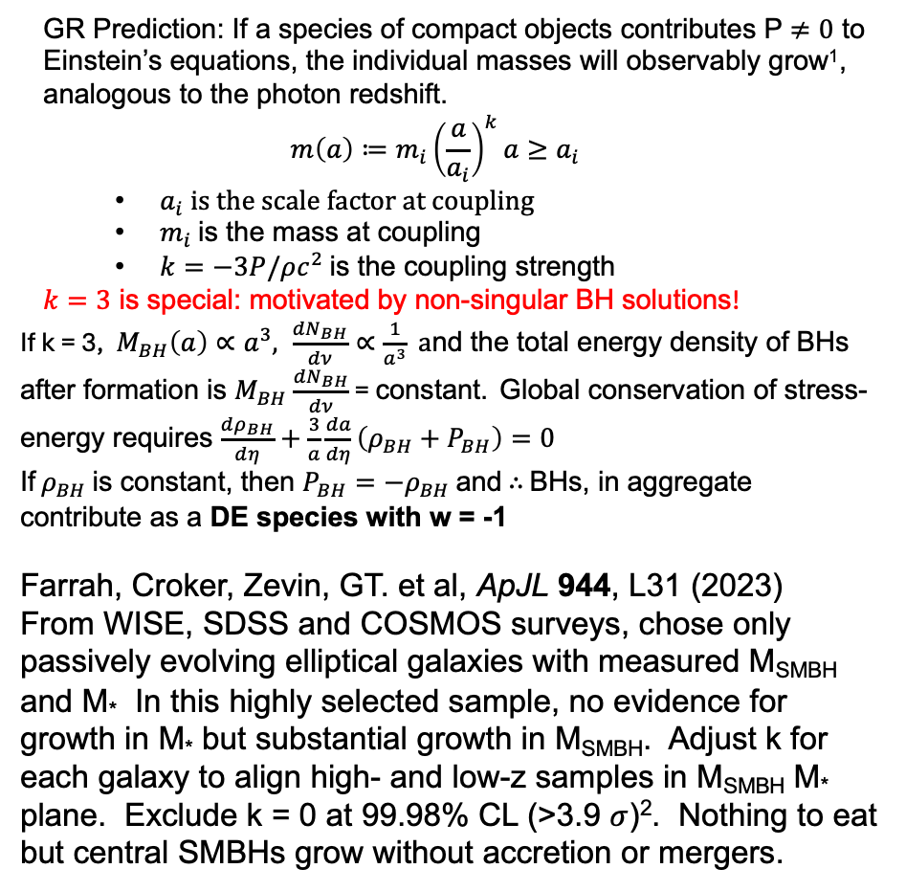
Cosmological Coupling and BH Mass Growth
GR Prediction: If a species of compact objects contributes P $≠0$ to Einstein’s equations, the individual masses will observably grow¹, analogous to the photon redshift.
$$m\left(a\right)≔m_{i}{\left(\frac{a}{a_{i}}\right)}^{k}a≥a_{i}$$
  $a_{i} is the scale factor at coupling$
  $m_{i}$ is the mass at coupling
  $k=−3P/ρc^{2}$ is the coupling strength
$k=3$ is special: motivated by non-singular BH solutions!
If k = 3, ${ M}_{BH}\left(a\right)∝a^{3}, \frac{{dN}_{BH}}{dν}∝\frac{1}{a^{3}} a$nd the total energy density of BHs after formation is $M_{BH}$ $\frac{{dN}_{BH}}{dν}$ = constant. Global conservation of stress-energy requires $\frac{{dρ}_{BH}}{dη}+\frac{3}{a}\frac{da}{dη}\left(ρ_{BH}+P_{BH}\right)=0$
If $ρ_{BH}$ is constant, then $P_{BH}=−ρ_{BH}$ and $∴$ BHs, in aggregate contribute as a DE species with w = -1
Farrah, Croker, Zevin, GT. et al, ApJL 944, L31 (2023)
From WISE, SDSS and COSMOS surveys, chose only passively evolving elliptical galaxies with measured M_{SMBH} and M* In this highly selected sample, no evidence for growth in M* but substantial growth in M_{SMBH}. Adjust k for each galaxy to align high- and low-z samples in M_{SMBH} M* plane. Exclude k = 0 at 99.98% CL (>3.9 $σ$)². Nothing to eat but central SMBHs grow without accretion or mergers.
¹Croker and Wiener, ApJ 882.1,19 (2019)

Slide 11
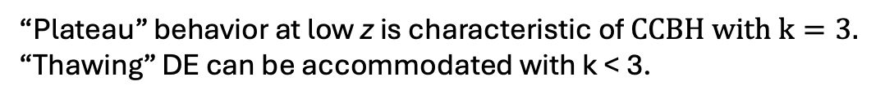
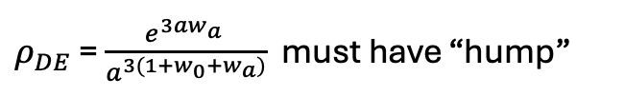
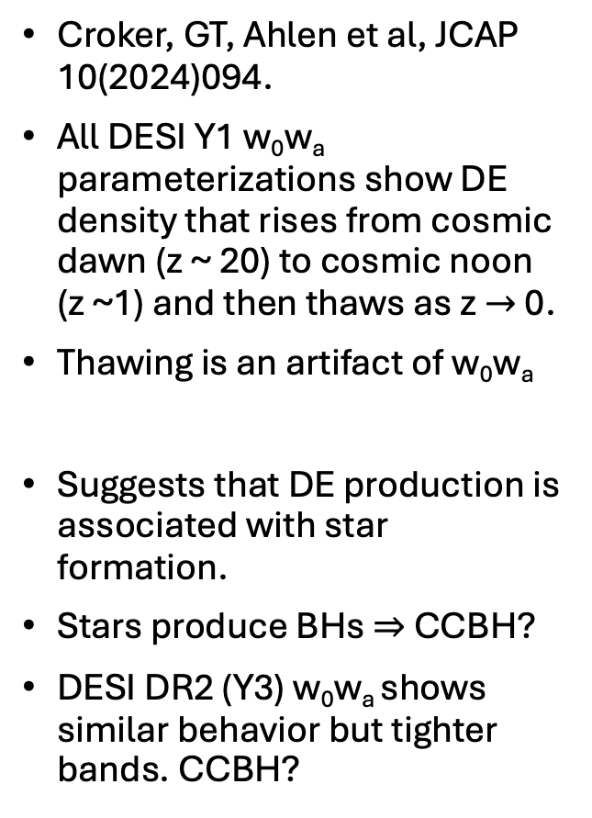
w₀w_{a} parameterization tracks star formation
Croker, GT, Ahlen et al, JCAP 10(2024)094.
All DESI Y1 w₀w_{a} parameterizations show DE density that rises from cosmic dawn (z ~ 20) to cosmic noon (z ~1) and then thaws as z $→$ 0.
Thawing is an artifact of w₀w_{a}
Suggests that DE production is associated with star formation.
Stars produce BHs $⇒$ CCBH?
DESI DR2 (Y3) w₀w_{a} shows similar behavior but tighter bands. CCBH?
“Plateau” behavior at low z is characteristic of $CCBH with k=3.$ “Thawing” DE can be accommodated with k < 3.
$ρ_{DE}$ = $\frac{e^{3aw_{a}^{}}}{a^{3(1+w_{0}+w_{a})}}$ must have “hump”

Slide 12
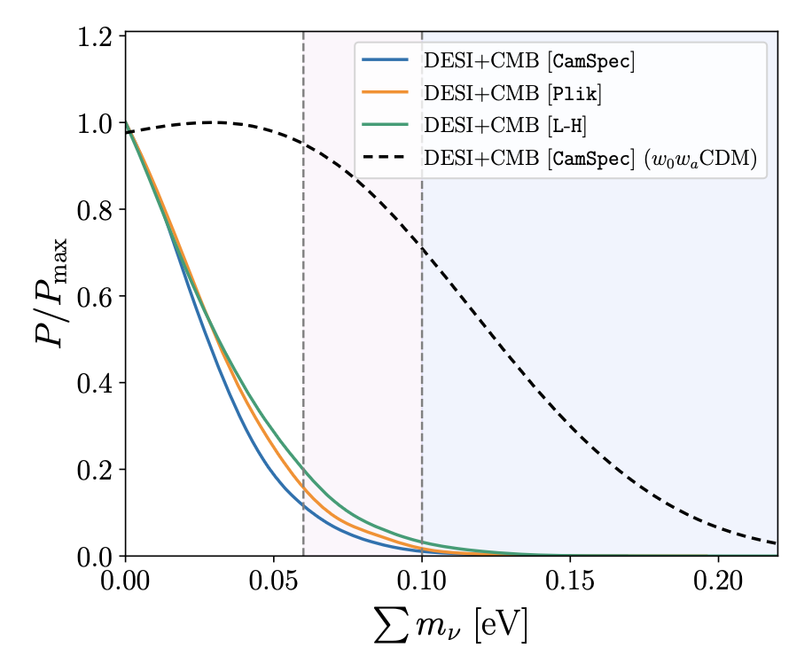
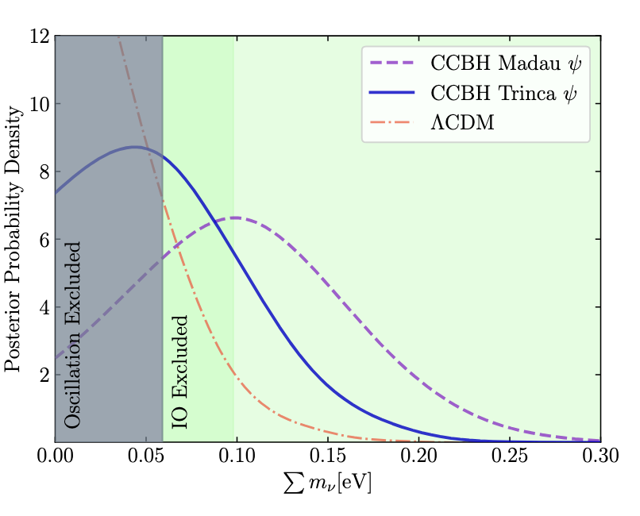
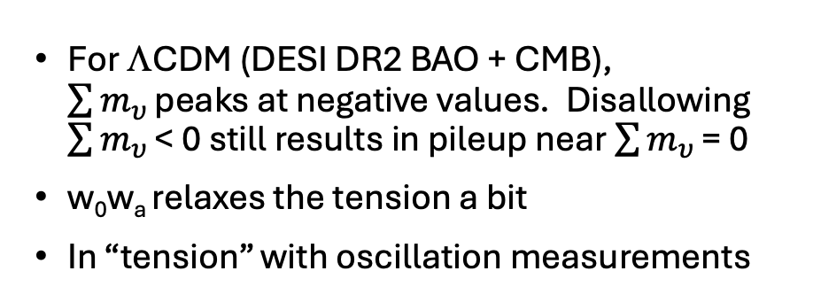
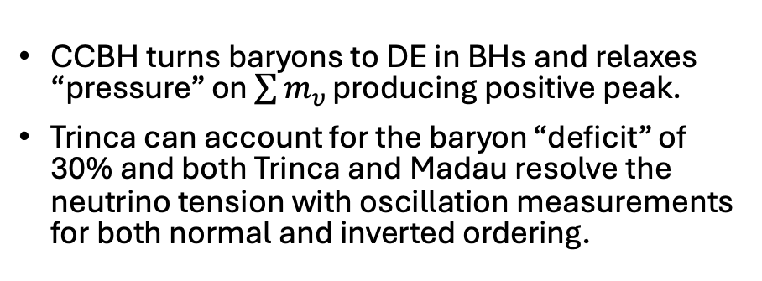
CCBH Resolves Neutrino Tension
For ΛCDM (DESI DR2 BAO + CMB), $\sum{m_{υ }}$peaks at negative values. Disallowing $\sum{m_{υ }}$< 0 still results in pileup near $\sum{m_{υ }}$= 0
w₀w_{a} relaxes the tension a bit
In “tension” with oscillation measurements
CCBH turns baryons to DE in BHs and relaxes “pressure” on $\sum{m_{υ }}$producing positive peak.
Trinca can account for the baryon “deficit” of 30% and both Trinca and Madau resolve the neutrino tension with oscillation measurements for both normal and inverted ordering.
Oscillation Excluded
IO Excluded
DESI, S. Ahlen et al., arXiv 2504.20338v1 PRL, in press (2025)

