Slide 1
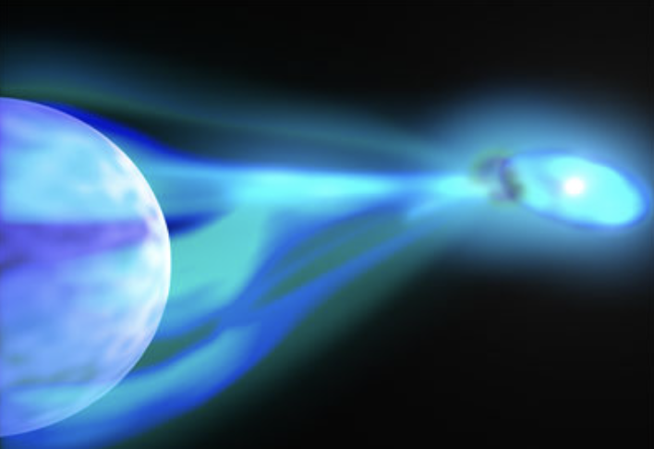

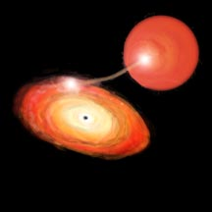
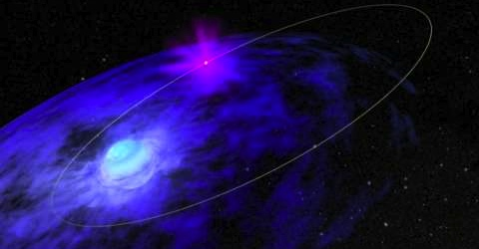

NS X-ray Binaries
Fiamma Capitanio. INAF-IAPS
Esa
Esa
NASA

Slide 2
X-ray Binaries
Binary systems of stars where one of the components is a collapsed star (neutron star or black hole). They are strong X-ray emitting objects (L_{X}~10³⁷ -10³⁹ erg s⁻¹) due to mass accretion onto the compact object
High mass X-ray binaries
  Companion star:
    Young object (<10⁷ yr), pop I
    Spectral type O, B
    Mass >5 Solar mass
  L_{x}/L_{ott}~0.001-100
  Orbital period: 1-100 d
  X-ray pulsations
  Accretion via stellar wind
  both accretion regimes can occur in HMXB because it depends on the mass ratio (e.g. Cyg X-1
Low Mass X-ray binaries
  Companion star:
    Old object (K, M), pop II
    Mass < 2 Solar mass
  L_{x}/L_{ott}~100-1000
  Period: 10 min-10 d
  rare X-ray pulsations
  Accretion via Roche lobe overflow.

Slide 3
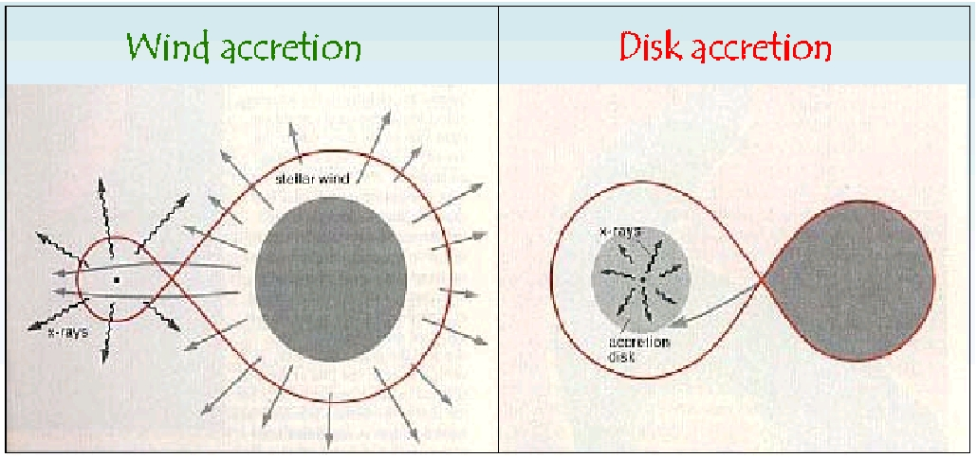
Two different accretion regimes
Tauris, van den Heuvel et al. 2006
The evolution of X-ray binaries is still uncertain.
LMXBs are considered old systems, and it is possible that they were originally HMXBs that lost most of their mass through accretion.

Slide 4
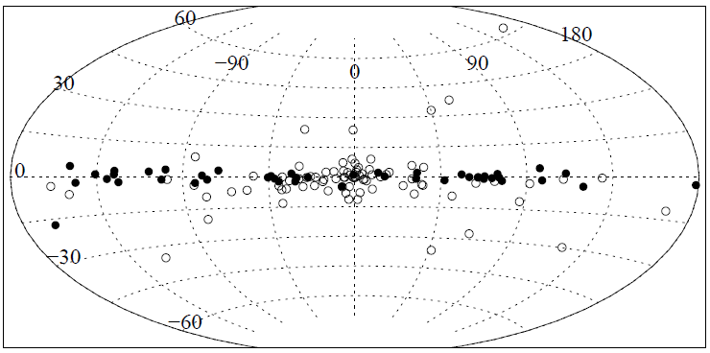
Spatial Distribution
Different spatial distribution in the galaxy because of the different age of the systems
HMXB → Spiral Arms
LMXB → Galactic Bulge
Grimm et al 2002
LMXB
HMXB

Slide 5
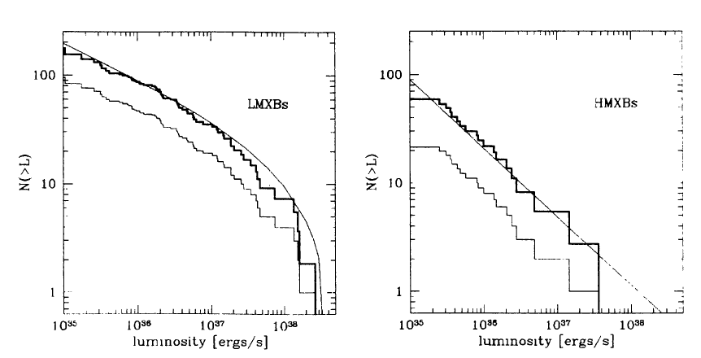
Luminosity Fuction
Grimm et al 2002
INTEGRATED Luminosity:
HMXB= 2*10³⁸ erg/s
LMXB= 10³⁹ ergs/s

Slide 6
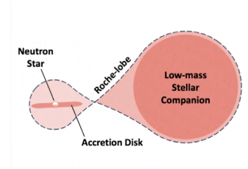
LOW MASS X-RAY BINARIES

Slide 7
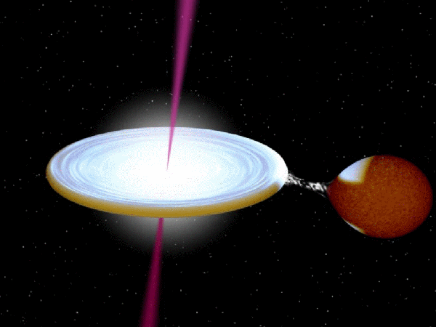
JETS
Corona ?
Low mass main sequence star (M~M_{sun})
Disc
Compact Object

Slide 8
In a LMXB the compact object interacts, through its gravitational field, with low mass donor star ((less than 1 M⊙ )
The lifetime is long enough to dissipate most of the NS magnetic field, resulting in fields of the order of 10⁸⁻¹⁰ Gauss.
The donor star fills its Roche lobe and hence transfers mass to the compact object through the inner Lagrangian point forming an accretion disk also emits radiation produced via viscous dissipation due to gravitational potential energy release
They emit almost all of their radiation in X-rays, so they are among the brightest objects in the X-ray sky

Slide 9
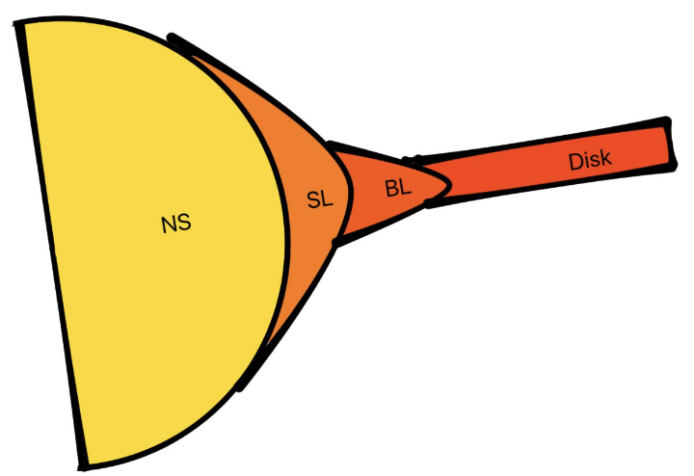
The luminosity of these systems (ranging from few 10³¹ erg/s up to few times the Eddington limit ~10^{38/39} ergs/s) depends on different parameters: the mass, the accretion rate and the system’s geometry
Although the geometry of the innermost part of the system is still unclear, the low magnetic field of NSs should allow the accretion disk to approach the NS surface
The region connecting the inner edge of the disk to the NS, where velocity of disk matter approaches the velocity at the NS surface, is called boundary layer
than the matter spreads forming a belt-like spreading layer onto the NS surface
Boundary/Spreading layer is an important source of radiation as well.

Slide 10
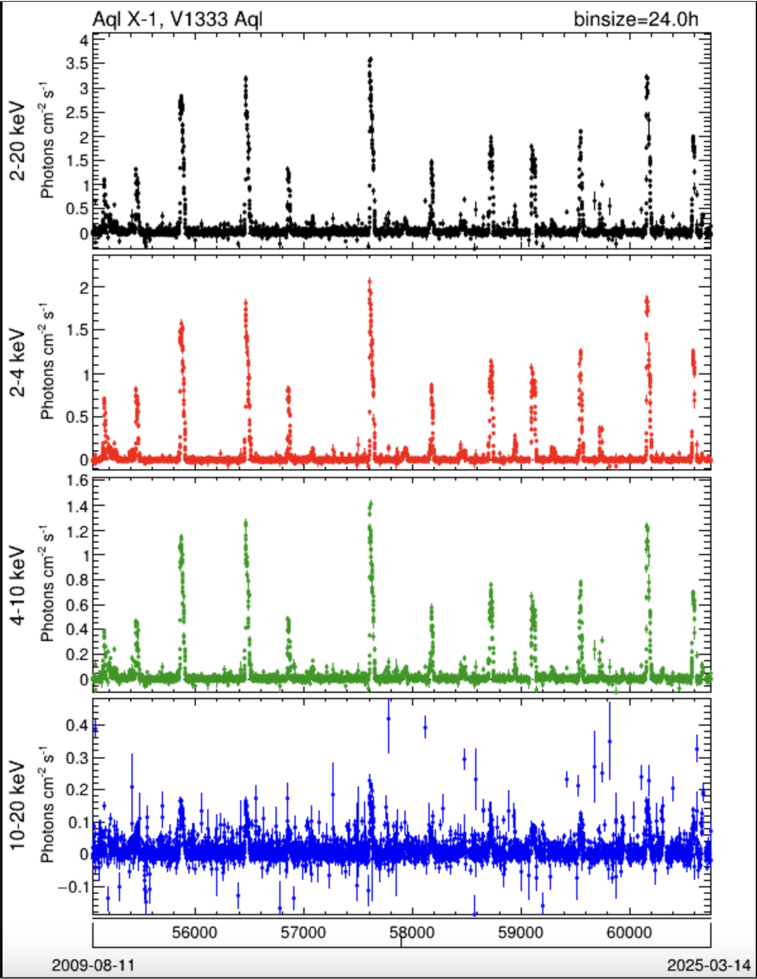
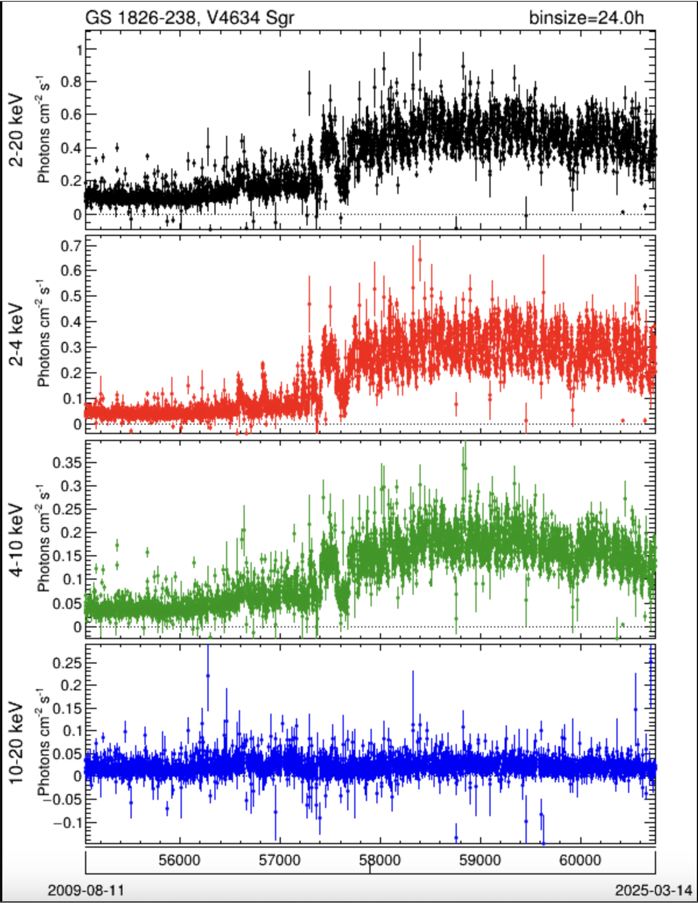
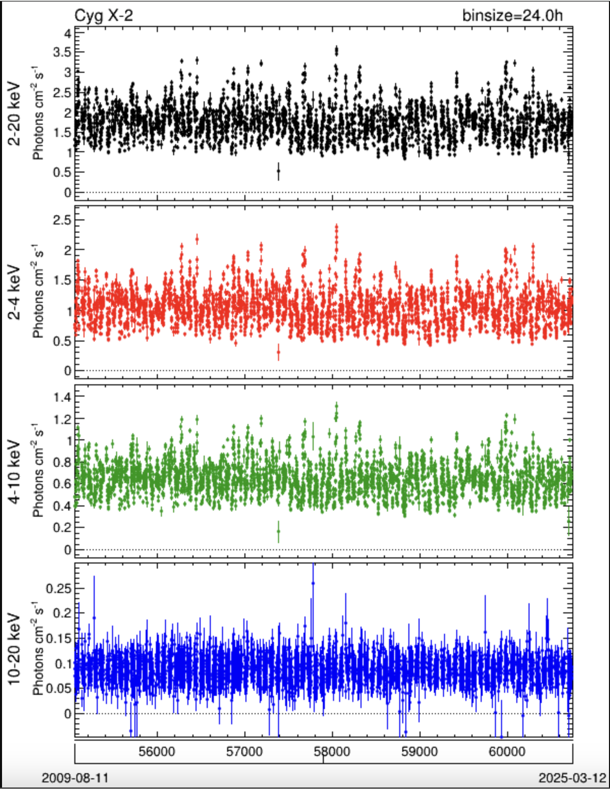
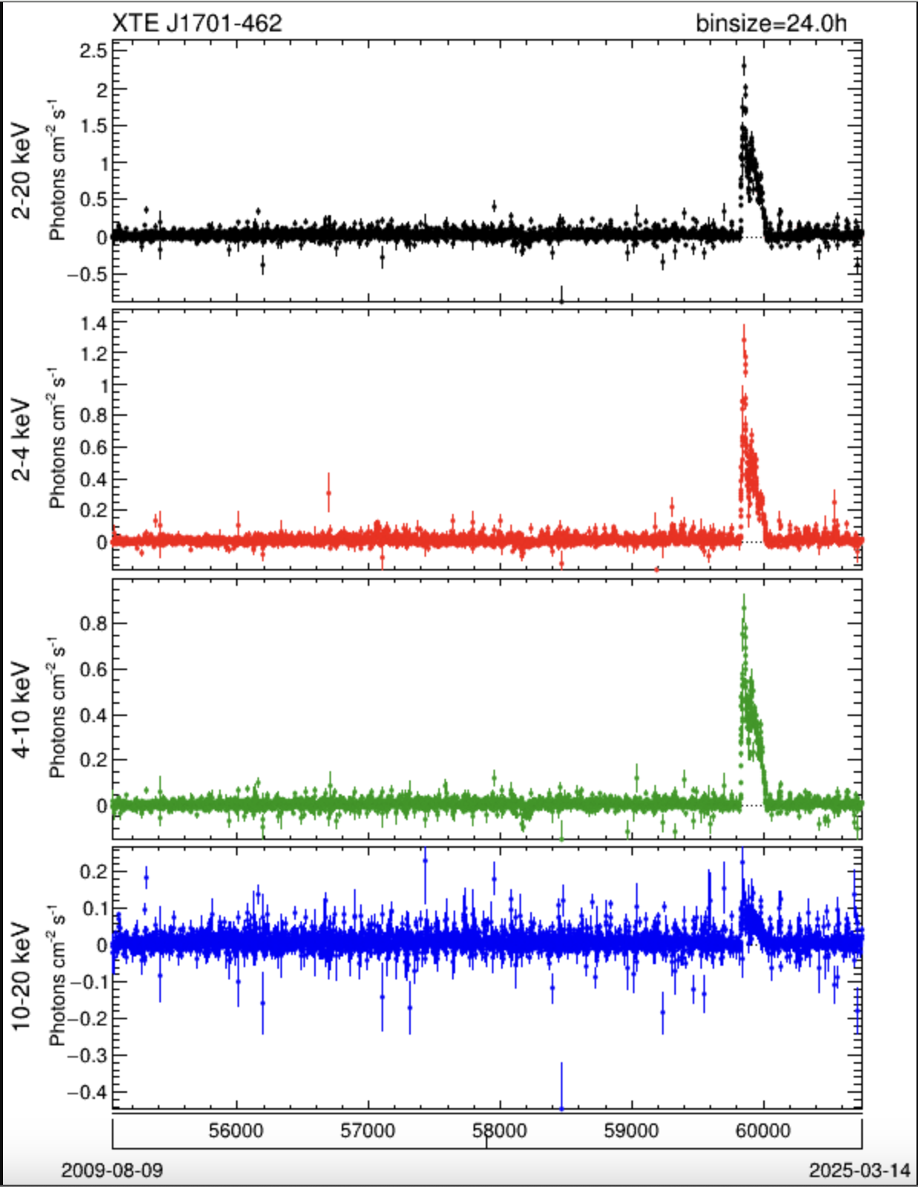
LMXBs can be persistent or transient sources
MAXI Riken light curves of a WM-LMXB sample showing a wide range of behaviours:
strong and unpredictable variable X-ray emission, spectral variability, timing variability
Transient behaviour in some NS systems
MJD
MJD
MJD
MJD

Slide 11

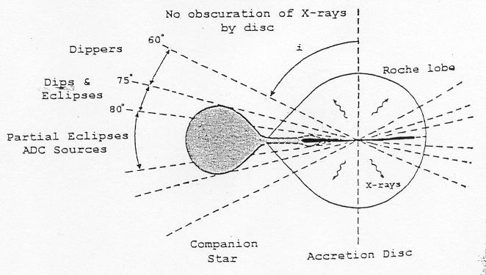
Inclination effects
Some observable characteristics in X-ray depends on the inclination of the system respect to the observer:
  Eclipses (i> 75°) (The companion star interposes itself between the observer and the disk, obscuring the inner part of the disk and the compact object).
i=0° face-on;
i=90° edge-on
  DIPS (60° < i < 75°): are caused by the bulge of material created at the point where the accretion stream impacts the accretion disc that passes in the line of site of the observer .
  i < 60°no obscuration
Frank et al. 1987

Slide 12
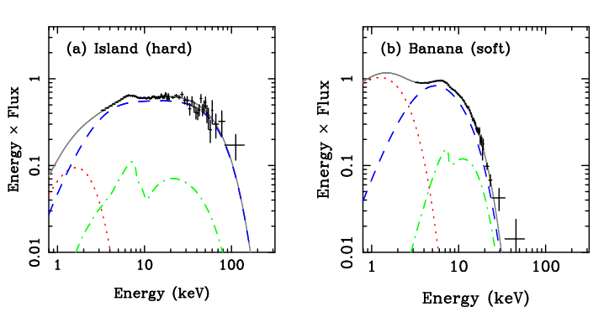
Spectral States
Soft state.
high luminosities generally near L_{E}
strong thermal disc
reflection components: believed to be due to X-ray illumination of the disk
Inverse Compton component: believed to be produced through thermal comptonisation of the star seed photons in a hot electron corona (kTe~3/4 keV ).
Sometimes in soft state hard tails are detected (scattering in hybrid or non-thermal corona?)
Done & Gierlinsky 2007 astroph 0708.0148
Hard States
luminosities lower than a few percent of Eddington (generally)
much weaker disc blackbody and reflection features
Thermal distribution of comptonising electrons kTe ~20/30 keV. The comptonised photons dominate the spectrum

Slide 13
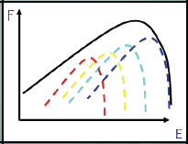
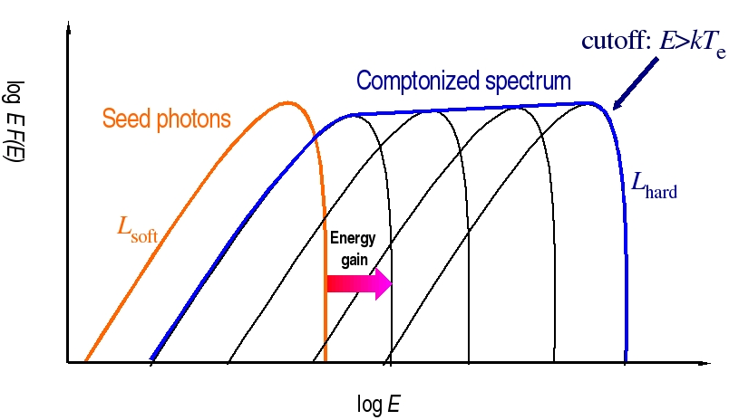
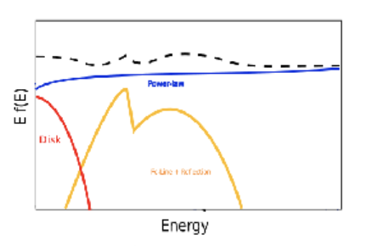
Spectral components
Accretion disk emission: black body emission of each single anulus of the disk.
Thermal Comptonization: due to inverse Compton scattering of the seed photons (inner part of the disk ? or NS surface ?) in a hot electron corona which nature and geometry is not known
e⁻
KT_{e} , electrons temperature, τ_{e} , optical depth, T_{o},seed photon temperature
Reflection: The Comptonized photons illuminate the disk: Compton scattering and absorption followed by fluorescent emission generates the reflection spectrum of the disk
e⁻
Fe line
Geometry and location of the Compton electron corona is still unknown, but polarimetry can help

Slide 14
Eastern and Western model
In the Eastern model the cold photon population is described by a multicolour disc blackbody and is directly observed, while the hotter neutron star component (spreading layer) is fully Comptonized by the hot electron plasma.
In the Western model the hotter neutron star emission is directly detected and modeled as a pure blackbody, while the colder disc photons are Compton-upscattered by the electron corona.
Although these two models were proposed more than 30 years ago, it is still debated which one is correct, as they are largely degenerate in their spectral signatures.
However, studies of timing properties support an Eastern-like scenario for the accretion geometry in NS-LMXBs
e⁻

Slide 15
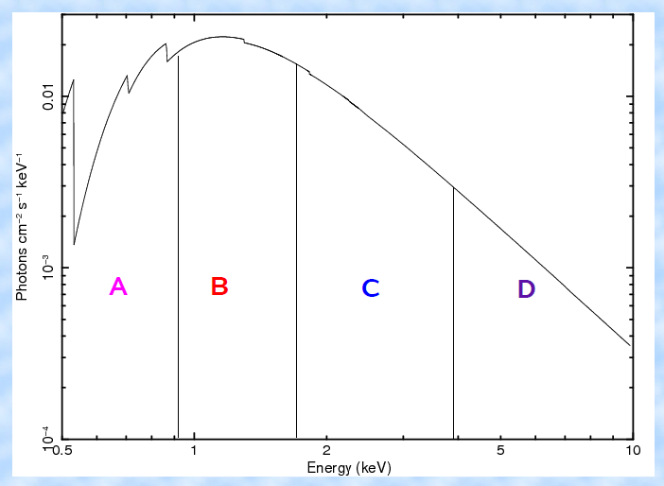
Color-Color Diagram
A convenient way to study how the X-ray spectrum of a LMXB changes with time and how it is correlated with changes in timing features is to compute a color-color diagram (CCD). The energy range is divided into 4 contiguous energy bands: two soft bands (A and B) and two hard bands (C and D). The plot results as:
hard(2)-hard(1) vs Soft(2)-Soft(1).

Slide 16
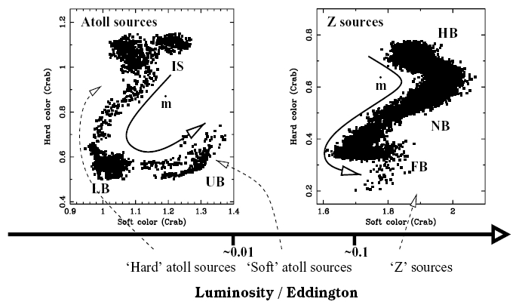
They are typically classified into two main categories: Atoll sources and Z sources based on different track in the color-color diagram (CCD), which reflects different spectral changes. There are some sources able to show both behaviours such as XTE 1701-XX – Atoll and Z sources are two different accretion regimes of the same object
Zeta sources
More luminous
No transitions
Smaller variations
Atoll sources
Less luminous
Hard/soft spectral transitions

Slide 17
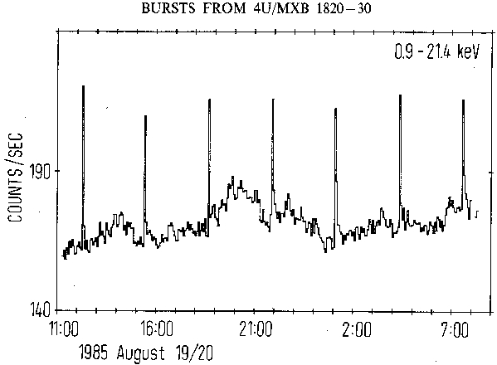
In light curves of WM-LMXB, type I X-ray bursts are often detected.
They appear in all classes of NS LMXBs: Atolls and Z sources, with or without pulsations and in all spectral states.
They are sudden increase of luminosity with a duration ranging from a few seconds to several hundreds of seconds, and even up to a few tens of hours for the so-called super bursts.
Type I XRB are thermonuclear flashes occurring at the surface of the NS.
The observation of a Type I burst from an LMXB securely identifies it as a NS system
Type I XRB are explosions result from the unstable burning of the accreted matter. It can fuse in different processes depending on its composition (H/He).
There are also another type of X-ray bursts, type II. They are very rare and due to accretion instabilities
X-ray Burst
Di Salvo, Papitto et al 2023

Slide 18
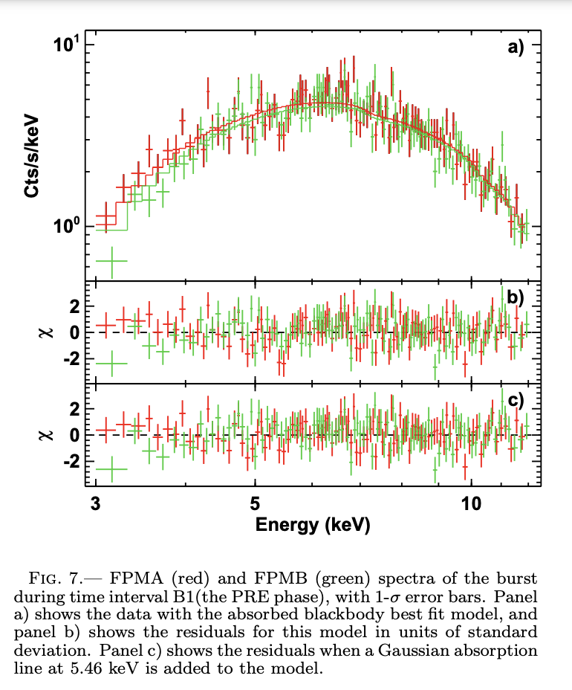
Type I XRB physical properties, such as duration, intensity, recurrence time and spectral energy distribution, are far from being homogeneous, as they are influenced by, e.g., the chemical composition of the disk, mass-accretion rate
Studying the X-ray emission from X-ray buirsts can provided information on:
  mass,
  radius,
  spin period o
  constraints on the distance
Their spectrum is well modeled by a black-body, arising from the hot photosphere of the NS during thermonuclear reactions and decaying during its subsequent cool down.
Spectra of the bursts
Barriére et al 2014
Di Salvo, Papitto et al 2023

Slide 19
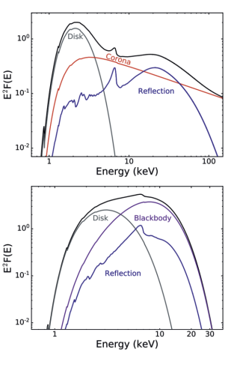
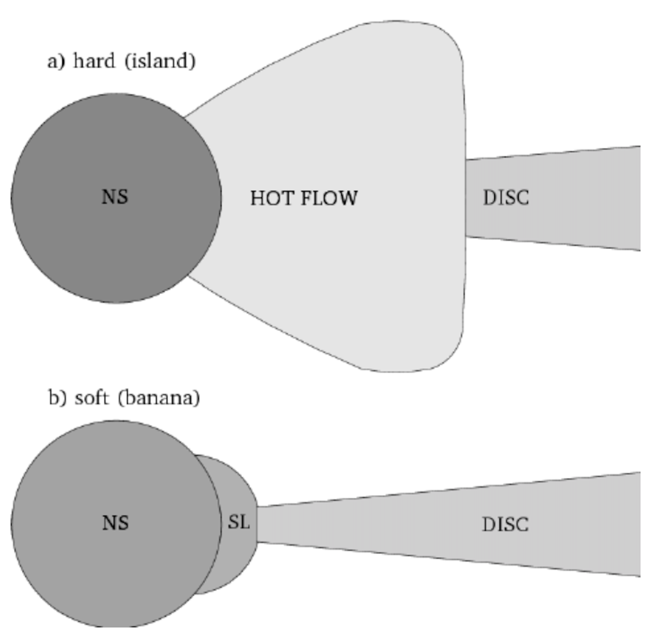
Open questions
The classification into Z and Atoll sources and the state transitions of the sources lack physical explanations (as in the case of BHLMXB).
The geometry of the region between the NS surface and the inner parts of the accretion disk is also not known.
Polarimetry is a powerful tool to examine the geometry of the surroundings of compact objects.

Slide 20
POLARIZATION
X-ray spectroscopy and timing techniques allow us to study the physical properties of NS-LMXBs in depth, while geometry remains elusive.
X-ray polarimetry adds two more observables:
  the polarization degree (PD)
  The polarization angle (PA),
PA and PD depend on the geometry of the accretion flow.
X-ray polarization measurements can distinguish between radially extended regions such as the accretion disk, and vertically or spherically extended structures such as the BL or SL.
Radiation reflected off the disk is also expected to be significantly polarized

Slide 21
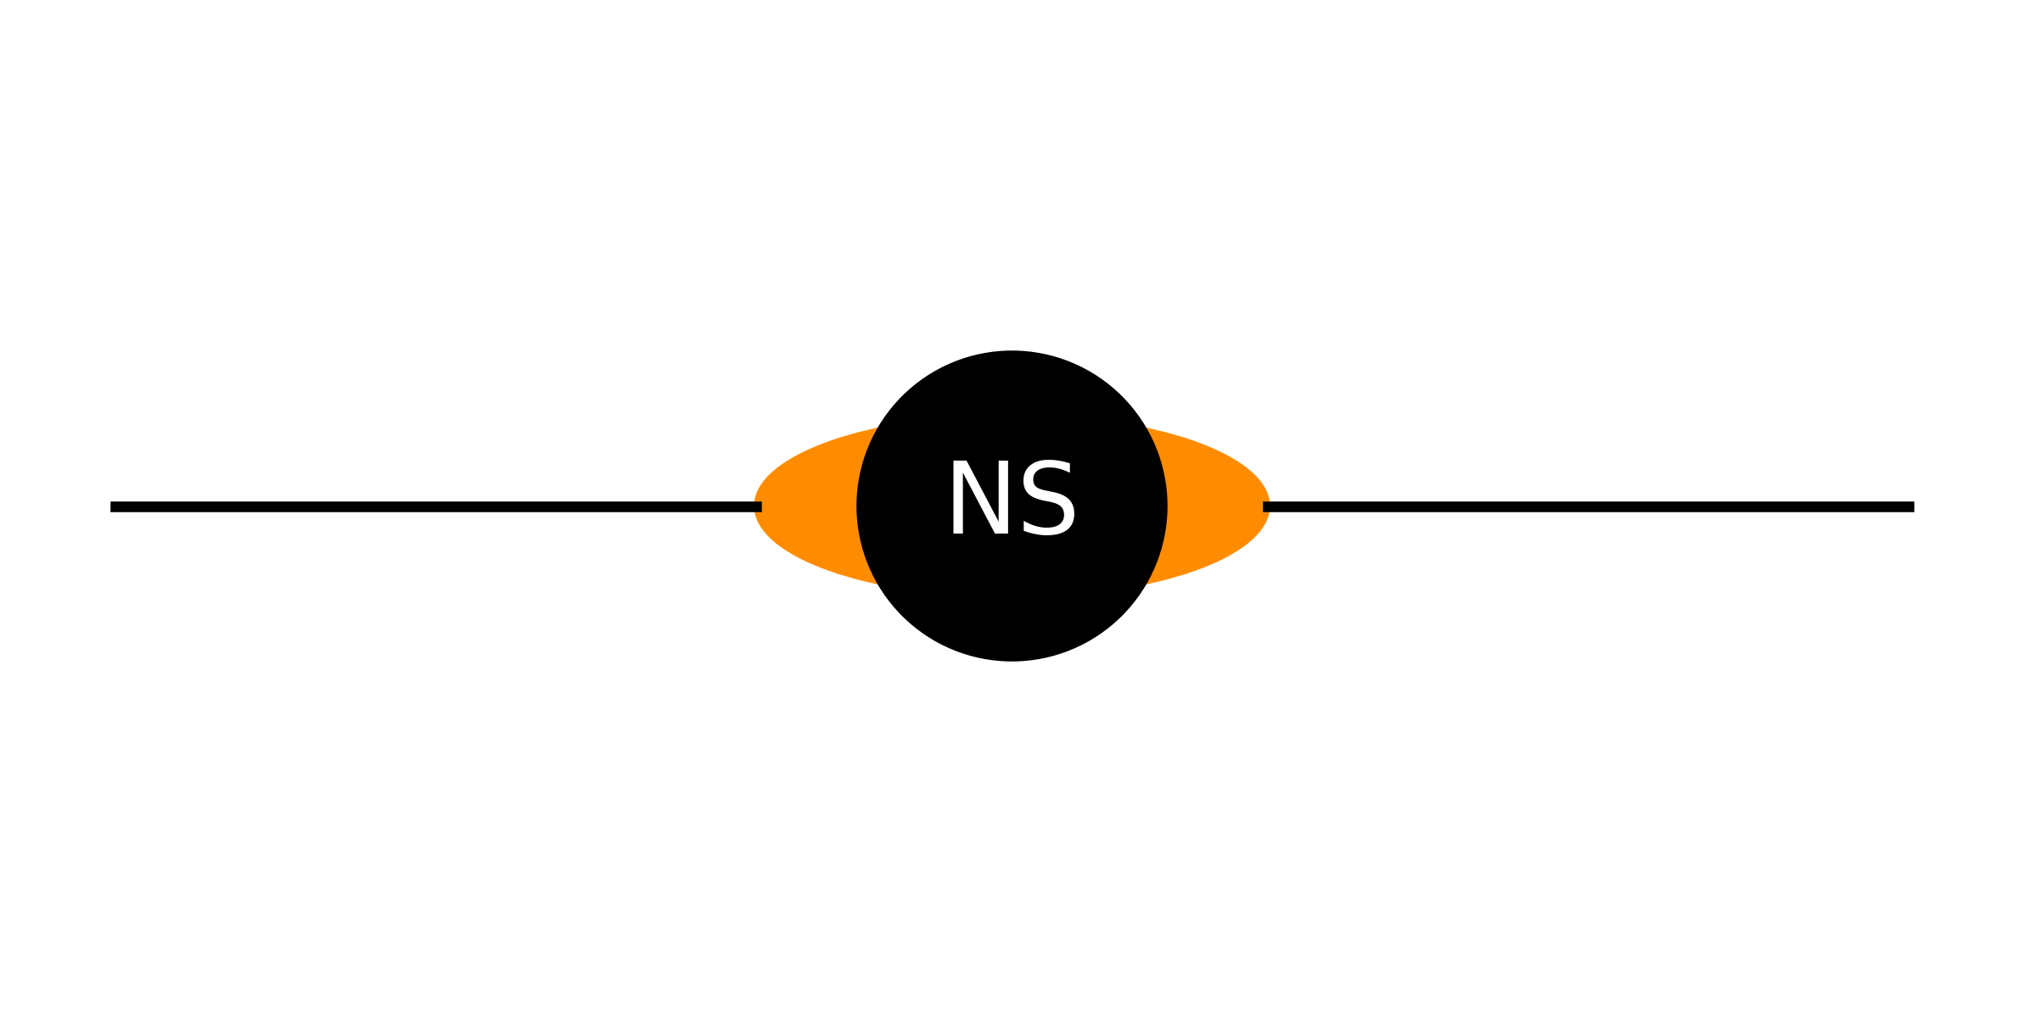
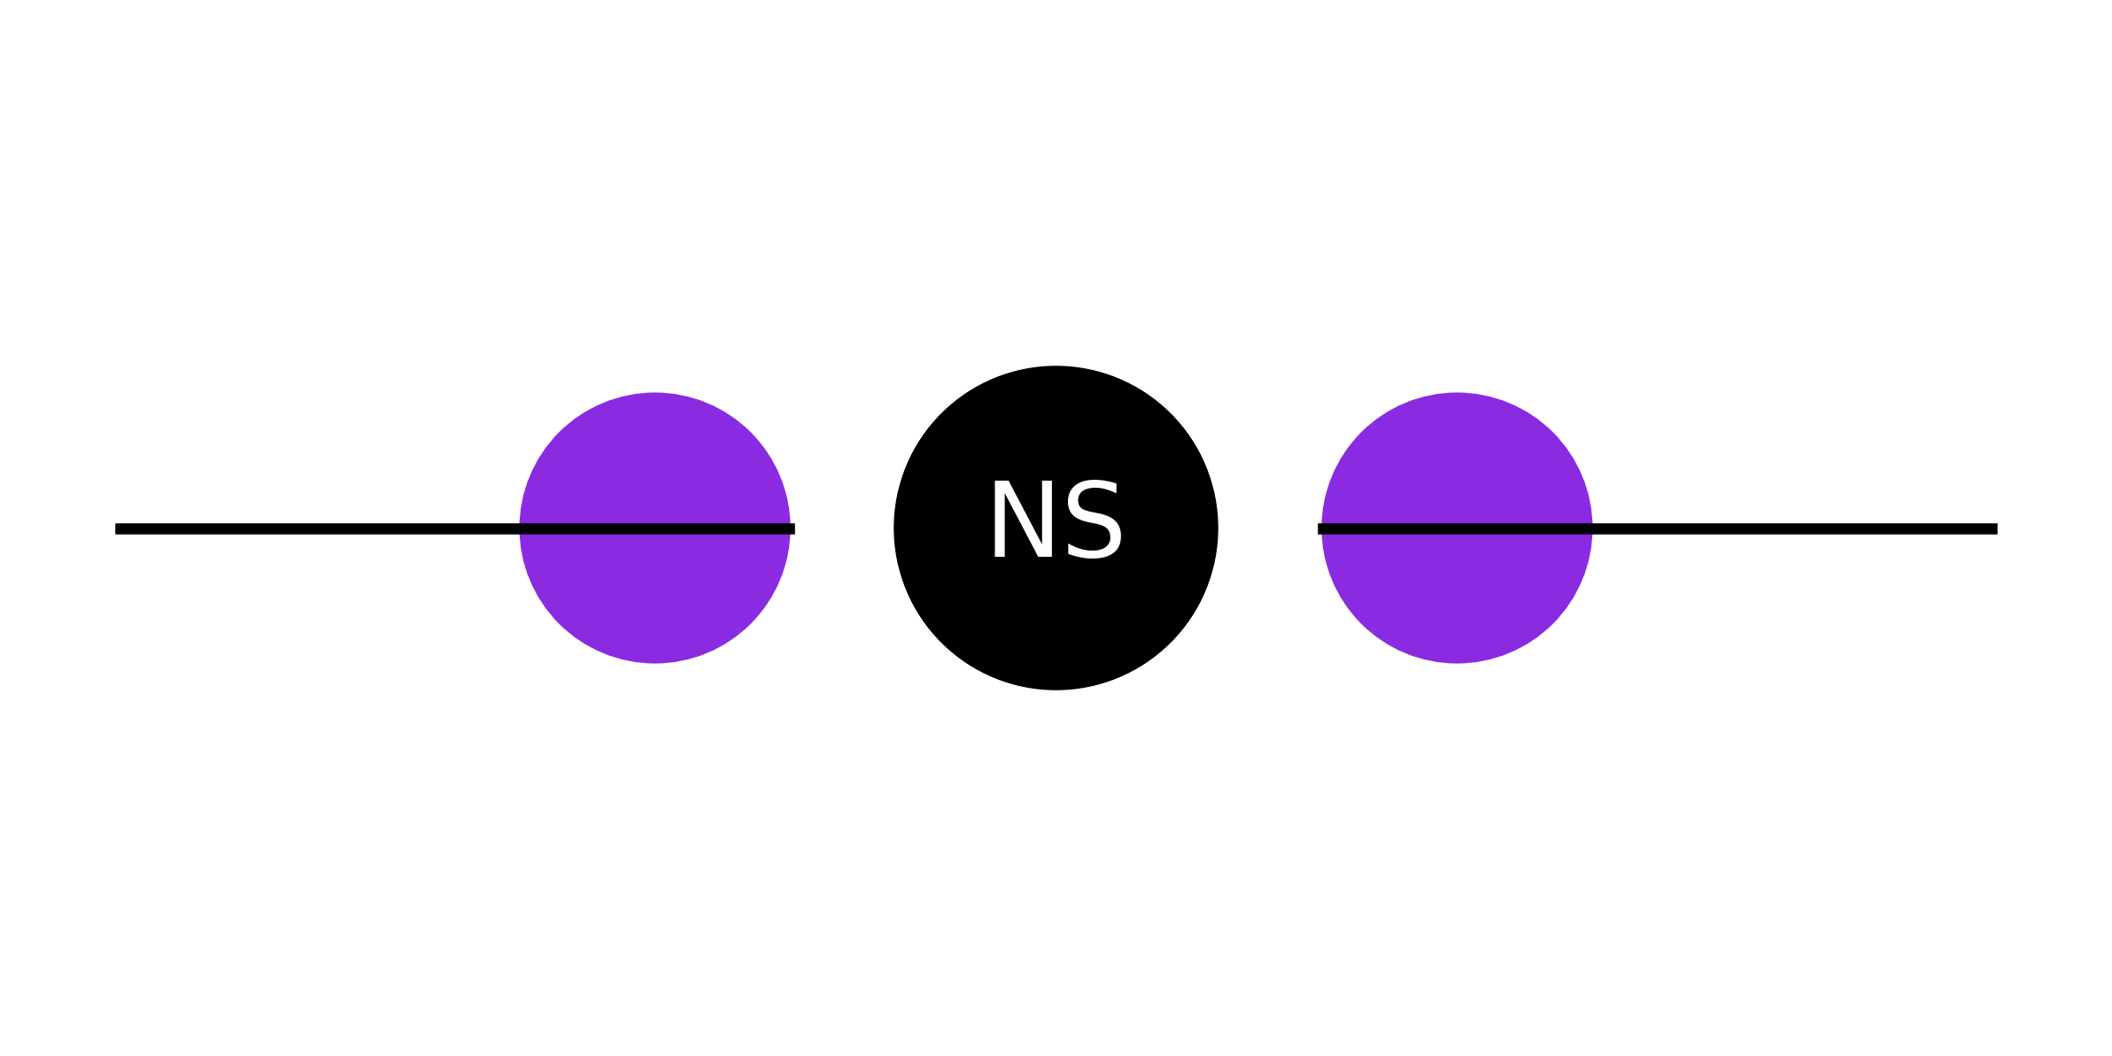
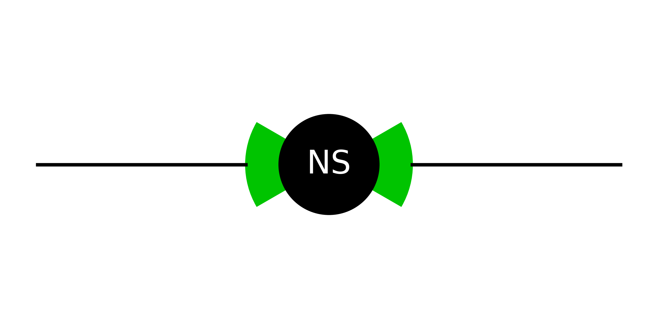
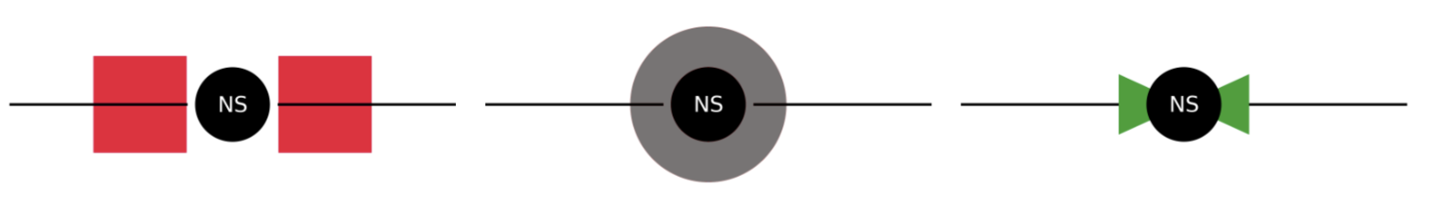
Monk Simulations:
Simulations adapting the fully relativistic Monte Carlo code MONK were published before the launch of IXPE to compute the X-ray polarized radiation coming from weakly magnetized NS-LMXBs
Different coronal geometries and different viewing angles result in significantly different X-ray polarization properties, which can therefore be used to constrain the geometry of the systems: Different geometry simulated
Spreding layer like
Torous-like
Wedge-like 1
Slab-like
Shell-like
Wedge-like 2
Shell-like
Gnarini et al 2022 ; Zhang et al. 2019

Slide 22
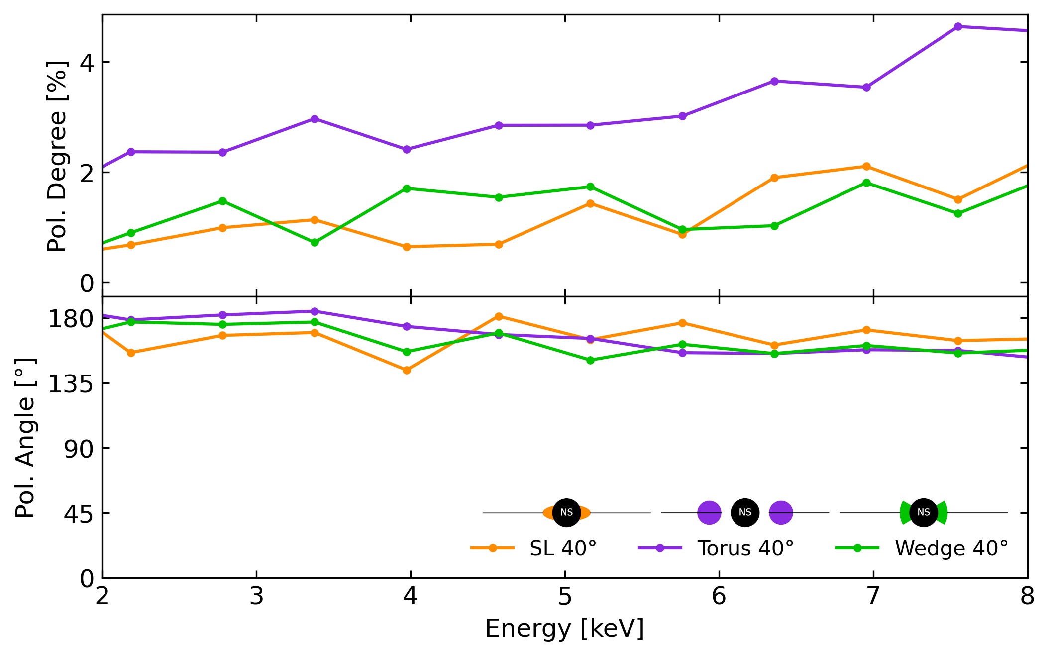
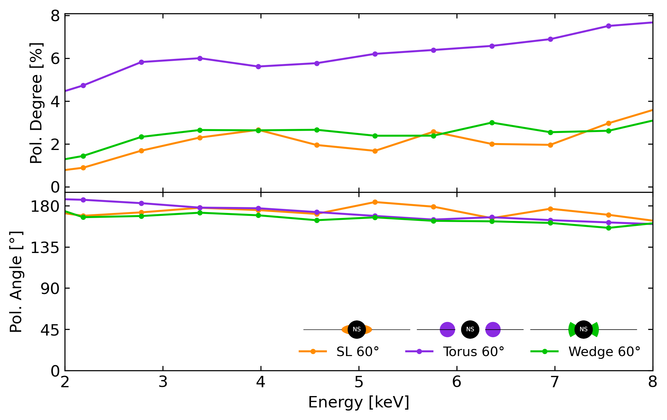
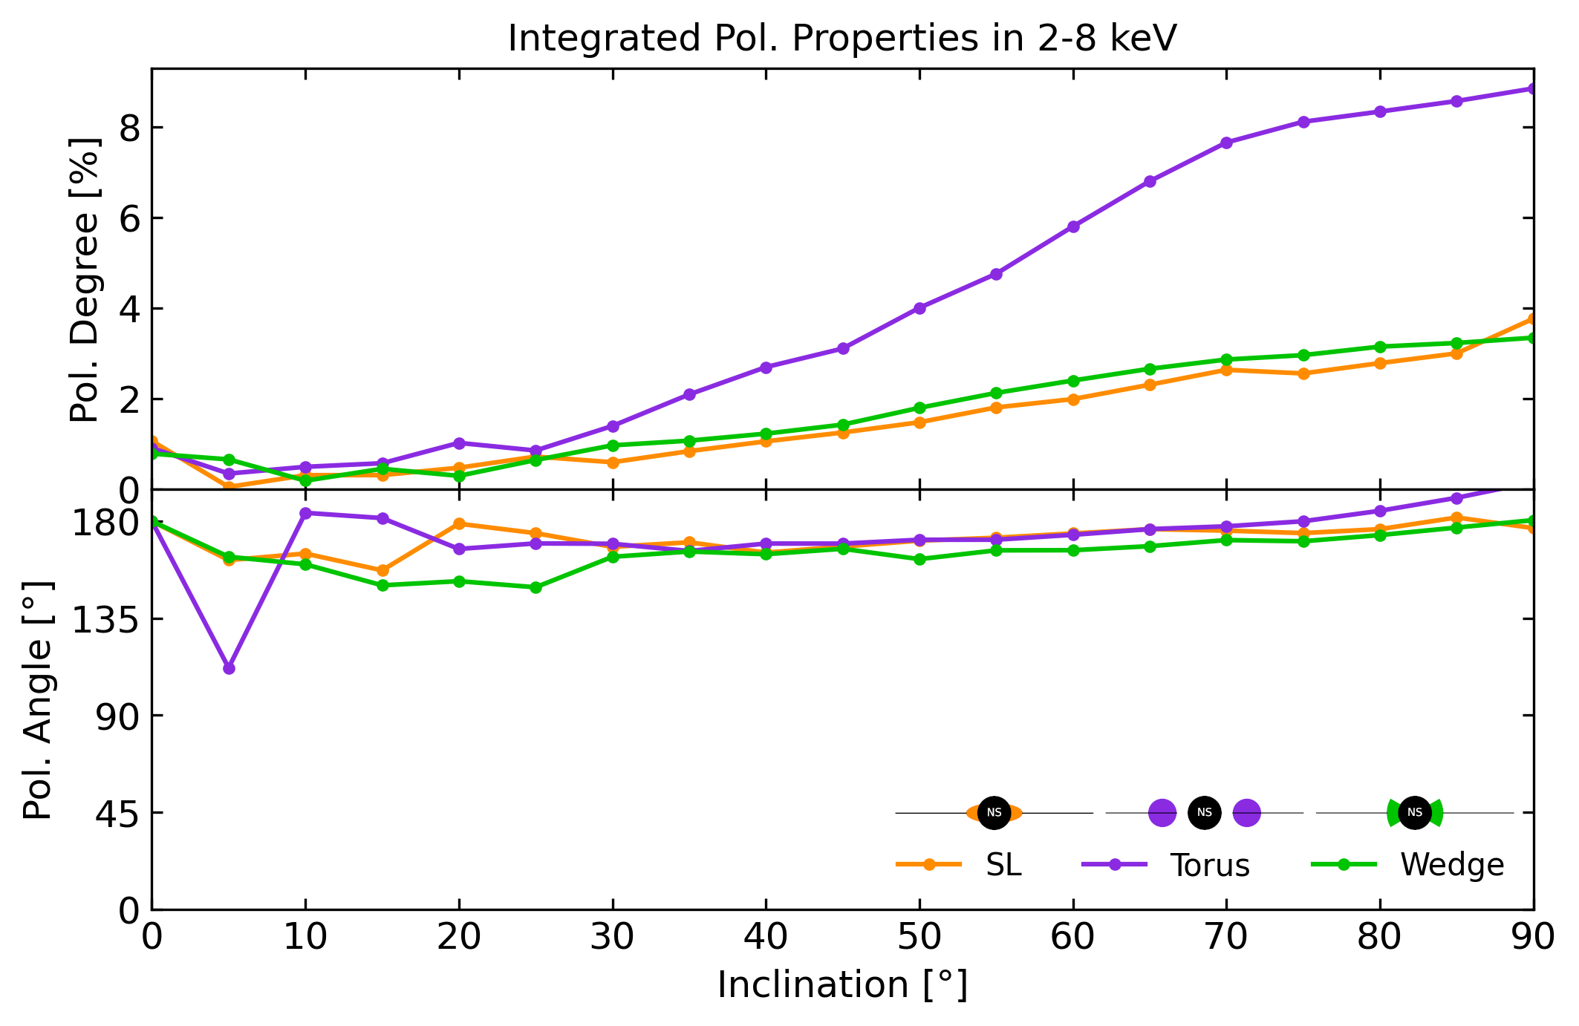
Different Inclinations & Geometries
some Monk simulations of polarization degree and angle in function of the viewing angle for a standard WM-LMXB or in function of energy

Slide 23
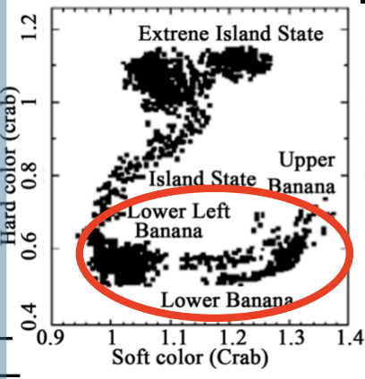
Atoll sources
Results on Atoll sources have been reported only in soft state (banana state)
The first observation on an Atoll source in hard state was performed some months ago but the results have not been published yet
In Soft state the polarization is quite low and strongly dependent on the inclination of the source as expected from theory

Slide 24
IXPE Results on the Polarization of Atoll Sources
source | PD (2-8 keV) | PA (2-8 keV) | Max PD (band) | Inclination (°)
Ser X–1 | < 2% | Unconstrained | - | 25.1^{+1.3} _{−1.5}
GS 1826−238 | < 1.3% | Unconstrained | - | < 60°
GX 9+9 | 1.4% ± 0.3% | 68 ± 6 | 2.2% ± 0.5% (4–8 keV) | 28 ± 8
4U 1820−303 | < 1.3% | Unconstrained | 10.3% ± 2.4% (7–8 keV) | 31⁺⁹ ₋₅
GX 9+1 | < 1.9% | Unconstrained | - | 34±12
4U 1735−44 | < 2.4% | Unconstrained | - | 35 ± 1
GX 3+1 | < 1.3% | Unconstrained | - | 36.1^{+1.1} _{−1.9}
4U 1624−49 | 3.1% ± 0.7% | 81°± 6° | 6% ± 2% (6–8 keV) | 62⁺¹² ₋₉

Slide 25
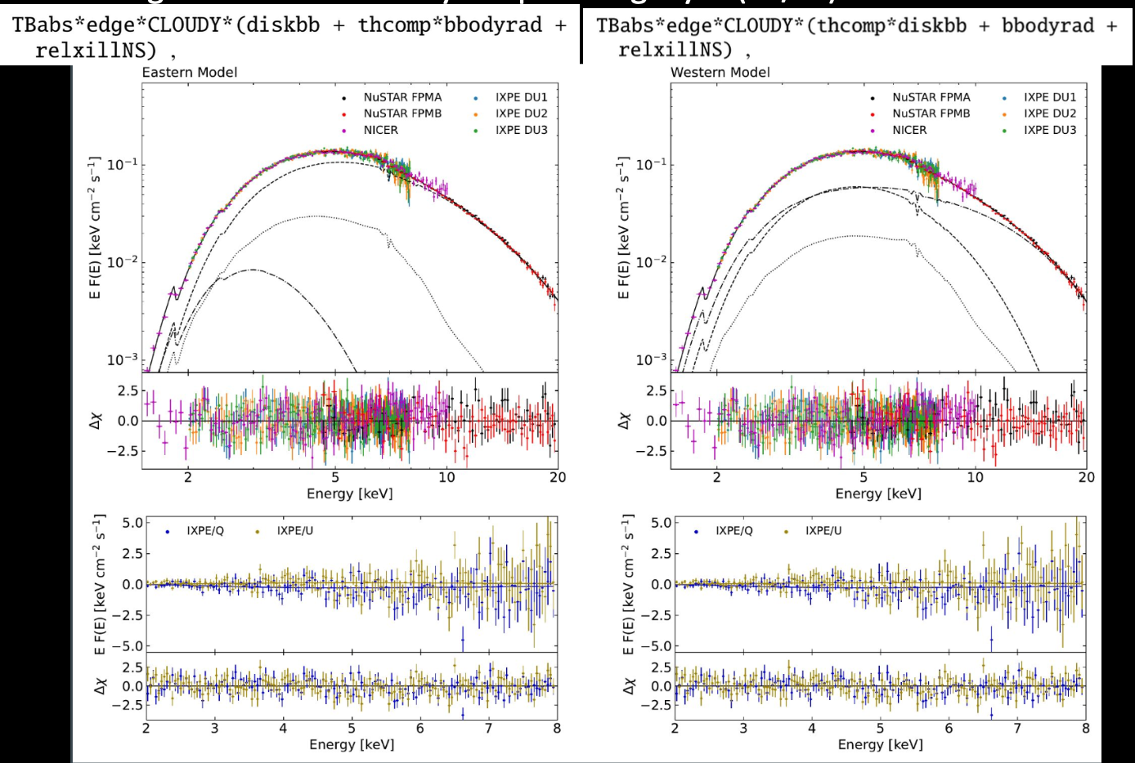
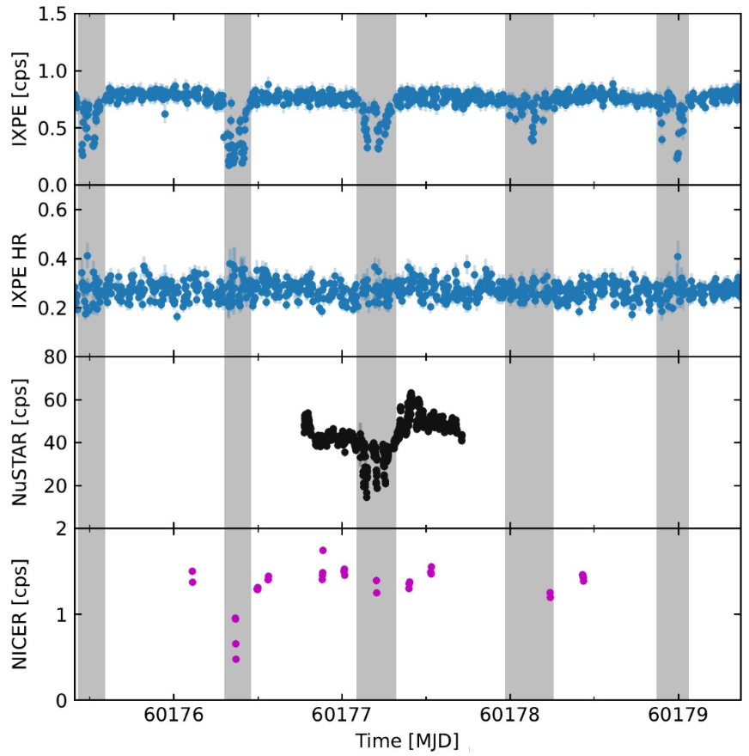
4U 1624-49
Western model with a black body representing the star and comptonization from a hot corona extended above the disk ->slab;
Eastern model with soft component attributed to the accretion multicolour disc, while Comptonization originates in a hot plasma in the region of the boundary or spreading layer (BL/SL) close to the NS
Dividing the light curve during dips and non-dips: in dips PD<3.3% and no rotation of PA and significant variation of PD.
Gnarini et al. 2024

Slide 26
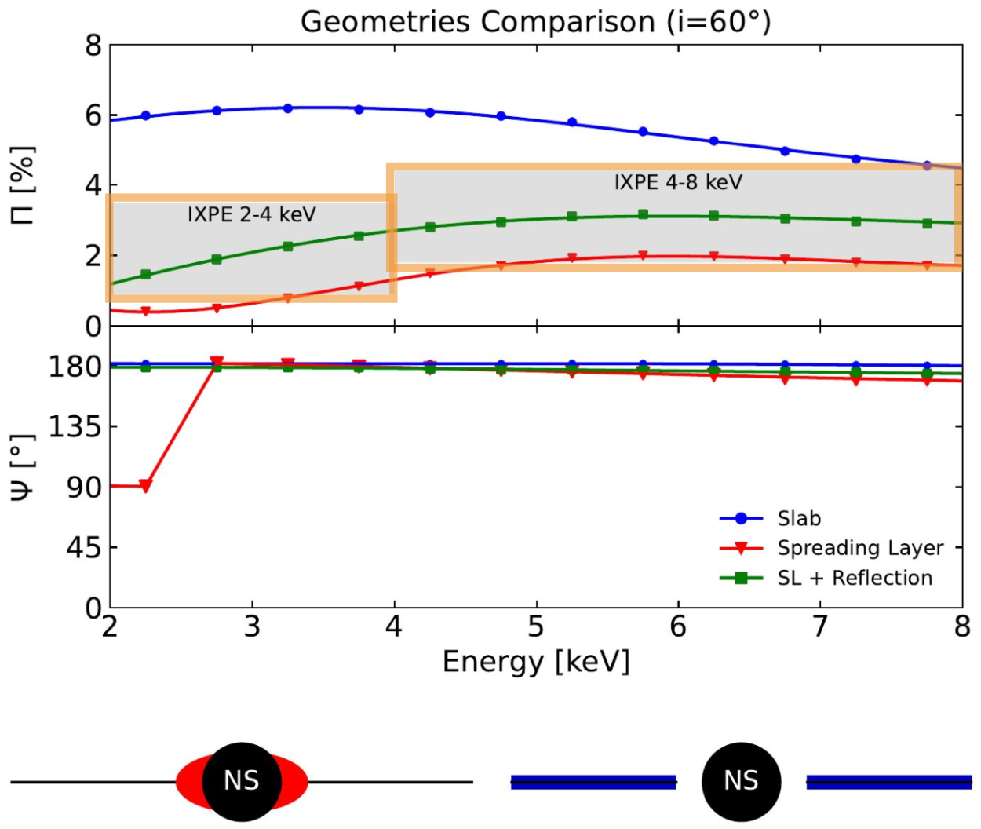
4U 1624-49
• 4U 1624–49 is the most polarized Atoll source observed by IXPE with: PD=2.7% ± 0.9% (2–8 keV)
• The spectro-polarimetry can distinguish the scenario respect to simple X-ray spectroscopy: Eastern like scenario with reflection in good agreement with MONK simulations (Zhang et al 2019; Gnarini et al. 2022)
Gnarini et al. 2024

Slide 27
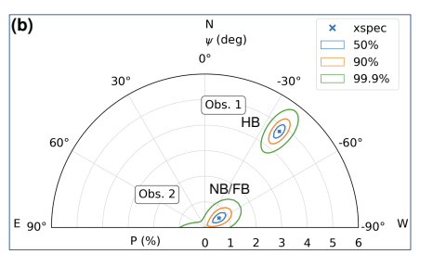
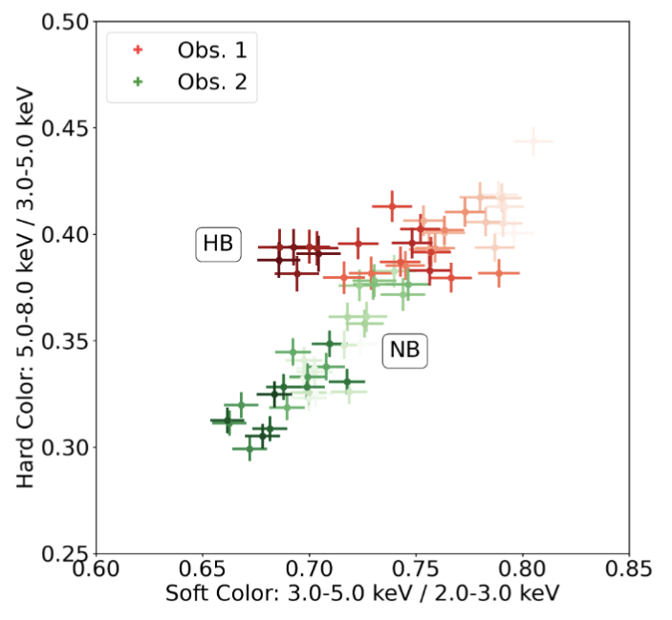
Z sources
IXPE observations enabled polarization measurements along the whole Z track. The Horizontal Branch is the hardest spectral state, while flaring branch is the softest.
IXPE revealed that the polarization is correlated with the position along the Z track: PD is high (up to 4–5%) for HB, and low (1–2%) for NB and FB
This correlation was first observed in XTE J1701−462, a transient NS-LMXB observed by IXPE twice in 2022. During the first pointing, the source was in HB and exhibited a 2-8 keV PD of 4.6%. Ten days later, the source was observed in NB and the 2-8 keV dropped to < 1.5%
Cocchi et al 2022;

Slide 28
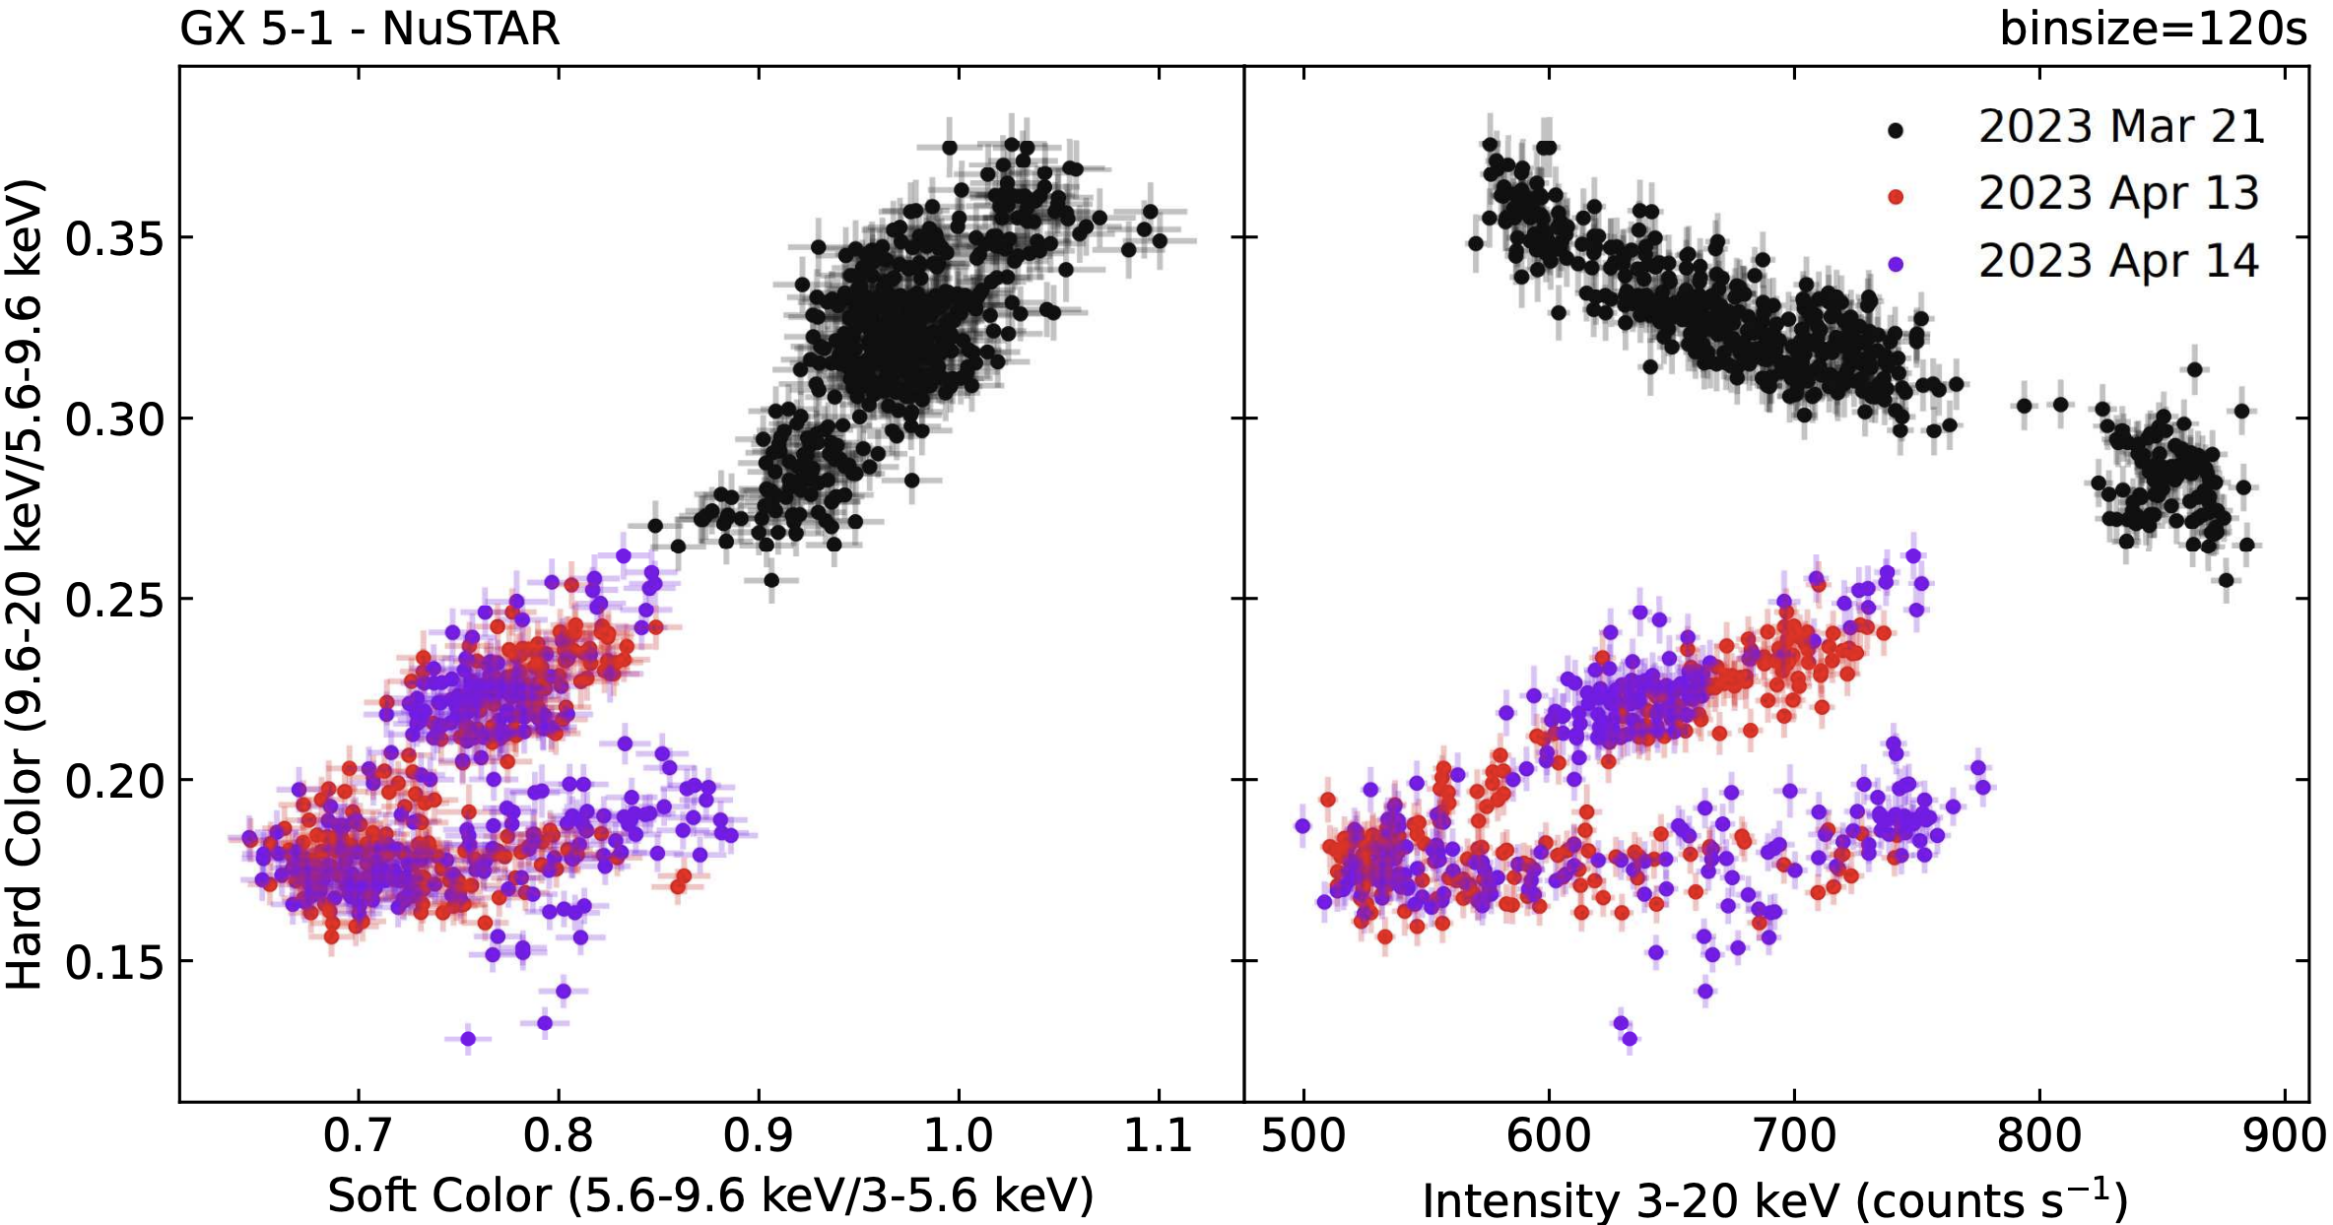
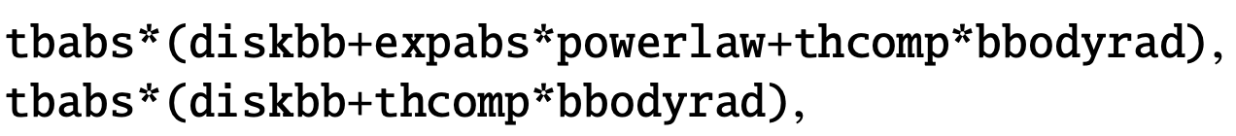
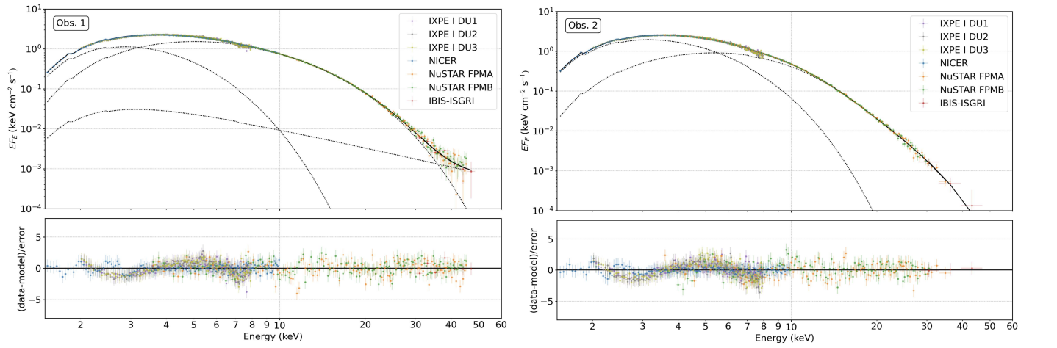
Obs 1: horizontal branch;
Obs 2: normal-flaring branch
GX 5-1
Huge observation campaign simultaneous with IXPE:
CCD
HID
X-ray: Nicer, Nustar, INTEGRAL,
optical (REM and LCO), U.L.,
near-infrared (REM), U.L.
mid-infrared (VLT VISIR), U. L.
radio (ATCA). U. L.
disney
Obs 1
Obs 2
Nicer, Nustar, IXPE, INTEGRAL spectra of obs 1 and 2
Farinelli et al. 2023
Fabiani et al 2023
Notes:
As far as I know one of the best example is another Z source: GX 5-1
A huge multiwavelength observation campaign has been carried on simultaneous with IXPE for this source. However, except X-ray data, the other measurement gave only upper limits
Spectra with nicer, ixpe (the wings are from IXPE) INTEGRAL
IXPE matrix still not corrected.

Slide 29
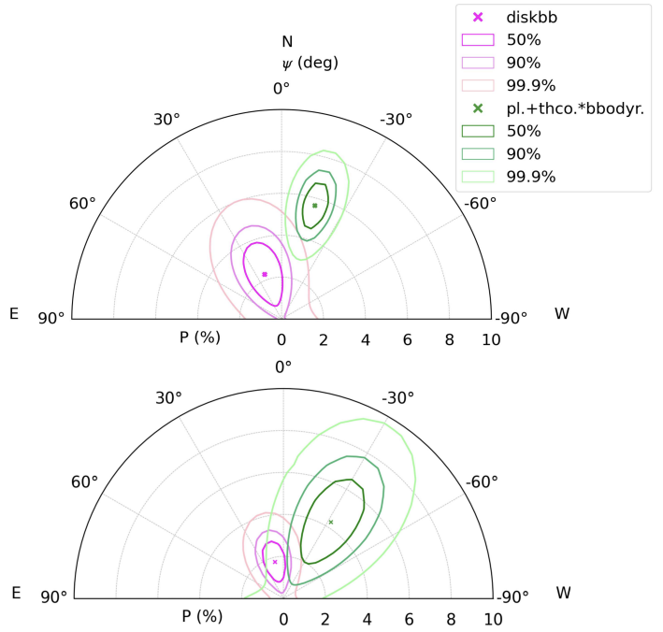
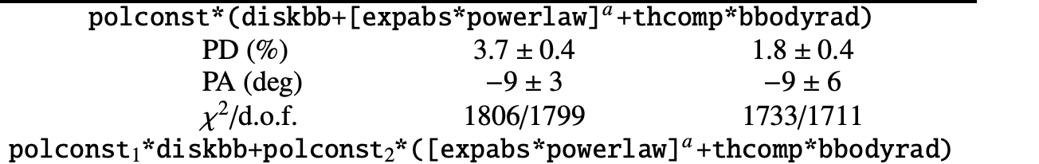
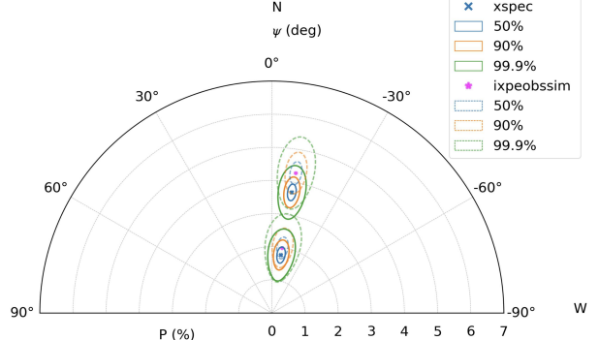
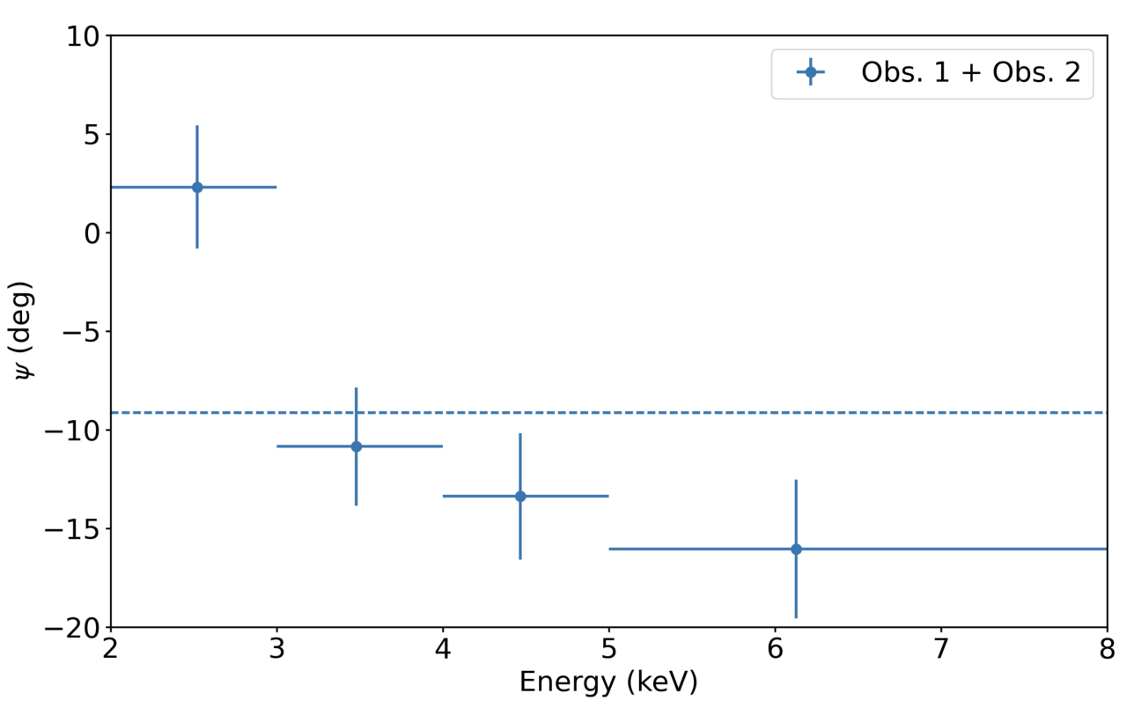
GX 5-1
Disk and comptonization are not perpendicular to each other
Polarization depends on the position of the source in the CCD/HID diagram
Obs 1
Obs 2
Farinelli et al. 2023
Fabiani et al 2023
Notes:
It was possible to infer polarization to disk and to comptonization.
This was particularly easy because thre are not detectable reflection in GX %-1.
The unexpected sesults is that disk and comptonization are not perpendicular but the PA has an angle < 90°.
This imply a rotation of the PA.

Slide 30
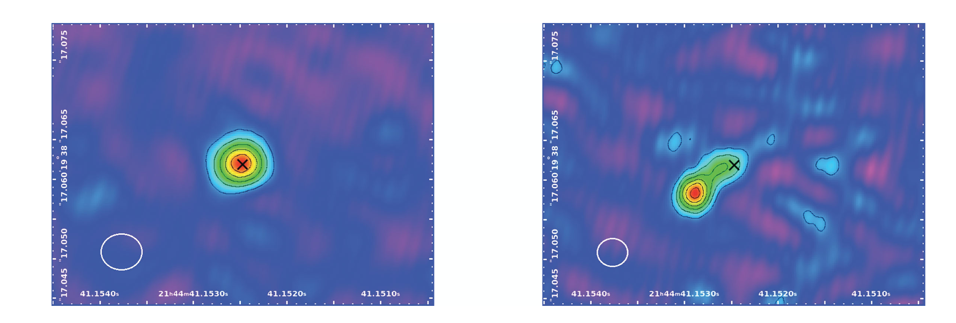
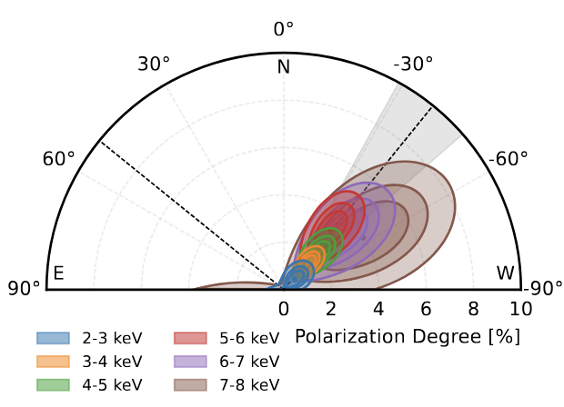
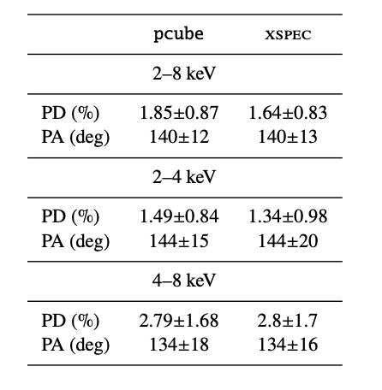
Cyg X-2
Farinelli et al. 2022. (plot by A Gnarini)
Cyg X-2 ws obserbed only in HB
The synergy with radio band that provided important results on the geometry of the accretion flow .
A common characteristic in AGNs and BH LMXBs is that Optical and X-ray polarization angles are generally both parallel to relativistic radio jets
This indicates an equatorial geometry of the X-ray corona
The PA of Cyg X-2 results alligned with archivial riadio jets
GX 339-4
Spencer R. et al 2013
Notes:
First and obvious synergy: radio/X
Polarization angle parallel to radio jets
This is true for BH XRB as GX339-4 and Cyg x-1, for the Z source Cyg X-2 and a couple of AGN
For GX 339-4 the radio ejections are observed simultaneously with ixpe
radio jets and PA having the same direction implies
Iplying an equatorial geometry of the system (jets symmentry axis)
This might seem like established knowledge; however, it is not always the case:

Slide 31
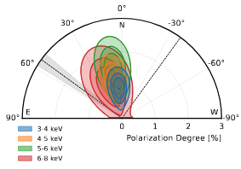
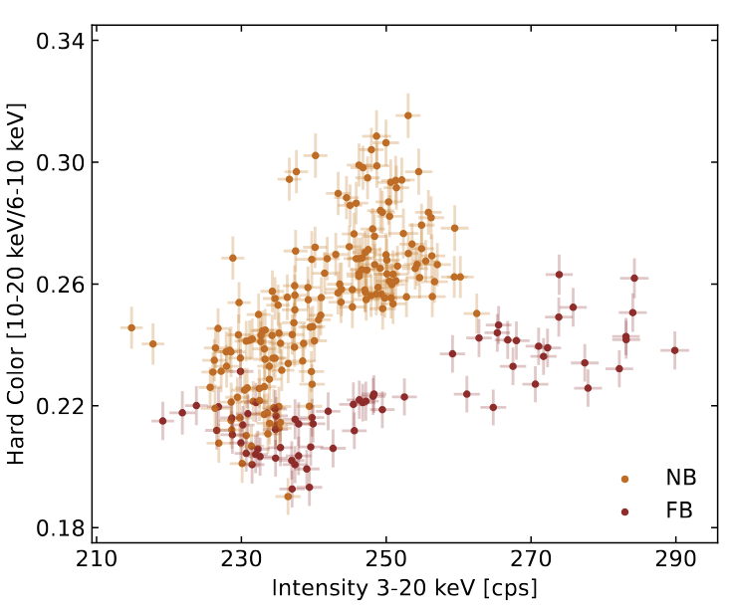
La Monaca et al. 2024
However, PA is not aligned with the jets in the case of Sco X-1
Sco X-1 shows PA misaligned with respect to the radio jet in both Flaring and Normal branch.
The misalignment is by ≈ 50◦ in NB and ≈ 35◦ in FB
The observations were performed near the apex of the Z.
The misalignment could probably suggest the presence of preceding radio jets.
disney
Plots by A. Gnarini
Farinelli et al. 2023
Notes:
Sco X-1 is another Z source
In this case the jets are misaligned
The angle between PA and radio jets depends on the position in the color-color diagram.
presence of preceding radio jets?
It has been noticed that the IXPE observation is near the apex of the Z between NB and FB. Around the transition.

Slide 32
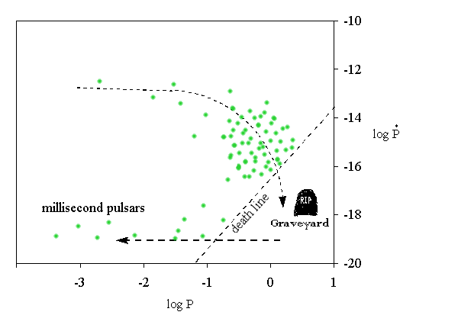
Accreting millisecond pulsars
Di Salvo, Papitto et al 2023
AMSPs are X-ray transients with outbursts typically lasting from few weeks to several years.
Their outburst typically reachs no more than 10% of the Eddington rate.
The observed X-ray pulsations result from the inflowing plasma being channeled to hot spots near the magnetic poles of AMSPs.
When the magnetic stress overcomes the viscous stress in the disk, the plasma starts to follow the magnetic field lines and fall towards the NS surface.
Conseguntly, the rotating magnetosphere of the NS has to truncate the disk flow before the matter reaches the NS surface
The size of the disk truncation radius depends on the physics of the disk/field interaction and is still a matter of debate.
Recycled pulsars: the matter falling onto the compact object transfers angular momentum, causing the pulsar period to increase. Conversely, isolated pulsars lose angular momentum, and their period decreases over time.

Slide 33

Di Salvo, Papitto et al 2023
The population of AMSPs is a small fraction of the ∼200 LMXBs currently known. What causes such a rarity is still an open question
They are characterized by orbital periods of just a few minutes and pulsar spin periods of a few milliseconds.
Are they extremely old systems. Possibly, as they host a recycled pulsar and a companion that has transferred a large amount of mass.
Many accreting millisecond pulsars are found in ultra-compact LMXBs
Remarkably, a few AMSPs showed pulsations only intermittently.
The reason why some LMXBs do not host recycled pulsars is not known
Notes:
Aql X-1 was an even more extreme case as it showed coherent X-ray pulsations for just 120 s over a couple of Ms of data collected over the years [119]. In this case, the time scale of the magnetic field re-emergence would be way faster than expected according to the magnetic screening scenario. Therefore, it seems clear that the problem of understanding what determines the lack of pulsations from most LMXBs remains open

Slide 34

X-ray spectra of AMSPs
Di Salvo, Papitto et al 2023
The model for the hard component is a thermal Comptonization in electrons plasma thought to be in the accretion column (slab geometry τ ≈ 1 − 3; kT_{e} ≃ 25 − 50 keV),
The plasma upscatters a seed blackbody spectrum with temperature kT_{bb} ≃ 0.3 − 1.0 keV emitted by a surface with a size compatible with a hot spot.
There are also one or two thermal components:
the colder one is compatible with the inner rings of the truncated accretion disk.
the hotter from the fraction of the NS surface that feeds the accretion columns with soft photons.
Broad emission lines emerged at the energies of the Iron K-α transition and sometimes also of ionized species of Sulfur, Argon, and Calcium at lower energies.
A disk reflection component is also present in the spectra
Notes:
The X-ray spectra of AMSPs are dominated by a power-law with a photon index Γ ≃ 2 that extends even beyond 100 keV
The commonly accepted model locates the origin of these hard X-ray photons in the accretion columns that develop above the NS polar cap: . the freely falling plasma moving along the magnetospheric field lines decelerates in a shock just above the NS surface.
The electrons energized at the shock upscatter the soft thermal photons emerging from the underlying surface yielding a spectrum extending up to their equilibrium temperature.

Slide 35

The model of X-ray pulse profiles of MSPs is one of the most powerful techniques to obtain informations on M and Req .
The shape of the pulse depends on several geometrical and physiscal parameters:
inclination i, the spot colatitude θ, and its angular size ρ, the angular pattern of the emitted radiation, Gamma and equivalent radius.
However, all these paramenters are degenerate with X-ray spectral-timing data or in a case of a bright AMSPs can be achieved but a very large number of counts are needed to break the degeneracy.
X-ray polarimetry might provide key information on the geometrical parameters of the spots.
Rotating vector model (RVM) is used for modeling the X-ray polarization of XRPs as introduced by R. Tavena for the magnetar
Rotating Vector Model (RVM) describes PA in Pulsars taking into account geometrical ad viewing effects

Slide 36
Soft photons from the NS surface are Compton upscattered by hot electrons in the accretion shock achieving a polarization degree (PD) from a few percent up to 10– 20%.
For the magnetic field strength of AMSPs (10⁸−10⁹ G), the typical energy of X-ray photons is higher by several orders of magnitude than the fundamental cyclotron energy ('1−10 eV), and scattering is not affected by the magnetic field.
As a result of azimuthal symmetry, the polarization vector of the X-rays emitted from the accretion shock is expected to lie either in the meridional plane, which is formed by the photon momentum and the normal to the surface, or perpendicular to it As the NS rotates, the polarization angle (PA) should thus swing as a function of the pulsar spin phase in accordance with the rotating-vector model. In AMSPs, the relativistic motion of the emission regions causes an additional rotation of the polarization plane (Poutanen 2020);

Slide 37


SRGA J144459.2–604207
Papitto et al 2025
The only AMSP observed by IXPE till now
tbabs* polconst*(bbodyrad+nthcomp),
PD = 2.6% ± 0.5% and PA = 59◦ ± 6 ◦ (90%c.l.)
Consideting the 3-6 keV : PD= 4.0% ± 0.5% (90%c.l.)
Spectral parameters consistent with previous results: hot electron plasma (kTe ∼ 20−60 keV) in slab geometry of moderate optical depth (τ ≈ 1−2) located above hot spots (kTbb ∼ 1 keV) on the NS
No variation of polarization with time
52 bursts detected (upper limit on PD < 8.5%, 90%cl)
tbabs*(polconst *bbodyrad+ polconst *nthcomp)
bbodyrad:PD = 8% ± 5% at PA = −43◦ ± 19◦
nthcomp PD = 4.6% ± 1.1% and PA = 55◦ ± 7 ◦ .
The polarization arrives from the comptonised component that domitate the emission between 3-6 keV.

Slide 38




The pulse phase of SRGA J1444 is rather stable throughout the with an upper limit on the spin-frequency derivative of ˙ν < 1.2 × 10−13 Hz s−1
The observed phase-resolved Stokes parameters are compatible with a constant function (before and after the increasing of pulse fraction).
A simple approximate model of the Stokes vector expected from the sum of two almost antipodal spots on the NS surface reproduced the observed values for a binary inclination of i = (74.1 ^{+5.8} _{−6.3} ) ◦ and relatively low magnetic inclination of the spots θ₁ = (11.8 ^{+2.5} _{−3.5} ) ◦ , θ₂ = (172.6 ^{+2.0} −1.0 ) ◦ .
The little phase-resolved variability shown by the Stokes parameters, does not permit to obtain constraints on the NS mass and radius based a simple modeling
Phase-resolved spectropolarimetric analysis
Papitto et al 2025

Slide 39


High Mass X-ray Binaries
The Polarimetry properties in HMXB and AMSP are focused on the timing of the pulsar respect to the spectral parameters.

Slide 40

Spectra of HMXBs
The companion stars in HMXBs can have masses reaching several tens of solar masses.
As a result, these stars release a strong stellar wind.
Part of this wind falls onto the compact object (Bondi-Hoyle accretion) and forms a generally small and often transient disk.
The compact object is often a pulsar.
In case of pulsar as compact object, the disk is truncated far away or may not form at all, and accretion can occur along the poles and at the contact point with the surface, a "hot spot" is created, emitting in X-rays.
HMXBs exhibit rather hard spectra, V reaching energies of 100–200 keV.
The spectra are composed, above 2 keV, by the comptonising emission of several components connected to the wind accretion.
Fornasini et al 2023
Comptonization of
Comptonization of
Comptonization of

Slide 41

  The compact object orbits within the supersonic wind of the companion star, which is a young supergiant (NS spin period about 100 s).
  X-ray luminosity is produced by wind accretion, although Roche-lobe overflow may also occur.
  In the case of pure wind accretion, the luminosity is persistent and typically around 10³⁵–10³⁶ erg s⁻¹.
  However, if an accretion disk also forms, the luminosity increases and approaches the Eddington limit (~10³⁸ erg s⁻¹).
  Objects of this type are generally persistent X-ray emitters.

Slide 42
Polarization in HMXB
All existing theoretical models of emission from accreting XRPs predict very high PD, up to 80%, making them the most promising targets for X-ray polarimeters.
IXPE have demonstrated an inconsistency between expectations and reality.
In fact, the PD of the observed XRPs has a typical values varying between 5 and 15% or even below.
However, both PD and PA showed significant variability over the pulse phase
In particular, the PA shows very smooth and simple variations over the pulse phase.
It is possible to apply the Rotation vector model (RVM, see Roberto Taverna talk) to independently determine the geometrical configuration of XRPs.
The RVM describes PA in Pulsars taking into account geometrical ad viewing effects
With RVM It is possible to break the degeneracy between the geometry of the pulsar and the physics of its emission.

Slide 43


Polarization properties of HMXBs
Rotating Vector Model parameters observed by IXPE
Examples of the phase-resolved spectropolarimetric analysis for two XRPs: Cen X-3 (left) and X Persei
Thanks to this, it was possible to confirm the free precession of the NS in Her X-1 and discover unpulsed but strongly polarized emissions from the bright transients LS V +44 17 and Swift J0243.6+6124.
Phase-resolved spectropolarimetric analysis for two XRPs: Cen X-3 (left) and X Persei
Poutanen et al 2024

Slide 44

Poster from A. Salganik
Notes:
It was possible to infer polarization to disk and to comptonization.
This was particularly easy because thre are not detectable reflection in GX %-1.
The unexpected sesults is that disk and comptonization are not perpendicular but the PA has an angle < 90°.
This imply a rotation of the PA.

Slide 45
Essential Biliography
Di Salvo at al. 2023 Handbook of X-ray and Gamma-ray Astrophysics (Section Eds. V. Doroshenko, A. Santangelo; Eds. C. Bambi and A. Santangelo, Springer Singapore, 2023). arXiv:2311.1251
Gnarini et al 2024A&A...690A.230 arXiv:2408.02309
Ursini et al. Galaxies 2024, 12, 43. https://doi.org/10.3390/galaxies12040043 and references there in
Papitto et al 2025 A&A, 694, A37 https://doi.org/10.1051/0004-6361/202451775
Juri Poutanen et al. 2024 Galaxies, Volume 12, Issue 4 and references there in
Fornasini et al 2023 Handbook of X-ray and Gamma-ray Astrophysics (Section Eds. V. Doroshenko, A.
Santangelo; Eds. C. Bambi and A. Santangelo, Springer Singapore, 2023). arXiv:2308.02645v1

Slide 46
Thank you

Slide 47
Be X-ray binaries
Be HMXBs hosts as companion star a Be star with a circumstellar disk. One of their defining characteristics is that they exclusively contain neutron stars.. Or at least, the sources that are thought to be composed of a Be star and a black hole show completely different observational features (the reason is still unclear; see Zhang, Li & Wang 2004; Munar-Adrover et al. 2014).
The neutron star is in an eccentric orbit. When it passes through the circumstellar disk of the companion, it accretes matter by interacting with the medium (wind accretion).
X-ray emission occurs only when passing through the disk. The emission is transient and recurrent, with an outburst period equal to the orbital period.

Slide 48


Slide 49


Intrinsic absorption
19 of 23 sources
have a significant
(>5x10²² cm⁻²)
intrinsic absorption

Slide 50



