Slide 1
X-ray polarimetry of solar flares: from Heliophysics to Space Weather
Sergio Fabiani

Slide 2
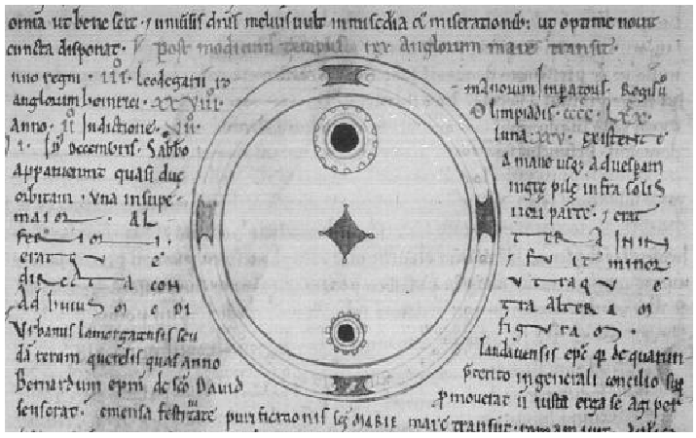
Solar activity… a long lasting story in the human history…
Chinese and Korean astronomers recorded solar activity (sunspots) at least since 800 B.C., but no illustrations
On December 8th 1128 A.C. John of Worcester’s chronicle recorded the appearance of two sunspots visible by eyes:
“In the third year of Lothar, emperor of the Romans [Holy Roman Empire], in the twenty-eighth year of King Henry of the English…on Saturday, 8 December, there appeared from the morning right up to the evening two black spheres against the sun.”
On December 13th (5 days later) astronomers in Songdo (Korea) witnessed a red vapour that “soared and filled the sky” from the northwest to the southwest. Northern Lights (Aurora Borealis) at relatively low latitude
Moreover, Chinese astronomers reported that “there was a black spot on the Sun” on March 22nd 1129, which “died away” on April 14th. Probably one of the sunspots observed by Worcester 104 days earlier, on the other side of the world
It was the first Space Weather event witnessed in the human history
See Claeck et al. 1978 and Wittmann et al. 1987
Worcester’s chronicle
Korean auroral description
See https://chandra.harvard.edu/edu/formal/icecore/The_Historical_Sunspot_Record.pdf for details

Slide 3
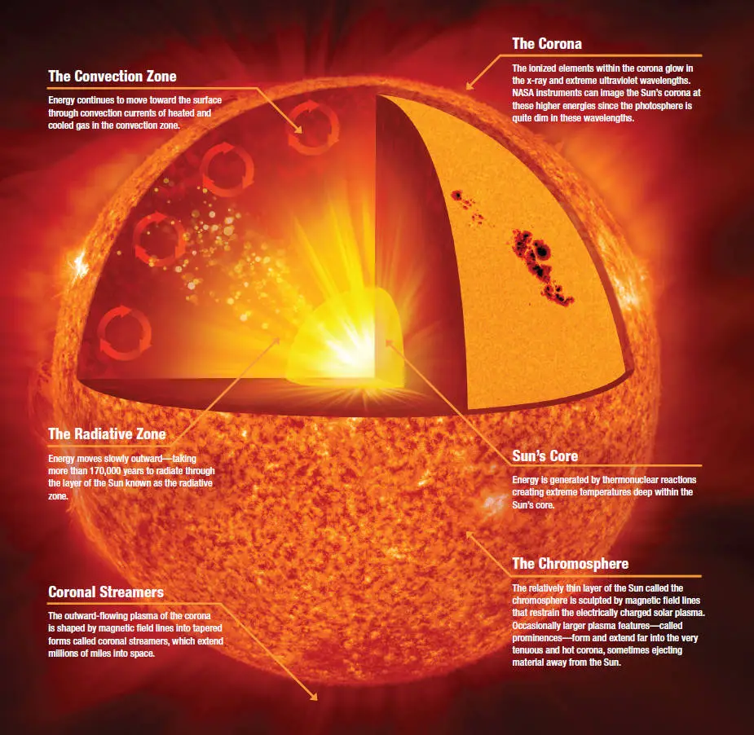
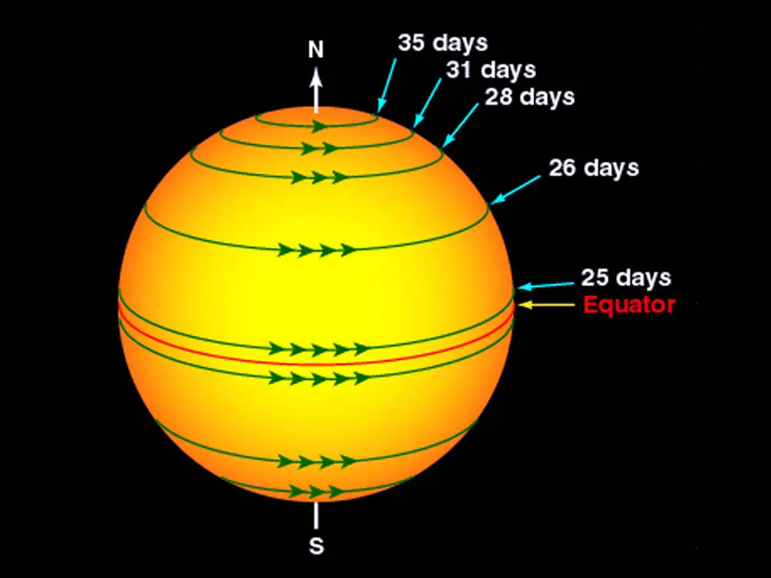
Here comes the Sun…
Main sequence G2V star
Distant about 150x10⁶ km (1 AU) from us
Diameter 1.4x10⁶ km
Rotation periods:
36 days at the poles
25 days at the equator

Slide 4
The Solar Cycle
Solar activity follows a 11-year cycle
Increased solar activity induces an increase of ultraviolet and x-ray emissions from the Sun which produce dramatic effects in the Earth’s upper atmosphere:
temperature and density increase induce a larger atmospheric drag on satellites in low Earth orbit
more frequent occurrence of solar flares (SF) and coronal mass ejections (CMEs) and energetic particles events (SEPs)
Solar Cycle produced by the solar dynamo processes within the Sun (Charbonneau, 2005)

Slide 5
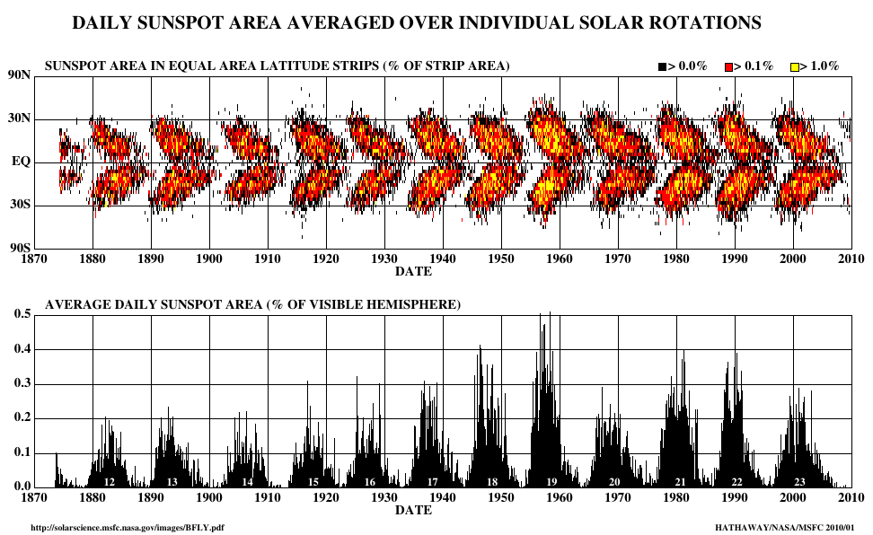
Sunspots and solar cycle
The Sunspot Number is the key indicator of solar activity
length of the available record
Solar cycle maxima and minima are usually given in terms of these smoothed numbers.
The Sunspot areas are a more meaningful physical measure measurement of solar activity
The 10.7 cm Solar Flux is the disk integrated radio emission at 10.7 cm (2800 MHz) (Tapping and Charrois, 1994).
parameter completely objective

Slide 6
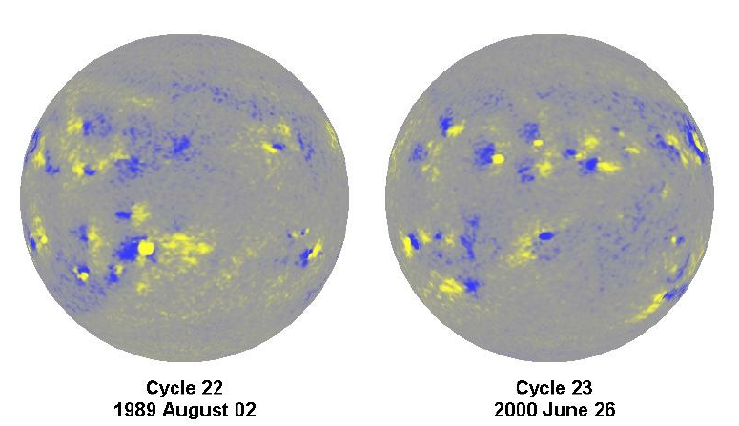
Sunspot magnetic field polarity
Yellow positive polarity
Blue negative polarity
Magnetic fields on the Sun were first measured in sunspots by Hale (1908)
The first description of “Hale’s Polarity Laws” for sunspots: “. . . the preceding and following spots of binary groups, with few exceptions, are of opposite polarity, and that the corresponding spots of such groups in the Northern and Southern hemispheres are also of opposite sign. Furthermore, the spots of the present cycle are opposite in polarity to those of the last cycle.”
YB
BY
BY
YB

Slide 7
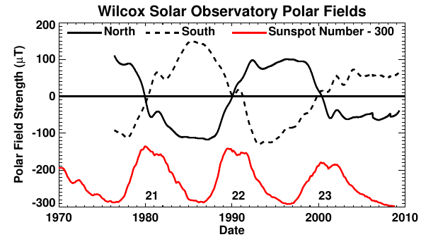
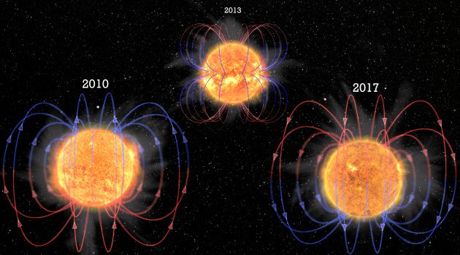
Magnetic field inversion
The Sun polar fields reverse every solar cycle at about the time of solar cycle maximum (Babcock, 1959)
Polar fields are at their peak near sunspot minimum (Sheeley Jr, 1991)
Magnetic fields are generated by a “dynamo”, which involves the differential rotation of the star as well as convection and the rising and falling of hot gas in the star’s interior
https://www.si.edu/stories/3d-simulations-reveals-why-sun-flips-its-magnetic-field-every-11-years
Hathaway, 2010

Slide 8
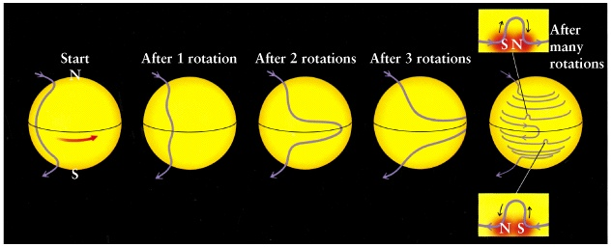
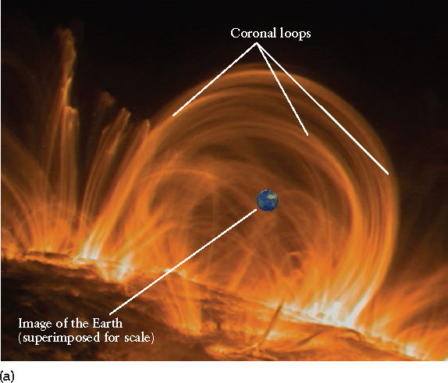
Magnetic field loop formation
The magnetic field lines are frozen into the plasma they are dragged along when the gas moves
This produces loops of magnetic field of the right polarity sticking out of the surface.
Magnetic loops pinched and twisted store energy that is released due to magnetic reconnection that release the energy and accelerate particles

Slide 9
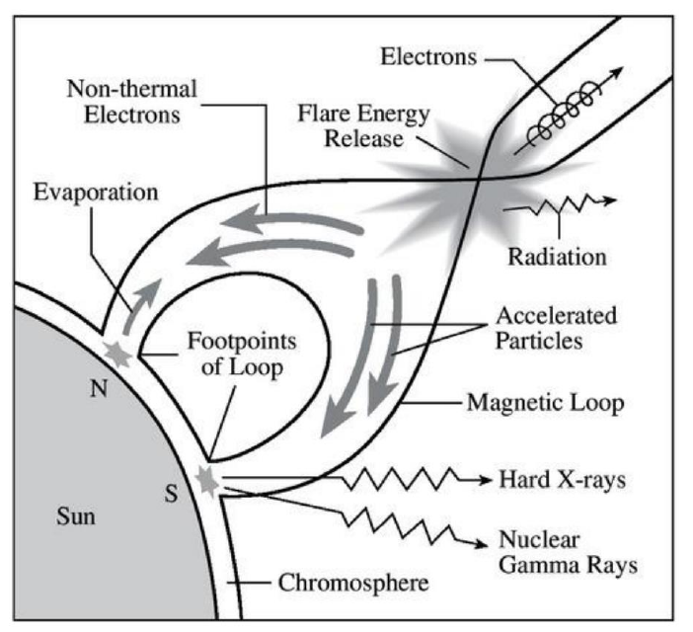
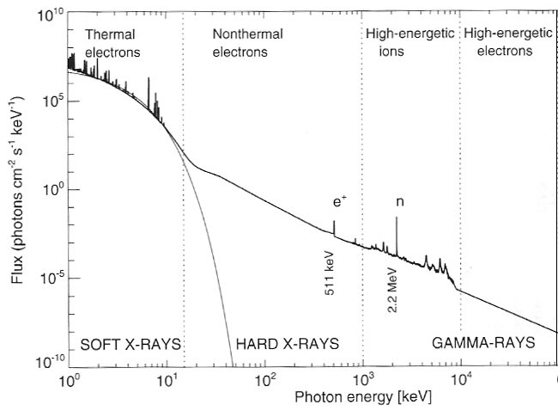
The solar flare
Sub-relativistic electrons (Brown 1971; Brown et al. 2006) possibly, mixed with protons (Simnett 1995) accelerated in the Corona deliver the energy required to account for the observed features in HXR, MW, UV and other emission
They precipitate downwards to the lower solar atmosphere, while depositing their energy into the ambient plasma and heating it
Aschwanden (2005)

Slide 10
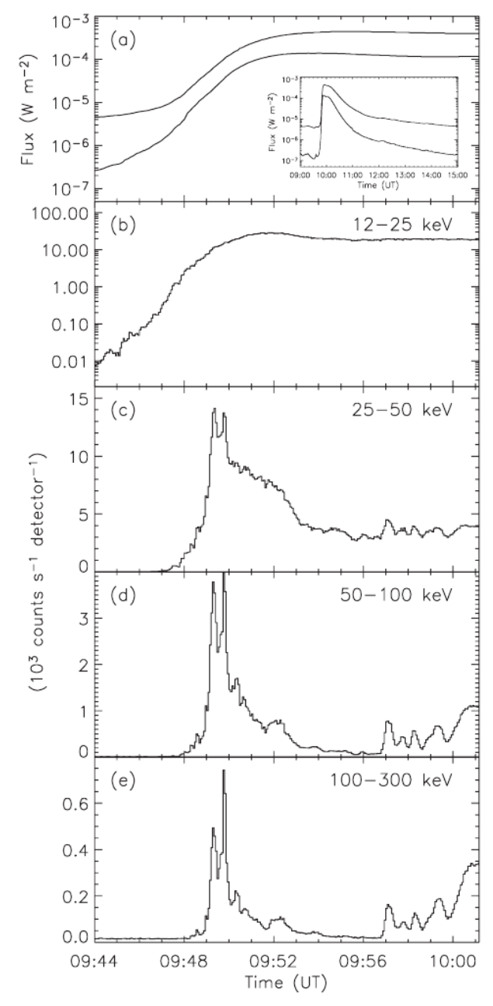
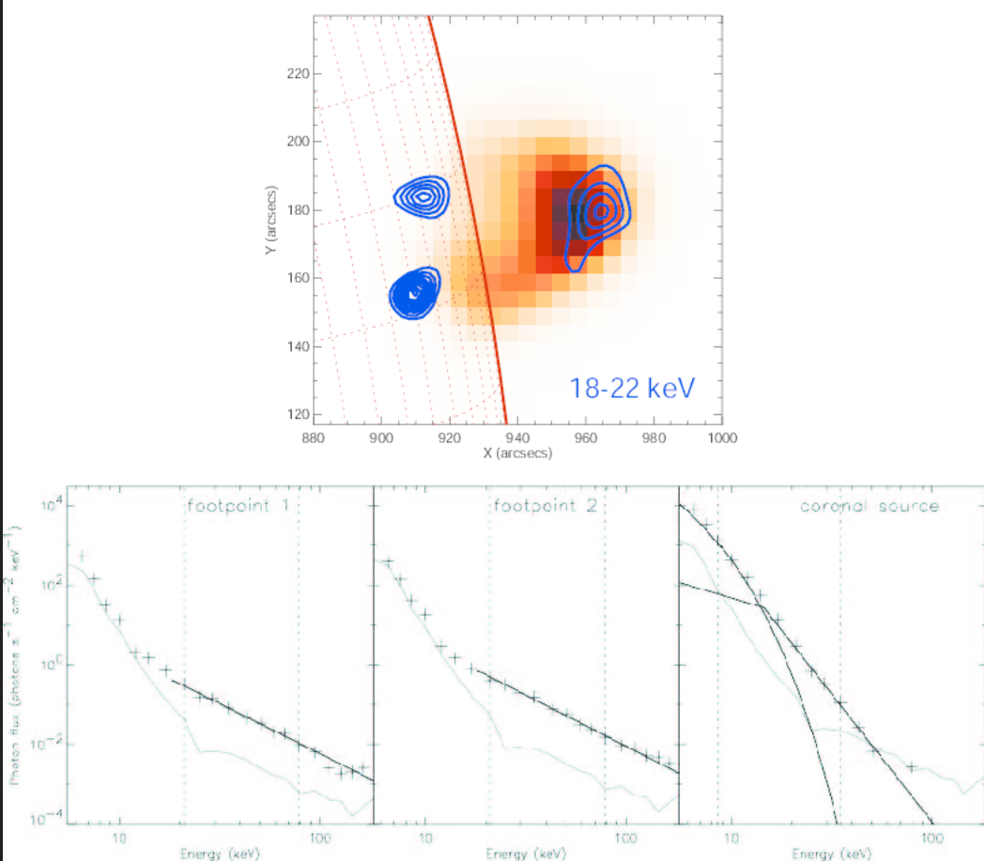
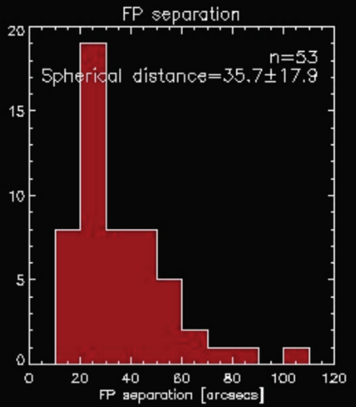
The solar flares light curve and structure
Krucker et al. 2008
Llight curves for the impulsive phase of the 2003 November 3 X3.9 flare.
(Veronig et al.,
2006)

Slide 11
A rather complex kinematics
The distribution function of high energy electrons in precipitation injected into a cold hydrogen plasma confined in a converging magnetic field structure is described by the Fokker-Planck equation (Landau 1937; Siversky & Zharkova 2009)
Zharkova 2010 highlight that precipitating electron beam has a high density and brings a large electric field that generate return currents of the ambient plasma (Knight & Sturrock 1977; van den Oord 1990) and precipitating electrons itself returning to the source in the corona (Emslie 1980; Zharkova et al. 1995).
they increases the pitch-angle anisotropy of precipitating beam electrons Diakonov & Somov (1988); McClements (1992); Zharkova & Gordovskyy (2005) and Siversky & Zharkova (2009)
The angular distribution of the emission is given by the directivity parameter (Brown 1972; Leach & Petrosian 1983)

Slide 12
The solar flare
MW is related to gyro-synchrotron emission of high-energy electrons from few tens keV (Kundu et al. 2001a,b) up to several MeV (Bastian 1999; Kundu et al. 2004)
HXR is produced by electrons from 10 to 300 keV(Lin et al. 2003; Holman et al. 2003), rarely few hundred MeV (Kuznetsov et al. 2006).
Bremsstrahlung is the most effective process to produce X-rays
Aschwanden (2005)

Slide 13
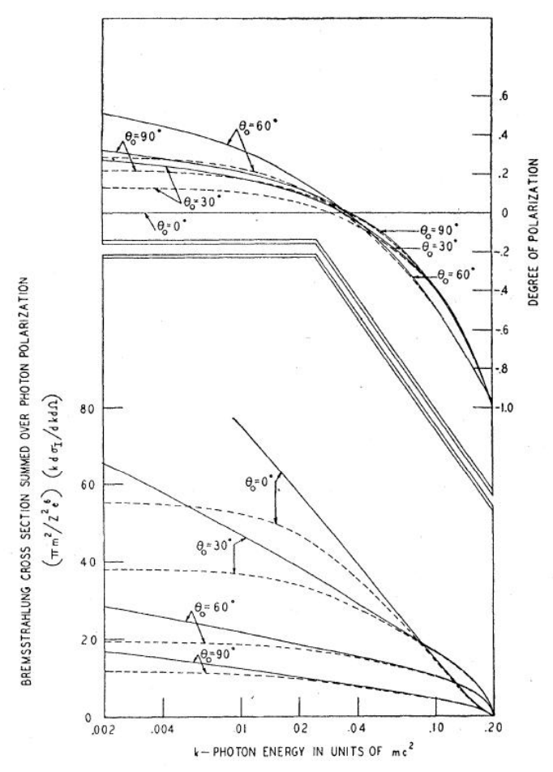
Polarization and Bremsstrahlung
Bremsstrahlung emission is polarized wrt the radiation plane:
low energy photons polarization is orthogonal to the radiation plane
high energy photons polarization is parallel to the radiation pane
Gluckstern & Hull, 1953
Z=13
Electron beam energy 0.1 MeV
radiation plane
radiation plane

Slide 14
Polarization and Bremsstrahlung
Solar flares models assuming an anisotropic distributions of accelerated electrons in an ordered magnetic field predict HXR non-thermal Bremsstrahlung highly polarized (Brown et al., 1974; Langer & Petrosian, 1977; Emslie & Vlahos, 1980; Leach & Petrosian, 1983; Zharkova et al., 1995; Charikov et al., 1996) with a polarization degree as high as 40% at 20 keV (Zharkova et al., 2010)
Models of X-ray thermal emission are expected to be polarized at a low level (Emslie & Brown, 1980)
marginal polarization from anisotropies of the Maxwellian distribution of velocities due to heat transfer in the plasma confined by magnetic field
The albedo due to backscattering of radiation on lower layers of solar
atmosphere can modify polarization properties (Langer & Petrosian, 1977; Bai
& Ramaty, 1978; Jeffrey & Kontar, 2011).

Slide 15
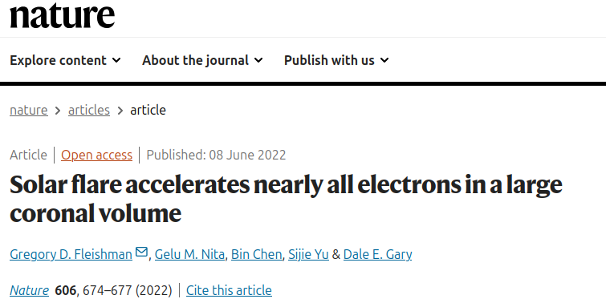
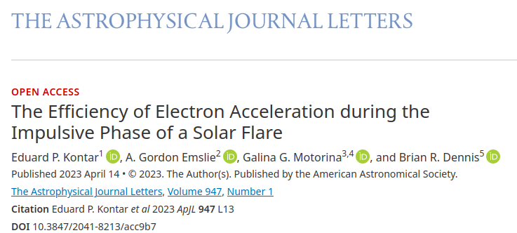
Non-thermal vs thermal electrons: still a debate…
~100% non-thernal electrons
~1% non-thernal electrons
<< …volume filled with only (or almost only) non-thermal electrons while being depleted of the thermal plasma, implying that all electrons have experienced a prominent acceleration there.>>
<<…Our results strongly indicate that the fraction of accelerated electrons in the coronal region at any given time is relatively small…>>>
The larger the fraction of accelerated non-thermal electrons, the higher the expected polarization degree
Polarimetry will allow to correlate the fraction of accelerated electrons with polarization degree in the Hard X-rays

Slide 16
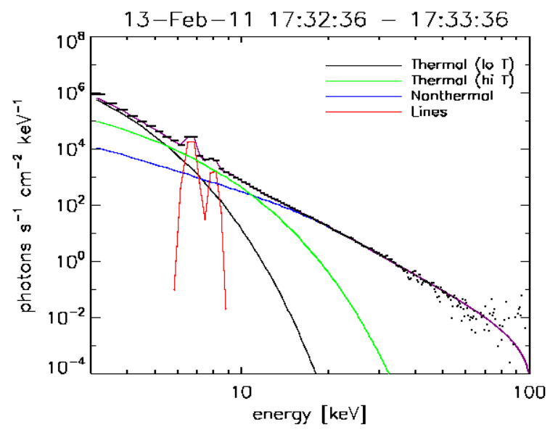
In summary… the energy spectrum of SF and its components
SFs energy spectrum in the X-rays comprises:
thermal Bremsstrahlung (due to plasma heating, expected weakly polarized by Emslie & Brown 1980) + emission lines < 10 keV
non-thermal Bremsstrahlung (at the loop top and footprints, due to particle acceleration along magnetic field lines) expected highly polarized [Zharkova+ (2010)] >10-20 keV
McTiernan et al. 2016

Slide 17
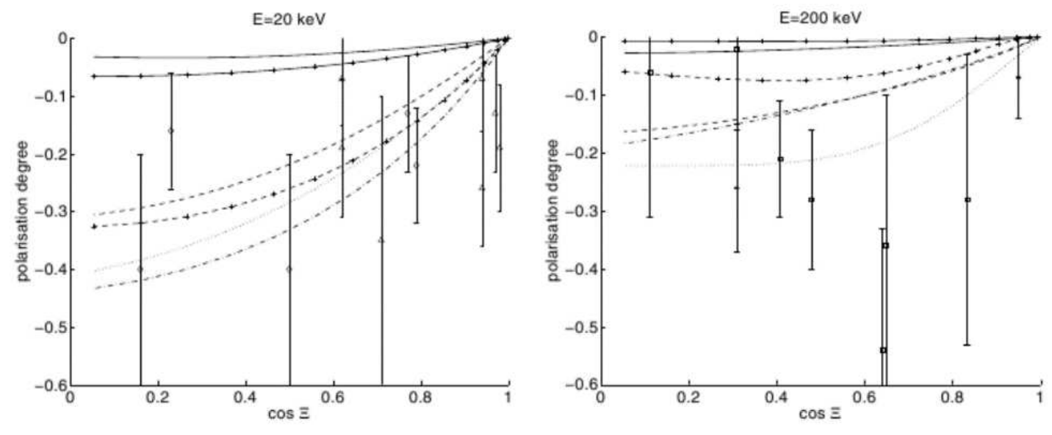
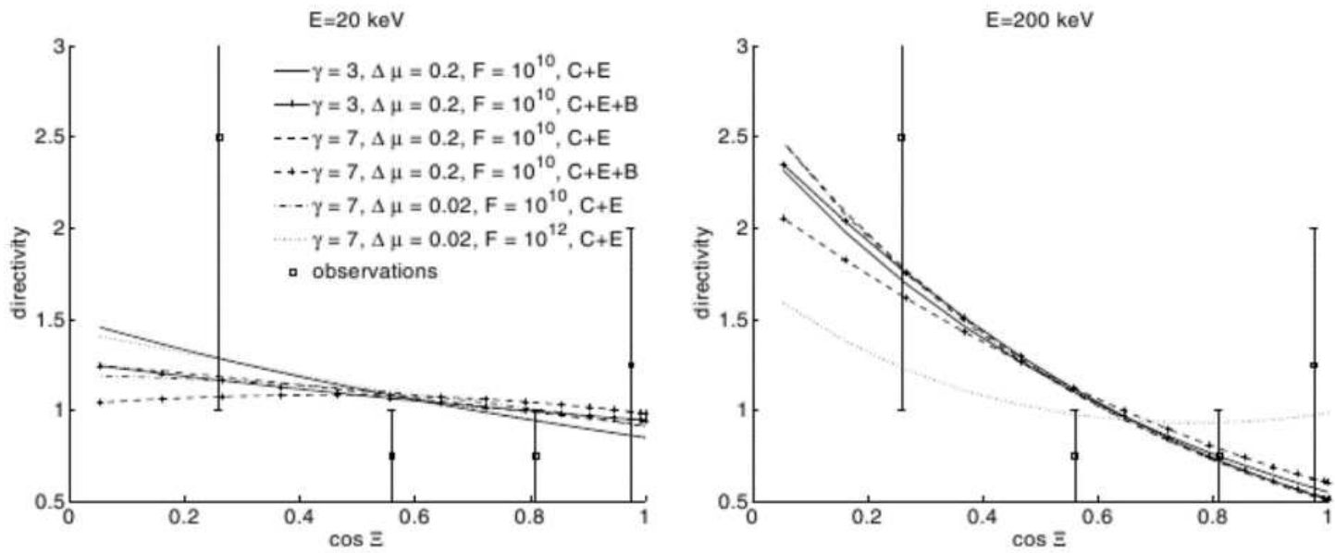
What so far?
Theoretical models predict high linear polarization in the X-rays, depending on the particle beaming and magnetic field properties [Zharkova et al. 2010 (A&A), Jeffrey et al. 2020 (A&A)]
Until now few measurements with low significance, no constrains on models
Data:
20 keV plots: diamonds - Tindo et al. (1970, 1972a,b) at 15 keV, triangles - Tramiel et al. (1984) at 16-21 keV,
200 keV plots: squares – Suarez-Garcia et al. (2006) at 100−350 keV, and asterisks - Boggs et al. (2006) at 200−400 keV.
Pol. Deg.
Zharkova et al. 2010 (A&A)
Directivity

Slide 18
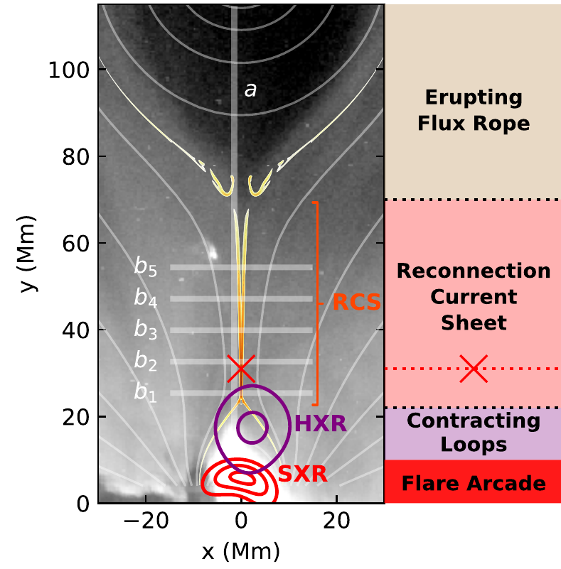
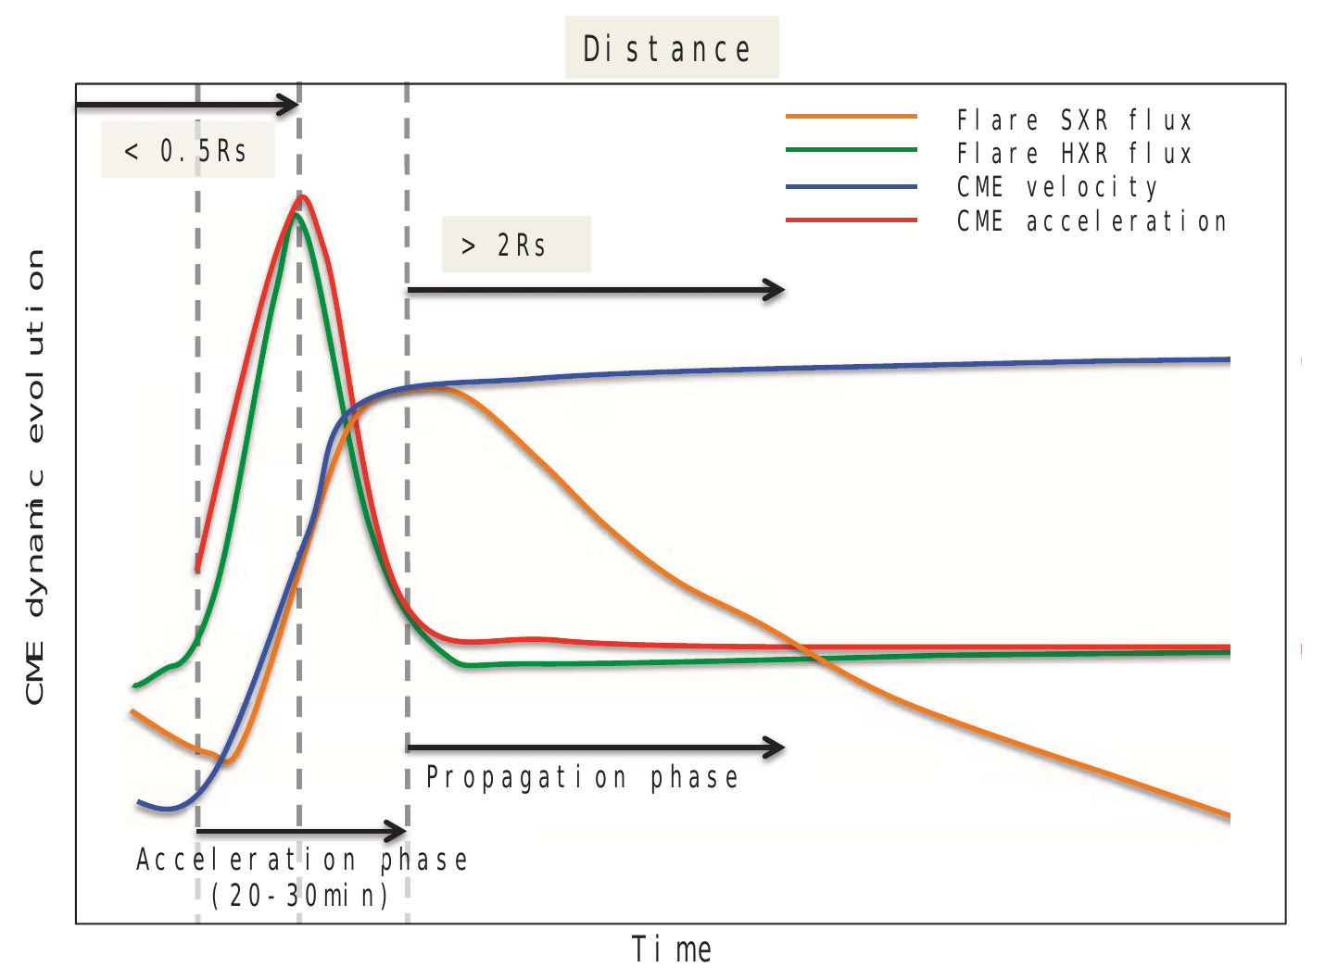
Solar Flares - CME link
HXR polarimetry could improve the knowledge of the initial conditions of the eruption of most powerful CME
Most powerful eruptions associated to powerful flares
HXRs are related to CME acceleration
SXRs are related to CME velocity
See also:
Zhang et al. (2001, 2004), ApJ;
Chen & Krall (2003), JGR;
Maričić (2007), Sol. Phys.
Temmer et al. (2008), ApJ Lett.;
Temmer et al. (2010), ApJ.
Berkebile-Stoiser et al., 2012
The rapid CME development in the lower corona during the acceleration phase strongly correlates with the associated flare activity.
CME accel.
CME velocity
SXRs
HXRs
Temmer (2016), Astron. Nachr.

Slide 19
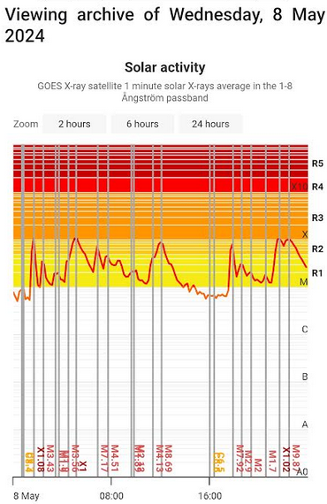
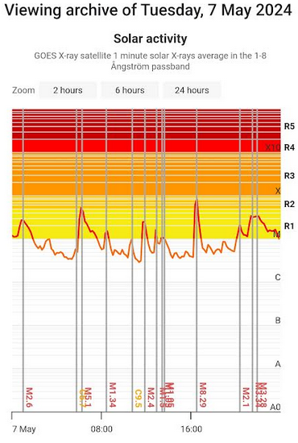
Do you remember what happened in May 2024 ? Merging of 2 CMEs @ the Earth
Stereo-A
Earth
Sun
Stereo-B

Slide 20
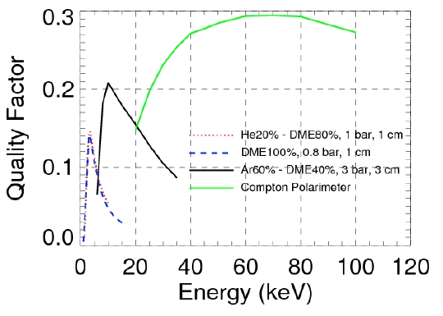
Which kind of polarimeters?
Quality factor
Of a dual-phase Compton polarimeter compared with photoelectric polarimeters filled with low-Z (He-DME / DME) gas mixtures and high-Z (Ar based)

Slide 21
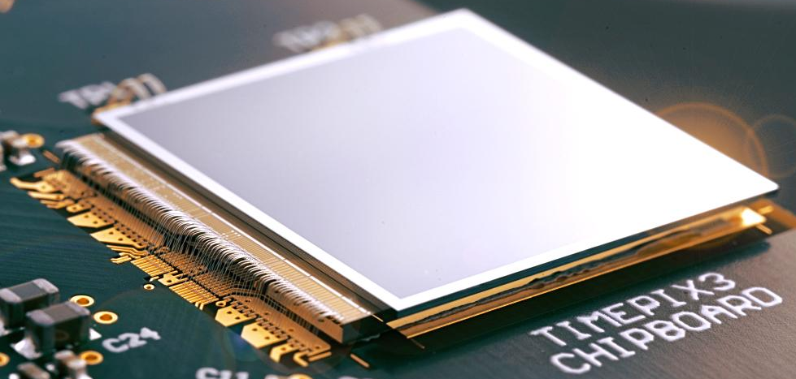
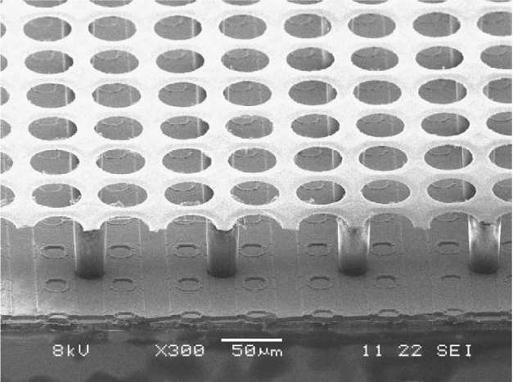
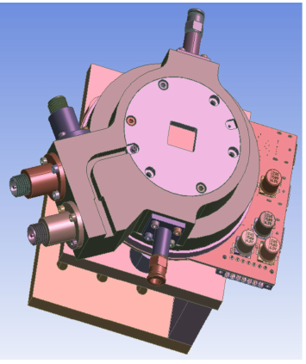
Imaging spectro polarimetry with a photoelectric polarimeter
Current status
X-ray polarimeter exploiting the photoelectric effect in a gas mixture effective in the 2-8 kev (Ratheesh et al. 2024, SPIE) for the after IXPE
Funding PRIN MIUR 2020 “HypeX: High Yield Polarimetry Experiment in X-rays” coordinated by da Elisabetta Baracchini (GSSI) and Paolo Soffitta (INAF)
Readout ASIC TimePix3 (next TimePix4) in collaboration with the University of Bonn [Bilevych et al. 2020, Ligtenberg et al. 2021]
Dead time 10% at 10⁶ cts/s
3-D track imaging promises to increase the sensitivity
Next Steps…
allow the development of an hard X-ray polarimeter (Ar based Gas mixture, 3 bar, 3 cm of absorption gap, effective > 6 keV) for Space Weather and Heliophysics.

Slide 22
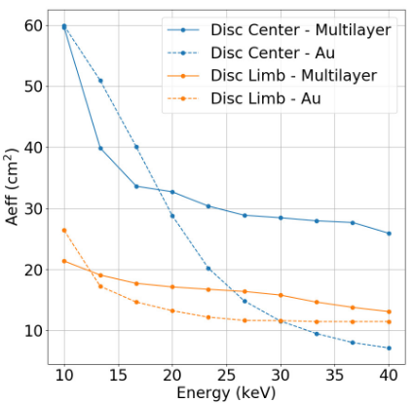
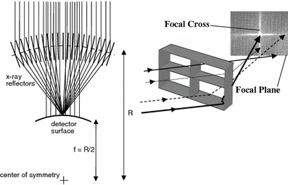
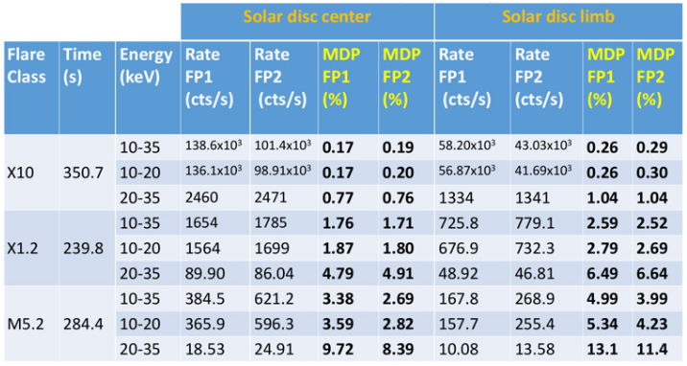
Imaging spectro polarimetry with a photoelectric polarimeter
A possible configuration for a full solar disc monitoring for Space Weather
The gas polarimeter if coupled with a multilayer Lobster eye optics module 5 m focal length with few tens of cm² of effective area is able to measure the polarization down to a mid-M class solar flare at few % level (Fabiani et al. 2024a, SPIE).
Gas cell 3 cm thick filled with an Ar/DME (60%/40%) gas mixture at 3 bar of pressure is suited to perform polarimetry in the 10-35 keV energy band
Coupling to the optics module allows to do a polarization map of the solar flare (disentangling the 2 footprints) thanks to F.O.V is 0.5° and HEW 20-27 arcsec.

Slide 23
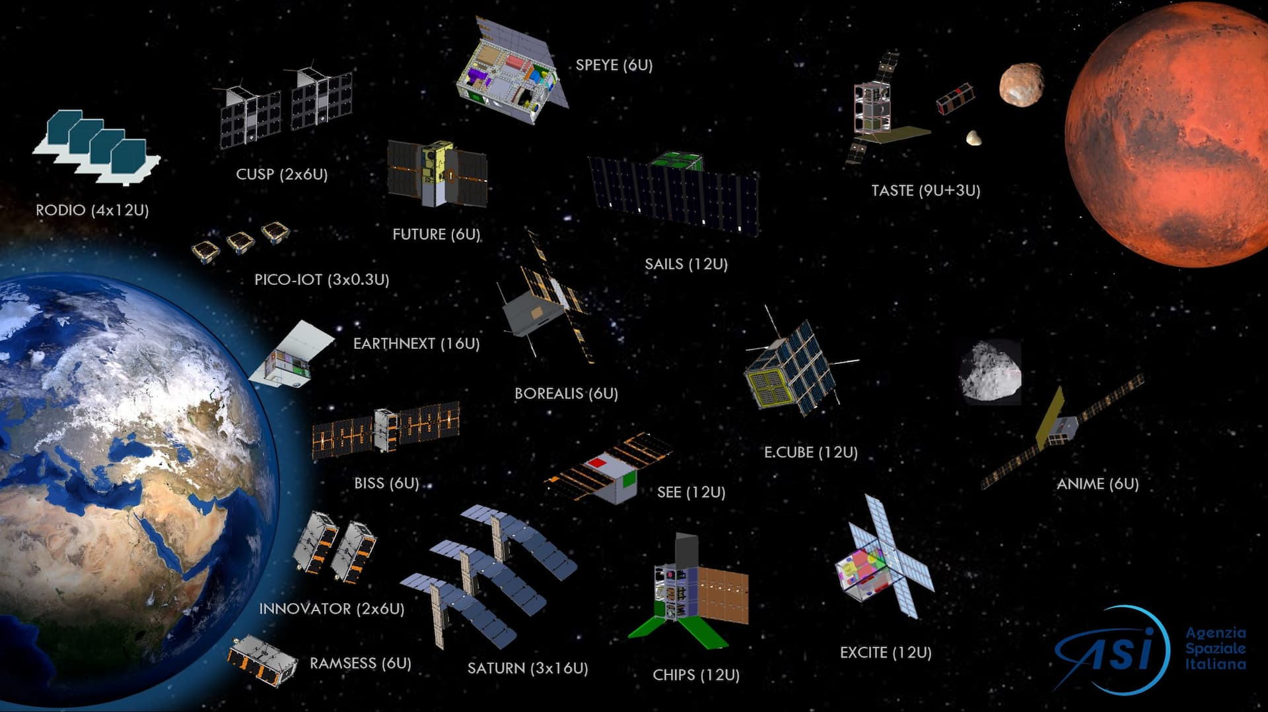
The CUbesat Solar Polarimeter
The Italian Space Agency (ASI) started a new national program named Alcor for funding the development of CubeSat technologies and missions
CUSP (Fabiani et al. 2024b, SPIE) is one of the 20 selected missions among 49 proposals
22 participants from Research Institutes and Universities and 78 companies, mainly Small and medium-sized ones

Slide 24
CUSP Team
INAF
IAPS (Prime, PI and Payload)
OAS-Bologna (Detector Simulation)
OAR (Lab-SW support)
OACT (Science expertise)
IMT s.r.l. (Platform)
Deda Connect s.r.l. (Payload Electronics)
Università di Bologna – CIRI AERO (Mission Analysis)
Università della Tuscia (Ground Segment)
ASI (Project Control)

Slide 25
Let’s built our Compton polarimeter for the Sun in a CubeSat !
Some requirements:
measure the linear polarization above 20 keV
good background rejection capability (we will fly very likely in polar orbits because cubesats typically do not choose their orbit, they just take a ride ! Polar orbits are requested for commercial use.)
Minimum detectable polarization of few % for mid M-class and X class flares
Proved radiation hardness to operate for 2-3 years in space
Fast implementation of the mission, no time for R&D of sensor technology

Slide 26
Scintillators
INORGANIC (crystalline structure)
Up to 100k photons per MeV
High Z
Large variety of Z and ρ
Undoped and doped
ns to μs decay times
calorimeters
E.m. calorimetry (e, γ)
Fairly Rad. Hard (100 kGy/year)
scintillation related to the crystallin structure
ORGANIC (plastics or liquid solutions)
Up to 10k photons per MeV
Low Z
ρ~1 gr/cm³
Doped, large choice of emission wavelength
ns decay times
Tracking, TOF, trigger, veto counters,
Medium Rad. Hard (10 kGy/year)
scintillation related to the molecular structure

Slide 27
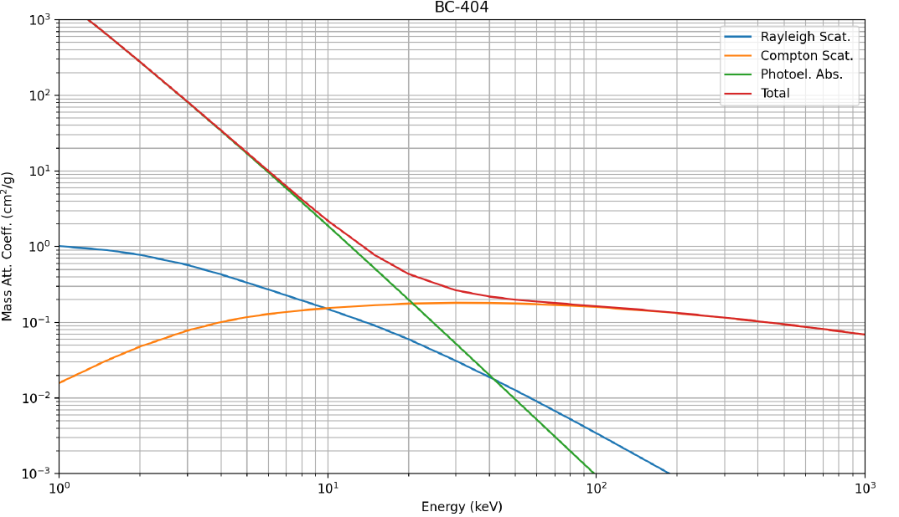
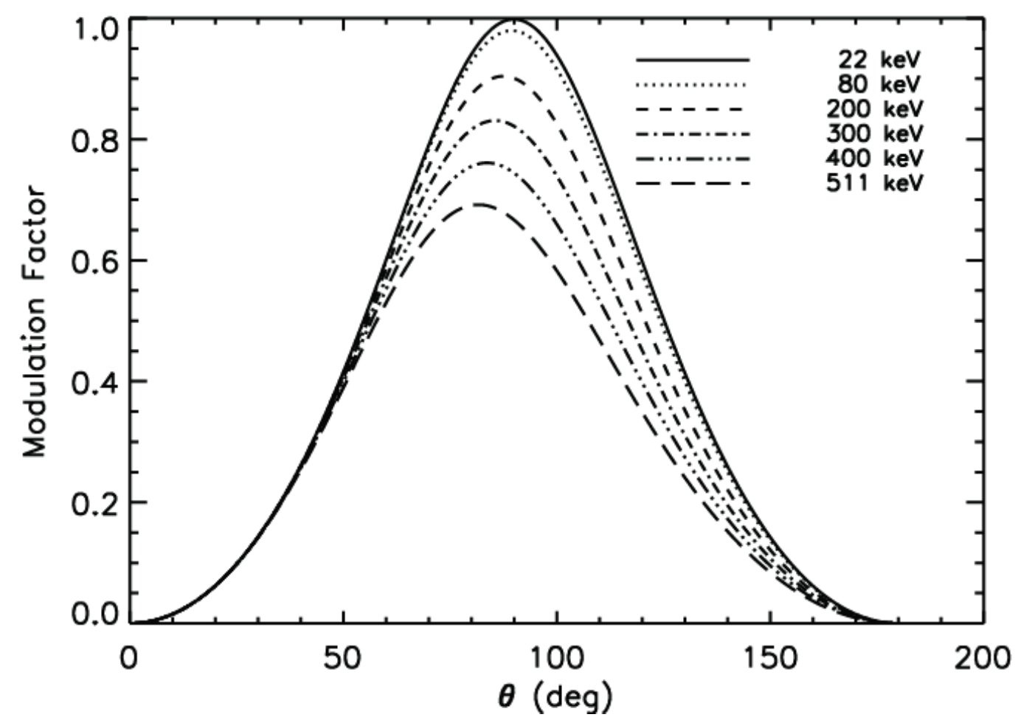
The scattering phase
Plastic (organic) scintillators are efficient for Compton interaction starting from 20 keV (Compton cross section equals photoelectric)
Compton energy deposit for 20 keV incoming photon is 700 eV at 90° scattering angle
Higher modulation around 90° scattering angle in this energy range
Del Monte et al. 2023
Fabiani et al. 2013
Fabiani & Muleri, 2014

Slide 28
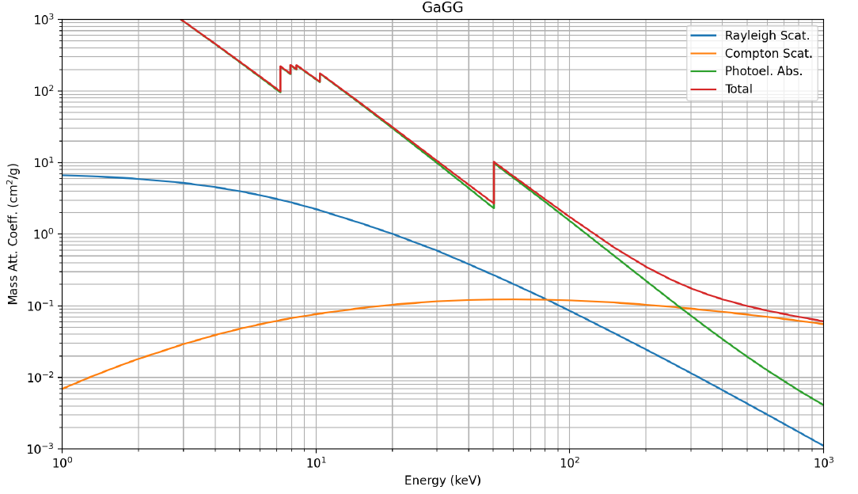
The absorption phase
Inorganic (Crystal) scintillator such as GAGG(Ce) - gadolinium aluminum gallium garnet (Gd₃Al₂Ga₃O₁₂), Ce doped is suitable to detecting scattered photons via photoelectric effect
Del Monte et al. 2023

Slide 29
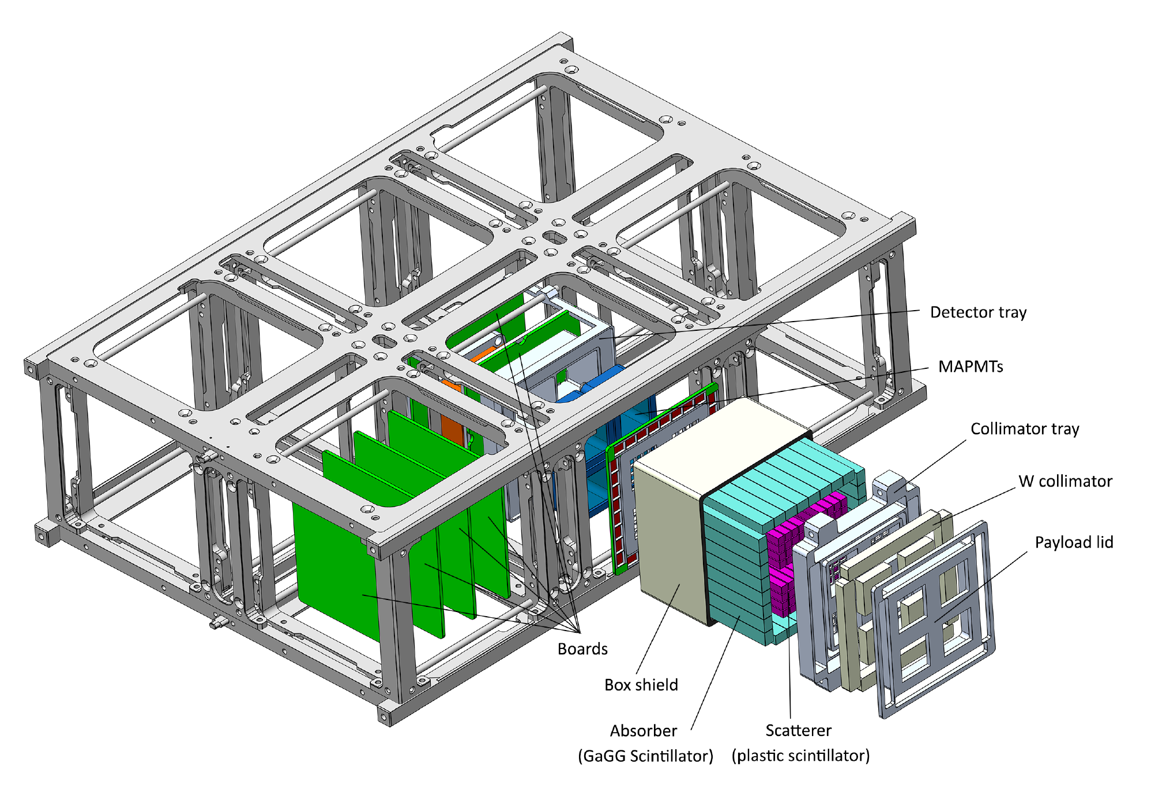
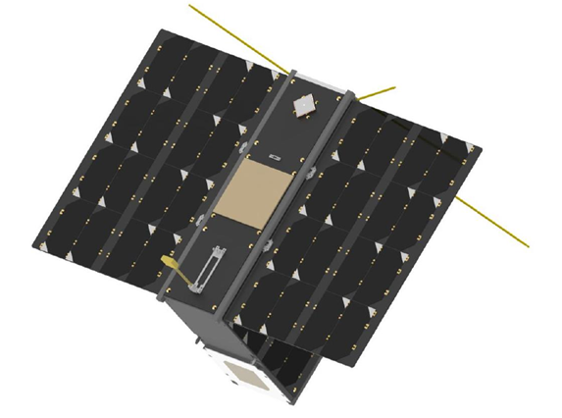
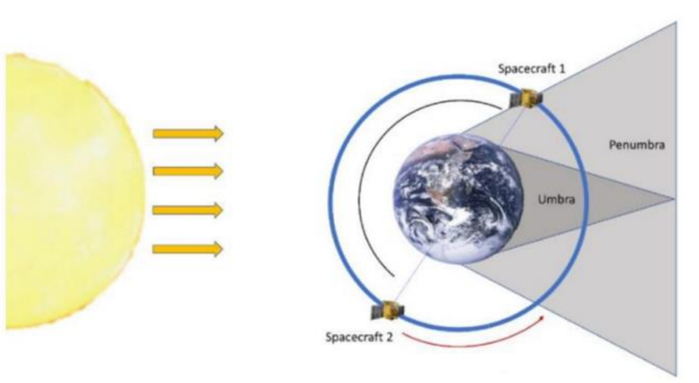
The payload
Constellation of two 6U CubeSats orbiting the Earth on SSO orbit (~470 km) to observe the Sun
Monitoring of the Sun with a time fraction >68% during the 3 years nominal life-time
X-ray polarimetry of Solar Flares in the 25-100 keV energy band
Each satellite hosts a dual-phase Compton scattering polarimeter that exploits coincidence measurements between plastic (scatterer) and inorganic (absorber) scintillator rods
1 RPM rotation of the spacecraft around the polarimeter symmetry axis pointing the Sun allows to reduce the systematic effect known as spurious polarization
End of Phase A payload design

Slide 30
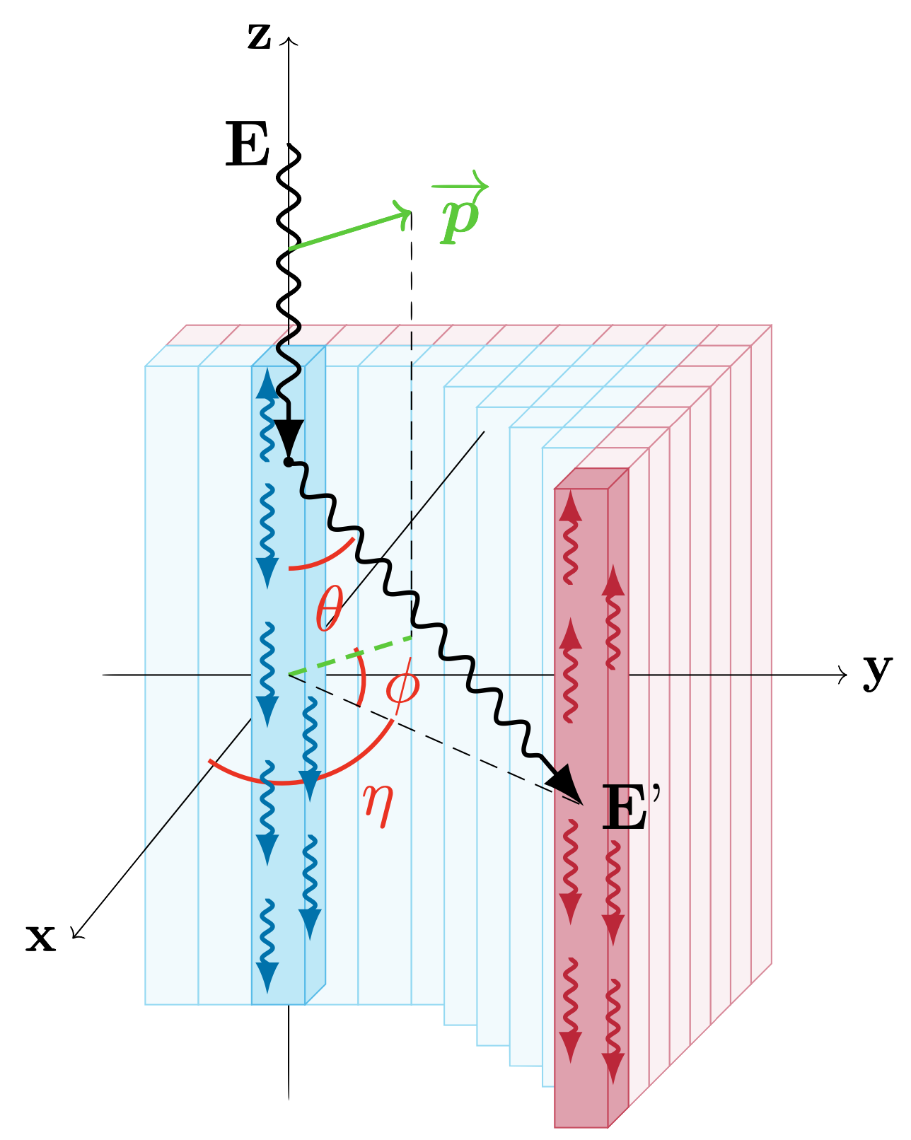
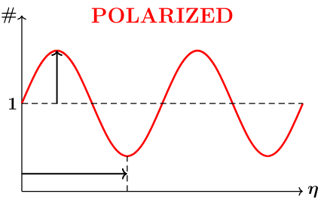
Compton polarimeter working principle
Klein-Nishina:

Slide 31
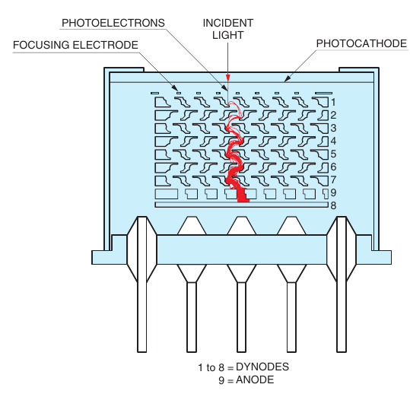
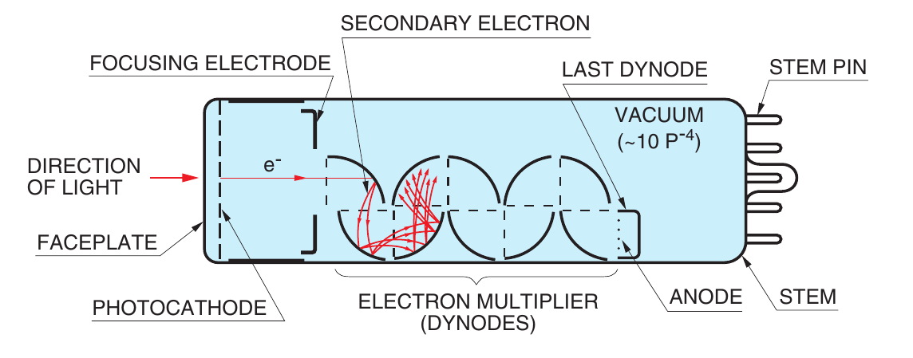
Multianodes Photomultiplier tubes to readout plastics
A Photomultiplier tube (PMT) is a vacuum tube consisting of an input window, a photocathode, focusing electrodes (dynodes) and an anode
A photon entering from the window extracts via photoelectric effect an electron that is accelerated towards the first dynode by means of a potential difference applied, causing the extraction of secondary electrons. This chain is repeated along the dynodes
At the last dynode the multiplication factor is typically from 10⁶ to 10⁷
Finally electrons are extracted from the anode
Multichannel

Slide 32
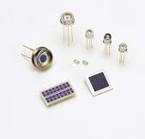
Avalanche Photodiode (APD) to readout GAGG
Avalanche photodiodes (APDs) are high speed, high sensitivity photodiodes with a similar structure to PN or PIN photodiodes, but multiplies the photocurrent (high gain) in the so-called "avalanche region" when a large reverse voltage is applied (typically about 300 V)

Slide 33
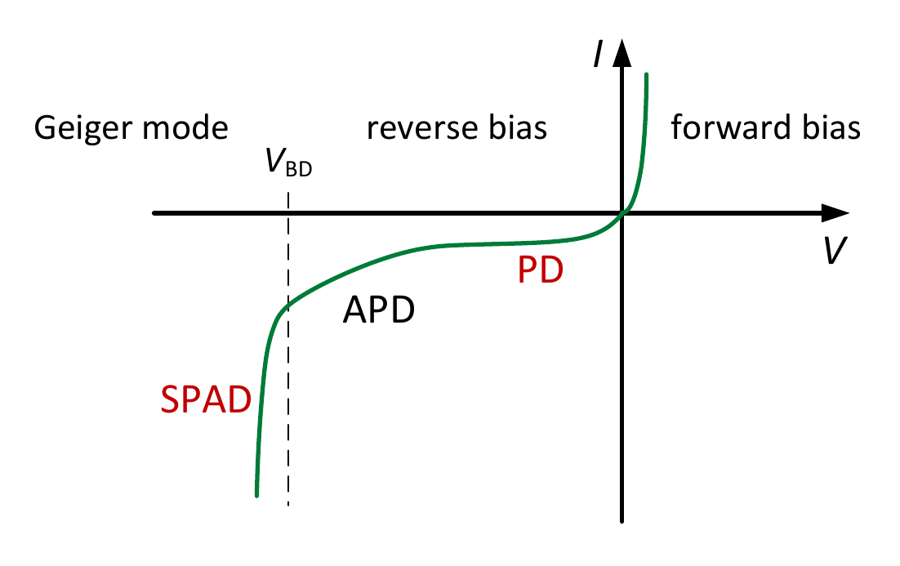
Avalanche Photodiode (APD) to readout GAGG
Reverse bias operation of photodiodes (PD) comprises: PD, APD, and SPAD (Single Photon Avalanche Diode)
The APD Gain is
I_{D} is the total dark current of the diode,
I_{ds} is the surface leakage current
I_{dg} is the bulk generated current inside the APD substrate.
G_{APD} is determined by the ionization rate, and this in turn is determined by the electric field across the depletion zone then G_{APD} = f(V_{bias})

Slide 34
APD gain is very sensitive to temperature
Test and characterization of the APDs @ INAF-IAPS
APD gain is strongly dependent on the temperature
APD directly illuminated with a ⁵⁵Fe source

Slide 35
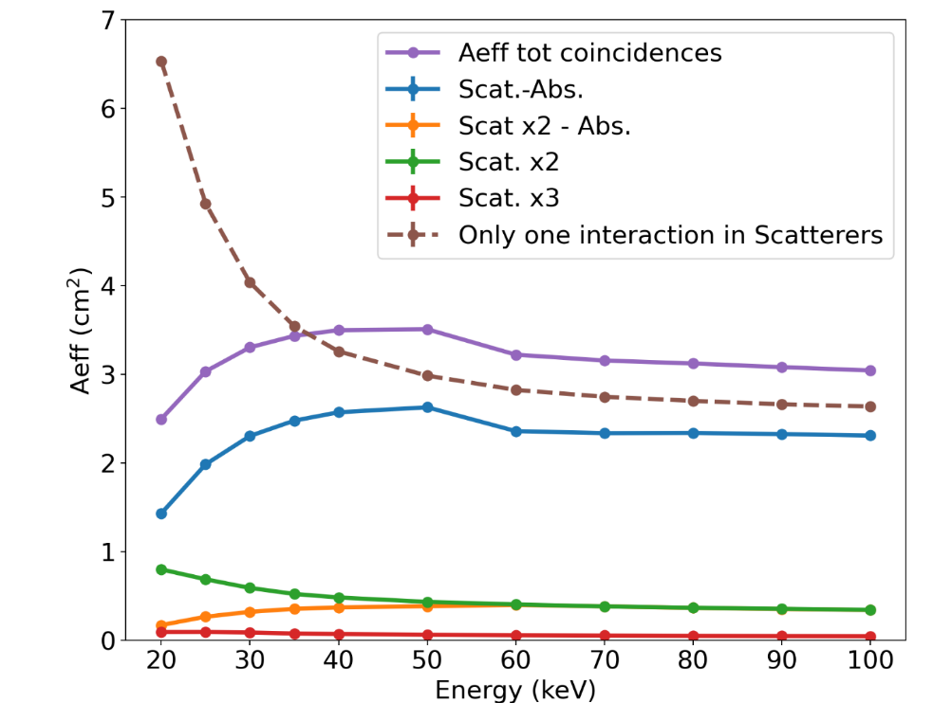
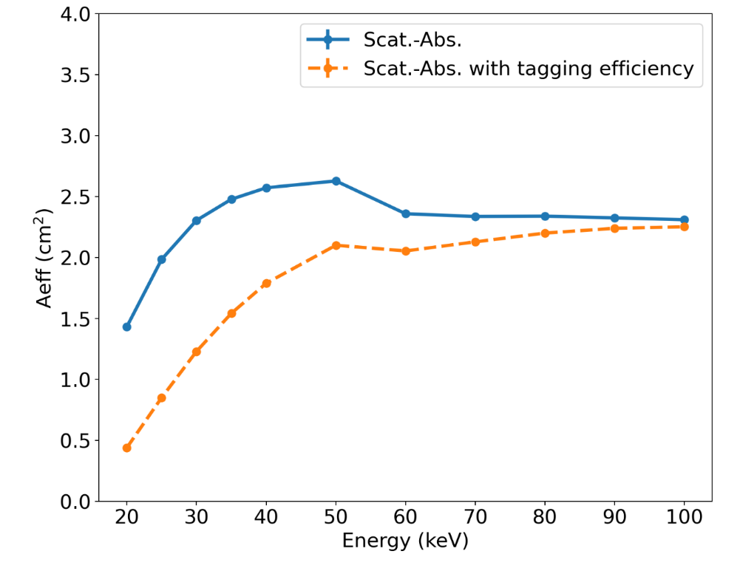
Which coincidences are we interested in?
De Cesare et al, 2024, SPIE
Tagging efficiency by Fabiani et al. 2013 Astrop.Phys .

Slide 36
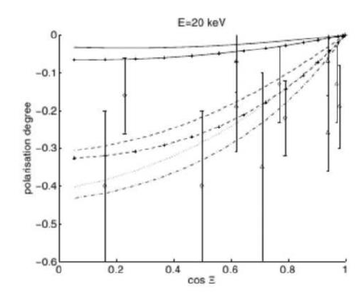
The payload sensitivity (under refinement in phase B)
Minimum Detectable Polarization (Weisskopf+ 2010, SPIE; Strohmayer & Kallman 2013, ApJ)
MDP~3σ (Strohmayer & Kallman 2013, ApJ)
Past measurements with Pol. Degree errors of about:
15% with a C.L. of 90% (~ 1.645 σ) corresponds to an MDP ~27%
20% corresponds to an MDP ~37%
CUSP will reduce significantly the MDP wrt past observations.
Flares are expected to be polarized at tens of %, CUSP will measure with high significance flares polarization
R: source rate
B: background rate
T: integration time
μ: modulation factor
ε: quantum efficiency
X 10
X 1.2
M 5.2
CUSP MDP
MDP for PD_err=15% @ 90% C.L.
PAST MDP
MDP for PD_err=20% @ 90% C.L.
Zharkova+ 2010 (A&A)

Slide 37
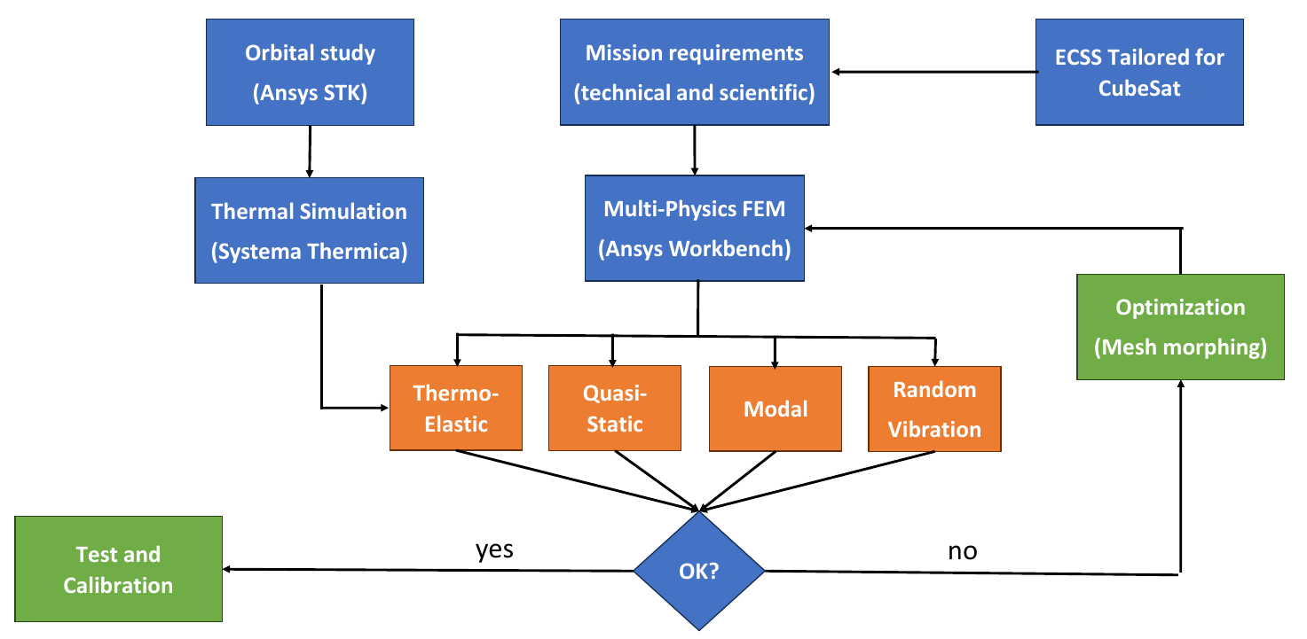
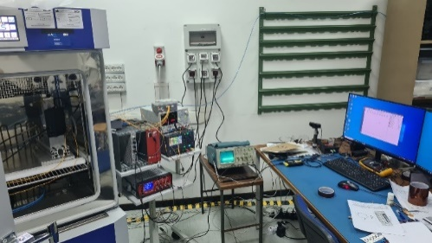
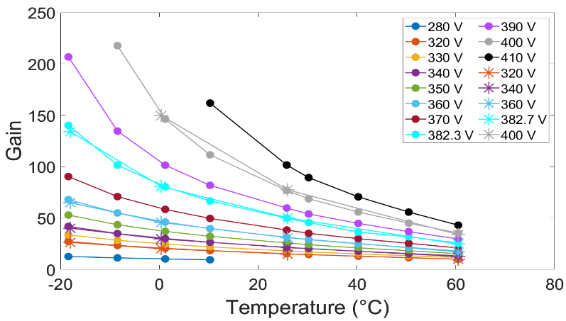
Currently Phase B in progress
Geant4 detector simulator development
Definition of the thermo-mechanical analysis method and hypothesis of payload mechanical optimization
Test @ INAF-IAPS
Estimation of the MDP requires:
effective area, modulation factor (spurious modulation)
Background estimation
Tests on the Avalanche Photodiodes to readout GaGG absorbers scintillators
Lombardi et al. SPIE 2024
De Cesare et al. SPIE 2024
Cologgi et al., SPIE 2024
Alimenti et al., IMEKO 2024 Proc. Subm.
Alimenti et al., Sensors 2025

Slide 38
The satellite platform
Phase B in progress
It will be updated
Designed and prduced by IMT s.r.l. Italian company
6U CubeSat platform based on the heritage of the HORTA and EOSS platforms (funded by Italian regional POR / FESR 2014-20 projects of Lazio and Puglia regions, respectively).

Slide 39
The Ground Station
Located on a building of the Università della Tuscia in Viterbo (Lazio, Italy)
Built in 2019 for the HORTA project (funds POR/FESR 2014-2020 by Lazio Region)
Available antennas and bands:
VHF: Uplink and Downlink
UHF: Uplink and Downlink
S-band: Downlink
UHF/VHF bandwith:
Downlink: default 9.6 kbps (available also 1.2/2.4/4.8 kbps)
Uplink: default 1.2 kbps (available also 2.4/4.8/9.6 kbps)
S-band bandwith:
Downlink: up to 1 Mbps

Slide 40
Planning
Model Philosophy:
Payload:
1 detector prototype at the end of Phase B. Representative of the detector front-end functionalities (from TRL 3 to TRL 4)
1 payload subsystem Structural Model at the end of Phase B (scintillator bars holding system)
1 payload EQM (design phase B, production and test phase C). Representative of the payload (from TRL 4 to TRL 7)
Trade-off assessment to allow ASI to decide if to continue with a 2 CubeSats constellation or with a 1 CubeSat
Depending on the trade-off 1 or 2 CubeSats:
1 Proto-flight Model (PFM). To qualify at proto-qualification level.
1 additional Flight Model (FM). To qualify at acceptance level.
Next Phases:
Phase B will start soon (12 months)
Proposed phase C/D 15 months
Calibration of the Hard X-ray Polarimeter of each CubeSat will be carried out at INAF-IAPS calibration facility (possibly also measurements at Synchrotron facilities)

Slide 41
Bibliography
https://chandra.harvard.edu/edu/formal/icecore/The_Historical_Sunspot_Record.pdf
Bai, T., & Ramaty, R. 1978, ApJ, 219, 705
Babcock, H.D., 1959, “The Sun’s Polar Magnetic Field”, Astrophys. J., 130, 364–365
Brown, J. C. 1972, Sol. Phys., 26, 441
Bastian, T. S. 1999, in Proceedings of the Nobeyama Symposium, held in Kiyosato, Japan, Oct. 27−30, 1998, ed. T. S. Bastian, N. Gopalswamy, & K. Shibasaki, NRO Rep., 479, 211
Charbonneau, P. Dynamo Models of the Solar Cycle. Living Rev. Sol. Phys. 2, 2 (2005). https://doi.org/10.12942/lrsp-2005-2
Charikov, J. E., Guzman, A. B., & Kudryavtsev, I. V. 1996, A&A, 308, 924
Clark, D.H. and Stephenson, F.R., 1978, “An Interpretation of Pre-Telescopic Records from the Orient”, Quart. J. R. Astron. Soc., 19, 387–410.
David H. Hathaway, “The Solar Cycle”, Living Rev. Solar Phys., 7, (2010), 1, http://www.livingreviews.org/lrsp-2010-1
Diakonov, S. V., & Somov, B. V. 1988, Sol. Phys., 116, 119
Del Monte et al., Handbook of X-ray and Gamma-ray Astrophysics. Edited by Cosimo Bambi and Andrea Santangelo, Springer Living Reference Work, 2023
Emslie, A. G. 1980, ApJ, 235, 1055
Emslie, A. G., & Vlahos, L. 1980, ApJ, 242, 359
Fabiani et al. 2013, “Characterization of scatterers for an active focal plane Compton polarimeter”, Astroparticle Physics, Volume 44, p. 91-101.
Fabiani et al . 2024a, “Towards imaging-spectro-polarimetry of solar flares in the x-rays”, SPIE
Fabiani et al. 2024b, “The CUbesat Solar Polarimeter (CUSP) mission overview”, SPIE
Gluckstern, Hull and Breit, Polarization of Bremsstrahlung Radiation, Phys. Rev. 90, 1026 – Published 15 June, 1953
Haigh, J.D. The Sun and the Earth’s Climate. Living Rev. Sol. Phys. 4, 2 (2007). https://doi.org/10.12942/lrsp-2007-2, 2006, Sol. Sys. Res., 40, 104
Holman, G. D., Sui, L., Schwartz, R. A., & Emslie, A. G. 2003, ApJ, 595, L97
Knight, J. W., & Sturrock, P. A. 1977, ApJ, 218, 306
Krucker, S., et al. 2008, A&A Rev., 16, 155
Kundu, M. R., Grechnev, V. V., Garaimov, V. I., & White, S. M. 2001a, ApJ, 563, 389
Kundu, M. R., Nindos, A., White, S. M., & Grechnev, V. V. 2001b, ApJ, 557, 880
Kundu, M. R., Nindos, A., & Grechnev, V. V. 2004, A&A, 420, 351
Kuznetsov, S. N., Kurt, V. G., Myagkova, I. N., Yushkov, B. Y., & Kudela, K. 2006, Sol. Sys. Res., 40, 104
Landau, L. D. 1937, Zh. Eksp. Teor. Fiz., 7, 203
Langer, S. H., & Petrosian, V. 1977, ApJ, 215, 666
Leach, J., & Petrosian, V. 1983, ApJ, 269, 715
Lin, R. P., Krucker, S., Hurford, G. J., et al. 2003, ApJ, 595, L69
McClements, K. G. 1992, A&A, 253, 261
McTiernan, Amir Caspi, Amir Caspi, Harry Warren “The EVE plus RHESSI DEM for Solar Flares, and Implications for Residual Non-Thermal Soft X-Ray Emission”, December 2016, Conference: American Geophysical Union, Fall Meeting 2016

Slide 42
Bibliography
Ratheesh et al. 2024, SPIE
Siversky, T. V., & Zharkova, V. V. 2009, A&A,
Tapping, K.F. and Charrois, D.P., 1994, “Limits to the Accuracy of the 10.7 cm Flux”, Solar Phys., 150, 305–315
Veronig, A. M., Karlický, M., Vršnak, B., Temmer, M., Magdalenić, J., Dennis, B. R., Otruba, W., & Pötzi, W. 2006, A&A, 446, 675
van den Oord, G. H. J. 1990, A&A, 234, 496
Wittmann, A.D. and Xu, Z.T., 1987, “A catalogue of sunspot observations from 165 BC to AD 1684”, Astron. Astrophys. Suppl., 70, 83–94
Zharkova et al. A&A 512, A8 (2010)
Zharkova, V. V., Brown, J. C., & Syniavskii, D. V. 1995, A&A, 304, 284
Zharkova, V. V., & Gordovskyy, M. 2005, A&A, 432, 1033

