Slide 1
Photoelectric polarimeters R&D
-HypeX-
Davide Fiorina^{a,b}, Elisabetta Baracchini^{a,b}, Giorgio Dho^{c}, Paolo Soffitta^{d}, Samuele Torelli^{a,b},
David J. G. Marques^{a,b}, Enrico Costa^{d}, Sergio Fabiani^{d}, Fabio Muleri^{d} , Giovanni Mazzitelli ^{c}
ªGran Sasso Science Institute
^{b}INFN Laboratori Nazionali del Gran Sasso
^{c}INFN Laboratori Nazionali di Frascati
^{d}IAPS - INAF Istituto di Astrofisica e Planetologia Spaziali

Slide 2
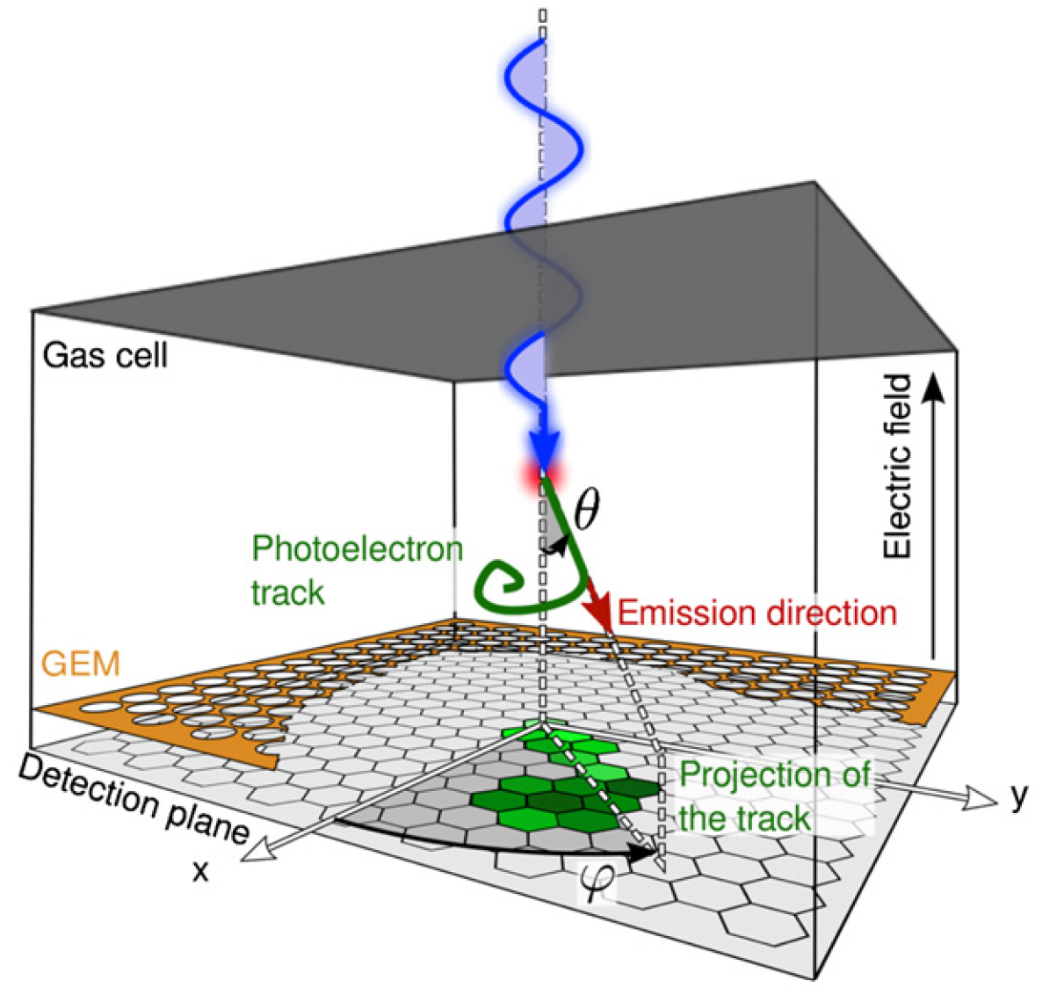
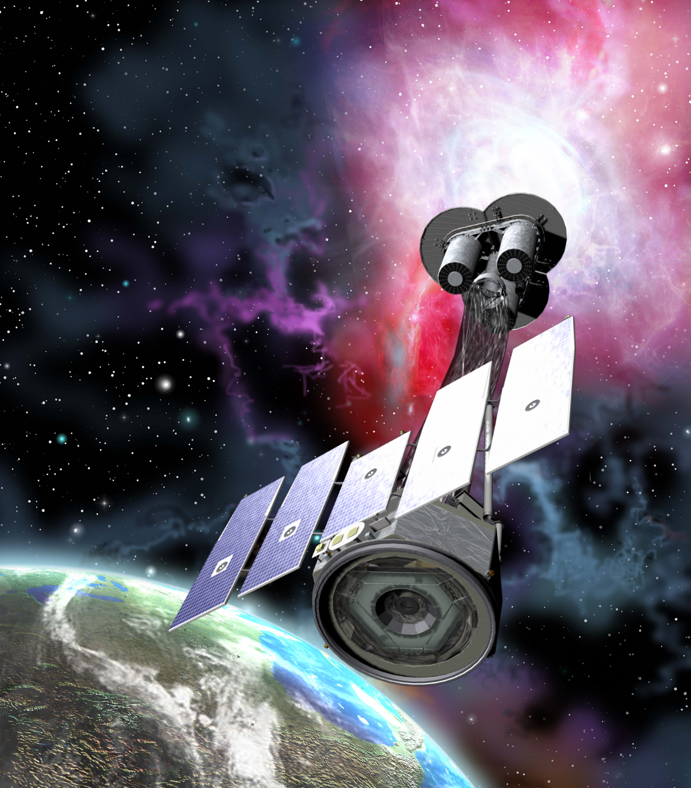
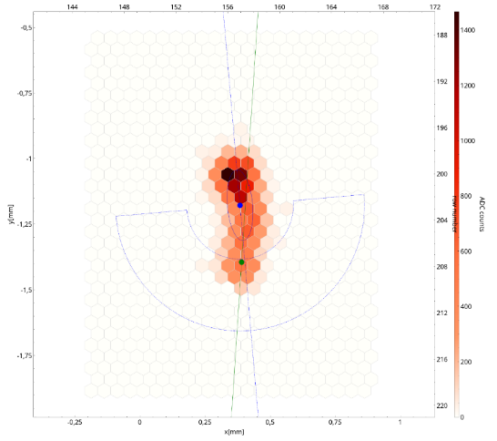
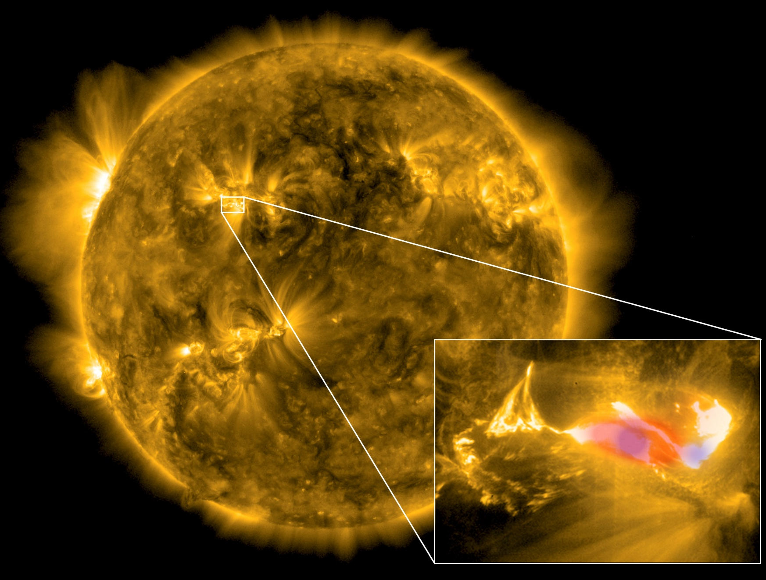
IXPE
IXPE is a great success but as experimentalists we can do better
– P.Soffitta
Limitations of IXPE
Deadtime of 1 ms per event
  Need to evaluate pedestal after every event
Continuous calibrations
  Caused by GEM and ASIC and glue absorption of gas
2D readout
  Lower discrimination power to tracks oriented toward the sensor plane
  (more background)
Limited to focal plane of X-ray optics
  Limited field of view
  Loss to sensitivity to transients (helpful for multimessanger physics)
Energy range <9 keV
  Higher energies can increase information on coronas, magnetars tackle non-thermal bremsstrahlung in Solar flares and NS binaries
Fabiani et al, 2012
Westfold 1959

Slide 3








HypeX: High Yield Polarimetry Experiment in X-rays
Keep up the good work!
This grant is also paying for the school!

Slide 4
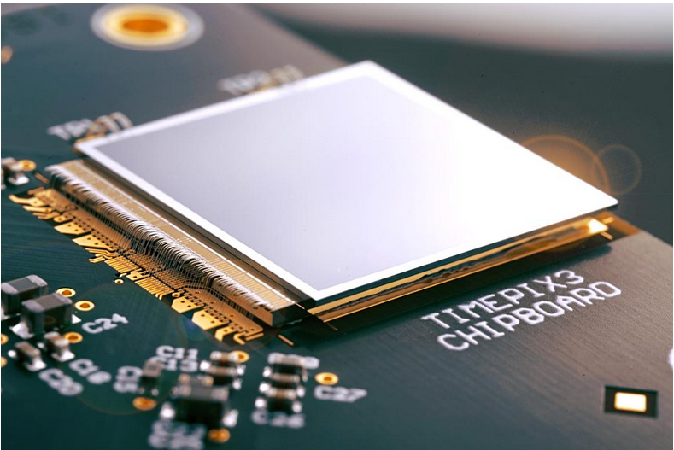
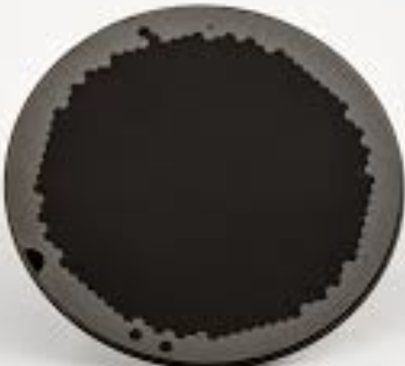
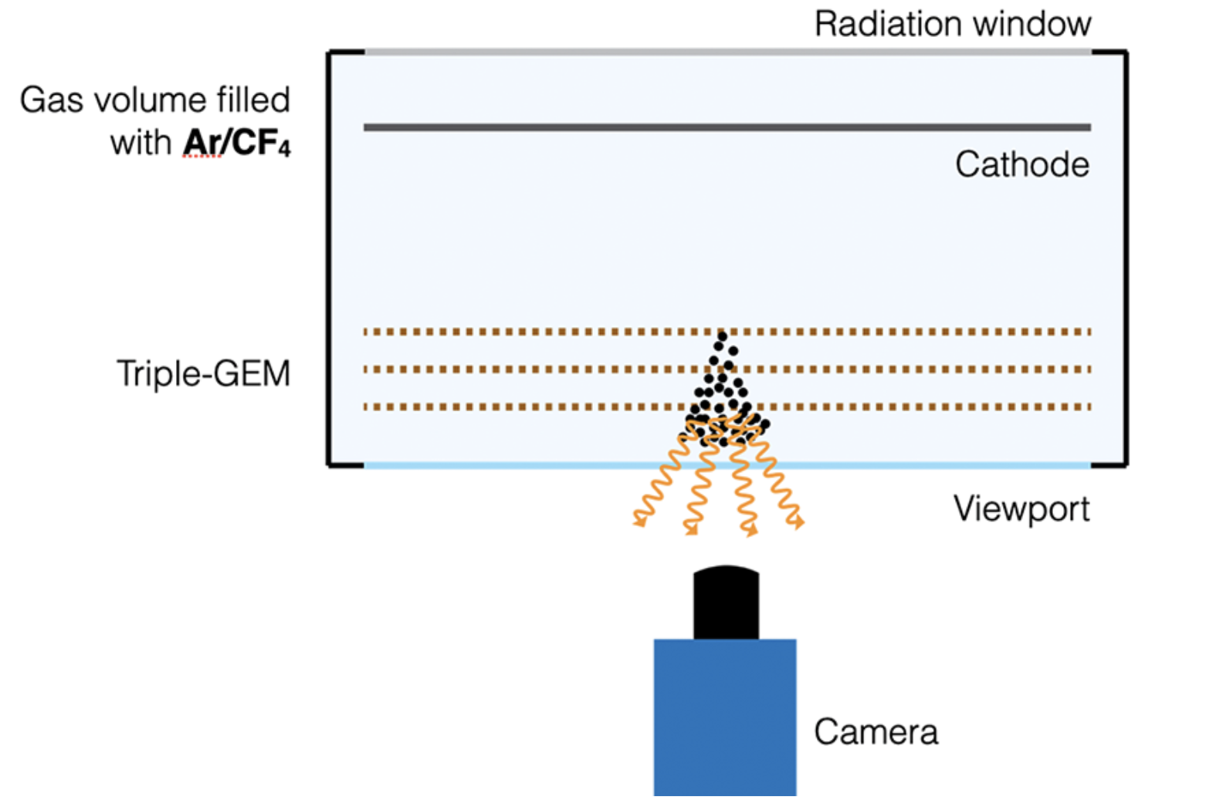
HypeX overview
The HypeX project aims to develop innovative detectors and techniques for measurement of the polarization of X-rays through photoelectic technique
Improvements on IXPE expertise
Funds of about 1 M€ until this May
GPD3D
Enhance Gas Pixel Detector (GDP) performance for X-ray polarimetry.
Improve sensitivity, energy resolution, and high flux handling.
Extend sensitivity to higher energy X-rays (20-30 keV).
Upgrade the ASIC to Timepix3 chip for 3D tracking.
Address performance issues: signal fluctuations, spurious modulation.
Optimize gas mixtures and detector materials for broader energy range.
Xray-CMOS
Develop a large-field-of-view TPC for X-ray polarimetry.
Large area:
- 100 cm2 with a narrow collimator set (e.g. Lead-glass capillary plates by Hamamatsu 1-2 deg FoV) with the goal of monitoring the
polarization of bright galactic sources or repointing on transients once known the celestial coordinates.
- Large Area > 100-1000 cm2 with a wide collimator (20-40 deg FoV) to catch unpredictable known transient sources (Magnetars burst) or X-ray counterpart of Gamma Ray Bursts etc.
Extend sensitivity to higher energy X-rays (10-50 keV).
Optimize gas mixtures and detector materials for broader energy range.
Enable study of transient sources like Gamma Ray Bursts (GRBs) and solar flares.

Slide 5
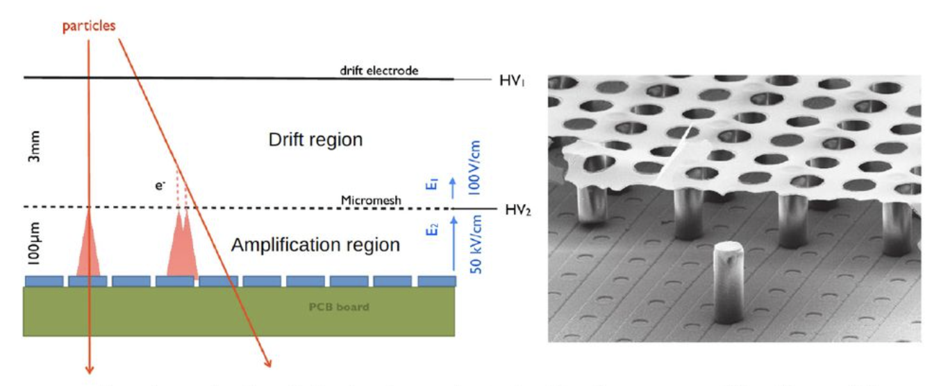
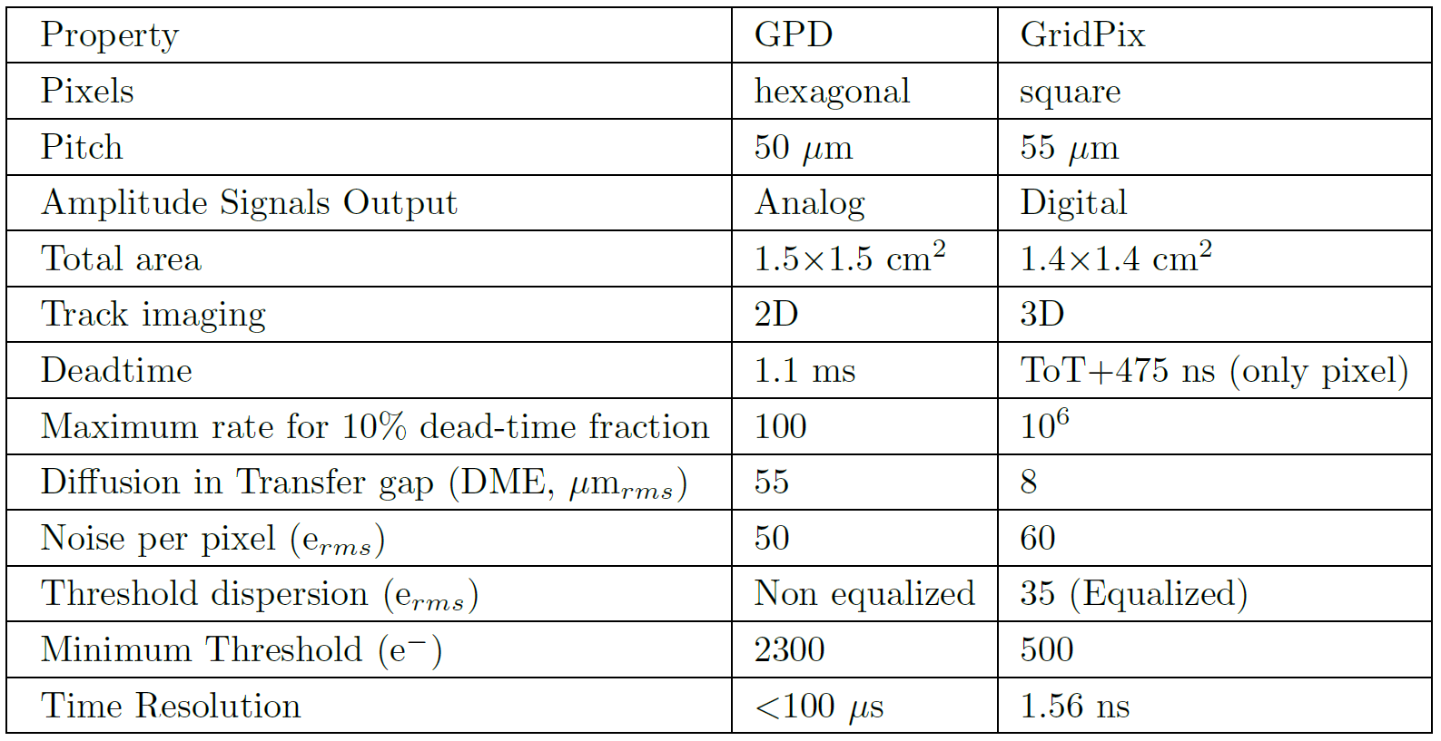
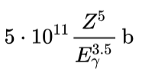

GDP3D sub-project
Effort guided by P. Soffitta
Lupberger et al, 2014
Employ TimePix3 ASIC
Gromov et al, 2011
Already used in space
Survival to heavy ions (tests next month)
Employ Different amplification strategies
GEM feared to induce spurious modulation
InGrid structure as a possible replacement (Micromegas placed over TimePix3 chip)
Improvement in resolution and gain uniformity
Stress and thermo-vibrational tests passed
Employ larger Z gases as argon
Photoelectric effect depends on Z⁵
Stable gas mixture configuration to be determined
Optimization of track lengths as density increases with Ar-mixture

Slide 6
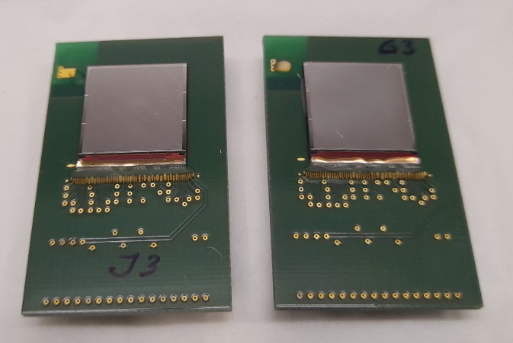
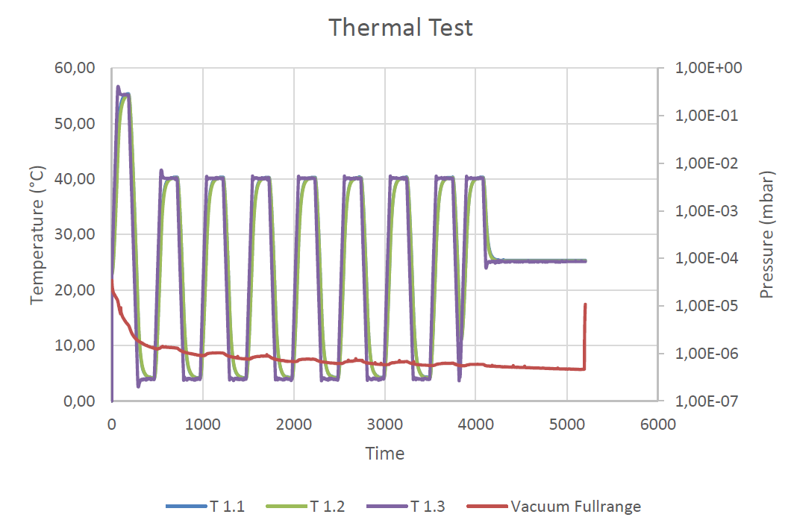
Thermovacuum and Vibration test
Performed InGrid Environmental Test
Random test vibration (GEVS) test structure
Thermo-vacuum test 4-40 ºC 8 duty-cicles (4h10 each)
Each sandwich maintained at 100º C for 220 min (for baking)

Slide 7
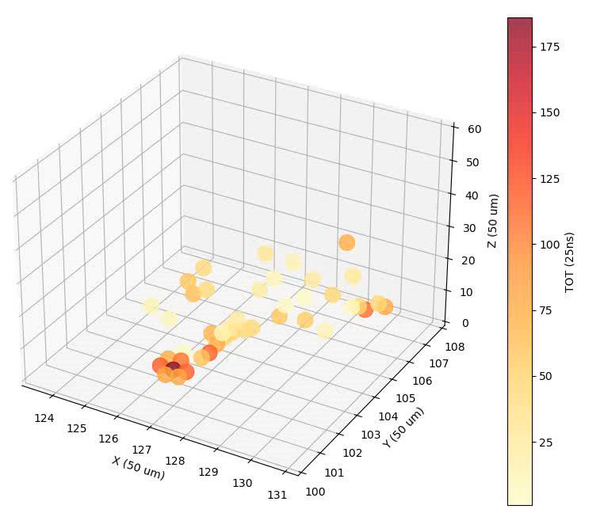
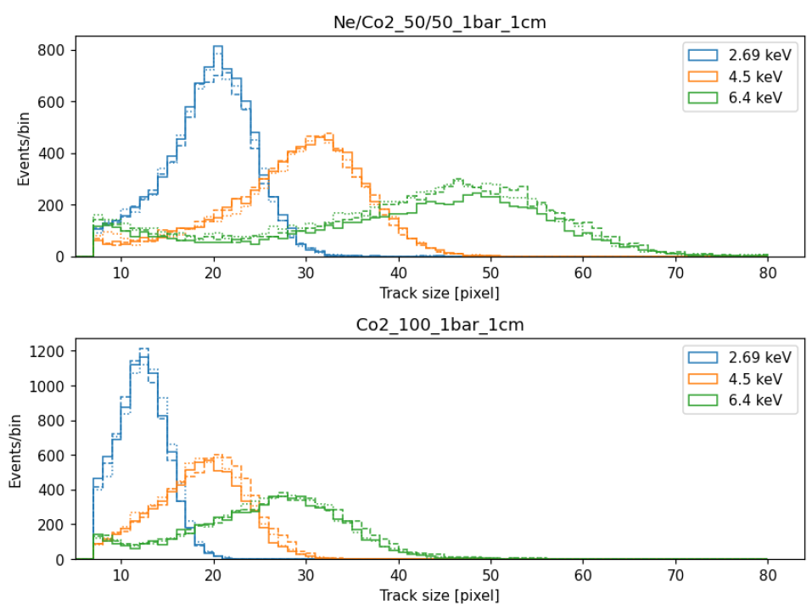
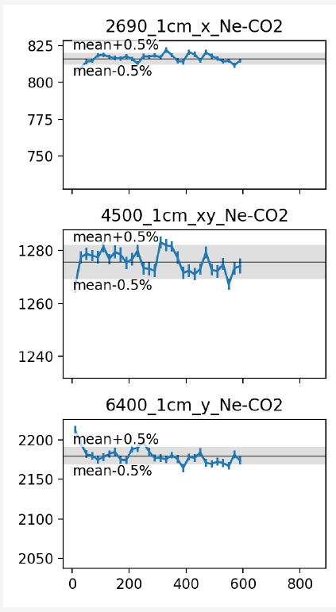
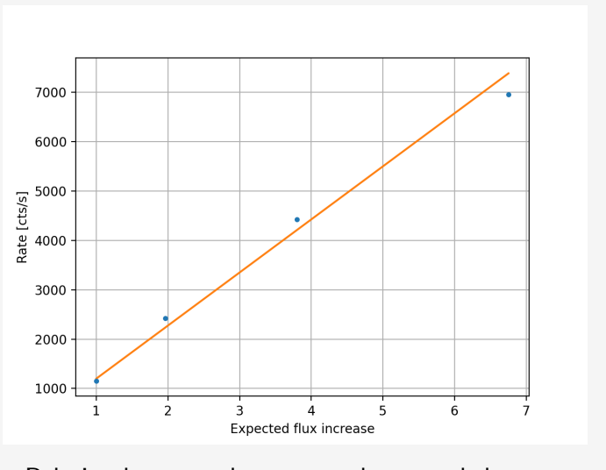
First 3D tracks
Ne-CO₂ (50/50) mixture tested with polarized X-rays @ 2.69 4.5 and 6.4 keV
Size vs energy
Rate measurement vs show very good stability
Real 3D track
Ratheesh, A. et al., 2024
6.4 keV
Number of pixels per tracks smaller than IXPE’s GPD
The transfer gap is 1/16 of the GPD
Real drift velocity for Z coordinate determination to be confirmed
TBA:
- Ar-DME 80-20.
- Flat Field Unpolarized 8.04 keV 17.4 keV.
- Polarized 8.04 keV 17.4 keV
Configuration: 1024 mbar 2-cm

Slide 8
Simulation Infrastructure
Geant4 infrastructure with custom gas diffusion and multiplication of electrons
Preliminary 3D Impact point and PE direction algorithm
Output in FITS format!
New generation of 3D detectors for x-ray polarimetry: simulation of performances
InGrid exepectation pure DME @ 800mbar

Slide 9
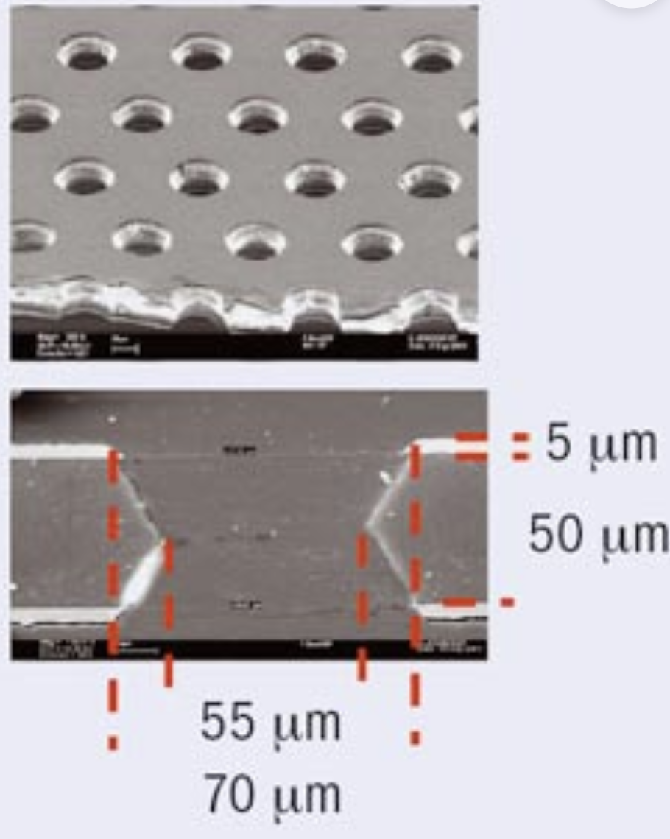
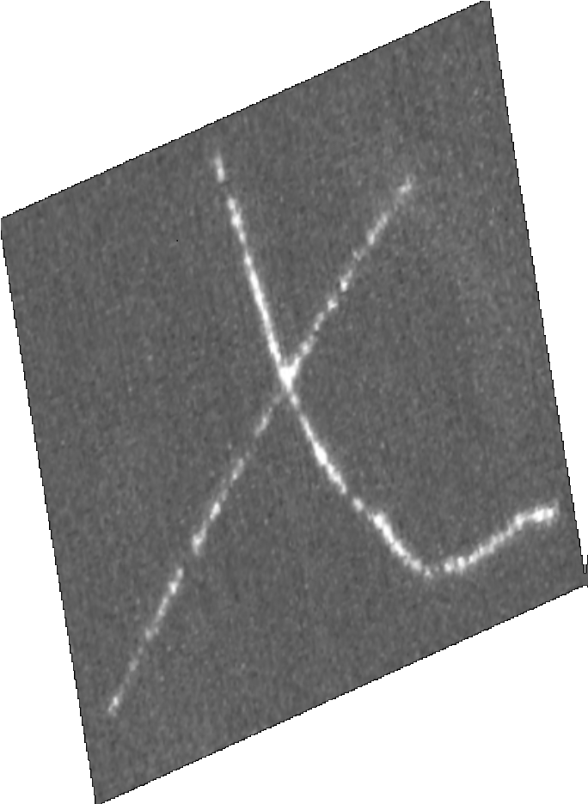
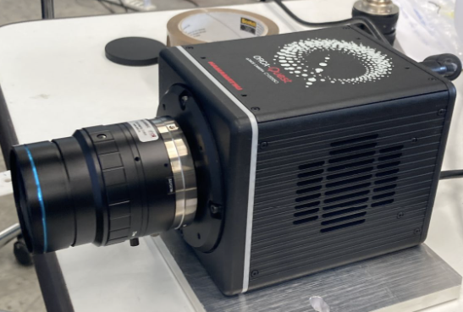
Xray-CMOS sub-project
Gas volume filled with He/CF₄ 60/40
1atm
CMOS
Hamamatsu ORCA Quest (2)
High-granularity
X+Y+Energy measurement

Slide 10
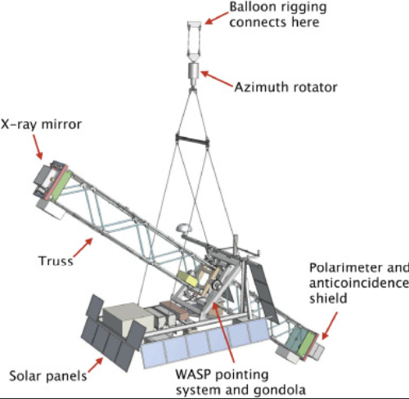
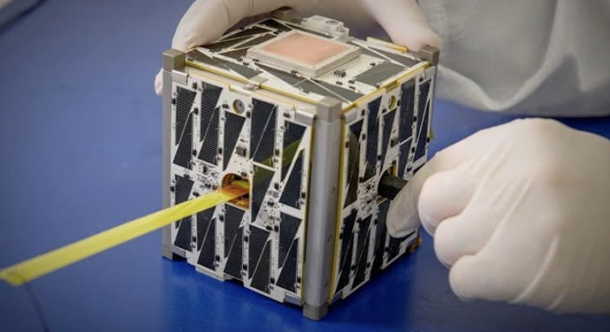
Xray-CMOS sub-project
Large FoV up to 25°
Gas volume filled with He/CF₄ 60/40
1atm
Collimator

Slide 11
Photographing particle tracks

Slide 12
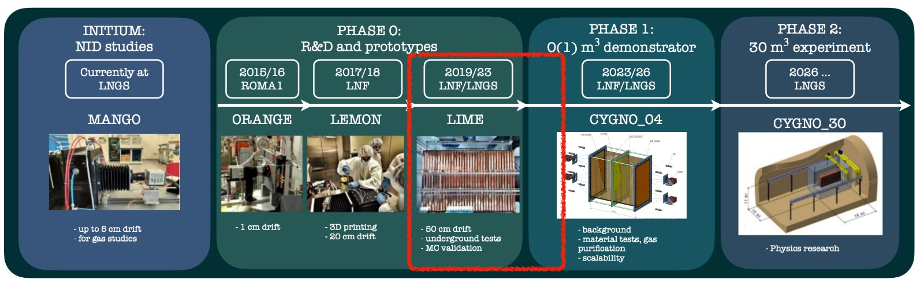
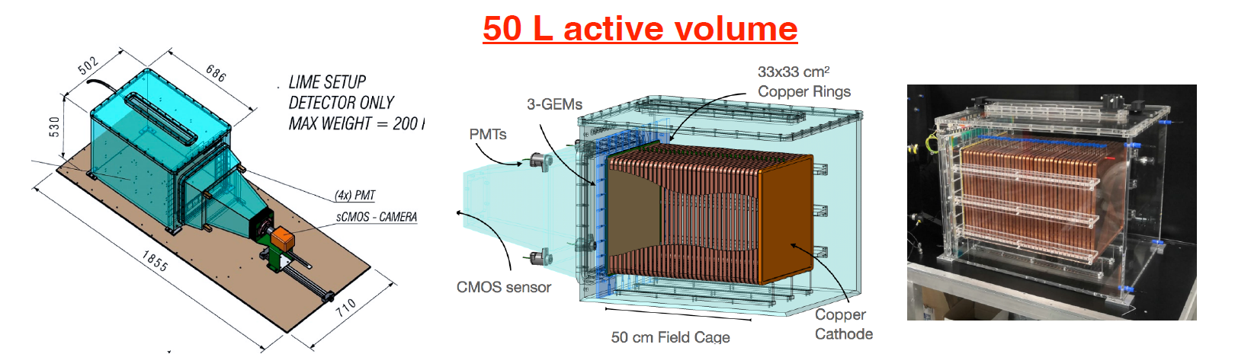
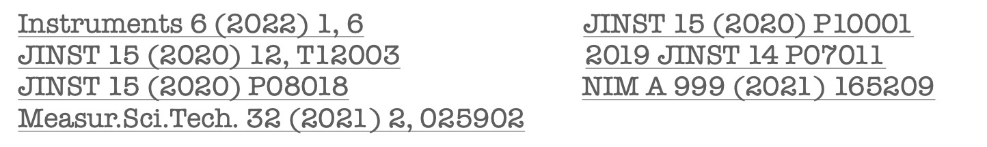



Detector
PMT
Integrated
Z + Energy measurement
Drift
direction
Straight track:
Drift
direction
Tilted track:
pixels 2304 x 2304 pixels - Imaging 36 x 36 cm2 area Effective - pixel granularity 155 x 155 um2

Slide 13
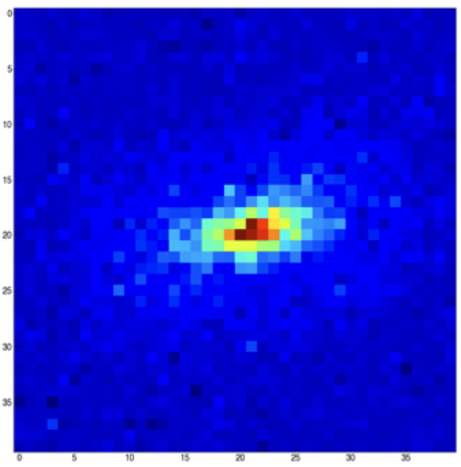
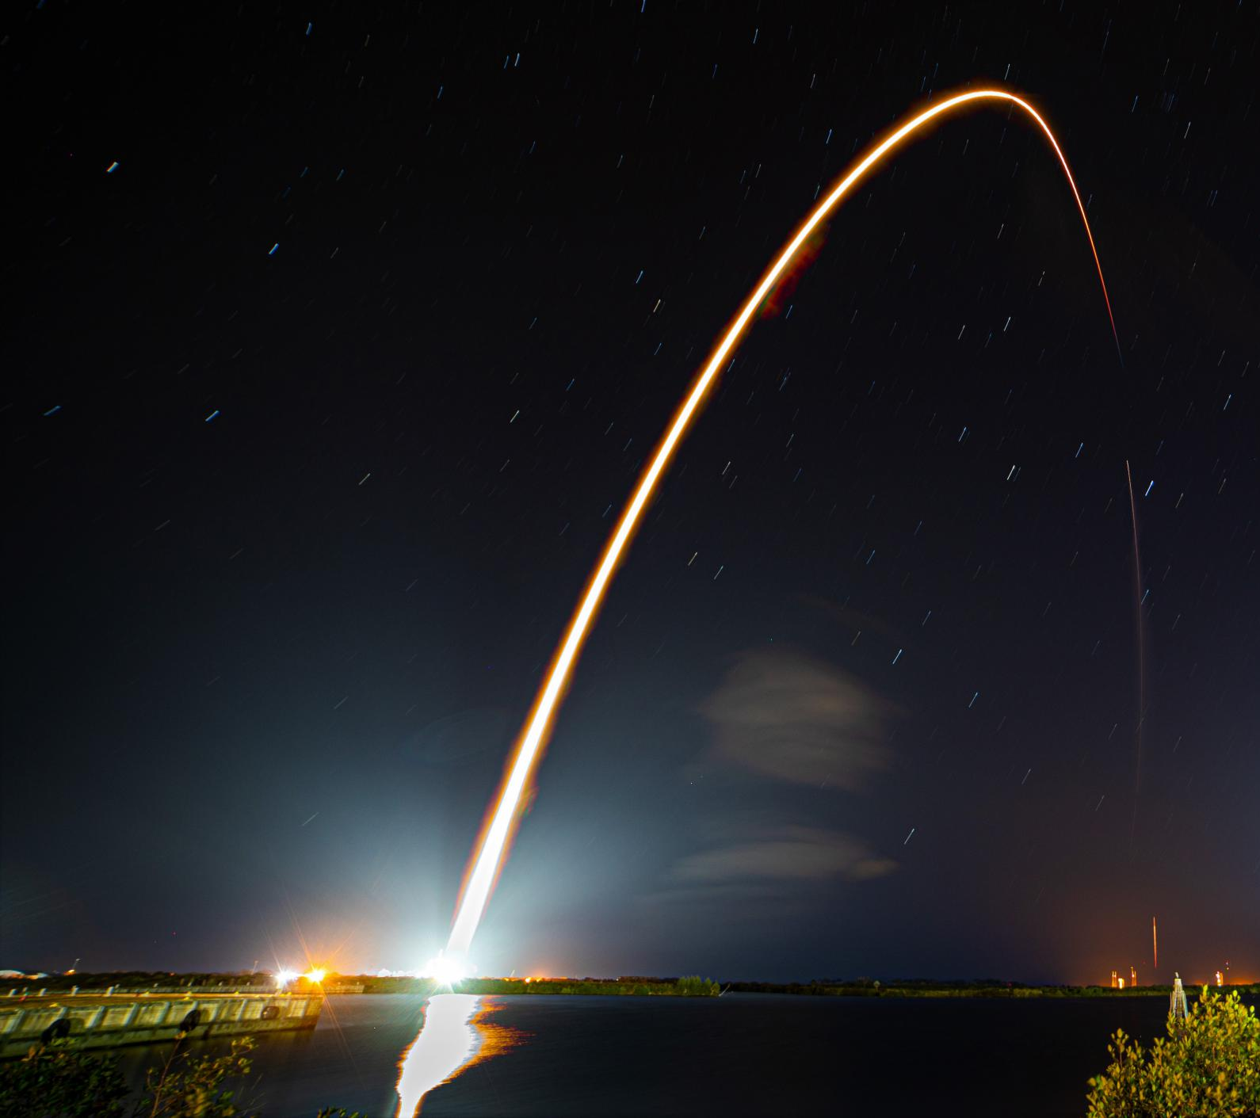
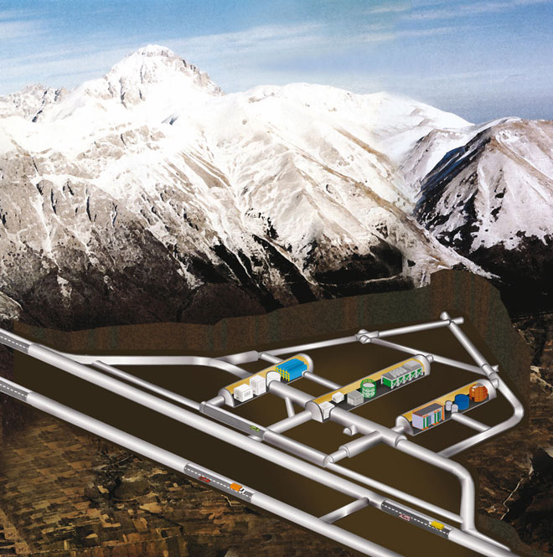

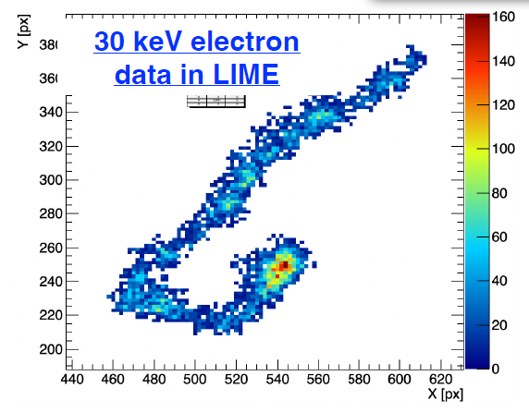
From Underground to Space
He⁺⁺ recoil
From Nuclear Recoils
Dark Matter on nuclei
To Electron Recoils
X-rays on atoms

Slide 14
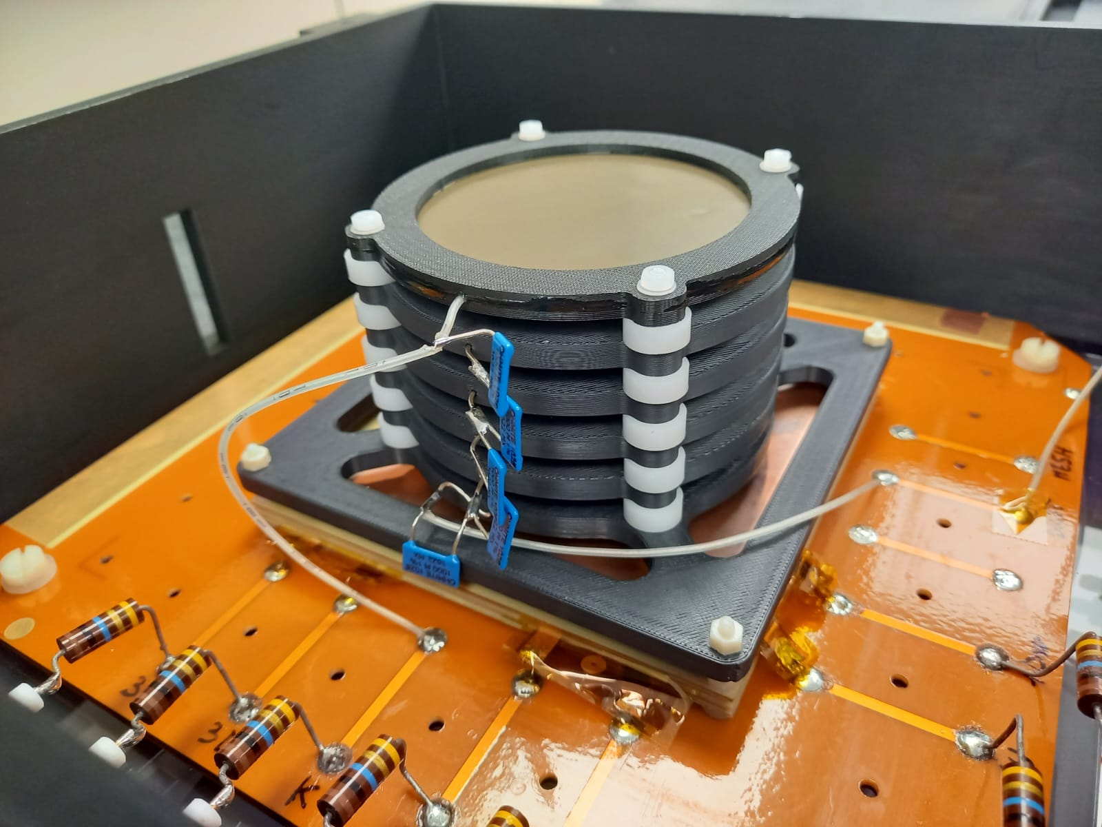
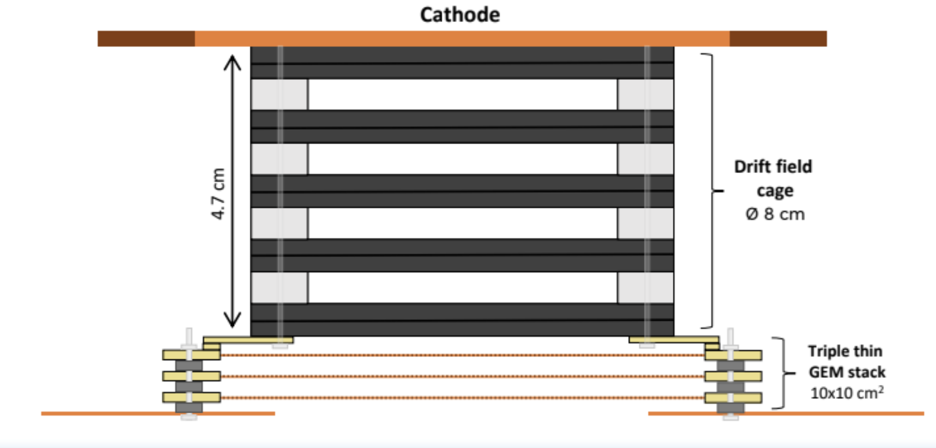
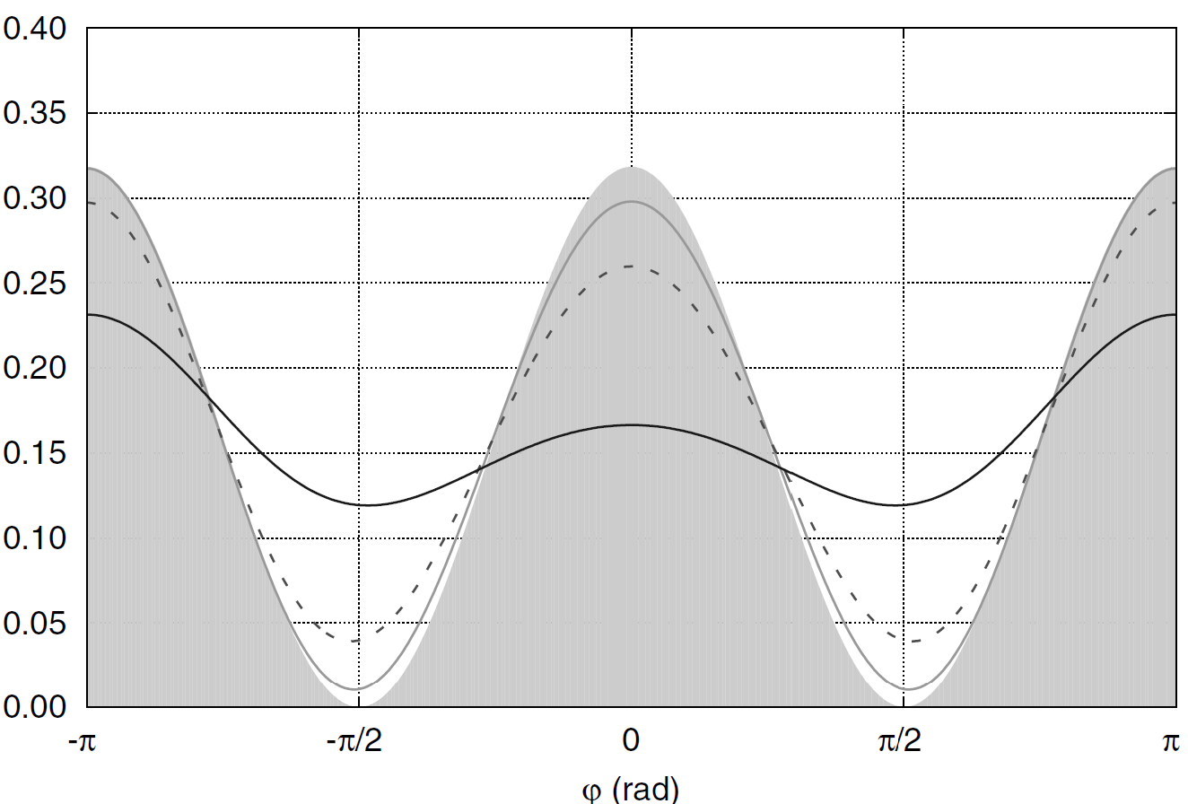
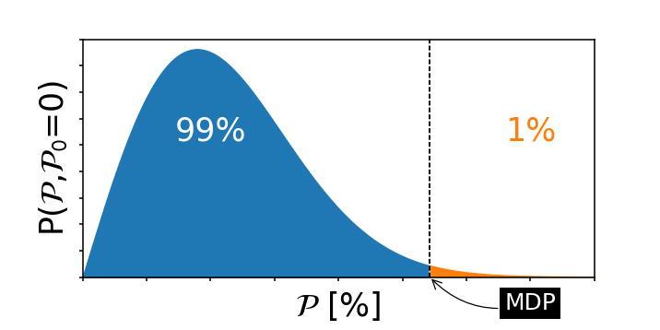

Angular resolution Estimation
Measure the Angular Resolution of our detector to electron
  Collimated 90Sr shooting perpendicularly to the GEM surface (and readout plane)
  2D tracking (possibility to have 3D in future) and energy measurement
Measure the performance of a triple-GEM TPC optically readout for polarimetry in the range [10,50] keV
  Infer the expected modulation factor µ → detector response to a fully polarized source
  Deduce the expected figure-of-merit µ√ε → modulation factor weighted for the efficiency. Related to Minimum Detectable Polarization
Source Position
The modulation factor is the ‘efficiency’ of detecting fully polarized photons
The MDP is the maximum polarization that we
expect to measure with a probability of 99% when the true polarization is zero
N=Flux×efficiency

Slide 15
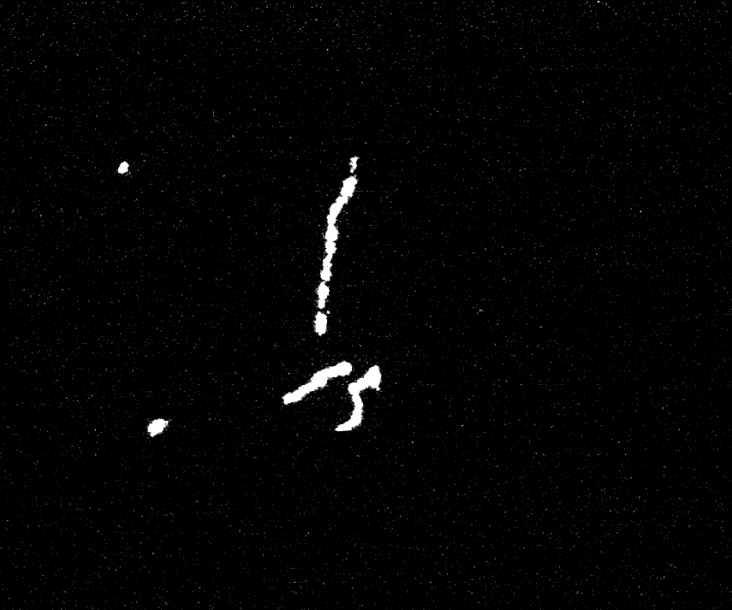
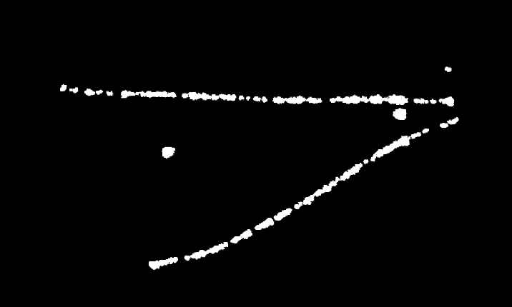
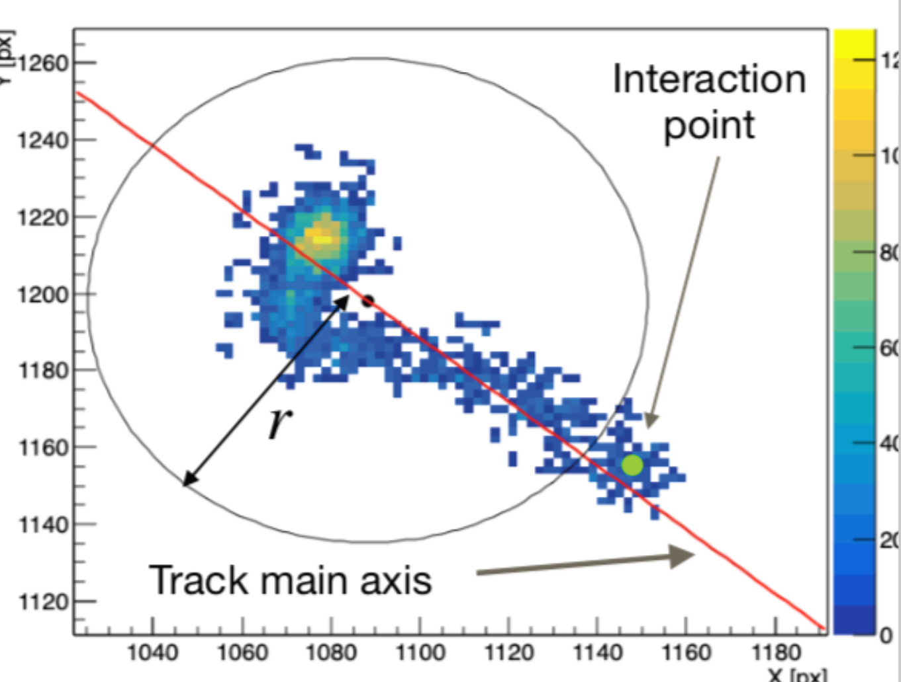
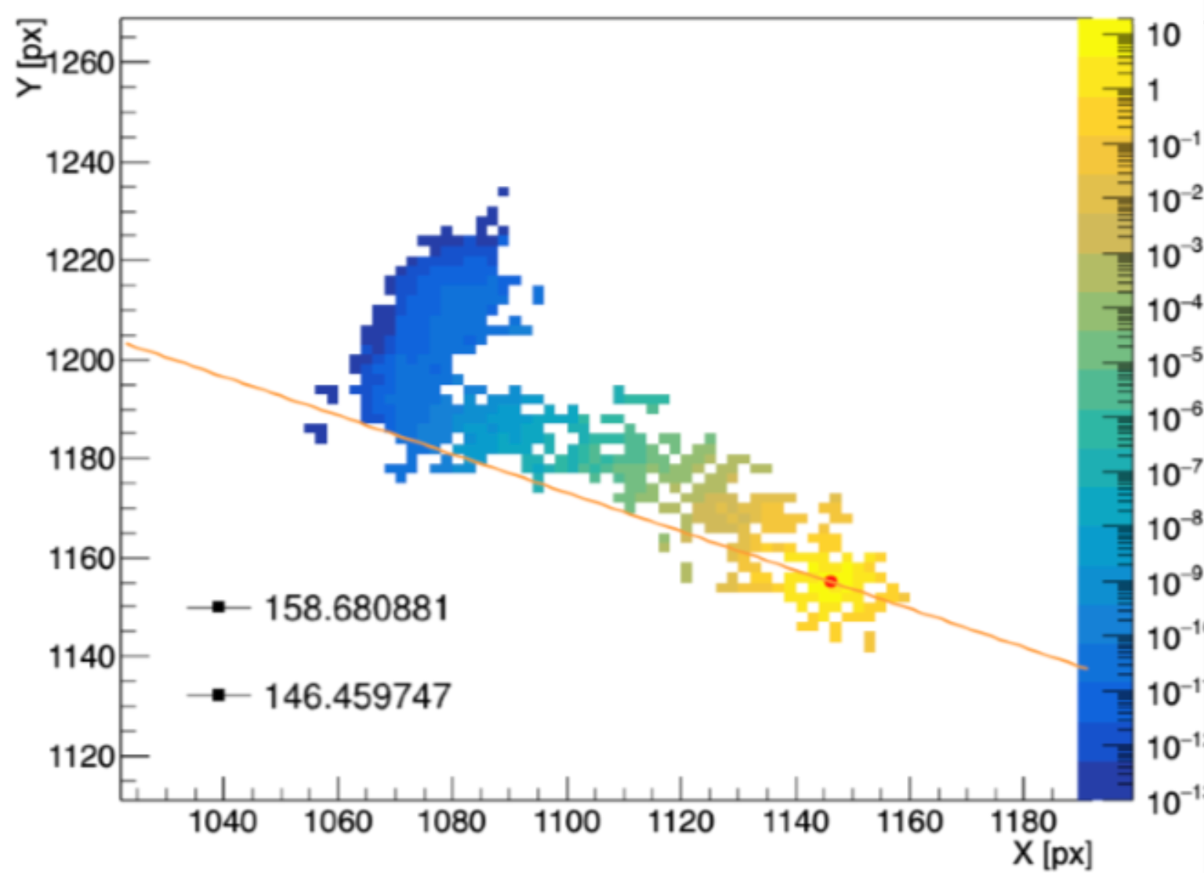
Reconstruction and Direction
Tracks reconstructed with the actual reconstruction code used by the CYGNO collaboration
Low energy electrons <10keV dominated by diffusion in the GEM, limited directionality
e- track
Source Position
8keV photons
5.9keV photons
Source Direction
Compton/photoelectric form 22keV/80keV
-Journal of Instrumentation 15, T12003
-Measurement Science and Technology 34, 125024
8keV photons
The directionality algorithm is inspired from IXPE:
Optimized for our energy range
New strategies under evaluation
Astroparticle Physics 133, 102628 (2021)
[2408.03760] Feasibility of a directional solar neutrino measurement with the CYGNO/INITIUM experiment

Slide 16
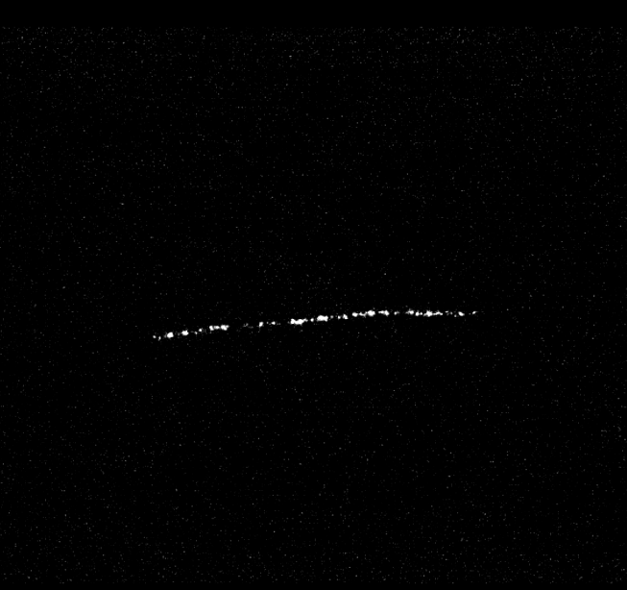



Angular resolution measurement
Detector:
He(Ar)/CF₄
6cm drift gap 1kV/cm
Triple GEM 420V each electron gain several 10⁵
2.5kV/cm transfer filed
GEM3 Bottom is the anode
Readout:
Hamamatsu ORCA QUEST
Exposure time 300 ms
Raw data
After reco
e- track
5.9keV photons
From ⁹⁰Sr
Selection of interesting pixels
Separation of different tracks
Energy estimation
Directional algorithm inspired by IXPE’s one
Determination of impact point
Determination of sense of direction
Fit weighted on distance from impact point
Determination of direction

Slide 17
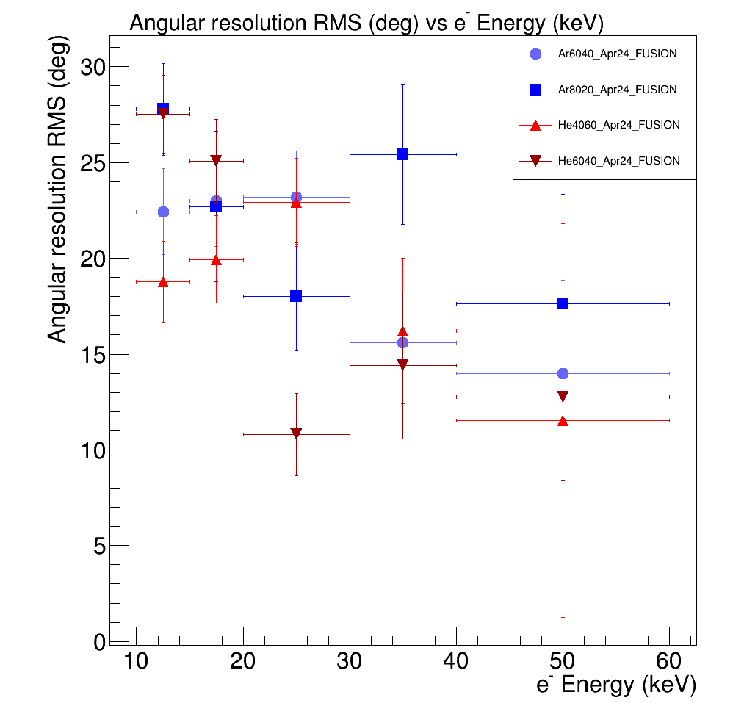
Angular resolution measurement
Detector:
He(Ar)/CF₄
6cm drift gap 1kV/cm
Triple GEM 420V each electron gain several 10⁵
2.5kV/cm transfer filed
GEM3 Bottom is the anode
Readout:
Hamamatsu ORCA QUEST
Exposure time 300 ms
Raw data
After reco
e- track
5.9keV photons
From ⁹⁰Sr
Selection of interesting pixels
Separation of different tracks
Energy estimation
Directional algorithm inspired by IXPE’s one
Angular resolution from 30° to 10°
No strong dependence on the gas used
Determination of impact point
Determination of sense of direction
Fit weighted on distance from impact point
Determination of direction

Slide 18
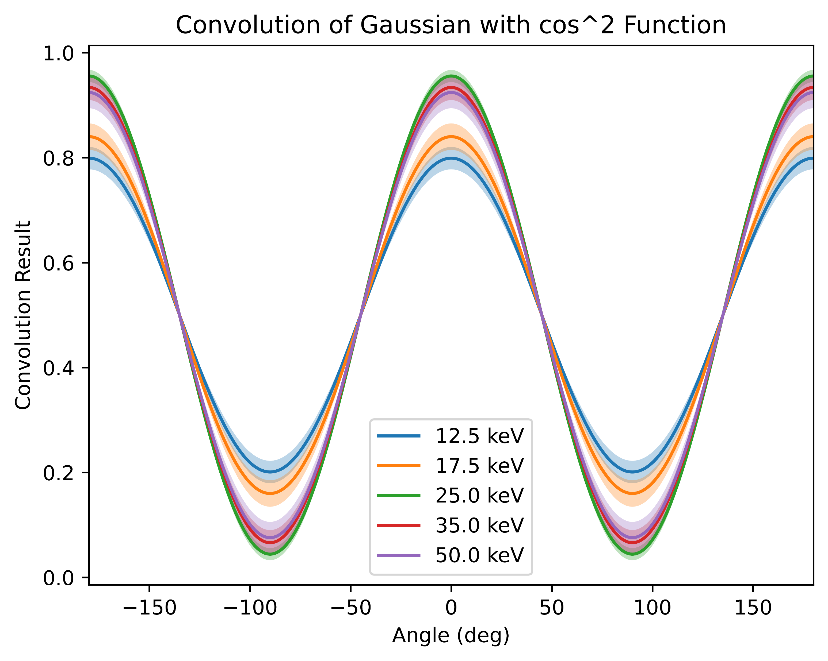
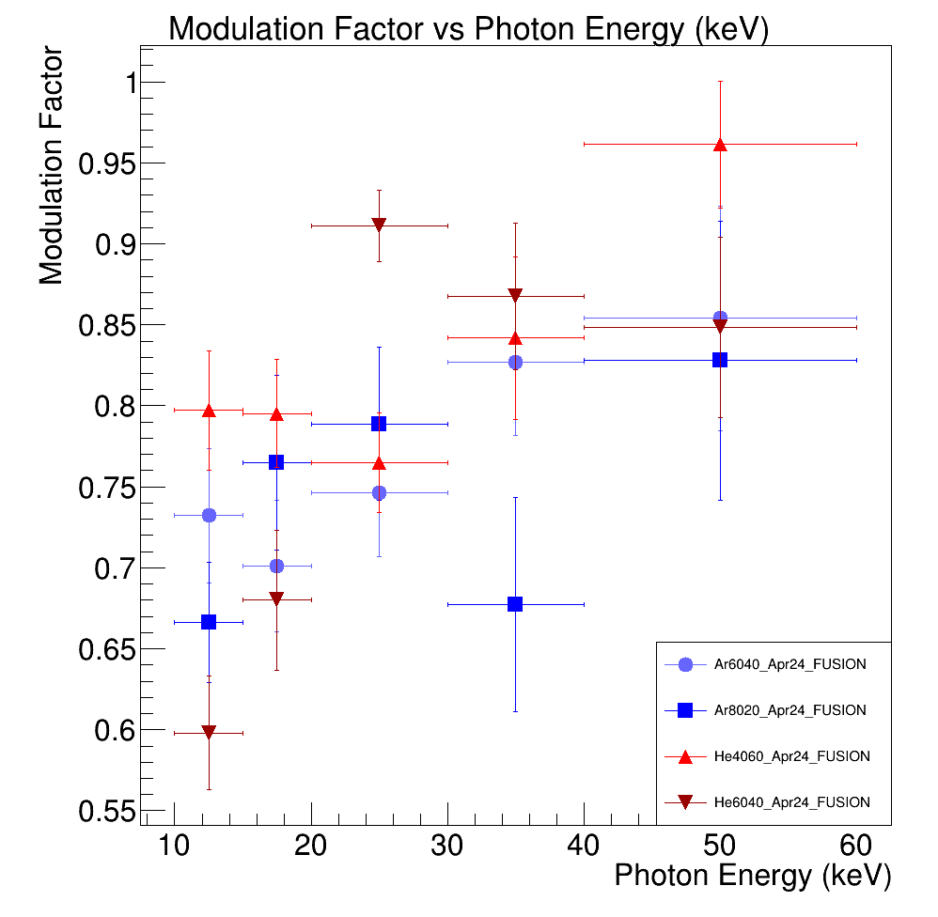

Modulation factors and efficiencies
Could we just convolve the gaussian resolution with a cos² function and get the modulation?
Very good results!
BUT
Not a measurement
Controversy in the community if this is a ‘’legal move’’

Slide 19
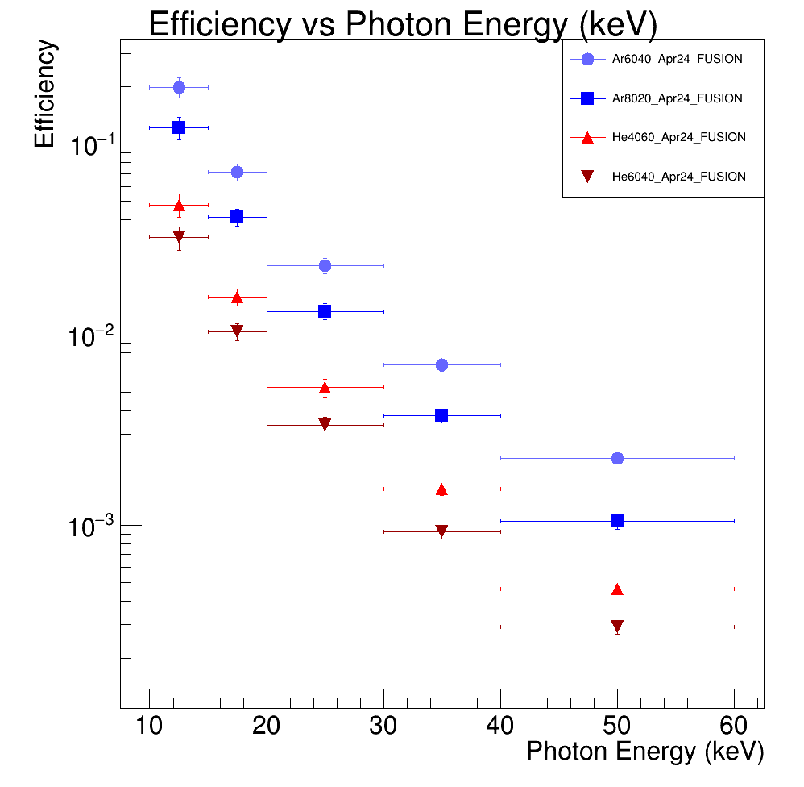
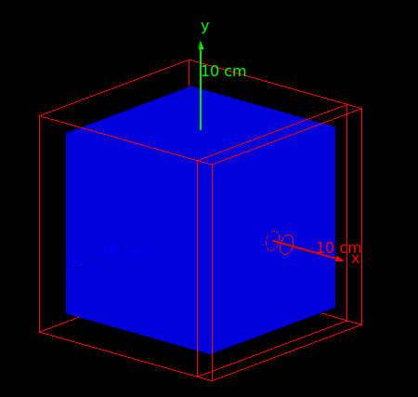
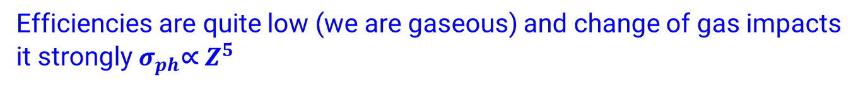
Modulation factors and efficiencies
Could we just convolve the gaussian resolution with a cos² function and get the modulation?
Very good results!
BUT
Not a measurement
Controversy in the community if this is a ‘’legal move’’
Geant4 simulation to estimate the efficiency to photons
→ Fully contained photoelectron in a 10 cm side cube
Efficiencies are quite low (we are gaseous) and change of gas impacts it strongly $σ_{ph}\text{∝} Z^{5}$

Slide 20
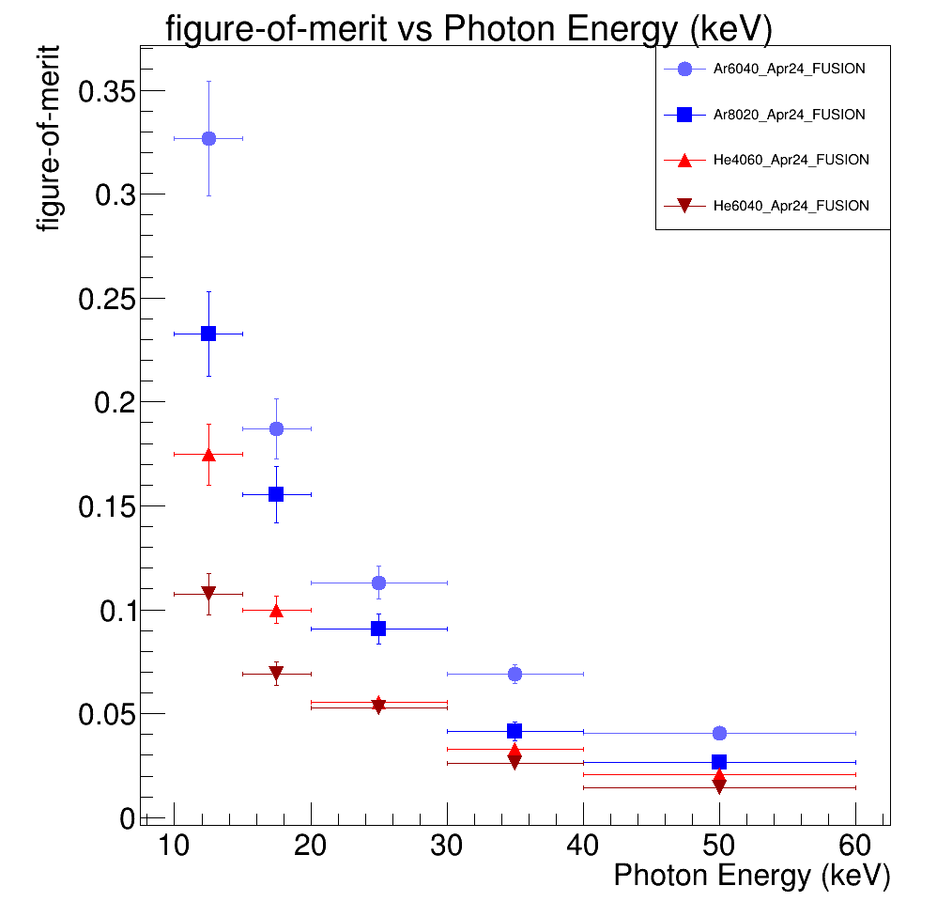
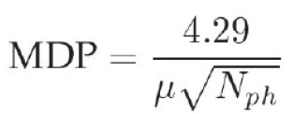
Figure-of-merit
When no measurements are available, the Minimum Detectable Polarisation (MDP) can describe how well you expect your detector to be
Square root of Efficiency multiplied by modulation factor 𝝁√𝜺 is a valid parameter for goodness of detector
With negligible background
IXPE values:
0.11 @ 2.6 keV
0.074 @6.4 keV
Our value are in the ballpark.
This does not mean we are similarly good
Measure modulation!

Slide 21
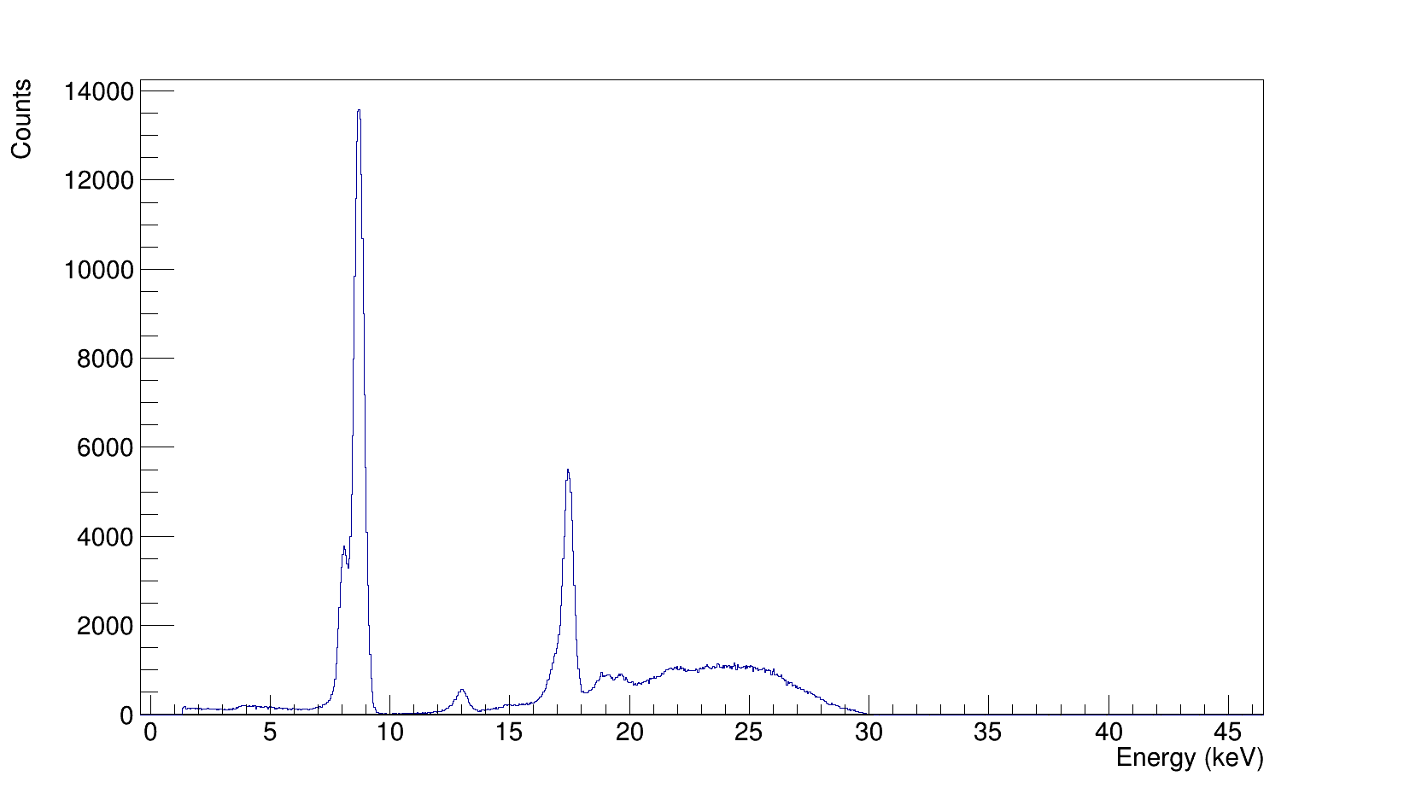
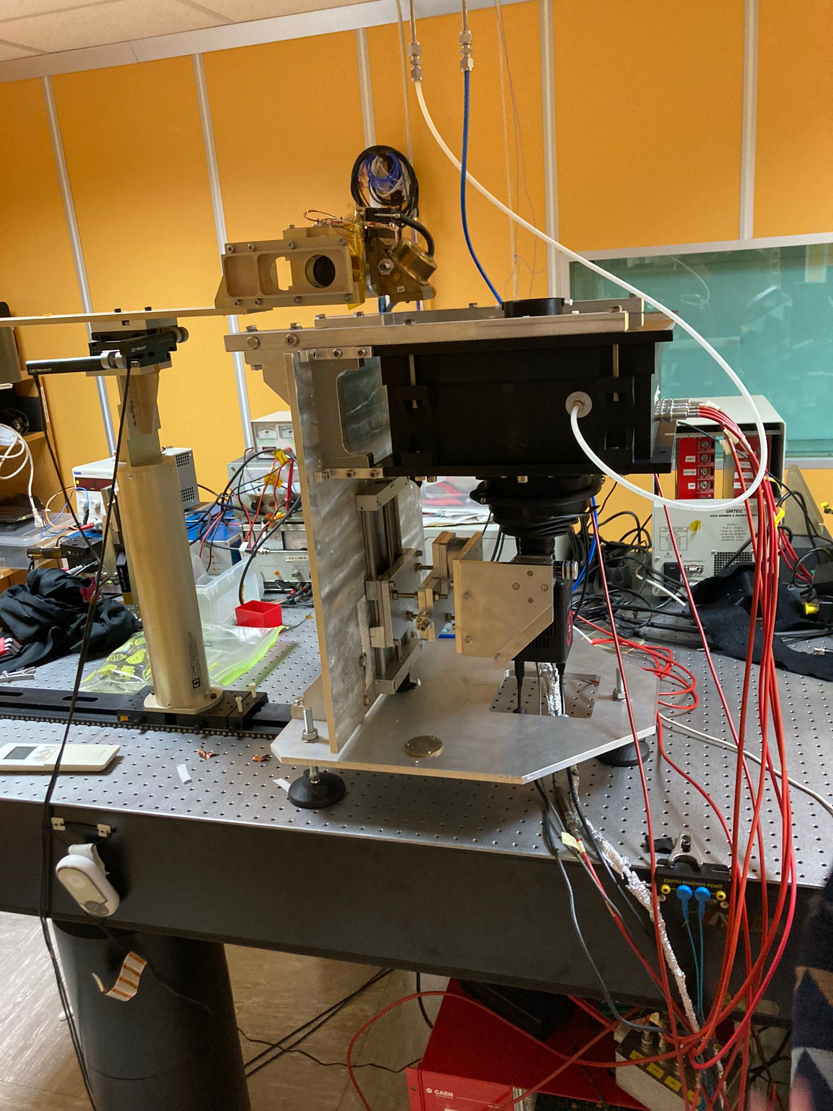
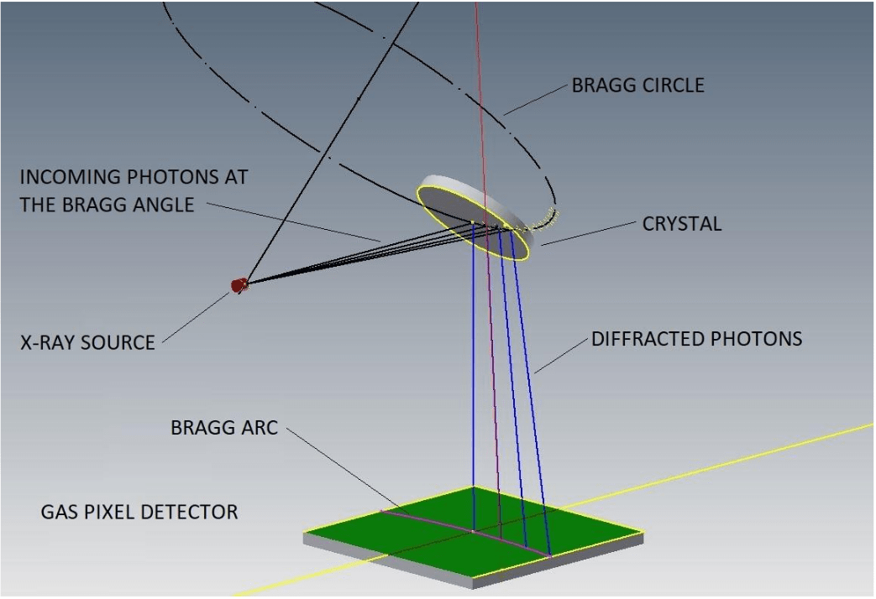
Polarized Source Measurements
8.7 keV
X-ray tube
Diffractor crystal
8.1 keV Cu K_{α}
Collimator
17.4 keV
4.3 keV
Completely absorbed by Cu
Gas volume
13 keV
Almost completely absorbed by Cu (K_{edge} =8.9 keV)
Bremsstrahlung bump
Camera and lens
X-ray tube powered at 30 kV with tens of microamperes to adjust flux
Molybdenum target K_{α} emission 17.4 keV (λ = 0.7107 A°)
Bragg diffractor crystal of LiF (800)
reflects @ 45° λ_{Mo} and integer multiples with 100% polarization
Polarized energies: 4.3, 8.7, 13, 17.4 keV
Using a copper 35um cathode was not a smart move, but we learned from that!

Slide 22
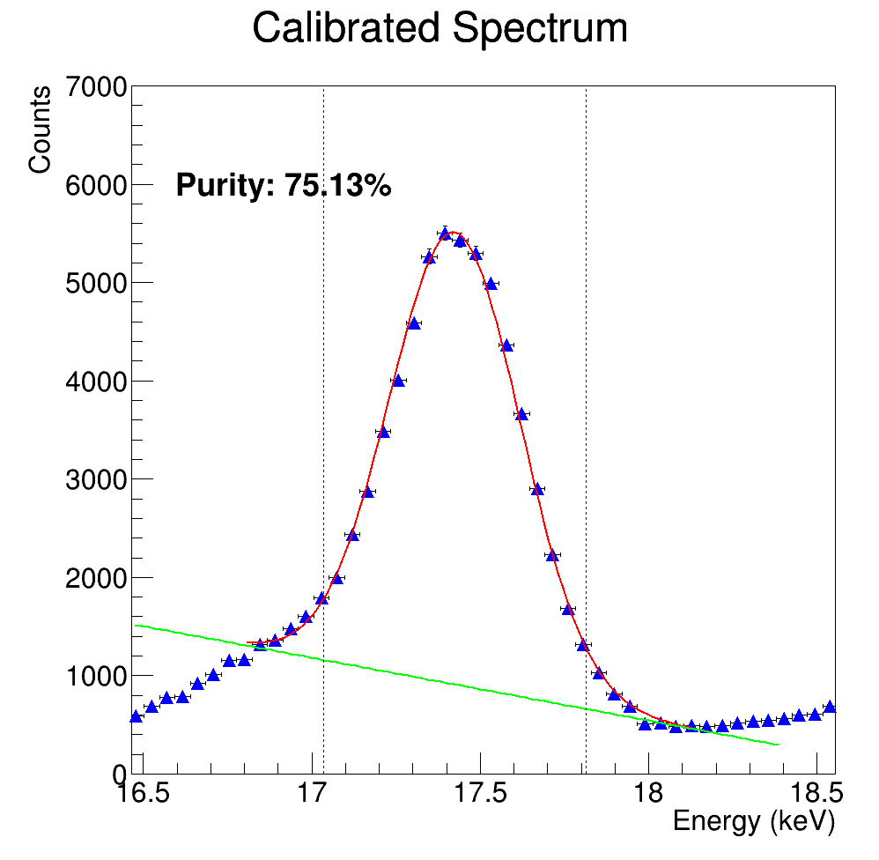
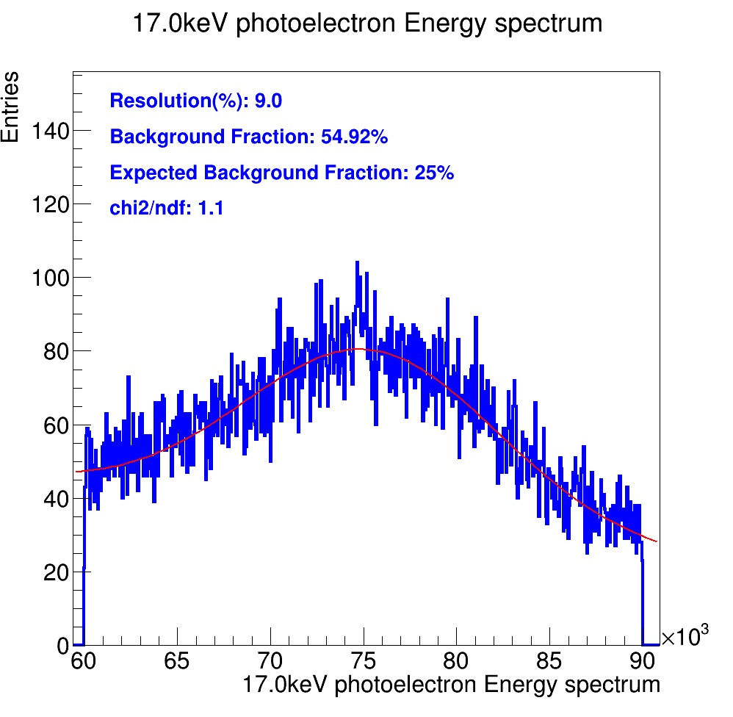


Polarized Source Measurements
Energy spectrum calibrated with ⁵⁵Fe (5.9 keV) and ¹⁰⁹Cd (22 and 80 keV) sources.
Selection of events in energy range of interest but some background is present (purity of the line estimation from CdTe spectrum)
He/CF₄ 60/40
ORCA Fusion
Simple trapezoidal method
(can be improved)
Measured 17.4 keV peak
First ever modulation measured with our detector
Half of our prediction with angular resolution
Large background to be removed.
→Can definetely improve
Preliminary sensitivity also to 8.7 keV modulation!

Slide 23


Improvement
Data analysis and Readout
Reduction of pile-up and background
  Better selection strategies
  Reduction of exposure 200ms → 10ms
  Argon has a reduced compton cross section
Improved Camera
  QUEST has a factor 2 lower noise than FUSION
  Better lens EHD with larger aperture→ more light
Data taken!
To be analyzed

Slide 24


Improvement
Data analysis and Readout
Reduction of pile-up and background
  Better selection strategies
  Reduction of exposure 200ms → 10ms
  Argon has a reduced compton cross section
Improved Camera
  QUEST has a factor 2 lower noise than FUSION
  Better lens EHD with larger aperture→ more light
Data to be analyzed
Data reduction
Large amount of data from the 8 Mpixel camera when only a fraction contain information
Fast preprocessing could shrink data output of 100 times
In line with CYGNO needs

Slide 25



Improvement
Data analysis and Readout
Reduction of pile-up and background
  Better selection strategies
  Reduction of exposure 200ms → 10ms
  Argon has a reduced compton cross section
Improved Camera
  QUEST has a factor 2 lower noise than FUSION
  Better lens EHD with larger aperture→ more light
Data to be analyzed
Data reduction
Large amount of data from the 8 Mpixel camera when only a fraction contain information
Fast preprocessing could shrink data output of 100 times
In line with CYGNO needs
Tweak amplification stage
Reducing the intrinsic diffusion will improve tracking
New camera and lens collect more light
Found new ways to enhance light yield
Amplification can be milder.. Reduce GEM number?
Negative ion drift to reduce diffusion could also help
ED
NID
Negative Ion Drift

Slide 26

Conclusions
Among various missions, IXPE has provided an incredible amount of information measuring polarization in the 2-8 keV range
HypeX aims to improve the detection technique for the measurement of the polarization of X-rays via the photoelectric effect
GPD3D shows strong potential to extend standard GPD capabilities
The X-ray CMOS subproject inherits the detector concept from the CYGNO experiment and adapts it to image and detect X-ray polarization in the range 10-50 keV with a large area and field of view concept
Early measurement yields promising results, but the way though space is still long

