Slide 1
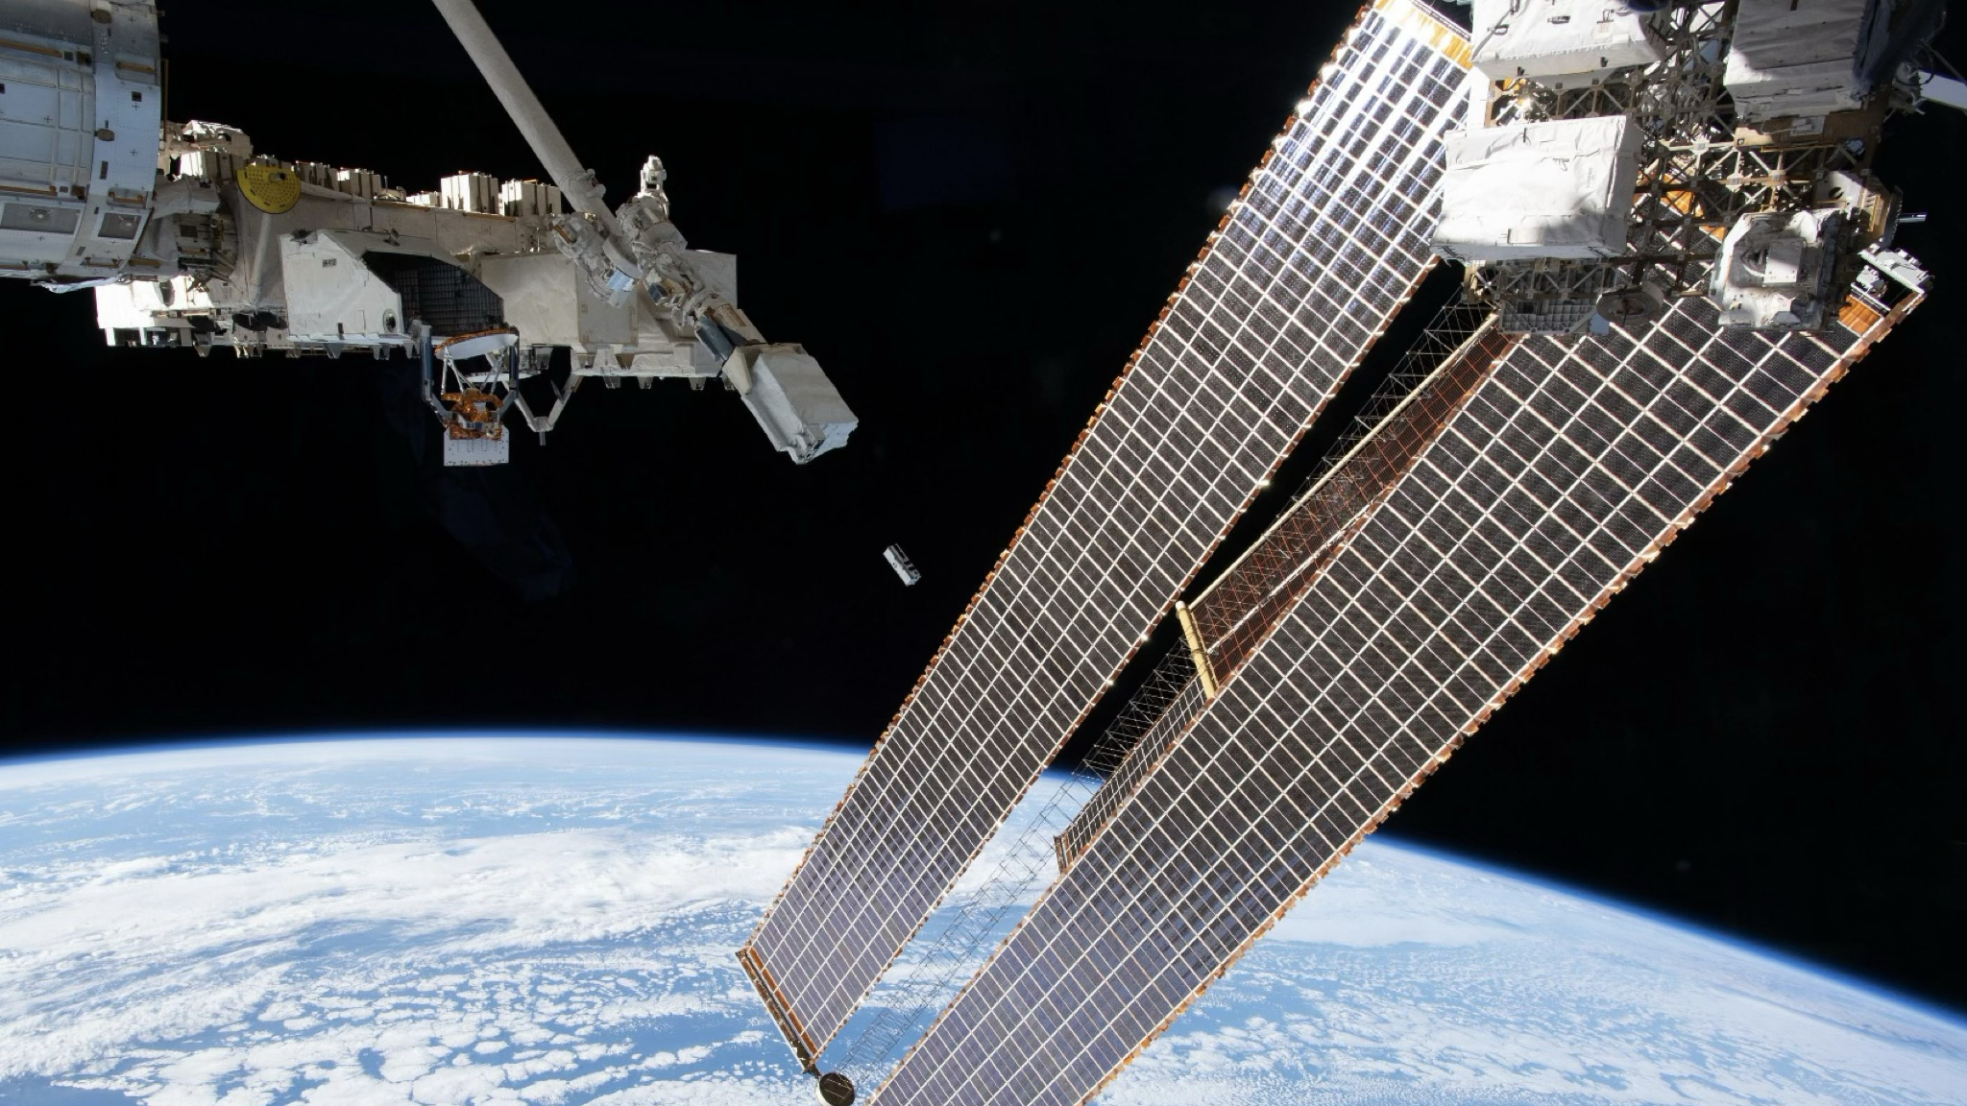

What's between the payload and the data?
Adriano Di Giovanni, FiXP Academy, April 7-11, GSSI

Slide 2
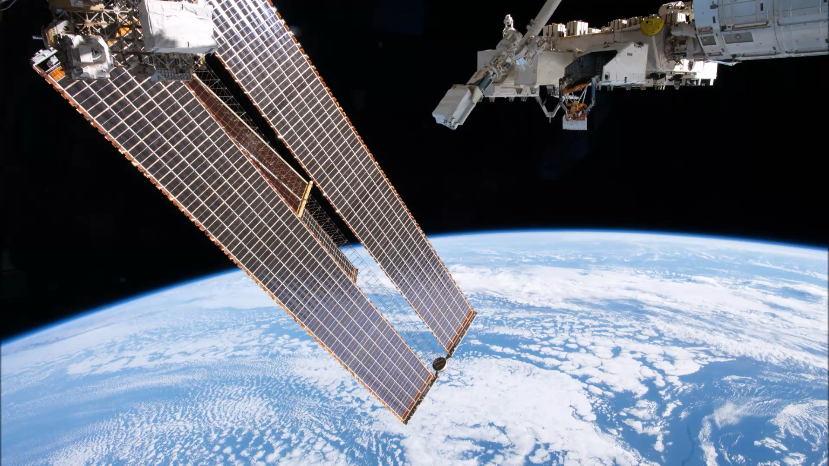

Slide 3

Outline
A space mission storyline
Technology Readiness Level
Mission/Model Phylosophy
Brutal Environments
Mission Analysis
Mission Budgets
Design
Environmental Testing
Project Management

Slide 4
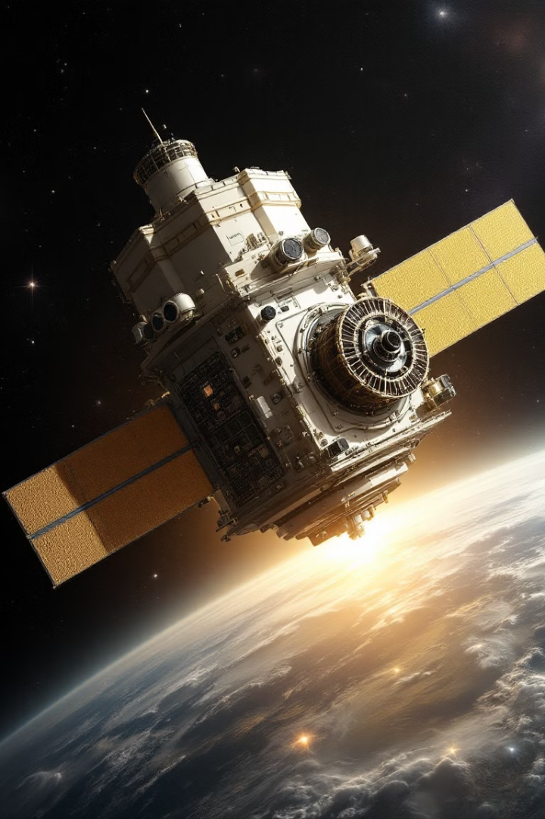
A space mission storyline
Every scientific space mission starts with an idea.
The idea requires a technology
The tecnology requires a design
The design is tailored around the mission requirements
The system analyses validate the design
The design becomes an instrument (Hardware+Software)
The instrument gets qualified and eventually accepted
The instrument gets integrated in the spacecraft
The spacecraft hardware gets validated, its functionality tested
The spacecraft is embarked and launched
The scientific mission starts (BoL) and ends (EoL)
The satellite shall re-enter with no casualties on its path

Slide 5
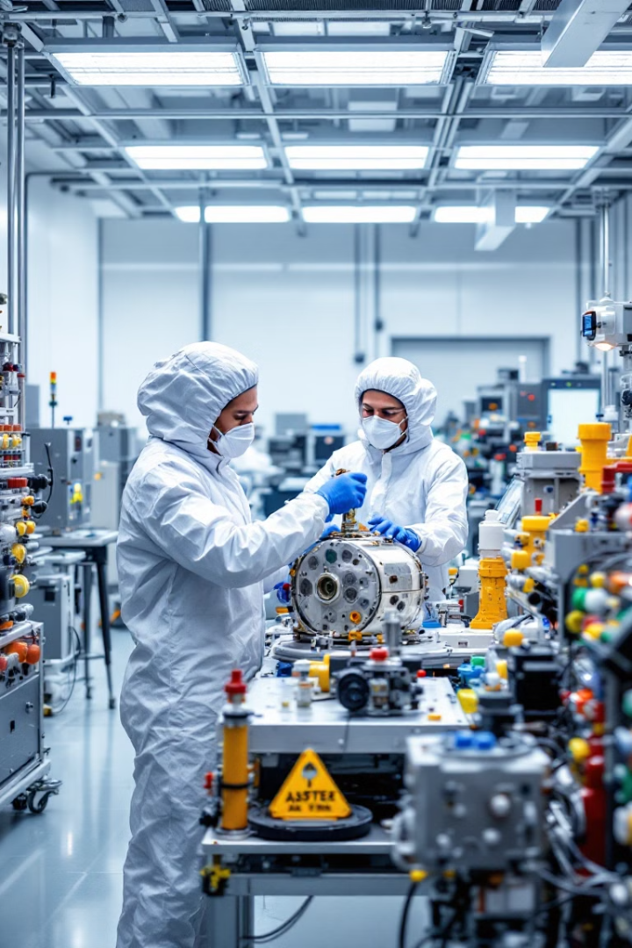
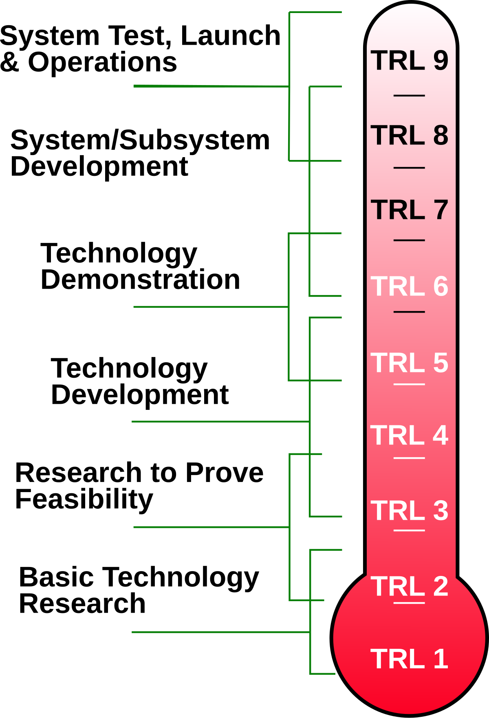
Technology Readiness Level
Technology Readiness Level (TRL)
It is a standardized scale used to assess the maturity of a particular technology before it is deployed in a space mission.
It ranges from TRL 1 (basic idea) to TRL 9 (fully flight-proven system).
Adriano’s Golden Rule N.1: a space mission is not the right place for hostingan R&D

Slide 6
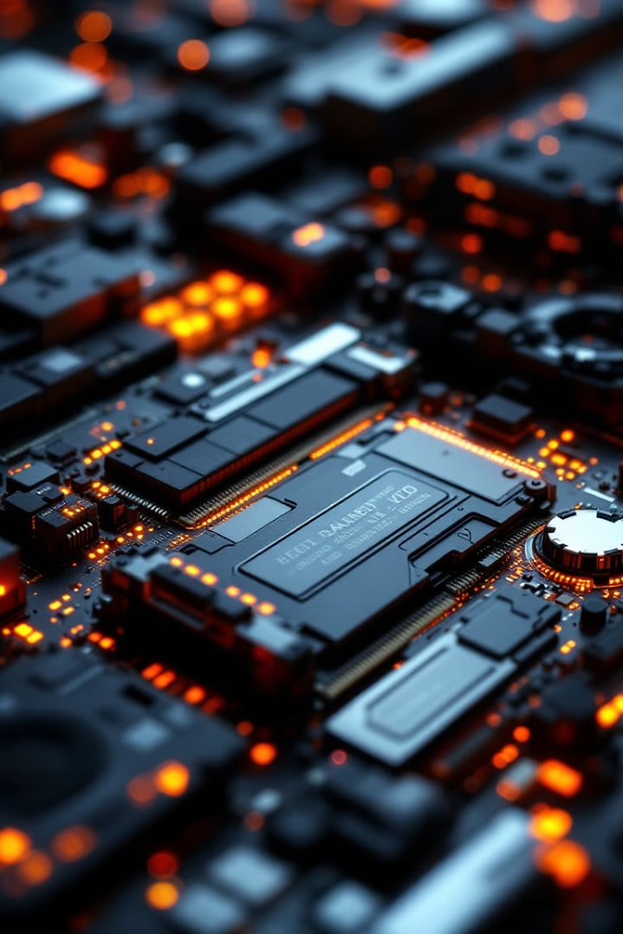




Technology Readiness Level
Space Mission Model Philosophy: Key Development Milestones (light version)
Mission Concept Review (MCR)
Initial mission feasibility assessment and requirements definition
Preliminary Design Review (PDR)
Validation of conceptual design and system architecture
Critical Design Review (CDR)
Finalization of detailed design and technical readiness confirmation
Flight Readiness Review (FRR)
Final verification of mission preparedness before launch
Model progression flows from Structural/Thermal Model (STM) through Engineering Qualification Model (EQM) to Proto-Flight Model (PFM).
Adriano’s Golden Rule N.2: 1 kg of payload corresponds to 1 kg of paperwork

Slide 7
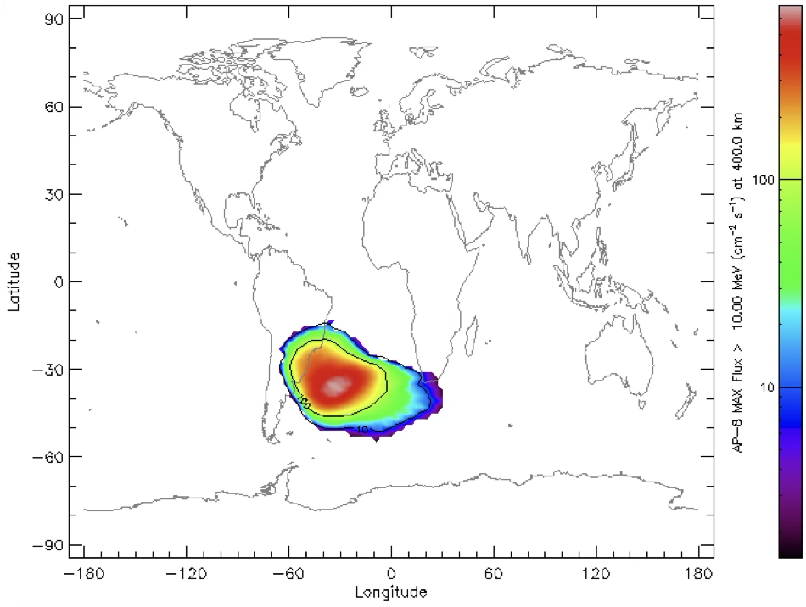
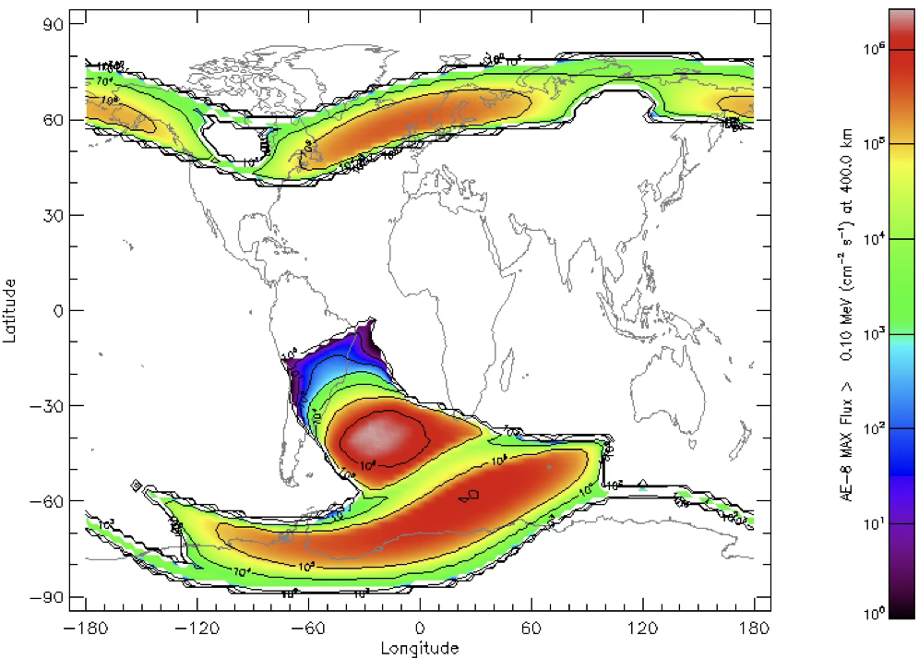
Radiation Hardness for Satellite Missions
Space is harsh for electronic components, with radiation posing one of the most significant threats to satellite mission success.
Satellites must endure years of exposure to high-energy particles and cosmic radiation that can degrade or damage critical systems.
Trapped protons
Trapped Electrons
Particle Flux by SPENVIS (free tool by ESA) using AP-8 & AE-8 Rad Belt models (LEO, 535 km altitude, 2025-2028)

Slide 8
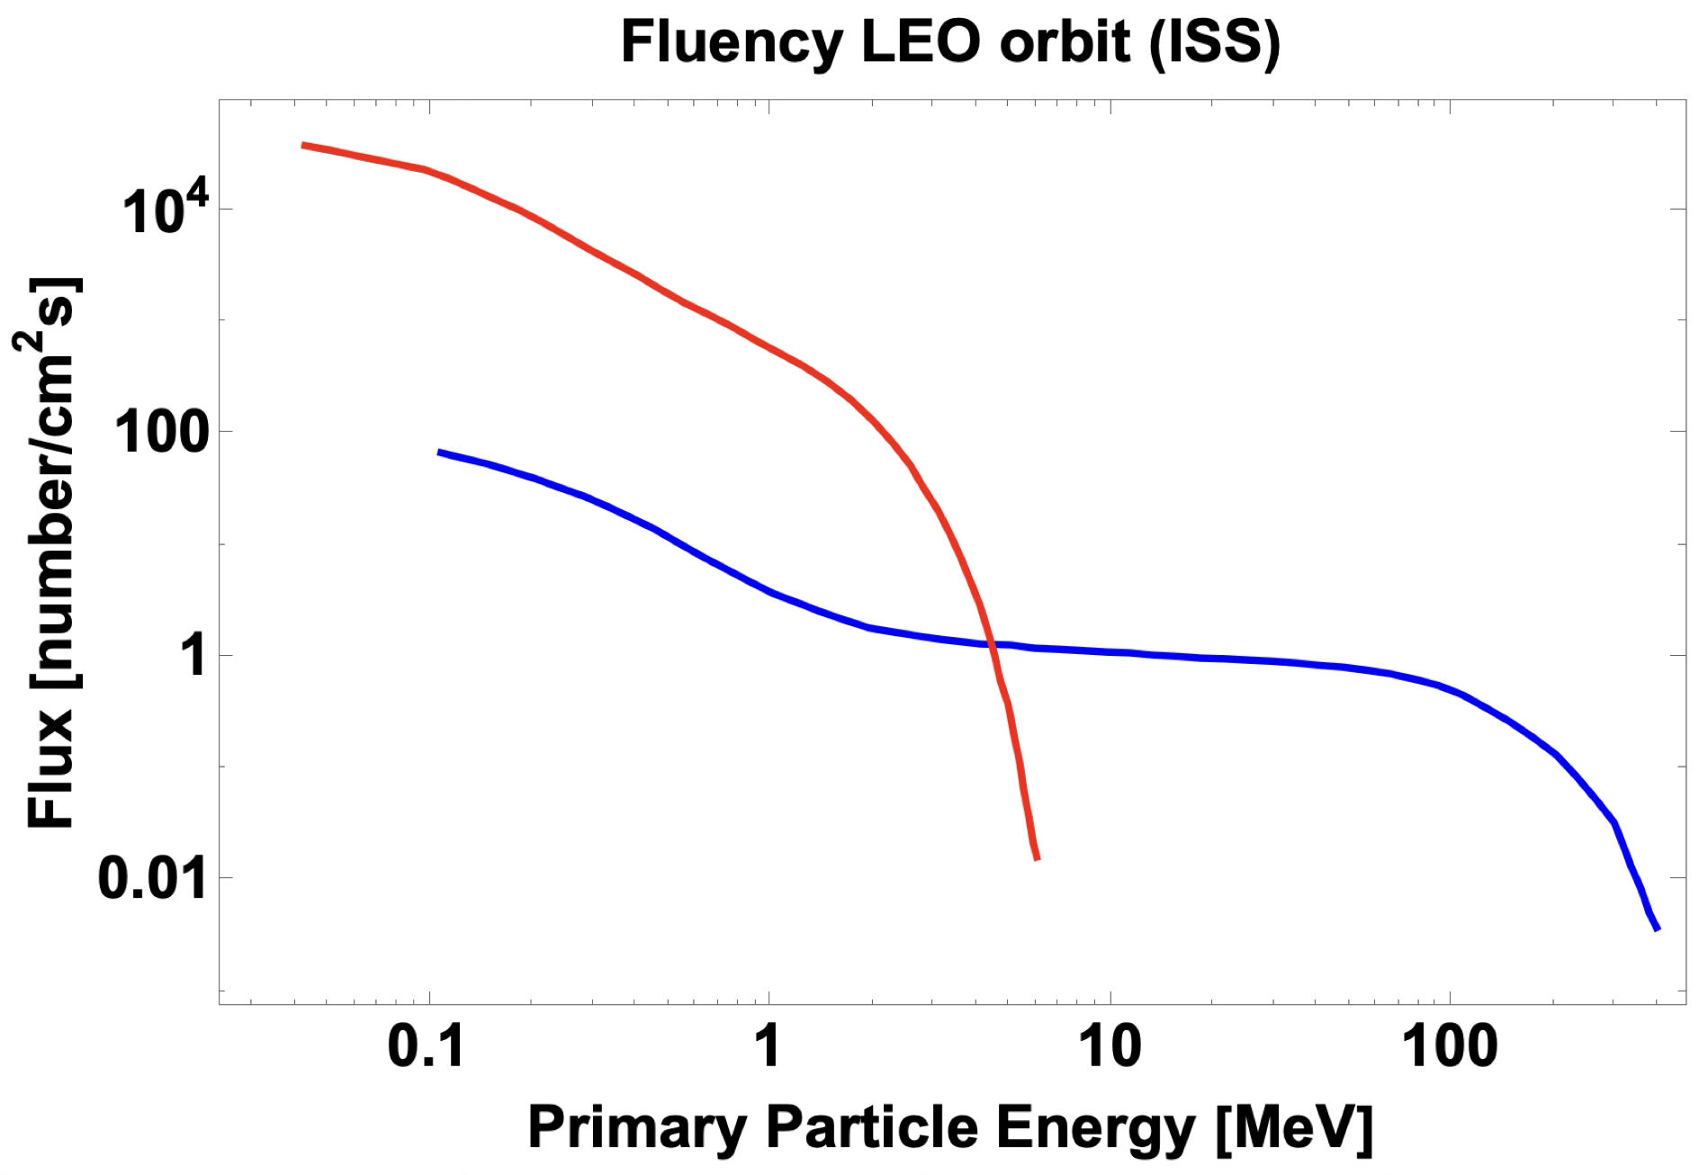
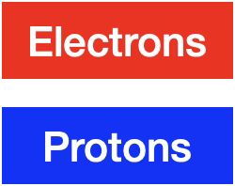
Radiation Hardness for Satellite Missions
Particle Flux by SPENVIS (free tool by ESA) using AP-8 & AE-8 Rad Belt models (LEO, 535 km altitude, 2025-2028)

Slide 9
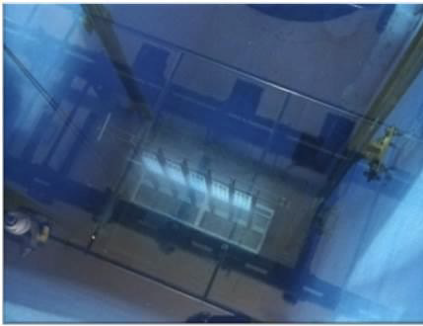
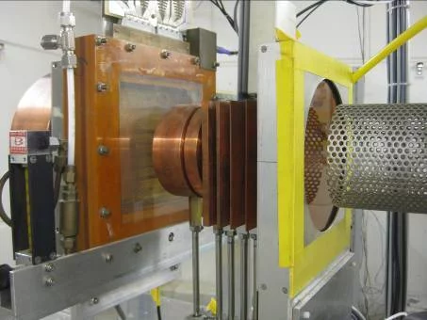
Radiation Hardness for Satellite Missions
Two primary test methodologies—Total Ionizing Dose (TID) and Single Event Effects (SEE)—evaluate how components respond to different radiation challenges encountered in orbit.
TID, ENEA-Calliope, ⁶⁰Co (1.173 MeV and 1.332 MeV)
Activity: 1.08 X 10¹⁵ Bq, as of Today
SEE, Proton Irradiation Facility (PIF-Zurich),
74 MeV – 100 MeV – 150 MeV – 200 MeV - 230 MeV protons
Max Flux (230 MeV, 2x10⁹ protons s⁻¹cm⁻²
These specialized tests simulate years of space radiation exposure, allowing engineers to identify vulnerabilities and implement appropriate countermeasures before a satellite ever leaves Earth's atmosphere.

Slide 10
Total Ionizing Dose (TID) Testing
Step ID | Operation | TID rate (rad/h) | TID step (rad) | Time
#1 | Arrival at the facility and set up of the DUT (Device Under Test) | N/A | 0 | 2h
#2 | First irradiation cycle | 100 rad/h | 400 | 4h
#3 | Functional test | N/A | N/A | 2h
#4 | Second irradiation cycle | 100 rad/h | 800 | 4h
#5 | Functional test | N/A | N/A | 2h
#6 | Night cycle | 50 rad/h | 1200 | 8h
#7 | Third irradiation cycle | 100 rad/h | 1600 | 4h
#8 | Functional test | N/A | N/A | 2h
#9 | Fourth irradiation cycle | 100 rad/h | 2000 | 4h
#10 | Functional test | N/A | N/A | 2h
Parameter Monitoring
Parameter Monitoring
Parameter Monitoring
Parameter Monitoring
Parameter Monitoring
Radiation
Exposure
Threshold
Identification
According to ESCC-22900 (European Space Components Coordination 22900), TID is followed by a room temperature annealing (24 h + Parameter Monitoring), and by a 100 °C annealing in a controlled environment (168 h + Parameter Monitoring).

Slide 11
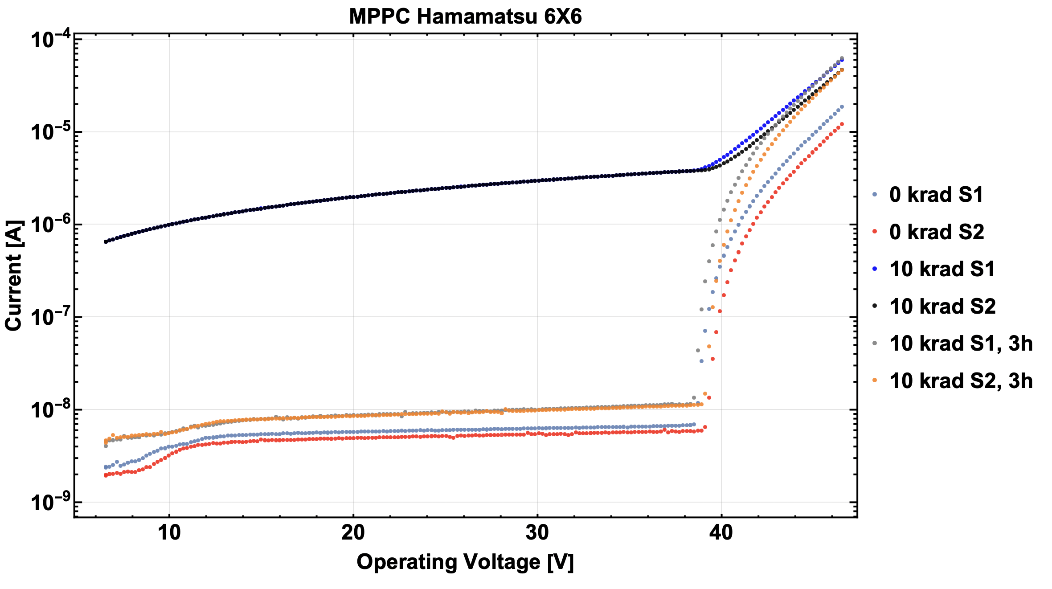
Effect of 10 krad on Silicon Photomultipliers (SiPM)

Slide 12
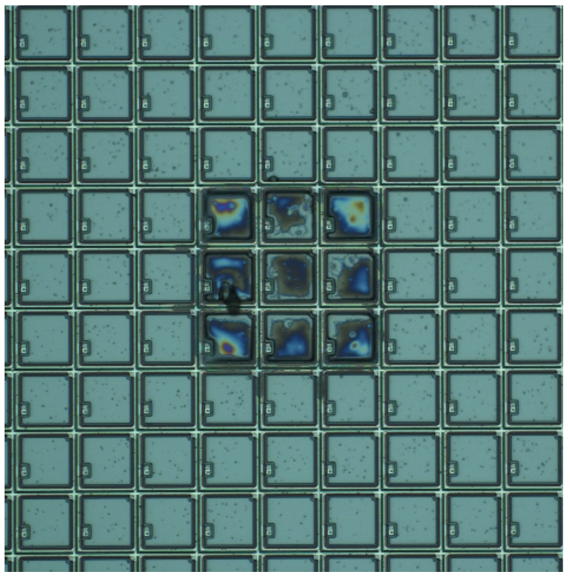
Single Event Effects (SEE) Testing
Testing typically uses linear accelerators (mostly medical facilities) to generate particle beams (protons, neutrons, heavy ions) that simulate cosmic rays and solar particles encountered in space.
Single Event Transient (SET)
Temporary voltage spikes in analog circuits and digital signals that can propagate through the system
Single Event Upset (SEU)
Bit flips in memory cells or registers without permanent damage to hardware
Single Event Latchup (SEL)
Dangerous high-current states that can cause permanent component damage if not quickly mitigated
When a high-energy particle penetrates a semiconductor, it creates an ionization track that can deposit sufficient charge to change memory states, trigger parasitic structures, or even cause destructive burnout in power devices.

Slide 13
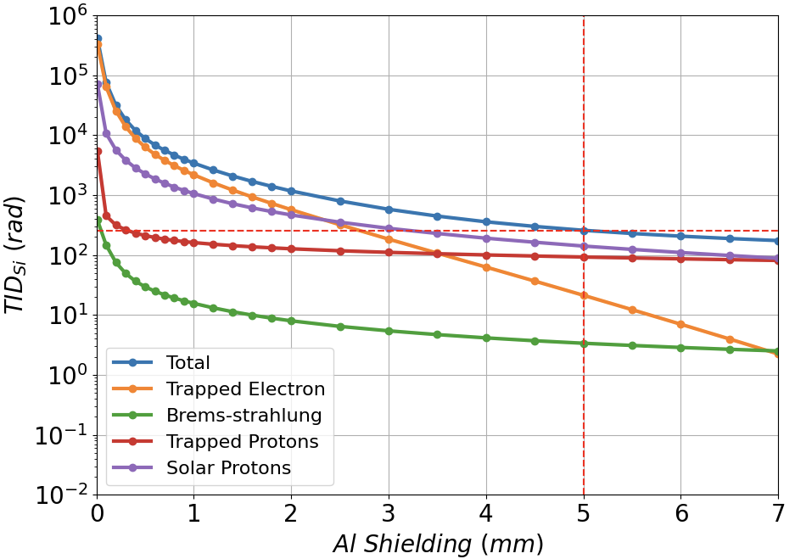
Radiation effects: mitigation strategies
Option1: increase material shielding thickness
(almost no effect above 5 mm Al equivalent).
Calculated with SPENVIS (LEO, 535 km altitude, 2025-2028)
Option 2: use radiation tolerant (or with space heritage in similar missions) electronic components.
Option 3: implement redundance
Option 1 has a direct impact on mass budget
Option 2 has a direct impact on costs (up to x100)
Option 3 has a direct impact on electronic design
Adriano’s Golden Rule N.3: there is no room for ”ideal” in space, it is always matter of optimization and trade-off

Slide 14
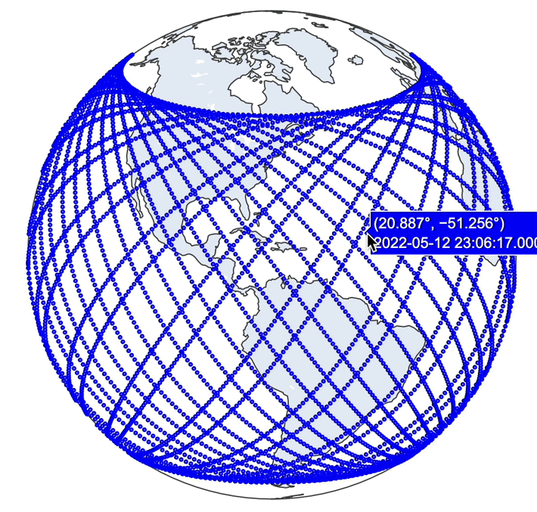
Satellite Mission Systems Analysis: a definition from ESA
‘Mission analysis’ is the analysis of satellite orbits to determine how best to achieve the objectives of a space mission. This is performed during the entire definition, development and preparation phases of each project.
Orbit Analysis: Trajectory Simulation
Power and Thermal Budget
Comm/Down Link Budget
On-Orbit Mission Planning
Mass and Configuration
Modeling
Since October 2023, all missions must comply with the requirement ESSB-ST-U-004 (0-debris policy). Potential showstopper.
Debris and Re-entry
Analysis

Slide 15

Orbit Analysis: Trajectory Simulation
Initial Orbit Determination
High-fidelity numerical integration of equations of motion with perturbation effects (it depends on the Launcher In-Orbit injection)
Computational Modeling
Precise calculation of orbital elements using Keplerian parameters and reference frames (Ansys, STK and other software)
Environmental Influence
Accounting for gravitational harmonics, atmospheric drag, and solar radiation pressure (in general time dependent, unforeseeable events accounted as the worst ever happened)
Position Prediction
Advanced algorithms for long-term orbit prediction and station-keeping maneuvers (it is in general time-based (Epoch), using TLE, Two-Line Element for Earth Orbiting spacecrafts)
This is a highly predictive task, mostly based on classical mechanics and statistics (Impact of debris, orbital correction failures, …)

Slide 16
Power Budget Analysis: P/L power supply and heat generation
 | Ch 1 | Ch 2 | Ch 3 | Ch 4 | Ch 5 | Ch 6 | Ch 7
Voltage Output (V) | 1.00 | 2.20 | 3.70 | 5.00 | 47.00 | 68.00 | 26.00
Current Output (A) | 3.80 | 2.70 | 9.90 | 3.06 | 0.15 | 0.00 | 0.00
Power Output (W) | 3.80 | 5.94 | 36.63 | 15.30 | 7.05 | 0.14 | 0.00
Efficiency | 78.60% | 87.00% | 94.00% | 95.00% | 86.00% | 50.00% | 10.00%
Power dissipation (W) | 1.03 | 0.89 | 2.34 | 0.81 | 1.15 | 0.14 | 0.24
Power Input (W) | 4.83 | 6.83 | 38.97 | 16.11 | 8.20 | 0.27 | 0.30
Current Input @ 12V (A) | 0.40 | 0.57 | 3.25 | 1.34 | 0.68 | 0.02 | 0.03
Total Current Input @12 V tot. (A) | 6.27
Current Input secondary (A) | 1.40
Total Current Input @12V (A) | 7.67
Power (W) | 92.01
Efficiency Conversion | 88.00%
Pin (W) | 104.55
Current Input Satellite @ 56V Vbus (A) | 1.87
Ch1
56 V
12 V
Ch2
Ch3
104,55W
Ch4
92,01W
Ch5
Ch6
Secondary
Ch7

Slide 17
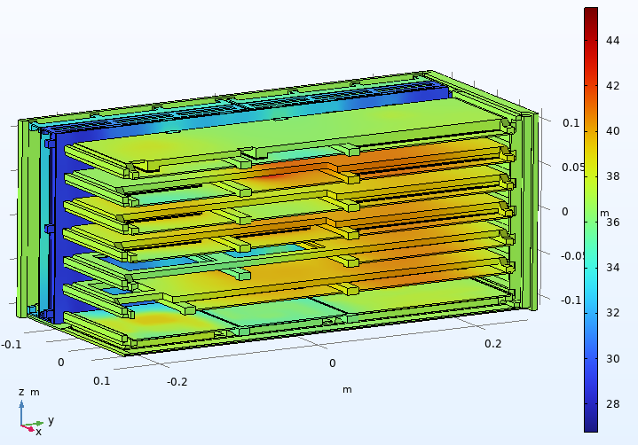
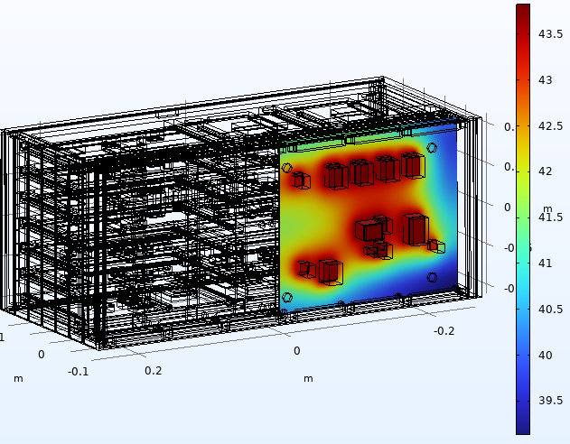
Power and Thermal Budget Overview
Temperature Ranges
Extreme environmental conditions: from Deep Space
to Direct Sun Exposure
Cooling Systems
Radiators, heat pipes, fluid loops (in UHV, Ultra High Vacuum)
Heat Generation
Electronics, instruments, solar radiation
Thermal Protection
MLI (Multi Layer Insulator) blankets, coatings, heaters
Boundary conditions
Definition of contacts between parts, heat flows. All the above
contributes to the definition of the boundaries

Slide 18
An example: Electronics Architecture and Data budget
Field | Number Of Bits | Description
Flags | 4 | 16 possible configurations
EventNumber | 29 | Counter resets after 536870912 ev or 24 h
TimeStamp | 52 | 5 y of mission at 100 ns resolution
DET1 channels | 10 | DET1 ID channel
DET1 HG | 12 | DET1 HG ADC res
DET1 LG | 12 | DET1 LG ADC res
DET2 channels | 8 | DET2 ID channel
DET2 HG | 12 | DET2 HG ADC res
DET2 LG | 12 | DET2 LG ADC res
DET3 channels | 7 | DET3 ID channel
DET3 HG | 12 | DET3 HG ADC res
DET3 LG | 12 | DET3 LG ADC res
DET4 channels | 4 | DET4 ID channel
DET4 HG | 12 | DET4 HG ADC res
DET4 LG | 12 | DET4 LG ADC res
DET5 channels | 5 | DET5 ID channel
DET5 HG | 12 | DET5 HG ADC res
DET5 LG | 12 | DET5 LG ADC res
DET 1
DET 2
DET 3
DET 4
DET 5

Slide 19
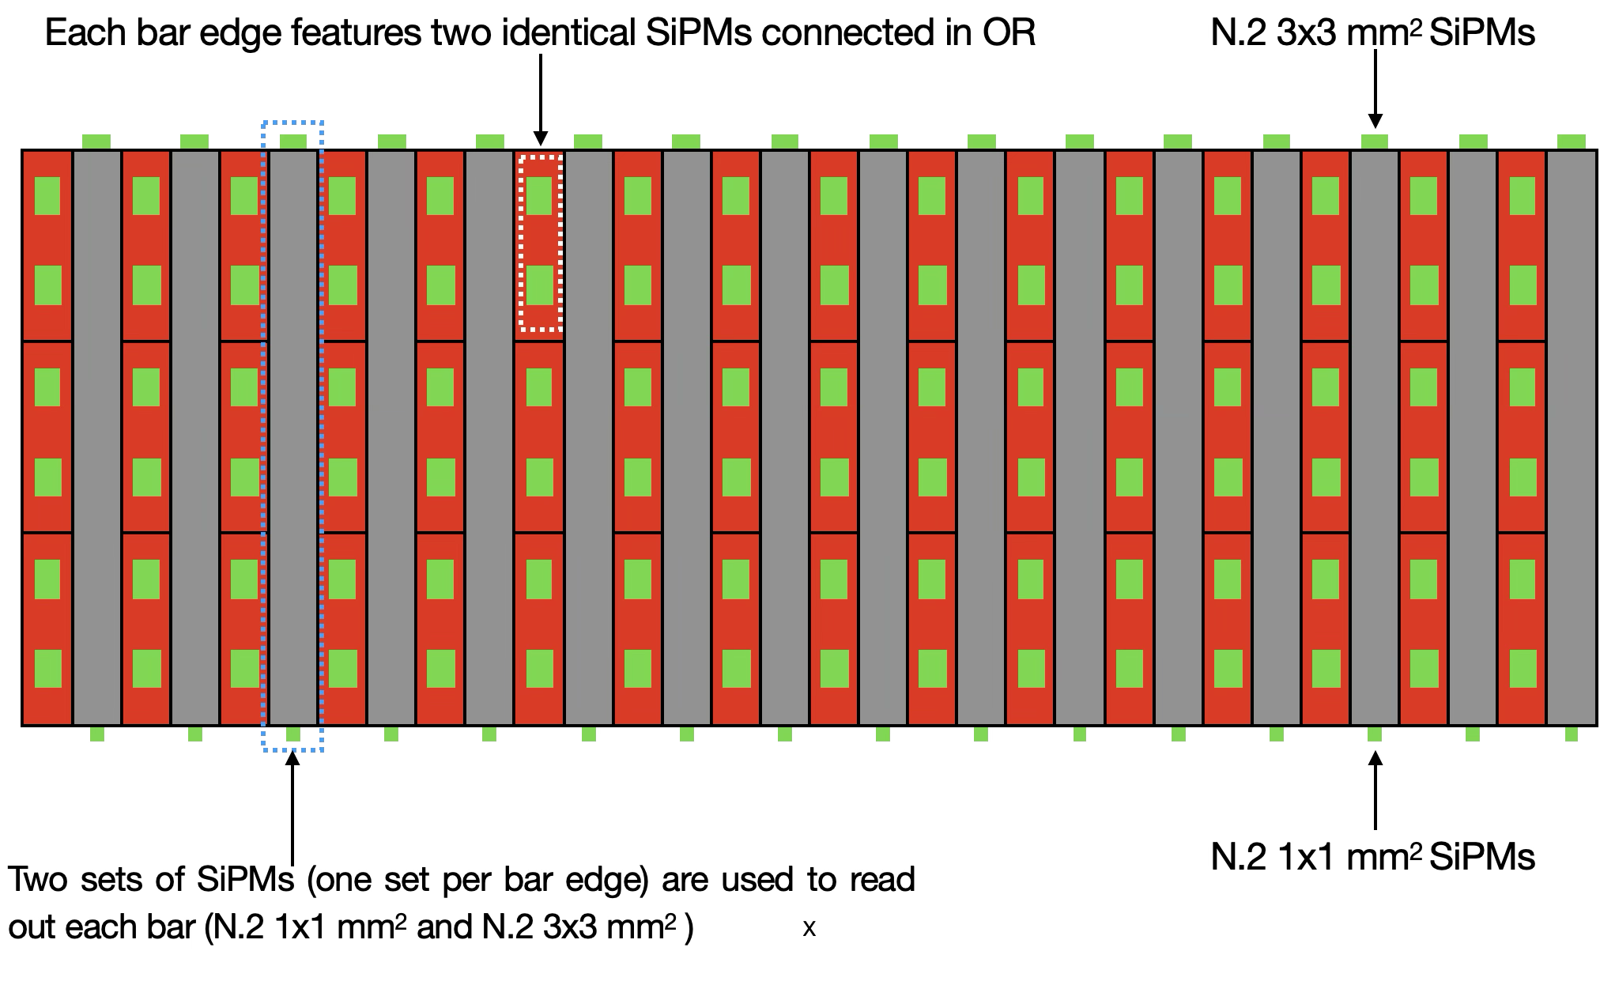
An example: Electronics Architecture and Data budget
DET 2

Slide 20
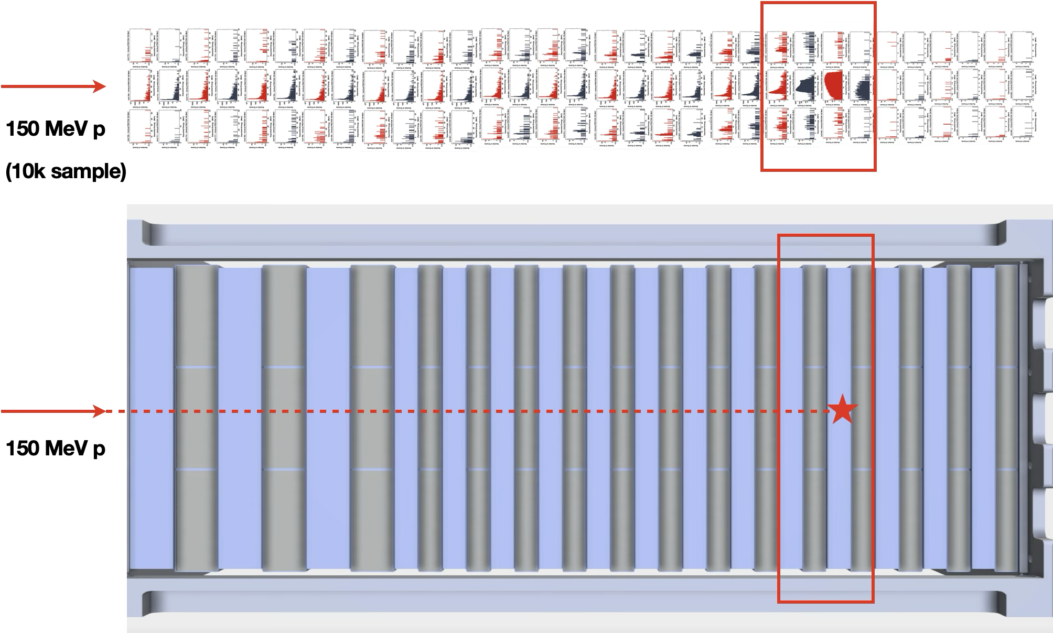
An example: Electronics Architecture and Data budget

Slide 21
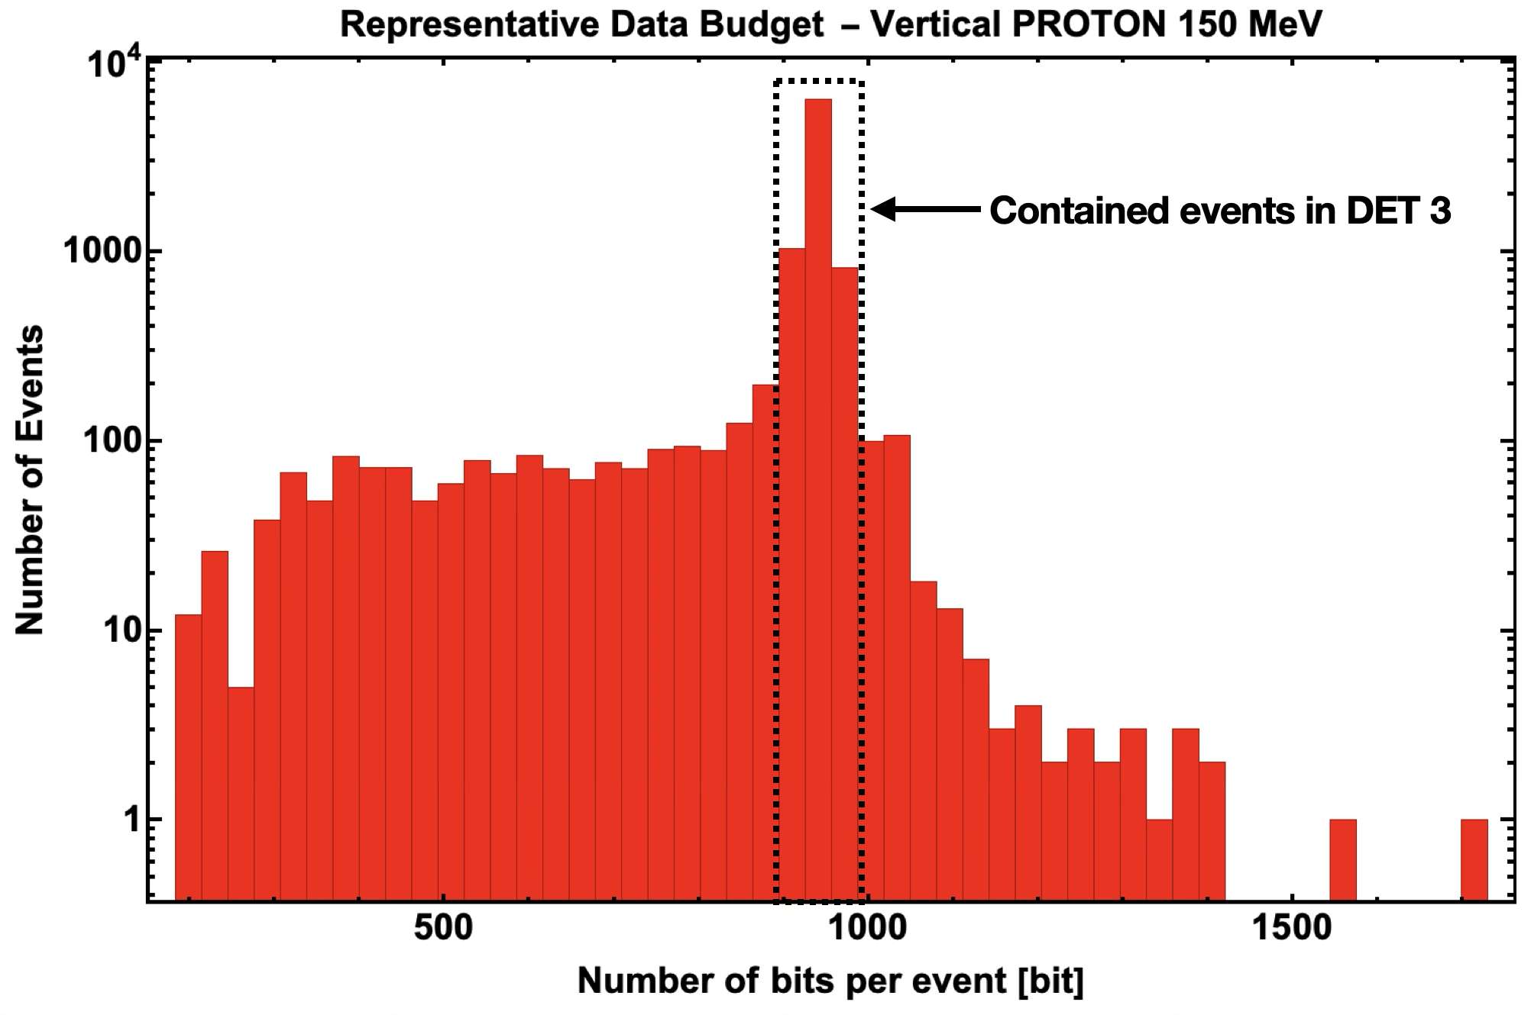
An example: Electronics Architecture and Data budget
DET 1
DET 2
DET 3
DET 4
DET 5

Slide 22
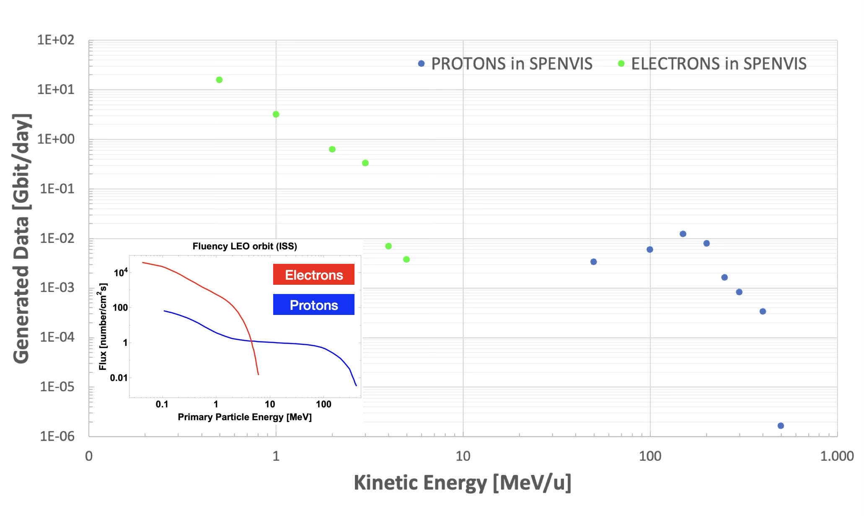
An example: 1 kHz of detected p and e according to SPENVIS model
Estimated generated DATA(SPENVIS only): 19.9 Gbit/day (DC 100%)
HSSL (High Speed Scientific Link) ⍯ House Keeping (VHF/UHF)

Slide 23
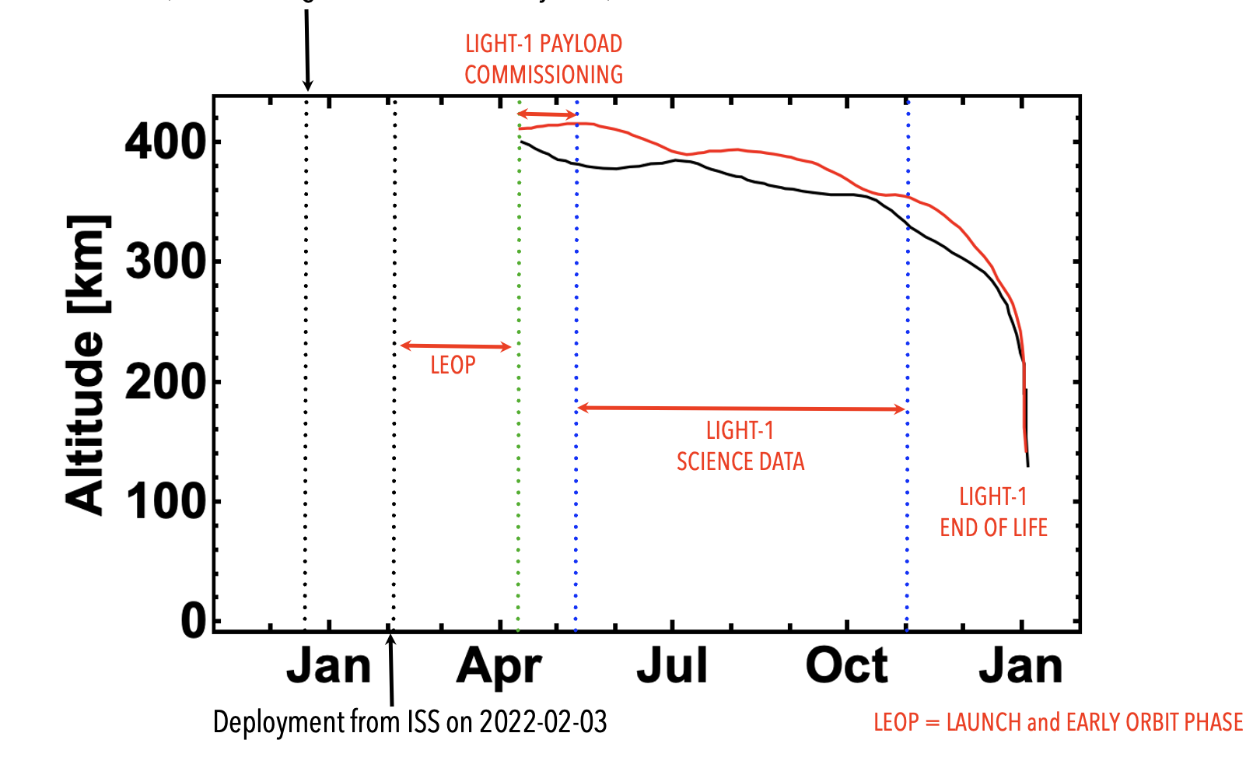
On-Orbit Mission Planning (an example: LIGHT-1 3U CubeSat mission)
SpaceX Launch from Kennedy Space Center on 2021-12-21 (Falcon9/Dragon docked ISS the day after)

Slide 24


Slide 25
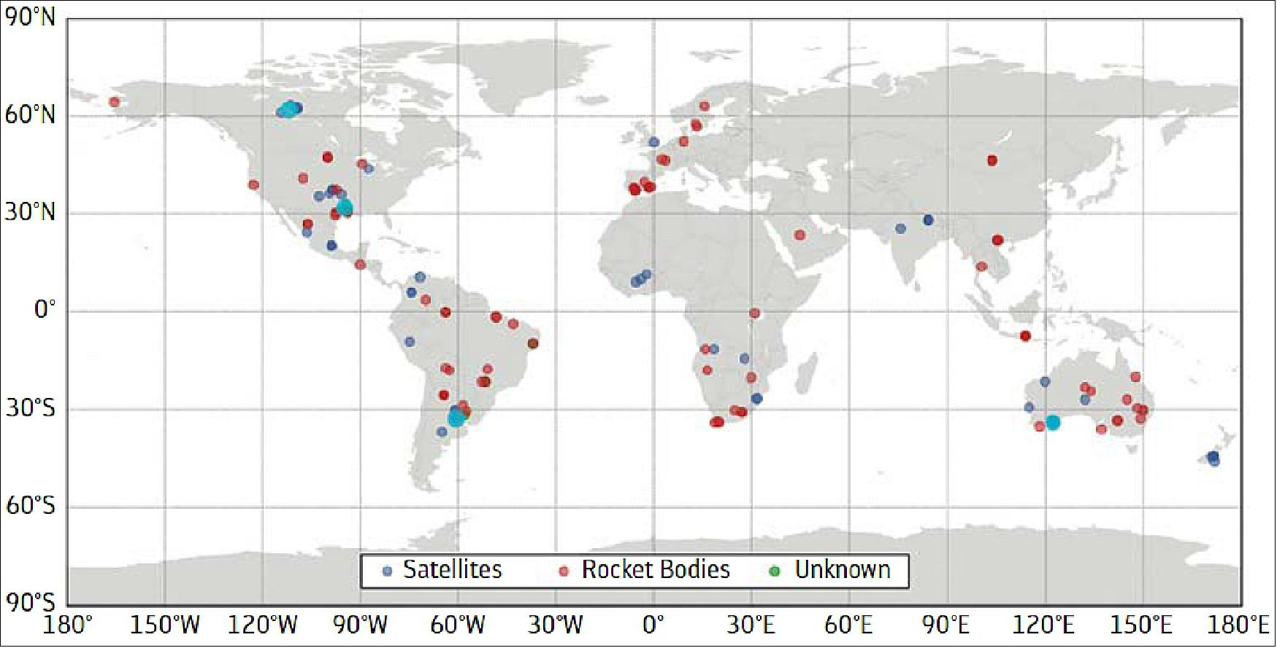
Space Debris and Risk Mitigation
DRAMA (Debris Risk Assessment and Mitigation Analysis) is the reference tool

Slide 26
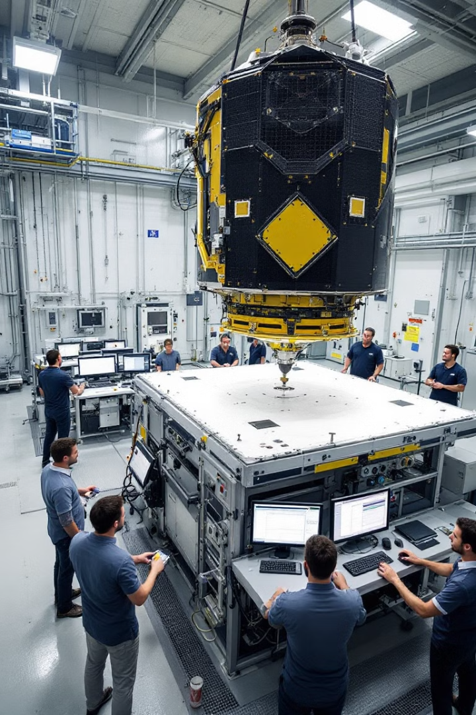
Technology Readiness Level
Before getting into Space …
A series of environmental tests to ensure satellites can withstand extreme launch and space conditions.
Vibration Test
Simulates intense mechanical stresses during rocket launch. Reveals structural weaknesses and loose components.
Pyroshock Test
Evaluates survivability during violent separation events. Tests resilience to brief, high-frequency shock waves.
Thermal Vacuum Test
Replicates extreme temperature cycling in high vacuum conditions. Verifies thermal design and material behavior.
EMC/EMI/ESD Tests
Ensures electronic systems maintain integrity. Validates performance despite electromagnetic interference and discharge events.

Slide 27
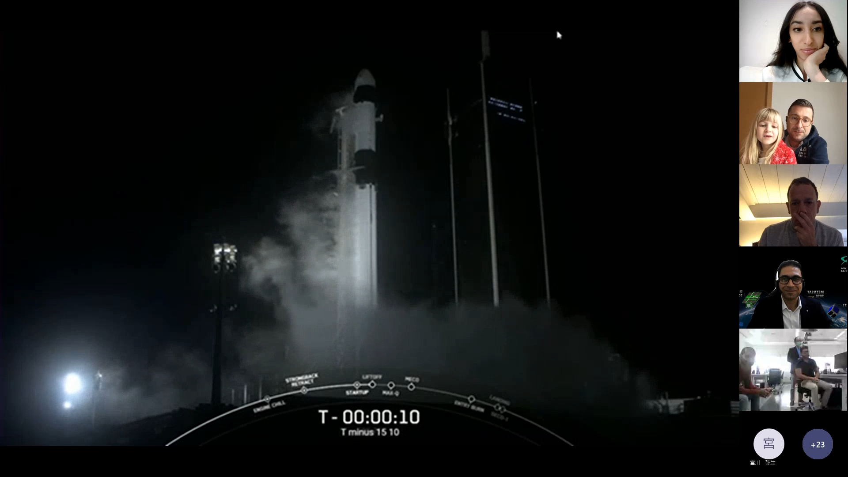

Slide 28
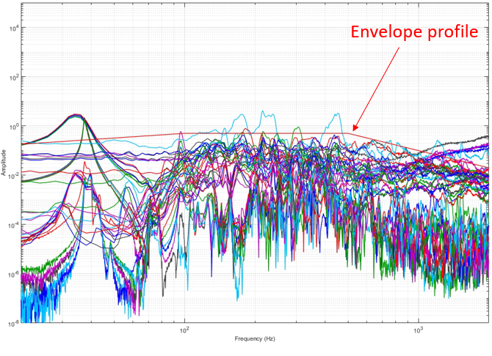
Technology Readiness Level
Vibration Test
According to the ECSS, the vibration tests for an EQM (Engineering Qualification Model) are designed to qualify the mechanical integrity and performance of space hardware under the dynamic loads expected during the launch and operation.
Sine Vibration Test
Typically applied in all three axes (X, Y, Z)
Frequency range: typically, 5 Hz to 200 Hz
Dwell time at resonance frequencies
Random
Random Vibration Test
Typically applied in all three axes (X, Y, Z)
Frequency range: typically, 20 Hz to 2000 Hz (or higher)
Input as Power Spectral Density (PSD) in g²/Hz
Test sequence
1) Pre-test modal (search for resonances).
2) Sine vibration.
3) Random vibration.
4) Post-test modal (to check possible discrepancy before/after test) and inspection.
Golden Rule N.4: Mechanical tests are launcher driven! Before getting into the payload development, insists to get the launcher manual!

Slide 29
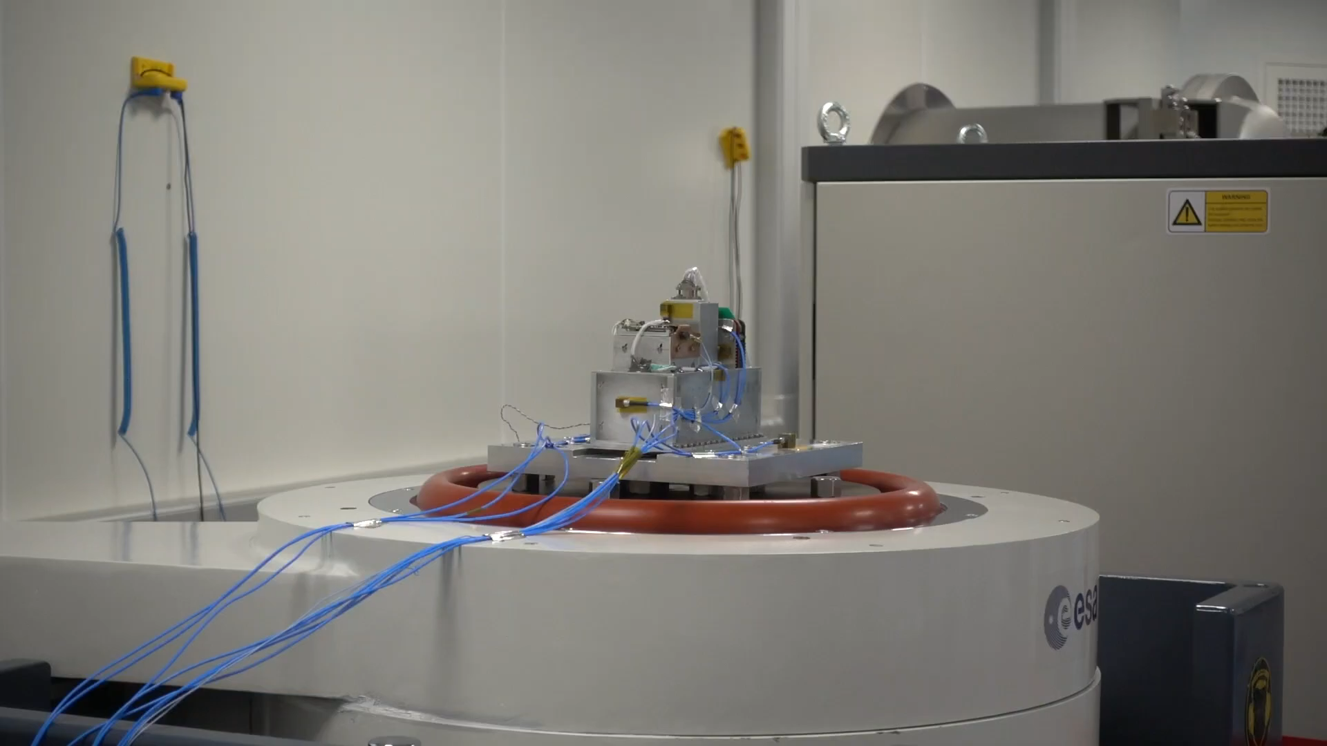
Technology Readiness Level
Vibration Tests (don’t feel the pressure)

Slide 30
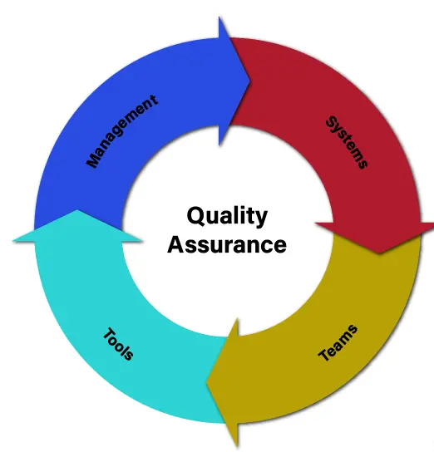
Project Management: project macro timeplan
Launch Preparation
Final checks and integration with launch vehicle
Qualification & Validation
Environmental testing and performance verification
Versus
Integration & Testing
System assembly and functional testing
Hardware Development
Sensors, electronics, and radiation hardening
Time
Preliminary Design
Requirements analysis and conceptual design
Golden Rule N.5: There is only one way to make your wish come true: stay organized and do not panic!

Slide 31
An example of Work Breakdown Structure (WBS): SPACE-BIO 3U
GST (1000)
SSSA (2000)
GSSI (3000)
Program
Management
Container
& Logistic
Integrazione, Test Funzionali e Accettazione SAT.
Valorizzazione dei risultati e trasferimento tecnologico e scientifico
SIA (4000)
GST (5000)
5000
6000
1500
7000
Test Funzionali P/L Ibrido + P/L Radiazioni
Supporto Integrazione e Accettazione SAT.
Supporto Integrazione e Accettazione SAT.
Supporto Integrazione e Accettazione SAT.
Assemblaggio Struttura SAT. + Sistemi di bordo
1400
2500
3400
4600
4500
Assemblaggio P/L Bio-ibrido
Assemblaggio
P/L Radiazioni
Supporto Test Funzionali P/L Radiazioni
2400
1300
3300
Progettazione
P/L Bio-ibrido
Acquisto
Materiali e Parti P/L Bio-ibrido
Costruzione Sottoassiemi P/L Bio-ibrido
Progettazione P/L Radiazioni
Acquisto Materiali e parti P/L Radiazioni
Costruzione Sottoassiemi P/L Radiazioni
Supporto Assemblaggio P/L Radiazioni
Progettazione Struttura SAT. e Sistemi di Bordo
Acquisto Materiali e Parti SAT.
Costruzione Struttura SAT.
Costruzione Sistemi di bordo
2100
2200
2300
3100
1100
1200
3200
4100
4200
4300
4400

Slide 32
SPACE-BIO 3U High-level project timeline
T₀+1
T₀+2
T₀+3
T₀+4
T₀+5
T₀+6
T₀+7
T₀+8
T₀+9
T₀+10
T₀+11
T₀+12
T₀+13
T₀+14
T₀+15
T₀+16
T₀+17
T₀+18
T₀+19
T₀+20
T₀+21
T₀+22
T₀+23
T₀+24
Design T0 + 10 mesi
K.O..
Progress Trimestrale
Progress Trimestrale
Progress Trimestrale
Progress Trimestrale
Progress Trimestrale
Progress Trimestrale
Progress Trimestrale
RF
Design P/L Ibrido
Design P/L Radiazioni
Design Struttura SAT. + Sistemi di bordo
PDR
CDR
Procurement Materiali e Parti
Costruzione P/L Ibrido
Assemblaggio P/l brido
Costruzione P/L Radiazioni
Assemblaggio P/l Radiazioni
Costruzione Strut. SAT. + Sist. bordo
Test Funzionali P/L Ibrido e Radiazioni
TRR
Integrazione e Test accettazione SAT.
Data collection
PSR
Design e Costruzione Container per Trasporto Payload e SAT.
Forms desk elaboration and first results
Delivery
Network analysis post-initiative.

Slide 33
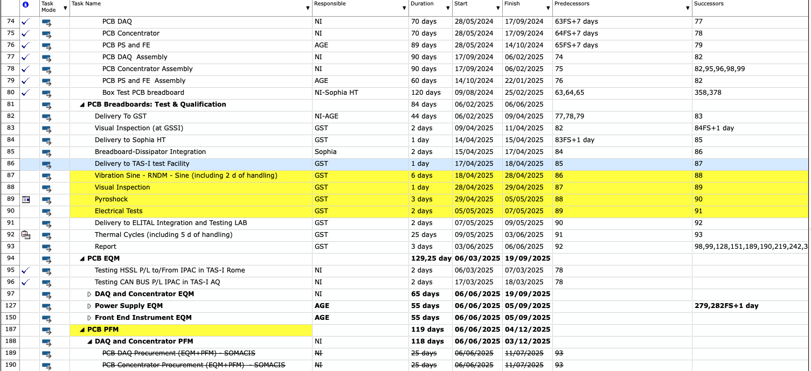
Project Management: Integrated Schedule
Things can get easily overcomplicated. Follow up, periodic meetings, lot of plan B(s), Monitoring, …

Slide 34
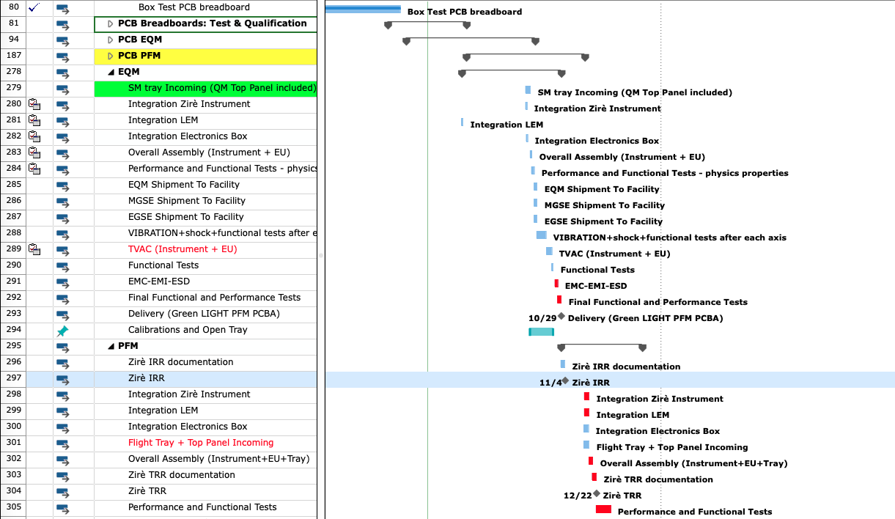
Project Management: Integrated Schedule
Golden Rule N.5: DO NOT USE EXCEL for integrated scheduling! Always use evolute software (i.e. critical path highlighting)

Slide 35
Project Management: Construction Workflow

Slide 36
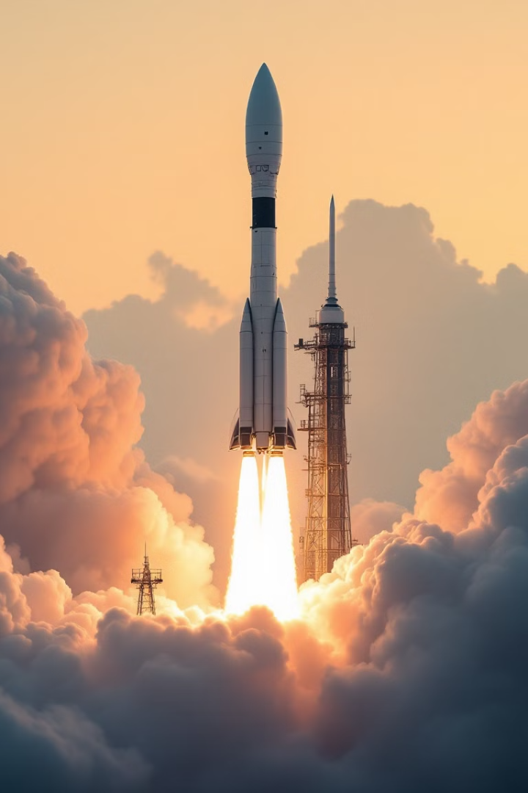
Let me conclude with a summary of my preferred Golden Rules
N.1: a space mission is not the right place to host an R&D
N.2: 1 kg of payload corresponds to 1 kg of paperwork
N.3: there is no room for ”ideal” in space, it is always matter of optimization and trade-off
N.4: Mechanical tests are launcher driven! Before getting into the payload development, insists to get the launcher manual!
N.5: There is only one way to make your wish come true: stay organized and do not panic!
And with an additional set of Golden Rules:
N.6: Integrate all mission budget categories from mission conception. Systems engineering approach prevents costly redesigns on a later stage.
N.7: Keep margins (5%-20%, depending on the development stage) for each budget category. Better to cut rather than add on a later stage.
N.8: Review budgets throughout the development phases. Always run optimization checks.
N.9: Stick to the ECSS rules (whenever is possible)
N.10: Enjoy the flight!

