Slide 1
Polarimetry in the context of X-ray astronomy - Past and future
Enrico Costa
Senior CoI of IXPE
IAPS/INAF

Slide 2

X-ray polarimetry
Information on celestial (extra-solar) sources are mostly provided by electromagnetic radiation.
They can be obtained by studying the spatial, spectral, timing and polarization properties of the observed radiation.
In particular, the polarization properties give us information on geometry (in a broad sense: geometry of the emitting matter but also of magnetic and gravitational fields, of space-time, etc.). The polarization degree depends on the level and type of symmetry of the system, the polarization angle indicates its orientation.
Our knowledge of the emission from a celestial source in any energy band is therefore incomplete without polarimetry.
However, polarimetric information were basically missing
in the X-ray band before IXPE!

Slide 3
X-ray polarimetry
Only one positive measurement (Crab Nebula: 19%) in the classic X-ray band, dating back to the ‘70s (OSO-8)
No X-ray polarimeters onboard X-ray satellites after ARIEL-5 and OSO-8, due to lack of sensitive enough detectors
Now such detectors do exist, based on the photoelectric effect
The Imaging X-ray Polarimetry Explorer (IXPE) was selected by NASA in 2017 in the framework of the SMEX program, launched on 2021 and is successfully performing since 3 years.
So far we can divide the history of X-Ray Polarimetry in before IXPE and after IXPE

Slide 4
X-Ray Physics and Polarimetry
X-rays were discovered in 1895 by Wilhelm Konrad Röngen. He was immediately aware of the practical applications but had fancy ideas about what those rays could be.
In 1906 the Charles Glover Barkla demonstrated that X-rays are scattered according to the rules of polarization. This demonstrates that X-rays are electromagnetic radiation.
Physics and Polarimetry of X-Rays are borne together.

Slide 5
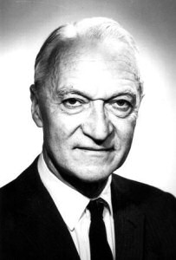
X-Ray Astronomy and Polarimetry
Extrasolar X-Ray Astronomy was started by Bruno Rossi and Riccardo Giacconi in 1962 with the first sounding rocket.
The first experiment of X-Ray Polarimetry was performed on 1971 by Robert Novick .

Slide 6
Why was Polarimetry left behind?
Is the Polarimetry a niche subtopics? Definitely it is not.
Since the first discovery of X-Ray sources many theoreticians proposed that polarimetry would become an important diagnostic tool. The most active was Vitali Ginzburg.
IN THE WHOLE ELECTROMAGNETIC SPECTRUM X-RAYS ARE LIKELY THE BAND WHERE POLARIMETRY HAS THE MAXIMUM DIAGNSTIC POWER
Non thermal processes
Synchrotron, Cyclotron Inverse Compton, Non thermal Bremmstrahlung
Scattering with highly aspheric geometries
Disks, Columns, Reflections
Fundamental Physics at work
Extreme Fields
Extreme Energies
Extreme compactness
New Physics
Axions/ALPs
LIV

Slide 7
The Giacconi vision
Soon after the first discovery Giacconi sketched a strategy, based on the development of optics, to bring X-Ray Astronomy to the same level of other bands.
This strategy was in practice adopted by NASA
A satellite based on the same techniques of sounding rockets to have a first comprehensive view of X-Ray Sky → UHURU (1970)
A satellite with a first implementation of X.ray optic → Einstein (1978)
A satellite with a full exploitation of X-Ray optics (arcsecond resolution) → Chandra (1999)
Polarimetry started soon after with rockets (1971) and OSO-8 (1975) but missed the passage from 1) to 2).
A polarimeter was foreseen in the original design of Einstein but was removed
A polarimeter was foreseen in the original design of Chandra but was removed
The equivalent of Einstein will be IXPE to be launched 43 years later!

Slide 8
What is a polarimeter
A Polarimeter is composed of:
A delimiter of the direction of the input radiation (a slit, a collimator, an optics, ….)
An analyzer where a physical process sensitive to polarization occurs
An output unit to detect the products of the process
One of the three components has a dependence on the angle.
The outcome of the measurement is usually an histogram of detected events in function of the angle.
If the radiation is polarized the histogram is modulated.
If the radiation is not polarized the histogram is flat.
The histogram is named modulation curve
If all the angles are sampled at the same time the polarimeter is named non dispersive
If each angle is sampled at a time the polarimeter is named dispersive

Slide 9
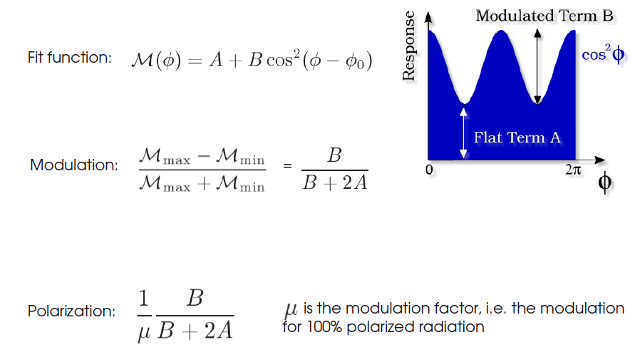
Again: The conventional formalism
Modulation curve
See the lesson by Fabio Muleri
But I anticipate a few points needed to understand the story

Slide 10

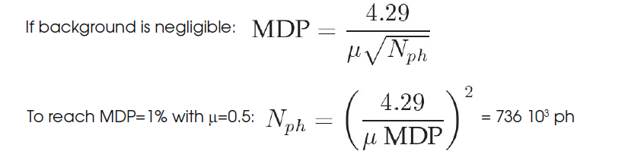
The first limit: In polarimetry the sensitivity is a matter of photons
Minimum Detectable Polarization (MDP at 99 % Confidence Level)
R_{S} is the Source rate, R_{B} is the Background rate, T is the observing time
μ is the modulation factor: the response of the polarimeter to a 100% polarized beam (spanning from 0 or no sensitivity, to 1 or maximum sensitivity)
Source detection > 10 counts
Source spectral slope > 100 counts
Source polarization > 100.000 counts
Caution: the MDP describes the capability of rejecting the null hypothesis (no polarization) at 99% confidence. For a 3-sigma meaurement an observing time 2.2 times longer is needed while the 1-sigma error scales like : 28º.5/S/N

Slide 11
To perform Polarimetry you need
From the previous equations we see:
A process modulated with polarization
Counts
Low background
An important point. The sensitivity, the feasibility of a measurement and the prediction of the observing time strongly depends on the relative intensity of counting rate from the source and from the background. This is especially true for the weakest sources of the sample, namely sources at the limit of sensitivity of an instrument.
Here we need a historic step back

Slide 12
Seasons in X-Ray Astronomy
I already mentioned the Seasons in X-Ray Astronomy
Soon after the discovery of extrasolar X-Rays in 1962 Riccardo Giacconi outlined a path to transform X-Ray Astronomy in a new window on the Sky.
Rocketts → UHURU → HEAO-2 (Einstein) → AXAF (Chandra)
This path has been followed with great success.
Polarimetry, especially thanks to Columbia University Team headed by Robert Novick, has been in the game in the rocket era and in the UHURU era, but has totally missed the further two steps.
The position was lost at the passage from instruments with collimators (or modulation collimators or coded masks) to instruments in the focus of an optic. This passage was performed with HEAO-2 satellite re-named Einstein.
The position was recovered by IXPE 43 years later

Slide 13
Optics in X-Ray Astronomy
X-Ray Optics
Physics Constraints:
X-Rays reflect at grazing angles, namely at small angles from the reflecting surface. Very schematically we canstate that there is a critical angle 𝜗_{c}. At angles between 0 and 𝜗_{c}. 100% of the photons is reflected with an angle equal to the angle of incidence, at angles > 𝜗_{c}. the radiation enters the surface and if this is thick enough .
is absorbed. We will see that this is an oversimplified view, but at higher energies is not far from the truth.
This phenomenology is described by the Fresnel laws (a in other wavelengths) and the properties of the reflection is described in terms of the index of refraction:
n = 1 – 𝛿 + iβ
𝛿 and β are small quantities function of the wavelength ƛ determining the reflection properties included those related to polarization-
1-𝛿 is the real part and determines the phase velocity; β is the imaginary part and determines the absorption.

Slide 14
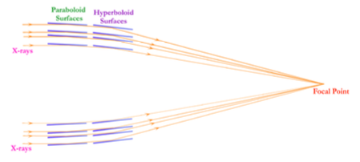
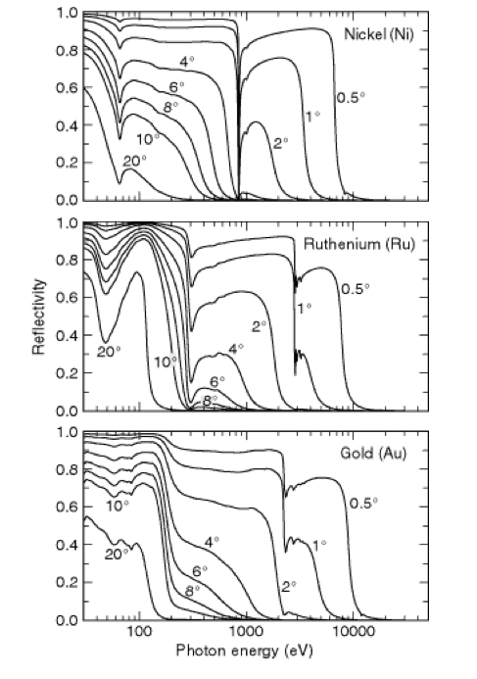
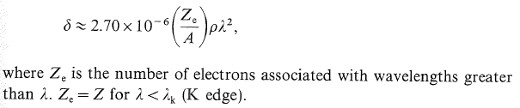
X-Ray telescopes
Each pair paraboloid/Hyperboloid would provide a small collecting surface
→ many confocal mirrors nested.
→ rigid but thin.
The other point is the choice of the material.
These angles are very small. E.g. at 3keV the critical reflection angle on a Ni surface is around 1°.
In the oversimplified approach that the reflectivity is 1 below 𝜗c and 0 above, and that 𝜗c ∝ √2𝛿∝ √ϱ the choice should be driven only by the density of the material: e.g. Ni 8.9 Au 19.3 Ir 22.5 g/cm³.
But the reflectivity is much more complicated. Around the absorption edges the reflectivity drops dramatically. Moreover electrons of binding energy below the edge poorly contribute to reflection.
In the case of IXPE the figure on the right (From Lawrence Berkley X-Ray Data Booklet, 2009) shows that Nickel is definitely better than Au (or even Ir). Actually IXPE is using an alloy of Nickel and Cobalt.

Slide 15
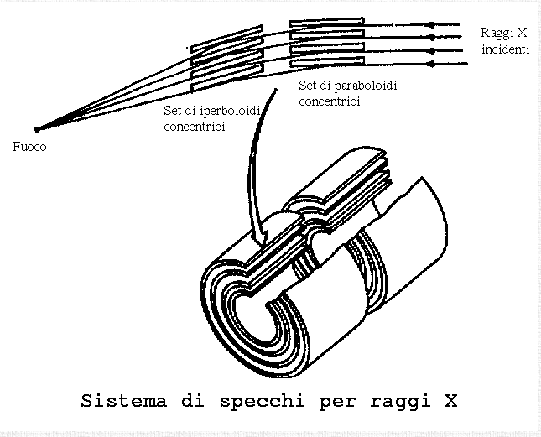
Different Satellites Different Optics
A good number of telescopes has been used aboard Astronomical missions.
In the philosophy of R.Giacconi the angular resolution is always the first driver.
Einstein telescope had a resolution of 2”. Most of data of Einstein were acquired with the IPC. The resulting resolution was 1’.
In the same philosophy AXAF (Chandra) was built with 0.5” namely the best angular resolution ever achieved in Astronomy (and nothing better is approved for long time). Also in this case the quality is preserved with a HRI. But the baseline instruments are CCDs that preserve a resolution of around 1”.
These optics are extremely difficult and costly. For many other missions cheapest and fastest technologies have been developed based on the integration of “petals” or with replica by electroforming of superpolished mandrels. This technique arrived to resolutions of the order of 10-12” (eROSITA).
Resolution needed for cosmology. For spectroscopy and timing the area is the driver.
More recently with ITOMI and NUSTAR optics of higher energy have been flown. The resolution is in the arcminute range but the extension of the band is the main goal
Satellites with optics can be confined in limited dimensions with extensible booms (like IXPE) or multi-mirror configuration (like NICER). But for sue they are missing the nanosat/microsat revolution.

Slide 16
What can telescopes do?
Image extended sources
Localize and associate a source with a known astrophysical object
Perform separate measurements in complex fields
Disentangle the variation of a source from the variation of the background in timing
Detect very weak sources because compares their flux with fluctuations of the background in the point spread function and not on the whole detector or ½ of that (as in experiments with collimators, modulation collimators or coded masks)
Discover weak sources in the field of view and build up a statistics to do cosmology with X-Rays
Coma Cluster and Cas-A as ← seen by UHURU (left)
and
Einstein (Right) ➜

Slide 17
Optics and Polarimetry: a difficult marriage
These capabilitiues of telescopes are the main reason for Einstein break-through
IXPE is the first mission of X-ray Polarimetry that uses telescopes half a century later. Why?
A detector to move to the focal plane of an X-Ray optics and fully exploit the advantages must have some specific performance.
An adequate efficiency to allow for a reasonable crop of sources
An adequate capability to localize the impact point of each photon to benefit of background reduction and possibly to perform imaging polarimetry
A consume of resources (mass, power, volume, movements) adequate to the returns
Early time polarimeters were missing some or all

Slide 18
What is needed to a detector to benefit of optics
Some seminal points are:
The detector/instrument must have the capability to measure the position of the first interaction with a resolution comparable and possibly better than that of the optical syste.
The probability of each angle should be the same or, at least, perfectly known so that any found modulation can be only interpreted in terms of polarization.
Given that the modulation will typically depend on the energy of the original photon the energy must be known.
The structure of the background should be well understood to well perform the background subtraction in the limit of very weak sources
I will try to understand how these points apply to the case of IXPE and possibly of other present or future polarimeters.

Slide 19
Interaction of X-Rays with Matter
Major Interactions of X-Rays with matter in the classic X-Ray band are:
Photoelectric effect
Compton (Thomson) scattering
Other Interactions of a certain interest are:
Bragg Diffraction
Rayleigh scattering
All the detectors for Soft/Medium/Hard X-Ray Astronomy are expoloiting the photoelectric effect
Moving from Hard X-Ray to Soft Gamma-Ray Astronomy Compton Scattering becomes the main first interaction.
Gamma-Ray detectors above 20 MeV use pair production but this is another story.

Slide 20
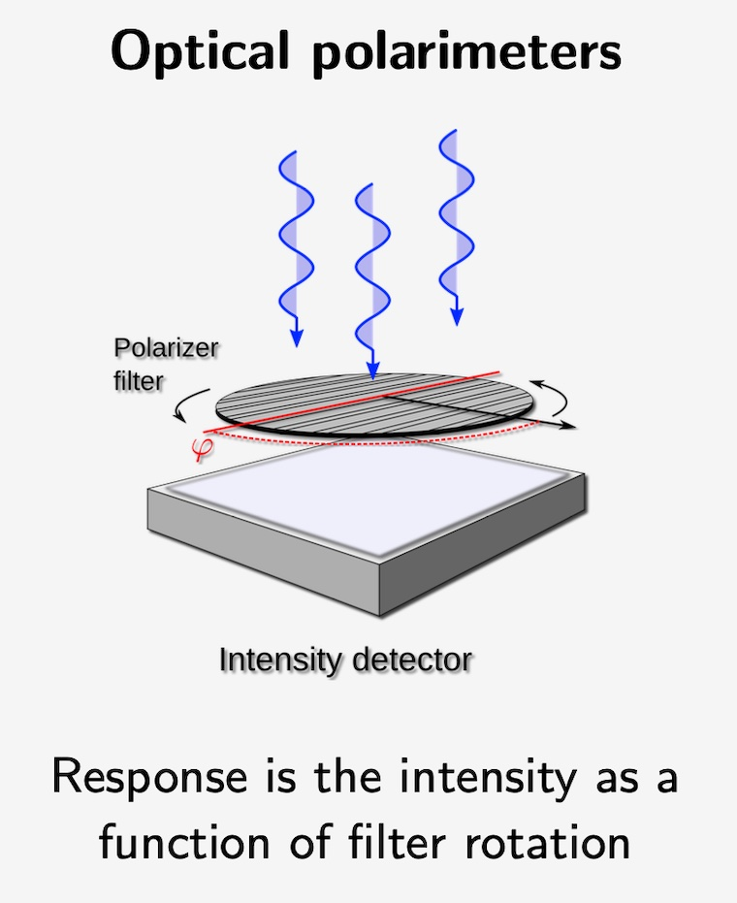
A naif question. Why not a transmission filter sensitive to polarization?
A typical optical polarimeter (not the only one) is a filter interposed in the optical path. The filter is transparent to one mode and opaque to the other. By rotating the filter a modulation curve can be built.
Can this work with X-Rays?
The absorption is expressed as:
I=I₀e^{-µx} = I₀e-^{(µ/𝜌)×(𝜌x)}
µ cm-1 x cm or more usual µ/𝜌 cm²/g 𝜌x g/cm²
The absorption coefficient is the sum of different contribution. In practice photoelectric + scattering.
Photoelectric is the absorption of a photon by a bound electron with the ejection of a photoelectron:
If E_{p}>E_{b} the photon is absorbed an a photoelectron of kinetic energy T=E_{p}-E_{b} is ejected.
Photoelectric effect occurs preferencially with inner photons (provided that the energy is above the thresholds).
The atom is ionized in an inner shell. This ion is extremely instable and immediately reassessed by the fall of an electron of the shell above the one ionized. The energy difference between the two states of the ion can be released by one of two processes:
A fluoresce photon preferentially from the decay from the upper shell (followed by other photons or electrons of lower energy
An Auger electron.
Booth the fluorescence and the Auger have a similar energy but the effect on the detector is quite diifferent.

Slide 21
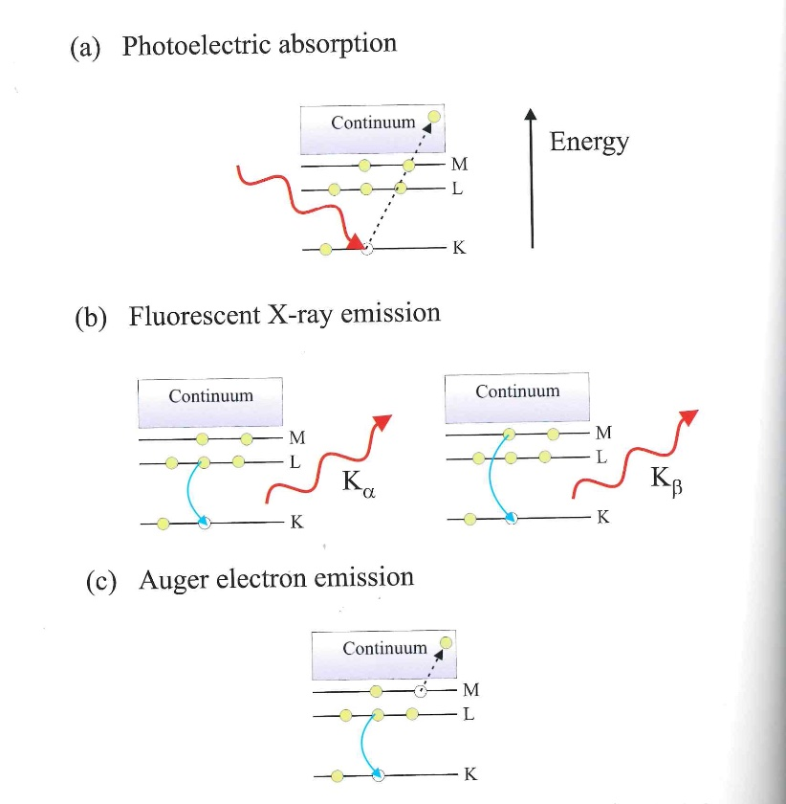
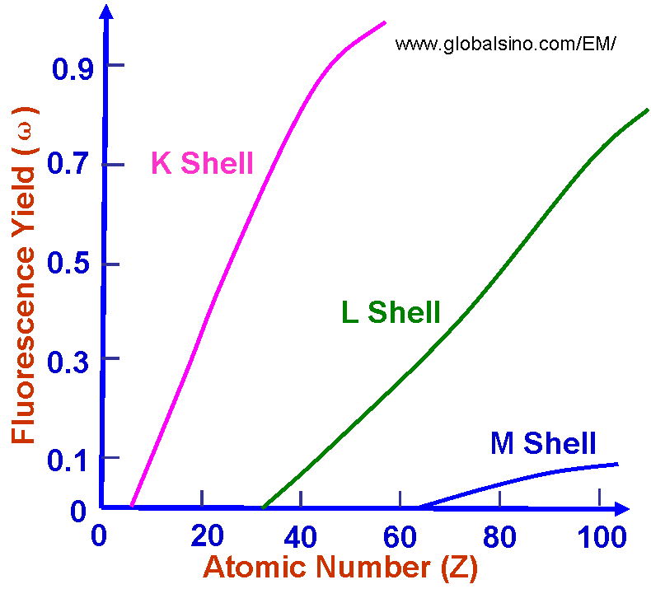
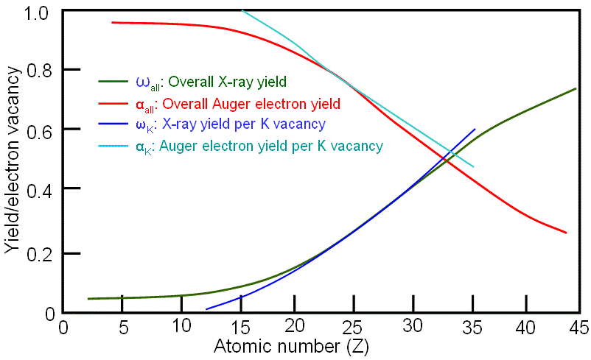
µ vs polarization
If the photon energy is > E_{K} the absorption is typically (80%) on the shell K.
The shell K only hosts s electrons with a wavefunction spherically symmetric. The absorption coefficient is independent on polarization.
As to the byproducts of the interaction:
Auger Electrons (prevailing in low atomic number materials such as C, Si or A) are isotropic
K Flurescence photons are isotropic
Photoelectrons have memory of polarization. But they (as well as Auger electrons) are absorbed locally.
If the absorption is in the L shell we have 6 p electrons. The L fluorescence photons would bring memory of the original polarization but a not radiative transition destroys this memory. Only L𝛄 photons bring memory but they are a few % of the total and their energy is close to that of the isotropic L𝛂 and L𝜷 phhotons.
Als-Nielsen&McMorrow, Elemets of Modern X-Ray Physics Wiley 2001
In conclusion what comes out through the filter will be independent on the polarization.

Slide 22
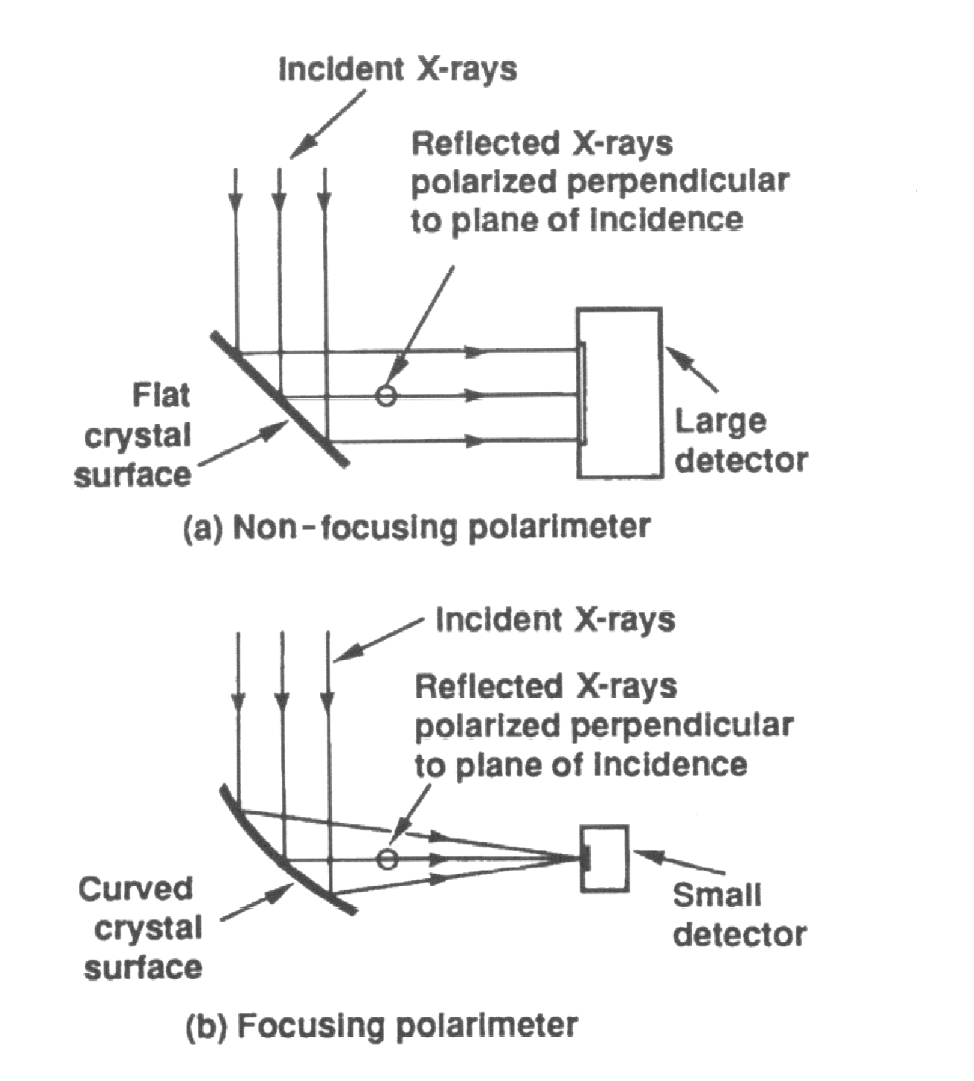
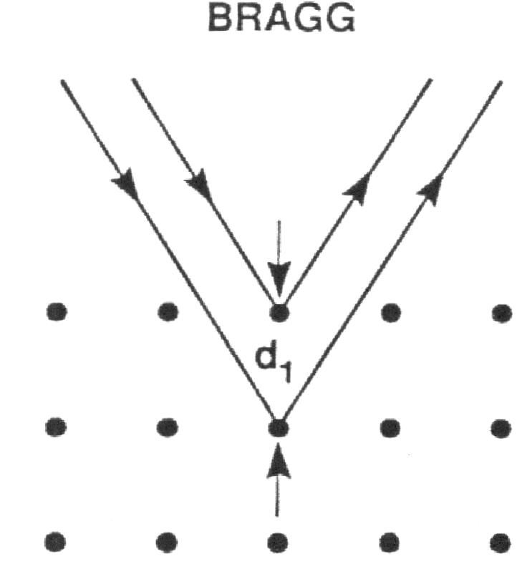
A filter does exist: the Bragg
A Bragg crystal reflects the radiation at an energy that depends on the lattice spacing and on the incidence angle according to the Bragg law.
Bragg diffraction from a crystal can be exploited to measure the degree and the angle of polarization P of a photon beam.
Muleri, F. Et al., Nucl.Ins.&Meth, A 584 (2008) 149–159
θ
θ
A crystal oriented at 45º to an incident linearly polarized x-ray beam acts as a perfect polarization analyzer for photons with energies that satisfy the condition of Bragg reflection. Therefore it is a narrow band technique. At 45º only the component of polarization perpendicular to the incidence plane is reflected
Bragg law.

Slide 23
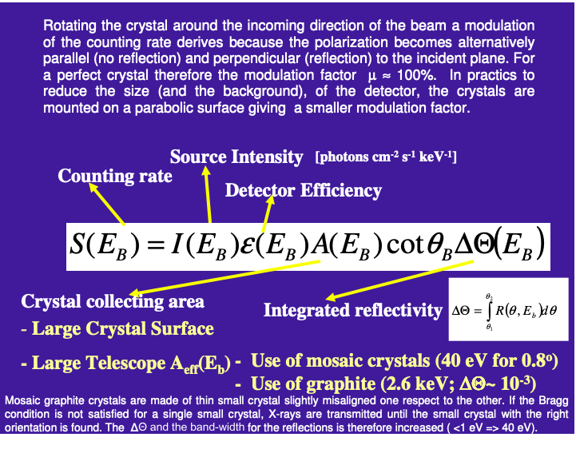
Courtesy of Paolo Soffitta

Slide 24
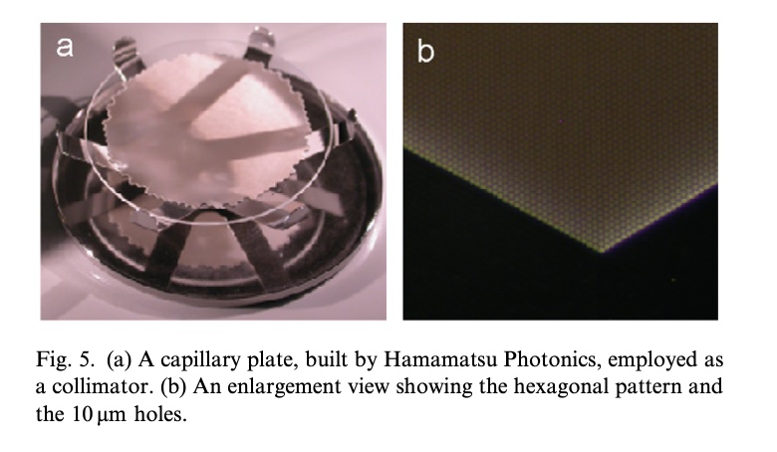
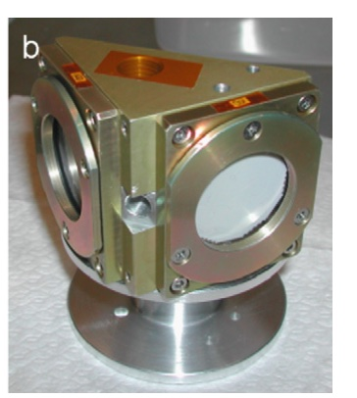
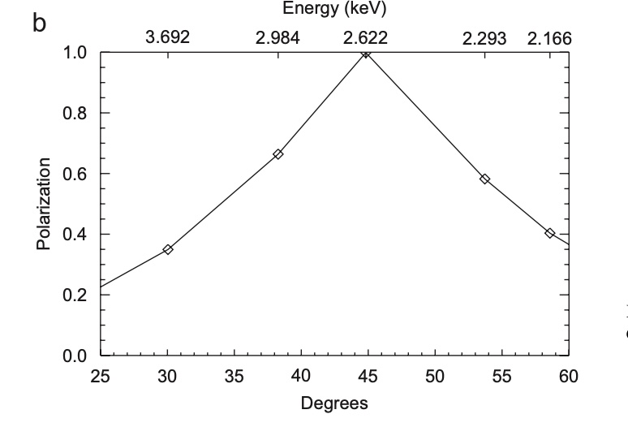
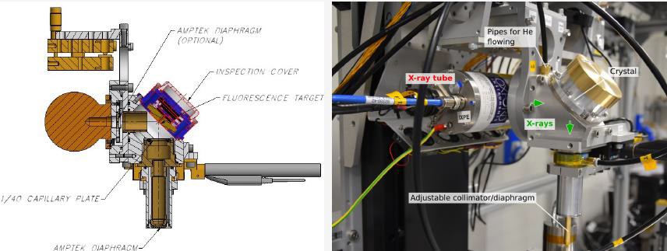
Bragg is how we produce polarized lightin thge Lab
Capillary Plate is a disk of lead glass with holes on an hexagonal pattern. Actually it is the blank of Microchannelplates. The lead glass is a good absorber so that the object is suitable to collimate photons, namely to accept photons within a small angle from the normal (< 1°)
A polarizer host a crystal at 45° from the direction of the incoming beam and of the outcoming beam, as defined by the capillary collimators.
As an example the polarization degree of radiation after the diffraction from a graphite bragg crystal. The technique is still effective for angles around 45°
Or with a conventional collimator

Slide 25
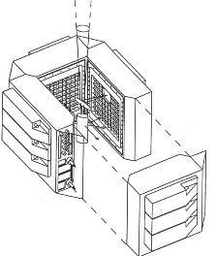
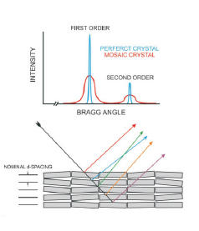
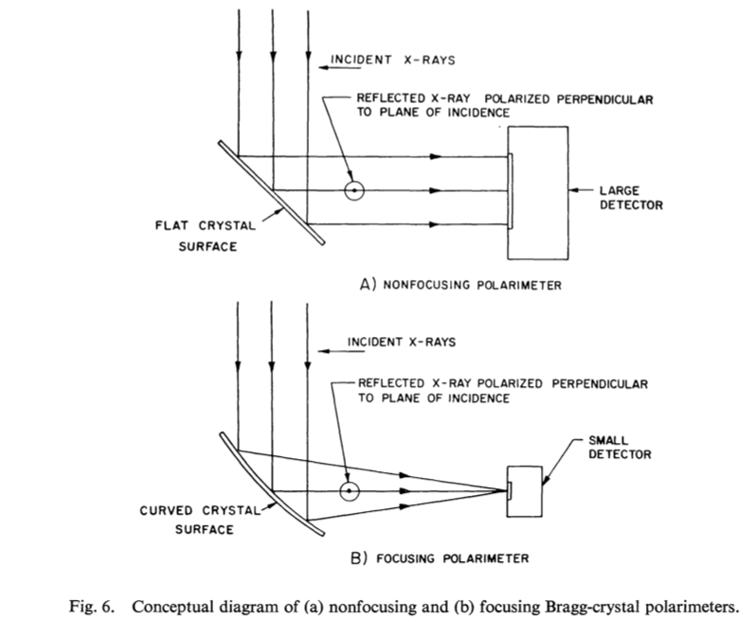
Improvements
Since the beginning the astrophysicist tried to increase the efficiency and/or decrease the background.
1) Mosaic Crystals. If the crystal is an assembly of small domains all slightly misaligned each other , with angles of the order of 0.2, 0.5, 1.0 degrees, each of these domains has a bragg angle that depends on the alignement. The photons of energy near to that of the nominal bragg will penetrate until they find the domain with the right angle that scatters them according to the Bragg Law. The total gain is significant.
2) Use of bent crystals to provide a certain focussing and reduce background with some trade-off on modulation.
In Bragg the radiation is diffracted at the same angle of incidence. From the point of view of geometrical optics is a reflection. Then Bragg diffractors can be introduced in focussing elements.
Bragg Objective (a flat crystal in front of the telescope); Bragg crystal at 45° above the focal plane and a detector at 90°, in a newtonian mounting. This is how it worked with SXRP.

Slide 26
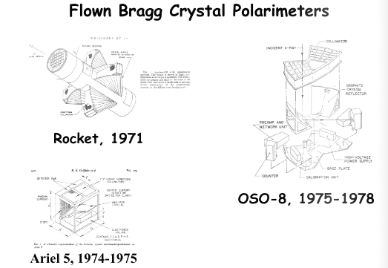
Flown Bragg Polarimeters

Slide 27
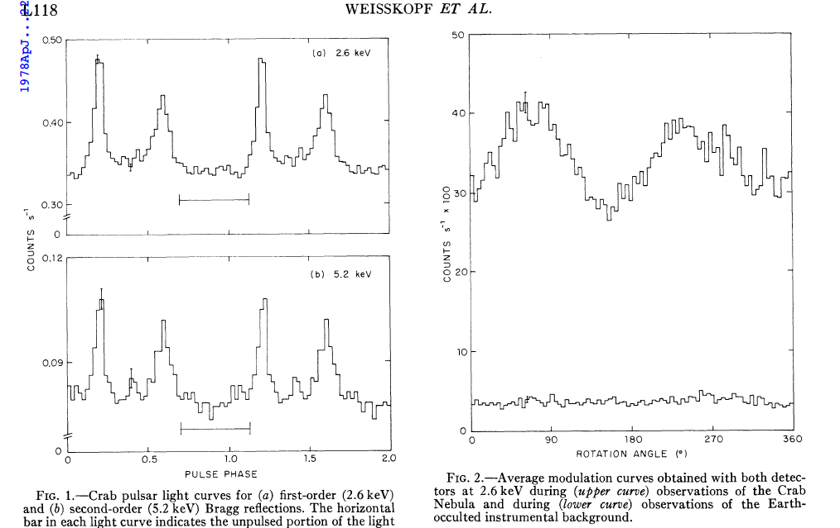
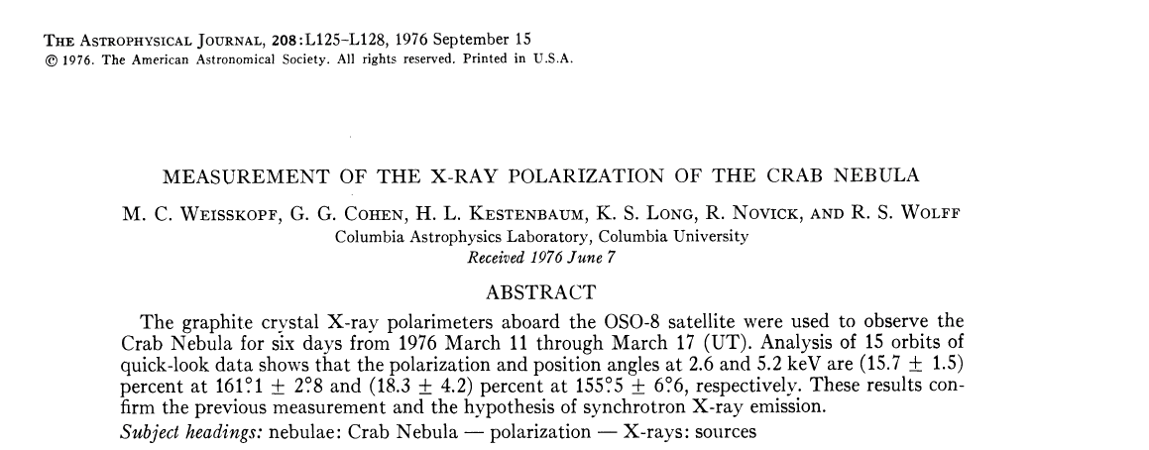
Results from OSO-8
The first rocketts by Columbia (Novick) had already detected (by overimposing the data of three rockett of
OSO-8 observed a dozen of sources. The only unambigus positive detection was that of the Crab (Nebula + Pulsar).
The polarization was detected of 15.7% ± 1.5% , definitely above the Chandrasekhar liimit (of 12%), that fixes the maximum polarization that can be acrrived by scattering of unpolarized photons on a highly asymmetric cloud.
The X-Rays are emitted by Crab by non thermal process.
The idea of Vitali Ginzburg was confirmed.

Slide 28
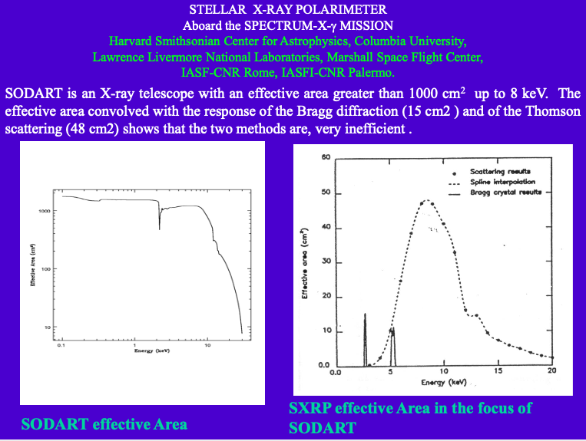
Polarimetry is the Bragg:value and limits
OSO-8 (and Ariel-5) results fixed the standard for 30 years about X-Ray Polarimetry:
The technique is the Bragg
Sensitivity is poor. Only a limited number of sources can be arrived
Rotation is needed
Improvements of feasible but within the above mentioned frame.
One of the major improvements was to put a flat Brragg crystal above the focus of a telescope to diffract photons around the bragg condition on a secondary focal plane at 90° in a kind of a Newtonian Mounting.
Starting from a telescope of > 1000cm² SXRP Bragg had an effective area of 15 cm² with a band width of 100 eV. At least it is imaging and the background is null.
The Bragg passes the 1.5% of the collecting area and <1% of the energy band!
The thomson polarimeter is “almost” 50 cm² of area but the background was around 300 mCrab.

Slide 29
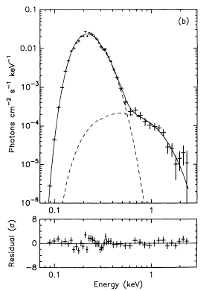
DIFFRACTION: No Soft X-Ray Polarimetry
Geminga
The case of PSR is very strong.
The soft X-Ray Polarimeter proposed by Herman L.Marshall would be active in an energy range where the X-ray flux is 4 orders of magnitude higher than in the band covered by IXPE.
XTEJ1118480 a binary with solar mass BH.
Very Soft. Likely a jet.
I would add jets. Blazars.
A TDE like the flare from NGC5905 should also be a good target
One of the main difficulty is the absorption.
The other difficulty is that the soft X-ray sky is very bright but also very thermal.
The spectro-polarimetric capabilities of th instrument proposed by Herman L. Marshall is that has also spectral capabilities. Notwithstanding the poor resolution of detectors at that energy it can separate lines from continuum.
Halpern, J. P. & Ruderman, M., ApJ, Part 1, vol. 415, p. 286-297.

Slide 30
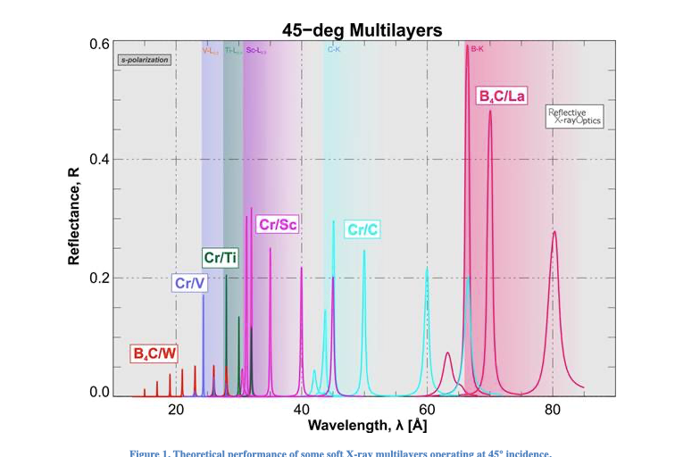
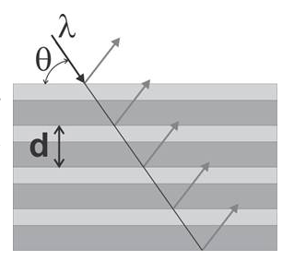
Diffraction with Multi-layer components
The technique of diffraction can be extended to longer wavelengths (lower energies), not covered by natural crystals by artificial periodic structures.
The range of very soft X-Ray and in particular that below the Carbonium K-edge (0.28 keV or 44Å), allowed by plastic windows, from 44 to 70 Å, has been covered by multilayer artificial crystals alterning a high Z and a Low Z material. Exactly like the Bragg crystals they polarize at 45°.
Below Carbonium K-edge
From the site of Reflective X-Ray Optics http://www.rxollc.com/index.html

Slide 31
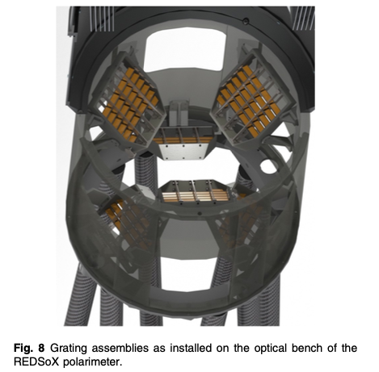
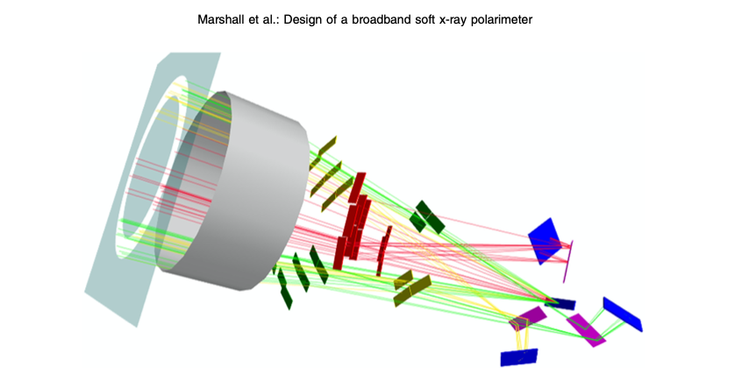
Maybe in the future the new Soft X-Ray Polarimeter
The new broadband soft X-ray polarimeter has a telescope.
Below there are 3 sets of CAT gratings. Each disperse 1/3 of the radiation toward a secondary focus. Soon before a Laterally Graded Multi Layer diffracts the photons of a range of energies spanning from 35 to 75 Å. The photons are then detected by a CCD.
Marshall, H., L. Design of a broadband soft x-ray polarimeter, JATIS, 4 (1), 2018

Slide 32
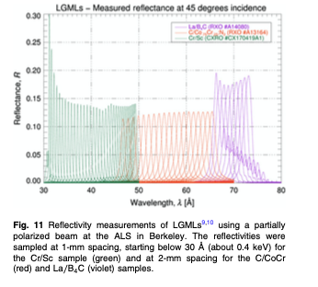
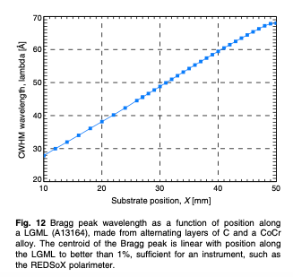
A further improvement is the use of multi-layer with laterally graded (LGML), that significantly enlarge the band.
Selected band
H.Marshall et al. SPIE JATIS 011005-1 fig

Slide 33
Has all this a future?
Studies for the mission ar ongoing since 15 or more years
A rocket precursor (named RedSox) has been recently approved by NASA.
Could have a dedicated telescope in a multi-band X-Ray Polarimetry Mission
Matching with the sensitivity of other instruments has not been yet studied

Slide 34
Bragg and Scattering
That is all for the diffraction polarimeters
The other important class of conventional polarimeters are
Scattering Polarimeters

Slide 35
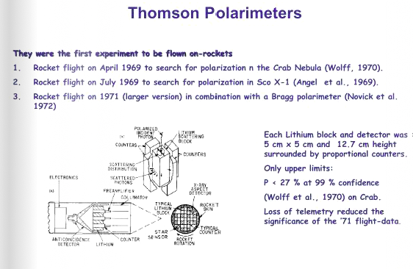
The situation for Thomson was not better. Frankly Speaking it was even worse. Since the first rockets and balloons thomson scattering polarimeters could not prduce any reliable result.

Slide 36

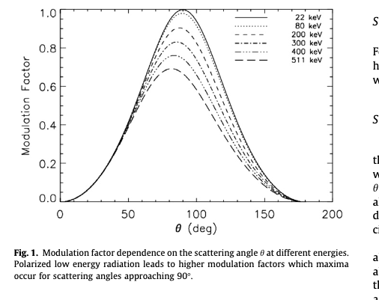
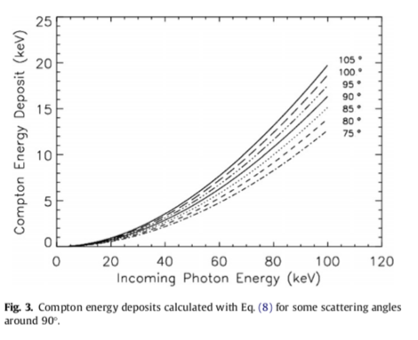
Compton
Fabiani et al. 2013

Slide 37
Not any angle!
The scattering (Thomson, Compton, Rayleigh) is a good analyser at around 90° and a bad analyser for forward and bakword scattering.
Any scatterting polarimetr is a trade-off of efficiency and modulation (remind that 𝛆^{1/2}µ is the quality factor).

Slide 38
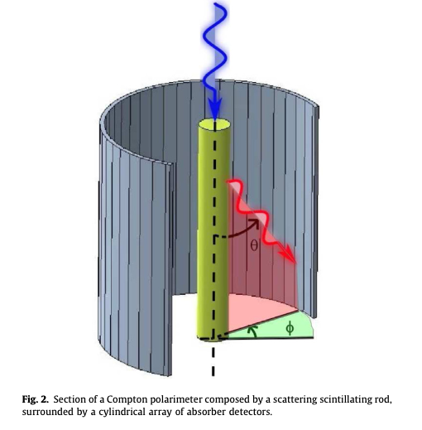
Is scattering alive? Any focal plane scattwring polarimetry?
The modulation factor s maximum around 90°
Fabiani et al. 2013
Ideal scattering focal plane polarimeter. But the absorber should be subdivided to minimize forward and backward scattering

Slide 39
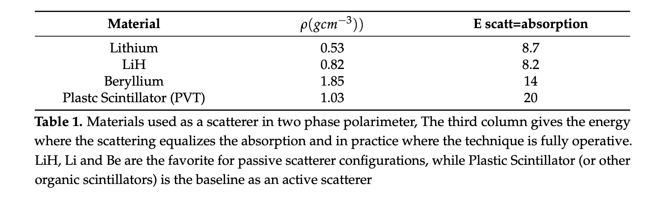
Why Focal Plane Scattering Polarimeters are hard to build and hard to believe?
A compton polarimeter can be passive or active when the scatterer is an inert material or a detector in coincidence with the absorber.
The scattering around 90° is highly modulated. The polarimeter must somehow limit the scattering angle.
The Thomson/Compton competes with photoelectric. The scatterer should be of the lowest possible Z. Even with Li below 10 keV the photoelectric is overwhelming.
The absorption coefficient is ≳ 5 g/cm2. The scatterer must be solid. The absorption point is very uncertain (poor imaging or no imaging at all).
A further effect is that the detectors have an area of tens of cm² or even more.
The energy passed to the electron for scattering around 90° is very weak at low energies. To detect the first event a starting energy from 20 to 35 keV is needed.
The polarimeter need to be rotated to compensate systematics.

Slide 40
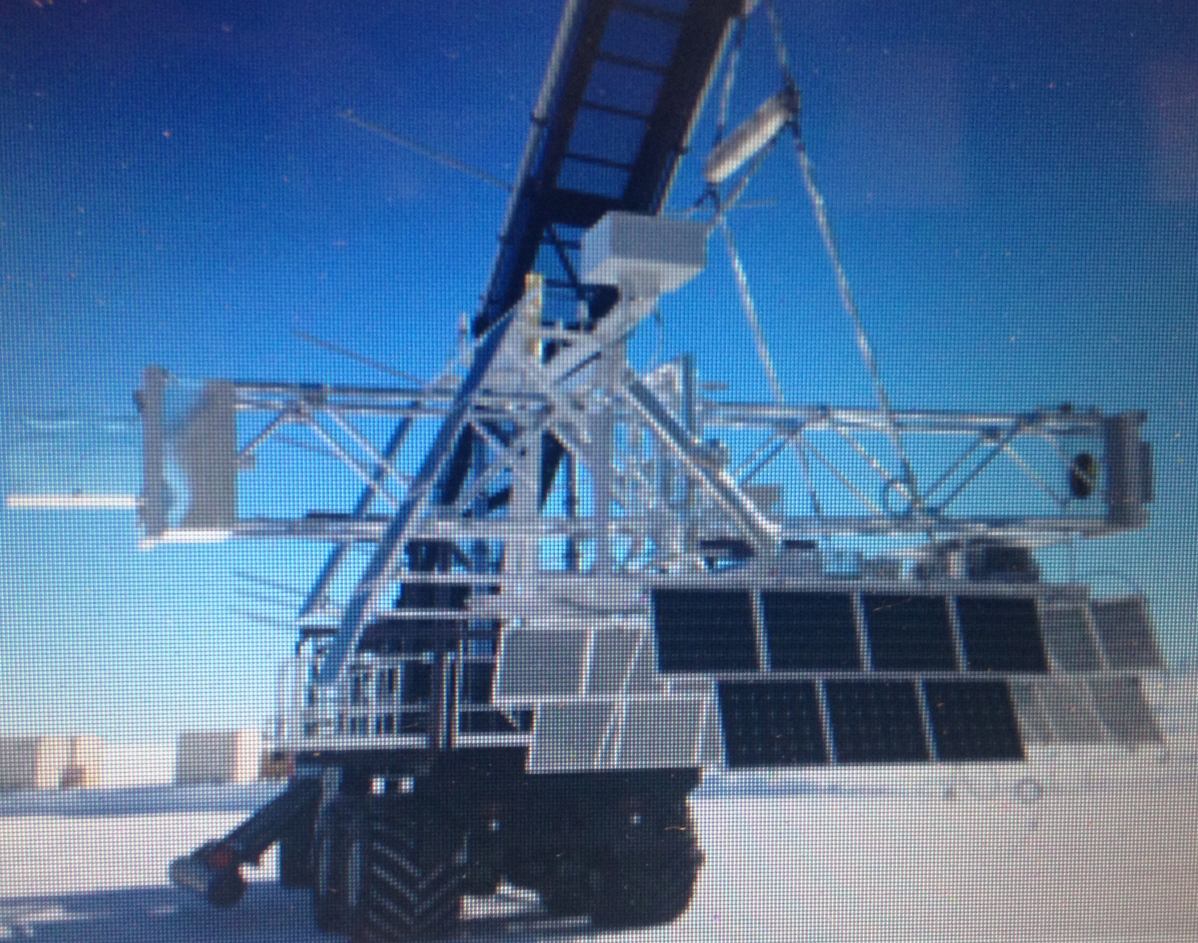
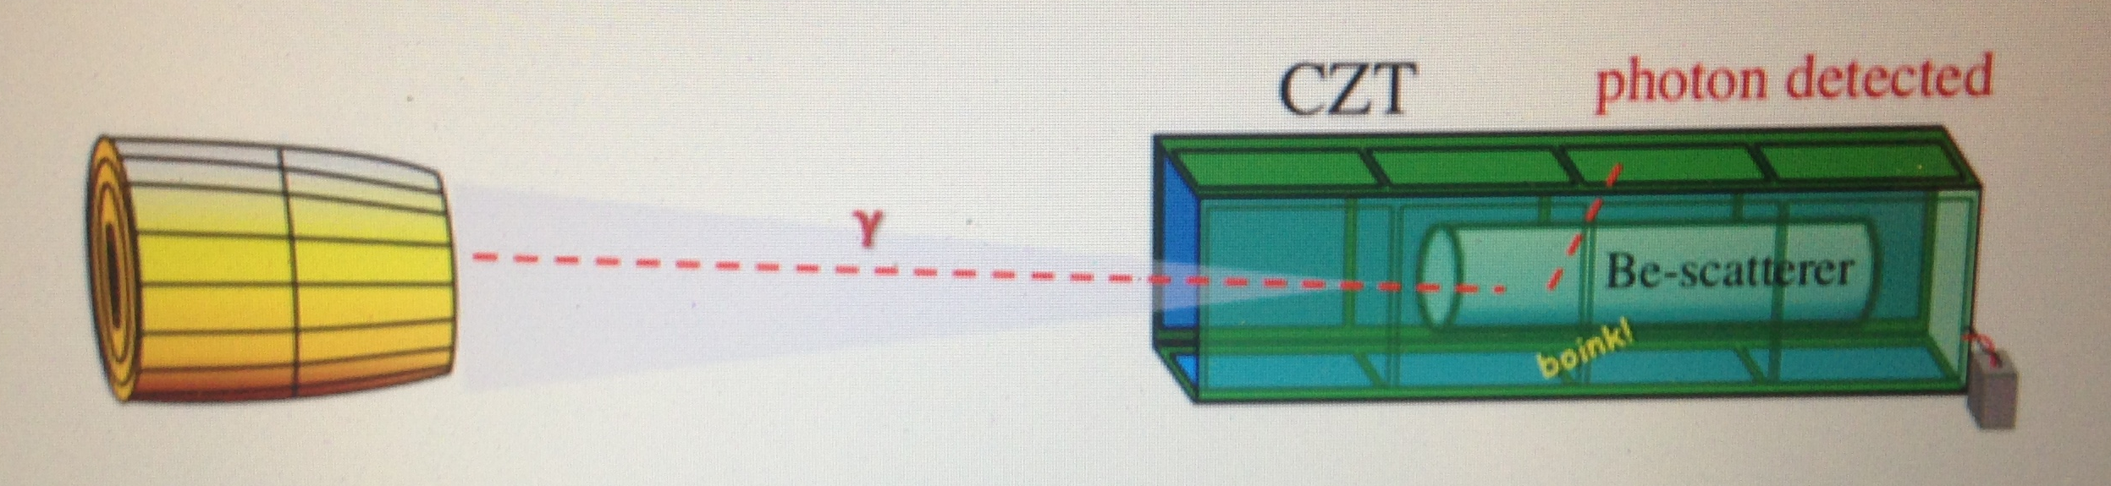
What during IXPE mission (more or less): X-Cailbur
X-Calibur is an experiment of Hard X-Ray Polarimetry designed to be flown aboard Long Duration Stratospheric Balloons.
It is based on a Multi-layer Hrd X-Ray Optics with a focal length of 8m (TBC). A cylinder of Beryllium scatters photons near the foca plane. Scattered photons are absorbed by a Cadmium Zinc Telluride detectors disposed around to build a square well. From the angular distribution of the scattered photons the amount and angle of linear polarization is derived.
The sensitive range is 15 – 35 keV
From Abarr et al.ApJ, 2020
X-Calibur has pointed GX301-2 on december 2008 for 8 hours with an equivalent time spent for background. The flight, planned to last weeks, aborted.

Slide 41
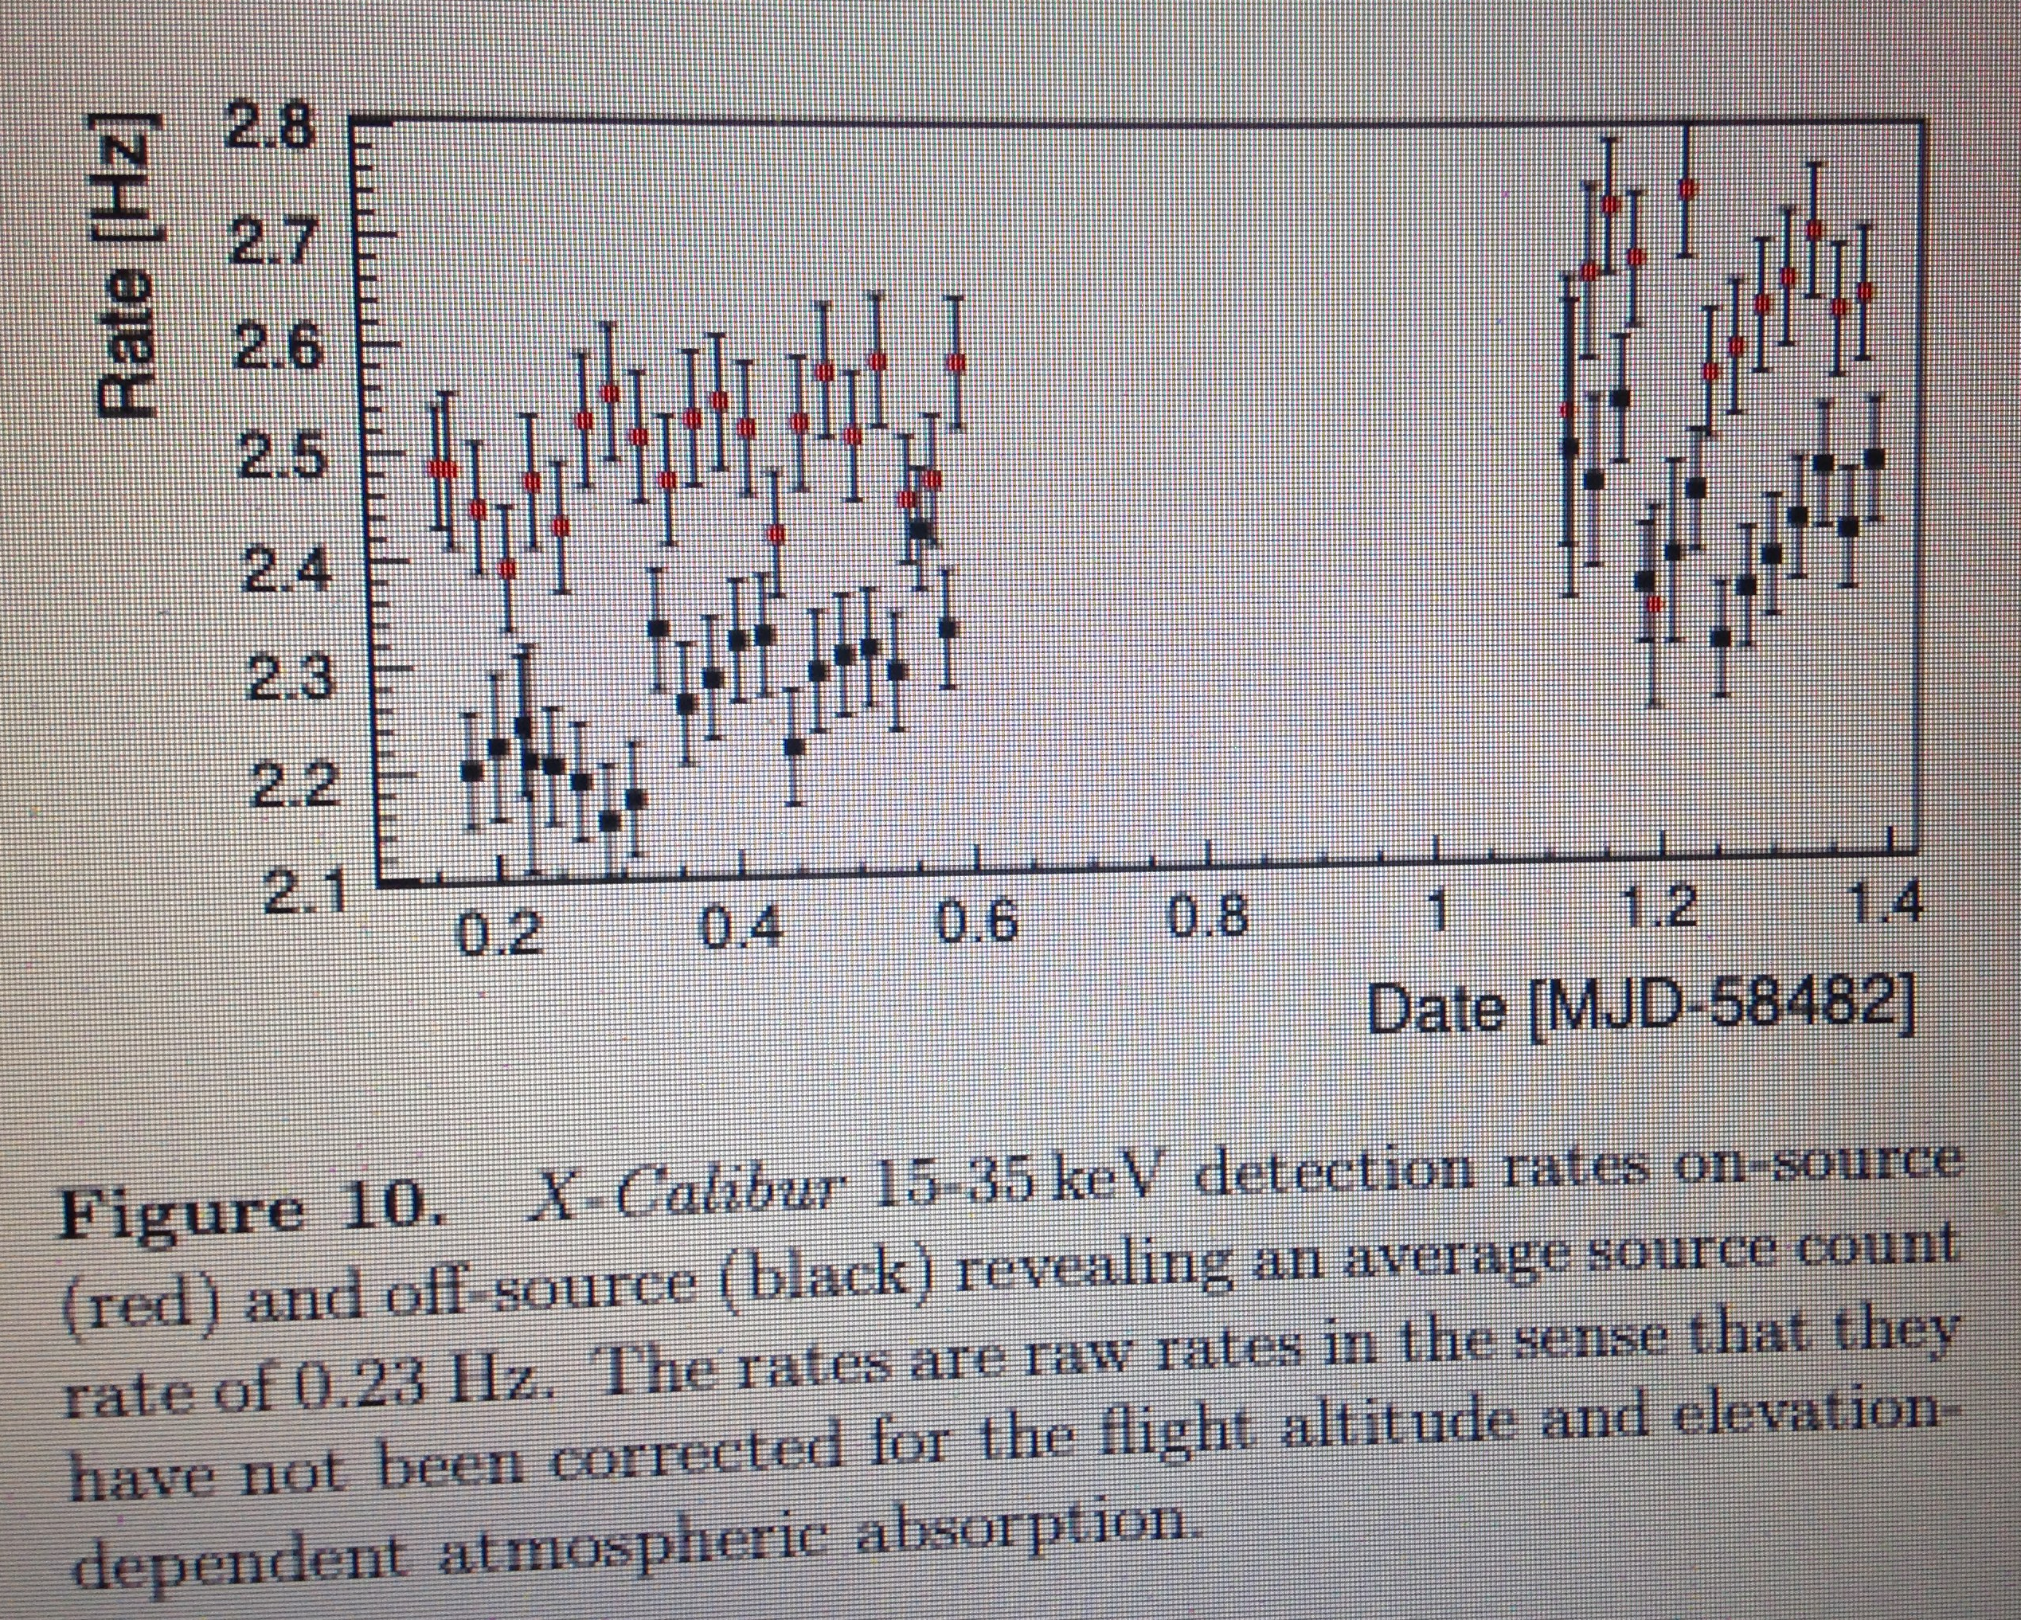
These first data from X-CALIBUR are very interesting because demonstrate the feasibility of focal plane scattering polarimetry. But some caution is needed. As a short term concern the freedom in the selection of targets is limited.
Long Duration Balloons are only launched from Arctic or Antartic sites
McMurdo, Antartica 78°S Longyearbyen, Svalbard 78° N
But the observation cannot be performed at too high inclination. Assuming that this must b < 35° we have that 𝝳<-43° or 𝝳>+43.
GX 301-2 is at 𝝳=-62° . A good choice for sure but not completely free.
Our freedom to select the target is very limited. Anyway this is typical in all balloon experiments.

Slide 42
But with a very heavy anticoincidence the background can be reduced so that the hard X-ray polarization of at least the Crab and Cyg X-1 have been very recently measured
SEE THE LESSON BY MARK PEARCE

Slide 43
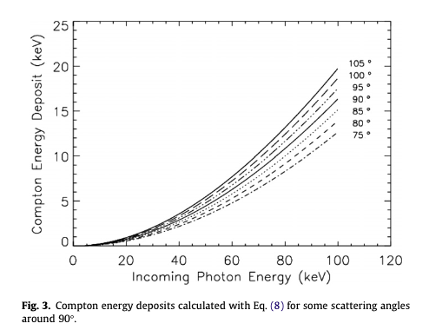
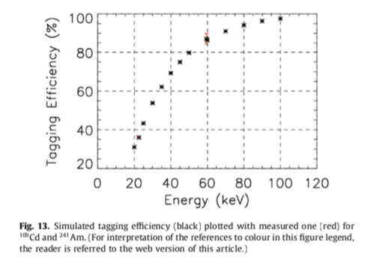
Limits of the focal plane scattering
In an experiment with an optics the huge advantage is that the photons from the source are to be compared with the background events in the psf. In a focal plane polarimeter the blurring due to the inclined penetration and the finite absorption thickness keeps this .psf to something ≤ 1mm².
In an experiment with focal plane scatterer the optics concentrates the photons of the source but the scatterer (which have a finite thickness) spreads them again on an array of detectors of several cm². You have seen on the previous slide that GX301-2 was 10 – 15% of the background.
In other term scattering polarimetry misses some of the basic requirements for a full exploitation of focal plane:The photon positioning is bad for intrinsic reasons
Morover the path from the scatterer to the deector will be very far from axial symmetry and the rotation is needed to compensate systematics. And this will not work unless we rotate exactly around the axis of the scatterer.
Another way to reduce background would be to have an active scatterer, namely e detector and take the coincidence between the scatterer and the absorber. The point is that at angles when the modulation is srong at low energies the energy passed to the compton electron is very low. We measured the tagging efficiency for a scatterer of pplastic scintillator.
X-Calibur is using (so far) a passive scatterer (Be) as SXRP would have done.

Slide 44
Photoelectric
The third process useful for polarimetry is photoelectric
We have shown that:
Photons surviving through an absorber
Photons emitted following a photoelectric absorption
Auger electrons emitted following a photoelectric absorption
Are unsensitive to Polarization
But
Photoelectrons emitted following a photoelectric absorption are very sensitive to polarization.
s-electrons (most from K but not only) are perfect analyzers of polarization namely have a cos² distribution around the electric vector. p-electrons have still a good modulation (energy dependent but of the order of a 60%).
But the distance scales are the problem

Slide 45
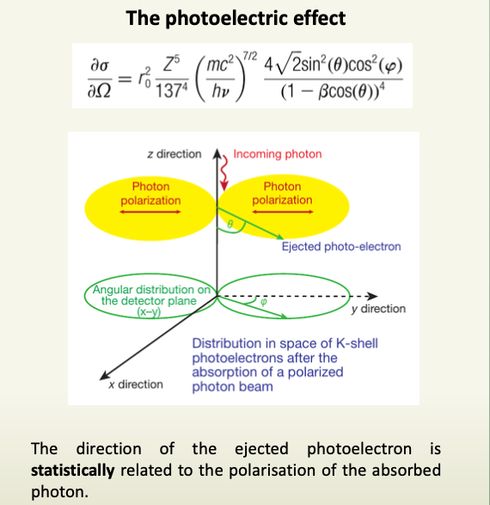
Photoelectrons
.
The s photoelectrons are an ideal analyzer of polarization with 100% modulation. (→ cos² distribution)
The p electrons are still highly modulated but the modulation depends on the energy and is in average of the order of 60%.
If the hν> Ek the s interaction are the large majority.
The photoelectron excite and ionizes the gas and is scattered. The ionization cloud is named the track and, at the beginning, brings the information on the polarization of the parent photon.
By analyzing the track we can reconstruct the interaction point and the initial direction of the photoelectron.
The range of an electron of 2 keV in Silicon is of the order of 0.2 µm. For a serious analysis we need at least 1/5 of this. This is why solid state is not viable so far.
This is why there is no alternative to a gas detector

Slide 46
Viability of Photoelectric in gas
When a photon is absorbed and an electron of the K-shell is ejected, with a kinetic energy equakl to T=hν-E_{k} .
In practice at the low energies organic gases or Ne and, at high energies, Argon are the only viable solution.
From this discussion we can state that:
If the track is well imaged the point of the first interaction ca be easily derived
The system can be built axis-symmetric
All the energy is released in the gas and can be measured
The background could be adequately understood and efficiently rejected because of rich information
A photoelectric polarimeter based on fine subdivision in gas is good for the focal plane
This is why we have built IXPE

Slide 47
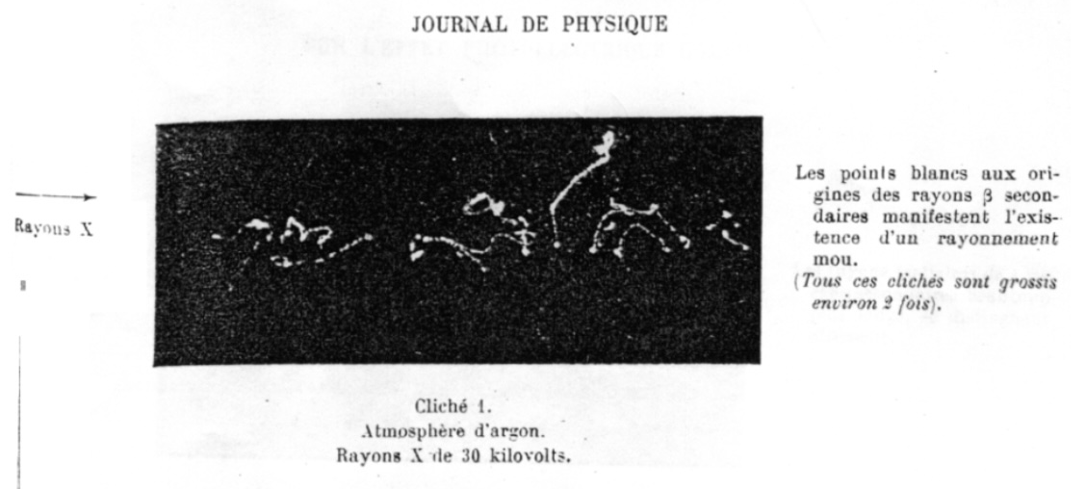
Ptoward photoelectric polarimetry
SXRP would observe a certain number of bright X-Ray sources and extend the sample of OSO-8. But for sure the exoloitation of the optics would be uncomplete.
And eventually the SRG satellite was never completed and launched due to the collapse of Soviet Union
At Marshall Space Flight Center in Hntsville (AL) and at Institite of Space Astrophysics of CNR in Rome (now IAPS) a R&D activity started in the ‘90s to perform photoelectric polarimetry
To perform polarimetry you have to image the track of the photoelectron in the gas and reconstruct the starting direction of the electron. This requires an imaging at sb.mm level as that performed by pierre Auger with cloud chamber in 1928.
The goal
Build a moderrn cloud chamber with electronic readout and self trigger suited for space

Slide 48
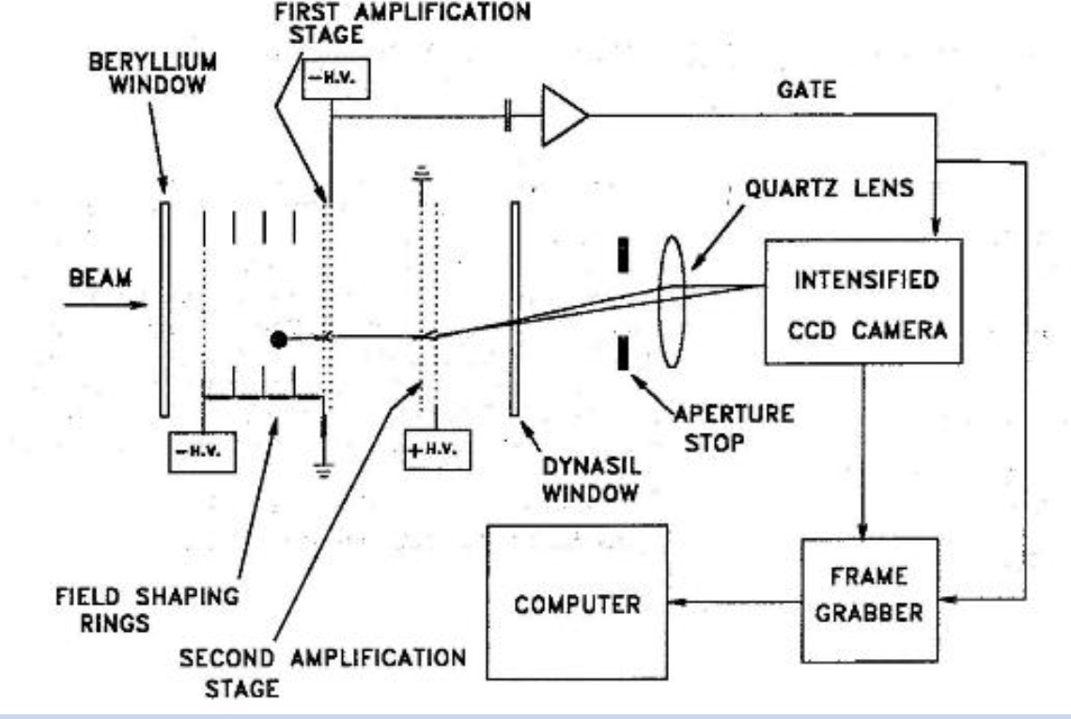
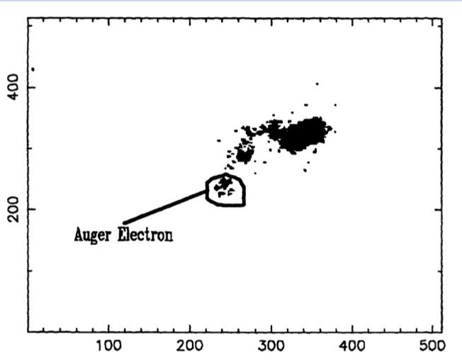
After SXRP in USA
SXRP would observe a certain number of bright X-Ray sources and extend the sample of OSO-8. But for sure the exoloitation of the optics would be uncomplete
At Marshall Space Flight Center in Hntsville (AL) and at Institite of Space Astrophysics of CNR in Rome (now IAPS) a R&D activity started in the ‘90s to perform photoelectric polarimetry
Optical readout as Auger with CCD instead than photografic film.
• The future IXPE Deputy PI Brian Ramsey & colleague Robert Austin
developed the first X-ray polarimeter to directly exploit the polarization
dependence of the primary photoelectron.
• Light emitted by electron avalanches in a parallel-plate proportional
counter was used to image the tracks of photoelectrons initiated by the
interaction of an incident x-ray with gas filling the chamber.
• The device lent itself for imaging polarimetry.
• Using Argon gas, the demonstration was for 54 keV X-rays.
image

Slide 49
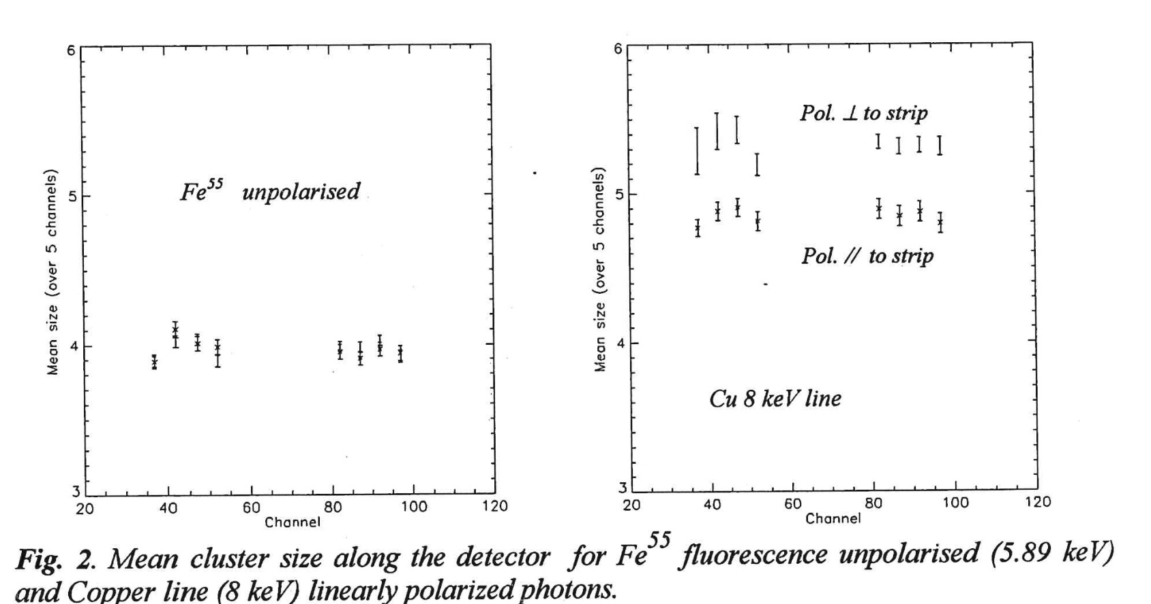
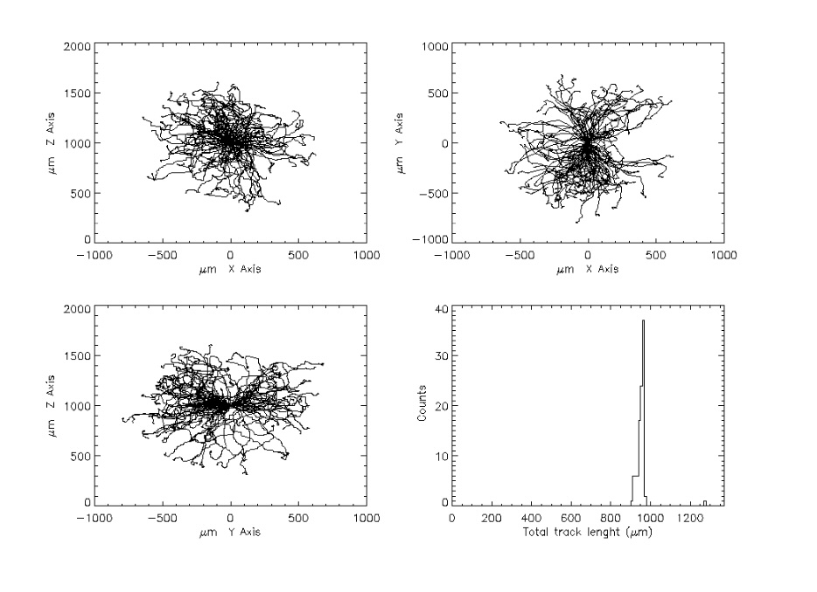
After SXRP in Italy
In the same time in Italy at Frascati CNR (now IAPS Roma) and Pisa INFN it was started an R&D activity.
The driver was to detect the image of the track with position sensitive gas detectors. Contrary to MSFC we started with 1-D images but already in the range <10 keV.
Poor images but the proof that the measurement were consistent with simulations and photoelectric polarimetry < 10 keV was feasible
NEXT STEP 2-D IMAGING THANKS TO THE TECHNICAL EVOLUTION OF MICROELECTRONICS

Slide 50
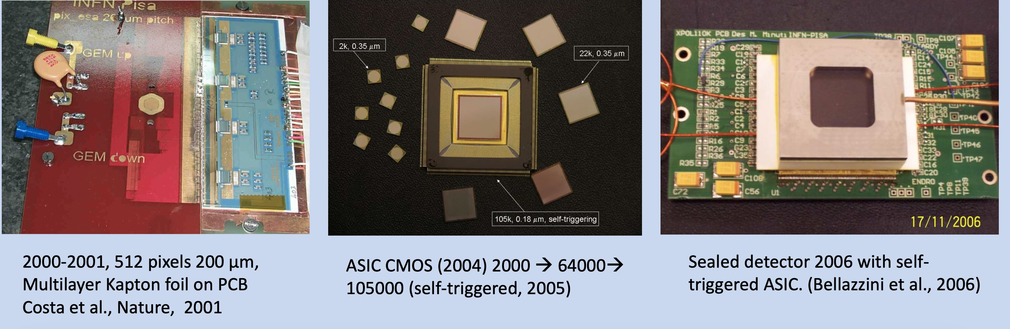
The optical read out was straightforward (quartz window, optics, CCD) the charge readout should face the difficulty to route the charge of each pixel, based on a metal pad on a honycomb matrix, to an independent electronic chain. In the first prototipe this was achieved with vias through layers of PCB and strips toward asic chips surrounding the gas cell. This was a prototype but it worked!
To increase the number of pixels Ronaldo Bellazzini designed ASIC chips hosting below each pad its electric chain. This configuration was compatible with a very compact sealed mounting.

Slide 51
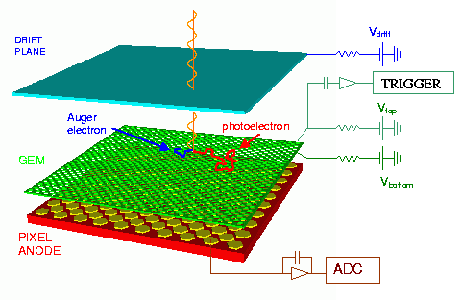


The Gas Pixel Detector a polarization-sensitive instrument capable of imaging, timing and spectroscopy
A Gas Pixel Detector with:
1 Atm DME 80% He 20%
10 mm absorption/drift gap
50 μm pitch GEM
Existing ASIC (100000 pixel, 50 μm pitch, auto-trigger, ROI)
E. Costa, R.Bellazzini et al. 2001
The core: an asic chip
Peaking time: 3-10 μs, externally adjustable;
Full-scale linear range: 30000 electrons;
Pixel noise: 50 electrons ENC;
Read-out mode: asynchronous or synchronous;
Trigger mode: internal, external or self-trigger;
Read-out clock: up to 10MHz;
Self-trigger threshold: 2200 electrons (10% FS);
Frame rate: up to 10 kHz in self-trigger mode
(event window);
Parallel analog output buffers: 1, 8 or 16;
Access to pixel content: direct (single pixel) or serial
(8-16 clusters, full matrix, region of interest);
Fill fraction (ratio of metal area to active area): 92%)

Slide 52


IXPE DETECTORS
The electrons drifting from the absorption point to the GEM are suject to a diffusion that blurs the track at increasing thickness. Therefore this thickness cannot be too large and is fixed to a value that maximizes the 𝛆^{1/2}µ product.
The efficiency is not tremendous 0.8 Bar DME 10mm thickness. But the use of the optics and the very low level of the background allow anyway for a jump of orders of magnitude in sensitivity with respect to OSO-8
With the 0.8 Bar/1 cm filling of Dymethilether the tracks are very well resolved.
The ASIC measures the charge of each pixel.
The analysis determines the impact point and the original direction of the electron.

Slide 53




From tracks to modulation curve
Image of a real photoelectron track. The use of the gas allows to resolve tracks in the X-ray energy band.
Real modulation curve derived from the measurement of the emission direction of the photoelectron.
Muleri et al. 2008,2010
Bellazzini et al. 2012
Modulation factor as a function of energy.
Residual modulation for unpolarised photons.

Slide 54

How to move from a concept and a prototype to a mission
The GRPD, also on the basis of experimental data, was suited to be the detector of a mission hosting X-Ray telescope or of small satellites .
Competing with the Time Projecrtion Chamber, a different detector, developed by Goddard (after us) with some commnalities and some important differences.,
The TPC drift the photons on the sideI. It is not really imaging and needs rotation, but is more efficient than GPD.
In 2007 GSFC proposed GEMS a small mission based on the TPC in competition with IXPE, based on the GPD. After one year GEMS was selected but on 2011 was cancelled due to programmatic difficulties.

Slide 55


Photoelectric effect to measure polarization of X-rays
Proposed missions to date
Mission | Date | PI
XMM | Late 80’ | G.W. Fraser (UK)
SXRP /SRG | Late 80’ Early 00’ | R.Novick (USA)
XEUS/IXO | 2007-2012 | R. Bellazzini (IT)
POLARIX | 2007-2008 | E. Costa (IT)
IXPE (OLD) | 2007 | M. Weisskopf (USA)
HXMT | 2007-2009 | E. Costa (IT)
NHXM | 2011 | G. Tagliaferri (IT)
LAMP | 2013 | H. Feng (China)
XIPE (Small) | 2014 | E. Costa (IT)
ADAELI+ | 2014 | F. Berrilli (IT)
SEEPE (ESA-CAS) | 2014 | S.Liu-P. Soffitta
XIPE M4 | 2014-2017 | P. Soffitta (IT)
IXPE | 2017+ | M. Weisskopf (USA)
Costa et al., 2001, Bellazzini et al, 2005,2006, Baldini et al., 2021, Soffitta et al. 2022

Slide 56





Linear Polarization, Image, Energy, Time
⁵⁵Fe
Bellazzini et al. 2006
Emiss. Direct.
Baricenter
Real modulation curve derived from the measurement of the emission direction of the photoelectron.
Conv.
Point
Muleri et al. 2016
Fabiani et al 2012
Energy, space and time resolved X-ray polarimetry
Position resolution < 120 µm (HEW)
Energy resolution as function of energy

Slide 57


The Vela PWN
Average polarization of 45%, larger than 60% is some, small regions → close to the Synchrotron limit!
High polarization suggests B less turbulent than expected.
Polarization consistent with radio, but X-rays sample regions closer to the site of acceleration.
(Xie et al. 2022)

Slide 58


SuperNova Remnants
Bleeker 2001
Allen ‘97
Rotating each photon with respect to the center and selecting the energy range between the calcium line and the Iron line we demonstrated that, as in radio, the polarization angle is perpendicular to the radius of the SNR as in radio band(Vink et al. 2022)
Notes:
Cas A’s 2–8 keV spectrum is dominated by K-shell line emission
from Si, S, Ar, Ca, and Fe, and continuum emission that is in
many regions dominated by synchrotron radiation we found that a priori the
3–6 keV band offered a better sensitivity for detecting polarization,
despite the presence of Ar-K and Ca-K line emission

Slide 59


Cyg X-1 Low-Hard state
  Cyg X-1 observed for about 250 ks in hard state, in coordination with NICER and NuSTAR
Krawczinsky, H. et al., 2022

Slide 60



Cyg X-1 in hard state
  Polarization degree (2-8 keV): 4.0+/-0.2
  Larger than expected given the ≈30° orbital inclination
  Misalignement between the inner accretion flow and the orbital plane?
  Flattish configuration of the emitting region
  Polarization angle parallel to the radio jet
  Observational evidence of link between disc and jet
  Sandwich Corona geometry favored. Lamp-post/Cone excluded.

Slide 61

Mrk 421: x-ray polarization angle rotation
During X-ray rotation millimiter-wave, infrared and optical polarization angle didn’t vary substantially.
Rotation in optical light is few-few tens of degree/day
PD_{X} was roughly constant and higher wrt Optical, Infrared and Radio
At GeV was in a quiescent state
(80º ±9º/day) (91º ±8º/day)
A model may explain the observed rotation is a shock propagating along the helical magnetic field down the jet.
Di Gesu L. et al., Nature Astronomy 2023

Slide 62
Conclusions
IXPE is really opening a new observing window!
As expected, significant polarization is rather common in X-ray sources
Not surprisingly, most of the detections are related to strong Magnetic Fields (PWN, SNR, Magnetars, X-ray Pulsars, Blazars)
But polarization by scattering is also often detected! (e.g. Cyg X-1, Cyg X-3, Circinus Galaxy, …)
In many cases, results (even upper limits) are discriminating between competing models, or challenging popular ones
For experimentalist it is time to think to new missions: Broad Band Polarimetry from 0.1 to 80 keV is the straightforward candidate

Slide 63

The only approved mission eXTP
The only X-Ray mission approved or in an advanced status of approval is eXTP
It includes 4 telescopes for a total area 5 timews IXPE
In the focus GPDs like those of IXPE improved especially to reduce dead time.
It would benefit of the larger area.
It would also benefit of contemporary data from other instruments: e.g. QPO phase from LAD.
A political block o the delivery of european devices to China induced a major chage in the e XTP design. In the case of the Polarimeter IHEP is developing new ASIC to sbstitute those from INFN.
Zhang, N. + 2020

Slide 64
A few criticalities of IXPE
Relatively narrow band.
Some soft objects are out of reach. E.g. isolated pulsars
SNR are observed where most are overwhelmed by unpolarized lines and continuum difficolt to disentangle
All cyclotron lines are out of range
Reflection bmp is out of range
Poor energy resolution
The structures arounf Fe K are not resolved
Low sensitivity
IXPE is an Exlorer in practice a pathfinder
Dead time
Impacting on a few sources
Charge build up in the detector
Can be corrected but is cumbersome
High background
For very weak and extended sources the residual BKG is hgher than in proportional counters. No pulse shape and no anticoincidence.
Spurious modulation
Should be prevented but can be calibrated
Contemporary observations
Limited as usual for LEO and solar panels at 90° from the f.o.v.
Slow reaction
A mtater of bdget that can be allocated to the Grond Segment
Bursts and flares from unexpected direction
Impossible with IXPE

Slide 65

Some guidelines: the band
The band of photoelectric detectors can be extended slightly to low energies, by SiN windows and low pressure but not much. The sub-keV range is definitely the domain of diffraction.
The extension to higher energies (up to 25-30 keV) is feasible with photoelectric detectors filled with pressurized Argon (2-3 atm, 2-3 cm) as computed and partially verified in the past.
The extension to energies 20-80 keV is feasible with focal plane scattering polarimeters as demostrated by XL Calibur. Active instrumets with low background should be rejuvenated.
Stacking in the focus of the same optics scattering polarimeters with gas polarimeters is one of the goals for the near future. The ASIC which is the basis of a photoelectric polarimetr is grown on a chip whose

Slide 66
Some gidelines: the sensitivity
New generation ASIC chips should improve sensitivity by:
3-D imaging of tracks
Better background rejection by rise-time and anticoincidence
Lower dead time
Larger field of view by tiling
Energy resolution can be slightly improved but not much
A moderate imprvement of efficiency is feasible with an adequate R&D. A more radical one by electronegative gas is to be studied but not sure.
Systematics as spurious modulation or charge build-up should be reduced or suppressend with a R&D activity

Slide 67
Some guidelines: future mission concepts or profiles
The improvement of the contemporary coverage could be achieved with:
Different solar panel position
Orbit far from Earth
Other instruments onboard (e.g. a X-Ray spectrometer or an Optical Polarimeter)
The reaction rapidity is mainly a matter of money
An instrument for bursts or other sources of unknown position require a large area that can be achieved with large scale tiling of ASIC chips or wiith optical read out
We should seriously consider that for bright sources also in a collimated instrument the background should be negligible. An instrument devoted to bright sources cold be much cheaper and much faster than the future missions.

Slide 68



A hint to the future from the recent past
But the photoelectric, thanks to the band, can be also operated with a collimator as in the UHURU Epoch.
PolarLight is the First (aand not necessarily the only).
Hua Feng 2017
For sur this can be repeated with a larger area and/or a broader band
Hong Li, 2018

Slide 69
The main choice
Should we propose a mlti-instrument X-Ray Astronomy mission including 1 or 2 polarimeters.
Or
Should we propose a multipolarimeter mission with some auxiliary instrumentatio?
This is a serious matter of discussion

Slide 70
THE END

