Slide 1
XGCD E-test suspensions
Anthony Amorosi and Haidar Lakkis of PML

Slide 2
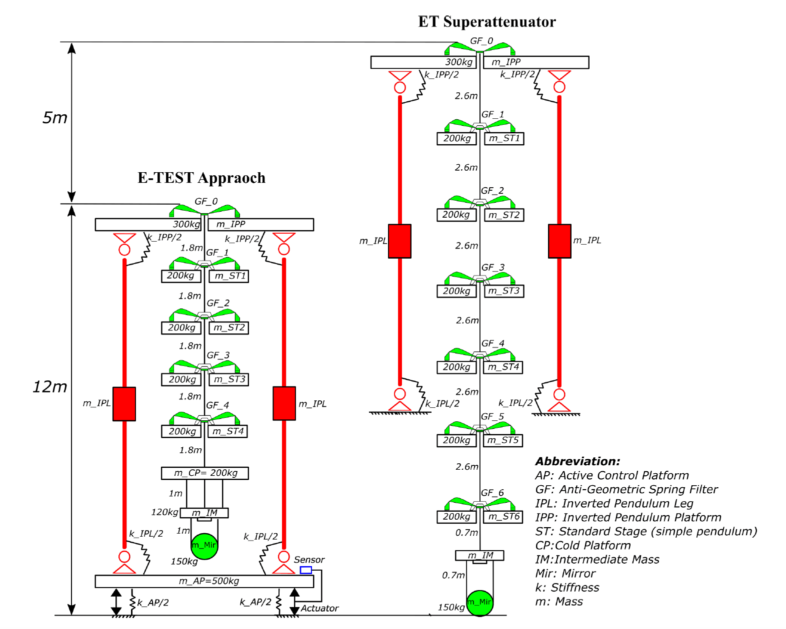
Hybrid isolation (Active + Passive)
Hybrid Isolation → shorter chain

Slide 3
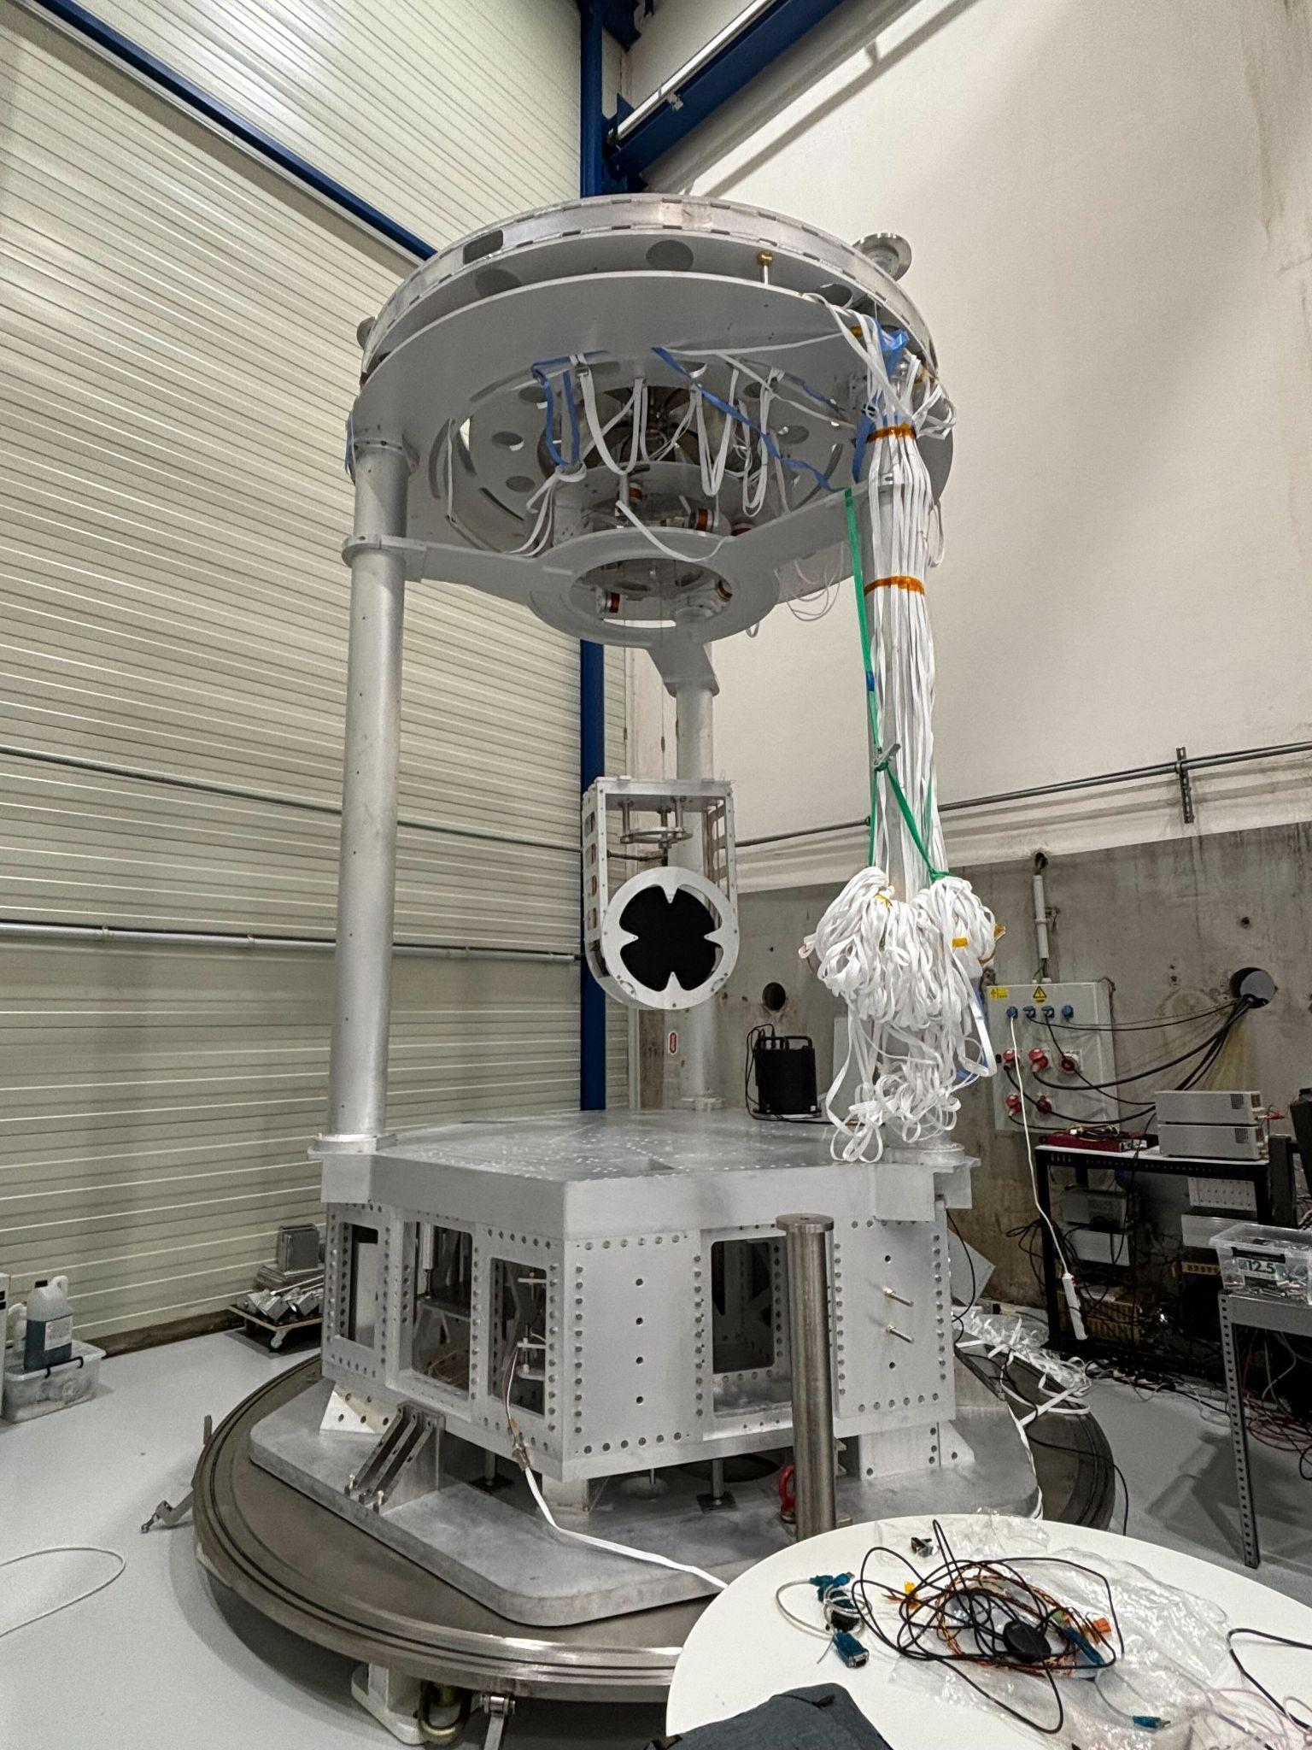
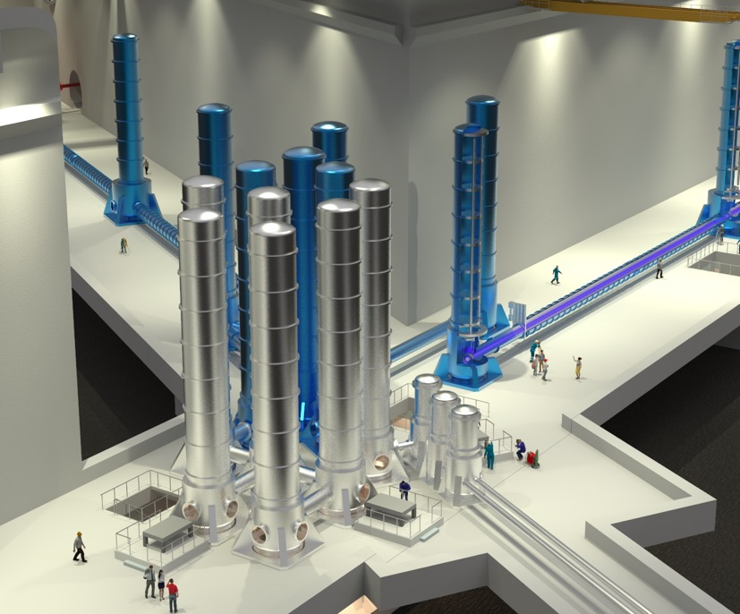
E-test
Large mirror (100 Kg)
Isolated at low frequency (0.1-10 Hz)
Compact suspension (4.5 meters)
Inverted pendulum
marionette
test mass
Active platform
Liège Space Center

Slide 4
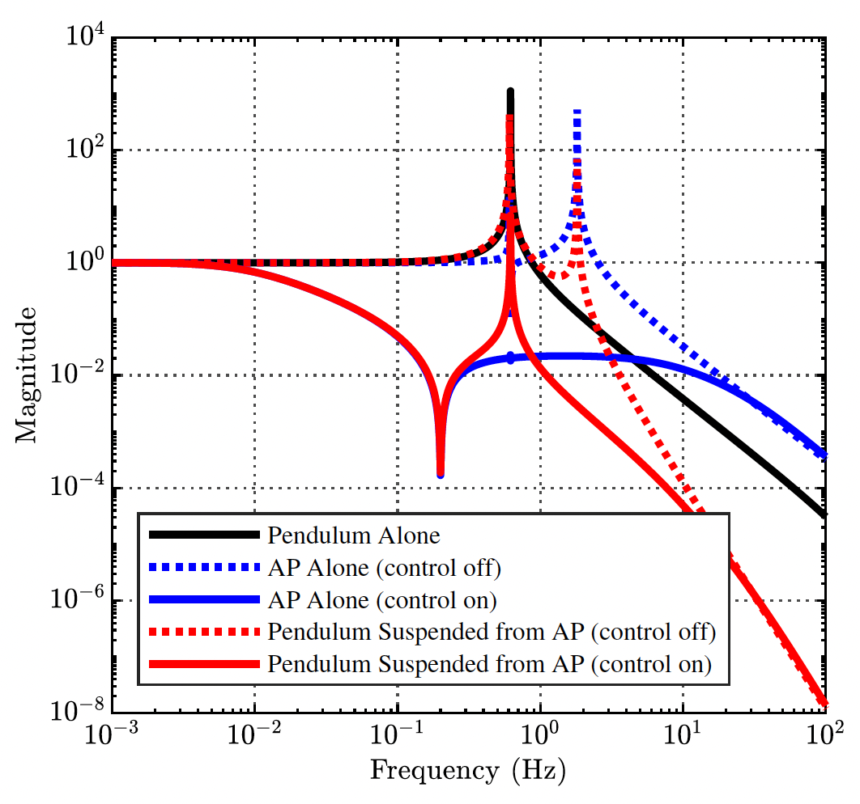
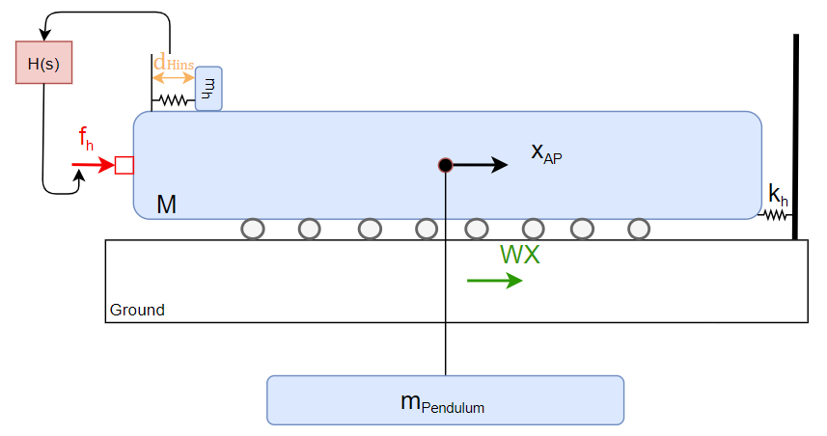
Active platform + pendulum
low resonance freq = long wire

Slide 5
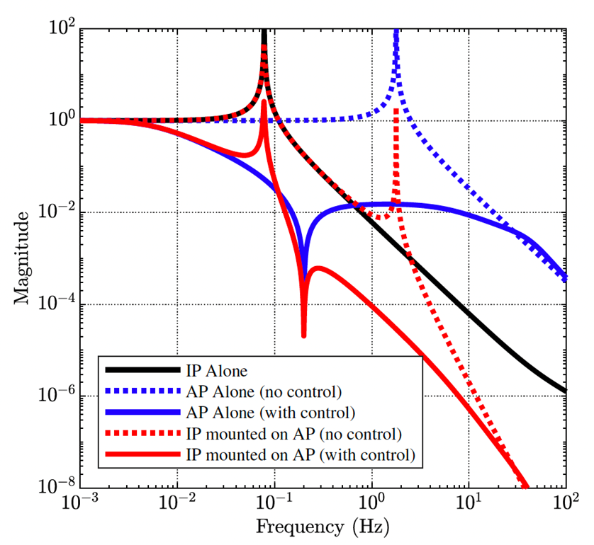
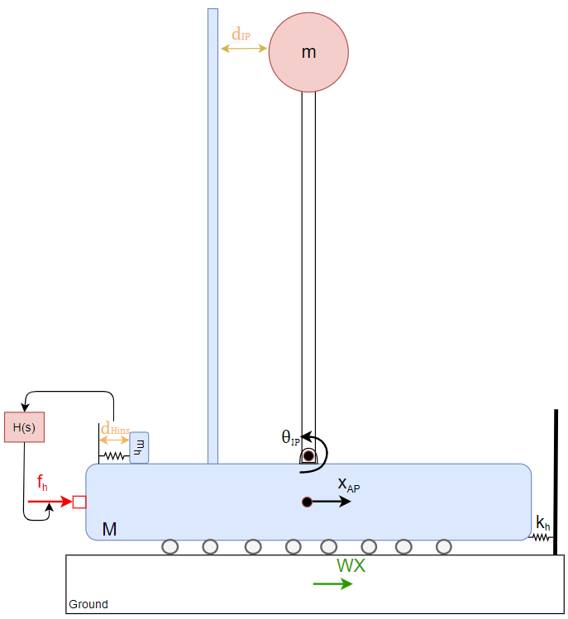
Active platform + inverted Pendulum
Why inverted Pendulum?
More compact
lower resonance frequency → more isolation

Slide 6
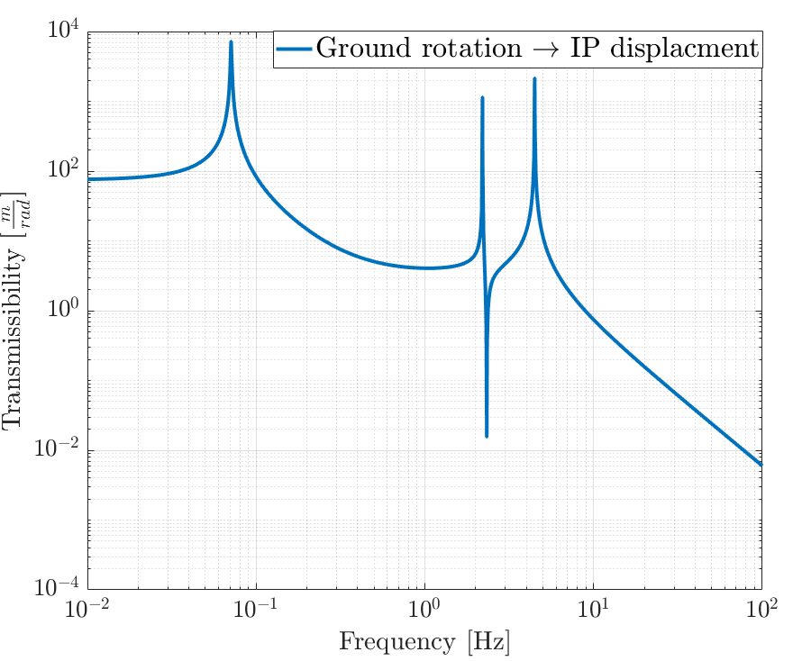
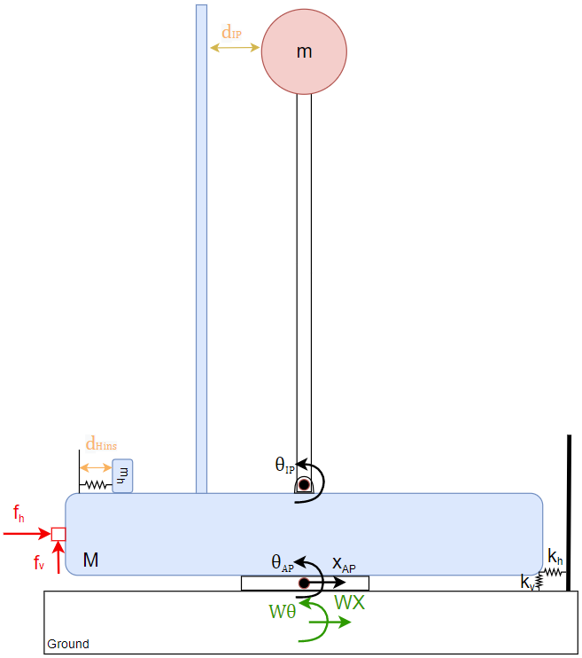
Active platform + inverted pendulum (+tilt)
High tilt-translation coupling from ground to IP
Can we use our IP as a rotation sensor? and feedback to the AP ?

Slide 7
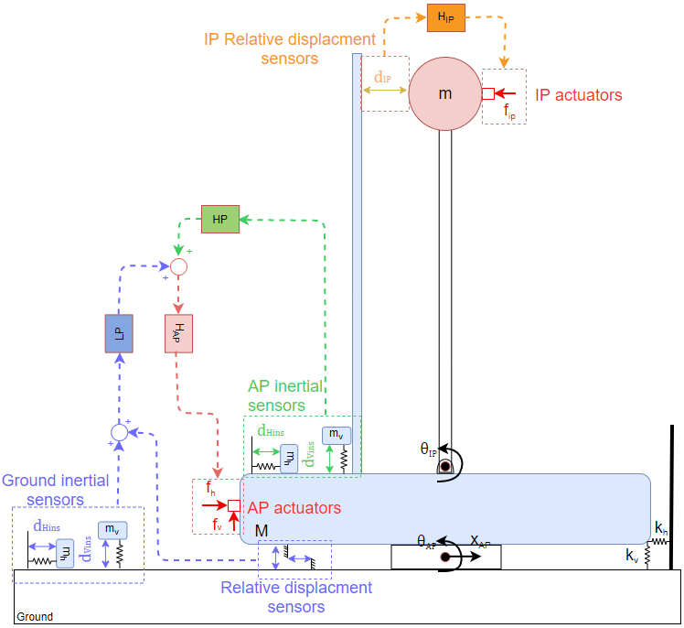
E-test Control Plan
E-test control plan:
For Active platform:
Inertial feedback (damping and isolation)
Relative displacement feedback + sensor correction (isolation)
For Inverted Pendulum:
Relative displacement feedback (damping)
Other potential ideas:
Feedforward ?
IP deisplacment to AP actuators ?

Slide 8
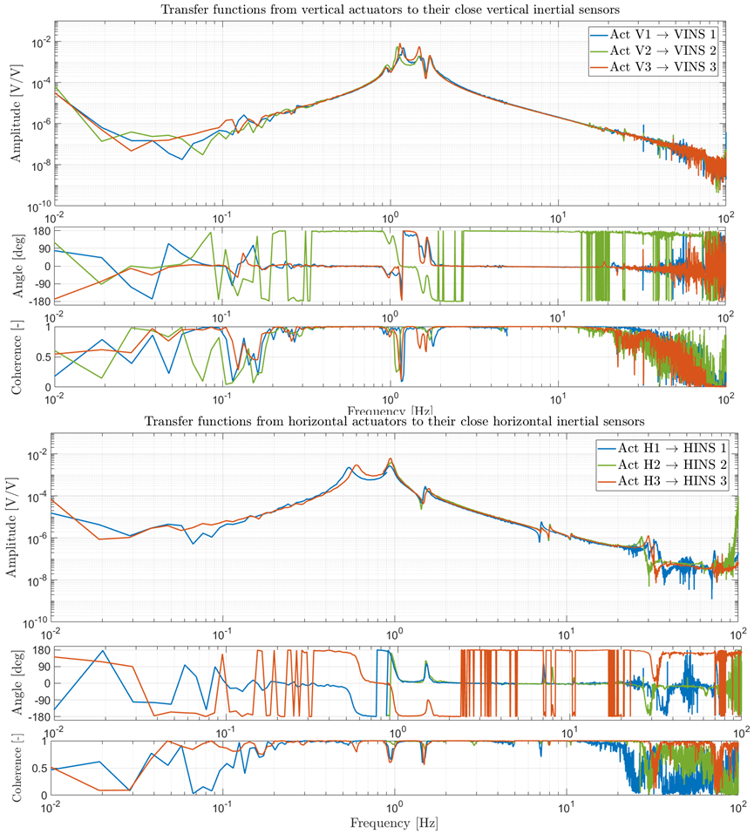
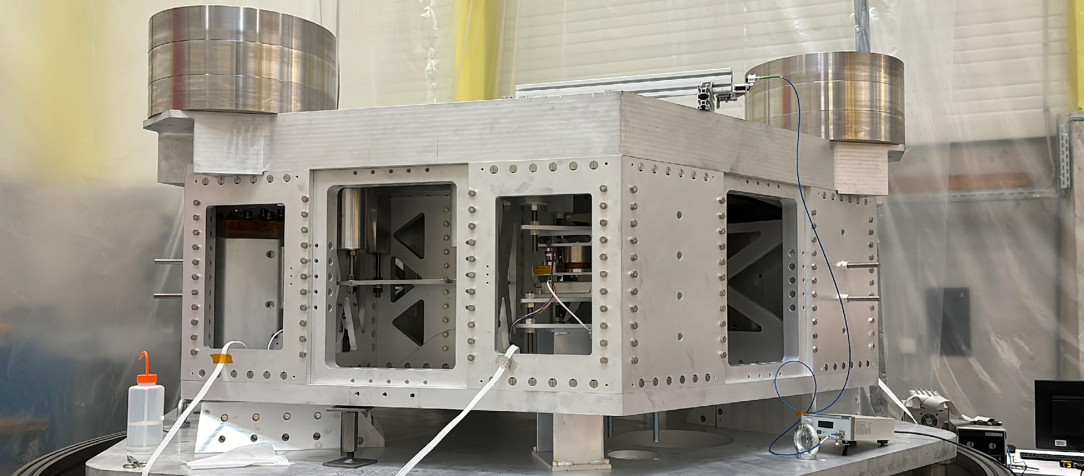
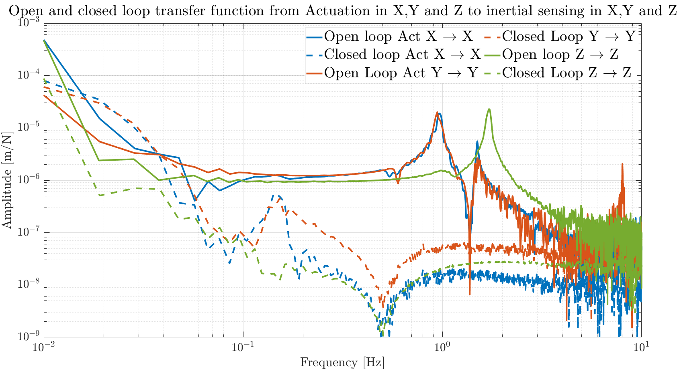
Active platform

Slide 9
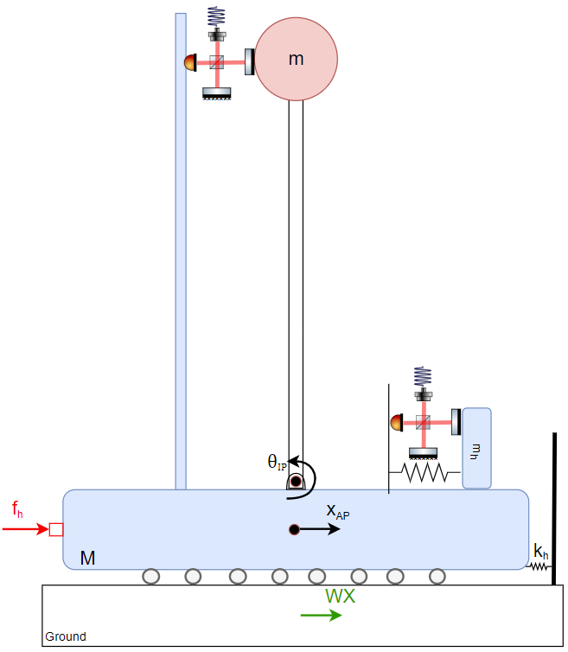
Optical sensing
High performance control calls for high performance sensing.
Optical sensing is probably the most promising technology for very high resolution sensing, commonly breaking through the pm-resolution.
Two types of sensors are required:
Relative displacement sensors: low-frequency blending, alignment & monitoring, decoupling, …
Inertial sensor: inertial control, sensor correction, feedforward, ...
Notes:
This is slide is for introducing the “concept” of high resolution optical sensing for control. The message is: “After you solve all control-related problems, sensor noise is your first limitation. For high isolation performance -> needs optical technologies”. Then I do here a kind of non-exhaustive litterature review of optical technologies for relative motion sensing and applied to inertial sensing.

Slide 10
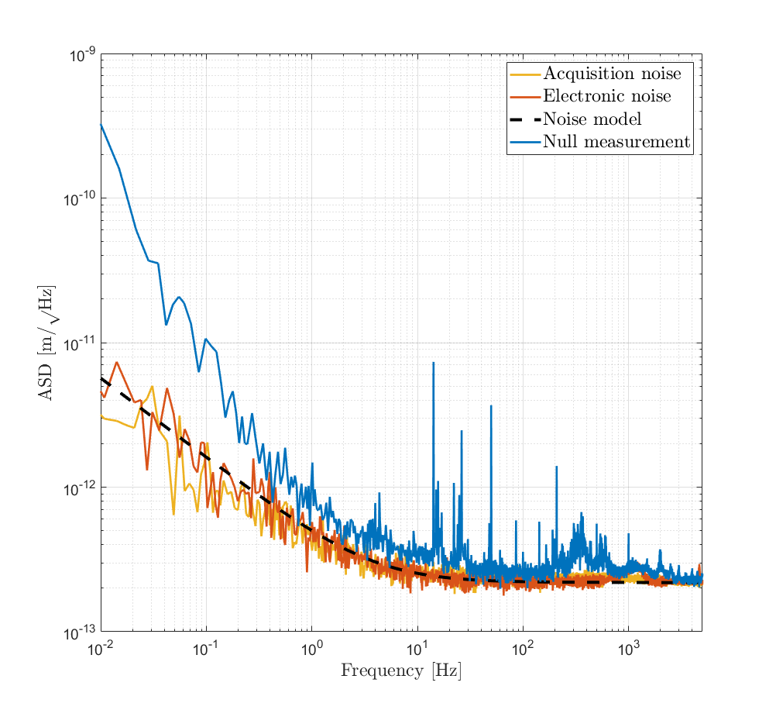
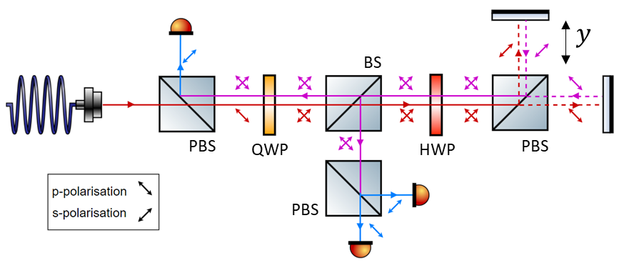
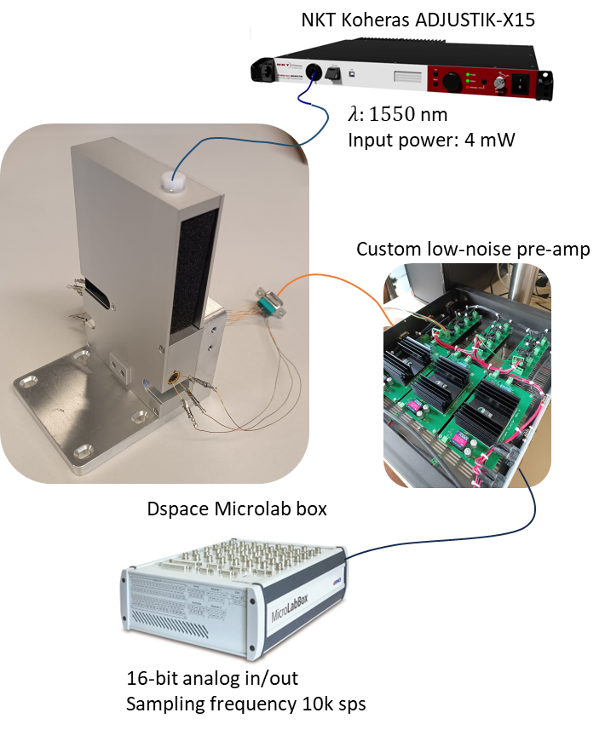
Example: interferometric displacement sensor
Homodyne quadrature Michelson interferometer.
Can demodulate displacement over multiple wavelength.
Notes:
This slide shows an example of the performance you can obtain with an optical relative motion sensor. I am showing only ours, but I believe it would be great to superimpose other technologies on that, but probably won’t have time…

Slide 11
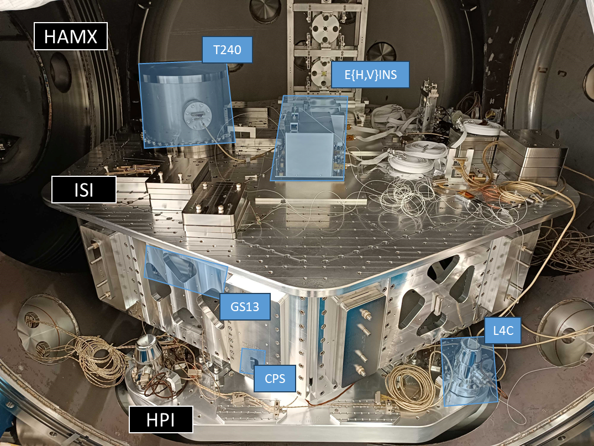
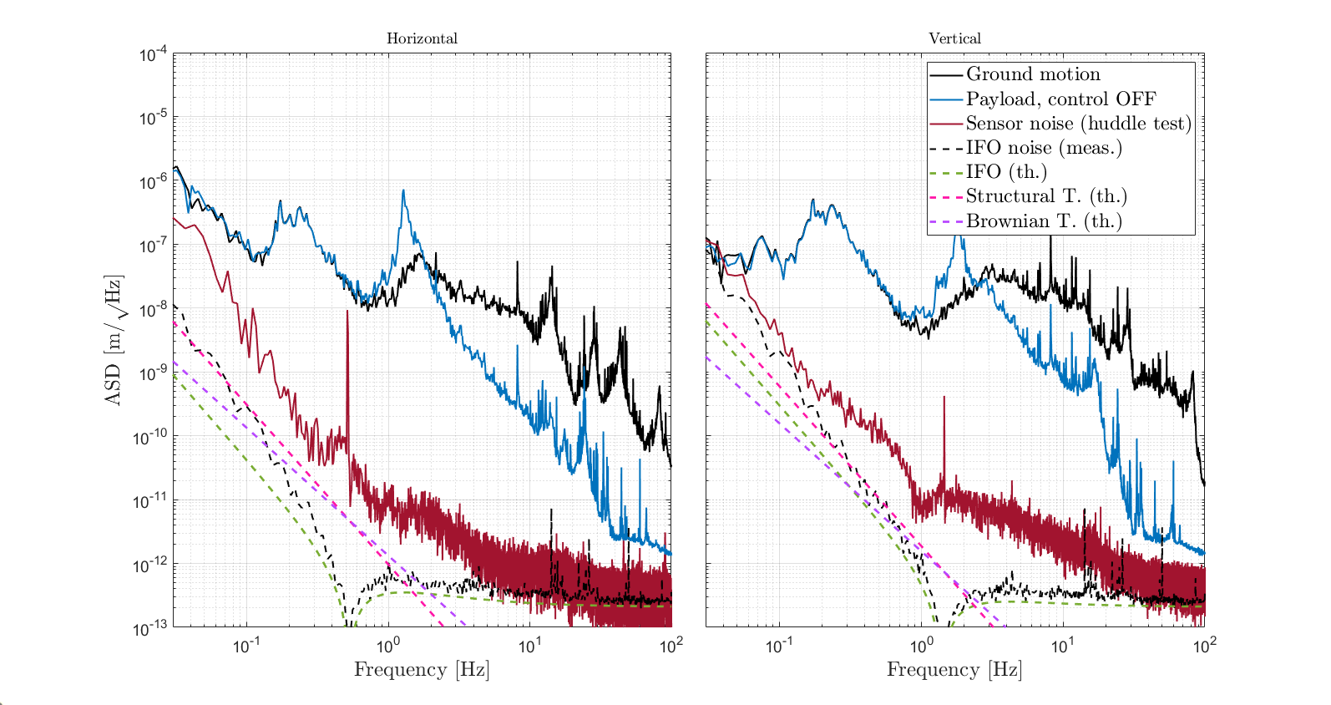
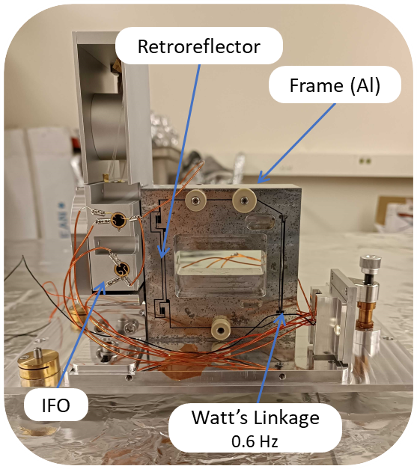
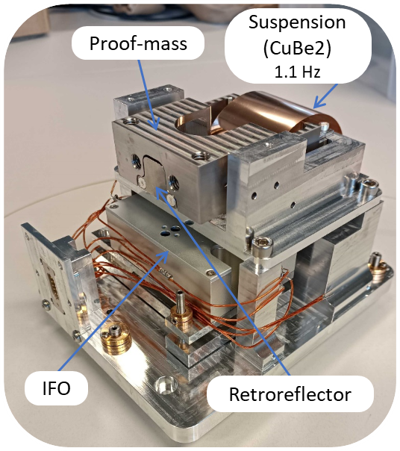
Example: interferometric inertial sensor
Test campaigns of inertial sensors usilizating a homodyne quadrature michelson interferometer on the LIGO MIT ISI table.
pm-resolution above the sensor resonance frequency.
Notes:
This slide shows an example of the performance you can obtain with an optical open-loop inertial motion sensor. I am showing only ours, but I believe it would be great to superimpose other technologies on that, but probably won’t have time…

Slide 12
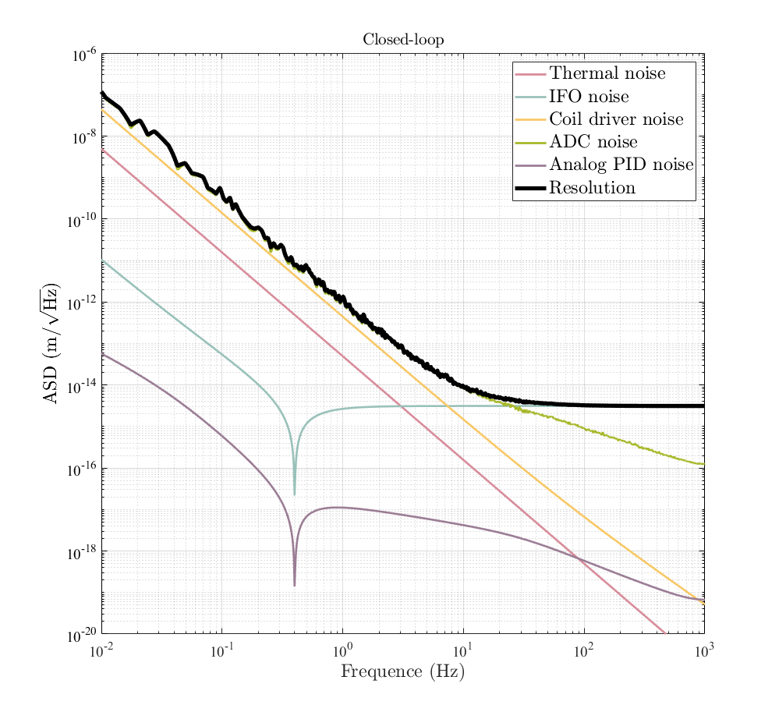
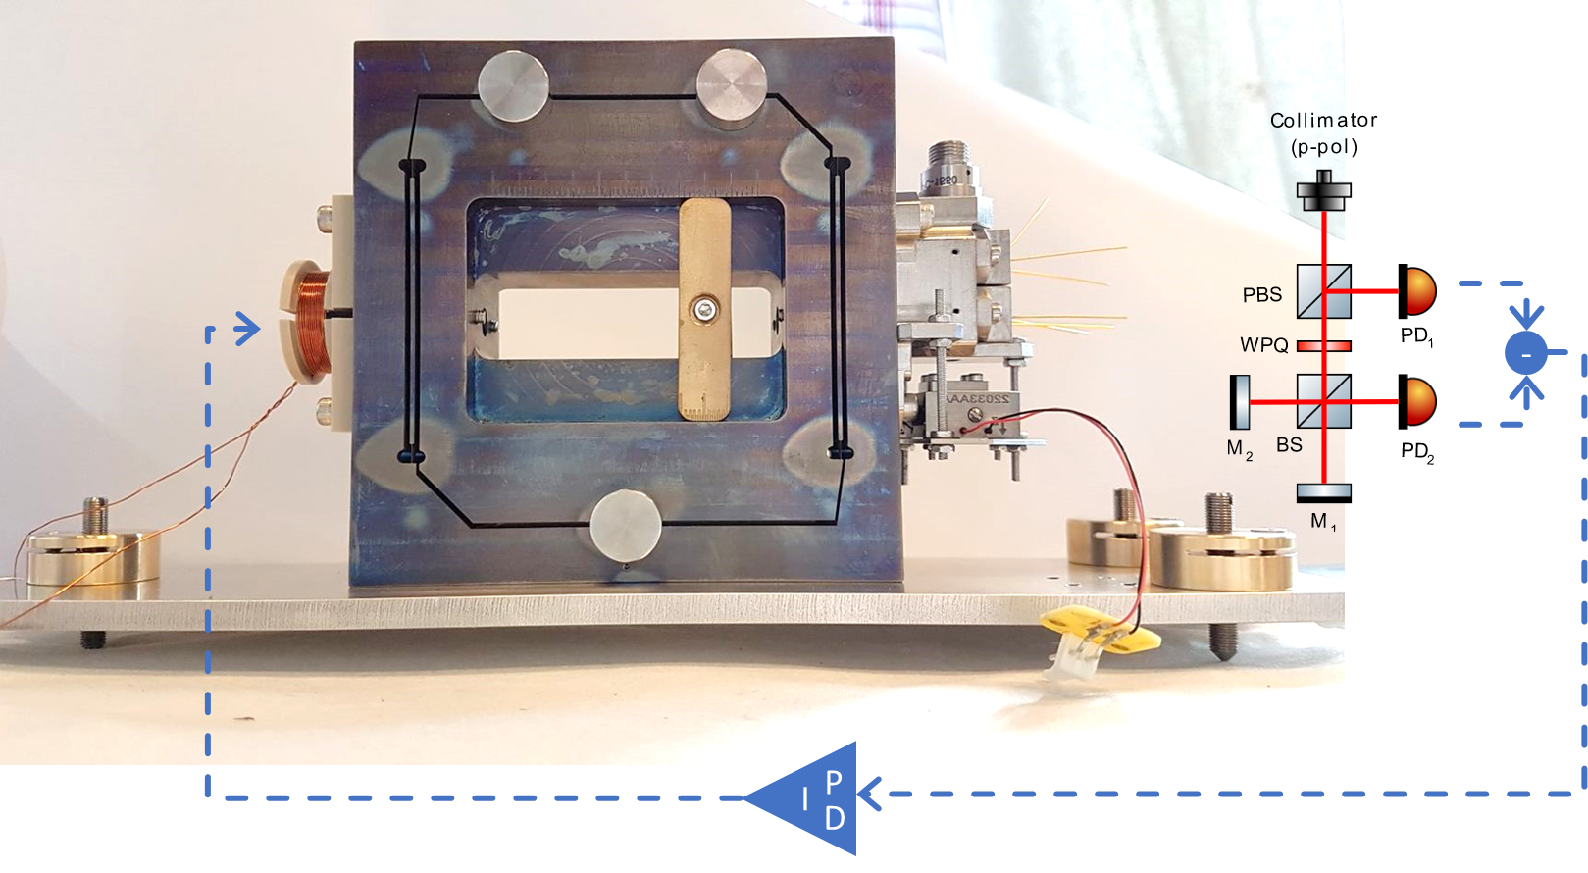
Example: optical accelerometer
Operating the optical inertial sensor in with a force-balance feedback scheme:
Eliminates non-linear behaviour of the optical readout.
Larger dynamic range.
(th.)
Frame (Ti)
IFO
Quadrupole actuator
Watt’s Linkage
Analog control loop
Notes:
This slide shows an example of the performance you can obtain with an optical closed-loop inertial motion sensor. I am showing only ours, but I believe it would be great to superimpose other technologies on that, but probably won’t have time…

