Slide 1
Positron Emission Tomography and Single-Photon Emission Computed Tomography in Neurology
Prof. M. Onofrj

Slide 2
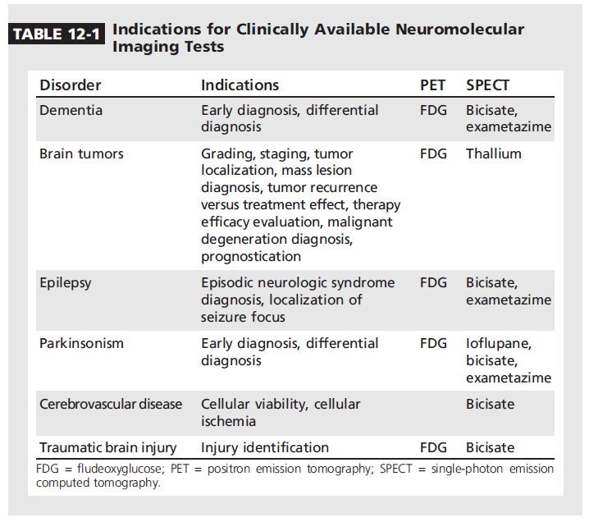
Positron Emission Tomography and Single-Photon Emission Computed Tomography in Neurology
PET in parkinsonism
PET in epilepsy
PET in dementia

Slide 3
Positron Emission Tomography and Single-Photon Emission Computed Tomography in Neurology
The clinical diagnosis of PD is incorrect 20% of the time
Early diagnosis and differential diagnosis of parkinsonism
hyperperfusion or hypermetabolism within the striatum
FDG-PET: distinguish PD from atypical parkinsonian syndromes with greater than 90% accuracy
PET in parkinsonism
PET in epilepsy
PET in dementia

Slide 4
Central SPM
All PET images sent to Hammersmith
Transformed into standard stereotactic space with an ¹⁸F-dopa template (all images have same size and shape)
Images combined into 'mean (SD)' baseline and endpoint images for each treatment group
Within and between treatment group analyses performed on a voxel basis (effective resolution 1cm)
Notes:
This analysis is regarded as the most objective, requiring the least subjective assessment of the PET scans, as it applies a computerised algorithm to the analysis, and does not rely on subjective visual determinations from human readers

Slide 5
Areas of significant reduction in ¹⁸F-dopa uptake
(p<.005; 100 voxels)
putamen
nigra
Levodopa
ropinirole

Slide 6
Central SPM* - Left & right putamen averaged peak voxel % change in Ki
Ropinirole (63)
L-dopa (58)
0
-5
Relative
difference: 38%
95% CI (4.24, 13.32)
p < 0.0001
Wilcoxon
-10
% Change in ¹⁸F-dopa uptake
-15
-14
-20
*Analysis of voxel of peak change
(1cm diameter sphere)
-25
-23
Significant difference in favour of ropinirole
Notes:
Central SPM analysis show that there was a mean reduction in putamen ¹⁸F-dopa uptake of 22.87% in the L-dopa group compared to only 14.09% in the ropinirole group.
This 38% relative difference was significant with a p value of less than 0.0001

Slide 7
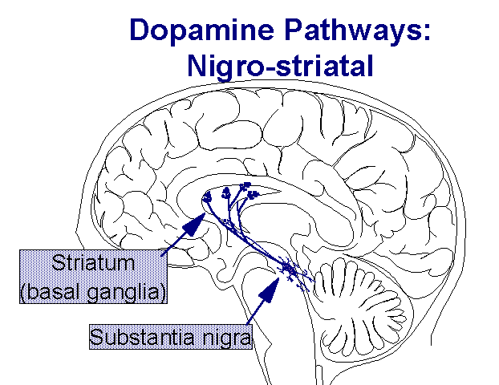
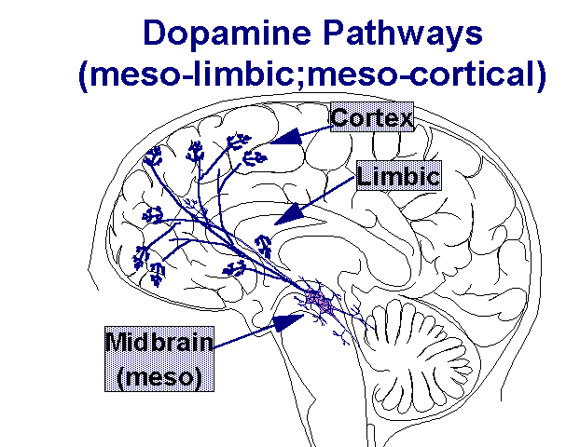
DOPAMINE SYSTEMS
dopamine-PET
[11C]FeCIT PET
DAT measures

Slide 8
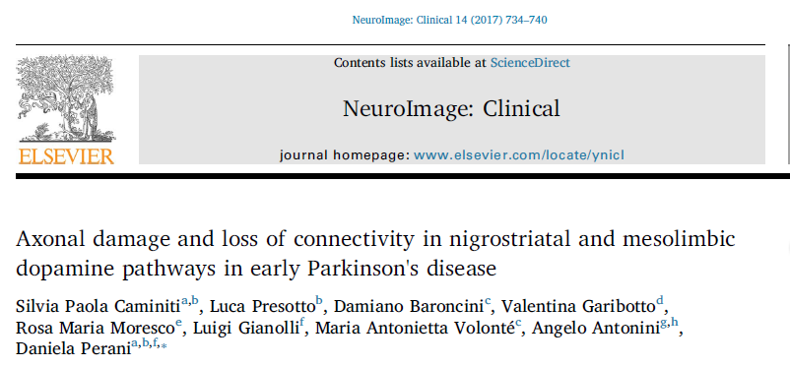
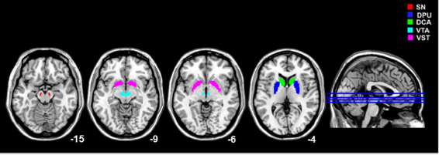
DOPAMINE SYSTEMS
[11C]FeCIT PET
DAT measures

Slide 9
Positron Emission Tomography and Single-Photon Emission Computed Tomography in Neurology
Differential diagnosis of episodic syndromes (epileptic spasms, tuberous sclerosis, Sturge-Weber syndrome, various congenital malformations, and even Rasmussen encephalitis);
help localize the epileptogenic zone in candidates for surgical resection
ictal SPECT at 96%, interictal SPECT at 44%, postictal SPECT at 75%, and interictal FDG-PET on modern equipment up to 90% for temporal lobe
epilepsy and 67% for extratemporal
epilepsy
PET in parkinsonism
PET in epilepsy
PET in dementia

Slide 14
Positron Emission Tomography and Single-Photon Emission Computed Tomography in Neurology
Early diagnosis and differential diagnosis of dementia;
positive PET amyloid imaging is a biomarker of brain amyloid-deposition
FDG-PET hypometabolism in the temporal and
parietal cortices and MRI atrophy in the temporal and parietal lobes are biomarkers of neuronal degeneration or injury.
FDG-PET was also best in discriminating AD from other dementias: AD has been hypometabolism or hypoperfusion in the temporal and parietal cortices
PET in parkinsonism
PET in epilepsy
PET in dementia

Slide 15
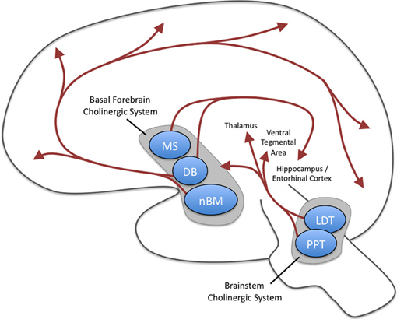
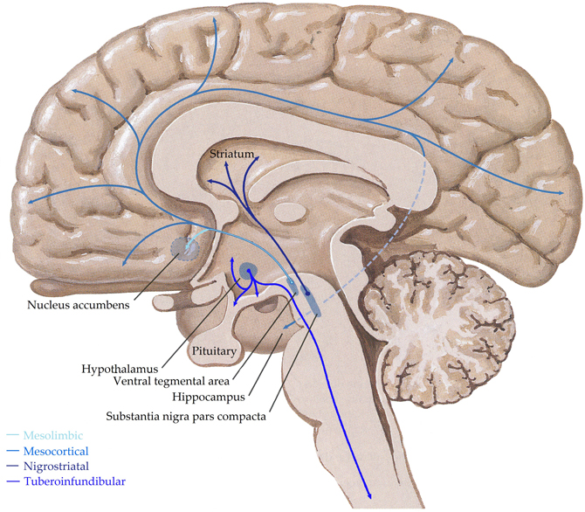
CHOLINERGIC SYSTEM
ACh-PET
[11C]-MP4A PET
AChE activity
AChE is membrane-bound predominantly on presynaptic cholinergic neurons and, to a lesser degree, on postsynaptic cholinergic neurons in the cerebral cortex

Slide 16
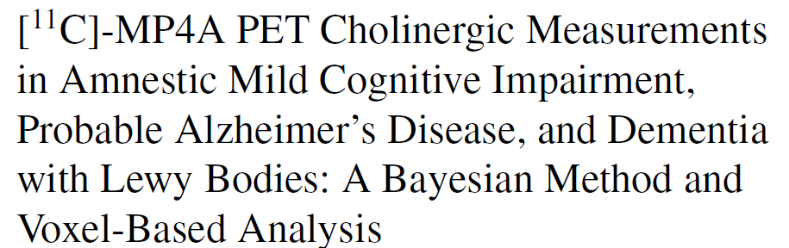

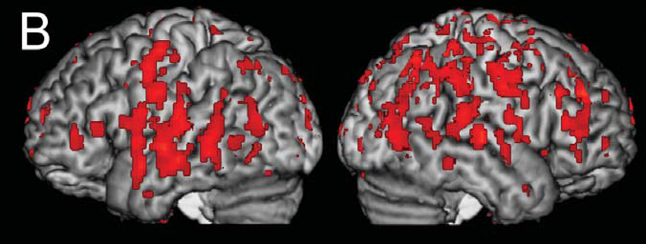
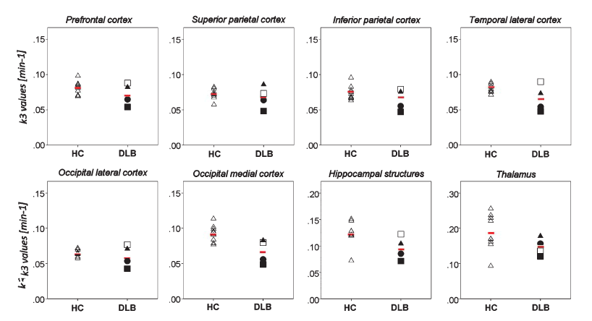
CHOLINERGIC SYSTEM

Slide 17
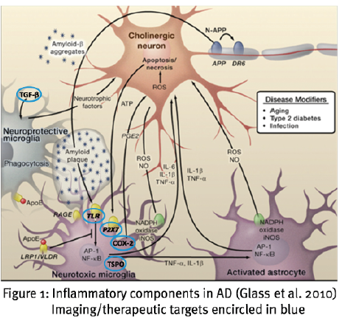
MICROGLIA ACTIVATION
11C-PK11195 PET
Microglia express the 18kDa translocator protein (TSPO) which can be quantified by the PET ligand (11)C]PK11195
TSPO-PET
REPAIR
TOXICITY

Slide 18
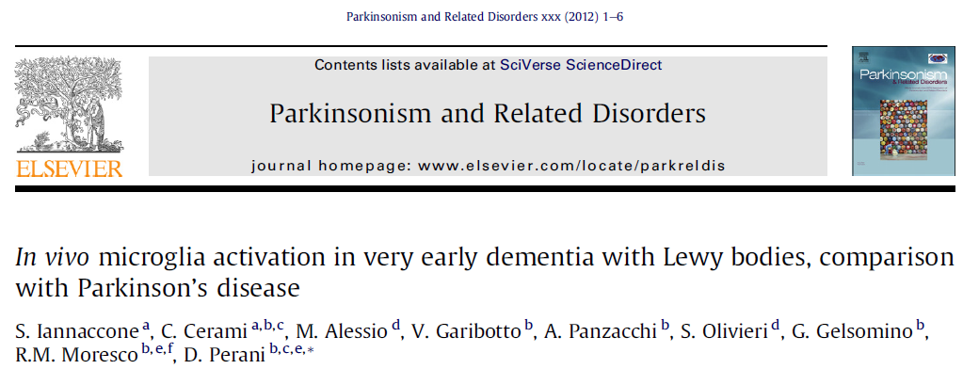
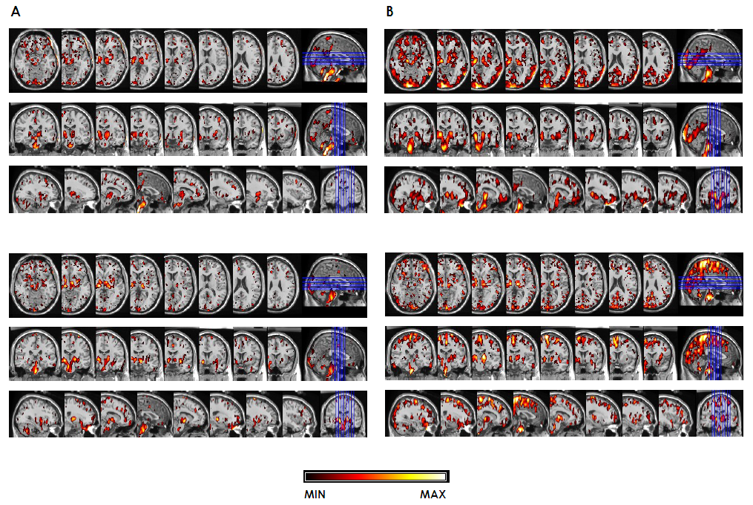
11C-PK11195 PET
MICROGLIAL ACTIVATION IN SYNUCLEOPATHIES
Statistic threshold: ** p<0.01, *** p<0.001
PD cases
DLB cases

Slide 19
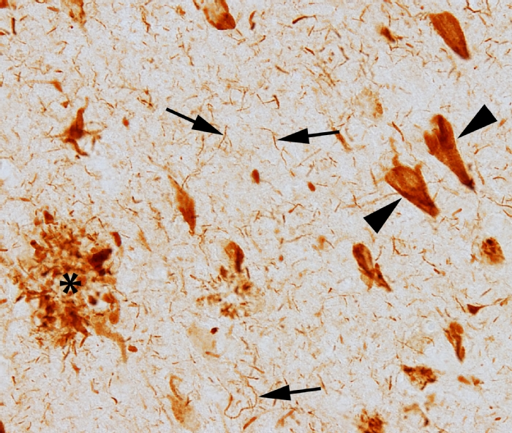
Tau-PET
¹⁸F-AV1451 ¹⁸F-THK5105
¹⁸F-THK523
¹⁸F-THK5117
¹¹C-PBB3

Slide 20
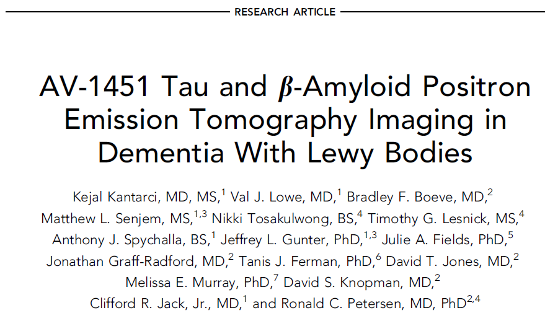
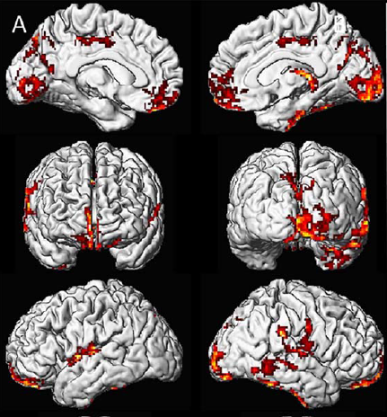
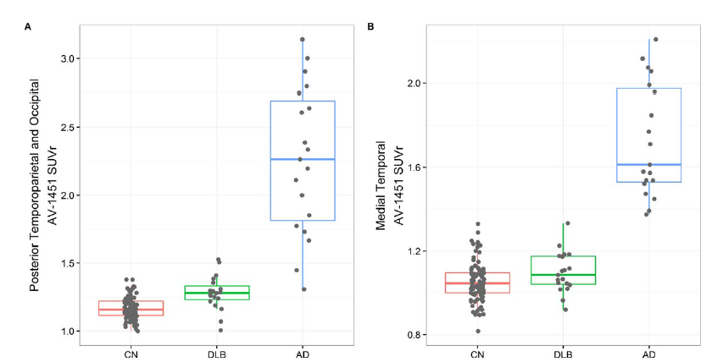
Medial temporal lobe AV-1451 uptake distinguishes AD dementia from probable DLB, which may be useful for differential diagnosis.
Elevated posterior temporoparietal and occipital AV-1451 uptake suggest an atypical pattern of tau deposition in DLB.

Slide 21


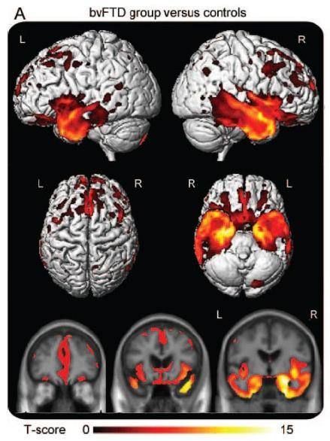
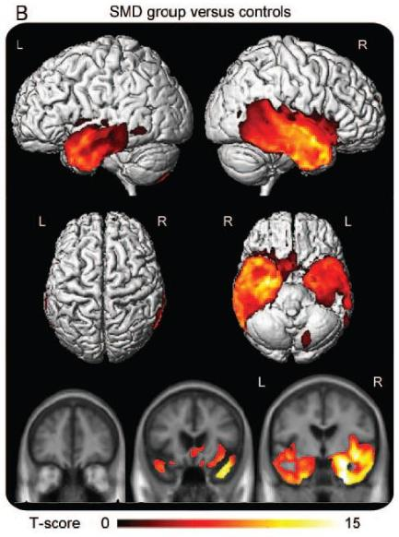
RIGHT TEMPORAL VARIANT
bvFTD
SMD

Slide 22
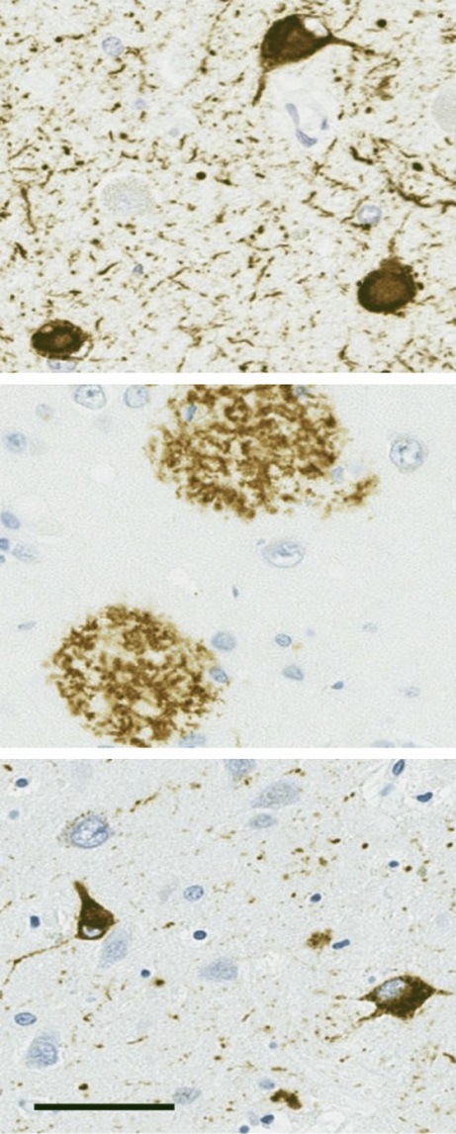
Future: α-synuclein PET
[11C]-BF-227
In DLB, a-synuclein is an important predictor of disease duration, both independently and synergistically with tau and b-amyloid.
Patients with diffuse Lewy body disease had more severe pathology of each type and a
shorter duration of illness
20% of 24% total variance in the model for duration of illness is accounted for independently
by a-synuclein

Slide 23
PET neuroimaging in
Neurodegenerative dementia
In vivo investigation of underline pathophysiological mechanisms
Supporting clinical diagnosis and differential diagnosis
Providing disease evidence in early and preclinical phase
Evaluating prognosis and risk progression
Monitoring therapy
Iaccarino L, Caminiti S, Perani D F2000, 2017
Nordberg et al. Nat. Rev. Neurol. 2015
Sanchjez-Juan et al. Neurology 2014

Slide 24
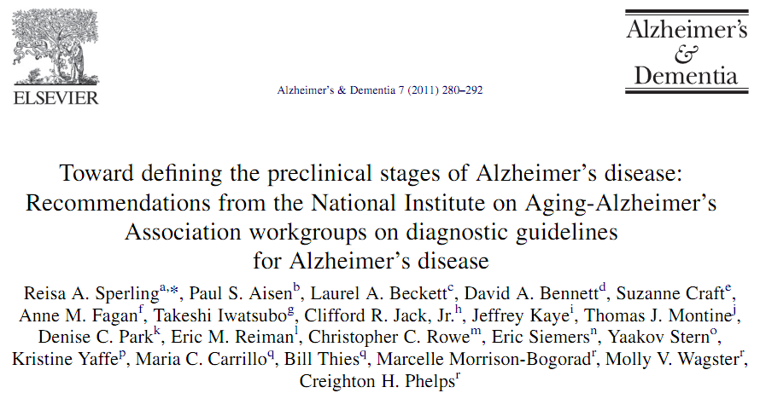
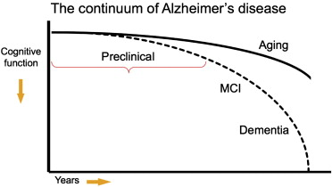
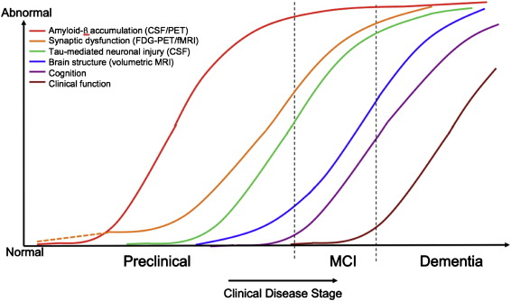
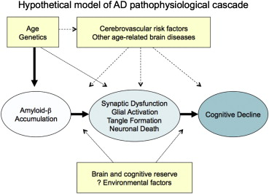
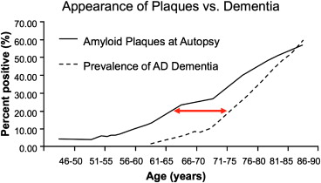
Dementia: new criteria but no new treatments

Slide 25
Amyloid-PET
[¹¹C] -PiB
[¹⁸F]- Florbetaben (Pyramal)
[¹⁸F]- Florbetapir (AVID)
[¹⁸F]- Flutemetamol (GE)
Amyloid load
(insoluble plaques)

Slide 26

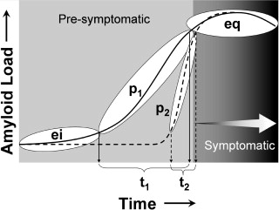
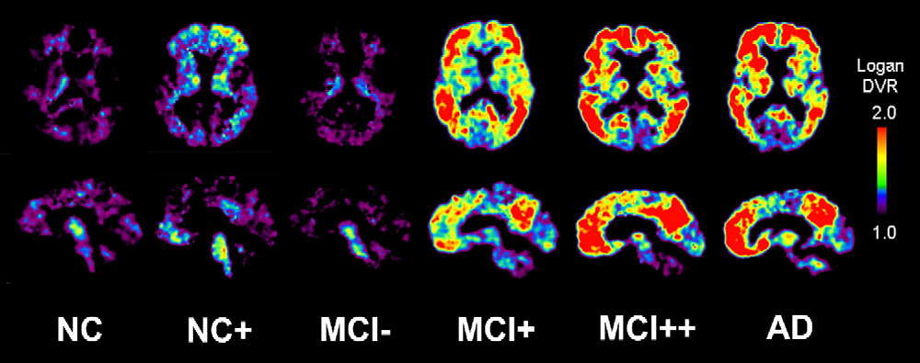
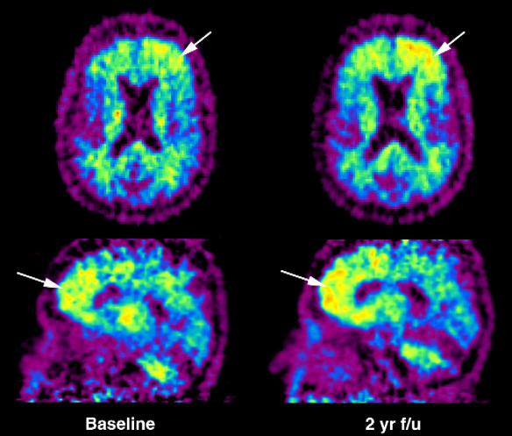
Transaxial and sagittal [11C]PiB parametric images of the reference Logan DVR using cerebellar tissue as input in an elderly NC at baseline and 2
years later. The subject shows increased and unilateral [11C]PiB binding in the FRC (arrows) over the 2-year period, perhaps suggesting a future course of
cognitive decline.
Notes:
Schematic diagram of the hypothetical progression of Aβ deposition over time from the early initiation (ei) phase to the continuously progressive (p) phase and finally the late equilibrium (eq) phase. Subjects may experience either a long (p₁/t₁) or brief (p₂/t₂) p phase of Aβ deposition, which snapshots such as those shown in Fig. 3 can capture at a single point in time. Cognitive symptoms may not be evident until the eq phase (MCI+, MCI++ and AD subjects in Fig. 3), but the cascade of pathological events that may lead to these symptoms (i.e., neurofibrillary pathology, synapse and neuron loss) may be initiated during the p phase

Slide 27
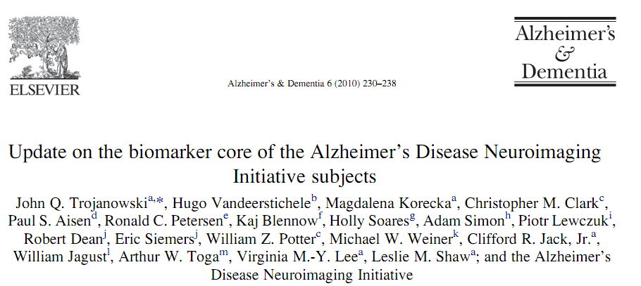
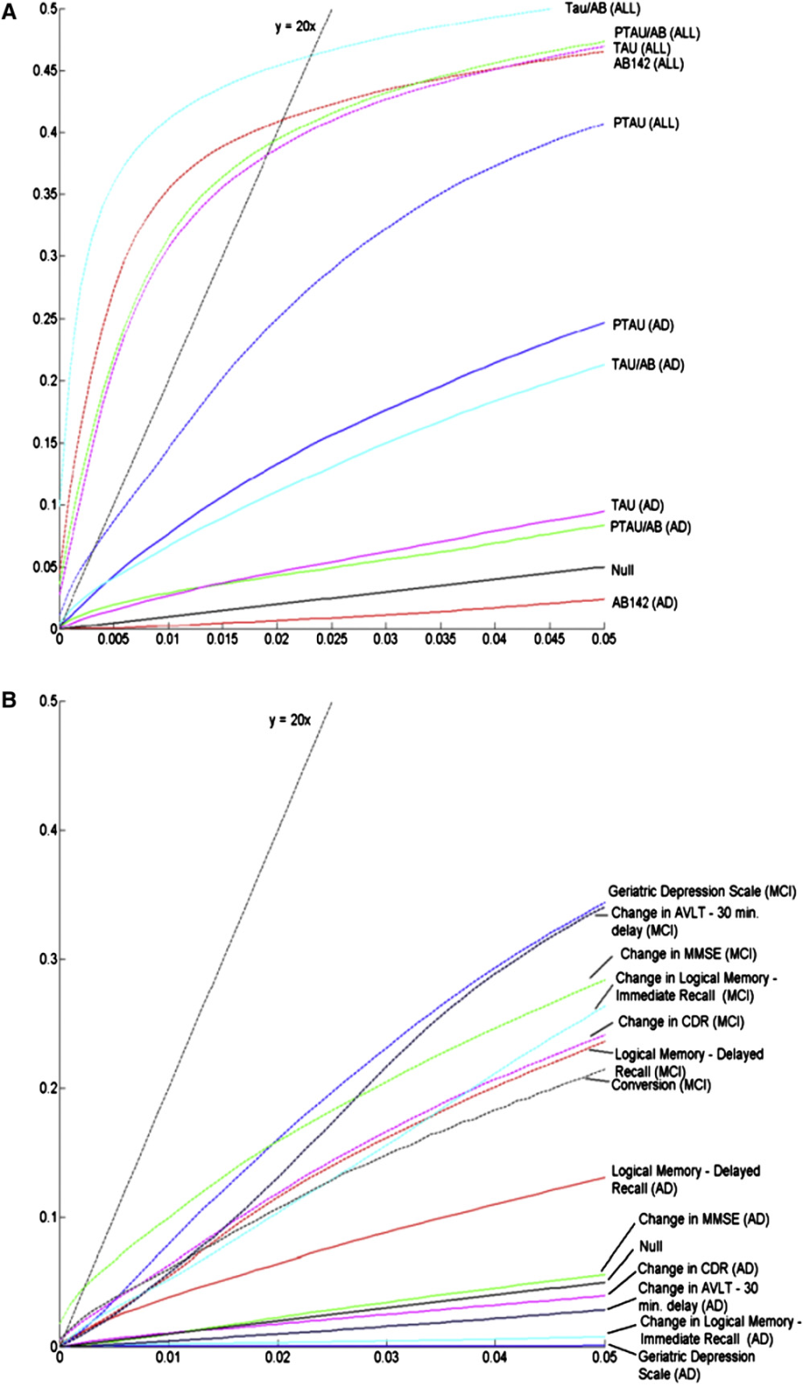
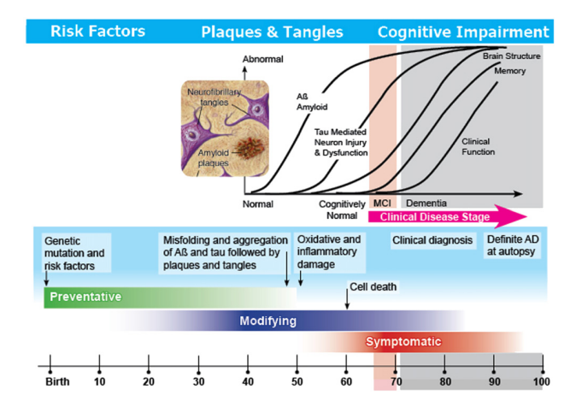
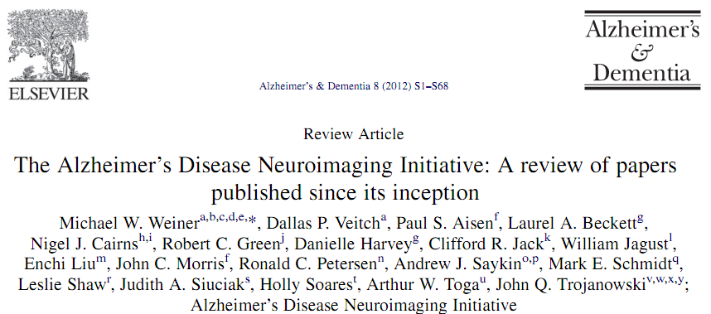

Slide 28
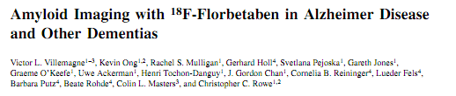
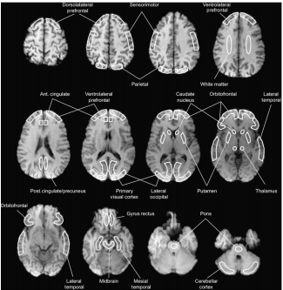
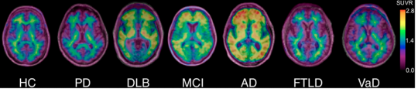
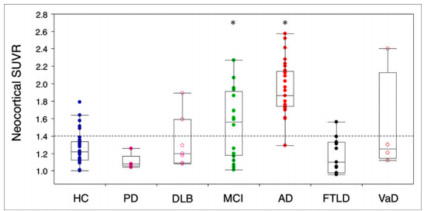

Slide 29
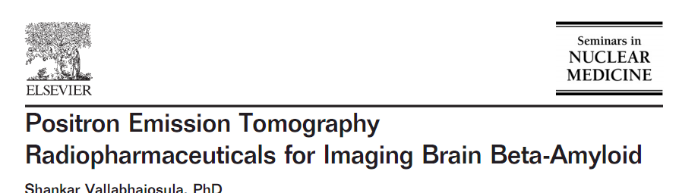
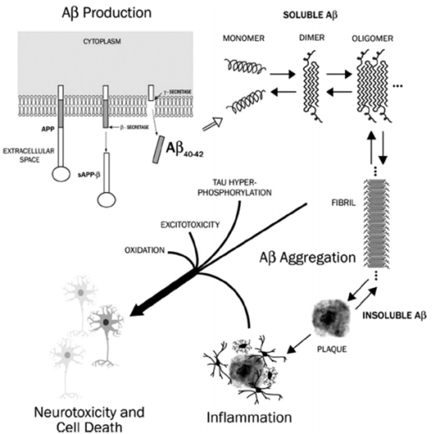
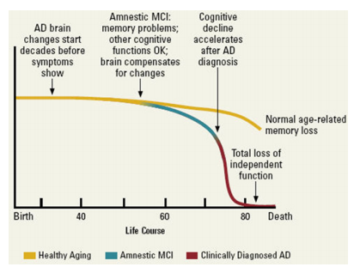
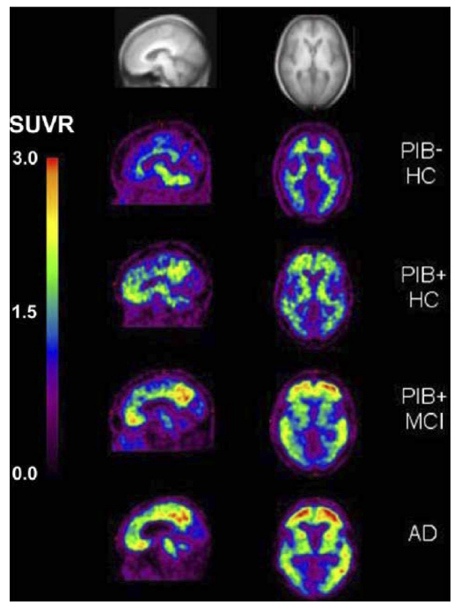
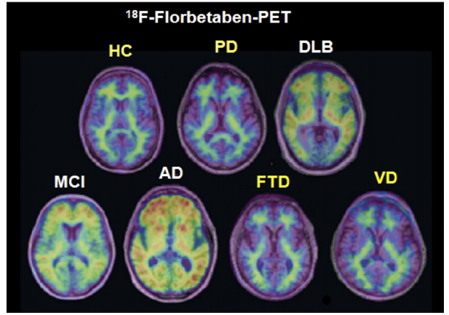
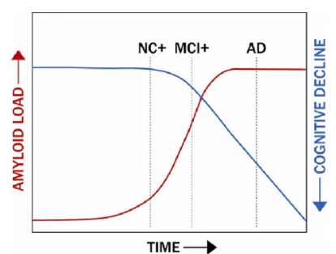

Slide 30
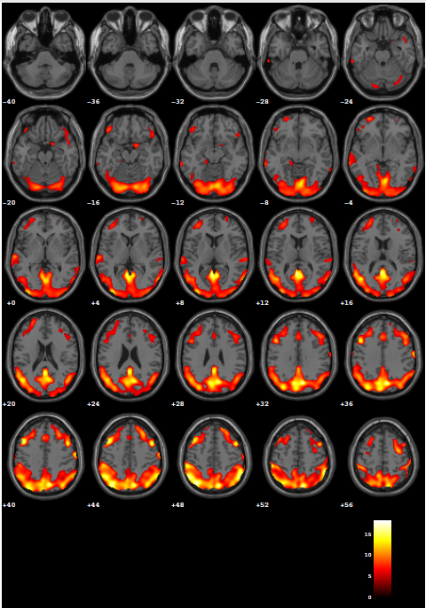
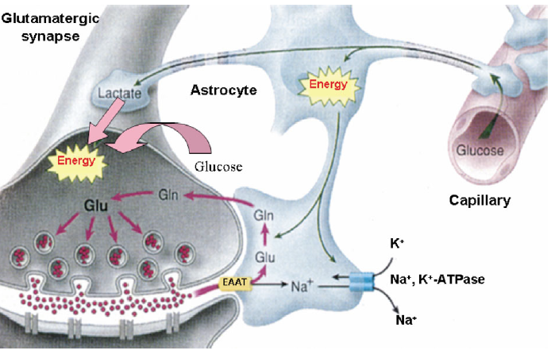
FDG-PET
[18F]FDG-PET is an index of integrated
local synaptic activity, and its signal has been associated to synaptic density and function
DLB typical hypometabolism
Magistretti, 2003

Slide 31
Statistical Parametric Mapping SPM
[¹⁸F]FDG-PET
VOXEL-BASED ANALYSIS
at a GROUP and SINGLE SUBJECT
LEVEL
Notes:
31
31
Validated topographical markers, such as FDG-PET temporo-parietal hypometabolism in AD, may reliably detect neurodegenerative disorders and can be used in addition to structural imaging to improve the diagnostic accuracy even at single subject level.

Slide 32

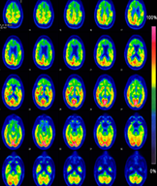
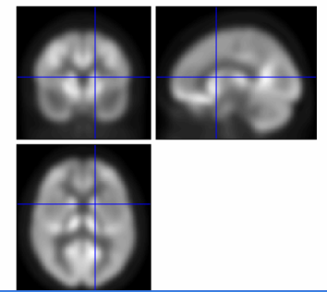

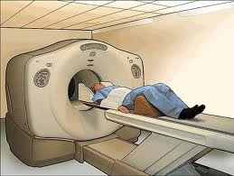
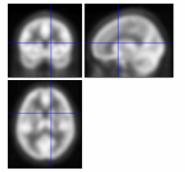
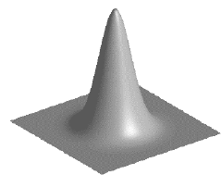
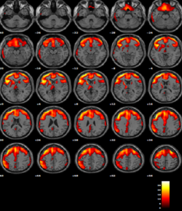

validation of the new SPM tool
Raw patient FDG-PET image
Della Rosa et al., 2014
FDG-PET Template
Spatial Normalization to a reference Template
SPM t-maps
smoothing
Statistical Comparison vs. a control group 112
Perani et al. 2014
statistical inference
Notes:
32
32

Slide 33

18F-FDG PET in DLB are characterized by
Decreased glucose metabolism in the posterior temporoparietal regions and cingulum

Slide 34


500 MBq of 99mTc-HMPAO

Slide 35




B(type 1); asymmetric uptakewith normal or almost normal putamen activity in one hemisphere and a more marked change on the other side
C (type 2) greatly reduced uptake in the putamen on both
D (type 3) the right and left sides; uptake virtually absent

Slide 36


Cingulate island sign
CIS is a PET sign, yet there are some evidences for fMRI and SPECT in its assessment
AD
Prominent temporoparietal hypometabolism and hypoperfusion
posterior cingulate gyri (PCG) is mainly affected even in early stages
DLB
Prominent occipital hypometabolism and hypoperfusion
posterior cingulate gyri (PCG) is typically spared in early stages
The 18F-FDG PET Cingulate Island Sign and Comparison to 123I-b-CIT SPECT for Diagnosis of Dementia with Lewy Bodies, Lim et al., J Nucl Med 2009
Clinica Neurologica Ospedale Clinicizzato “SS Annunziata” Chieti
Direttore Prof. Marco Onofrj

Slide 37

The Default Mode Network (DMN)
Interconnected set of brain regions that is active when the brain is in a resting state.
Typically deactivates during memory encoding and other cognitively demanding tasks focused on processing of external stimuli.
DMN includes the dorsal and ventral medial prefrontal cortices, medial and lateral parietal cortex, and parts of the medial and lateral temporal cortices.
DMN has been correlated with periods of autobiographical ‘task independent’, self-referential internal thought (e.g. ‘mind wandering’), during which the retrieval and manipulation of episodic memories and semantic knowledge occur.

Slide 38


Slide 39

In DLB a preserved activity of the posterior cingulate cortex (PCC), a main hub of DMN, is usually encountered.
This activity is defined as the "cingulate island sign", now considered a diagnostic marker of DLB

Slide 40

Multiple system atrophy had reduced DMN activity compared with controls and PD with hallucinations, and no differences with PD (early or severe) without hallucinations.
In PD with visual hallucinations, activity and connectivity was preserved compared with controls and higher than in other groups.
In early PD, connectivity was lower than in controls but higher than in multiple system atrophy and severe PD without hallucinations

Slide 41



Default Mode Network in Dementia/Parkinson
ICA confirmed the presence of typical DMN patterns.
There is no evidence of a DMN disruption in presence of fluctuating cognition in DLB.
.
PCC showed the highest activity level in control subjects and DLB patients
Franciotti et al., 2012
Clinica Neurologica Ospedale Clinicizzato “SS Annunziata” Chieti
Direttore Prof. Marco Onofrj

