Slide 1

Conference in memory of
Veniamin Sergeevich Berezinsky

Slide 2
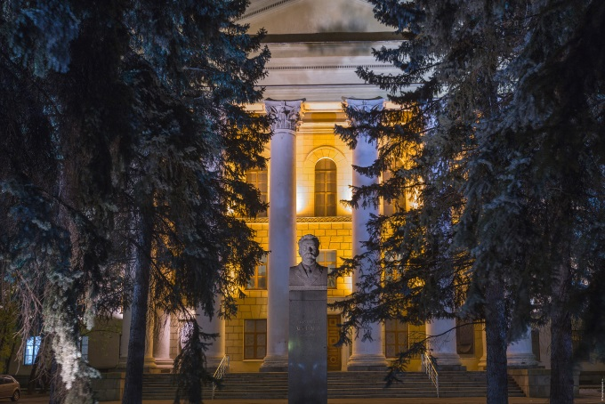
Galactic Cosmic Ray Transport
Talk from Vladimir Dogiel
P. N. Lebedev Institute of Physics (Moscow)

Slide 3
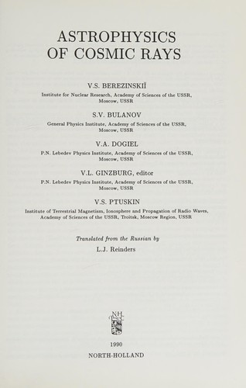
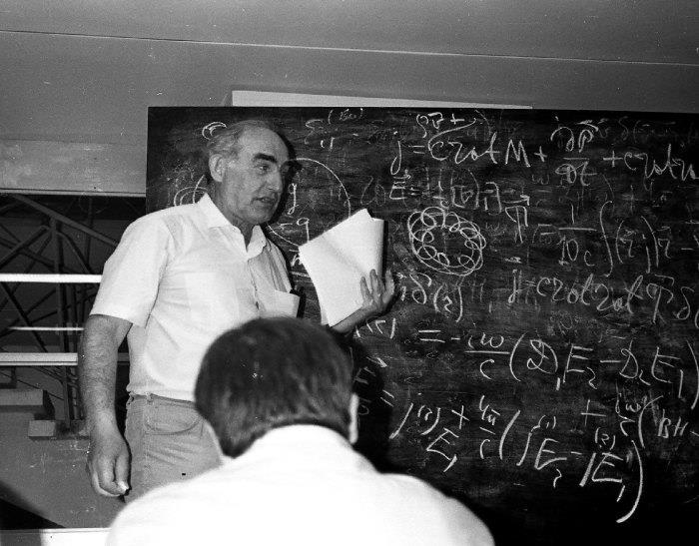
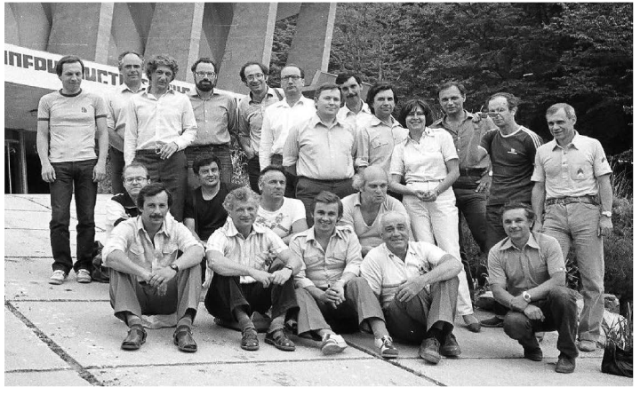
A few memories
Workshop “Sochi-2” 1985

Slide 4
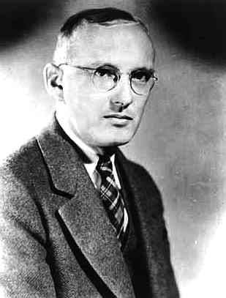
Hystorically, the first evidence for the existence of the Galactic cosmic ray halo came from radio observations. The diffuse radio emission of the Galaxy was discovered by an American radio
engineer, Karl Jansky, in 1932 who investigated
a background radio noise and found
its maximum in the direction of the
Galactic plane.
Measurements of the diffuse radio
emission showed from that its
distribution of the sky is anisotropic,
but the intensity of the radio emission does not significantly vary for for directions perpendicular to the galactic plane. From this one may conclude that a considerable part of the radio flux is generated inside our Galaxy, and the radio emitting region is not to the galactic disk.

Slide 5
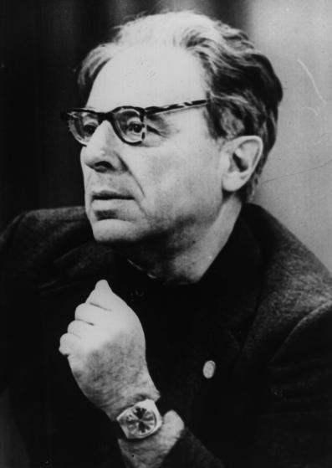
Shklovskii (1952) proposed that the
radio emission is generated in a
quasi-spherical halo-type volume.
However, he connected this radio
halo to the stellar halo, suggesting
that the radio emission is generated
by hypothetical “radio stars” filling
the halo region

Slide 6
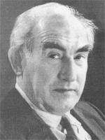
Alternative assumption was suggested by
Ginzburg (1963) which boils down to
the fact that non-thermal galactic radio
emission is the synchrotron radiation of
relativistic (cosmic ) electrons in the interstellar
magnetic fields.

Slide 7
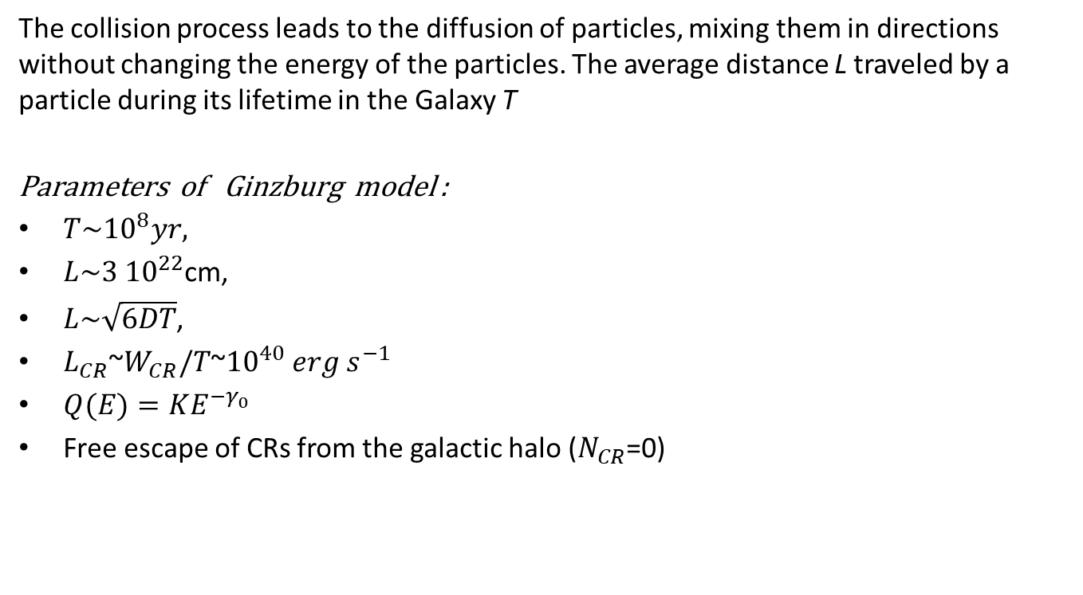
The key point of V.L.Ginzburg from his paper of 1953
The collision process leads to the diffusion of particles, mixing them in directions without changing the energy of the particles. The average distance L traveled by a particle during its lifetime in the Galaxy T
Parameters of Ginzburg model :
$T\sim {10}^{8}yr,$
$L\sim 3 {10}^{22}$cm,
$L\sim \sqrt{6DT}$,
$L_{CR}$~$W_{CR}/T$~${10}^{40}$ ${erg s}^{−1}$
$Q(E)=KE^{−γ_{0}}$
Free escape of CRs from the galactic halo ($N_{CR}$=0)

Slide 8
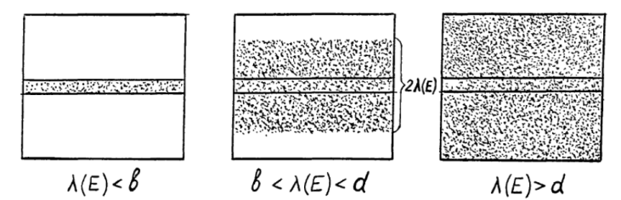
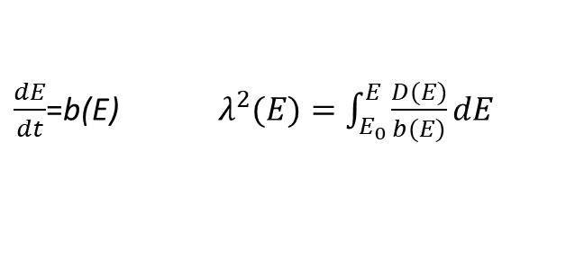
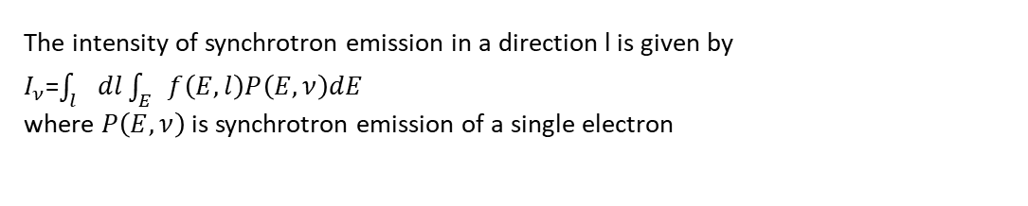
Cosmic ray Electrons (general case) – Syrovatskii 1959
$\frac{dE}{dt}$=b(E) $λ^{2}(E)=\int_{E_{0}}^{E}{\frac{D(E)}{b(E)}dE}$
The density of CR electrons varies because of synchrotron energy losses in magnetic fields and the spectrum index varies from about 2 to 3, which is consistent with radio astronomy data (see Bulanov, Syrovatskii & Dogiel, 1976),
The intensity of synchrotron emission in a direction l is given by
$I_{ν}$=$\int_{l}{dl\int_{E}{f\left(E,l\right)P\left(E,ν\right)dE}}$
where $P\left(E,ν\right)$ is synchrotron emission of a single electron

Slide 9
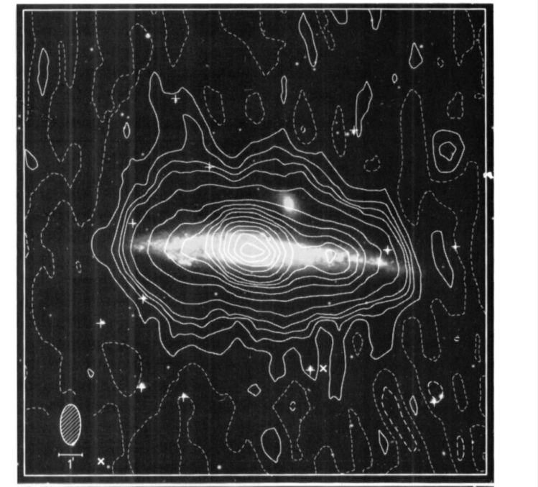
Shklovskii I.S. (1952) - radiostars
Ginzburg V.L. (1953) synchrotron radiation of relativistic electrons
1961 – Electrons were detected in the CR flux ~1% (Earl)
1966 – Linear polarization of the galactic diffuse radio emission was measured (Wielebinski et al.)
1977 – the discovery of the pronounced radio halo in the edge-on galaxy NGC 4631 (Ekers & Sancisi)

Slide 10
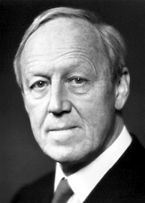

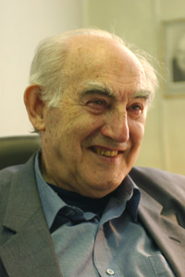
Origin of Cosmic Ray Protons and Nuclei
Solar (Alfven)
Extragalactic (Burbidge)
Galactic (Ginzburg)

Slide 11
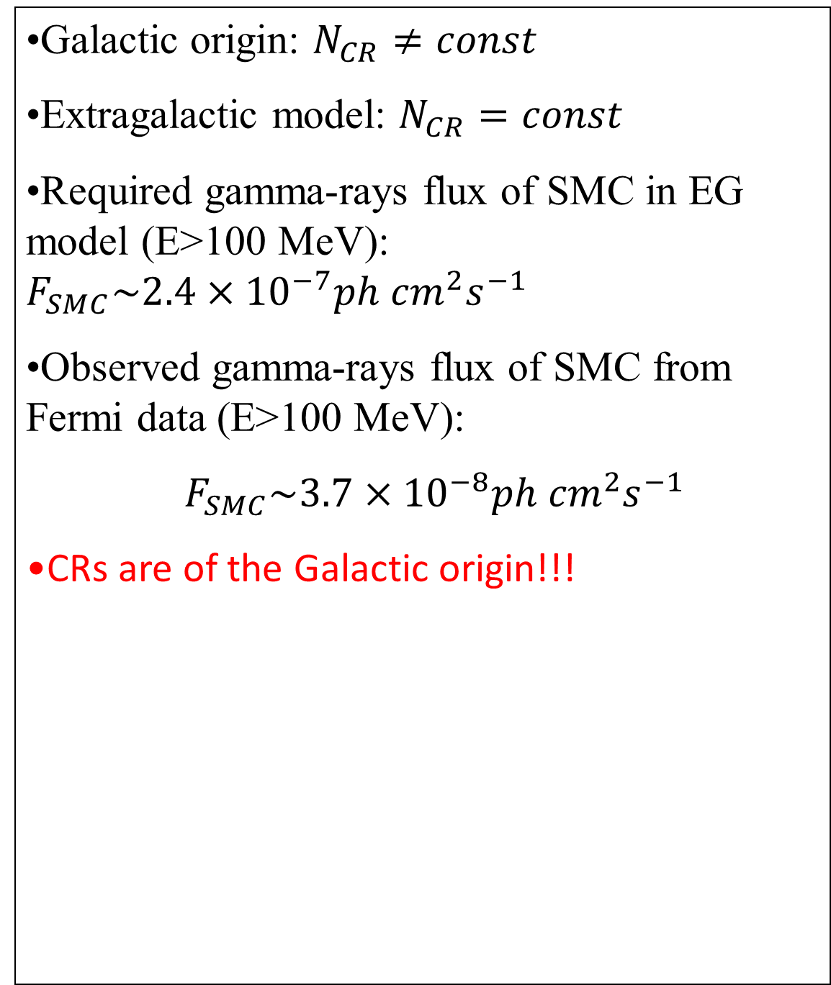
Ginzburg’s Test (1972)
Galactic origin: $N_{CR}≠const$
Extragalactic model: $N_{CR}=const$
Required gamma-rays flux of SMC in EG model (E>100 MeV): $F_{SMC}\sim 2.4×{10}^{−7}ph{ cm}^{2}s^{−1}$
Observed gamma-rays flux of SMC from Fermi data (E>100 MeV):
${ F}_{SMC}\sim 3.7×{10}^{−8}ph{ cm}^{2}s^{−1}$
CRs are of the Galactic origin!!!

Slide 12
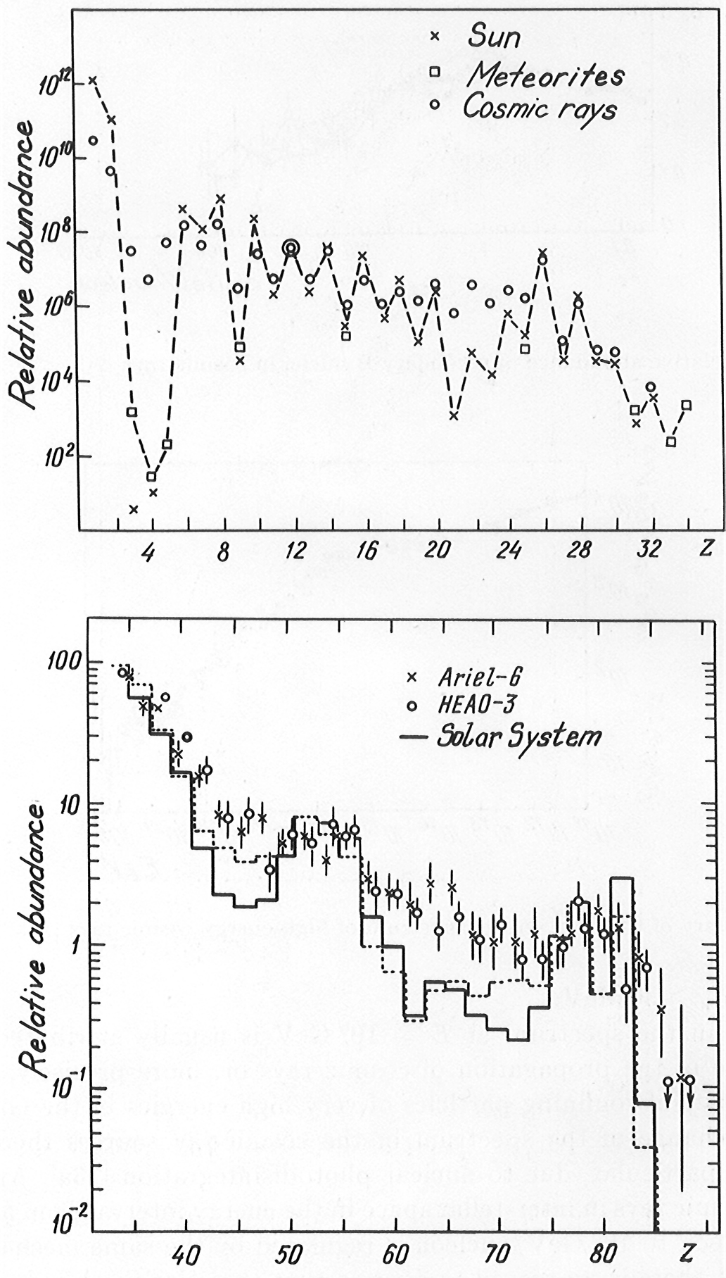
CR Chemical composition

Slide 14
Secondary Cosmic Rays
detector
source
Secondary CRs
Primary CRs
gas

Slide 15

Stable Secondary CRs (leaky-box model)
$\frac{N_{s}}{T}≈\overline{n}σ{cN}_{p }$
$\frac{N_{s}}{N_{p}}≈$ $\overline{n}σcT$
x(E)=$\overline{ρ}cT(E)$ - grammage
$x(1 GeV)\sim 10 gr {cm}^{−2}$

Slide 16
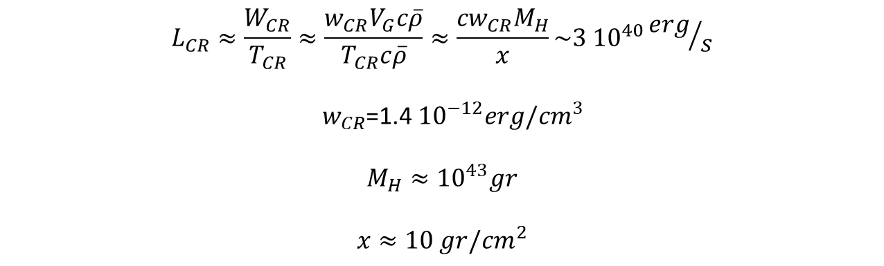
CR Luminosity (Syrovatskii’s estimate)
$$L_{CR}≈\frac{W_{CR}}{T_{CR}}≈\frac{w_{CR}V_{G}c\overline{ρ}}{T_{CR}c\overline{ρ}}≈\frac{{cw}_{CR}M_{H}}{x}\sim 3 {10}^{40}{erg}/s$$
${ w}_{CR}$=1.4 ${10}^{−12}erg/{cm}^{3}$
$$M_{H}≈{10}^{43}gr$$
$$x≈10 gr/{cm}^{2}$$

Slide 17
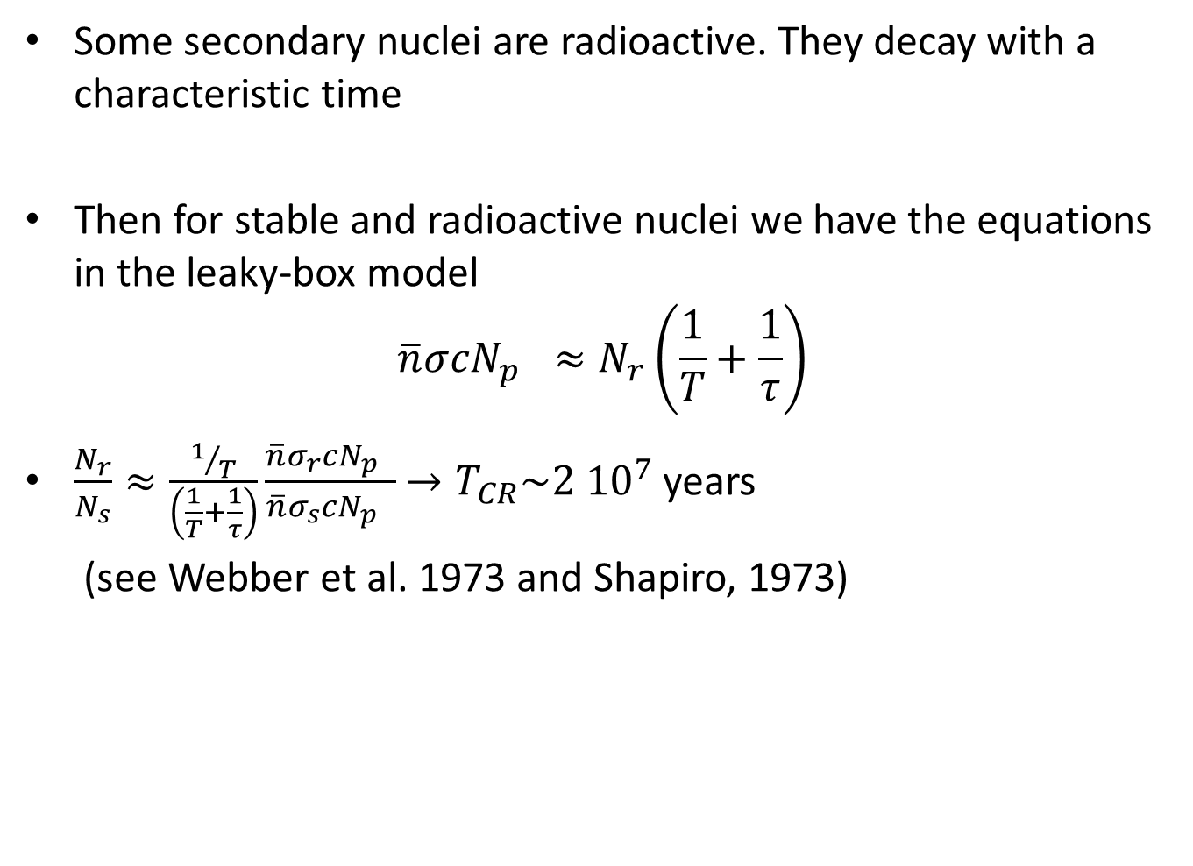
Origin of the light elements Li, Be, B??
Cosmic ray Clocks
Some secondary nuclei are radioactive. They decay with a characteristic time
Then for stable and radioactive nuclei we have the equations in the leaky-box model
$$\overline{n}σ{cN}_{p }≈N_{r}\left(\frac{1}{T}+\frac{1}{τ}\right)$$
$\frac{N_{r}}{N_{s}}≈\frac{1/T}{\left(\frac{1}{T}+\frac{1}{τ}\right)}\frac{\overline{n}σ_{r}{cN}_{p }}{\overline{n}σ_{s}{cN}_{p }}$ $→T_{CR}\sim 2 {10}^{7}$ years
(see Webber et al. 1973 and Shapiro, 1973)

Slide 18
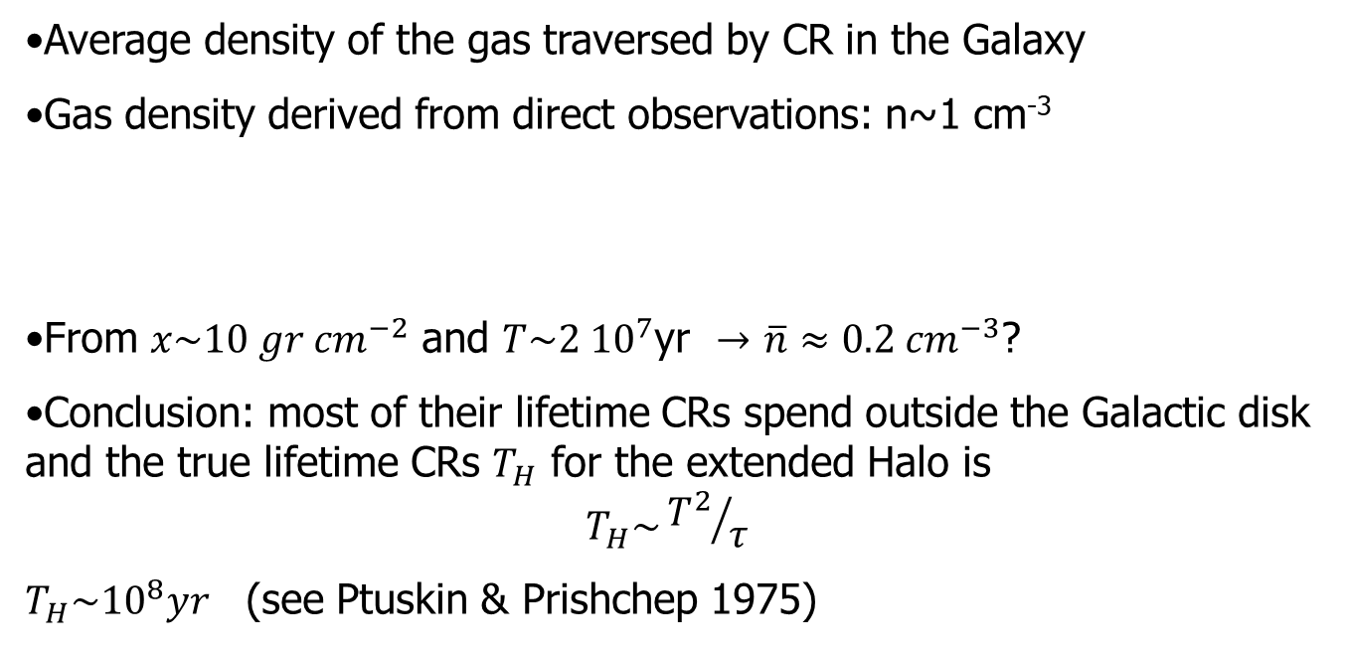
Evidence for CR halo from CR chemical composition
Average density of the gas traversed by CR in the Galaxy
Gas density derived from direct observations: n~1 cm⁻³
From $x\sim 10 gr {cm}^{−2}$ and $T\sim 2 {10}^{7}$yr $→$ $\overline{n}≈0.2 {cm}^{−3}$?
Conclusion: most of their lifetime CRs spend outside the Galactic disk and the true lifetime CRs $T_{H}$ for the extended Halo is
$$T_{H}\sim {T^{2}}/τ$$
$T_{H}\sim {10}^{8}yr$(see Ptuskin & Prishchep 1975)

Slide 19
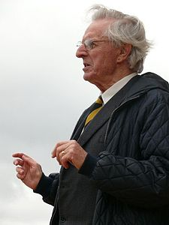
The evidence against the leaky box model of cosmic ray propagation and point to a more complex manner of propagation, probably involving considerable fractions of particle lifetimes spent in the galactic halo.
(see e.g. Szabelski, Wdowczyk, & Wolfendale, 1980)
Sir Arnold Wolfendale

Slide 20
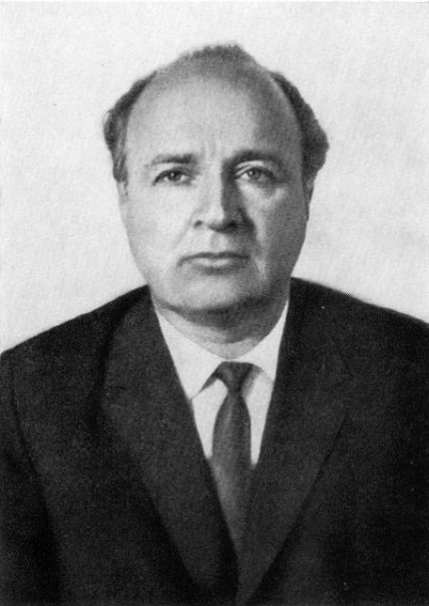


“Godfathers” of the Theory of Cosmic Rays
V.L.Ginzburg
1916-2009
S.I.Syrovatskii
1925-1979
1964, “Bible” of cosmic ray physics

Slide 21
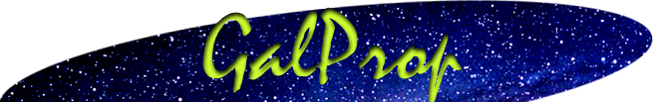
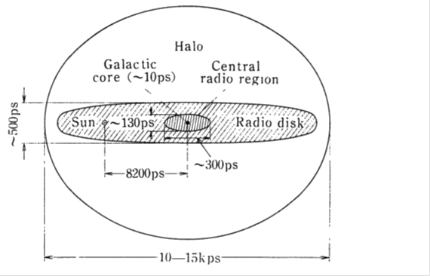

numerical
Strong A.W. Max-Planck Institut fuer Extraterrestrische Physik
Moskalenko I. GSFC
http://galprop.stanford.edu/web_galprop/galprop_home.html
GalProp numerical code describes propagation of cosmic rays in the Galaxy by phenomenological parameters, estimated from observational data:
$L\sim 3 {10}^{22}$cm,
$L\sim \sqrt{6DT}$,
$L_{CR}$~$W_{CR}/T$~${10}^{40}$ ${erg s}^{−1}$
$T(E)∝E^{−0.3}$
$T_{∗}\sim {10}^{8} y$r
$D(E)∝E^{0.3}$
$D\sim {10}^{28}{cm}^{2}s^{−1},$ $E\sim 1 GeV$
$Q\left(E\right)=KE^{−γ_{0}}$, $γ_{0}=2.3$
Free escape of CRs from the galactic halo where ${L=const, N}_{CR}$=0.

Slide 22
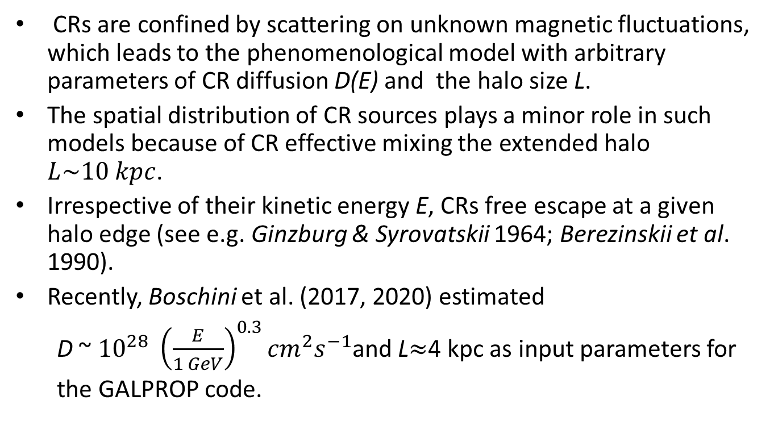
Static halo
CRs are confined by scattering on unknown magnetic fluctuations, which leads to the phenomenological model with arbitrary parameters of CR diffusion D(E) and the halo size L.
The spatial distribution of CR sources plays a minor role in such models because of CR effective mixing the extended halo $L\sim 10 kpc$.
Irrespective of their kinetic energy E, CRs free escape at a given halo edge (see e.g. Ginzburg & Syrovatskii 1964; Berezinskii et al. 1990).
Recently, Boschini et al. (2017, 2020) estimated
D ~ ${10}^{28} {\left(\frac{E}{1 GeV}\right)}^{0.3}{cm}^{2}s^{−1}$and L$≈$4 kpc as input parameters for
the GALPROP code.

Slide 23
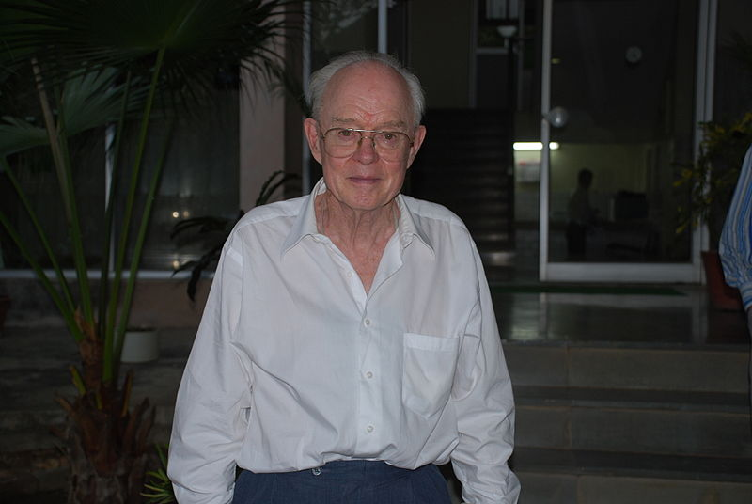
Diffusion model of CR propagation (Parker, 1965)
Parker: The feature of magnetic field which determines the nature of the propagation of energetic particles in the presence of small-scale irregularities. The irregularities appear with dimensions comparable to the radius of gyration. The irregularities scatter, or reflect, the energetic particles back and forth along the line of force of the large-scale field, so that there is no tendency for the particles to move systematically in either direction. Then the effect of magnetic irregularities is to cause the cosmic ray particles to random walk.
The random walk of the cosmic ray particles is a Markoff process, describable by a Fokker-Planck equation (see formal discussion in Chandrasekhar,1943)

Slide 27
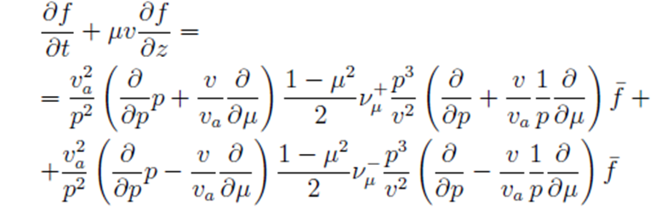
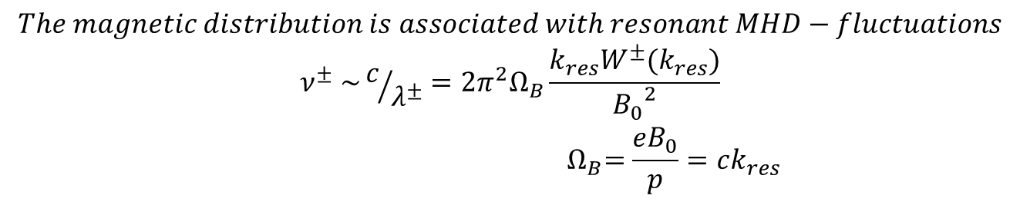
Diffusion coefficient produced by MHD-waves (the case δH<<H)
$$The magnetic distribution is associated with resonant MHD−fluctuations$$
$$ν^{±} \sim c/{λ^{±}}=2π^{2}Ω_{B}\frac{k_{res}W^{±}(k_{res})}{{B_{0}}_{}^{2}}$$
$${ Ω}_{B}=\frac{eB_{0}}{p}=ck_{res}$$
The Fokker-Planck equation for CRs propagation in space of MHD-fluctuation, where $μ=\cos{θ}$is the cosine of particle pitch-angle:

Slide 28
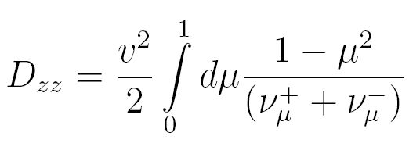
Parameters of the kinetic equation
CR advection by MHD-waves
The coefficient of spatial diffusion
The coefficient of momentum diffusion

Slide 29
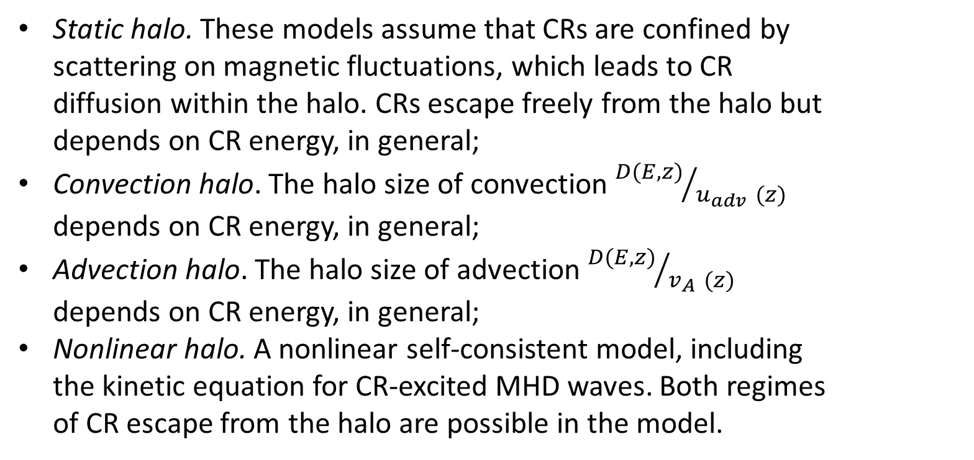
Models of CR Halo
(see, e.g. the review of Blasi 2019)
Static halo. These models assume that CRs are confined by scattering on magnetic fluctuations, which leads to CR diffusion within the halo. CRs escape freely from the halo but depends on CR energy, in general;
Convection halo. The halo size of convection ${D(E,z)}/{u_{adv }(z)}$ depends on CR energy, in general;
Advection halo. The halo size of advection ${D(E,z)}/{v_{A }(z)}$ depends on CR energy, in general;
Nonlinear halo. A nonlinear self-consistent model, including the kinetic equation for CR-excited MHD waves. Both regimes of CR escape from the halo are possible in the model.

Slide 30


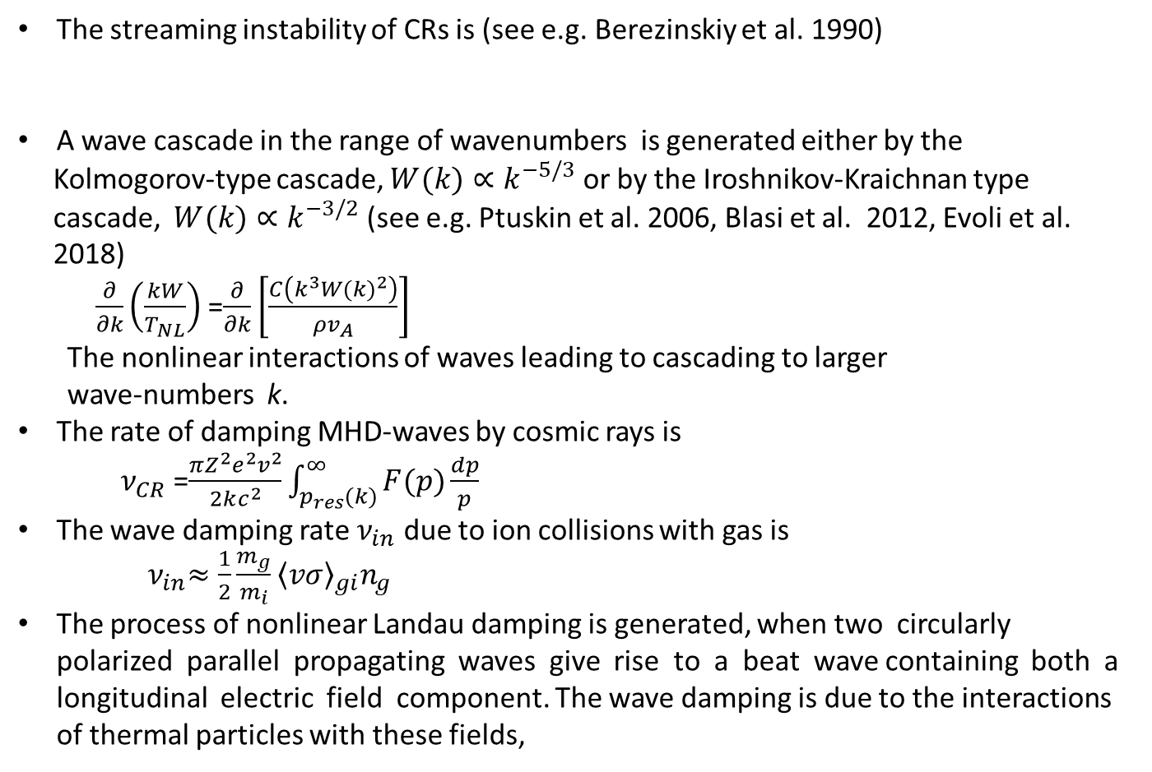
MHD-wave excitation and damping
The streaming instability of CRs is (see e.g. Berezinskiy et al. 1990)
A wave cascade in the range of wavenumbers is generated either by the
Kolmogorov-type cascade, $W(k)∝k^{−5/3}$ or by the Iroshnikov-Kraichnan type
cascade, $W(k)∝k^{−3/2}$(see e.g. Ptuskin et al. 2006, Blasi et al. 2012, Evoli et al.
2018)
$\frac{∂}{∂k}\left(\frac{kW}{T_{NL}}\right)$ =$\frac{∂}{∂k}\left[\frac{C\left(k^{3}{W(k)}^{2}\right)}{ρv_{A}}\right]$
The nonlinear interactions of waves leading to cascading to larger
wave-numbers k.
The rate of damping MHD-waves by cosmic rays is
${ ν}_{CR}$=$\frac{πZ^{2}e^{2}v^{2}}{2kc^{2}}\int_{p_{res}(k)}^{∞}{F(p)}\frac{dp}{p}$
The wave damping rate $ν_{in}$ due to ion collisions with gas is
${ ν}_{in}≈\frac{1}{2}\frac{m_{g}}{m_{i}}{\left\langle vσ\right\rangle }_{gi}n_{g}$
The process of nonlinear Landau damping is generated, when two circularly polarized parallel propagating waves give rise to a beat wave containing both a longitudinal electric field component. The wave damping is due to the interactions of thermal particles with these fields,

Slide 31
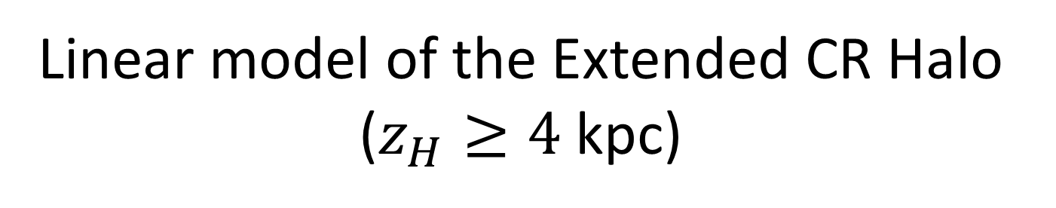
Linear model of the Extended CR Halo ($z_{H}≥4$kpc)

Slide 32
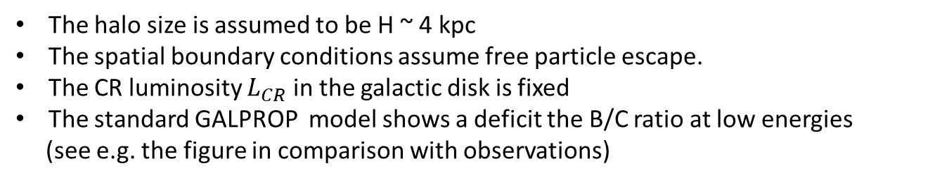
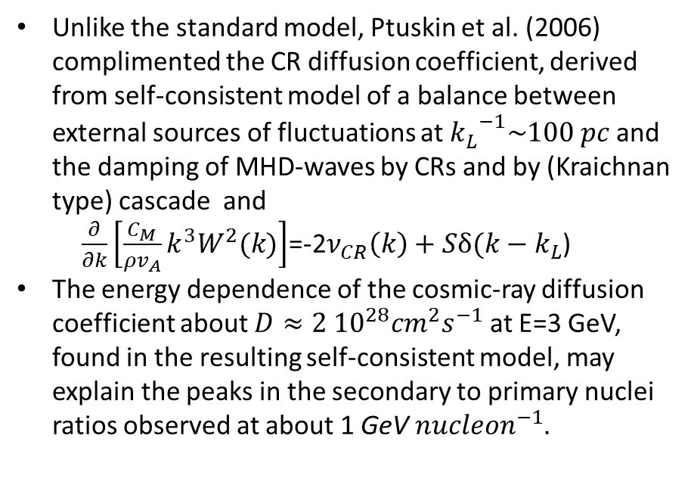
CR transport in the Galaxy in the frameworks of the GALPROP code (Strong & Moskalenko 1998; Moskalenko et al. 2002)
The halo size is assumed to be H ~ 4 kpc
The spatial boundary conditions assume free particle escape.
The CR luminosity $L_{CR}$ in the galactic disk is fixed
The standard GALPROP model shows a deficit the B/C ratio at low energies
(see e.g. the figure in comparison with observations)
Unlike the standard model, Ptuskin et al. (2006) complimented the CR diffusion coefficient, derived from self-consistent model of a balance between external sources of fluctuations at ${k_{L}^{}}^{−1}\sim 100 pc$and the damping of MHD-waves by CRs and by (Kraichnan type) cascade and
$\frac{∂}{∂k}\left[\frac{C_{M}}{ρv_{A}}k^{3}W^{2}(k)\right]$=-2$ν_{CR}\left(k\right)+Sδ(k−k_{L}$)
The energy dependence of the cosmic-ray diffusion coefficient about $D≈2 {10}^{28}{cm}^{2}s^{−1}$ at E=3 GeV, found in the resulting self-consistent model, may explain the peaks in the secondary to primary nuclei ratios observed at about 1 GeV ${nucleon}^{−1}$.

Slide 33
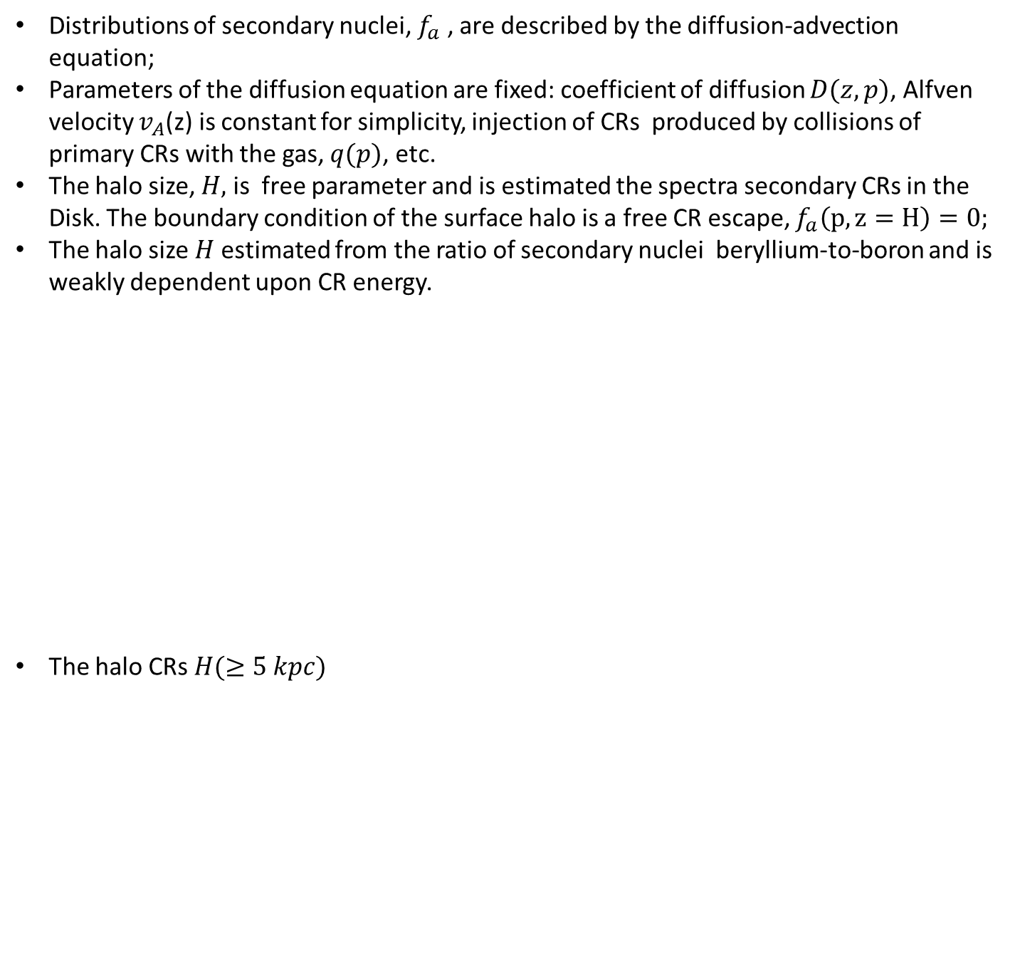
CR Secondary Nuclei in Evoli et al. (2020)
Distributions of secondary nuclei, $f_{a}$ , are described by the diffusion-advection equation;
Parameters of the diffusion equation are fixed: coefficient of diffusion $D(z,p)$, Alfven velocity $v_{A}$(z) is constant for simplicity, injection of CRs produced by collisions of primary CRs with the gas, $q(p)$, etc.
The halo size, $H,$ is free parameter and is estimated the spectra secondary CRs in the Disk. The boundary condition of the surface halo is a free CR escape, $f_{a}\left(p, z=H\right)=0;$
The halo size $H$estimated from the ratio of secondary nuclei beryllium-to-boron and is weakly dependent upon CR energy.
The halo CRs $H(≥5 kpc)$

Slide 34
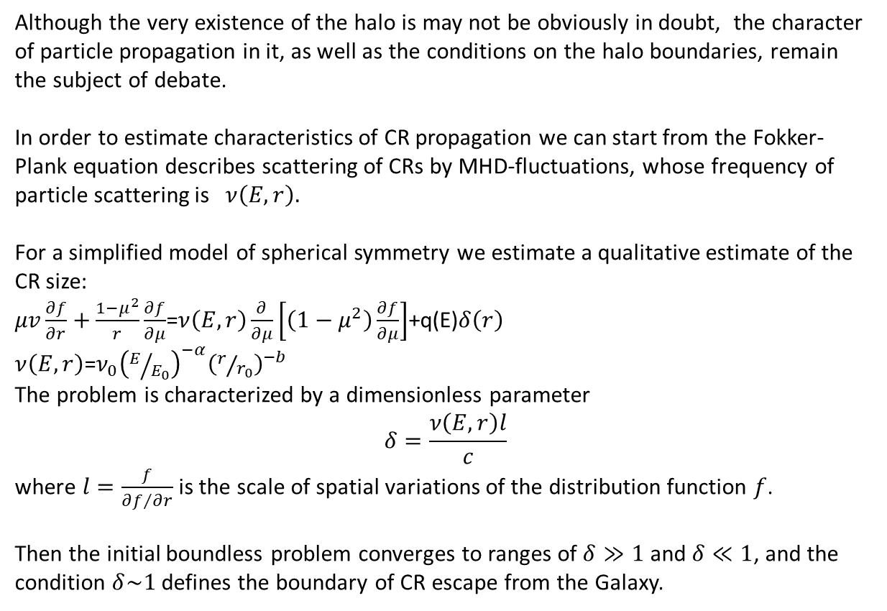
CR escape from the galactic halo - Static halo
(see Earle (1976) and Dogiel, Gurevich & Zybin (1993 ))
Although the very existence of the halo is may not be obviously in doubt, the character of particle propagation in it, as well as the conditions on the halo boundaries, remain the subject of debate.
In order to estimate characteristics of CR propagation we can start from the Fokker-Plank equation describes scattering of CRs by MHD-fluctuations, whose frequency of particle scattering is$ν\left(E,r\right).$
For a simplified model of spherical symmetry we estimate a qualitative estimate of the CR size:
$μv\frac{∂f}{∂r}+\frac{1−μ^{2}}{r}\frac{∂f}{∂μ}$=$ν\left(E,r\right)\frac{∂}{∂μ}\left[\left(1−μ^{2}\right)\frac{∂f}{∂μ}\right]$+q(E)$δ\left(r\right)$
$ν\left(E,r\right)$=$ν_{0}{\left(E/{E_{0}}\right)}^{−α}{\left(r/{r_{0}}\right)}^{−b}$
The problem is characterized by a dimensionless parameter
$$δ=\frac{ν\left(E,r\right)l}{c}$$
where $l=\frac{f}{{∂f}/{∂r}}$ is the scale of spatial variations of the distribution function $f$.
Then the initial boundless problem converges to ranges of $δ≫1$ and $δ≪1$, and the condition $δ\sim 1$ defines the boundary of CR escape from the Galaxy.

Slide 35
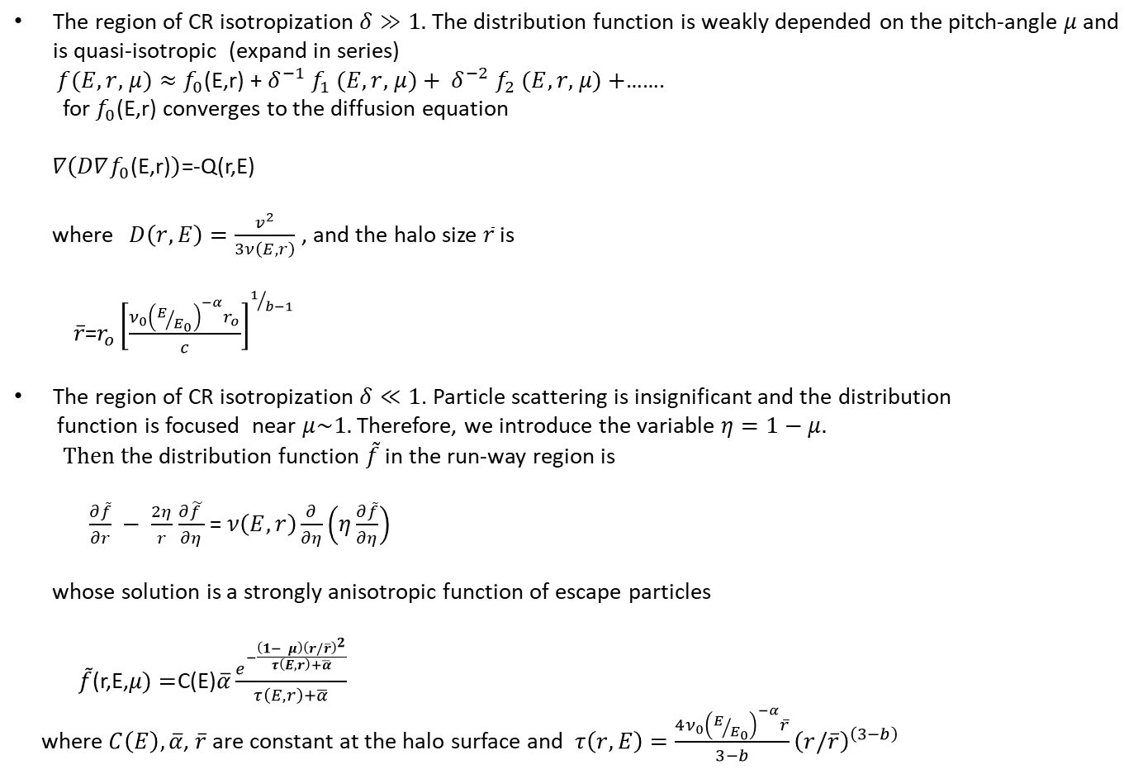
The region of CR isotropization $δ≫1.$ The distribution function is weakly depended on the pitch-angle $μ$ and is quasi-isotropic (expand in series)
$f(E,r,$ $μ)≈f_{0}$(E,r) +${ δ}^{−1}$ $f_{1}$ $(E,r,$ $μ)+$ ${ δ}^{−2}$ $f_{2}$ $(E,r,$ $μ)+$…….
for $f_{0}$(E,r) converges to the diffusion equation
$∇\left(D∇f_{0}\text{(}\text{E}\text{,}\text{r}\text{)}\right)$=-Q(r,E)
where$D\left(r,E\right)=\frac{v^{2}}{3ν\left(E,r\right)}$ , and the halo size $\overline{r}$ is
$\overline{r}$=$r_{o}{\left[\frac{ν_{0}{\left(E/{E_{0}}\right)}^{−α}r_{o}}{c}\right]}^{1/{b−1}}$
The region of CR isotropization $δ≪1$. Particle scattering is insignificant and the distribution
function is focused near $μ\sim 1.$ Therefore, we introduce the variable $η=1−$ $μ.$
$Then t$he distribution function $\tilde{f}$ in the run-way region is
$\frac{∂\tilde{f}}{∂r} − \frac{2η}{r}$ $\frac{∂\tilde{f }}{∂η}$ =$ν\left(E,r\right)\frac{∂}{∂η}\left(η\frac{∂\tilde{f}}{∂η}\right)$
whose solution is a strongly anisotropic function of escape particles
$\tilde{f}$(r,E,$μ)=$C(E)$\overline{α}\frac{e^{−\frac{\left(1− μ\right){\left(r/\overline{r}\right)}^{2}}{τ\left(E,r\right)+\overline{α}}}}{τ\left(E,r\right)+\overline{α}}$
where $C\left(E\right),\overline{α}$, $\overline{r}$are constant at the halo surface and $τ\left(r,E\right)=\frac{4ν_{0}{\left(E/{E_{0}}\right)}^{−α}\overline{r}}{3−b}{\left(r/\overline{r}\right)}^{\left(3−b\right)}$

Slide 36
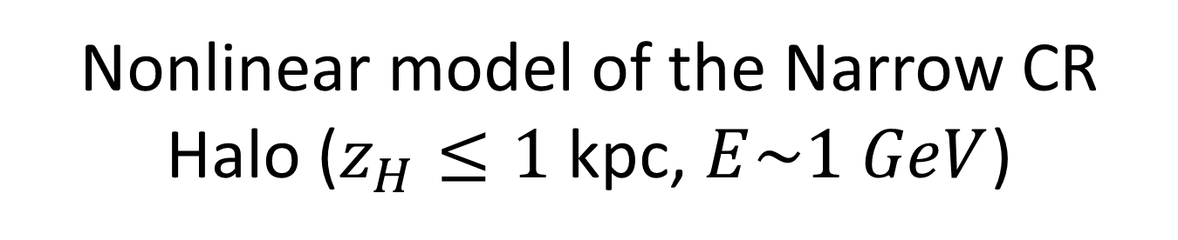
Nonlinear model of the Narrow CR Halo ($z_{H}≤1$kpc, $E\sim 1 GeV$)

Slide 37
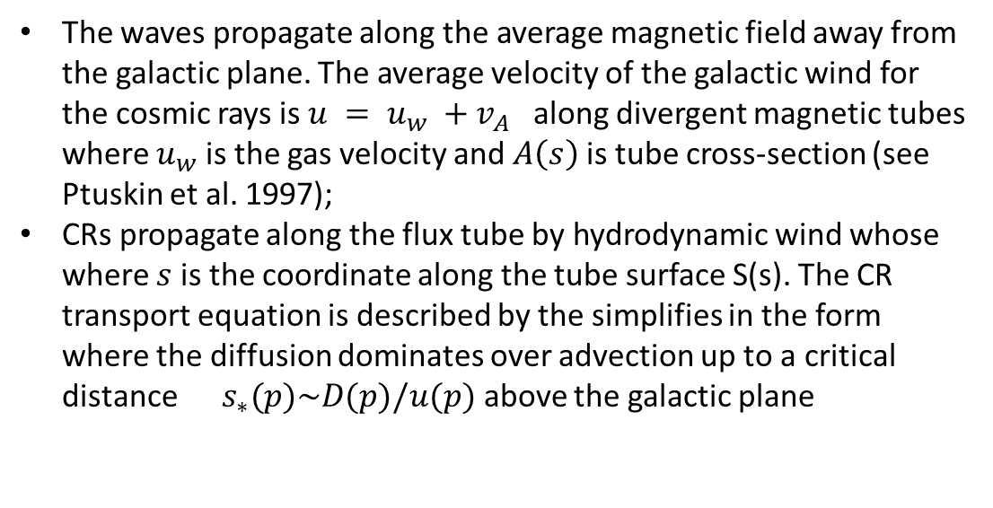
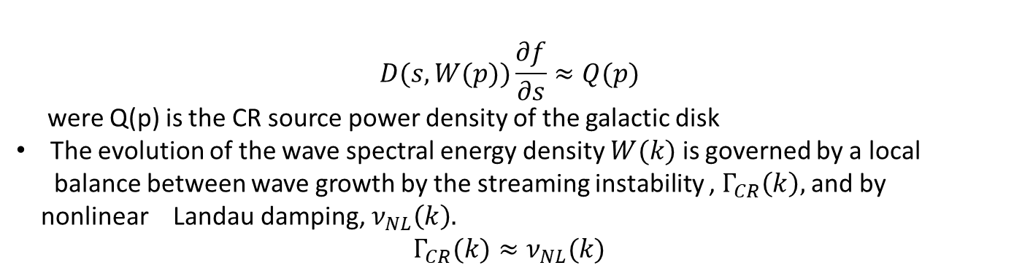
CR “escape” by a galactic wind from the Galaxy. Convection halo
(see e.g. Jones 1979; Lerche & Schlickeiser 1982; Bloemen et al. 1993; Ptuskin et al. 1997, Breitschwerdt et al. 2002).
The waves propagate along the average magnetic field away from the galactic plane. The average velocity of the galactic wind for the cosmic rays is $u = u_{w} +v_{A}$ along divergent magnetic tubes where $u_{w}$ is the gas velocity and $A\left(s\right)$is tube cross-section (see Ptuskin et al. 1997);
CRs propagate along the flux tube by hydrodynamic wind whose where $s$ is the coordinate along the tube surface S(s). The CR transport equation is described by the simplifies in the form where the diffusion dominates over advection up to a critical distance ${ s}_{∗}(p)\sim D(p)/u(p)$ above the galactic plane
$$D(s,W(p))\frac{∂f}{∂s}≈Q(p)$$
were Q(p) is the CR source power density of the galactic disk
The evolution of the wave spectral energy density $W(k)$ is governed by a local
balance between wave growth by the streaming instability , $Γ_{CR}\left(k\right),$and by
nonlinear Landau damping, $ν_{NL}\left(k\right).$
$$Γ_{CR}(k)≈ν_{NL}(k)$$

Slide 38
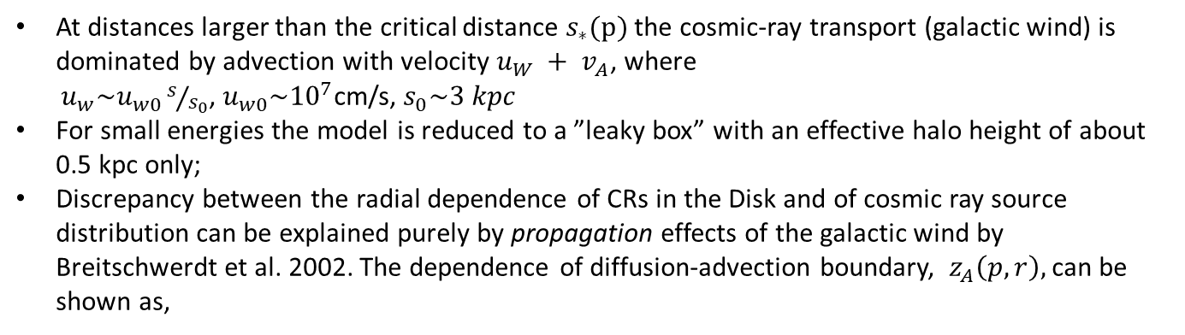
CR “escape” by a galactic wind from the boundary convection in the Galaxy. Convection halo.
At distances larger than the critical distance $s_{∗}(p)$ the cosmic-ray transport (galactic wind) is dominated by advection with velocity $u_{W} + v_{A}$, where
$u_{w}\sim u_{w0}s/{s_{0}}$, $u_{w0}\sim {10}^{7}$cm/s, $s_{0}\sim 3 kpc$
For small energies the model is reduced to a ”leaky box” with an effective halo height of about 0.5 kpc only;
Discrepancy between the radial dependence of CRs in the Disk and of cosmic ray source distribution can be explained purely by propagation effects of the galactic wind by Breitschwerdt et al. 2002. The dependence of diffusion-advection boundary, $z_{A}\left(p,r\right),$can be shown as,

Slide 39
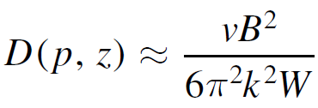
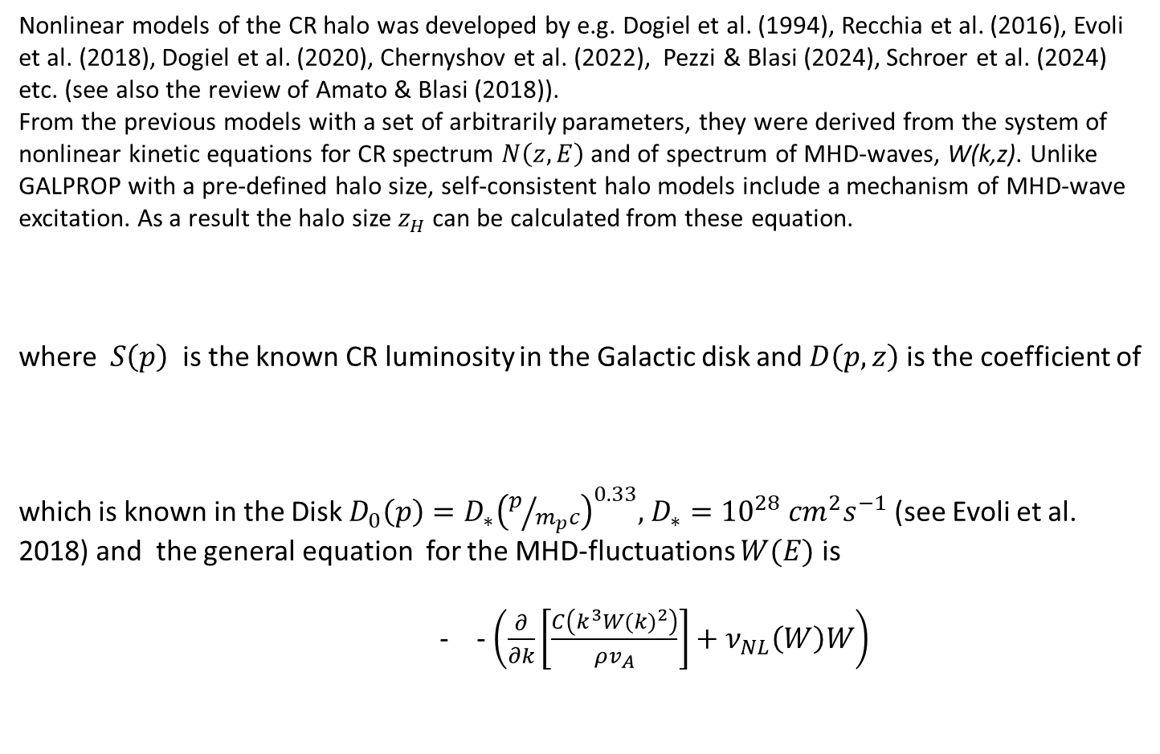

Nonlinear models of CR propagation and escape from the Galaxy
Nonlinear models of the CR halo was developed by e.g. Dogiel et al. (1994), Recchia et al. (2016), Evoli et al. (2018), Dogiel et al. (2020), Chernyshov et al. (2022), Pezzi & Blasi (2024), Schroer et al. (2024) etc. (see also the review of Amato & Blasi (2018)).
From the previous models with a set of arbitrarily parameters, they were derived from the system of nonlinear kinetic equations for CR spectrum $N\left(z,E\right)$and of spectrum of MHD-waves, W(k,z). Unlike GALPROP with a pre-defined halo size, self-consistent halo models include a mechanism of MHD-wave excitation. As a result the halo size $z_{H}$ can be calculated from these equation.
where $S\left(p\right)$is the known CR luminosity in the Galactic disk and $D\left(p,z\right)$is the coefficient of
which is known in the Disk $D_{0}\left(p\right)=D_{∗}{\left(p/{m_{p}c}\right)}^{0.33},$ $D_{∗}={10}^{28}$ ${cm}^{2}s^{−1}$ (see Evoli et al. 2018) and the general equation for the MHD-fluctuations $W(E)$ is
- - $\left(\frac{∂}{∂k}\left[\frac{C\left(k^{3}{W(k)}^{2}\right)}{ρv_{A}}\right]+ν_{NL}\left(W\right)W\right)$
$$S(p)δ(z)$$

Slide 40
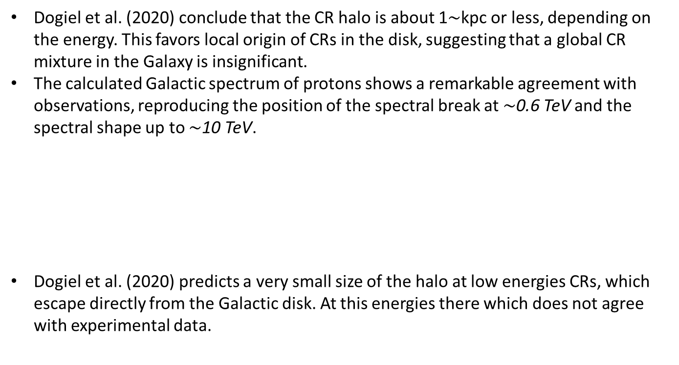
Nonlinear model of CR propagation and escape from the Galaxy (Dogiel et al, 2020)
The simplified equation for the MHD-fluctuations is
Dogiel et al. (2020) conclude that the CR halo is about 1$\sim$kpc or less, depending on the energy. This favors local origin of CRs in the disk, suggesting that a global CR mixture in the Galaxy is insignificant.
The calculated Galactic spectrum of protons shows a remarkable agreement with observations, reproducing the position of the spectral break at $\sim$0.6 TeV and the spectral shape up to ∼10 TeV.
Dogiel et al. (2020) predicts a very small size of the halo at low energies CRs, which escape directly from the Galactic disk. At this energies there which does not agree with experimental data.

Slide 41
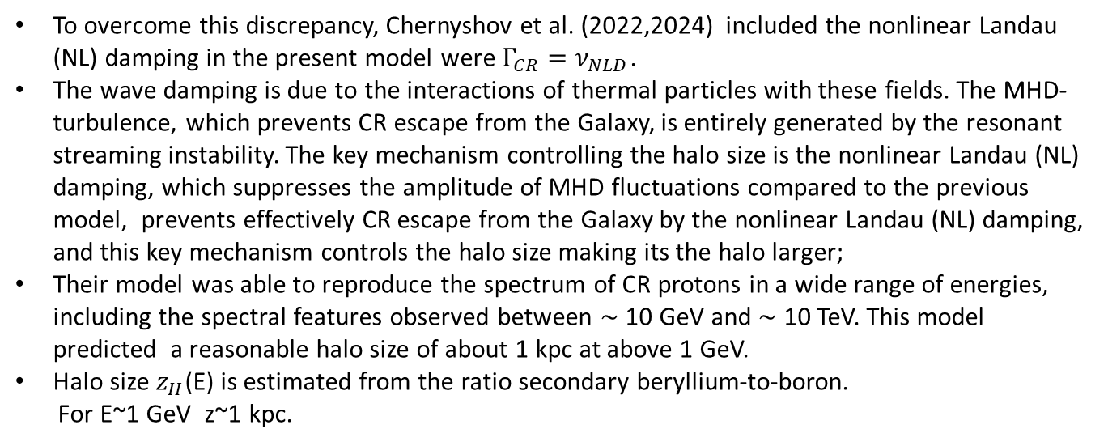
Nonlinear Landau damping of MHD-fluctuations
(Chernyshov et al.(2022,2024), Pezzi & Blasi (2024), Schroer et al. (2024) etc. )
To overcome this discrepancy, Chernyshov et al. (2022,2024) included the nonlinear Landau (NL) damping in the present model were $Γ_{CR}=ν_{NLD}$.
The wave damping is due to the interactions of thermal particles with these fields. The MHD-turbulence, which prevents CR escape from the Galaxy, is entirely generated by the resonant streaming instability. The key mechanism controlling the halo size is the nonlinear Landau (NL) damping, which suppresses the amplitude of MHD fluctuations compared to the previous model, prevents effectively CR escape from the Galaxy by the nonlinear Landau (NL) damping, and this key mechanism controls the halo size making its the halo larger;
Their model was able to reproduce the spectrum of CR protons in a wide range of energies, including the spectral features observed between ∼ 10 GeV and ∼ 10 TeV. This model predicted a reasonable halo size of about 1 kpc at above 1 GeV.
Halo size $z_{H}$(E) is estimated from the ratio secondary beryllium-to-boron.
For E~1 GeV z~1 kpc.

Slide 42
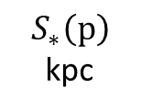
Nonlinear advection of CRs from the Galaxy
(Recchia et al.2016)
Analysis of the CR galactic spectrum together with the hydrodynamic equations for the galactic wind when cosmic rays propagation is defined by self-generated diffusion and advection with the wind and the self-excited Alfven waves (balance of CR excitation and nonlinear Landau damping)
Unlike previous models, the distribution of Galactic wind, density of CRs and the spectra of MHD-waves are calculated from nonlinear hydrodynamic equations for the gas leave from the Disk and the kinetic equations for CR propagation and escape by diffusion and advection.
Effective boundary, s∗(p), between the diffusion and the advection regions reaches a critical boundary below which CR are mixed by diffusion, above – escape by the galactic wind
$$S_{∗}\left(p\right)$$
kpc

Slide 43
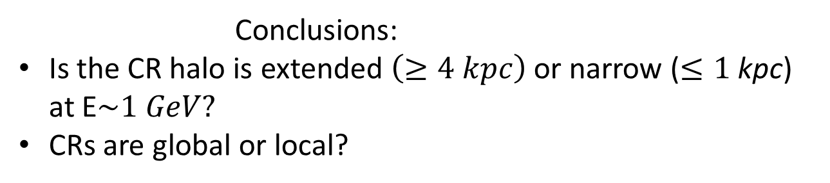
Conclusions:
Is the CR halo is extended $\left(≥4 kpc\right)$or narrow ($≤1$ kpc) at E$\sim 1 GeV?$
CRs are global or local?

