Slide 1
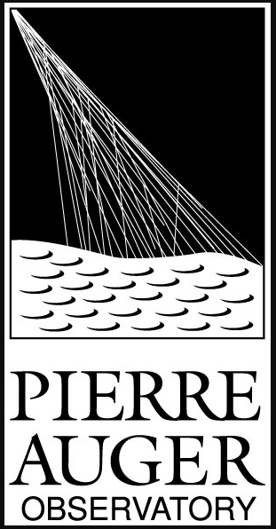
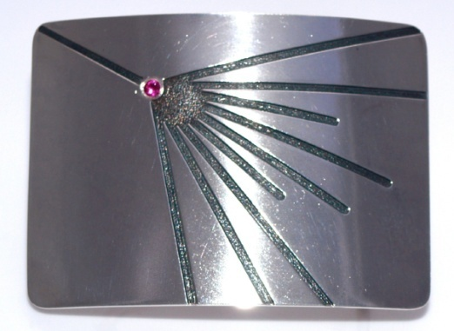
Some memories of Venya – and his impact of the field of UHECR
Venya Berezinsky Memorial Event
L’Aquila 1- 3 October 2024
Alan Watson
University of Leeds, UK
a.a.watson@leeds.ac.uk

Slide 2
Outline
Some Memories
Prediction of neutrinos and search at Pierre Auger Observatory
Demise of protons at high energies
Importance of theorists such as Venya

Slide 3
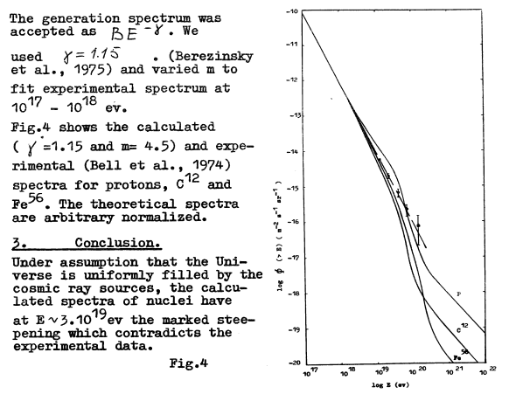
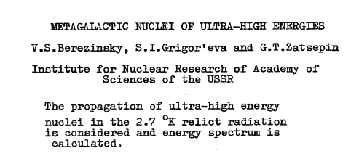

First meeting:
ICRC (Munich) 1975
Question by Maury Shapiro

Slide 4
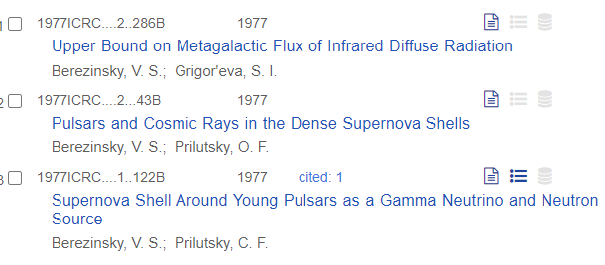
ICRC (Plovdiv) 1977
Dinner with Venya and John Linsley

Slide 5
1980: Meeting on Acceleration in Erice
organised by Shapiro
aaw:
Some ideas about acceleration in galactic and inter-galactic winds
vsb:
“Stick to doing what you know how to do!”

Slide 6
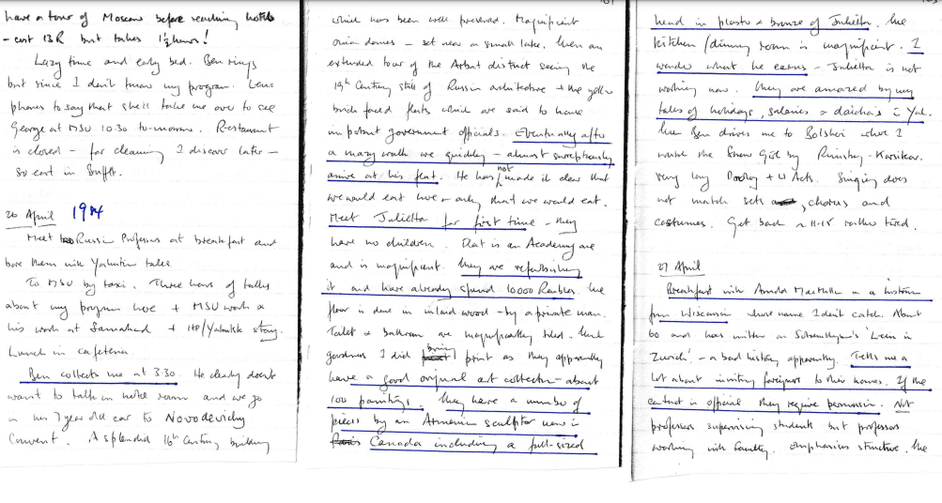
Hospitality in Moscow in 1984

Slide 7
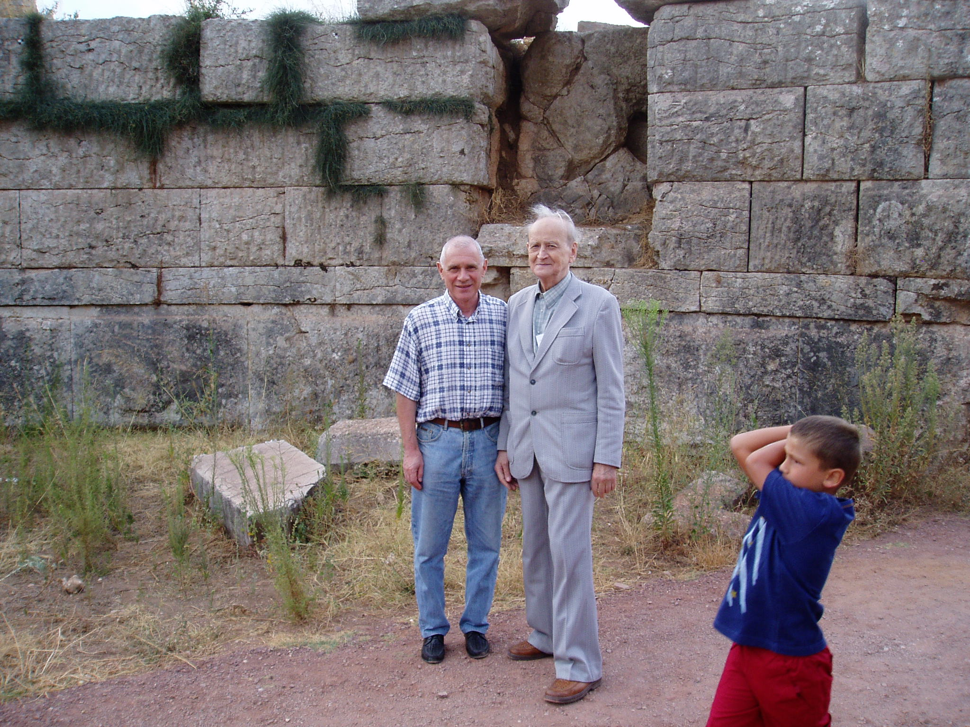

First paper?
Astrophysical neutrinos became an obsession!
Pylos 2004

Slide 8
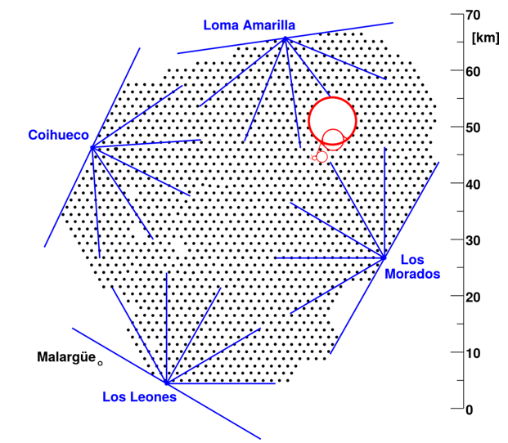
The Pierre Auger Observatory: Malargüe, Argentina
3000 km²: 1/8th of area of Sicily
1400 m (875 g cm⁻²)
1600 water-Cherenkov
detectors: 10 m² x 1.2 m
Fluorescence detectors
at 4 locations
.
LHC
LHC
.
XLF
..
CLF
Telescope Array in Northern Hemisphere is ¼ size

Slide 9
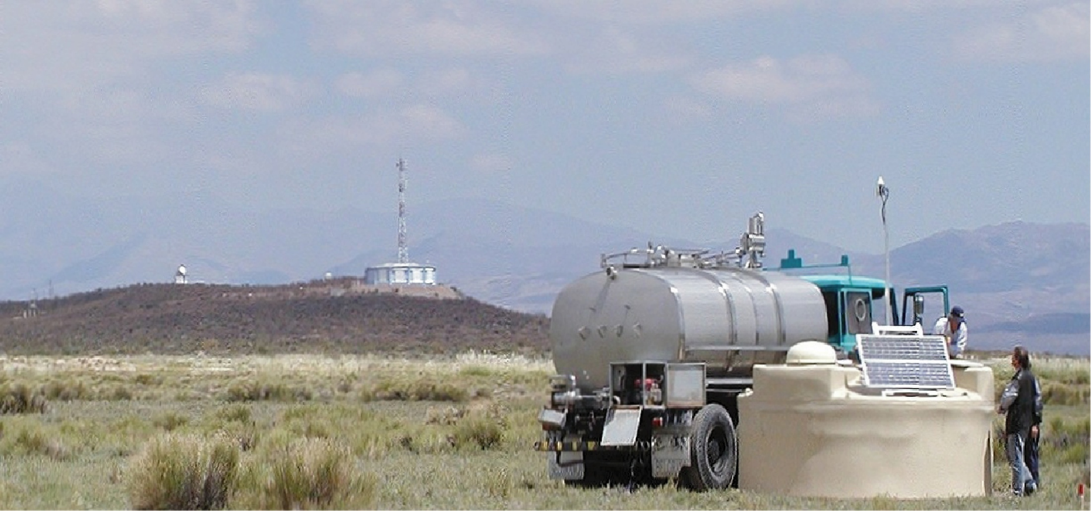
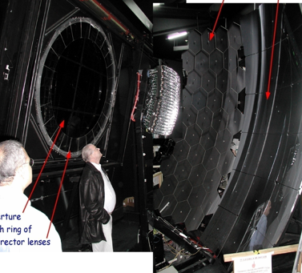
GPS Receiver and radio transmission
At 1000 m in vertical event, signal in W-C detectors is 50/50 muons (> 250 MeV) and electromagnetic (<E> ~ 10 MeV) Muon fraction increases with distance and zenith angle

Slide 10
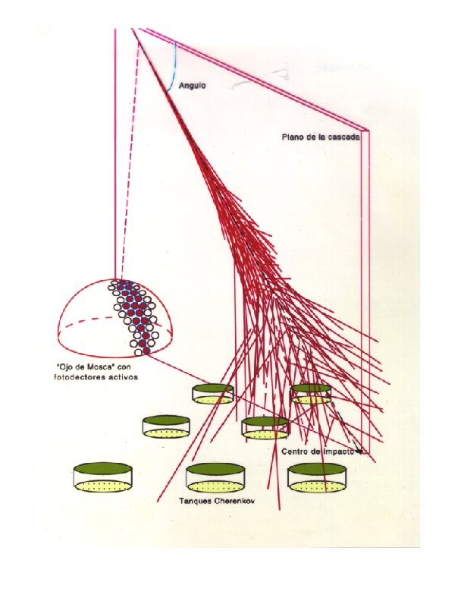
Auger Observatory combines these two techniques – the hybrid method
Fluorescence light emitted isotropically
from excited
molecular nitrogen.
Detection by pmts allows
determination of direction and energy deposition as
function of atmospheric depth
⇒ Calorimetric Energy Estimate
~10¹¹ particles at
shower maximum
at 10²⁰ eV
Particle number and
relative arrival times
found with particle
detectors
Model-independent energy estimate:
ΔE/E~ 8 % at highest energies
Diagram by Enrique Zas (Santiago de Compostela)

Slide 11
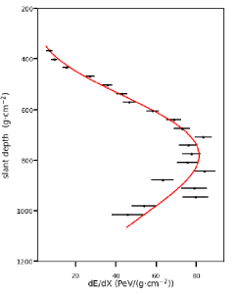
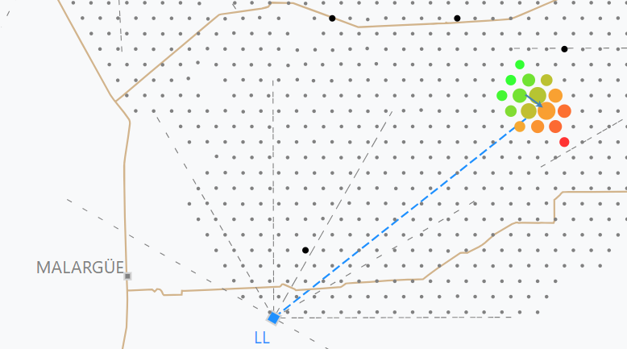
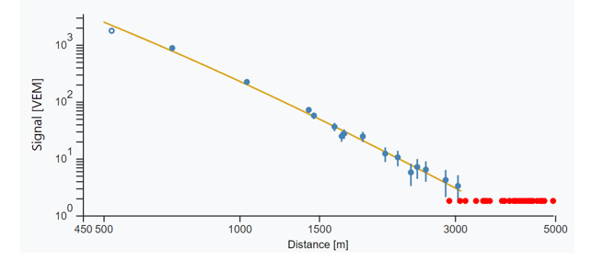
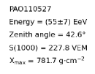
~ 30 km
S(1000)

Slide 12
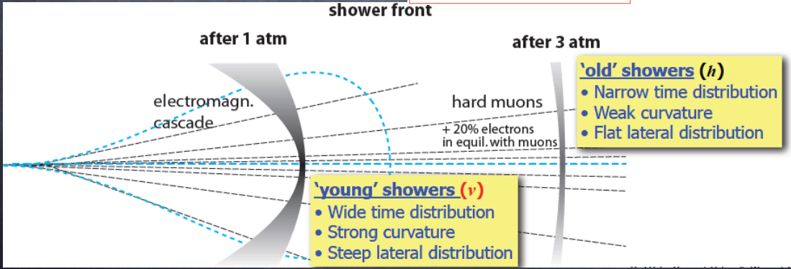
Searching for neutrinos
Look for inclined, BUT YOUNG, showers

Slide 13

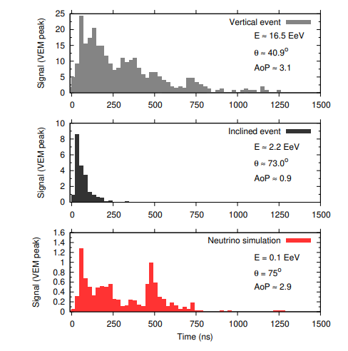
Principles of neutrino detection
Simulations
Measuring the Area-over-peak
of the FADC traces has
advantages

Slide 14
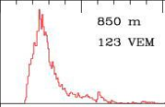
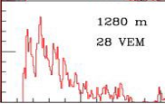
96 stations triggered
10¹⁹ eV, 13°, 4 μs

Slide 15
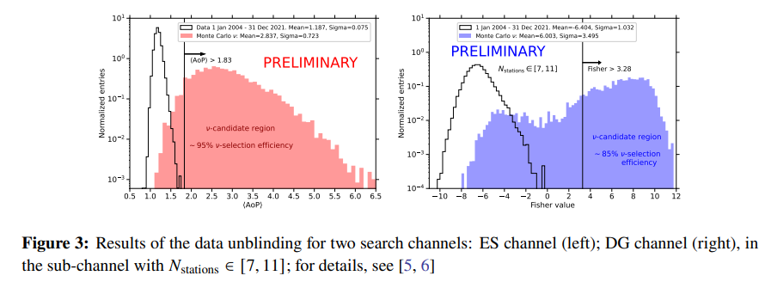

Slide 16
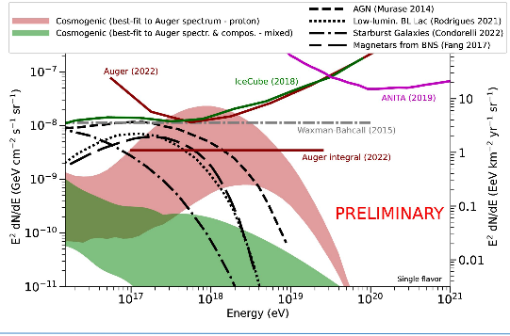
Fewer neutrinos expected from heavier nuclei

Slide 17
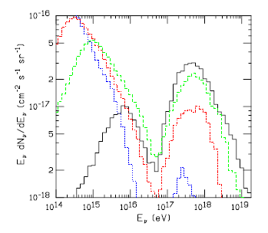
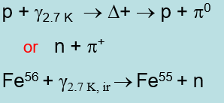
Neutrino flux very dependent on primary mass
p
He
O
GZK effects:
Greisen (1966)
Zatsepin and Kuzmin (1966)
Fe
From Hooper, Taylor and Sarkar 2005
- also Ave, Busca, Olinto, aaw and Yamamoto 2005

Slide 18
Mass Composition
Perhaps the most unexpected finding from the work of the Auger Collaboration is that there are very few protons at the highest energies
The ‘proton paradigm’ has held sway for a very long time
“We remain with the dilemma: protons versus heavy nuclei. A clear-cut decision cannot be reached yet. I believe that up to the highest energies the protons are the most abundant in the primary cosmic rays. However, I must confess that a leak proof test of the protonic nature of the primaries at the highest energies does not exist. This is a very important problem. Experimentally it is quite a difficult problem.”
G Cocconi:
Fifth International Cosmic Ray Conference
(Guanjuato) 1955
“Fere libenter homines id, quod volunt, credunt!”
Men wish to believe only what they prefer

Slide 19
How we try to infer the variation of mass with energy
X_{max}
photons
< 2% above 10 EeV
protons
Data
Fe
Energy per nucleon is crucial – and NEED MODELS
log (Energy)

Slide 20
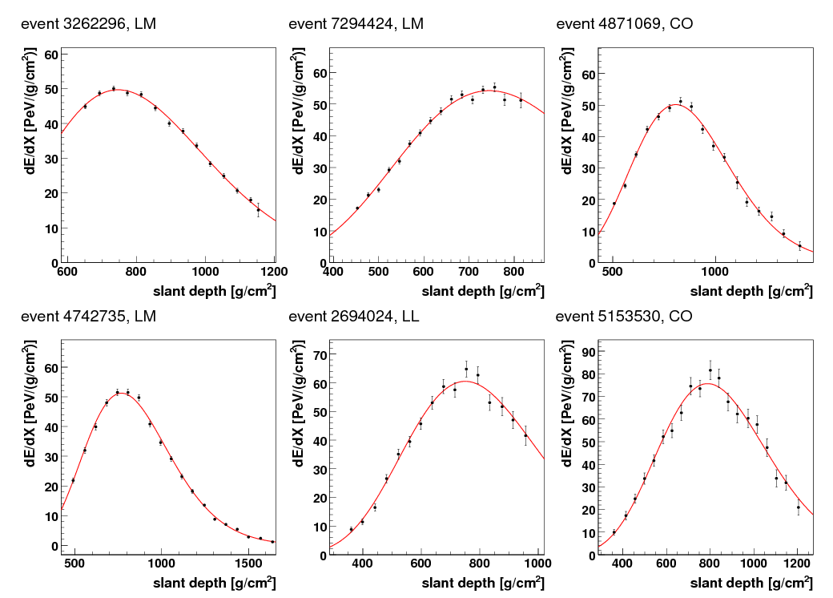
Reconstructed longitudinal profiles
rms uncertainty in X_{max} < 20 g cm⁻² from stereo measurements

Slide 21
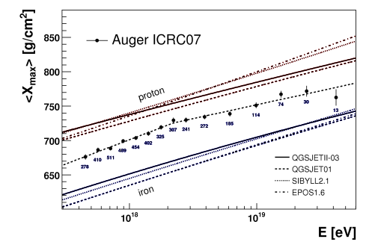
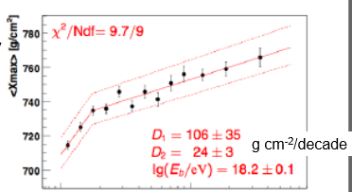
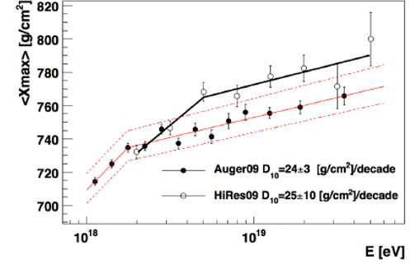
2009: Trondheim meeting for Venya’s 75 birthday
First reported at ICRC in Merida (2007):
extensive and exhausting discussions with Venya

Slide 22
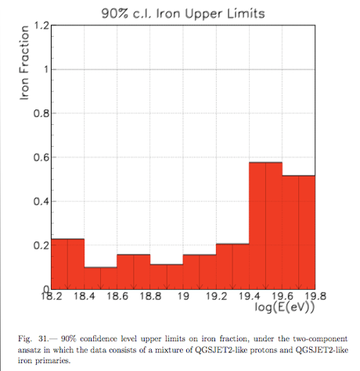
Sokolsky at Trondheim meeting (2009)
Two component (p-Fe) model
using the QGSjet model favoured
at that time
Fe upper limit would be higher with
more modern models

Slide 23
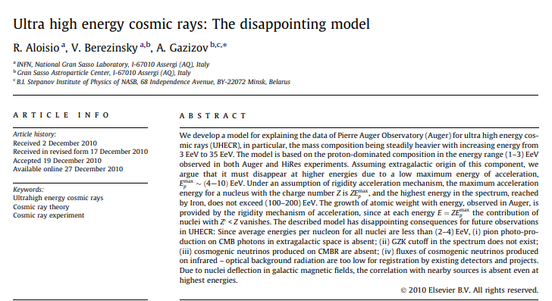
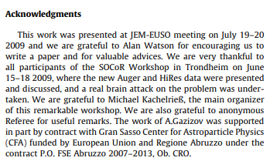

Slide 24
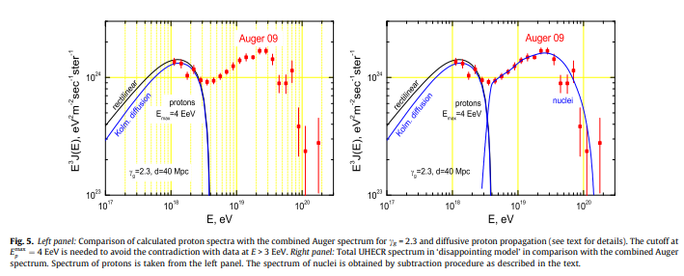
Assumptions (to explain Auger data only):
Protons at 1 -3 EeV
Protons are extragalactic
Rigidity-dependent acceleration

Slide 25
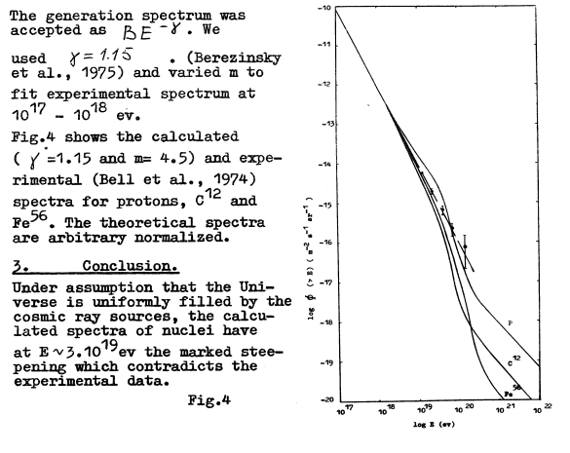
Disappointing Consequences for Future Observations of UHECR
1: No proton interactions with CMB
2: Correlations with UHECR sources not
expected
3: GZK cut-off does not exist – restrictive
definition of GZK predictions
4: Cosmogenic neutrinos from CMB
interactions absent
5: Flux of neutrinos from other sources are
too low to be measured

Slide 26
More on the mass at high energies
Break in the Elongation Rate implies that mass is becoming heavier
UNLESS there is an increase in the p-air cross-section, independent of simulations
Of course, this is not impossible
– recall what theorists were pushing before the ISR took data (1973)
Auger Collaboration are very clear on the mass situation
Mean Mass Increases With Energy
- Antonella Castellina will give details
I find Telescope Array messages confusing: Petr Tinyakov may clarify

Slide 27
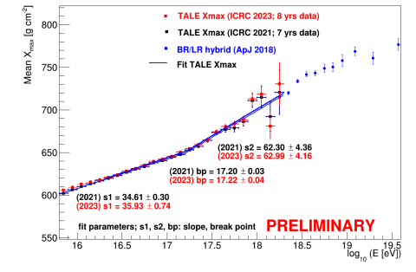
Kim (TA), at Nagoya ICRC, argued that statistics are insufficient to make statement at high energies, but she and John Matthews (joint spokesperson) consistently state in presentations that protons dominate at highest energies
Protons are assumed in TA energy estimation
Why are ApJ 2018 data not used?
ApJ 2018
Recent anisotropy analysis from TA attribute high
degree of isotropy at very highest energies to
presence of large fraction of heavy nuclei
arXiv: 2406.19287

Slide 28
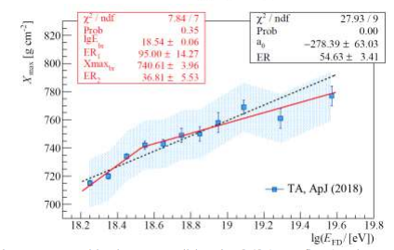
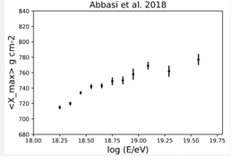
Auger TA
2007 2018
All 4026 3330
>E_{b} 1236 744
>10 EeV 117 113
Very similar numbers
Very similar results
In my view, TA data show
that mass is becoming heavier as energy increases

Slide 29
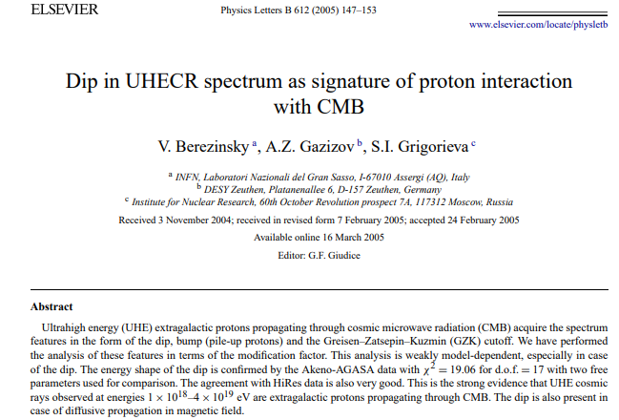
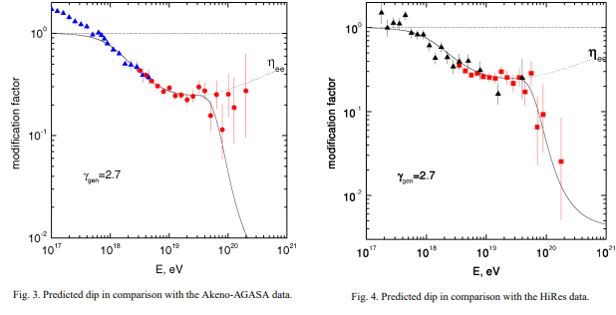
Assume all protons, with sources out to
1000 Mpc so uniform source distribution
justified
p + γ_{CMB} → p + e⁺ + e⁻
Dip (5 – 50 EeV) centred at ~ 8 EeV

Slide 30
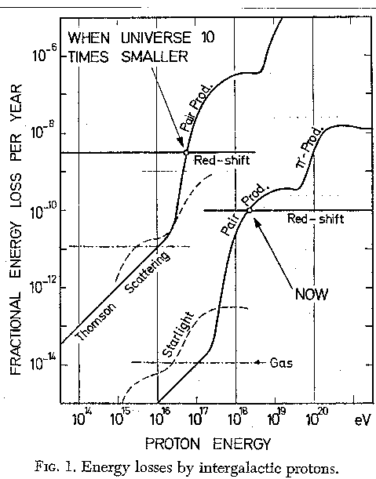
1 | 2 | BEREZINSKY  UHE spectrum of PROTONS |3 | 4| 5
(2) BEREZINSKY ARGUES FOR PROTON-DOMINATED UHE SPECTRUM,
AS γ + p  p + e⁺ + e⁻ REACTION EXPLAINS SHAPE OF “ANKLE”
VB  If primary protons have injection spectrum dN/dE ∝ E^{-2.7} (for E>E_{break}) the spectrum has a hollow near the “ankle” -- & shape fitted many published spectra -- though other spectral slopes acceptable if (e.g.) sources evolve.
I had suggested this interpretation of the “ankle” in 1967 *, in the context of evolution of source power.
But later, in 2005, Venya objected that I was then going astray, by including other C.R. nuclei,
--- I am grateful to him for redirecting me to more profitable work !
(*VB’s study was much more detailed)
1967
(T=3°)
A M Hillas at Trondheim Meeting 2009

Slide 31
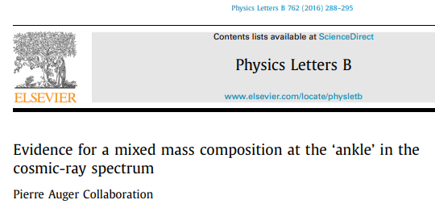
The observed correlation between X_{max} and S(1000) differs significantly
from expectations for a pure cosmic-ray composition
A light composition made up of protons and helium is equally inconsistent
Data are best explained by a mixed composition with A> 4
Proton-dip model, with almost pure composition, is disfavoured

Slide 32
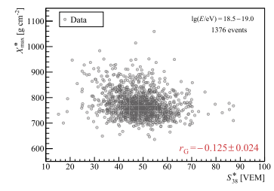
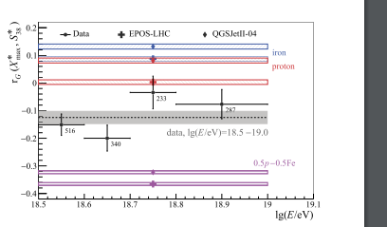
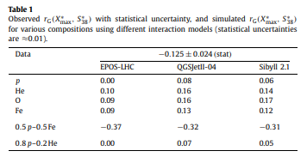
In the proton dip model, even small admixtures of heavier nuclei, such as a 15–20% helium fraction at the sources, were shown to upset the agreement of the pair-production dip of protons with the observed flux

Slide 33
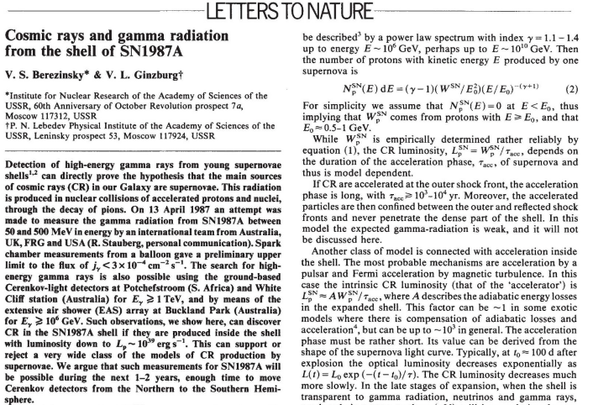

Slide 34
Venya had a remarkably fertile imagination
Perhaps over-stressed importance of protons
Current interpretations of data from Auger Collaboration do not support some of his proposals.
However, his ideas on the proton-dip, on neutrino fluxes
and on the energy spectrum steepening (not discussed)
led to important experimental studies – and, in the case of the
latter, a prediction that rules out the GZK-effect as being the
dominant reason for the steepening
I do not regard his efforts as being ‘disappointing’!
On the contrary, he provided many stimuli for better experiments
and for better exploitation of the data

