Slide 1




Development of new approaches for optical aberration control in gravitational wave interferometers
Ph.D. defence in Astroparticle Physics – Cycle XXXI
Ph.D. candidate: Lorenzo Aiello
Advisors
Tutors
Prof. Viviana Fafone
Dr. Matteo Lorenzini
Dr. Alessio Rocchi
Dr. Ilaria Nardecchia
L’Aquila – July 26th, 2019

Slide 2
outline
Gravitational waves and interferometric detector
Optical aberrations and their correction: the Thermal Compensation System (TCS)
Advanced Virgo TCS commissioning
  TCS pre-commissioning
  TCS commissioning
  TCS for the third observing run (O3)
Conclusions and prospects
R&D for TCS improvement
  Mode Cleaner cavity design for CO₂ laser
  Optical simulations for TCS actuation error signal investigation
  Adaptive optics for future TCS actuation

Slide 3
Gravitational waves and interferometric detector

Slide 4
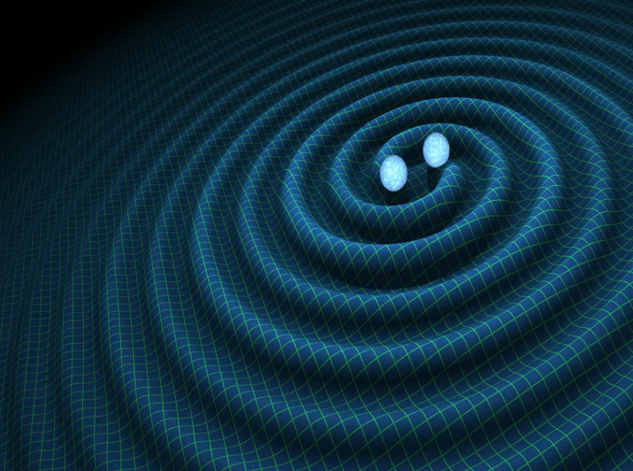
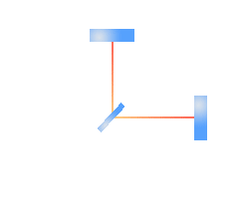
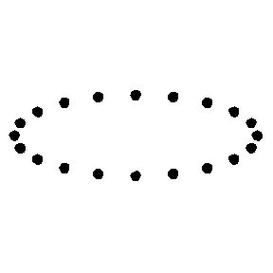
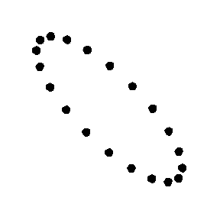
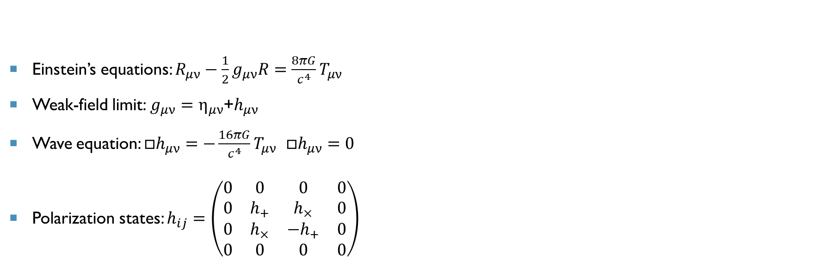
Gravitational waves
General Relativity: connection between space-time geometry and matter distribution.
Einstein’s equations: $R_{μν}−\frac{1}{2}g_{μν}R=\frac{8πG}{c^{4}}T_{μν}$
Weak-field limit: $g_{μν}=η_{μν}$+$h_{μν}$
Wave equation: ${□h}_{μν}=−\frac{16πG}{c^{4}}T_{μν}$ ${□h}_{μν}=0$
Polarization states: $h_{ij}=\left(\begin{matrix}0 & 0 & 0 & 0 \\ 0 & h_{+} & h_{×} & 0 \\ 0 & h_{×} & {−h}_{+} & 0 \\ 0 & 0 & 0 & 0\end{matrix}\right)$

Slide 5
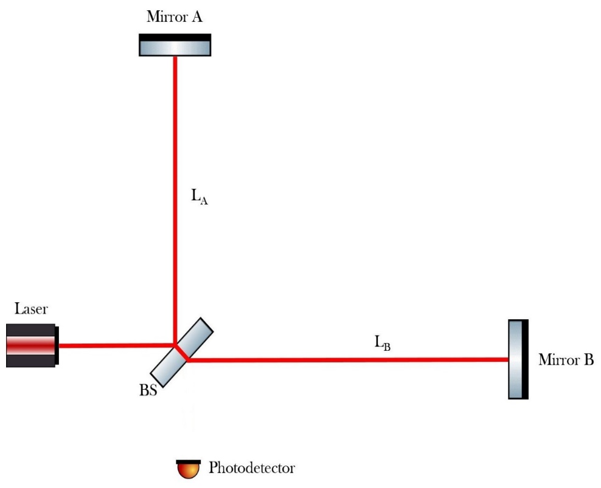
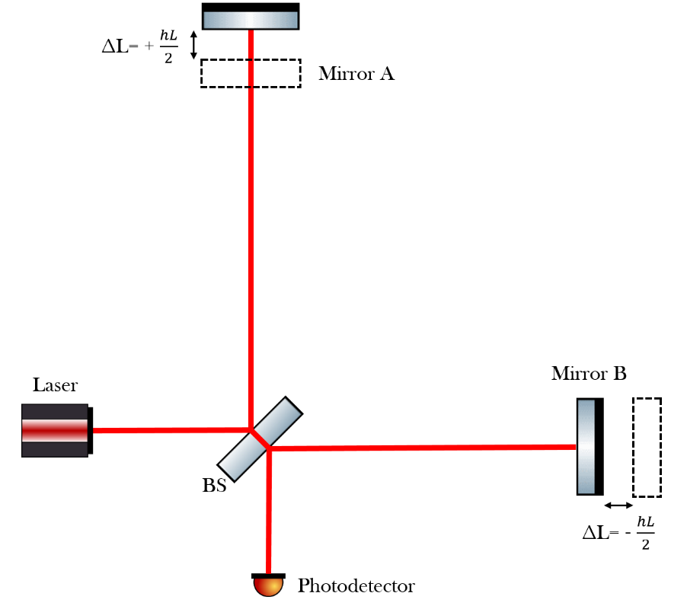



Detection principle
No GW
Interaction with + polarized GW
$$∆L=\frac{h·L}{2}$$
$$h\sim {10}^{−21} \\ L\sim {10}^{3} m$$
$$∆L\sim {10}^{−18} m$$

Slide 6
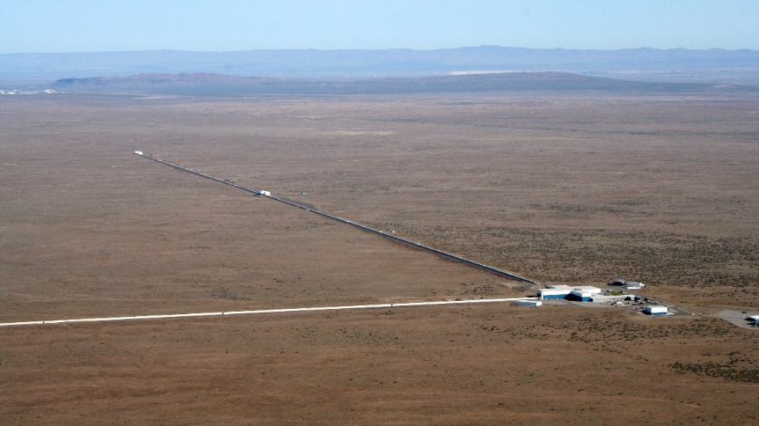
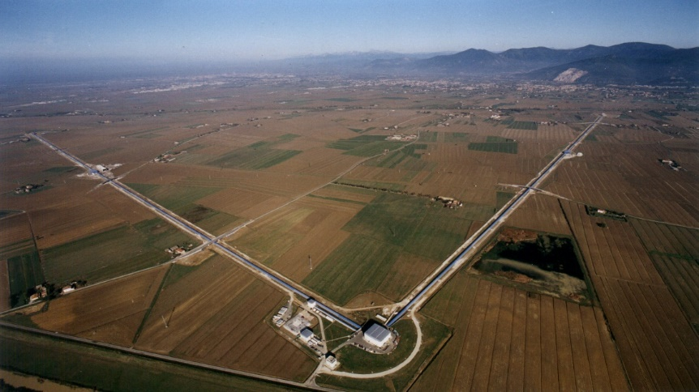
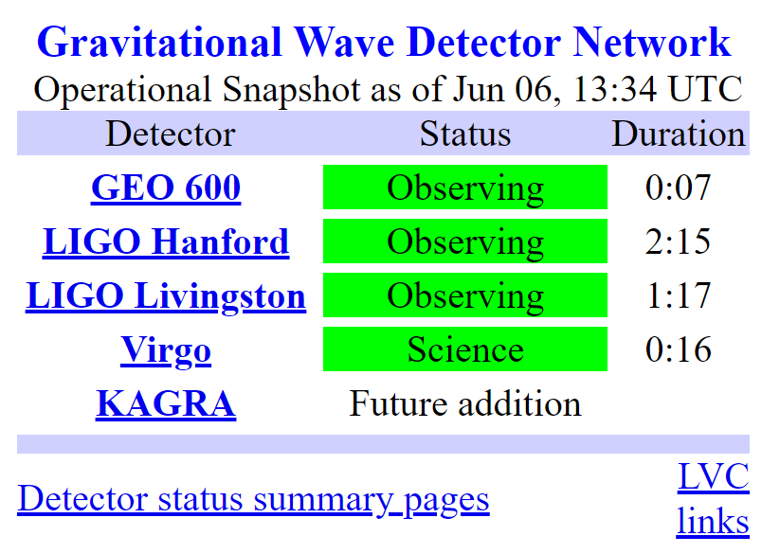

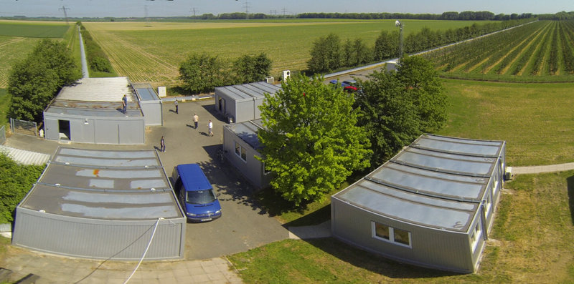
Detector network
LIGO Hanford
(Washington, USA)
VIRGO
(Pisa, Italy)
[hh:mm]
LIGO Livingston
(Louisiana, USA)
GEO
(Hannover, Germany)

Slide 7
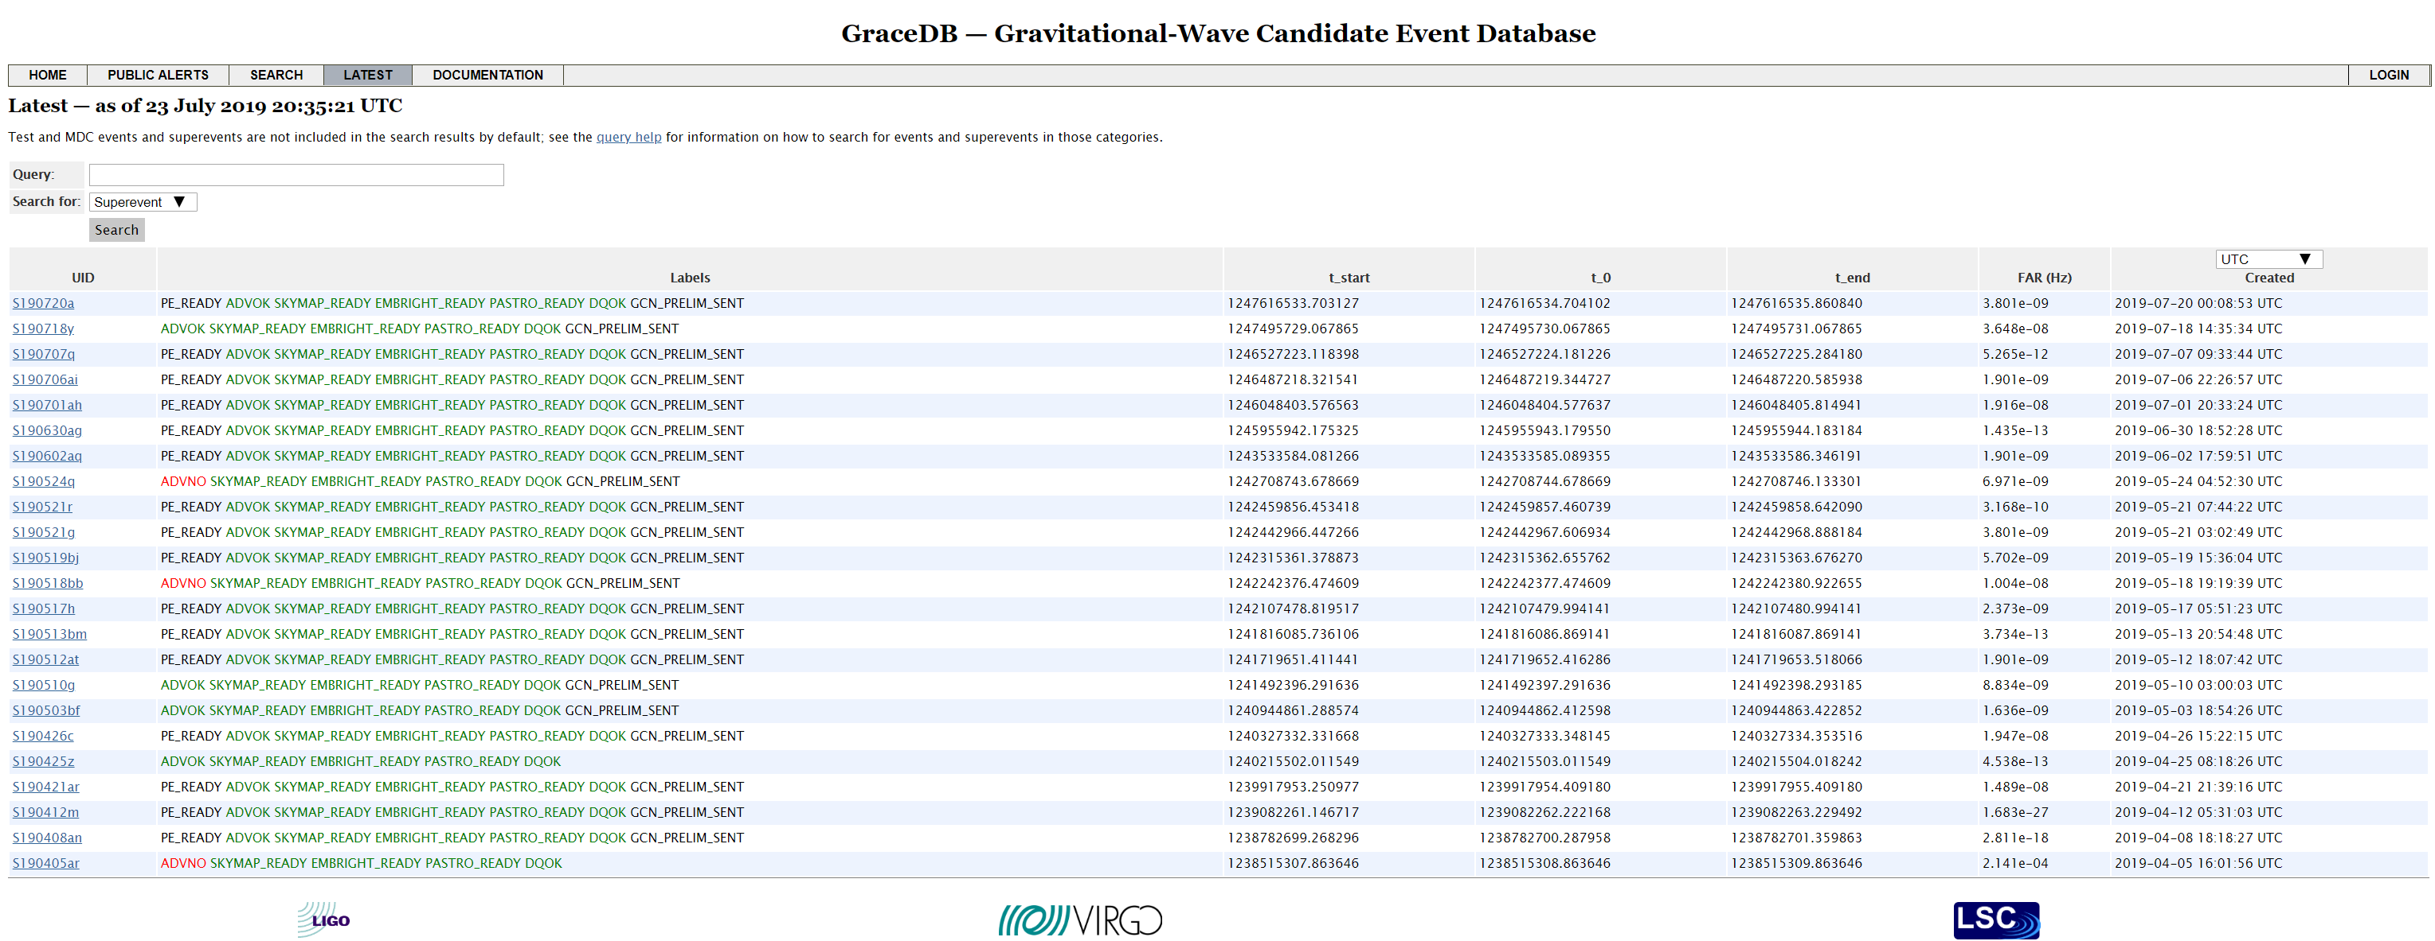
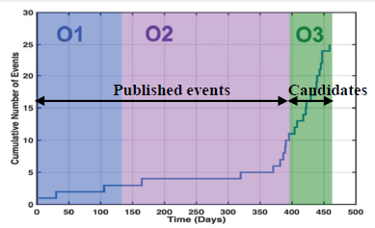
Public alerts in o3

Slide 8
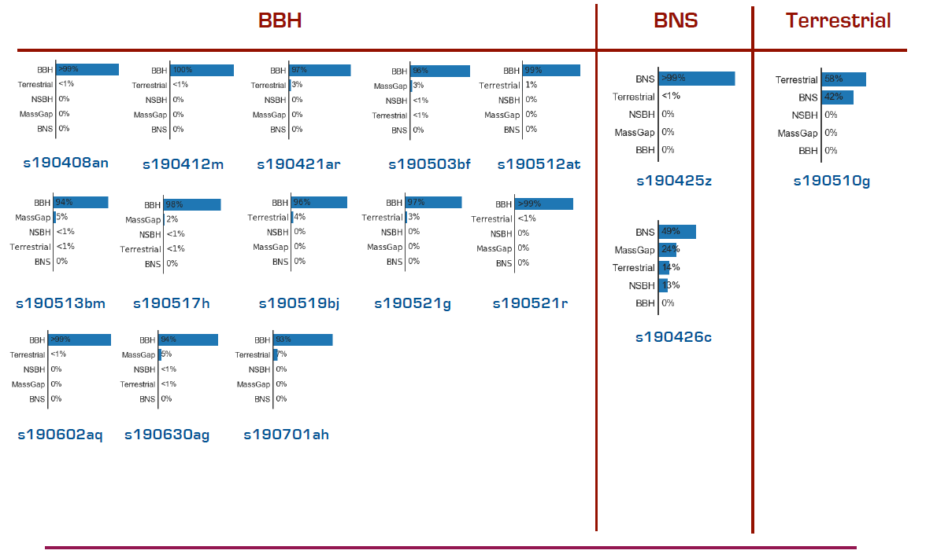
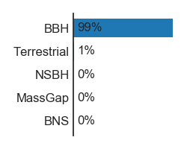
Public alerts in o3 – type distribution
Initially sent out as a BNS, then “upgraded” NSBH.
s190706ai
s190707q
From E. Porter - VIR-0592C-19
The farthest ever: 5.6 Gpc (z ~ 1,3)

Slide 9
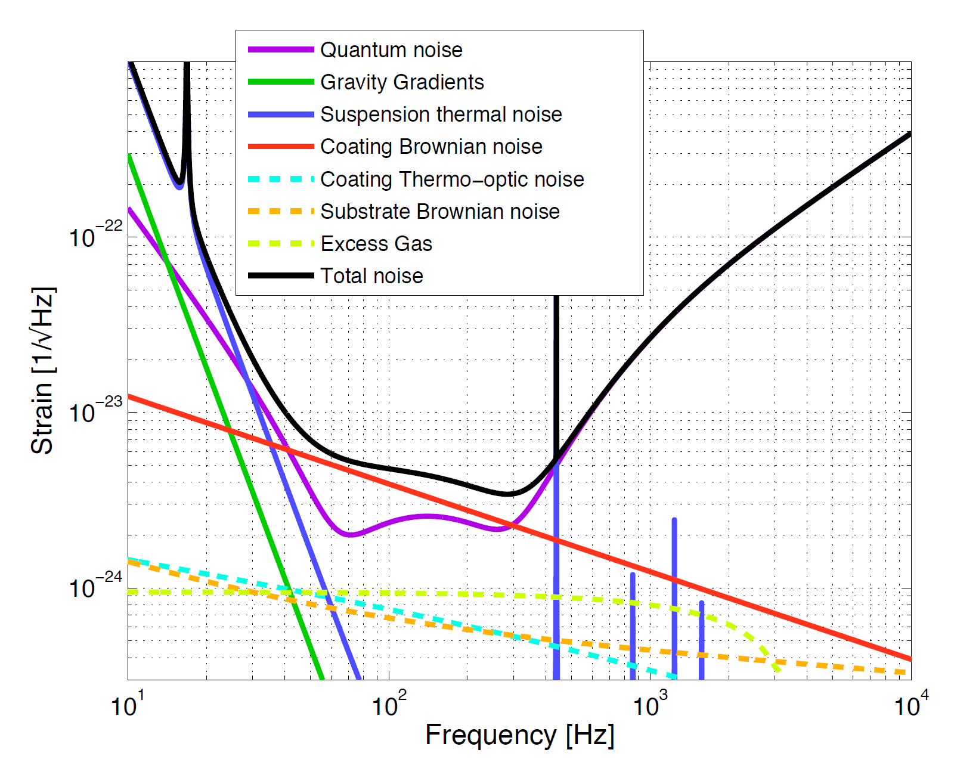
Sensitivity curve
Represents the figure of merit to understand the limits and the performances of the detector.
Different noise sources dominate in different frequency ranges:
low frequency: Newtonian noise and suspension thermal noise;
mid frequency: thermal noise;
high frequency: shot noise.

Slide 10
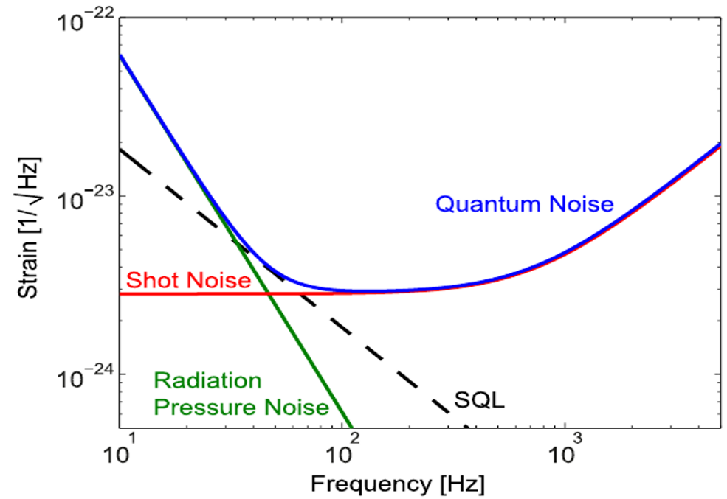


Quantum noise
Quantum noise:
low-frequency: radiation pressure noise;
high-frequency: shot noise.
Key parameters: L and P_{in}.
If detector not radiation pressure limited: it is convenient to increase the input power.
$$h_{rp}∝\frac{1}{L}\sqrt{P_{in}}$$
$$h_{shot}∝\frac{1}{L\sqrt{P_{in}}}$$
Notes:
L: increase the arm length decrease the quantum noise;
Pin: increase the input power reduce the shot noise, but increase the radiation pressure

Slide 11
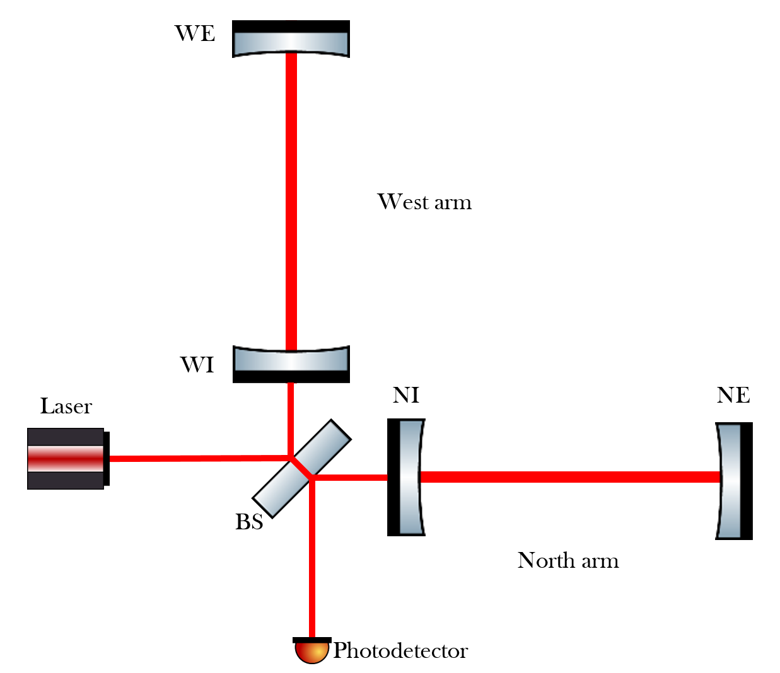
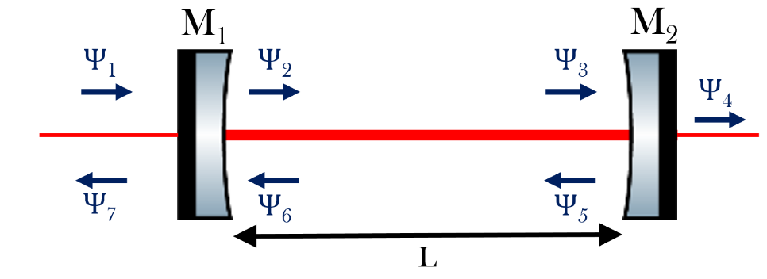



From Michelson interferometer to gw detector
$$h_{rp}∝\frac{1}{L}\sqrt{P_{in}}$$
Arms length increase: Fabry-Pérot (FP) cavities.
Finesse: $F=\frac{π\sqrt{r_{1}r_{2}}}{1−r_{1}r_{2}}$
Effective length: $L^{′}=L∙\frac{2F}{π}=L∙G$
h_{shot} improves by a factor equals to the optical gain.
$$h_{shot}∝\frac{1}{L\sqrt{P_{in}}}$$
Notes:
Inside the FP cavity the electromagnetic field resonates, traveling for many round-trip before exiting from the cavity. In this way the effective length travelled by the laser radiation is much higher of the length of the arms.
The minimum detectable strain h_{shot} improves by a factor equals to the optical gain.
For AdV F_{FP}~ 450, resulting in an optical gain (and in a sensitivity improvement) of ~ 286.

Slide 12
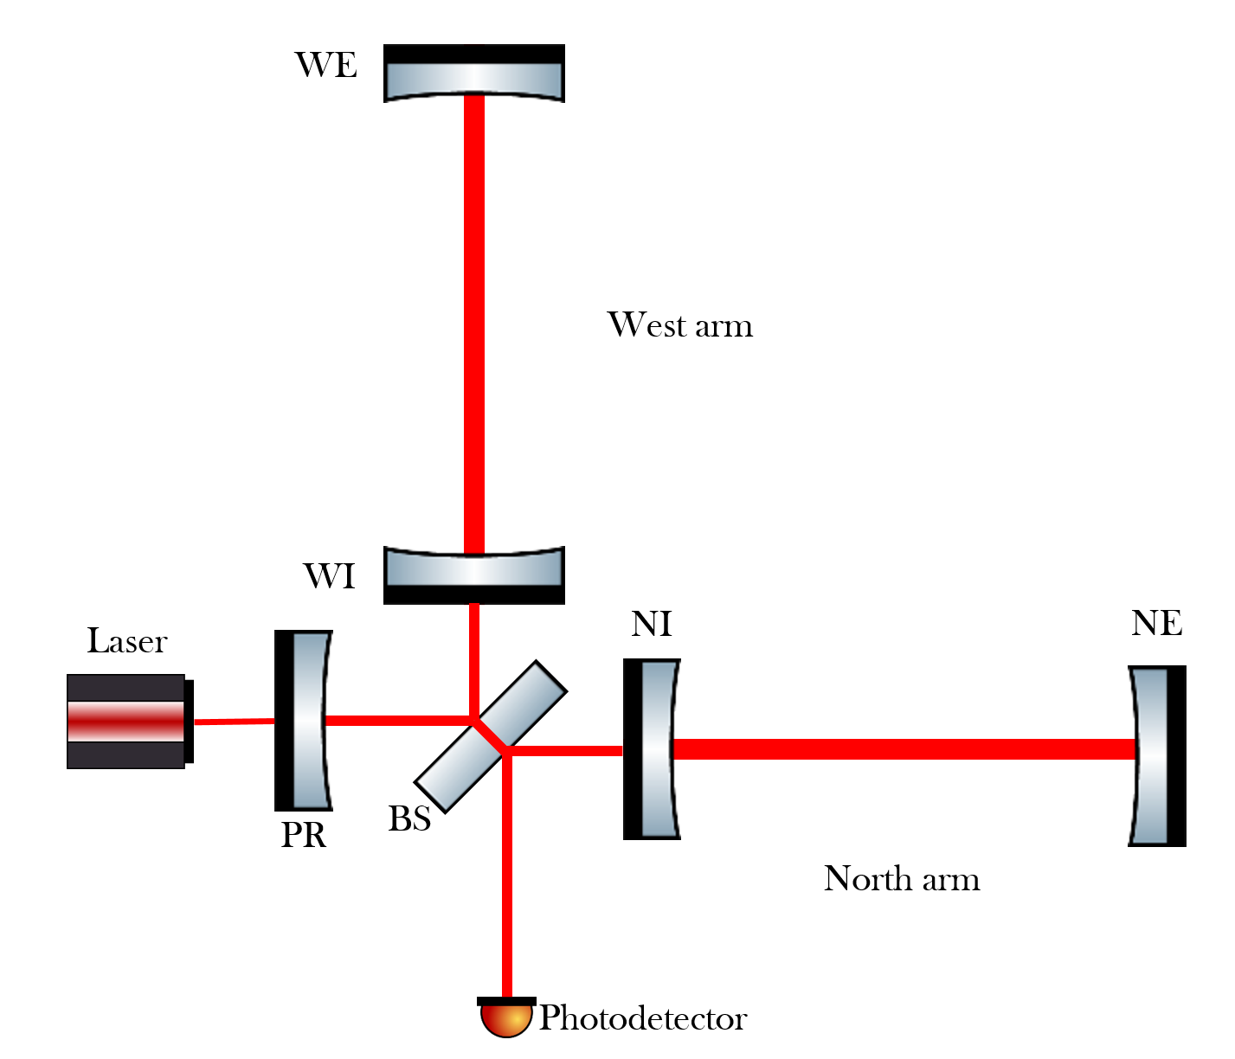
From Michelson interferometer to gw detector
Power increase: Power Recycling Cavity (PRC).
Interference at the BS among the beams coming from the two arms is destructive: very low power arrives on the detection photodiode, most of it is reflected back toward the laser.
Circulating power in the ITF increase by a factor G_{PR} (PRC optical gain).
Notes:
Increase in sensitivity of a factor $\sqrt{\text{G}\text{PR}}$ (for AdV ~6).

Slide 13
Optical aberrations and their correction: the thermal compensation system (TCS)

Slide 14
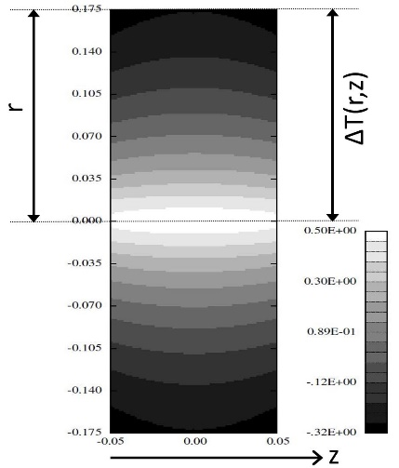
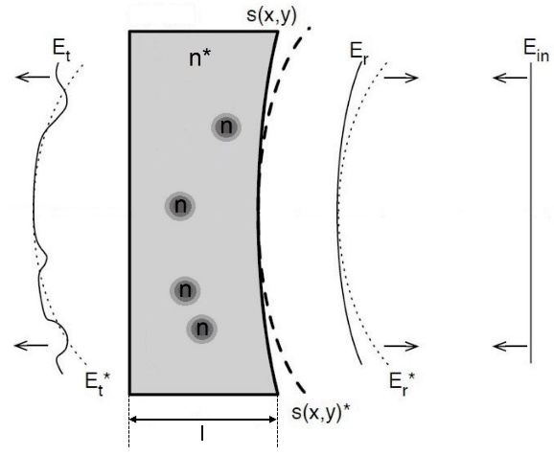
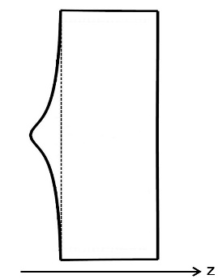
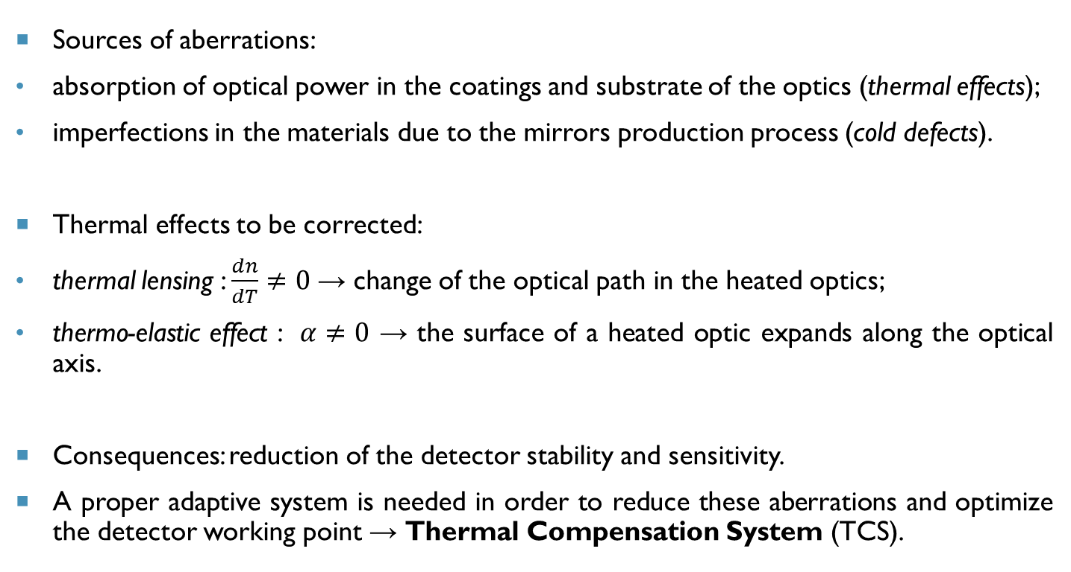
optical aberrations
Sources of aberrations:
absorption of optical power in the coatings and substrate of the optics (thermal effects);
imperfections in the materials due to the mirrors production process (cold defects).
Thermal effects to be corrected:
thermal lensing : $\frac{dn}{dT}≠0$ → change of the optical path in the heated optics;
thermo-elastic effect : $α≠0$ → the surface of a heated optic expands along the optical axis.
Consequences: reduction of the detector stability and sensitivity.
A proper adaptive system is needed in order to reduce these aberrations and optimize the detector working point → Thermal Compensation System (TCS).
Notes:
absorption of optical power in the coatings and substrate of the optics (thermal effects);
imperfections in the materials and due to the mirrors production process (cold defects).

Slide 15
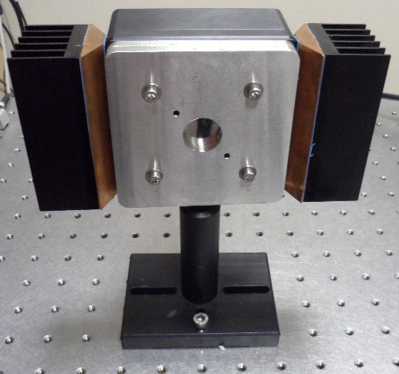
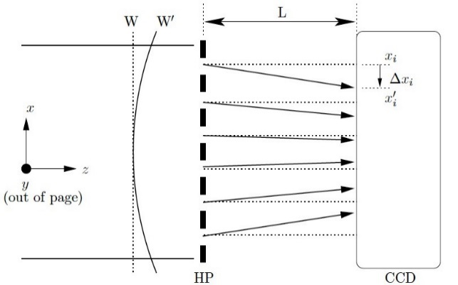

TCS sensing: Hartmann wavefront sensor (HWS)
Differential sensor that measures the change of a ‘live’ wavefront relative to a reference wavefront through an uncoherent probe beam (SLED) fiber-coupled.
The beam pass through an holed plate, resulting in a series of light spots on the CCD. From the displacement of the spots on the CCD, the sensor is able to identify the presence of aberrations in the analysed wavefront.
$$\frac{∂W}{∂x}=\frac{∆x_{i}}{L}$$

Slide 16
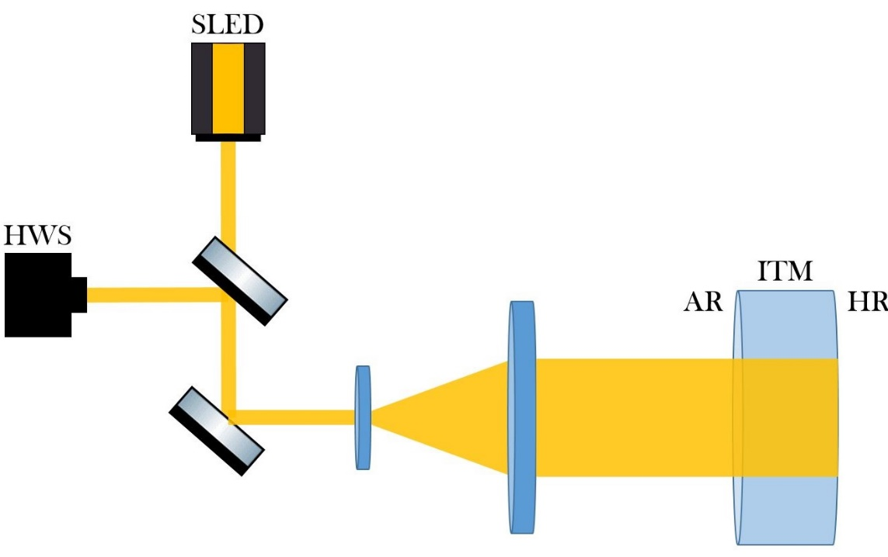
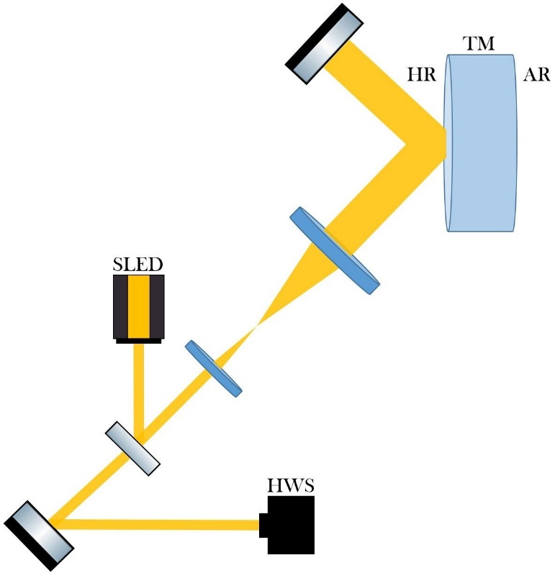
TCS sensing: on-axis and Off-axis setup
Thermal lensing measurements (HWS-RC)
RoC variation measurements (HWS-HR)
Notes:
On axis: The probe beam, superimposed on the main laser, impinges on the Input Test Masses, pass through them and then it is reflected toward the sensors along the same path.
Off-axis: The probe beam impinges on the mirrors with an angle of 45°, then propagates up to an optics that reflects it back on the High Reflectivity surface and then toward the sensor.
HWS placed in the image plane${RoC}_{TM}=M^{2}∙{RoC}_{HWS}$

Slide 17
TCS sensing: Phase camera
The Phase Camera (PC), developed by the Nikhef group, is a sensor able to measure the amplitude and phase maps of the carrier and of the sidebands.
At present two PCs are operative: one is placed on the bright port to monitor the presence of aberrations in the PRC, and one on the dark port to check the aberration budget in the beam at the output of the detector.
PC is a complementary sensor to the above-described HWS, with the difference that it takes global measurements, i.e. it cannot distinguish between the different optics.
Notes:
These maps are obtained with the use of two beams: the signal beam, picked up where the PC is placed and that contains the information on the thermal status of the mirrors, and a reference beam, picked up before the laser enters in the ITF and then not containing any cavity aberrations.
These two signals, after recombination on a BS, reach a scanner and then are detected by a photodiode.

Slide 18
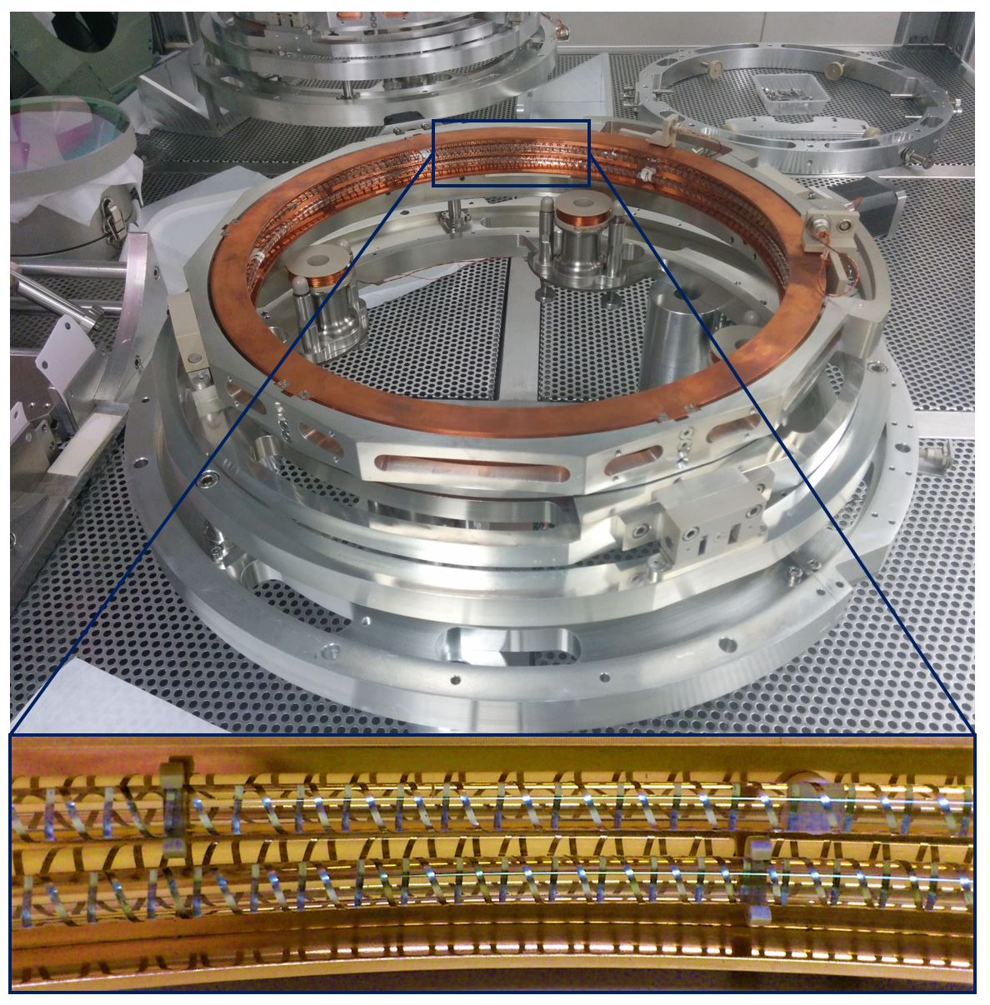
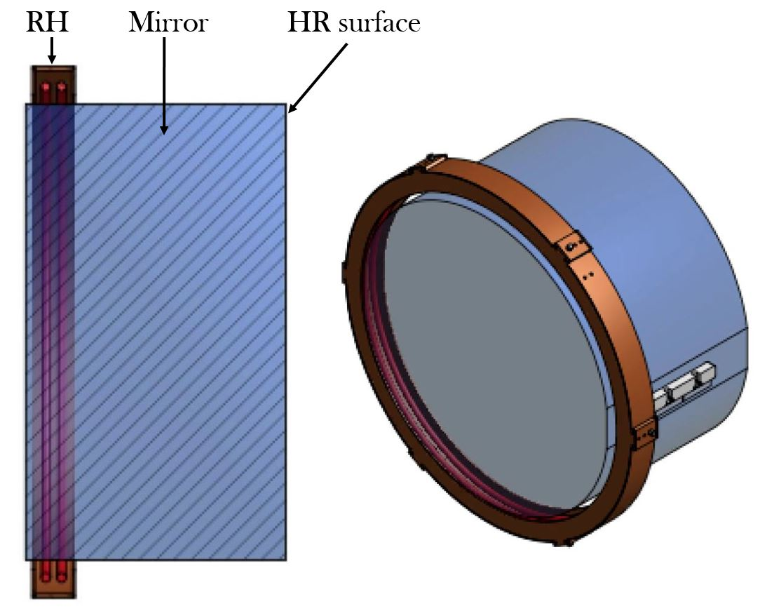
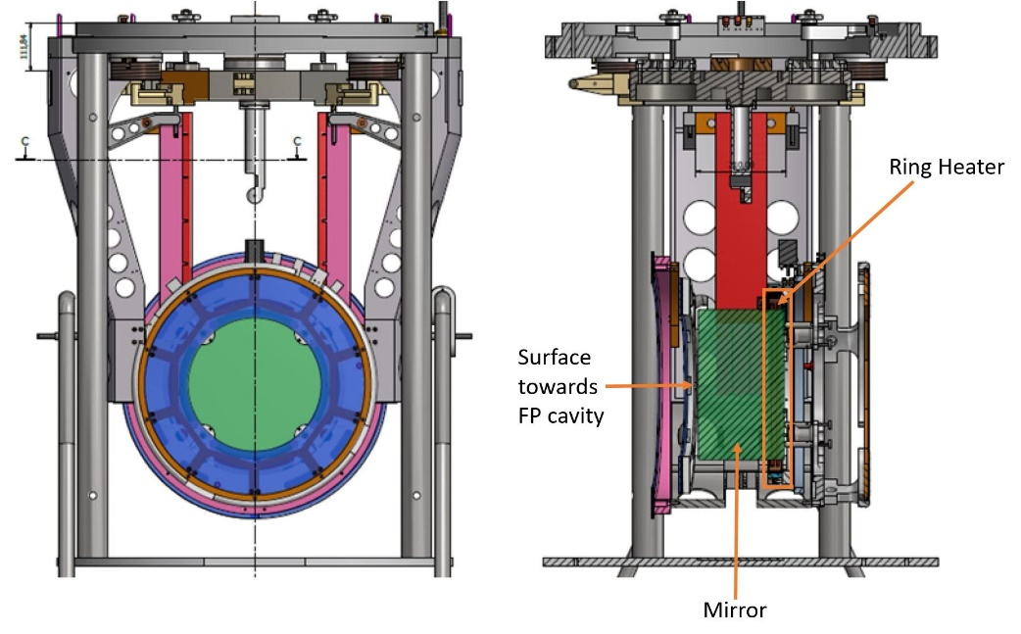
TCS actuation: Ring heater
The heater is a coil of NiCr wires wrapped up on a fused silica ring, that is heated via Joule effect.
The actuator, mechanically centred around the mirror, is composed by two heaters and a shield and act directly on the mirrors to compensate the thermo-elastic deformation.
Correct errors in the radius of curvature of mirrors due to the absorption of the laser power and manufacturing accuracy.

Slide 19
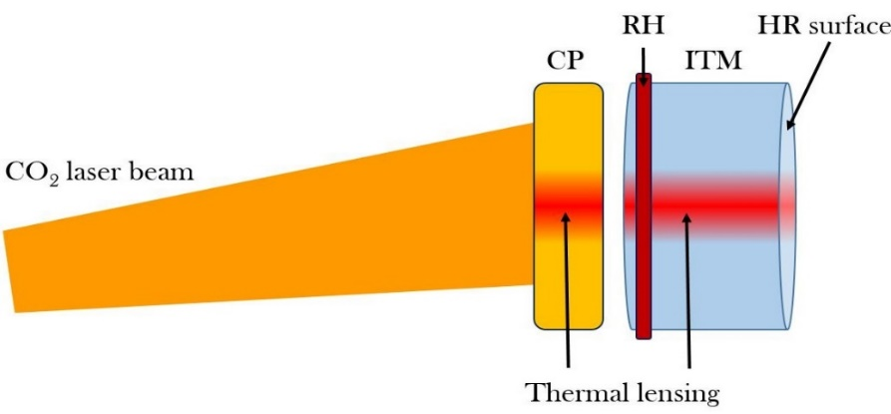
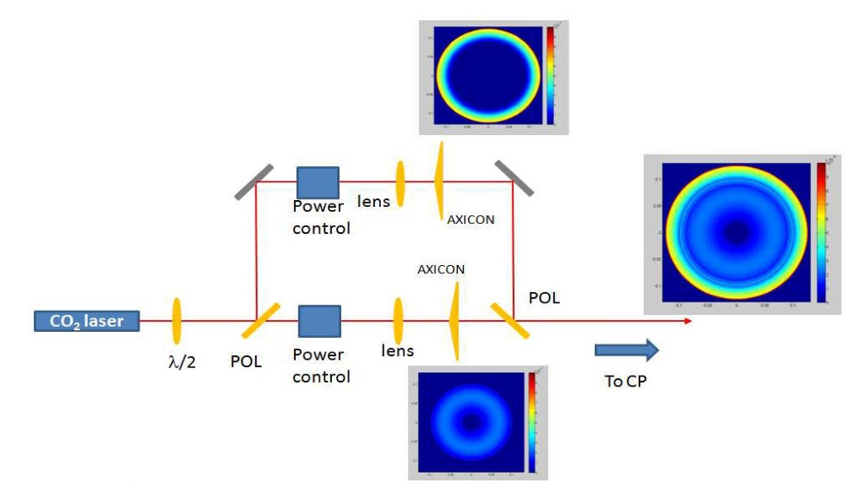
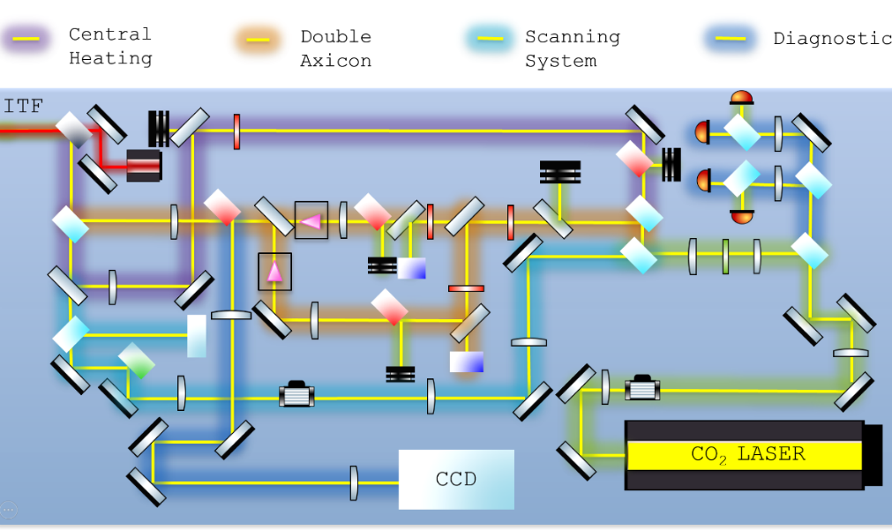

TCS actuation: Co₂ lasers
Thermal lensing correction in ITMs performed with high-power CO₂ lasers projector.
CO₂ wavelength (λ=10.6 µm) completely absorbed by silica.
Actuation performed not directly on the mirrors but on dedicated optics placed before the cavity input mirrors: Compensation Plates (CPs).
Three different types of actuation:
a) axi-symmetric centred pattern (Central Heating);
b) axi-symmetric annular correction (Double Axicon System);
c) not axi-symmetric residual patterns (Scanning System).
$$P_{outer} :P_{inner}=2 :1$$
Notes:
DAS power ratio: out/in 2:1

Slide 20
Advanced virgo tcs Commissioning

Slide 21
TCS pre-commissioning

Slide 22
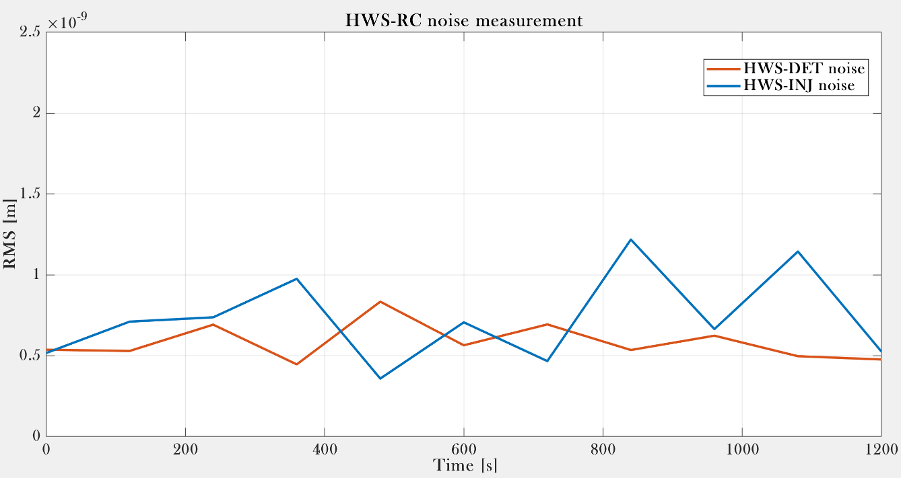
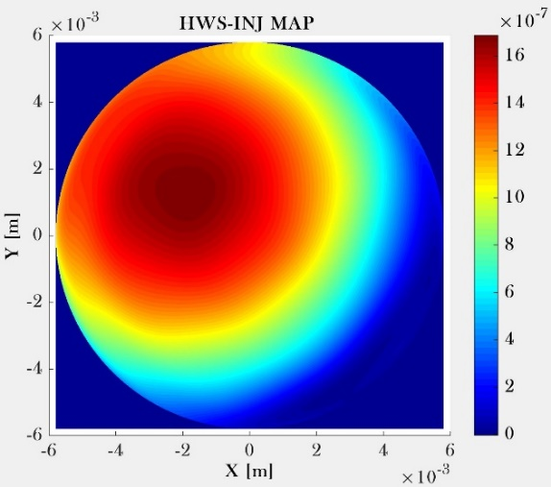
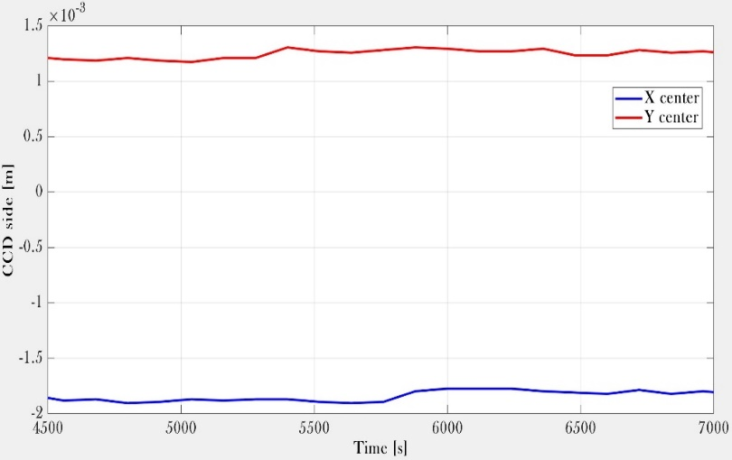
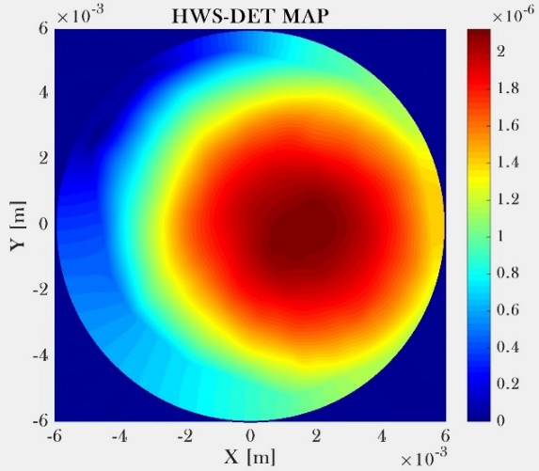
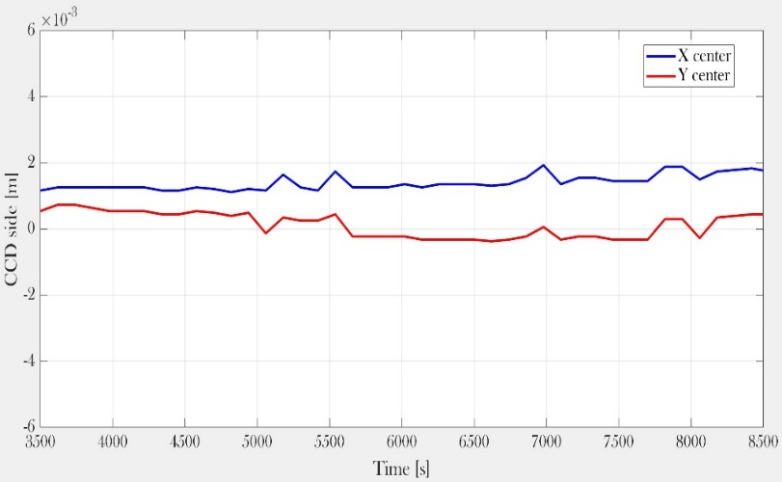
hws-rc pre-comissioning
Noise measurement
Mirror centre identification
WI mirror
Noise level requirement¹: 2 nm RMS
Measured noise level: 0.5-1 nm RMS
NI mirror
¹Advanced Virgo Technical Design Report (TDR) VIR-0128A-12

Slide 23
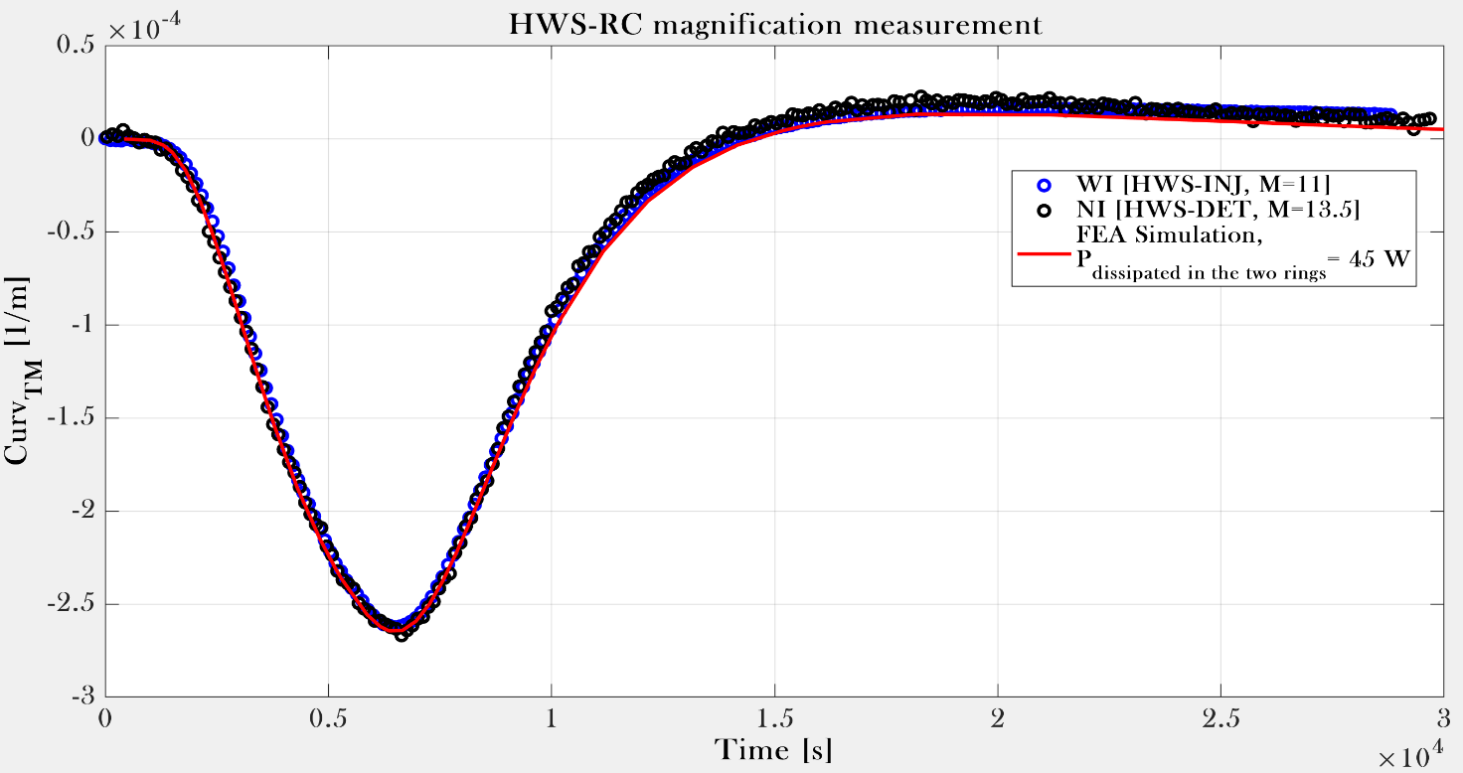
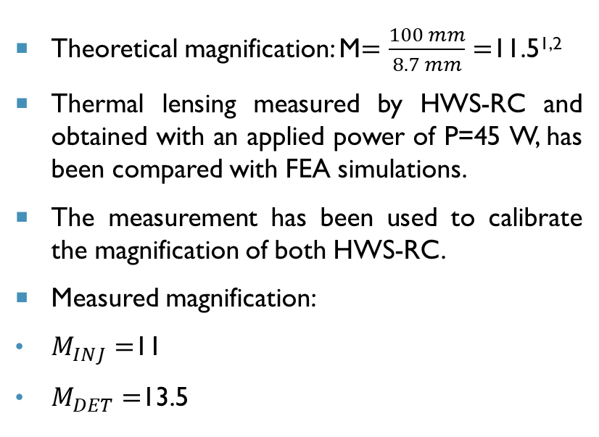
hws-rc pre-comissioning
Magnification measurement
Theoretical magnification: M$=\frac{100 mm}{8.7 mm}=$11.5^{1,2}
Thermal lensing measured by HWS-RC and obtained with an applied power of P=45 W, has been compared with FEA simulations.
The measurement has been used to calibrate the magnification of both HWS-RC.
Measured magnification:
$M_{INJ}=$11
$M_{DET}=$13.5
¹Advanced Virgo Baseline Design VIR-0027A-09
²I. Nardecchia, Control of Optical Aberrations in Advanced Interferometric Gravitational Wave Detectors, Ph.D. thesis (2015)

Slide 24
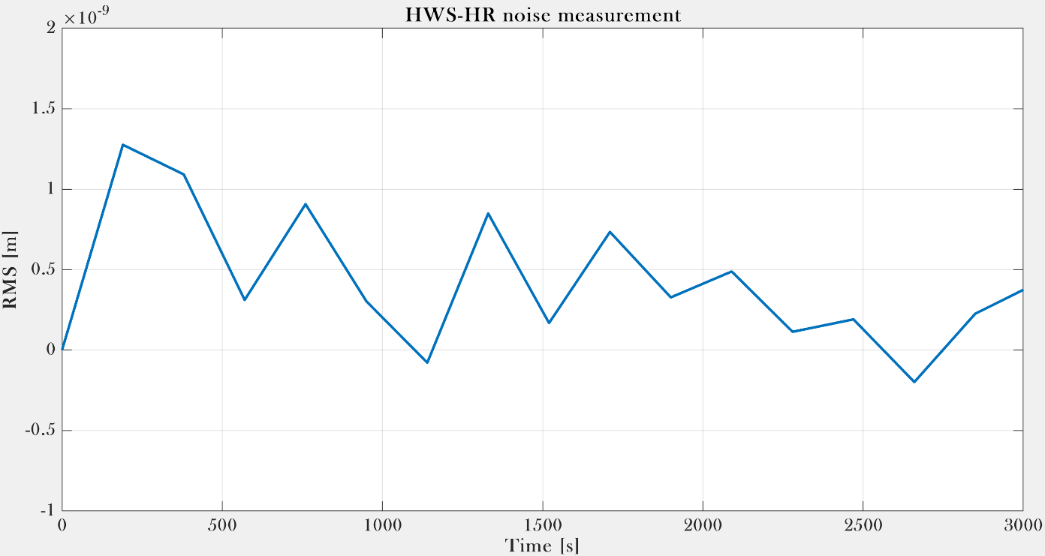
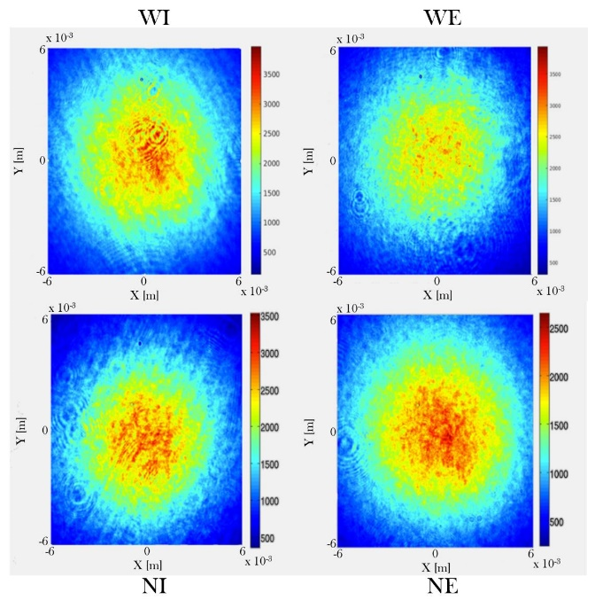





hws-HR pre-comissioning
Noise measurement
SLED beam size measurement
Magnification measurement
Theoretical value:
Measured values
Theoretical value:
M=7
Measured values
Noise level requirement: 2 nm RMS
Measured noise level: <1.5 nm RMS
$w$=8.7 mm

Slide 25






Central heating pre-commissioning
Size measurement
Actuator alignment
Target spot size: 150 mm
Measured spot size: ~140 mm
Notes:
WI CH aligned on the CP within 9.7 mm
NI CH aligned on the CP within 5.8 mm

Slide 26





Double axicon system pre-commissioning
Actuator profile
Actuator shape
Measured in the object plane of the optical system that allows to proper magnify them on the CPs.
Inner annulus
Inner + outer annuli
Outer annulus
Notes:
DAS annuli dimensions have been measured 60 mm after the recombiner, the object plane of the optical system that allows to proper magnify them on the CPs.

Slide 27






Double axicon system pre-commissioning
Actuator alignment – Step I (HWS maps)
WI mirror
NI mirror

Slide 28


Double axicon system pre-commissioning
Actuator alignment – Step II (ITF signals)
WI mirror
NI mirror

Slide 29



Ring heater pre-commissioning
NE RH:
P=30 W: expected RoC decrease about 40 m;
good agreement observed between the measured RoC variation with the NE HWS-HR and the Ansys simulations;
checked tilt of the test mass along the X and Y direction, compared with the signals provided by the optical levers. Signals in agreement.
NI RH:
P= 15 W: expected RoC decrease about 16.5 m;
good agreement between the simulations and the experimental data.

Slide 30
TCS commissioning

Slide 31



Input test masses coating absorption estimation

Slide 32


Contrast defect enhancement
Contrast: $C=\frac{P_{max}−P_{min}}{P_{max}+P_{min}}$ → $CD=1−C=\frac{2∙P_{min}}{P_{max}+P_{min}}$
Natural lens in NI CP → WI CH engaged.
Checked the long-term effect with two consecutive actuation steps:
P_{CH}=100 mW: CD 0.0033 → 0.0015;
P_{CH}=200 mW: CD 0.0015 → 0.0010.
Net improvement of more than a factor of 3 with respect to the CH-off state.
Notes:
From cold aberration budget: converging lens in the NI CP.

Slide 33


Power recycling cavity gain improvement
ITF input power: P=10 W
ITF input power: P=17.5 W
The effect was a decreasing of the sideband gain, accordingly with optical simulations¹. Confirmed the reliability of the models adopted in the simulations.
Best compensation obtained with actuation power:
P_{IN}= 125 mW P_{OUT}= 250 mW.
Improvement of the sidebands gain:
G=8.8 → G=10.2 (+14%).
¹TCS-Aberration Control: update, simulations and planning VIR-0855A-17
Notes:
DAS designed to restore 56 MHz sideband gain degrading by the thermal effects at high values of ITF input power.

Slide 34



Power recycling cavity gain improvement
With the increase of the input power and no TCS the sidebands gain progressively decreased for the arising of the thermal effects, as expected.
When the TCS has been engaged, the DAS actuators have been able to restore a good working point.

Slide 35


Intracavity power increase and darker fringe
Around 30% of the power lost in the first 200 seconds after the begin of the lock¹.
Possible reason: presence of HOMs circulating in the FP cavities due to the wrong values of the ETMs RoCs².
Commissioning tests with the ETMs RHs carried on in order to try to reduce the gap between the real ETMs RoC value and the nominal one and to see if this could minimize the power drop inside the FP cavities.
N arm (B7): 630 mW
W arm (B8): 610 mW
Arms power increase
N arm (B7): 455 mW
W arm (B8): 435 mW
Darker fringe
¹Advanced Virgo Commissioning Report to the STAC VIR-0676A-18
²TCS activity: tests with ETM RHs, VIR-0624A-18
L. Aiello - Development of new approaches for optical aberration control in gravitational wave interferometers
Notes:
Optical power drop inside the FP cavities as soon as the lock at the dark fringe has been acquired.
Indeed, the ETMs had a cold RoC measured value of 1695 m and 1696 m for NE and WE, respectively, with respect to a design value of 1683 m.
Higher power circulating in the ITF → higher thermal effects → decrease the 56 MHz sidebands → further tuning of the DAS powers (in collaboration with ISC).

Slide 36


Intracavity power increase and darker fringe
Optical power in the arms
North arm: 455 mW → 535 mW.
West arm: 435 mW → 520 mW.
Net increase of the intra-cavity power of about 15%.
Dark fringe
Power detected at the dark port: 0.300 mW → 0.179 mW.
Improvement of around 68%.
L. Aiello - Development of new approaches for optical aberration control in gravitational wave interferometers

Slide 37


Dark fringe mode content improvement
Exploiting a code developed by Nikhef group¹ (in collaboration with prof. Hiro Yamamoto), mode content of the carrier at the dark port with RH on and off has been analysed and compared.
RHs off
The dominant modes resulted to be the ones of the order 10 and 8, followed by 13, 9 and 11.
RHs on
Reduction of all the higher order modes content, in particular of the ones of order 10 and 8.
The dominant modes became the ones of the order 9 followed by 13, 8, 12 and 11.
¹L. van der Schaaf, The phase cameras of Advanced Virgo, Ph.D. thesis (2019)
L. Aiello - Development of new approaches for optical aberration control in gravitational wave interferometers

Slide 38

Sensing and actuation validation
Reference wavefront: ITF was in the recombined state with DAS off.
Begin of the measurement: ITF reached the dark fringe. Curvature started to increase, due to the natural thermal lensing of the YAG laser.
WI DAS shined: curvature on the related ITM started to decrease toward the zero.
ITF unlocked: the curvature sign changed as expected because the DAS was on but there were no more the YAG thermal lensing to balance it.
ITF relocked (with the actuator still on): the curvature started to come back to zero.
L. Aiello - Development of new approaches for optical aberration control in gravitational wave interferometers

Slide 39
TCS for the third observing run (O3)
L. Aiello - Development of new approaches for optical aberration control in gravitational wave interferometers

Slide 40

Commissioned Tcs engagement
The presence/absence of the DAS actuators has clear visible effects on:
the dark fringe
the 56 MHz sidebands power
the binary neutron stars range
L. Aiello - Development of new approaches for optical aberration control in gravitational wave interferometers
Notes:
O3 working input power: P=20 W (a factor of 2 higher with respect to O2).

Slide 41


Advanced virgo tcs for the current observing run
Final power values of all the (currently) engaged TCS actuators in O3 run.
L. Aiello - Development of new approaches for optical aberration control in gravitational wave interferometers

Slide 42


Ni double axicon system compensation
Imbalance of the power in the NI DAS due to the presence of the converging natural lens on the NI CP.
NI DAS is actually correcting both NI CP natural lens and thermal lensing in the NI ITM.
Optical simulations based on the measured NI DAS profile demonstrated that about the 40% of the NI outer DAS is needed to compensate the natural lens¹.
NI outer DAS: about 1 W corrects the natural lens and 1.25 W compensates the thermal lensing.
NI inner DAS: about 600 mW.
Consistency with the ratio 1:2 between the powers of the inner and outer annuli (as expected by the simulations).
¹O4 laser power discussion: TCS, VIR-0340A-19
L. Aiello - Development of new approaches for optical aberration control in gravitational wave interferometers
Notes:
NI CP lens compensation possible approaches:
engagement of the WI CH in order to create on the WI CP another lens and then equalize the effect among the two arms;
engagement of the NI DAS in order to directly remove the natural lens.
→ NI DAS replaced the action of the CH on the WI CP.

Slide 43
Commissioning - results
TCS subsystem fully commissioned with its sensor and actuators.
Commissioning tests and measurements shown a clear positive effect of the TCS on the detector, with an improvements of its performances and stability.
TCS currently engaged in the present Observing Run O3.
L. Aiello - Development of new approaches for optical aberration control in gravitational wave interferometers

Slide 44
R&D for TCS improvement
L. Aiello - Development of new approaches for optical aberration control in gravitational wave interferometers

Slide 45
mode cleaner cavity design for CO₂ laser
L. Aiello - Development of new approaches for optical aberration control in gravitational wave interferometers

Slide 46




Co₂ mode cleaner: why and which?
Efficiency of the TCS CO₂ actuators is directly related to the quality of the laser.
Sometimes the high-power CO₂ lasers exhibit a bad shape. Spatial beam filter has been placed on the optical benches in the laser beam waist position.
Improvement of the beam shape, but with the cost of a consistent reduction of the available laser power, resulting in a not negligible limitation of the actuators dynamic.
With the present TCS it is possible to compensate the thermal effects up to an input power value of P=30 W¹. Another way to improve laser beam quality is mandatory for the future TCS, in order to be ready to face also higher input power values.
Linear
Triangular
Bow-tie
Mode Cleaner for CO₂ lasers
Cavity geometry
¹O4 laser power discussion: TCS, VIR-0340A-19 (2019).
L. Aiello - Development of new approaches for optical aberration control in gravitational wave interferometers

Slide 47


Triangular cavity linearization
Advantages: avoid the backreflections problem (no suitable Faraday Isolators for λ=10.6 µm).
$$α=\frac{\frac{π}{2}−θ}{2}$$
Disadvantage: astigmatism must be taken into account because of the not-normal incidence on the end (concave) mirror. The problem have then to be split and analysed on two different planes, the transverse and the sagittal one.
L. Aiello - Development of new approaches for optical aberration control in gravitational wave interferometers

Slide 48







Cavity stability requirements
g-factor: $g_{i}=1−\frac{L}{{RoC}_{i}}$
Stability requirement: ${0<g}_{1∙}g_{2}<1$
Concave mirror:
sagittal plane: $g_{1S}=1−\frac{L∙cosθ}{{RoC}_{1}}$ $L<\frac{{RoC}_{1}}{cosθ}$
transverse plane: $g_{1T}=1−\frac{L}{{RoC}_{1}∙cosθ}$ $L <{RoC}_{1}∙cosθ$
Plane mirror: $g_{2S}=g_{2T}=1$
Gouy phase shift: $Φ_{i}=\cos^{−1}\left(±\sqrt{g_{1i}g_{2}}\right)$
$i=S,T$
$${∆Φ}_{ST}=\left|Φ_{S}{−Φ}_{T}\right|<γ=\frac{π}{2F}$$
L. Aiello - Development of new approaches for optical aberration control in gravitational wave interferometers
Notes:
Along its propagation direction, a Gaussian beam acquires a phase shift which differs from that for a plane wave with the same optical frequency.
The Gouy phase shift of any focused beam originates from the transverse spatial confinement, which, through the uncertainty principle, introduces a spread in the transverse momenta and hence a shift in the expectation value of the axial propagation constant.

Slide 49

Cavity design - requirements
What we want
What we need
Stability
${0<g}_{1∙}g_{2}<1$
Higher order modes cleanliness
Finesse: F ~ 60-100
Cavity easy lockable
Compactness
Cavity length: L < 1 m
L. Aiello - Development of new approaches for optical aberration control in gravitational wave interferometers

Slide 50


Cavity design – roc, θ and l
End (concave) mirror RoC:
lower limit: 0.5 m (manufacturing reason)
upper limit: computed the stability of a linear cavity with g₂ = 1 in order to see the trend as a function of the RoC. Upper limit set to 2 m;
Angle of incidence: 0.5°-10°.
L < Rcosθ: RoC values between 1 m and 2 m considered (to fulfil compactness: L < 1 m).
Gouy Phase shift difference investigated for different angles of incidence and RoC. Computation performed for the cases relative to the extrema of the interval that has been considered (F=60 and F=100).
L. Aiello - Development of new approaches for optical aberration control in gravitational wave interferometers
Notes:
Cavity stability requires L < Rcosθ, then for RoC values between 1 m and 2 m all the values of the chosen cavity length range (L < 1 m) could be considered.

Slide 51



Cavity design – finesse and transverse mode spacing
FSR
Finesse $F=\frac{FSR}{FWHM}=\frac{π}{2\sin^{−1}\left(\frac{1−\sqrt{R_{1}R_{2}}}{2{\left(R_{1}R_{2}\right)}^{\frac{1}{4}}}\right)}\sim \frac{π{\left(R_{1}R_{2}\right)}^{\frac{1}{4}}}{1−\sqrt{R_{1}R_{2}}}$
Higher finesse, higher cleaning of the laser beam but also greater difficulty in locking the cavity.
Transverse Mode Spacing (TMS) $∆ν_{tr}=\frac{c}{2nL}\left(\frac{\cos^{−1}\left(±\sqrt{g_{1}g_{2}}\right)}{π}\right)$
The reference for this figure of merit is that this separation have to be larger than the FWHM.
FWHM
L. Aiello - Development of new approaches for optical aberration control in gravitational wave interferometers

Slide 52

Cavity design – finesse
Very high reflectivity of the cavity mirrors is required in order to have a Finesse value in the investigated range.
L. Aiello - Development of new approaches for optical aberration control in gravitational wave interferometers

Slide 53

Cavity design – transverse mode spacing
Investigation for:
RoC= θ=0.5÷2.0 m;
θ=0.5°÷10°;
F=60 and F=100.
All the investigated values gave a TMS higher than the FWHM, resulting then suitable for the cavity design.
L. Aiello - Development of new approaches for optical aberration control in gravitational wave interferometers

Slide 54

Cavity design – final parameters
Compactness
Quasi-normal
incidence
High finesse,
but good for avoid
locking problems
Stability
Very low
astigmatism
L. Aiello - Development of new approaches for optical aberration control in gravitational wave interferometers

Slide 55


Geometrical design
L. Aiello - Development of new approaches for optical aberration control in gravitational wave interferometers

Slide 56

Mechanical design
L. Aiello - Development of new approaches for optical aberration control in gravitational wave interferometers

Slide 57


Cavity Thermal expansion and material choice
The variation of the environmental temperature induces a change of the cavity length $∆L=α∙∆T∙L$.
Performed measurements of the environmental temperature fluctuations.
Fluctuations within 1°C (∆T_{max}=0.728 °C).
Expected variation of the cavity length due to environmental thermal fluctuations:
0.5 µm for an invar-made cavity;
8.5 µm for an aluminum-made cavity.
Present available actuators range: tens of µm.
Invar is preferred in order to have in future an easier development of the control acting on the piezo-electric actuator.
L. Aiello - Development of new approaches for optical aberration control in gravitational wave interferometers
Notes:
In order to allow to the eigenmode to resonate, the length of the cavity must be monitored in such a way that the condition L_{rt} = pλ, with p a positive integer, is always fulfilled.
Invar is preferred in order to have in future an easier development of a proper control acting on the piezo-electric actuator to keep the cavity at the right working point.

Slide 58

Integration in the co₂ optical benches
L. Aiello - Development of new approaches for optical aberration control in gravitational wave interferometers

Slide 59








Mode matching telescope
Mode matching telescope layout
Matching formulas
$$d_{1}=f±\frac{w_{1}}{w_{2}}\sqrt{f^{2}−f_{0}^{2}}$$
$$d_{2}=f±\frac{w_{2}}{w_{1}}\sqrt{f^{2}−f_{0}^{2}}$$
$$f_{0}=\frac{πw_{1}w_{2}}{λ}=147.7 mm$$
w₁ estimation: knife-edge method
$$f_{1}=254 mm$$
Mode matching telescope final design
w₂ estimation: optical resonator theory
$$w_{2}=\sqrt{\frac{Lλ}{nπ}}{\left[\frac{g_{1}g_{2}(1−g_{1}g_{2})}{{\left(g_{1}+g_{2}−2g_{1}g_{2}\right)}^{2}}\right]}^{\frac{1}{4}}$$
L. Aiello - Development of new approaches for optical aberration control in gravitational wave interferometers

Slide 60

Modulation strategy: eom vs aom
EOM modulation
In order to proper lock the cavity, an error signal is needed. This is usually obtained with PDH technique, in which the laser beam is modulated with an EOM.
Problem of this well-known approach: for CO₂ wavelength a custom EOM with a CdTe crystal for modulate the beam is highly expensive.
AOM modulation
Possible alternative: use the frequency modulation of an AOM's carrier signal to generate two spatially and spectrally separated sidebands¹.
This approach will need to be deeply studied in order to careful check if it is adaptable to the studied MC case. Indeed, the AOM for CO₂ lasers are well developed and much cheaper with respect to the related EOM.
The feasibility of this approach it will be one of the highest priorities in the next steps of the development of the MC.
¹M. Aldous, J. Woods, A. Dragomir, R. Roy, M. Himsworth, Carrier frequency modulation of an acousto-optic modulator for laser stabilization, Optics Express(2017).
L. Aiello - Development of new approaches for optical aberration control in gravitational wave interferometers

Slide 61
Mode cleaner design - results
Performed geometrical and mechanical design of the cavity.
Investigated the most suitable material for its realization.
Identified a possible (cheaper) alternative of the cavity locking strategy (to be tested…)
Important upgrade for the AdV+ TCS now designed.
L. Aiello - Development of new approaches for optical aberration control in gravitational wave interferometers

Slide 62
Optical simulations for tcs actuation error signal investigation
L. Aiello - Development of new approaches for optical aberration control in gravitational wave interferometers

Slide 63

Error signal investigation
Chosen sensor: Phase Camera (PC). It could provide information on the amplitude and on the phase of all the fields circulating in the ITF.
PC signals could be simulated with a dedicated optical simulations tool: Static Interferometer Simulation (SIS), developed by prof. Hiro Yamamoto of Caltech with whom I collaborated.
SIS allows to simulate the detector with many different physical parameters, exploiting then several optical layouts, and to check the fields behaviour in various parts of the ITF.
In simulating the detector an optical aberration has been induced in the CPs and, examining the PC simulated maps, a linear correlation has been looked for with a physical quantity in order to build an appropriate error signal.
L. Aiello - Development of new approaches for optical aberration control in gravitational wave interferometers

Slide 64

Simulations procedure
Two different types of SIS simulations:
simulations of perfect ITF (design optical parameters, no mirror maps nor thermal effects);
simulations with the real (measured) optical values and taking into account also aberrations.
For each simulation type, three cases investigated:
curvature aberration induced only in W CP;
curvature aberration induced only in N CP;
same curvature aberration induced in both CPs.
Quantities considered as candidates for an error signal:
beam size extracted from the intensity maps;
curvature extracted from the absolute phase maps;
curvature extracted from the phase difference maps (USB-CAR, LSB-CAR, USB-LSB).
L. Aiello - Development of new approaches for optical aberration control in gravitational wave interferometers
Notes:
The behaviour of the carrier (CAR) and of the upper/lower sidebands (USB/LSB) fields has been investigated both at the symmetric port (B4 photodiode) and at the antisymmetric one (B1p photodiode).

Slide 65




Perfect interferometer case study
Differential
Common
Correlations for the two differential aberrations are similar (as expected).
In the design case an aberration has the same weight if it lies in one or in the other detector arms, i.e. there is no unbalance among them.
Correlations are nearly twice with respect to the differential one (as expected).
The combined effect of curvature aberrations in the two arms affects also the signal at the output of the detector, while a single-arm aberration it is not producing this.
L. Aiello - Development of new approaches for optical aberration control in gravitational wave interferometers

Slide 66




Real interferometer case study - differential
L. Aiello - Development of new approaches for optical aberration control in gravitational wave interferometers

Slide 67



Real Interferometer case study
Real Interferometer case study - common
The curvature range detected by PC is of the same order of magnitude both for only W CP or only N CP aberrated, on both detector ports, but with a different response on the two arms.
Looking at the angular coefficients of the fit performed in the common case, it is possible to see that for all the four candidates they are about the sum of the coefficients in the two differential cases, in agreement with what expected.
L. Aiello - Development of new approaches for optical aberration control in gravitational wave interferometers

Slide 68

Power mode content
Another figure of merit investigated: power mode content of the fields on the symmetric port.
The different fields power has been decomposed in their mode content both in the Hermite-Gauss (HG) and Laguerre-Gauss (LG) base.
All the modes from the 00 up to the 88 has been computed for the two sideband fields.
Modes selection criteria:
modes showing only linear correlation;
modes in which the linear fit resulted in a R²>0.95;
modes with a power content at least 1% of the total power.
L. Aiello - Development of new approaches for optical aberration control in gravitational wave interferometers
Notes:
Total of 324 possible candidates.

Slide 69

Power mode content
Clear correlation with the content of some modes emerged in the differential case, not in the common one.
Presence of a good correlation also between the mode content of the sidebands power at the symmetric port and induced curvature aberration.
L. Aiello - Development of new approaches for optical aberration control in gravitational wave interferometers

Slide 70
Sis simulations - results
Simulations of the ITF have shown the clear presence of different PC channels to be used as error signal for TCS.
Good correlation also between the mode content of the sidebands power at the symmetric port and induced curvature aberration, less clear identification of an error signal.
L. Aiello - Development of new approaches for optical aberration control in gravitational wave interferometers
Notes:
The drawback has been that this correlations seems to be not present in the case of a common aberration. However this is not a limit because usually the differential aberration working condition is the normal one.

Slide 71
Adaptive optics for future tcs
L. Aiello - Development of new approaches for optical aberration control in gravitational wave interferometers

Slide 72

Not axi-symmetric aberrations: scanning system
Performed with a modulated CO₂ beam that scans the surface of the compensation plate¹.
CO₂ beam spot scanned along a raster map 25x25.
Beam intensity modulated with acusto-optic modulator.
Target heating pattern is obtained as a sum of all the spots in the raster scan.
Problem: this actuation method introduce noise in the sensitive bandwidth of the detector through coupling mechanisms (mainly thermorefractive noise and radiation pressure noise).
Deformable Mirror (DM) studied as possible future actuator.
Goal: proper shape the laser beam, producing a specific intensity pattern on an image plane by applying a phase imprint in an object plane.
Advantage: the applied correction is static and adaptive. Noise coming from surface scan is removed.
¹R. C. Lawrence, Active Wavefront Correction in Laser Interferometric Gravitational Wave Detectors, Ph.D. thesis (MIT, 2003)
L. Aiello - Development of new approaches for optical aberration control in gravitational wave interferometers
Notes:
The aberration spatial frequencies to be corrected had been estimated to be of the order of 40 m⁻¹, corresponding to dimensions of about 1 cm.
Being the area to be corrected about 80 mm in radius, a DM with 144 actuators could be used to correct them. With a proper optical system, 12x12 actuators could be expanded on an area 16x16 cm² and this allows to have nearly one actuator for each cm of area to be corrected.
Correction of residual non-symmetric terms of the thermal lensing.
La scan frequency (about 5-10 Hz) e la step frequency (max 3kHz) sono nella banda di AdV quindi lo SS può creare problemi attraverso accoppiamenti col thermo-refractive noise (OPL non resta esattamente costante ma oscilla con una frequenza) e RADIATION PRESSURE NOISE (dovuto al fatto che lo “scuoto” con la correzione scansionando)

Slide 73





Deformable mirror
DM: optic whose surface can be deformed in order to proper correct optical aberrations.
Under the DM surface actuators are placed through which the activation with specific values of applied voltage allow to obtain the required surface deformation.
TARGET
DM 12x12
Prototype developed by Adaptica. Features:
40 mm in diameter;
144 piezo-electric actuators placed under its membrane in 6 concentrically circular regions;
push-pull actuators.
Characterization performed with a solid state laser (λ=532 nm).
Gerchberg-Saxton algorithm
No activation
Push activation
Pull activation
Single-actuator activation check (intensity)
L. Aiello - Development of new approaches for optical aberration control in gravitational wave interferometers
Notes:
SOME ACTUATORS NOT WORKING
Each of the actuators on the DM could be activated applying to the relative electrodes a certain voltage between -150 V and 150 V, with positive voltage values raising the actuator and negative values lowering it, respectively
For each actuator an a actuation value from 0 to 1 is required, with 0 corresponding to the maximum lowering, 1 to the maximum raising and 0.5 to the no-actuation point.

Slide 74







Mechanical hysteresis and its correction
Responsible of the generation of non-reproducible actuators behaviour.
Voltage losses dissipated as heat result in an evident difference in the effect of the activation of one or more actuators over a cycle (hysteresis width).
In order to correct it, Degauss technique has been exploited. It consists in applying a damped oscillating field set to the working point in order to erase all the hysteresis effect.
Tests have been performed applying a field of the form
$$A\left(t\right)=A_{0}\left(1+sin(ωt)e^{−\frac{t}{τ}}\right)$$
A good choice for the parameters of the field A(t) has been found to be:
a) T=5 s
b) $ω=\frac{2π}{T}=$1.257 rad/s
c) τ=10 s
The application of the damped oscillating field has been able to restore a good flatness on all the DM membrane.
L. Aiello - Development of new approaches for optical aberration control in gravitational wave interferometers

Slide 75


Residual hysteresis evaluation
Two wavefronts acquired by a Shack-Hartmann sensor after the application of the Degauss technique.
The difference between the two wavefronts was computed to get the difference in the DM deformation.
This check confirmed that the applied field A(t) with the chosen parameters removed very well the hysteresis, allowing a reproducible actuation behaviour.
The applied field allowed to reset the mirror in the flat condition within ±0.1% difference with respect to the previous one.
L. Aiello - Development of new approaches for optical aberration control in gravitational wave interferometers

Slide 76




Relaxation correction
t₀
t=t₀+15 min
Relaxation: time-dependent change in strain that occurs a few minutes or seconds after actuation.
No correction engaged
Also in this case, after the application of the damped oscillating field A(t), the situation has been clearly improved.
Degauss applied
L. Aiello - Development of new approaches for optical aberration control in gravitational wave interferometers

Slide 77


Influence functions
Target: understand what actuation signals have to be sent to the DM in order to obtain a required deformation.
Method: for each actuator a specific quantity had to be evaluate, the influence function (i.e. the maximum deformation produced by individual actuators).
The influence function of each actuator combines linearly in first approximation with the ones of all the others, giving the surface displacement.
The final matrix $𝒜$, formed by all the single influence functions, is known as the influence function matrix.
L. Aiello - Development of new approaches for optical aberration control in gravitational wave interferometers

Slide 78


Influence functions measurement
L. Aiello - Development of new approaches for optical aberration control in gravitational wave interferometers

Slide 79

Influence functions measurement
L. Aiello - Development of new approaches for optical aberration control in gravitational wave interferometers

Slide 80


Influence functions measurement
L. Aiello - Development of new approaches for optical aberration control in gravitational wave interferometers

Slide 81

Influence functions measurement
L. Aiello - Development of new approaches for optical aberration control in gravitational wave interferometers

Slide 82

Push-pull actuators response
Some actuators shown a different response when activated in one direction with respect to the other.
Their dynamics resulted to be not perfectly balanced for the pushing and the pulling.
This information has been kept into account in the evaluation of the influence function matrix, together with the one of the not working actuator, in order to proper compensate with other actuators the lack of actuation in some regions of the DM.
L. Aiello - Development of new approaches for optical aberration control in gravitational wave interferometers

Slide 83



Target reconstruction
With the measured influence functions of each actuator, the matrix $𝒜$ has been evaluated.
A code has been developed in order to reconstruct the input target pattern with the measured influence functions and to evaluate the proper actuation commands to be sent to the DM actuators.
The application of a specific pattern to the DM is equal to solve a linear problem of the form $C∙x=b$.
Being C not squared, the system could be solved using the Moore-Penrose pseudoinverse matrix: $x=C^{+}∙b$ where x is a solution in the least-square sense, i.e. that minimizes the quantity$∥Cx−b∥^{2}$.
L. Aiello - Development of new approaches for optical aberration control in gravitational wave interferometers

Slide 84



Deformable mirror actuation results
L. Aiello - Development of new approaches for optical aberration control in gravitational wave interferometers

Slide 85
Deformable mirror - results
The DM has been characterized performing the evaluation of the influence functions of all its actuators.
The influence function matrix has been evaluated, showing a good reconstruction of the chosen target profiles.
The experimental results shown a good agreement with the expectations.
L. Aiello - Development of new approaches for optical aberration control in gravitational wave interferometers

Slide 86
Conclusions and prospects
L. Aiello - Development of new approaches for optical aberration control in gravitational wave interferometers

Slide 87


thesis outcome – commissioning
The correction of the optical aberrations with the full engagement of the TCS resulted in an effective increase of the sidebands gain, an improvement of the dark fringe and an enhancement of the detector stability, leading to an higher duty cycle and sensitivity. Both Double Axicon Systems and Ring Heaters on the end masses are being used in the present Observing Run.
They have contributed to reach a daily duty cycle up to the 100% with the detector permanently locked for more than 24 hours at 50 Mpc (almost twice as in O2).
L. Aiello - Development of new approaches for optical aberration control in gravitational wave interferometers

Slide 88
Thesis outcome – CO₂ Mode Cleaner Cavity design
Concerning the actuation efficiency of the CO₂ lasers, related to the quality of the beam, a Mode Cleaner cavity has been designed for this laser wavelength. In order to avoid the backreflections problem, due to the lack of suitable Faraday Isolators, the cavity has been designed in a triangular configuration.
All the geometrical and optical parameters have been evaluated, together with the mechanical design in order to ensure the right compactness to allow a future easy integration on the TCS optical benches).
The cavity material choice has been performed in order to avoid as much as possible dependence from environmental temperature fluctuations.
A CO₂ laser has been characterized and a proper MMT has been designed based on it.
L. Aiello - Development of new approaches for optical aberration control in gravitational wave interferometers

Slide 89
Thesis outcome – sis simulations
In order to better understand and predict the effect of the aberrations inside the detector, optical simulations have been developed. With the target of looking for a possible error signal candidate for the TCS actuator, the ITF has been simulated both in the design case and with the actual mirror radius of curvature values, transmission and surface maps and with the addition of thermal effects.
A curvature aberration has been included in the simulations in different locations of the recycling cavity and a correlation with the simulated Phase Camera (PC) channels has been looked for.
The results obtained have shown an evident linear correlation between the induced aberration and the curvature measured by the PC phase difference maps. This correlation has been observed both in the design case simulation and in the more realistic one, and it can be exploited as possible error signal for TCS actuation.
As a further crosscheck another figure of merit, the mode content at the bright port, has been investigated, and also in this case a linear correlation between the amount of some modes and the curvature aberration has been put in evidence.
L. Aiello - Development of new approaches for optical aberration control in gravitational wave interferometers

Slide 90
Thesis outcome – deformable mirror
Looking for new actuation strategies in order to reduce the noise injected by the TCS in the sensitive band of the detector, a Deformable Mirror (DM) has been studied as possible future actuator.
The DM has been characterized performing the evaluation of the influence functions of all its actuators. Starting from them, the influence function matrix to properly command the DM has been developed, showing a good reconstruction of the chosen target profile.
Finally, the same target profile has been tested on the DM in order to see its effective actuation performances.
The experimental results showed a good agreement with the expectations, despite of the fact that some of the actuators are not working and some others have a different response when they are pulled or pushed. The work confirmed the reliability of this system and also of the adopted model to properly reconstruct any given input target.
L. Aiello - Development of new approaches for optical aberration control in gravitational wave interferometers

Slide 91
Prospects
CO₂ Mode Cleaner Cavity design
As next step, a MC cavity prototype will be assembled and characterized, also to study the best locking strategies.
SIS optical simulations
The obtained results will be used as a preliminary starting point for a future investigation on an error signal for the TCS actuators from the PC data, in order to make the compensation of the optical aberration more automatized with a proper control loop system.
Deformable mirror
Small variations in the measured influence functions will be corrected with the implementation of a proper loop for the DM. The next step will be to investigate the DM response in terms of intensity, and to perform a full characterization with a CO₂ laser, like those used on Advanced Virgo.
L. Aiello - Development of new approaches for optical aberration control in gravitational wave interferometers

Slide 92

prospects – towards the Adv+ tcs
From TCS AdV+ design (VIR-0592C-19)
L. Aiello - Development of new approaches for optical aberration control in gravitational wave interferometers

Slide 93


Thanks for your attention!
“Somewhere something incredible is waiting to be known.” (Carl Sagan)

Slide 94
Spare slides

Slide 95

What a time to be alive…

Slide 96

From Michelson interferometer to gw detector
Starting point: Michelson interferometer.

Slide 97
From Michelson interferometer to gw detector
$$h_{rp}∝\frac{1}{L}\sqrt{P_{in}}$$
Arms length increase: Fabry-Pérot (FP) cavities.
Finesse: $F=\frac{π\sqrt{r_{1}r_{2}}}{1−r_{1}r_{2}}$
Effective length: $L^{′}=L∙\frac{2F}{π}=L∙G$
h_{shot} improves by a factor equals to the optical gain.
$$h_{shot}∝\frac{1}{L\sqrt{P_{in}}}$$
Notes:
Inside the FP cavity the electromagnetic field resonates, traveling for many round-trip before exiting from the cavity. In this way the effective length travelled by the laser radiation is much higher of the length of the arms.
The minimum detectable strain h_{shot} improves by a factor equals to the optical gain.
For AdV F_{FP}~ 450, resulting in an optical gain (and in a sensitivity improvement) of ~ 286.

Slide 98
From Michelson interferometer to gw detector
Power increase: Power Recycling Cavity (PRC).
Interference at the BS among the beams coming from the two arms is destructive: very low power arrives on the detection photodiode, most of it is reflected back toward the laser.
Circulating power in the ITF increase by a factor G_{PR} (PRC optical gain).
Notes:
Increase in sensitivity of a factor $\sqrt{\text{G}\text{PR}}$ (for AdV ~6).

Slide 99

From Michelson interferometer to gw detector
Power increase: Power Recycling Cavity (PRC).
Interference at the BS among the beams coming from the two arms is destructive: very low power arrives on the detection photodiode, most of it is reflected back toward the laser.
PRC optical gain: $G_{PR}={\left(\frac{t_{PR}}{1−r_{PR}r_{ITF}}\right)}^{2}$.
Circulating power in the ITF increase by a factor G_{PR}.
ITF
Notes:
Increase in sensitivity of a factor $\sqrt{\text{G}\text{PR}}$ (for AdV ~6).

Slide 100

From Michelson interferomter to gw detector
In order to shape the frequency response of the detector another cavity is foreseen to be engaged in the next Observing Run O4.
This will be performed with the addition of another mirror, the Signal Recycling (SR), placed between the BS and the output port.
This ITF configuration is called Dual Recycled.
Notes:
Tuning of the SR position at a microscopic scale allows to change the frequency of the maximal sensitivity, optimizing the ITF for different astrophysical sources.

Slide 101





sidebands
Sidebands are used for the different (longitudinal and angular) controls of the detector in order to keep it at the right working point.
The laser electromagnetic field arriving on the EOM
$$Ψ\left(t\right)=Ψ_{in}e^{iω_{L}t}$$
After has been passed through it, the electromagnetic field of the laser becomes
$$Ψ′\left(t\right)=Ψ_{in}e^{i(ω_{L}t+m∙sin⁡(Ωt))}$$
$=$ $Ψ_{in}\sum_{n=−∞}^{n=∞}{J_{n}(m)e^{i\left(ω_{L}+nΩ\right)t}}$
For m$≪$1:
$$Ψ′\left(t\right)\sim Ψ_{in}(J_{0}\left(m\right)e^{{iω}_{L}t}+J_{1}\left(m\right)e^{{i(ω}_{L}+Ω)t}+J_{−1}\left(m\right)e^{{i(ω}_{L}−Ω)t})$$

Slide 102

Sidebands and error signals
Sidebands are used for the different (longitudinal and angular) controls of the detector in order to keep it at the right working point.
The error signals for the controls of the ITF are extracted from different photodiodes and quadrant photodiodes placed on the various detection benches:
B1p: output of the ITF detected before the two OMCs.
B4: power inside the PRC.
B7/B8: power transmitted from the N/W Arm FP cavity.
Notes:
The beam is extracted from the cavity and deflected toward the B4 photodiode with a dedicated optic, the Pickoff Plate (POP), tilted by 6° with respect to the main laser beam;

Slide 103

Cold aberration budget
The TCS subsystem compensation strategy for the correction of the cold defects has to be able to cope with the cold mirror transmission maps measured at LMA of the central interferometer.
According to these maps, what it has been observed is that the most offending optic was the NI CP.
While all the other optics have a RoC value of several hundreds of km, the one of the NI CP resulted to be around 70 km and converging.
TCS has to take into account this value in order to define the best compensation strategy.

Slide 104

Thermal effects localization
Thermal lensing:
- NI, WI
Thermoelastic deformation:
- NI, NE
- WI, WE
- PR, SR

Slide 105

Compensation plates
While in Virgo the compensation on the WI/NI were performed shining directly on the mirrors, in AdV this is no more possible due to the more stringent requirements on the laser fluctuations.
In order to avoid that this noise decreases the performance of the detector in the 50-100 Hz frequency region, an additional transmissive optic is required.
Compensation Plate (CP), placed in the RC 20 cm before the related Input Test Mass (ITM).
This allow also to decouple the effects of the two actuators acting on the ITM.
Notes:
In Virgo stabilization servos had been already implemented with a noise reduction of a factor 10 in the whole frequency window of interest but, nevertheless, the limit of ${10}^{−7} {Hz}^{−\frac{1}{2}}$of the intrinsic noise of the photodetector is not enough for AdV. The stabilization servos should gain another order of magnitude to go below the required sensitivity, but this cannot be achieved with the current technology.

Slide 106

Sensing – on-axis

Slide 107


Sensing – off-axis

Slide 108


TCs Actuation – Double axicon system
Two CO₂ superimposed annular beams to correct the axi-simmetrical terms of thermal lensing.
The annuli are obtained with axicons, conical lenses which transform a Gaussian beam in an annular one.
The power of the outer annulus is set to a value twice the one of the inner annulus¹.
¹Advanced Virgo Technical Design Report (TDR) VIR-0128A-12

Slide 109

Das and optimized heating pattern

Slide 110

TCs Actuation – scanning system
Correction of residual non-symmetric terms of the thermal lensing. This is performed with a modulated CO₂ beam that scans the surface of the compensation plate.
CO₂ beam spot scanned along a raster map 25x25.
Beam intensity modulated with acusto-optic modulator.
Scanning pattern

Slide 111

Advanced virgo thermal compensation system

Slide 112
Post-o2 and pre-o3 commissioning
Pre-commissioning: all the tests and the characterizations performed on the TCS sensors and the actuators in order to make them fully capable to measure and compensate the optical aberrations.
Commissioning: all the measurements carried out on the detector with the TCS engaged.
The pre-comissioning and commissioning phases have been performed in two different time windows.
Post-O2: from September to November 2017 (immediately after the end of O2). In this phase the detector response and the TCS efficiency for a progressively increased ITF input power have been tested.
Pre-O3: from March 2018 to March 2019, regarded all the work to set the TCS in its final configuration actually engaged in the current observing run O3.

Slide 113





Hws-rc pre-commissioning

Slide 114

Actuation pre-commissioning

Slide 115

Central heating precommissioning
WI CH aligned on the CP within 9.7 mm
NI CH aligned on the CP within 5.8 mm

Slide 116

Double axicon system pre-commissioning

Slide 117


Mask for das central peak prevention

Slide 118


Ring heater pre-commissioning
The RHs have been tested to verify they work properly and to check they do not cause any damage to the other elements of the payload.
All RHs have been turned on and during these tests the temperature of the shield increased as expected.

Slide 119
Advanced virgo tcs commissioning
Observing run O2
ITF input power set to P=10 W, the TCS not needed to keep the ITF locked.
Optical simulations including cold maps demonstrated that at this low input power the YAG thermal lensing and central interferometer transmission maps combine to maximize the recycling cavity gain.
For these reasons, in O2 the TCS has not been engaged.
Observing run O3
The higher input power (P=20 W) made the TCS fundamental to ensure the proper operation of the detector.
Once that all the sensors and the actuators have been commissioned, they have been engaged in the ITF standard operation in order to better understand and improve the performances of the detector.
All these tests allowed to define the final TCS configuration for O3.

Slide 120

Input test masses coating absorption

Slide 121





Sidebands gain
The main laser beam is modulated at $±Ω.$In this way also higher harmonics propagate inside the ITF.
In the ideal case in which the modulation is perfectly sinusoidal, the propagating electromagnetic field and the power detected by a photodiode can be written in terms of a Jacobi-Anger expansion as:
$$P={{|E}_{0}|}^{2}[const.+O(e^{±iΩt})+O(e^{±2iΩt})]$$
Mean power
(DC signal)
Beating between the
sidebands and the carrier
Superposition between
the two sidebands
These are the components proportional to the sidebands recycling cavity gain
They are no mixed
with the carrier
$$G_{B4}^{sid}=T_{PR}\frac{P_{recy}^{2Ω}}{P_{rec}^{2Ω}}$$

Slide 122

Intra-cavity power increase and darker fringe

Slide 123


Intra-cavity power increase and darker fringe

Slide 124
R&D for future TCS
In parallel with the TCS commissioning work, activities for the improvement of the future TCS have been developed on three different fronts:
Design of a Mode Cleaner (MC) cavity for the CO₂ laser actuator, in order to improve its beam shape and then its efficiency in compensating the optical aberrations.
Optical simulations for the extraction of an error signal for the TCS actuation from a dedicated sensor, the Phase Camera (PC).
Characterization of a particular Micro Electrical Mechanical System (MEMS), a Deformable Mirror (DM), to be used as possible future TCS actuator, and evaluation of its performances.

Slide 125










Cavity stability requirements
Linear cavity
g-factor:
$$g_{i}=1−\frac{L}{{RoC}_{i}}$$
Stability requirement:
$${0<g}_{1∙}g_{2}<1$$
Sagittal plane
Transverse plane
Linearized triangular cavity
$$g_{1S}=1−\frac{L∙cosθ}{{RoC}_{1}}$$
$$g_{1T}=1−\frac{L}{{RoC}_{1}∙cosθ}$$
$$g_{2S}=g_{2T}=1$$
$$L<\frac{{RoC}_{1}}{cosθ}$$
$$L <{RoC}_{1}∙cosθ$$
Gouy phase shift
$$Φ_{S}=\cos^{−1}\left(±\sqrt{g_{1S}g_{2}}\right)$$
$$Φ_{T}=\cos^{−1}\left(±\sqrt{g_{1T}g_{2}}\right)$$
$${∆Φ}_{ST}=\left|Φ_{S}{−Φ}_{T}\right|<γ=\frac{π}{2F}$$
L. Aiello - Development of new approaches for optical aberration control in gravitational wave interferometers
Notes:
Along its propagation direction, a Gaussian beam acquires a phase shift which differs from that for a plane wave with the same optical frequency.
The Gouy phase shift of any focused beam originates from the transverse spatial confinement, which, through the uncertainty principle, introduces a spread in the transverse momenta and hence a shift in the expectation value of the axial propagation constant.

Slide 126

Cavity design - fwhm

Slide 127




Cavity design – gouy phase shift

Slide 128








Cavity design – transverse mode spacing

Slide 129




Thermal expansion and material choice
$$V_{G}=V_{in}\left(\frac{R_{2}}{R_{1}+R_{2}}−\frac{R_{4}}{R_{3}+R_{4}}\right)$$
$$R_{2}=\frac{R_{1}(V_{G}R_{3}+V_{G}R_{4}+V_{in}R_{4})}{V_{in}R_{3}−V_{G}(R_{3}+R_{4})}$$

Slide 130

Thermal expansion and material choice
The fluctuations has been always of the order of some tenths of °C (largest one: T_{max}=0.728 °C).
Expected change of the cavity length due to environmental thermal fluctuations:
- 0.5 µm for an invar-made cavity;
- 8.5 µm for an aluminum-made cavity.
The present available actuators have a dynamic range of tens of µm.
The invar is preferred in order to have in future an easier development and implementation of a proper control acting on the piezo-electric actuator to keep the cavity at the right working point.

Slide 131

Mode matching telescope

Slide 132


Actuators status and mapping
Actuator mapping
Actuator status

Slide 133



Average stroke evaluation
Parameter to evaluate actuators performances and dynamics: stroke and inter-actuator stroke (deformation when the maximum voltage is applied only to a single actuator, i.e. no voltage applied to all other ones).
A sinusoidal actuation has been sent to all the membrane and the average stroke has been evaluated as
$$s=\frac{nλ}{2}$$
with N the number of fringes crossing the output port in an actuation semi-period.

Slide 134





Sensing setup – telescope b
Analytical computation
p₂=102 mm
q₂=$\frac{f_{2}p_{2}}{p_{2}−f_{2}}$=-118 mm
p₃=${d−q}_{2}$=943 mm
q₃=$\frac{f_{3}p_{3}}{p_{3}−f_{3}}$=81.5 mm
Acquired pictures with the CCD camera
q₃=80 mm
q₃=82 mm
q₃=84 mm

Slide 135

Residual hysteresis evaluation

Slide 136



Influence functions
Target: understand what actuation signals have to be sent to the DM in order to obtain a required deformation.
Method: for each individual actuator a specific quantity had to be evaluate, the influence function (i.e. the deformation produced by individual actuators).
$𝒜_{ij}$the coefficients derived from solutions of the Poisson’s equation
z_{i} the displacement in a position (x_{i},y_{i}) over the membrane surface
P_{j} the pressure exerted over the surface of the j-th electrode
N_{e} the total number of electrodes
$z_{i}=\sum_{j=1}^{N_{e}}{𝒜_{ij}P_{j}}$
Keeping fixed j and varying i, the obtained column vector represents the values of the j-th inuence function at surface position labelled i=1,...,N_{p}, where N_{p} is the number of surface points.
The influence function of each actuator combines linearly with the ones of all the others, giving the surface displacement z_{i}.
The final matrix $𝒜$, formed by all the elements $𝒜_{ij}$, is known as the influence function matrix.

Slide 137
Influence functions measurement
The influence function of each actuator has been evaluated both for raising and lowering it (positive and negative influence function, respectively).
They have been acquired in the relative mode, according to the following procedure:
the Degauss technique is engaged to correct the hysteresis and set the mirror in a flat configuration;
a reference image is acquired with the SH;
the actuator is engaged raising/lowering it at its maximum value;
the image is acquired with the SH.
Influence function is obtained by the difference between the data of the SH with the actuator engaged and the ones with the DM in at condition.
In order to further reduce possible residual mechanical hysteresis effects, for each actuator the (positive and negative) influence functions have been taken twice and the final one is obtained by averaging them.

Slide 138



Influence functions matrix
The measured influence functions have been used to build the influence function matrix $𝒜$. This matrix includes all the information about the DM dynamic and is exploited to evaluate the voltage values to be given to the actuators in order to best fit the membrane surface z to the target b at a selected set of surface-matching points.
Because of the data acquired by the SH resulted in a not regular shape with small sizes differences, the influence functions have been computed on a restricted area. This has been evaluated from the smallest of all the SH sensitive areas in the data, in which the circle with the largest radius has been inscribed. This defined a mask, inside which all the computations have been performed.
With the measured influence functions of each actuator, the elements $𝒜_{ij}$has been individually computed and then the final influence function matrix $𝒜$ has been evaluated. The information regarding the not working actuators has been inserted, in order to proper compensate with other actuators the lack of actuation in some regions of the DM.

Slide 139

The pseudo-inverse matrix
The application of a specific pattern to the DM is equal to solve a linear problem of the form
$C∙x=b$
where x is the column vector of the unknown quantity, b the column vector of the constant terms and C the matrix . of the coefficients of the system. If C is squared and all its rows are independent, the solution is unique and given by
$$x=C^{−1}∙b$$
Unfortunately, this does not hold for the studied DM, being the influence function matrix not squared. In this case, the inverse matrix does not exist.
However, it is possible to overcome the problem using the Moore-Penrose pseudoinverse matrix, denoted $C^{+}$, that allows to solve in an approximate way the previous equation as
$$x=C^{+}∙b$$
where x is a solution in the least-square sense, i.e. that minimizes the quantity$∥Cx−b∥_{2}^{2}$.
The obtained actuation coefficients have to be properly rescaled in the DM actuation range with the transformation
$$x_{DM}=\frac{x_{PS}+1}{2}$$
with x_{PS} the coefficient evaluated by the pseudoinverse matrix and x_{DM} the ones rescaled in the DM range.

Slide 140

Actuation test procedure
The target patterns to be tested on the DM have been chosen in order to verify the performances of the DM on all its surface and to check the response of the actuators to the push/pull engagement.
For each of them, the following procedure has been followed:
a specific pattern has been chosen and converted in a vector b;
the pseudoinverse $𝒜^{+}$ of the influence function matrix has been evaluated;
the actuation coefficients for the reconstruction of the patter have been computed as $x=𝒜^{+}b$;
the obtained coefficients have been rescaled to DM range using $x_{DM}=\frac{x_{PS}+1}{2}$.
The final result is a vector, x, with 144 elements (one for each actuator).
The computation of the pseudoinverse has been performed specifying, for each tested pattern, a determined tolerance.

Slide 141


