Slide 1
Baffles strategies and materials (Alena)
LIGO Stray Light Control engineering practices and what we can learn for CE
Baffles materials research
CE beam tube treatment consideration

Slide 2
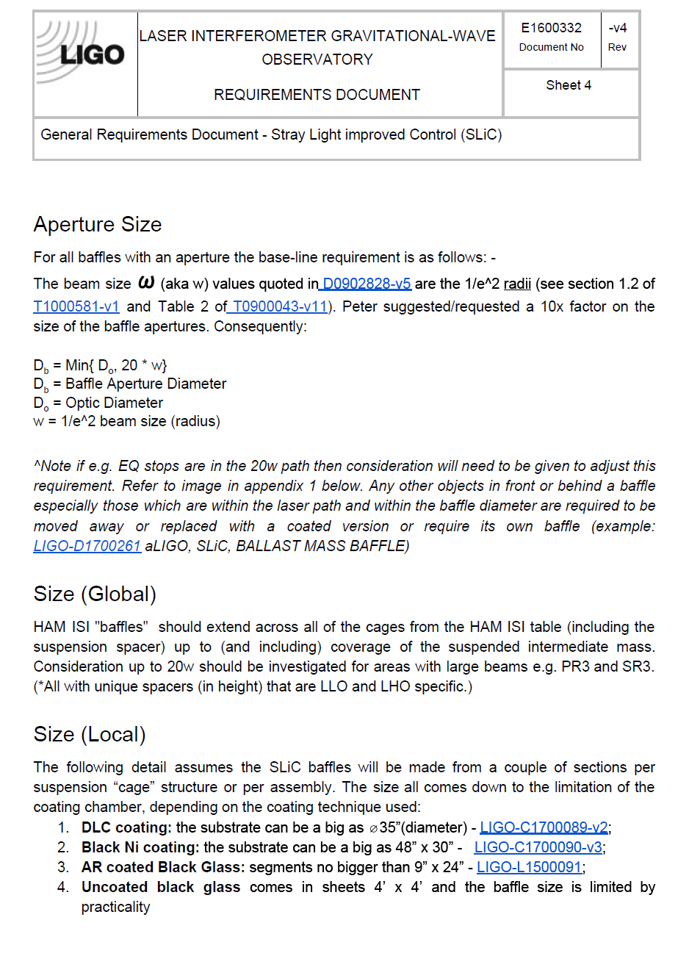
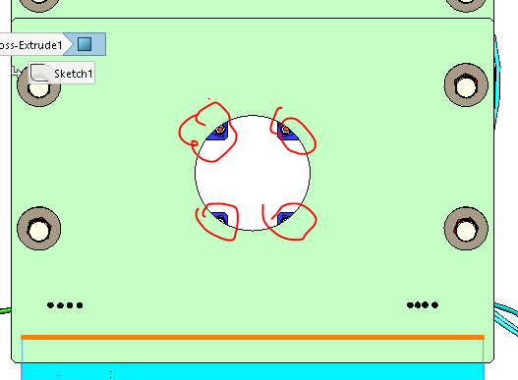
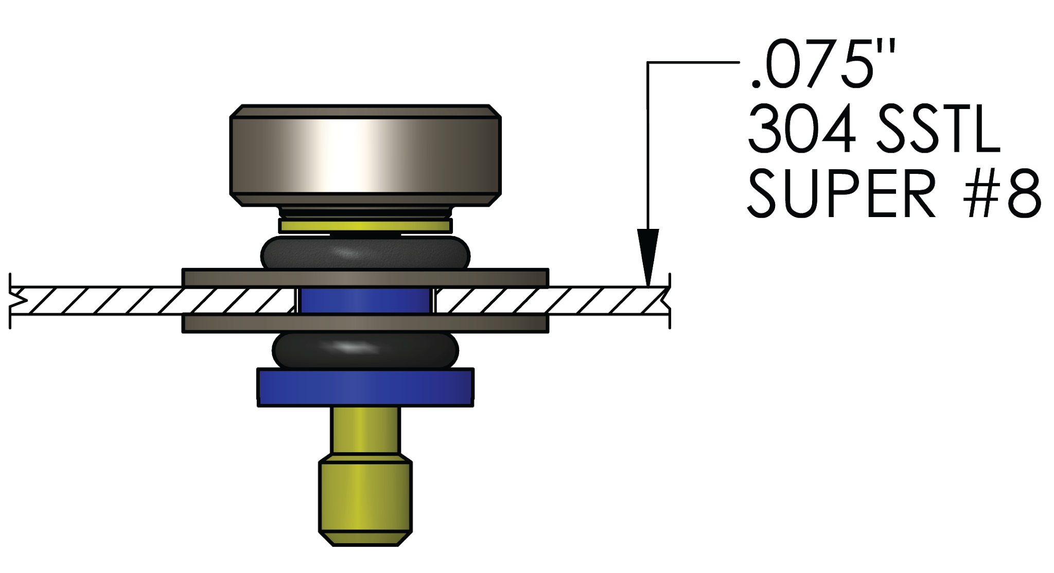
LIGO General Requirements Document - Stray Light Improved Control (SLiC) LIGO-E1600332
The aperture is usually defined as 20w of the beam or as large as the optic (for large beams). Hardware within the aperture needs to be covered or coated
Coated crew cap
Viton o-ring
LIGO-D1700232

Slide 3
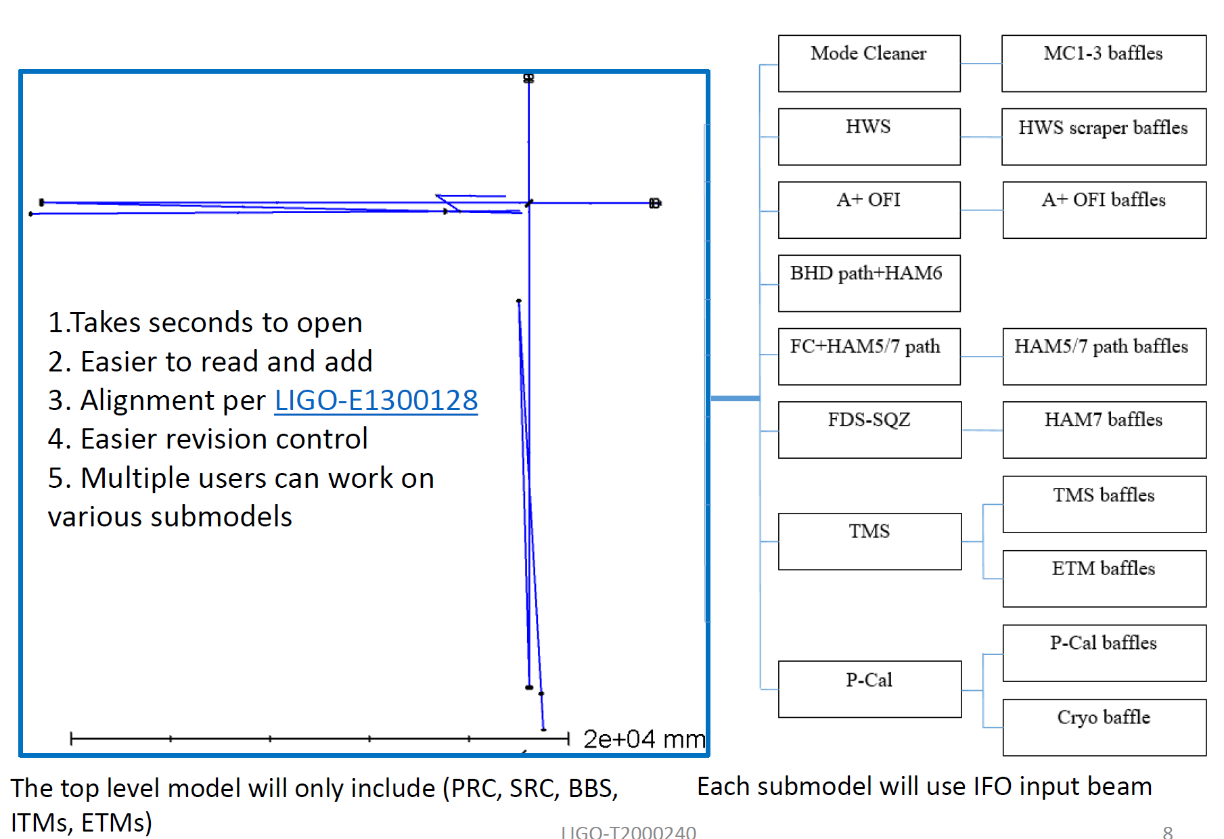
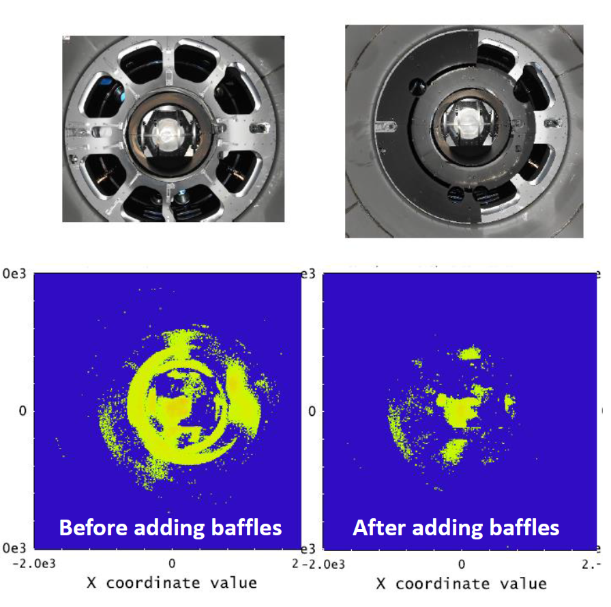
Zemax model of A+ configuration of LIGO
The model is used for the SYS layouts, ghost beams hunting and stray light analysis. A+ filter cavity, layout, OFI and BHD layouts were designed within this Zemax model and exported to Solid Works
Zemax stray light analysis example:
Tree structure Zemax model of the interferometer: (slide ref LIGO-T2000240). How to use the model LIGO-E2000223.

Slide 4
CE vs LIGO
Using zemax for 3D optical layouts and stray light analysis is one of the candidates. Other options are being considered as well
General requirements for baffles apertures will be redefined along with selecting core optics dimensions, beam size and etc
Active damping options will be considered for some baffles
Materials: see next slide

Slide 5
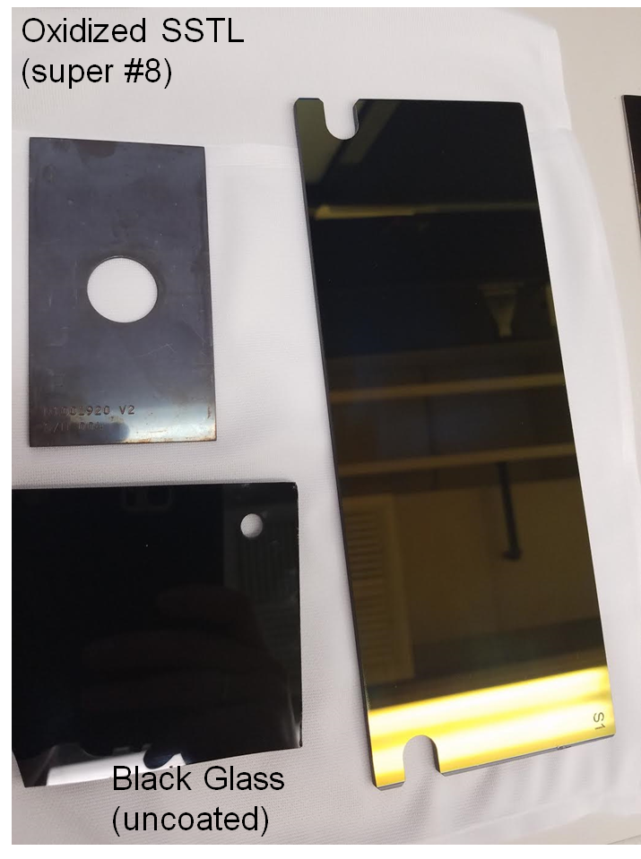
LIGO IR black coatings campaign (before 2017)
Oxidized SSTL - main baffles material during initial LIGO times
“Black glass” has higher absorption and lower BRDF but is more expensive and require special processing and special mounting hardware
AR coated “black glass” was specifically developed for 1064 nm to have , R<1%

Slide 6
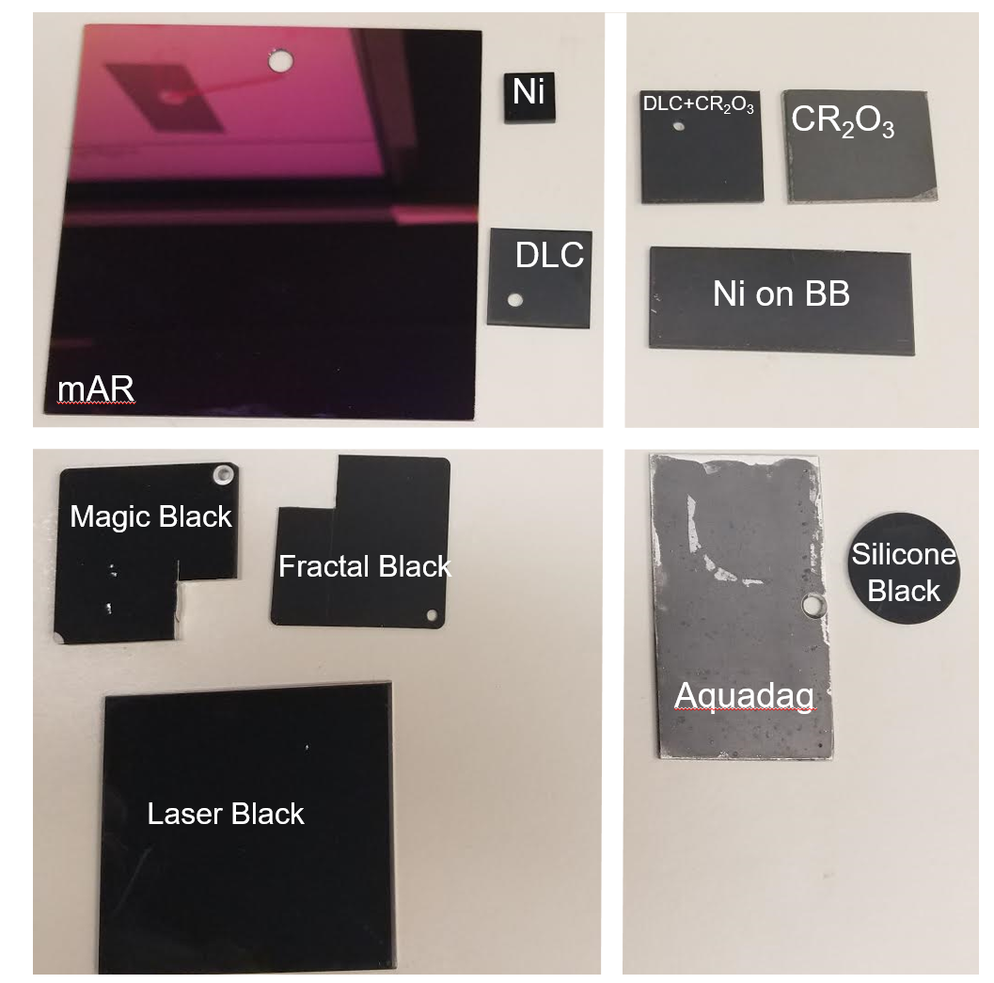
LIGO IR black coatings campaign (2017)
Coatings on rough substrates:
Chromium Oxide on SSTL (porous coating)
Diamond-like Carbon on Chromium Oxide on SSTL
“Black Nickel” on bead blasted SSTL
Smooth coatings:
Multi-layer AR (for 57 AOI) on SSTL (super #8)
Black Nickel on SSTL mill finish
DLC on SSTL mill finish
Paints:
“Aquadag” graphite paint on aluminum
AZ technologies “Silicone Black” paint on aluminum
Structural coatings:
“Laser Black” on SSTL
Actar “Magic Black”on aluminum
Acktar “Fractal Black” on aluminum

Slide 7
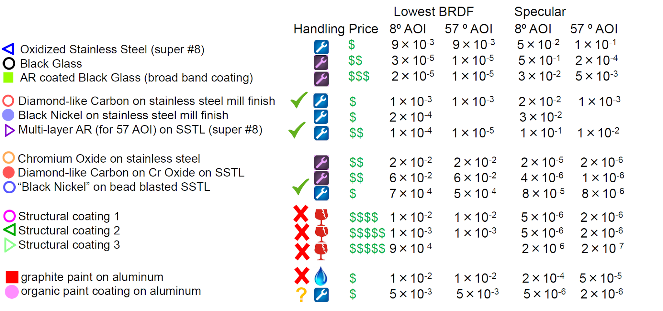
Materials comparison: robustness and availability vs performance

Slide 8
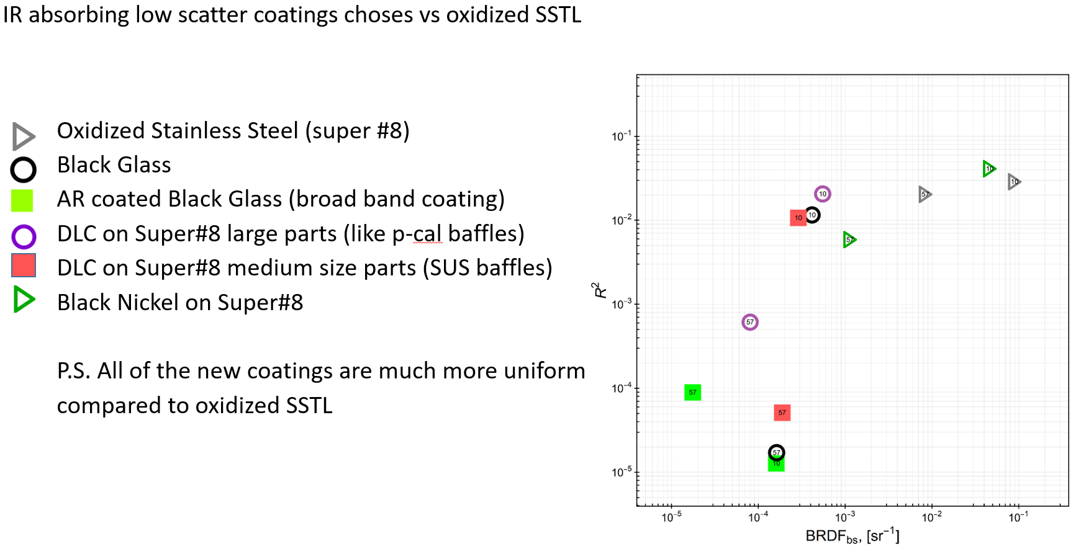
Materials comparison: reflectivity vs backscatter
(low AOI coating)
Multi bounce approach is an option instead of AR coating!

Slide 9
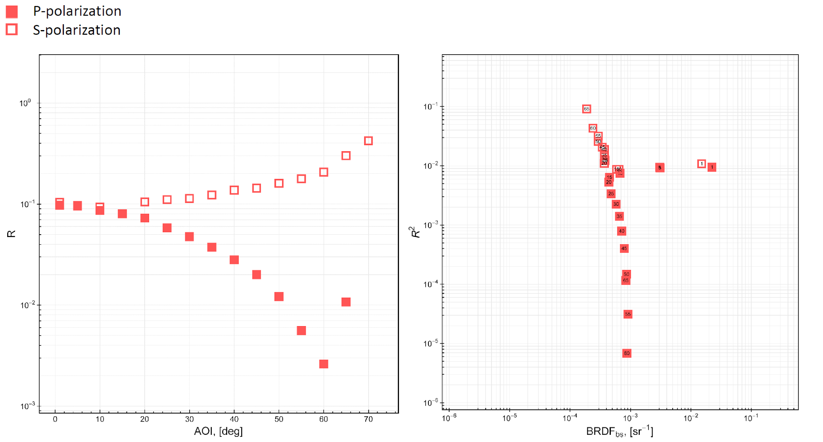
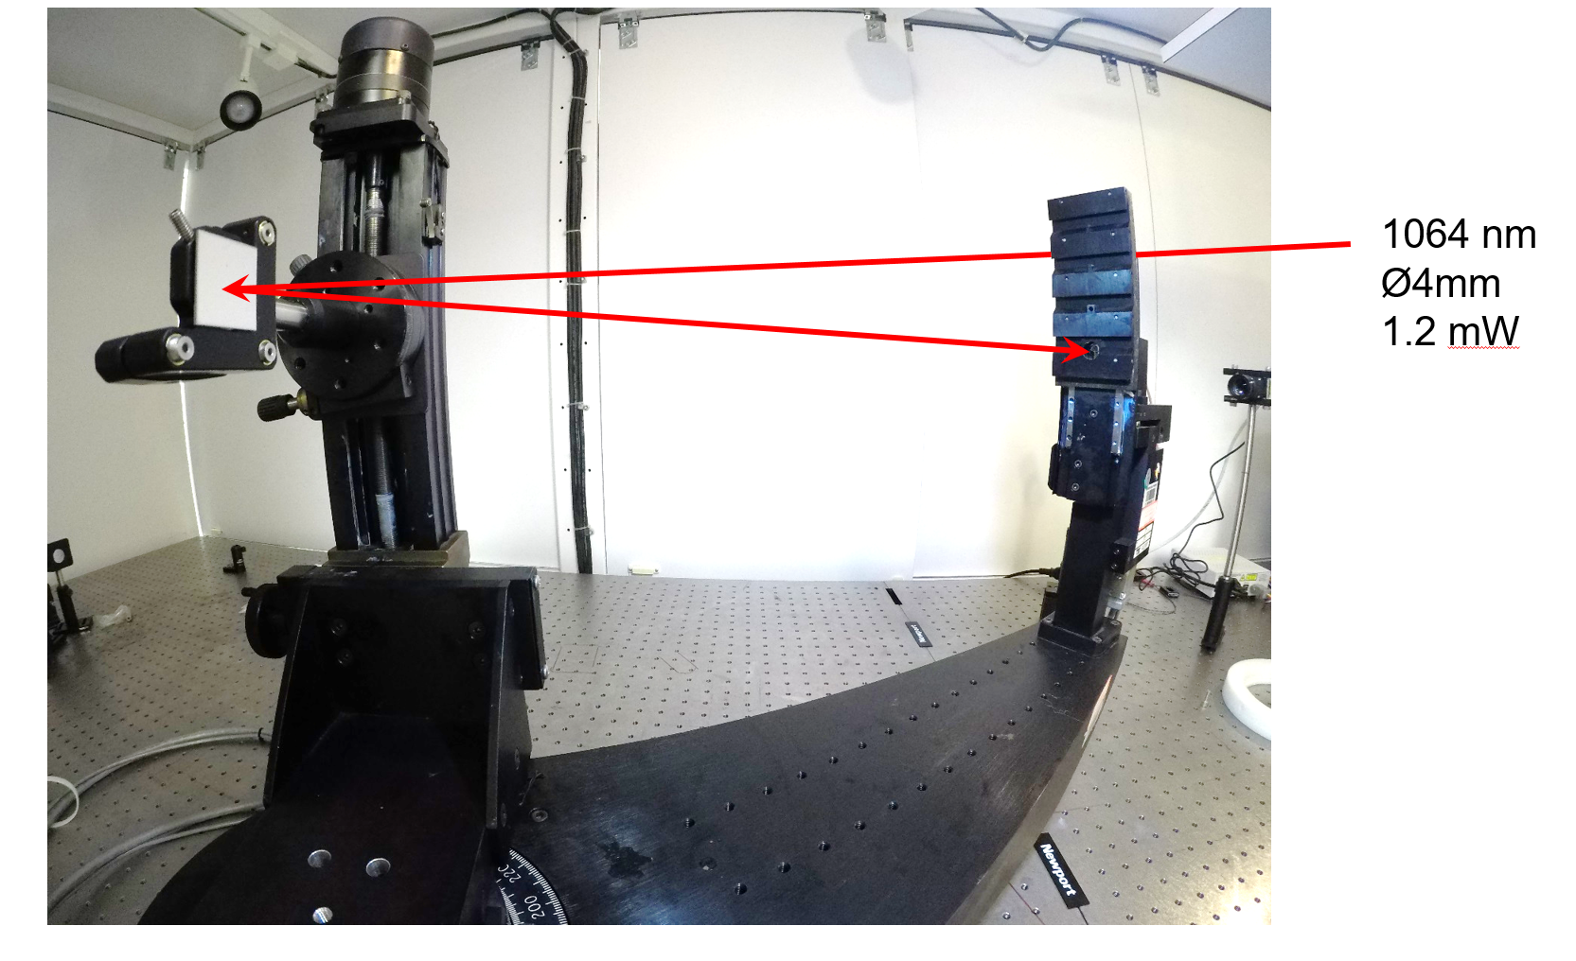
CASI scatterometer at CIT
Diamond-like carbon on super#8 non-directional SSTL 304
The measurements were performed at Caltech using CASI scatterometer at 1064 nm
https://dcc.ligo.org/LIGO-T1700128/public

Slide 10
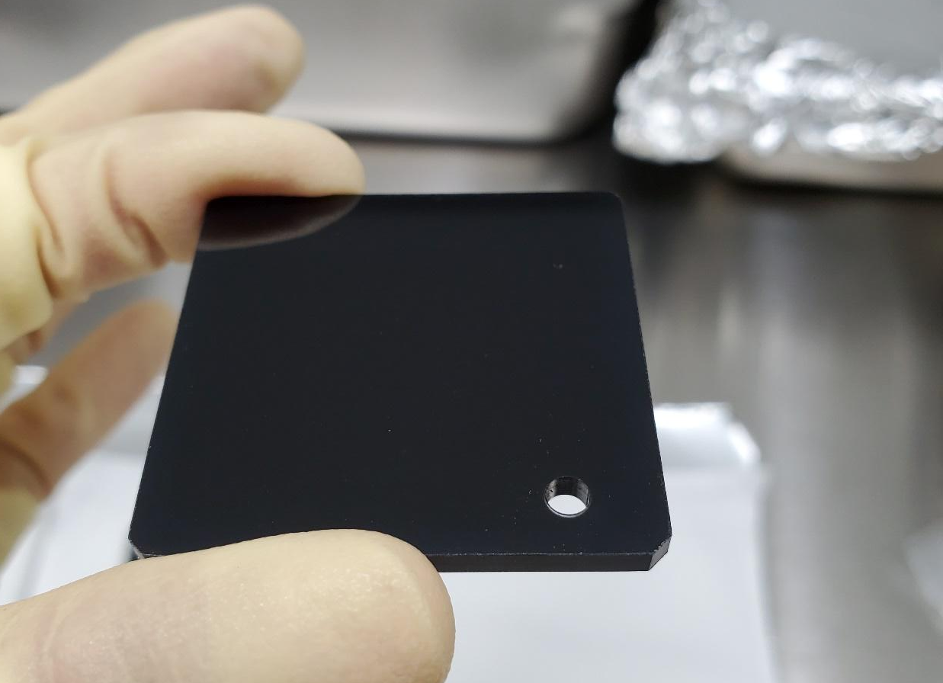
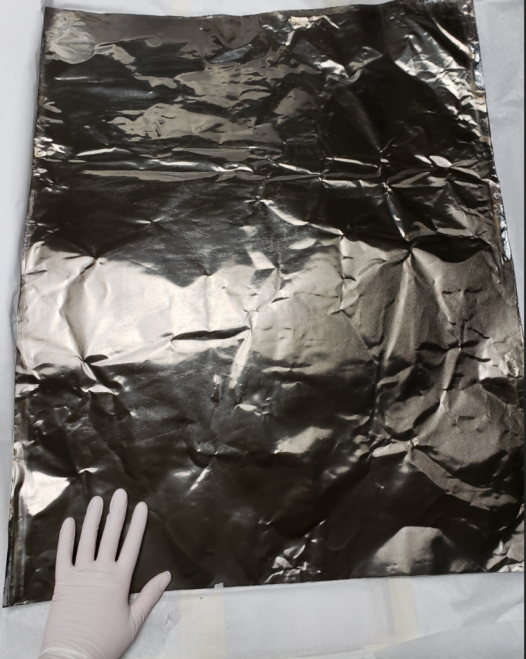
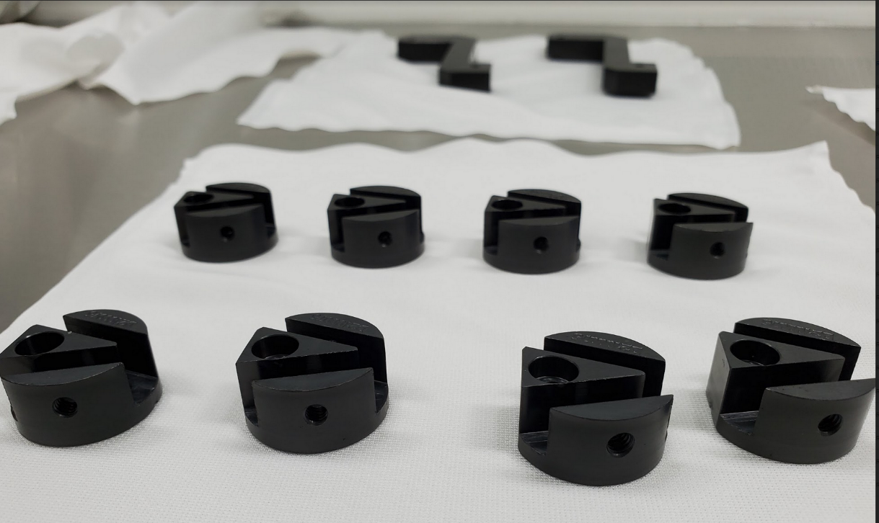
Mounts and hardware are successfully coated with DLC and black nickel!
No more black glass!
DLC SSTL
New!
Black nickel coated Al
DLC Al
Black nickel coated Al coil!
Pliable 1145-0 Al coil (thick foil 0.003”) is considered for wrapping objects in-situ
LIGO-T2000608

Slide 11
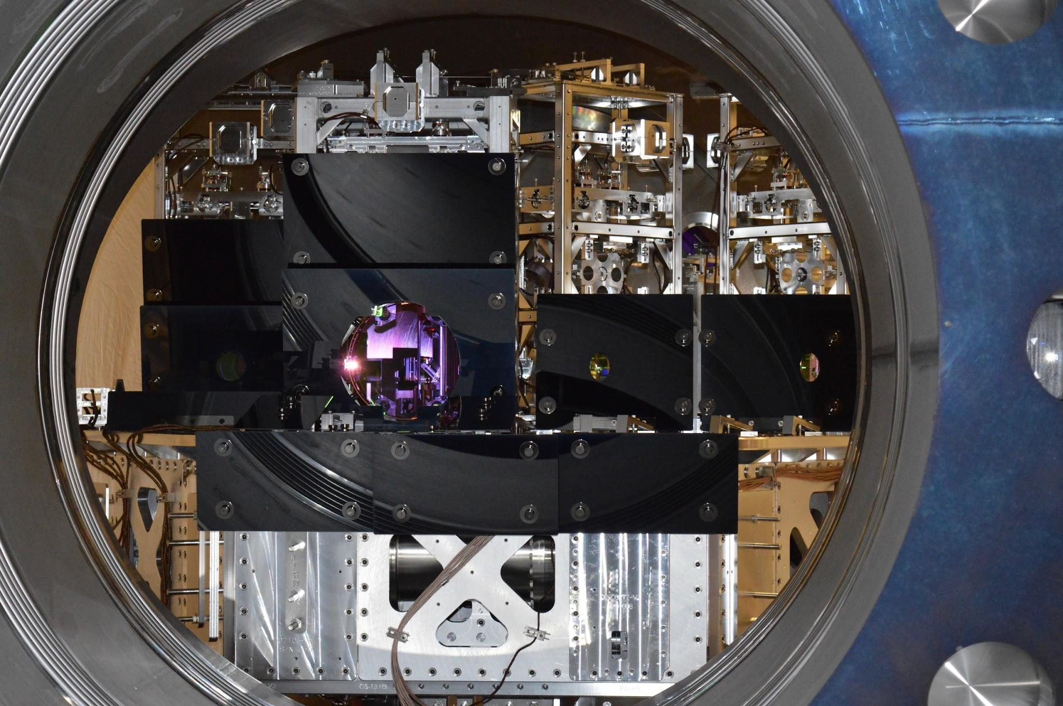
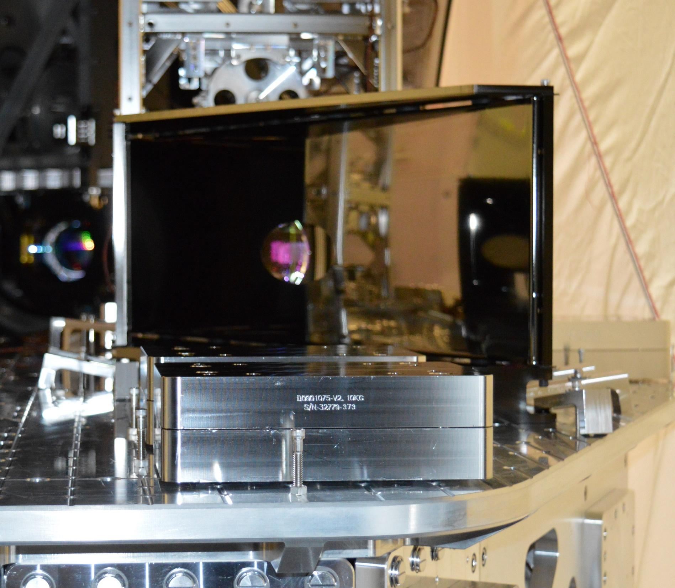
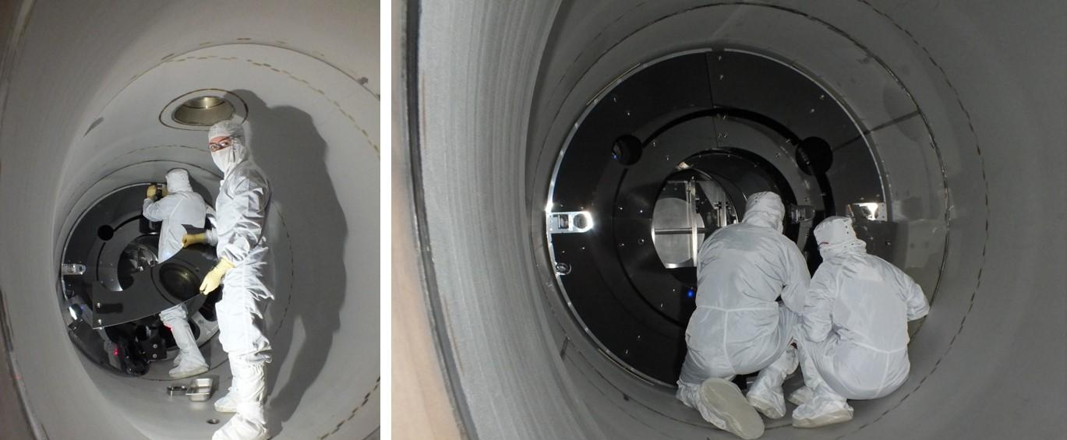
O2&O3 baffles made with new coatings!
DLC SSTL
Black Nickel
DLC SSTL

Slide 12
Why continue baffles materials research?
Some coatings could become more available because of applications in other industries (this means cheaper and less lead time)
Higher absorption materials would require less damping and less angling, no need for polish (cheaper and simpler)
A dream paint to apply in-situ as needed and etc

Slide 13
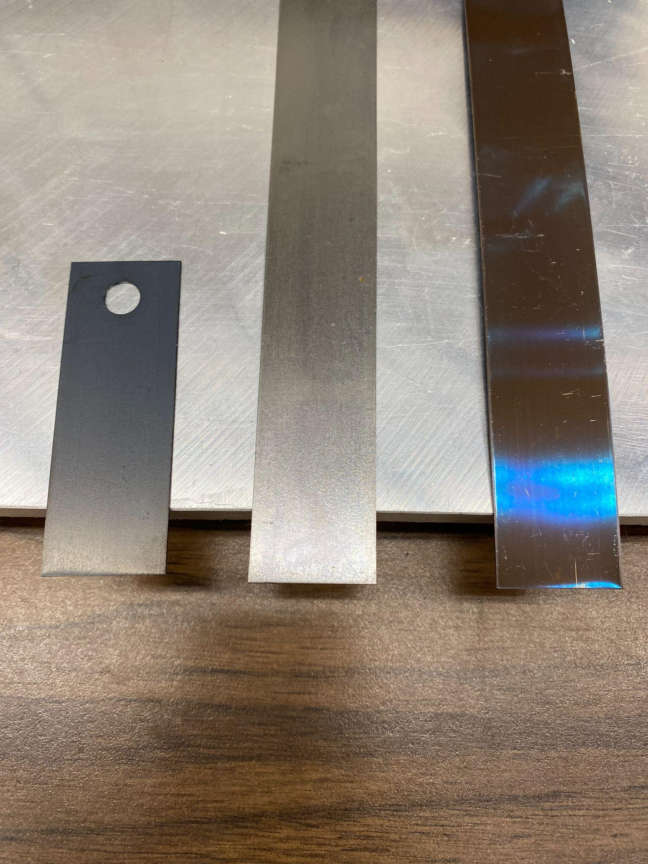
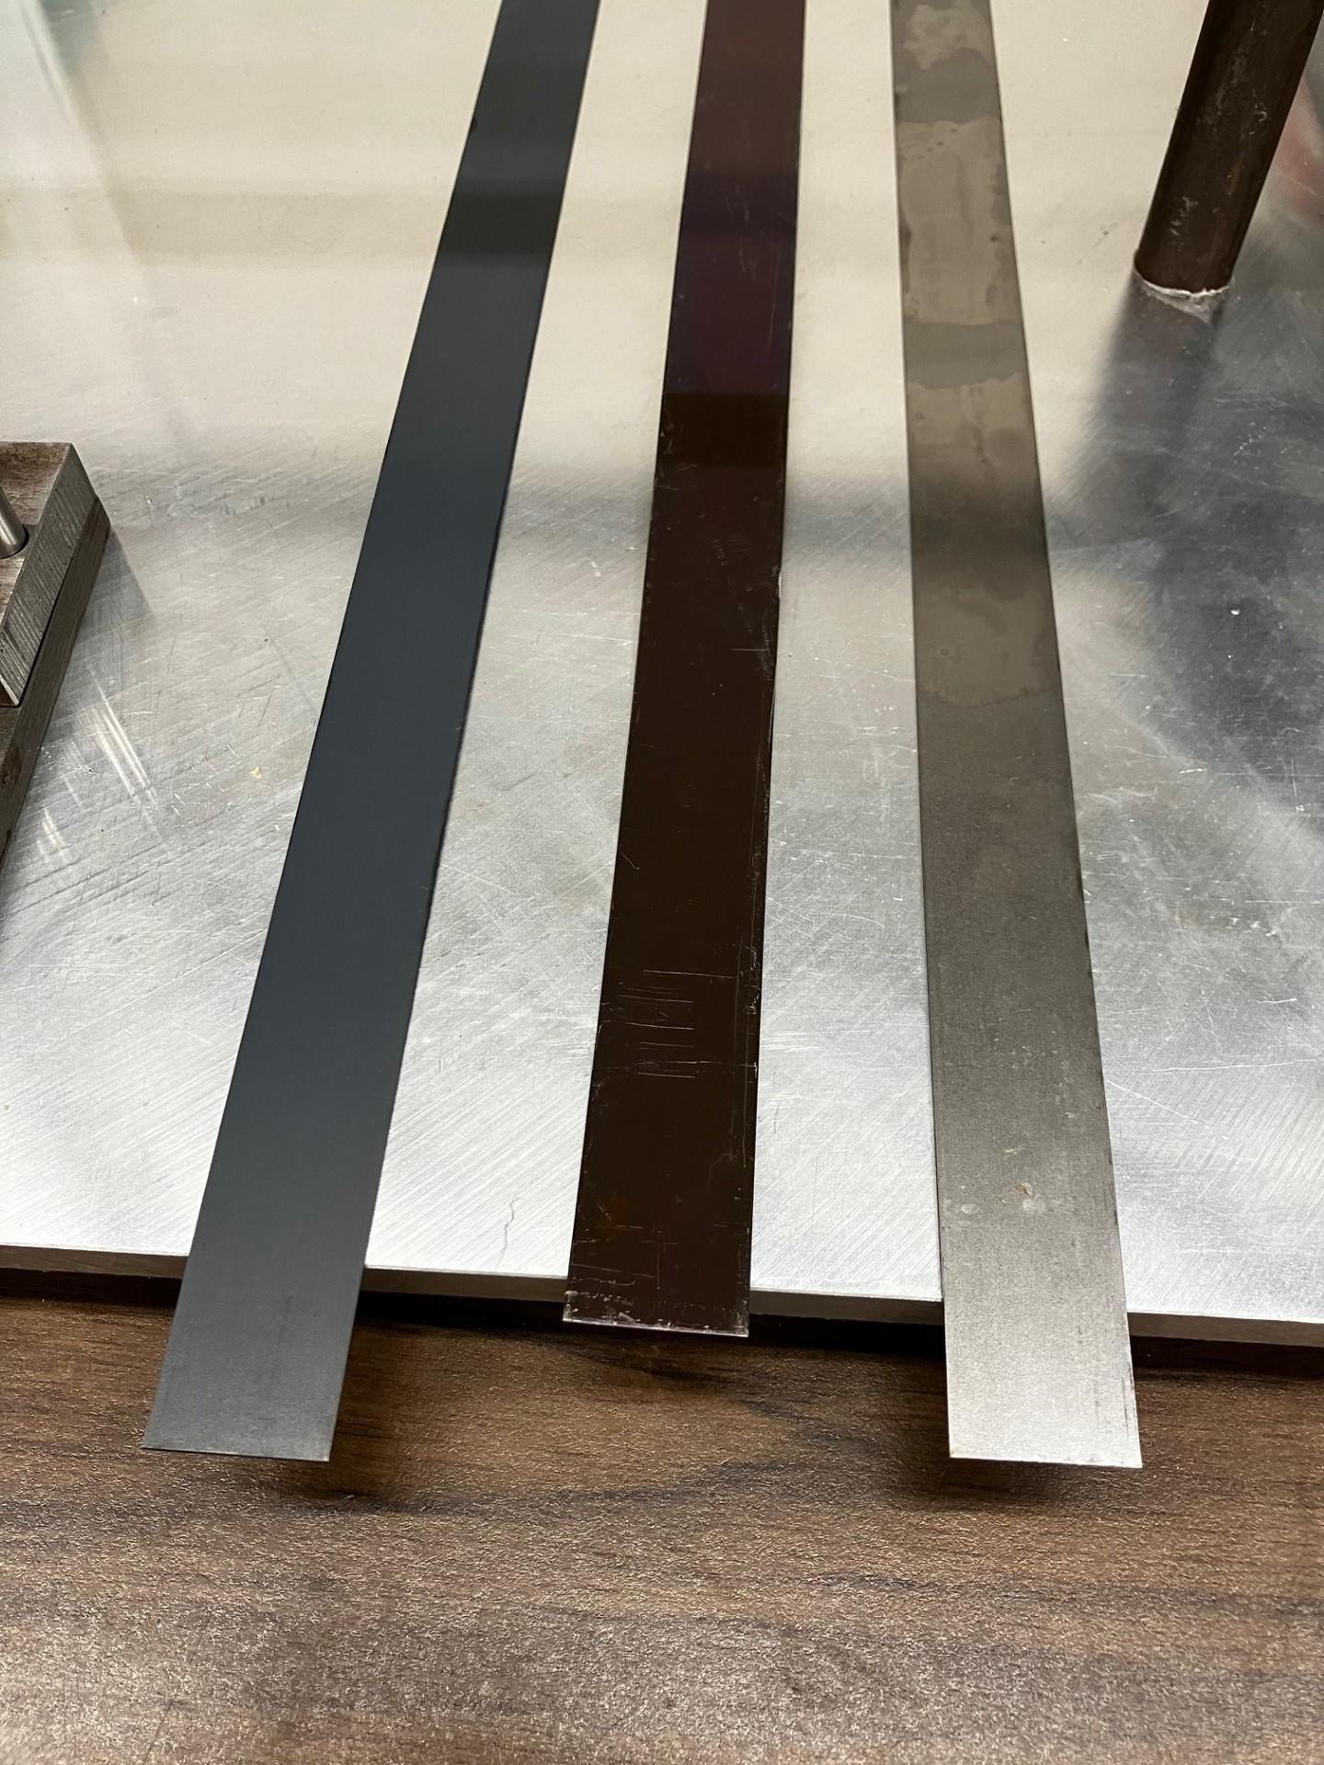
CE beam tube treatment consideration
Magnetite processing of mild STL [ref CE-E2300014]
The process is called steam blackening or steam magnetite. Band ovens and retort ovens specifically designed to do this process.
A few hundred mild steel strips were first cleaned and baked at CIT before being sent for magnetite processing.
Steam process (performed at Sun Steel Treating Inc.) at 900°F (482°C), 1 hour steam. Makes Fe₃O₄. Retort furnace. Cheap!
*LIGO Oxidized Stainless Steel: 304 SSTL, air fired at 440°C for 36 hrs, cold finished (bright annealed)
*NOTE: Oxidized SSTL strips have different surface finish than BT surface.
Magnetite processed mild steel
Mild steel as received
LIGO oxidized stainless steel
Magnetite mild steel vs LIGO oxidized SSTL
Ligo SST
Magnetite
Mild steel A/R
Notes:
Both beamtube (BT) and strips are 304 SST
Both air fired at 440C for 36hrs, which is used to control hydrogen diffusion
BT steel was HRAP (hot rolled annealed pickled)
Strips were cold finished
Strips have better surface finish, called bright annealed
Hard to find strips in HRAP finish (no market)
Surface roughness plays into BRDF, so BT and strips are not 1-1 comparison, just looking at qualitative differences.
*Sun Steel’s state-of-the-art facility utilizes a steam treating furnace with a capacity of 22″ diameter x 36″ deep (56cm x 92cm), capable of processing 800 lb/load. [Sun Steel Treating Inc.] https://sunsteeltreating.com/services/steam-treating/

