Slide 1
neXt-Generation Collaborative Design
Straylight control
https://indico.gssi.it/e/xgcd

Slide 2
Lisa’s thoughts on possible outline
What is straylight control and why is it important? 5 minutes
Focus on beam tube straylight mitigation, since it is the highest risk aspect
Historical perspective – 15 minutes
How was this done in LIGO and Virgo?
Can’t we just copy paste approach in ET? Why not
Can’t we just copy paste approach in CE? Why not
Areas of common interests – 15 minutes
Modeling
SIS-based baffle modeling - updated of CE-T2300004
Baffle material
Stray light from deposited dust update of ET-0418A-23 https://apps.et-gw.eu/tds/ql/?c=16919 See also added slide - presenter: Andrea Moscatello
Case for instrumented baffles
ET specific highlights – 15 minutes
CE specific highlights – 15 minutes
Next steps and discussion

Slide 3
Literature/Historical Review
Optical properties of the LIGO beam tubes (1989) Calculations on beam tube reflectivity and scattered light attenuation from multiple reflections
Noise due to backscatter off baffles, the nearby wall, and objects at the far end of the beam tube; and recommended actions (1994) First calculations due to backscatter from baffles and other surfaces
Light Scattering and baffle configuration for LIGO (1995) Addition of diffraction noise in the calculations
Specifications for the Baffle Serrations in the LIGO Beam Tubes (1996) Specific recommendations on the size of serrations
Science Requirements for the LIGO beam tube baffles (1996) Reference for the LIGO beam tube baffle design and configuration, with serration and location information
Scattered light noise in gravitational wave interferometric detectors: A statistical approach (1997) Similar calculations with Flanagan’s and Thorne’s, and includes a Monte Carlo estimation, with and without baffles

Slide 4
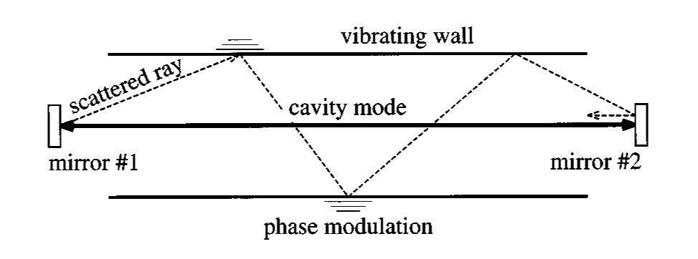
The Need for Beam-Tube Baffles
Estimate how many reflections and attenuation as a function of incidence angle
→ Maximum angle we need to catch
Optical properties of the LIGO beam tubes (1989) Calculations on beam tube reflectivity and scattered light attenuation from multiple reflections
Noise due to backscatter off baffles, the nearby wall, and objects at the far end of the beam tube; and recommended actions (1994) First calculations due to backscatter from baffles and other surfaces
Light Scattering and baffle configuration for LIGO (1995) Addition of diffraction noise in the calculations
Specifications for the Baffle Serrations in the LIGO Beam Tubes (1996) Specific recommendations on the size of serrations
Science Requirements for the LIGO beam tube baffles (1996) Reference for the LIGO beam tube baffle design and configuration, with serration and location information Scattered light noise in gravitational wave interferometric detectors: A statistical approach (1997) Similar calculations with Flanagan’s and Thorne’s, and includes a Monte Carlo estimation, with and without baffles

Slide 5
The Need for Beam-Tube Baffles
Not to mention, beam tubes are not one-piece, and baffles are needed to cover the edges of anything sticking out
Optical properties of the LIGO beam tubes (1989) Calculations on beam tube reflectivity and scattered light attenuation from multiple reflections
Noise due to backscatter off baffles, the nearby wall, and objects at the far end of the beam tube; and recommended actions (1994) First calculations due to backscatter from baffles and other surfaces
Light Scattering and baffle configuration for LIGO (1995) Addition of diffraction noise in the calculations
Specifications for the Baffle Serrations in the LIGO Beam Tubes (1996) Specific recommendations on the size of serrations
Science Requirements for the LIGO beam tube baffles (1996) Reference for the LIGO beam tube baffle design and configuration, with serration and location information Scattered light noise in gravitational wave interferometric detectors: A statistical approach (1997) Similar calculations with Flanagan’s and Thorne’s, and includes a Monte Carlo estimation, with and without baffles

Slide 6
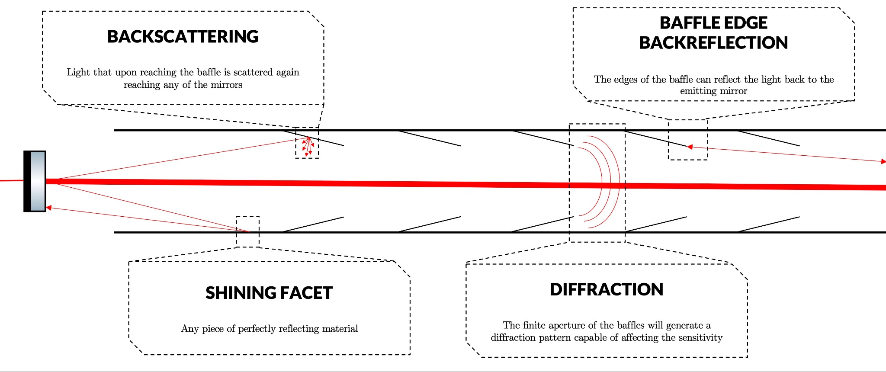
Noise from Baffles
By solving one problems you are introducing another.
Baffle Backscatter Noise
Backscattered light from moving baffles and recombines with the main beam will add noise.
Baffle Diffraction Noise
Light diffracted from the baffles and recombines with the main beam will add noise.
Adds significant cost to the facility.
Credit: Marc Andres-Carcasona

Slide 7
The Need for Beam-Tube Baffles
Optical properties of the LIGO beam tubes (1989) Calculations on beam tube reflectivity and scattered light attenuation from multiple reflections
Noise due to backscatter off baffles, the nearby wall, and objects at the far end of the beam tube; and recommended actions (1994) First calculations due to backscatter from baffles and other surfaces
Light Scattering and baffle configuration for LIGO (1995) Addition of diffraction noise in the calculations
Specifications for the Baffle Serrations in the LIGO Beam Tubes (1996) Specific recommendations on the size of serrations
Science Requirements for the LIGO beam tube baffles (1996) Reference for the LIGO beam tube baffle design and configuration, with serration and location information Scattered light noise in gravitational wave interferometric detectors: A statistical approach (1997) Similar calculations with Flanagan’s and Thorne’s, and includes a Monte Carlo estimation, with and without baffles

Slide 8
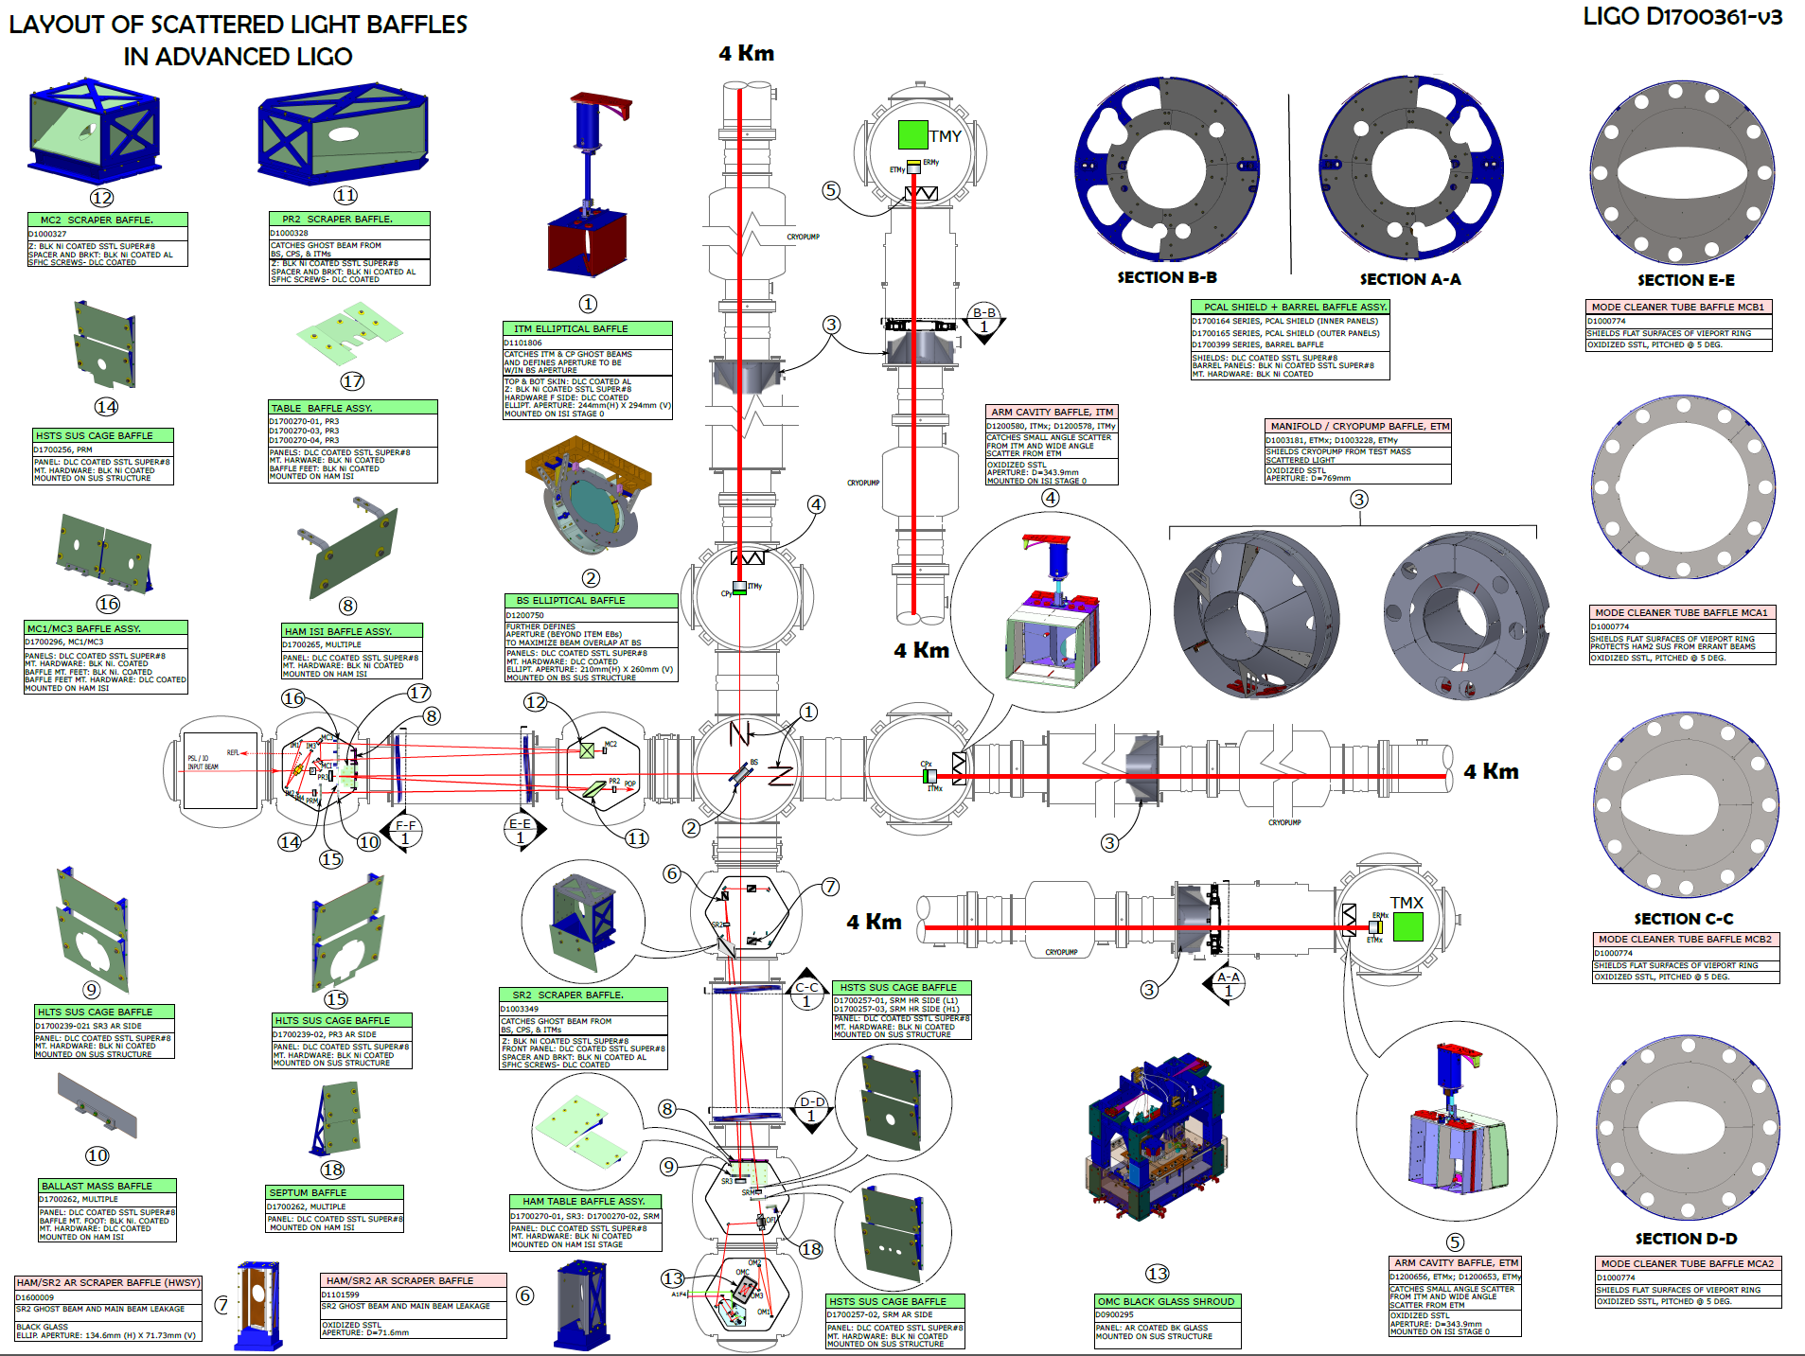
O2&O3 baffles scope [LIGO-G2301503]
LIGO-D1700361
SUS baffles for recycling cavities optics (improved coatings, better damping)
Scraper baffles (improved coatings, better damping)
Improved baffles coverage in HAM chambers
Pcal periscope baffles

Slide 9
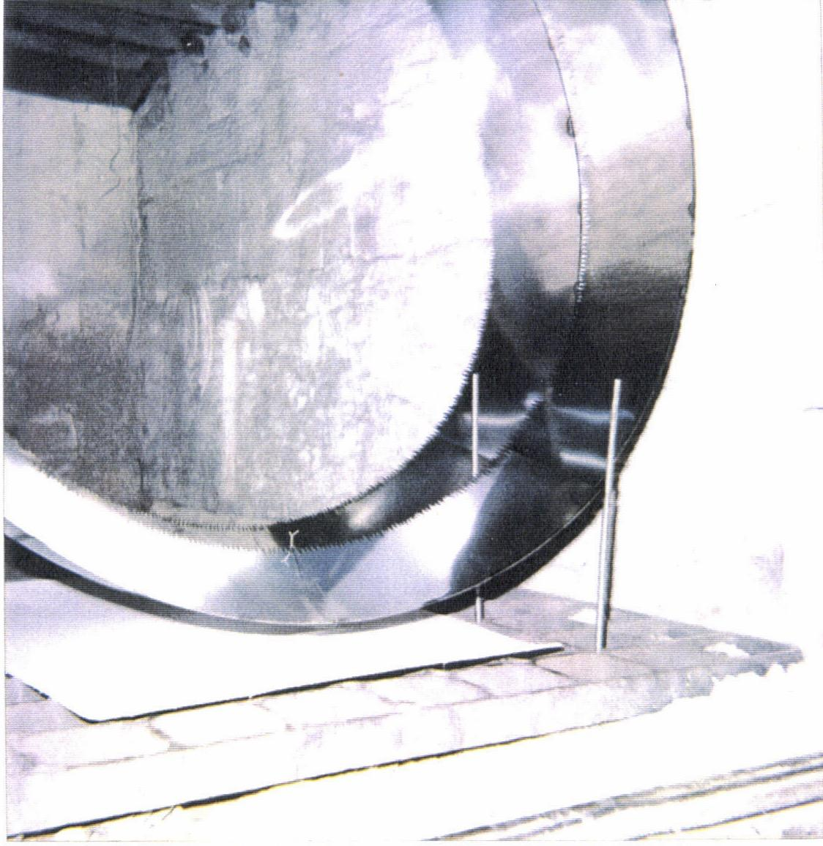
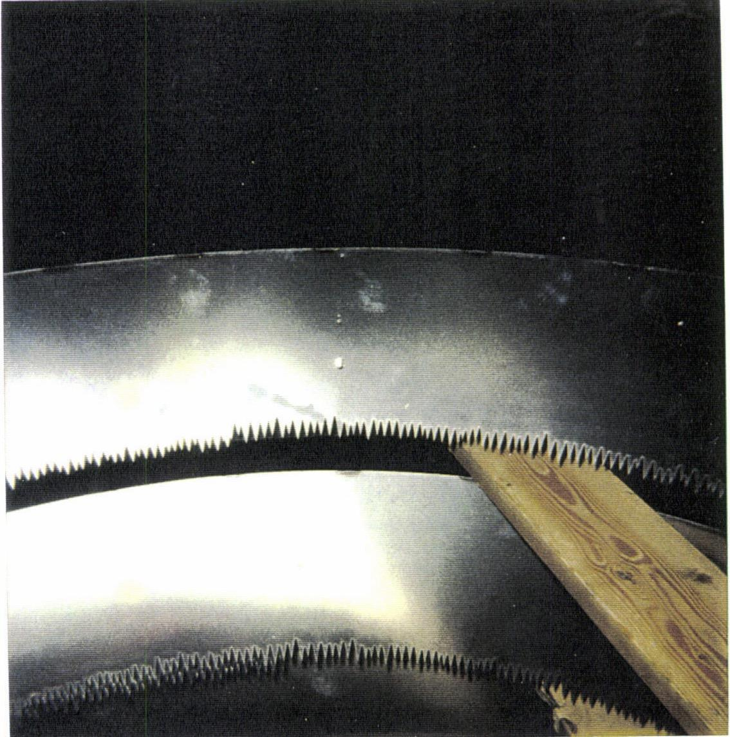
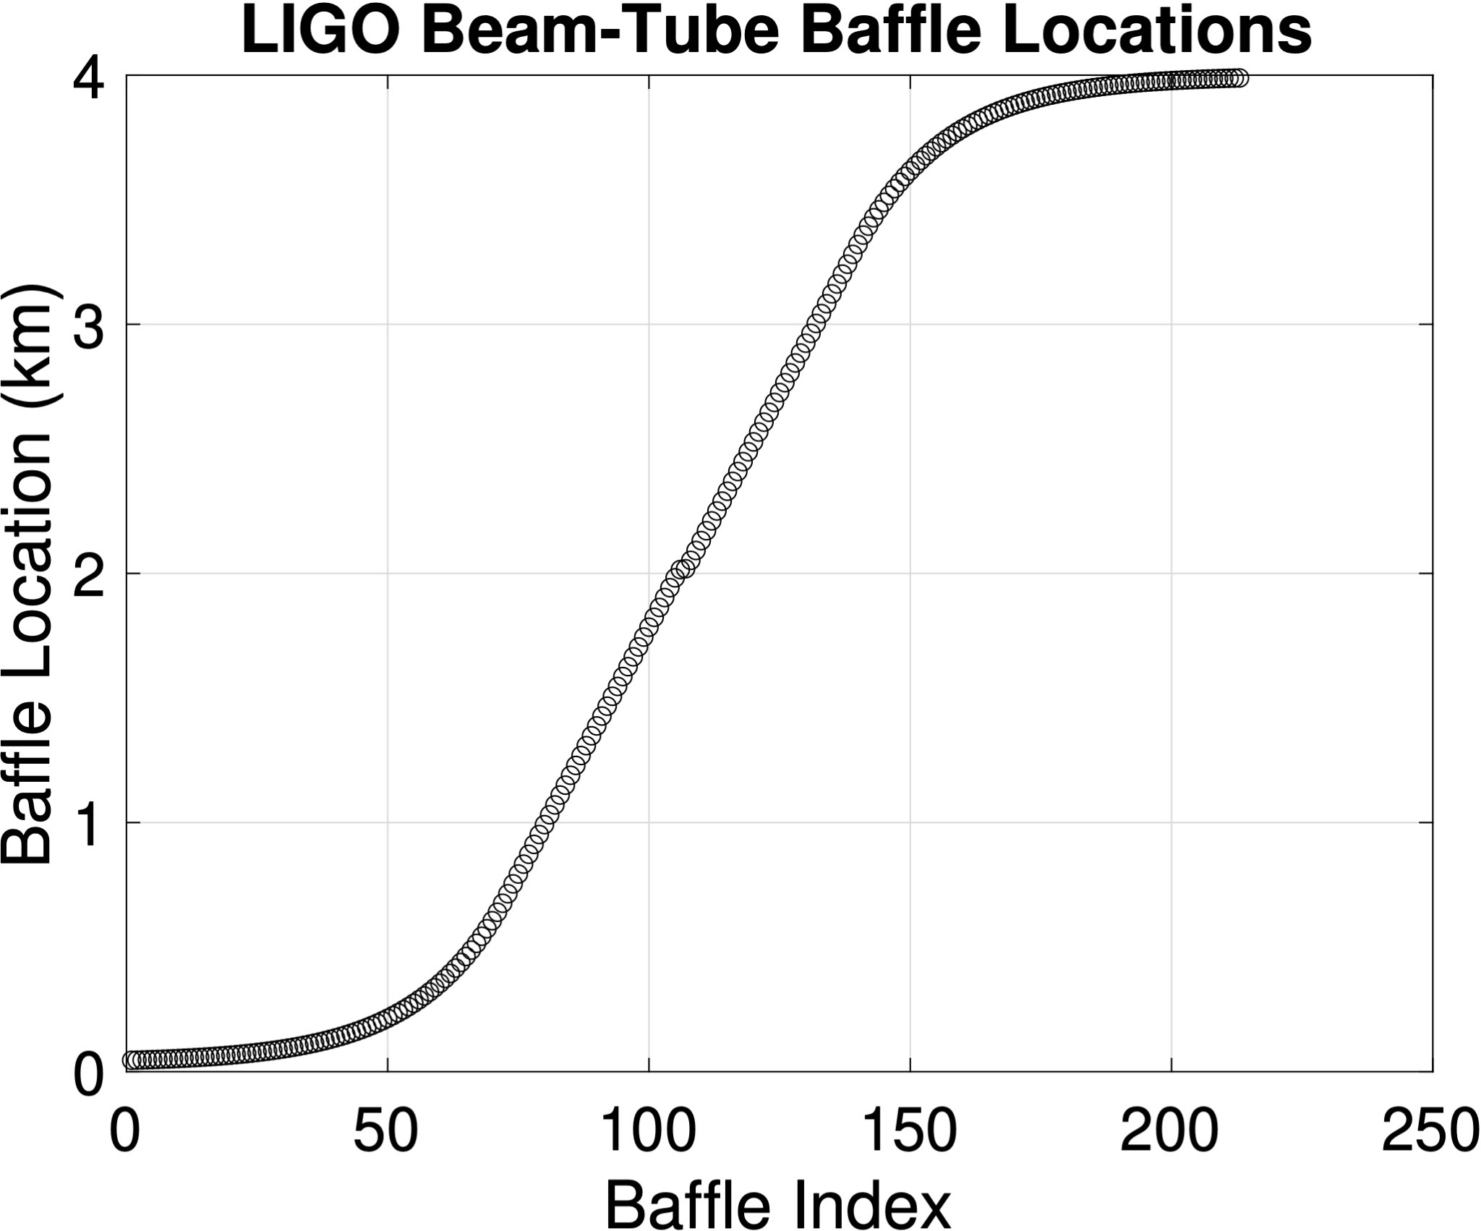
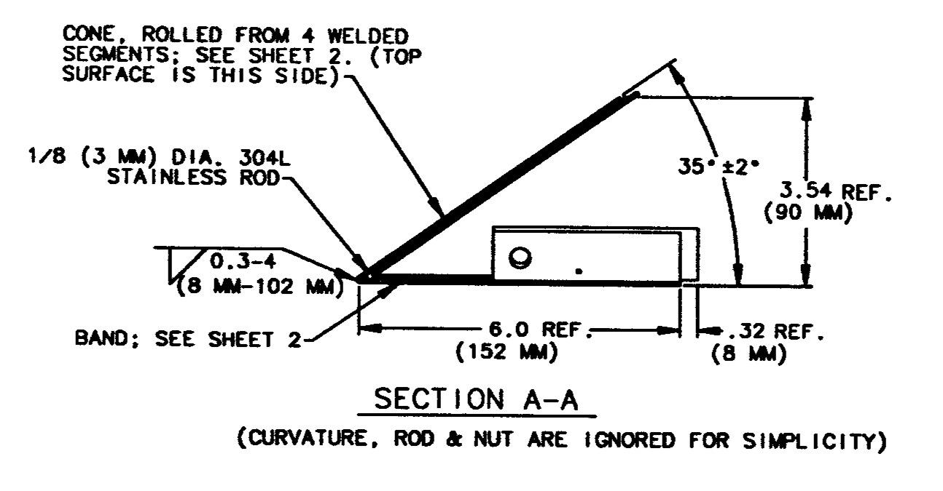
LIGO Beam-Tube Baffles
LIGO CE
Beam-tube diameter: 124cm (48") 124 cm?
TM diameter: 35 cm 70 cm
TM Beam diameter: 5.3/6.2cm 12 cm
Number of Baffles/arm: 213 ? (SLC)
Baffle Inner diameter: 104cm (41") ? (SLC)
Random serration P-V: 8mm ? (SLC)
Angle relative to tube: 35 deg 35 deg?
Material: Oxidized SS ? (SLC)

Slide 10
Similar Strategy for VIRGO
Slide Credit: Mario Martinez

Slide 11
Why not more of the same
There will likely be some of the same, such as:
Conical baffles at ~35(?) degrees away(?) from mirrors
Equations for noise estimation will still guide strategy
Main point is that due to the longer tube, low-angle scattering from test mass mirrors will come from lower spatial frequencies, whose amplitude is uncertain and very likely much higher! (see Hiro's slides later)
Longer tubes may mean many more baffles, and we want to make sure the design is cost effective.
Unclear if Stray Light Noise from beam tube/baffles is an issue in LIGO, but we want to improve
More accurate tools for noise estimation
Baffling strategies and material
Suspended baffles
Issues with baffle contamination
Baffle Instrumentation
Hiro Yamamoto
Alena Ananyeva
Andrea Moscatello
Mario Martinez

