Slide 1
Cosmic Explorer: Why not just scale up LIGO design?
Minimum beam size for 40 km arms is ~12 cm. For <1 ppm clipping loss on ITMs, require ~70 cm ITMs. Beamsplitter should be √2 bigger*. 1m diameter unfeasible?
Consider alternate layouts with different beamsplitter location.
FSR of 40 km arms is 3.75 kHz. Assuming aLIGO arm cavity finesse, DARM pole is 10x lower.
Need 10x higher signal extraction cavity finesse to recover bandwidth.
SEC resonance approaches detection band with 40 km or 20 km arms.
SEC length must be kept to < 200 m (40 km arms) or < 90 m (20 km arms).
10 dB squeezing assumed to meet sensitivity target.
SEC loss must be < 500 ppm.
Gouy phases must be chosen to minimize squeezing degradations (avoid HOM co-resonances).
*assuming 45° AOI

Slide 2
Cosmic Explorer: Why not just scale up LIGO design?
1.5 MW arm power assumed to meet sensitivity target. Thermal distortions have already posed major problem for aLIGO, and will be a central design driver for CE.
Aim for >20° Gouy phase accumulation between potential RoC actuator locations.
Need pick-off port locations to directly sense mode-matching between IFO cavities.
With 10x lower arm cavity FSR (3.75 kHz), nearly all HOM resonances will lie in the observation band.
Precision mode-matching critical to suppress noise couplings, SQZ loss, and SQZ angle mis-rotation around the frequencies of these resonances.
10x lower SEC loss requirement (500 ppm) precludes use of transmissive compensation plates for thermal compensation.
Requires new technique to mitigate ITM substrate lens (control higher-order SEC-arm mismatch).
With ~10 kW in PRC, significant loss due to thermal lensing of beamsplitter. Limited capability to thermally compensate at 45° AOI.
Lower AOI on beamsplitter can reduce thermal distortion loss while also relaxing size requirement.

Slide 3
Cosmic Explorer: Why not just scale up LIGO design?
1.5 MW arm power assumed to meet sensitivity target. Thermal distortions have already posed major problem for aLIGO, and will be a central design driver for CE.
Aim for >20° Gouy phase accumulation between potential RoC actuator locations.
Need pick-off port locations to directly sense mode-matching between IFO cavities.
With 10x lower arm cavity FSR (3.75 kHz), nearly all HOM resonances will lie in the observation band.
Precision mode-matching critical to suppress noise couplings, SQZ loss, and SQZ angle mis-rotation around the frequencies of these resonances.
10x lower SEC loss requirement (500 ppm) precludes use of transmissive compensation plates for thermal compensation.
Requires new technique to mitigate ITM substrate lens (control higher-order SEC-arm mismatch).
With ~10 kW in PRC, significant loss due to thermal lensing of beamsplitter. Limited capability to thermally compensate at 45° AOI.
Lower AOI on beamsplitter can reduce thermal distortion loss while also relaxing size requirement.
“Starting from scratch” is our best chance to seriously consider alternative designs, and challenge previous assumptions.

Slide 4
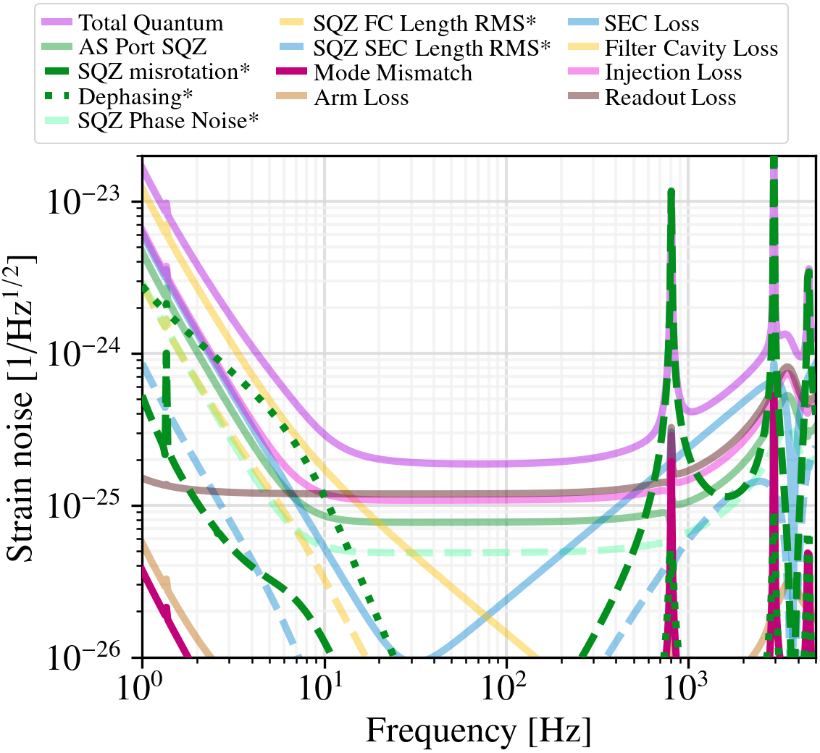
Precision mode-matching is a central design driver
Example of “anti-squeezing” around HOM resonances in DARM spectrum
Model assumes a 1% SEC mode-mismatch with arms
Effective rotation of SQZ angle via mode scattering process:
TEM00 → LG10 → TEM00*
*having accumulated different phase relative to the unscattered TEM00 field
HOM2 arm cavity resonance
Figure by K. Kuns

Slide 5
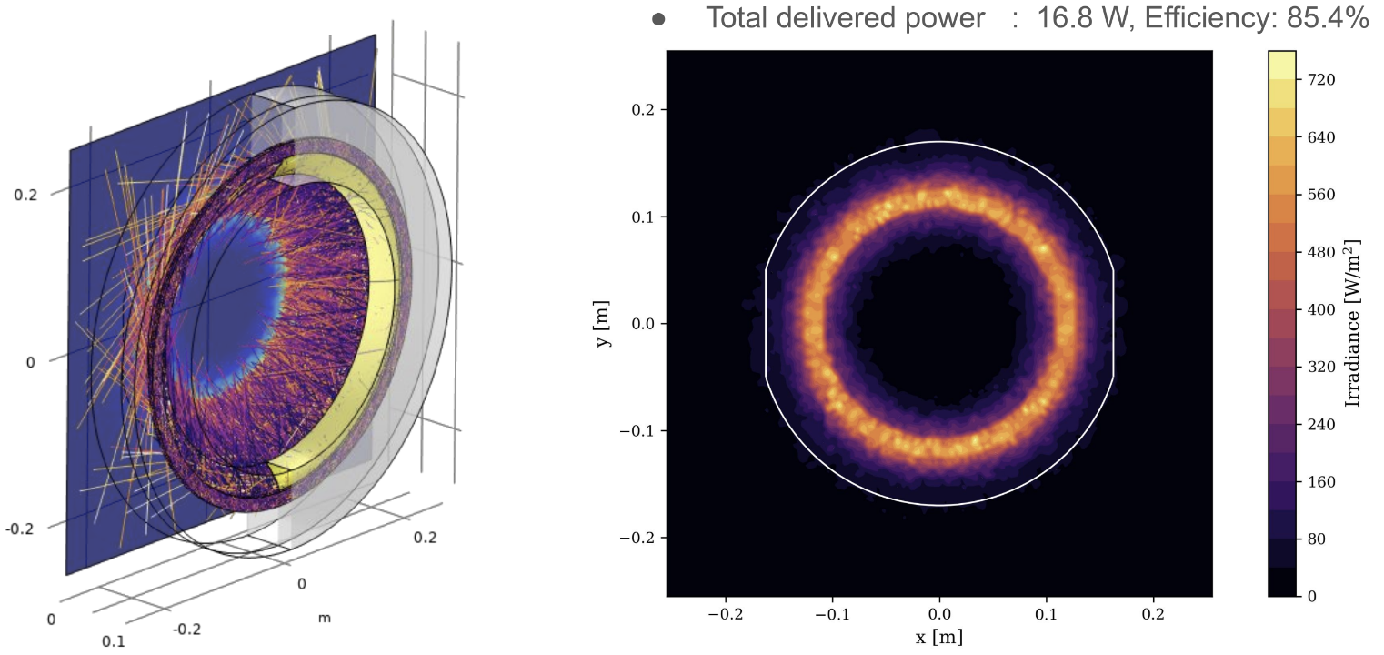
Achieving 500 ppm SEC loss: Eliminate compensation plates
R&D effort underway to demonstrate CP alternative: Direct ITM / ETM front-surface correction (LIGO-G2300506, CE-G2300032)
Based on aLIGO AR coatings, expect high angle scattering loss of up to ~200 ppm per CP
Figure from A. Brooks et. al. (2016)

Slide 6
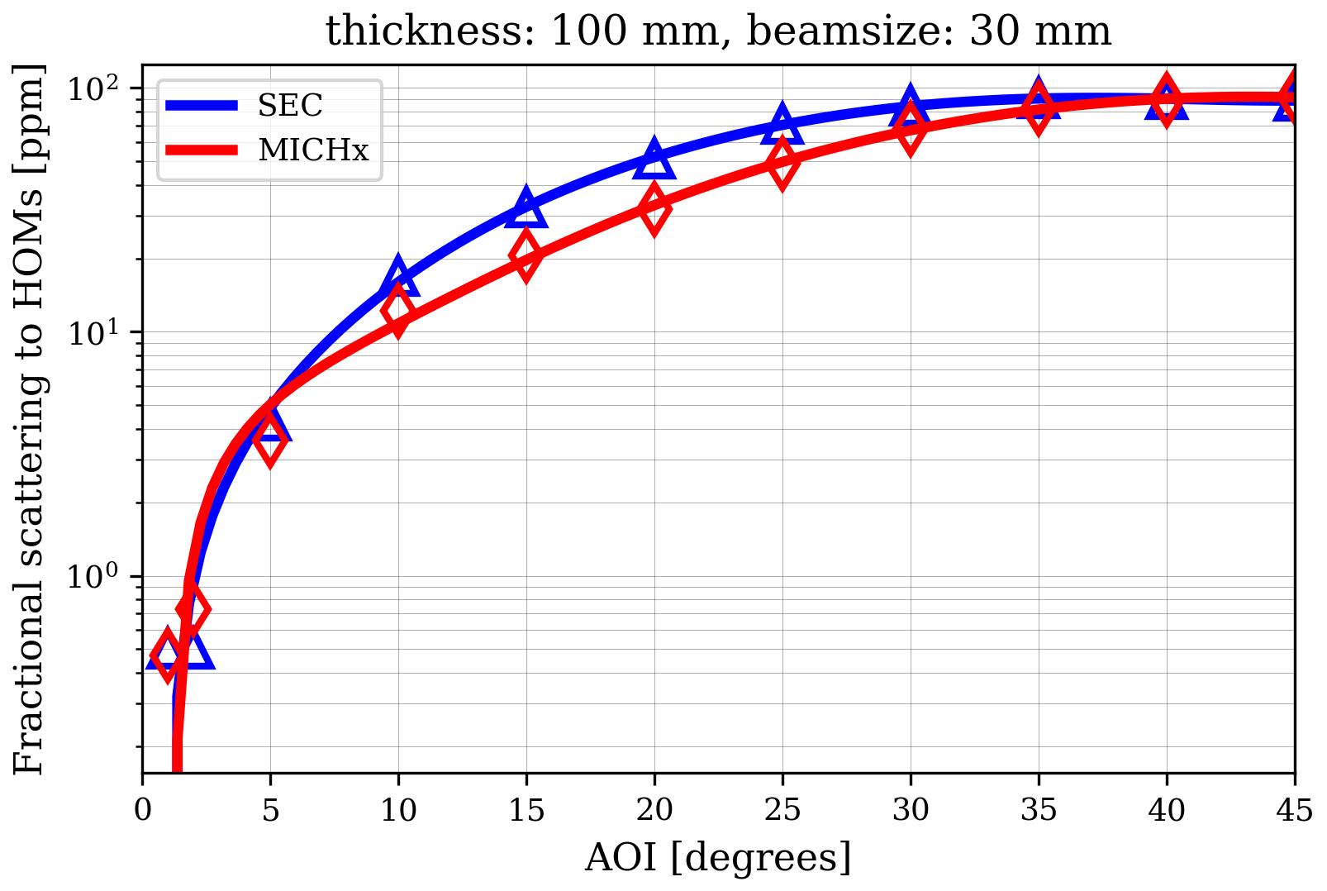
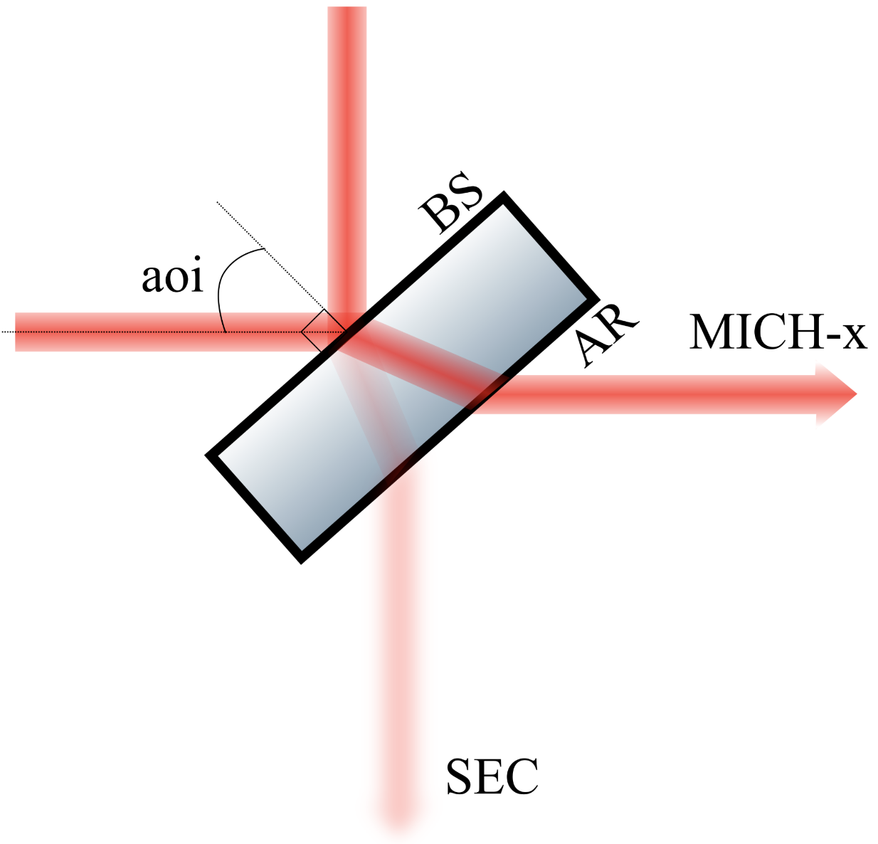
Achieving 500 ppm SEC loss: Control beamsplitter thermal lensing
Beamsplitter HOM scattering loss versus AOI, with optimal thermal compensation applied (by H.T. Cao)
Expect ~1 ppm total absorption by beamsplitter (dominated by HR and AR coating absorption)
Thermo-refractive substrate lensing is dominant effect
Initial modeling shows HOM scattering losses as high as 100s of ppm, depending on AOI, thickness, and absorption (ongoing analysis by H. T. Cao)
Thermal compensation of beamsplitter requires low AOI to be effective (due to divergence of MICH-x and SEC paths inside substrate)

Slide 7
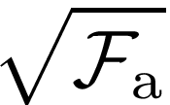
Arm Finesse: How low is realistic?
Baseline CE value is 450, the same as aLIGO
Fundamental sensitivity favors low arm finesse:
500 ppm SEC loss limits HF sensitivity; enhanced by arm finesse as .
Many squeezing degradations due to mode mismatch also enhanced by arm finesse.
High arm finesse makes short SEC problem even worse (see next slide).
But high finesse is needed to:
Suppress Michelson noise (by ).
Suppress thermorefactive noise (also by ).
Reduce power through ITM and BS substrates: needed for high power. Voyager upgrade necessary in order to radiatively cool test masses.

Slide 8
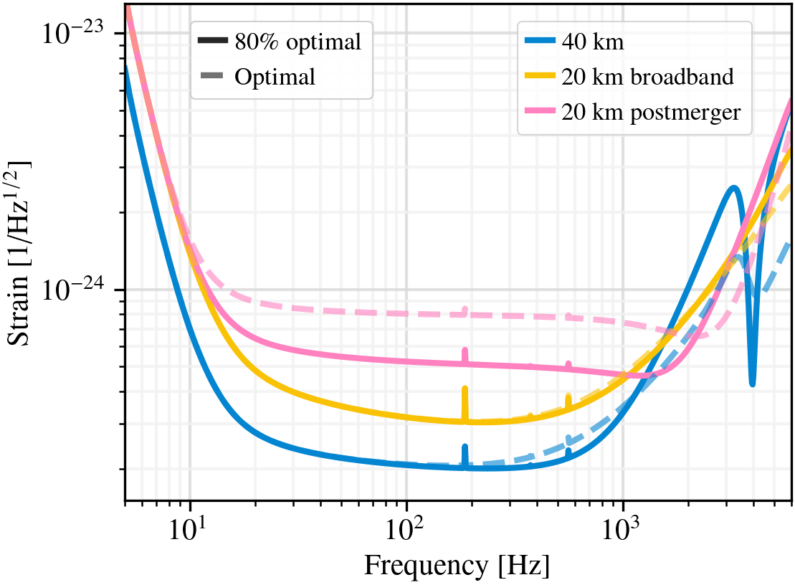
Signal Extraction Cavity (SEC) Length
Unlike in LIGO/Virgo, CE high frequency response is impacted by second SEC resonance due to long arms.
Can be used to make a narrow “tuning” targeting post-merger physics at the expense of broadband sensitivity.
Short* SEC needed to keep this resonance high.
Difficult to realize short SECs while accumulating Gouy phase and expanding beam to ~12 cm.
More realistic SECs make “post-merger” tuning increasingly unattractive and start limiting 40 km detector bandwidth.
High arm finesse requires even shorter SECs.
CE-G2300033/CE-G2300048
80% reduction in post-merger sensitivity:
L_{s}= 20→200 m for 40 km
L_{s}= 25→90 m for 20 km
* NEMO talks about a “long SEC” to create this effect. It is not only the length that matters, and the frequency scales as

Slide 9
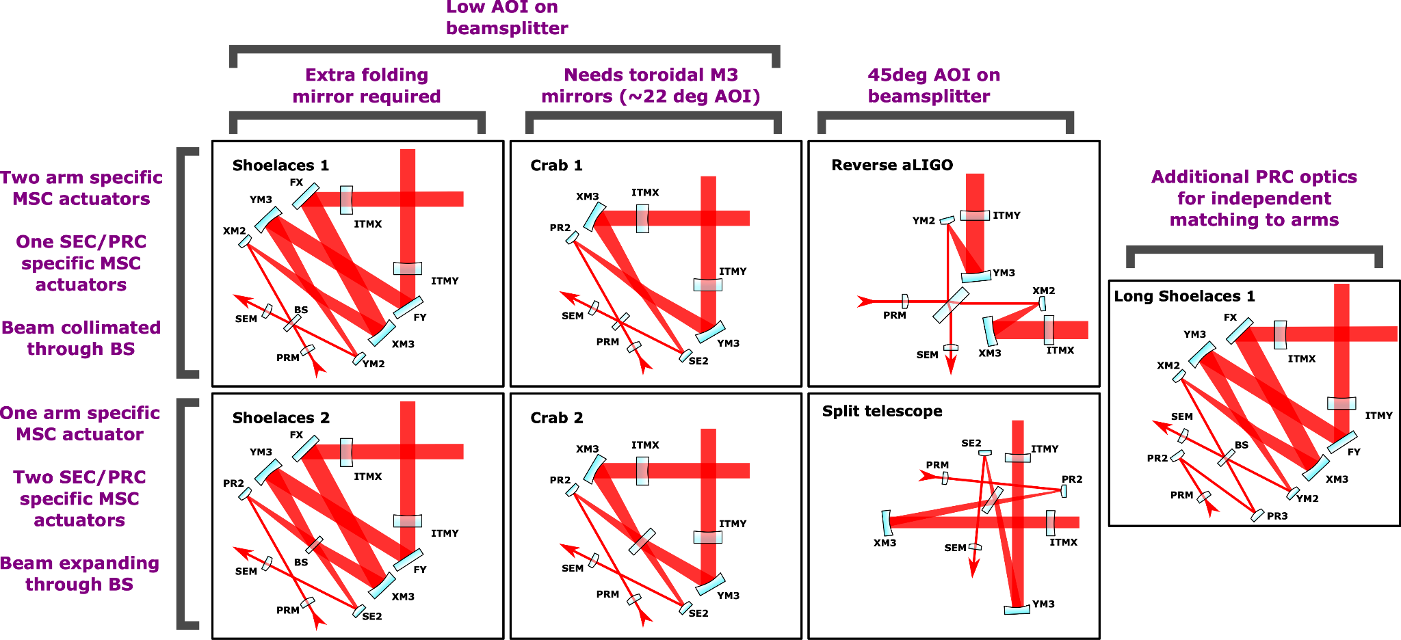
(Some) Corner Layout options

Slide 10
Layout agnostic SEC design options
Split the SEC geometrical design from the layout topology, identifying some “layout agnostic*” options:
Assume a ~100m focal length lens in ITM (feasibility being checked). Aim for >10deg Gouy phase accumulation between XM3 and XM2/SE2.
Assume we cannot make a strong ITM lens. Still aim for >10deg Gouy phase accumulation between XM3 and XM2/SE2.
Assume we can make a strong ITM lens. Ignore requirement for >10deg Gouy phase accumulation between XM3 and XM2/SE2.
Assume we cannot make a strong ITM lens. Ignore requirement for >10deg Gouy phase accumulation between XM3 and XM2/SE2.
Another constraint: beam size on BS must be >1cm to keep thermorefractive noise low.
Task: find which of the above can be achieved, for which corner layouts, and with what SEC lengths.
*Not all these options are available for all corner layout options, so not entirely agnostic in that sense

Slide 11
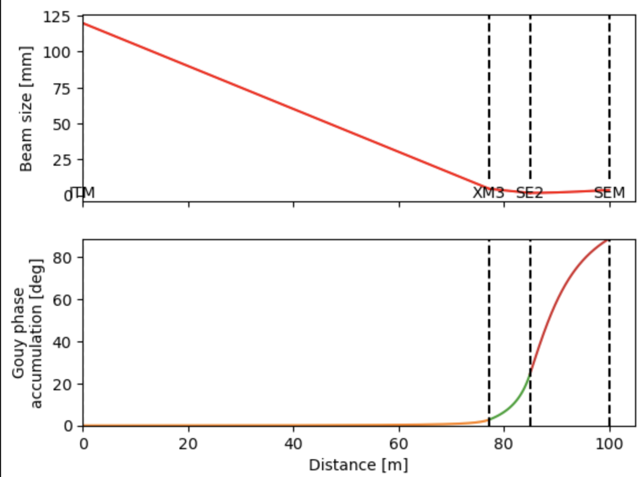
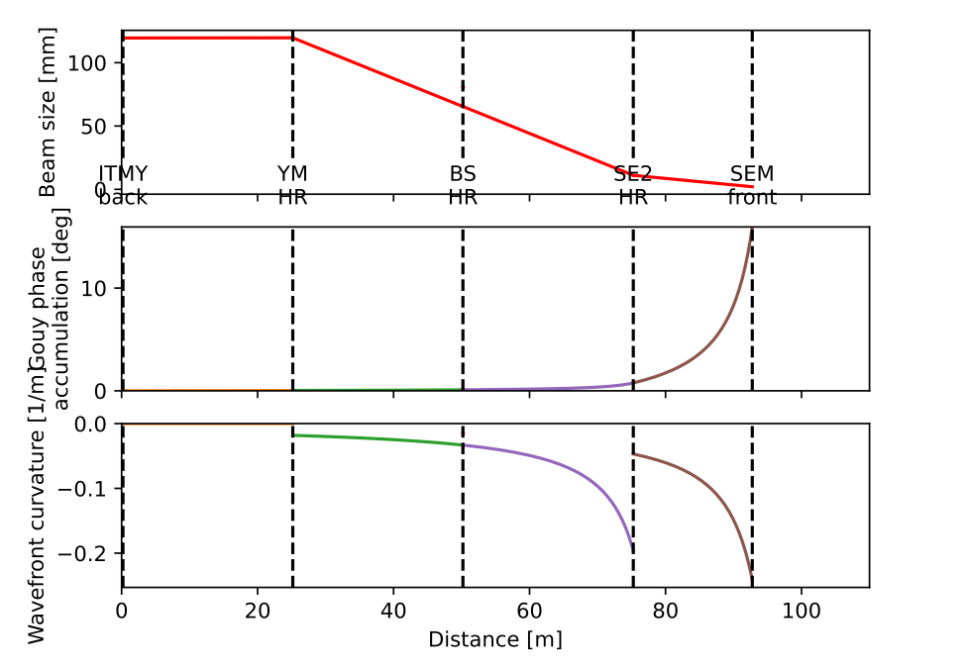
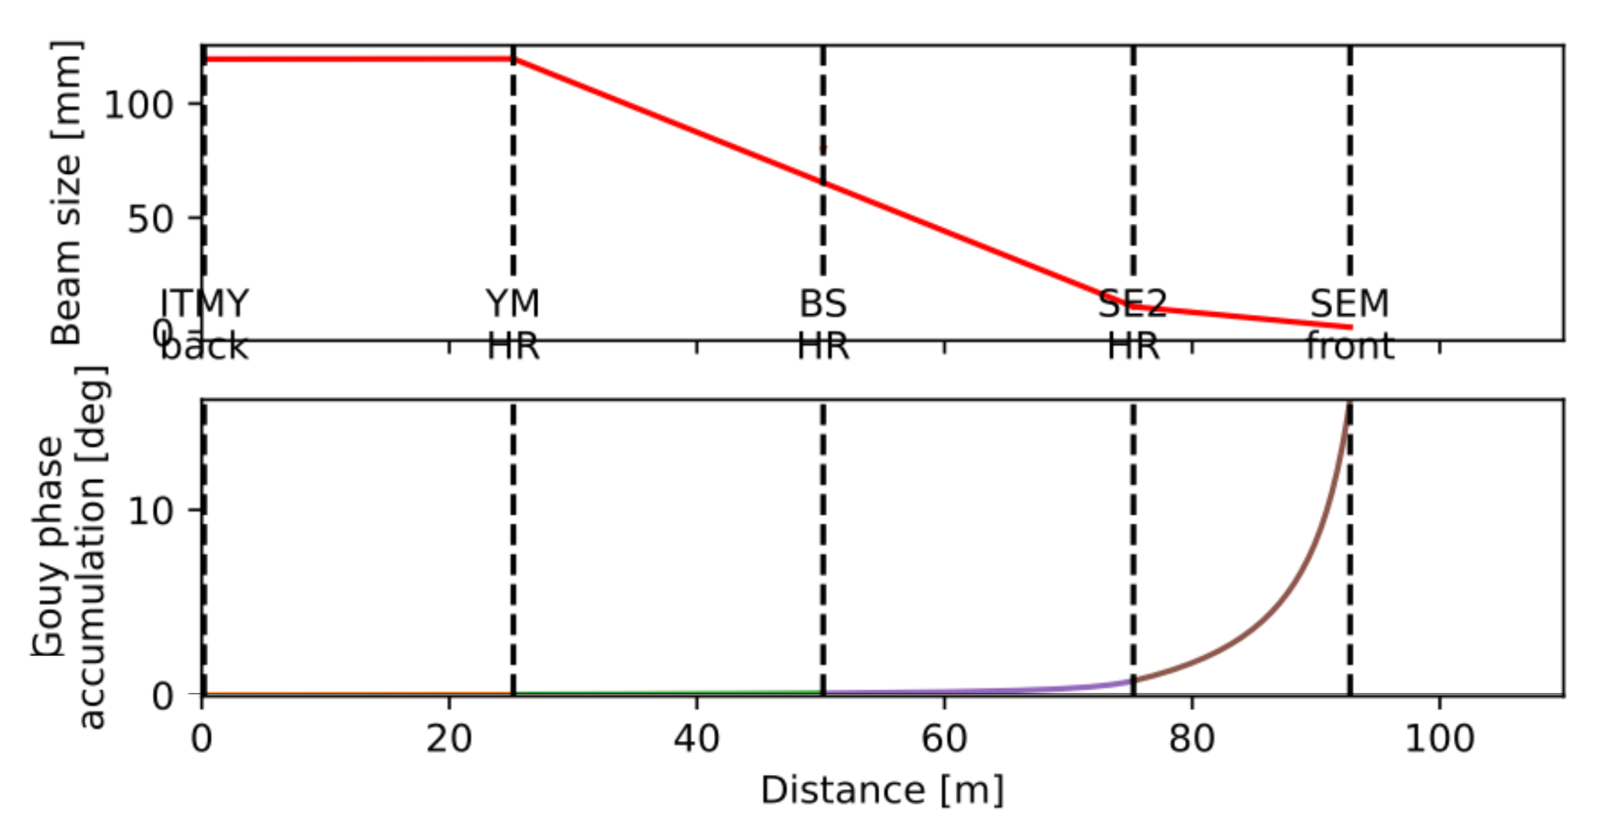
SEC design work in progress
Two examples of “layout agnostic” recycling cavity designs.
Example SEC based on (a)
Example SEC based on (d)
SEC designs by Sagar Gupta and Chance Jackson
University of Florida

Slide 12
To-scale optical layouts: GTrace → SolidWorks→ Zemax
ITMY
ITMX
Sketches shown previously are not to scale and can be misleading: parallel work on geometrical design of corner for different topologies
To-scale “Crab 1” layout, produced with GTrace
PRM
BS
SEM
Figure by P. Goodarzi

Slide 13
CARM Feedback Main problem
 | Advanced LIGO | Cosmic Explorer
Arm Length | 4 km | 40 km
FSR | 38 kHz | 3.8 kHz
CARM pole | 0.4 Hz | 0.04 Hz
For Cosmic Explorer, the arms will be 40 km long.
The free-spectral range of LIGO is 38 kHz.
The free-spectral range of Cosmic Explorer is 3.8 kHz.
Advanced LIGO
vs
Cosmic Explorer
L = 4 km
L = 40 km
Problem: LIGO’s current frequency stabilization bandwidth is around 30 kHz. However, the controller cannot extend beyond the FSR due to the overcoupled arm cavity phase dynamics. Additionally, the extremely low linewidth (0.04 Hz) makes the CE shot noise limit insufficient at 500 Hz.

Slide 14
Solution: do not rely on CARM for HF feedback
IMC1
IMC2
Do not rely on the interferometer for frequency noise suppression
Instead, use two long input mode cleaners First IMC is high-bandwidth to reach shot noise limit Second IMC is low-bandwidth to passively filter noise Main interferometer will also strongly filter noise Advantages: 1) Long cavity is a better frequency reference 2) No feedback from IFO required
L = 100 - 1000 m

Slide 15
Simulation tools for XG design
Finesse 3
For noise couplings, quantum noise calc., closed loop controls.
pyGWINC
Noise budgets, science metrics.
SIS
High-order scattering, stray light modeling.
GTrace, Zemax, …
Geometrical layouts, ghost beams.
FEA tools
COMSOL, ANSYS
FEniCSx (open-source)
Time domain optical modeling software.
Lock acquisition, glitch response, …
…others we should be aware of?
…physics that is needed but not covered by these?

Slide 16
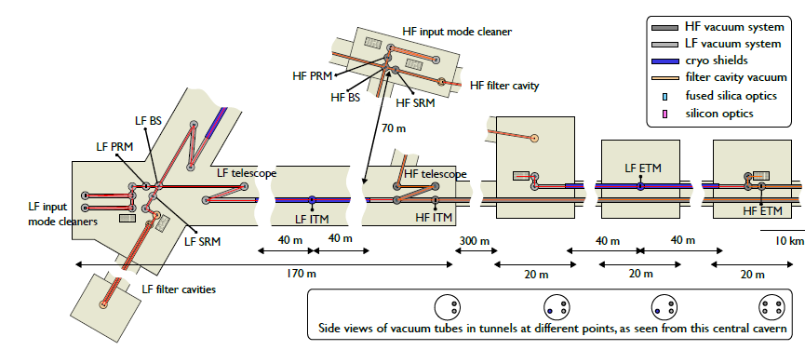
Einstein Telescope Optical Design
Phys. Rev. D 103, 023004

Slide 17
Reference Material

Slide 18
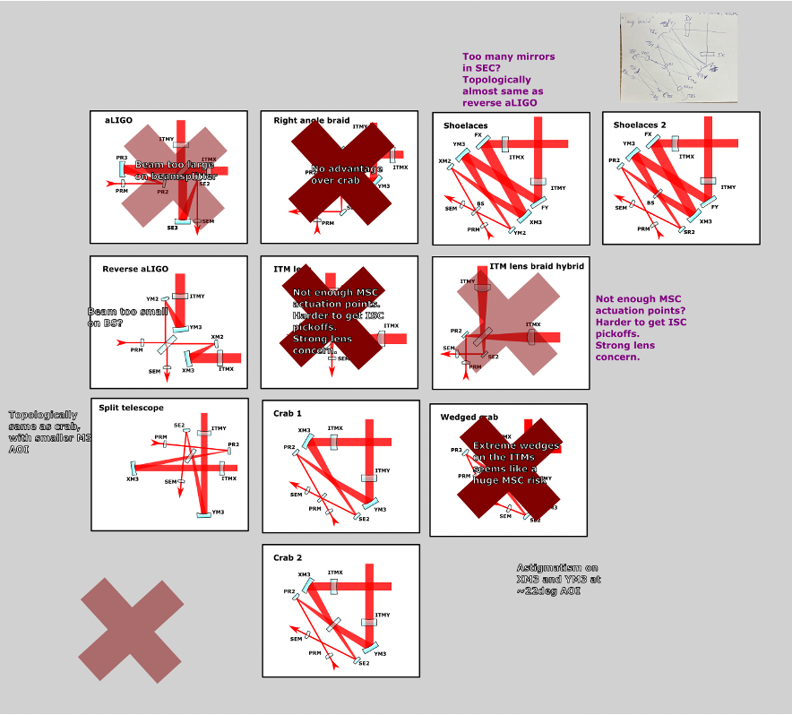
Corner Layout options
Starting “from scratch” allows us to consider new corner topologies.
Major considerations are:
Beam size and incident angle on beamsplitter.
Ability to maintain short SEC length.
Astigmatism in recycling cavities.
Suitable locations for MSC actuators.
Minimize squeezing degradations
Significant overlap with/impact on/from Mode Sensing and Control work.
Early priority is to down select to a few feasible layout options, and write up in technical note the reasoning.
More details can be found at CE-T2300006 and cross links.
Some early downselection…

Slide 19
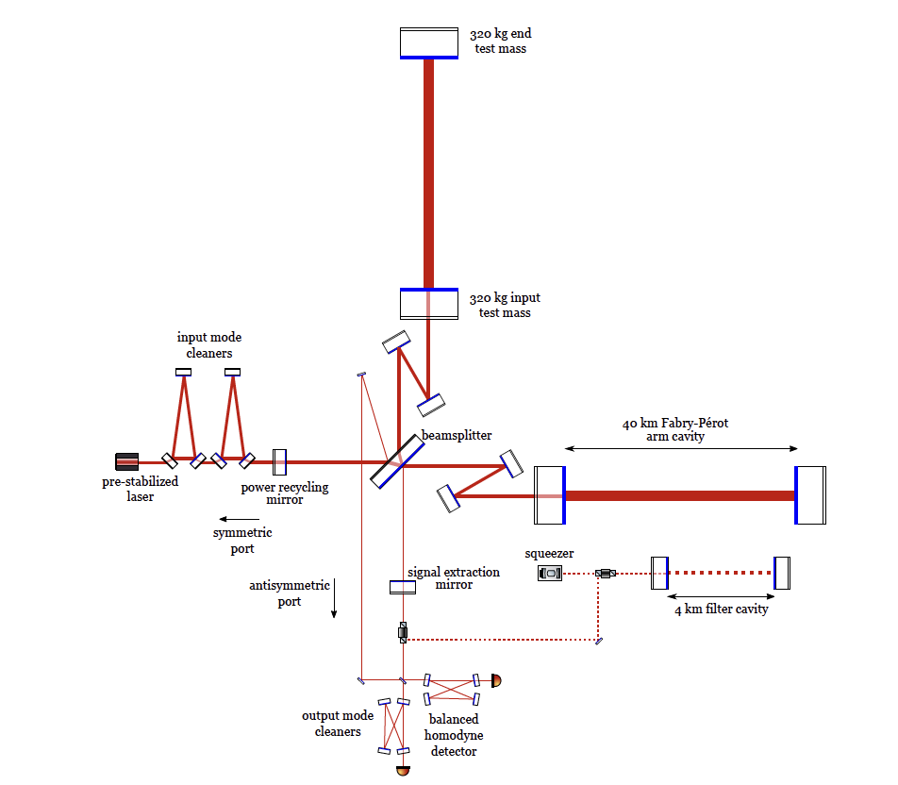
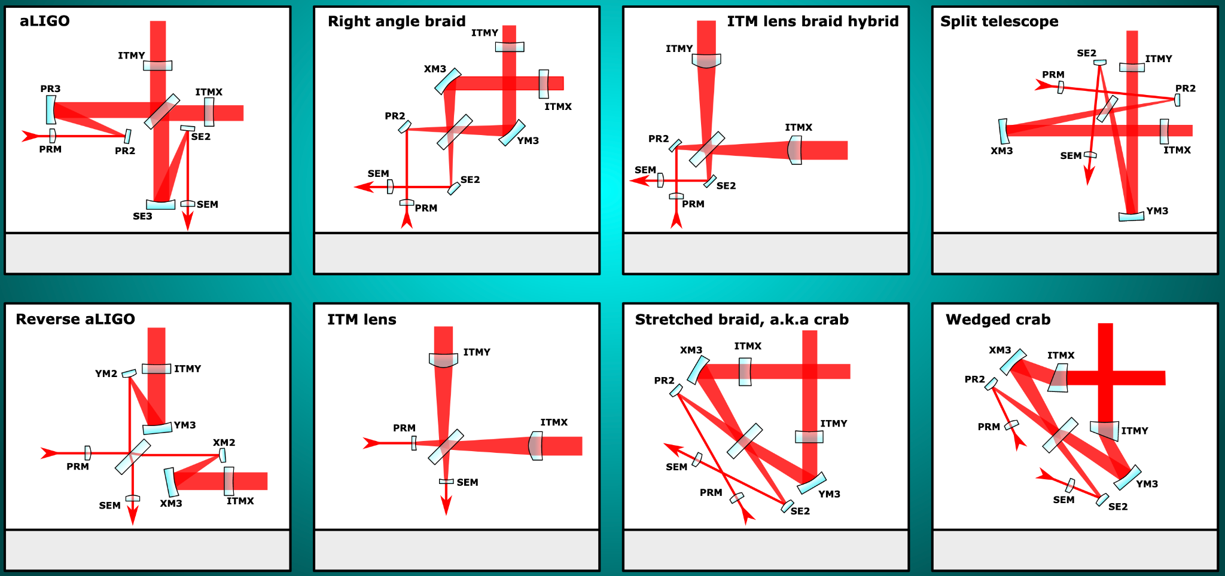
Cosmic Explorer Optical Design
Horizon Study Reference 2021
Focus of ongoing work: corner layout

Slide 20
Baseline vision of
wavefront control in core interferometer
ETMY
(Drawn as aLIGO-style vertex topology only for illustration)
40 km
ITMY
ITMX
ETMX
BS
PR3
40 km
To IMC
PR2
SE2
PRM
SE3
SEM
To OMC

Slide 21
Baseline vision of
wavefront control in core interferometer
ETMY
ITMs
Actuators: Ring heater (RH) + front-surface ring heater (FRH)
Function: Corrects ITM surface deformation and substrate lens
Subsumes functionality of compensation plates (CPs)
All higher-order mismatch with PRC / SEC corrected here
Requires major new R&D; under development for A# (G2300032, G2300506)
40 km
ITMY
ITMX
ETMX
BS
PR3
40 km
To IMC
PR2
SE2
PRM
SE3
SEM
To OMC

Slide 22
Baseline vision of
wavefront control in core interferometer
ETMY
40 km
ITMY
ETMs
Actuators: RH + FRH
Function: Corrects ETM surface deformation
Simpler FRH can likely be used (single, rather than double, heating annulus)
Full-scale prototype built for 40-kg test mass; testing planned at UCR and CIT (G2300506)
Possible to “overdrive” FRH to shift arm cavity HOM resonances (G2200399), if needed
ITMX
ETMX
BS
PR3
40 km
To IMC
PR2
SE2
PRM
SE3
SEM
To OMC

Slide 23
Baseline vision of
wavefront control in core interferometer
ETMY
SEC / PRC Mode-Matching
Test mass actuators are designed such that only low-order mismatch remains between arms and SEC / PRC
Correctable with simpler RoC actuators (e.g., RH, TSAMS), or astigmatic actuators (if AOI is high)
Ideal actuation scheme: Two pairs of RoC (or astigmatic) actuators at 45-degree Gouy phase separations, on both symmetric and antisymmetric sides of beamsplitter
Provides independent control of SEC and PRC matching to arms
Incorporate polishing “bias” into SEC / PRC mirrors for bidirectional actuation (mirror attains nominal RoC at midpoint of dynamic range)
40 km
ITMY
ITMX
ETMX
BS
PR3
40 km
To IMC
PR2
SE2
PRM
SE3
SEM
To OMC

Slide 24
Baseline vision of
wavefront control in core interferometer
ETMY
40 km
BS
Actuators: RH
Function: Corrects beamsplitter (BS) surface deformation and substrate lens
Substrate lens is dominant effect
Thermal compensation can reduce loss to ~1 ppm, but requires low AOI (see analysis by H. T. Cao)
For effective correction, MICH-x and SEC paths through substrate must be nearly coaligned
ITMY
ITMX
ETMX
BS
PR3
40 km
To IMC
PR2
SE2
PRM
SE3
SEM
To OMC

Slide 25
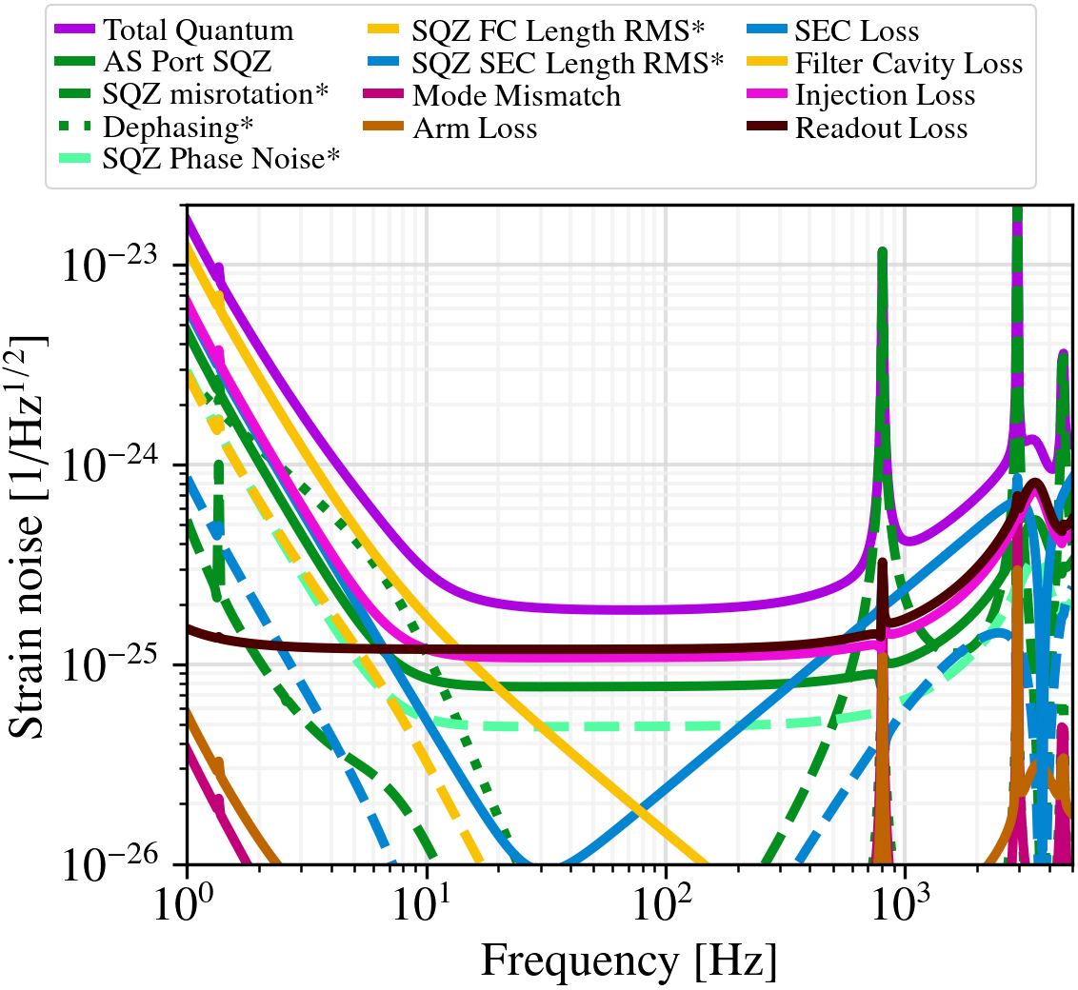
1% “Quadratic mismatch”

Slide 26
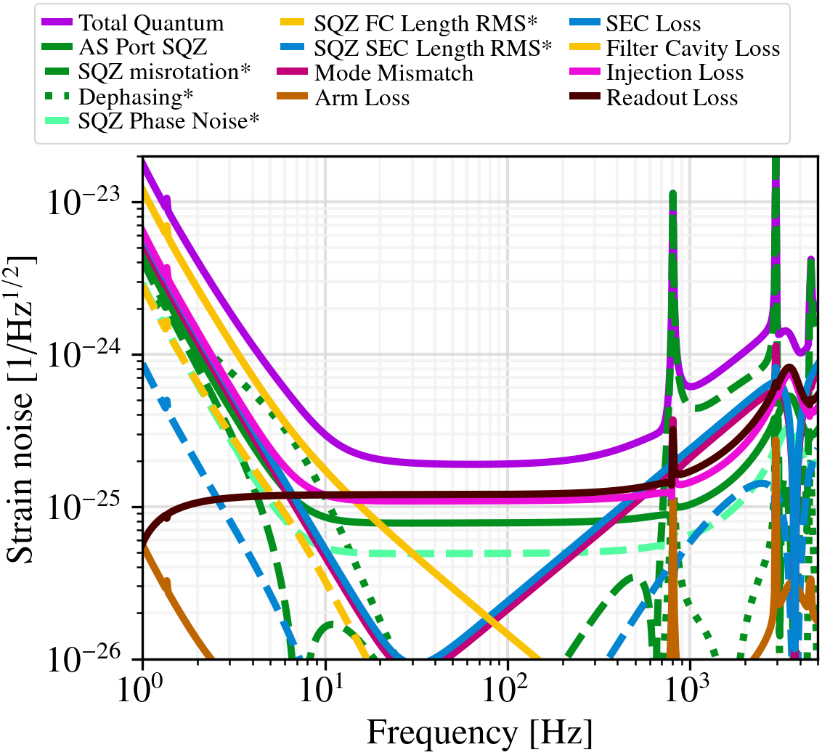
1% “OPD” mismatch
SEC detuned by 0.02 deg

Slide 27
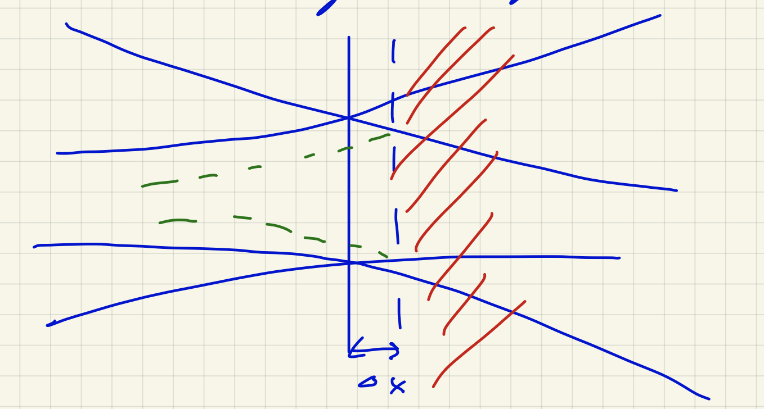
Beamsplitter in a strongly converging telescope: concerns
Especially at 45deg AOI, coating reflectivity will vary across the beam spot.
Linear dependence of reflectivity on AOI actually just has a mode matching effect.
Combines with the more obvious mode matching effect (see sketch).
Figure credit: Stefan Ballmer
Matthew Todd and Stefan Ballmer: CE-T2300014

