Slide 1
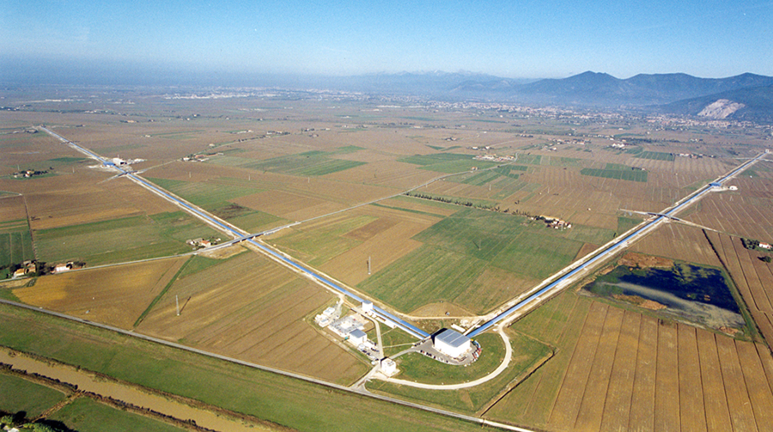
Gravitational Wave Experiments
S. Koley, J. Harms, M. Di Giovanni, T. Andric, F. Badaracco et al.

Slide 2
Contents
Gravitational wave detectors – Brief history
International Gravitational Wave Network
Gravitational wave detection – Laser interferometers
The Virgo gravitational wave detector
Fundamental and technical noises at Advanced Virgo+
Low-frequency noise at gravitational wave detectors
Newtonian noise
Estimation, cancellation array optimization, cancellation strategies
Sensing control noise
Preparing for future underground gravitational wave detectors
Site characterization studies
Newtonian noise estimation and subtraction
GEMINI experiment

Slide 3
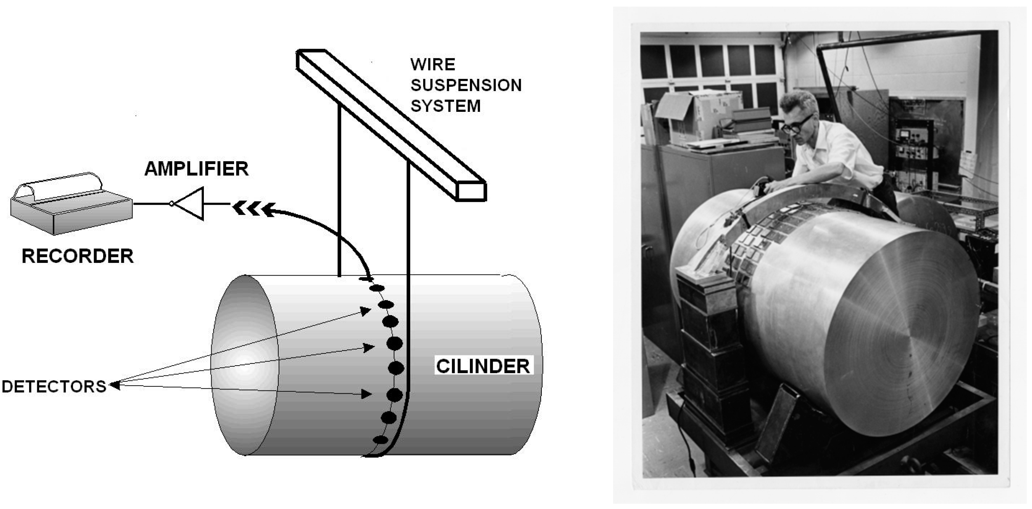
Gravitational wave detectors – a brief history
The year following the meeting at Chapel Hill, Joseph Weber began to speculate how he could detect gravitational waves.
He proposed the detection of gravitational waves by measuring vibrations induced in a mechanical system.
CYLINDER
By 1971 Forward reported the design of the first interferometer prototype (which he called a “Transducer Laser”)
Also in the 1970s, Weiss independently conceived the idea of building a Laser Interferometer, inspired by an article written by Felix Pirani
Weiss also held talks with Phillip Chapman, who had glimpsed, independently, the same scheme

Slide 4
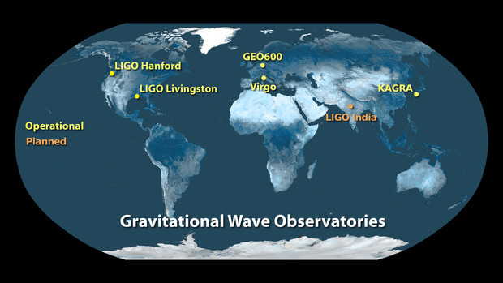
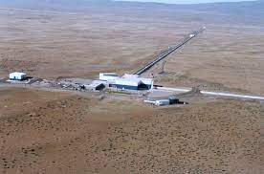
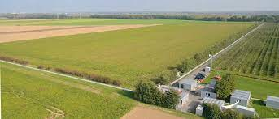
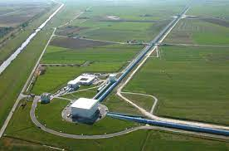
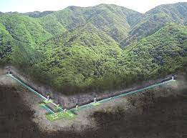
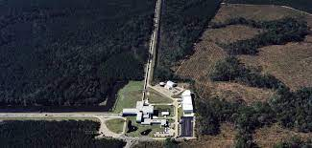
Current and planned 2nd generation GW detectors
Observe together as a network of GW detectors with integrated data-analysis
LIGO-Virgo started their first science run in 2007
Advanced Virgo joined Advanced LIGO in 2017
KAGRA joined in 2020
IGWN: International Gravitational Wave Network

Slide 5
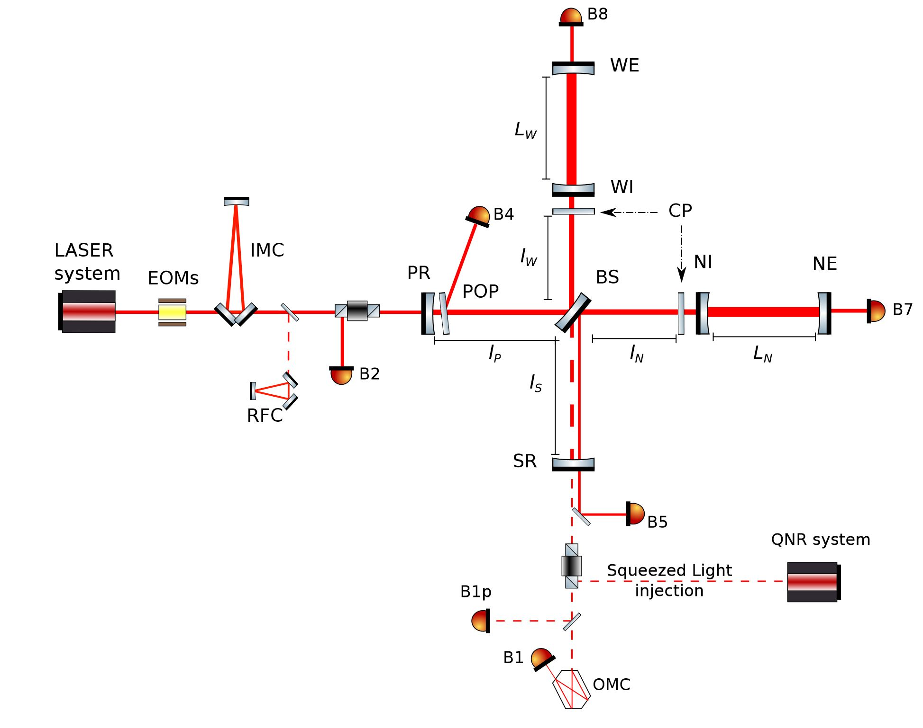
Advanced Virgo+ - A dual recycled Fabry-Perot interferometer
LIGO and Virgo are dual recycled Michelson interferometers equipped with Fabry-Perot cavities and input/output mode cleaners

Slide 6
Advanced Virgo+ - present sensitivity and O4 goals
Low-frequency sensitivity of AdV+ is more than an order of magnitude above the envisioned target sensitivity during the fourth observing run
Sensitivity features
Sensing control noise is a limiting factor for the low frequencies
About factor 3 – 4 above target sensitivity for high frequencies – mostly shot noise
Spectral lines – calibration lines, electromagnetic coupling, suspension modes, mirror modes

Slide 7
Advanced Virgo+ - Fundamental noises
Newtonian noise and suspension thermal noise are expected to be the major contributors to the fundamental noise for low frequencies
Sensitivity features
Technical noise obscures the observation of Newtonian noise or other fundamental noises at low frequencies
NN will be a fundamental limitation during the fifth observing run (BNS range > 150 Mpc)

Slide 8
Advanced Virgo+ - Technical noises
Angular control, beam jitter, and scattered light noise are some of the major contributors to the low-frequency technical noise budget
Modeling and requirements
Modeling AdV+ optical layout – Finesse
Identification of DOF – residual rms allowable, e.g. ${10}^{−16}$ m for DARM, ${10}^{−13}$ m for MICH
Quantifying the degree of coupling for each DOF to the strain channel

Slide 9
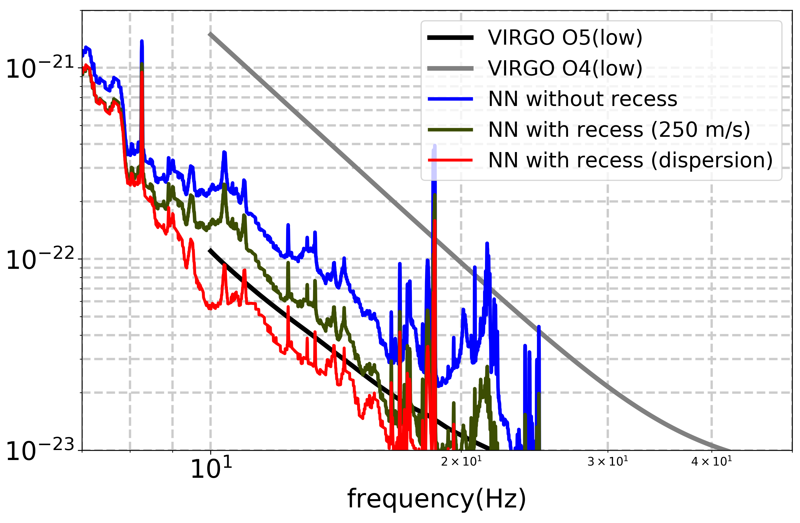
Newtonian noise estimation at AdV+
Newtonian and suspension-thermal noise are expected to be the two main contributors to the low-frequency noise at AdV+
Mirror acceleration
$δ\vec{a}\left(\vec{r_{0}} ,t\right)=G\int{dV ρ\left(\vec{r}\right)×\frac{1}{{\left|\vec{r}−\vec{r_{0}}\right|}^{3}}}\left(ξ\left(\vec{r},t\right)−3\left({\vec{e}}_{rr_{0}}ξ\left(\vec{r},t\right)\right)\right){\vec{e}}_{rr_{0}}$,
where $ξ(\vec{r},t)$ is the seismic displacement field, $ρ$ the density,
and ${\vec{e}}_{rr_{0}}=(\vec{r}−\vec{r_{0}})/|\vec{r}−\vec{r_{0}}|$
Relies on finite element/difference simulations
Elastic properties of the medium and the noise source properties need to be known (Singha et al., 2021, Tringali et al., 2019, Koley et al., 2017)
strain ($1/\sqrt{Hz}$)

Slide 10
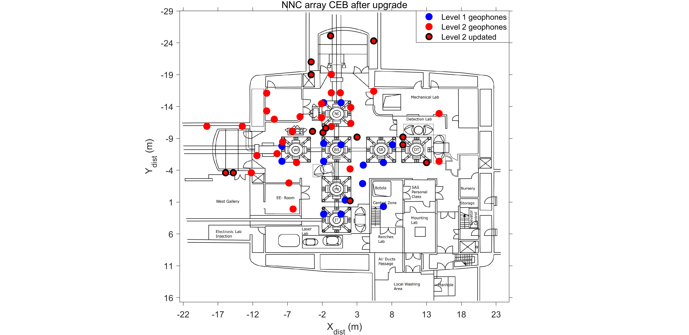
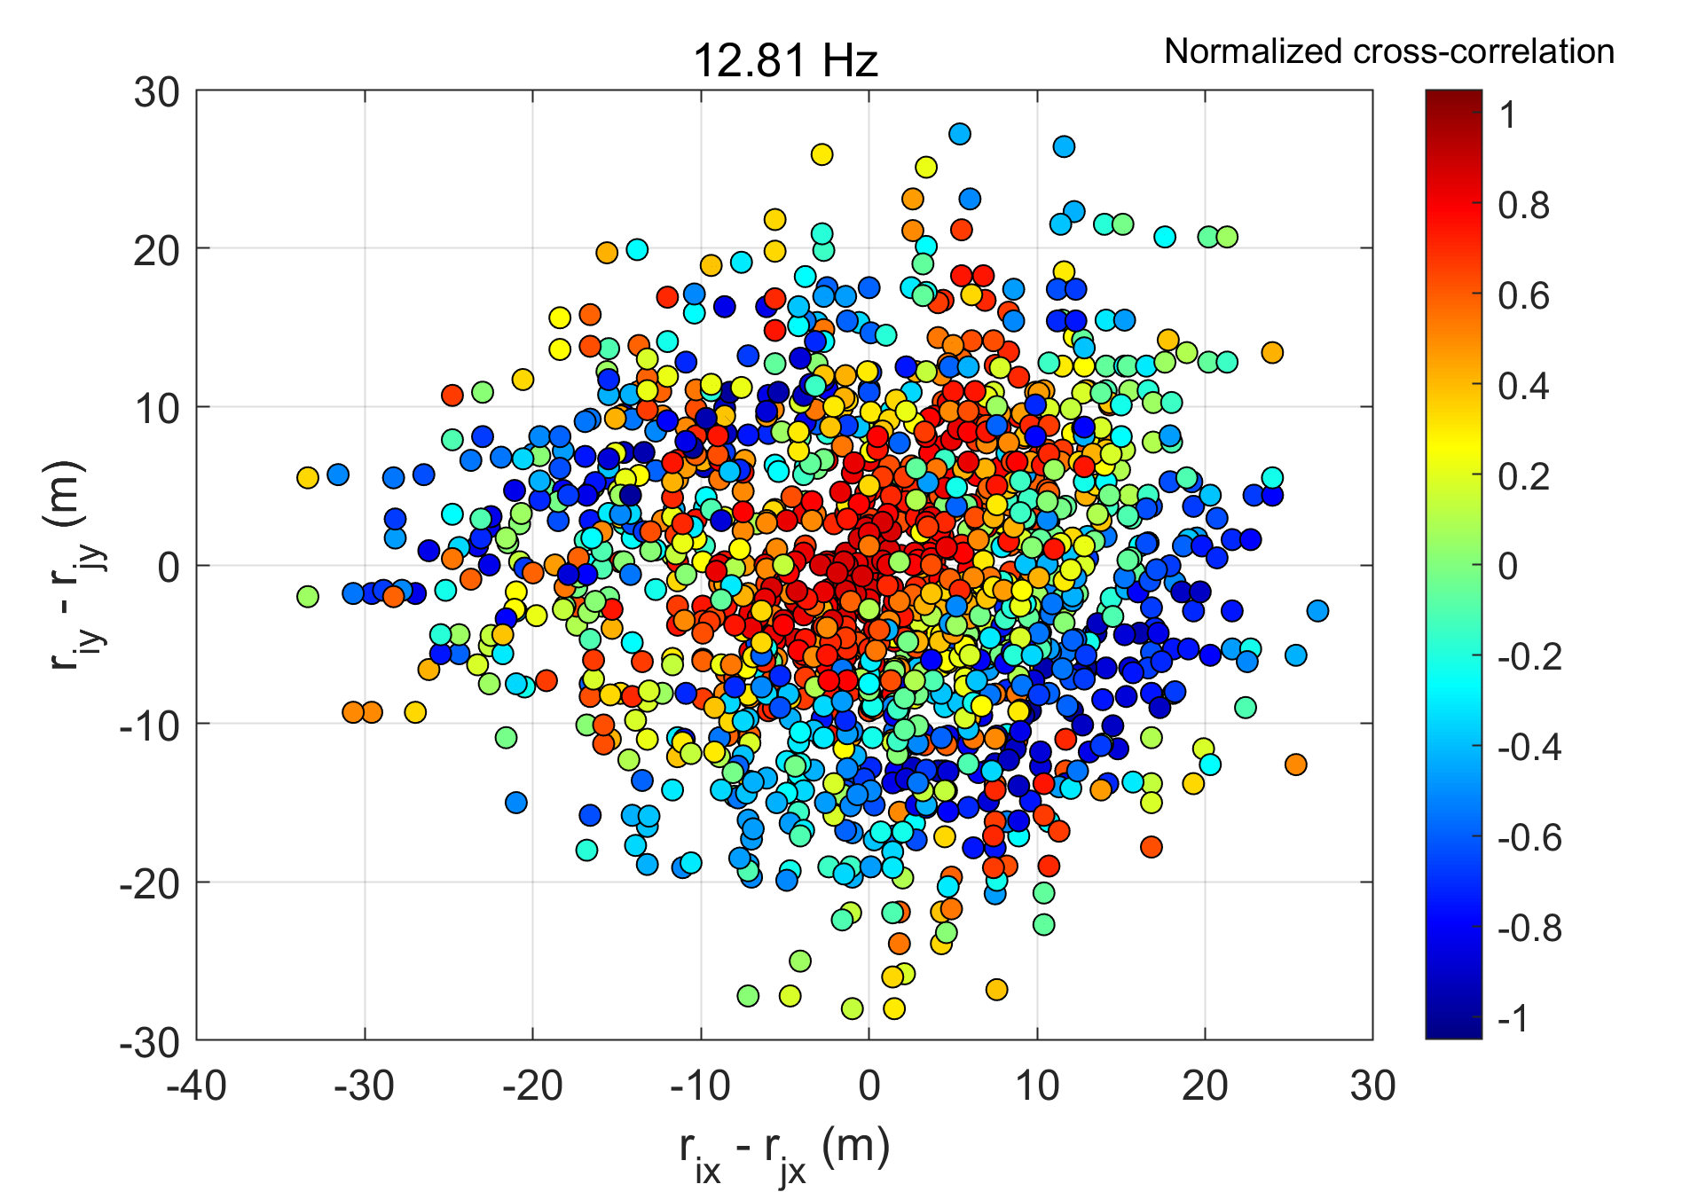
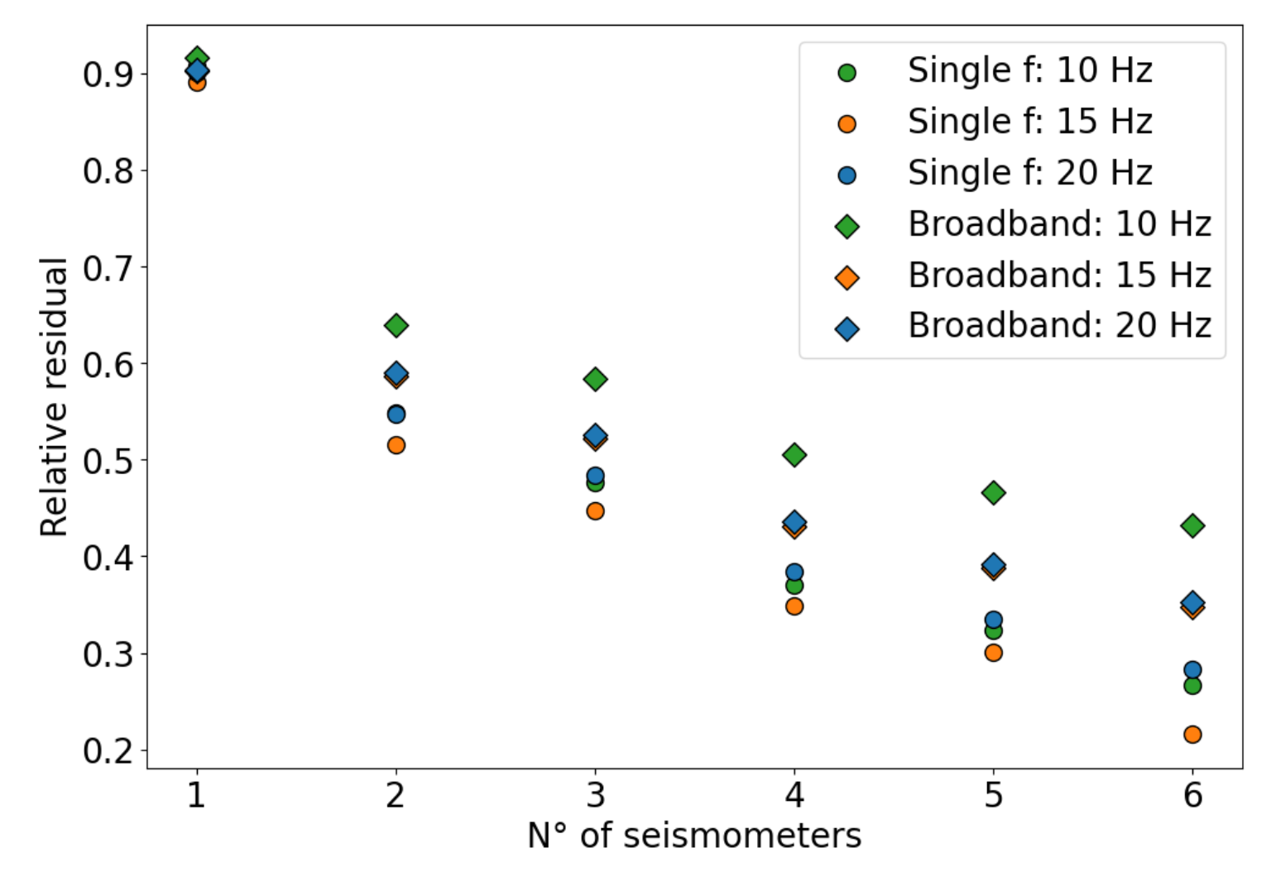
Newtonian noise cancellation – Array optimization
NN cancellation system based on observed two-point spatial correlations between seismometers deployed in an array. The solution takes the form of a surrogate Wiener filter with seismometers as input channels (Badaracco & Harms, 2020)
Perform seismic measurements around the test mass
Understand seismic wave types at the site
Build two-point spatial correlation models
Array optimization
Obtain optimal sensor locations around test-masses for subtraction of Newtonian noise
Global optimizers like Particle Swarm or Simulated Annealing
Perform quantitative study on the influence of number of seismometers with the subtraction performance
Relative residual R obtained from the broadband optimization (diamond)
compared with the one obtained from the single-frequency optimization (circle).

Slide 11
Newtonian noise cancellation – Wiener and adaptive filtering
Precalculated Wiener filters can be used to subtract NN from the GW channels – implementation has been tested using the tiltmeter as a target channel (S. Koley, J. Harms et al., 2024)
Cancellation array and target
Noise cancellation array comprises a total of 115 geophones laid out at the CEB, NEB, WEB
Target is the tiltmeter – marked with a star at the NEB
Subtraction performance
About a factor 3 subtraction possible in the 10 -25 Hz band
Dynamic filters beat the static Wiener filter implementation
Adaptive real-time cancellation
Adaptive filters of LMS and RLS class can match the performance of dynamic Wiener filter
Exploring computationally fast RLS algorithms for real-time noise cancellation

Slide 12
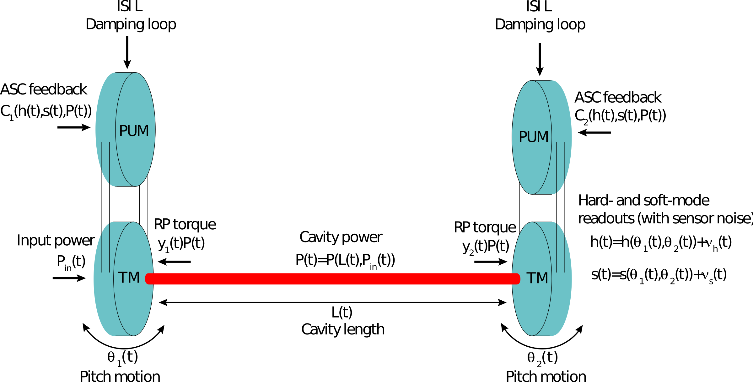
Angular sensing control noise – Lightsaber
Time-domain simulator of the Angular sensing and control (ASC) system for GW detectors (Andric & Harms, 2023)
LIGO and most probably ET-LF – limited by ASC noise
Sources of noise on the mirrors
Residual seismic motion from suspensions
Radiation pressure noise from the circulating beam in the cavities
Need for angular controls
maintain a high sensitivity state in a noisy environment
Fight against internal stability – Radiation pressure
Why Lightsaber?
Sensitivity limitation from the existing linear control system
Machine learning to handle the non-linearities and simultaneously stabilize control loops

Slide 13
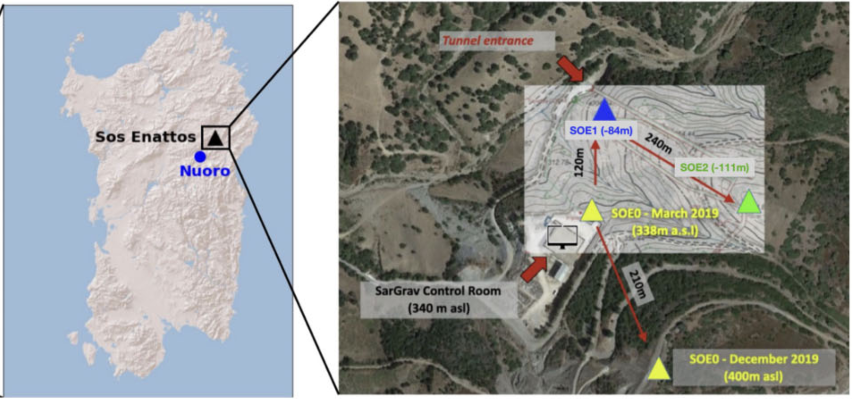
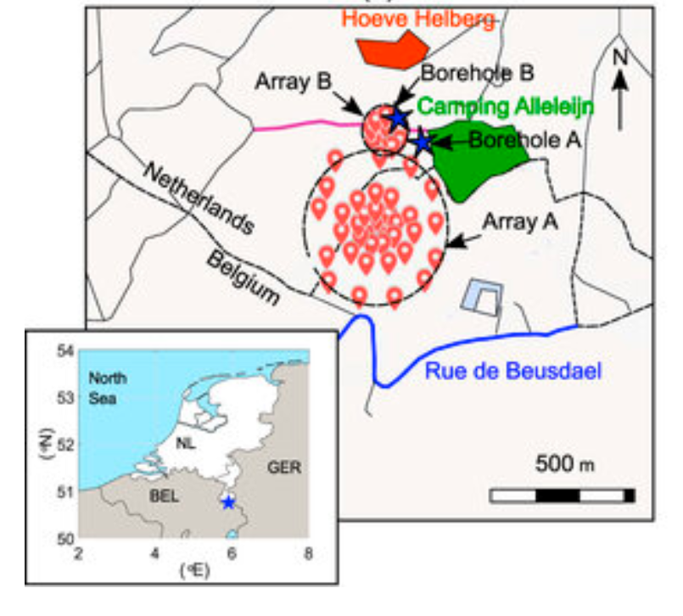
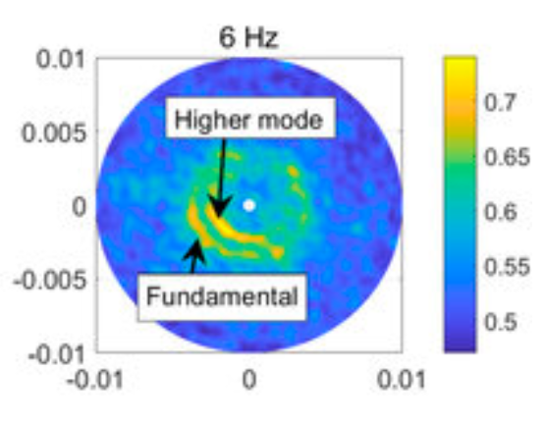
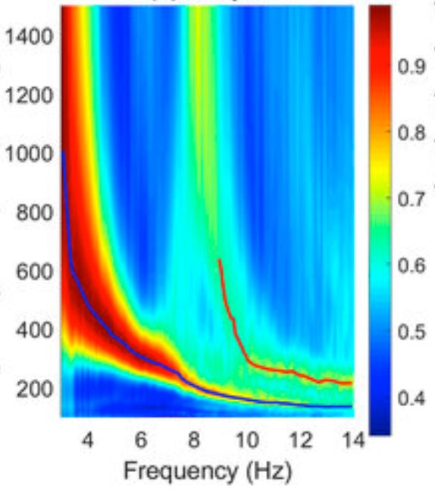
Einstein Telescope – site characterization studies
Einstein Telescope is a planned underground GW detector that is to be constructed at depths between 200 – 300 m
Seismic Arrays for seismic site characterization
Surface and underground noise level
Direction of ambient noise propagation
Seismic wave type
Surface waves
Phase velocity dispersion
Body wave - polarization
Surface and underground seismic noise at EMR - S Koley et al 2022
Temporal variations of ambient noise at Sos Ennatos – Giovanni et al, 2023
Extract phase
velocity
Beamforming
p$sinφ \left(s/m\right)$
Rayleigh wave
phase velocity (m/s)
pcos$φ (s/m)$

Slide 14
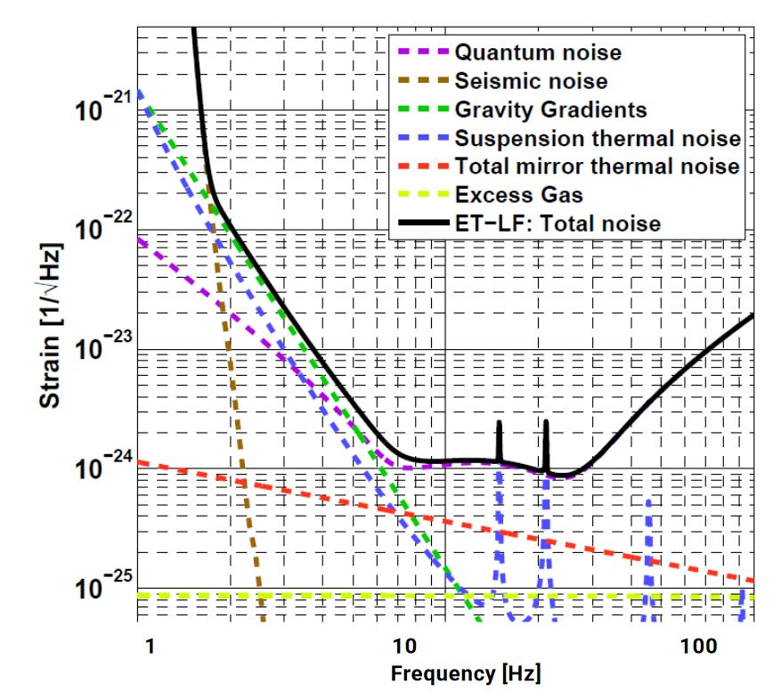
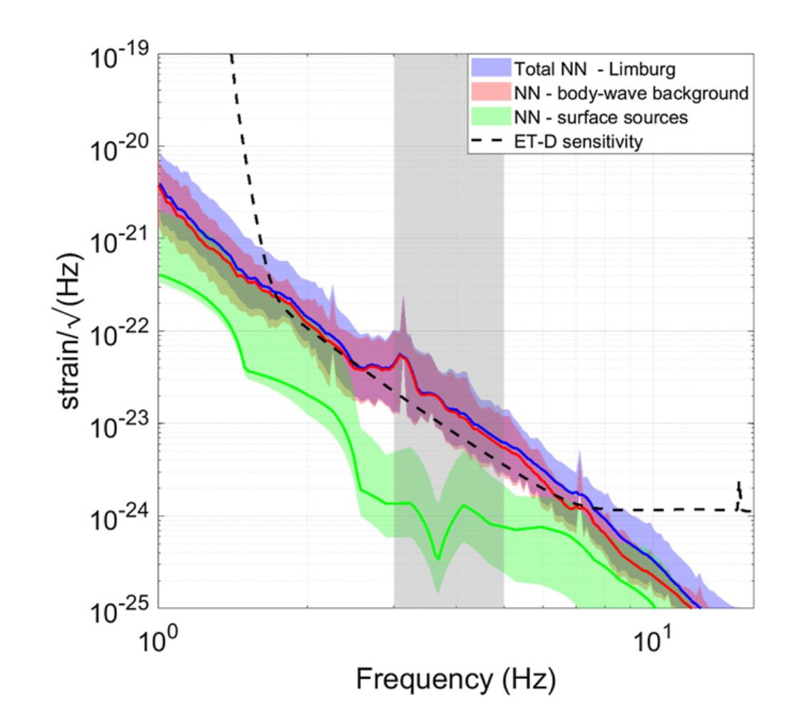
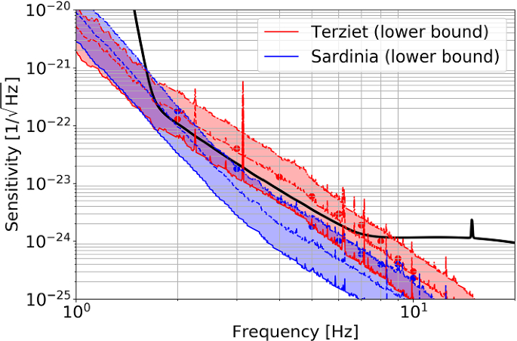
Einstein Telescope – Newtonian noise modeling
Einstein Telescope aims two order of magnitude sensitivity improvement over AdV+ at 10 Hz and achieve strain sensitivity of ${10}^{−22}/√Hz$ at 2 Hz – Newtonian noise is a severe limitation
Numerical simulations of NN (Bader et al, 2022)
Elastodynamic simulations – based on geology and noise source distribution
Impact of topography (Andric & Harms, 2020)
A lower limit for Newtonian-noise models of the Einstein Telescope (Harms et al., 2022)
Analytical models for seismic wave propagation
Cavern shape and sizes
Impact of wave content

Slide 15
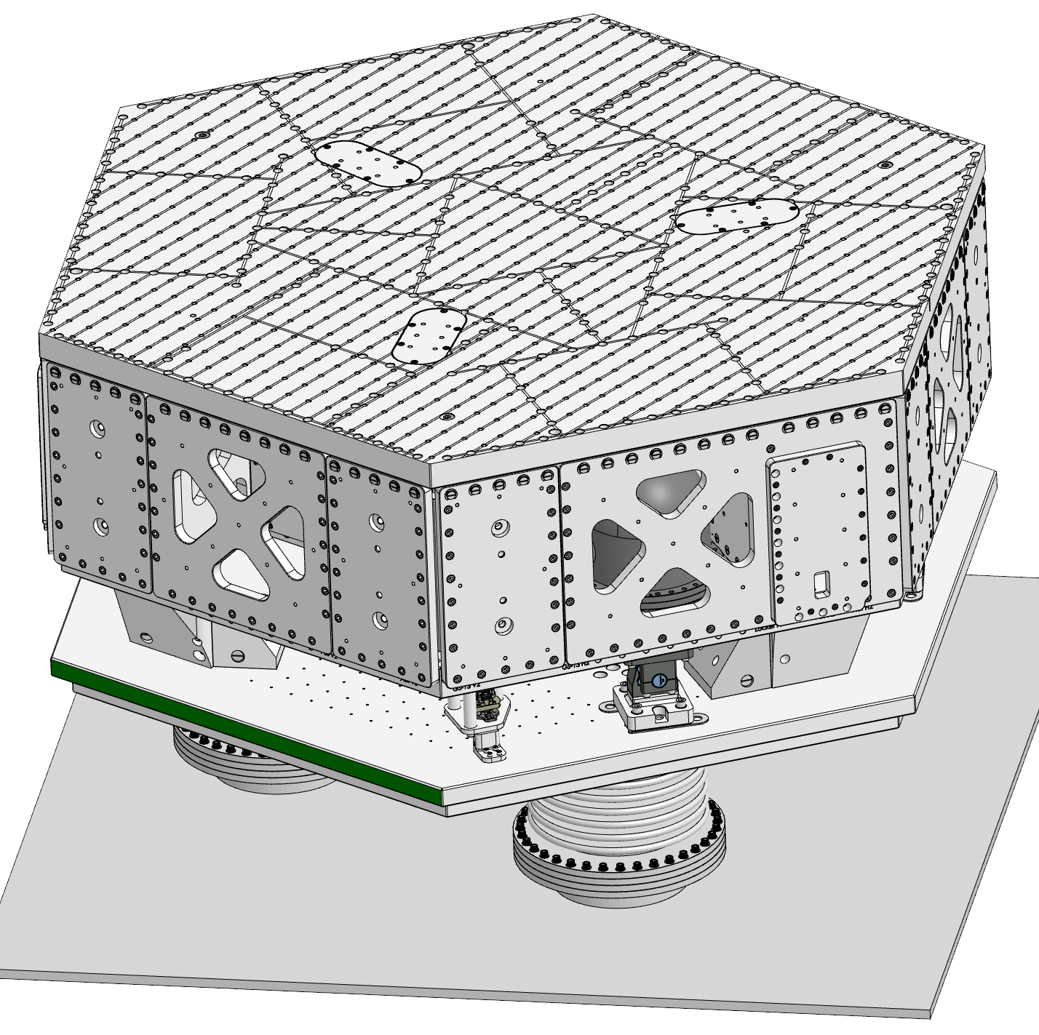
GEMINI
A revolutionary underground seismic-isolation facility at LNGS – from Einstein Telescope to the Lunar GW Antenna
Gran Sasso Science Institute
Jan Harms, Ilaria Caravella
INFN – LNGS
Carlo Bucci, Daniele Cortis, Nicola D’Ambrosio, Massimiliano De Deo, Marco D’Incecco, Alessandro Lalli, Donato Orlandi, Stefano Pirro
International Collaborators
Jeff Kissel (LIGO Hanford), Brian Lantz (Stanford), Rich Mittleman (MIT), Conor Mow-Lowry (VU Amsterdam), Jamie Rollins (Caltech), Jim Warner (LIGO Hanford)

Slide 16
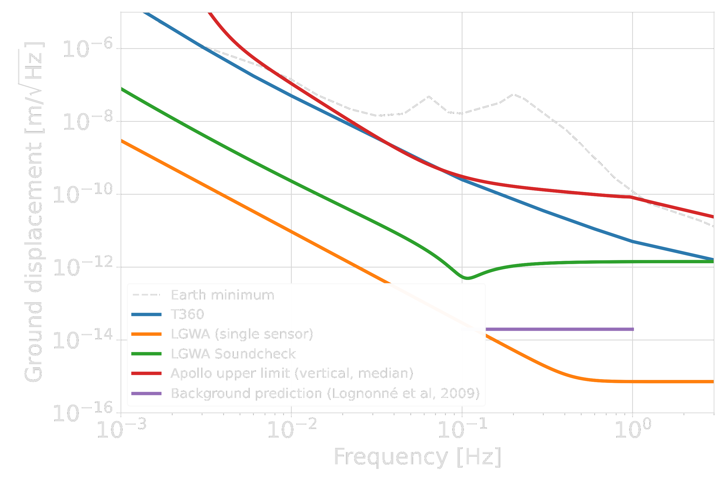
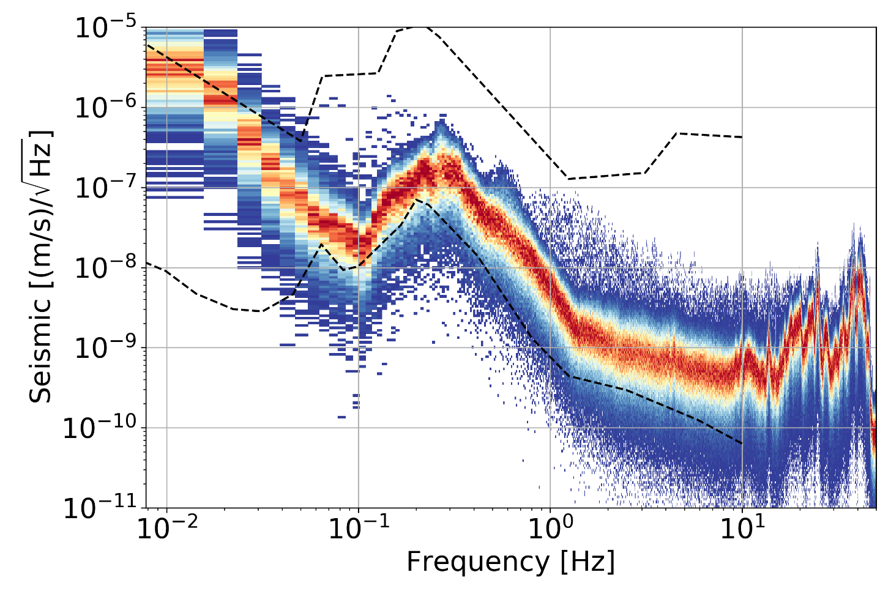
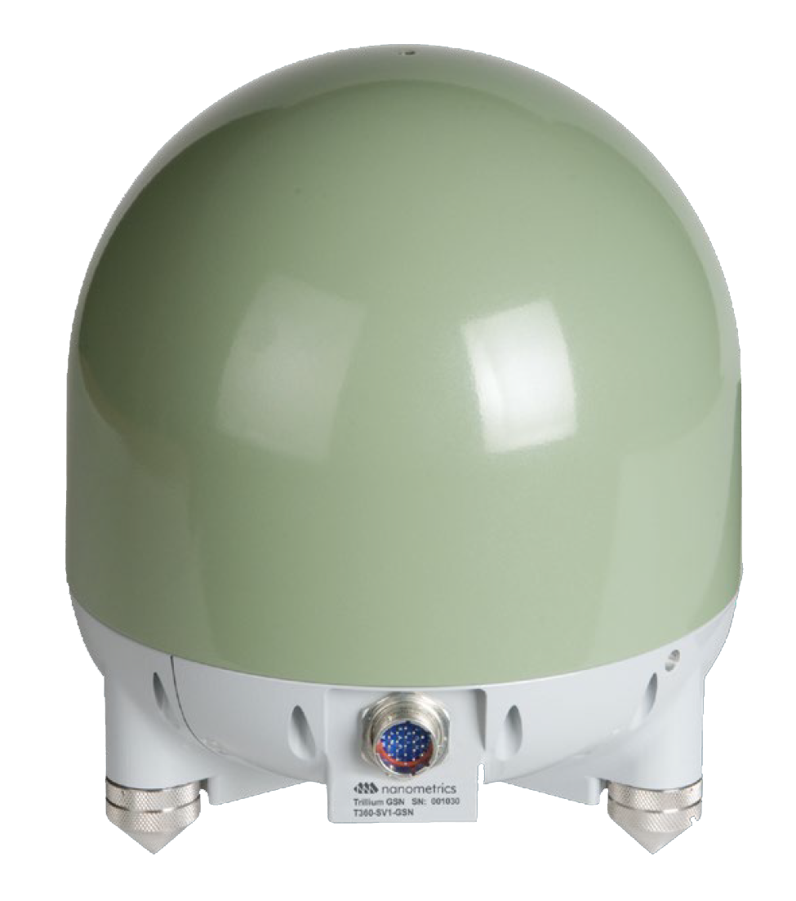
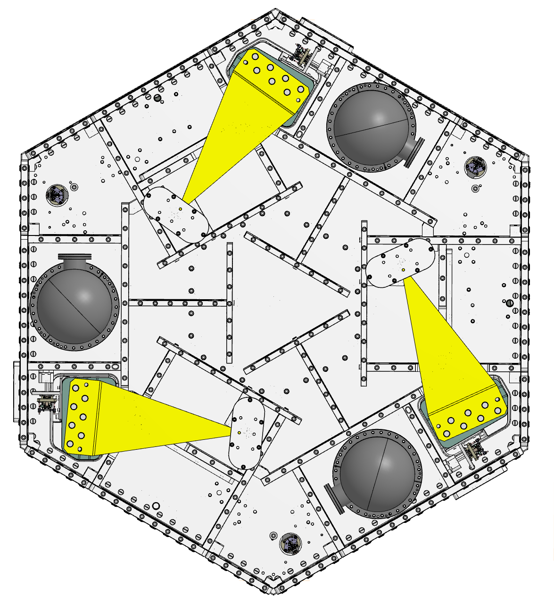
LNGS’ exceptional low-noise environment
Developing a lunar GW detector
Operating best available vibration sensors in a high-precision mechanical structure
Setting new records in active seismic-isolation performance below a few Hz – innovative control schemes for ET

Slide 17
Thank you! Questions

