Slide 1
SABRE @ LNGS
10th Astroparticle Physics Scienc Fair
GSSI Feb 6th, 2024
Aldo Ianni
INFN - LNGS

Slide 2
SABRE
Sodium-iodide with Active Background RejEction
The scientific motivation for SABRE is to verify the longstanding modulation effect shown by DAMA/LIBRA,
  determination of modulation amplitude and phase with a better background than that of DAMA/LIBRA
  this modulation finds possible justification in models of dark matter regardless of its interaction with the detector
Findings
  Observed annual modulation is of order 0.01 cpd/kg/keV (1 dru) in ROI [1,6]keV
  Background in ROI is of order of 1 dru

Slide 3
Strategy in SABRE
  High signal-to-background ratio by ultra-high purity NaI(Tl) crystals
    aim to 0.1-0.3 dru in ROI
  North-South «twin» experiments at LNGS(Italy) and SUPL(Australia)
    Rule out seasonal effects
  Proof-of-Principle (PoP) at LNGS --- DONE!
    Exploit active background rejection with a liquid scintillator
    Test crystals radio-purity

Slide 4
NaI(Tl) crystal production for SABRE
Crystals are grown from Astro Grade (developed in the framework of SABRE)
  a few ppt in U, Th and a few ppb in K and Rb
The Bridgman method has been selected to mitigate the risk of contamination during growth
  molten material is sealed inside a cleaned crucible
Crystal growth is performed by the industrial partner Radiation Monitoring Devices (RMD)
  some quality controls are performed prior to underground counting
Zone refining purification of the powder is performed before growth in collaboration with the industrial partner MELLEN

Slide 5
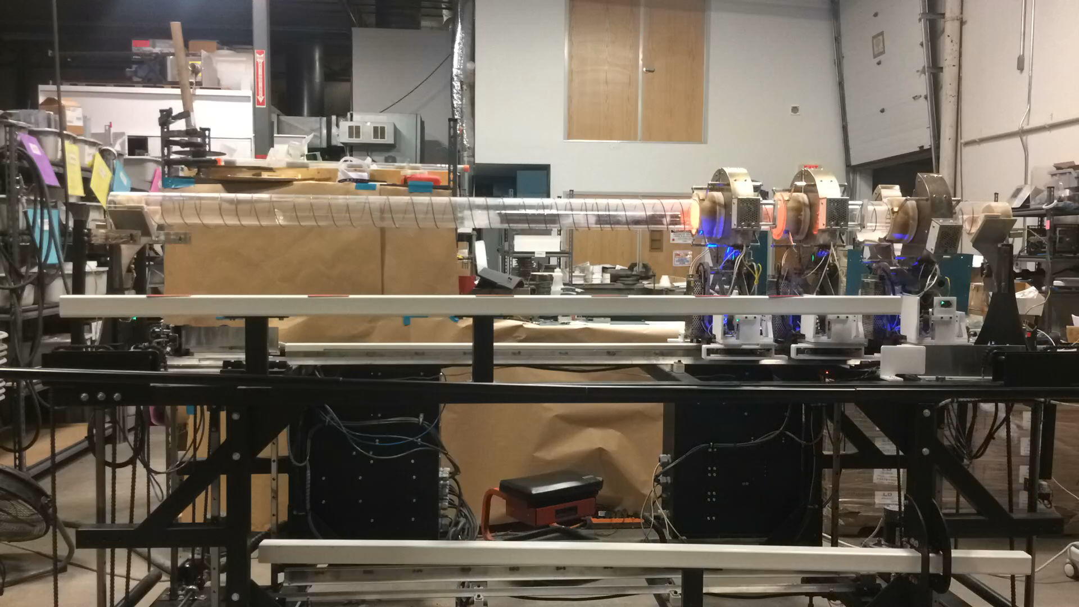
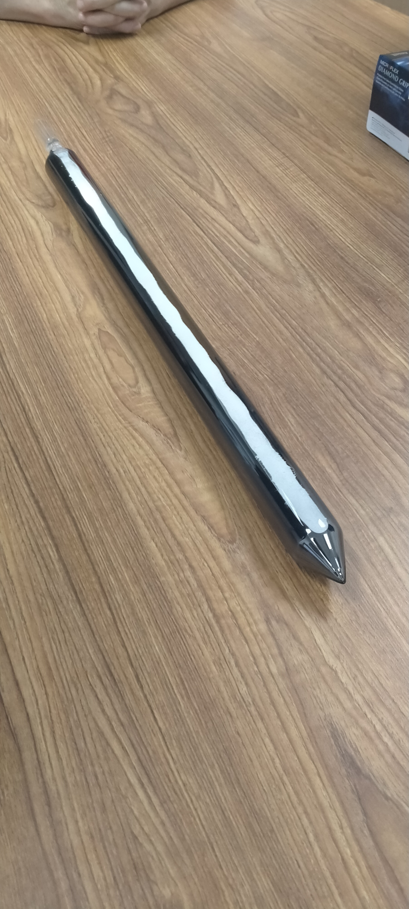
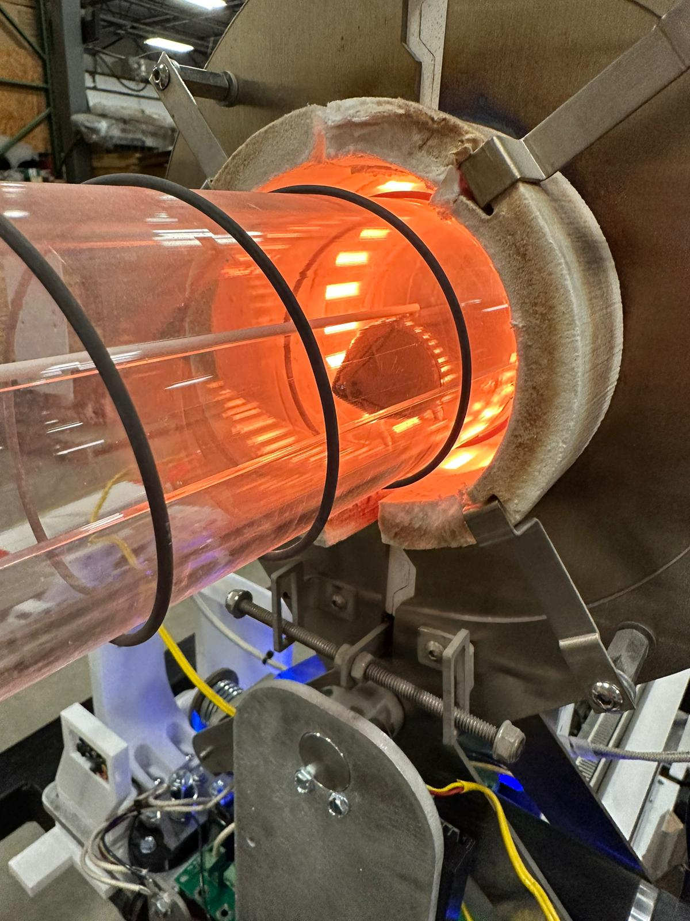
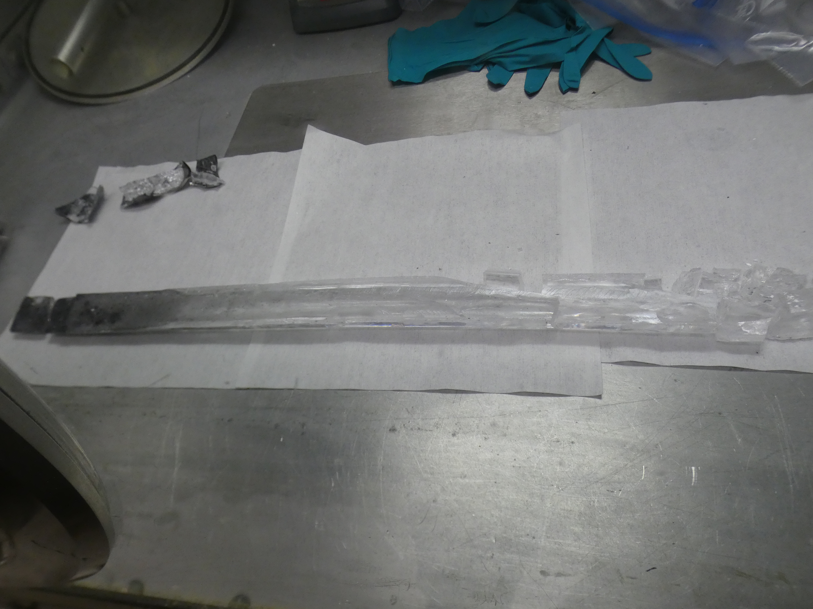
Zone refining of NaI powder
Zone refiner
Four runs with 900 gr of Astro Grade NaI powder have been performed at MELLEN, NH, USA
Number of passes: 26 or 50
Speed: 3.8cm/h and 5.08cm/h
Samples were taken along the length of the solid ingot and shipped for ICP-MS measurements
Ampoule
Broken ingot after ZR
Sample | 39K [ppb] | 65Cu [ppb] | 85Rb [ppb] | 133Cs [ppb] | 138Ba [ppb] | 208Pb [ppb]
 | LSC | LSC | LSC | LSC | LSC | LSC
powder | 14.4 | 17 | <0.8 | 36.7 | <0.6 | 2
Zone 1 | <4 | <5 | <0.8 | <0.3 | <0.5 | <1
Zone 2 | <4 | <5 | <0.8 | <0.3 | 0.8** | <1
Zone 3 | 6.7 | <5 | <0.8 | 0.4 | 0.8** | <1
Zone 4 | 40 | <5 | <0.8 | 0.4 | 3.8 | <1
Zone 5 | 540 | 234 | 1.3 | 447 | 10 | <1

Slide 6
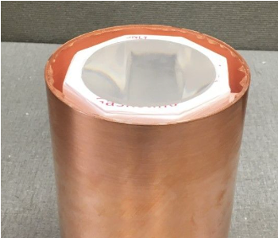
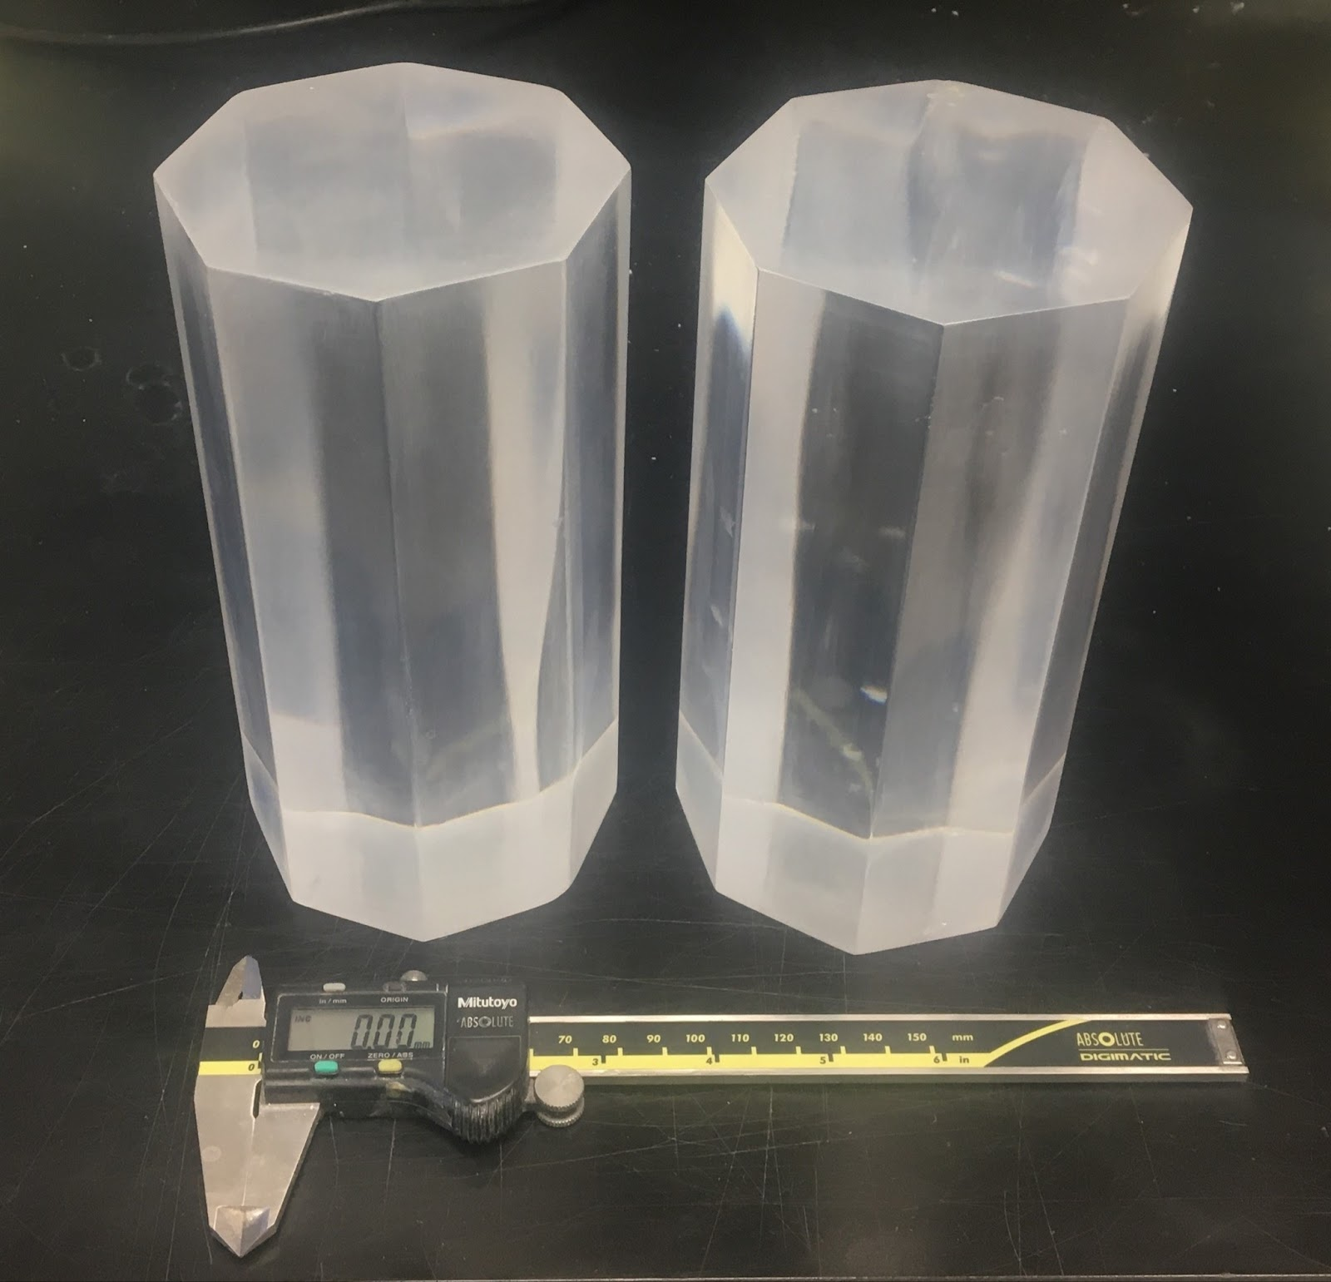
Grown crystals underground at LNGS
NaI-35
encapsulated
NaI-31 at LNGS since April 2019
NaI-33 since August 2019, assembled in Princeton
NaI-35 since May 2022, assembled at RMD
NaI-37 since March 2022, naked and encapsulated at LNGS
NaI-41 since December 2023, assembled at RMD and grown from chunks
NaI-35
NaI-37

Slide 9
Future activities
Complete and characterize a 5 kg crystal after zone refining
  June 2024: crystal expected at LNGS
Submit TDR for full scale experiment at LNGS
  Baseline: ~50 kg
  June 2024
Start crystal production and characterization
  Summer 2024

Slide 10
Thank you for your attention
For further questions write to: aldo.ianni@lngs.infn.it

