Slide 1
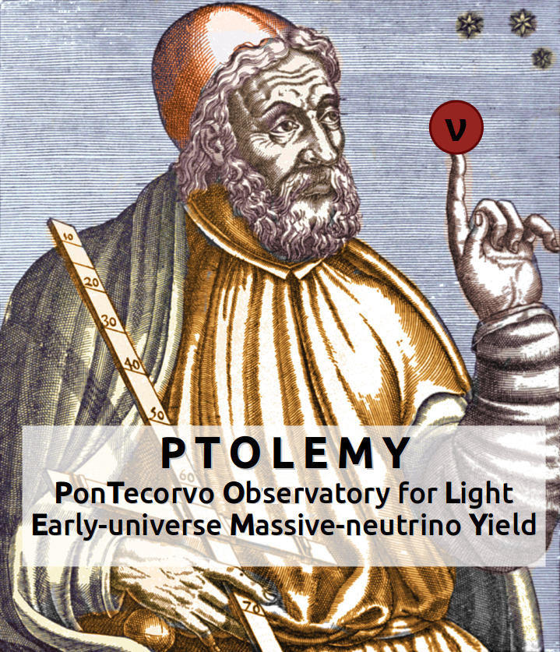
PTOLEMY
A challenge for a future
Cosmological Neutrino experiment
Federico Virzi
Università degli studi dell’Aquila
6/2/2024

Slide 2
PTOLEMY: physics goals
Neutrino mass measurement
Direct Cosmic Neutrino background observation

Slide 3
PTOLEMY: experimental method
Reaction: Neutrino Capture on Beta decaying nuclei (NCB)
Beta decay
Atomic tritium (³H) on graphene
e⁻
Sgn/Bkg vs K (kinetic energy)
(A, Z)
(A, Z + 1)
νe
10 events/yr per 100g ³H
Events
Beta decay
3x10¹⁶ e⁻/s
NCB
NCB event (Signal CνB )
νe
e⁻
2mν
(A, Z)
(A, Z + 1)
mν
K

Slide 4
PTOLEMY: experimental method
If you want:
You need:
Background rejection->new EM filter
Very good energy resolution->TES

Slide 5
PTOLEMY: experimental method
If you want:
You need:
Background rejection->new EM filter
Very good energy resolution->TES
That means in numbers:
Target: 100g ³H on graphene
Filter trigger (aka antenna region): fast meas. for single electron in 100 μs with σE =10eV
TES:σE =50meV

Slide 6
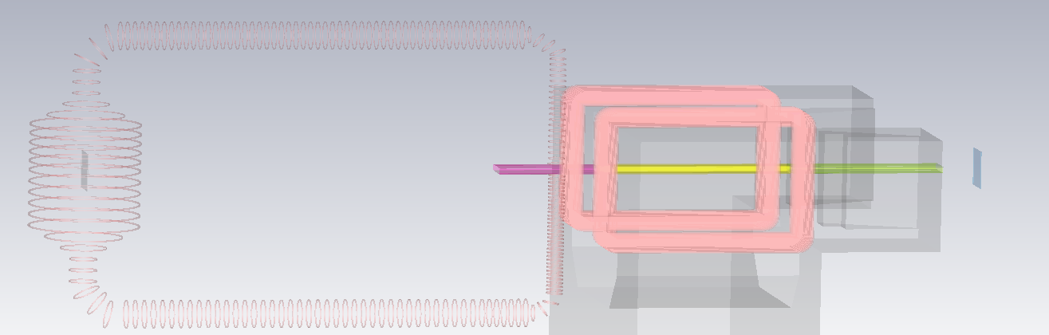
PTOLEMY concept
ΔV
Atomic tritium target
Injection to magnet
RF antenna region
filter
TES

Slide 7
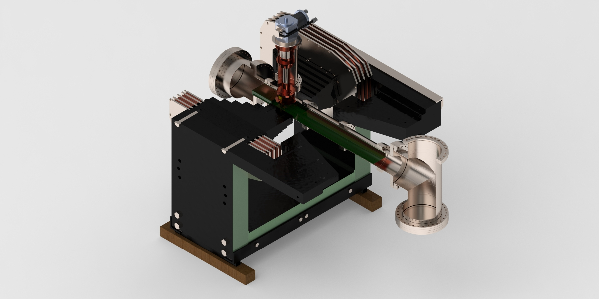
PTOLEMY demonstrator @ LNGS by next year
RF antenna region
Atomic tritium target
filter
TES

Slide 8
PTOLEMY:LNGS
now
Test electron trap (antenna region RF measurement)
EM filter test
Ultra stable HV (crucial for TES measurement)
TES for electrons
Electron gun for electron dynamics
Experiment simulation
Demonstrator will be at LNGS
LNGS Group
Marcello Messina
Alfredo Cocco
Nicola Rossi
Nicola D’Ambrosio
Alfredo Ferella
Andrei Puiu
Federico Virzi(PhD)
Soon
now
now
Soon
now

Slide 9
BACKUP SLIDES

Slide 10
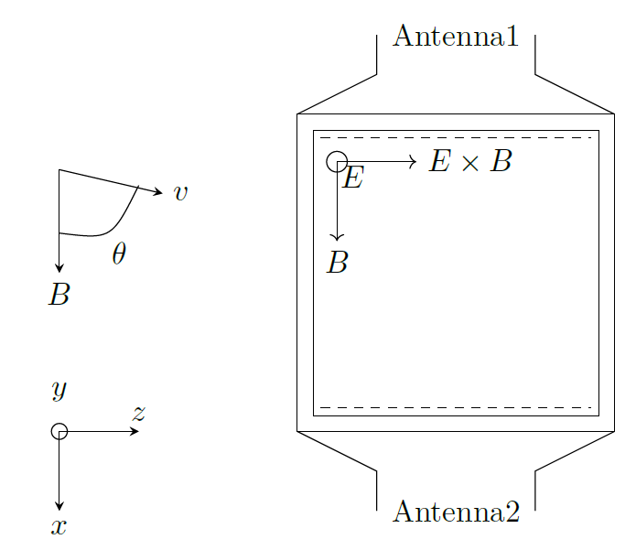
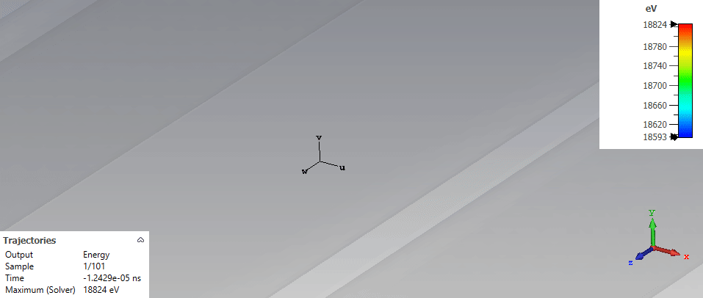
Antenna region
Measurement of electron kinematical variables (K, K_{ꓕ})
Measure frequency and bouncing period
Information about K e K_{ꓕ}=p_{ꓕ}²/2m

Slide 11
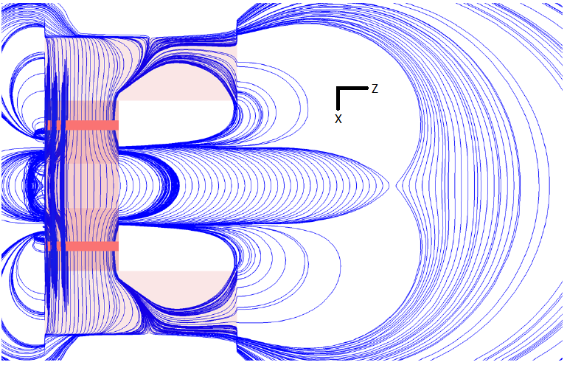
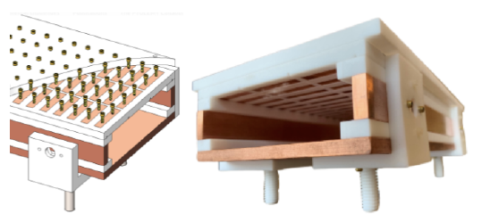
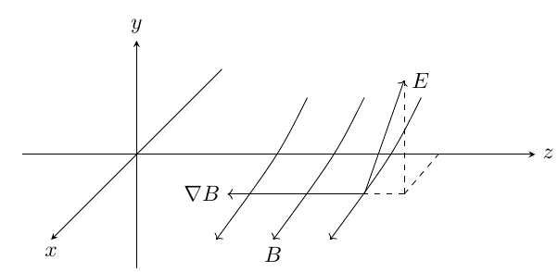
Filter and magnet

Slide 12
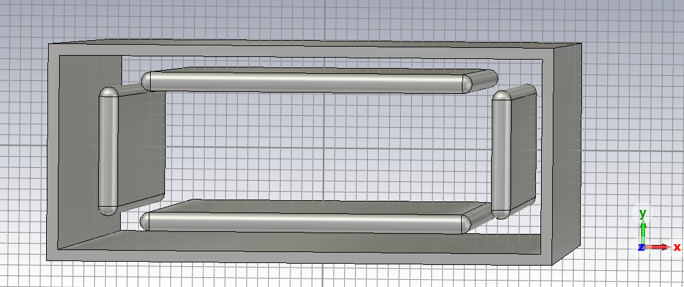
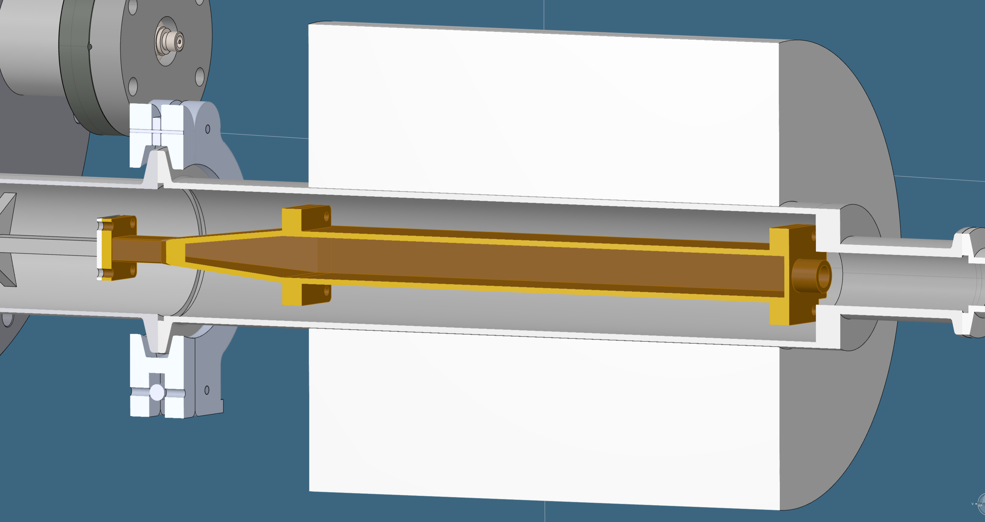
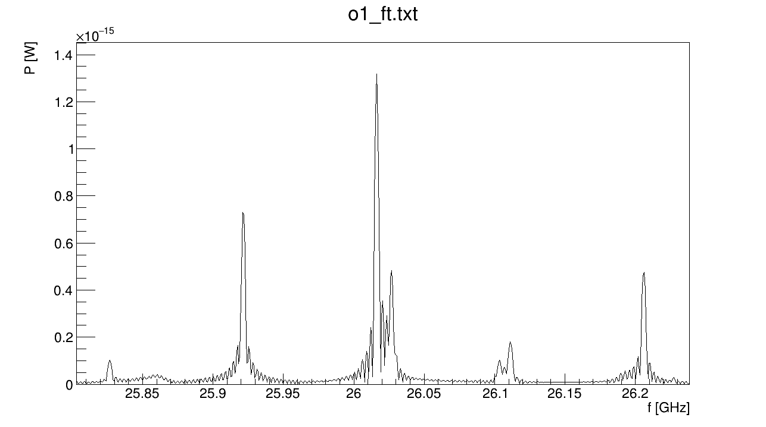
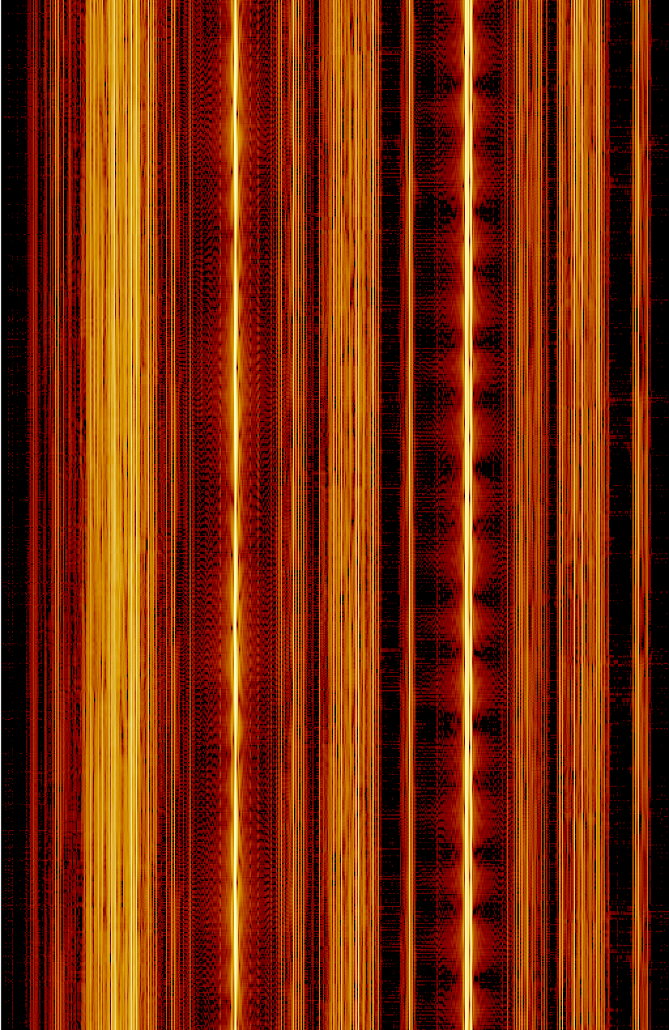
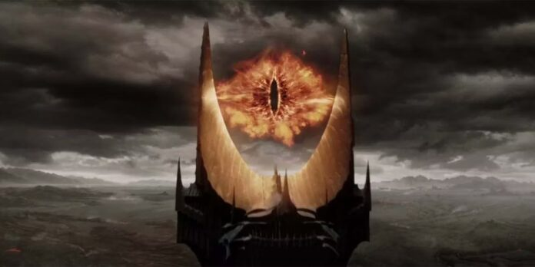
Electron trap: Sauron plot

Slide 13
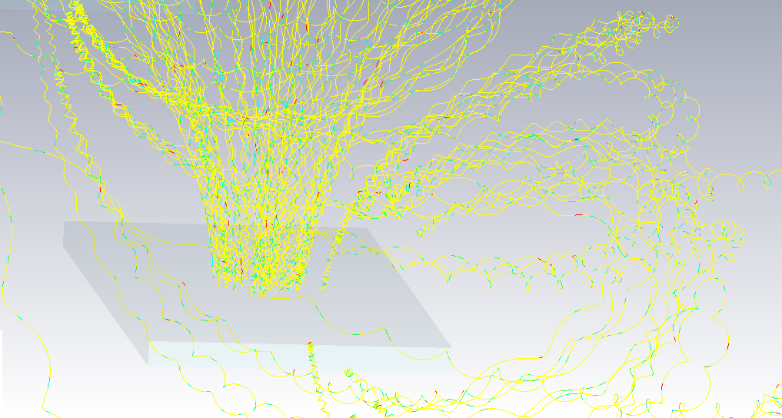
Particle trajectories

