Slide 1
Directional dark matter search with nuclear emulsions
Valeri Tioukov
INFN Napoli
NEWSdm collaboration

Slide 2





NEWSdm COLLABORATION
81 physicists
23 Institutes
ITALY
LNGS,
INFN: Napoli, Roma, Padova
Univ.: Napoli, Roma, Padova,
Potenza, Benevento
JAPAN
Chiba, Nagoya, Toho
SOUTH KOREA
Gyeongsang University
RUSSIA
LPI RAS Moscow
JINR Dubna
SINP MSU Moscow
INR Moscow
NUST MISiS Moscow
NRU HSE Moscow
TURKEY
METU Ankara
Website:
news-dm.lngs.infn.it
Letter of intent:
https://arxiv.org/pdf/1604.04199.pdf

Slide 3
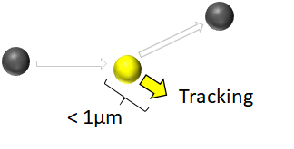
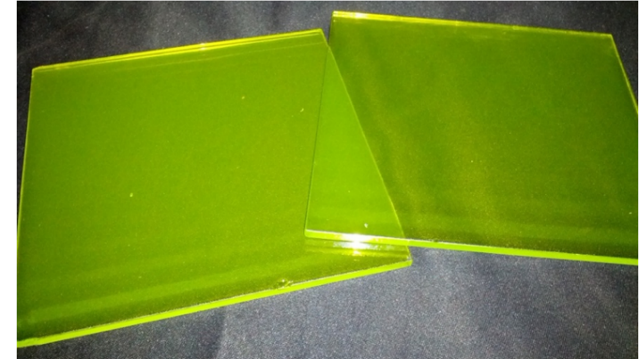
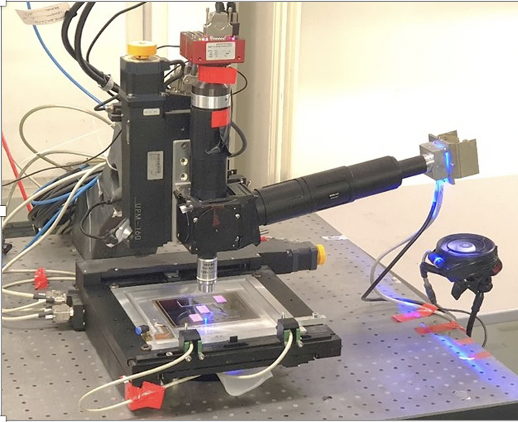
NEWSdm experiment concept
Direction sensitive dark matter search with nano-tracking technologies for super resolution nuclear emulsion
Super-high resolution device
Super resolution detector
Dark matter wind
Tracking
< 1μm
Optical image readout
exposure using telescope
Underground laboratory
Gran Sasso (LNGS)
Unique possibility to overcome the “neutrino floor”, where coherent neutrino scattering creates an irreducible background
Directional information is helpful in understanding the DM model
Notes:
蓄積したデバイス→ 事象解析

Slide 4
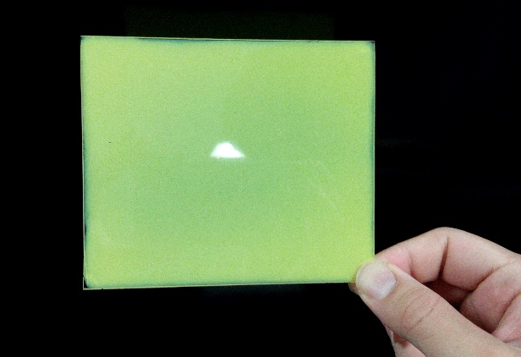
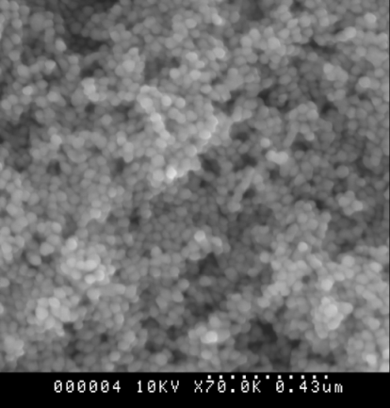
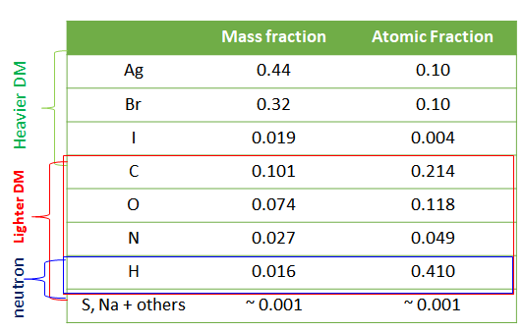
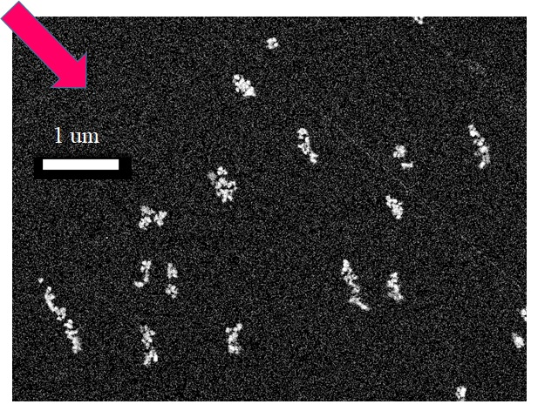
Nano Imaging Tracker (NIT) developed for NEWSdm
Ag core
AgBr(I) crystal
electron⁻
Developing
500 nm
Density : 3.1 ± 0.1 g/cm3
Crystal size : 20÷80 nm (tunable)
NIM A Nucl. Inst. Meth. A 718 (2013) 519-521
PTEP (2017)063H01
C ions 100 KeV (SEM image)
Solid-state detector
Density: 3.1 g/cm³
High-speed volume analysis for nanometric tracks is required
4

Slide 5
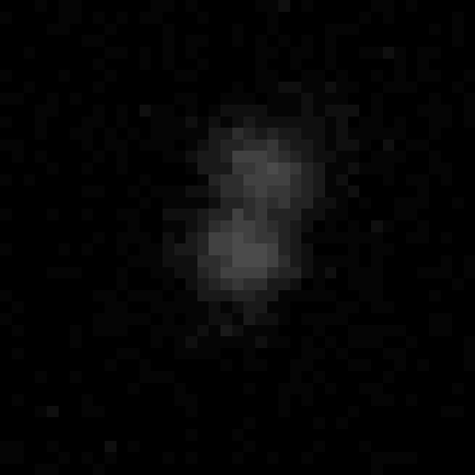

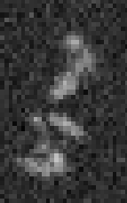
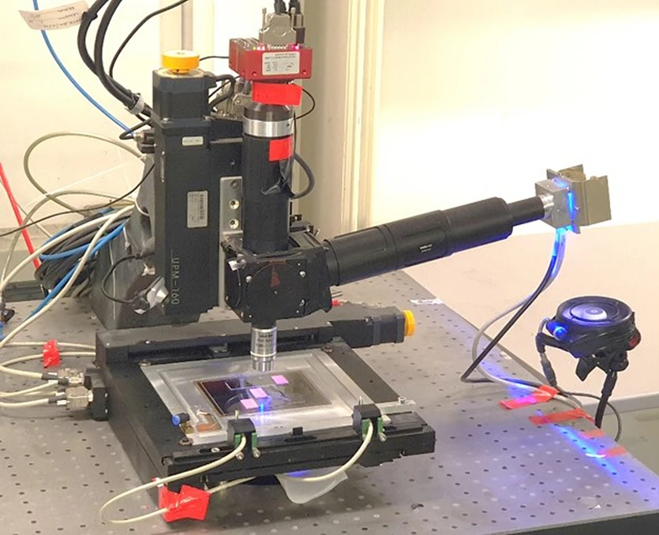

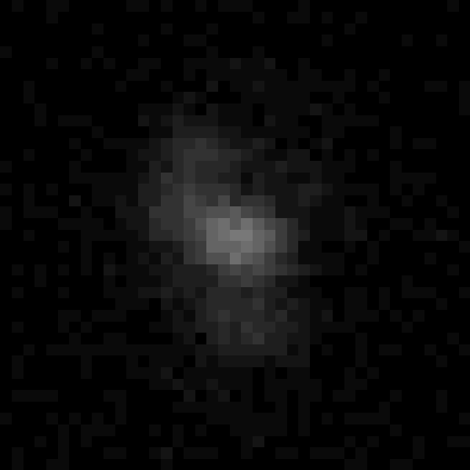
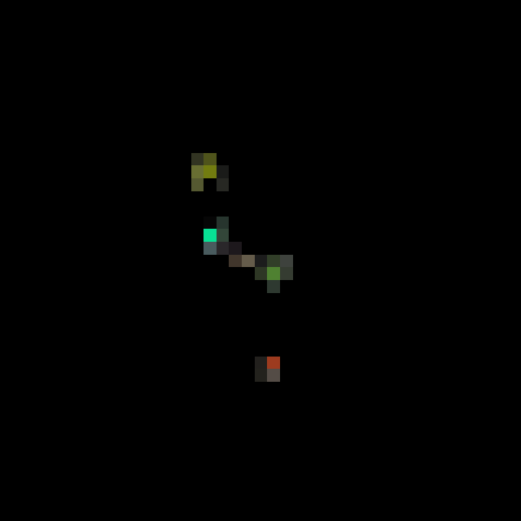
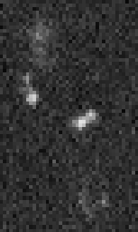

LSPR-based super-resolution imaging based on join deconvolution set of 8 polarized images
Optical images with 8 polarizations
Super-resolution image
L = 213 nm
L = 260 nm
SEM
Optical images with 8 polarizations
Super-resolution image
L = 200 nm
BS = 37nm
SEM
Alexandrov, A., et al. Super-resolution high-speed optical microscopy for fully automated readout of metallic nanoparticles and nanostructures. Sci Rep 10, 18773 (2020). https://doi.org/10.1038/s41598-020-75883-z

Slide 6
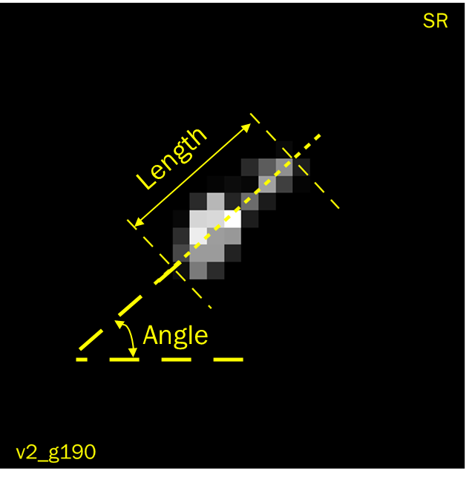
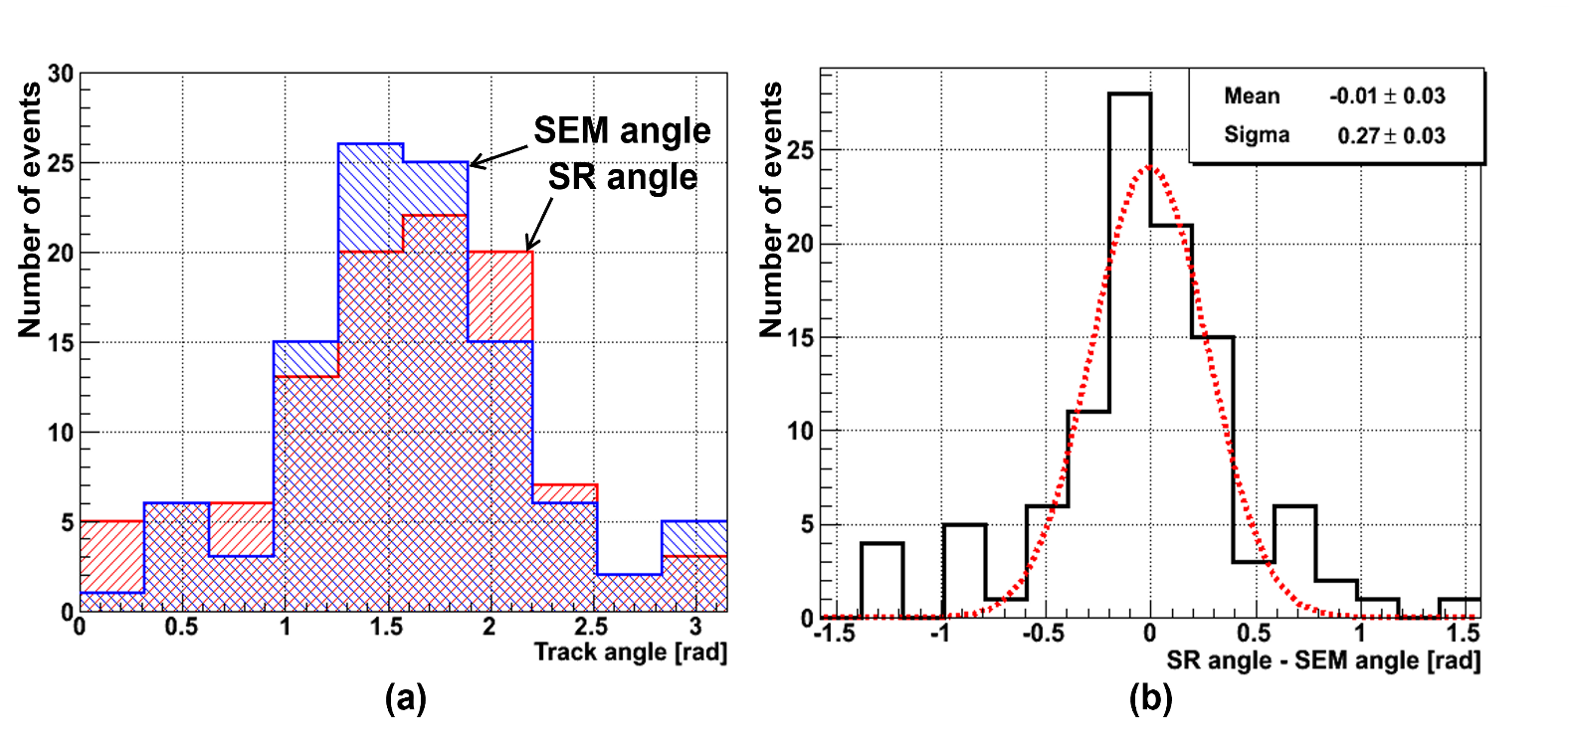
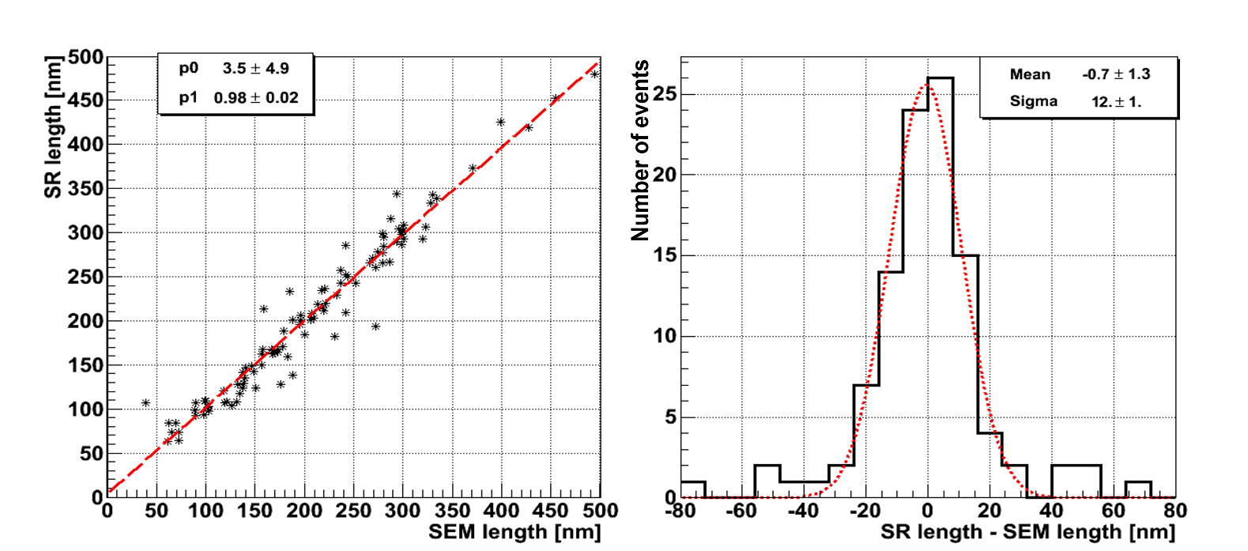
Joint Image Deconvolution - Comparison with SEM
Angular distribution
Angular difference
SR length vs SEM length
Length difference
Angular resolution: 270 ± 30 mrad
Length accuracy: 12 ± 1 nm
Spatial resolution: ~ 60 nm
NIT granularity: 71 nm
https://doi.org/10.48550/arXiv.2304.03645
Submitted to Sci. Rep.

Slide 7
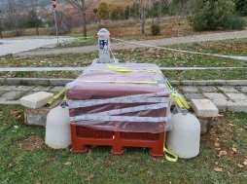

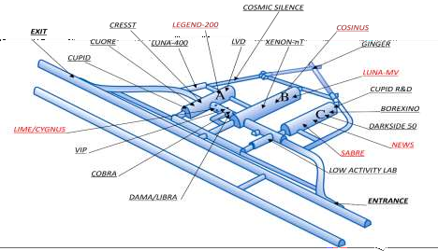
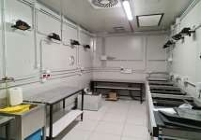
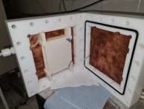
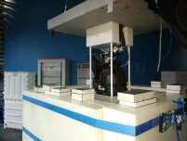

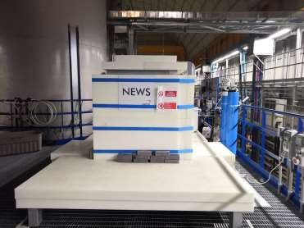

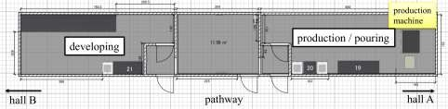
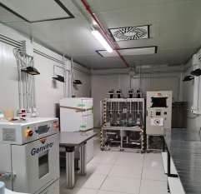
Experimental Activity @ Gran Sasso Lab (ITALY)
Neutron flux @ surface Lab
LNGS surface Lab
LNGS underground Lab
Development Room
Clean Room ISO 7
Cooling Box for Target
Target insertion by crane
Emulsion Handling Facility – Hall F
Shielded Exposure set-up – Hall C
Production Room Clean Room ISO 6 Capability ~100 g /day
Jan. 2021 – to date
~1.1 kg of dry NIT produced
>75 developments done
Lead shield : 5.6 cm Polyethilene : 31.5 cm

Slide 8
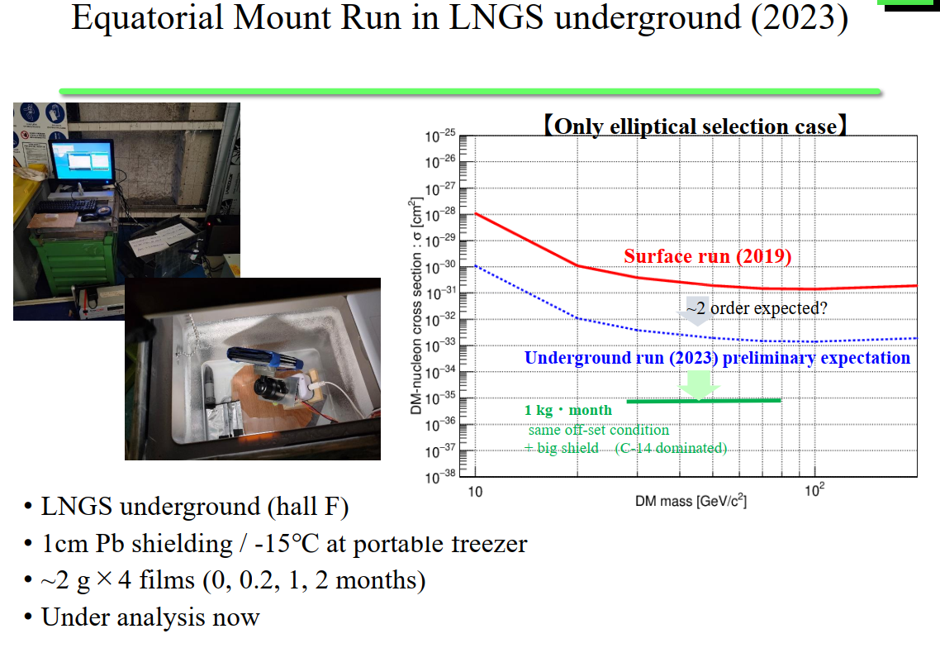

Slide 9
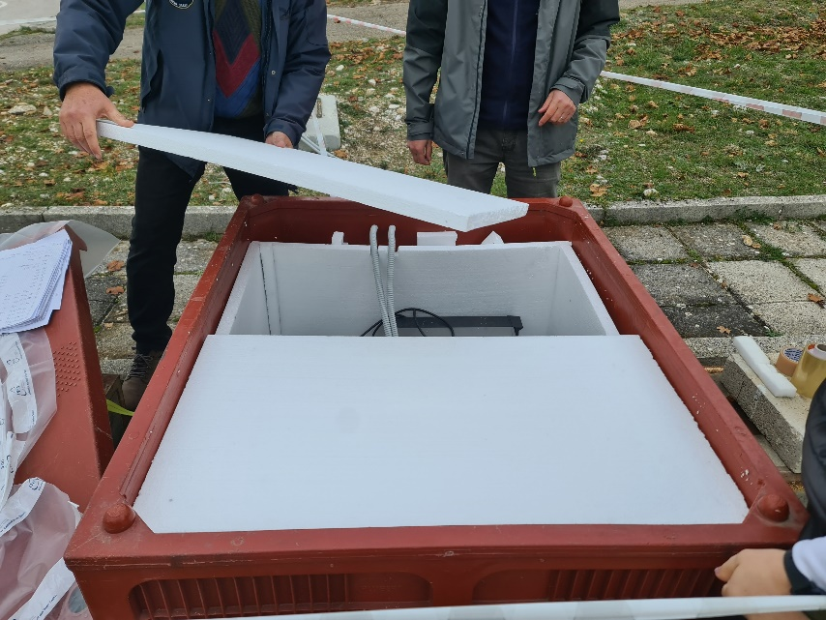
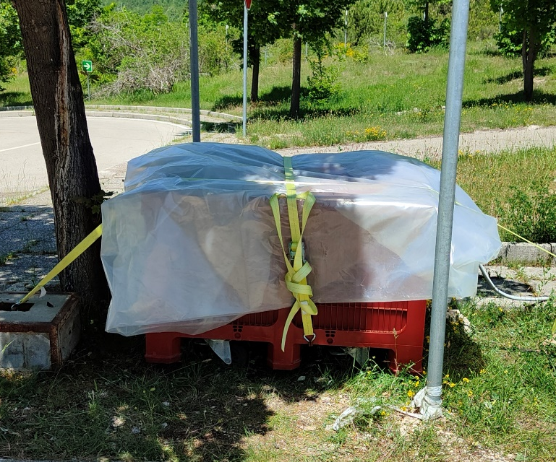
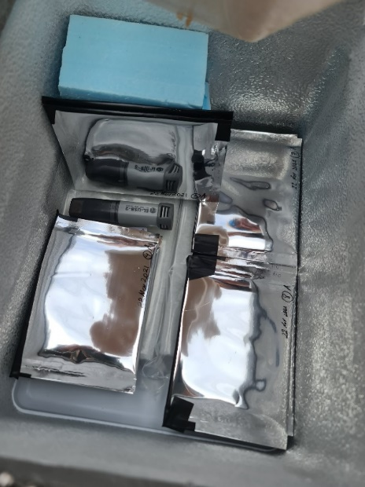
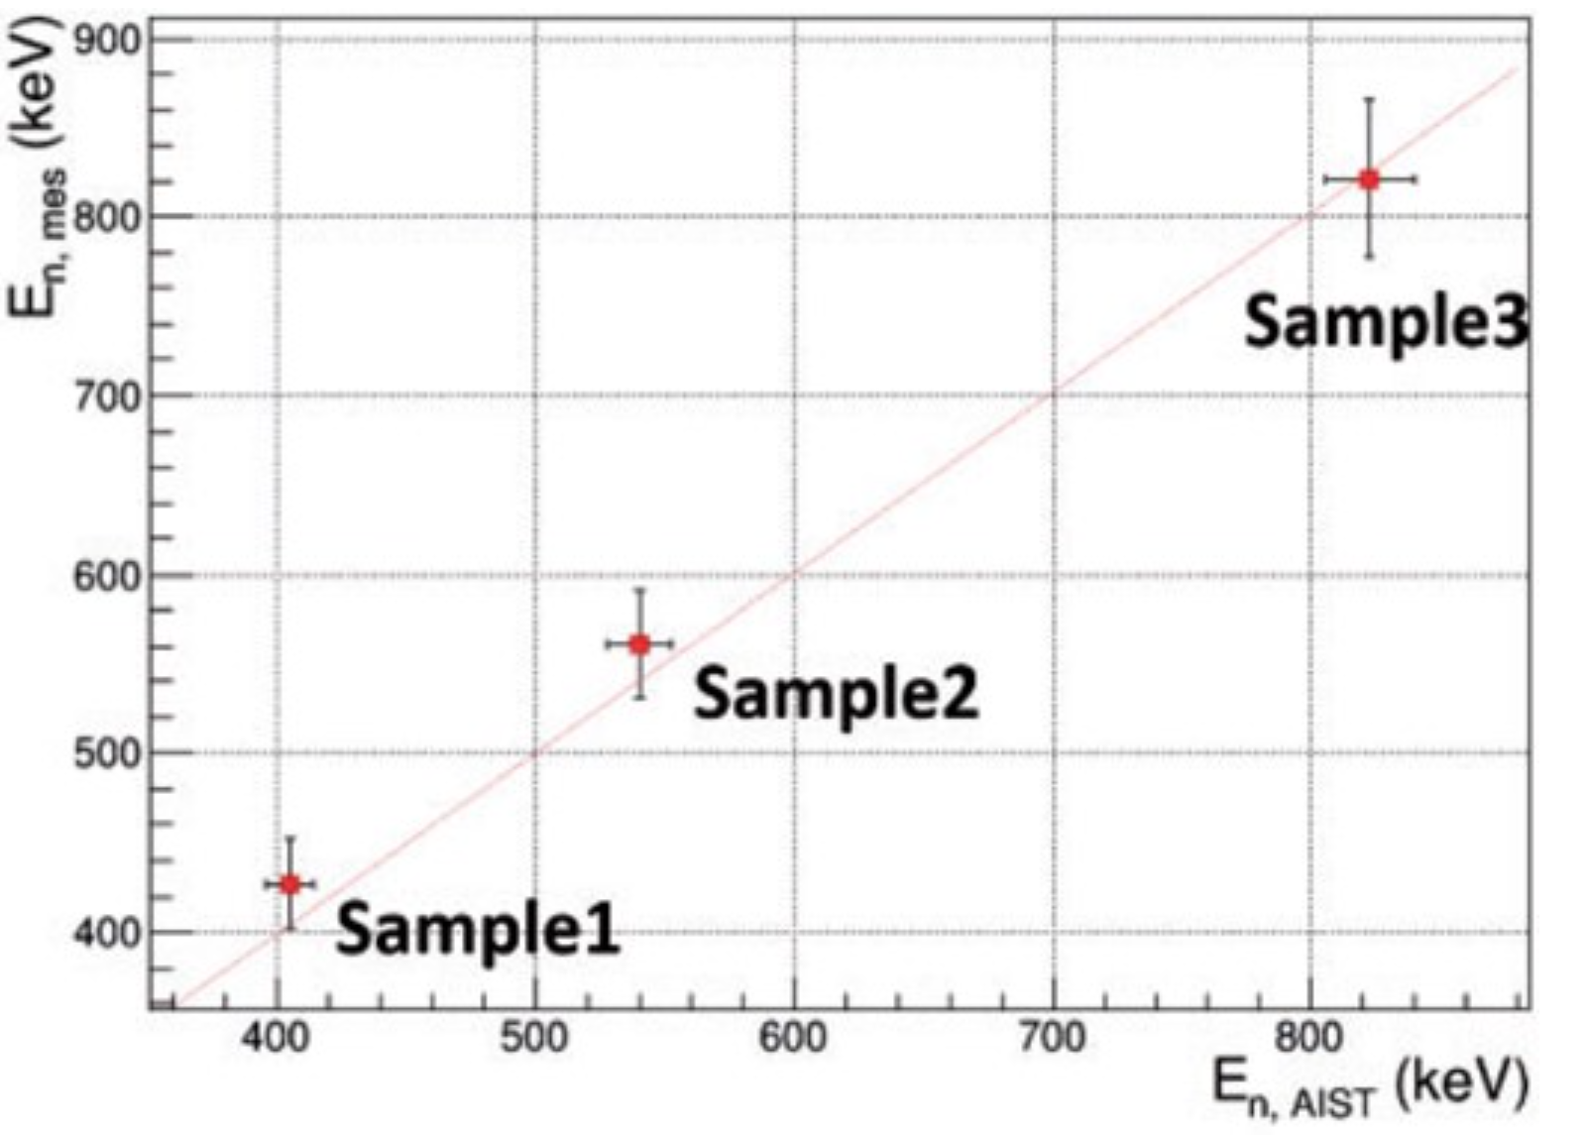
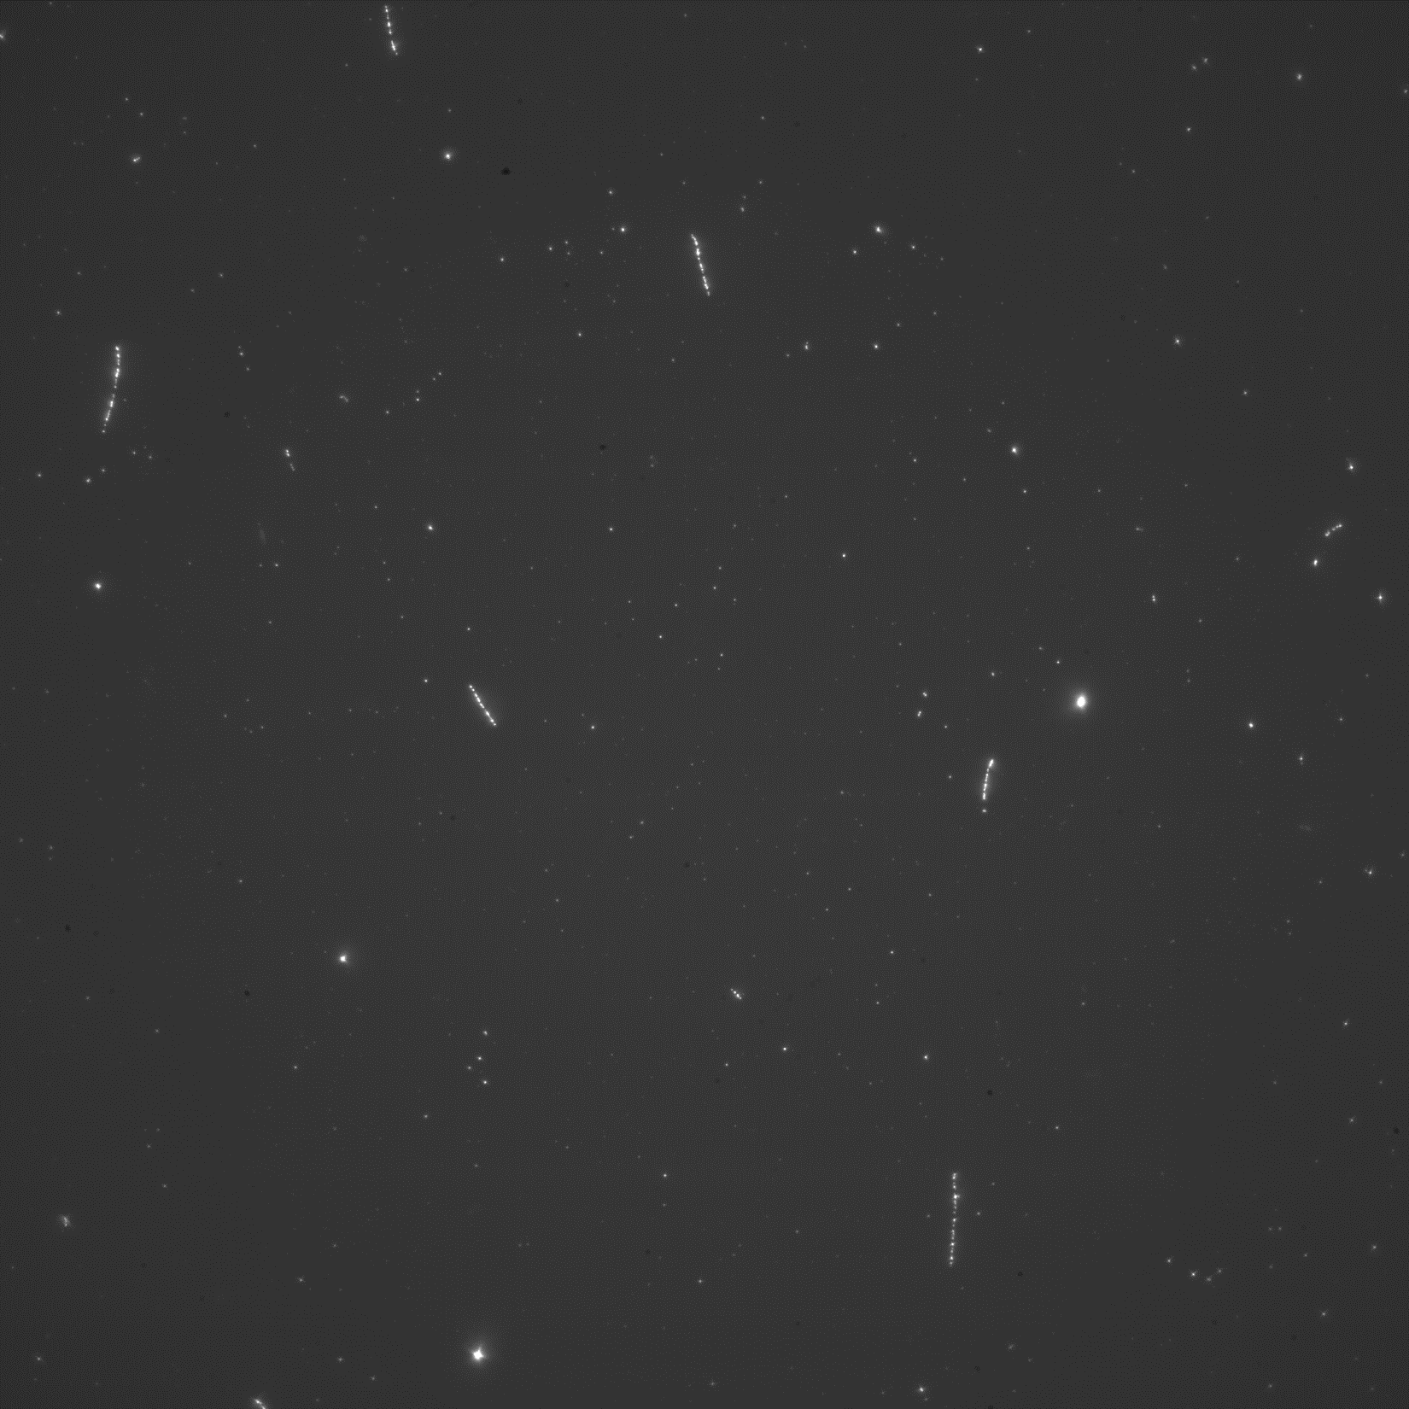
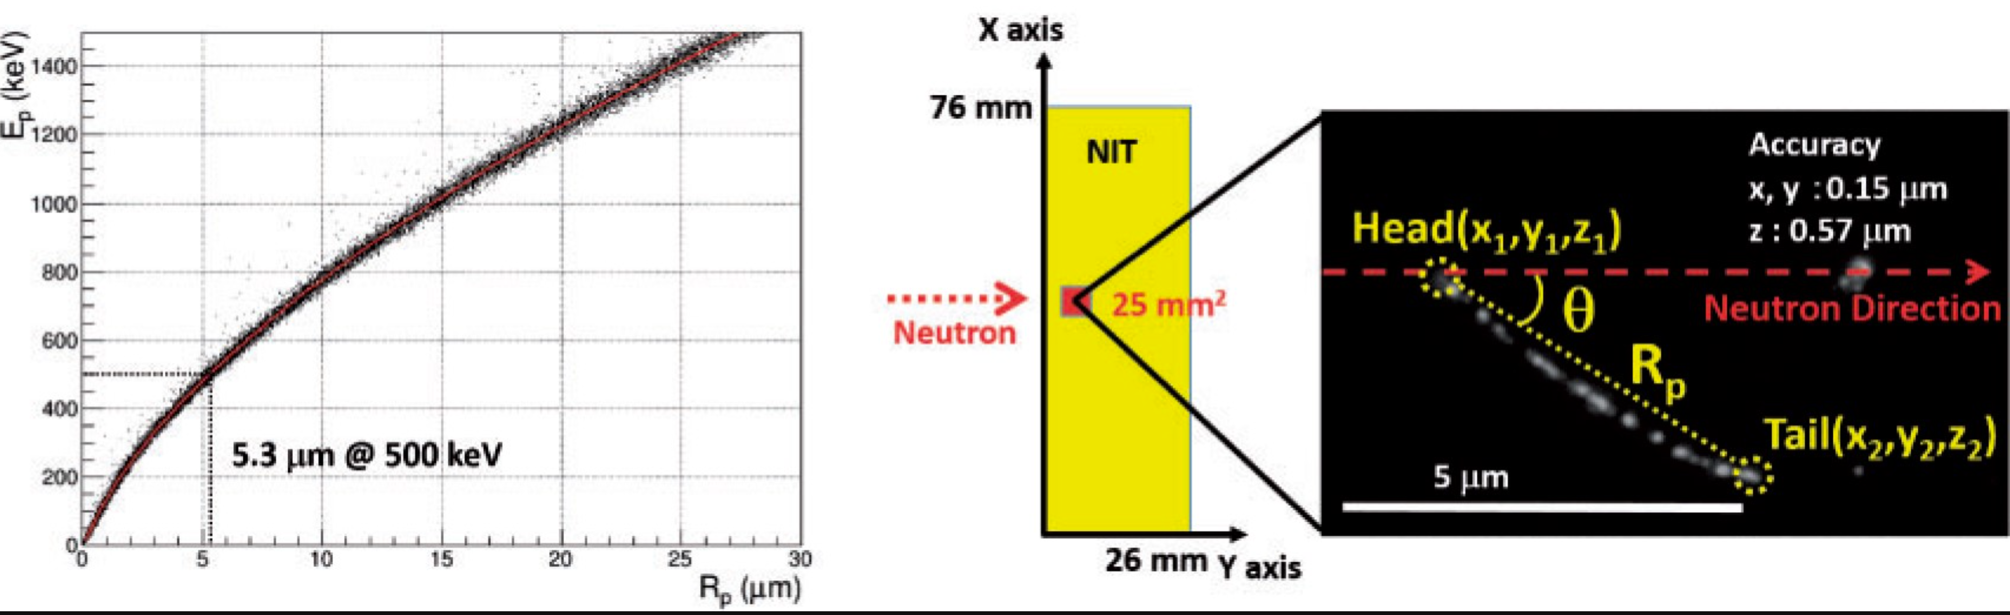
Neutron bg study at LNGS (external and underground)
first sub-MeV energy & direction n-spectrum measurement
Beam calibration result
MC
E vs range
NIT calibration @ n-beam
5.3 μm
（0.5 MeV）
Data:
p recoil tracks - precise energy and direction definition

Slide 10

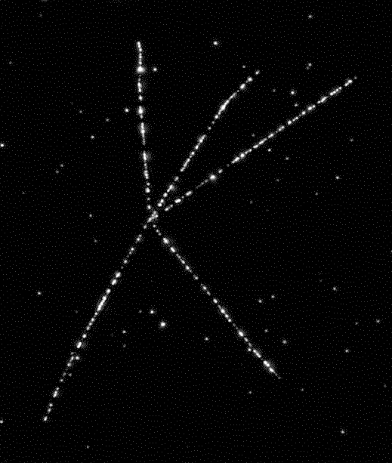
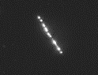
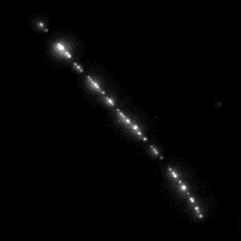

NIT as a Neutron Detector
α-ray
Th star (²²⁸Th → ²⁰⁸Pb)
Single-α in U series
Recoil proton signal
Topological or Range cut
²¹²Bi
²²⁸Th
50μm
5.3 μm
（0.5 MeV）
²¹⁰Po (24.5μm)
²¹⁶Po
5 μm
²²⁴Ra
²²⁰Rn
Clearly distinguishable
50μm
γ-ray (β-ray)
Exposed 5x10⁷ γ-ray/cm² from ²⁴¹Am
(5 years accumulation of environmental γ-ray)
There is no background in sub-MeV region (2 ~ 14 μm → 0.25 ~ 1 MeV in proton energy)
MeV region can be analyzed excluding single-α (especially ²¹⁰Po peak around 24μm)
5 μm
Environmental γ-rays cannot become background
T. Shiraishi, et al., Phys. Rev. C 107, 014608 (2023) Environmental sub-MeV neutron measurement at the Gran Sasso surface laboratory with a super-fine-grained nuclear emulsion detector

Slide 11
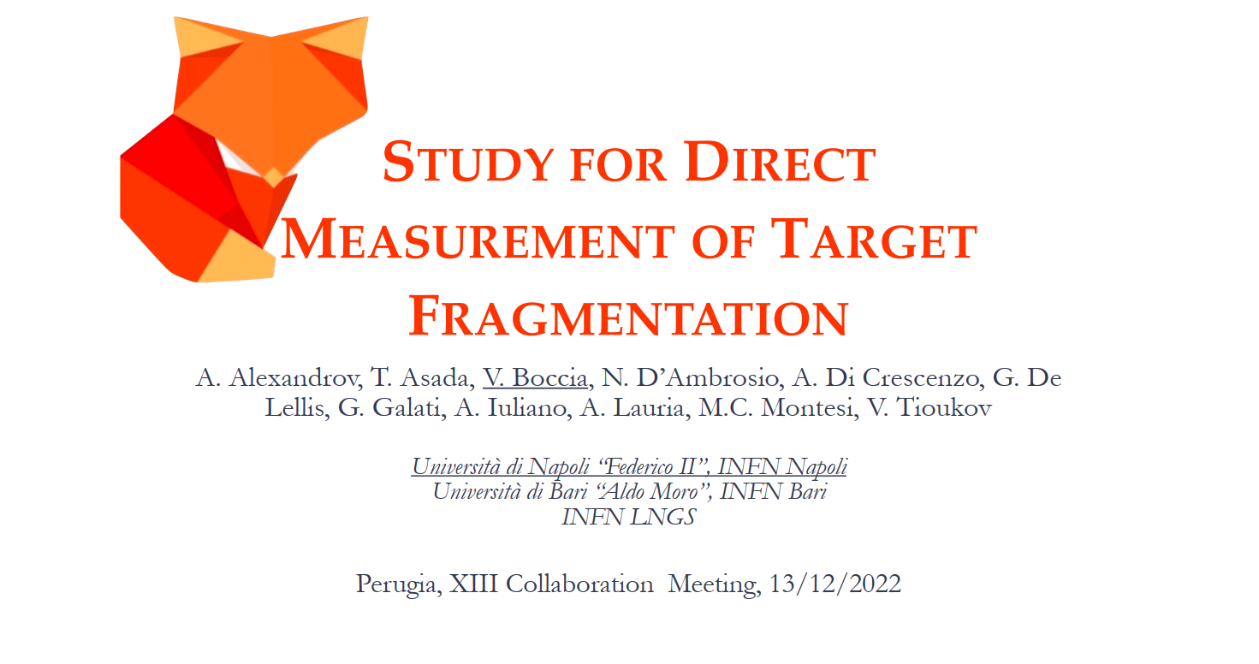
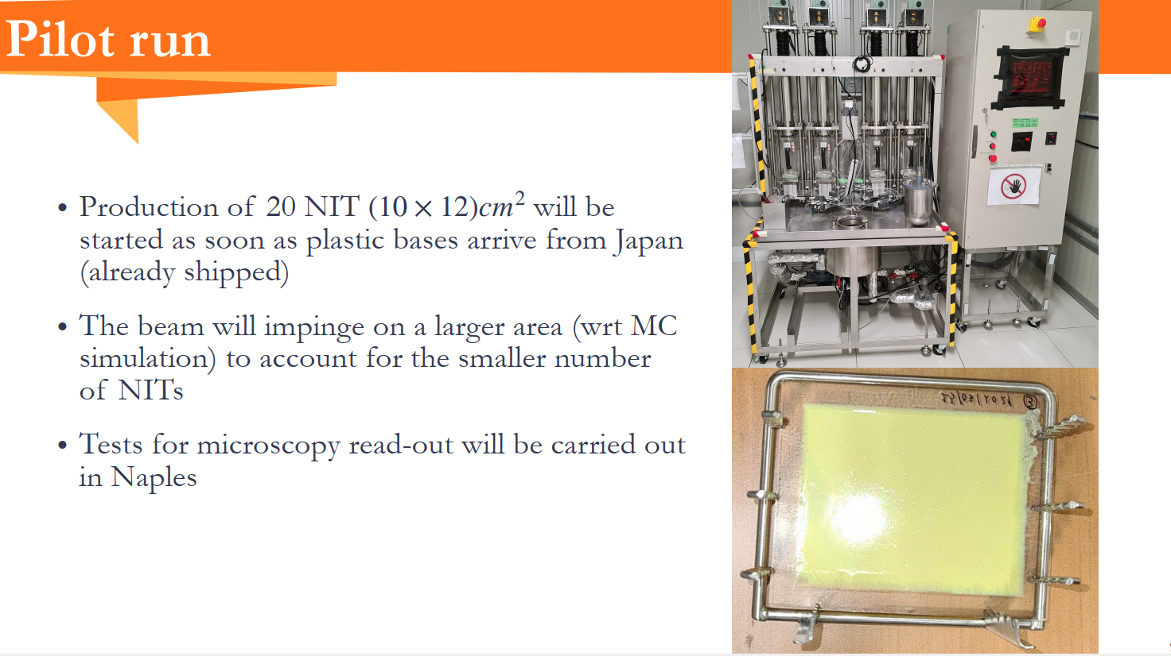
PRIN project in medical physics has started in January 2024
100 nanometer resolution required
LNGS hall F: unique in the world underground emulsion production laboratory

Slide 12
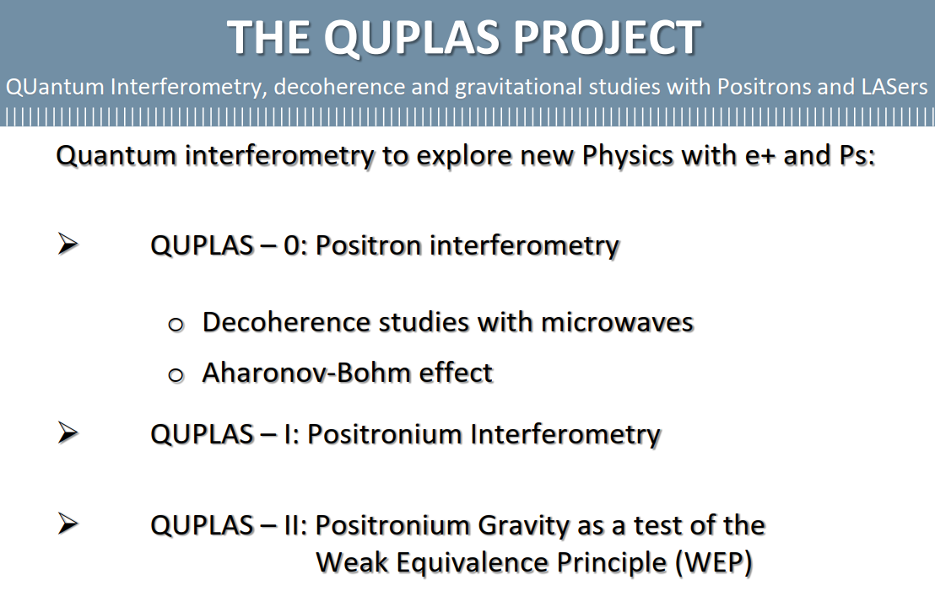
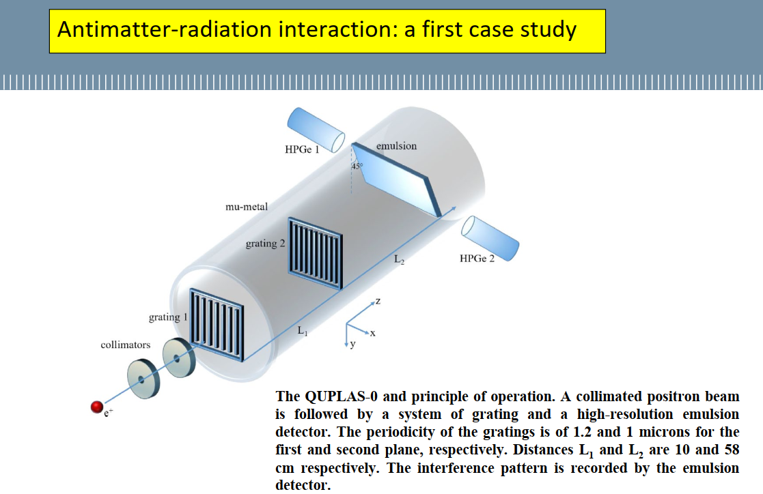
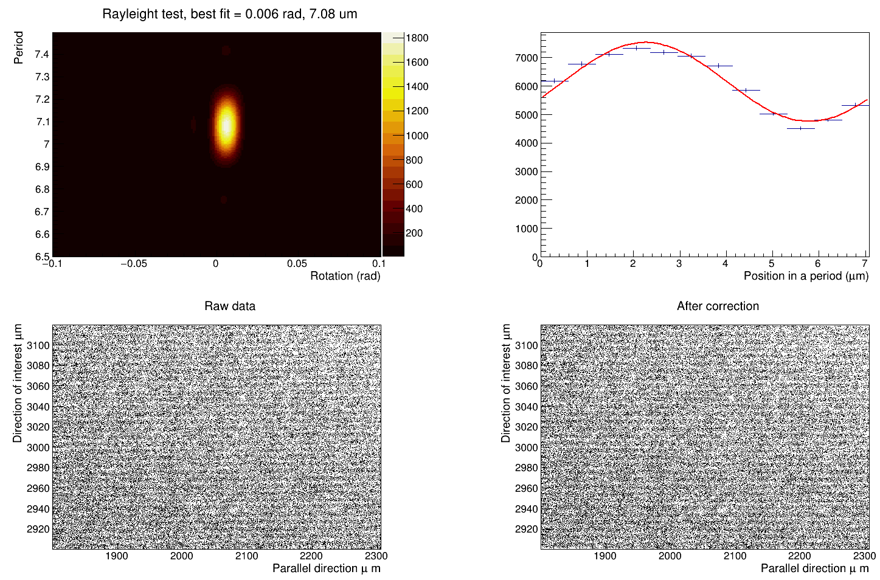
Feasibility test with NIT emulsion detector
7 um grate
10 KeV positron beam
Period is easily visible and measurable
Next step is a real interferometric exposure
NIT samples was produced, developed and analyzed at LNGS

Slide 13

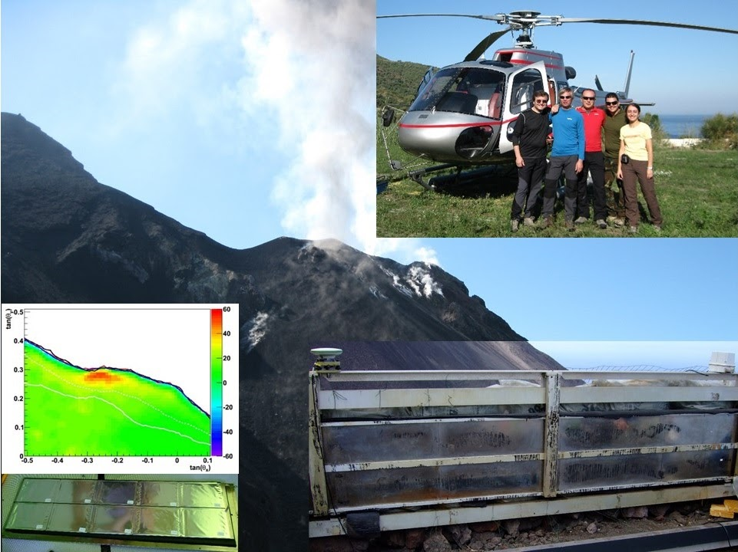

Muon radiography with nuclear emulsions
Stromboli
La Palma
Vesuvius
Napoli underground Necropolis

Slide 14
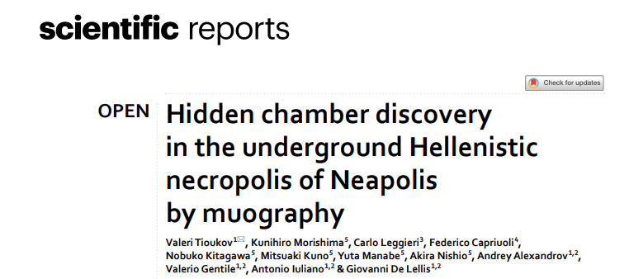
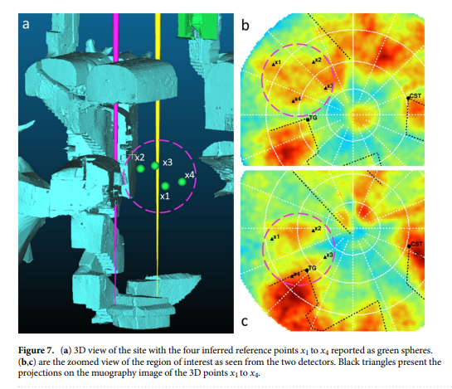
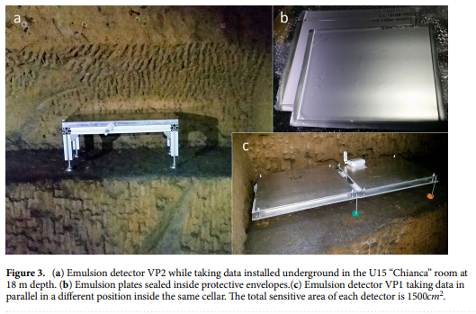
Muon Radiography with nuclear emulsions
Published: 03 April 2023
A full cycle of emulsion handling and powerful scanning facility, already available in the laboratory, gives LNGS the potential to play a key role in Muography projects based on this technique

Slide 15
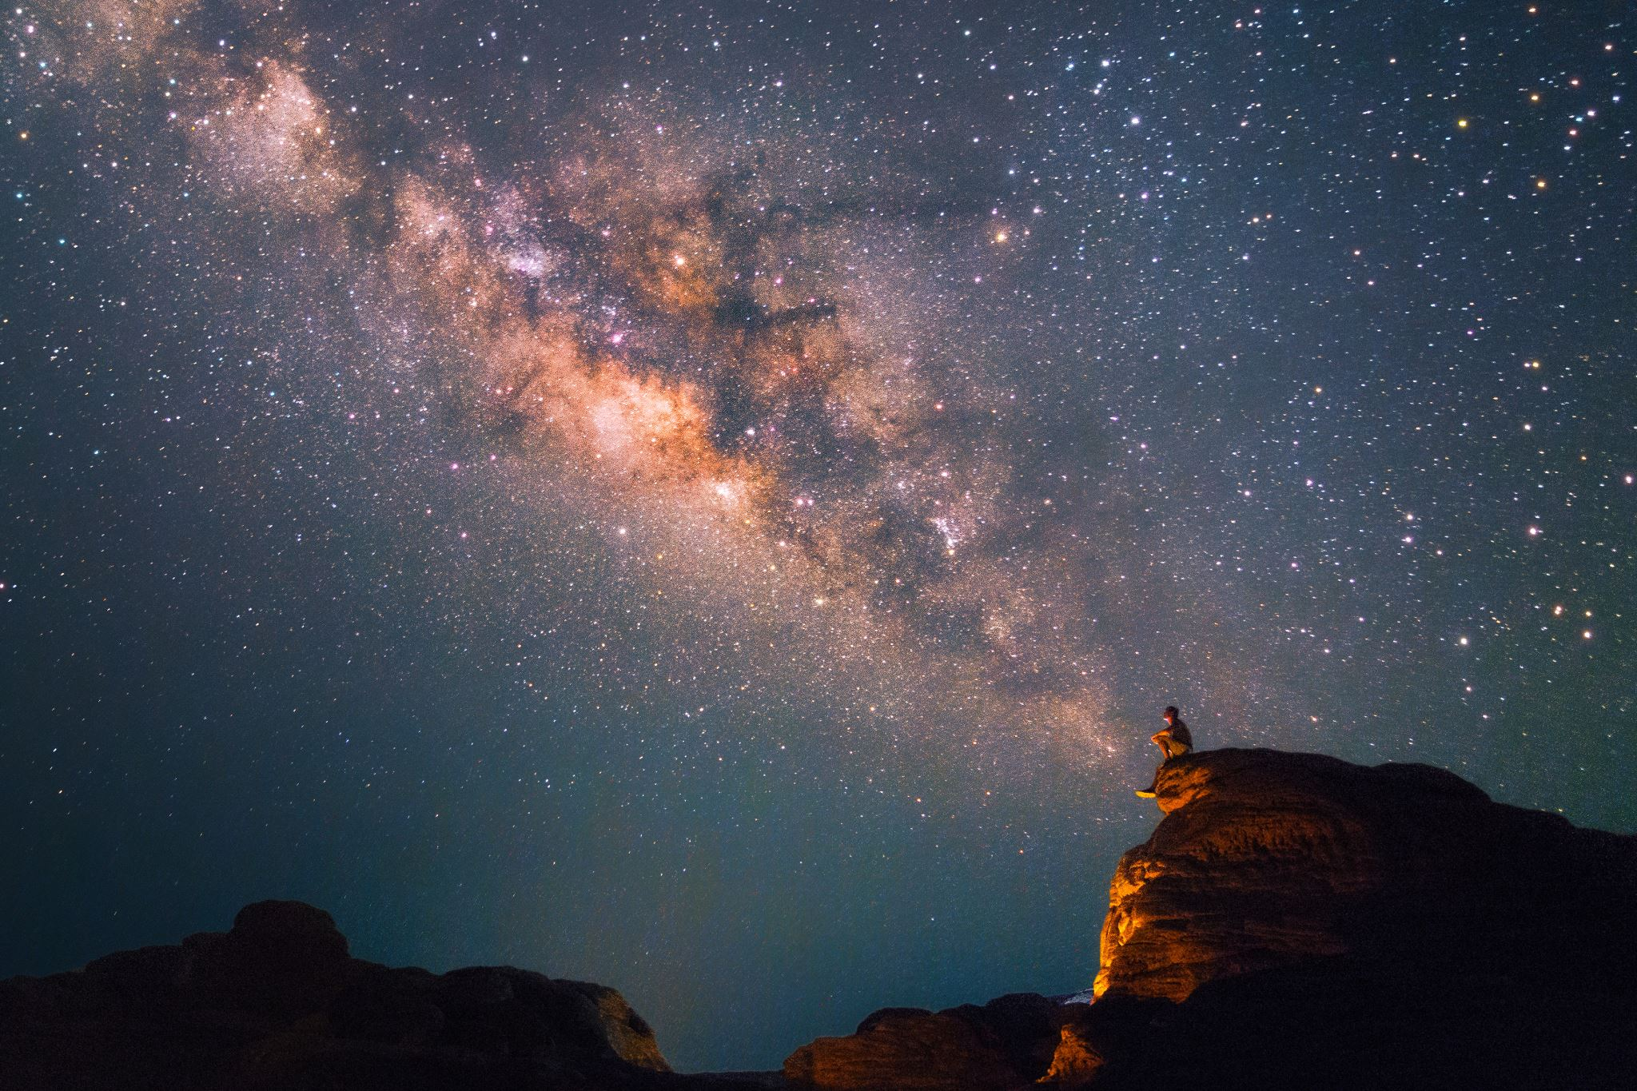
THANK YOU FOR ATTENTION!

