Slide 1
LUNA: present and future of Nuclear Astrophysics at LNGS
GSSI Science Fair
6 February 2024
Federico Ferraro
INFN - Laboratori Nazionali del Gran Sasso

Slide 2
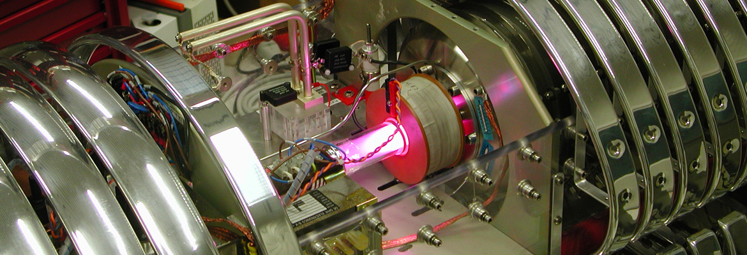
has been the only underground accelerator for nuclear astrophysics for over 25 years
measures nuclear cross sections impacting
solar physics (solar neutrinos)
cosmological model (baryon density)
big bang nucleosynthesis (BBN) stellar nucleosynthesis (H, He, C burning)

Slide 3
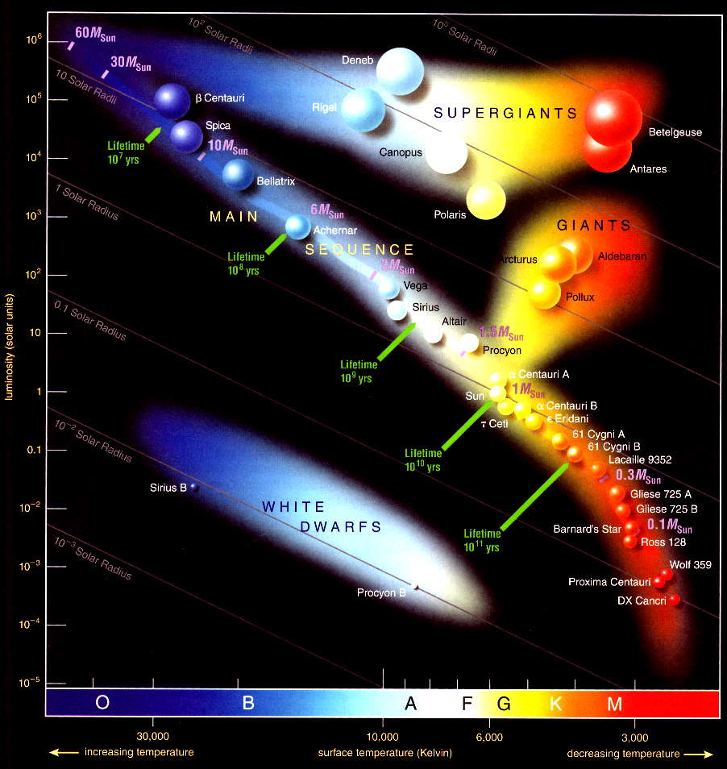
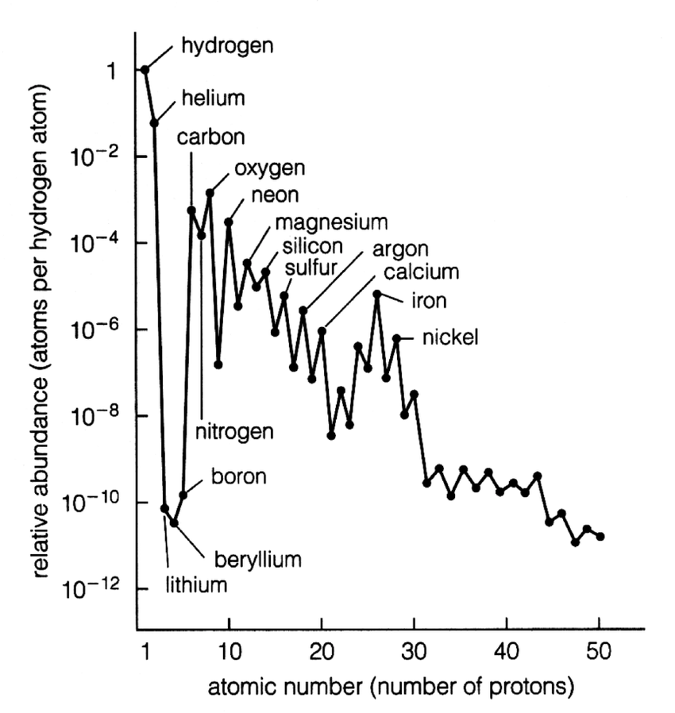
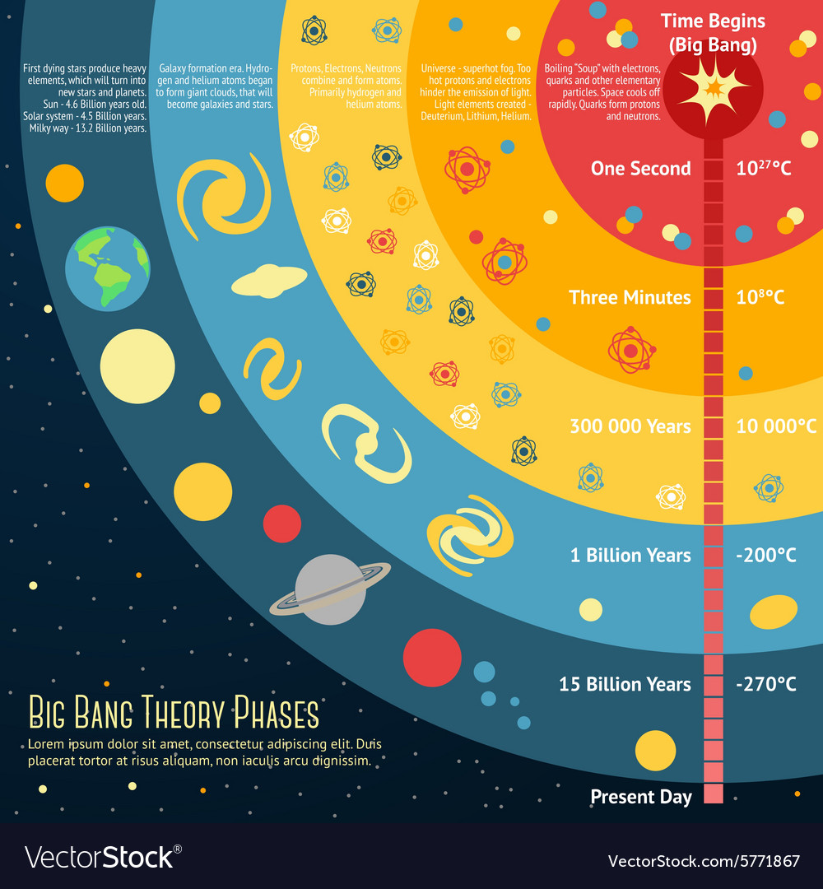
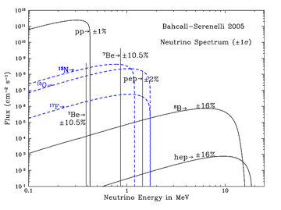
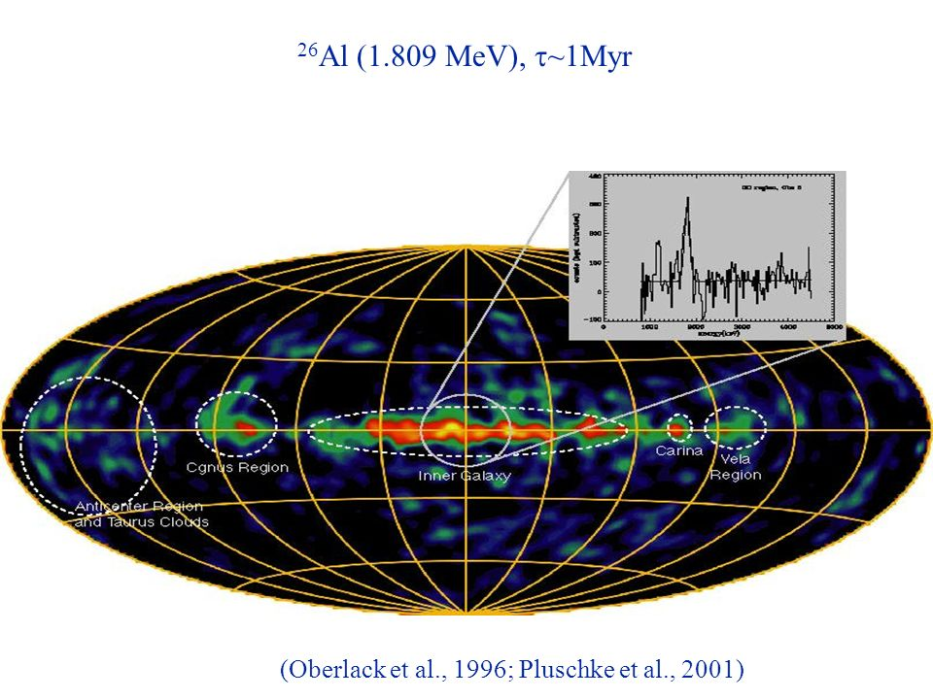
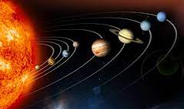
Stellar evolution
Nucleosynthesis
Evolution of early universe
Nuclear cross sections
Solar neutrinos
Astronomy
Solar system

Slide 4
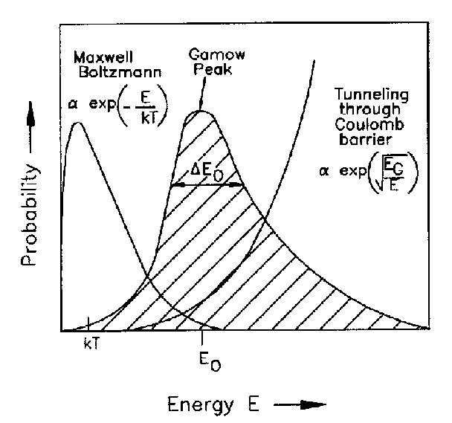
How do such nuclear reactions take place?
The energy of nuclei in a plasma follows a Maxwell-Boltzmann distribution
the cross section falls faster than exponentially as the energy decreases
The Gamow peak defines the relevant energy range for this reaction to occur
Consider a reaction
A + B → C + D
The reaction rate is given by
$$\left\langle r\right\rangle =N_{A}N_{B}\int_{0}^{∞}{φ\left(v\right) σ\left(v\right) v dv}$$

Slide 5
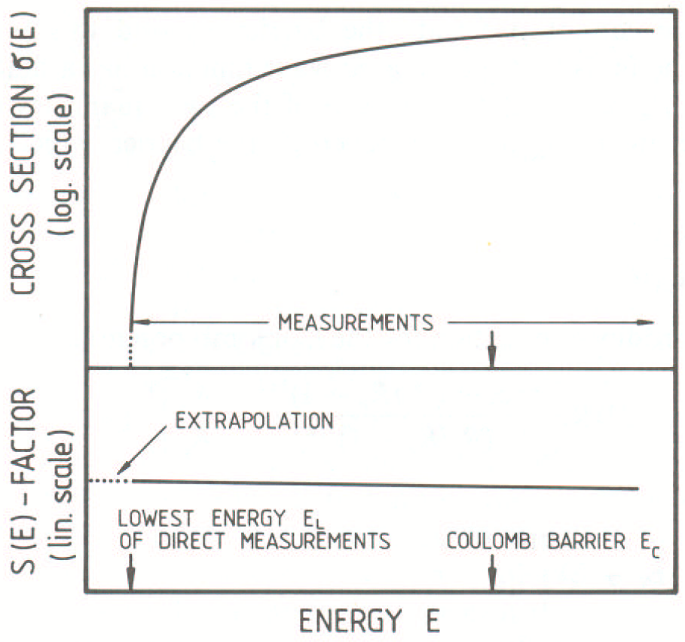
Low energy leads to small cross section…
Below a certain energy, the counting rate is too low and the cosmic-ray induced background prevents the direct measurement of the cross section
Introducing the astrophysical S-factor S(E) and factorizing the Coulomb interaction term apart:
$$σ\left(E\right)=\frac{1}{E}e^{−2πη}S(E)$$
EXTRAPOLATION
it is possible to measure the cross section at high energy and extrapolate the astrophysical factor S(E) in the interesting energy range (Gamow window)

Slide 6
…small cross section leads to rare events…
Below a certain energy, the counting rate is too low and the cosmic-ray induced background prevents the direct measurement of the cross section
But…
Introducing the astrophysical S-factor S(E) and factorizing the Coulomb interaction term apart:
$$σ\left(E\right)=\frac{1}{E}e^{−2πη}S(E)$$
unexpected low-energy resonances may be present in the extrapolation region!
it is possible to measure the cross section at high energy and extrapolate the astrophysical factor S(E) in the interesting energy range (Gamow window)

Slide 7
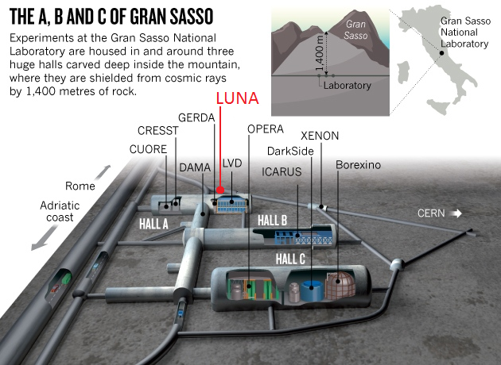
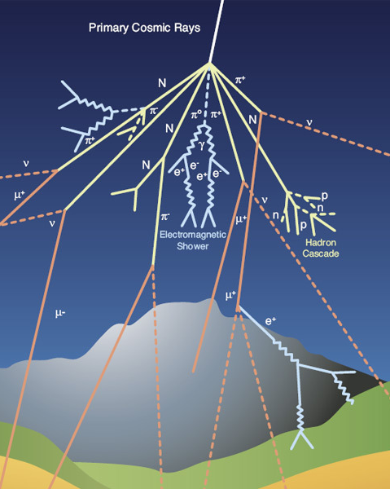
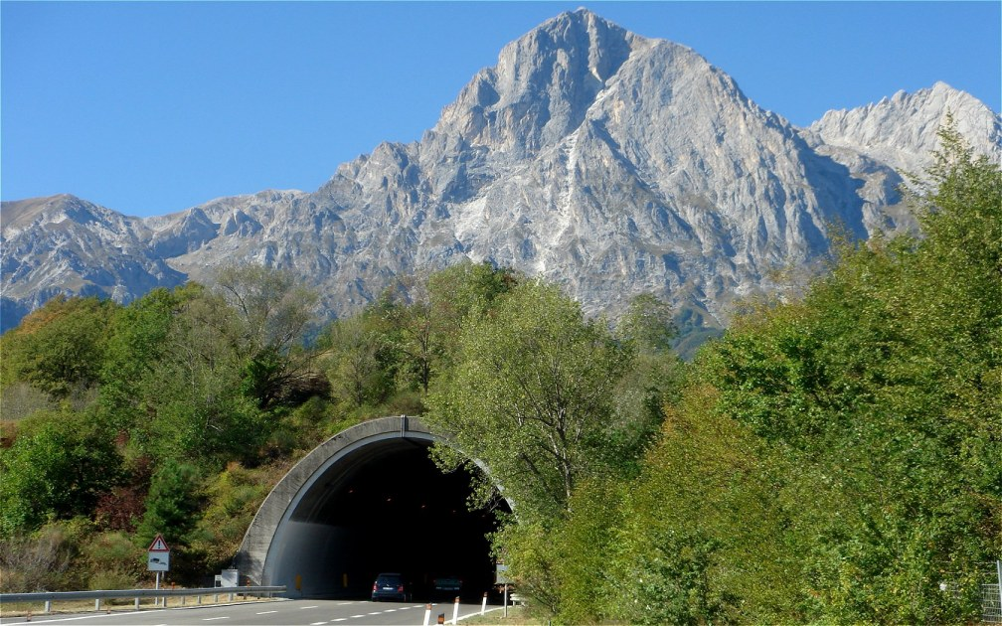
The Gran Sasso National Laboratory (LNGS)
Min. overburden: 3400 mwe muon flux reduction: ∼ 10⁶
neutron flux reduction: ∼ 10³
LUNA-MV

Slide 8
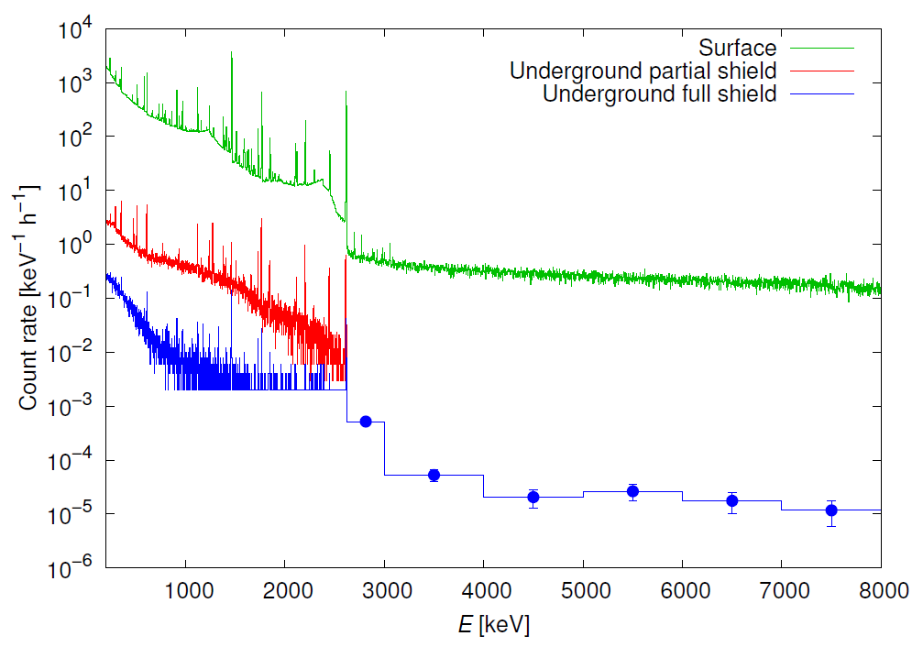
Gamma background reduction @ LNGS
mostly muons
gamma background reduction: ∼ 10⁴
radioactivity

Slide 9
Reduction of particle background @ LNGS
Neutrons
Charged particles

Slide 10
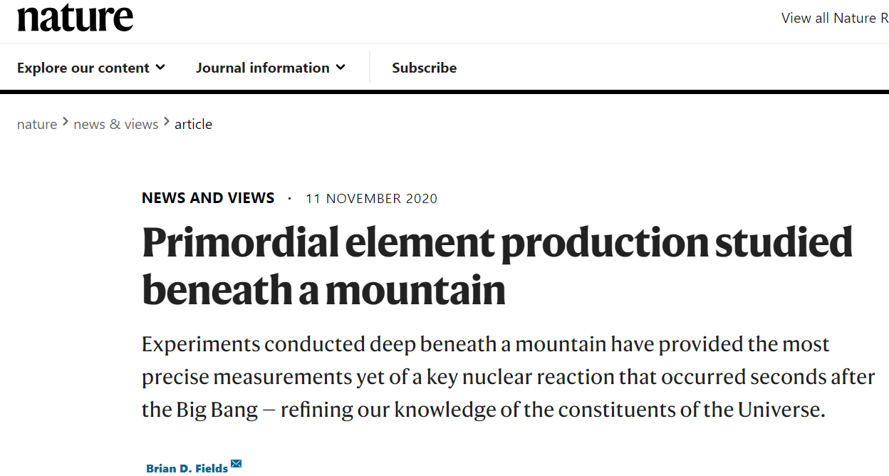
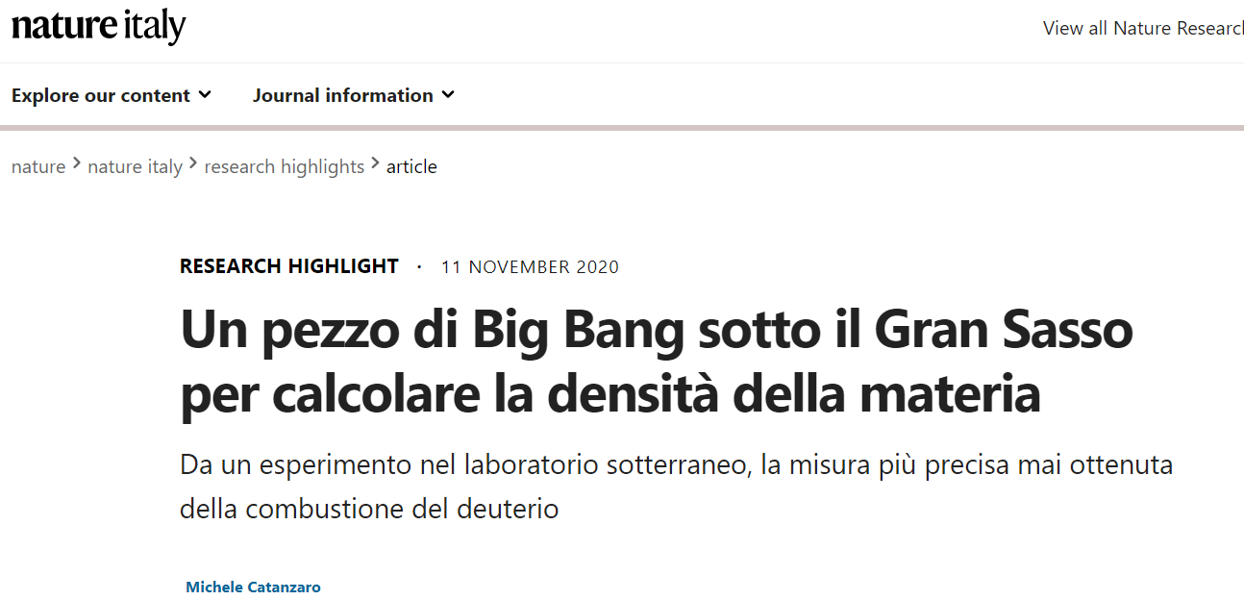
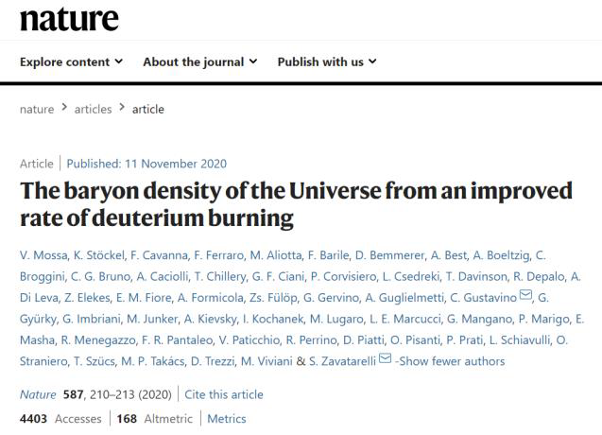
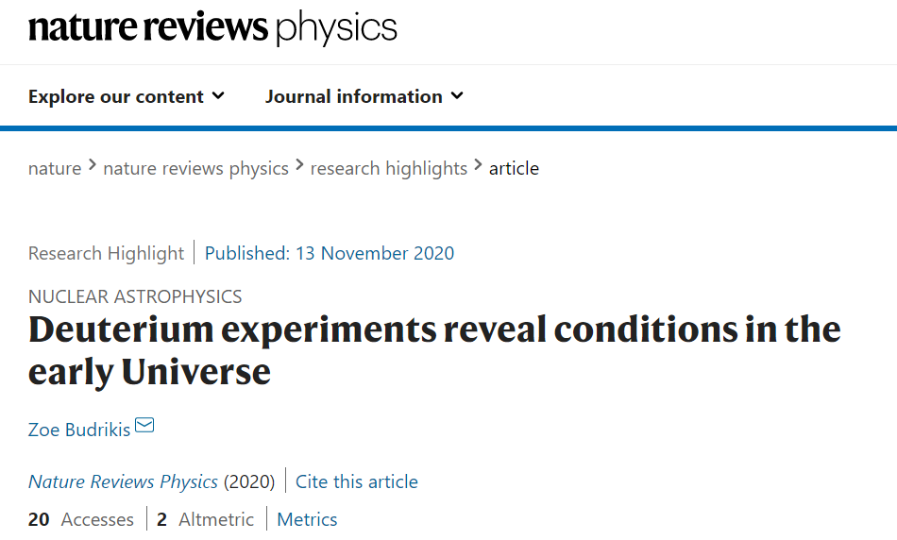
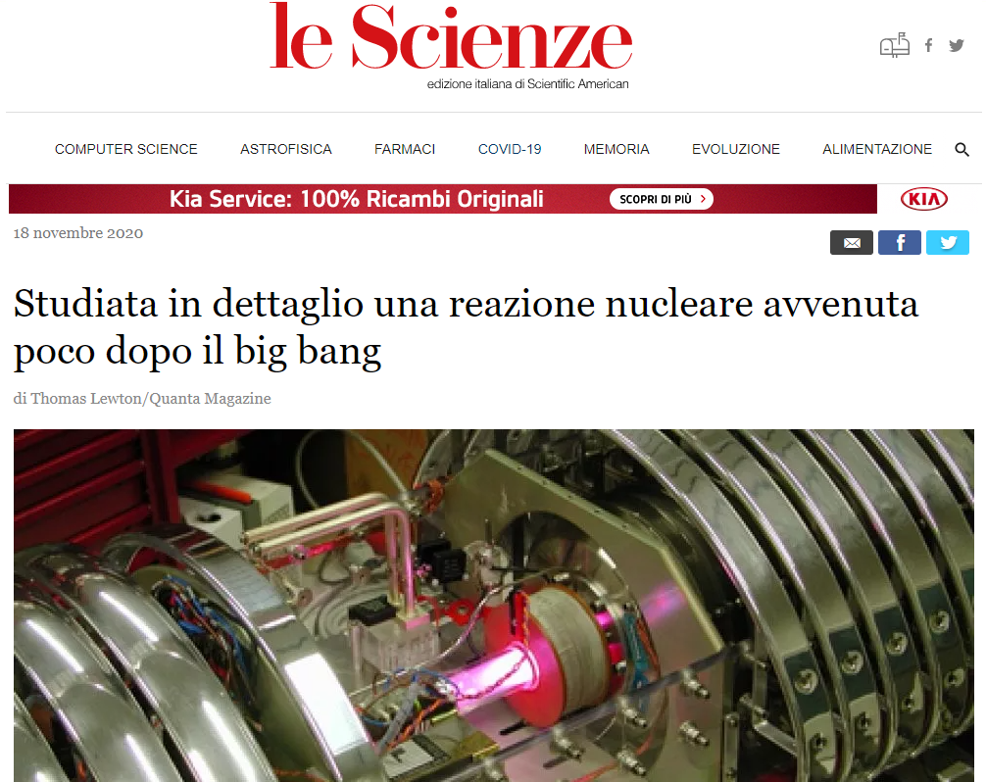
LUNA 400 kV
84 papers in 30 years (2.8 papers/year)
High-quality scientific output and fallout

Slide 11
LUNA MV
Scientific program (2023-2026)
LUNA will aim to shed light on the advanced stages of stellar nucleosynthesis using the new LUNA-MV accelerator at the Ion Beam Facility of LNGS
¹⁴N(p,𝛄)¹⁵O: bottleneck of the CNO cycle
²²Ne(α,n)²⁵Mg: neutron source for the s-process in AGB and massive stars
¹²C+¹²C: trigger of C burning in the stars
Lots of preparatory activities at LNGS!

Slide 12
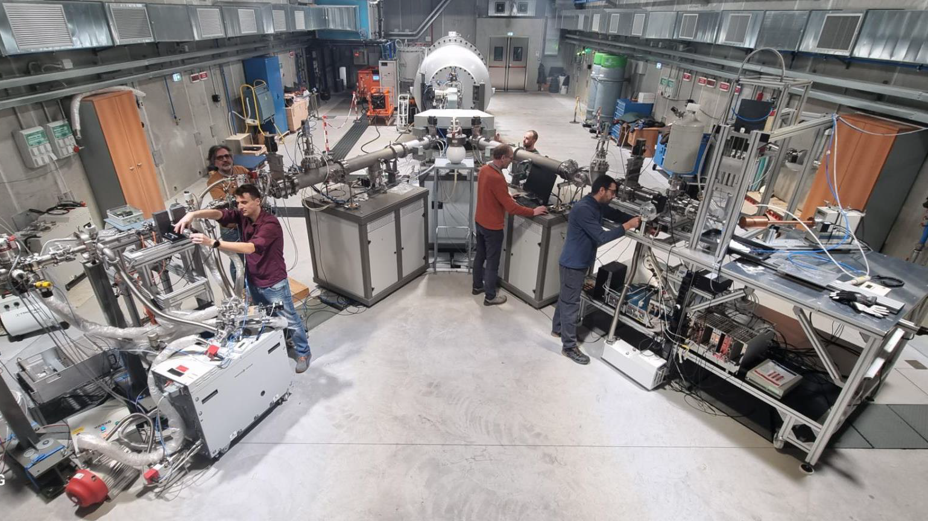

Slide 13
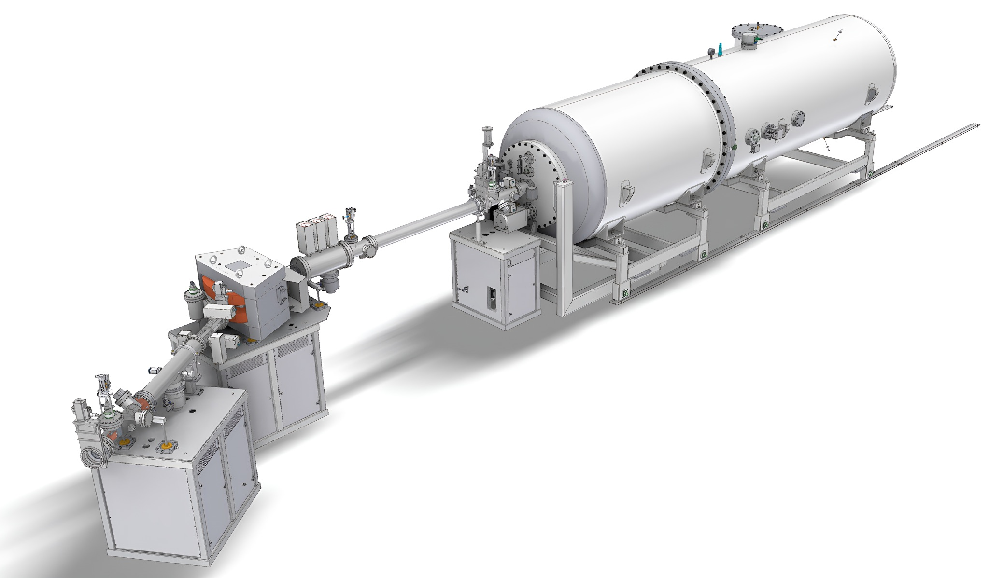
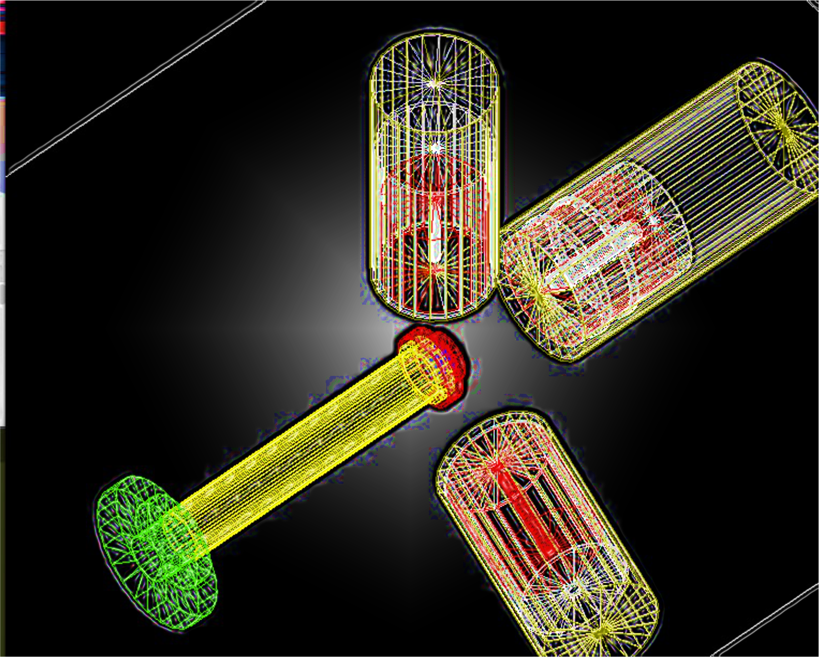
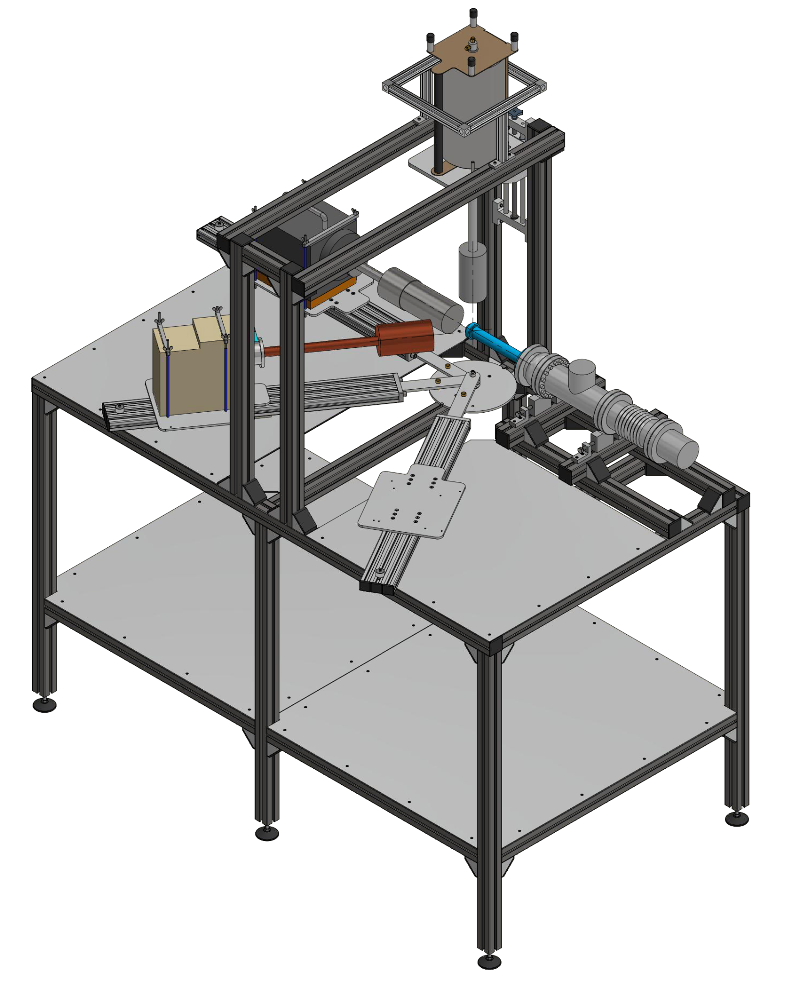
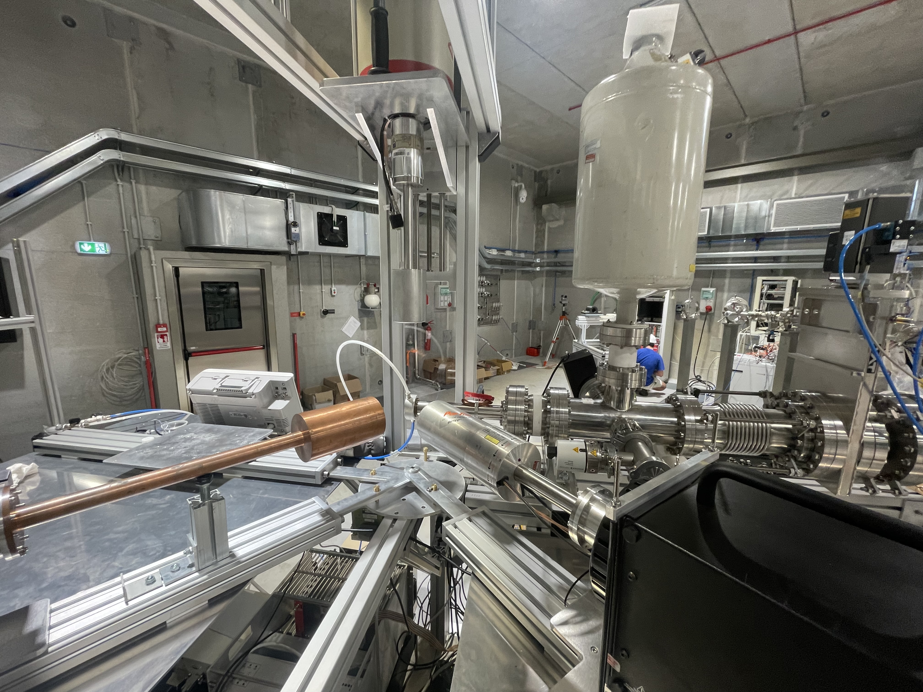
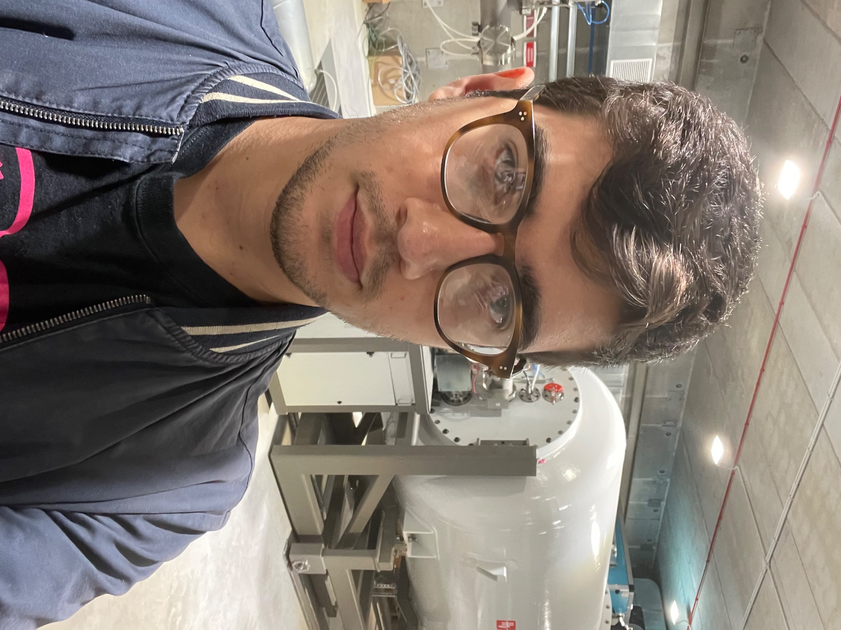
¹⁴N(p,𝛄)¹⁵O: bottleneck of the CNO cycle
PhD student on this topic
Alessandro Compagnucci
alessandro.compagnucci@gssi.it

Slide 14
¹⁴N(p,𝛄)¹⁵O: bottleneck of the CNO cycle

Slide 15
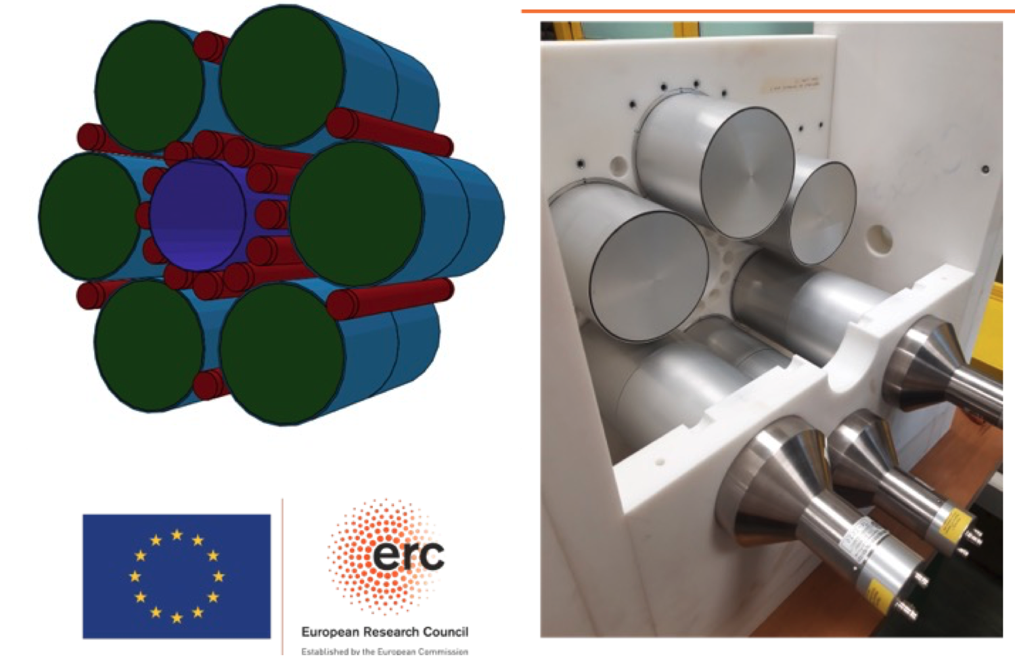
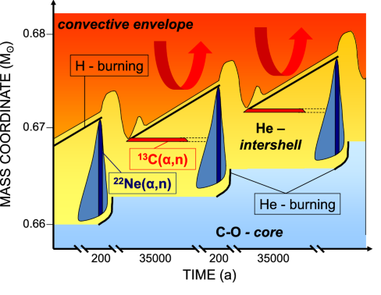
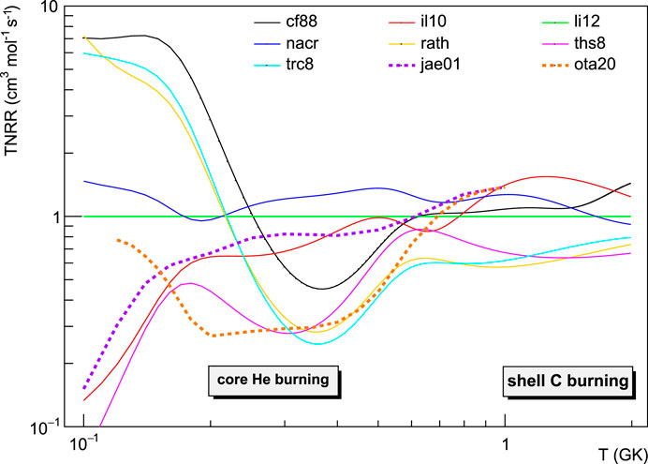
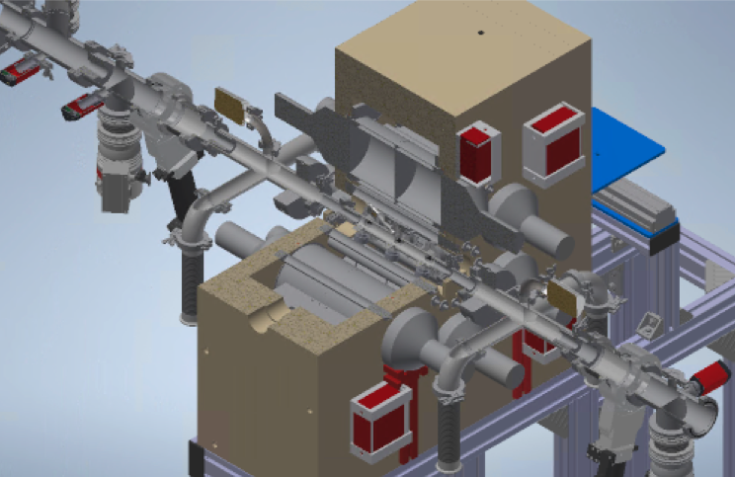
²²Ne(α,n)²⁵Mg: neutron source for the s-process
³He + LS neutron detector
Windowless, differential pumping gas target with RBS beam current reading
ERC starting grant
Andreas Best
(UNINA)

Slide 16
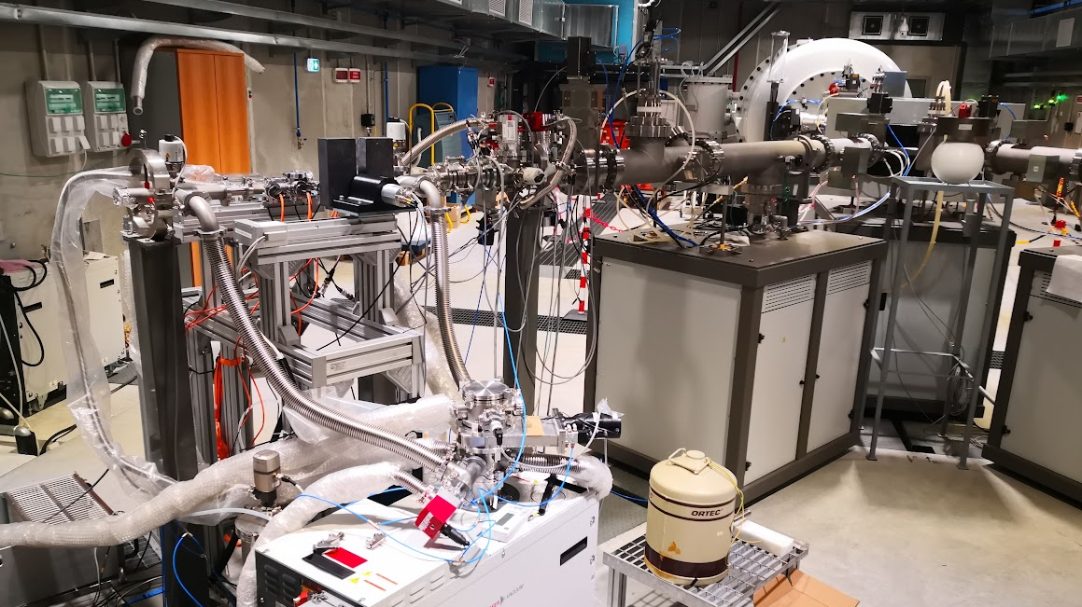

Slide 17
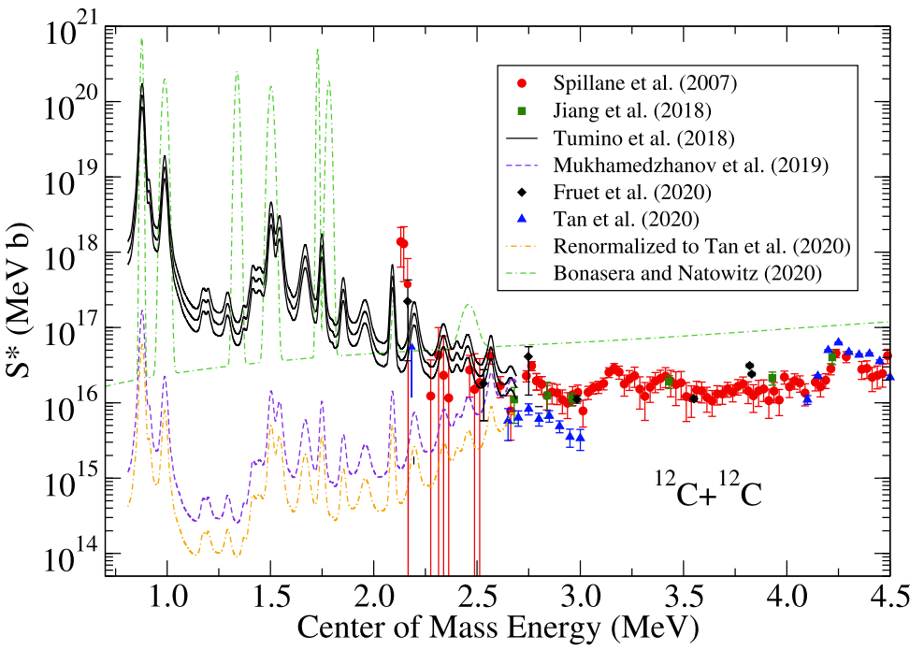
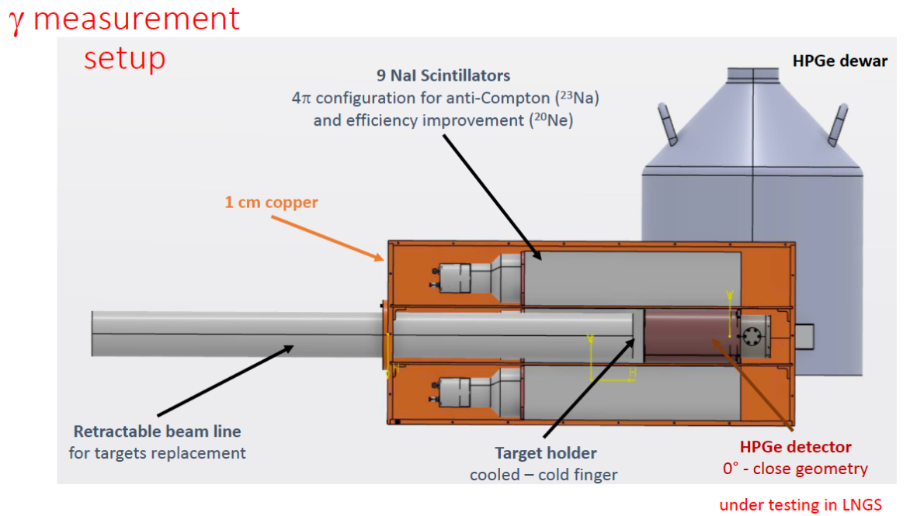
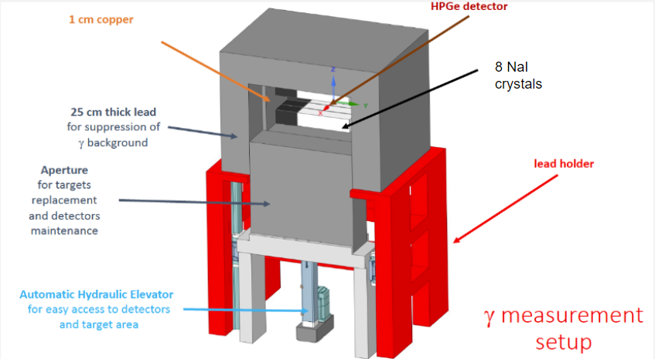
¹²C+¹²C: trigger of C burning in the stars
PhD student on this topic
Riccardo Gesuè
riccardo.gesue@gssi.it

Slide 18
¹²C+¹²C: trigger of C burning in the stars

Slide 19
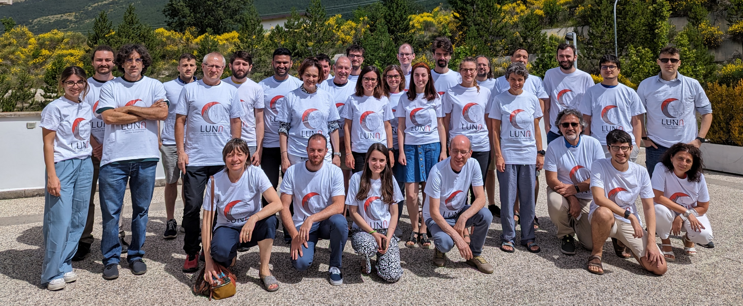
The LUNA collaboration
Laboratori Nazionali del Gran Sasso, INFN, ASSERGI, Italy
F.Ferraro, M. Junker
GSSI, L'AQUILA, Italy A. Compagnucci, R. Gesuè
Università degli Studi di Bari and INFN, BARI, Italy/*INFN Lecce, LECCE, Italy
F. Barile, G.F. Ciani
Konkoly Observatory, Hungarian Academy of Sciences, BUDAPEST, Hungary
M. Lugaro
Institute of Nuclear Research (ATOMKI), DEBRECEN, Hungary
L. Csedreki, Z. Elekes, Zs. Fülöp, Gy. Gyürky, T. Szücs
Helmholtz-Zentrum Dresden-Rossendorf, DRESDEN, Germany
D. Bemmerer, A. Boeltzig, E. Masha
University of Edinburgh, EDINBURGH, United Kingdom
M. Aliotta, L. Barbieri, C.G. Bruno, T. Davinson, J. Marsh, D. Robb, R. Sidhu
Università degli Studi di Genova and INFN, GENOVA, Italy
F. Casaburo, P. Corvisiero, P. Prati, S. Zavatarelli
Università degli Studi di Milano and INFN, MILANO, Italy
R. Depalo, A. Guglielmetti
Università degli Studi di Napoli ”Federico II” and INFN, NAPOLI, Italy
A. Best, C. Ananna, D. Dell’Aquila, A. Di Leva, G. Imbriani, D. Rapagnani
Università degli Studi di Padova and INFN, PADOVA, Italy
C. Broggini, A. Caciolli, P. Marigo, R. Menegazzo, D. Piatti, J. Skowronski, S. Turkat
INFN Roma1, ROMA, Italy
A. Formicola, C. Gustavino
Laboratori Nazionali di Legnaro, Italy
M. Campostrini, V. Rigato
Osservatorio Astronomico di Collurania, TERAMO and INFN LNGS, Italy
O. Straniero
Università di Torino and INFN, TORINO, Italy
F. Cavanna, P. Colombetti, G. Gervino

Slide 20
People on site
Matthias Junker
Federico Ferraro
Alessandro Compagnucci
Donatello Ciccotti
Riccardo Gesué
Massimo Orsini

Slide 21
Posters
3 posters
Nuclear Astrophysics at LNGS
A new underground measurement of ¹⁴N(p,𝛄)¹⁵O reaction at the LNGS Bellotti Ion Beam Facility
Direct measurement of the ¹²C+¹²C reaction rate
ASK ANY QUESTIONS!!!

