Slide 1
High energy follow-up of exceptionally luminous Gamma-ray bursts
3rd year PhD report
Alessio Mei
Astroparticle Physics PhD student
Supervisors:
G. Oganesyan, M. Branchesi, B. Banerjee
Alessio Mei
Credits: S. Ronchini

Slide 2
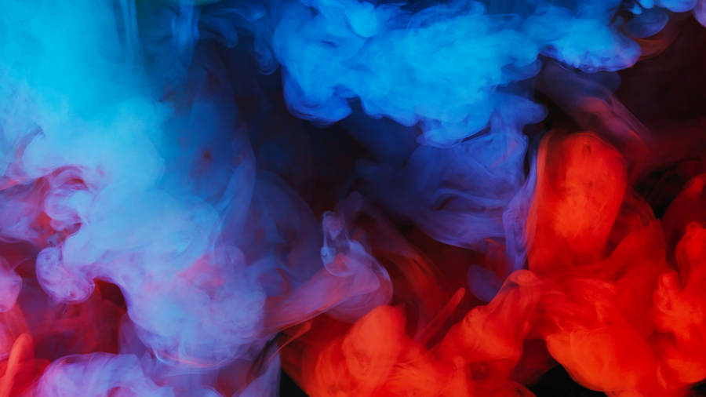
The main protagonist of (also) this research year
Large Area Telescope
Particle tracker measures $γ$ direction, calorimeter measures $E_{γ}$ and image the shower
Large sky coverage ($∼20\%$)
Poor angular resolution (PSF ~ 1 deg @ 1GeV)
Sensitive in the high energy range (30 MeV - 300 GeV)
Gamma-ray Burst Monitor
12 NaI detectors (8-900 keV) and 2 BGO detectors (300 keV - 40 MeV)
Good energy and temporal resolution (up to 64 ms)
Provides triggers for GRB prompt emission
Alessio Mei
3rd year report

Slide 3
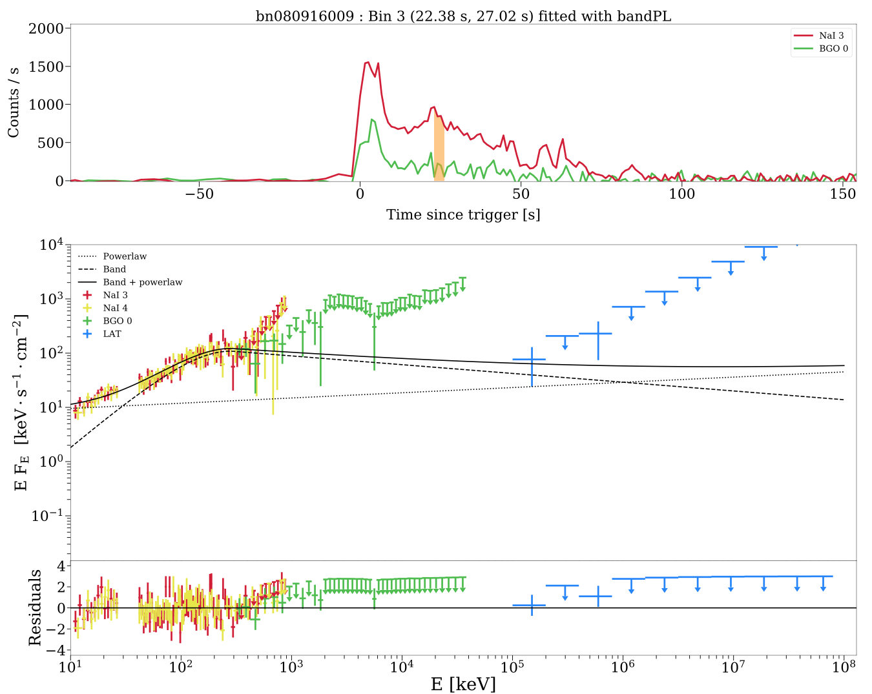
GBM data analysis
GBM
I developed a python-based tool able to analyse GBM data and produce light curves and (time-resolved) spectra
It is based on the GTBURST pipelines
In combination with XSPEC, it can provide also (time-resolved) spectral analysis
It can now handle an automatic analysis of large samples of sources in the Fermi/GBM catalog.
Applied to:
Analysing the BOAT GRB
Testing physical models on the GRB prompt spectra at high energies (with Samanta)
Unveiling the GRB progenitor origin
Testing empirical correlations of GRBs with measured redshift
Studying the soft extended emission in GRB prompt emissions

Slide 4
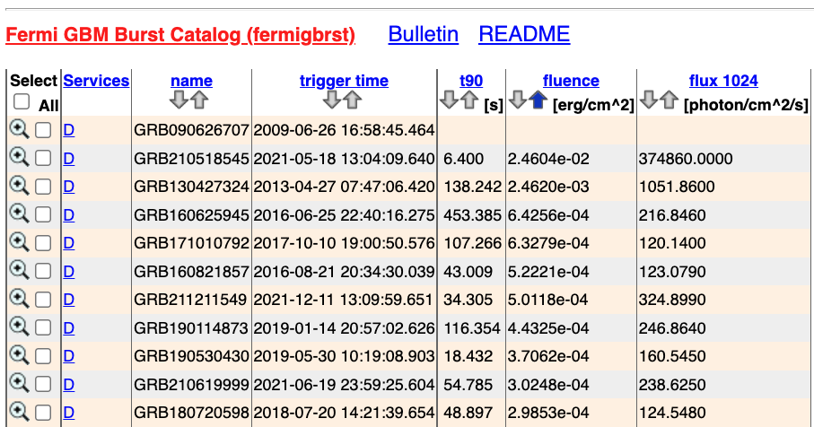
2021: a year of bright GRBs!
https://heasarc.gsfc.nasa.gov/W3Browse/fermi/fermigbrst.html

Slide 5
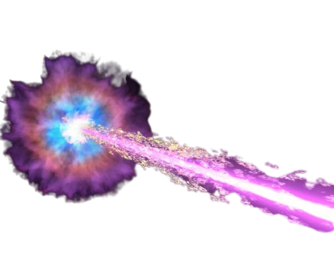
2022: the year of the brightest GRB!
B.O.A.T.
Credit: NASA's Goddard Space Flight Center and Adam Goldstein (USRA)

Slide 6
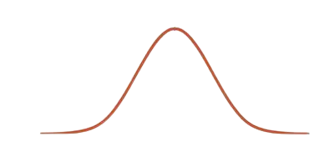
2022: the year of the brightest GRB!
230307A
B.O.A.T.
Credit: NASA's Goddard Space Flight Center and Adam Goldstein (USRA)

Slide 7
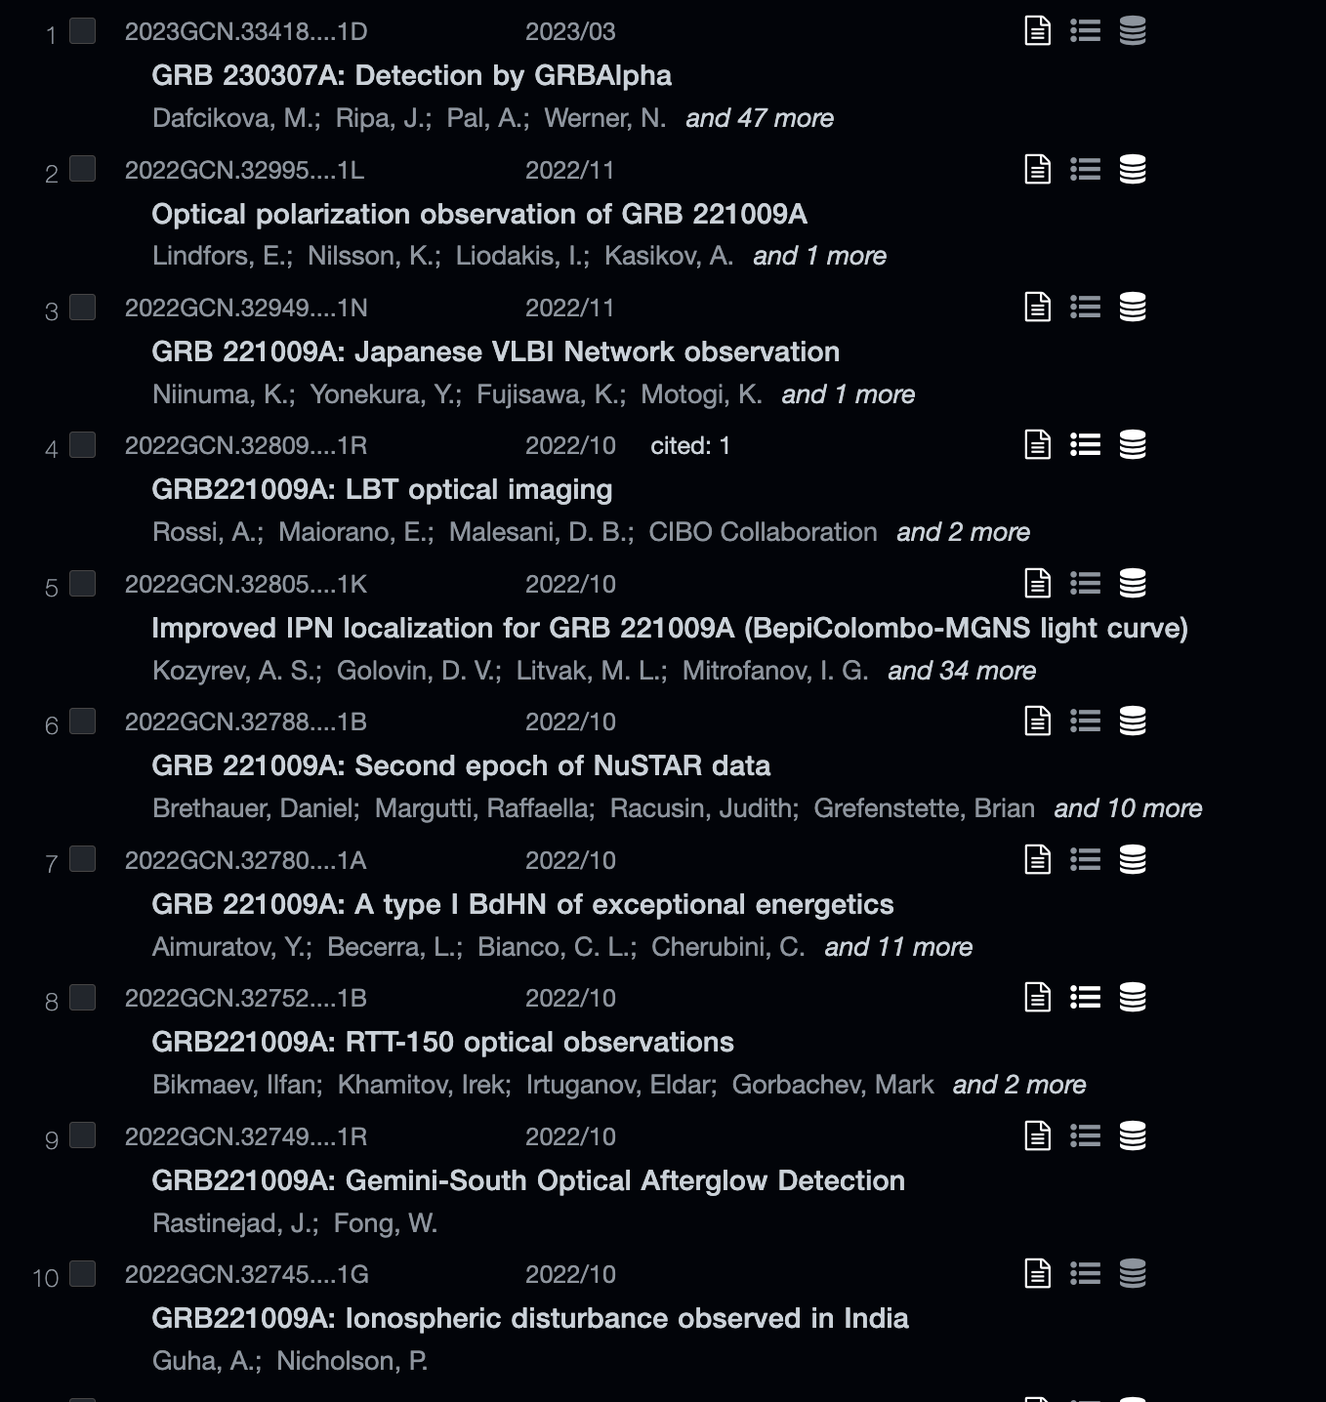
The BOAT: some milestones
On Oct 9, 2022 the BOAT triggered Fermi/GBM and Swift/BAT.
An unprecedented follow-up campaign started: BOAT triggered everything!

Slide 8
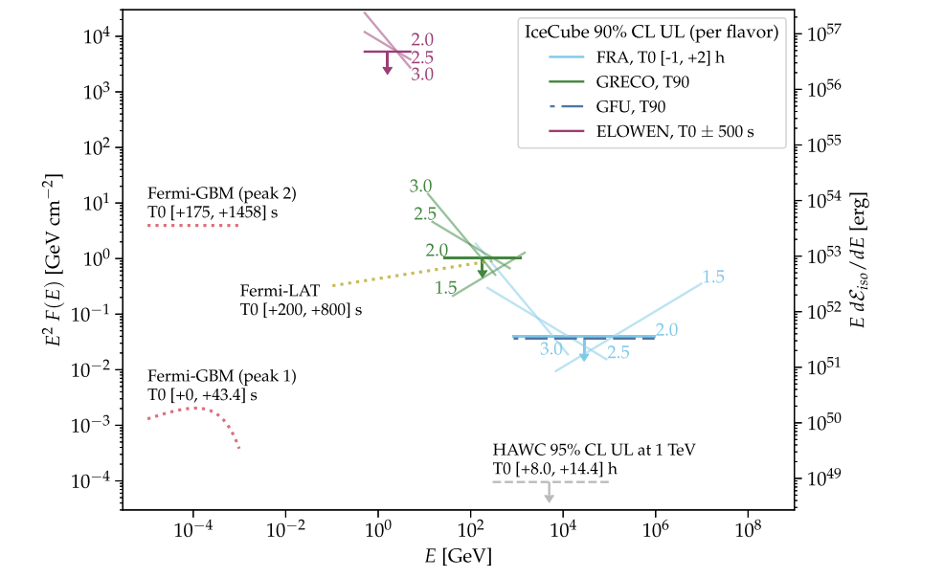
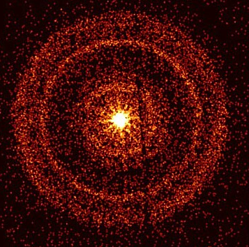
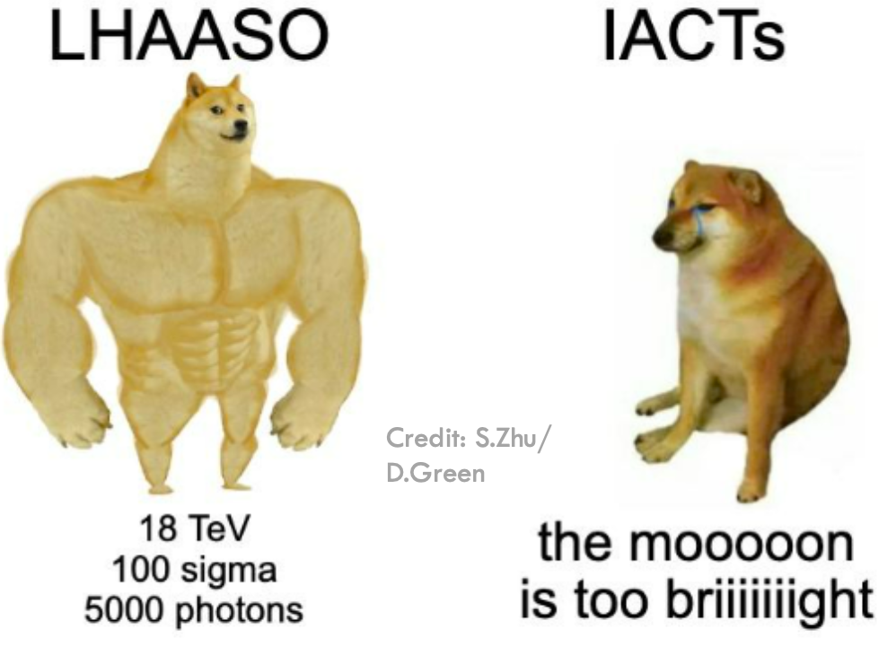
The BOAT: some milestones
IceCube & KM3Net did not find any evidence of high energy neutrinos coming from this source.
LHAASO observed several >100 GeV photons and one 13 TeV photon after ~200s from the burst trigger
XMM-Newton observed expanding X-ray rings generated by scattering in Galactic dust clouds
IceCube Collab. 2023
LHAASO Collab. 2023
Tiengo et al. 2023

Slide 9
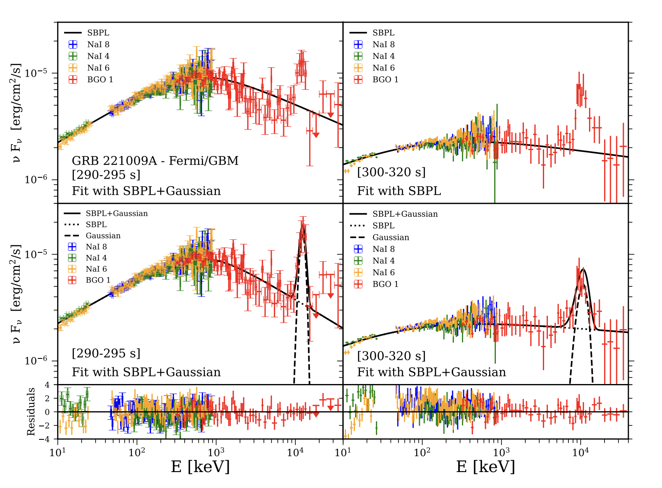
The first emission line in a GRB spectrum
Ravasio M.E., Salafia O.S., Oganesyan G., Mei A. et al. 2023, under review Science

Slide 10
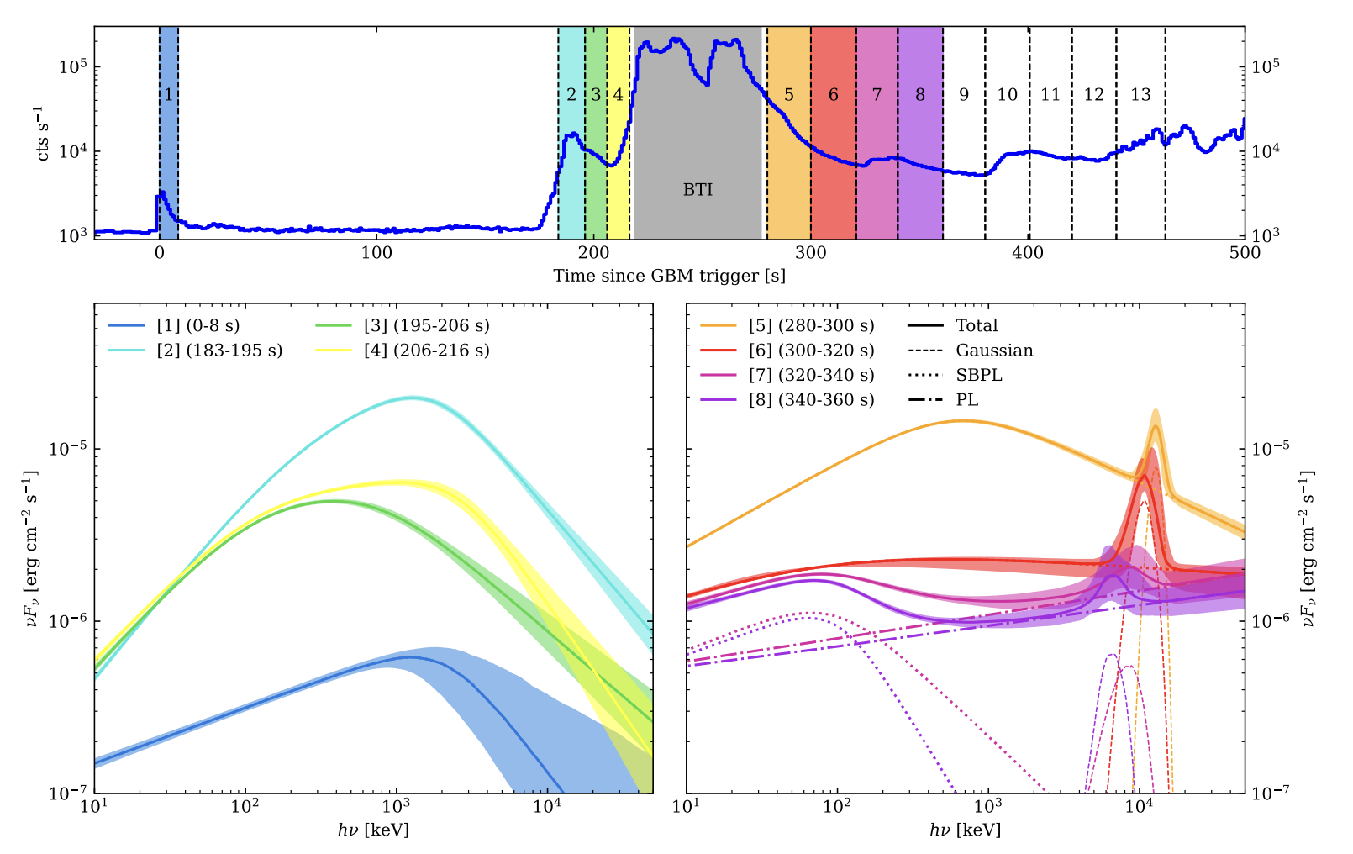
The first emission line in a GRB spectrum
Ravasio M.E., Salafia O.S., Oganesyan G., Mei A. et al. 2023
Akaike Information Criterion (AIC) confirms the presence of the line with $6.6σ$ and $11.6σ$ in the [280-300 s] and [300-320 s] time-intervals, respectively
Both the line peak energy $E_{peak}$ and peak luminosity $L_{peak}$ are decreasing over time. Instead, the width does not show any trend.
$$E_{peak}[MeV]:12.56±0.03→{6.12}_{-0.59}^{+0.74}$$
$$L_{peak}[erg/s]:(1.12±0.20)×{10}^{50}→(2.1±0.10)×{10}^{49}$$

Slide 11
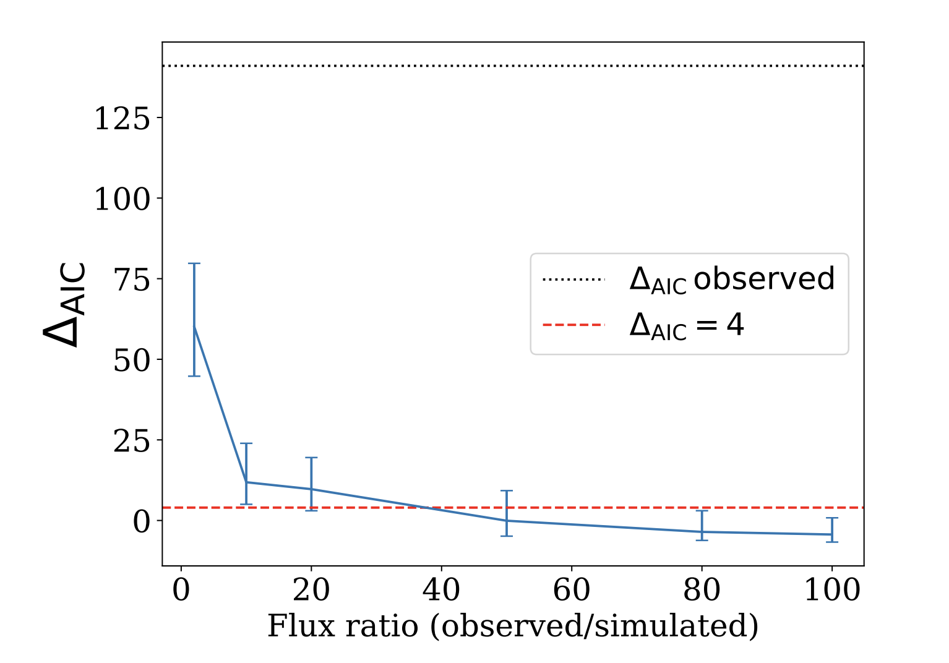
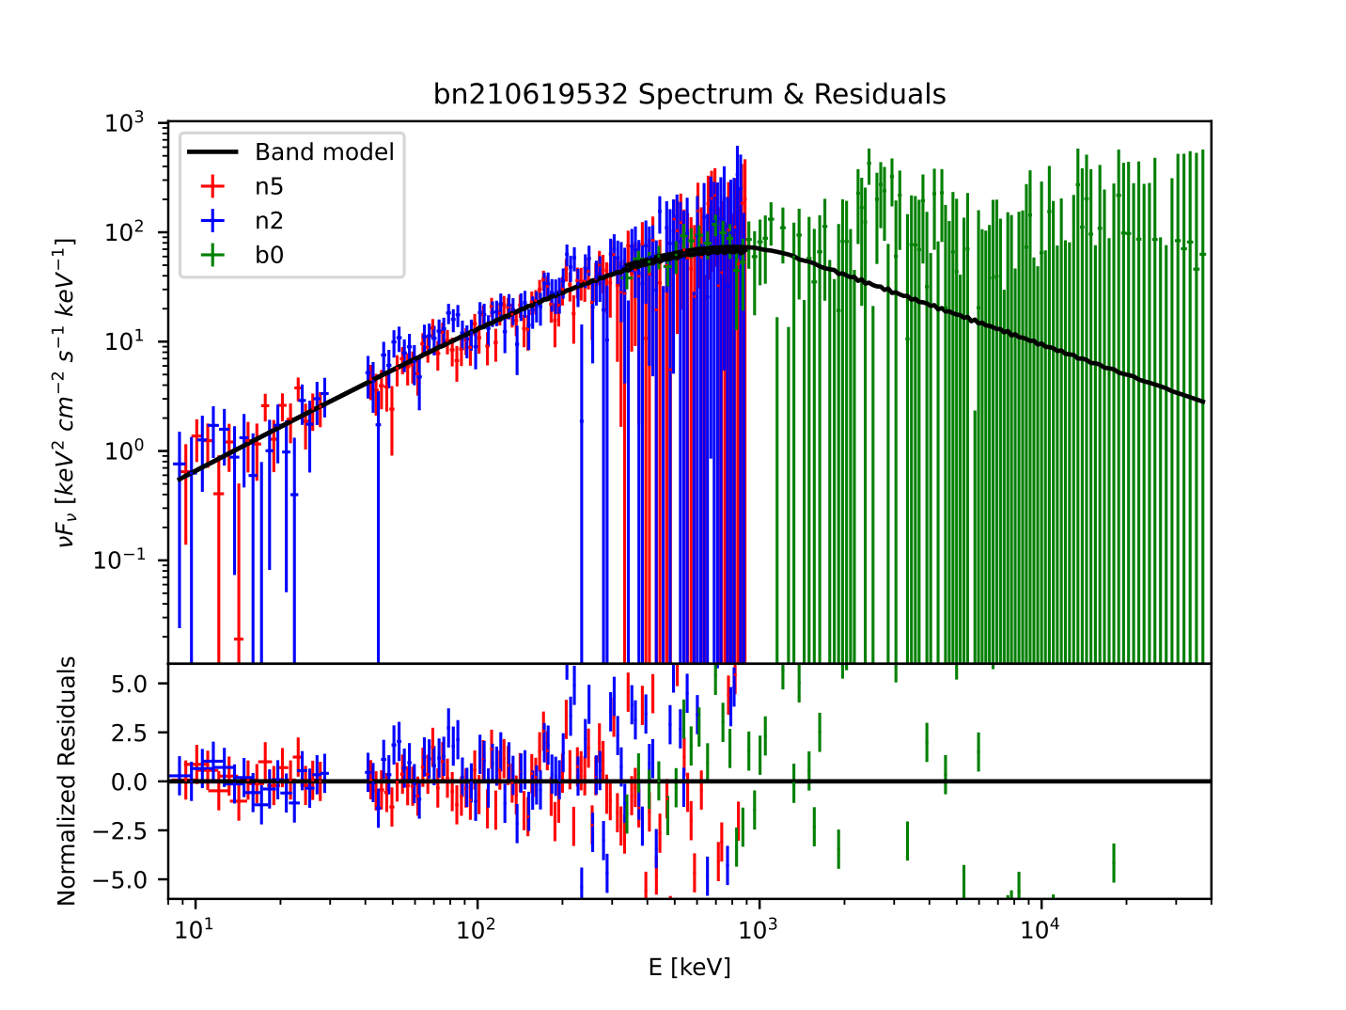
Looking for the line in other GRBs
We looked for the presence of a MeV line in a sample of 6 GRBs:
}
}
GRB 230307A
GRB 130427A
GRB 160625B
GRB 170409A
GRB 171227A
GRB 130606B
Best BGO viewing angle
$$θ_{BGO}≲{40}^{∘}$$
Brightest GRBs

Slide 12
Looking for the line in other GRBs
We looked for the presence of a MeV line in a sample of 6 GRBs:
}
GRB 230307A
GRB 130427A
GRB 160625B
Brightest GRBs
}
GRB 170409A
GRB 171227A
GRB 130606B
Best BGO viewing angle
$$θ_{BGO}≲{40}^{∘}$$

Slide 13
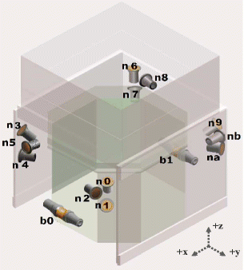
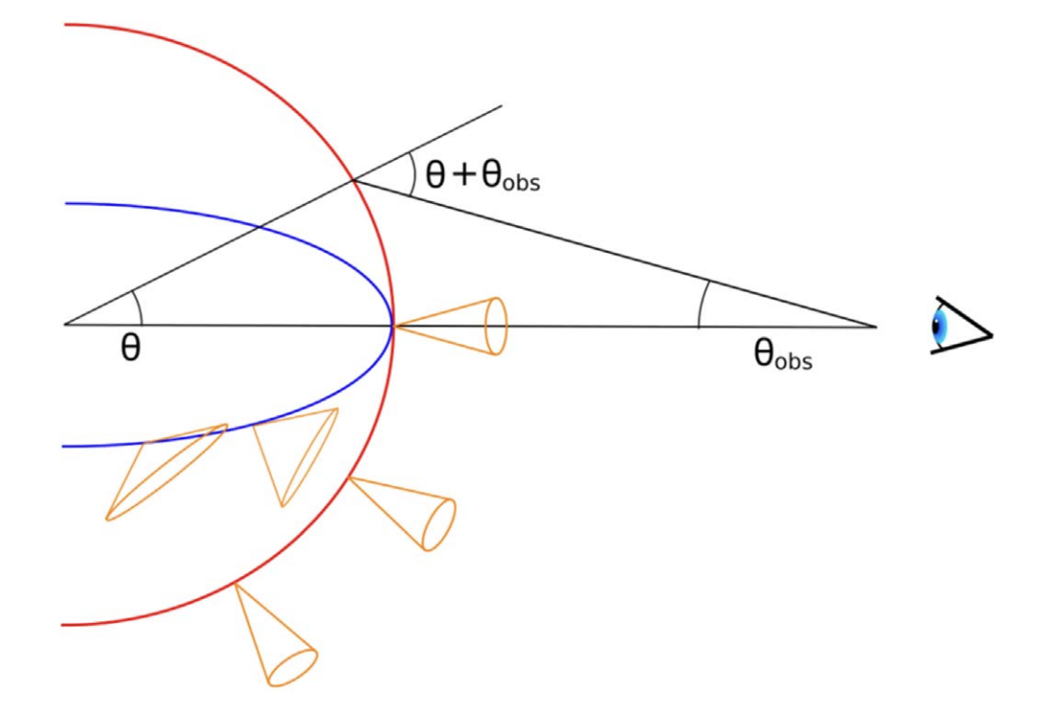
What can produce a MeV line?
Pair-annihilation blue-shifted line?
Instrumental effects?
$$E_{th,γγ}^{′}=m_{e}c^{2}=0.511MeV$$
$$e^{-}$$
$$E_{th,γγ}=Γm_{e}c^{2}≃10MeV→Γ≃20$$
$$e^{+}$$
$$γ$$
$$e^{+}$$
$$e^{-}$$
$$γ$$
$$e^{-}$$
$$γ$$
$$e^{+}$$
$$e^{-}$$
$$e^{+}$$
Usually $Γ_{GRB}≳100$ !!!
$$γ$$
$$γ$$
$$γ$$
$$γ$$
$$γ$$
$$γ$$
$$e^{+}$$
$$γ$$
$$γ$$
$$γ$$
$$e^{-}$$
$$e^{+}$$
$$e^{-}$$
$$Γ_{2}∼20$$
$$Γ_{1}≫Γ_{2}$$

Slide 14
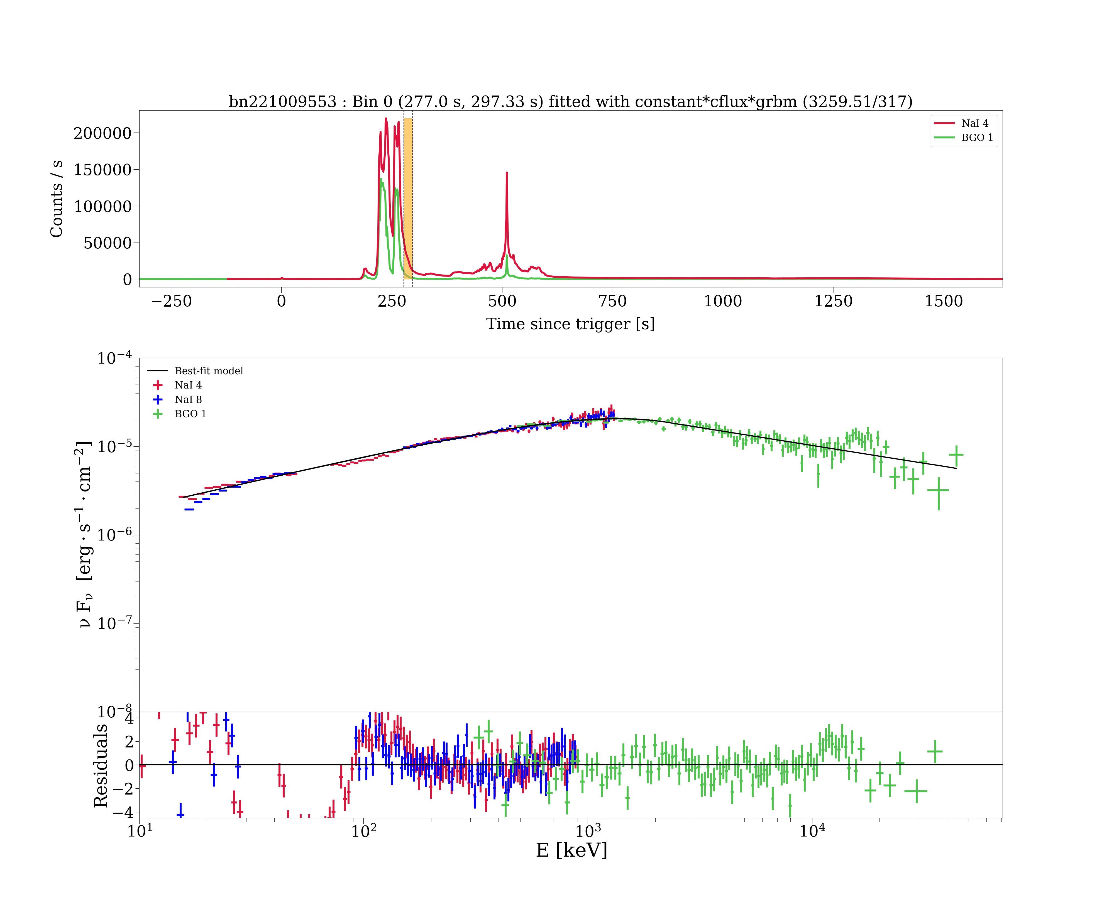
We are not done with the BOAT 🥲
PRELIMINARY

Slide 15
HE component in prompt emission phase
$$νF_{ν}$$
GBM
LAT
Additional power law
Prompt origin
High energy cut-off
$$E$$

Slide 16
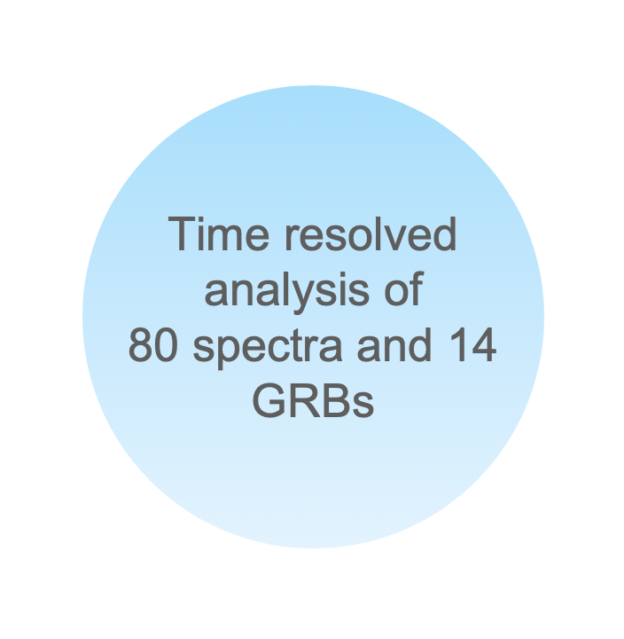
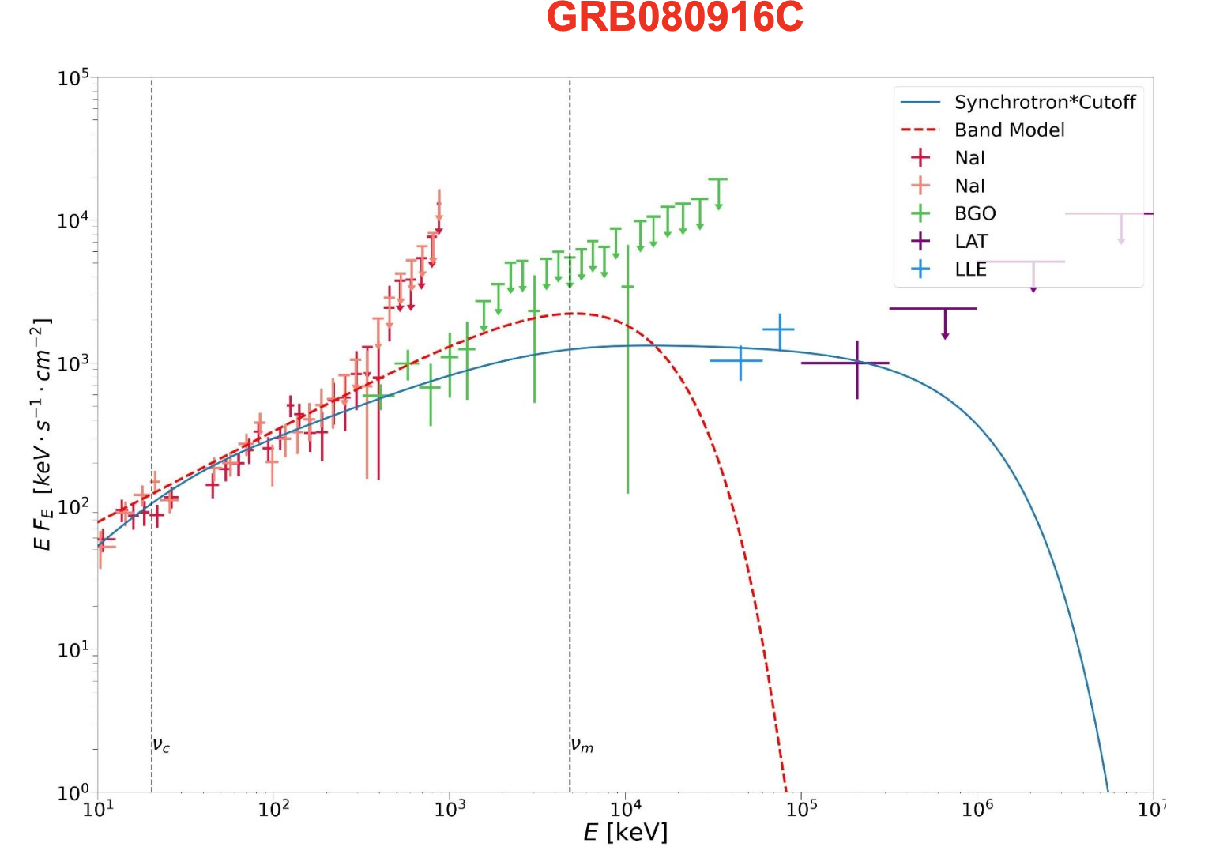
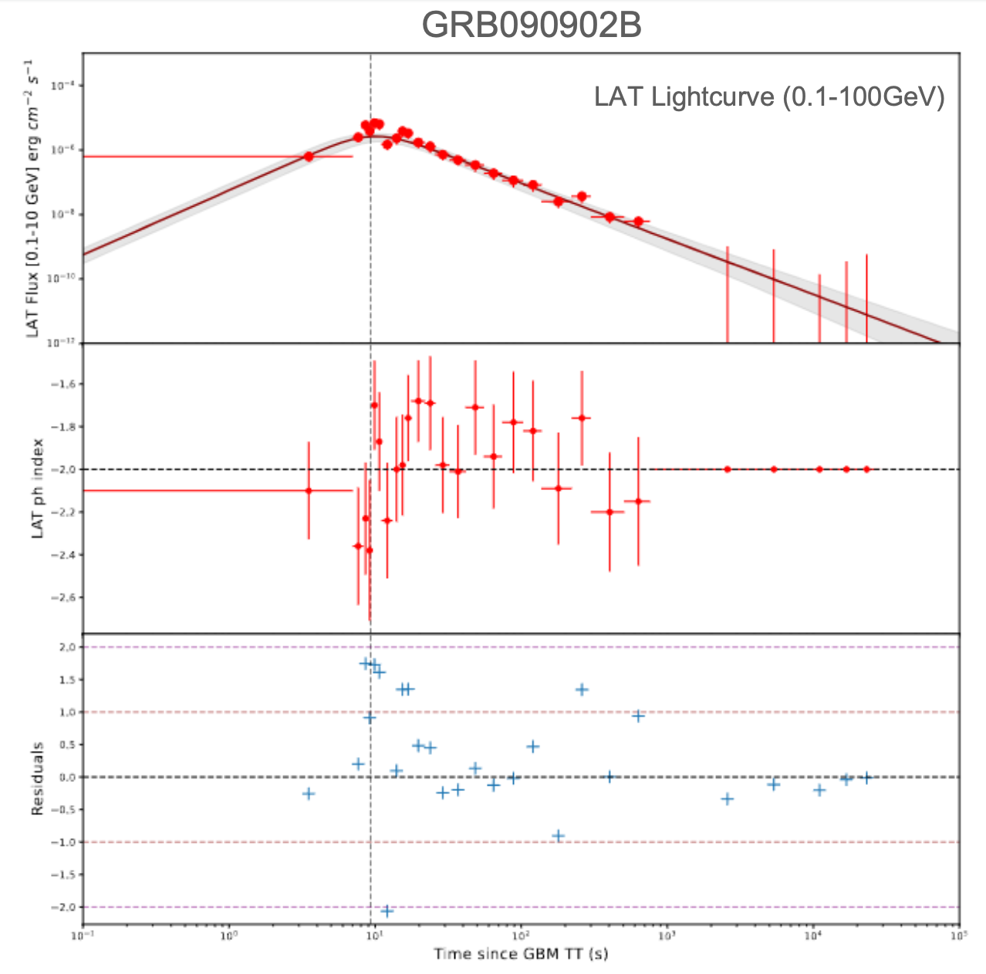
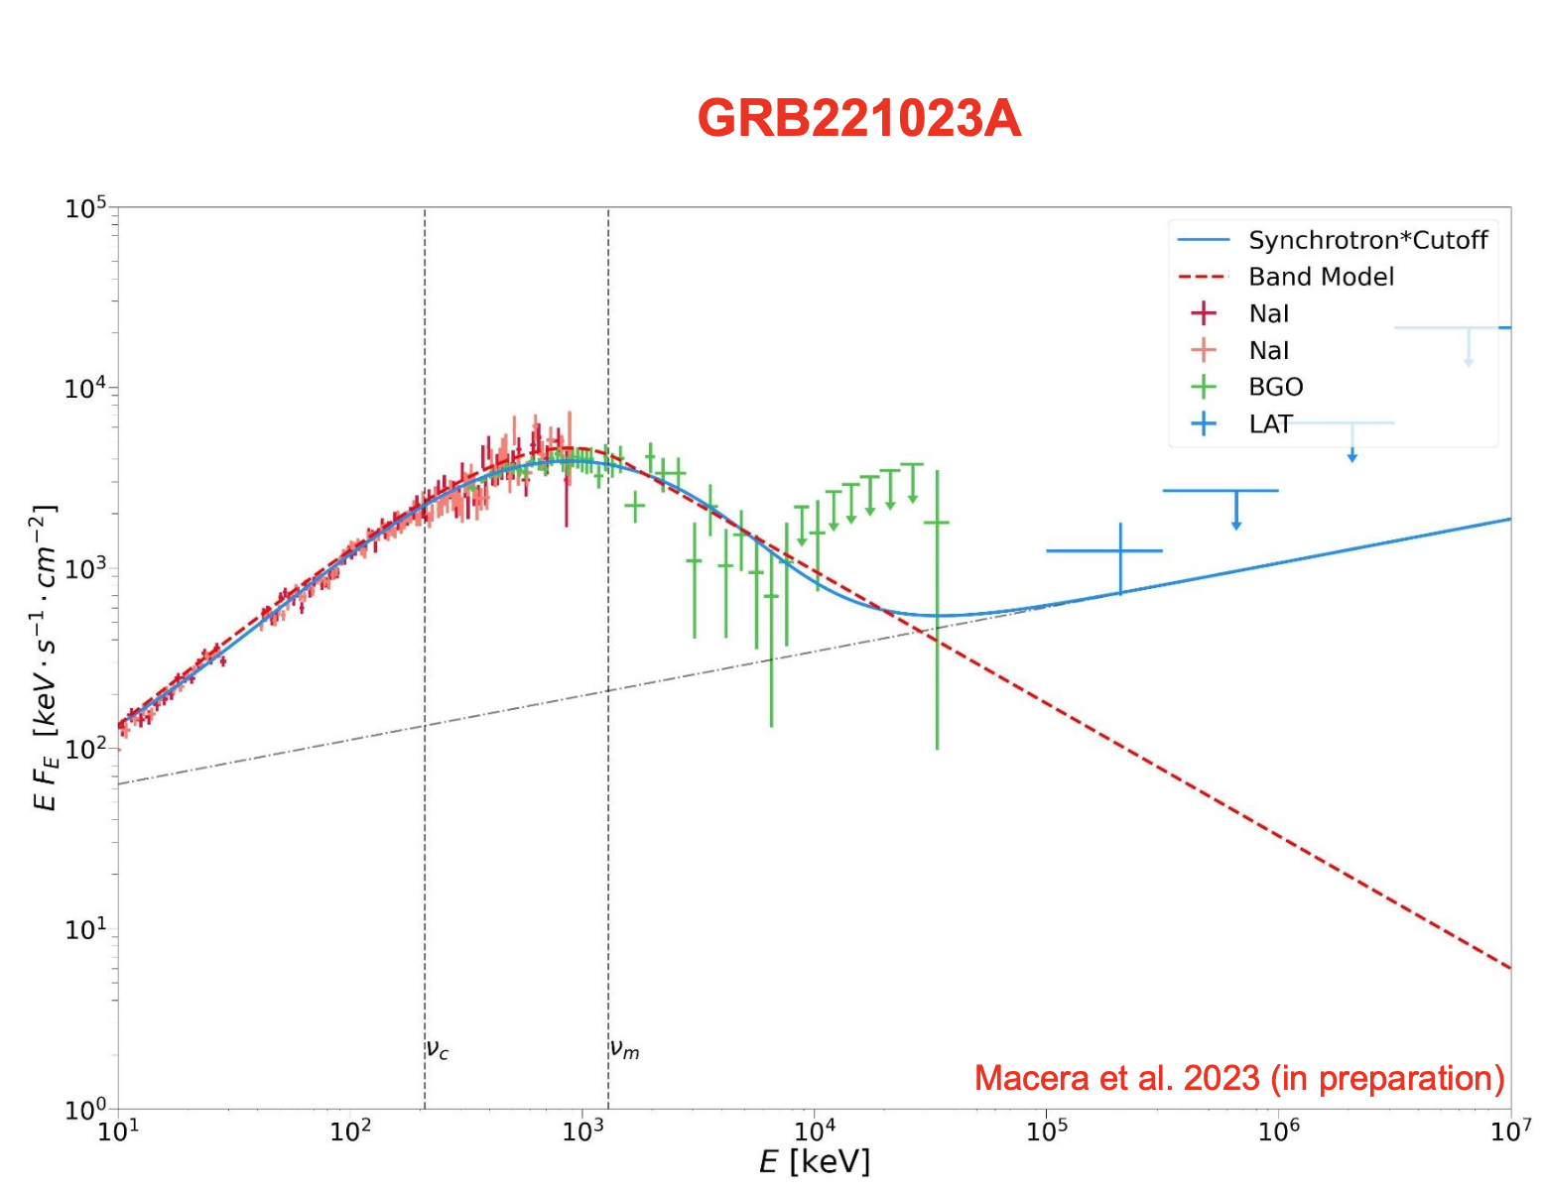
HE component in prompt emission phase
Only synchrotron
Synchrotron + power law

Slide 17
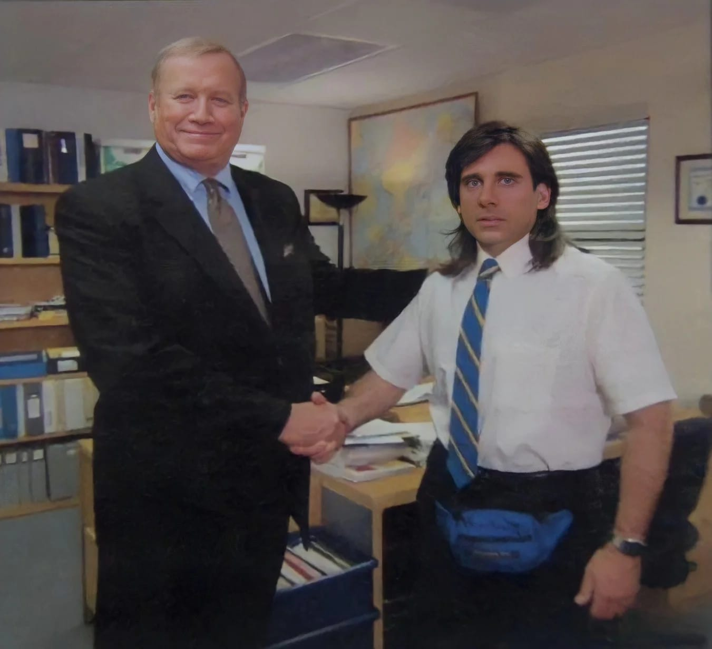
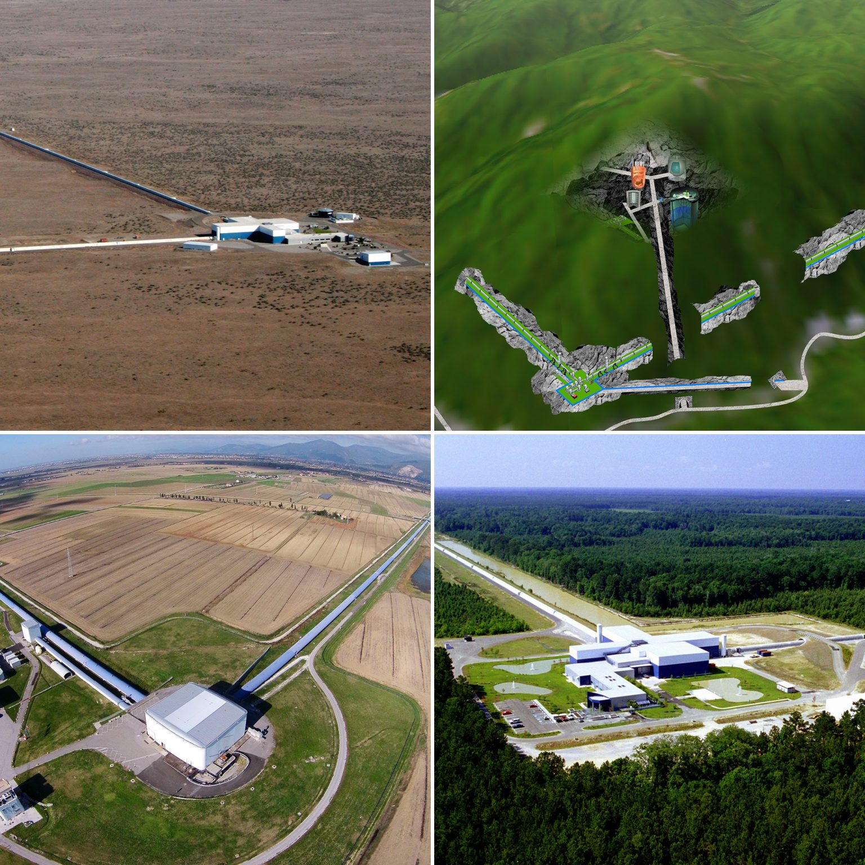
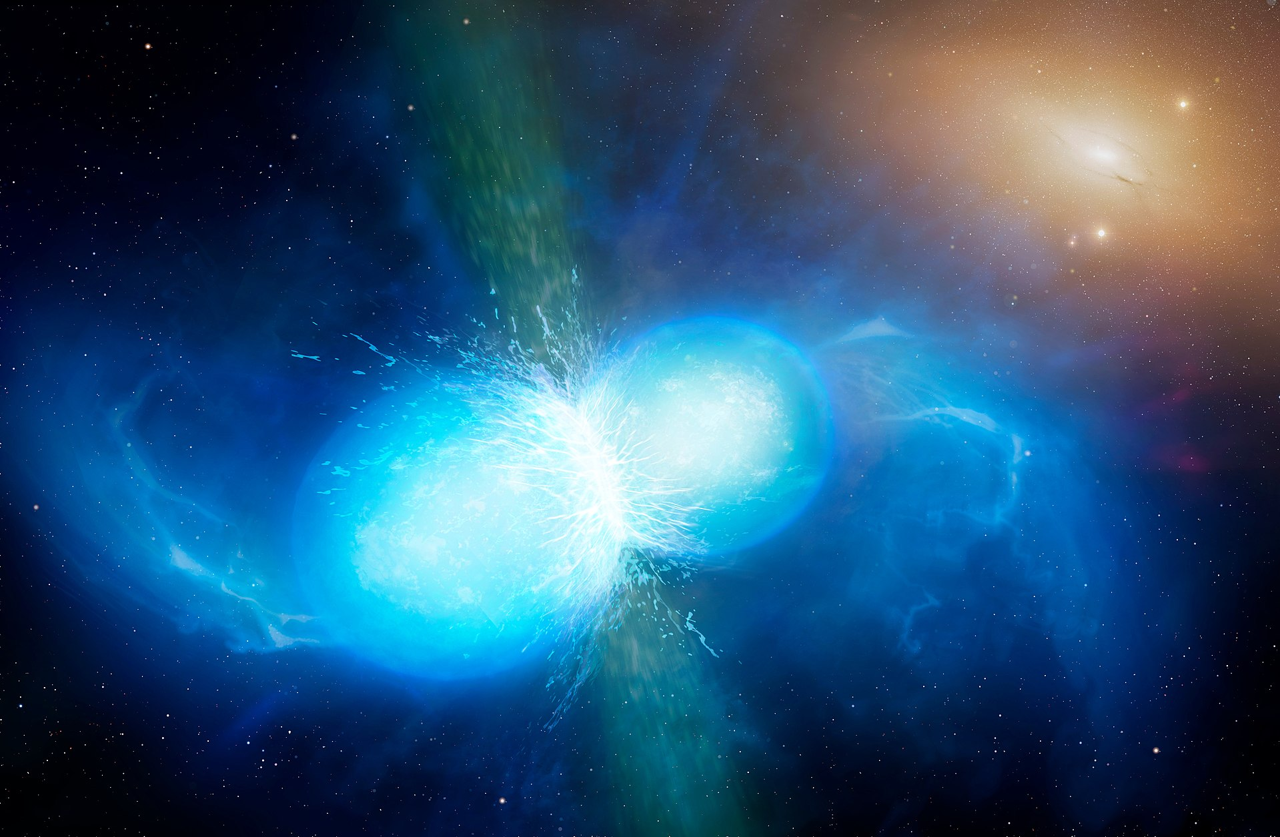
The fourth observational run (O4)
May 24, 2023: LIGO officially started the run
Virgo will join in March 2024, KAGRA still under commissioning
LIGO alone reaches a range of 150 Mpc
~50 BBH observed so far, no BNS!
Me trying to do MM astronomy for the first time with only LIGO
(Like GRB 211211A, GRB 230307A)
Looking for
Oddballs
In offline search
Challenge:

Slide 18
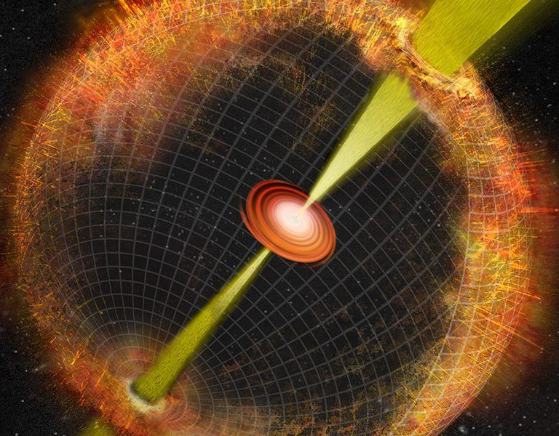
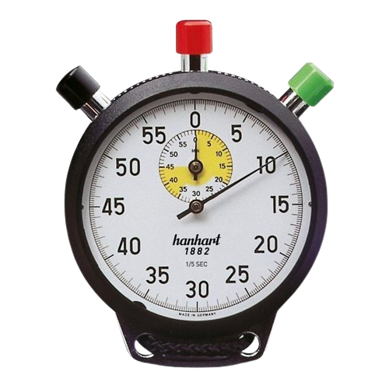
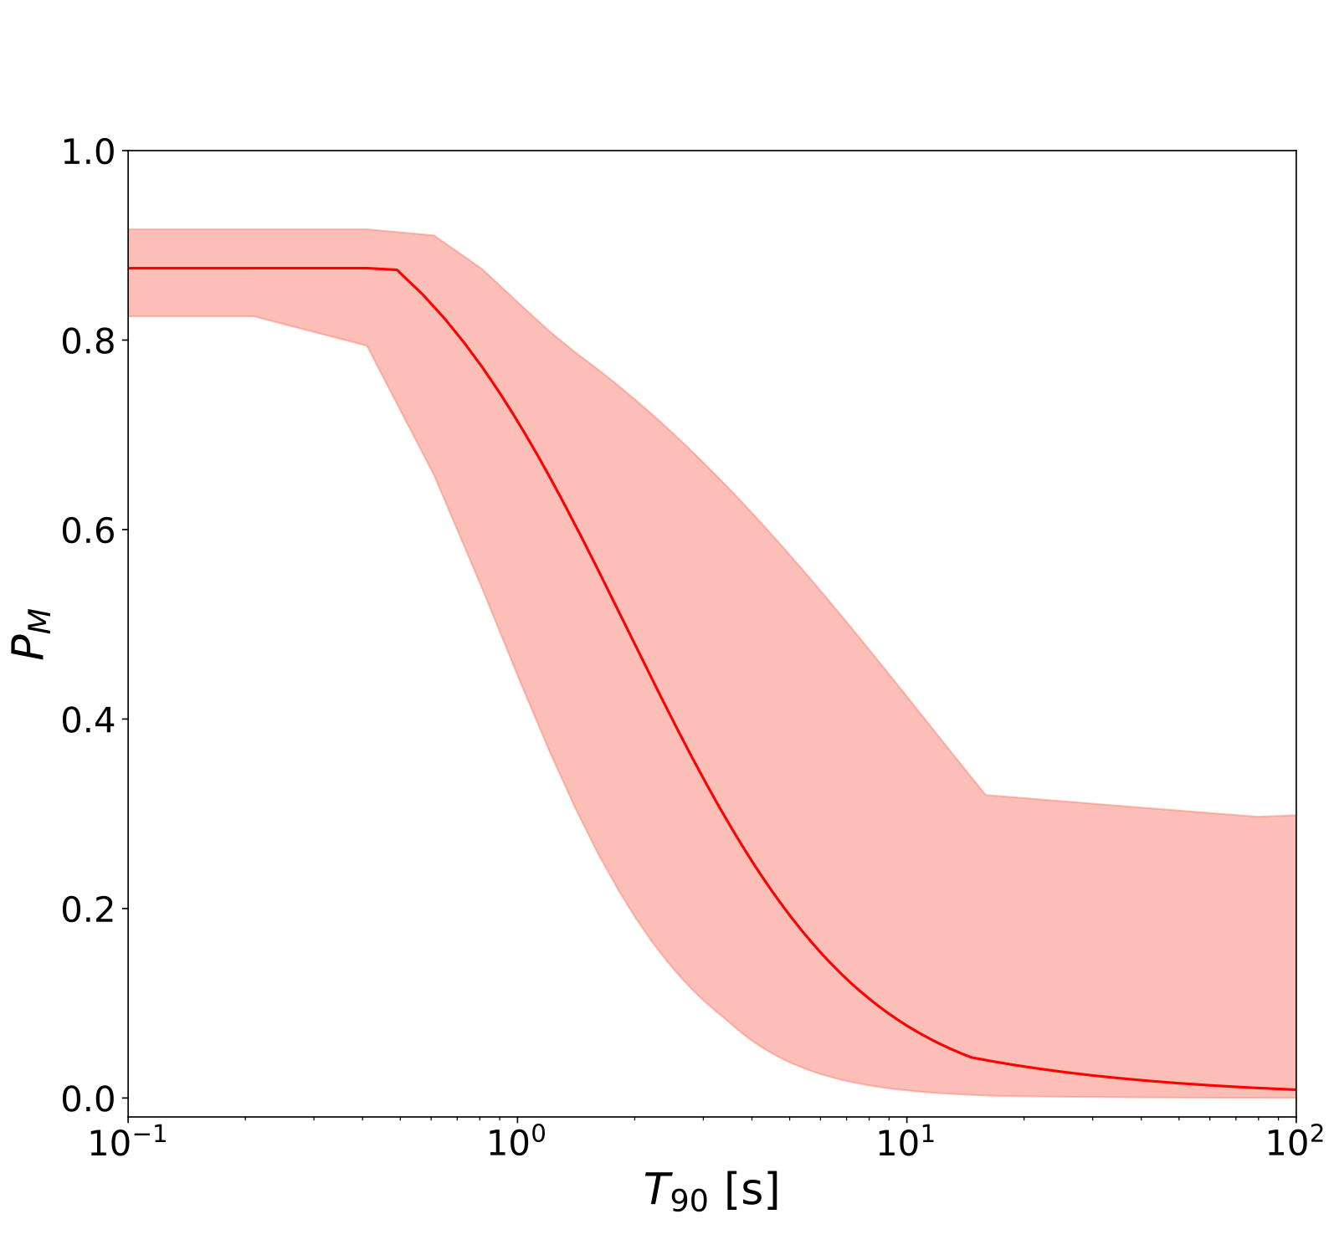
Searching for a new progenitor observable
Bromberg et al. 2011, 2012, 2013, Moharana & Piran 2017
$$T_{dur}$$
$$T_{BreakOut}∼10s$$
$$T_{engine}≃T_{BO}+T_{dur}$$

Slide 19
Summary
GBM automatic analysis tool applied to :
BOAT GRB prompt analysis, were we discovered the first MeV emission feature in a GRB spectrum and searched for others in the catalog.
A catalog of bright LAT sources, to systematically analyse which emission contribution is observed in LAT using physically-motived models.
The Fermi/GBM catalog (and a sub-sample with measured redshift), to look for a new observable able to give precious hints on the progenitor nature.
What’s next?
Systematic analysis of GRB soft extended emission
Very likely the next crazy GRB!
Mei A. , Banerjee B., Oganesyan G., Salafia O.S. et al. 2022. DOI:10.1038/s41586-022-05404-7
Mei A. , Oganesyan G., Tsvetkova A., Ravasio M.E. et al. 2022. DOI:10.3847/1538-4357/aca091
Ravasio M.E., Salafia O.M., Oganesyan G., Mei A. et al. 2023. DOI: 10.48550/arXiv.2303.16223
Macera S., … , Mei A. et al. 2023 in prep.

