Slide 1
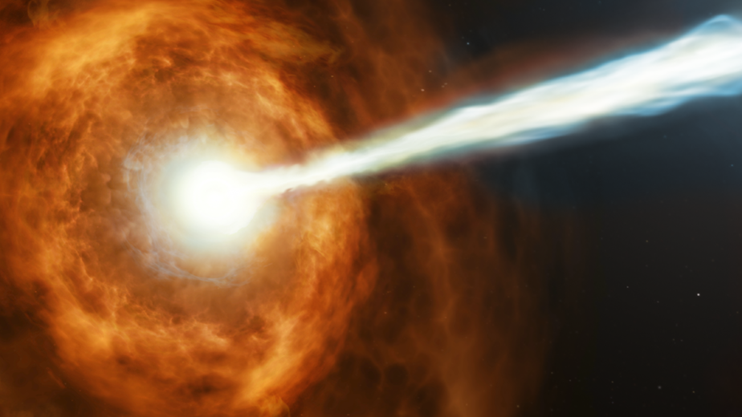
High-Energy emission in GRB prompt spectrum
Samanta Macera, 2nd year PhD progress report
Supervisors:
Prof. Marica Branchesi
Dr Gor Oganesyan
Dr Biswajit Banerjee

Slide 2
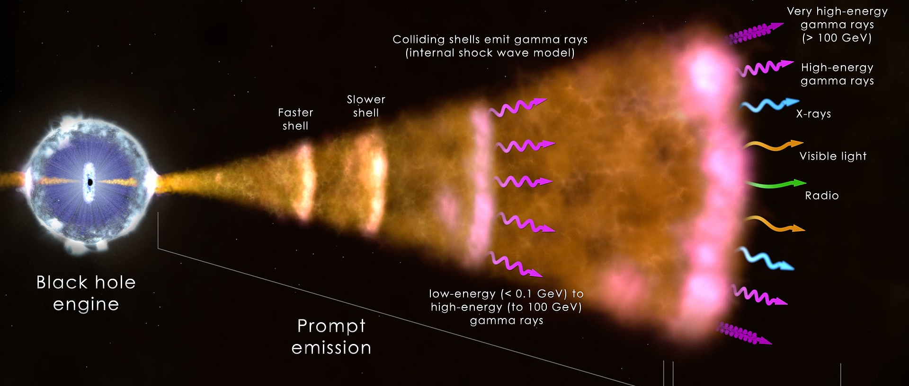
GRB phenomenology

Slide 3
Main Goal: study of the nature of prompt emission of Gamma-ray bursts
How?
Systematic analysis of a selected sample of GRBs to study the High-Energy emission
Follow up of the brightest GRB of all time → First detection of a MeV emission line in a GRB prompt spectrum

Slide 4
Detection of High-Energy photons temporally coincident with prompt emission
Prompt-related?
Afterglow?
…?

Slide 5
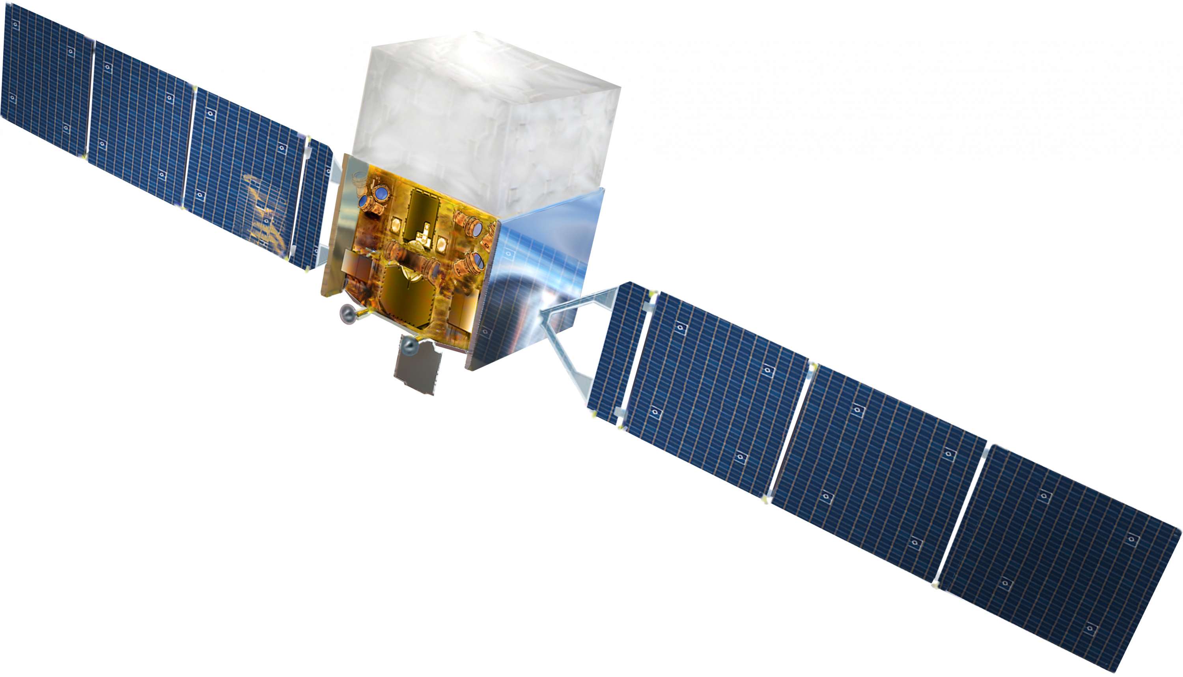
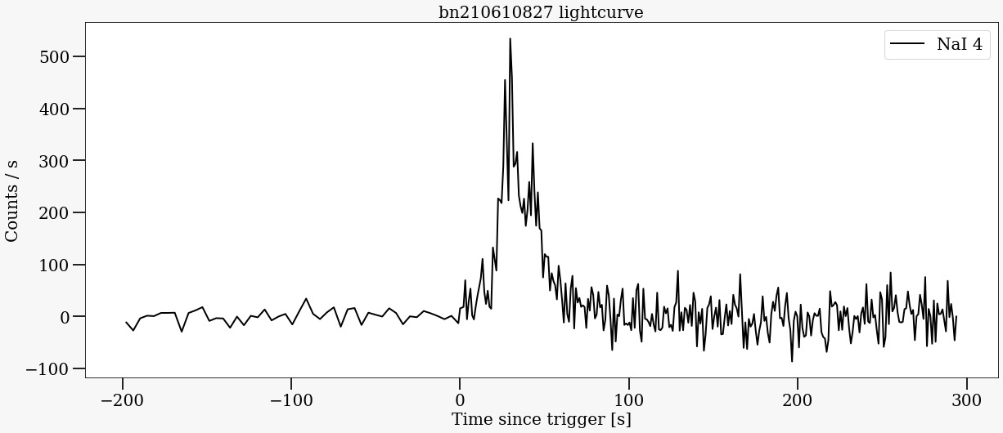
Prompt Emission: Internal Shocks Model
GBM LC
$$Γ_{1}$$
$$Γ_{2}$$
$$Γ_{1}>Γ_{2}$$
Shock Formation

Slide 6
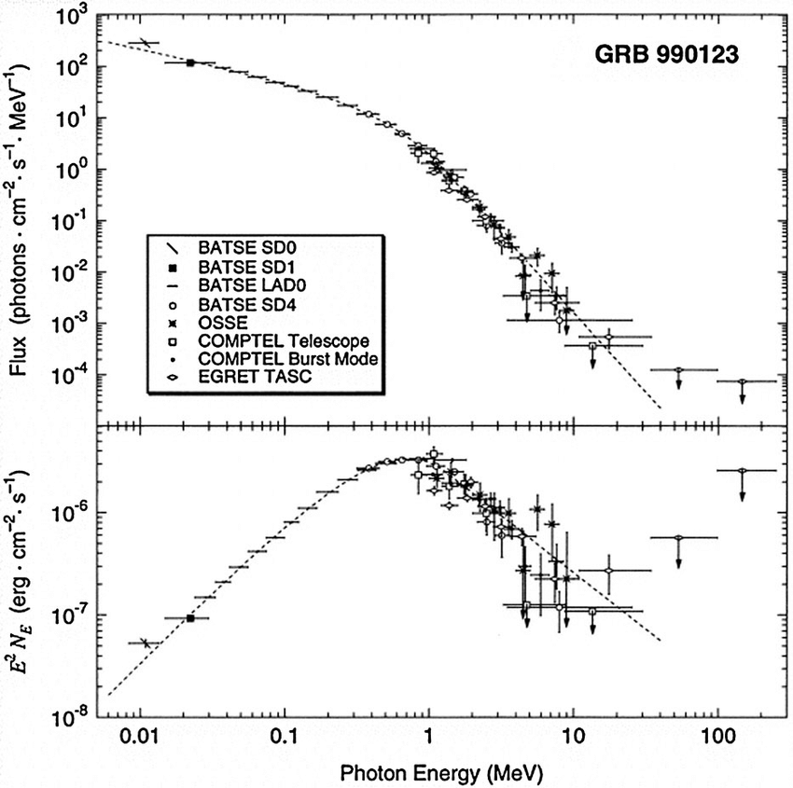
Prompt Emission:
Band Model
$$N\left(E\right)∝ \left\{\begin{aligned} E^{α} E<(α−β)E_{0} \\ E^{β} E≥(α−β)E_{0}\end{aligned}\right.$$
Briggs et al. 1999

Slide 7
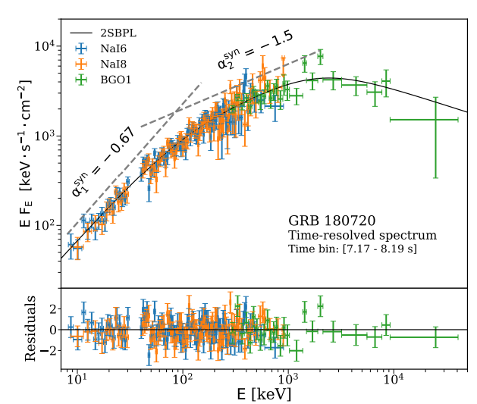
Prompt Emission: X-ray data and energy breaks
Ravasio et al. 2018

Slide 8
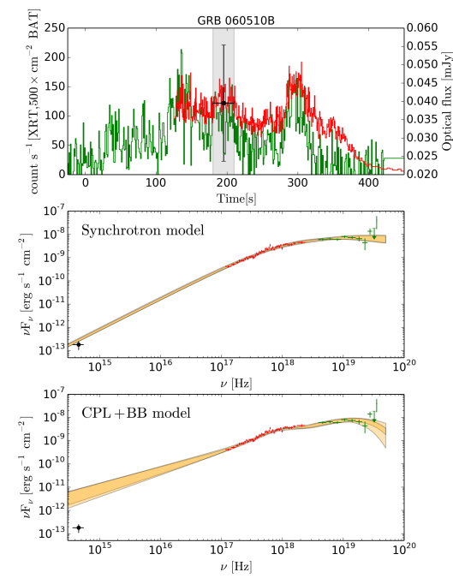
Prompt Emission:
towards a synchrotron model
Synchrotron
Prediction of optical flux
Burgess et al 2020
Zhang et al 2020
…
Oganesyan et al. 2019

Slide 9
Early GeV emission
Detection of High-Energy Photons during the prompt phase

Slide 10
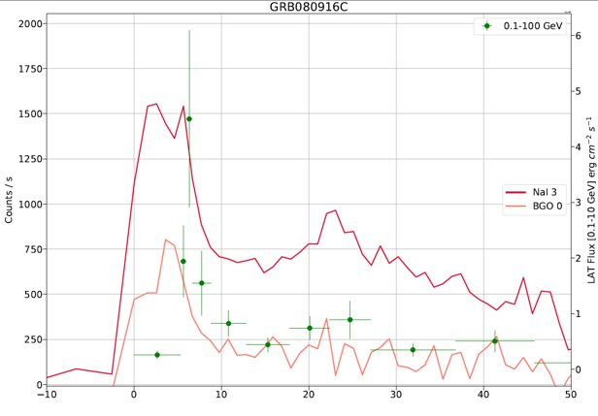
Early GeV Emission
Simultaneous detection between Fermi-GBM and Fermi-LAT
Delayed
Follows prompt variability
[0.1-100 GeV]

Slide 11
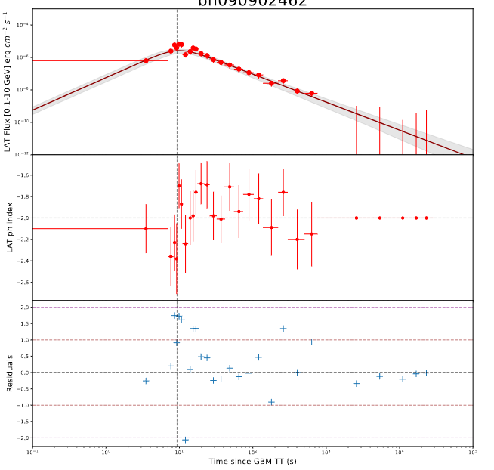
Early GeV Emission
GRB 090902B
LAT Lightcurve
(0.1-100GeV)
Afterglow LC evolution
Some points are in excess wrt the afterglow time evolution
Time evolution not enough to claim afterglow origin
Spectral analysis + Temporal analysis needed

Slide 12
Study of the prompt emission Spectrum
Extention to higher energies
+
Physical model for the prompt

Slide 13
Sample and Spectral Analysis
At least three significant temporal bins (>5 𝜎 detection) simultaneous with Fermi-GBM
GRBs with and without redshift up to year 2023
At least 20 photons within 10° of region of interest around the GRB location
GBM + LLE + LAT
--> total energy range
from 8 keV to >100 GeV
Time resolved spectral analysis of 14 GRBs, 80 spectra

Slide 14
Sample
GRB 080916C
GRB 090323
GRB 090510
GRB 090902B
GRB 090926A
GRB 110731A
GRB 150523A
GRB 160509A
GRB 160625B
GRB 170214A
GRB 190114C
GRB 221023A

Slide 15
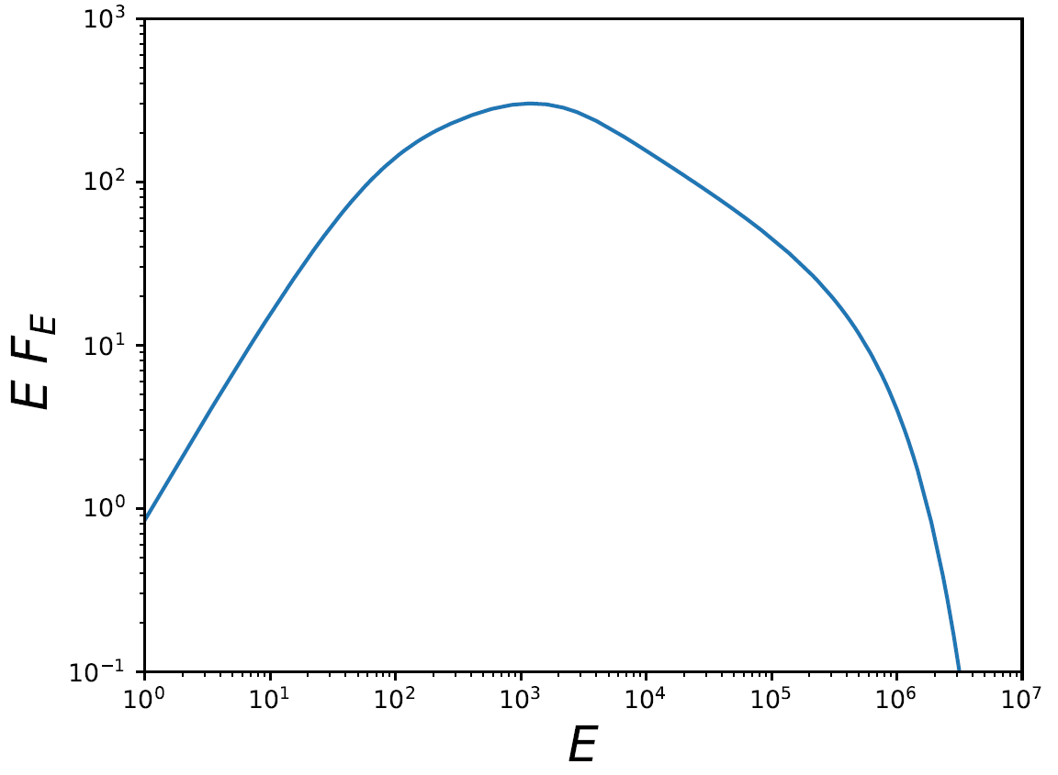
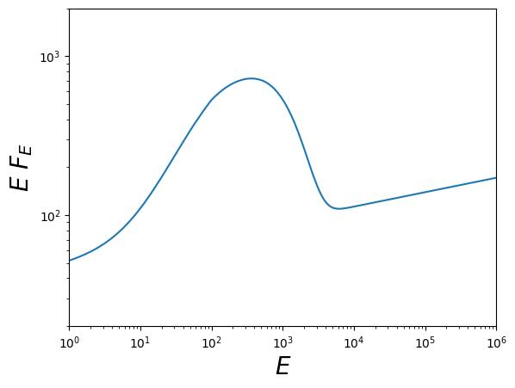
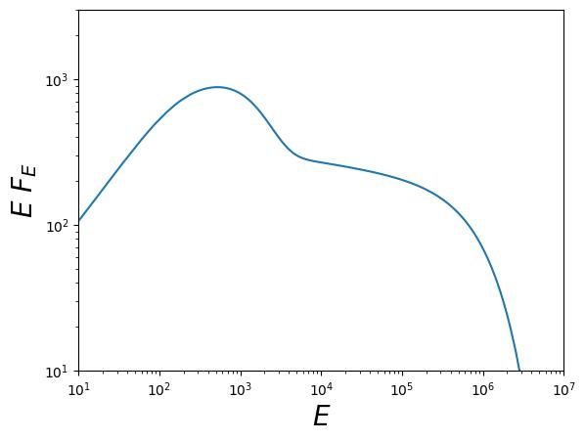
Tested Models
Synchrotron*HE cutoff
Synchrotron + Power Law
Synchrotron + Cutoff Power Law
$$υ_{c},υ_{m}$$
$$p$$
$$υ_{c},υ_{m}$$
$$υ_{c},υ_{m}$$
$$E^{−δ}$$
$$E^{−δ}$$
$$E_{cutoff}$$
1
2
3

Slide 16
Results
Two groups
1
2
High-Energy emission dominated by synchrotron
High-Energy emission dominated by power law
10 GRBs
4 GRBs
(no improvements in the fits using Model 3)

Slide 17
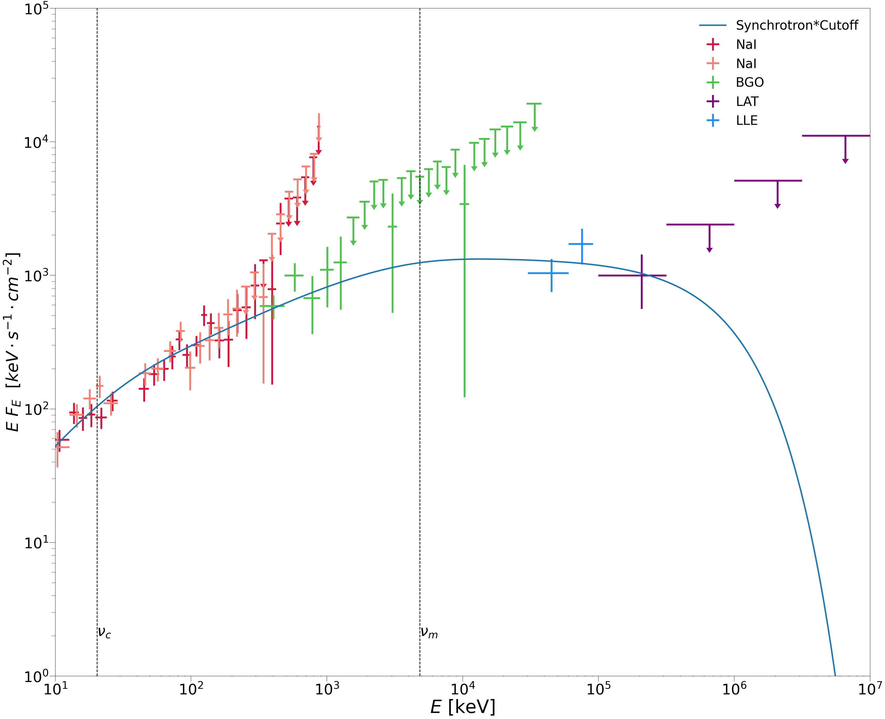
Results
1
2
GRB 080916C
GRB 221023A

Slide 18
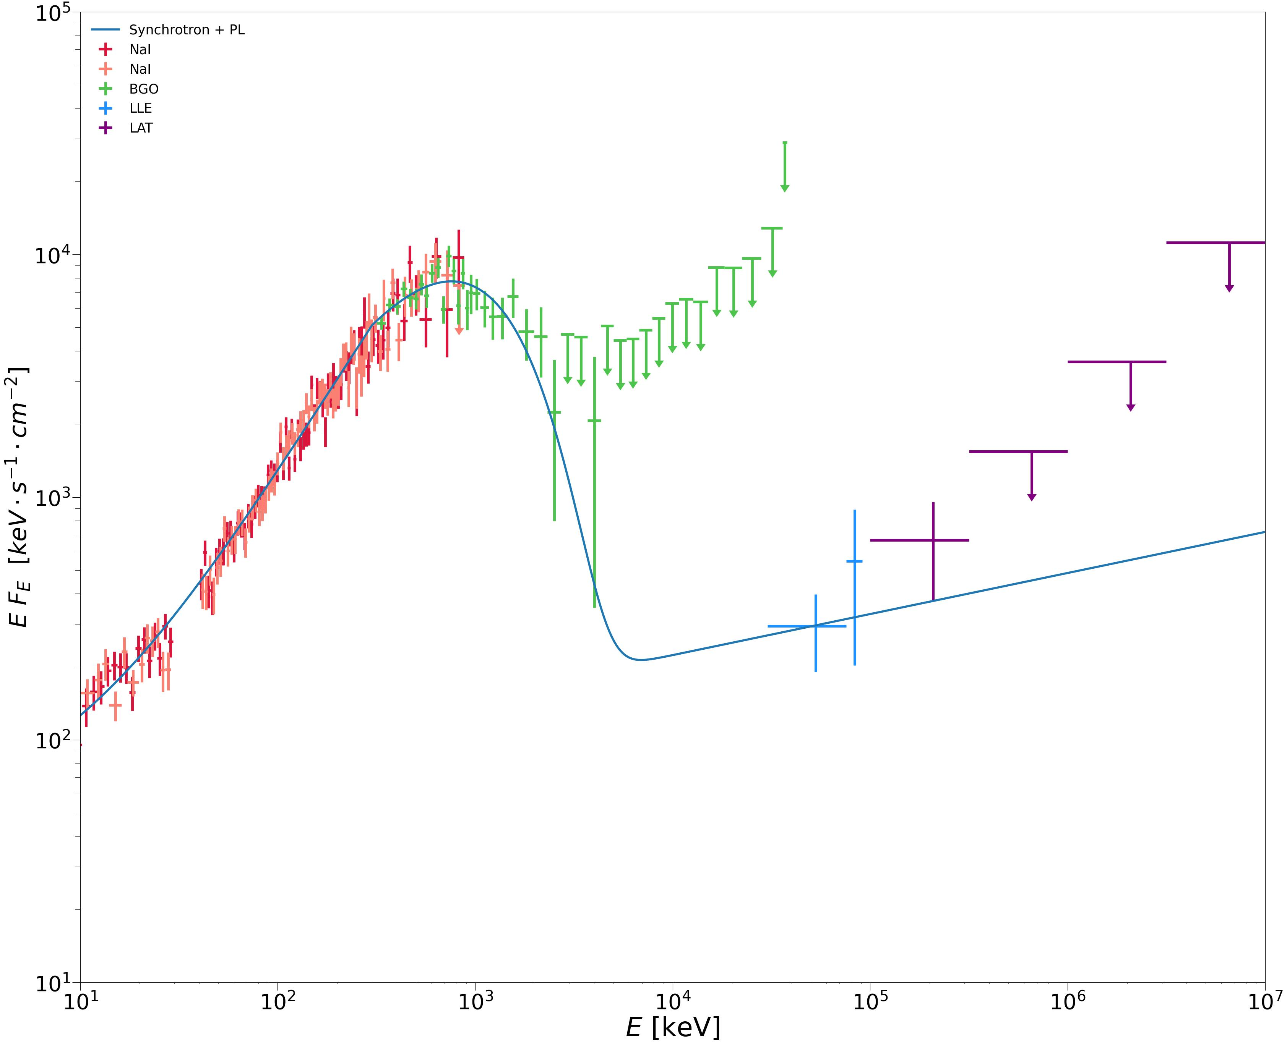
Results
2
GRB 090902B

Slide 19
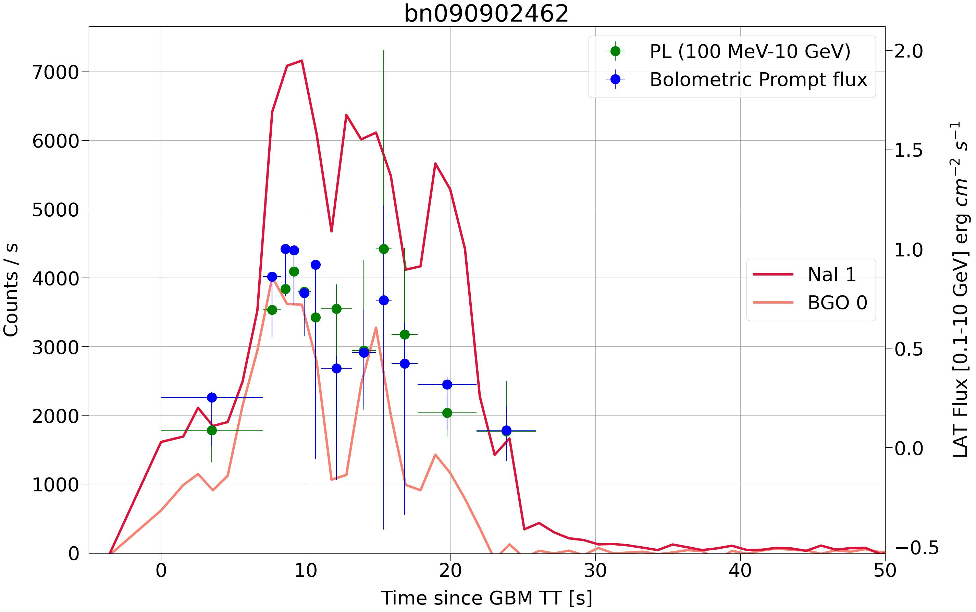
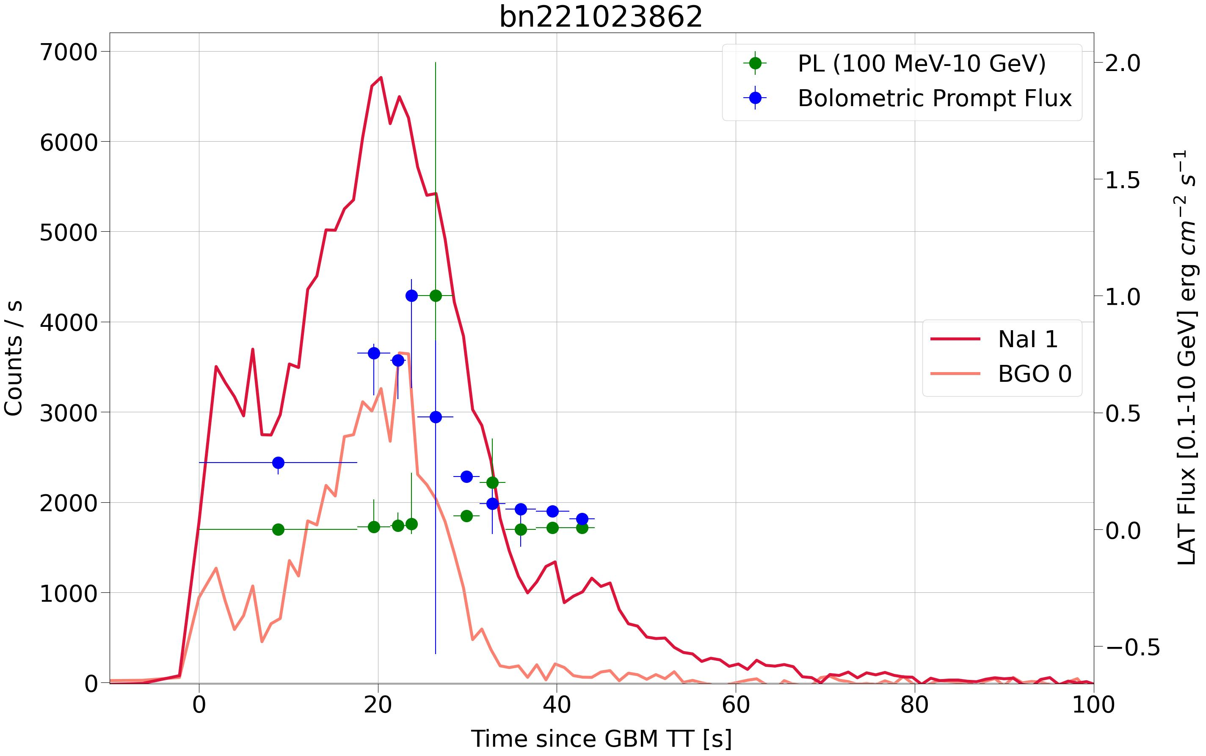
Temporal evolution of the power law flux
GRB090902B
GRB221023A
PL component following Synchrotron evolution
PL $\sim$ Constant → Afterglow ?

Slide 20
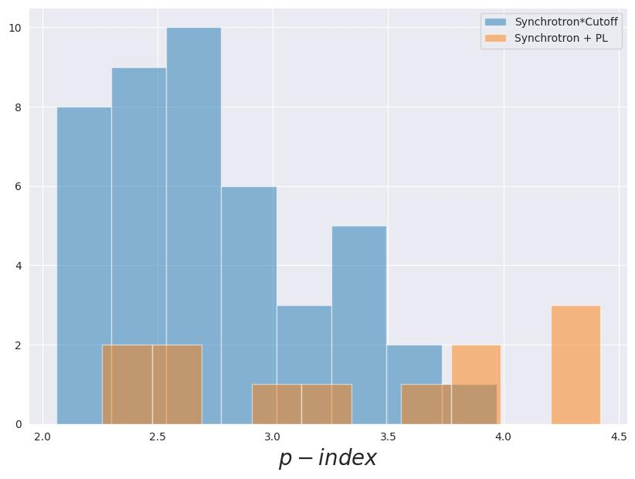
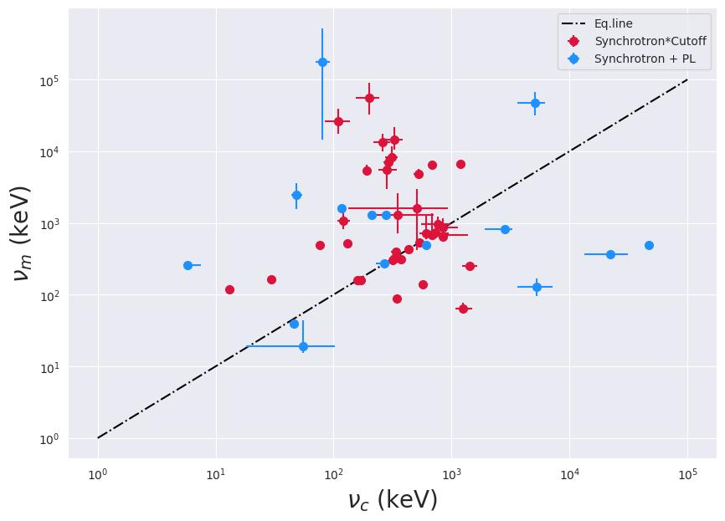
Parameter Space of Synchrotron

Slide 21
Results
In the majority of cases the HE emission can be explained as synchrotron emission
There are few cases for which a power law is needed; futher analysis are required to explain its nature

Slide 22
BOAT GRB:
Evolving MeV Emission Line
M. E. Ravasio, O.S. Salafia, G. Oganesyan, A. Mei, G. Ghirlanda, S. Ascenzi, B. Banerjee, S. Macera, M. Branchesi, P.G. Jonker, A.J. Levan, D.B. Malesani, K.B. Mulrey, A. Giuliani, A. Celotti and
G. Ghisellini

Slide 23
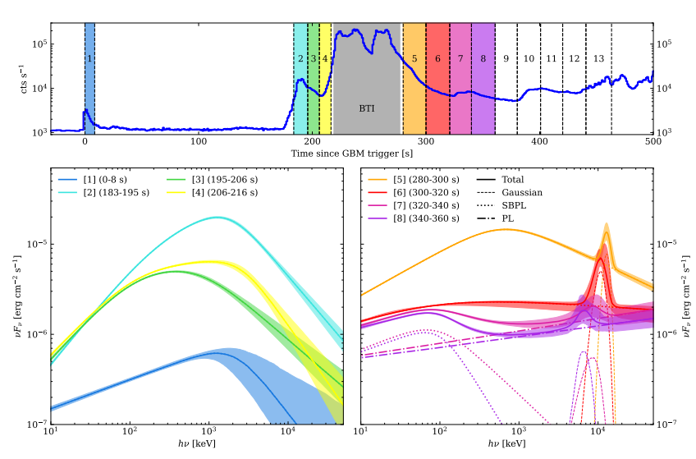
GRB 221009A
$E_{line } 12 MeV →6 MeV$
$L_{line } {10}^{50}erg/s →2×{10}^{49} erg/s$
(See Alessio Mei’s talk)
Ravasio et al 2023, under review Science

Slide 24
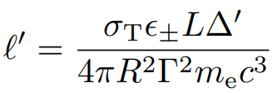
Interpretations
Blue-shifted pair annihilation line: Scenario 1
$$e^{−}e^{+}$$
$$Γ_{2}$$
$$Γ_{1}\sim 20$$
Large compactness parameter
Optically thick to Thompson scattering
Compactness drops after the end of the brightest pulse → Line fades away after pair creation stops

Slide 25
Interpretations
Blue-shifted pair annihilation line: Scenario 2
High Latitude Emission
$$θ$$
$$e^{−}e^{+}$$
$$Γ_{1}\sim 1000$$
$$θ>1/Γ$$
$$t> t_{dyn}$$
Doppler factor
$$δ=\frac{1}{Γ}(1−β\cos{θ})$$
$$E_{line}= δm_{e}c^{2}$$
HLE can be observed if luminosity drops

Slide 26
What’s next?
Electromagnetic follow-up of gravitational waves events
Modelling of the HE prompt component → Implications for Large Size Telescope (20 - 150 GeV)
Implications of anysotropic particle distribution function on the prompt and afterglow spectrum
Study of HE and VHE emission from prompt and afterglow, both on axis and off axis
Publications
Ravasio, Maria Edvige, et al. ”A bright megaelectronvolt emission line in γ-ray burst GRB 221009A.” arXiv e-prints (2023): arXiv-2303.
Macera, Samanta et al. ”High-Energy spectral component of the prompt emission of GRBs”, in preparation
Alladio, Franco et al. ”PROTO-SPHERA: a magnetic confinement experiment which emulates the jet + torus astrophysical plasmas”, submitted to Plasma Physics and Controlled Fusion.

Slide 27
Backup slides

Slide 28
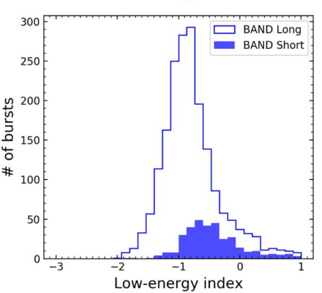
Synchrotron line of death problem:
α should not exceed −2/3 for an optically thin shocked material
Prompt Emission:
Band Model
If the effects of the synchrotron cooling are also taken into account the index can lie in the range of −3/2 to −2/3
Poolakkil et al. 2021
$$N\left(E\right)∝ \left\{\begin{aligned} E^{α} E<(α−β)E_{0} \\ E^{β} E≥(α−β)E_{0}\end{aligned}\right.$$
Inconsistency between α = -1 and $α_{fast cooling}=−\frac{3}{2}$
Spectral width observed is too narrow

Slide 29
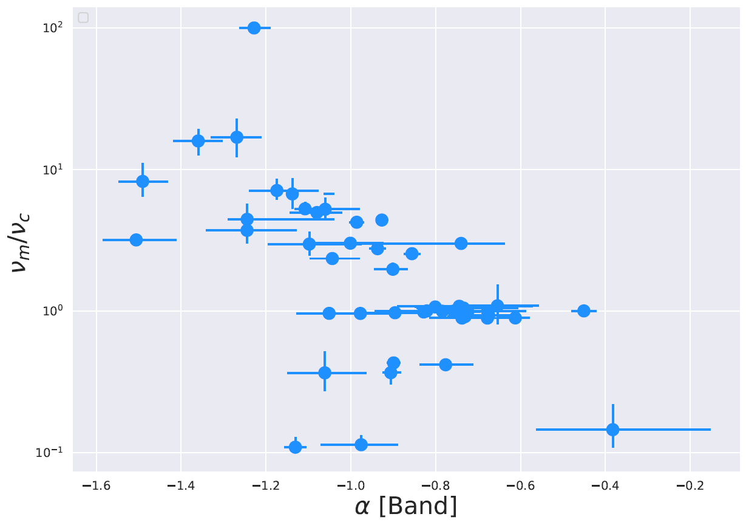
Parameter Space of Synchrotron
Fast Cooling
Slow Cooling
Poolakkil et al. 2021

Slide 30
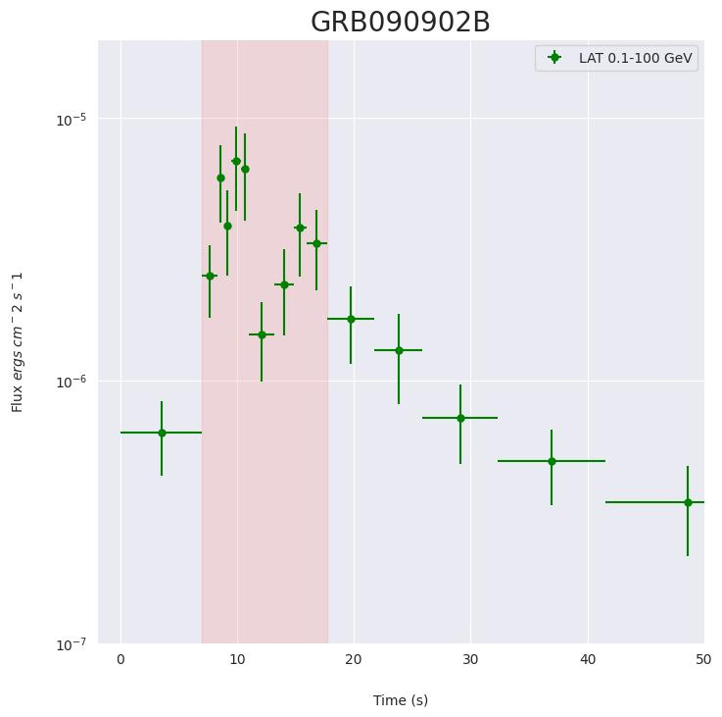
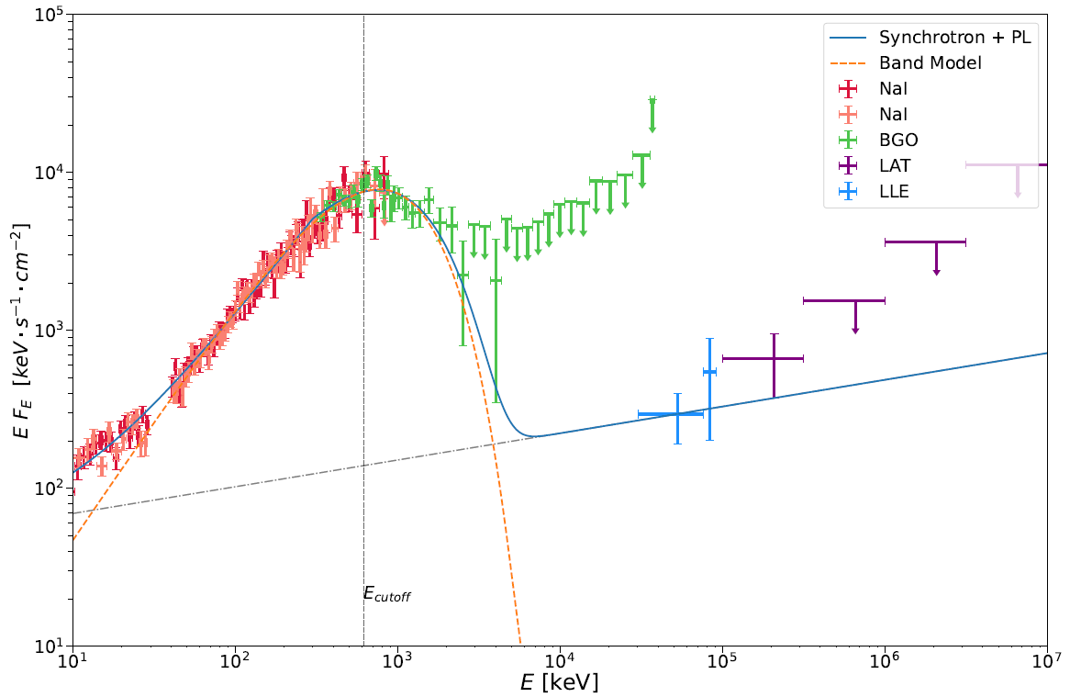
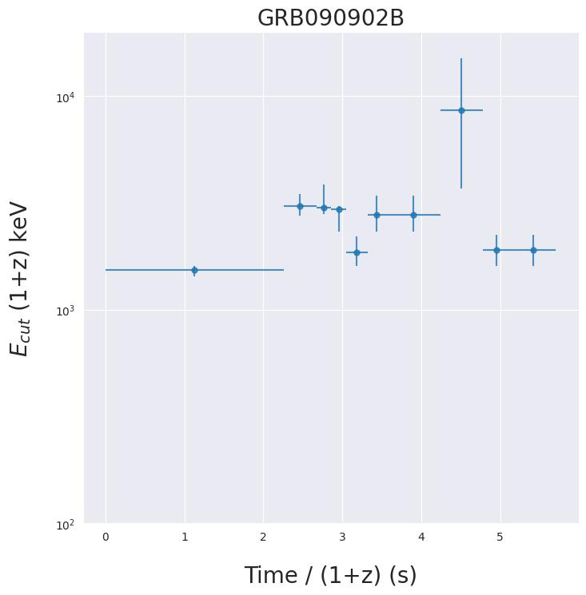
Group 2: HE dominated by power law

Slide 31
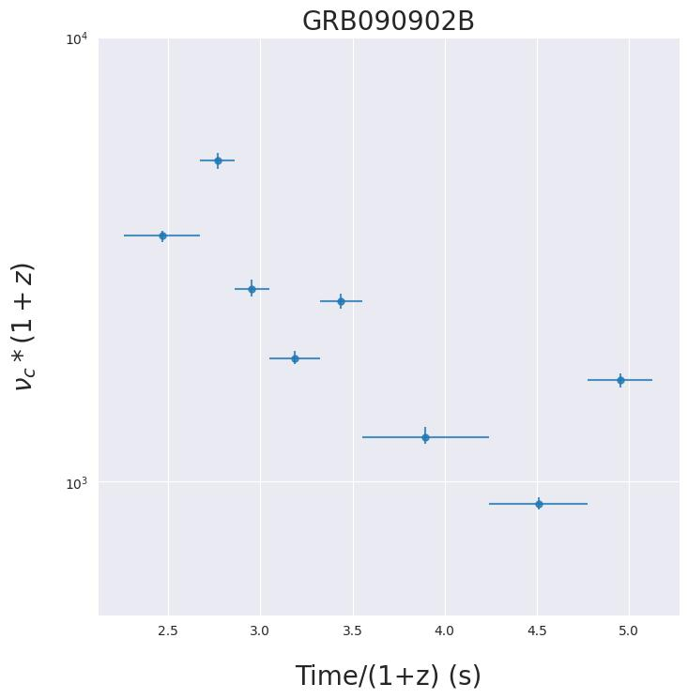
Group 2: HE dominated by power law

