Slide 1
@alfonsocelotto
Social Network regulation

Slide 2
Opening question
What are social networks today?
tools for work,
for communication,
for information,
for life…
...a new whole world? New Countries?

Slide 3
Numbers (1)
Facebook has nearly 3.1 billion users
WhatsApp has 1.6 billion subscribers with over 65 billion messages per day
Instagram has 1 billion users
TikTok has 800 million
and so on…

Slide 4
Numbers (2)
Facebook is blocked in China, Iran, North Corea, Syria, Russia…
Today, half of the world's population spends his days on Facebook

Slide 5
Facebook is a Country?
The three traditional requisites of a Country are:
People
Territory
Government
Can we assume that Facebook has its own people, territory and government today?
Can Facebook be considered an autonomous Country?

Slide 6
The social network regulation (and Human rights)
What ?
Who ?
When?
Where?
Why?

Slide 7
Human Rights
FIRST GENERATION: civil and political rights (XIX century)
SECOND GENERATION: economic, social and cultural rights (XX century – first part)
THIRD GENERATION: solidarity rights (XX century – second part)
FOURTH GENERATION: new rights related to respect for humans in the context of new technologies (XXI century)

Slide 8
CHARTER OF FUNDAMENTAL RIGHTS OF THE EUROPEAN UNION (2001)
«…it is necessary to strengthen the protection of fundamental rights in the light of changes in society, social progress and scientific and technological developments…»

Slide 9
What - positive side
Social networks have both positive and negative impacts on human rights.
On the positive side, they can provide a platform for freedom of expression, allowing individuals to share their opinions, ideas, and information with a wide audience. Social networks have played a crucial role in promoting social and political activism, enabling people to organize and mobilize for various causes and movements.

Slide 10
What – negative side
There are also concerns and challenges related to human rights in the context of social networks:
Privacy
Hate speech
restriction on freedom of expression
Fake news

Slide 11
Who?
National Regulations
International Regulations
Self-Regulation

Slide 12
National Regulations
National laws and regulations govern social networks. For example:
In the United States, the Children's Online Privacy Protection Act (COPPA) regulates the collection of personal information from children under the age of 13.
Germany's NetzDG requires social media platforms to promptly remove illegal contents, such as hate speech and fake news, or face significant fines. It aims to combat online hate speech and ensure platforms take responsibility for moderating contents. Fines of up to 5 million euros if platforms fail to remove content.

Slide 13
International Regulations
International organizations have also developed guidelines and standards for regulating social networks. For example:
the General Data Protection Regulation (GDPR) in the European Union regulates the use of personal data on social networks
the United Nations has developed guidelines on the use of social media during election campaigns.

Slide 14
Self-Regulation
Social networks have their own policies and terms of service. For example, Facebook prohibits hate speech and harassment, and Twitter prohibits the promotion of violence. Violations of these policies can result in the suspension or termination of a user's account.
«Guidelines» in social networks refer to the set of rules and policies that govern user behavior and content on the platform. These guidelines are designed to create a safe and inclusive environment, regulate content standards, and prevent abuse or misuse of the platform

Slide 15
Guidelines (1)
Community Standards: Social networks establish community standards that outline acceptable behavior and content on the platform. These standards typically prohibit hate speech, harassment, bullying, threats, violence, nudity, and other forms of harmful or inappropriate content.
Content Moderation: Social networks implement content moderation practices to review and remove content that violates their guidelines. Moderation can be carried out through automated systems, user reports, and human review teams.
Privacy and Data Protection: Guidelines in social networks address privacy and data protection concerns. They define how user data is collected, stored, and shared, and outline the platform's commitment to user privacy.

Slide 16
Guidelines (2)
Intellectual Property: Guidelines often include provisions related to intellectual property rights. They prohibit the unauthorized use or distribution of copyrighted materials, trademarks, or other protected content.
User Conduct: Guidelines typically outline the expected behavior of users on the platform. This may include guidelines on respectful communication, non-discrimination, and adherence to legal and ethical standards.
Enforcement and Penalties: Social networks establish enforcement mechanisms to deal with violations of their guidelines. They may issue warnings, suspend or terminate user accounts, or take other actions based on the severity of the violation.

Slide 17
Cases (1)
If you were expelled from a social network, who would you appeal to?

Slide 18
Forza nuova
At the end of 2019, Facebook closed the profile of the political organization Forza Nuova: they repeatedly violated the "community standards," specifically regarding the removal of content that incites hate and violence.
Forza Nuova's urgent appeal was rejected by the Rome Court.
Court noted that the content of the pages that were taken down is openly contrary to the fundamental values enshrined in numerous international and European documents, all of them united by the prohibition of discrimination, which is an inviolable limit to freedom of expression (Rome Court, Section for Human Rights and Civil Immigration, February 23, 2020, case no. 64894/2019).

Slide 19
Trump
«They are trying to STEAL the Election»
In 2021, Twitter and FB permanently banned former US President Donald Trump from their platform for inciting violence.

Slide 20
> Oversight Board
Trump did not appeal to a regular court, but the case was reviewed by the «oversight board».
The «oversight board» reviewed the suspension and issued a ruling on May 5, 2021. The board decided to uphold the suspension but criticized Facebook for imposing an indefinite penalty and called on the company to review the decision within six months.

Slide 21
«Oversight Board»
Independent «body» established by Facebook to review and make decisions on content moderation issues.
The board is composed of a diverse group of experts from around the world, including scholars, human rights advocates, journalists, and former political leaders.
It operates independently of Facebook and has the authority to make binding decisions on specific cases related to content removal, user bans, and other enforcement actions taken by Facebook.
The board aims to ensure that Facebook's content moderation decisions are fair, consistent, and aligned with human rights principles.

Slide 22
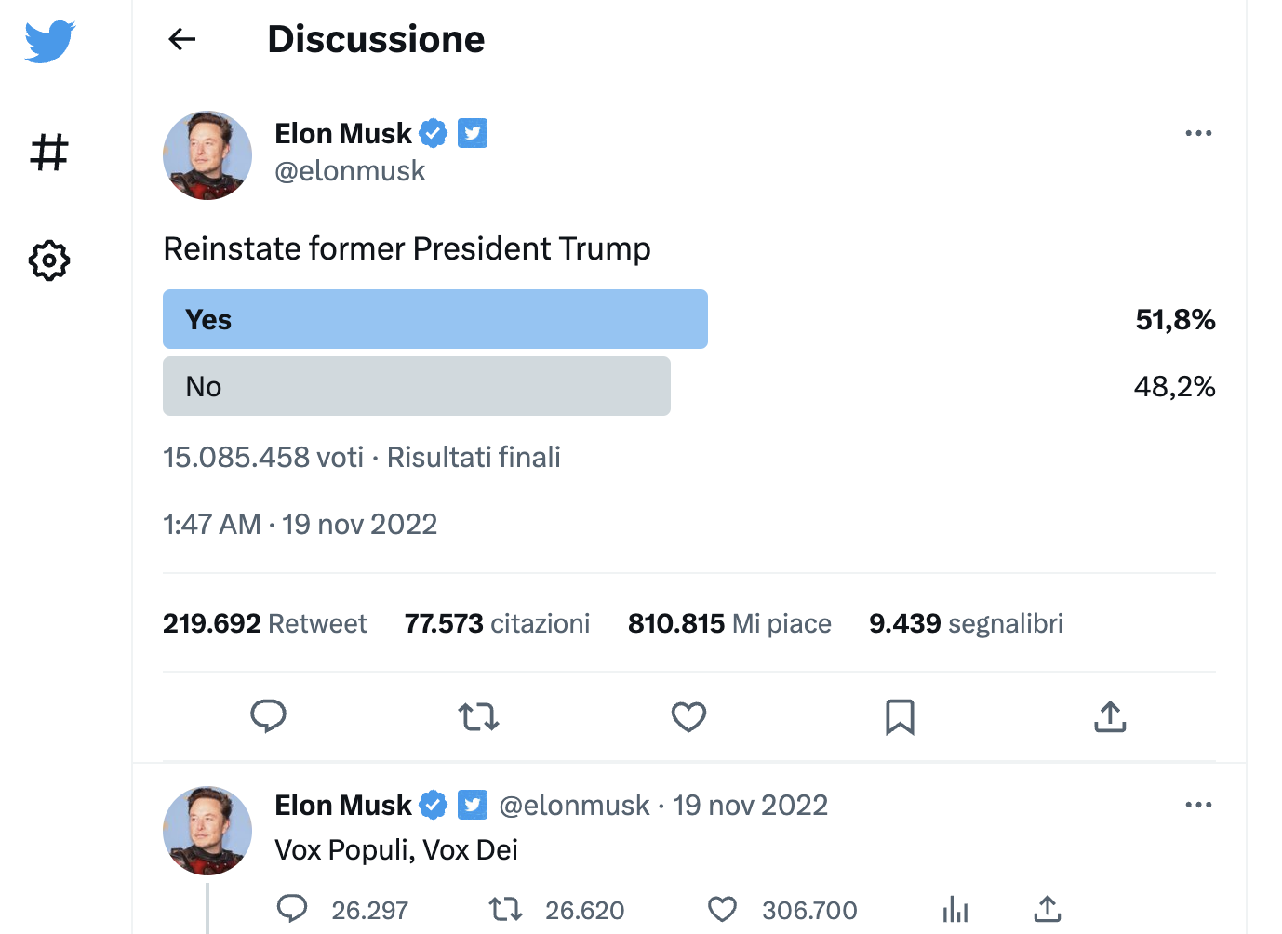
Different solution in twitter

Slide 23
How many votes?
To re-entry of Trump, it is reported that 15,085,458 users voted, and the former president was reinstated with approximately 7,845,000 votes.
Please note: in TW are active approximately 237 million of users!
Trump received the votes of 3.3% of active users on the social platform.
«Vox populi, vox Dei»? (medieval phrase used by Alcuin at the court of Charlemagne)

Slide 24
democracy (2)
Social networks have a significant impact on democracy.
They facilitate the rapid spread of information, empower political mobilization, and provide platforms for public discourse and deliberation.
Social networks are used in election campaigns and political advertising, but concerns exist about transparency and misinformation. They enable citizen journalism and fact-checking efforts.
However, challenges such as misinformation, algorithmic biases, and privacy concerns need to be addressed. Overall, social networks have both positive and negative effects on democracy and require ongoing scrutiny and regulation.

Slide 25
Cambridge Analytica
Cambridge Analytica provided the staff of Donald Trump with the psychological profiles of hundreds of millions of US voters, enabling the creation of personalized political advertisements aimed at influencing the 2016 US presidential elections. During the six-month election campaign, Trump's staff created 5.9 million variations of messages for his electorate, demonstrating the effectiveness of profiling for message customization.
In 2019, Facebook reached a settlement with the US Federal Trade Commission (FTC) to pay a record-breaking fine of $5 billion in relation to the violation of user privacy and its mishandling of personal data following the Cambridge Analytica scandal.

Slide 26
Block on ChatGPT in Italy
The Italian Data Protection Authority has blocked the use of ChatGPT in Italy: it did not ensure access for minors and did not provide adequate information on data processing.
(Decision No. 114 of April 11, 2023).
Partial effect only:
with a simple VPN, you could continue to use ChatGPT in Italy.
After 20 days, the platform has complied with the new regulations.

Slide 27
The power of the State
Today, when you enter in the platform, you will find a form regarding age and data processing.
Let's think about it: after the intervention of the Italian government, are our rights better protected in ChatGPT?

Slide 28
Power of social network
f Italy had direct election of the president today who would win?
a political leader as Giorgia Meloni or an influencer as Chiara Ferragni?

Slide 29
Final question
Are we subjects or citizens?
(How much democracy is there
inside social networks?)

Slide 30
We have fought for centuries for no longer being mere subjects, in order to achieve a role in the decision-making process democratically
Today, on social media, we users once again become subjects
Do we have participation in the fundamental decisions regarding the management of these social platforms?
Do we take part in? We need a co-regulation, to involve users and the entire chain of stakeholders in the formulation of rules.
Can we reclaim our status as citizens?

