Slide 1
https://github.com/SPECFEM/specfem3d
Introduction to simulation tools for LGWA
SPECFEM3D
Soumen Koley, Jan Harms et al.
GSSI, L’Aquila, Italy
Simulation courtesy: Dimitri Komatitsch - shows the propagation of seismic acoustic waves on Mars (several times around the planet) during a surface impact (eg meteorite).

Slide 2
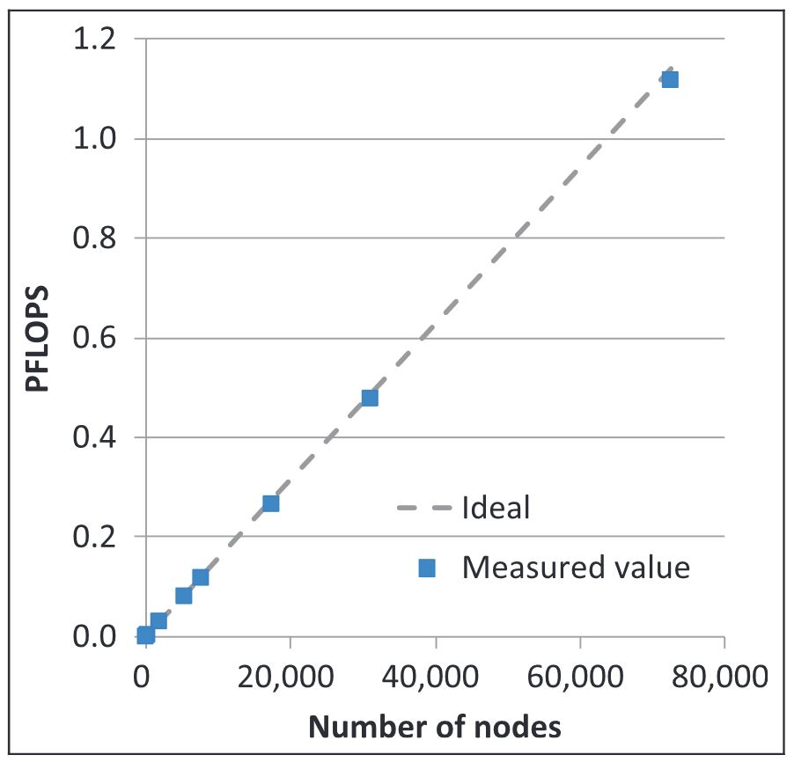
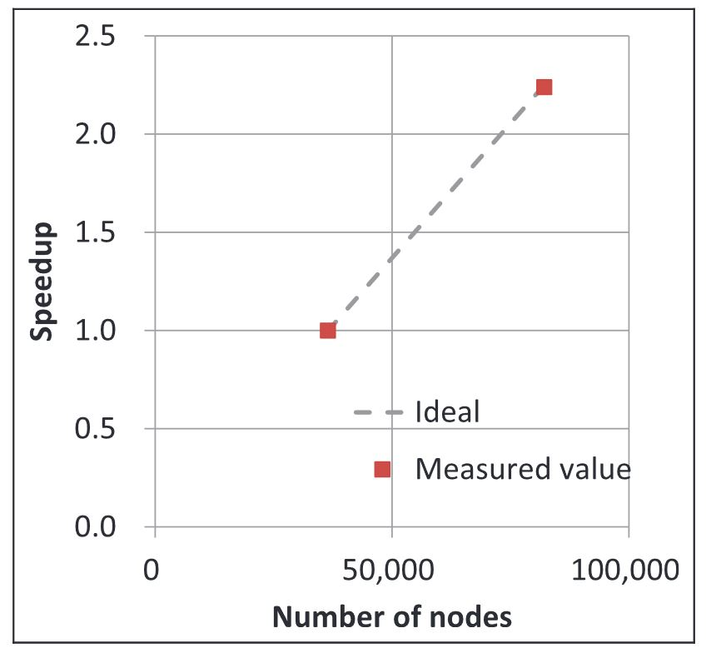
SPECFEM3D - Introduction
A classic seismic wave propagation software for acoustic, elastic, viscoelastic, poro-elastic medium optimized for high performance computing (Komatitsch et al., 2010)
FORTRAN + Message Passing Interface (MPI) + python wrappers (high-level)
MPI + GPUs + better algorithms: even better performance
SPECFEM performance is excellent w.r.t. both weak and strong scaling (Tsuboi et al. 2016)
Weak Scaling: Both number of processers and the problem size increases
Strong scaling: Problem size remains same, but the number of processors increase
$Speed up=\frac{t\left(1\right)}{t\left(N\right)},$ where $t\left(1\right),$ $t(N)$ is the time taken to execute the main time loop of the code for $1$, and $N$ nodes respectively
Problem size = $3,744$ elements per slice; $82,134$ slices, $6.65×{10}^{11}$ grid points
Physical time length of the seismogram = 7 min (about $43,000$ time-steps)
Weak scaling
Strong scaling
FLOPS = floating point operations

Slide 3
SPECFEM3D Motivation – Forward vs Inverse problem
General non-linear set up of our problem
$G\left(m\right)=d$ (1)
Where $G$ is the simulation function or the kernel
$m$ are the model parameters – in our case P (S)-wave velocity, density, Quality factor
$d$ are the observed variables – in our case, ground motion recorded (traces)
Given we know the physical process
Use $m$ to determine $d$ – Forward Problem
Use $d$ to determine $m$ – Inverse problem (seismic imaging)

Slide 4
SPECFEM3D - An example forward problem
Simulation domain is $400 km× 300 km× 60 km$
A total of $1,999,200$ elements
$7$ GLL ($7^{3}$ grid points ) points per element – a total of 442,592,131 grid points
Maximum grid point distance of about $5000 m$ at the bottom and about $92 m$ on the surface
time step of $0.002 s$ and iterated $100,000$ time-steps ($200 s$ total)..
The calculation took about $12.0$ hours on $240$ cores ($2880$ CPU-hours) on the high-performance computing cluster
Computer simulations for three earthquakes near Nenana basin, a sedimentary basin west of the town of Nenana on the Parks Highway between Fairbanks and Anchorage. Credit: Carl Tape

Slide 5
SPECFEM3D – Physics of elastic wave propagation
The wave equation is given by
$ρ\left(\vec{x}\right)\ddot{u} (\vec{x},t)+ ∇.T\left(\vec{x},t\right)=f\left(\vec{x_{s}},t\right) (2)$
where $T\left(\vec{x},t\right)=C\left(\vec{x}\right) :∇u\left(\vec{x},t\right) (3)$
$C(\vec{x})$ is the fourth order elasticity tensor
SPECFEM seeks a spectral element solution to this problem (Komatitsch & Tromp, 1999, 2002a, 2002b)
Continuous Galerkin method
Basis function generated using Lagrange polynomials at each GLL (Gauss-Lobatto-Legendre) points per element
Eqn (2) can be rewritten in FEM domain as
$M\ddot{u}+Ku=F$, where is $M$ is diagonal (4)
$\ddot{u}=M^{−1}\left(F−Ku\right) (5)$

Slide 6
SPECFEM3D – Some details of the SE-model
Explicit Newmark time stepping (Rietmann, 2017)
$M{\ddot{u} }_{n+1}+Ku_{n+1}=F_{n+1} (6)$
$u_{n+1}=u_{n}+Δt{\dot{u}}_{n}+\frac{Δt^{2}}{2}{\ddot{u}}_{n} \left(7\right)$
${\dot{u}}_{n+1}={\dot{u}}_{n}+\frac{Δt}{2}\left({\ddot{u}}_{n+1}+{\ddot{u}}_{n}\right) \left(8\right)$
$Δt{\left(\frac{c_{P}}{Δx}\right)}_{max}≤c$ : Courant–Friedrichs–Lewy condition
Last step: MPI called across mesh boundaries - synchronizing
Meshing
Only hexahedral elements supported
Setting up the model can be done in CUBIT (previously Trellis)
In case of tetrahedral meshes – other software like ADER-DG can be used (discontinuous Galerkin)

Slide 7
SPECFEM3D – Building the mesh
The first step in running a spectral-element simulation consists of constructing a high-quality mesh for the region under consideration
relying on the external, hexahedral mesher CUBIT
internal mesher xmeshfem3D
Using CUBIT is preferred
Using journal files – setting up scripts that can help keep track of changes and automate the process
Integration of CUBIT with python
GEOCUBIT is a python package maintained by Emanuelle Casarotti at INGV that helps I/O between SPECFEM3D and CUBIT
pyLith has useful examples of mesh-generation

Slide 8
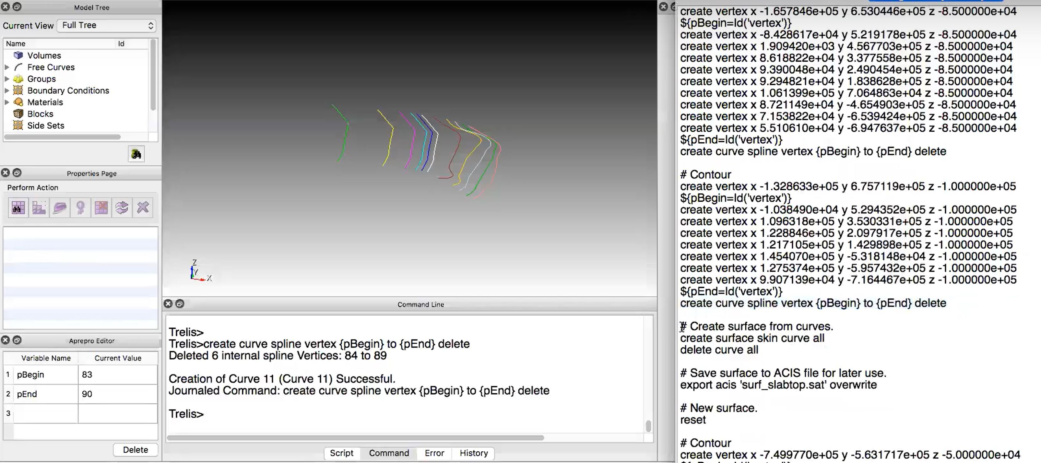
SPECFEM3D – Building the mesh – the steps (contours)
Generating contours
A CUBIT instance showing the few contours that are generated by the commands shown in the journal file (right)

Slide 9
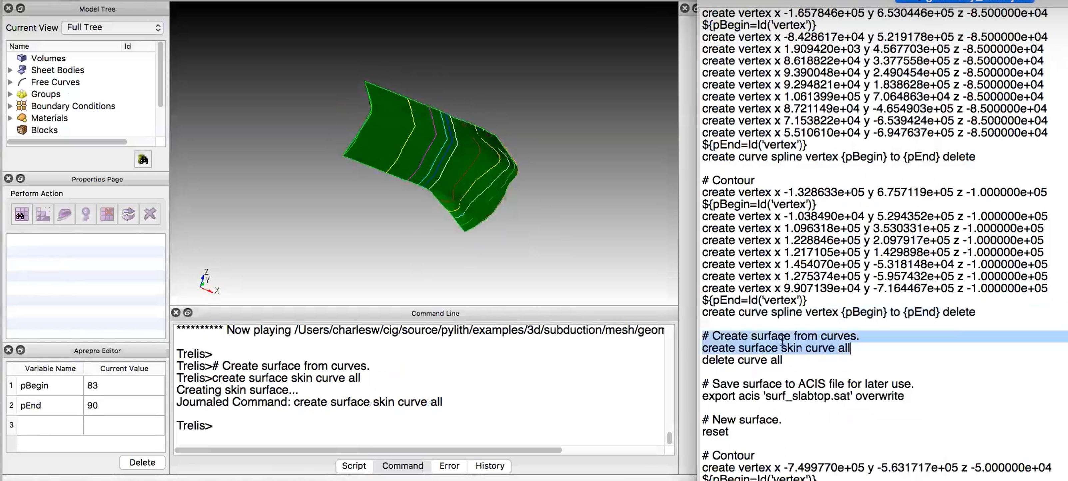
SPECFEM3D – Building the mesh – the steps (surfaces)
Generating contours
Constructing a surface using the contours
A CUBIT instance showing surface generated using the contours corresponding to the command “create surface skin curve all”

Slide 10
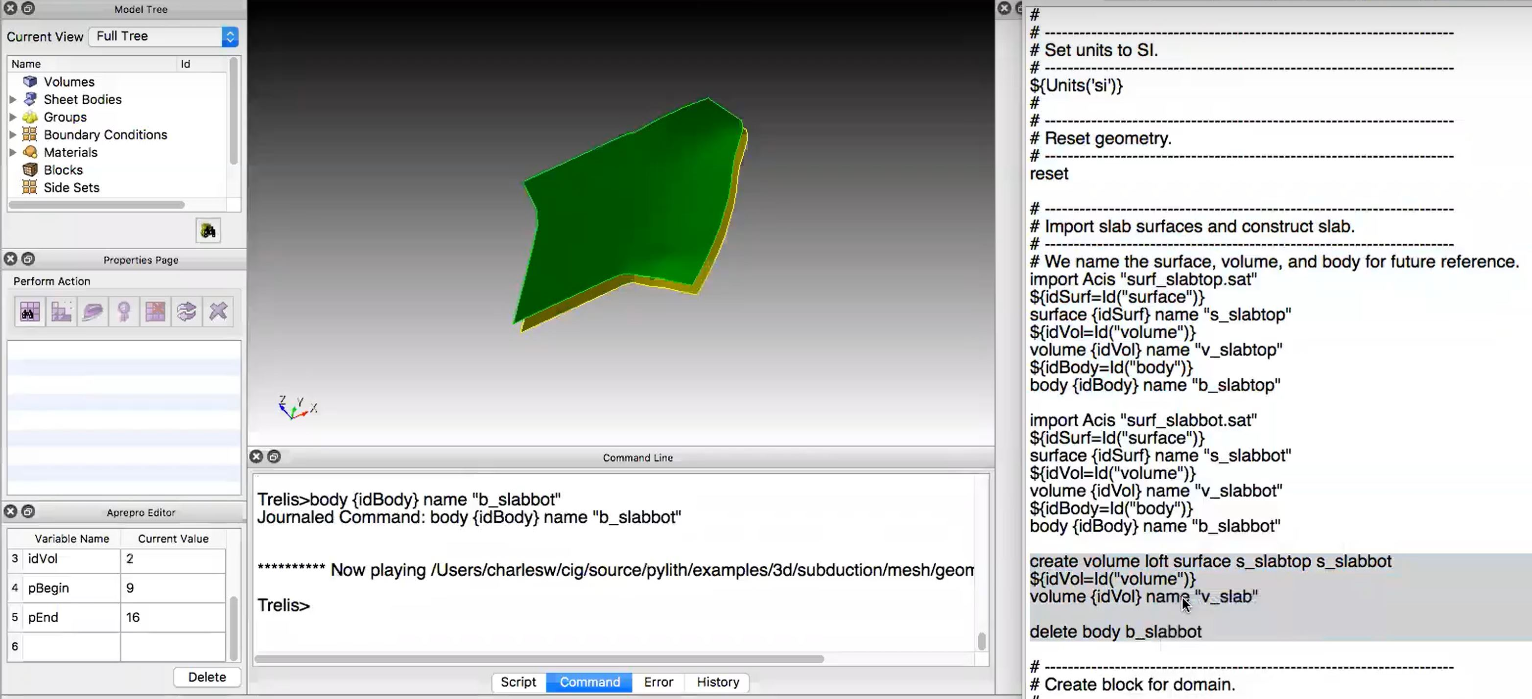
SPECFEM3D – Building the mesh – the steps (multiple surfaces)
Generating contours
Constructing a surface using the contours
Constructing multiple surfaces
A CUBIT instance showing two surfaces generated and named as the slabtop and slabbot respectively

Slide 11
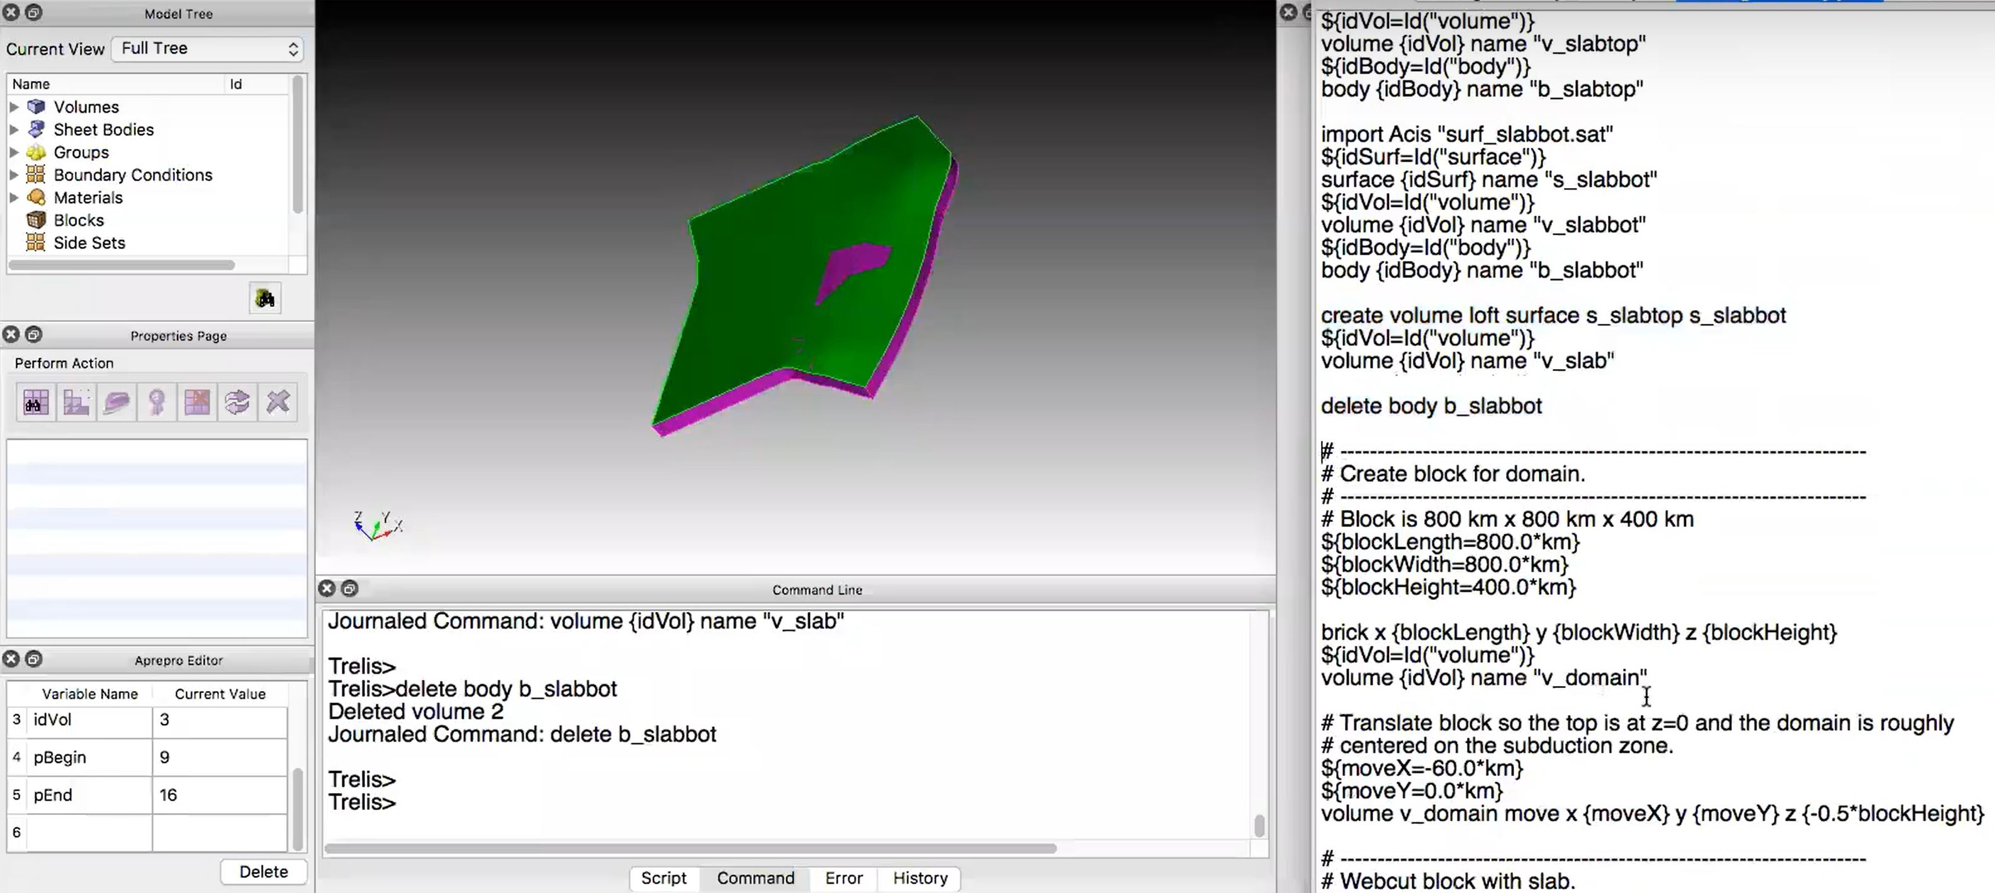
SPECFEM3D – Building the mesh – the steps (volume)
Generating contours
Constructing a surface using the contours
Constructing multiple surfaces
A CUBIT instance showing the volume constructed between two surfaces
Creating a volume enclosed by the surfaces

Slide 12
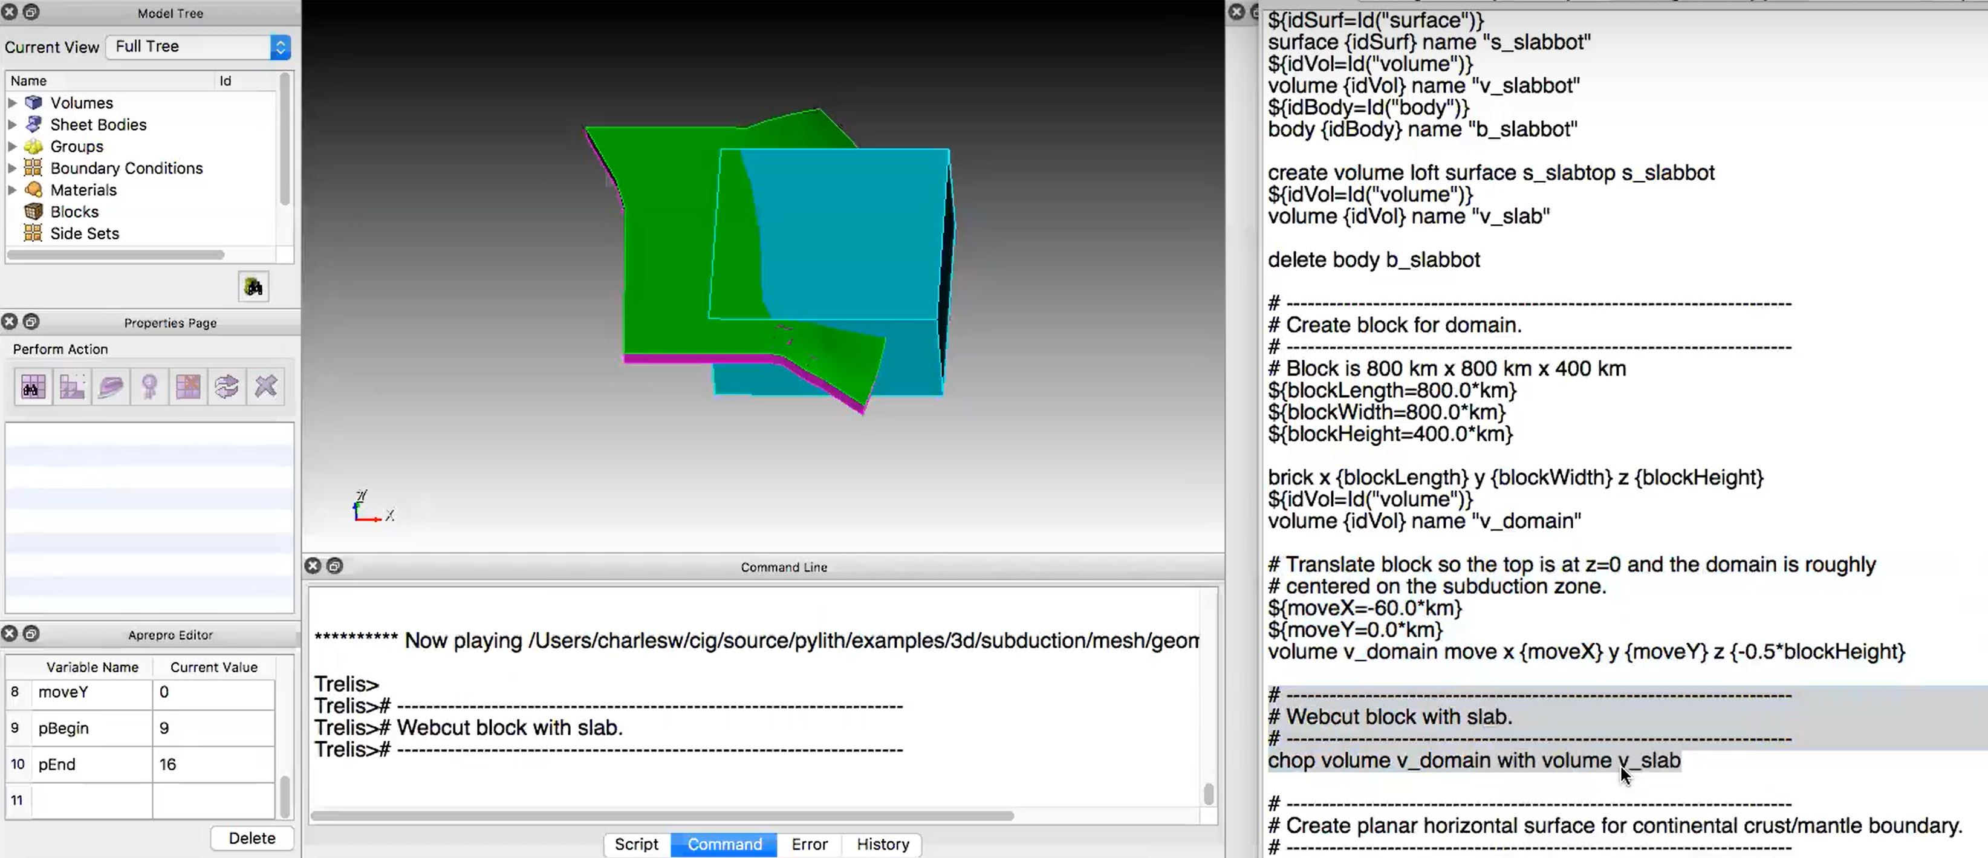
SPECFEM3D – Building the mesh – the steps (intersecting volumes)
Chopping volumes
A CUBIT instance showing the cube intersected with the volume created previously

Slide 13
SPECFEM3D – Building the mesh – the steps (merging and imprinting volume)
Chopping volumes
Merging/Imprinting
A CUBIT instance showing a case of subduction zone which was obtained by web-cutting two volumes and then merging

Slide 14
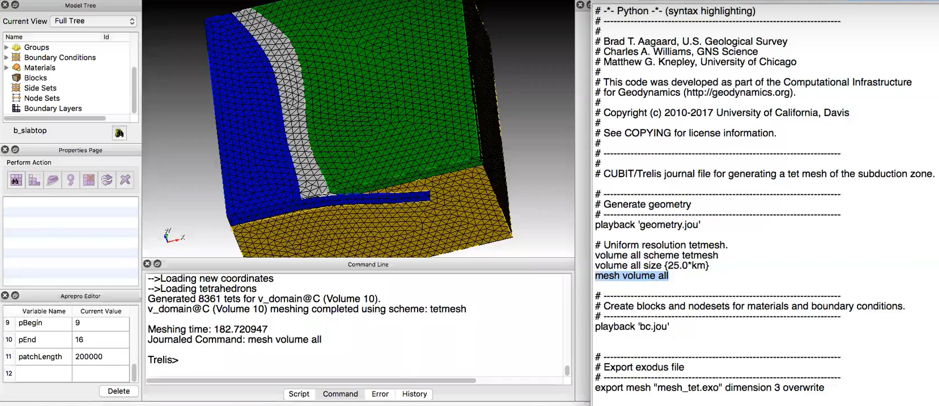
SPECFEM3D – Building the mesh – the steps (creating mesh elements)
Chopping volumes
Merging/Imprinting
Some more edits
Meshed volume
A CUBIT instance showing a tetrahedra meshed volume representing subduction zone over a half-space and splay fault

Slide 15
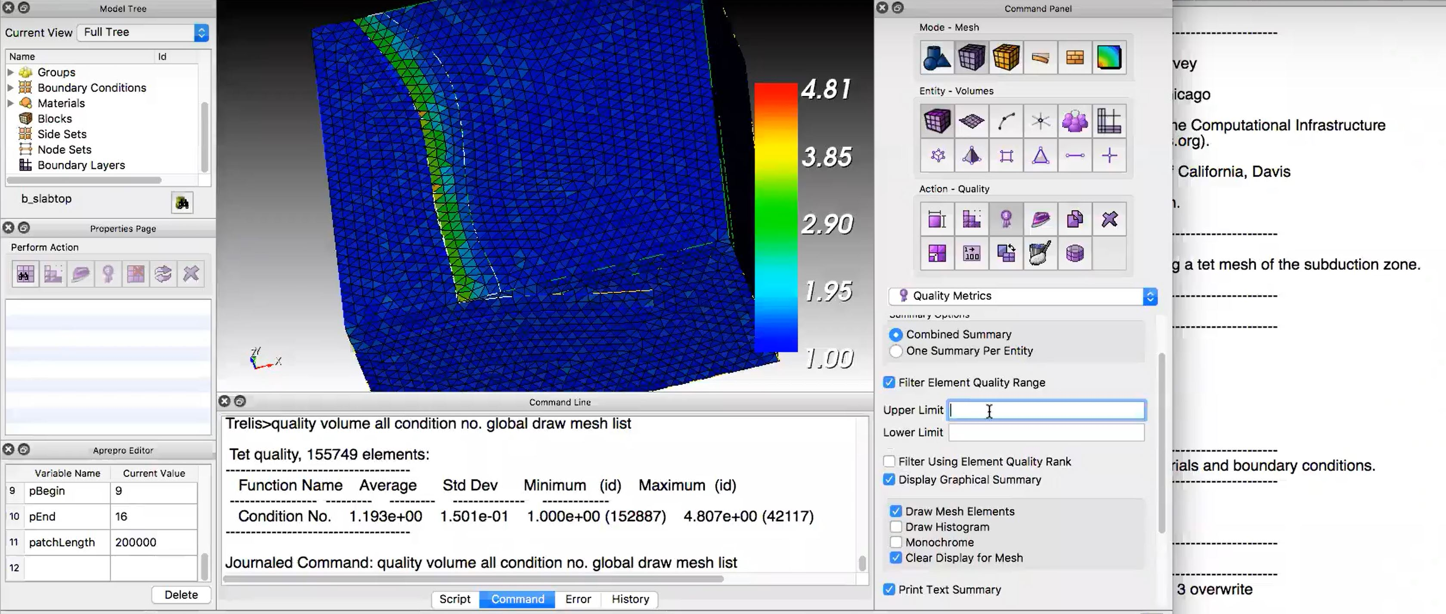
SPECFEM3D – Building the mesh – the steps (mesh quality)
Chopping volumes
Merging/Imprinting
Some more edits
Meshed volume
A CUBIT instance showing the mesh quality based on the condition number metric. Some elements have high condition number especially near edge transitions.
Check mesh quality/condition number between [1,2] is good

Slide 16
SPECFEM3D – Absorbing boundary conditions
SPECFEM provides two options for absorbing boundary conditions
Stacey ABCs (Paraxial approximation) Clayton and Engquist, 1977
Convolutional Perfectly matched layer (CPML) Komatitsch & Martin 2007
Flat PML edges must be parallel to coordinatexes
Constant thickness in each dimension (grid points can vary)
No velocity variation normal to PML elements
In case of tomography model, extent every outer element to PML
Warning: PML elements can be acoustic or elastic and not poroelastic and viscoelastic

Slide 17
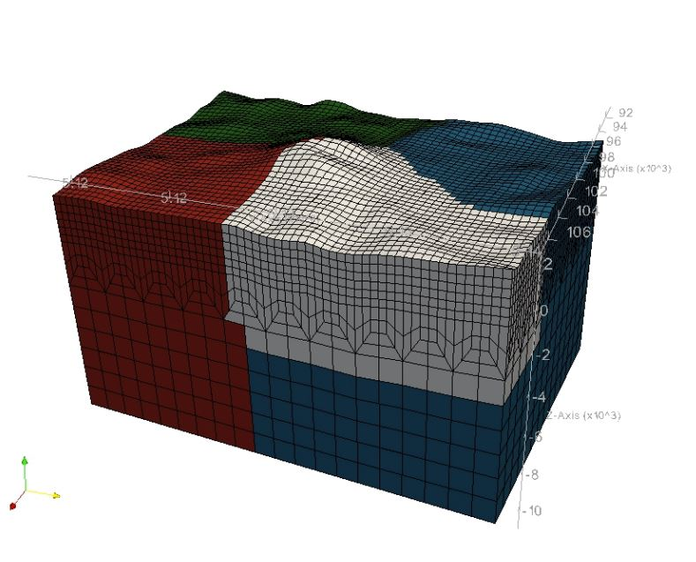
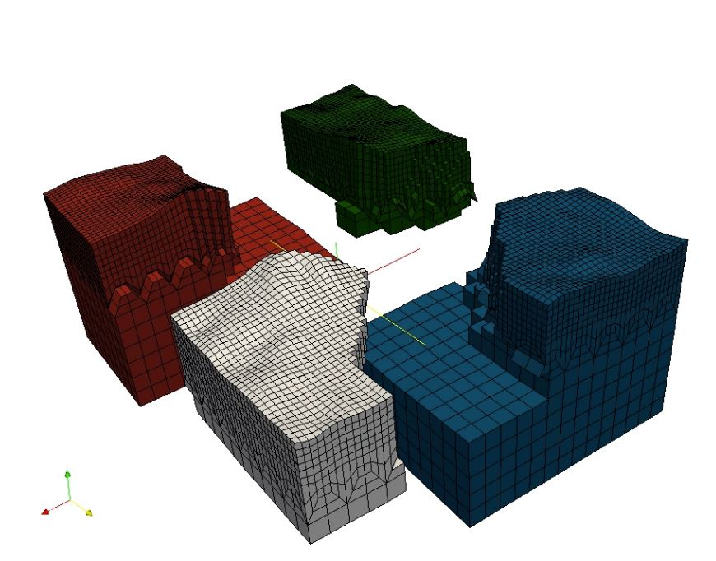
SPECFEM3D – Mesh decomposition
The SPECFEM3D Cartesian software package performs large scale simulations in a parallel ’Single Process Multiple Data’ way.
The spectral-element mesh created with CUBIT needs to be distributed on the processors.
This partitioning is executed once and for all prior to the execution of the solver so it is referred to as a static mapping.

Slide 18
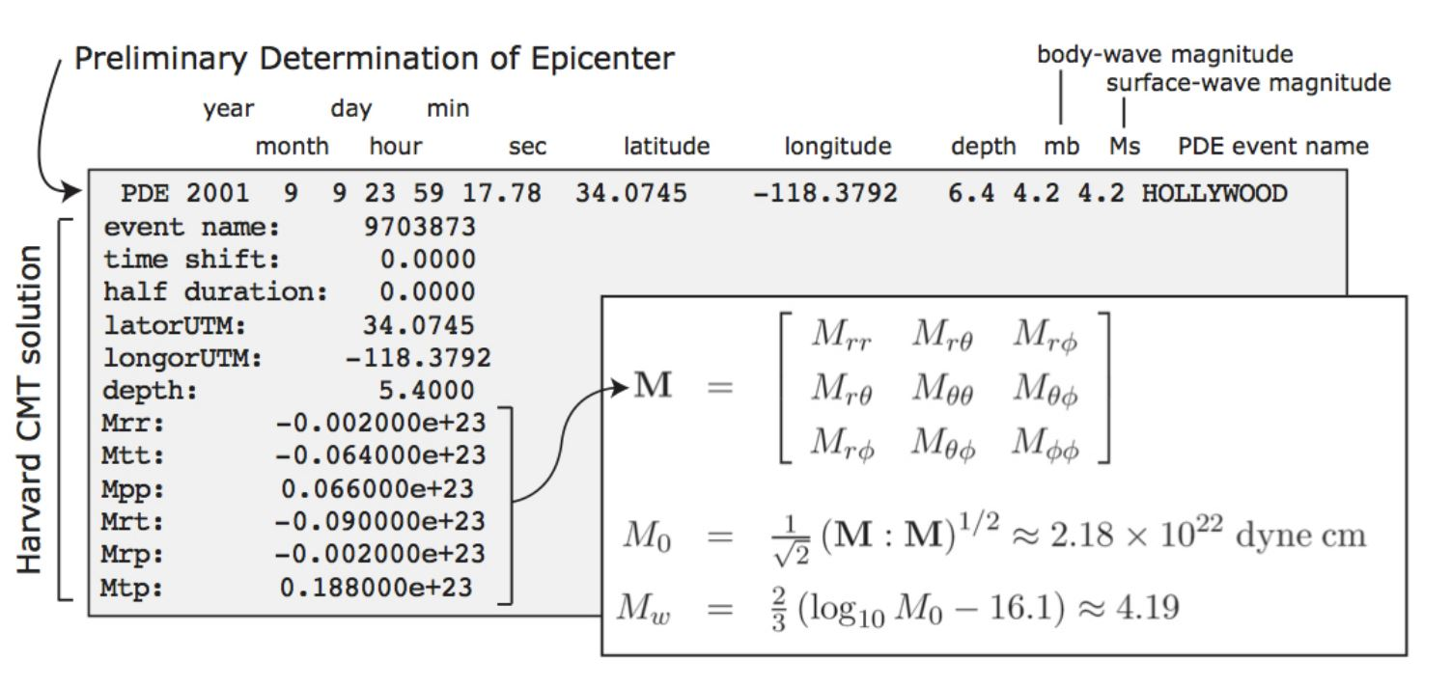
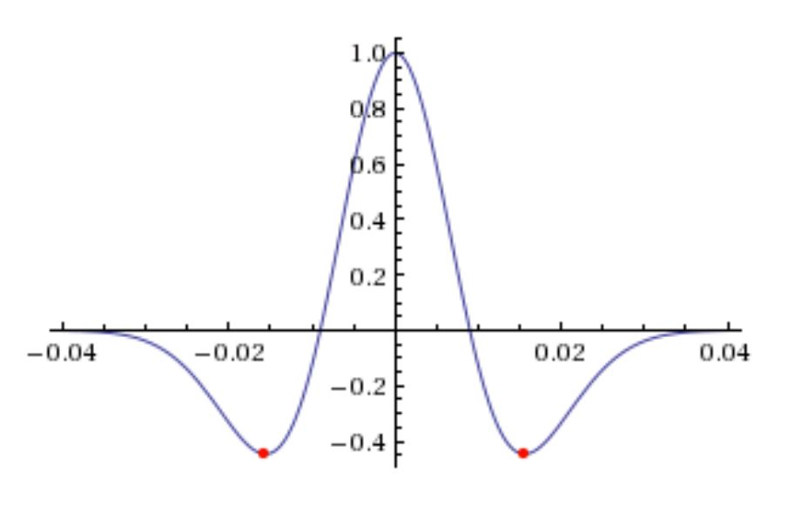
SPECFEM3D – Source excitation
SPECFEM accommodates different types of input sources:
User defined
CMT Solutions (Moment Tensor)
A Heavyside step function with a very short half-duration (depends on $f_{0}$) is used
Force solution
Can be oriented along any direction
If the source location is not a grid-point, Lagrange interpolation is performed to obtained the force solution at the nearest grid point
Wavelet
Default function is the Dirac-delta function
Ricker wavelet can also be used with a given peak frequency $f_{0}:s\left(t\right)=\left(1−2at^{2}\right)e^{−at^{2}}$, $a=π^{2}f_{0}^{2}$

Slide 19
SPECFEM3D – Run the forward model code xspecfem3d
Before running the forward modeling code, three main parameter files must be checked
Par_file the main parameter file
CMTSOLUTION or FORCESOLUTION the earthquake source parameter file or the force source parameter file, and
STATIONS the stations file.
1922 Sao Paolo earthquake Mb = 5.1

Slide 20
SPECFEM3D – Output files
SPECFEM3D can produce the following output files
Synthetic seismograms at the station locations (STATIONS FILE)
Specify NSTEP: multiple of simulation time step ‘dt’ at which seismograms are written to disk
Default units to velocity (can be changed to displacement)
Surface movies
Specify time-stepping factor
Volume movies
Specify high resolution (all GLL points used) or not
Time stepping factor
Finite frequency sensitivity kernels between specified station pairs
Run after executing the forward model
Useful for performing tomography (check Tromp, 2005)
Used in Noise cross-correlation simulations

Slide 21
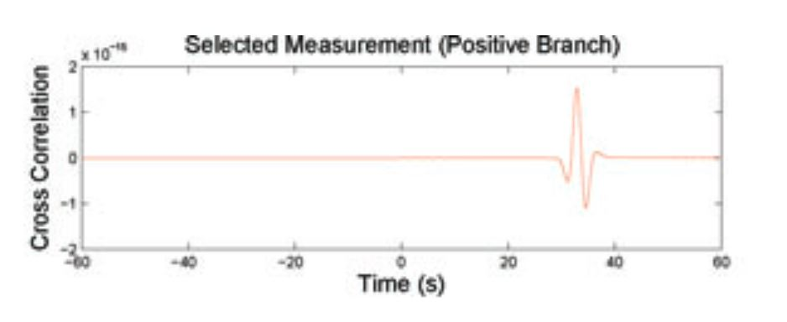
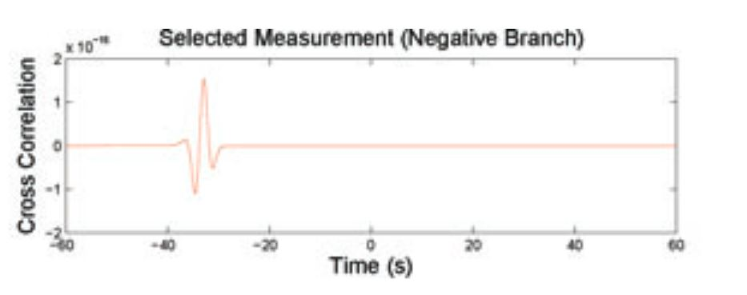
SPECFEM3D – Noise cross-correlation simulations
SPECFEM3D can computes the cross-correlations between station pairs in 3 steps (implying the simulations have to run together) Tromp, 2010
Set Noise tomography = 1, Simulation type =1 (Injecting source at receiver A, observed at B)
Save_forward set to False
Set Noise tomography = 2, Simulation type =1 (Adjoint case)
Save_forward set to True (will be used with the first step for kernel calculation)
Set Noise tomography = 3, Simulation type =3 (Sensitivity Kernel calculation)
Save_forward set to False
Ensemble density sensitivity kernel positive branch
Ensemble density sensitivity kernel negative branch

Slide 22
SPECFEM3D – Noise cross-correlation simulations – other parameters
Several other parameters need to be carefully set:
Manually set CMT Solution – 0 (since no earthquakes necessary)
The order of stations in STATIONS file is important . It will be used to determine the ‘main’ receiver, i.e., the one that simultaneously cross correlates with the others.
Specify the noise statistics, e.g., the ensemble-averaged noise spectrum. MATLAB scripts are provided
NOISE_TOMOGRAPHY(NSTEP, DT, Tmin, Tmax, NOISE_MODEL)
DT is given in Par_file, but NSTEP is NOT the one specified in Par_file.
Instead, you have to feed 2 NSTEP − 1 to account for the doubled length of cross correlations.
Tmin and Tmax correspond to the period range you are interested in
NOISE_MODEL denotes the noise model you will be using (’NLNM’ for New Low Noise Model or ’NHNM’ for New High Noise Model).

Slide 23
SPECFEM3D – Noise cross-correlation simulations – other parameters
Several other parameters need to be carefully set:
File irec_main_noise
contains only one integer, which is the ID of the ‘main’ receiver.
For example, if this file contains 10, it means that the tent receiver listed in DATA/STATIONS becomes the master node or the reference station for cross-correlation calculations
File nu_main:
This file holds three numbers, forming a (unit) vector. It describes which component we are cross-correlating at the ‘main’ receiver,’.
The three numbers correspond to E/N/Z components respectively. Most often, the vertical component is used, and in those cases the three numbers should be 0, 0 and 1
noise_tomography.f90.
The default assumes vertical noise and a uniform distribution across the whole free surface of the model.
Modifications can be done – then recompile the software
Careful: It is recommended to run all the three steps continuously in the same job in a cluster

Slide 24
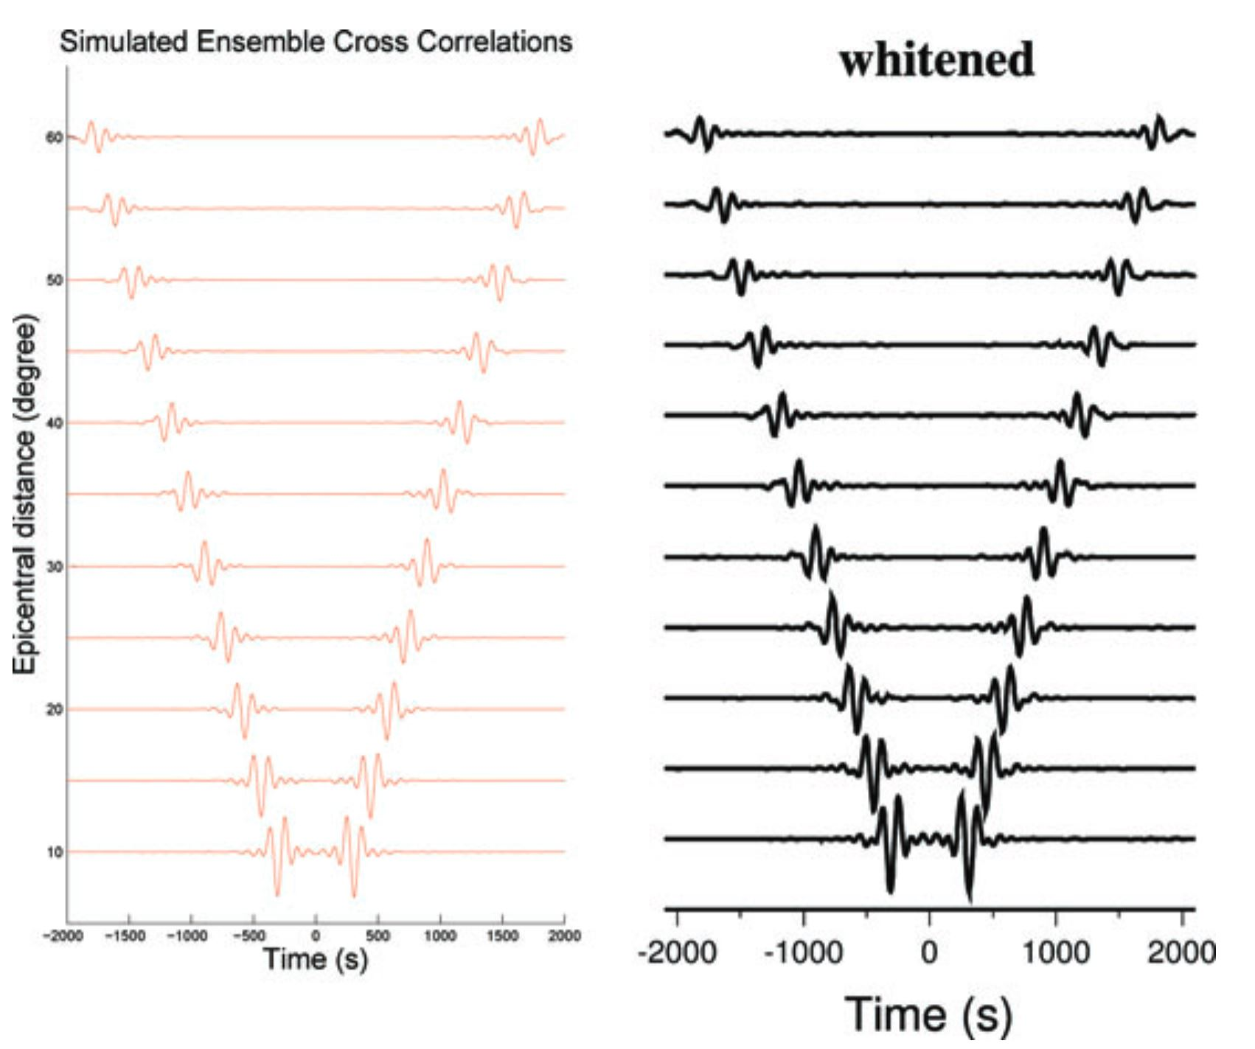
SPECFEM3D – Noise cross-correlation simulations – output
Outputs are generated for both time domain cross-correlations and sensitivity kernels
Record sections of cross correlations between the first and 11 other receivers in a linear array along the equator, with distances varying from ${100}^{0}$ to ${60}^{0}$. The noise is assumed to be uniform, and the earth model is PREM.

Slide 25
SPECFEM3D – Conclusions
Motivation: Understand the medium and propagation of seismic waves better
SPECFEM3D is a scalable (weak and strong) acoustic, elastic, viscoelastic, and a poro-elastic wave-propagation software
Only about 10% of the computation time is consumed by the MPI
Creating a model from the user-end is the most time-consuming process and must be done carefully
CUBIT is preferred when compared to the in-built mesher
Imposing the absorbing boundary conditions can be tedious process and if not well can degrade the simulation
CPML is preferred
Both CMT solutions and user-defined sources can be used (multiple earthquake sources can be simulated simultaneously)
Possibility to estimate noise cross-correlations between stations without simulating for individual sources manually – three step process to estimate the cross-correlation density sensitivity kernels

Slide 26
Questions

