Slide 1
Lunar GW Response

Slide 2
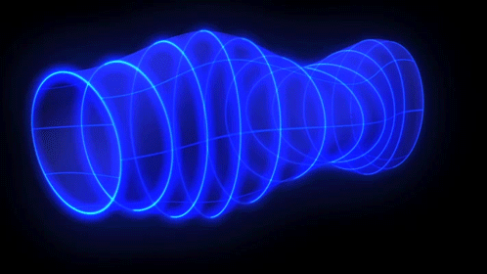
Gravitational Waves

Slide 3
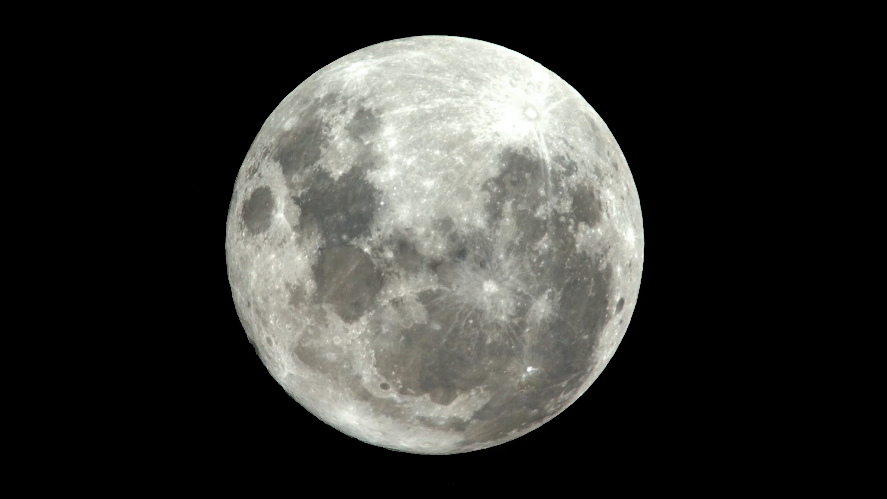
Quadrupolar vibration induced by a GW
Notes:
Taking the Moon and turning it into a resonant antenna to listen to our Universe would be a huge cultural achievement, and for science, you cannot get closer to science fiction than this.

Slide 4
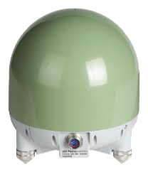
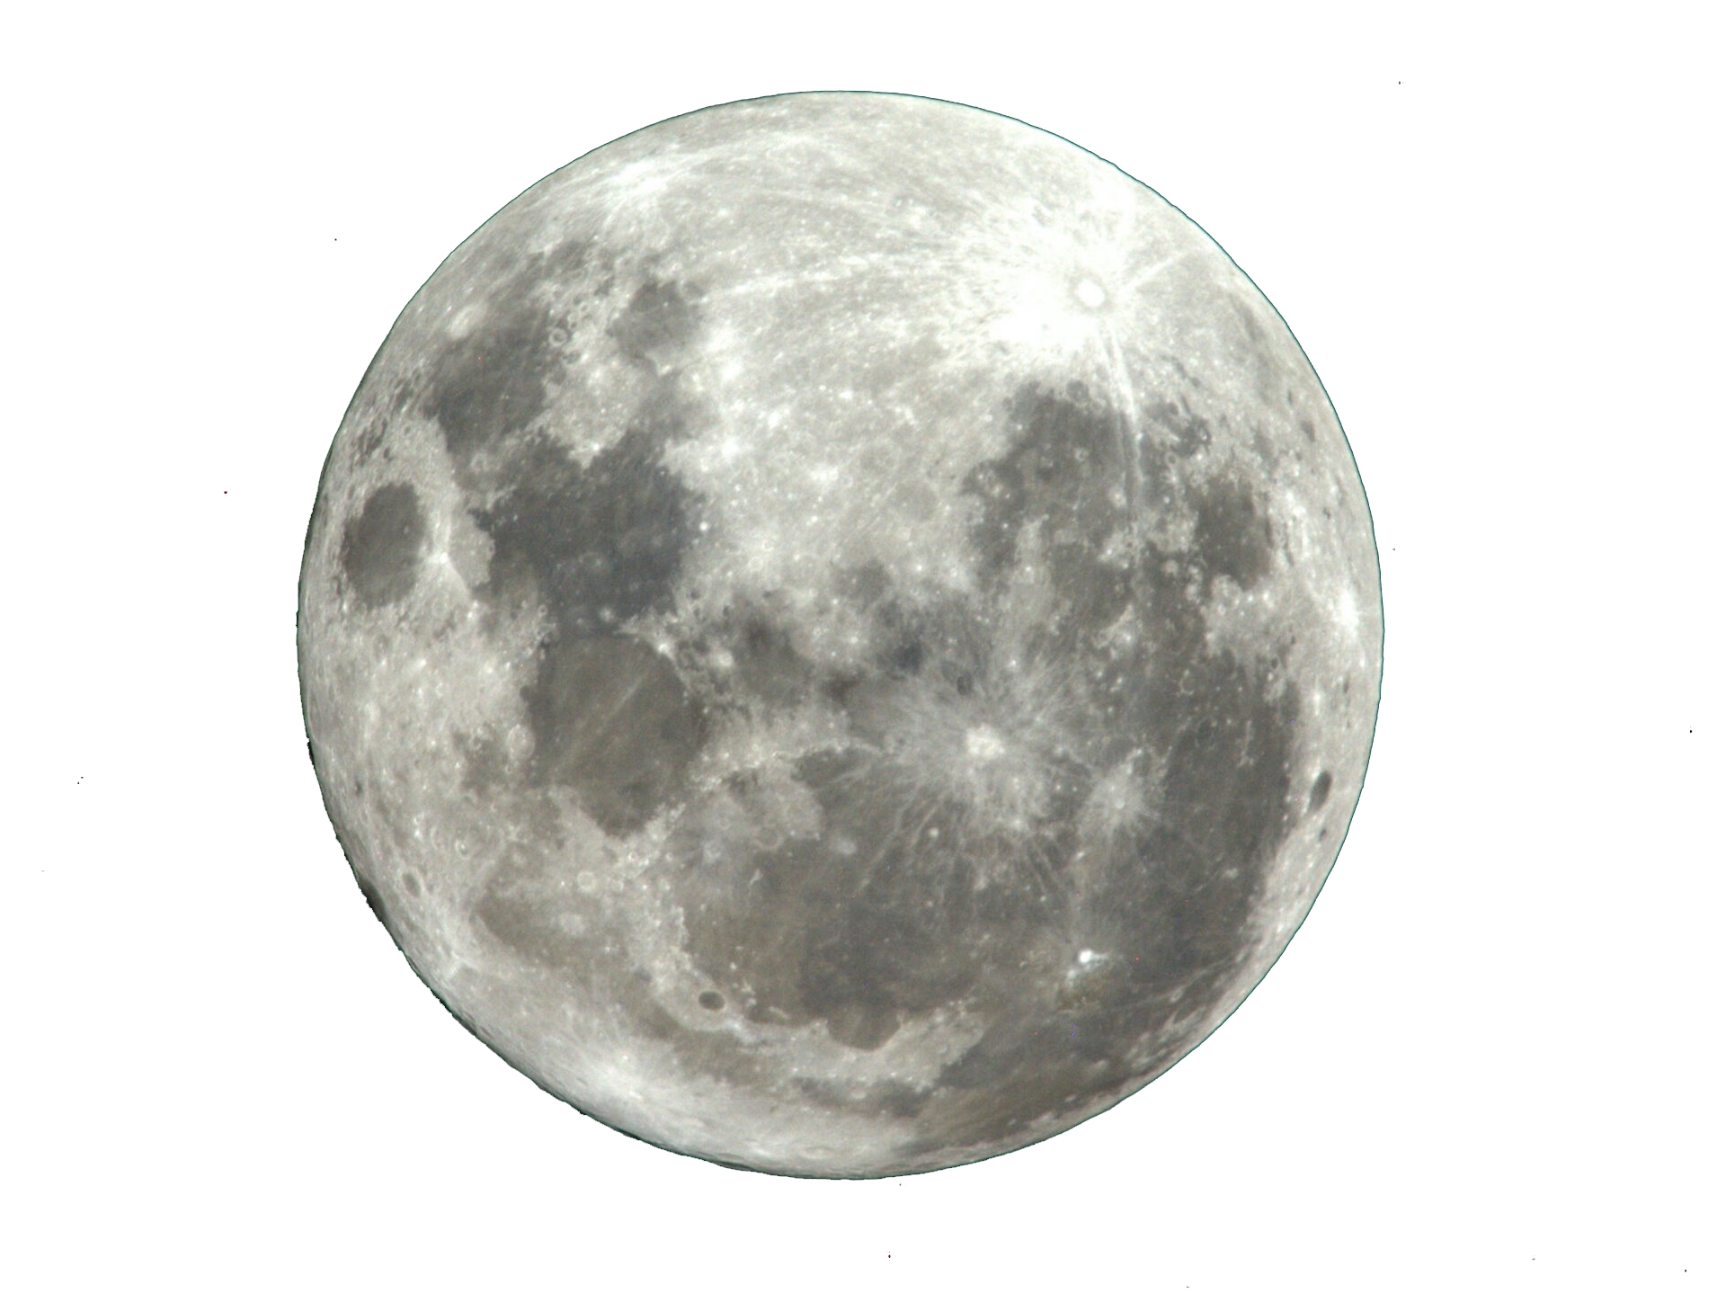

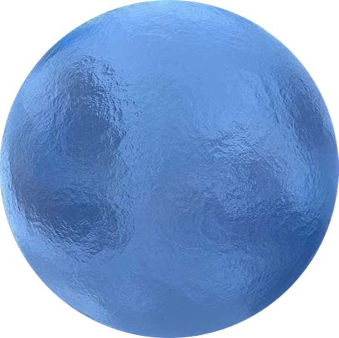
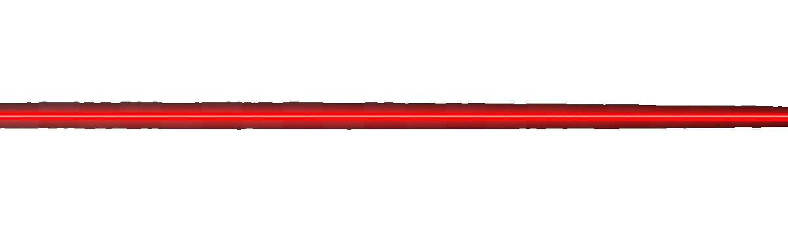
GW response in the dHz band
Case 1: Inertial measurement on liquid planet
Case 2: Inertial measurement on solid planet
Case 3: Deformation measurement on solid planet
GW signal due to material stiffness
GW signal dominated by free fall of Moon mass elements
No GW signal

Slide 5
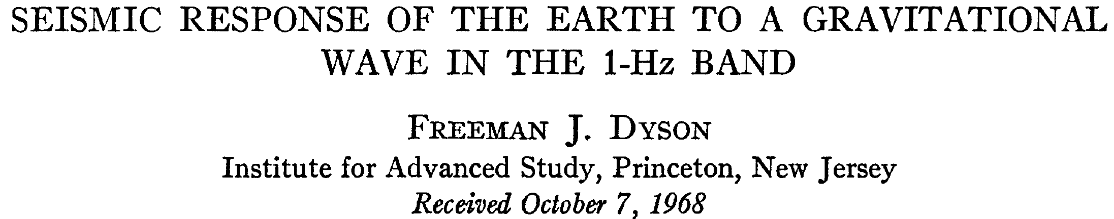
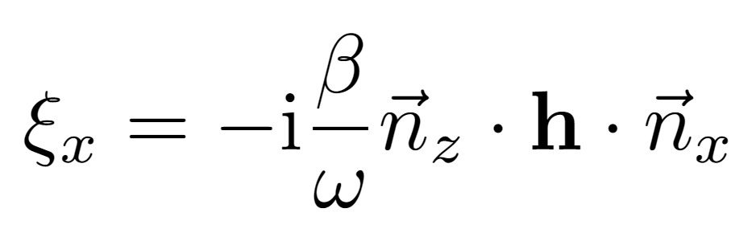
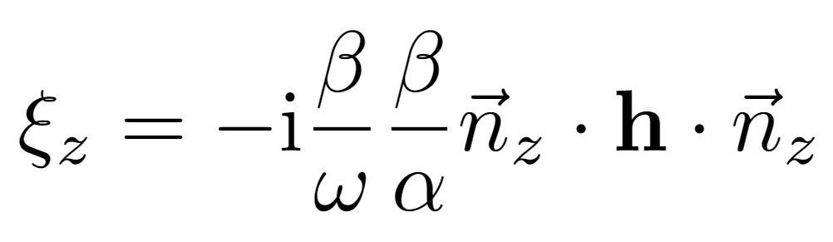
Dyson’s approximation
GW response of homogeneous half-space
Horizontal response stronger by a factor α/β compared to vertical response (α being the speed of compressional waves, β being the speed of shear waves).
λ_{s}/π is the effective baseline for the horizontal GW response of the half-space (λ_{s} being the length of shear waves).
Boundary conditions command that seismic waves are emitted along normal direction to the surface.
Horizontal displacement
Vertical displacement

Slide 6

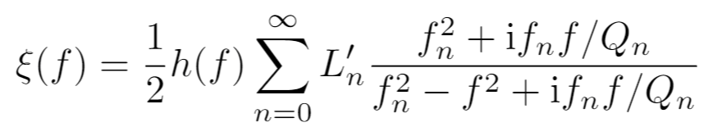
Normal-mode response to GWs
Local-Lorentz frame (best choice for LSGA)
GW couples to density distribution
Surface displacement
GW amplitude
Subtract PM position
Q-value
TT gauge (best choice for LGWA)
GW couples to gradient of shear modulus
Reference mass does not move
Normal-mode frequency
Effective baseline of mode n

Slide 7
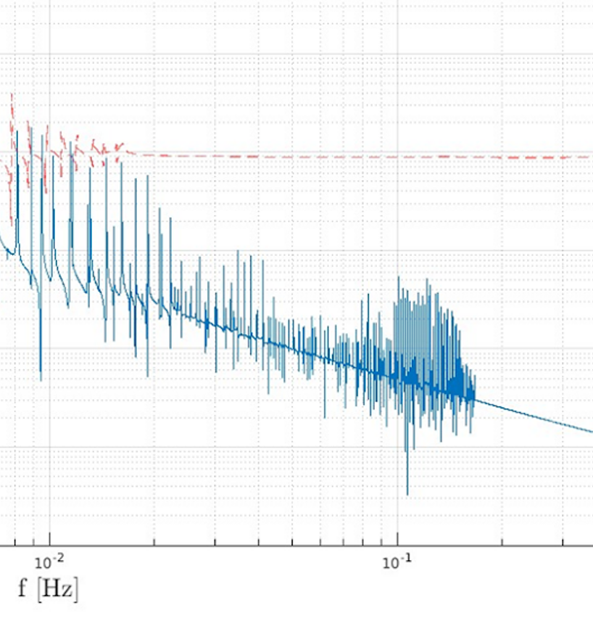
Might LSGA see stiffness of the Moon in the dHz band?
If a GW only excites quadupolar modes of the Moon, the >20mHz response of LSGA is dominated by free fall: seismic strain = gravitational strain.
Since the geology is not laterally homogeneous, a GW does not only excite quadrupolar vibrations of the Moon.
If the surface gradient of the displacement field is at least a factor 50 higher than predicted by the quadrupolar response, LSGA might start to see stiffness in the dHz band, which would enhance the seismic strain.
× 2/R_{moon} = 1
x50

Slide 8
Simulation tools
MINOS (other examples?): 1mHz – few times 10mHz
calculates normal modes for 1D (radial) models of the internal structure of a sphere
For weak deviations from 1D modes and spherical shape, one can extend the analysis through perturbative normal-mode coupling
SPECFEM3D (other examples?): few times 10mHz – 1Hz
Generic simulation tool limited mostly by our understanding of geology and computational resources
Challenge: for LGWA we need a geological model for (roughly) 1km – 100km length scales

