Slide 1
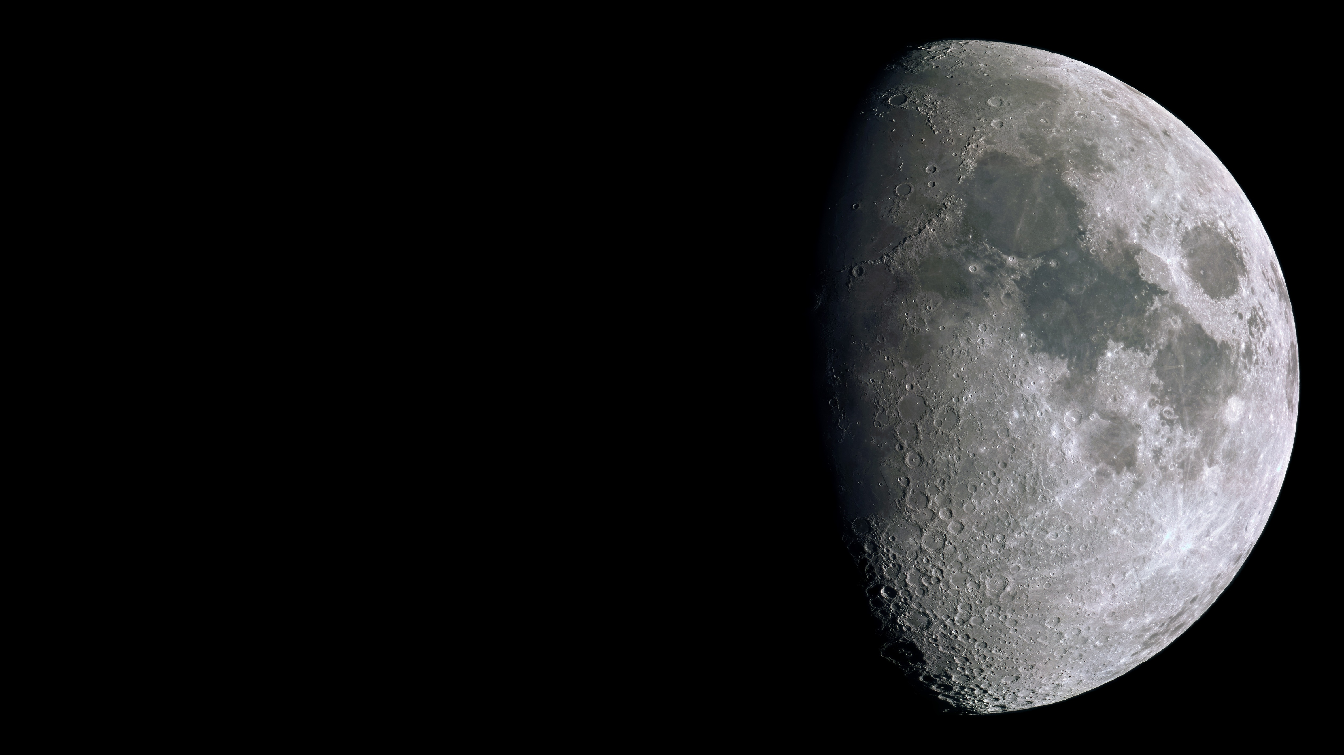



LGWA payload and sensitivity
J.V van Heijningen +, 2023 arXiv:2301.13685v2
Speaker: Morgane Zeolii
Contact: morgane.zeoli@uclouvain.be
Supervisors:
Joris van Heijningen
Christophe Collette
H.J.M. ter Brake, O. Gerberding, S. Chalathadka Subrahmanya, J. Harms, X. Bian, A. Gatti, A. Bertolini, A. Perali, N. Pinto, M. Sharma, F. Tavernier & J. Rezvani

Slide 2
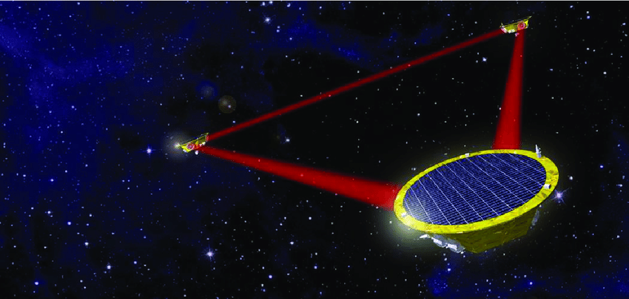

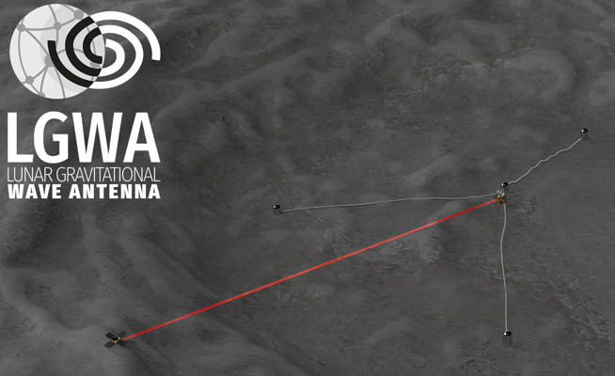
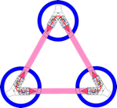

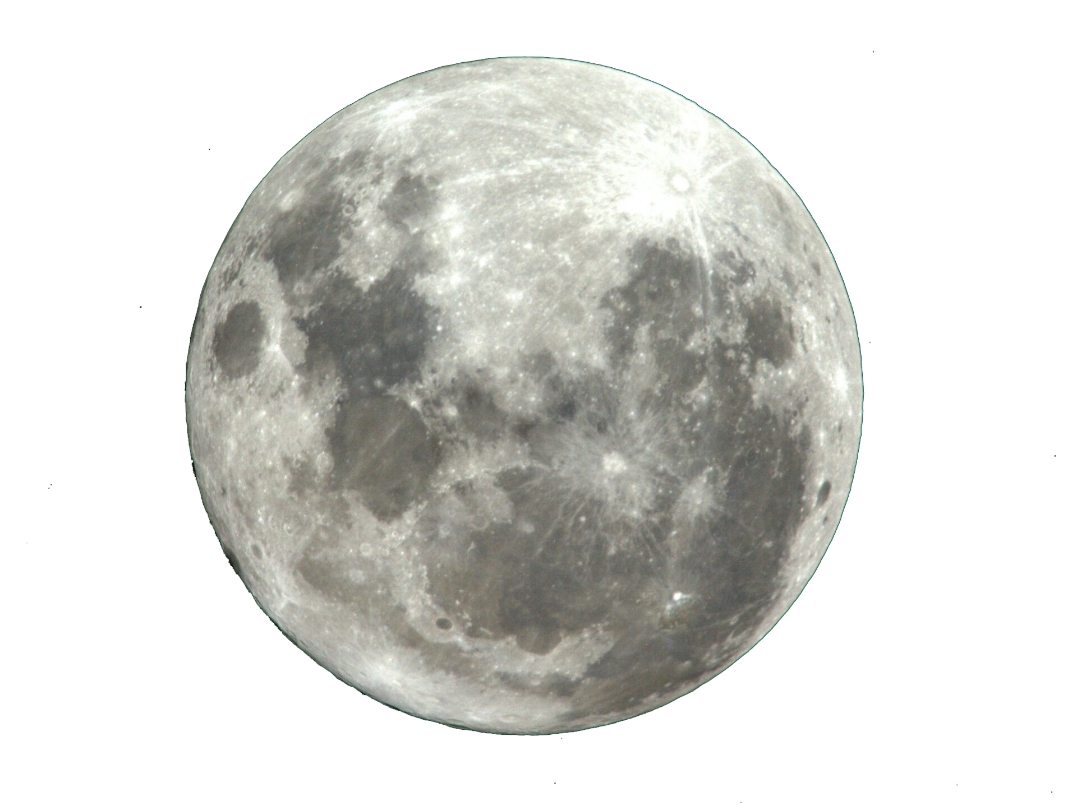

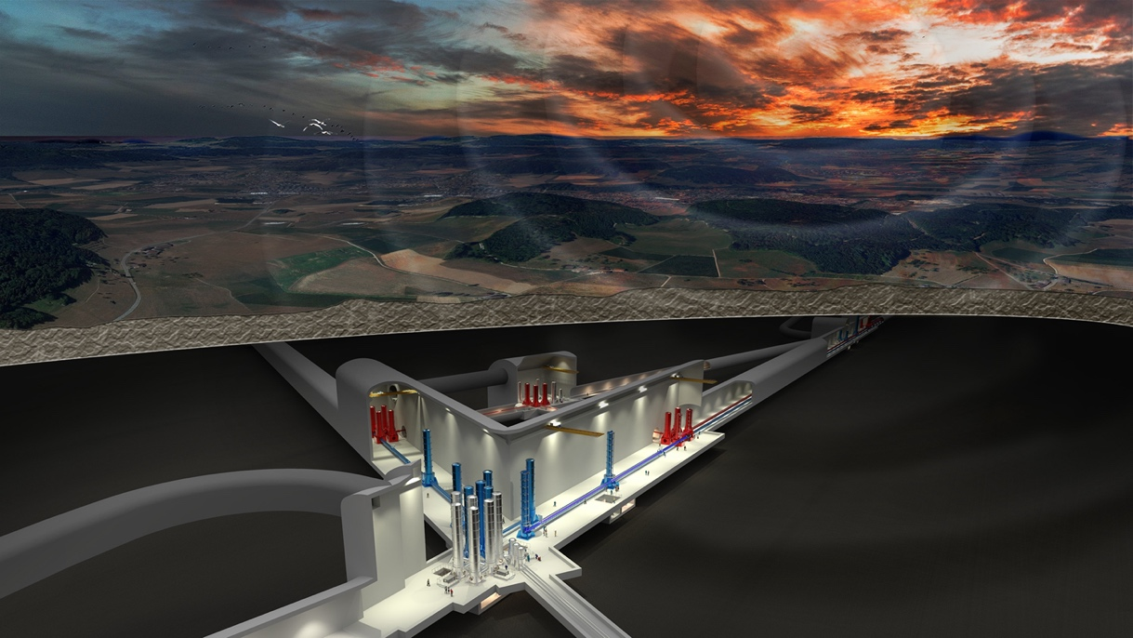
Bridging the sensitivity gap between LISA and ET

Slide 3
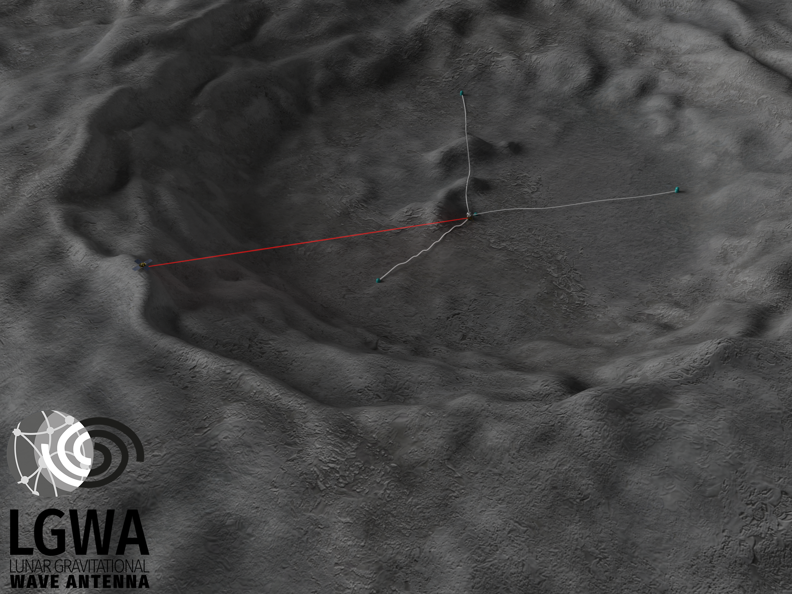
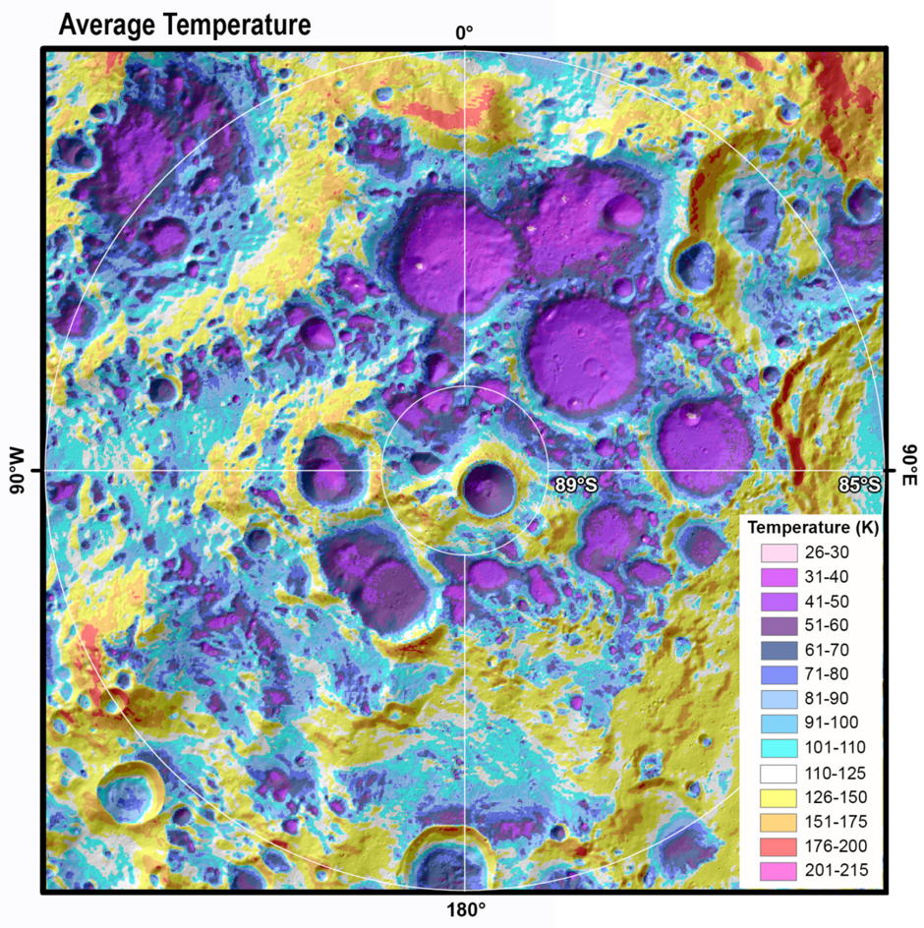
Mission outline

Slide 4



Mission outline
1 of 4
seismic
stations
solar power
and laser
transmission
lander/
central
station

Slide 5
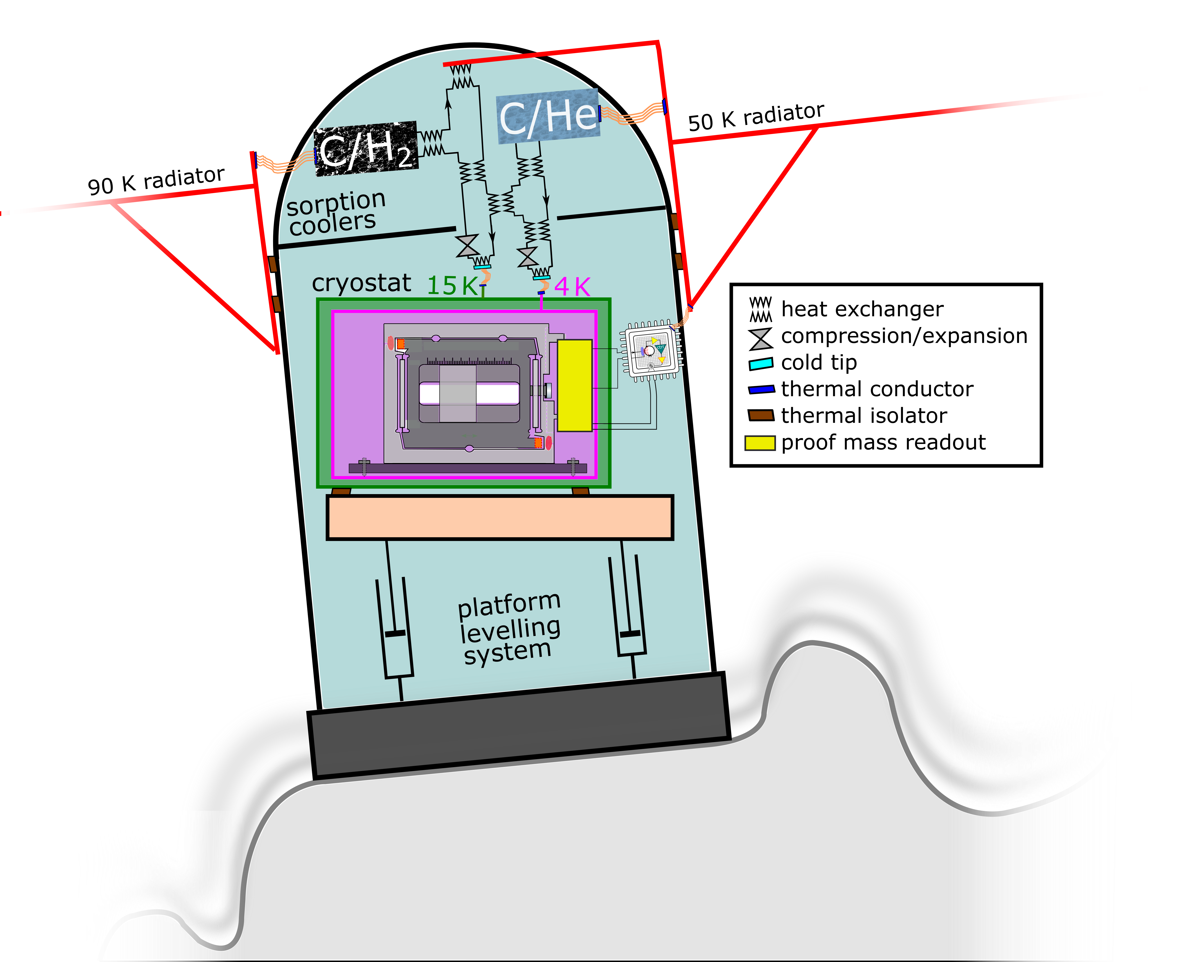
What would we deploy in the < 40 K environment?
1. Inertial sensor development
2
1
2. Sorption cooling and thermal management
3
3. Seismometer leveling system

Slide 6
Inertial sensor development
1

Slide 7
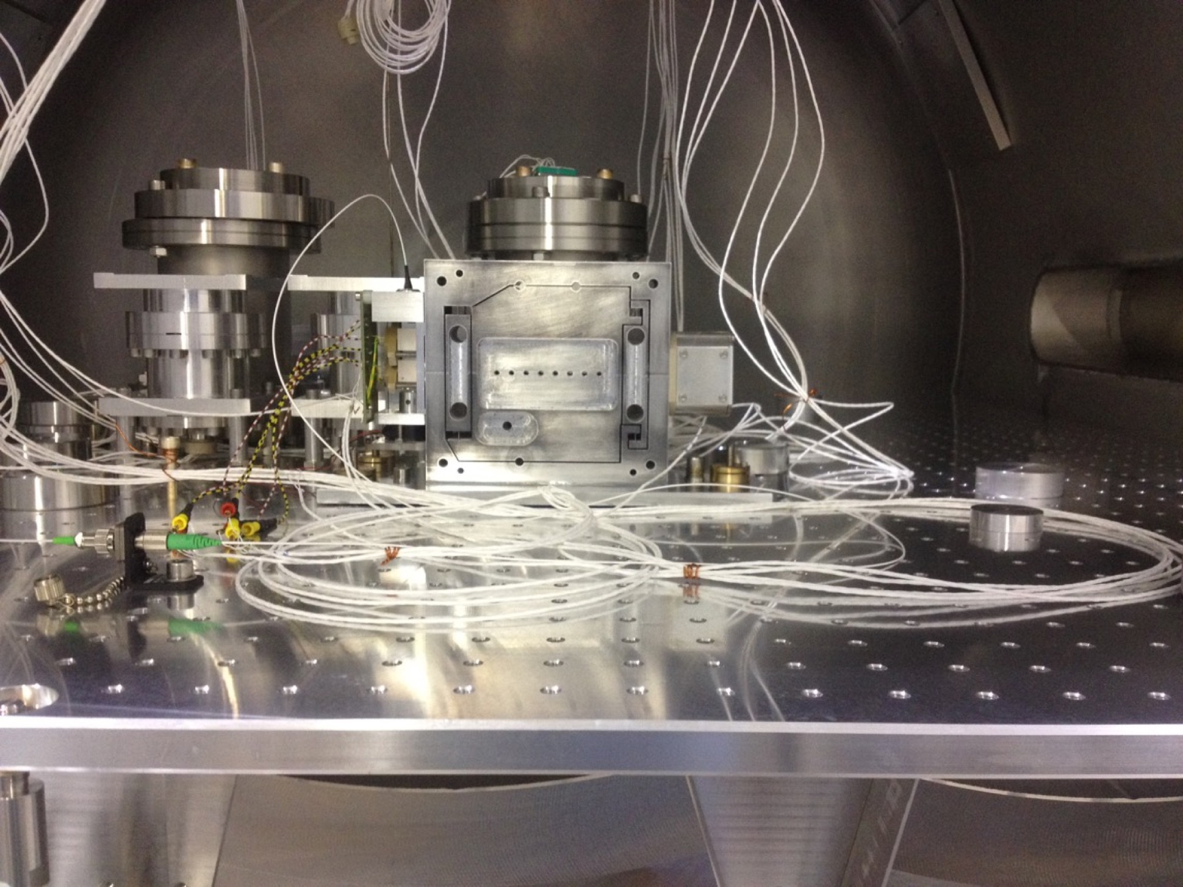
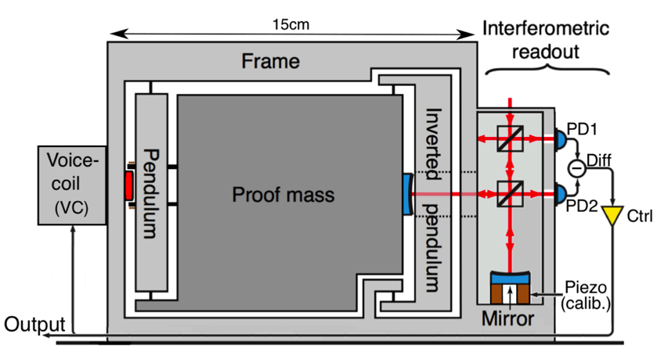
Inertial sensor design baseline
Requirements:
fm/√Hz sensitivity down to about 1Hz
Deployability
Low heat dissipation
Favourable electronic characteristics
suspension
wire of MultiSAS
frame
proof mass
Actu-ator
readout
J.V. van Heijningen +, 2018, IEEE SAS proc., pp 76-80

Slide 8
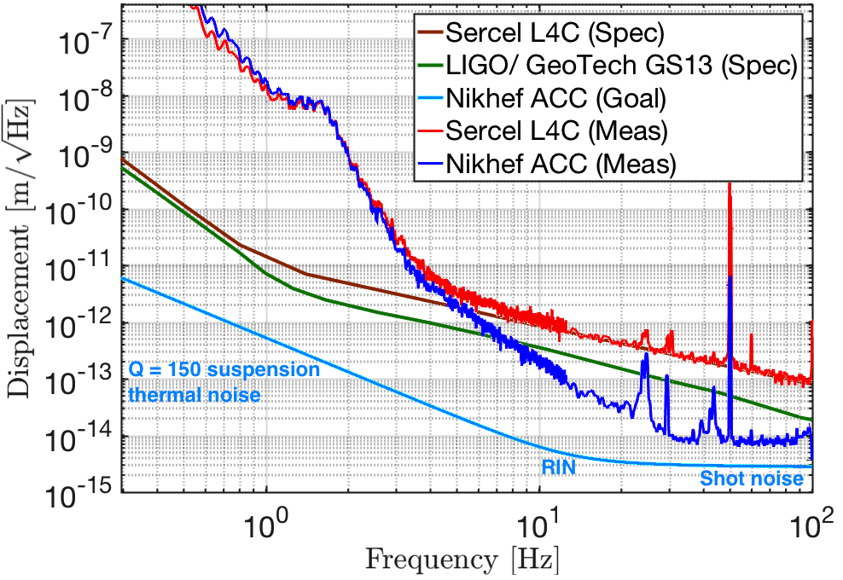
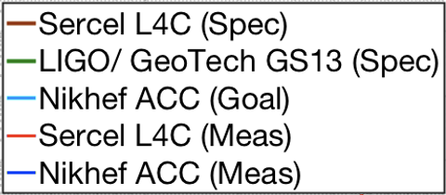




Final result of the room temperature inertial sensor
Measurement done on a seismically isolated optical table
Thermal noise not reached, but low Q expected due to (coil-magnet) actuator
An 8 fm/√Hz sensitivity above 30Hz, didn’t reach the goal
Need low-loss actuators and better proof-mass residual motion suppression
J.V. van Heijningen +, 2018, IEEE SAS proc., pp 76-80

Slide 9
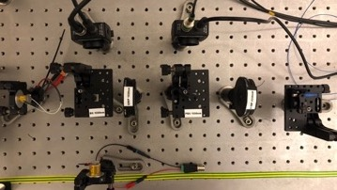
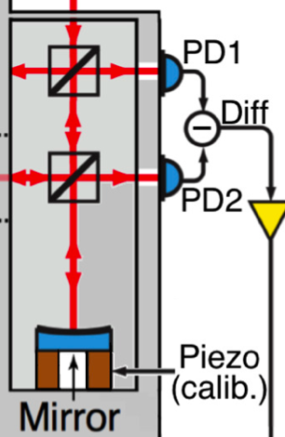
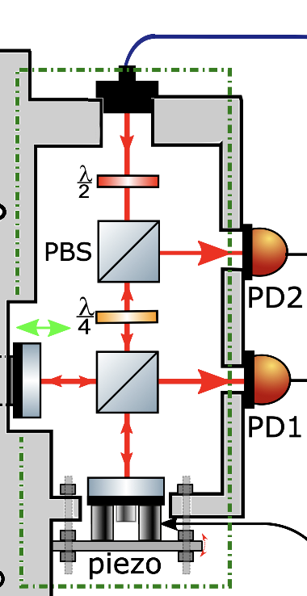
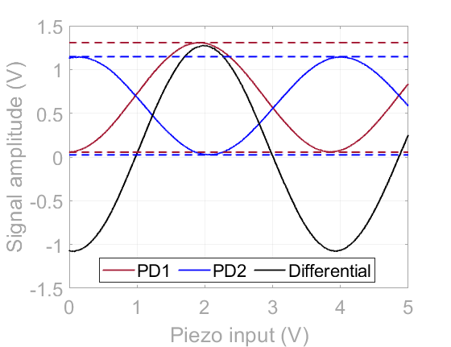
Cm-scale interferometric readout
Differential signal
All common mode noises are decreased to shot noise level
Polarizing optics
All light end up to the PDs so 41% less shot noise at same input power and less heat load
Working point

Slide 10


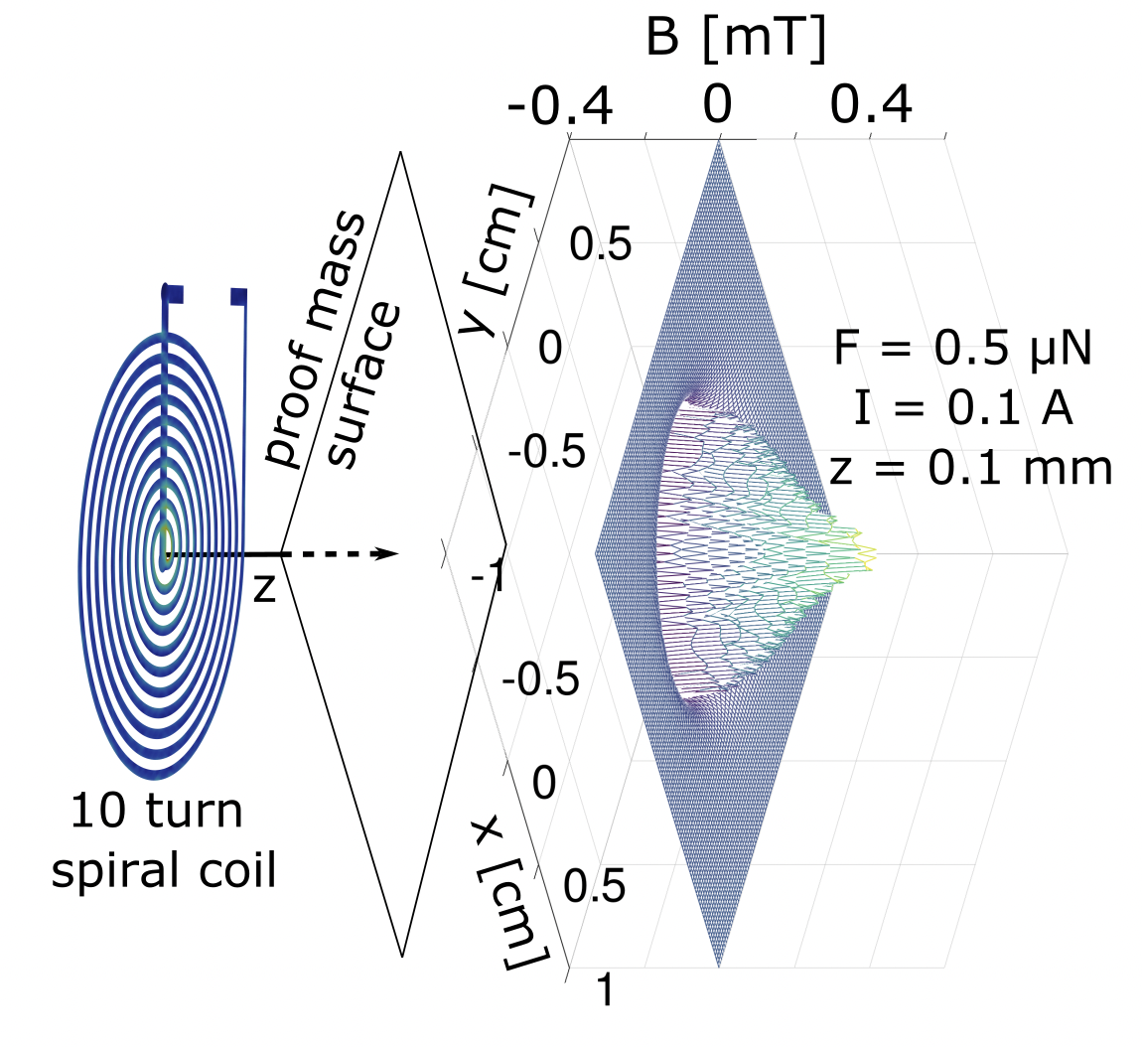
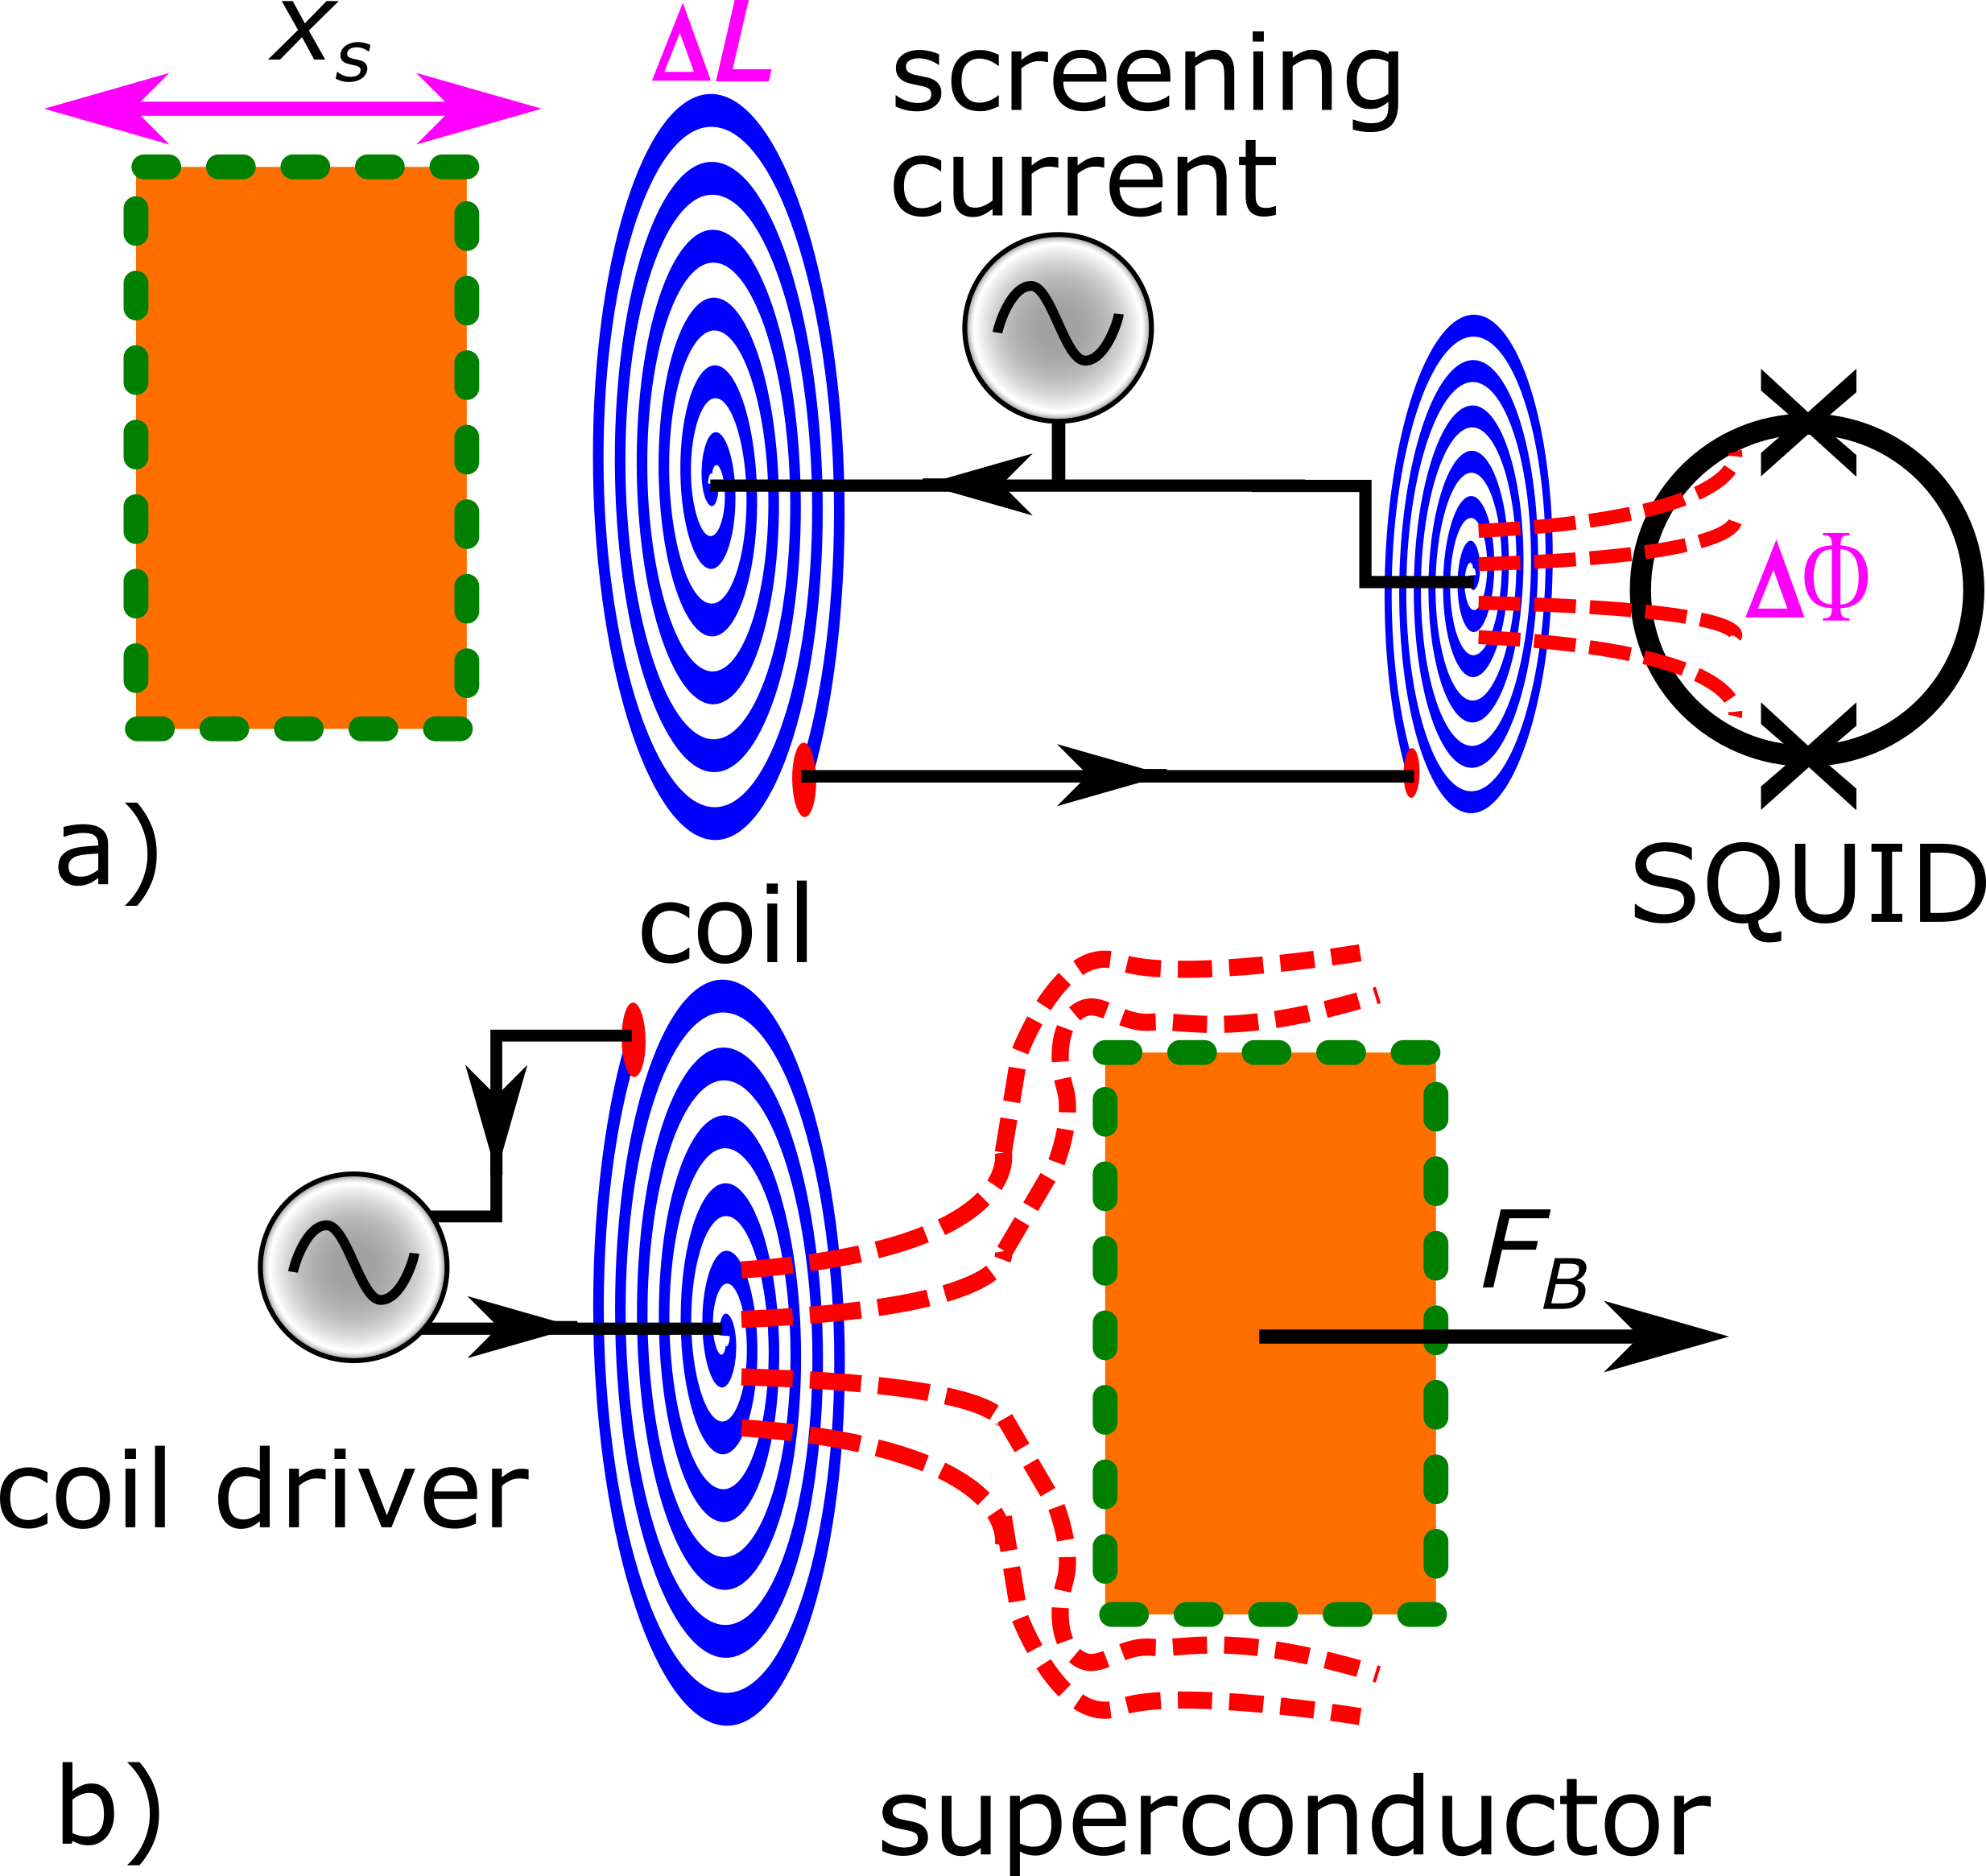


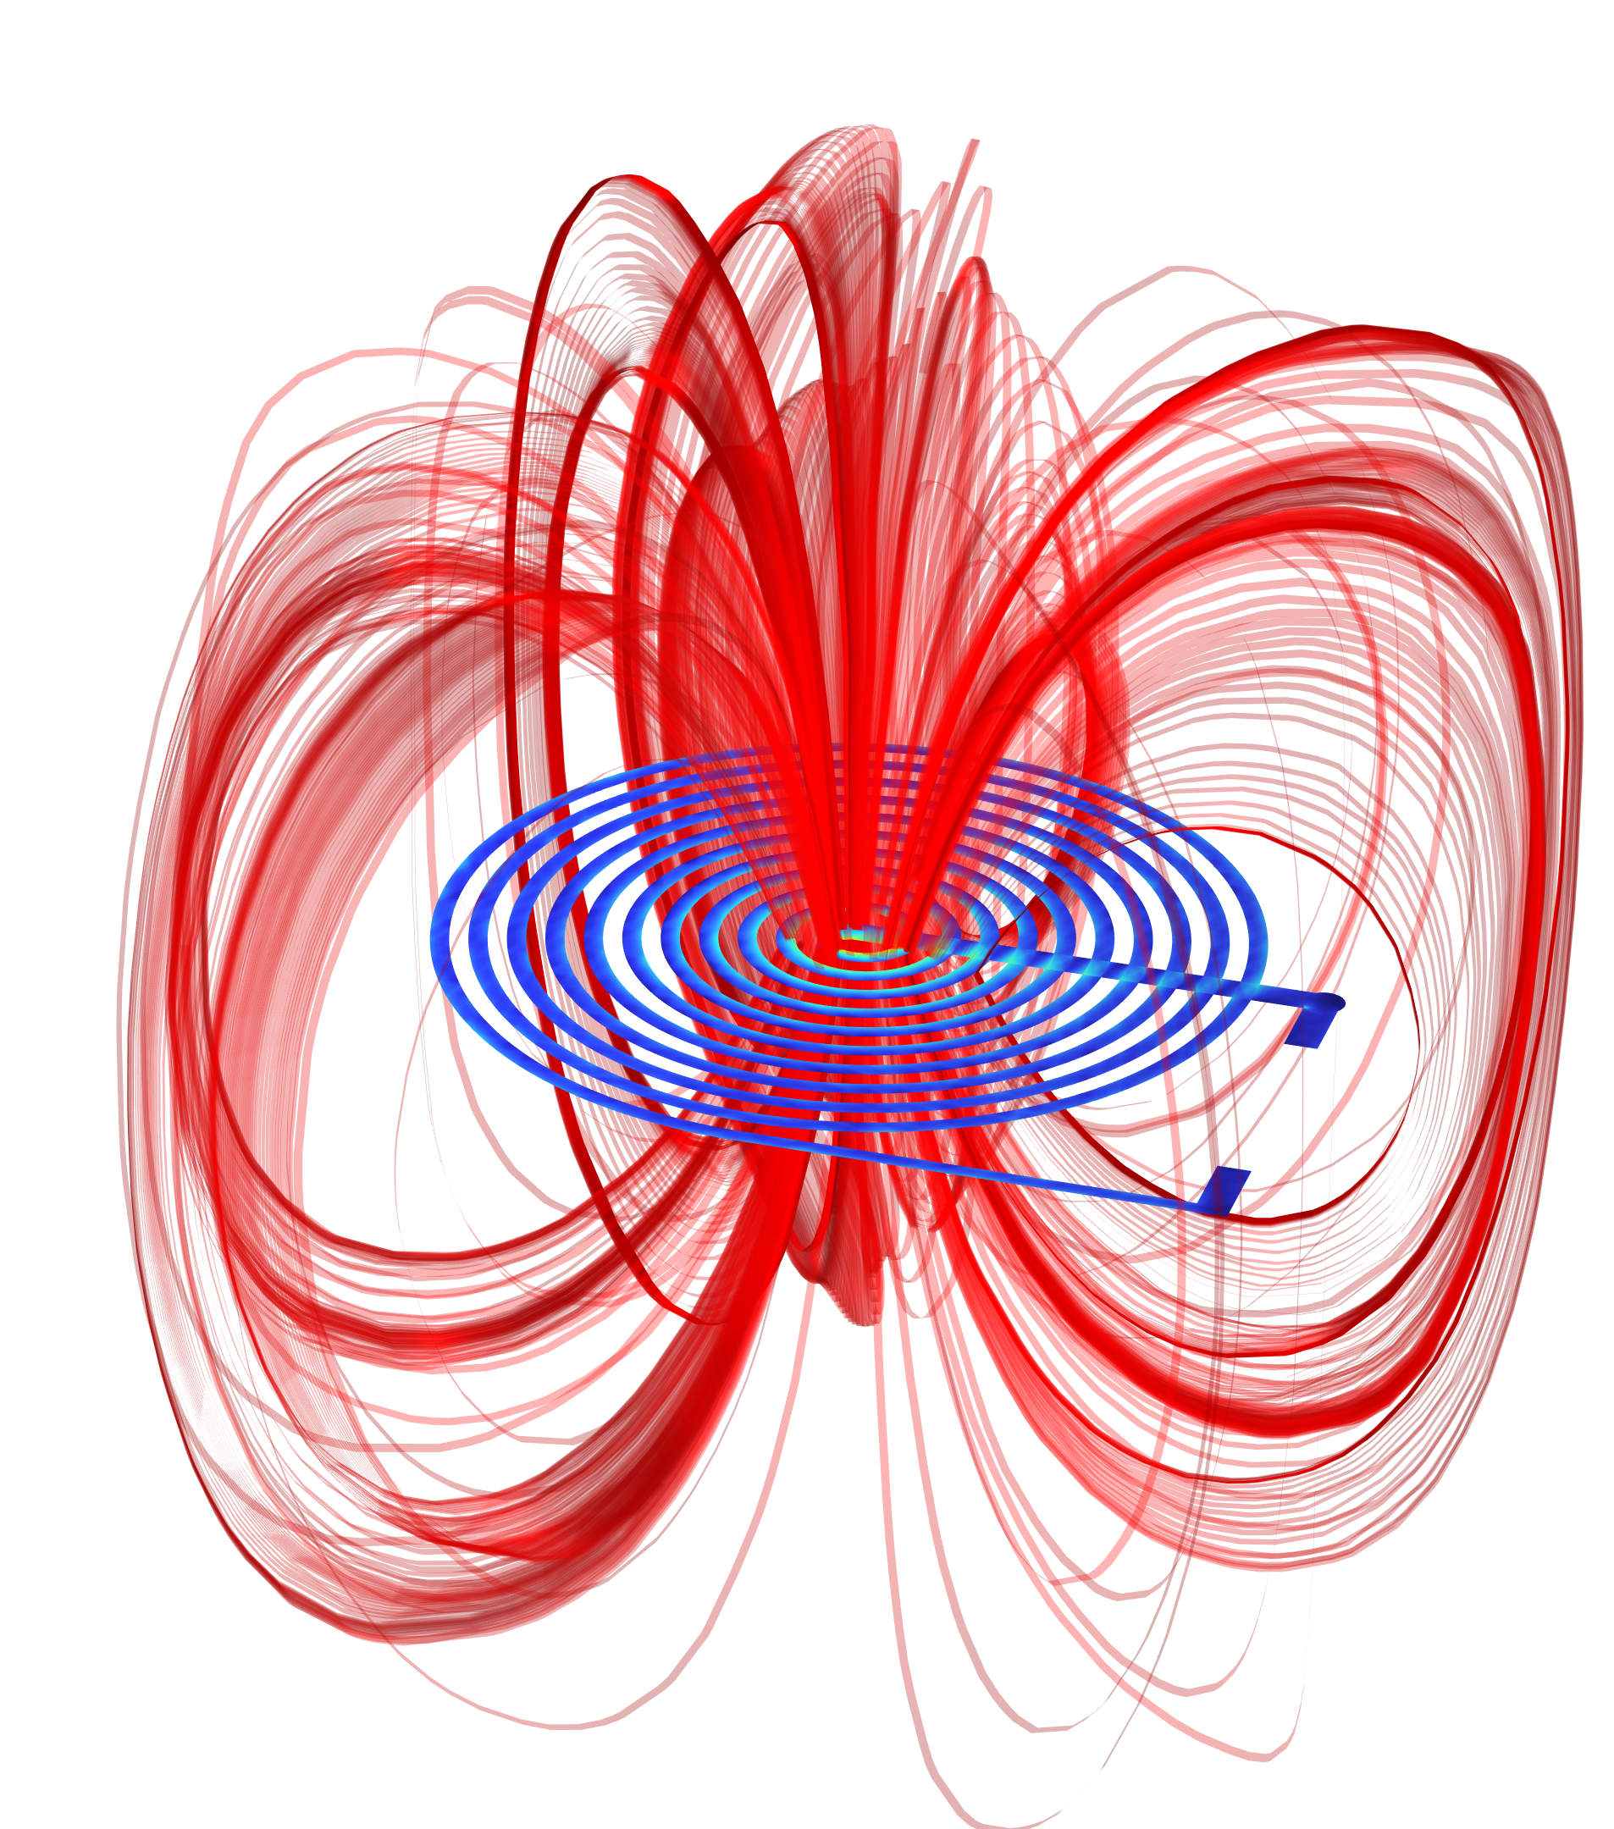

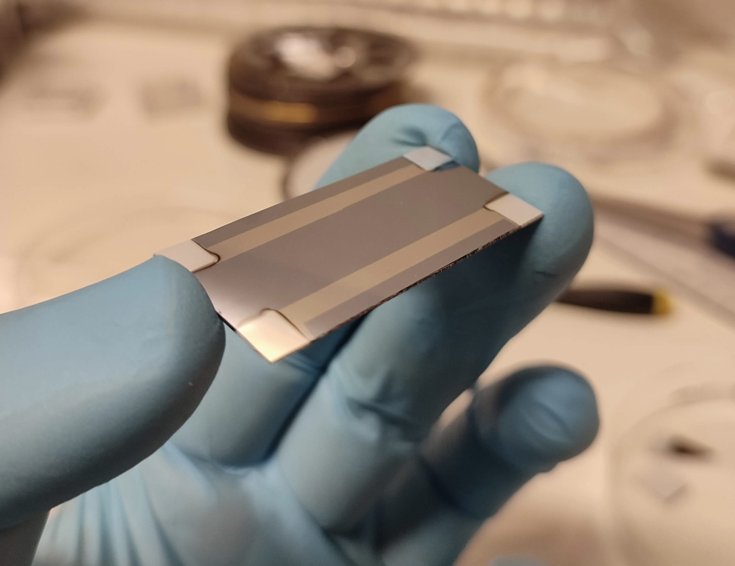

Low-loss actuation: superconductive actuators
1. Analytics
Coil-magnet
Supercon-ducting coil
2. Verification by COMSOL simulations
Suspension structurally damped
(no viscous damping due to eddy currents generated in the conductor by magnets)
Q ~ 10⁴ → decrease thermal noise!
Good sensitivity at low frequency
Cdt: Elvis Camilo Ferrera
Working principle
Actuation force applied on the proof-mass by magnetic pressure because of the Meissner effect
silicon substrate
3. Superconductivity theory and testing with Andrea Perali and Filip Tavernier
alumnium pads
superconductor
Thin film strips for testing

Slide 11
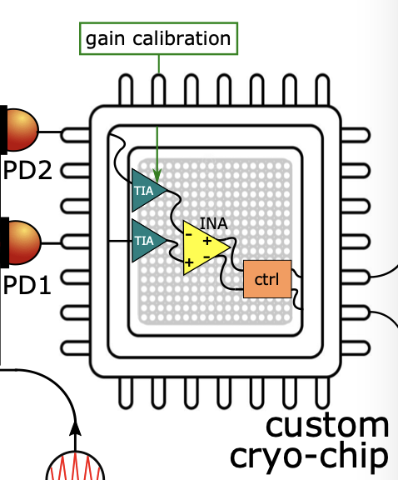
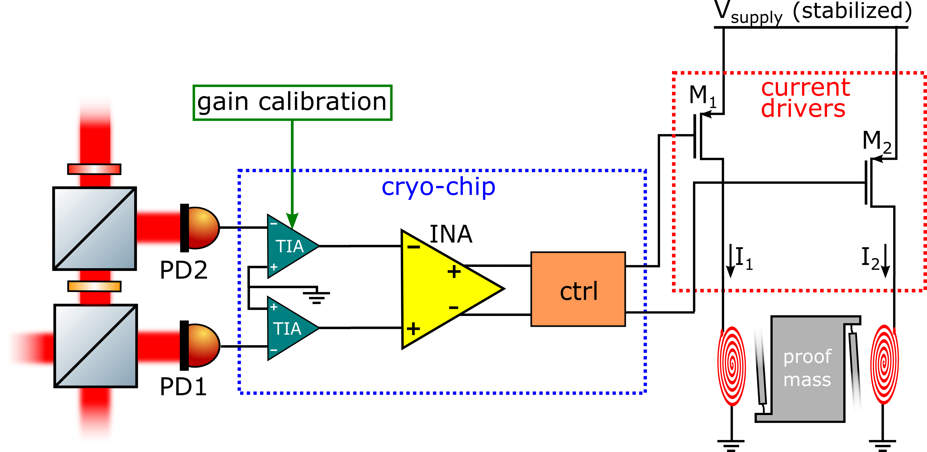

Low-noise interferometer electronics
Custom 65nm-CMOS cryo-chip
Lower thermal noise
Lower leakage
Increased 1/f noise
  Limited by custom design
Higher turn-on voltage
Collaboration with A. Gatti & F. Tavernier
JV van Heijningen +, NIM A 1041, 167231 (2022)
Notes:
What is turn on voltage?

Slide 12
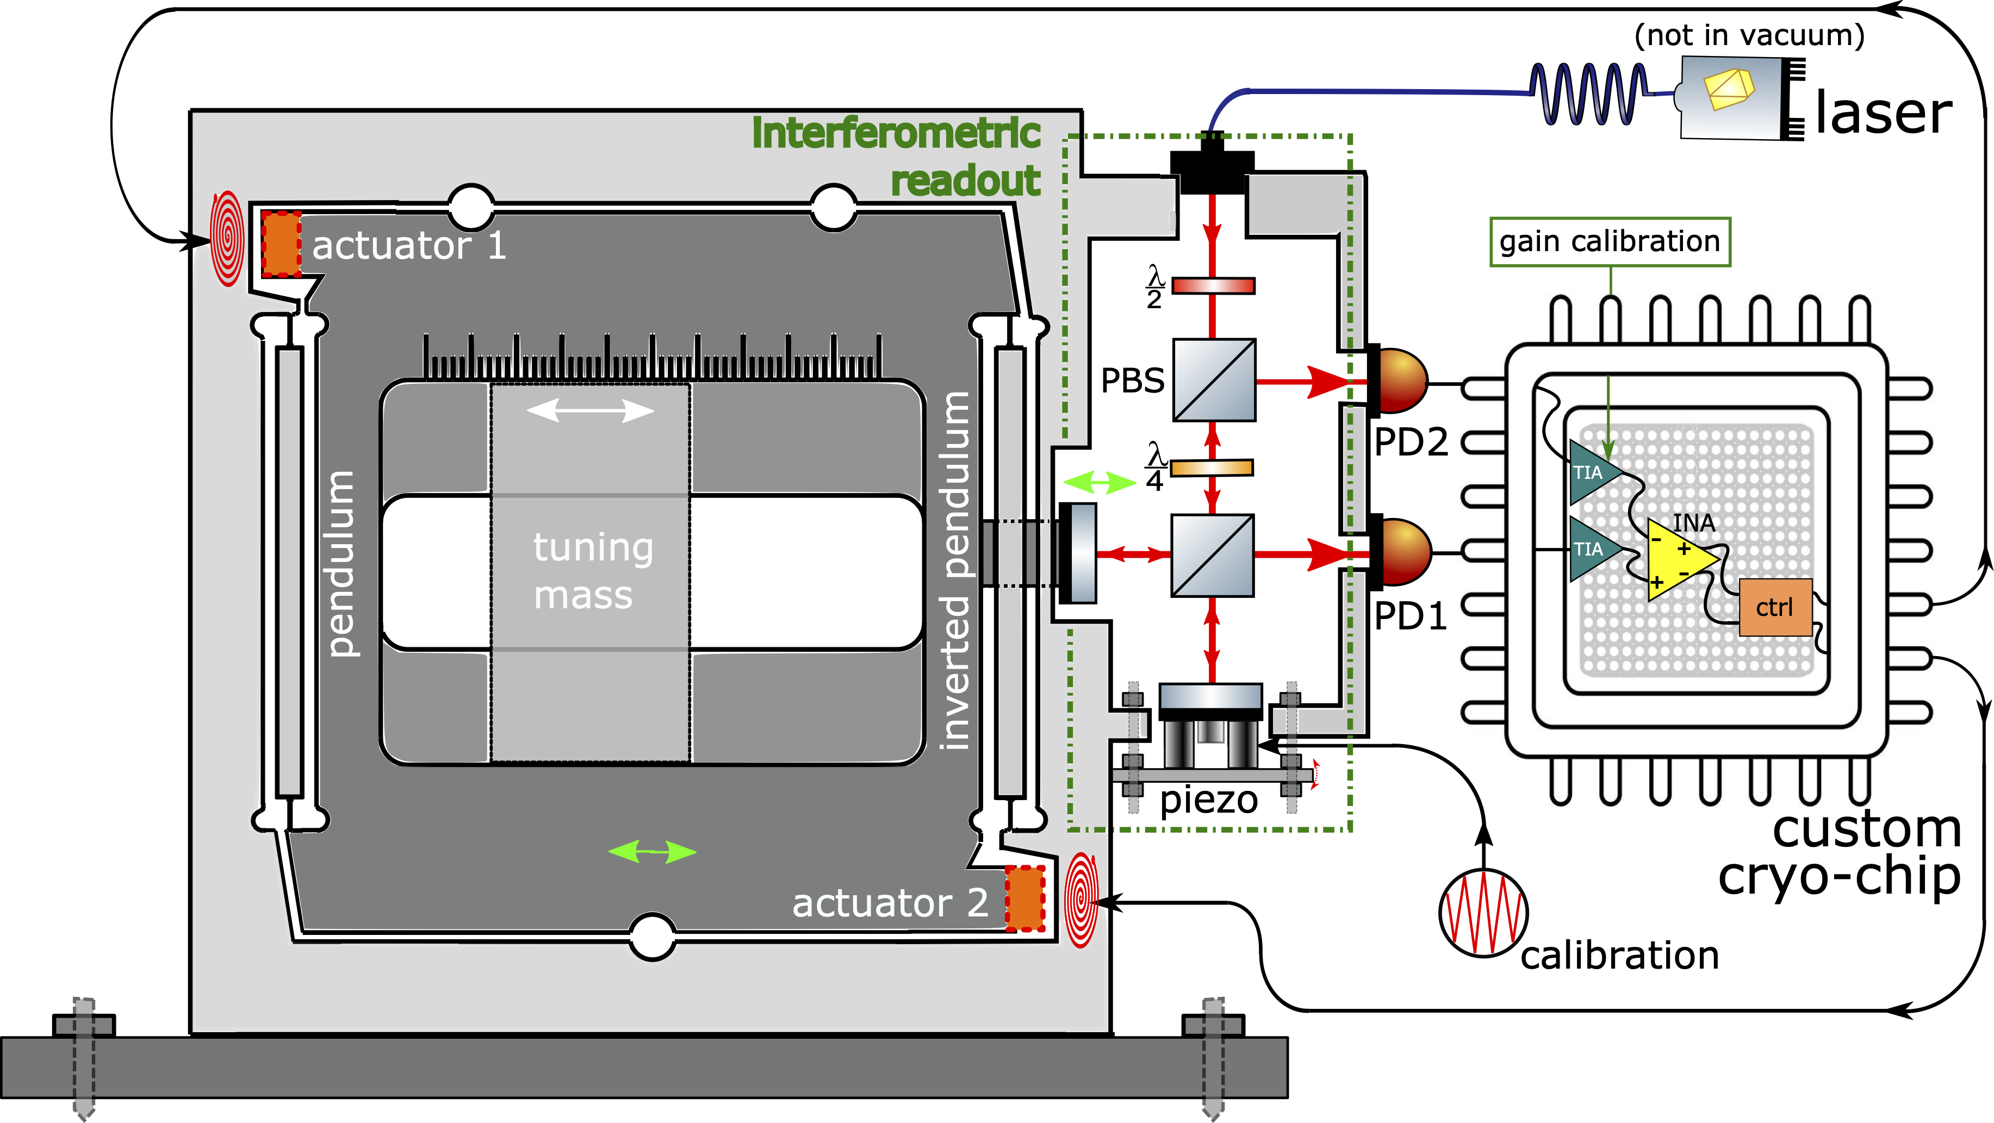
Cryogenic Supercondutive Inertial Sensor (CSIS)
10 cm
Superconductive actuator
Custom cryo-chip
Niobium proof-mass
(10kg)
Watt’s linkage
JV van Heijningen, 2020, JINST 15 P06034

Slide 13
Sensitivity improvement
1kg-proof-mass prototype
RT with single 🧲 actuator
RIN/ freq./ shot noise
Cryo niobium with 🌀 actuator
RT with 🛡️🧲 actuator
Notes:
Change plot

Slide 14
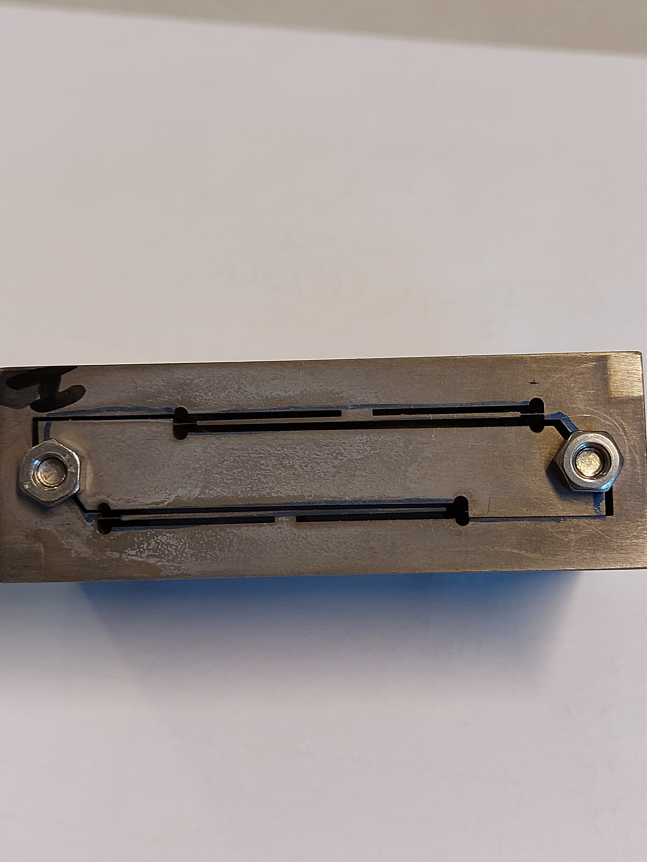
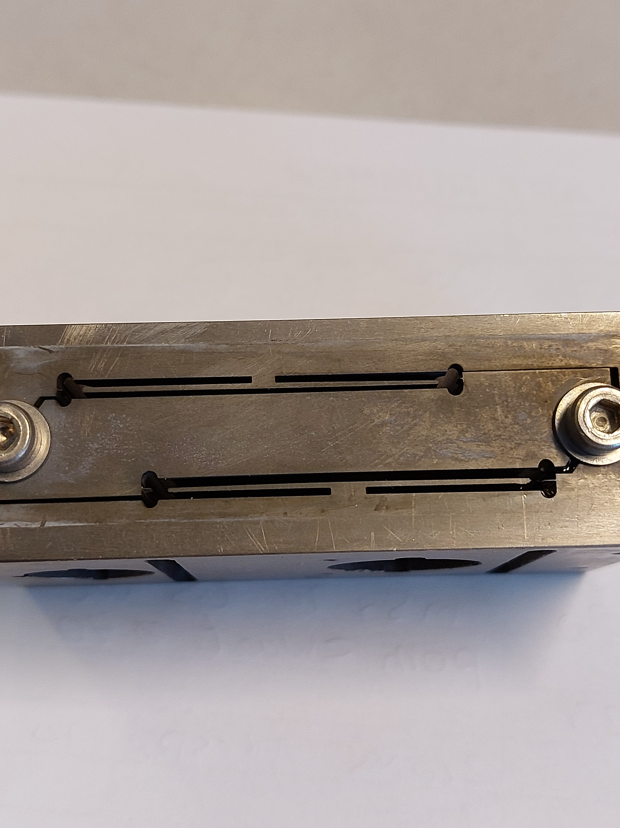
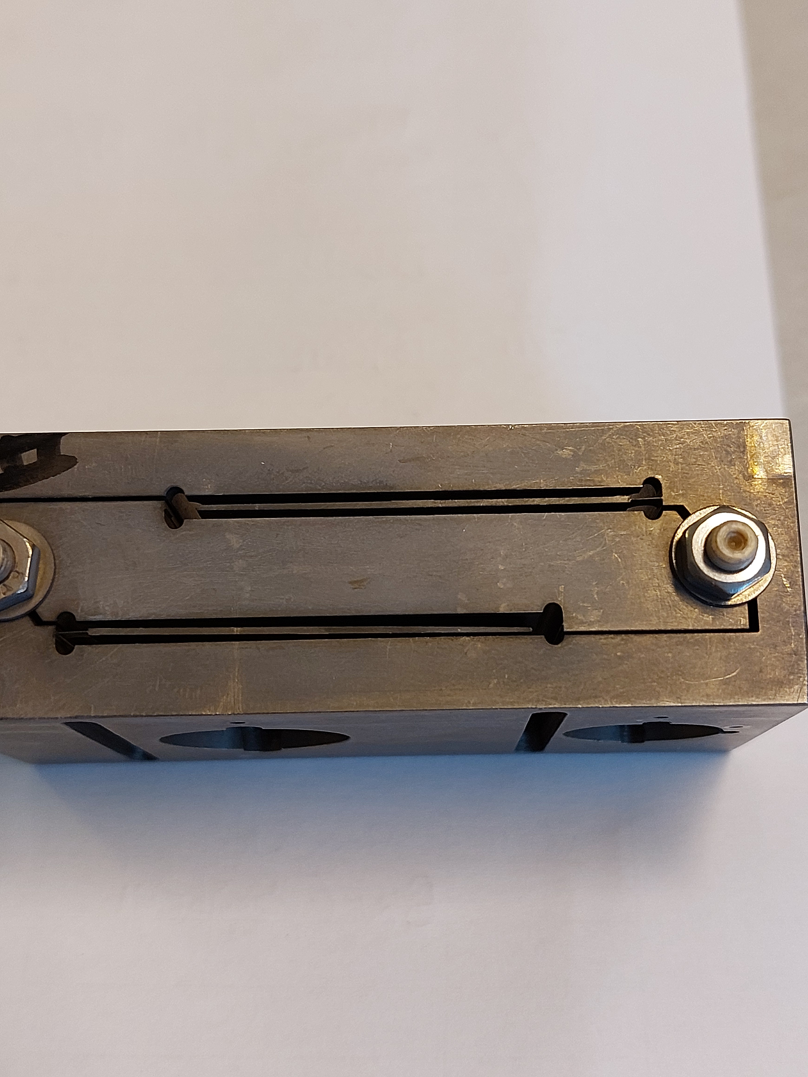
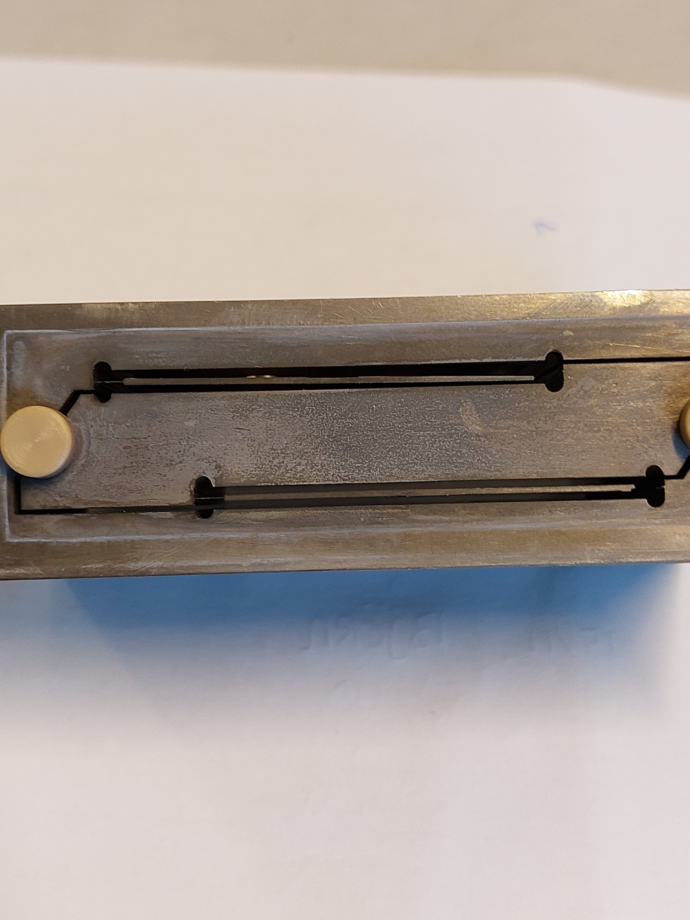
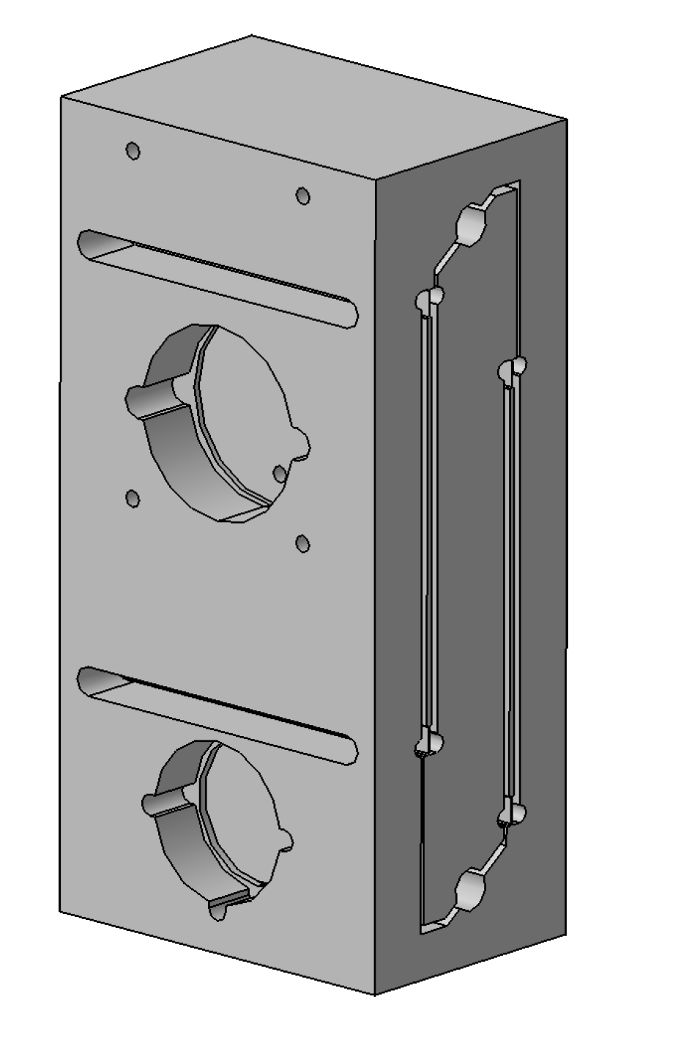
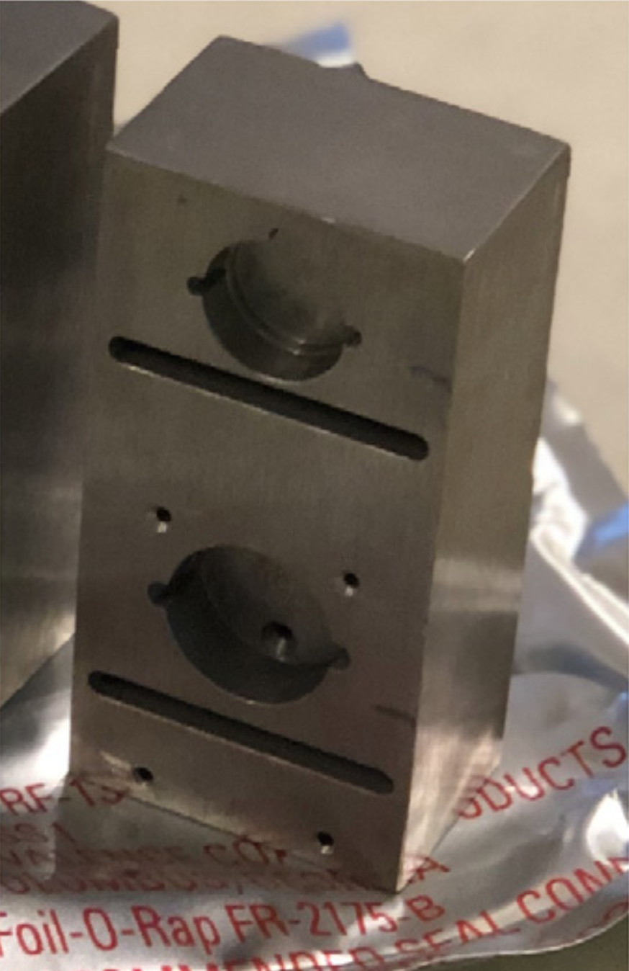
Current status: Niobium proof-mass manufacturing
Preliminary results show some failed flexures, but adequate interfacing between holes and EDM cuts
Two smaller test blocks with a compressed proof mass to test interfaces between milled holes and the spark-erosion cuts including the delicate flexures
pre-EDM
Block 1
Block 1
Block 2
Block 2
Now preparing other blocks with better cutting machine alignment and annealing, we expect better results

Slide 15
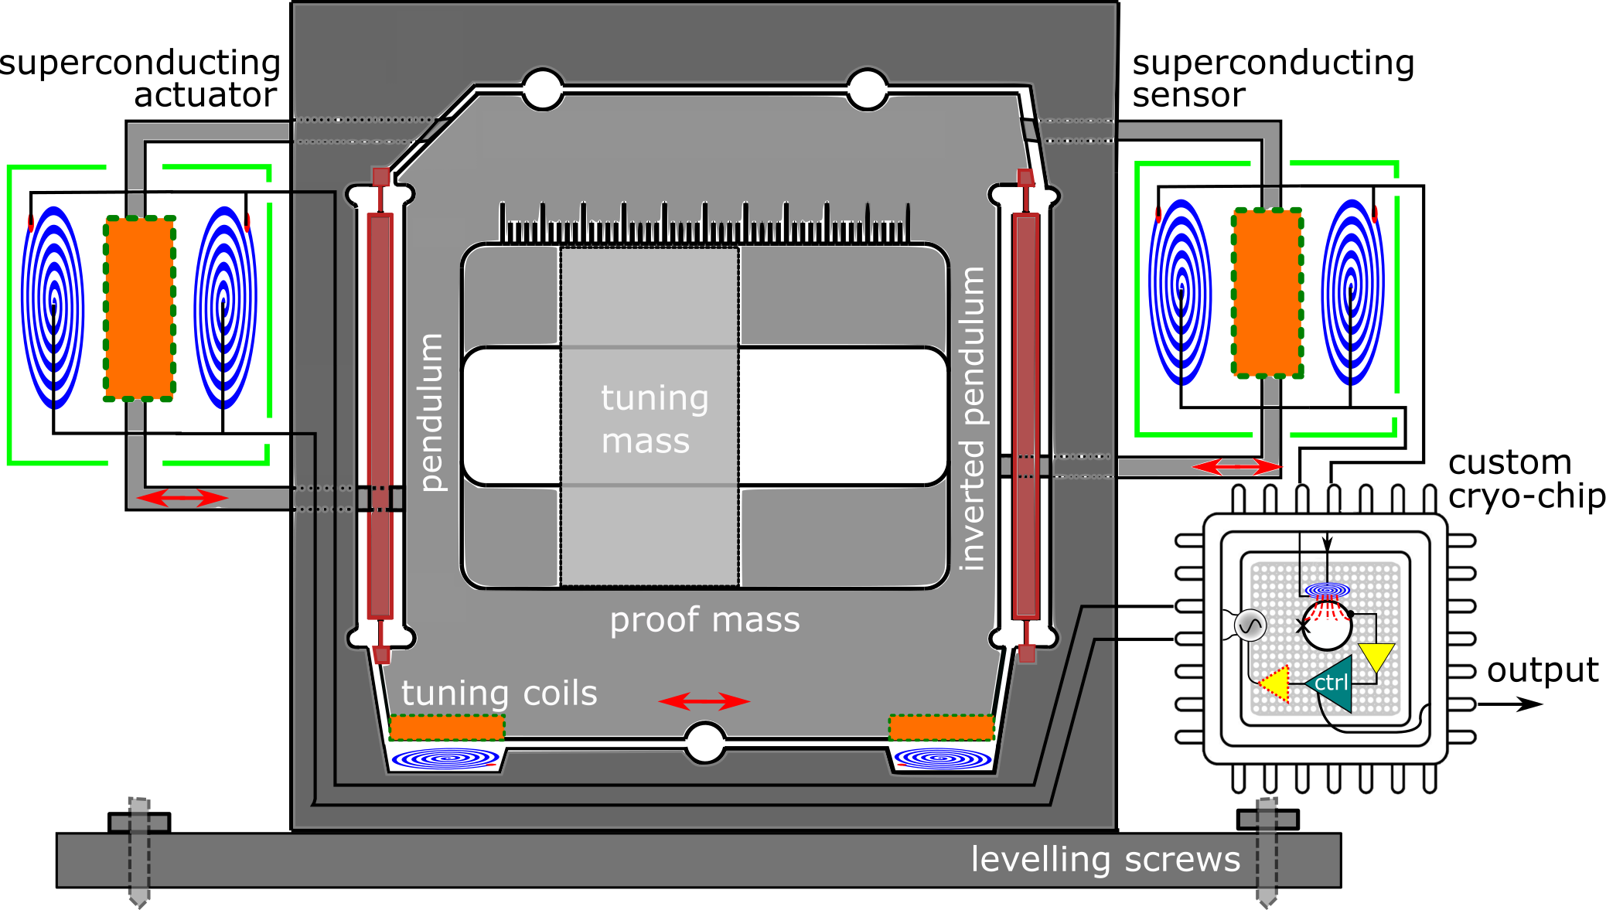
Alternative design: Silicon mechanics and SQUID read-out

Slide 16
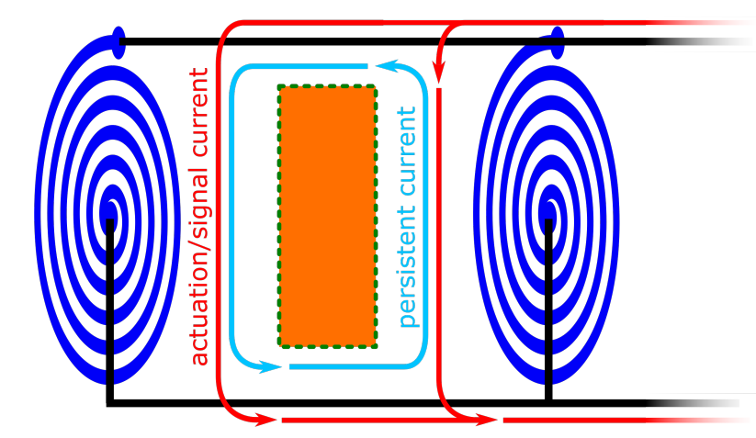
SQUID sensing and actuation
Actuation
Moving superconductor
Inductance change of the coil-superconductor system
Current change
Connection to a second coil to convert the current change in a magnetic field change readable by a SQUID read-out
Sub fm/√Hz precision
Sandwich configuration for read-out (linarity) and actuation (push actuation)!

Slide 17
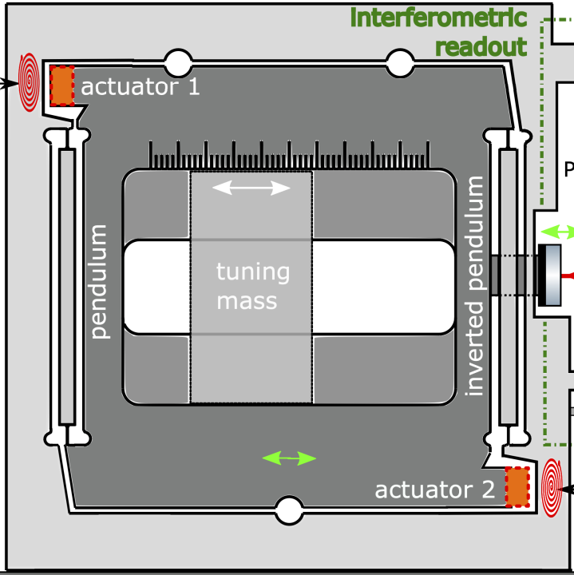
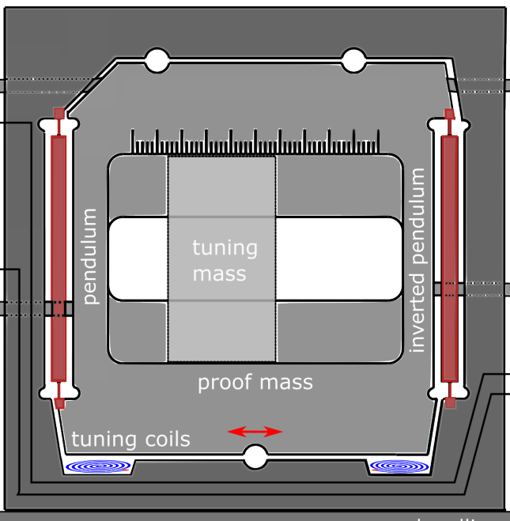
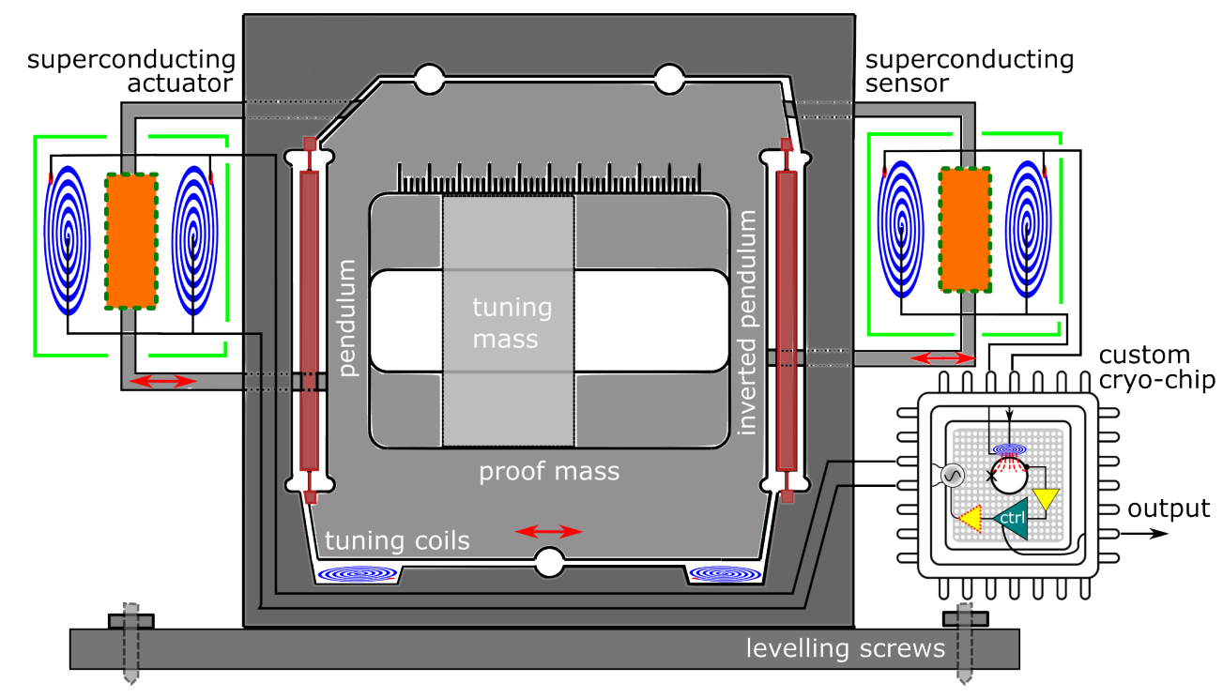

The design is not fixed!
Mechanics
Read-out
Superconducting actuators
Monolithic Niobium
Interferometric readout
Silicon
superconductive readout & actuation
Tuning coils

Slide 18
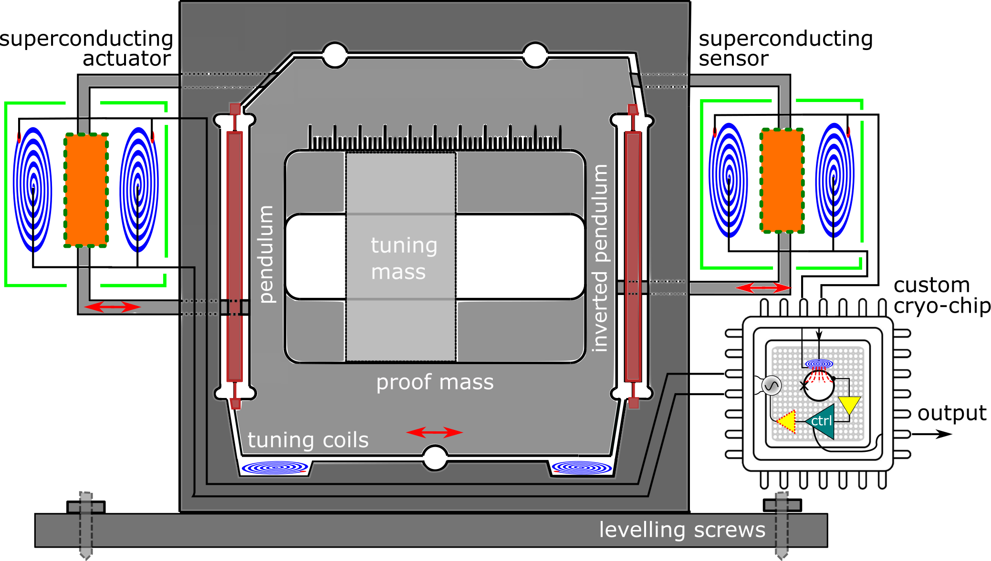
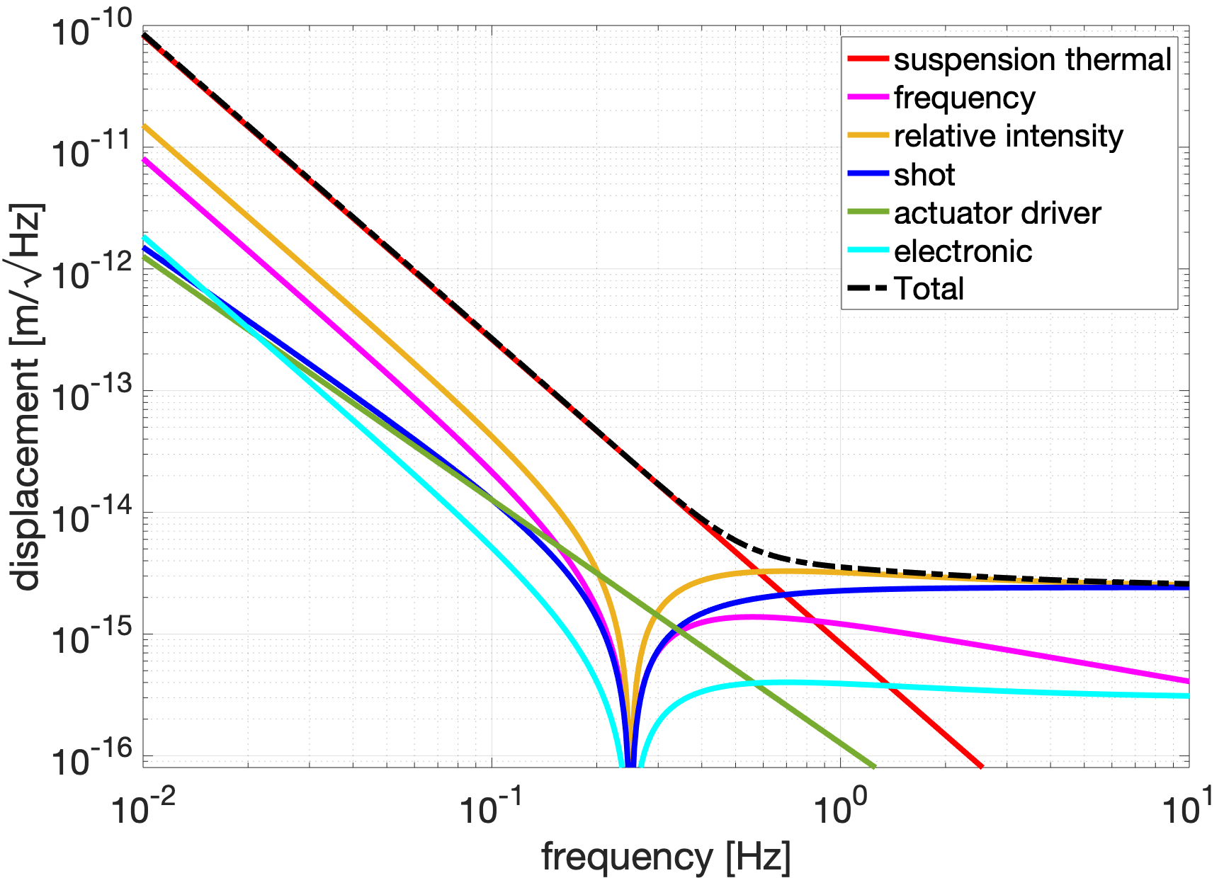
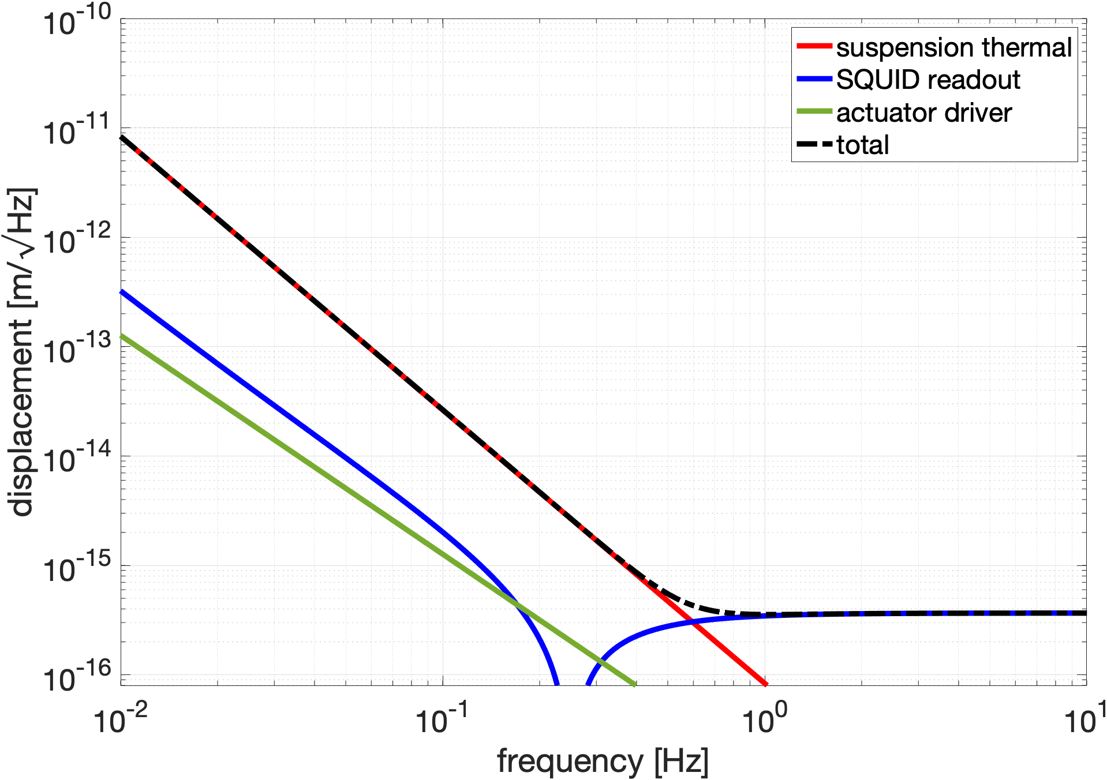
Sensitivities
10kg proof mass
Niobium (Q=10⁴) Watt’s linkage with interferometric readout
Silicon (Q=10⁶) Watt’s linkage with superconductive readout

Slide 19
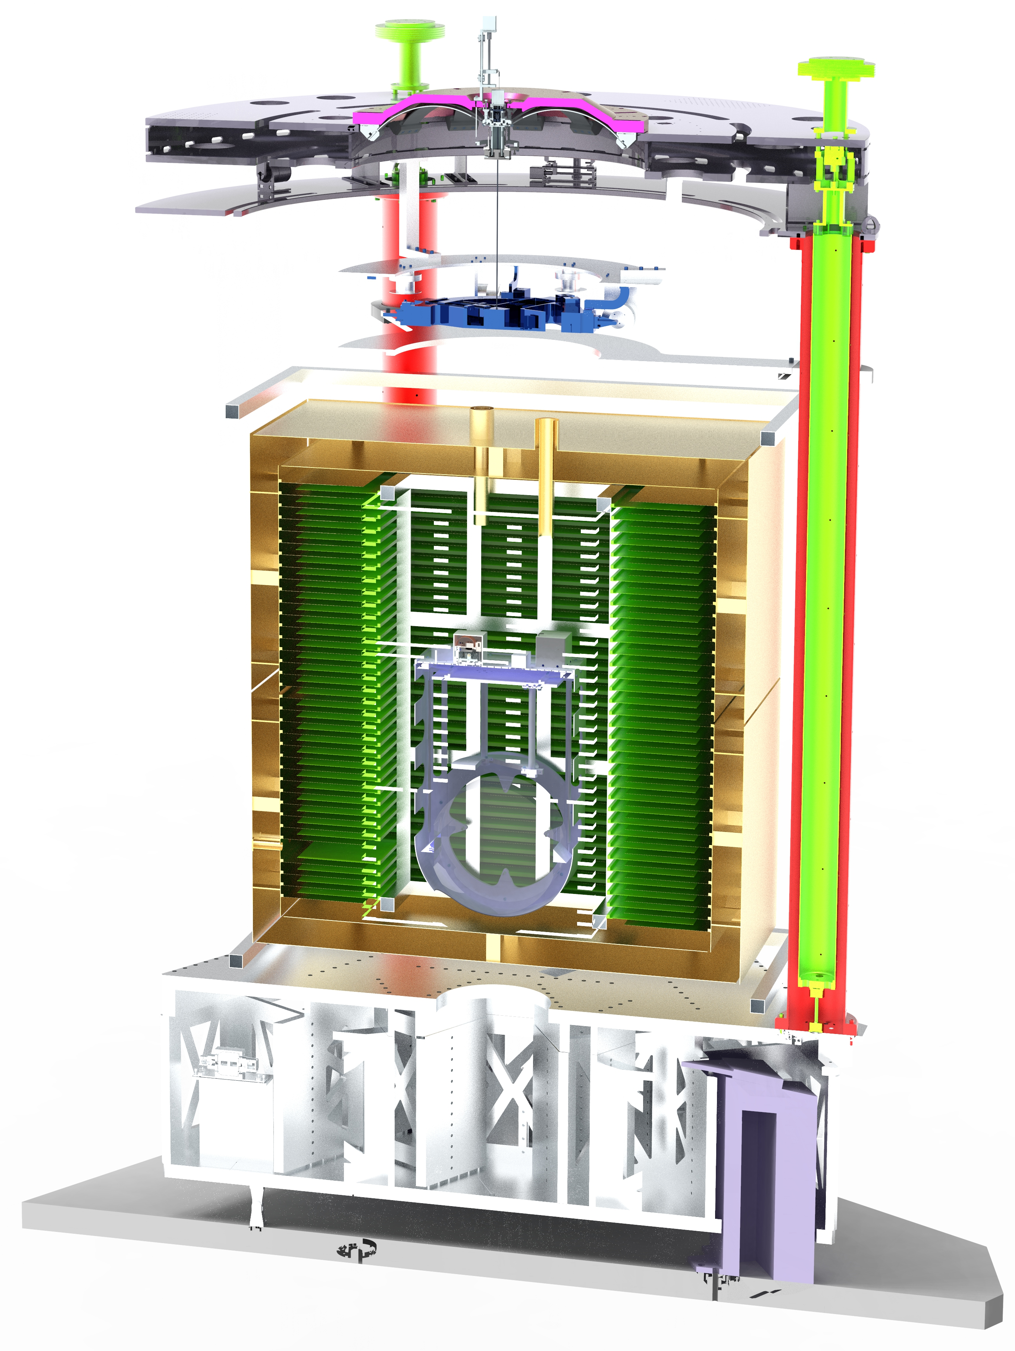
How to test such sensor on Earth? E-TEST prototype
Seismic isolation
Cryogenic payload
Geometric Anti-Spring filter
Inverted pendulum
Passive horizontal vibration isolation
Passive vertical vibration isolation
Cold platform
Suspended Cryostat
Test bench for cryogenic superconductive interferometric inertial sensors (CSIS)
Radiatively cool the test mass to 20K
Active platform
Inertial control of the 6 degrees-of-freedom
Test mass (Si mirror)

Slide 20
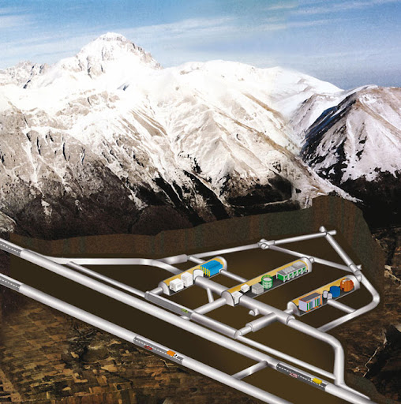
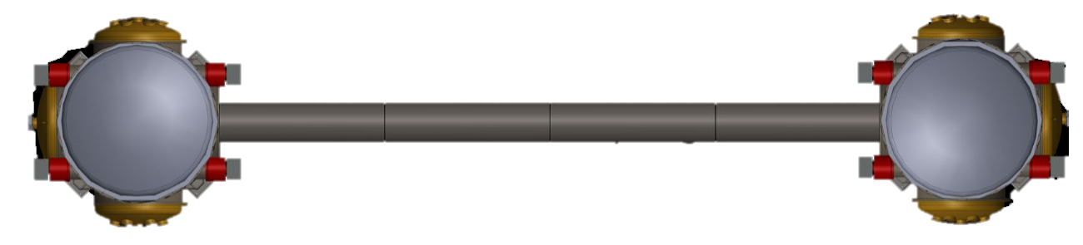
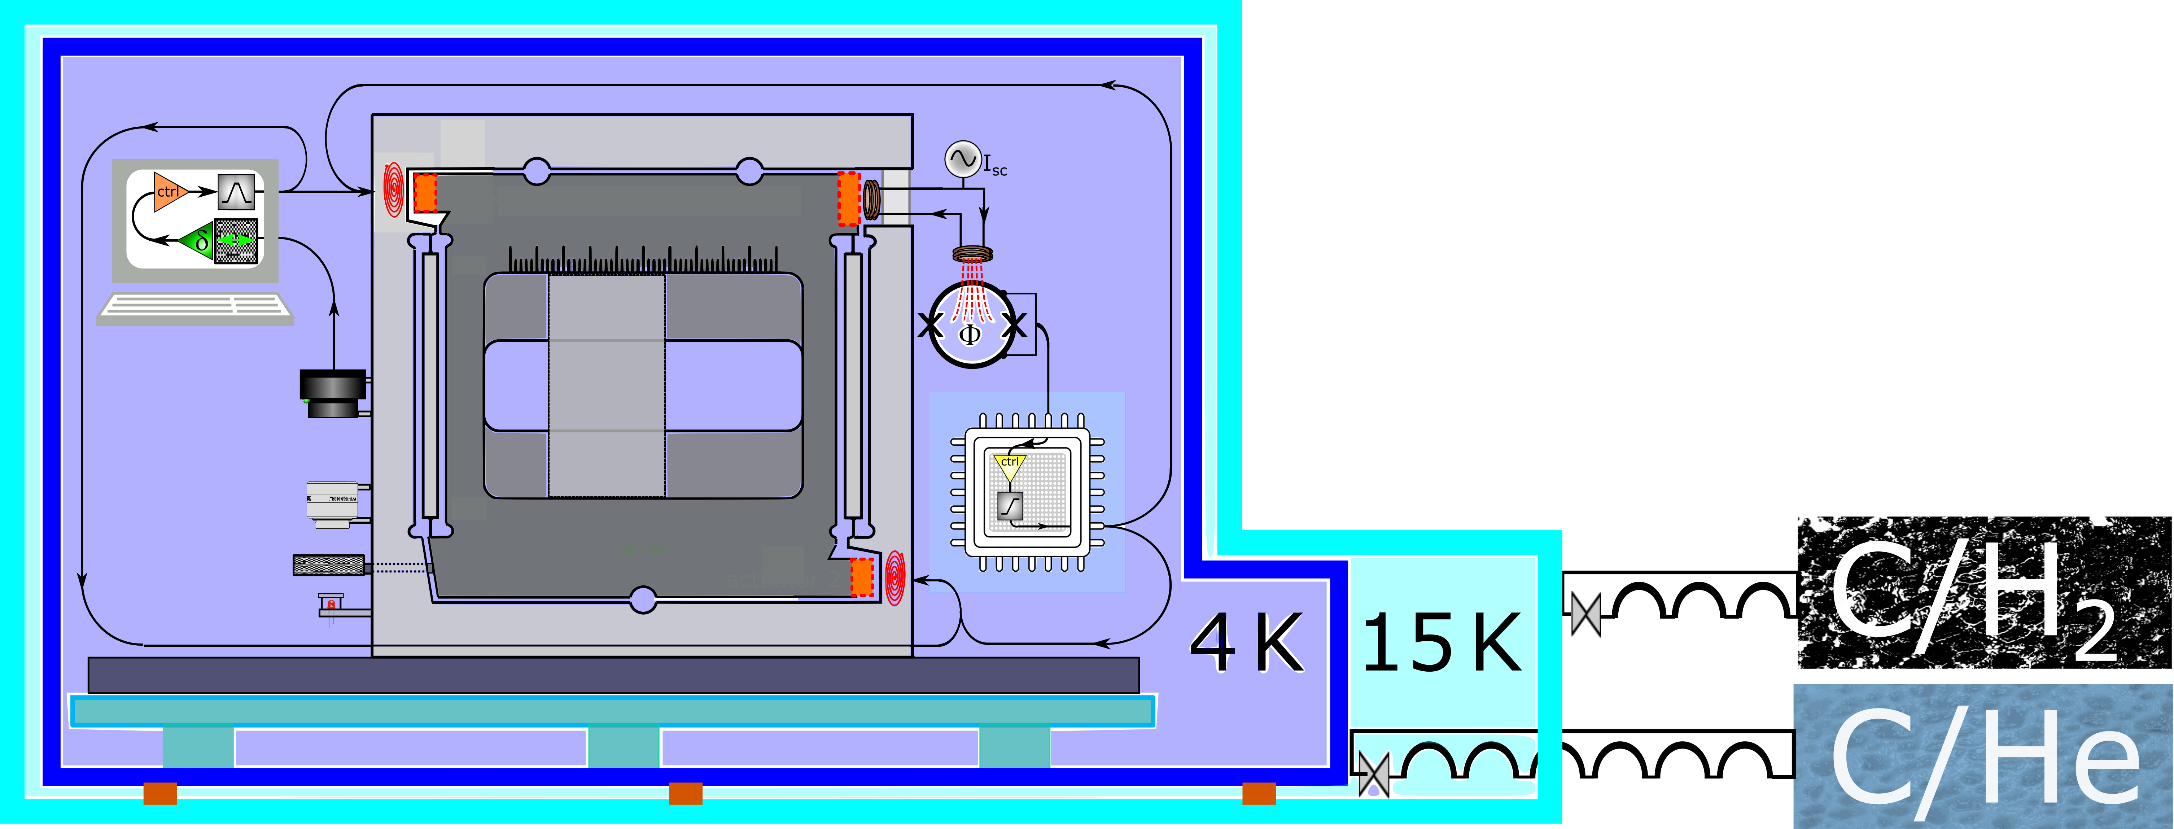
How to test such sensor on Earth? Gemini facility
2 connected active platforms, one with cryogenic volume
LNGS, Italy
Gran Sasso labs

Slide 21
Sorption cooling and thermal management
2

Slide 22

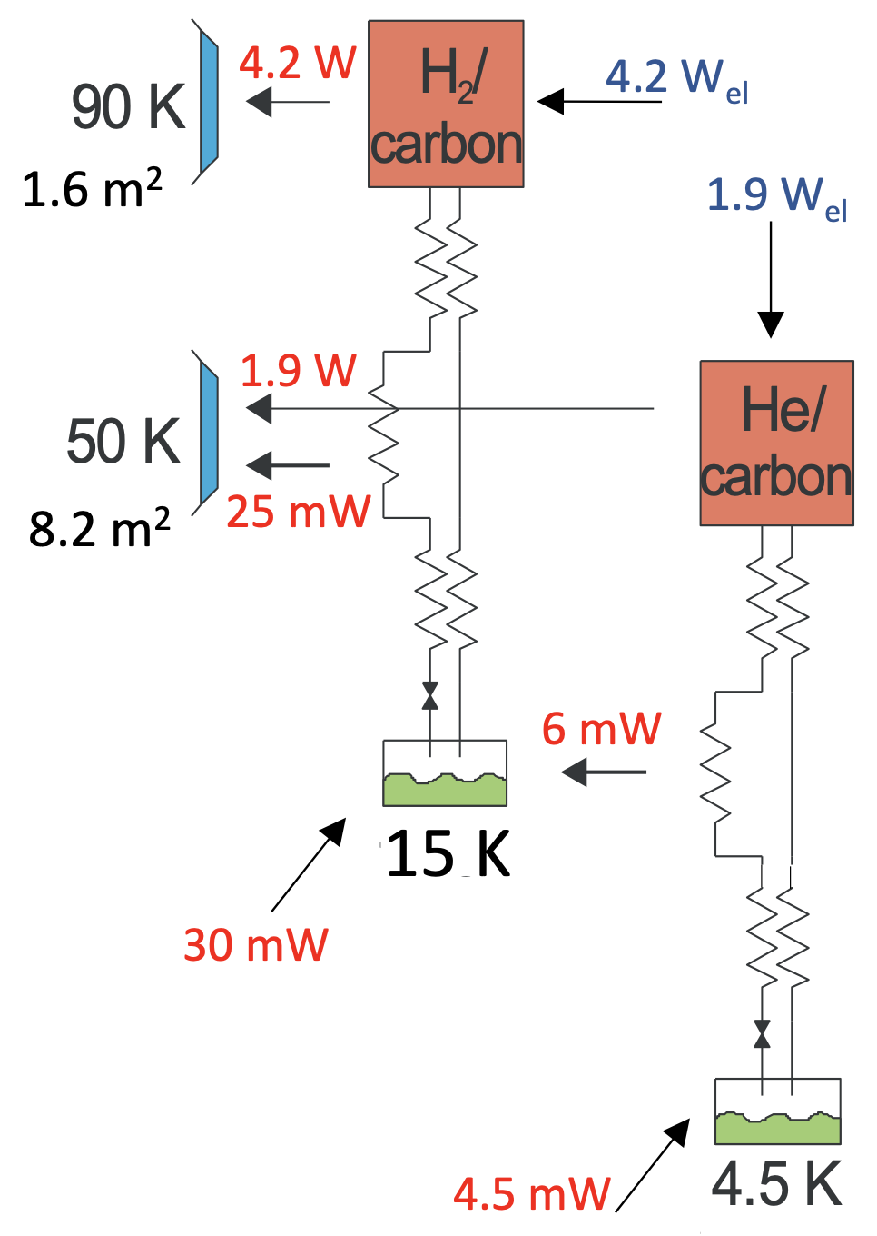
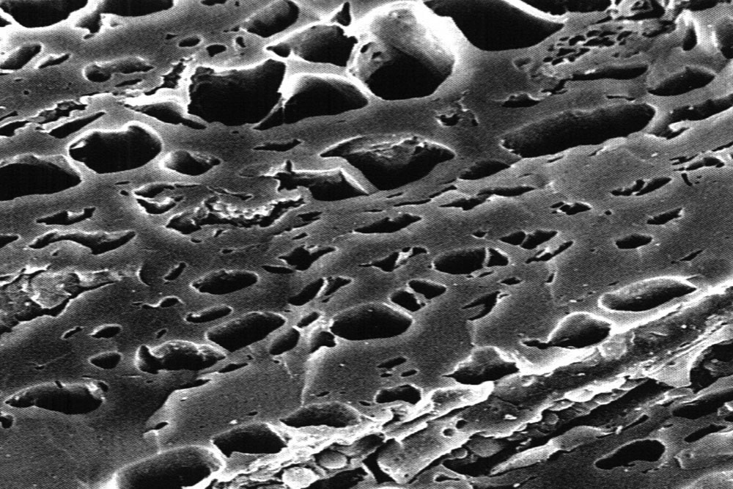
Cooling strategy
Two-stage sorption-based Joule-Thompson cooler
High-emissivity radiator
Sorber material Activated carbon
Working gas (H₂ & He)
Heat-sink platform
Heat
Thermal compressor
Desorption
Sorption
Expansion
Cooling
Notes:
Combination of two vibration-free cooling techniques: High emissivity radiator panel used to provide heat-sink platforms at temperatures 50K and 90K + Two-stages sorption-based Joule-Thompson cooler to cool further to 14,5K and 4,5K.
Working principle of thermal compressor (sorption).
Two-stages more efficient + pre-cooling
Gross-cooling power of 36mW and 4,5mW for a net input power of 6,1W
10kg

Slide 23
Advantages and challenges
Advantages
No mechanical moving parts (except for passive valve)
Need to be leveled & to withstand launch loads!
Laser for the interferometer operates at room temperature
Long life-time (no wear)
Challenges
Physical link partially decoupled once on the moon
Decouple laser room temperature environment from cryogenic environment
Extremely low vibration level

Slide 24
Seimometer leveling system
3

Slide 25
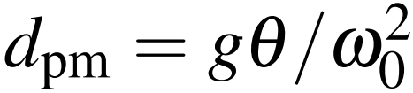
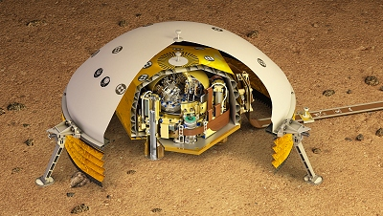
Leveling system
Compensate for ground slope and keep seismometer platform aligned within a few microradians
No contact
Requirement < 30µrad
Platform similar to the one developed for the SEIS experiment of the Mars InSight mission
https://www.seis-insight.eu/en/public-2/seis-instrument/summary

Slide 26

Thank you for your attention
Contact: morgane.zeoli@uclouvain.be

Slide 27
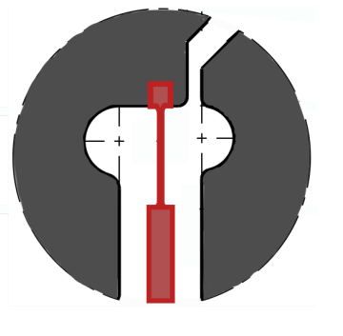
Silicon Watt’s linkage
Si has low mechanical loss at cryo temperatures
Q ~ 106 (bulk 108)
EDM (electro-discharge machining)
Etched out of a 500µm thick wafer
hydro catalysis bounded

Slide 28
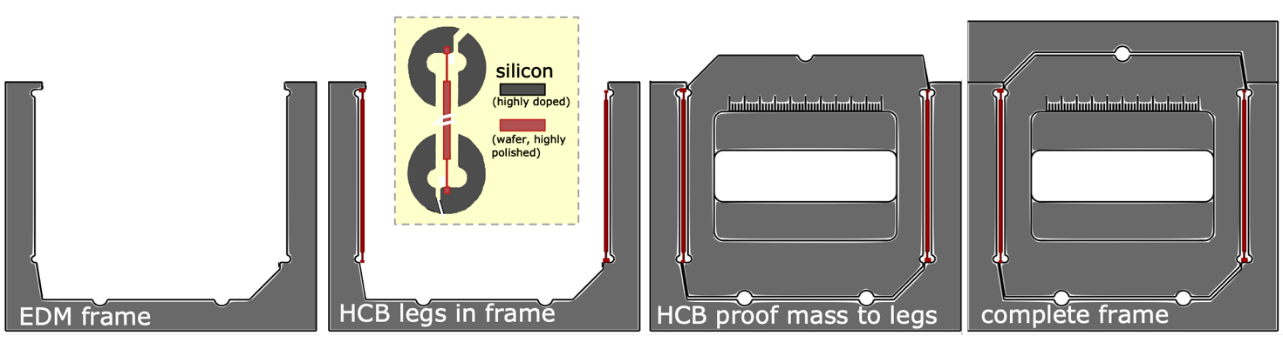
Assembly procedure for silicon Watt’s linkage

