Slide 1
Discussion session
Roberto Aloisio and Antonella Castellina

Slide 2
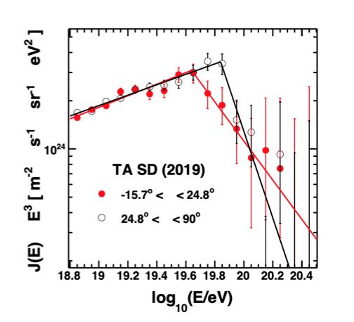
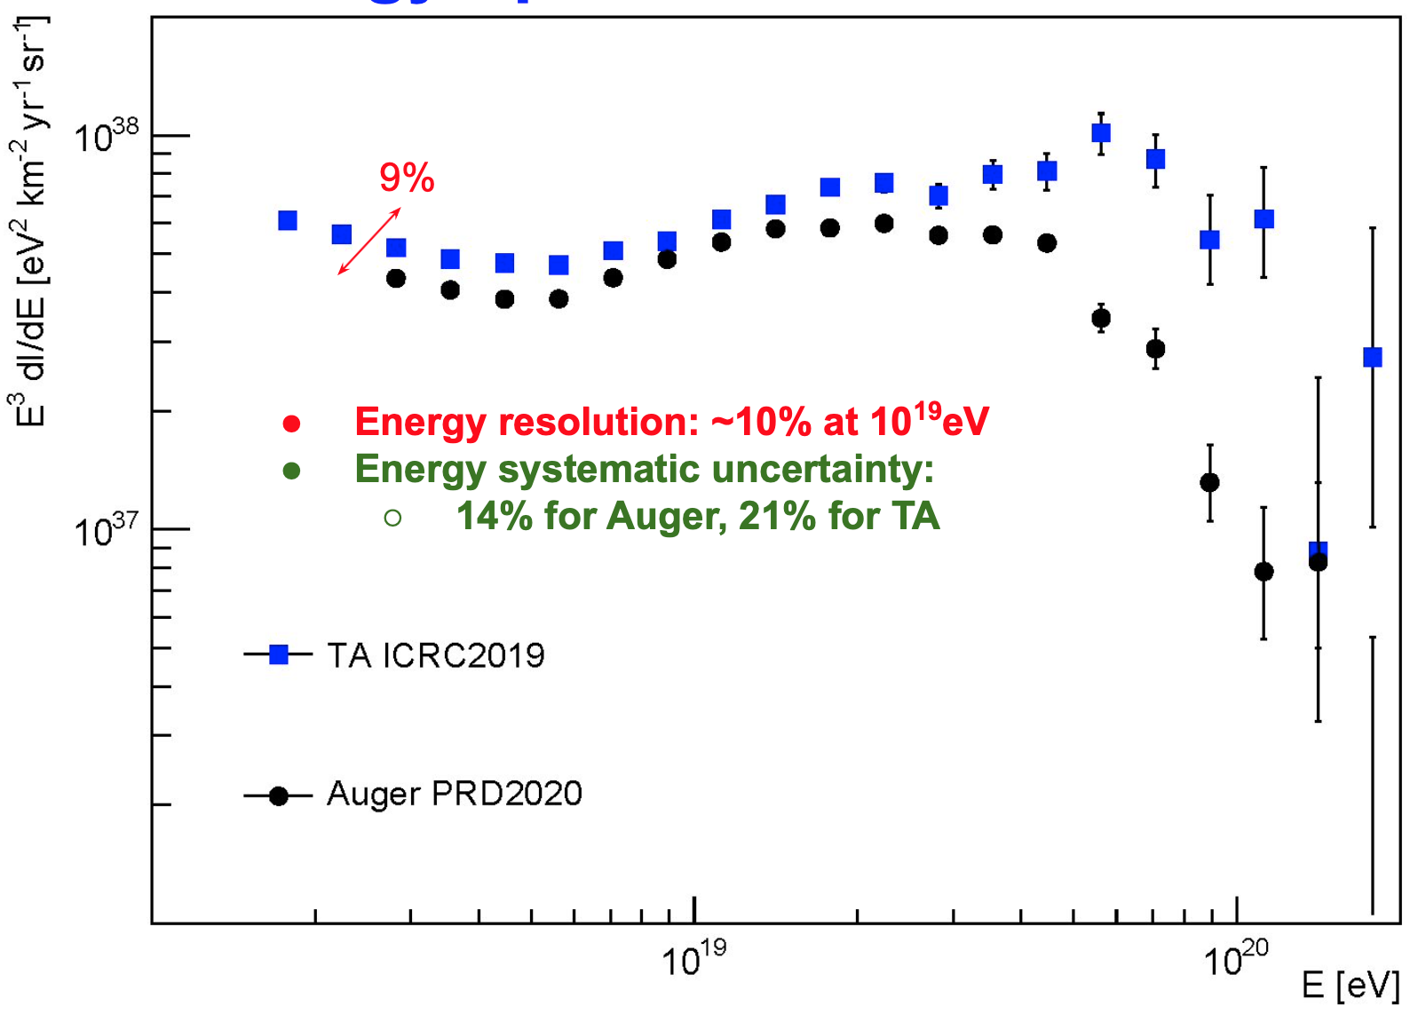
Differences in energy spectrum between Auger and TA
1) Is there really a disagreement? Is there a difference in the spectrum in the Northern and Southern sky?
2) It would be very useful if the two collaborations could use the same fluorescence yield and invisible energy.
[V.Verzi, Auger+TA working group]

Slide 3
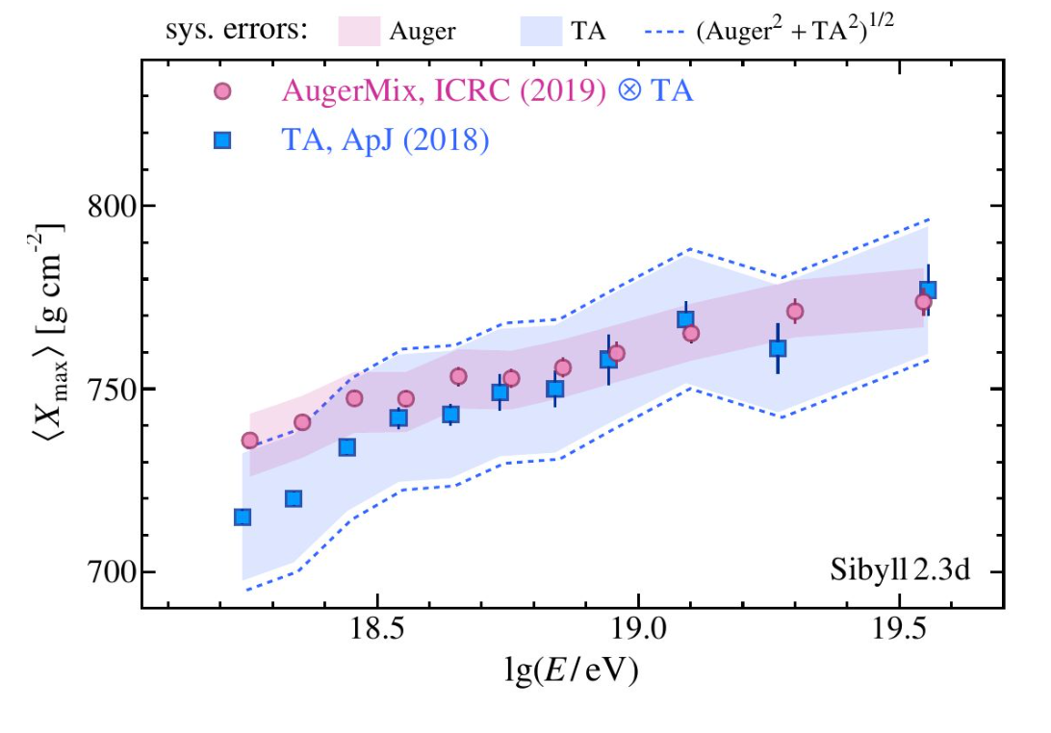
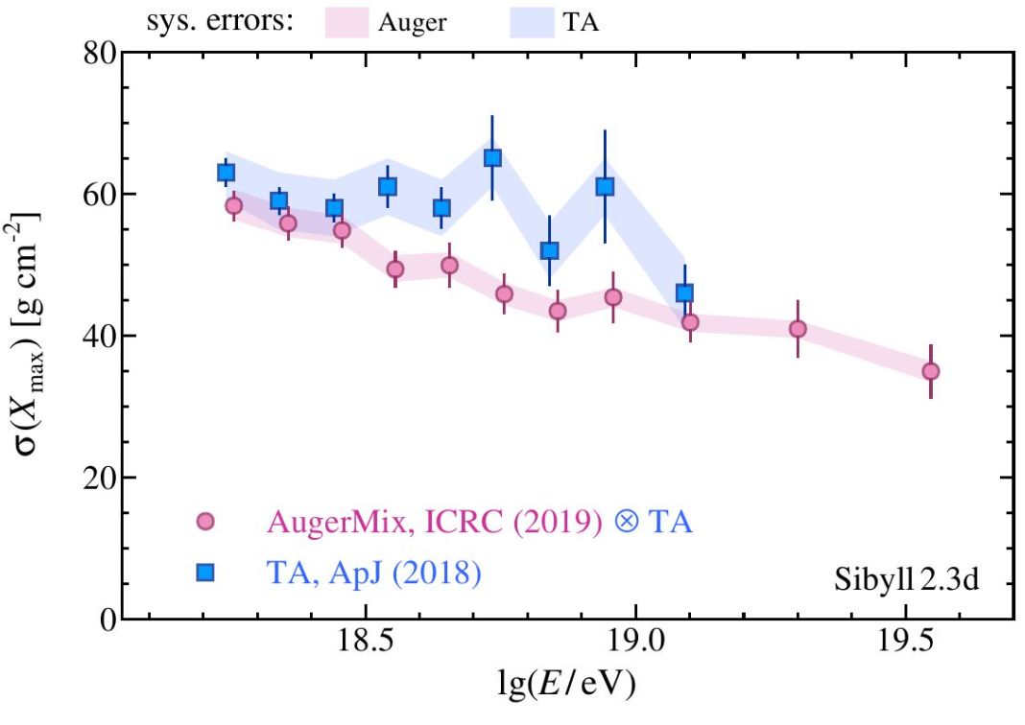
Differences in mass composition between Auger and TA
  Need for a clear statement to avoid confusion still present in the community
1) a robust difference between the Auger and TA Xmax measurements has not been found
2) can the two collaborations agree on a break at ~3 EeV?
3) can AugerPrime and TAx4 provide a measurement of the composition on an event-by-event basis? Perspectives to determine mass composition at the highest energies.
4) Perspectives for the description of the hadronic interaction models at UHE.
[D.Bergman, Auger+TA working group]

Slide 4
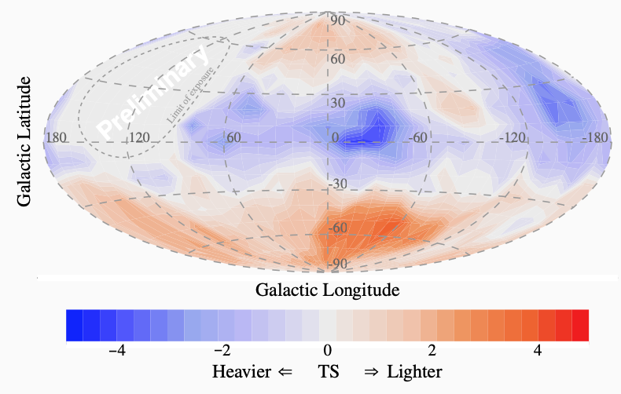
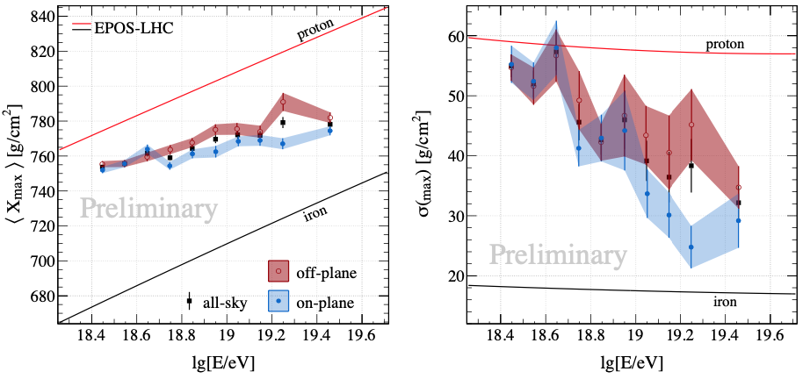
UHECR anisotropy
1) Dipolar anisotropy above 8 EeV confirmed
EGCR at E>8 EeV, amplitude increasing with energy as expected in the case of transition GCR-EGCR between 0.1-1.0 EeV.
2) Intermediate anisotropy above 38 EeV
Only indication of how significantly we can exclude isotropy, unless we know/include magnetic fields effects.
3) Hints of composition anisotropy: heavier nuclei around the Galactic Plane
How we can interpret this result? is this connected to the GMF?

Slide 5
Combined fits of observables and possible sources
1) Combined fits of spectrum and mass composition of UHECR show the need for two components: one soft and light at low energies (E ≲ 3x10¹⁸ eV) and one hard and heavy at high energy (E ≳ 3x10¹⁸ eV).
Gamma Ray Bursts
UHECR heavy composition favors LL-GRB with a large number density (vs HL-GRB) and mildly relativistic jets. [Transient]
Active Galactic Nuclei
Different models of acceleration: termination shock, compact regions at the base of the jet, shear acceleration. [Steady]
Pulsars
Very hard spectra γ~1, heavy composition due to internal dynamics at the source. [Steady]
Tidal Disruption Events
Not clearly assessed acceleration mechanism (shocks?), recently associated with one event of high energy neutrinos. [Transient]
Starburst galaxies.
Demanding in terms of luminosities and maximum energy, needs for Ultra Fast Outflows (UFO), hints of an excess in the Auger data at E>38 EeV. [Steady]
2) All models show some deficit in the description of data (spectrum) at low energies (~10¹⁸ eV). galactic or extra-galactic component?
3) Need for a clear-cut understanding of the dynamics inside EG sources: in-source backgrounds and UHECR interactions, magnetic field turbulence.

