Slide 1
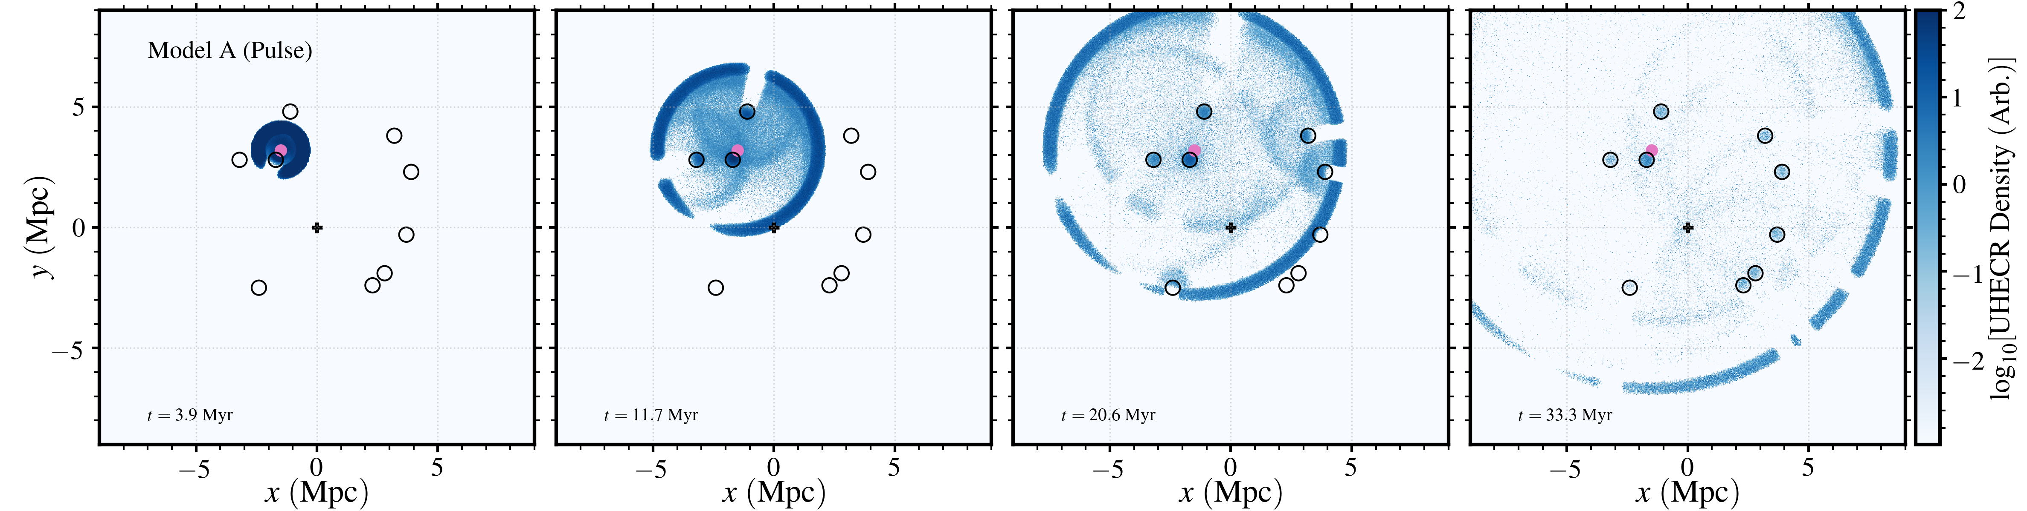
Echoes from Cen A’s Active Past
Work done in collaboration with:
James Matthews (University of Cambridge/Oxford)
and
Tony Bell (University of Oxford)
Building on the results of Bell et al. MNRAS 448 (2022)

Slide 2
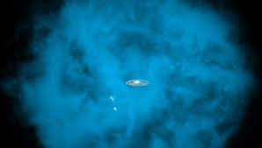
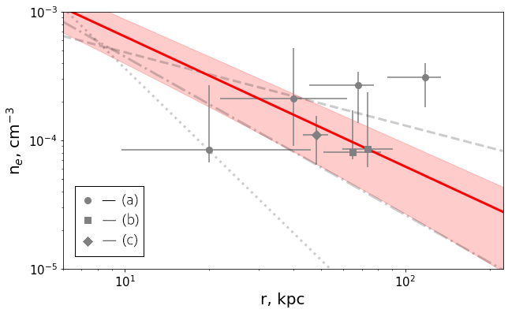
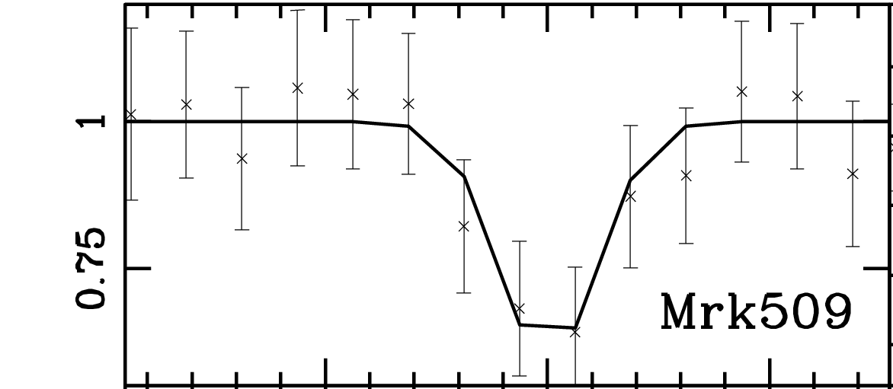
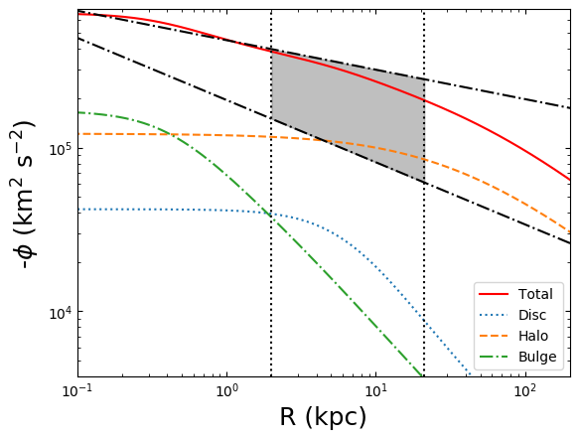
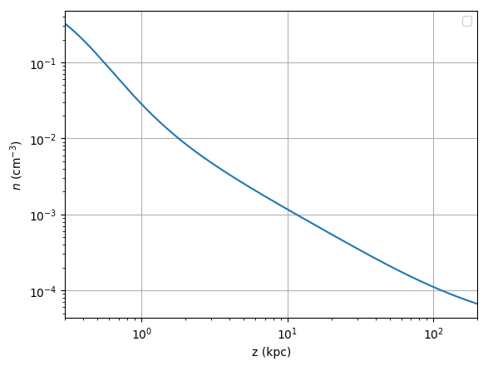
The Large Thermal Pressure in the Halo
More recently, the ram pressure stripping of satellite
galaxies + emission from the hot absorber have been
collectively used to probe the halo gas.
X-ray observations of bright AGN indicate the
presence of a hot local absorber.
Gupta ApJ, 756 (2012)
Faerman ApJ 835 (2017), Martynenko MNRAS, 511 (2022)
These results are consistent with expectations if the halo gas is in hydrostatic equilibrium
Faerman ApJ 835 (2017), Tourmente 2207.09189, (2022)
Faerman ApJ, 893 (2020)

Slide 3
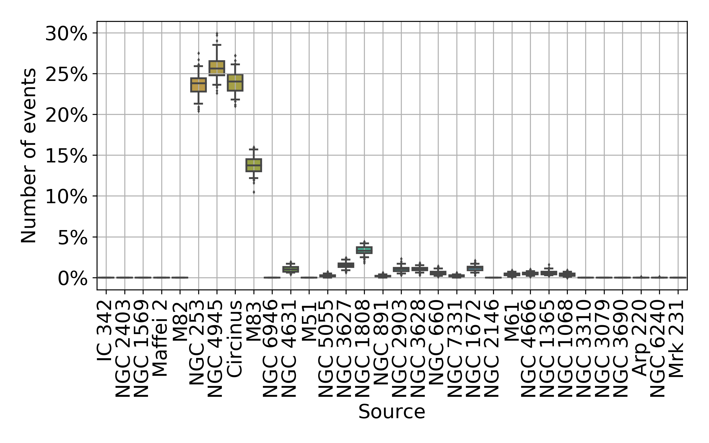
Our Local Extragalactic Neighbourhood
The local (<10 Mpc) extragalactic objects are structured, sitting in a roughly circular disk shape
van Vliet MNRAS 510 (2021)
McCall MNRAS 440 (2014)

Slide 4
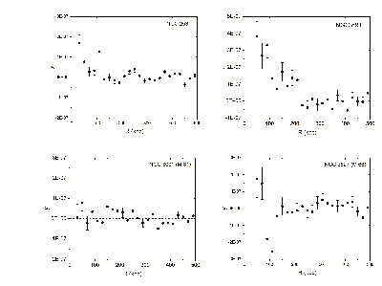
Extended Hot Gas Around CoG Members?
Bregman et al. ApJ 928 (2022)

Slide 5
Local Extragalactic Structure The Council of Giants
Cen A is unique within the council of giant structure are being the only object proving a kinetic luminosity capable of giving rise to multi EeV acceleration
Lovelace et al. (1976)

Slide 6
Simulation Setup
Particles initially fill 300 kpc region surrounding Cen A (isotropic momentum distribution)
Large angle particle scattering occurs within the virial region (< 300 kpc) of all members of the council of giant system
Outside the virial radii of these galaxies the particle propagation is treated as ballistic
Fundamental parameter of problem- optical depth of scattering regions
Echo signals results are rather insensitive to optical depth of scattering regions, provided
Only He and Fe injected into the system (fragile and robust species compared to crossing time of system)
Particles photo-disintegrate en-route in extragalactic radiation fields
30 EeV particles being focused on
Deflections from MW magnetized halo intentionally left out

Slide 7
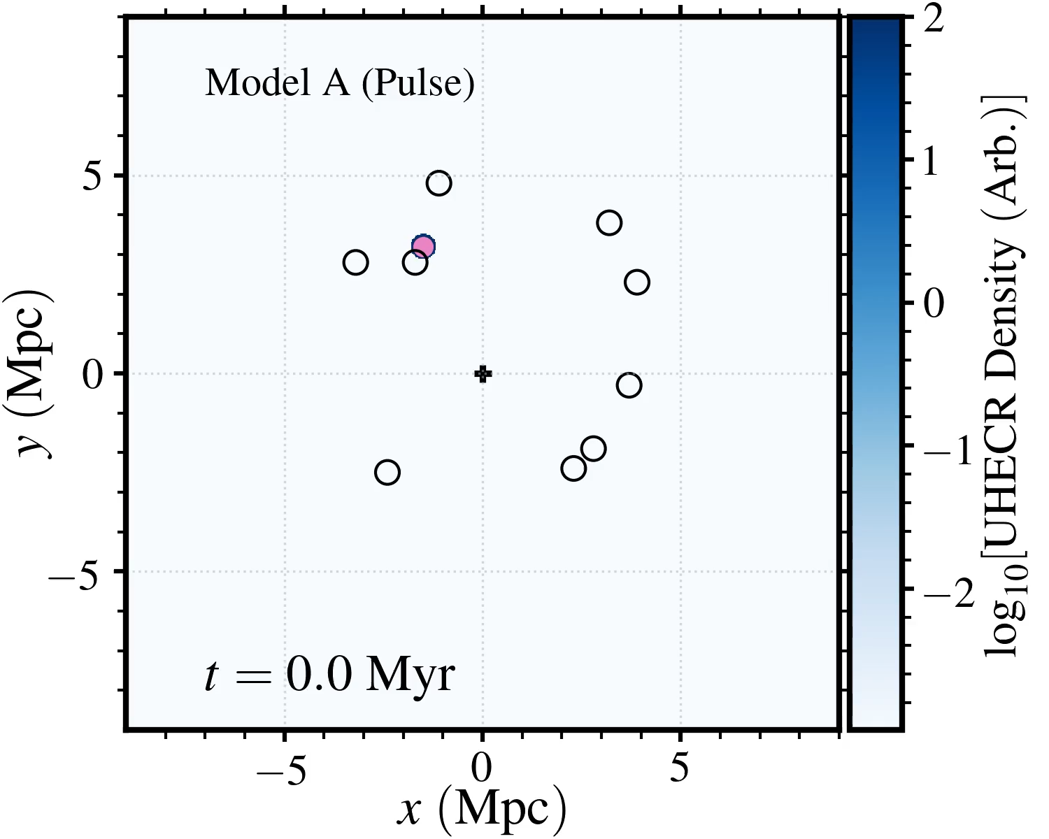
Simulations of UHECR Propagation Through the CoG Structure
Pulse release of particles from Cen A and propagation of these particles through the CoG structure

Slide 8
The Focusing of the Echo Waves

Slide 9
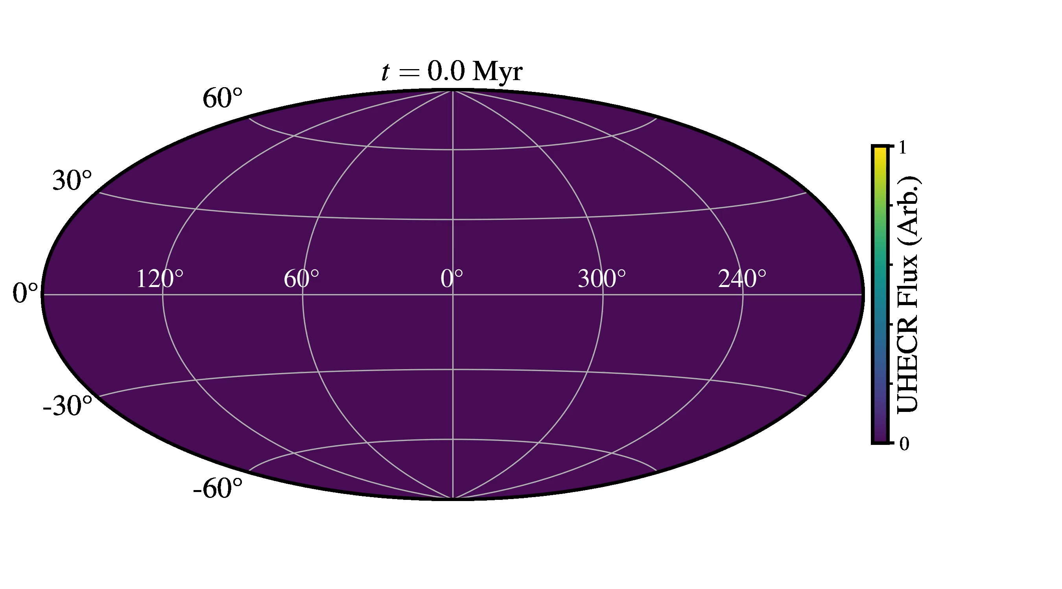
Milky Way Based Observers

Slide 10
Particle Acceleration/Release Scenarios
Model B:
The UHECR output of Cen A is described by:
The UHECR output of Cen A exponentially decays after the initial burst
Model C:
The UHECR leakage out of Cen A is rigidity dependent
The UHECR escape from the source region in a rigidity dependent manner

Slide 11
Distinguishing Between Model B and Model C Results
Model B
Model C

Slide 12
Conclusions
Observational evidence over the last 10 years has mounted suggesting that galaxies are significantly thermally pressured (suggesting magnetically pressured) out to their virial radius
UHECR propagating within the magnetic halos around local galaxies (in the Council of Giants structure) may be strongly deflected
If strong deflection in magnetic halos are at play, the presence of the Council of Giant structure, within which Cen A and the Milky Way reside, can imprint itself on the arriving UHECR skymap
Such an imprint may explain the correlation that PAO and TA have reported with local structure
A key diagnostic of this imprint comes from the composition skymaps, expected to He rich in the echo and source regions

Slide 13
Extra Slides

Slide 14
Echo Waves
Milky Way

Slide 15
The Uniqueness of Cen A within the Council of Giants
[AM Hillas (1984)]
Under the assumption of equipartition of energy between kinetic energy and magnetic field:
[Lovelace et al. (1976)]

Slide 16
Particle Acceleration/Release Scenarios

Slide 17
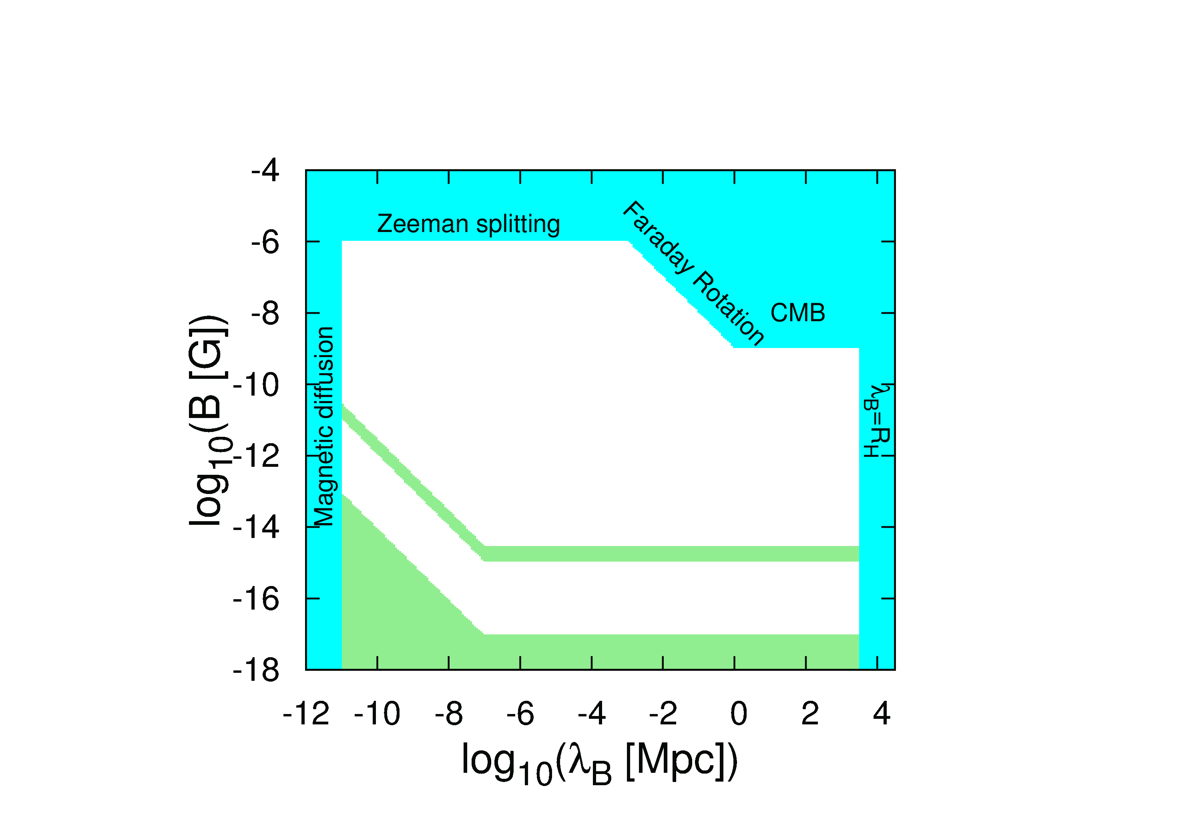
Extragalactic Magnetic Field is Hugely Uncertain

