Slide 1
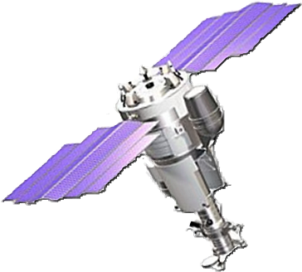
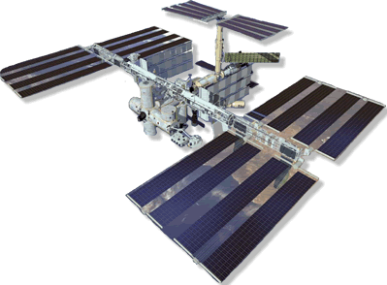
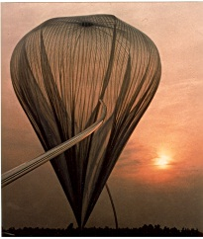
Cosmic Ray direct measurements in space
Piergiorgio Picozza
INFN, University of Rome Tor Vergata
Astroparticle Colloquia
GSSI
March 24, 2021

Slide 2
Cosmic Rays
Charged particles: protons, antiprotons, electrons, positrons, nuclei, antinuclei (?), Other (?)
They are affected by electric and magnetic fields
They carry a sample of galactic and extragalactic material from different distances accelerated up to very high energies

Slide 3
Cosmic Rays
Cosmic rays are one of the main components of the Galaxy
The energy density of cosmic rays in our galaxy is about 1eV/cm³, the same order of magnitude as the energy density of the Galaxy's magnetic field and the thermal agitation of interstellar gas
How were they discovered?

Slide 4
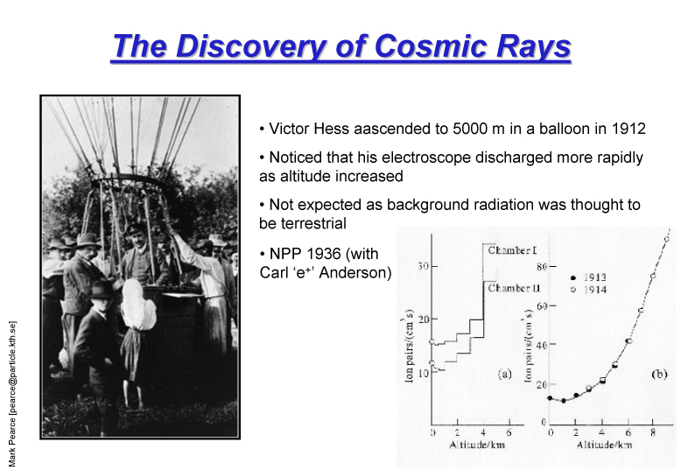
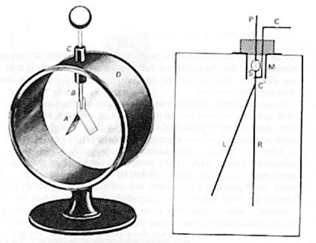

Slide 5

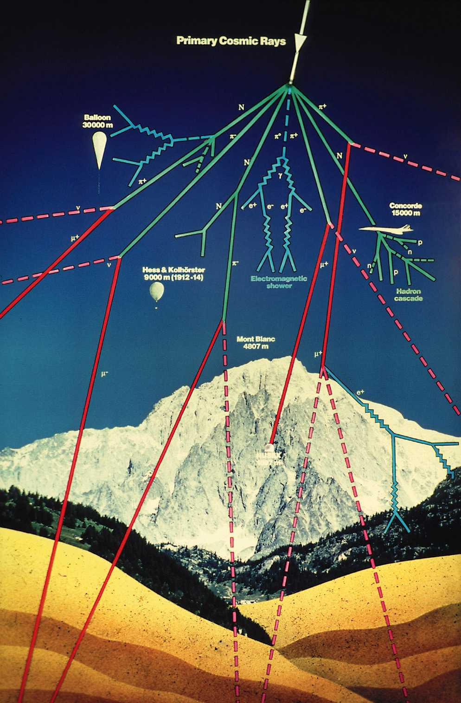
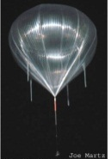

~500 km
Primary cosmic rays
Top of atmosphere
~40 km
~5 km
Ground
0 m

Slide 6
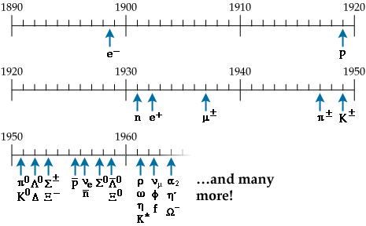
The Birth of Particle Physics
Hesse, Wulf, Wilson, Anderson,
Bothe, Kohlorster, Millikan,
Blackett, Skobeltsyn, Rochester,
Butler, Rossi, Pancini ,
Conversi, Powell, Occhialini
……
Particles from Accelerators

Slide 7
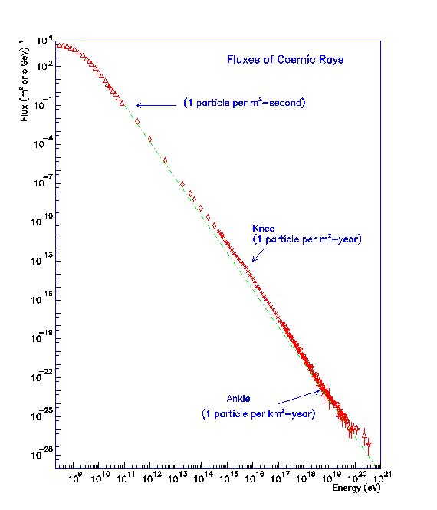
Direct Measurements
Indirect
Measurements

Slide 8
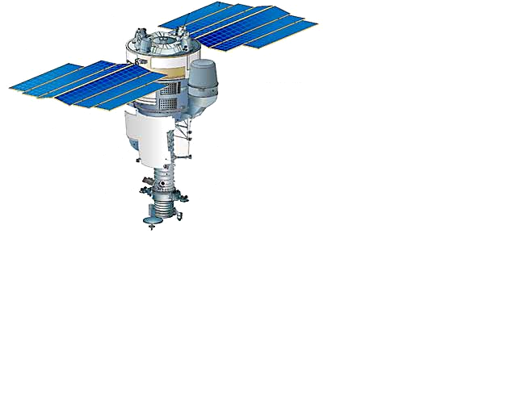
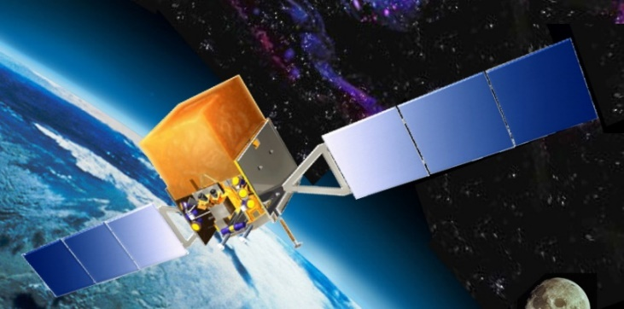
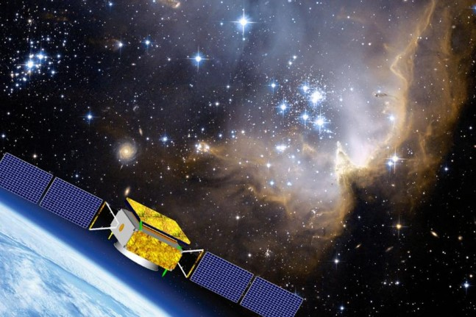
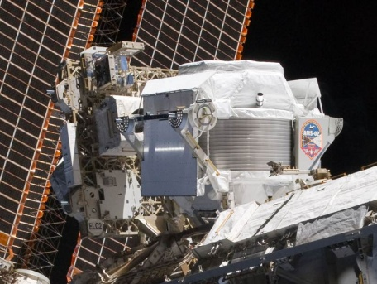

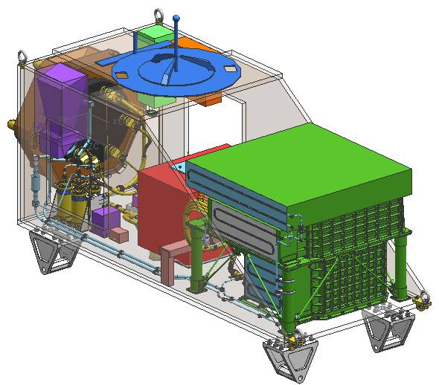
Cosmic Ray Space Missions
PAMELA
15-06-2006
Fermi
11-6-2008
DAMPE
17/12/2015
ISS
AMS
16-05-2011
CALET
19-08-2015
NUCLEON
28-12-2014
ISS-CREAM
14-08-2017

Slide 9
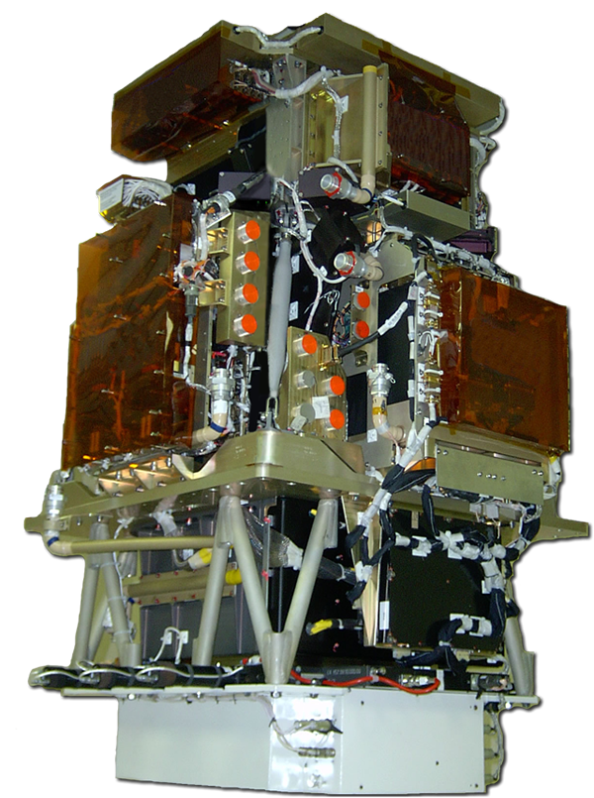
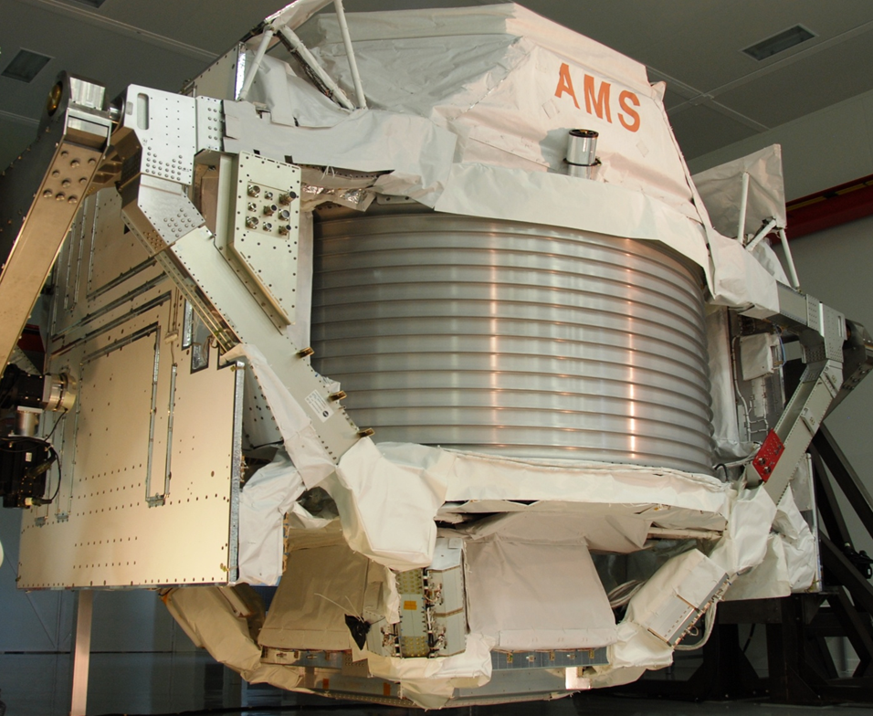
Magnetic Spectrometers
PAMELA 2006
AMS-02 2011
130x70x70 cm³
^{470 Kg}
5m x 4m x 3m
7.5 tons

Slide 10
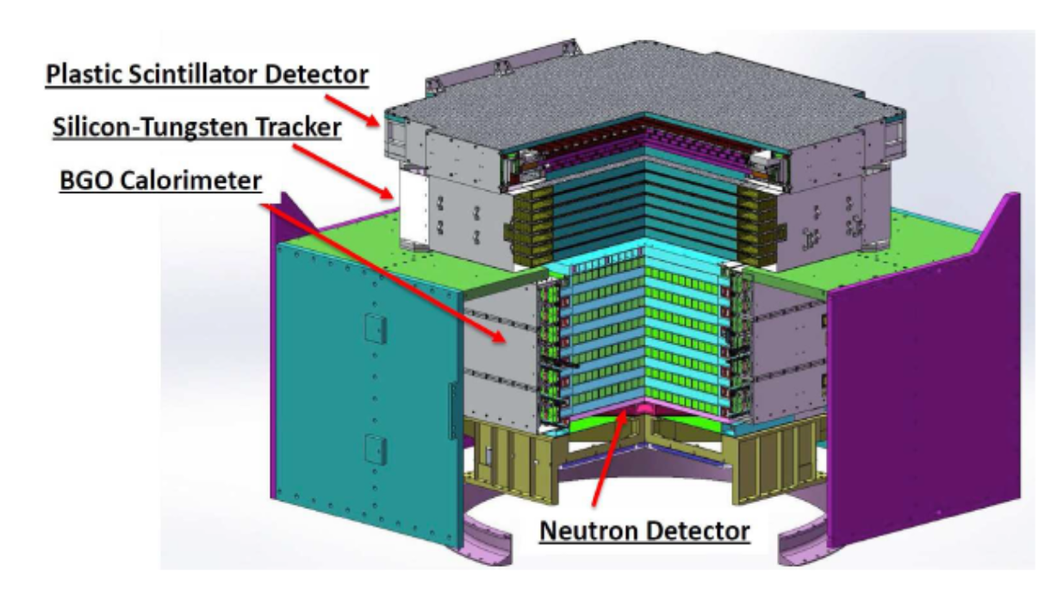
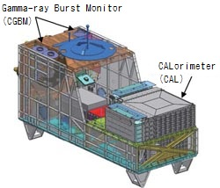
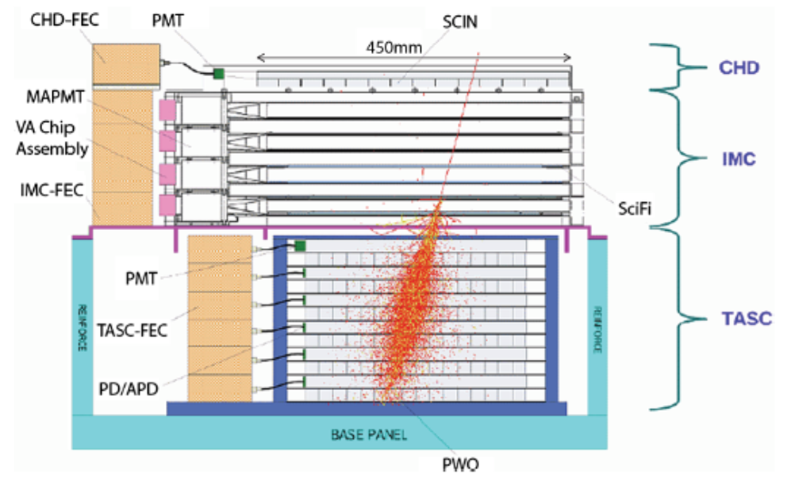
Calorimetric Instruments
DAMPE
CALET

Slide 11

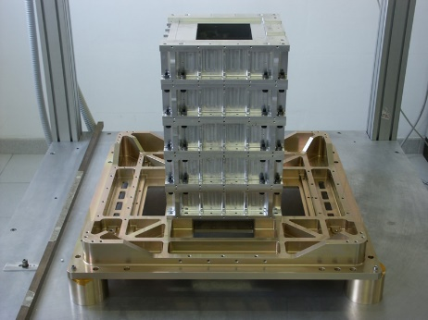
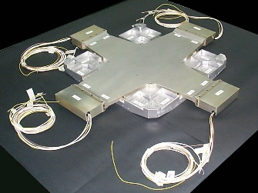
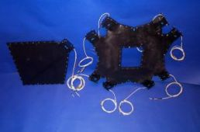
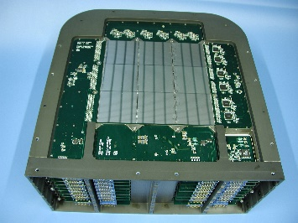
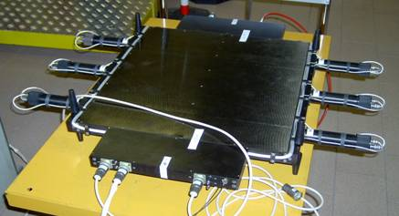
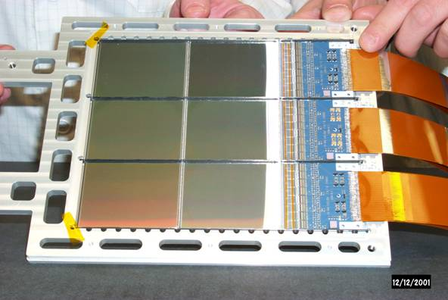
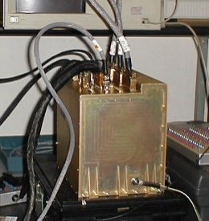
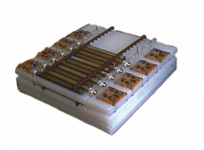
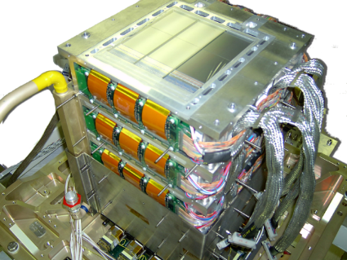
PAMELA

Slide 13
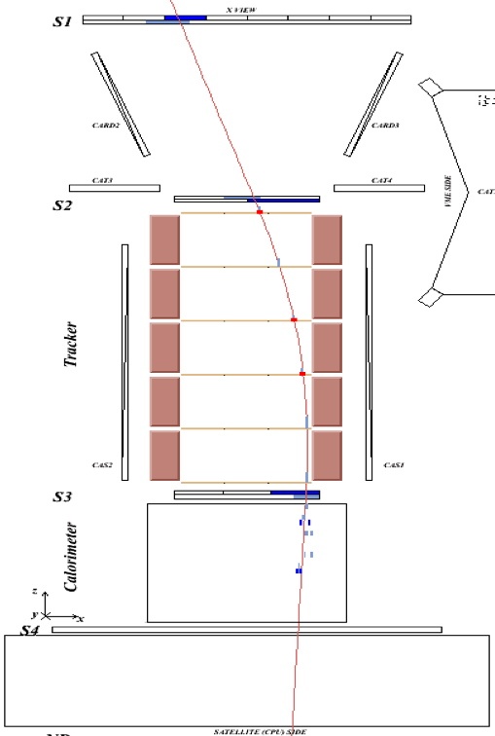
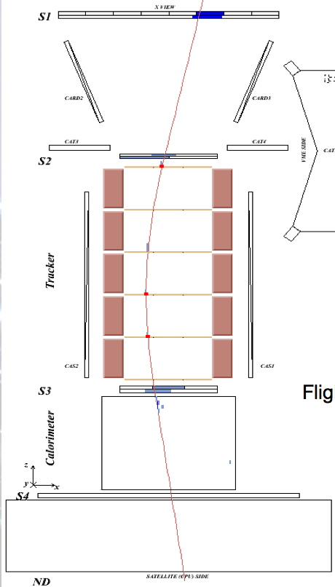
Flight data:
0.171 GV positron
Flight data:
0.169 GV electron

Slide 16
Flight data: 0.763 GeV/c
antiproton annihilation

Slide 17
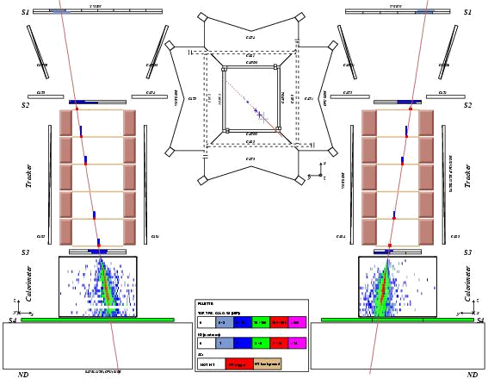
Flight data: 92 GeV/c
positron

Slide 18
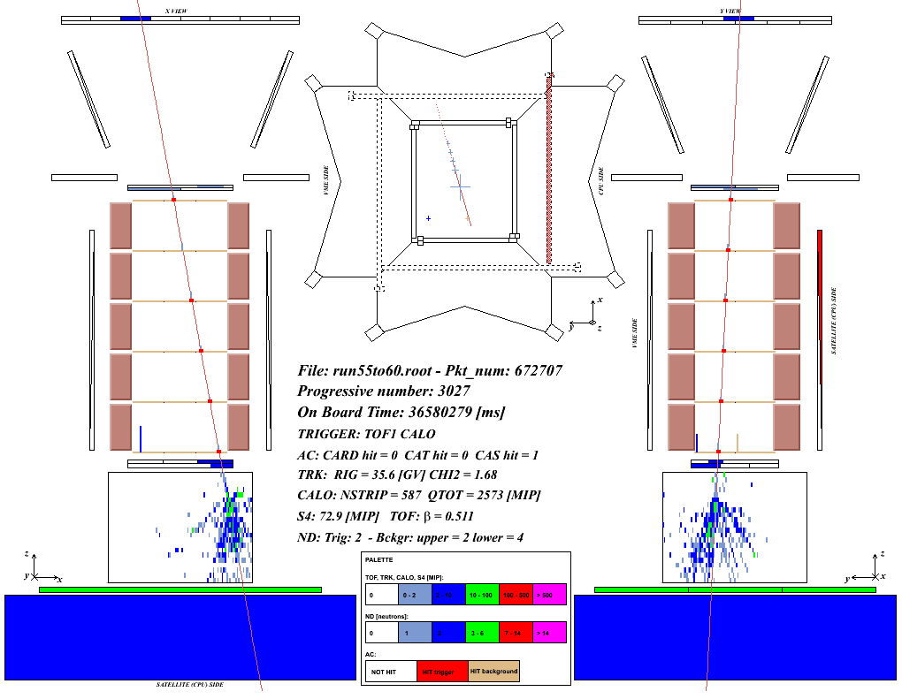
Flight data: 36 GeV/c
interacting proton
Mirko Boezio, INFN Trieste - San Diego IEEE2006

Slide 19
AMS-02

Slide 20
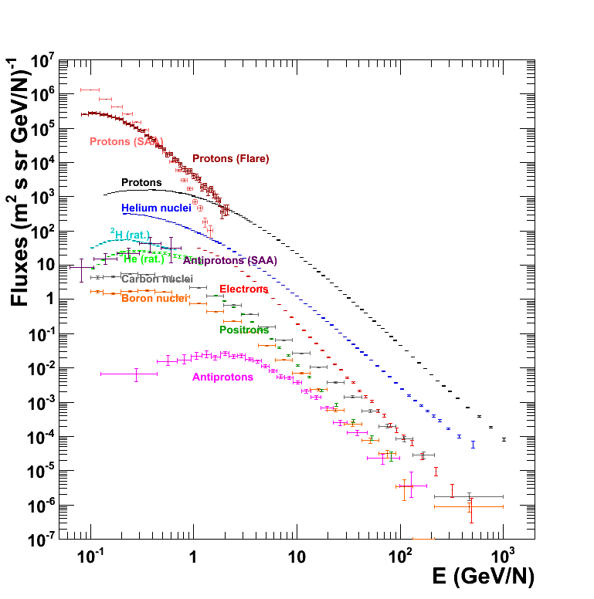
Summary of PAMELA results
Physics Reports 544/4 (2014), 323

Slide 21
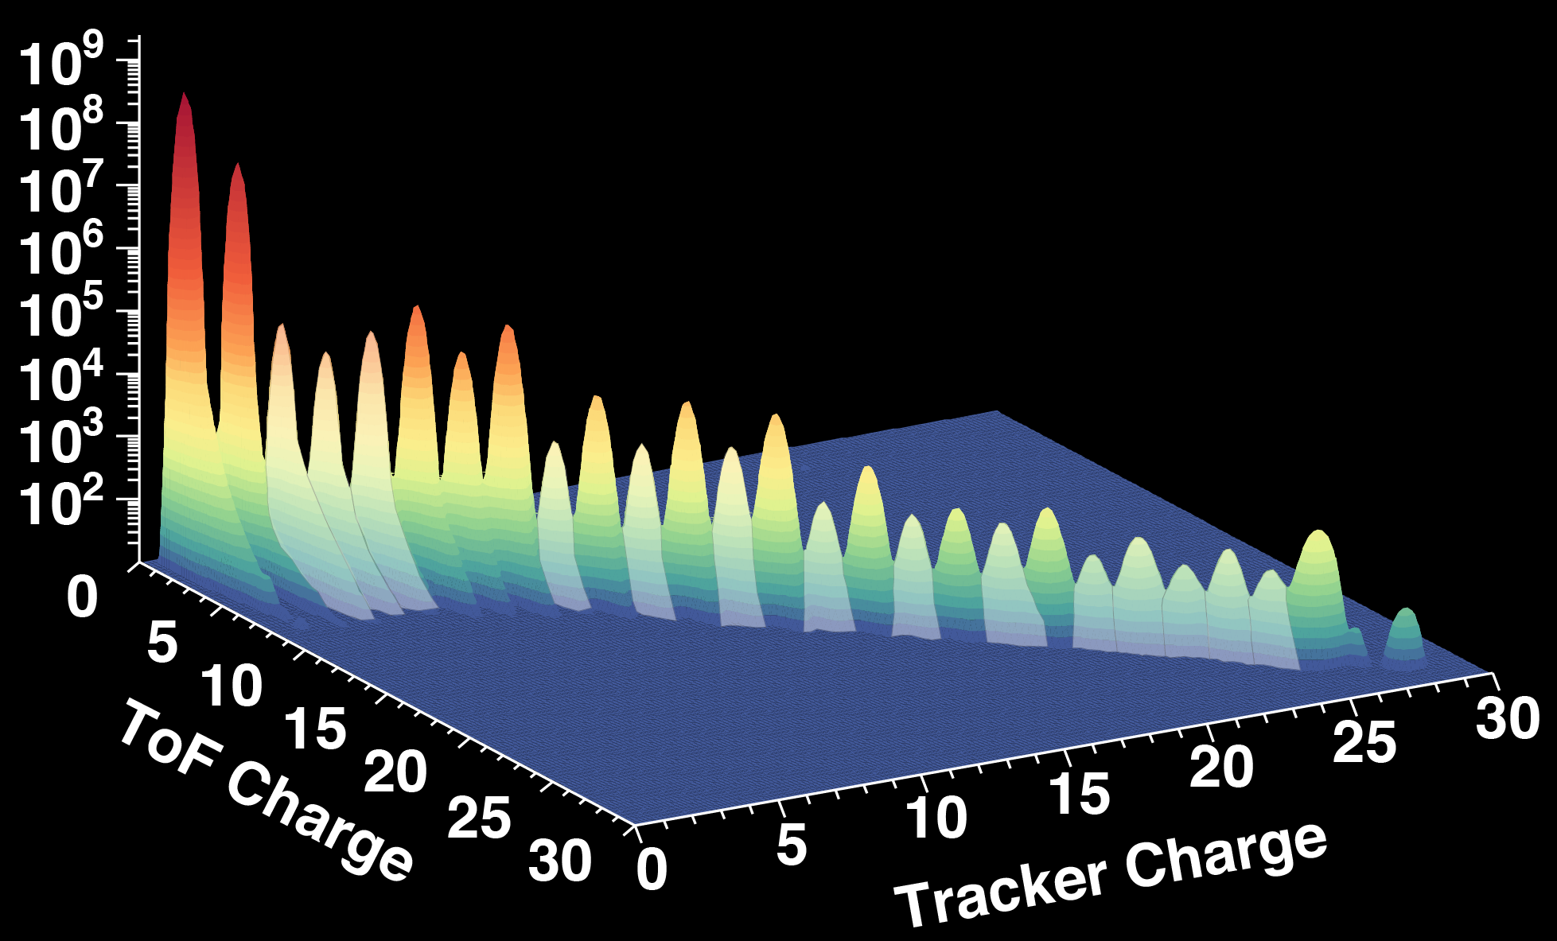




AMS-02 Chemical Composition Measurement
11
H
He
Li _{B}
Be
C
_{N} O
Ne
Mg
Si
F
Na
Al
S
P
_{Cl} Ar _{K} Ca
Ti
Cr
Fe
Sc
V
Mn
_{Co} Ni

Slide 22
AMS-02: A TeV Multi-Purpose Spectrometer
12
A Physics Report: The Alpha Magnetic Spectrometer on the International Space Station: Part II - Results from the First Seven Years, is under development.
10³
Courtesy of V. Formato (2019)
GeV)⁻¹]
10
₁₀−1
₁₀−3
Flux [(s sr m²
Proton Helium Lithium Beryllium Boron Carbon Nitrogen Oxygen Neon Magnesium Silicon
10
−5
10
−7
−9
S₋ulfur
10
e₊
e
p
₁₀−11
10
10²
R (GV)
10³

Slide 23
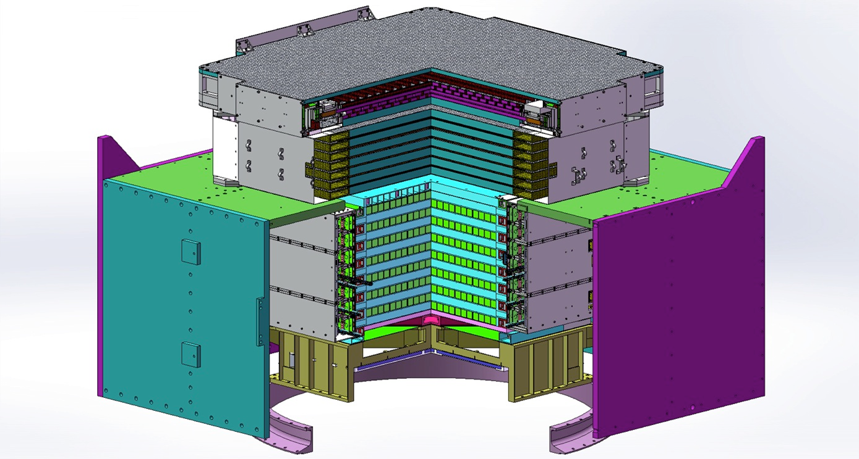
Calorimetric Instruments
CALET
DAMPE

Slide 24
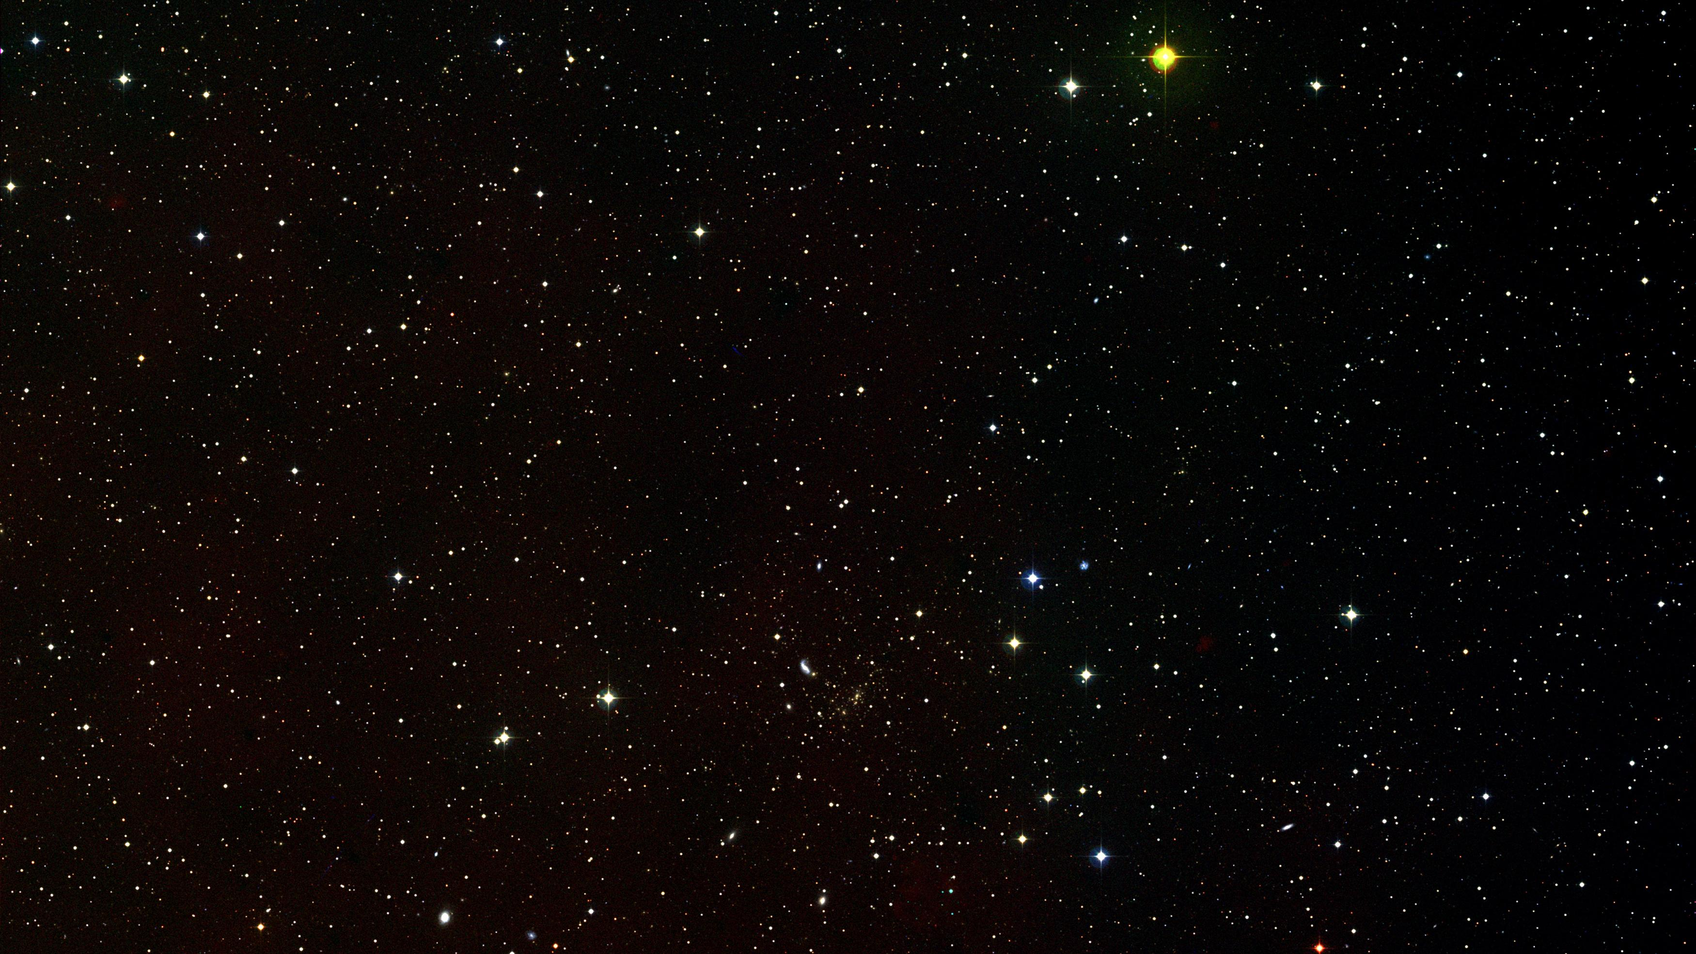
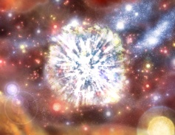
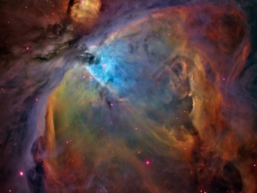
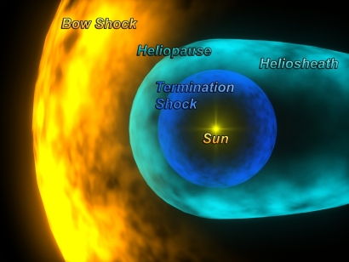
Anti-Particles in Cosmic Rays
e⁻
γs
e⁻ e⁺
Bremsstrahlung, Synchrotron,
Inverse Compton
p, He, C
N, O
ISM gas
decay
γs
π⁺, π⁻
π₀
Solar Modulation, lower
interstellar cosmic ray spectra
CR secondary
production
( pp → X )
decay
γs
p
p, He, C, N, O, Li, Be, B, ...
credit: ESA

Slide 25

Positron fraction
PAMELA
Top Ten 2008
ICHEP 2008
01/08/2008
Nature 458, 697, 2009
> 2500 citazioni

Slide 26
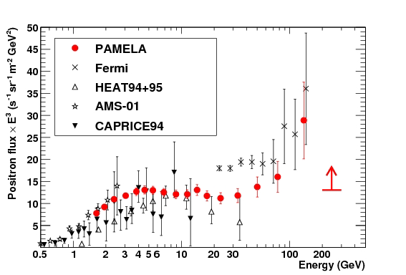
Positrons

Slide 27
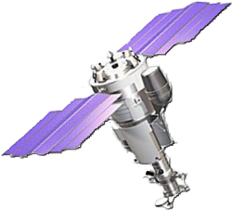

Slide 28
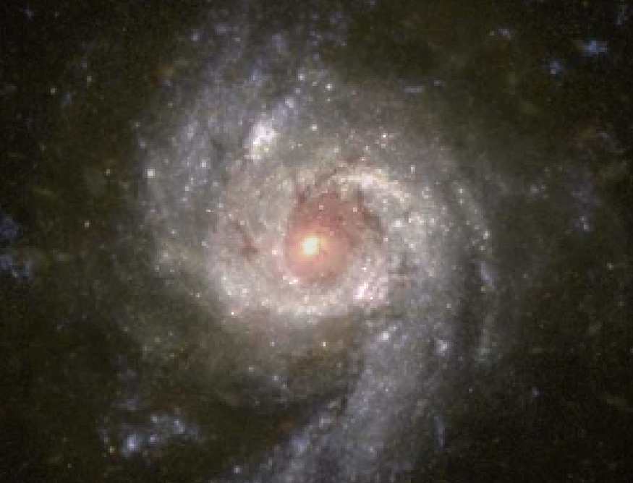
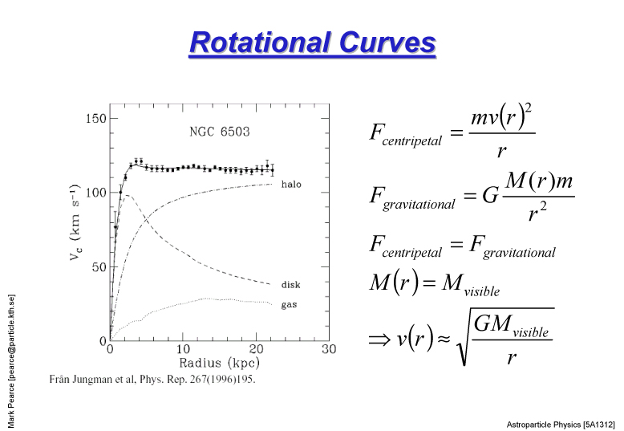
What is the Universe made of ?
The peripheral stars of the galaxy M63 rotate around the center so fast that they would fly away in space without the presence of additional mass inside the galaxy. This is indirect evidence for the presence of dark matter

Slide 29
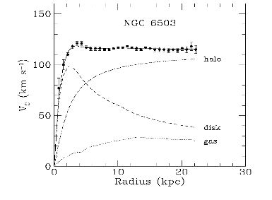

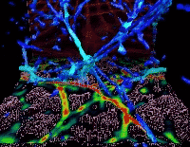
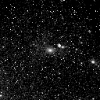
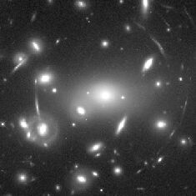
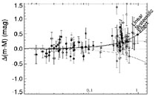
Dark Matter
Evidence for the existence of an unseen, “dark”, component in the energy density of the Universe comes from several independent observations at different length scales:
Rotation curves of galaxies
CMB
Large Scale Structure
Galaxy clusters
Lensing
SN Ia

Slide 30
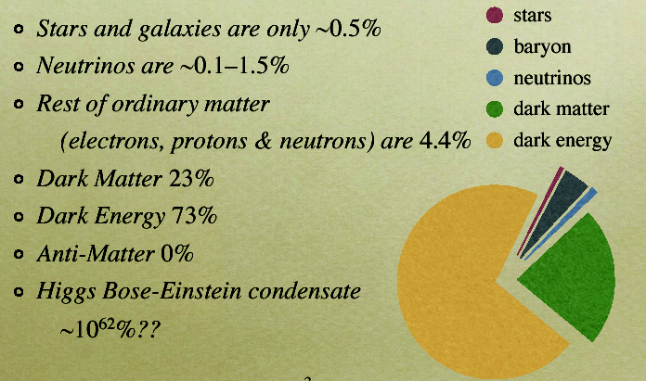
THE UNIVERSE ENERGY BUDGET
26.8%
68.3%

Slide 31
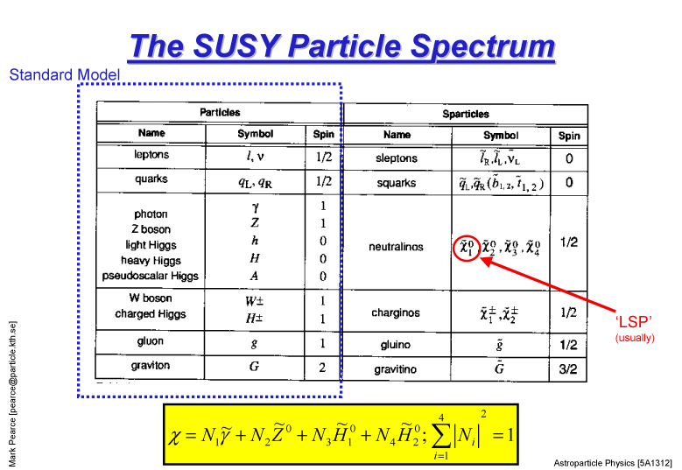

Slide 32


DARK Matter
Decay
No evidence so far
No evidence so far

Slide 33
Phys.Rev.D79:103529,2009
Phys.Rev.D8:103520,2008

Slide 34
Positron Ratio

Slide 35
Electrons Positrons
Phys. Rev. Lett. 122, 101101 (Mar. 2019)
Phys. Rev. Lett. 122, 041102 (2019)

Slide 36

AMS-02
A two component spectrum
fit the AMS e+ excess
AMS Collaboration, Phys. Rev. Lett. 122, 041102 (2019)

Slide 37
Profumo et al. arXiv:1903.07638v1 [hep-ph] 18 Mar 2019

Slide 38
Challenging Dark Matter Interpretation

Slide 39
Dark Matter Explanation
T. Linden, ICRC 2019, Madison, WI

Slide 40


PAMELA antip/p antiproton flux
O. Adriani et al.,
PRL 102 (2009) 051101
PRL 105 (2010) 121101

Slide 41


Dark Matter Explanation
J. Kopp, Phys. Rev. D 88 (2013) 076013; arXiv:1304.1184
I. Cholis et al., Phys. Rev. D 80 (2009) 123518; arXiv:0811.3641v1

Slide 42

A NEUTRON STAR WITH A STRONG MAGNETIC FIELD:
FAST ROTATING PULSAR (P = 33 msec)
L(spindown) = 5 10³⁸ erg/s

Slide 43


Example: pulsars
H. Yüksak et al., arXiv:0810.2784v2
Contributions of e- & e+ from Geminga assuming different distance, age and energetic of the pulsar
Hooper, Blasi, and Serpico
arXiv:0810.1527

Slide 44

SNR
P. Blasi, PRL 103 (2009) 05110

Slide 45
Antiprotons

Slide 46
AMS antiproton to proton fraction

Slide 48
Anti-Helium with AMS-02
A. Oliva, Dbar19, March 2019, UCLA

Slide 49

The AMS ⁴He/He ratio is six orders of magnitude greater than predictions based on cosmic ray collisions (AMS preliminary)
>6 orders of magnitude
model of ⁴He production
from cosmic ray collisions

Slide 50

Cosmic Ray Production and Propagation Mechanisms
e⁻

Slide 51

Absolute fluxes of primary GCRs
Protons, helium nuclei, light nuclei, electrons

Slide 52









(e⁺ + e⁻) Flux
VERITAS
CALET
AMS-02
MAGIC
Fermi-LAT
HESS
Spectrometer & EM Calorimeter
DAMPE
EM Calorimeter
CTA
HERD
Cherenkov Telescope

Slide 53


Recent e⁻+e⁺ Measurements
CALET: Phys.Rev.Lett. 120 (2018) 261102)
DAMPE: Nature 552 (2017) 63, 7

Slide 54


Slide 55

Proton and Helium fluxes
p
He
PAMELA Science 332,69 (2011)

Slide 56
Proton and Helium fluxes

Slide 57
Protons

Slide 58
HELIUM

Slide 59
P/He Ratio

Slide 60
Carbon flux
arXiv: 2012.10319 (astro-ph.HE

Slide 61
Oxygen flux
AMS
CALET
arXiv: 2012.10319 (astro-ph.HE)

Slide 62

AMS Primary Fluxes at High-Z
All deviate from single power law above 100 GeV.
A. Oliva

Slide 63
Interstellar Matter and Lifetime in the Galaxy

Slide 64

Abundances at Source: AMS Nitrogen Flux
41
M. Aguilar et al., Phys. Rev. Lett. 121 (2018) 051103
Nitrogen 2.2 M
Φ_{N} = (0.090±0.002) × Φ_{O} + (0.62±0.02) × Φ_{B}
A. Oliva
Also tested with C flux, revealing a secondary component of about 20% at 4 GV and less than 5% at 2 TV.

Slide 65

Boron and Carbon fluxes
PAMELA Coll., ApJ 791 (2014), 93

Slide 66
Boron to Carbon ratio

Slide 67
High Energy Antiprotons
Giesen et al., Evoli et al., Kappl et al.
M. Winkler, JCAP 1702 (2017) no.02, 048

Slide 69

Cosmic Ray Propagation
C. Evoli (2019)
If the hardening in CRs is related to the injected spectra at their source, then similar hardening is expected both for secondary and primary cosmic rays.
If the hardening is related to propagation properties in the Galaxy then a stronger hardening is expected for the secondary with respect to the primary cosmic rays.
A. Oliva

Slide 70





AMS Primary and Secondary Nuclei Spectral Indices
38
Deviate from single power law above 200 GV. Secondary hardening is stronger AMS favors the hypothesis that the flux hardening is an universal propagation effect.
Helium Carbon Oxygen
Lithium Beryllium Boron
M. Aguilar et al., PRL 120 (2018) 021101

Slide 71




Cosmic Ray Clock: AMS Be/B Flux Ratio
40
10_{Be}
C,N,O, …
B
ISS
Galactic Disk
M. Aguilar et al., PRL 120 (2018) 021101
0.45
Be/B
AMS Data
The secondary ¹⁰Be beta-decays with
Fit to Data
0.4
T
= 16.5
+4.0
Myears
t = 1.4 My through ¹⁰Be → ¹⁰B + e⁻ + ν.
Be/B Flux Ratio
esc
-2.0
1/2
The Be/B ratio rigidity dependence is related to the cosmic rays confinement time (or the galactic halo size in diffusion models).
0.35
A. Oliva
0.3
Rigidity [GV]
20 30 10² 2×10²
0.25 ₃ ₄ ₅ ₆
10
10³

Slide 72
Cosmic Rays in the Heliosphere
e⁻

Slide 73

Voyager 1

Slide 74

Propagation in the Heliosphere
APJL, 854, 1, 2018
O. Adriani et al., Rivista Nuovo Cimento 40 (2017) N. 10

Slide 75
Protons

Slide 76
Electrons

Slide 77

Radiation Belts
350 km
70^{ο}
610 km

Slide 78

Study terrestrial magnetosphere
Pamela World Maps: 350 – 650 km alt
36 MeV p, 3.5 MeV e-

Slide 79


Anti-proton radiation belt
PAMELA
O. Adriani et al., ApJL 737 (2011), L29

Slide 80
The Future

Slide 81
Antideuterons

Slide 82


Anti Deuterons (GAPS)
Segmented Detector
Atomic Transitions
π*
Auger e⁻
n_{o},l_{o}
TOF
19 keV
Refilling e⁻
Target
_
D
π*
n=n_{K}~15
n=6
γ
75 keV
n=5
γ
n=4
Ladder
Deexcitations
Δn=1, Δl=1
n=3
γ
Degrader
35 keV
π*
n=2
π⁺
n=1
π⁻
π⁺
Nuclear
Annihilation
π⁻
π^{ο}
K.Mori et al. APJ 566 604-616 2002
Notes:
C Target X-rays for Dbar

Slide 83


HERD
About a factor 10 increase in statistics respect to existing experiments with a weight 2.3 T ~1/3 AMS

Slide 84

GAMMA-400
AC – anticoincidence detectors
C – Conveter-Tracker
S1, S2 – ToF detectors
S3, S4 calorimeter scintillator detectors
CC1 – imaging calorimeter (2 X₀)
2 layers: CsI(Ti) 1 X₀ + Si(x,y) (pitch 0.1 mm)
CC2 - electromagnetic calorimeter
CsI(TI) 20 X₀ 3.6x3.6x3.6 cm³ – 22x22x10 = 4840

Slide 85

An Antimatter Large Acceptance Detector In Orbit
ALADInO
ESA Voyage 2050

Slide 86

ALADiNO
Performances (10x - 100x current/future)

Slide 87
AMS-100

Slide 88
Thanks!

