Slide 1
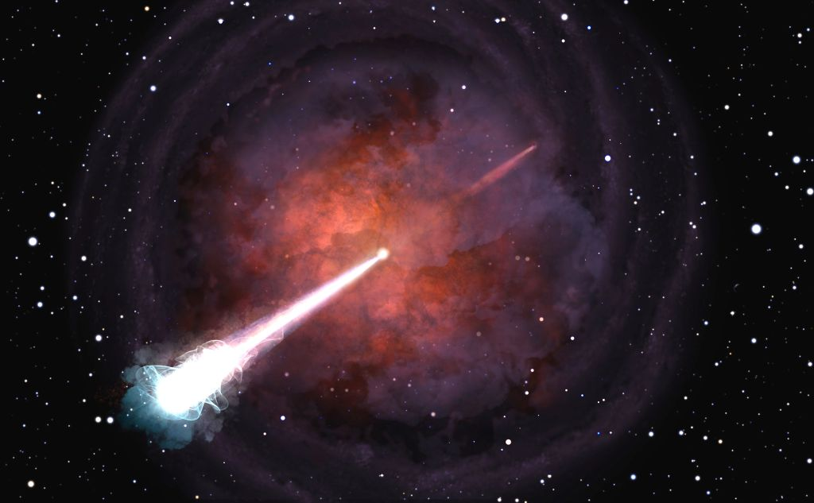


Angle matters: studying neutron star merger from a new perspective
Eleonora Troja
University of Maryland, College Park
NASA Goddard Space Flight Center

Slide 2
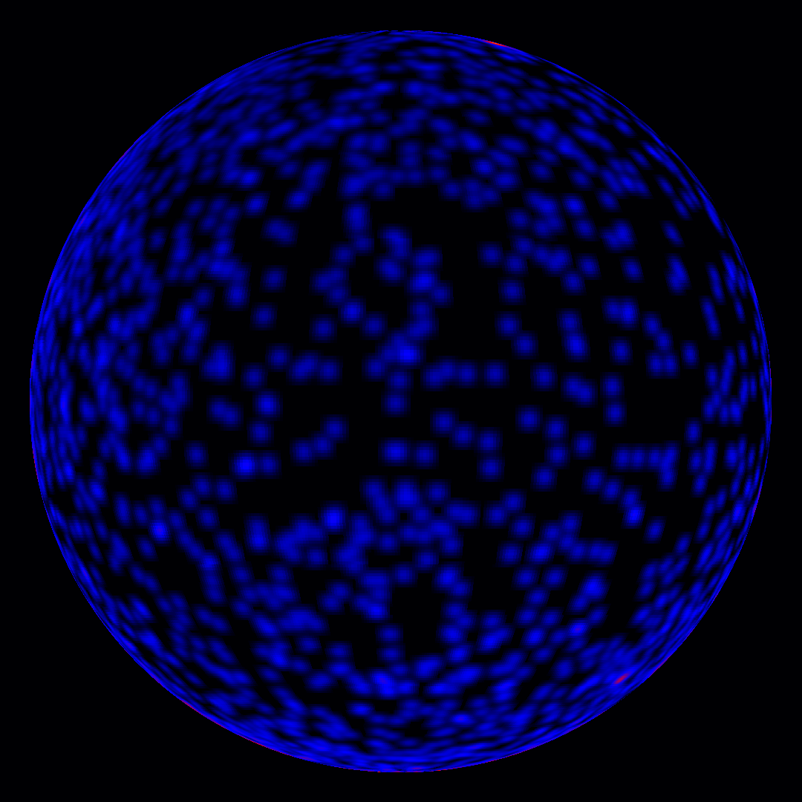
Gamma-ray bursts
GRB 130427A*
*GRB name = Date YYMMDD

Slide 3
Two flavors of GRBs
Kouveliotou+93
figure from Shahmoradi 2013

Slide 4
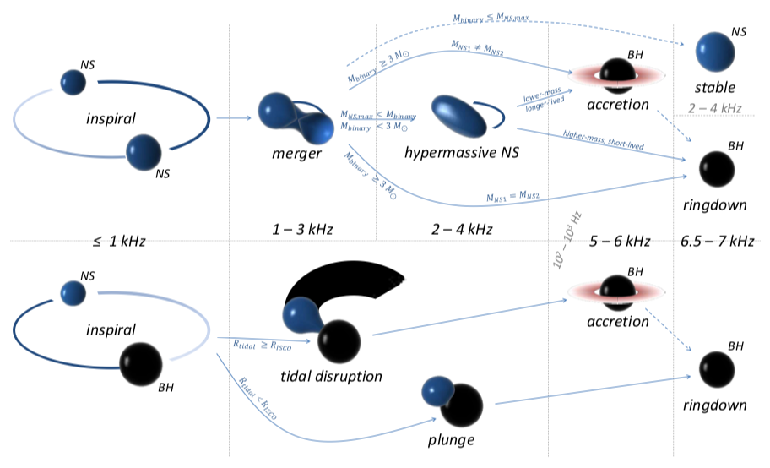
Connection with compact binary mergers
Bartos, Brady & Marka 2012

Slide 5
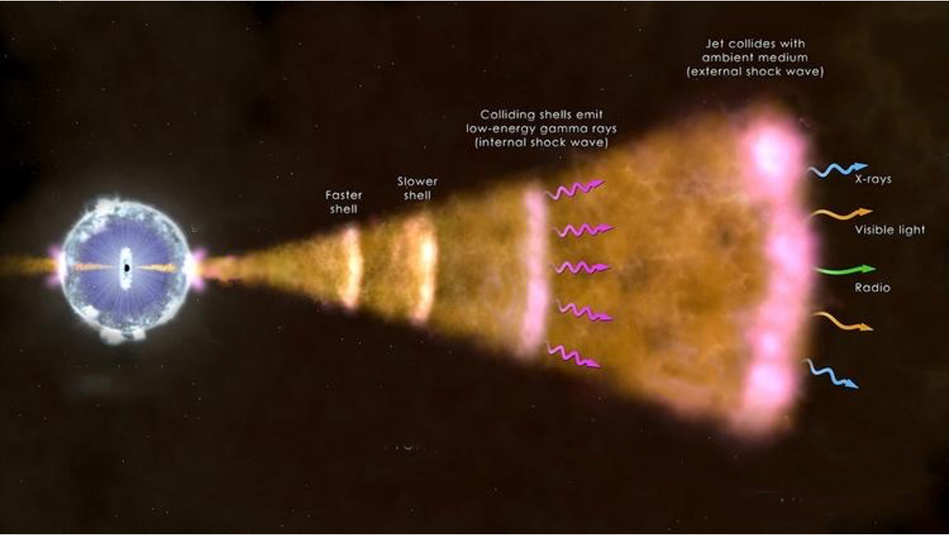
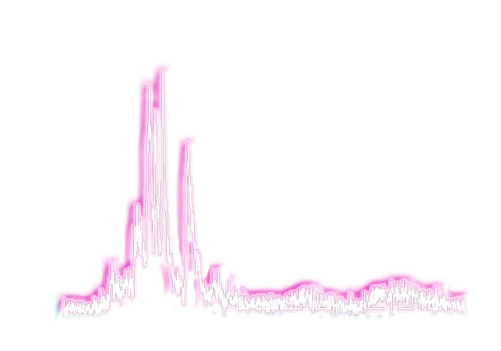
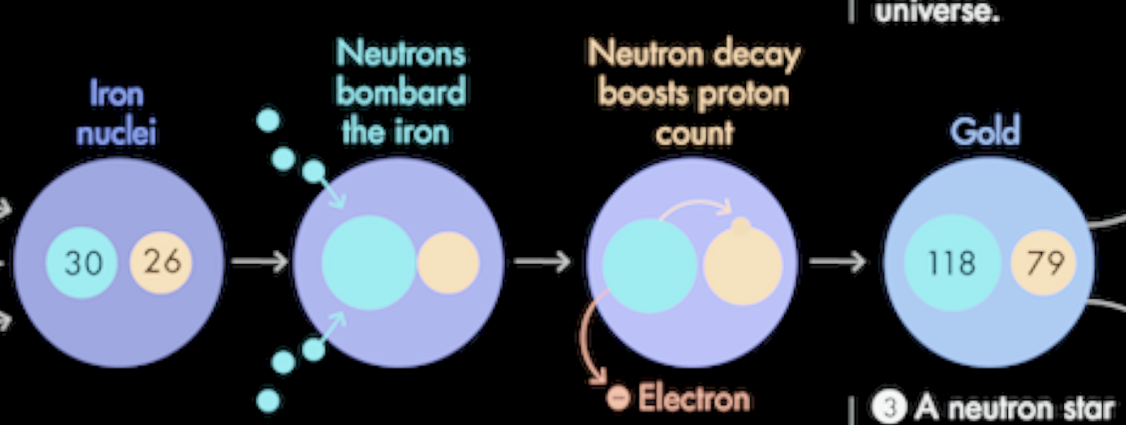
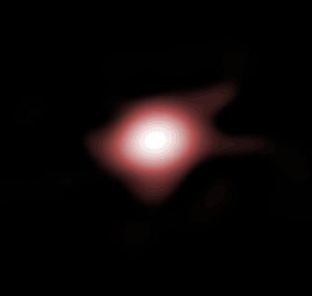

The aftermath of a NS merger
< 2 sec

Slide 6
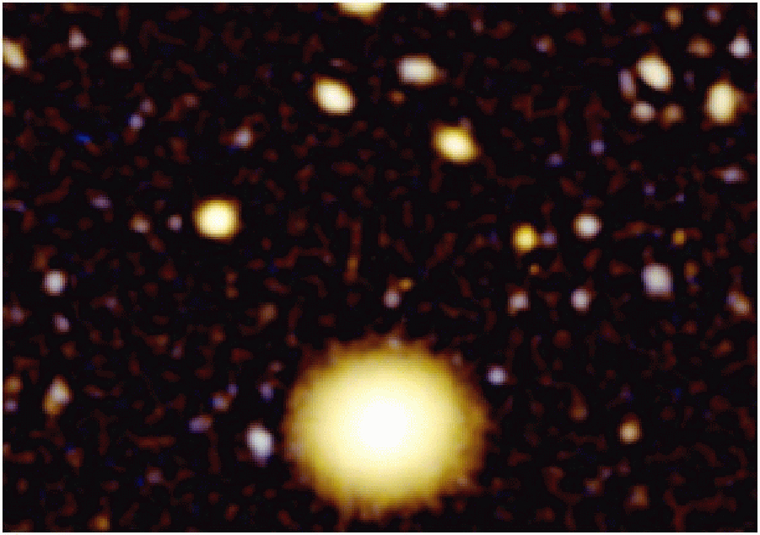
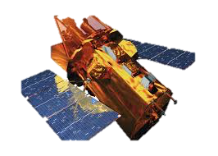
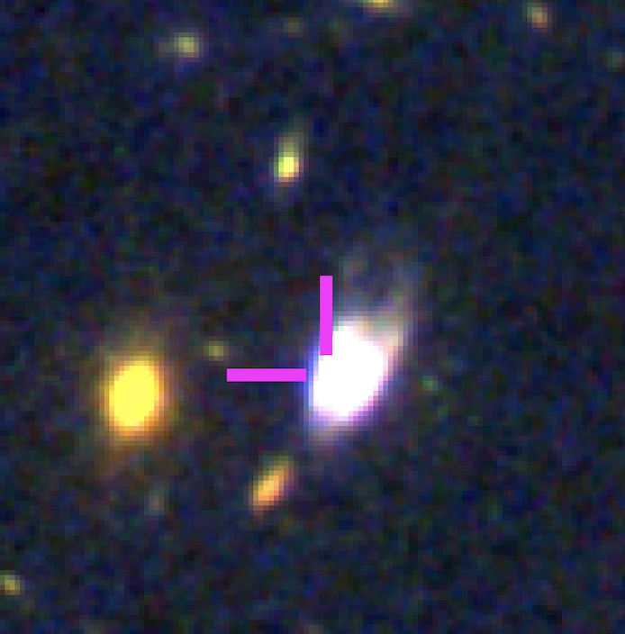
First observational evidence
Gehrels+05
Troja+18
Berger+05
Tanvir+13
Troja+19
OConnor+21
Fong & Berger 2013

Slide 7
A candidate kilonova
z = 0.161
Tanvir+13

Slide 8
A candidate kilonova
z = 0.161
Tanvir+13

Slide 9
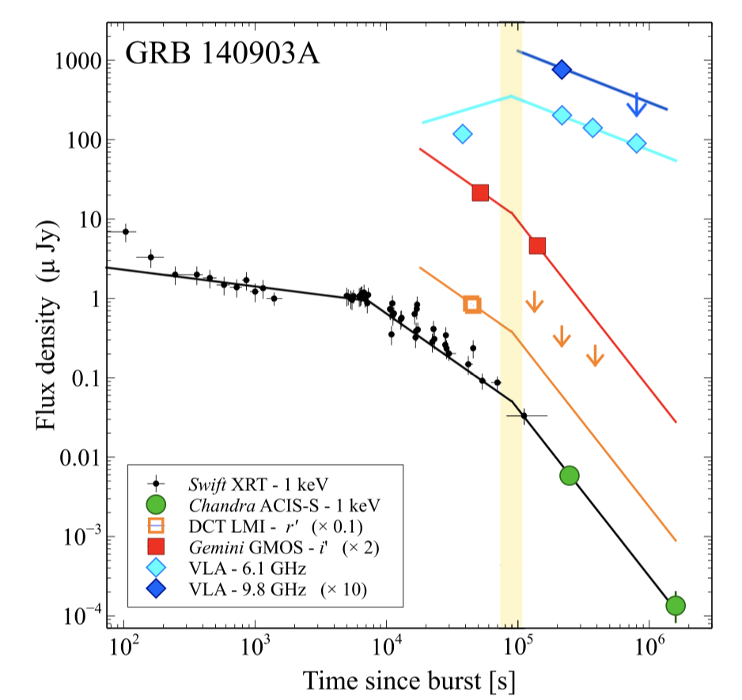
Jets from short GRBs
Troja et al. 2016

Slide 10
Jets from short GRBs
Spherical
Troja et al. 2016

Slide 11
Jets from short GRBs
Jetted
Troja et al. 2016

Slide 12
GW170817

Slide 13
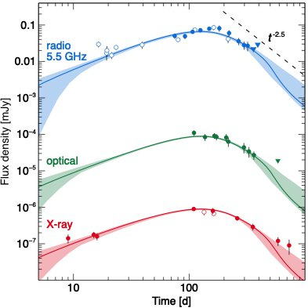
GW afterglow
Troja, van Eerten et al., 2019

Slide 14
Jets from mergers
Uniform jet
on-axis
Troja, van Eerten et al., 2019

Slide 15
Jets from mergers
Uniform jet
off-axis
Troja, van Eerten et al., 2019

Slide 16
Jets from mergers
Uniform jet
off-axis
Troja, van Eerten et al., 2019

Slide 17
Jets from mergers: choked?
Uniform jet
off-axis
Choked jet
Troja, van Eerten et al., 2019

Slide 18
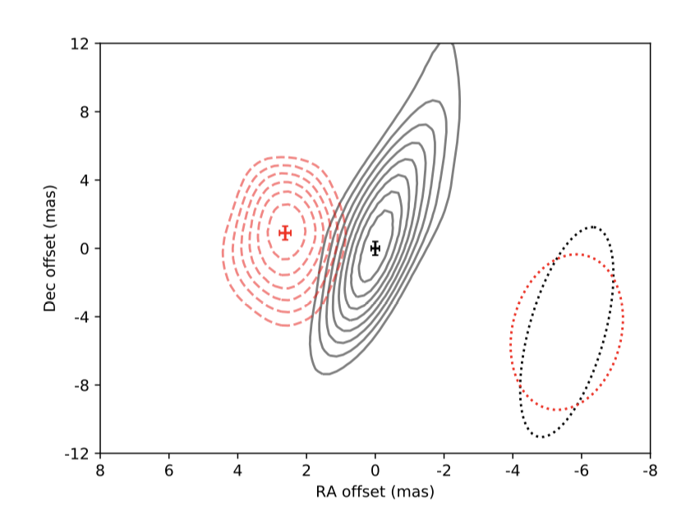
Evidence for a relativistic jet
Mooley et al., 2018
Ghirlanda et al., 2019
Troja, van Eerten et al., 2019
High-resolution radio imaging: compact unresolved radio source superluminal motion
Temporal monitoring: rapid afterglow decline

Slide 19
A structured jet seen off-axis
Zhang & Meszaros 02
Rossi+02
Aloy+05
Janka+05
Lazzati+18
Xu+18
Kathirmagaraju+18
Ryan+20

Slide 20

Effects of viewing angle
Troja, Ryan et al. 2018, Nature Communications
Short GRBs
z~0.7 (>Gpc)
GRB150101B
z=0.134 (~600 Mpc)
GW170817
40 Mpc

Slide 21
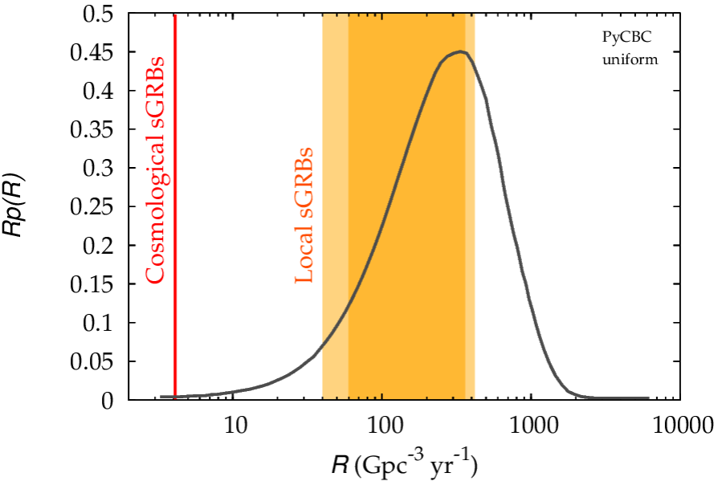
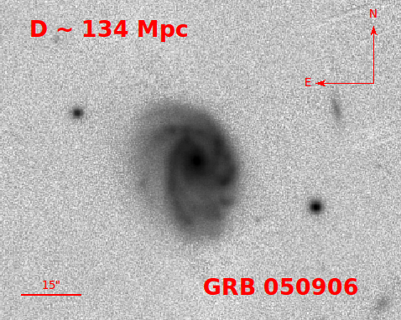
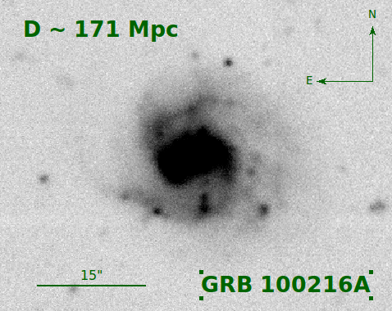
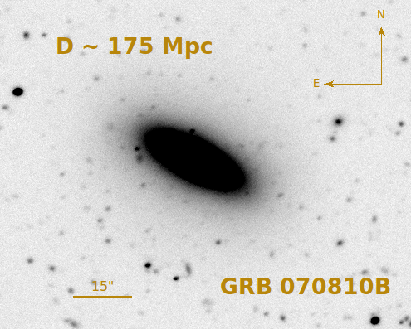
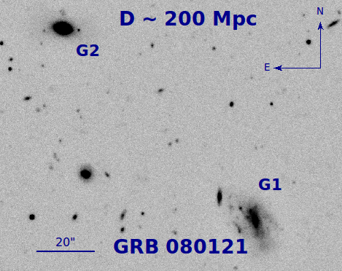
Search for short GRBs within 200 Mpc
Dichiara+20
Over 130 short GRBs localized by Swift in 15 years
GW170817-like events are rare:
R_{Swift} < 0.2 yr⁻¹ R_{Fermi} < 0.8 yr⁻¹

Slide 22
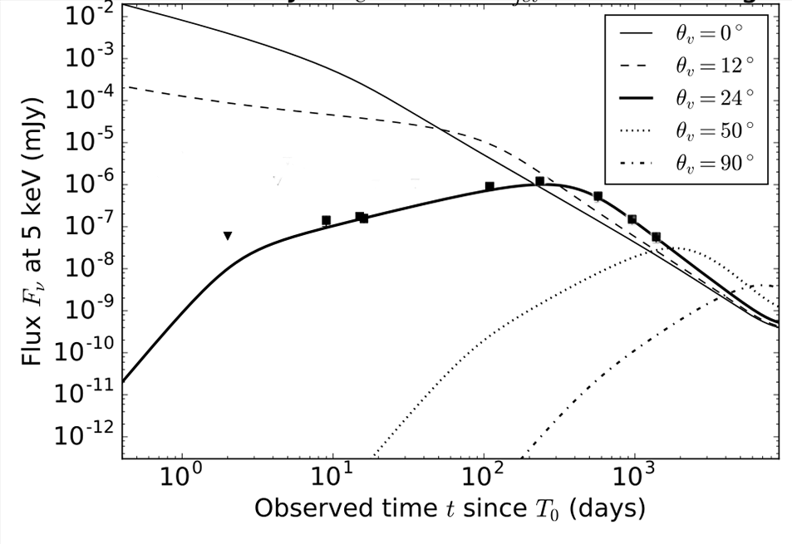
Future prospects
Swift
Chandra
Athena

Slide 23
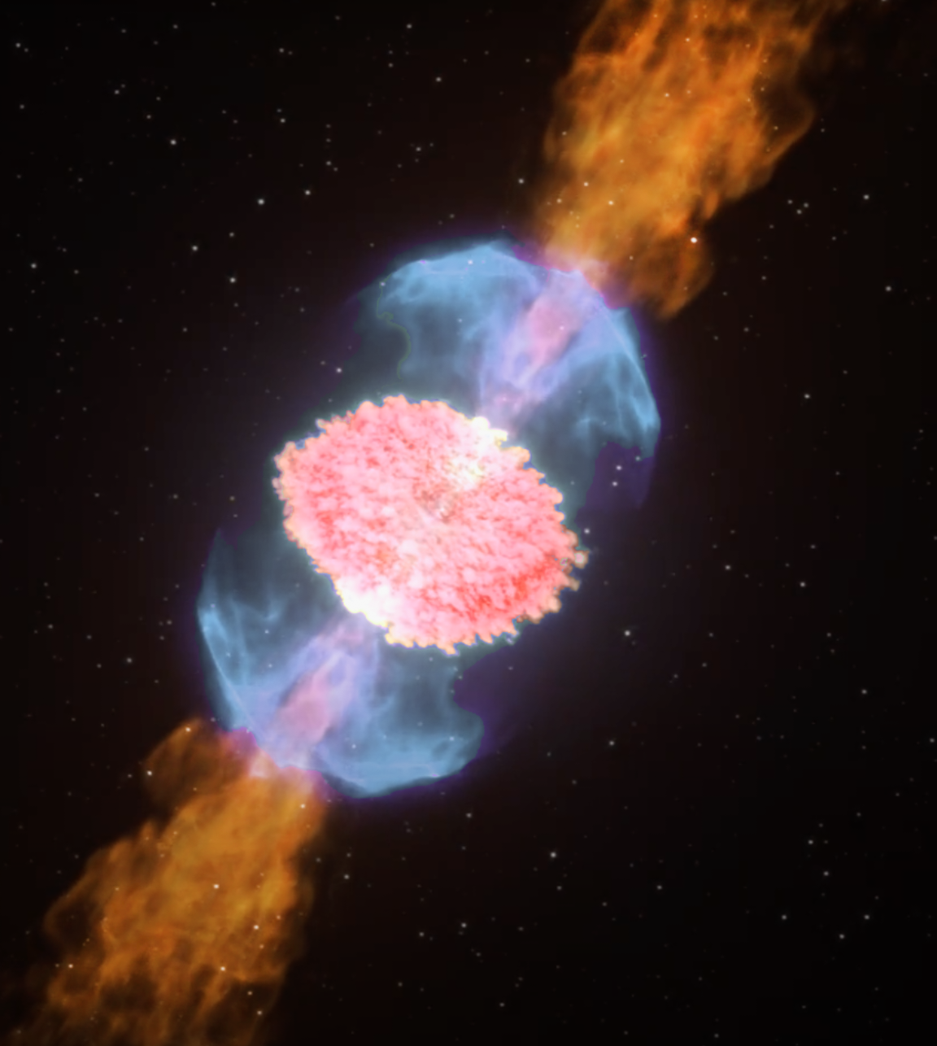

The kilonova AT2017gfo
VRO/LSST z~0.2
HST z~0.4
JWST z~1.0

Slide 24
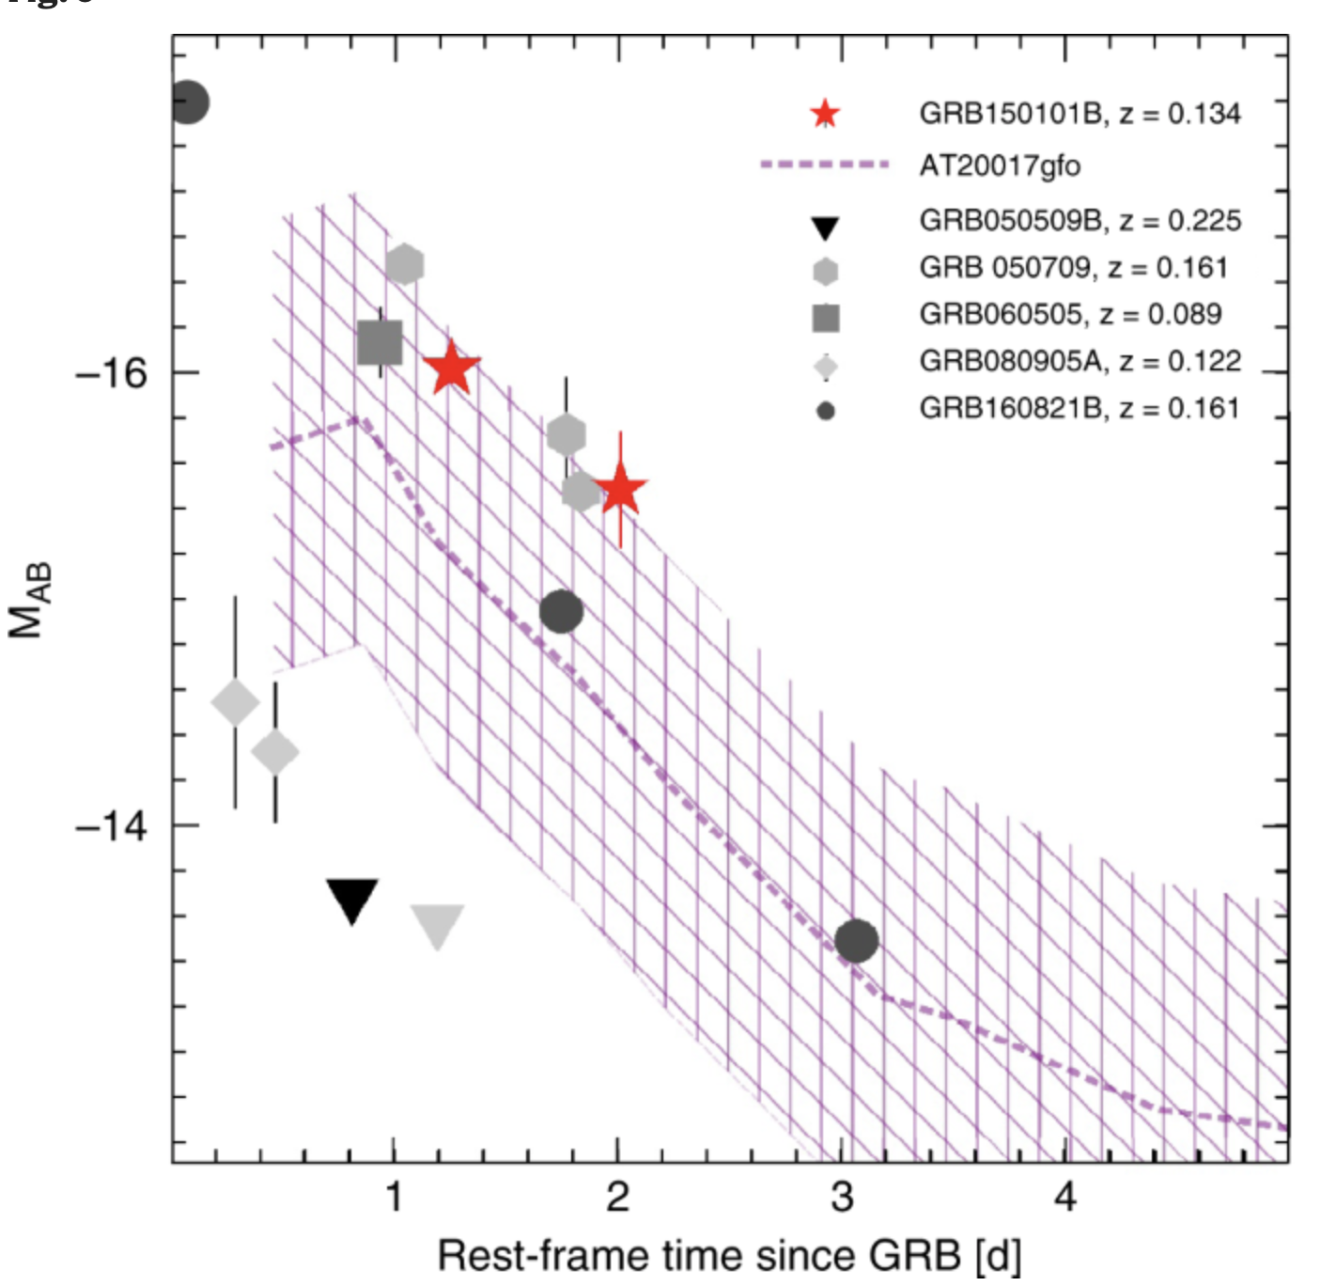
A blue kilonova in GRB150101B
Troja, Ryan et al. 2018
See also
Rossi et al. 2019
Gompertz et al. 2018
Jin et al. 2018
z = 0.161

Slide 25
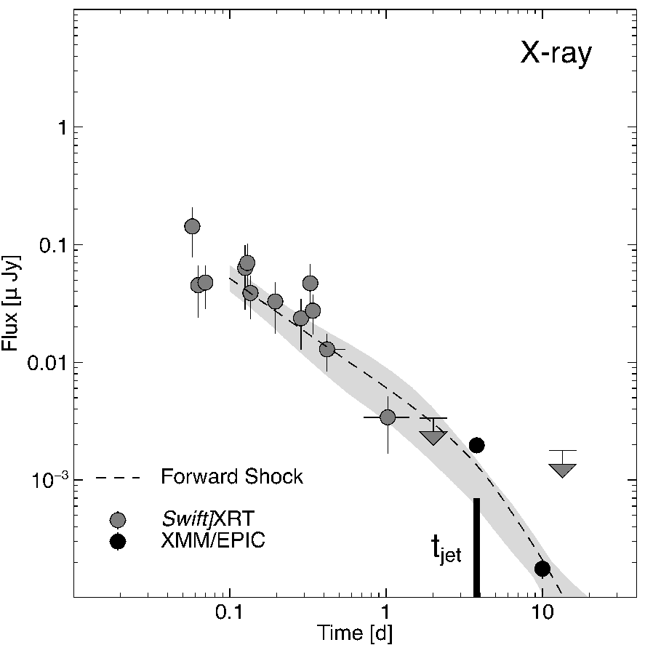
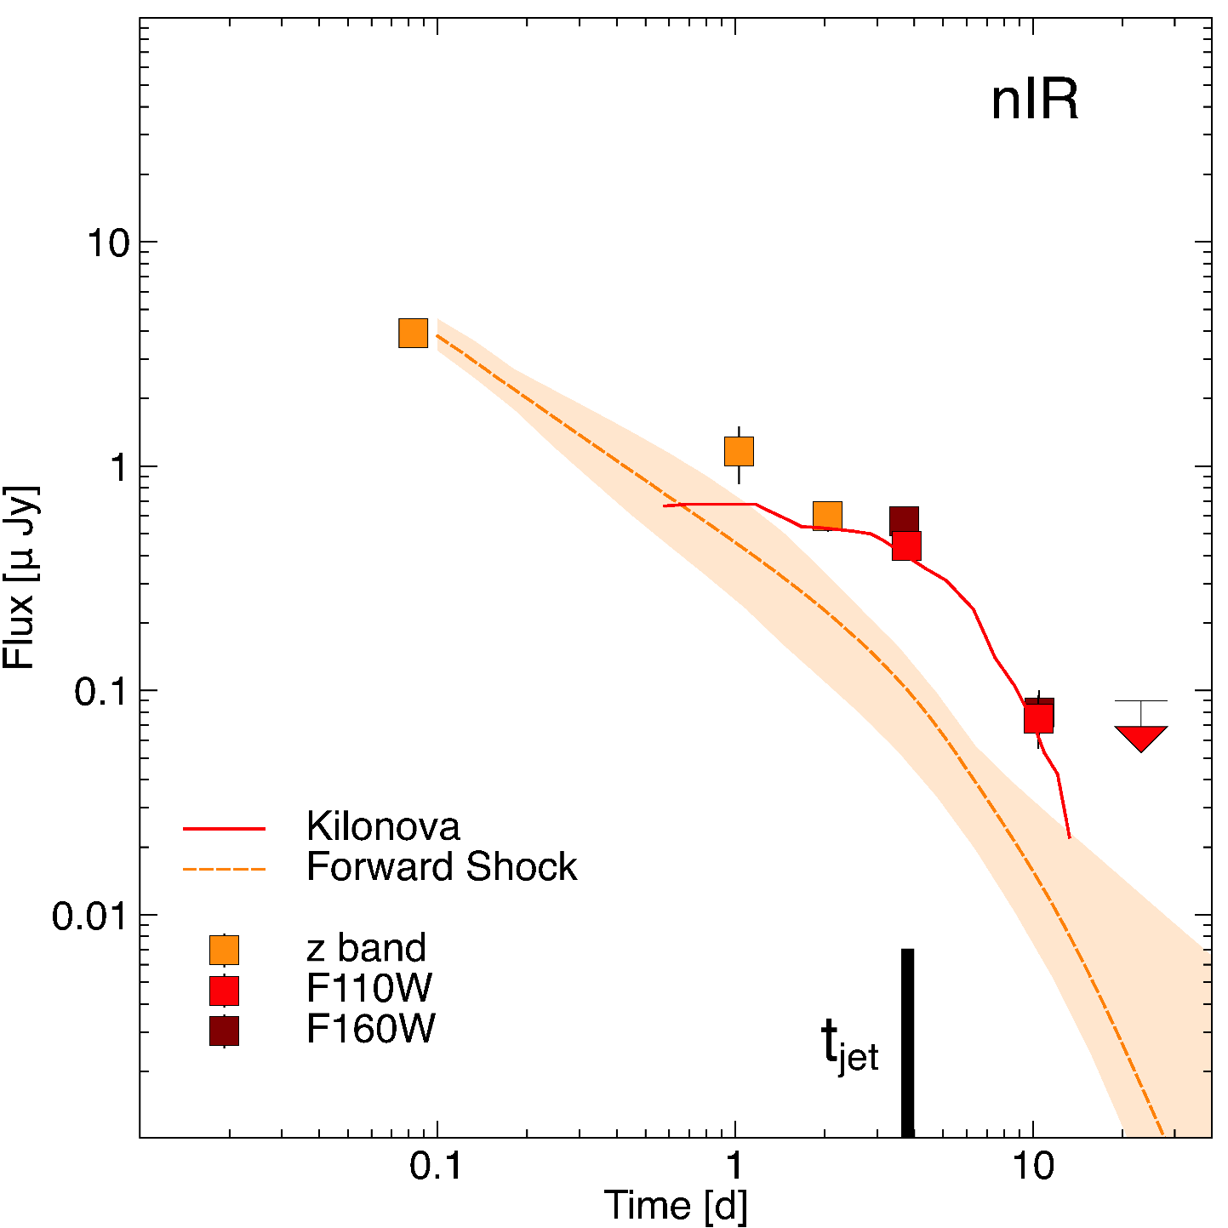
A kilonova in GRB160821B
z = 0.161
Troja, Castro-Tirado et al. 19
See also Lamb+19

Slide 26
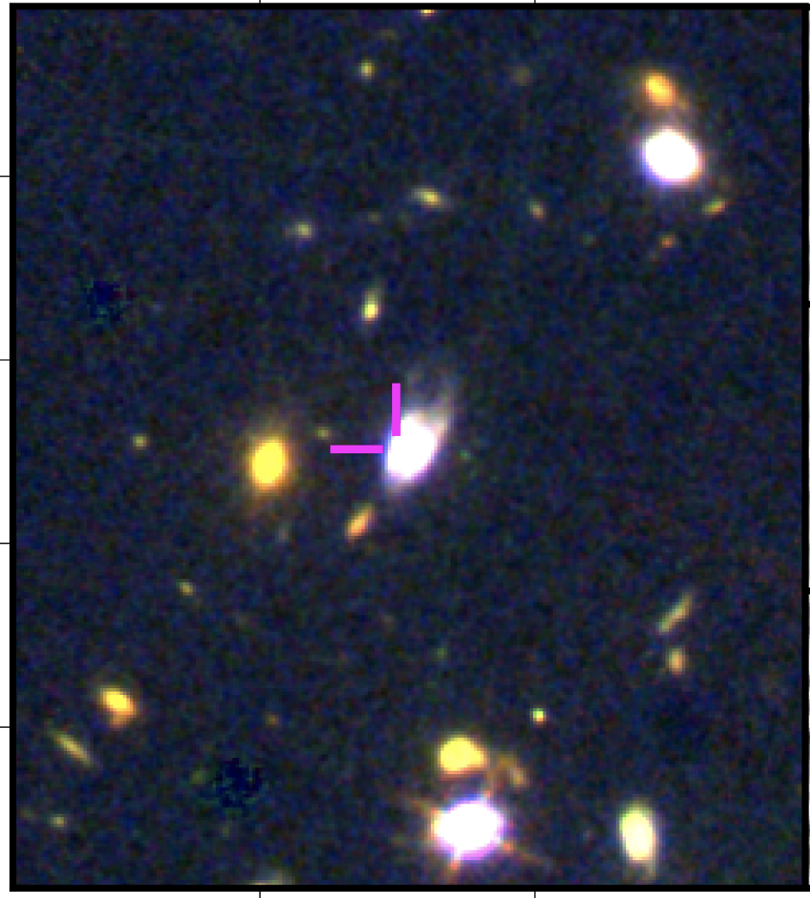
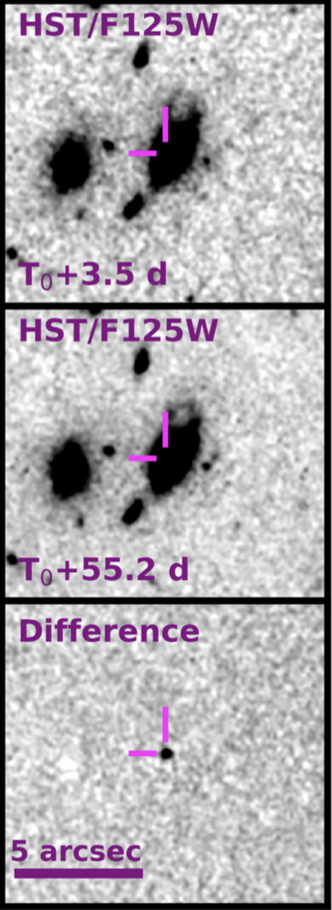
A luminous kilonova in GRB200522A?
brightness
GRB200522A
AT2017gfo
z = 0.554
wavelength
O’Connor et al. 2021

Slide 27
A luminous kilonova in GRB200522A?
brightness
magnetar-boosted
kilonova
GRB200522A
AT2017gfo
z = 0.554
wavelength
O’Connor et al. 2021
See also Fong et al. 2021

Slide 28
A luminous kilonova in GRB200522A?
brightness
magnetar-boosted
kilonova
GRB200522A
On-axis
kilonova
AT2017gfo
z = 0.554
wavelength
O’Connor et al. 2021

Slide 29
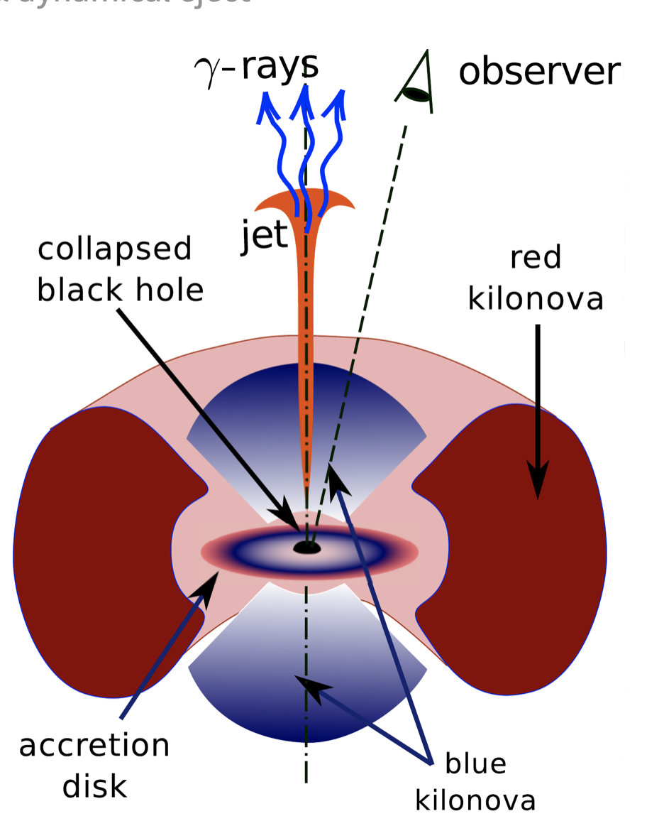
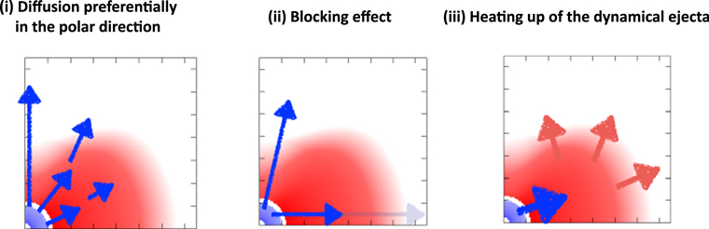
Ejecta morphology
GRB200522A
GW170817
Lanthanide rich
Lanthanide poor
Kawaguchi et al. 2020
Korobkin et al. 2020
Heinzel et al. 2020

Slide 30
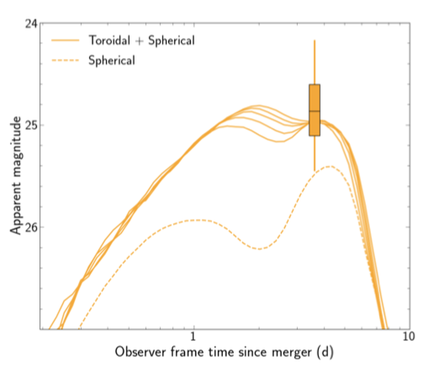
Ejecta morphology
GRB200522A
GW170817
Lanthanide rich
Lanthanide poor
O’Connor et al. 2021
See also Thakur et al. 2021

Slide 31
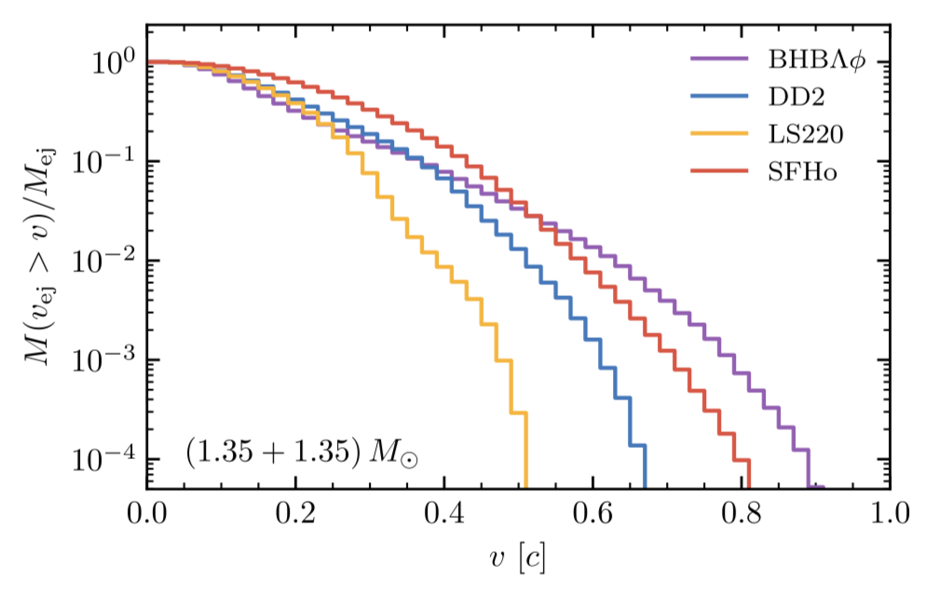
Merger dynamics
Radice et al. 2018

Slide 32
Merger dynamics
Optical/ nIR
Radice et al. 2018

Slide 33
Merger dynamics
Optical/ nIR
Radio/ X-rays
Radice et al. 2018

Slide 34
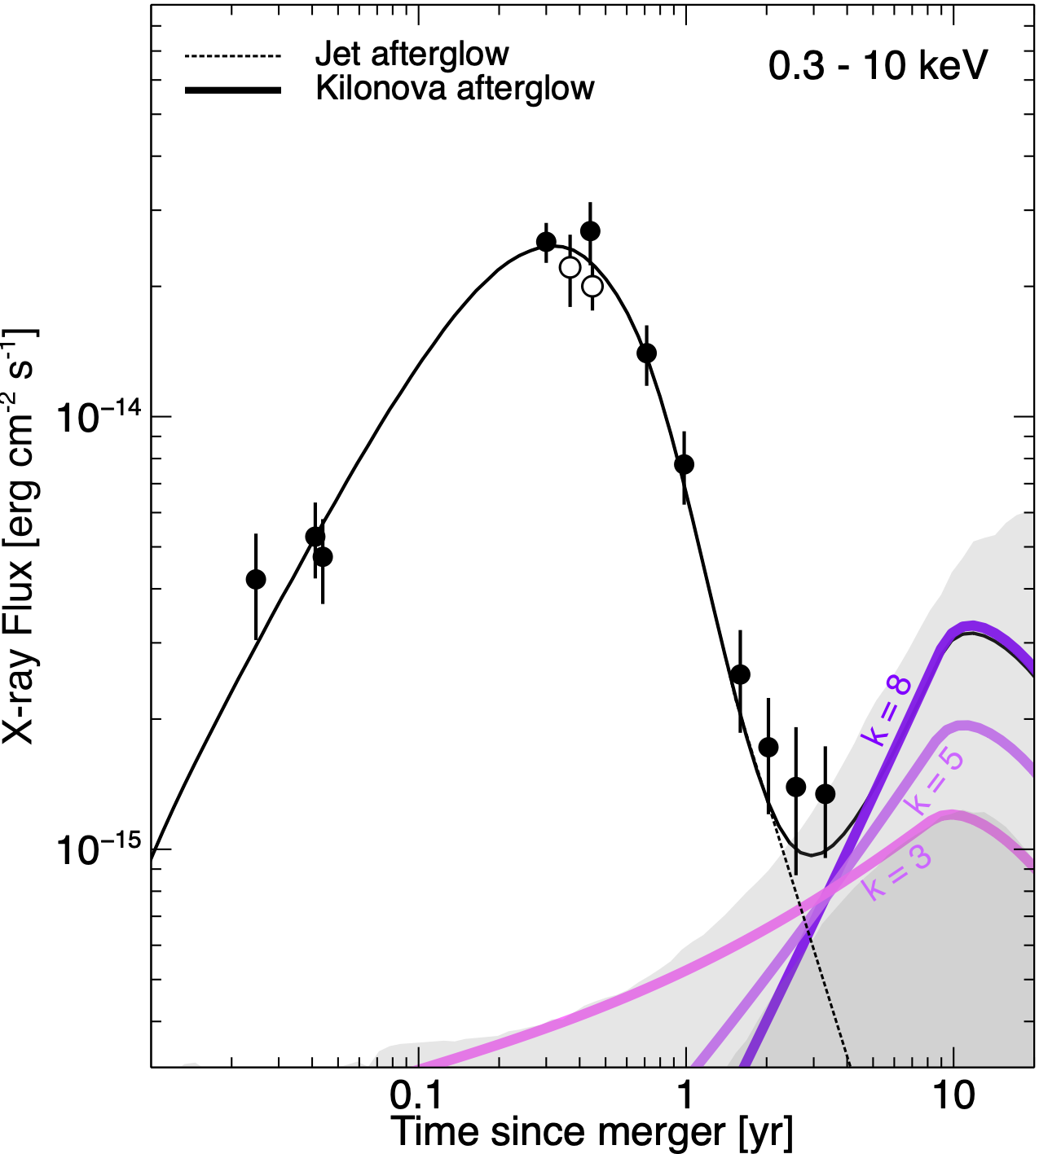
Non-thermal emission from kilonova ejecta
Troja et al., 2020, MNRAS, 498, 564

Slide 35
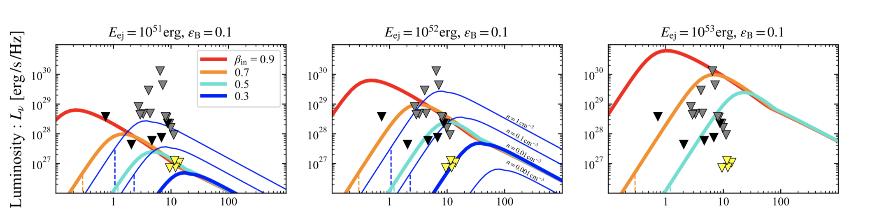
Radio search for kilonova afterglows
Ricci, R. et al., 2021, MNRAS, 500, 1708
See also Grandorf et al. 2021, Schroder et al. 2020, Klose et al. 2019

Slide 36
Summary
EM counterparts of NS mergers depend on the viewing angle
NS mergers can form and launch highly relativistic jets
  GW170817 consistent with a structured jet
  Events viewed off-axis dominate the local population (e.g. GRB150101B)
  Different mergers may lead to other outcomes (top-hat, choked jet)
Multiple outflows contribute to the observed kilonova:
  Growing evidence for kilonova in short GRBs (e.g. GRB160821B)
  Geometry and viewing angle effects also affect the kilonova luminosity (e.g. GRB200522A)
Late-time observations of NS mergers may reveal their remnant

