Slide 1
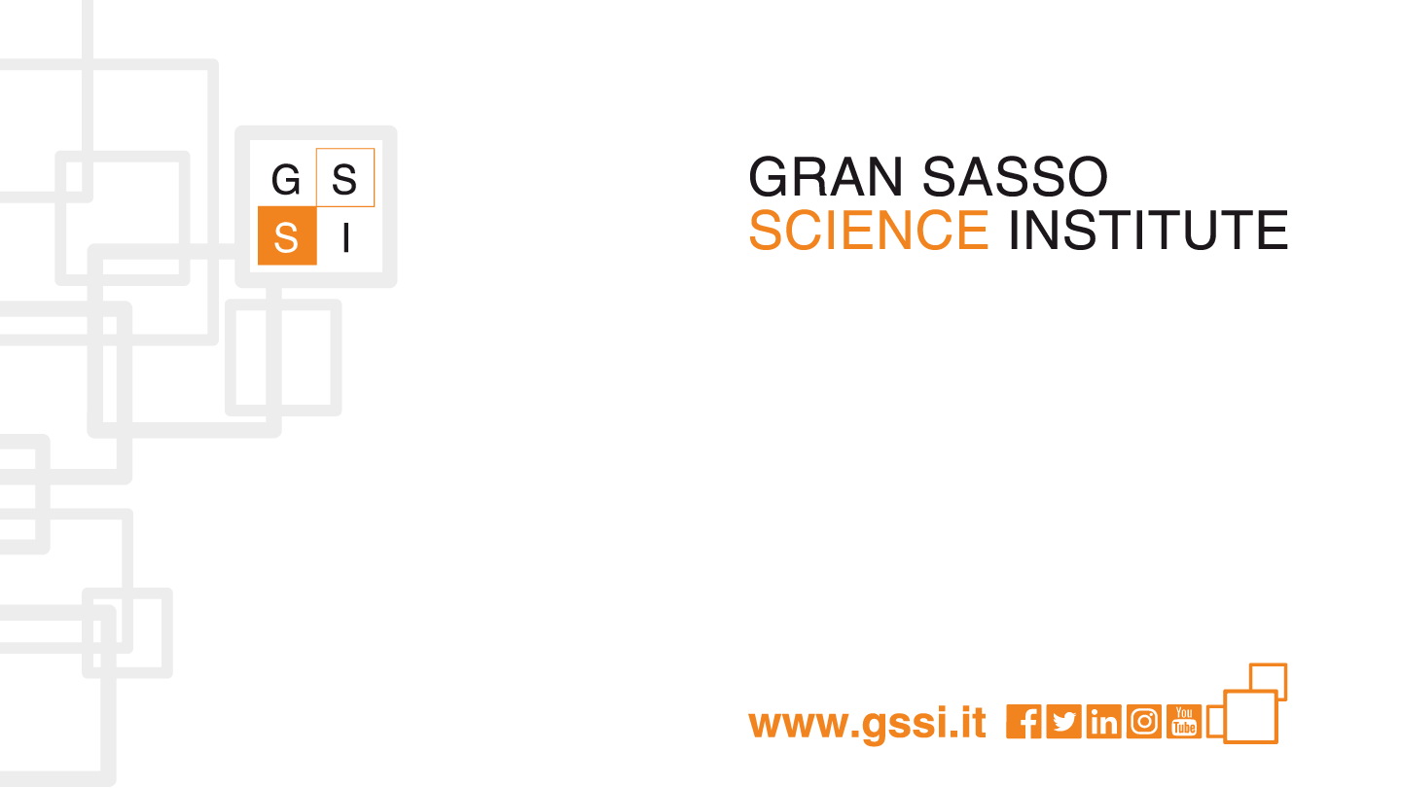
Gravitational Wave group
Science Fair 2020
GSSI, L’Aquila 2020

Slide 2

The group
Group leaders
  M. Branchesi, J. Harms
Assistant professors
  G. Pagliaroli, M. Drago
Post-doc
  S. Dall’Osso, G. Oganesyan
Ph.D.
  F. Badaracco, S.J. Grimm, O. Halim, N. Khetan, A. Sharma, D. Vescovi, T. Andric, S. Ronchini, N. Hazra

Slide 3
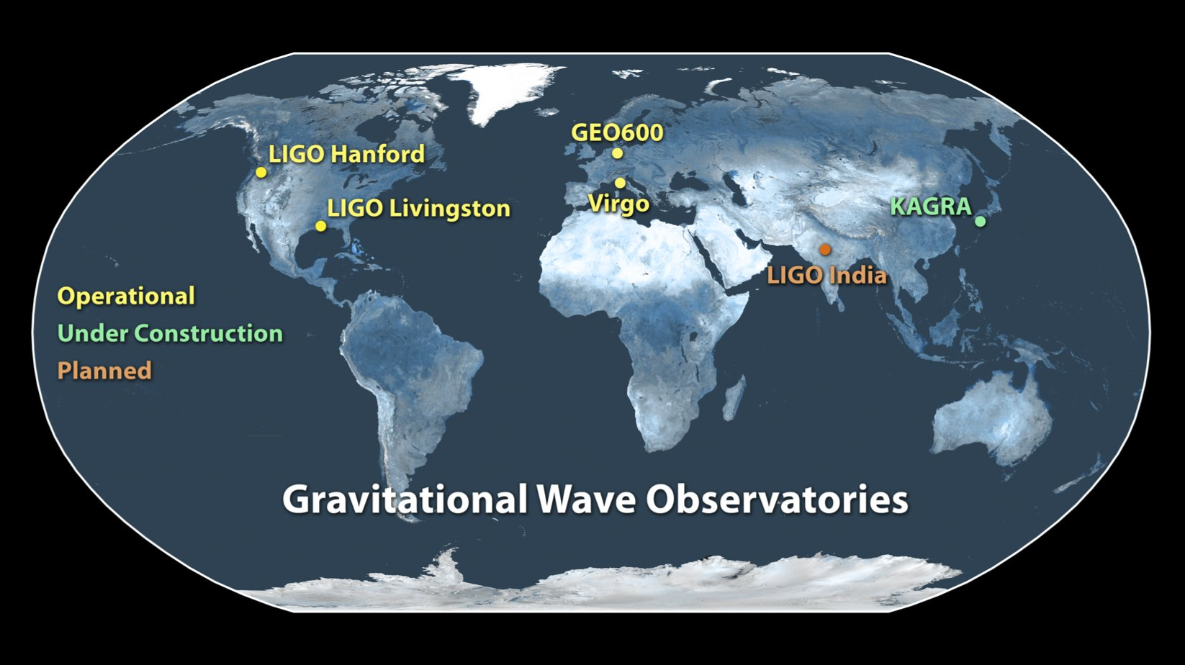
Introduction
GSSI group is part of Virgo collaboration http://www.virgo.infn.it/
Virgo and LIGO jointly search for gravitational waves
  KAGRA will join soon
  Future generation detectors in preparation (ET, LISA)
Gravitational waves have been detected for the first time in 2015
A total of 12 events have been found
  10 Binary Black Holes
  2 Binary Neutron Star (with a Gamma Ray Burst counterpart)
The group is involved in detector studies, data analysis and multi-messenger astrophysics

Slide 4
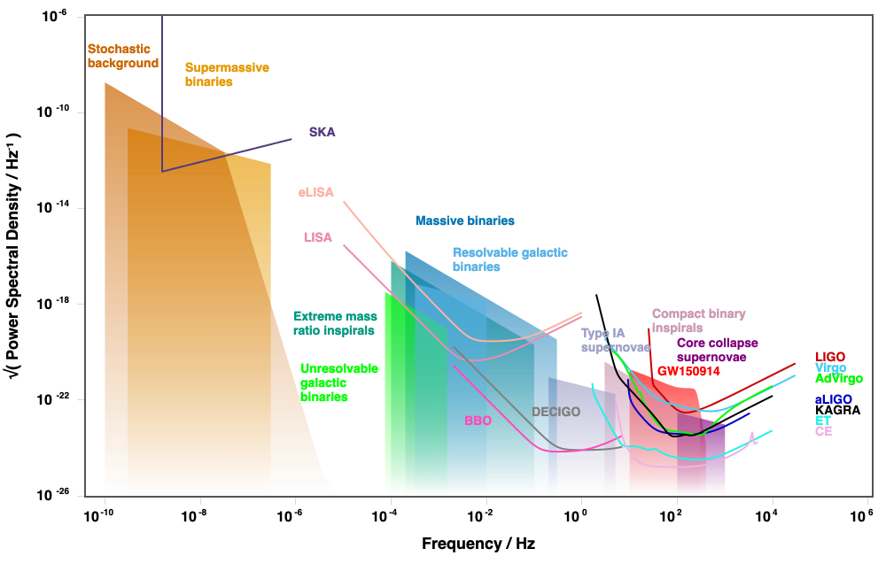
Gravitational wave detector and searches (http://gwplotter.com/)

Slide 5
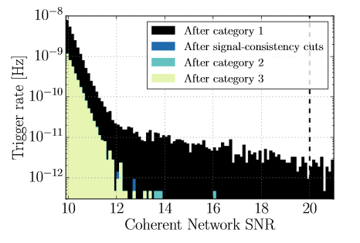
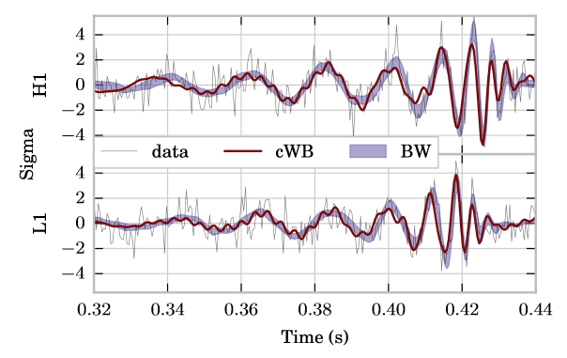
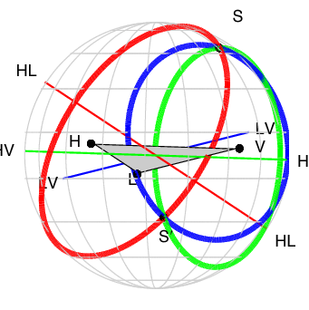
Burst Search
GSSI Working group: M. Drago
  Detection
    Distinguish the real signal from detector noise
  Source identification
    Waveform shape depends on generating process
  Sky localization
    Search of multi-messenger counterparts
Ref:
Di Palma, Drago, Phys.Rev. D97 023011 (2018)
P. Astone, Drago et al, Phys.Rev. D98 122002 (2018)
Salemi, Drago et al., Phys.Rev. D 100, 042003 (2019)
GW group
Science Fair 2019
5

Slide 6

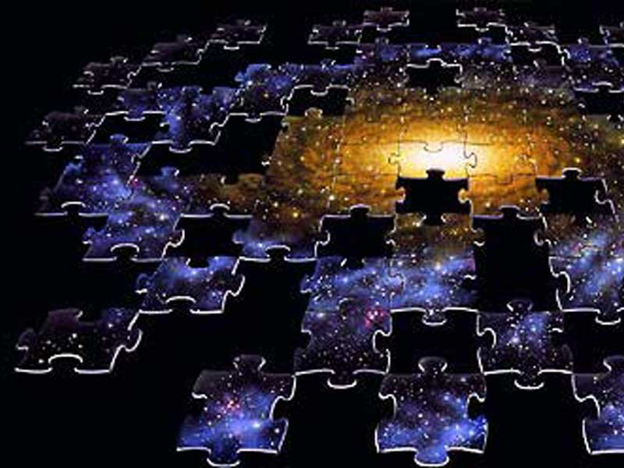
CORE Collapse Supernova
Neutrinos and Gravitational Waves
GSSI Working group: G. Pagliaroli, V. Fafone, M. Drago, O. Halim
Neutrinos and Gravitational Waves carry complementary information.
Neutrinos: primarily thermodynamics
GWs: primarily dynamics
Joint observation improve the detection potential and the physical learning.
Proposal for data exchange among GW detectors: LIGO, Virgo and neutrinos detectors: Borexino, LVD, KamLand and IceCube
Ref:
Casentini, Pagliaroli, Vigorito, Fafone, JCAP 1808 (2018) n.08,010
Halim, Vigorito, Casentini, Pagliaroli, Drago, Fafone, arXiv:1911.11450

Slide 7
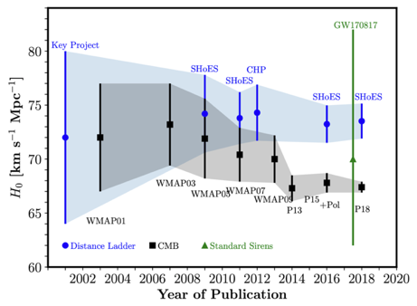
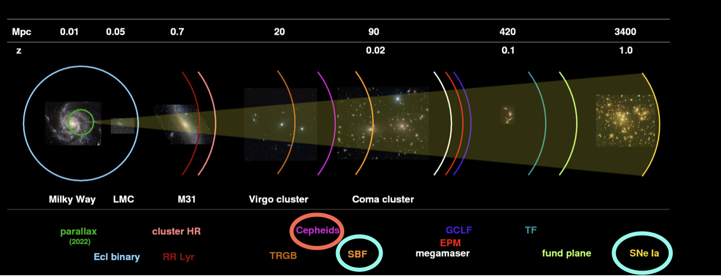
COSMOLOGY: how fast is the Universe expanding?
GSSI Working group: N. Khetan , M. Branchesi
Measurements from the early and late Universe in tension!
Cosmic Microwave Background vs SN type Ia
→
Systematic bias? Or new Physics?
Trying to solve the enigma using SN Type Ia and the surface brightness fluctuation of their galaxies

Slide 8
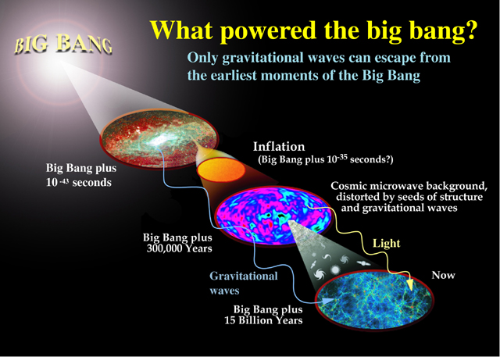
Stochastic Cosmological Background Study with 3G Gravitational Wave Detectors : Probing the Very Early Universe
GSSI Working group: J Harms, A Sharma
Produced very shortly after big bang by resolved and unresolved gravity-wave sources.
The cosmological background that we are after comes from unresolved sources, actually, from hypothetical quantum-vacuum fluctuations, or a network of cosmic strings.
A Stochastic background can be observed by cross-correlating the data of multiple detectors.
(@ LIGO, VIRGO, KAGRA, ET , COSMIC EXPLORER)
To detect a stochastic background one needs to resolve all
the binaries and noise background signals in the detector.
Methods Required are :
  Parameter Estimation of detected and
  resolved/un-resolved binary signals.
  Understanding and subtracting the noise to
  a good level.
  Implementing methods for stochastic signal
  search.
Ref:
Jan Harms et al., PRD 77, 123010 (2008)

Slide 9
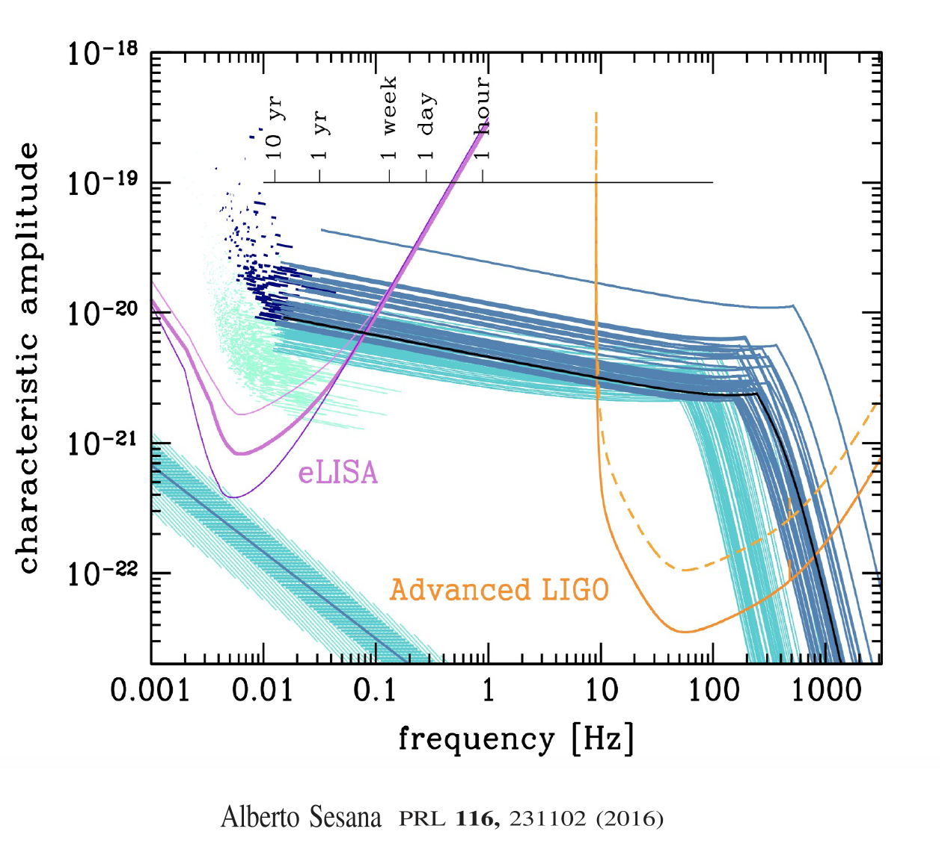
Multiband Gravitational Wave parameter estimation
GSSI Working group: S.J. Grimm, J. Harms
Combine information from several gravitational wave detectors
Perform tests of modified theories of General Relativity

Slide 10
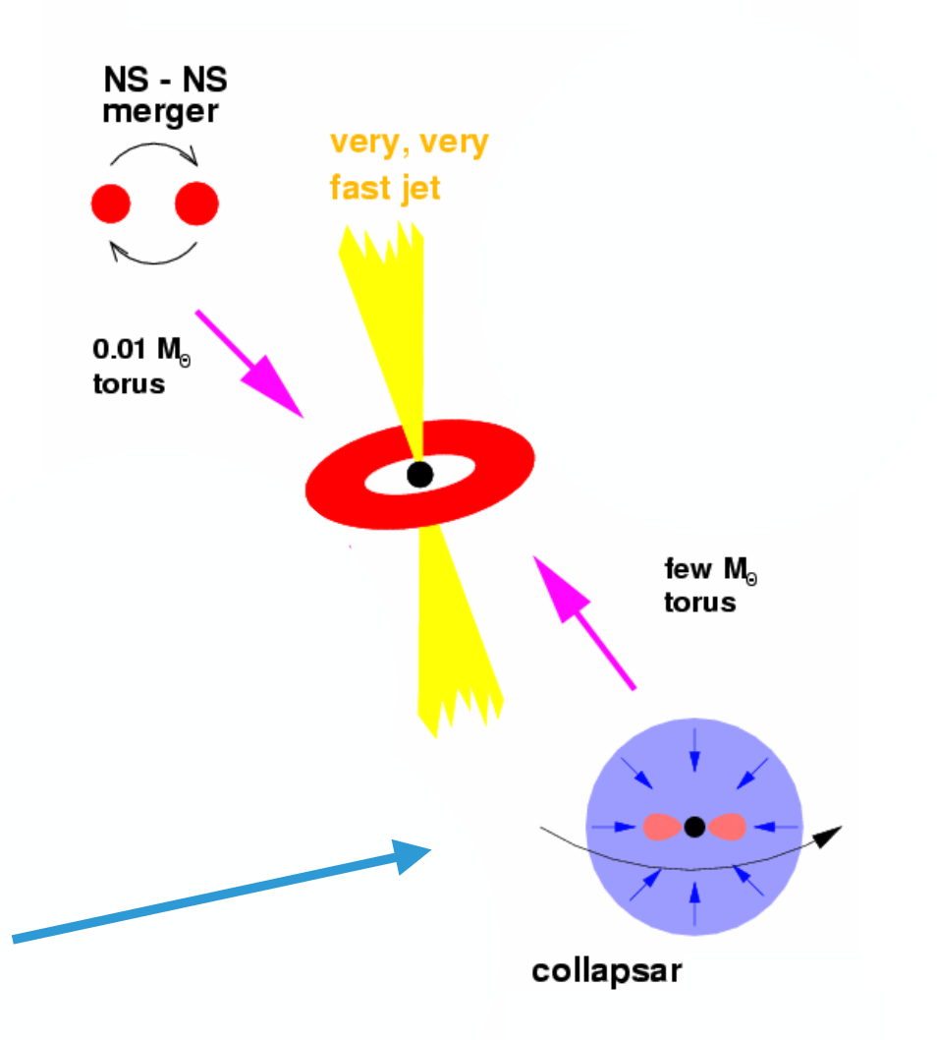
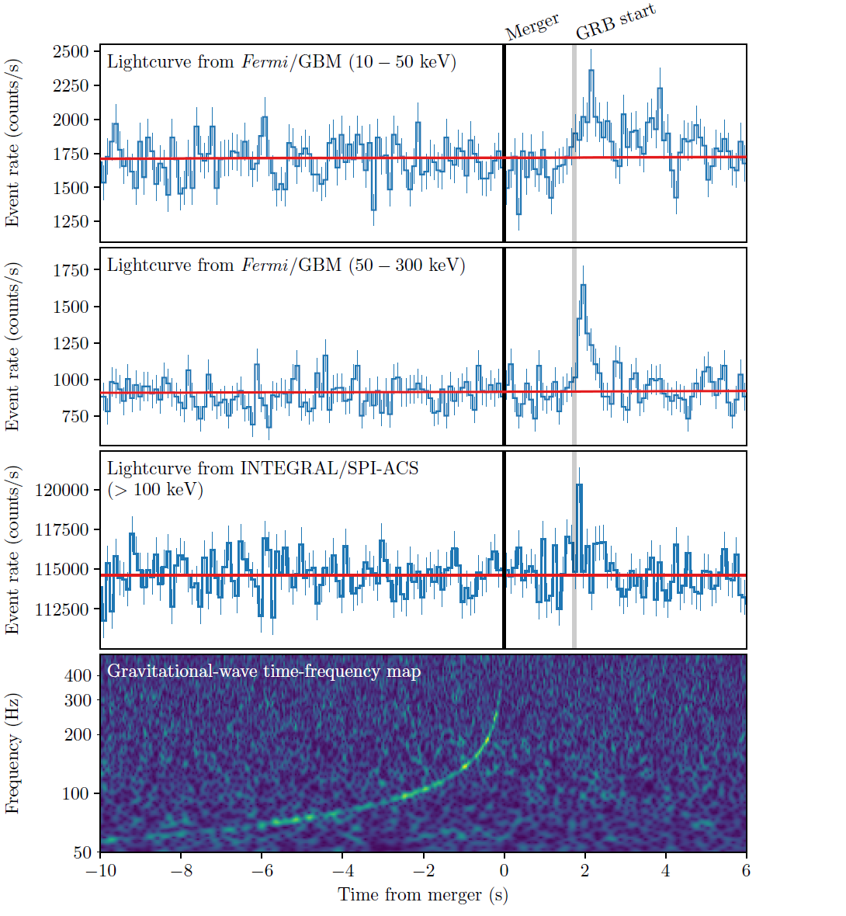
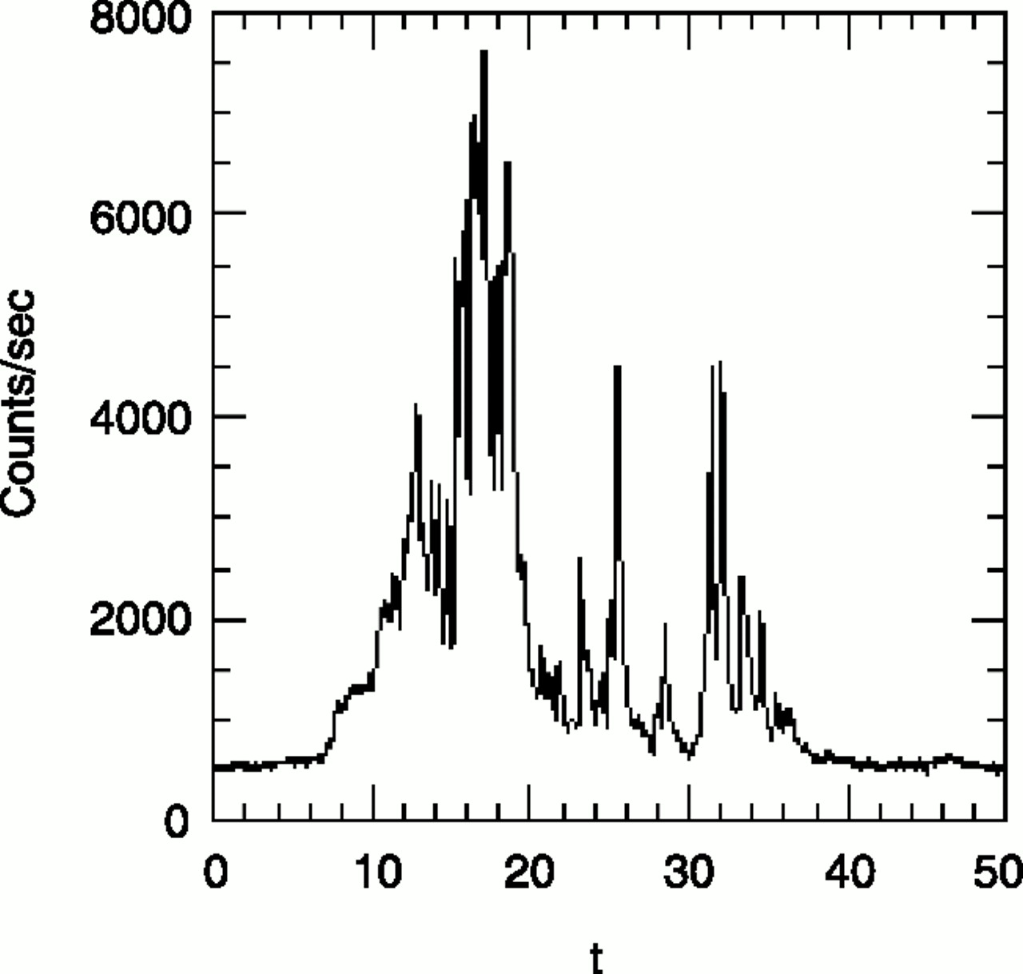
the Physics of γ-ray bursts and the multi-messenger astrophysics
GSSI Working group: M. Branchesi, S. Dall’Osso, G. Oganesyan, S. Ronchini
GW emission
Electromagnetic emission
In few seconds more energy released
then emitted by Sun in 10 billion years!
compact objects merger
and
death of massive stars
How the jets are launched?
What is in the jet?
How the jet is dissipated?
What does radiate?
First joint Gravitational Wave and GRB detection
Kilonova from NS-NS merger
Jet structure
What and when is the next?
The mystery of the GRB progenitors: black hole or a magnetar?

Slide 11
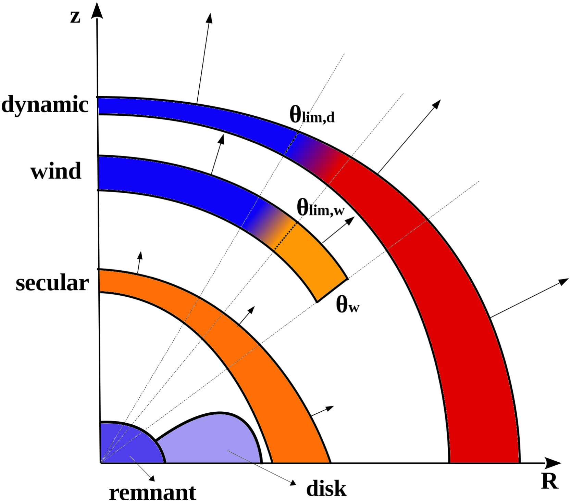
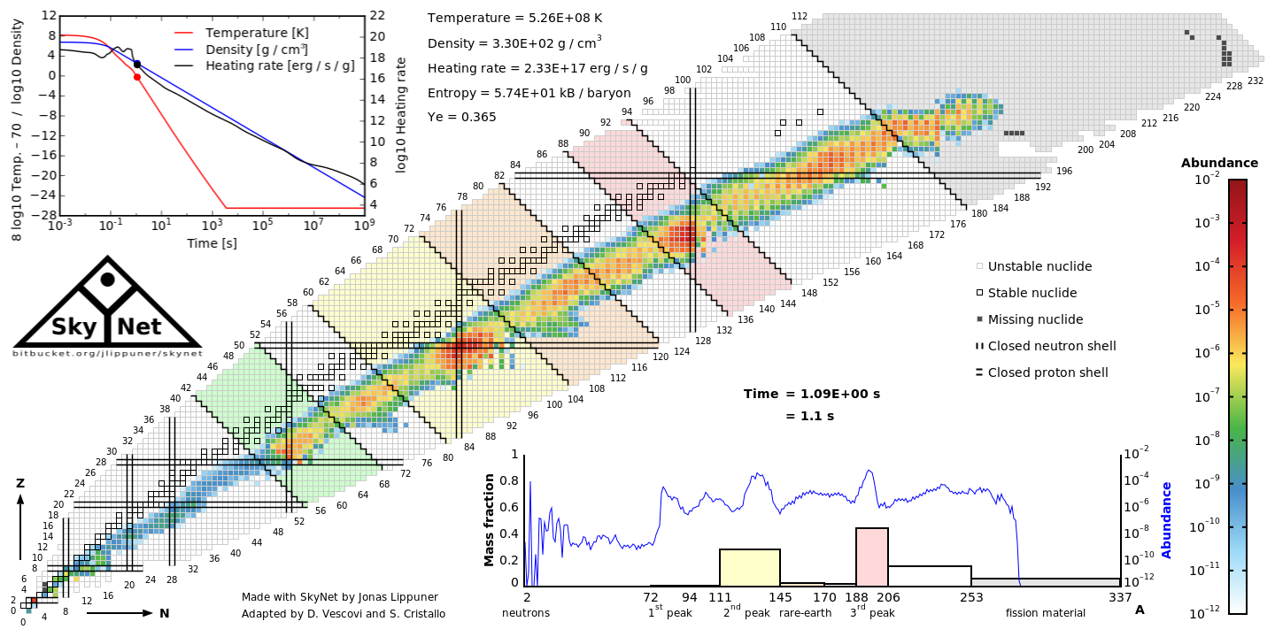
How heavy elements form in the Universe?
Kilonova and merger of neutron stars can solve the enigma
GSSI Working group: D. Vescovi , M.Branchesi
The amount of heavy elements formed determines:
opacity of the ejecta
amount of energy available for the electromagnetic transient (Kilonova)
Goal: understand how variations in the late-time nuclear heating rate and composition affect the kilonova emission.
Perego et al. 2017, ApJ, 850L, 37P Lippuner & Roberts 2017, ApJS, 233, 18L

Slide 12
The experimental part of GW group:

Slide 13
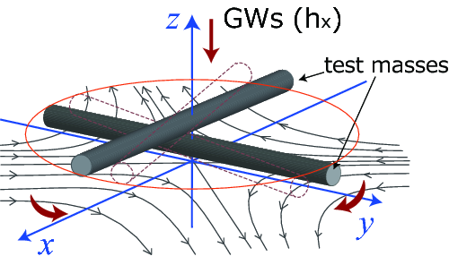
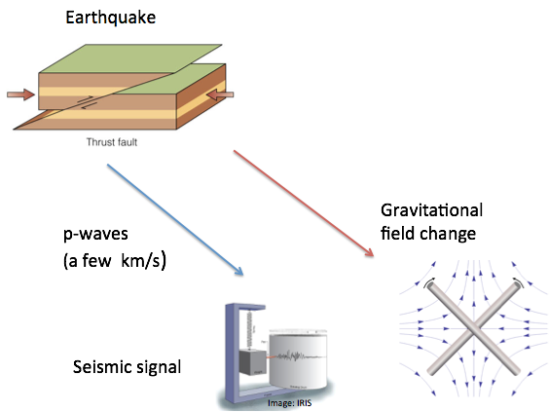
3G and low frequency detector
GSSI Working group: F Badaracco, J Harms, T. Andric
Einstein Telescope (ET)
Cosmic Explorer (CE)
Torsion bar antennas (TOBA)
atom interferometers
Superconducting gradiometers
But also…
Low frequency GW detectors, a different application
Earthquake early warning system based on prompt gravity perturbations from earthquakes
Ref:
K. Juhel et al. JGR Solid Earth Volume 123, Issue 12

Slide 14
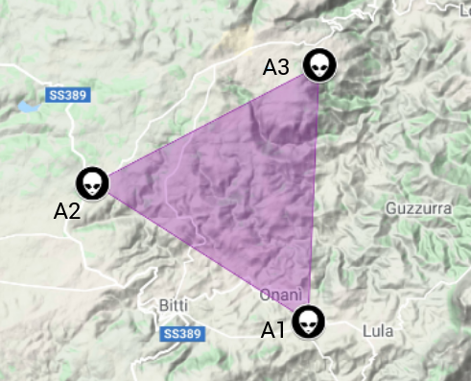
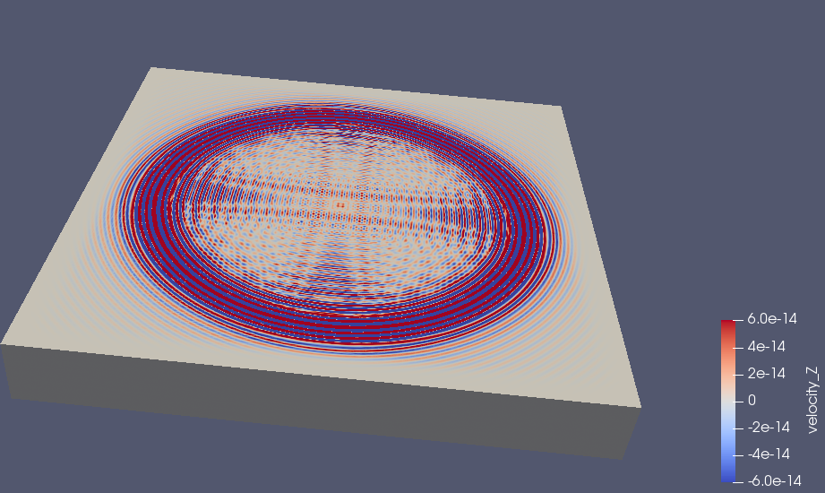
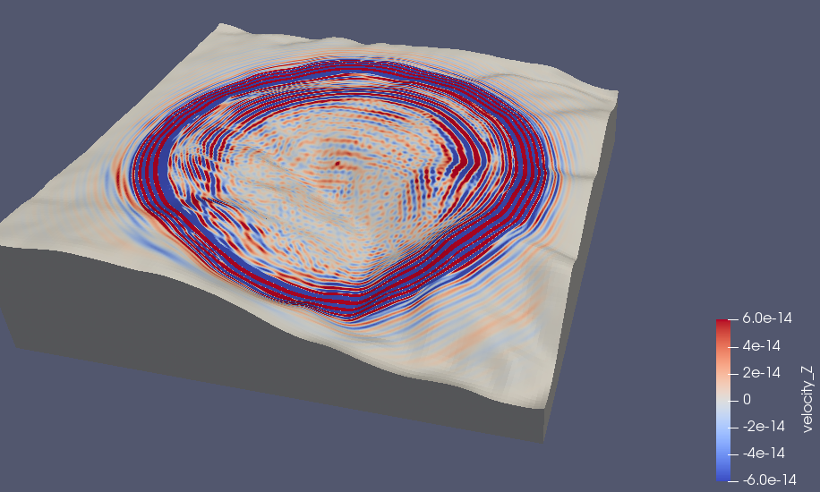
ET: site characterization (Sardinia)
Planned locations of vertices of Einstein Telescope
GSSI Working group: J Harms, T. Andric
Using cross correlation techniques we try to understand the effects that the topography can have on the NN produced in the detector (ET).
Seismic wave propagation in flat and not flat case

Slide 15
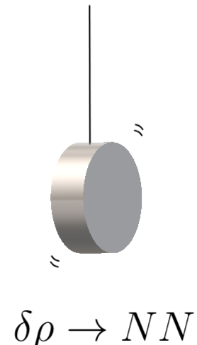
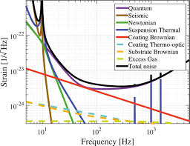
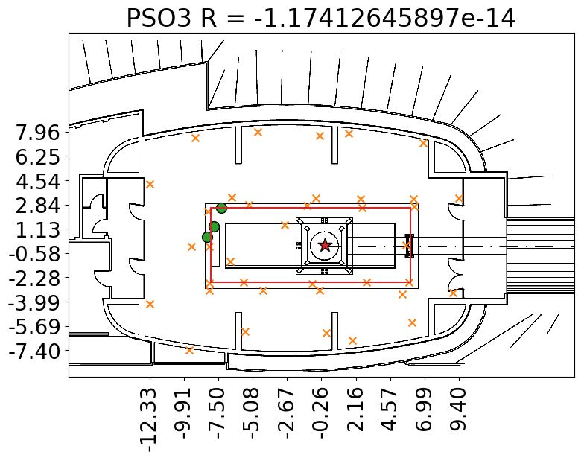
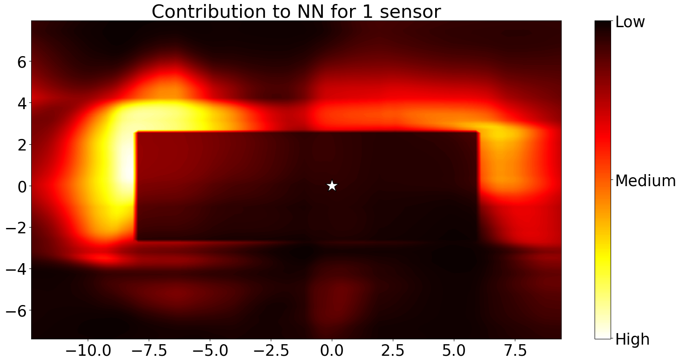
Newtonian noise cancellation
GSSI Working group: J Harms, F.Badaracco
# When there is some density perturbation in a medium the gravitational field around it experiences perturbations too. Seismic waves are an examples of this density perturbations!
# This can be really annoying for Gravitational-wave detectors, because the seismic waves can produce disturbances from both a vibration point of view and a gravitational one (the harder to shield!).
# We want to find a way to reduce this inconvenience.
For this purpose we can use seismometers and try to reconstruct the gravitational disturbance.
We “just” have to find the best positions of the seismometers!!!
This is really challenging!

Slide 16
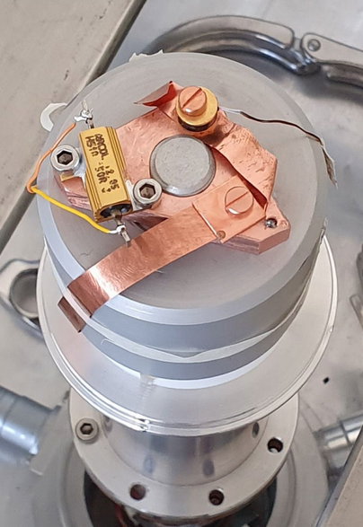
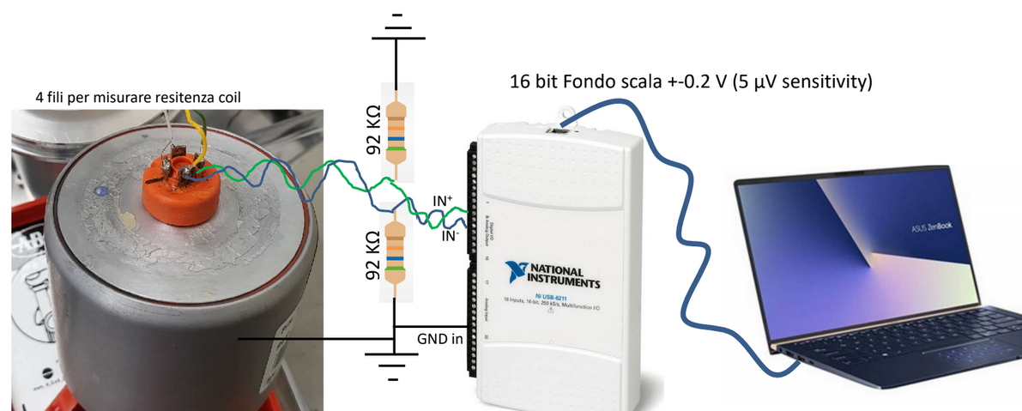
Cryogenic system for ET
Member of our ET group: Stefano Pirro (LNGS)
Contribution to the cryogenics development in KAGRA.
R&D for ET (Einstein Telescope)
The purpose of the current experiment is to characterize vibrations in cryogenic systems, and in particular to test the performance of geophones at low temperatures

Slide 17
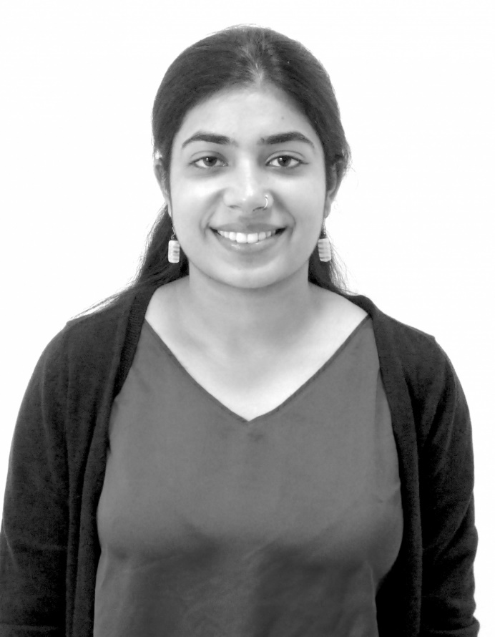
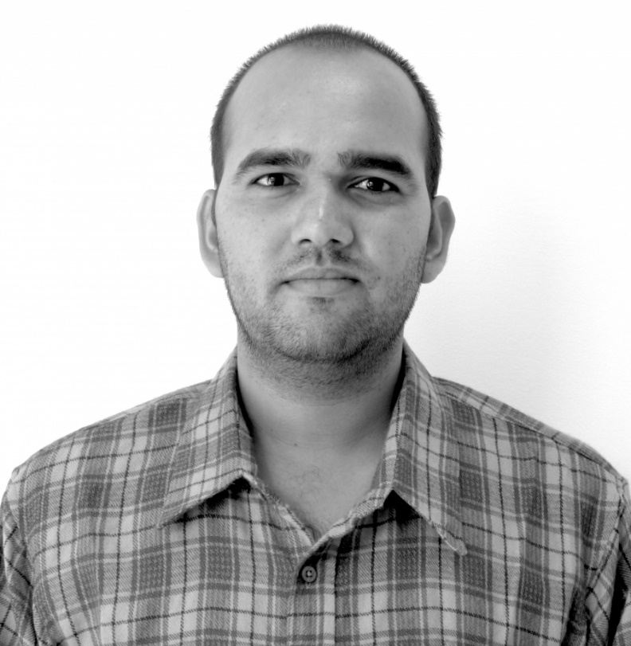
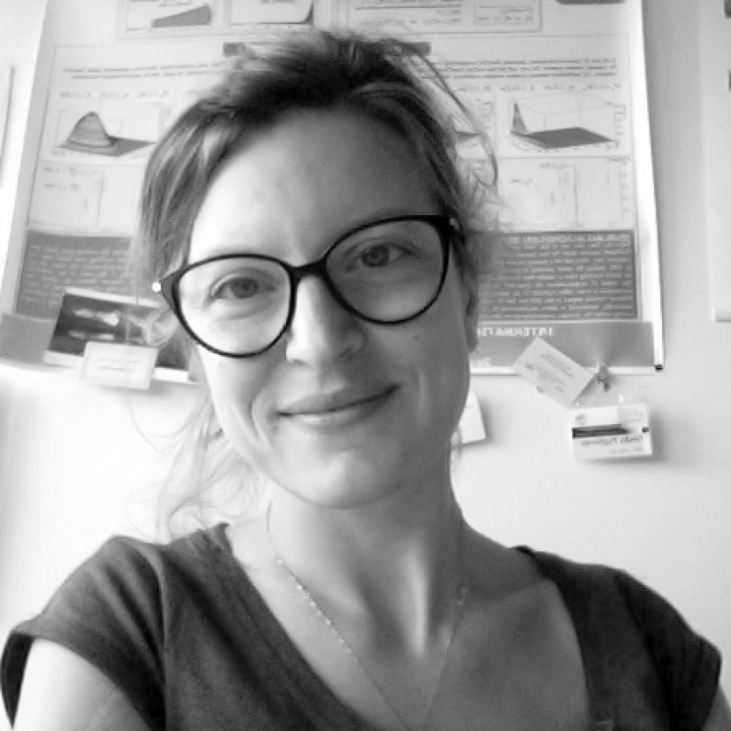

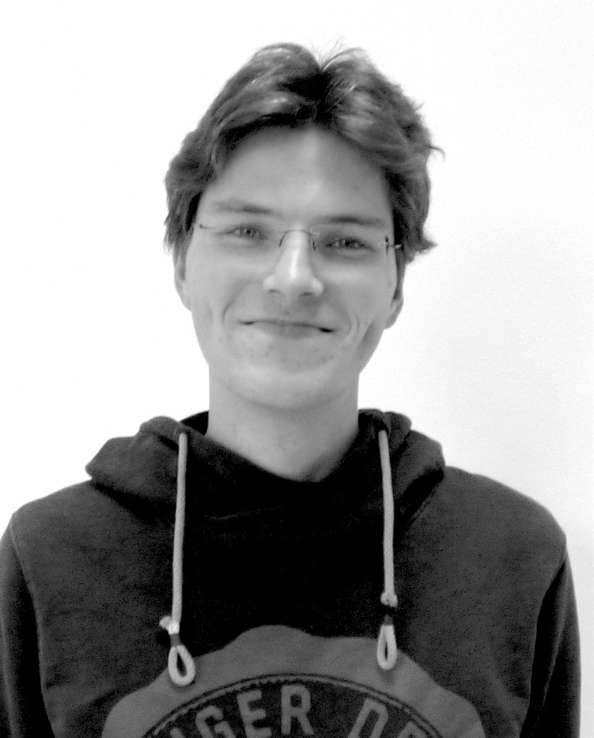
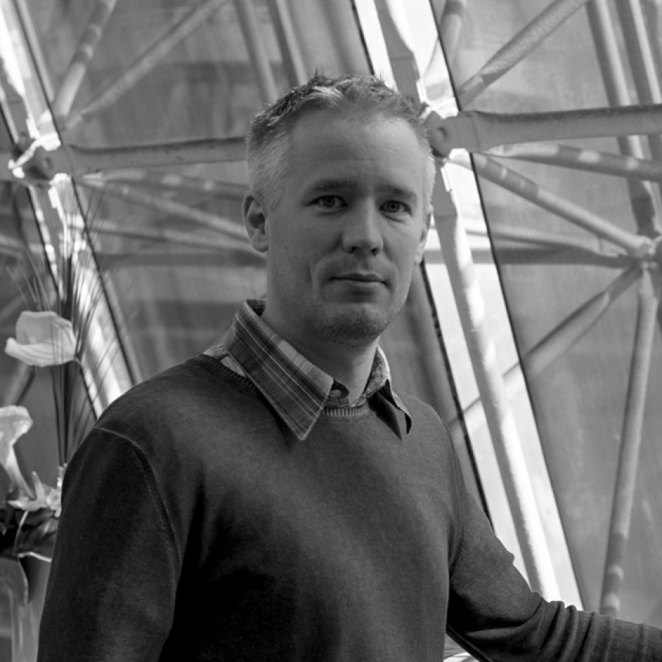
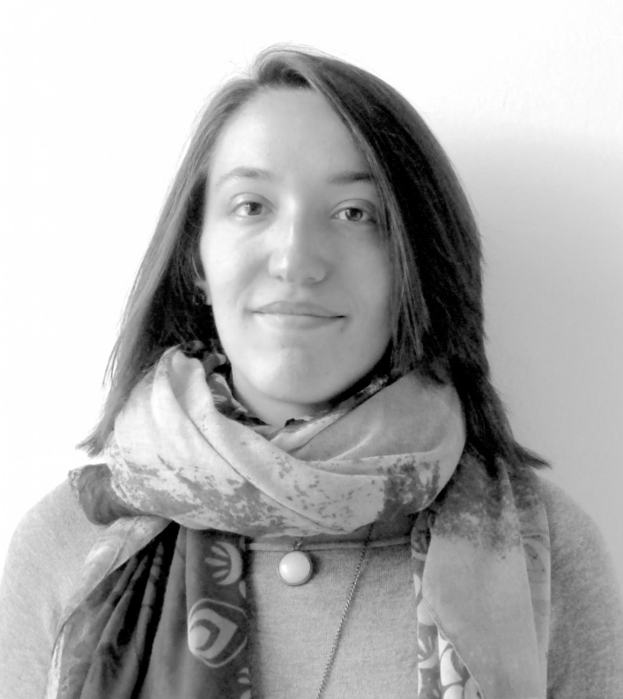
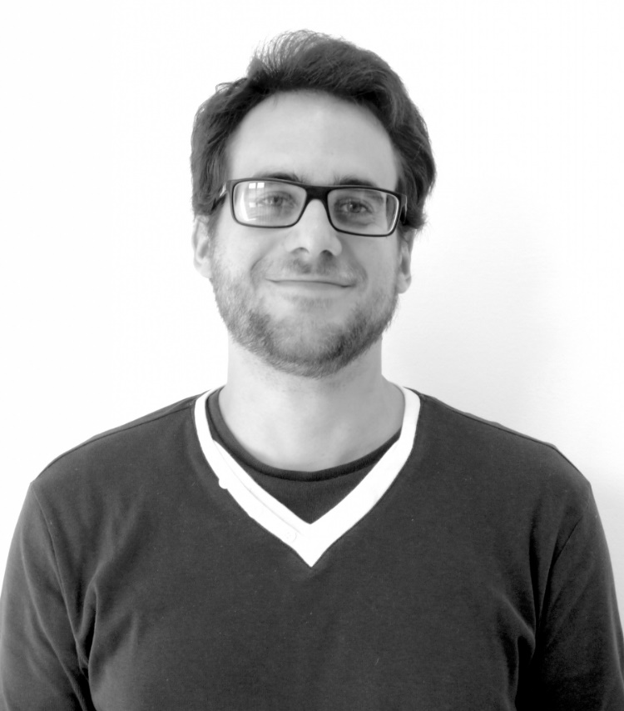
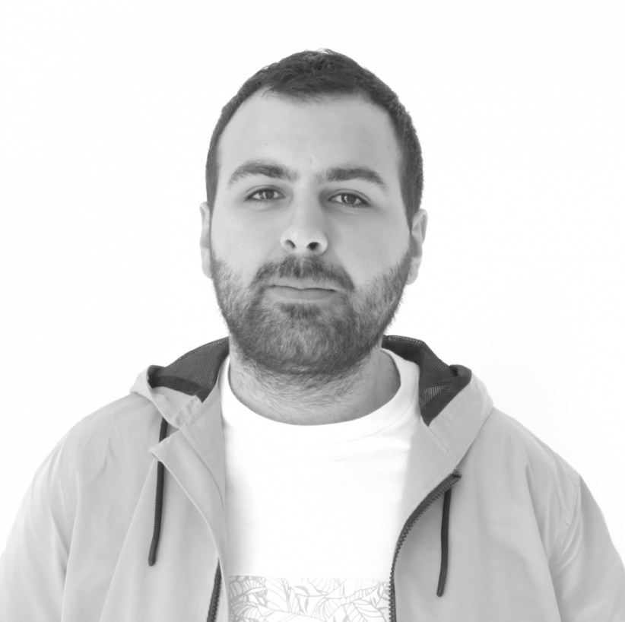
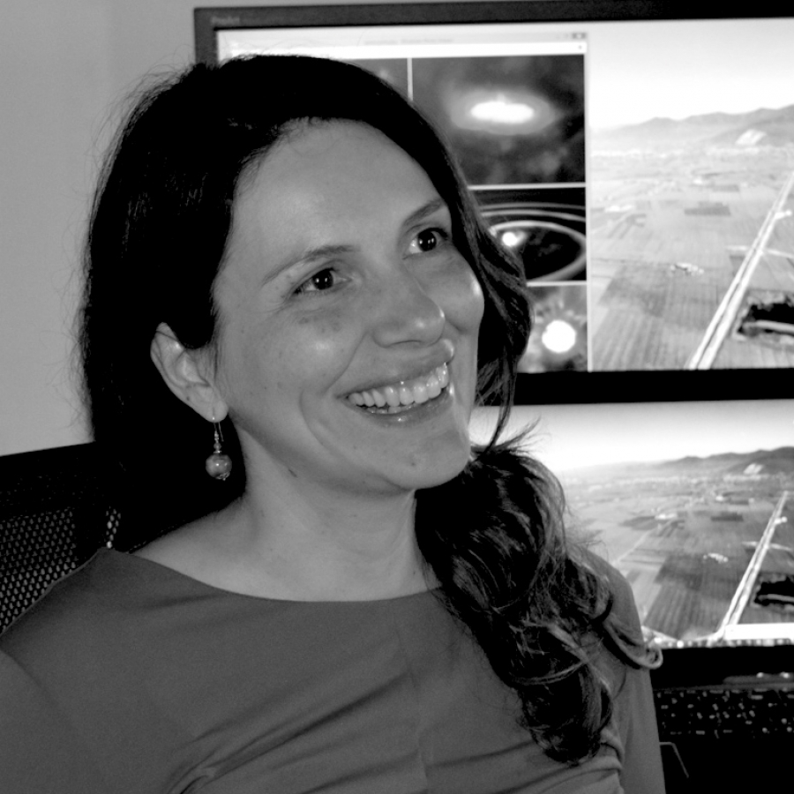
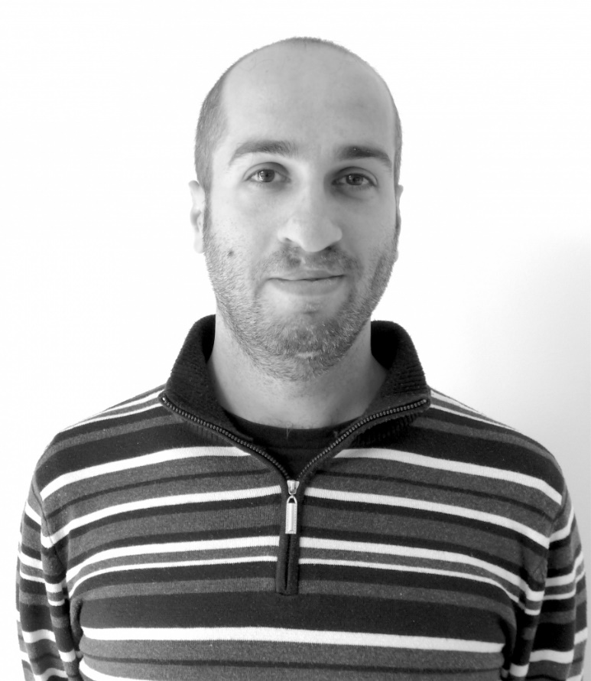
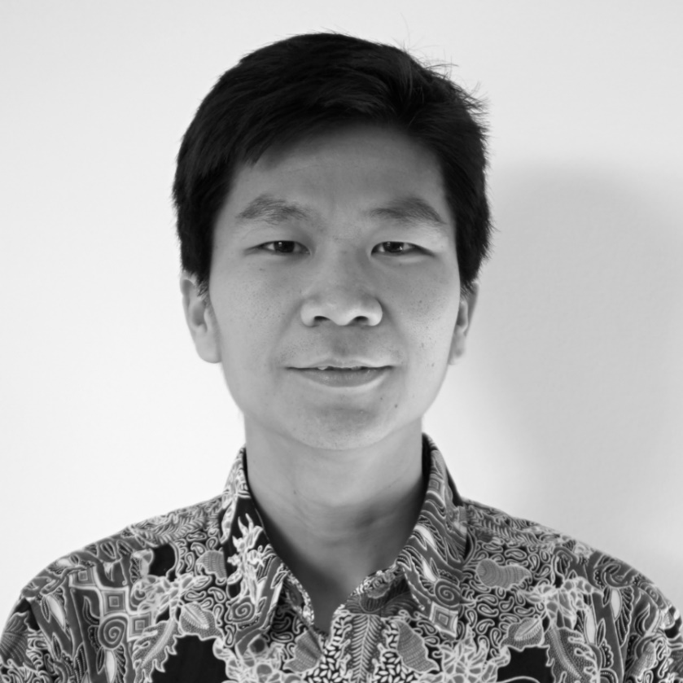
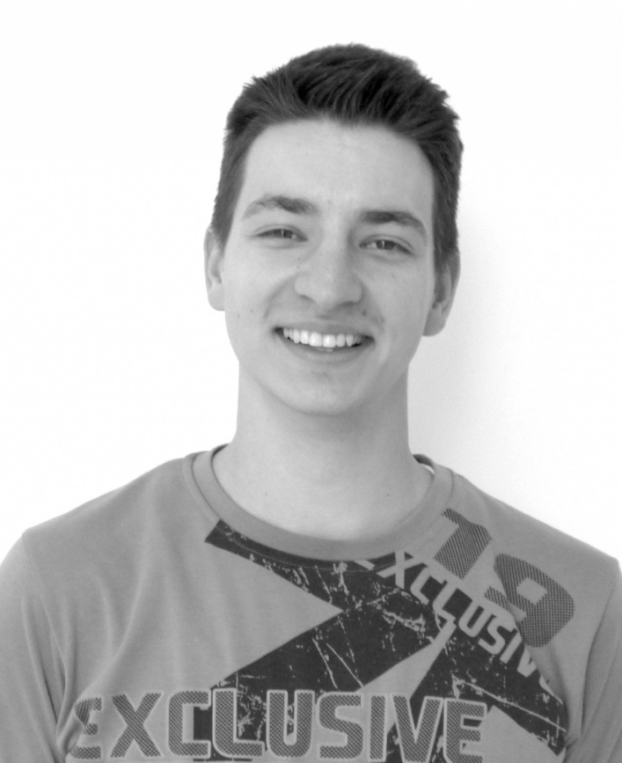
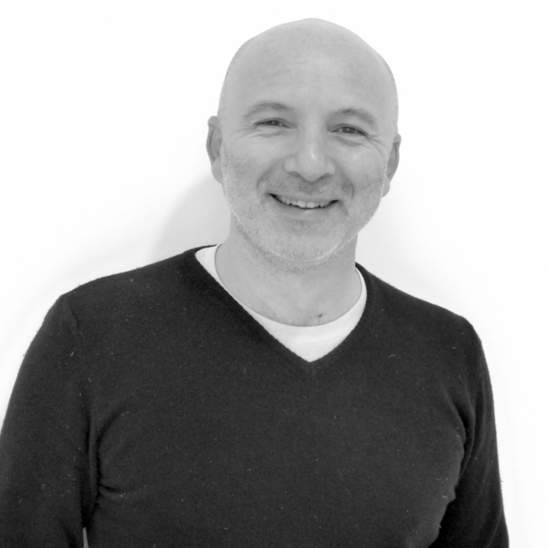
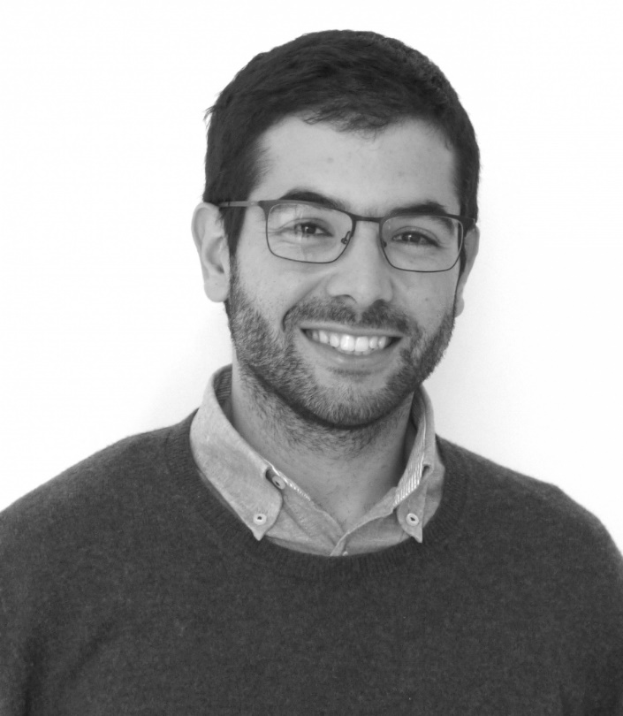
Thank you

