Slide 1
NEWSdm
Directional Dark Matter Search
T. Asada
INFN Post-Doctoral Fellowship at LNGS, Italy
On behalf of the NEWSdm Collaboration
21-Feb-2020 / Astroparticle Physics Science Fair / Ex-ISEF-Building-Library (GSSI)

Slide 2





NEWSdm COLLABORATION
75 physicists / 14 Institutes
NEWSdm
Nuclear Emulsions for WIMP Search with Directional Measurement
ITALY
University and INFN Bari
LNGS, Gran Sasso
University and INFN Napoli
INFN Roma
JAPAN
Chiba, Nagoya, Toho
RUSSIA
LPI RAS Moscow
JINR Dubna
SINP MSU Moscow
INR Moscow
Yandex School of Data Analysis
Website:
news-dm.lngs.infn.it
SOUTH KOREA
Gyeongsang University
Letter of intent:
https://arxiv.org/pdf/1604.04199.pdf
TURKEY
METU Ankara

Slide 3
What is the purpose of NEWSdm experiment?
WIMP
WIMP wind
WIMP
230km/sec
± 15 km/sec
WIMP
Target
nuclei
WIMP wind
< 540 km/sec
(escape speed)
30km/sec
Nuclear recoil
Annual Modulation
Diurnal Modulation
solar
~ 230km/sec
Earth revolution
~ 15 km/sec
Earth rotation
~ 0.4 km/sec
2–3 % variation
0.1–0.01 % variation

Slide 4
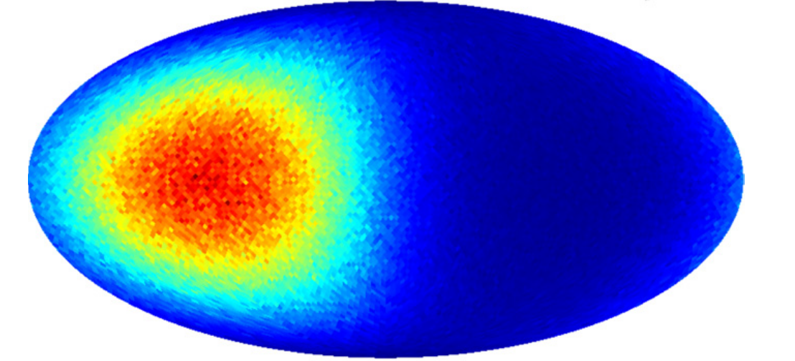


What is the purpose of NEWSdm experiment?
WIMP
WIMP wind
WIMP
230km/sec
± 15 km/sec
WIMP
Target
nuclei
WIMP wind
< 540 km/sec
(escape speed)
30km/sec
Nuclear recoil
Directionality can be very clear evidence of dark matter existence
(J. Billard et al.(2010))

Slide 5
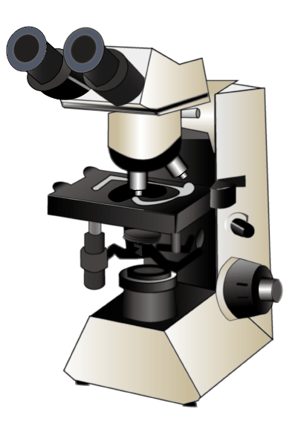
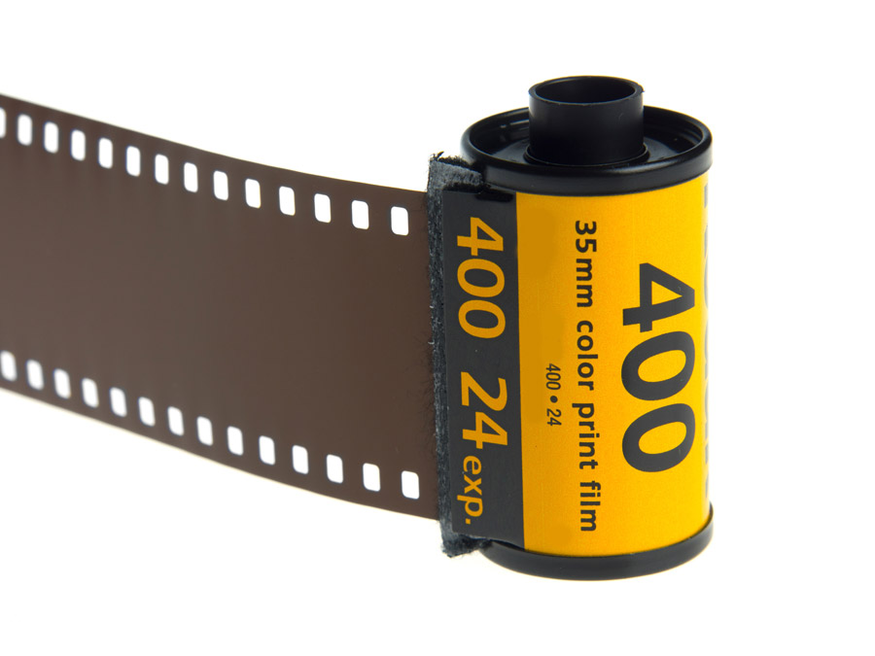
What is the concept of NEWSdm experiment?
Photographic film (Nuclear Emulsion)
Readout by
optical microscope
WIMP
Record directionality as “track”
Development
AgBr crystal
recoil
Silver grain

Slide 6
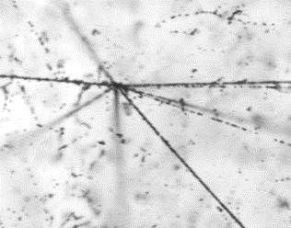
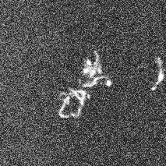
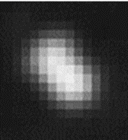
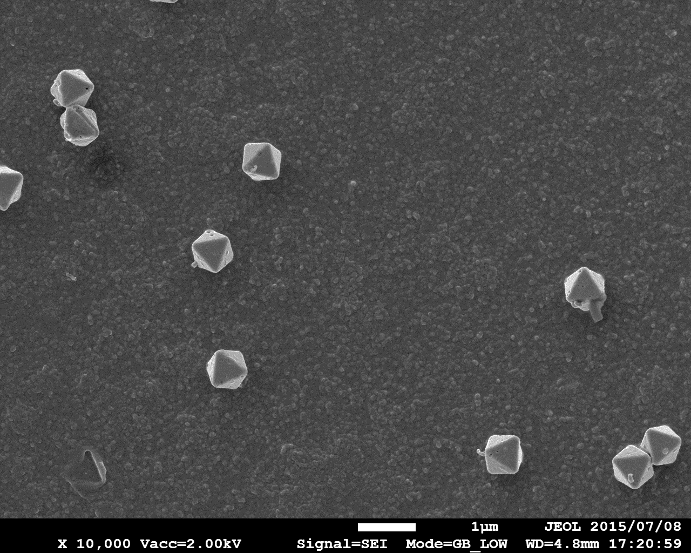
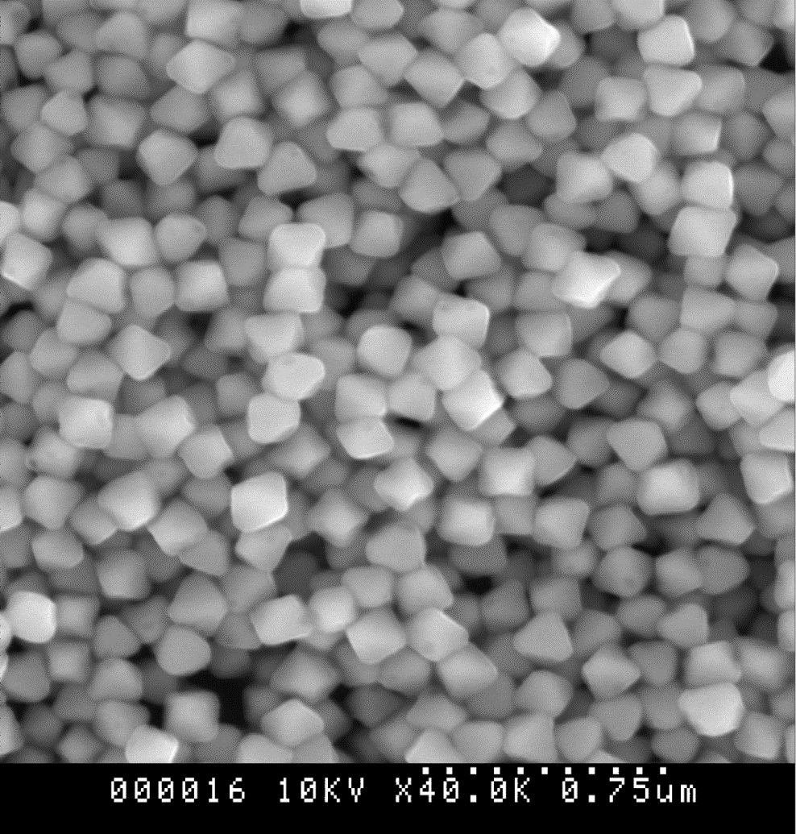
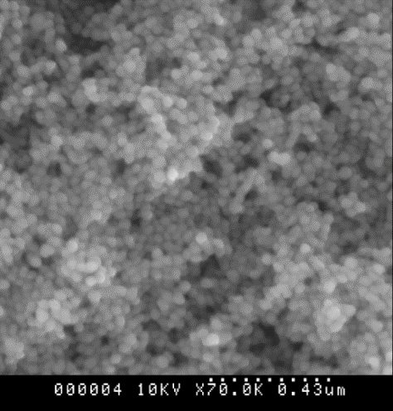
NEWSdm techniques / super fine-grained nuclear emulsion
Past emulsions: targeting >10 um track
Our target : < 0.5 um
30 μm
1 μm
Around the limit of optical resolution
Crystal of Nuclear emulsion (SEM image)
Target signal is 0.1-0.5 μm
New nuclear emulsion
(Super fine-grain) is needed
We product and developed
by ourselves!
0.8 um
0.2 um
0.02-0.07 um
500nm
500nm
500nm

Slide 7
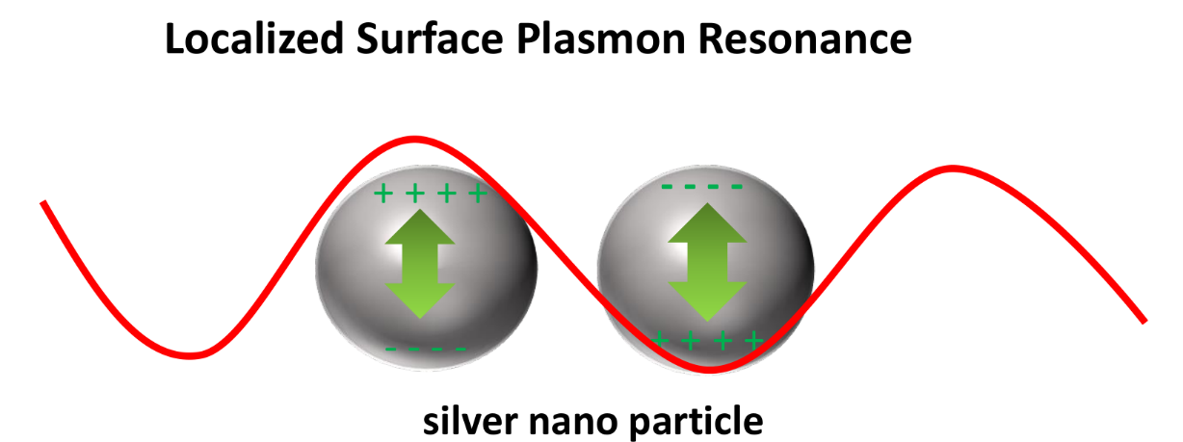
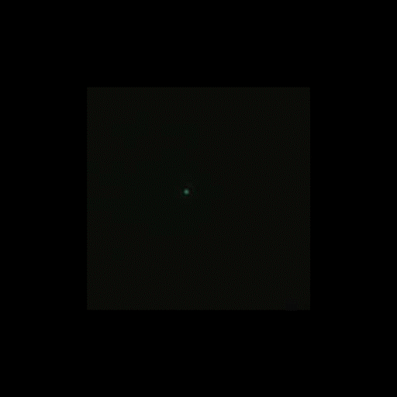
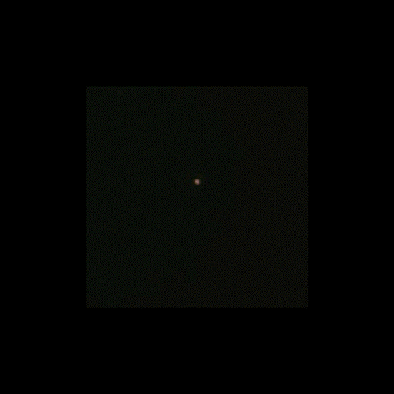
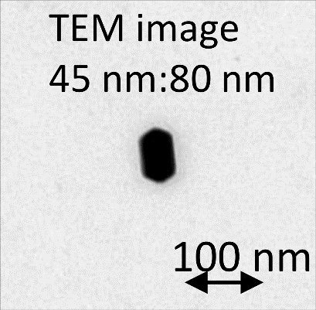
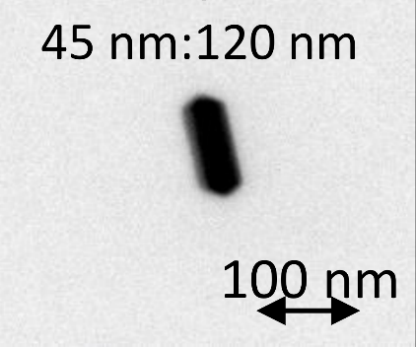
To overcome the optical resolution
LSPR (Localized Surface Plasmon resonance) effect
Colored optical image of silver rod
*polarization rotating
45x80
45x120
dipole in
metal particle
100 nm
100 nm
resonance
~45 nm : blue
~80 nm : green
~45 nm : blue
~120 nm :orang–red
the shape and size of metal particle affect to resonance
particle direction → resonance polarization
particle length → resonance wavelength (color)
1 μm

Slide 8
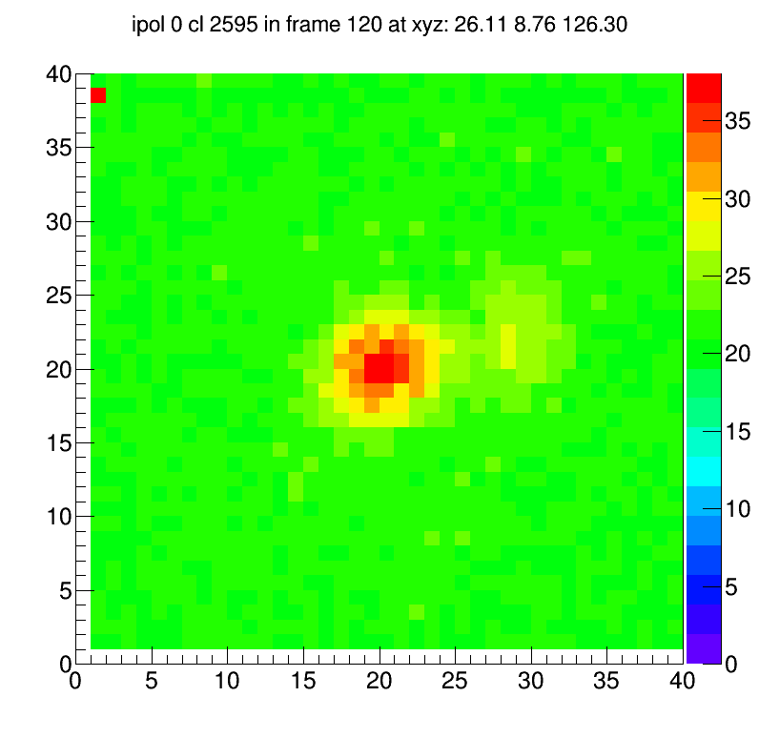
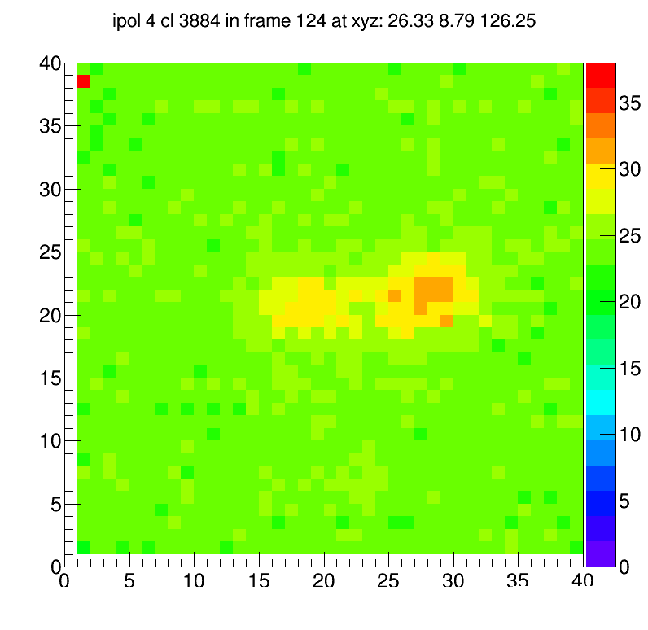
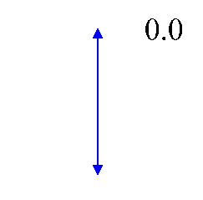
NEWSdm techniques / multi-method analysis
SEM image
High speed shape analysis
52.5 g/year now, and will be 1kg/year
1 μm
100,000 years for 1kg…
100 keV Carbon track with polarization filter
0 deg
90 deg
LSPR+pol filter
analysis
Recognition limit:
190 nm (shape)
→ 120 nm
+ color analysis, phase contrast analysis, machine learning analysis etc.
→ Combination analysis to achieve both speed and high precision analysis

Slide 9
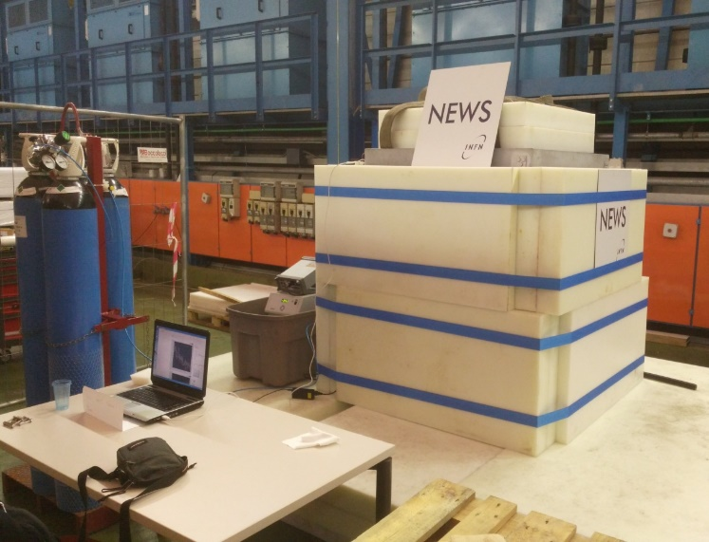
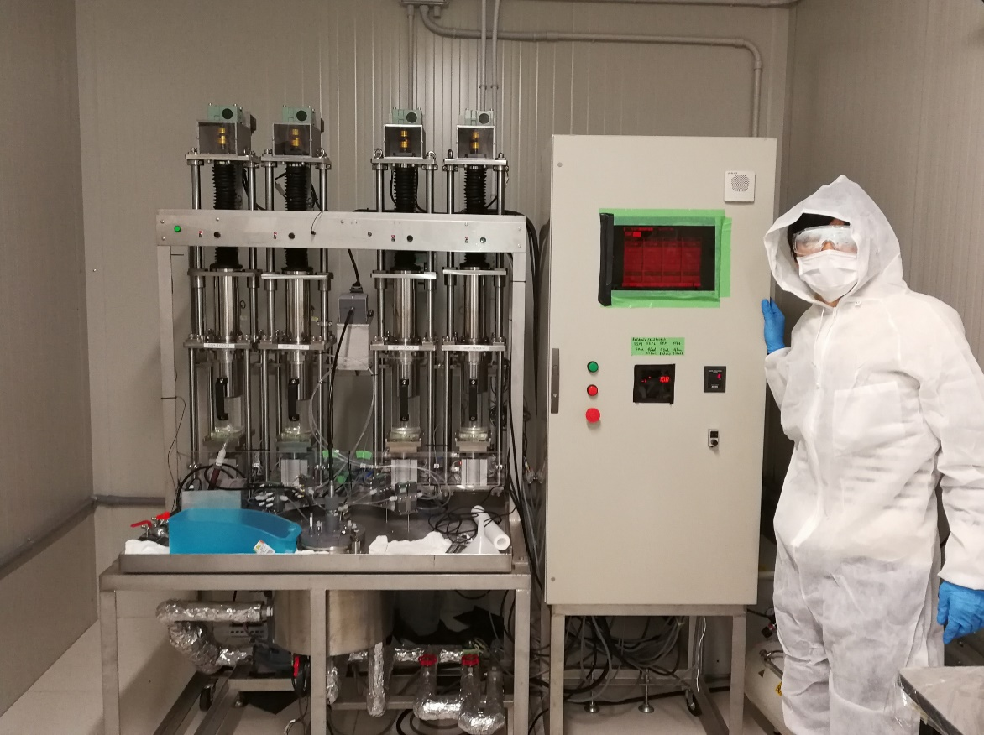
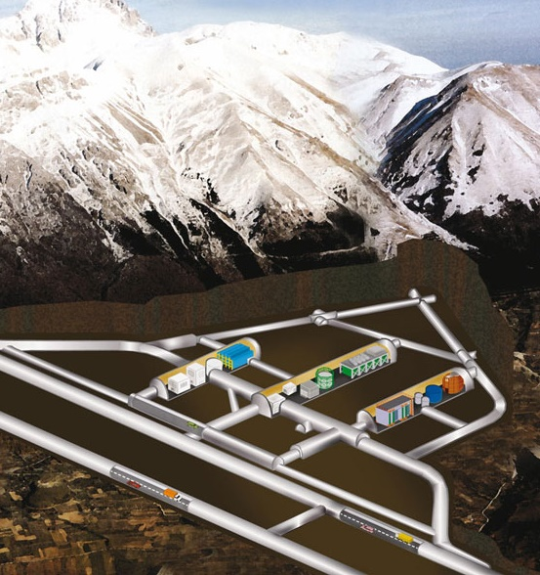
NEWSdm facility / direct emulsion production
Dark matter experiment requires extremely low level of background
We are trying to produce and install nuclear emulsion directly in LNGS underground lab!
Production machine of nuclear emulsion is setting up at a clean room in LNGS underground lab.
Gran Sasso underground laboratory

Slide 10
Summary
NEWSdm is a direct dark matter search with directionality using nuclear emulsion
Nuclear emulsion (a kind of photographic film) records recoil of dark matter, which is readout by microscope
We are using unique techniques, e.g.
  Direct emulsion production in the underground / cleanroom
  New Super fine-grained emulsion
  Multi-method analysis is applied to achieve both speed and high precision

Slide 12
Back up

Slide 13
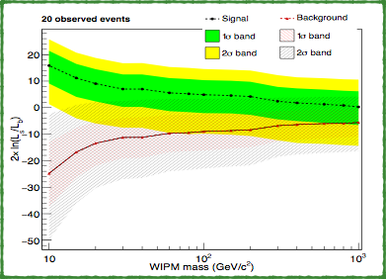
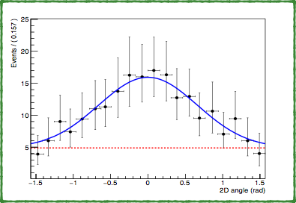
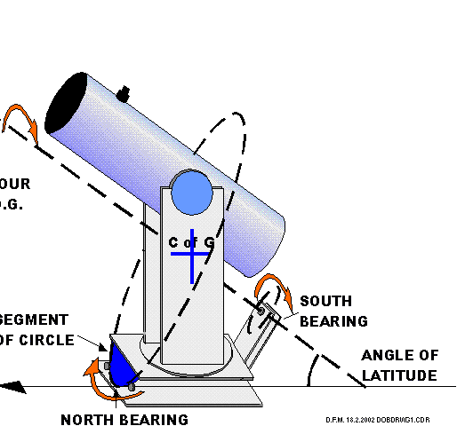
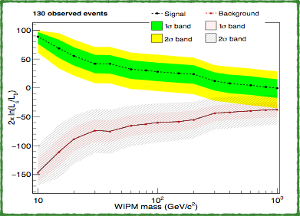

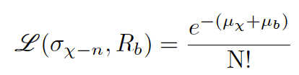
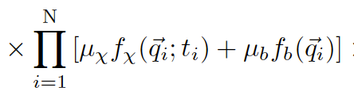
Potential of Directional Sensitive Search
N. Agfanova et al. (NEWSdm collaboration)
Eur. Phys. J. C (2018) 78: 578
Signal
Signal
Background
cygnus
Likelihood ratio
Background
Nobs=20
expected number of background events
WIMP
10
100
1000
expected number of WIMP events
WIMP mass [GeV/c2]
signal pdf
background pdf
Signal
total number of observed events
set of observables
Likelihood ratio
Direction information : Several 10 events
Background
Nobs=130
Gain of 100 times
Annual modulation : Several 1000 events
WIMP mass [GeV/c2]
Notes:
Antonia 論文参照
Range threshold check

Slide 14
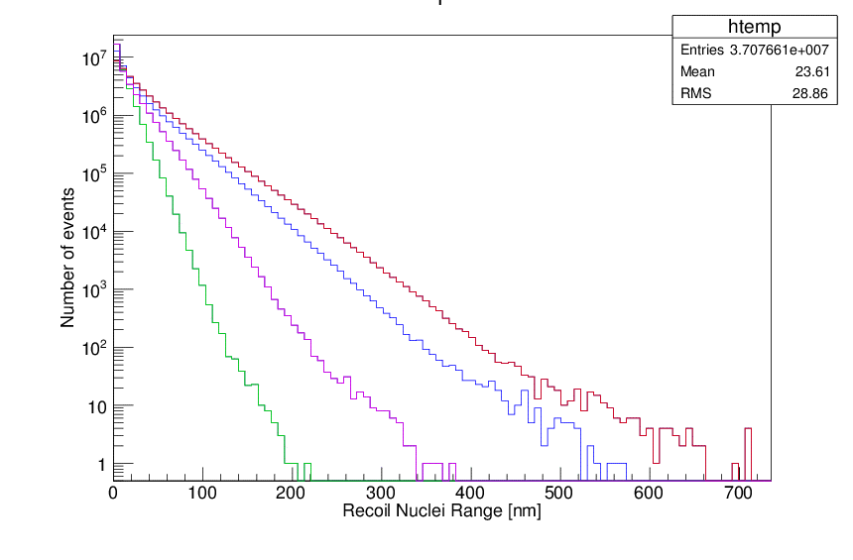
Dark matter sensitivity
Demonstrated new tech.
10 kg∙year simulated sensitivity [90 % C.L.] + zero BG
Current
Case for current readout ability
Case for extrapolation lower energy
Case for intrinsic detection ability
Intrinsic
Our device case
Density 3.2 g/cm3
Main Target : CNO + AgBr
Current readout performance
100 GeV/c²
Lower-energy readout
50 GeV/c²
Device potential
20 GeV/c²
10 GeV/c²
NIT detector / CNO sensitive / no Bkg no directionality
Simulation limit is “energy > 5 keV for all atoms (SRIM limit)”
& “Sensitivity > 0.1 % (Simulation statistics limit;10 event)”
Device potential : 10 keV of C recoil (> ~ 10% eff. and 45 °angl. Res.

Slide 15
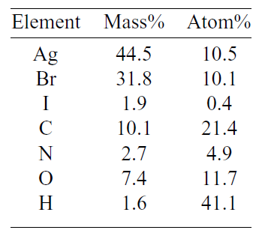
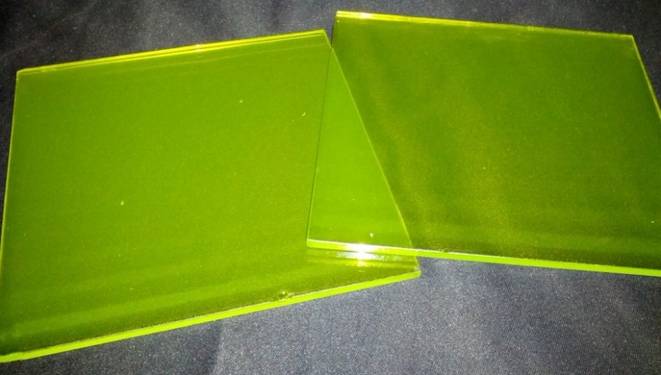

Directional search with nuclear emulsion
Good scalability
  Solid state & good uniformity
  Large scale production
    Self production ( ~ 10 kg / month)
  high scanning power
    46.5 g/year at current R&D, and ~kg scale in 2 years
Good Angular resolution
  ~ 20 deg (1 sigma) including scattering for Carbon
  DM direction sensitivity with equatorial telescope
Light & heavy component
Cygnus
WIMP
Fine crystal nuclear emulsion
NIT
Direction recognizing

Slide 16
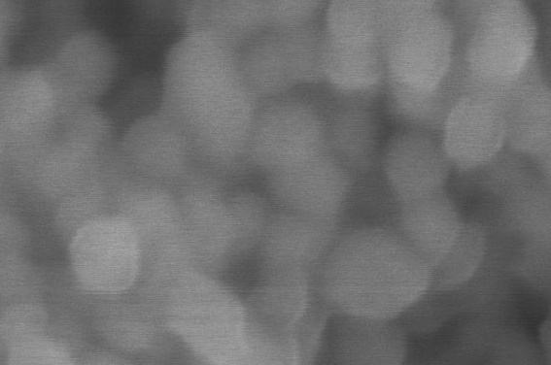
Nuclear emulsion
excitation by ion
electron
Interstitial Ag+
Ag+
2.6 eV
energy
development core
hole
100 nm
WIMP
Silver filament
Ag core
electron⁻
dissolved
Development
AgBr crystal
recoil

Slide 17
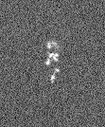

Characteristics of Nuclear Emulsion
Ag core
SEM
optical
electron⁻
1 um
1 um
Electron diffusion is limited to crystal scale → Good angular resolution
Sensitivity of 1 crystal for ions (≥ C) is almost 100% against the recombination.
Main parameter is flight length. Energy deposit is our future plan (e.g. color analysis reported in 1st and 2nd day)
Readout of nuclear emulsion is challenging
Dust reduction is important (not using clean room yet)

Slide 18
Production and study of nuclear emulsion for dark matter search
-2010 Company (Fuji Film in Japan)
  Proto type of fine-grained nuclear emulsion
2010- Nagoya University (Japan)
  First direct study of nuclear emulsion by physicist
  Fine-grained nuclear emulsion (NIT/UNIT)
  R&D and fine tuning of production recipe
  Study of material purification
2019- LNGS (Italy)
  Direct production at the underground experimental sites
  Production in a Clean room
Asada et al. PTEP 063H01 (2017)

Slide 19
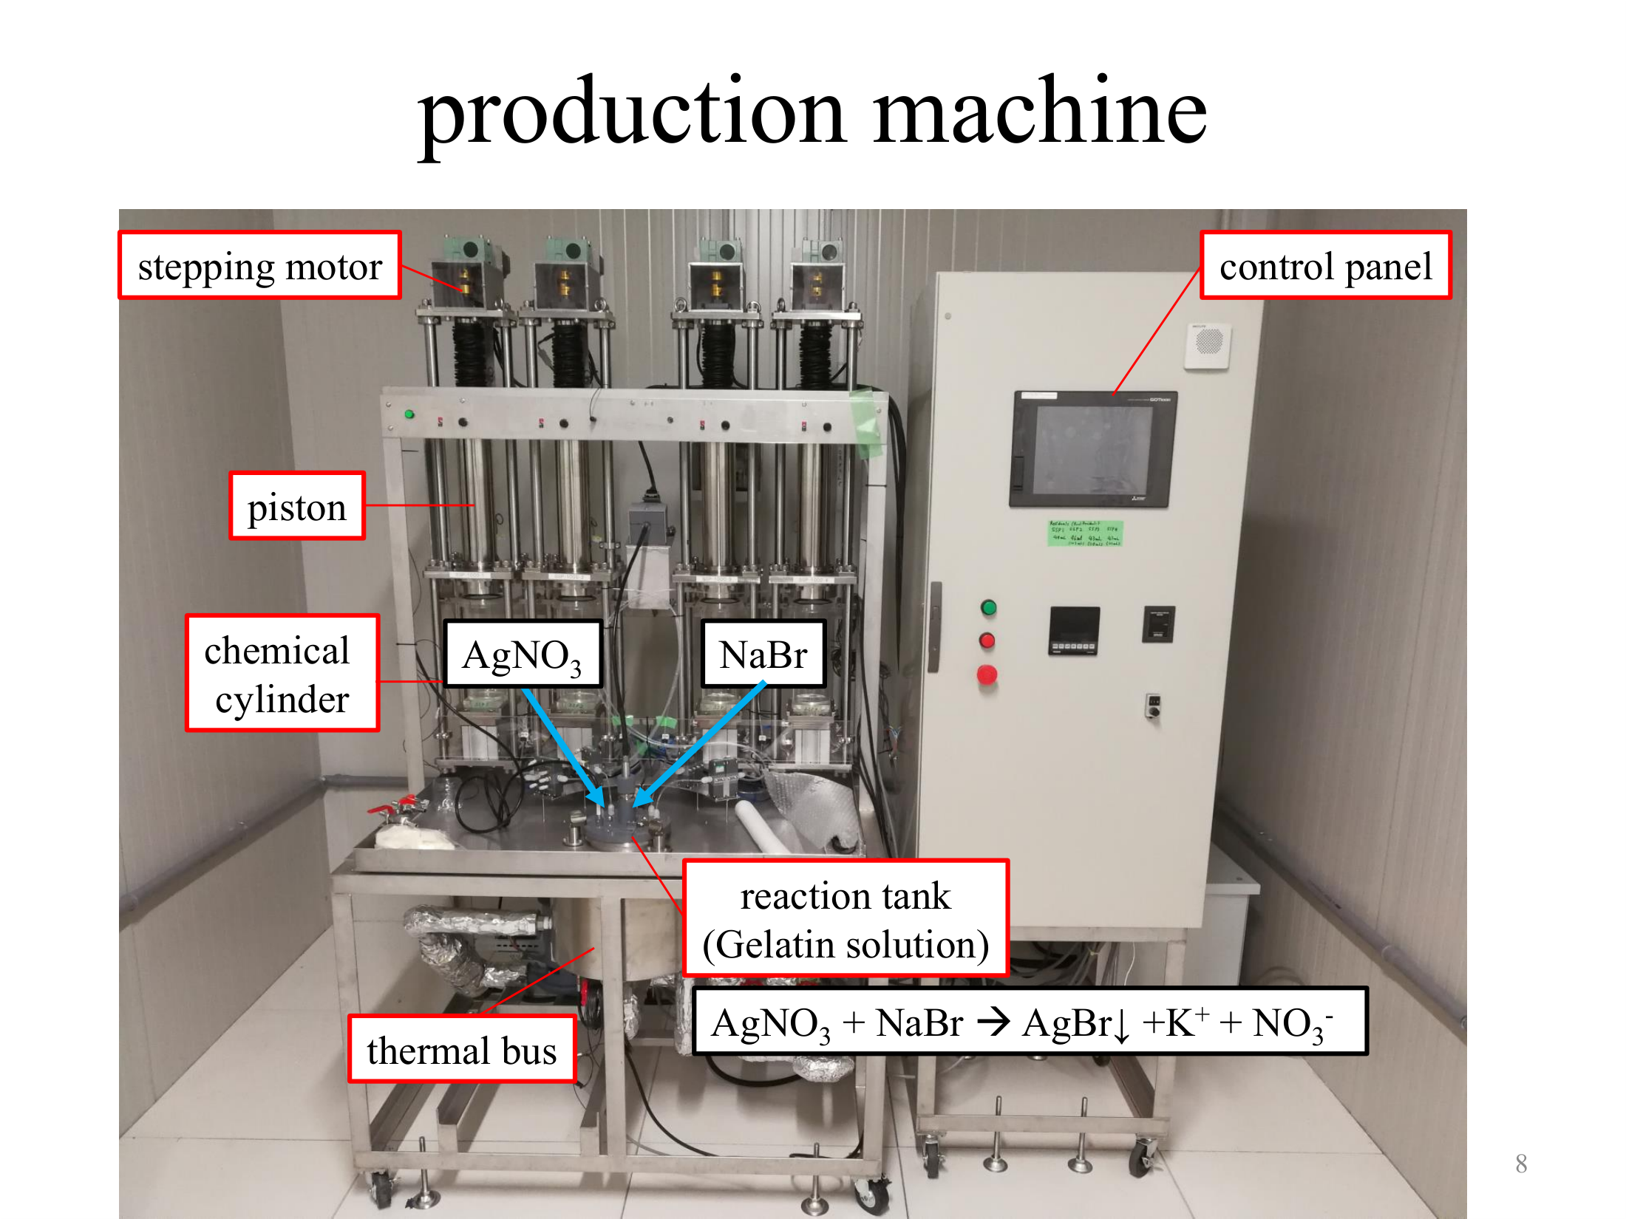

Slide 20
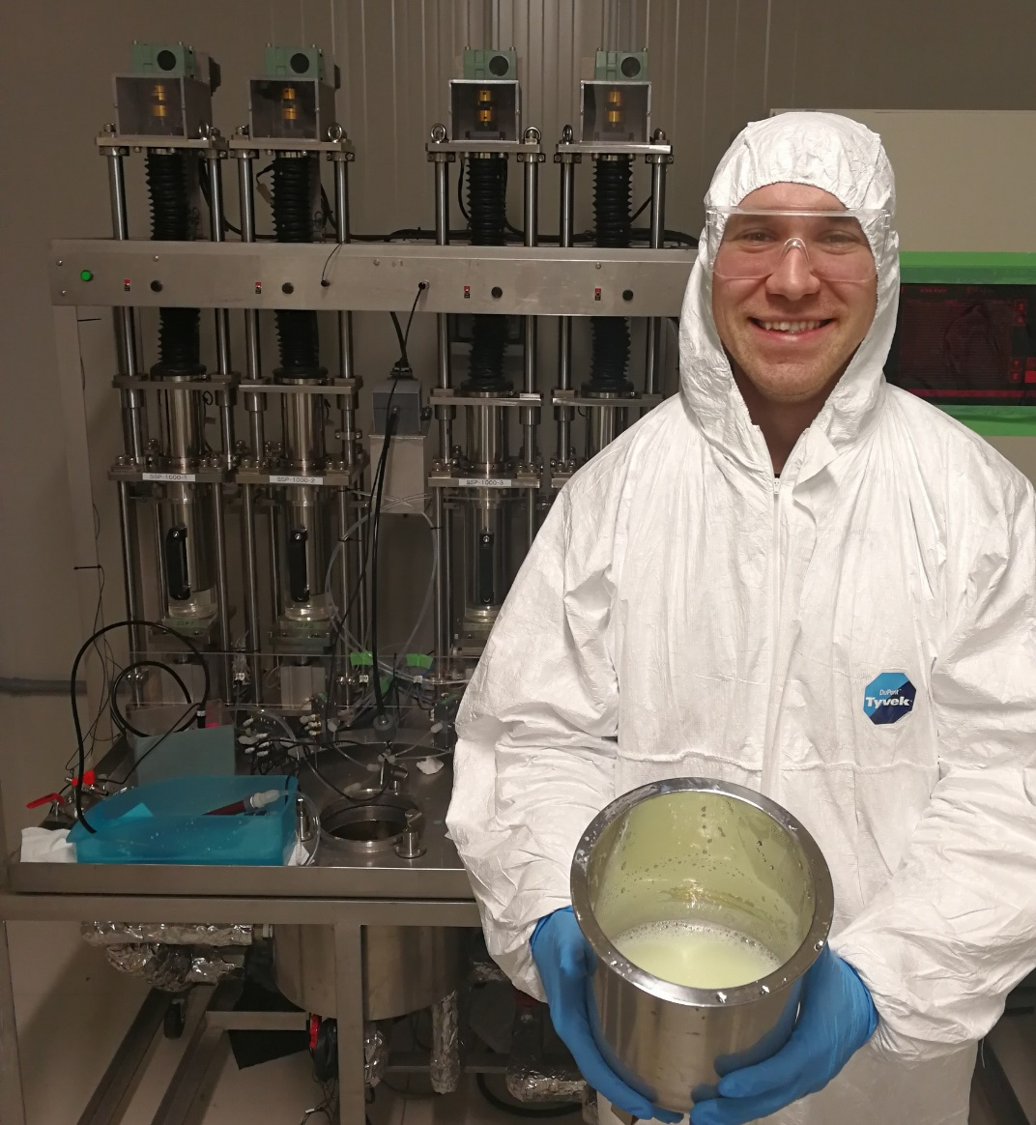
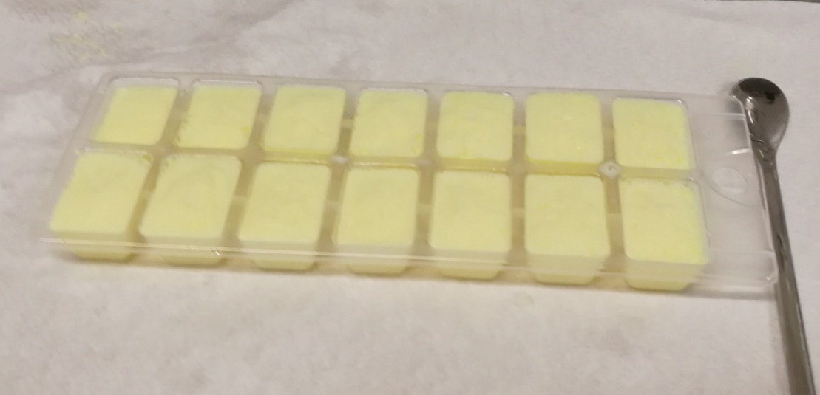
How to produce nuclear emulsion film
AgNO₃
NaBr
NO₃⁻
REACTION TANK
Na⁺
AgBr
Gelatin protects the crystal and keep small size
(protecting colloidal action)
gelatin
Liquid gel is produced
crystal formation
Frost the liquid by freezer
AgNO₃ + NaBr → AgBr ↓ + Na⁺ + NO₃⁻

Slide 21
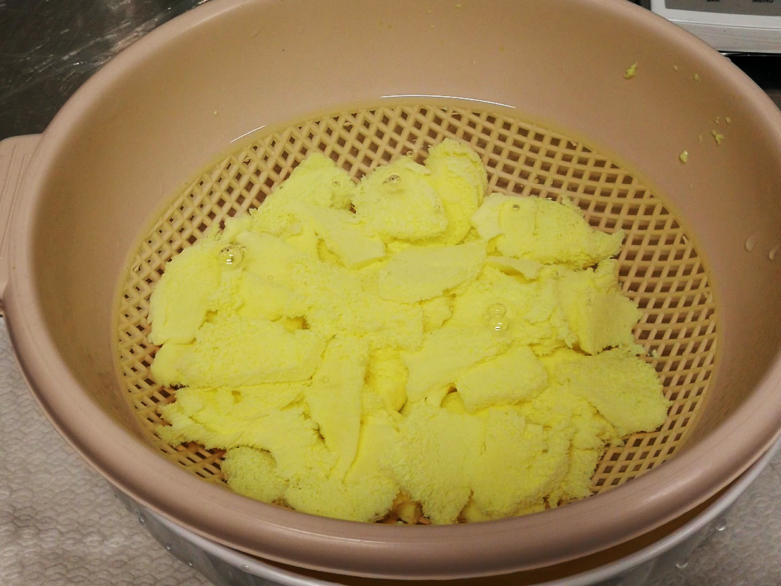
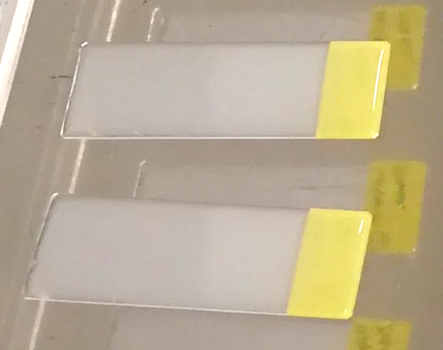
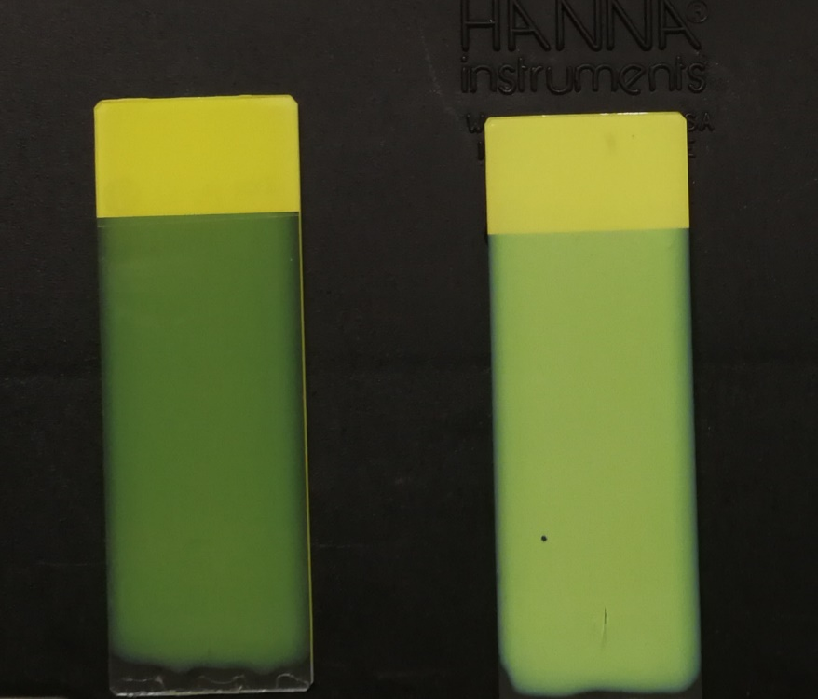
How to produce nuclear emulsion
Melting
& pouring
*dummy liquid
NO₃⁻
Na⁺
Volume ~1/20 by drying
Washing (deionization)
40 nm
70 nm
AgBr ↓ + Na⁺ + NO₃⁻
All production process is ready in the underground

Slide 22
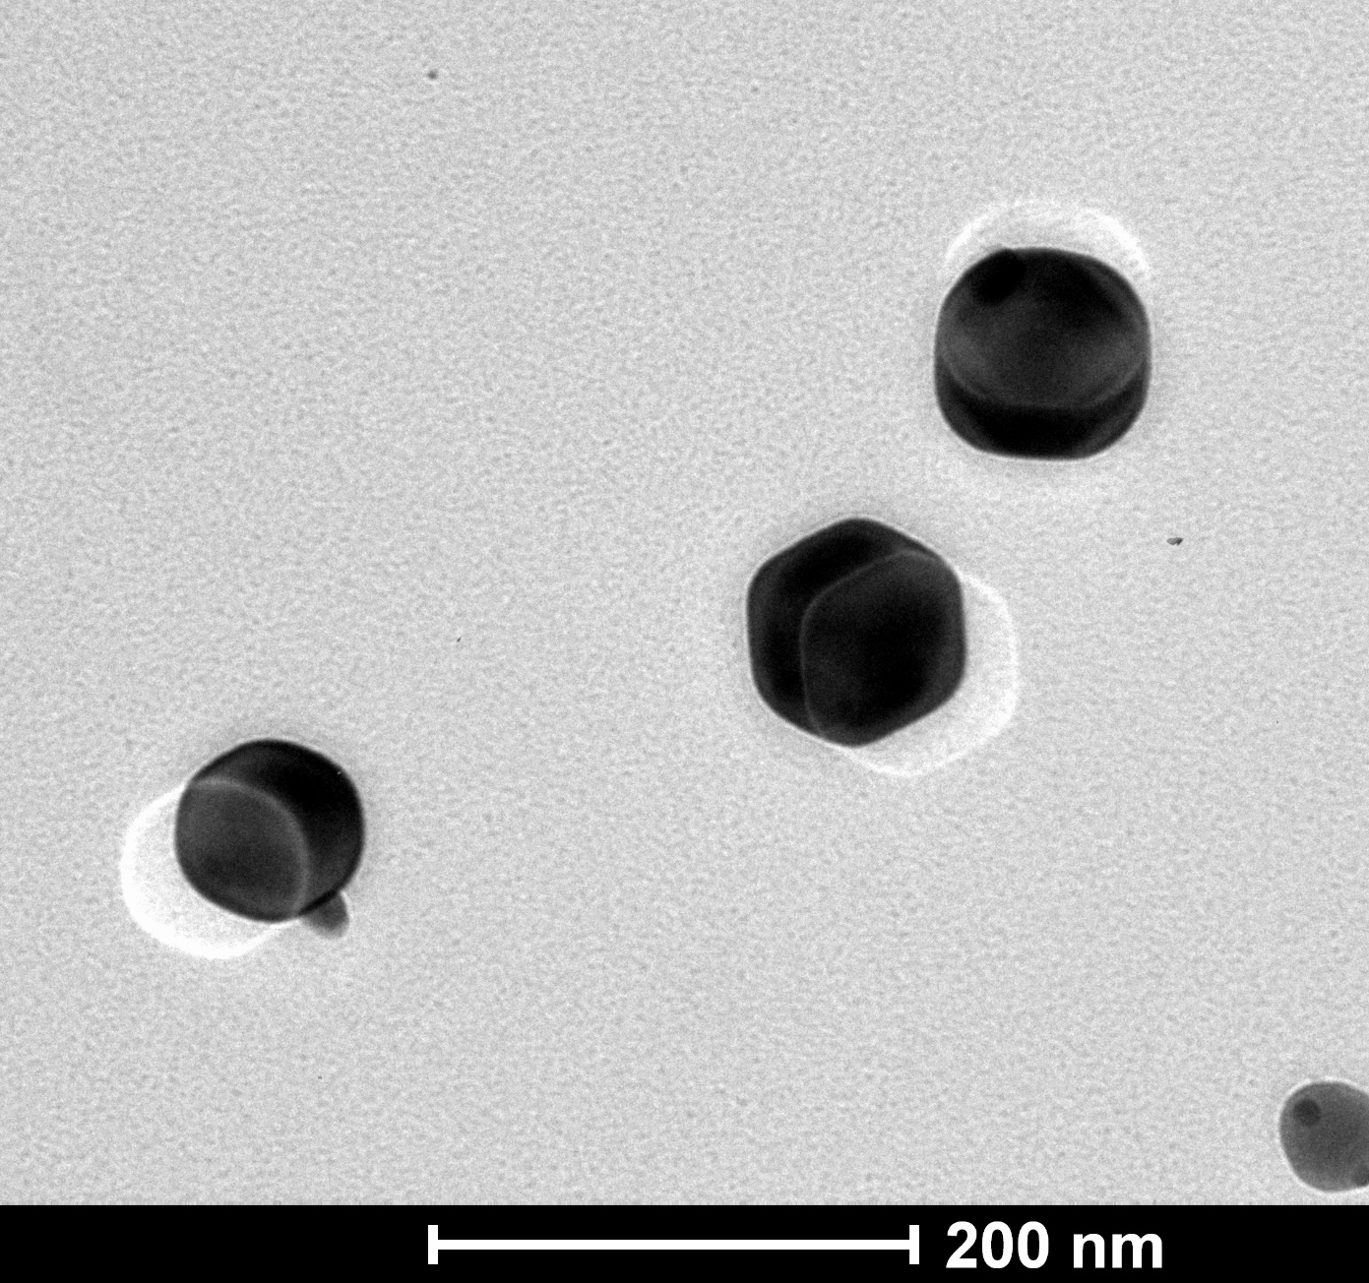
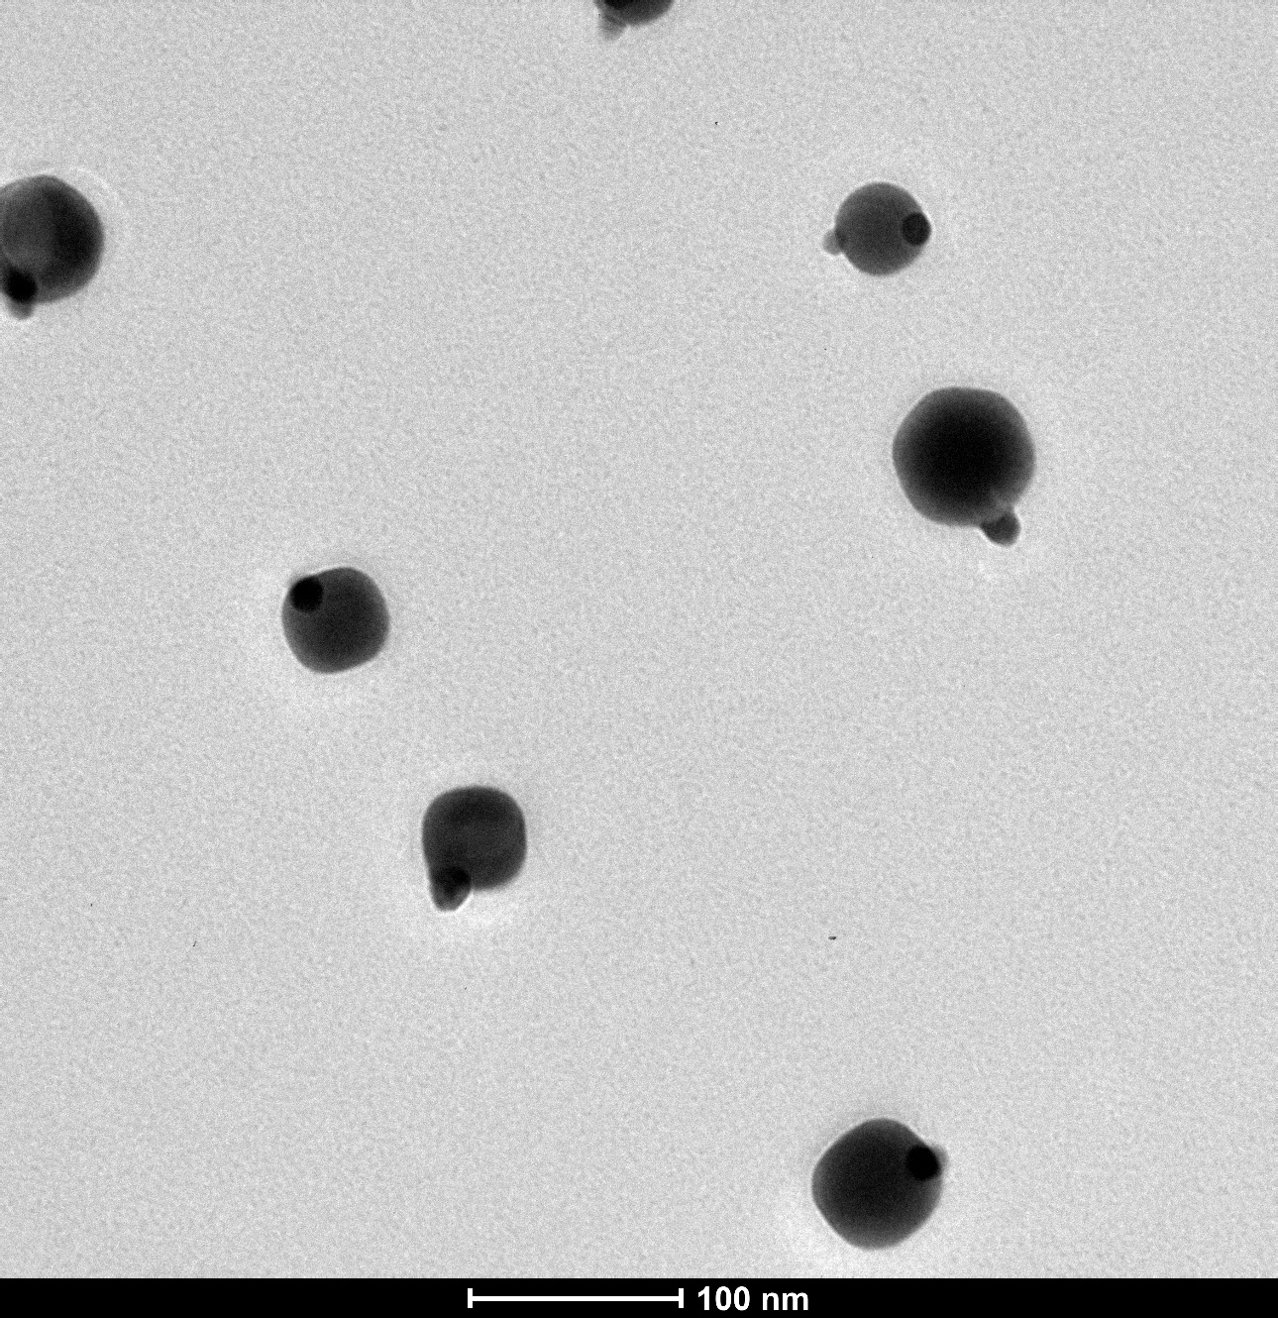
TEM images
EGS003 (80 nm aiming)
EGS004 (45 nm aiming)

Slide 23
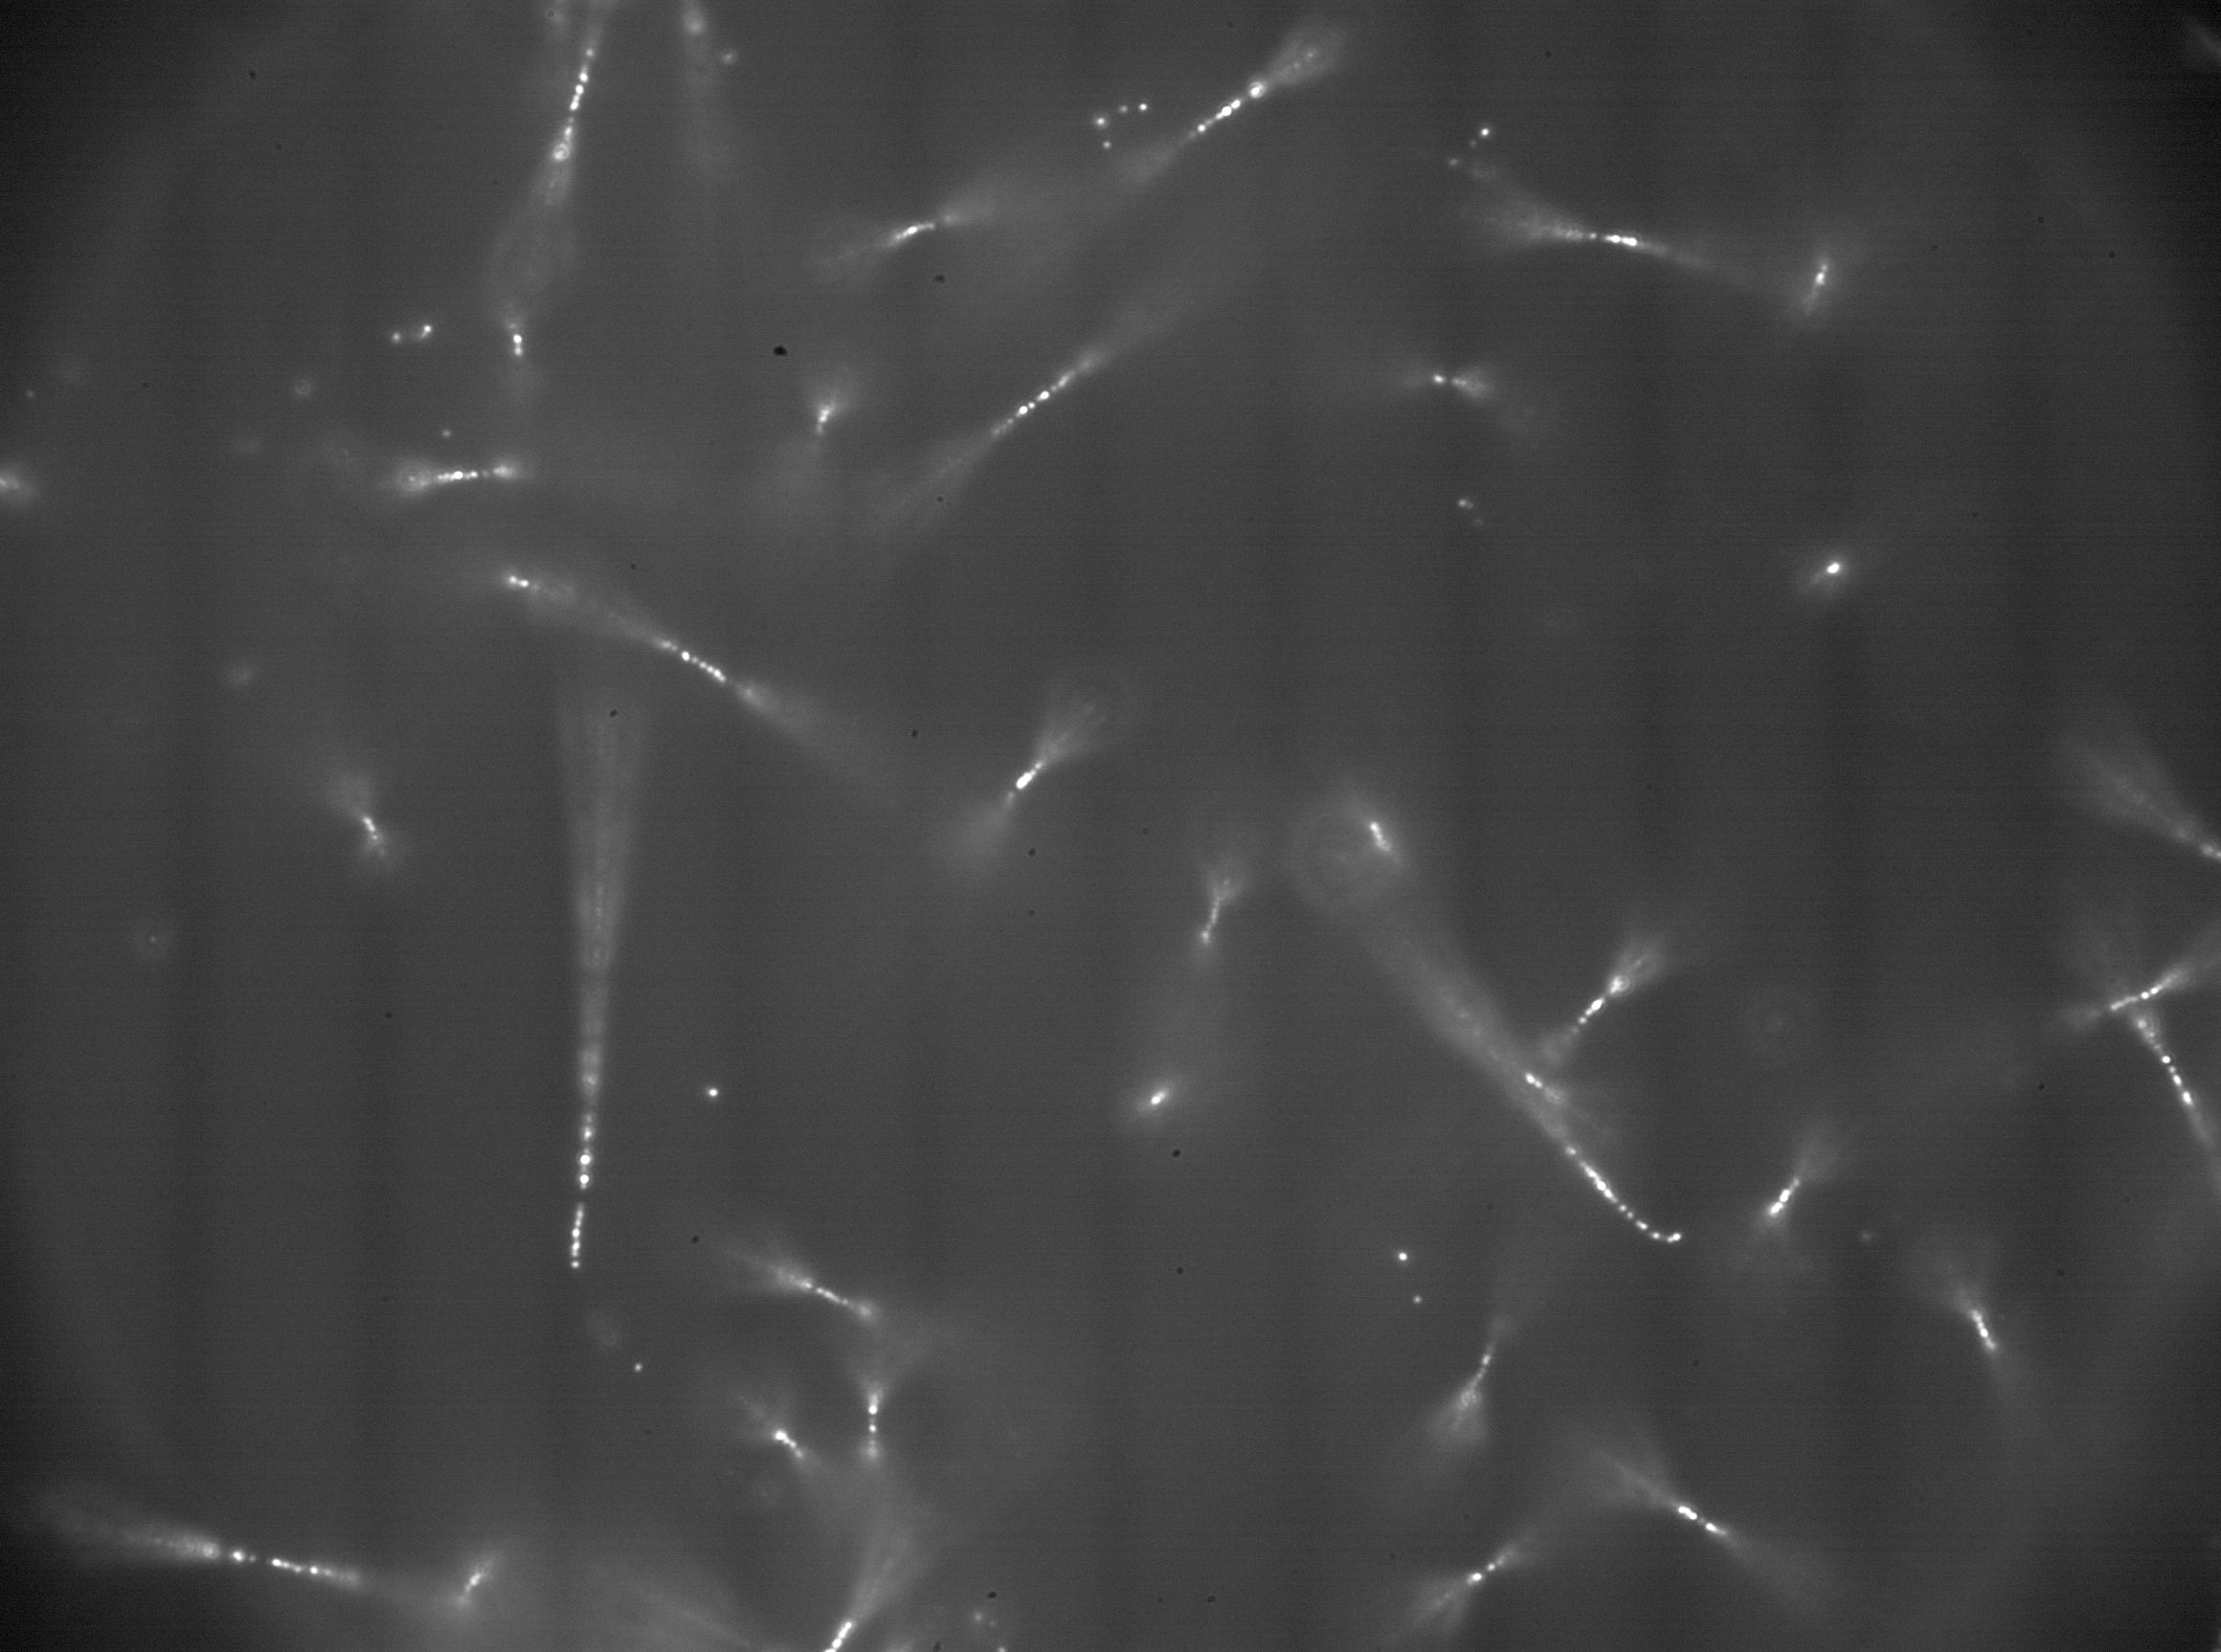
First observation of tracks with new nuclear emulsion films produced at LNGS
²⁴¹Am alpha

Slide 24
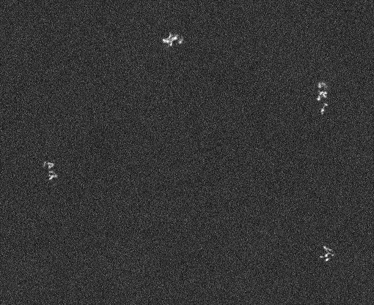
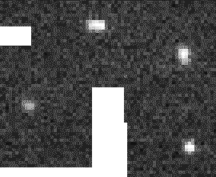
SEM / Optical Images with Position Matching
exposure
1 um
1 um
We found that elliptical shape is not always same with filament row
It maybe due to irregular optical response and non-negligible filament size

Slide 25
SEM / Optical Images with Position Matching
exposure
track
confusing BG
clear signal
track
low contrast signal
one grain
(but filaments due to
dispersed latent image )
1 um
1 um
clear BG
BG: induced event but not track (insensitive to direction)
We found that elliptical shape is not always same with filament row
It maybe due to irregular optical response and non-negligible filament size

Slide 26
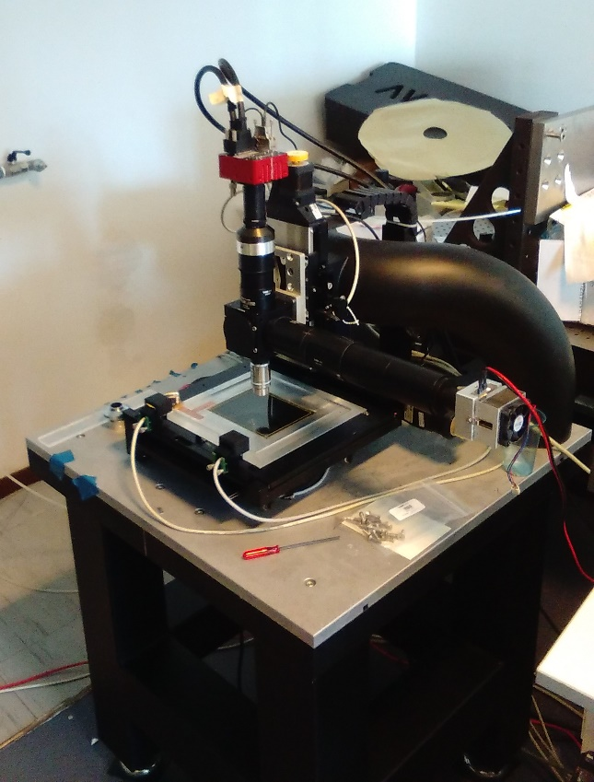
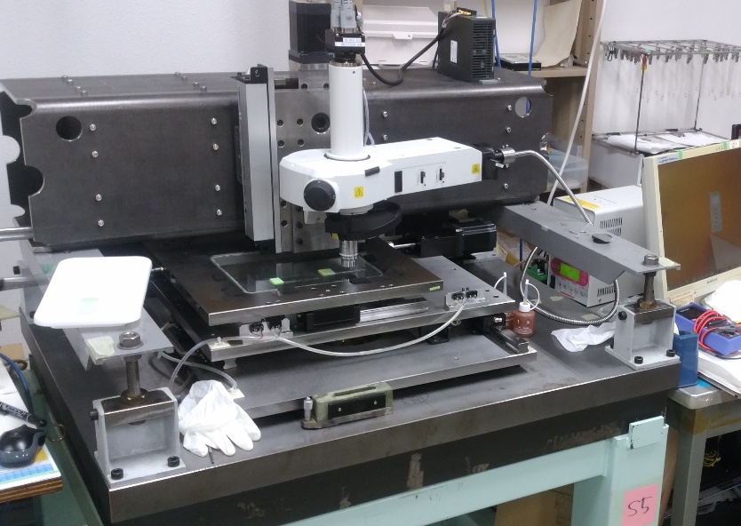


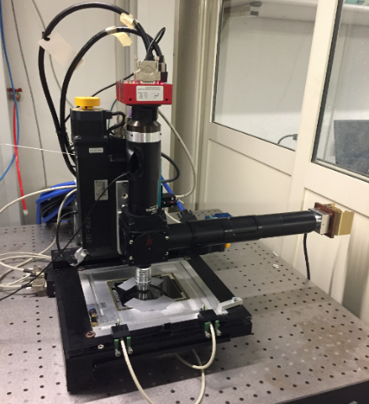
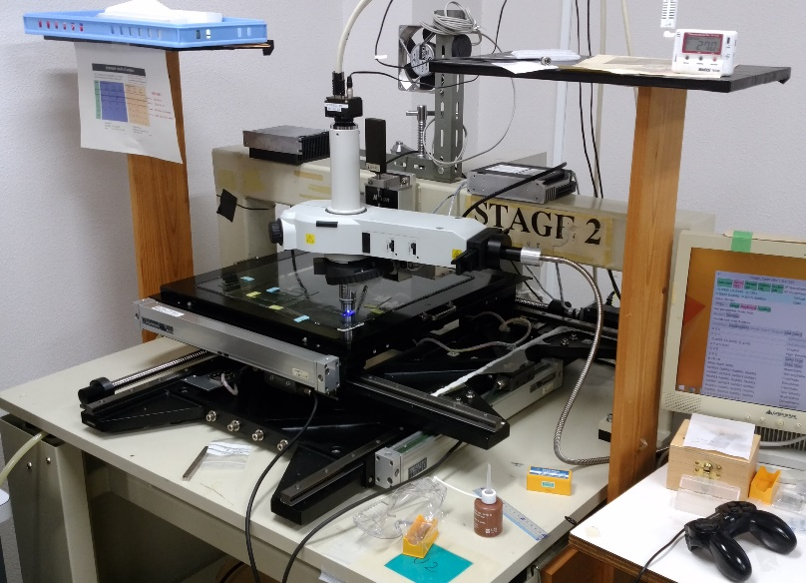
Readout technologies
One more machine will be constructed
LNGS
Napoli
Toho U.
Nagoya
x 2

Slide 27
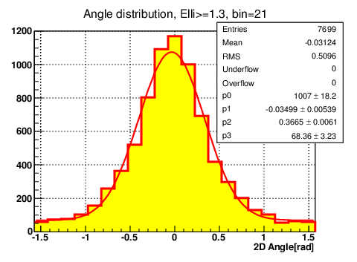
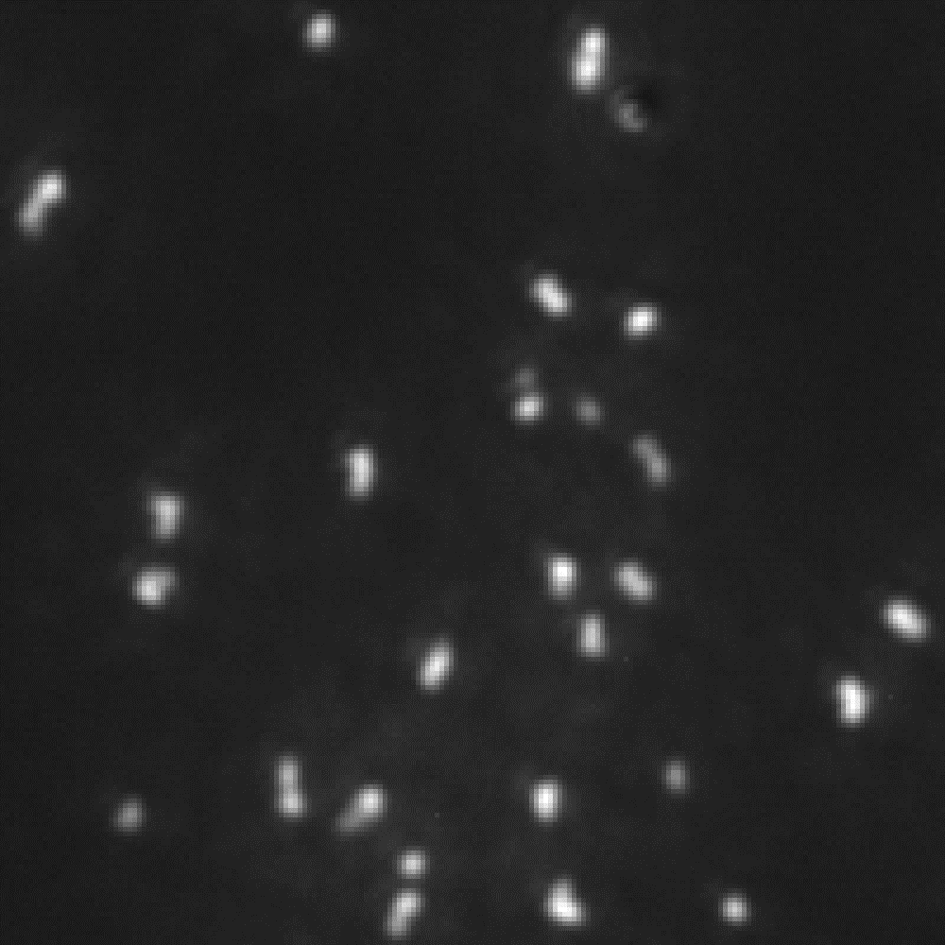
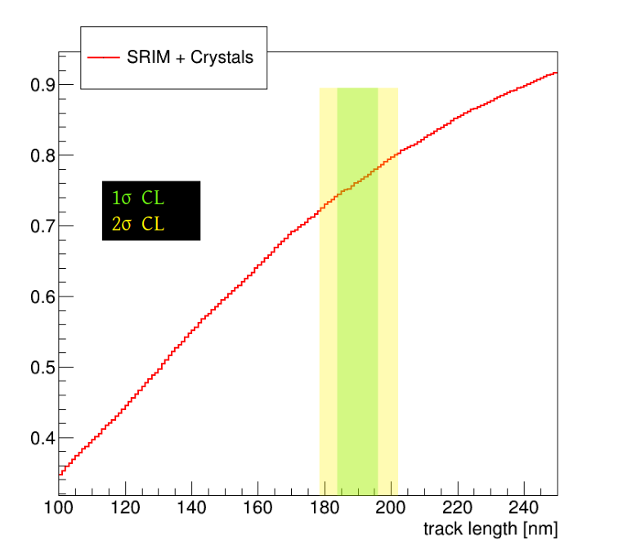
Sub-micron length track readout capability
Cleary observed angular distribution
⇒ angular resolution ~ 30 deg.
C 60 keV
Direction sensitive track length threshold in this algorithm
⇒ > ~ 190 nm
Energy threshold
> ~ 60 keV (eff. ~ 10 % ⇒ to be improve by upgrade optical condition)
11µm
K. Kimura and T. Naka, Nucl. Inst. Meth. A 680 (2012) 12-17
T. Katsuragawa et al, JINST 12 T04002 (2017)
Calibration by C 60 keV

Slide 28
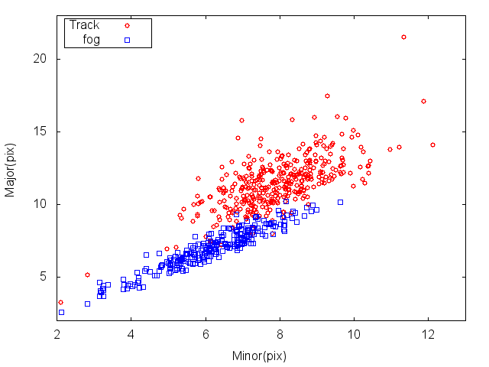

Demonstration of direction sensitive nuclear recoil detection due to 14.8 MeV neutrons
signal region
Red : confirmed track by X-ray microscope after optical microscope readout
Direction of neutron
Mostly detected target was Br recoil [ < 200 keV ]
Now on studying CNO recoil demonstration due to 565 keV (Li-p nuclear fission reaction)

Slide 29


Pilot-run (BG run) system
Cooling system to keep the stability of device and improvement of S/N by low-temperature
 | Event rate [/kg/d] w/o shield | Event rate [/kg/d] w/ shield | method
Environment γ-rays | 1 x 10⁷ | 5 x 10³ | Geant4
Environment neutron | ~1-2 /kg/day | < 0.1 /kg/day | Geant4
Cosmogenic neutron | < 1 x 10⁻³ /kg/day | 2 x 10⁻³ /kg/day | Geant4
Preliminary

Slide 30



Toward physics run with equatorial telescope
New shield project is going on
1 m PE shield
Cooling system
Built in Equatorial telescope
3 m x 3 m

Slide 31

Toward physics run with equatorial telescope
New shield project is going on
1 m PE shield
Cooling system
Built in Equatorial telescope
1 m polyethylene is enough
for environmental neutron

Slide 32


installation
Installation completed at 17Jun2019 16:00

