Slide 1
A Case for Microquasars as Galactic PeVatrons
Passage of the Year 2026 - 14/10/2026
Speaker/Candidate:
Loo Chun Khai
Supervisor:
Prof. Pasquale Blasi

Slide 2
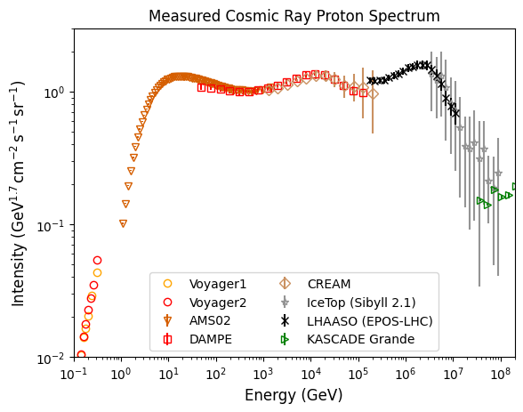
Cosmic Ray Protons ‘Knee’
LHAASO shows a “knee” in pure proton spectrum
Search for galactic PeVatron is still on
Hardening ~ 300 TeV could suggest a second class of source

Slide 3
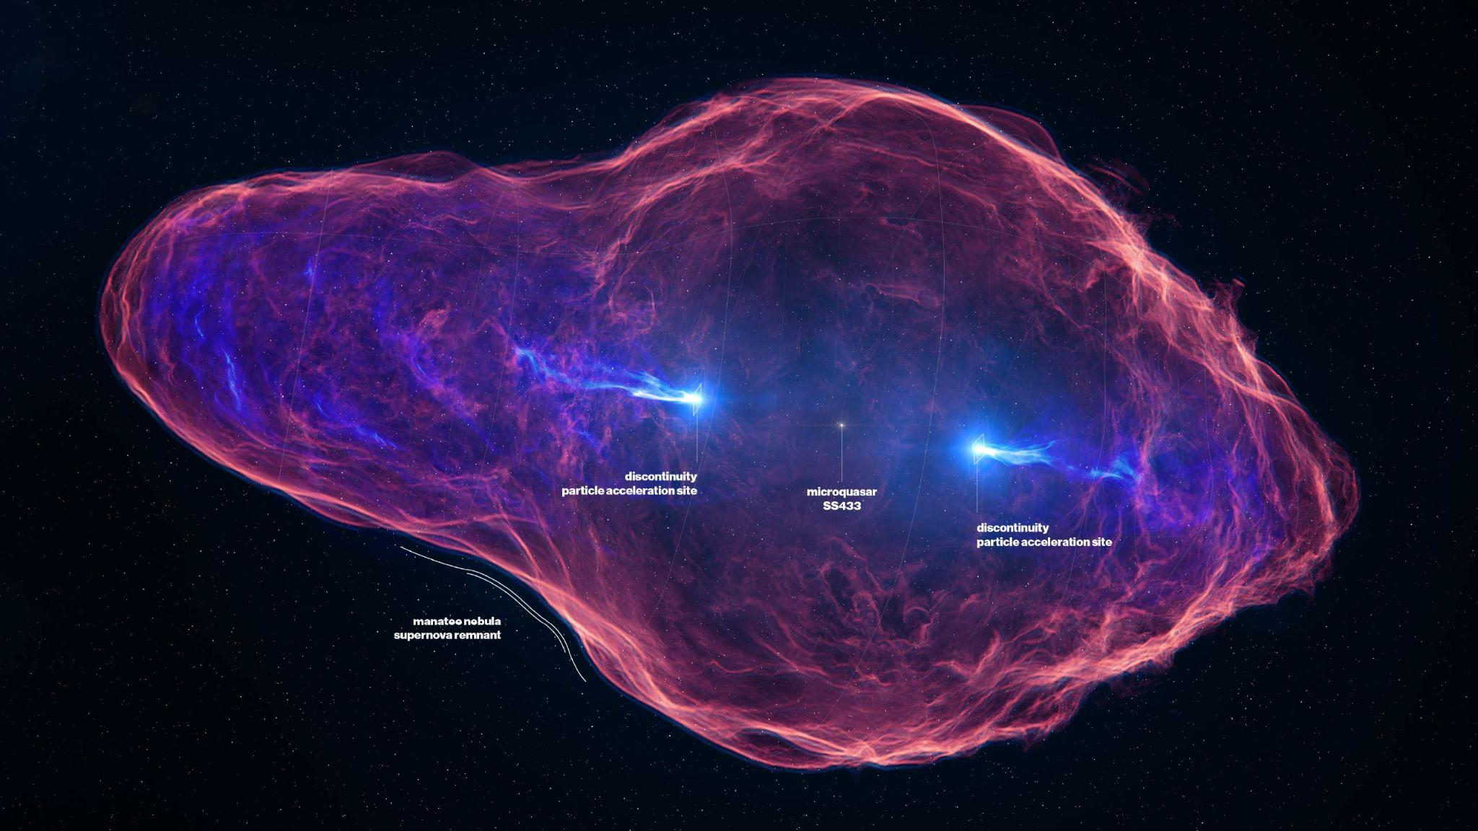
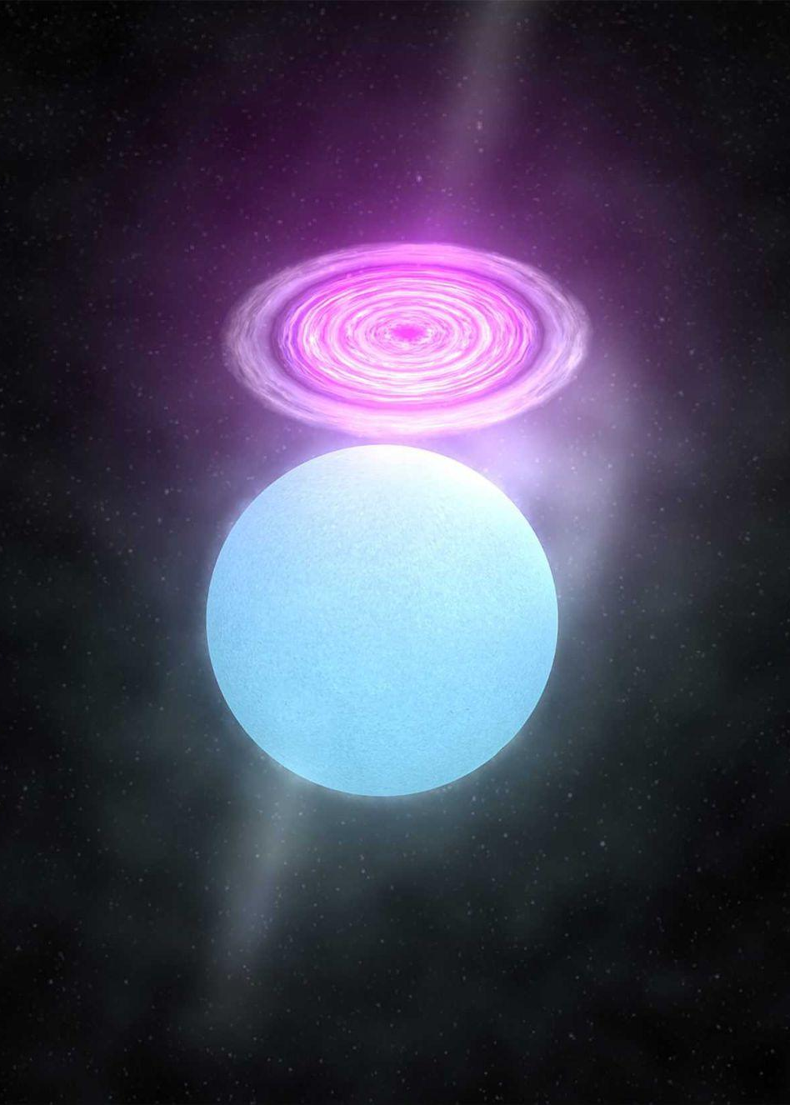
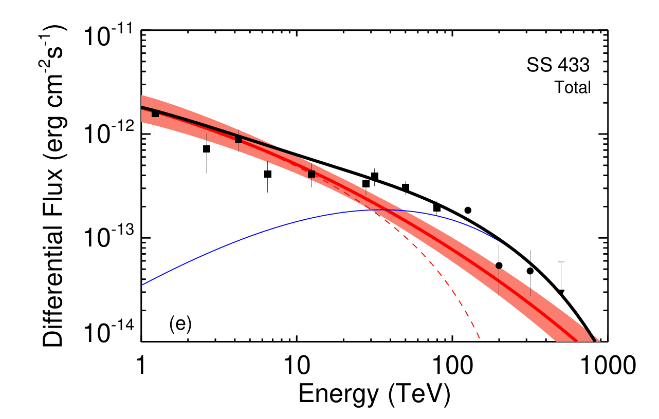
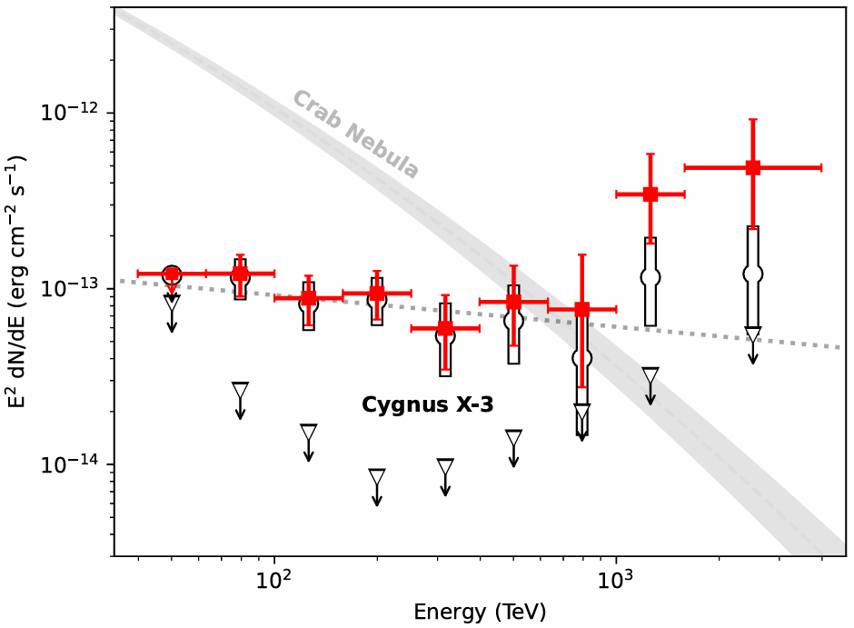
Microquasars (μQS)
Science Communication Lab
Binary systems with a compact object accreting material from its companion star
Luminosities > 10³⁹ erg/s in X-rays, very powerful sources
Hillas criterion E_{max} ≈ 57PeV √(L/1×10³⁹ erg/s)
100 TeV Ɣ-rays of SS433, Cygnus X-3, V4641 Sgr. suggest PeV protons in μQS
Likely active period 10⁵ years, formation rate 1 in 10⁴ years
Ultrahigh-Energy Gamma-ray
Cygnus X-3: A variable petaelectronvolt gamma-ray source
ID 10531: Index of Frames Files

Slide 4
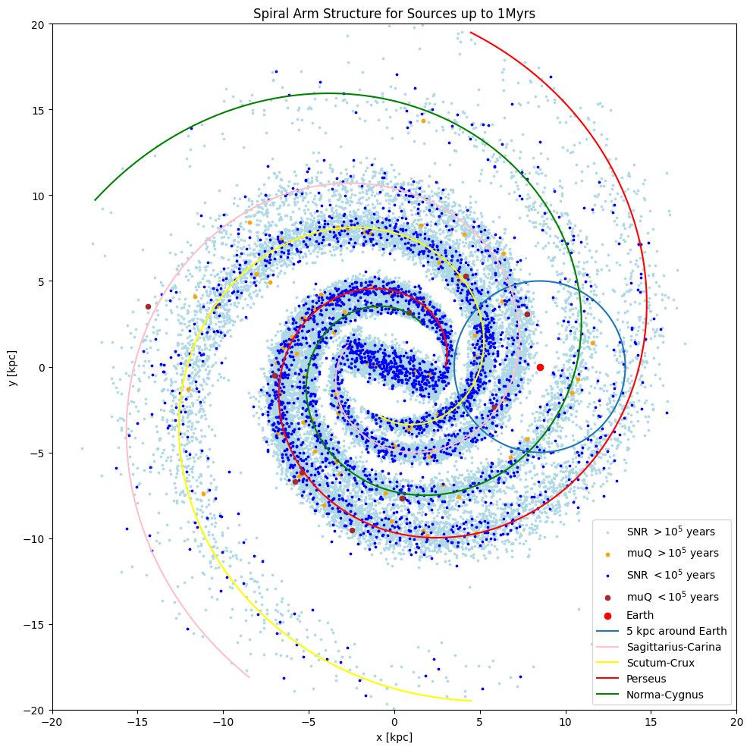
The Sources
We don’t know all sources ⇒ 2 approaches
Smooth source approximation, classic but misses stochasticity
Monte Carlo simulations
SNRs dominate below ~ 50 TeV and μQS above that
Different source properties and lifetime, but same spatial distribution
Included spiral arms for more accurate approximation of galaxy
Galactic factories of cosmic-ray electrons and positrons

Slide 5




Propagation - Diffusion and Causality
Limiting Propagation Speed
Valid at long times
Acausal tails
Bookkeeping variables
1610Tautz_2834_2015-0109.dvi
Free escape boundary n(z=±H) = 0, use mirror charge method

Slide 6
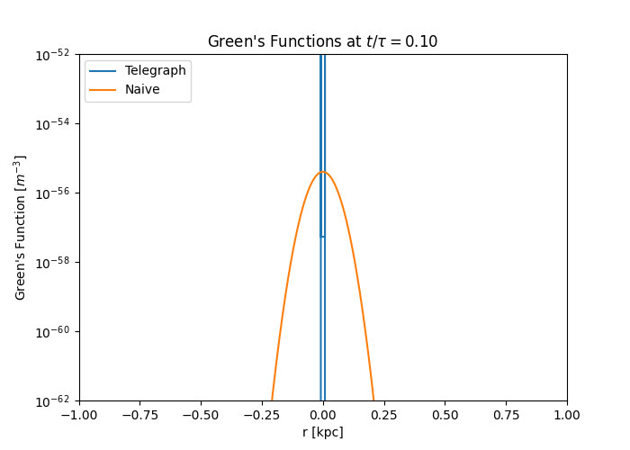
Green’s Function in Action
Pure diffusion violates causality
If most sources lie in diffusive regime ⇒ safe
Huge difference at small times (could be long for large E)
Ballistic domination ⇒ feature?
Notes:
At 1 PeV tau about 300years

Slide 7
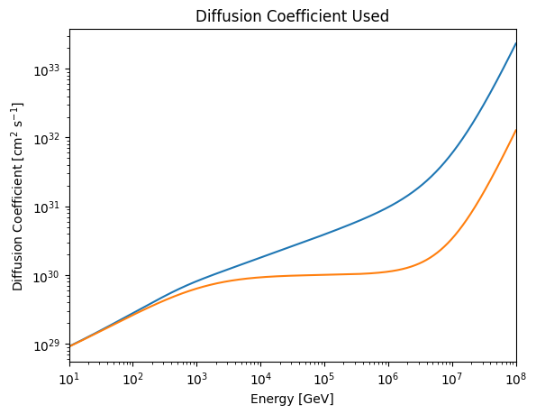

Diffusion Coefficient
< 1 TeV fitted from B/C and ¹⁰Be data
> 1 TeV poor constraints, choice:
Kolmogorov (classical)
Flat / Energy independent (no parallel modes)
Above ~ 10 PeV, r_{g}≈ l_{c}, we get E² diffusion
Origin of the spectral features observed in the cosmic-ray spectrum
Galactic factories of cosmic-ray electrons and positrons

Slide 8





Flux Calculation
10⁵¹ ergs for SNR
Source term
Flux calculation
Monte Carlo: draw position from 𝜌, age uniformly, for muQs draw Luminosity
Parameters: ⇒ Fit to DAMPE, LHAASO
Fraction of Hillas Criterion

Slide 9
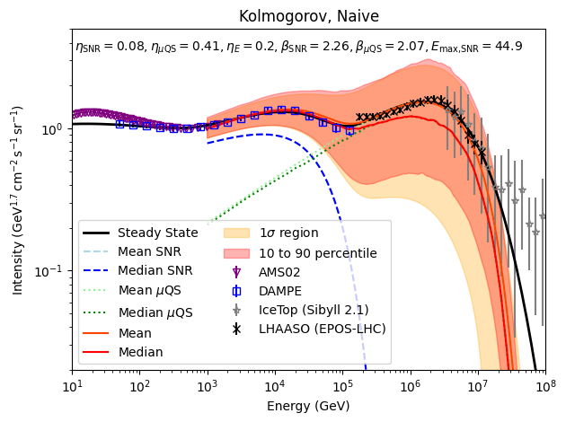
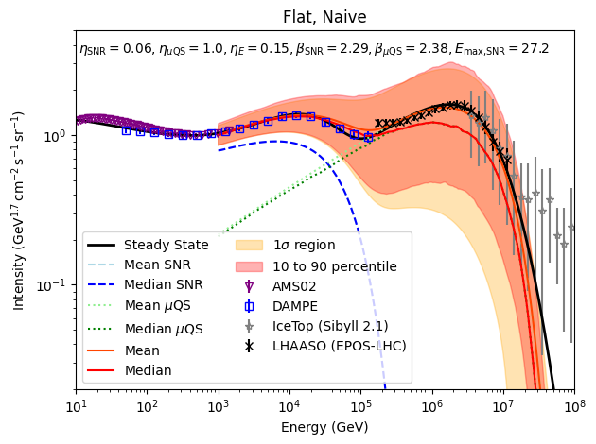
Results - Diffusion
Large, fast escape
Large, soft injection

Slide 10
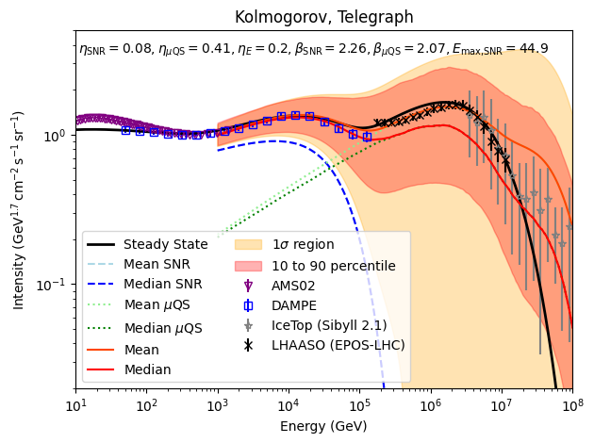
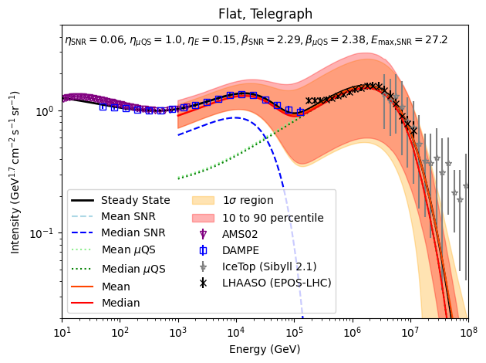
Results - Telegraph
New feature due to ballistic transport
Slightly larger here

Slide 11
Results - Ballistic Transport Effects
Ballistic transport, becomes important when H²/D ~ H/c, at high energies
Not present in flat diffusion case since D is still small

Slide 12
Dipole Anisotropy

Slide 13



Anisotropy Definition
Define as . Up to normalisations n and flux are the same.
Look at , identify
For telegraph equation , finite speed is included as well
Generally: more sources towards galactic centre ⇒ dipole points towards GC
Unused, computationally expensive and effect is ~ 1%

Slide 14
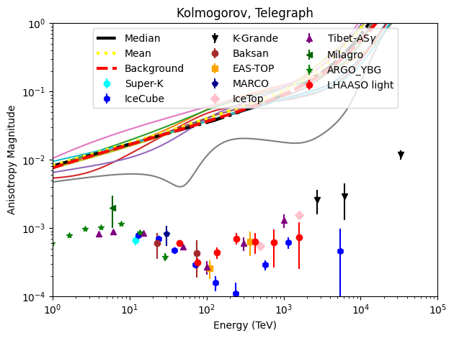
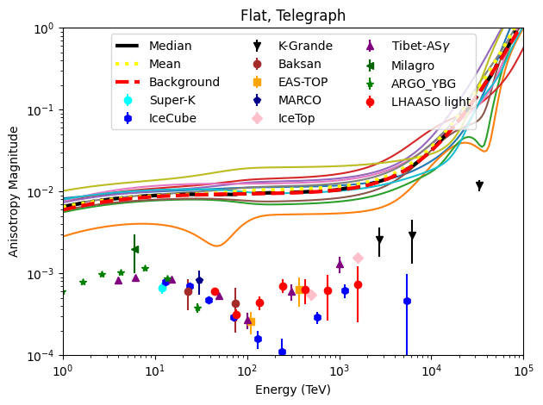
Results - Magnitude
Sum of background and fluctuations (very important)
Way too large compared to observations - even background is too much
Dip at ~ 100 TeV not reliably reproduced, but possible

Slide 15
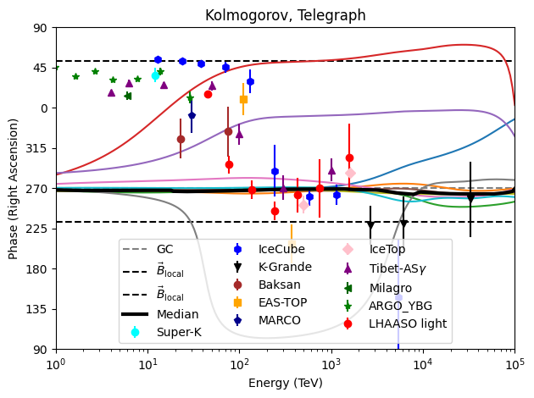
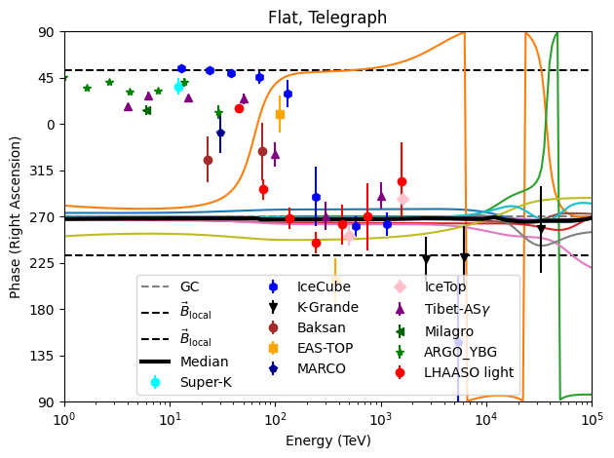
Results - Phase (Right Ascension)
Local magnetic field (49º)
Generally point toward centre, as expected, but don’t match observations
Large fluctuations due to nearby young source
Dip in magnitude correspond to phase reversal

Slide 16
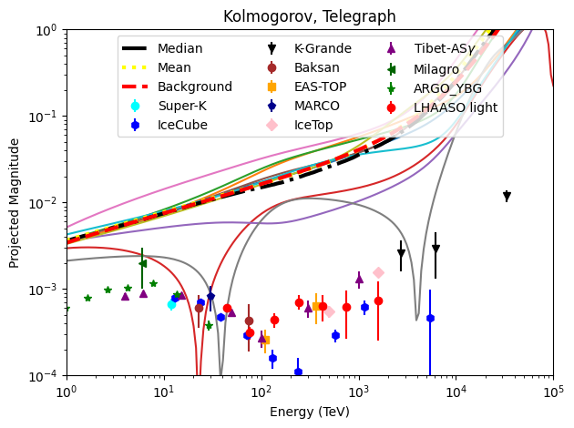
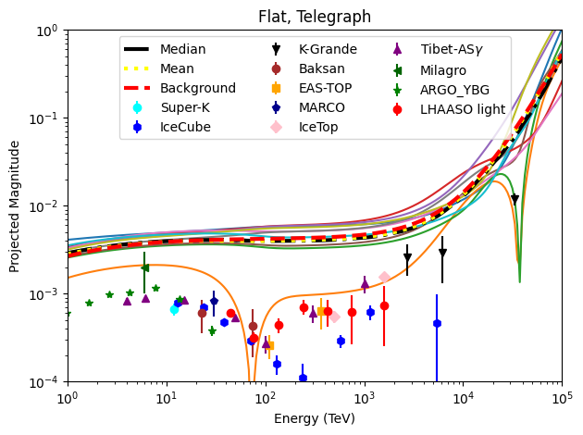
Projection onto Local Magnetic Field
Extremely anisotropic D (only parallel to B)
More dips since phase reversal (49º) easier to come by
Magnitude still too large - maybe suppressed D locally?

Slide 17
Conclusion
Proton Flux:
Microquasars together with SNR can reasonably reproduce the observed proton flux
Causality and corresponding ballistic transport need to accounted for; telegraph equation shows a feature at ~10 PeV
The “knee” is mainly due to propagation effects: transition to E² diffusion
Dipole Anisotropy:
Dipole anisotropy consists of background and fluctuations
Background already exceeds observations; fluctuations may reduce magnitude, but rarely seen
Projection onto local magnetic field explains dipole phase and makes dips in magnitude more common, but background points to the “wrong” side

Slide 19
Publication and Participations
Publication
Contribution of μQS to Galactic cosmic rays - in preparation
Participation
School
  Advances in Modeling High-Energy Astrophysical Sources: Insights from recent multimessenger discoveries” - Oral Presentation
  5th Graduate School on Astro-Particle Physics” - Poster
Conference
  29th European Cosmic Ray Symposium (ECRS2026) - Oral Presentation
  9th Heidelberg International Symposium on High-Energy Gamma-Ray Astronomy - Poster

Slide 20
Backup Slides

Slide 21
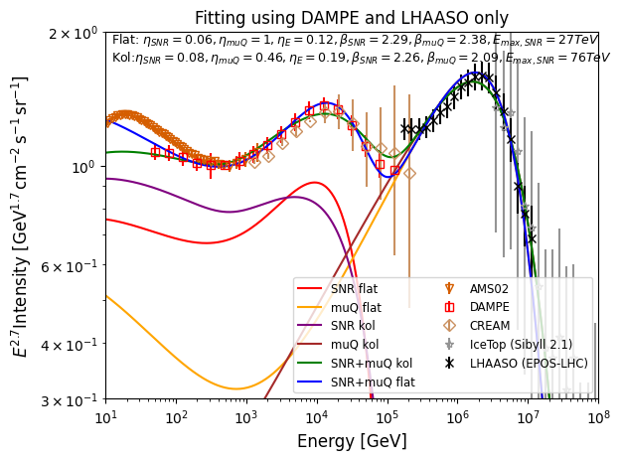
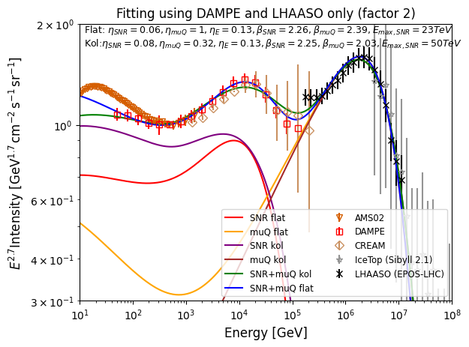
Fit Plots
Extended to lower energies and zoomed in
Included also possibility for E_{max,SNR} to change
All 𝛘²/d.o.f < 1on total error, reasonable fits

Slide 22
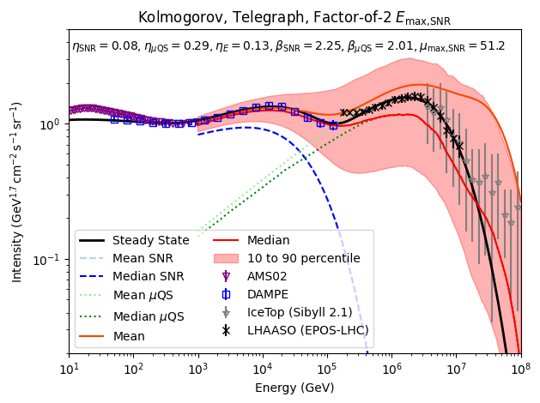
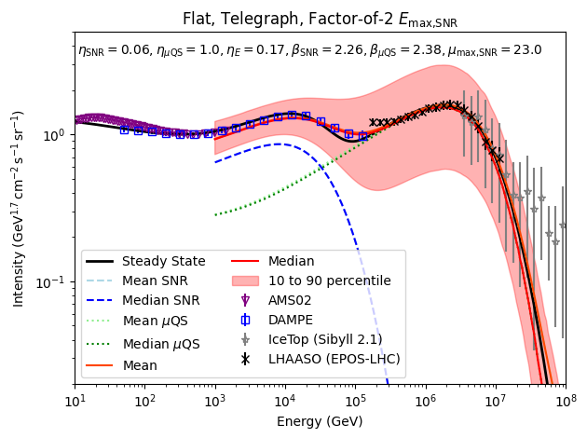
Results - E_{max,SNR} Vary by Factor 2
Not much changed, still good fit
Slightly lower μQS efficiency needed, but still high

Slide 23
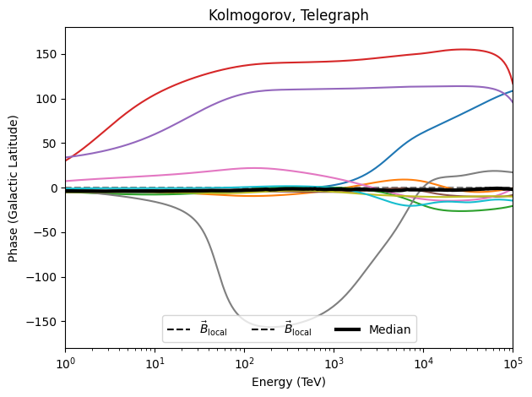
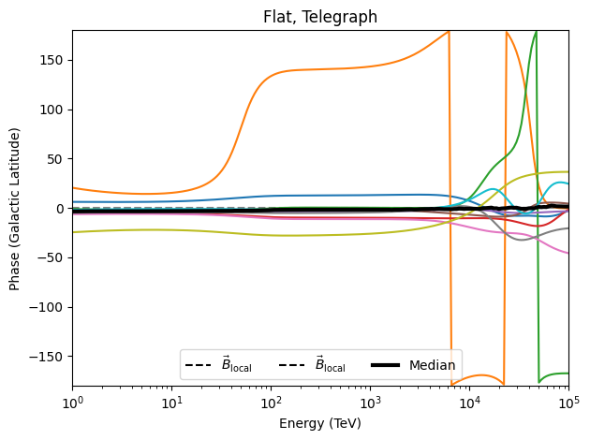
Results -Phase (Galactic Longitude)
Basically the same as right ascension, but shifted due to tilt

Slide 24
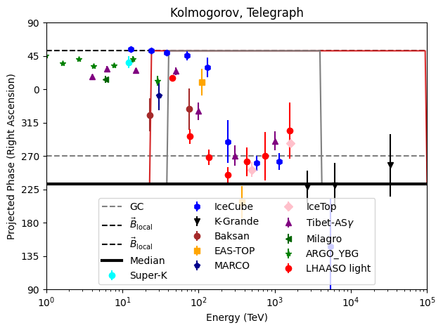
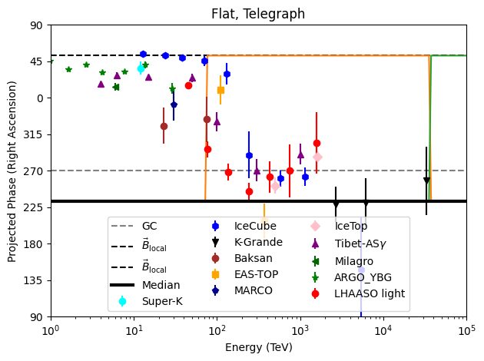
Results - Projected Phase (Right Ascension)
Uninteresting since its one way or the other
Phase flip ↔ Dip in dipole
Mostly still wrong direction at lower energies

Slide 25
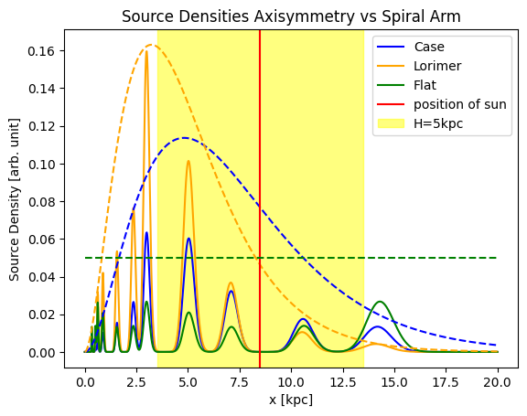
Source Distributions
Lorimer used for MC simulations
Solid lines are with spiral arms, dotted lines are axisymmetric case
Imbalance between sources between left and right of the red line within shaded region leads to dipole
Without spiral arms its large, including spiral arms further enhances the dipole

Slide 26
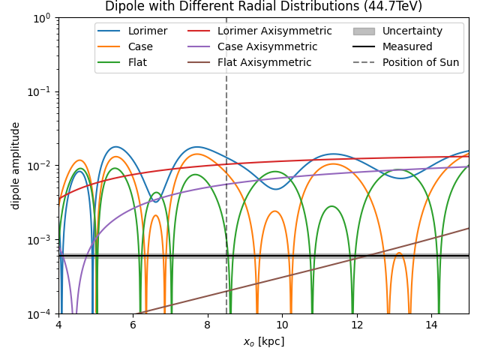
Position of Observer - Background
Lorimer the default distribution - no phase flip
Flat and Case - phase flip for tiny dipole - solution for magnitude?
Spiral arms strongly modulate the magnitude but minima non-trivial

Slide 27
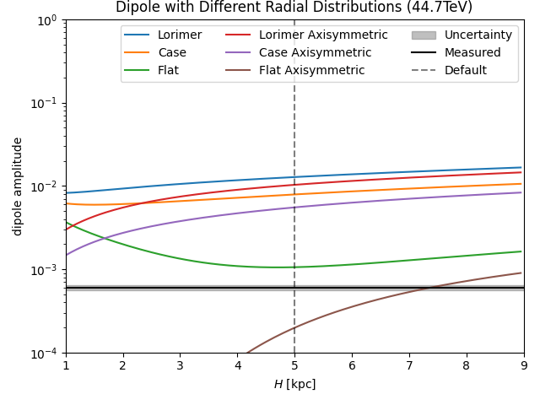
Halo Height - Background
Even with small H dipole exceeds observations (sun position)
Isotropic distribution dipole comes from edge of galaxy effect

Slide 28
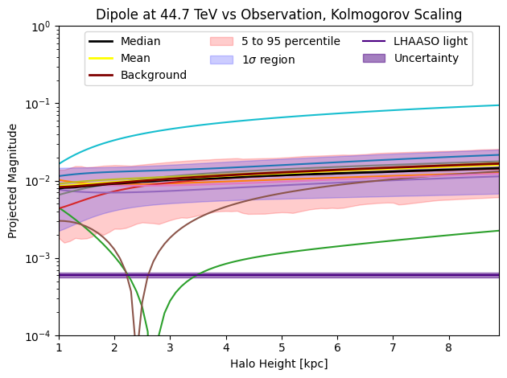
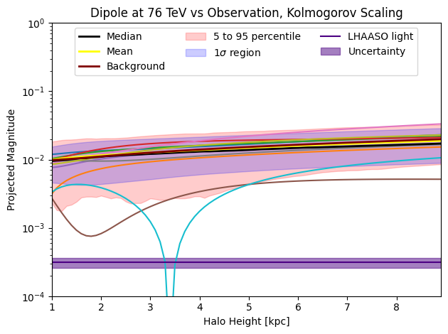
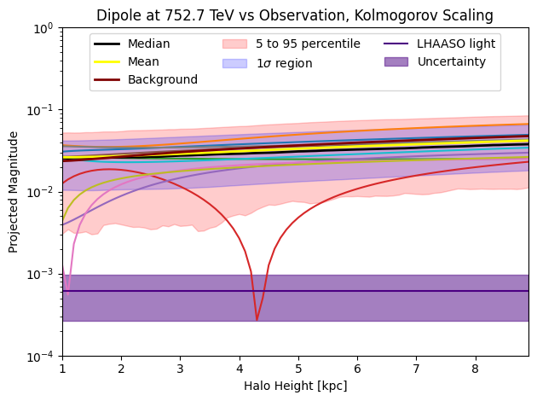

Integral vs Monte Carlo
Nearby sources much more important for dipole than for flux
Integral only captures the background dipole due to 𝜌
Actual dipole is sum of background and fluctuations (only seen in MC)

