Slide 1
CE Straylight Control
XGCD Part II
Antonios Kontos + CE Team, 2024-04-22

Slide 2
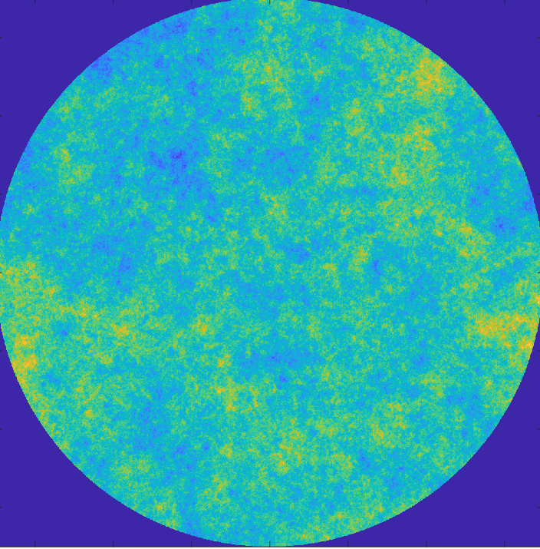
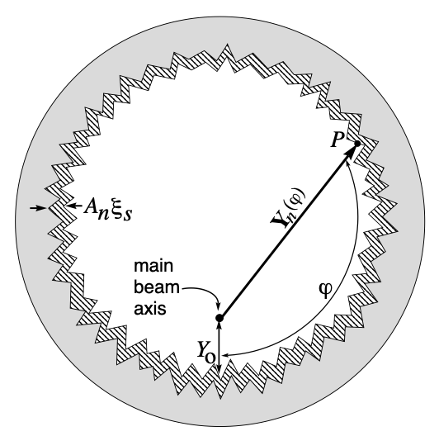
CE Investigations
Noise dependence on
Maps
Serration
Beam offset
Baffle configuration
…
Validation

Slide 3
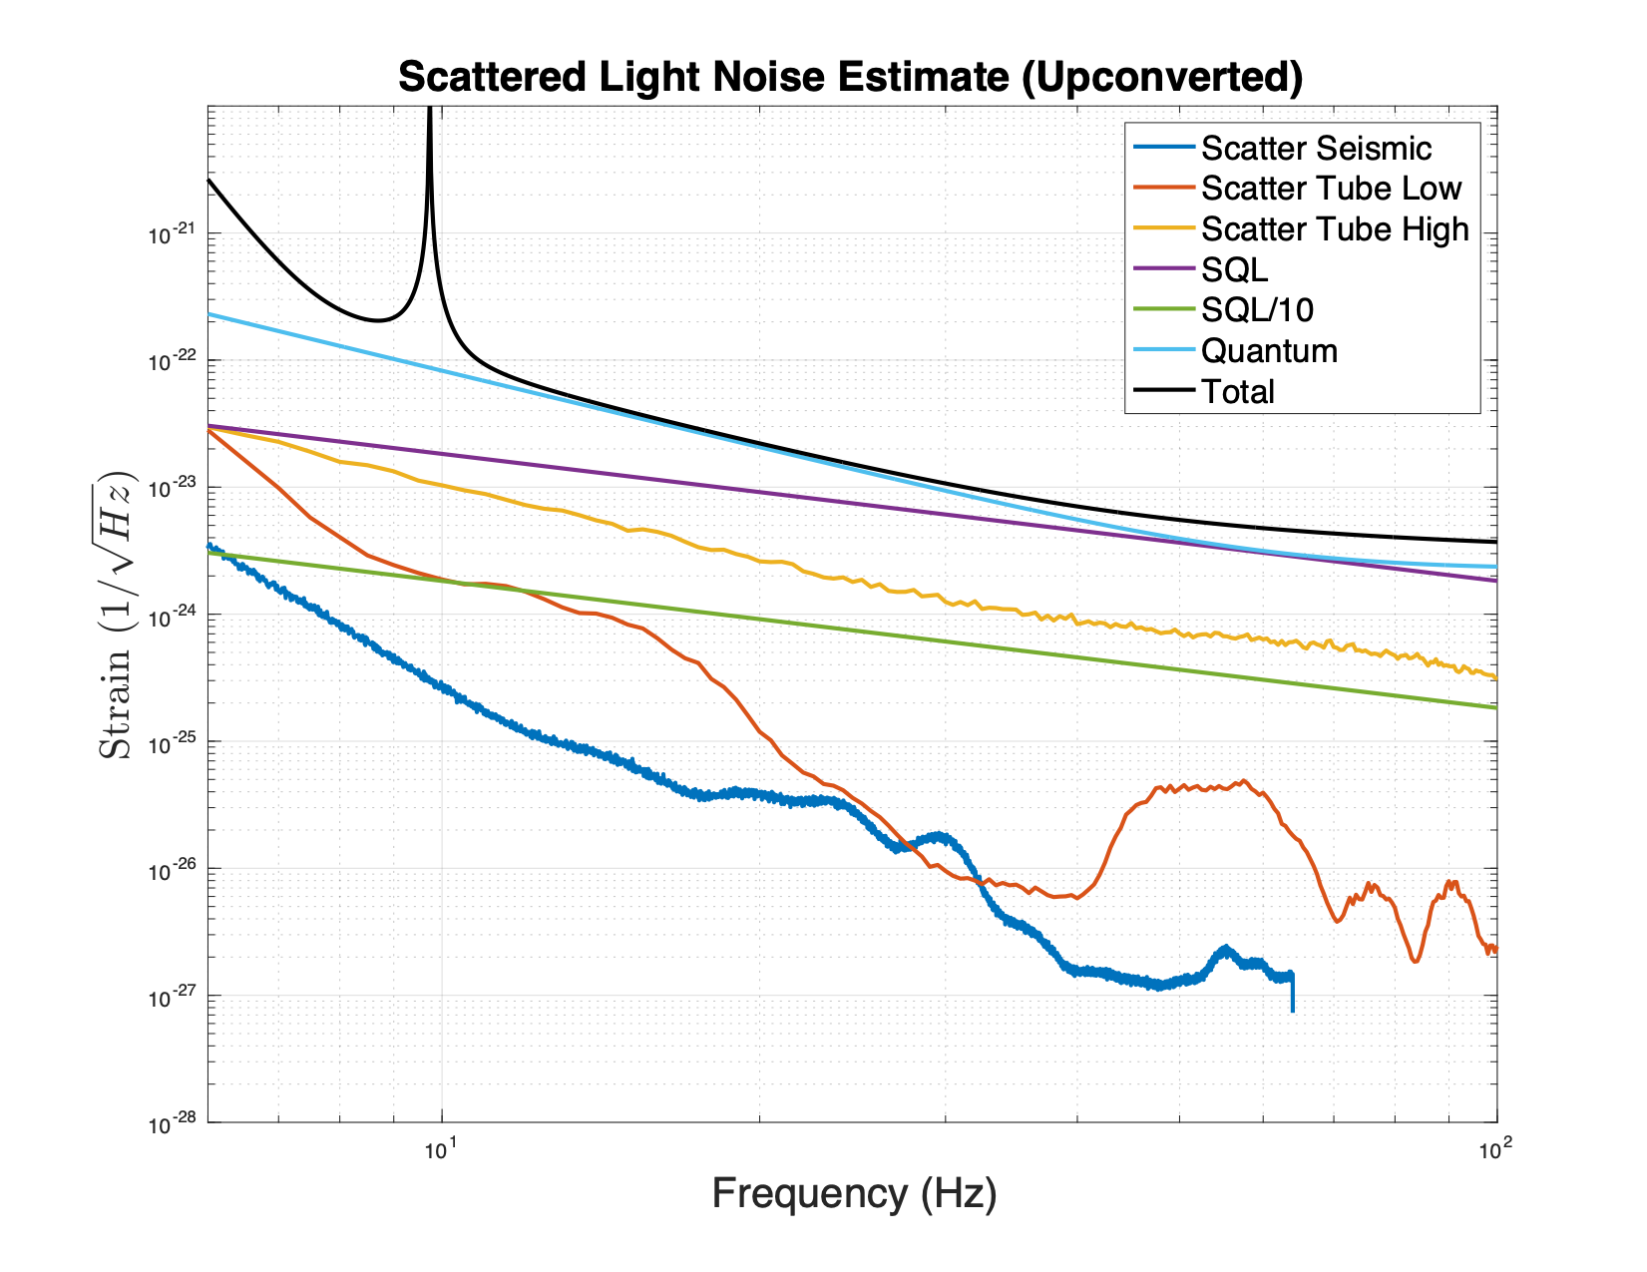
Validation Efforts of Scattered Light Noise Estimation
Goal is to compare our noise estimates of the scattered light noise in LIGO with measurements taken at the sites.
Input LIGO parameters
Baffle Locations
Material BRDF
LIGO Mirror Maps
The largest uncertainty for now is the transfer function between beam tube excitation and baffle motion

Slide 4
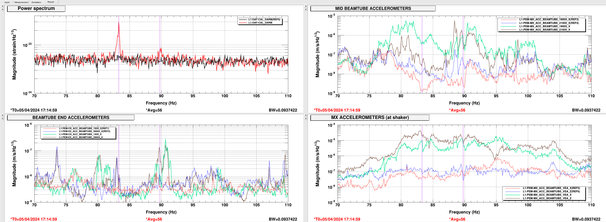
Validation Efforts of Scattered Light Noise Estimation
First Scattered Light Noise (possibly) from Beam Tube Baffles seen at LLO!
Noise injected on beam tube.
More measurements in the coming months.
LIGO Livingston aLOG
2024-04-05 Millie, Anamaria, TJ

Slide 5
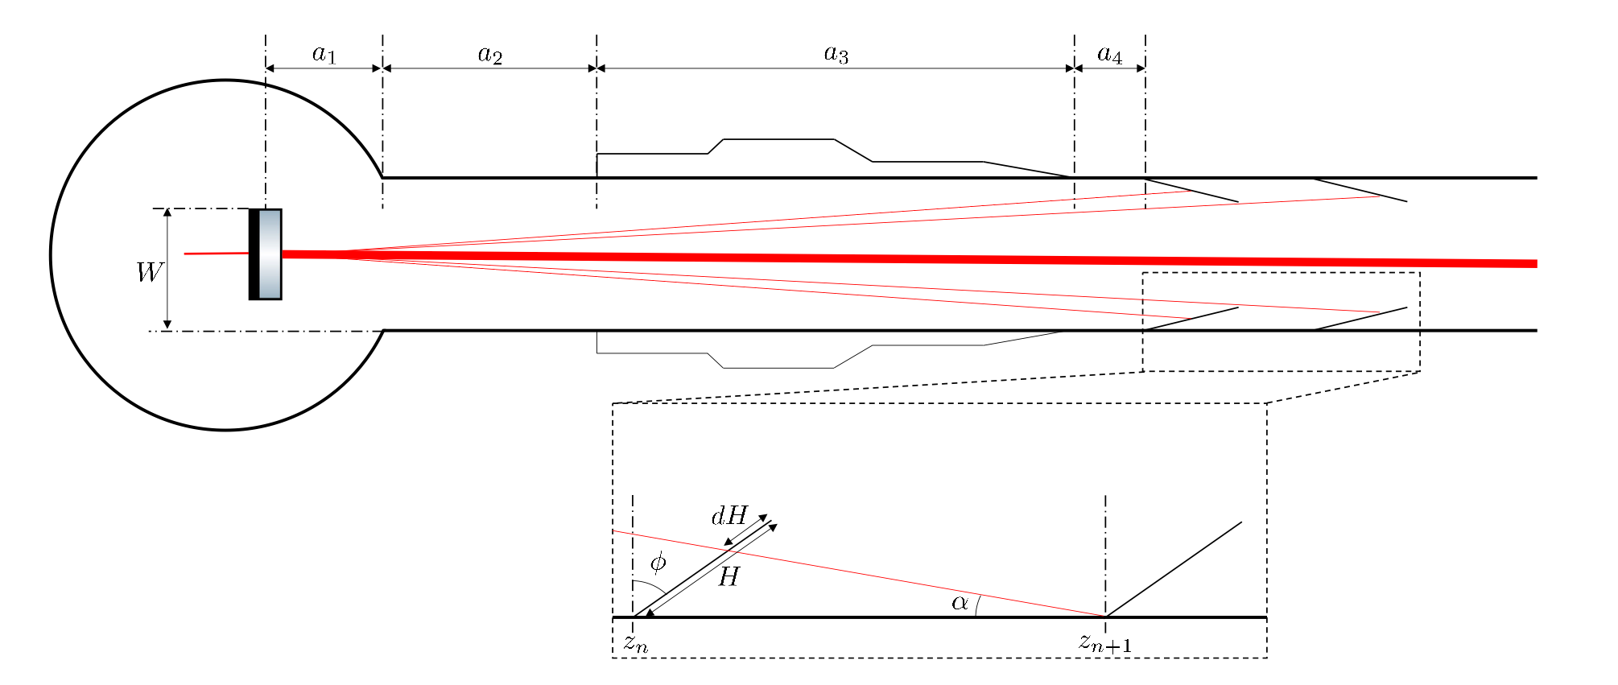
Baffle Locations: Going beyond ray optics
Traditional approach to the placement of baffles is to use ray optics and try to shadow the entire beam tube.
Another approach is to use SIS to calculate the wave propagation and calculate the power on the beam tube between baffles, and try to keep it below a given threshold
Ray Optics
Marc Andres-Carcasona Phys. Rev. D 108, 102001

Slide 6
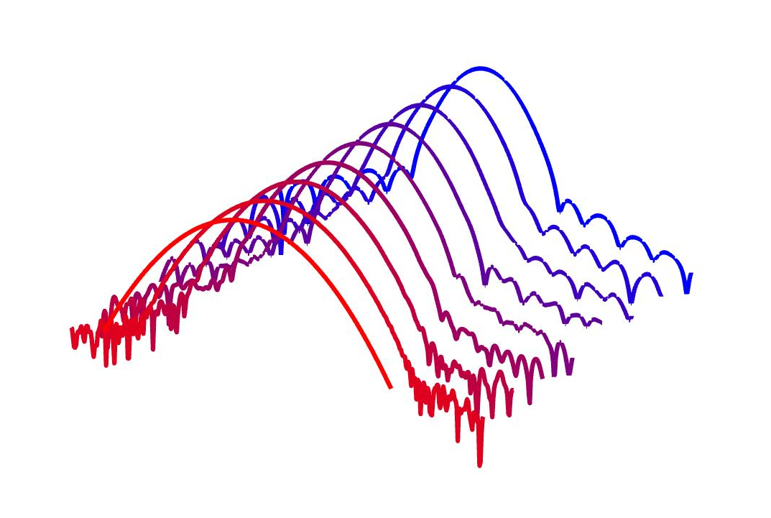
Baffle Locations: Going beyond ray optics
Traditional approach to the placement of baffles is to use ray optics and try to shadow the entire beam tube.
Another approach is to use SIS to calculate the wave propagation and calculate the power on the beam tube between baffles, and try to keep it below a given threshold
Next
Previous
Field on
tube
Wave Optics
Beam

Slide 7
Baffle Locations: Going beyond ray optics

Slide 8
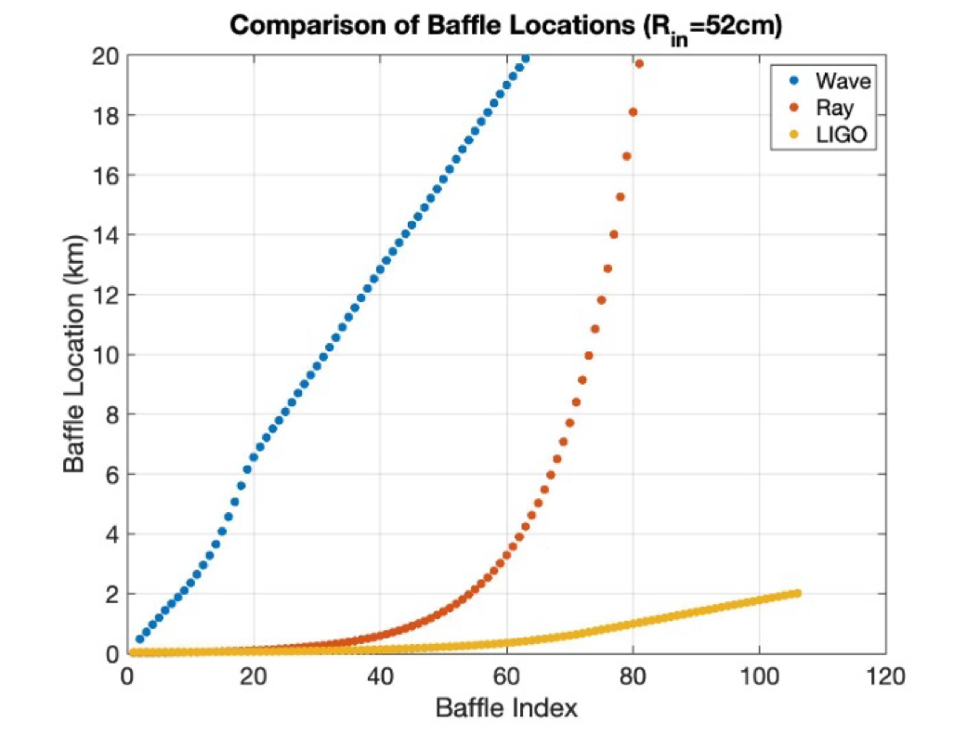
Baffle Locations: Going beyond ray optics
The two approaches can give very different locations for the beam tube baffles.
The wave optics approach places the baffles in nearly equal distances.
This is a reasonable result considering how collimated the resonating beam is.
Care should be taken for the placement of baffles close to the Test Masses, since large angle scattering from defects (which are not included in this study) may require different baffle placement.
We can use SIS for a reasonable estimate of the impact of large angle scattering

Slide 9
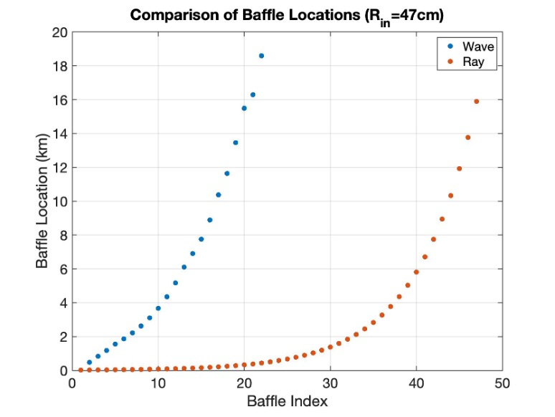
Baffle Locations: Going beyond ray optics
In this case we consider a larger baffle size (from 9cm to 14cm).
Larger baffles reduce the total number required, but can increase the noise.
For 14cm, the wave approach seems to more closely follow the ray approach, except for the baffles closest to the test mass.

Slide 10
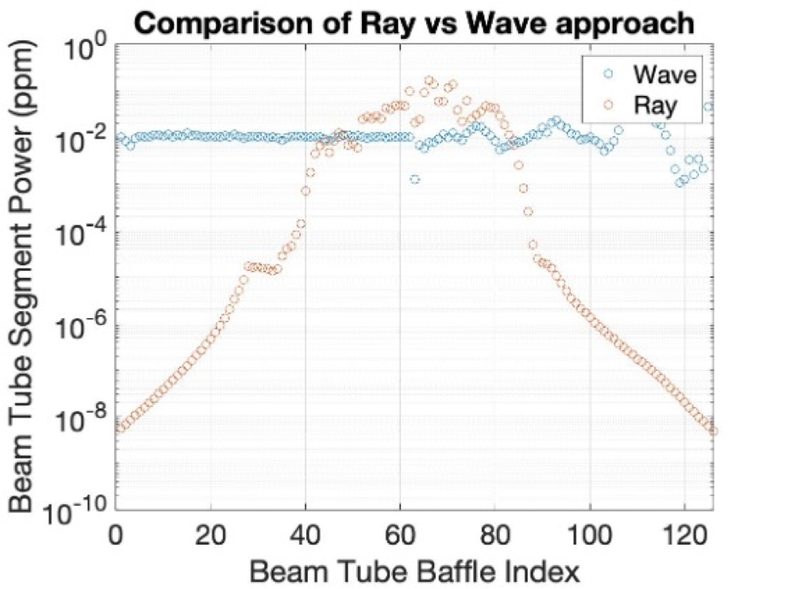
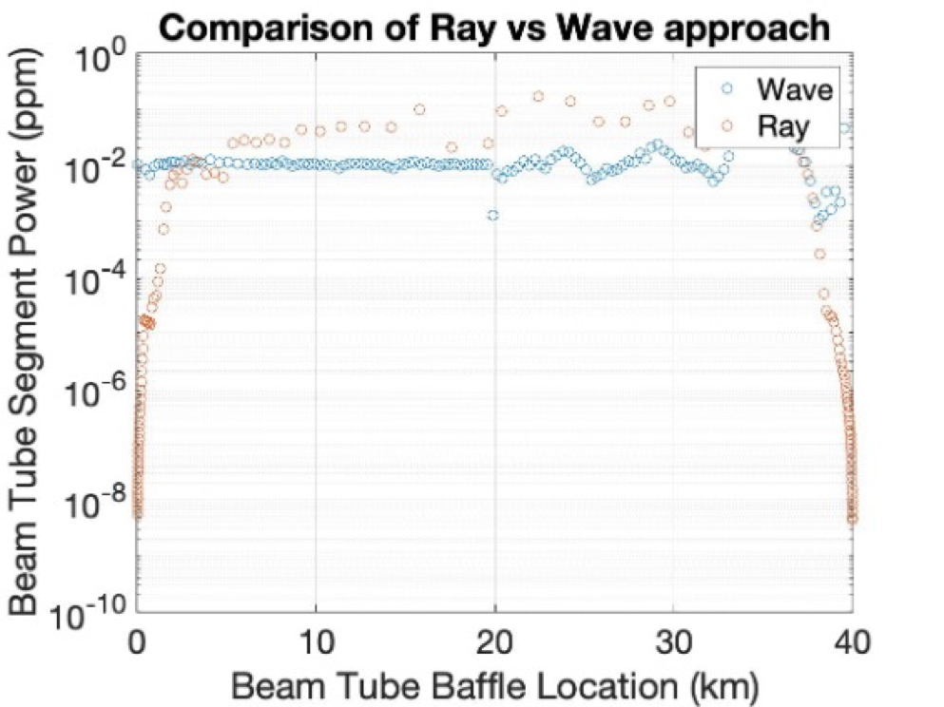
Baffle Locations: Going beyond ray optics
With the location of the baffles fixed, we can use SIS to estimate the power seen by the beam tube in each segment, between baffles.
A big question is: How much light on the tube is too much?
For a 9cm baffle, summing up the power on the tube we get: Wave ~ 1ppm, Ray ~ 2ppm

Slide 11
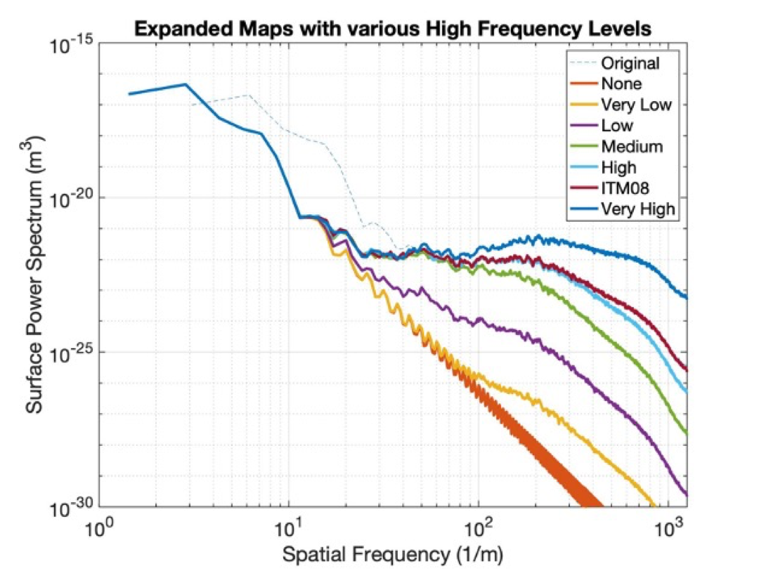
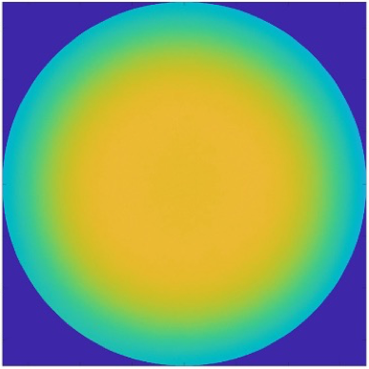
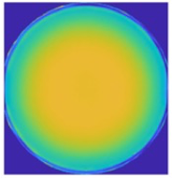
Mirror Surface Roughness Effect on Baffle Noise
We can test how mirror surface roughness affects Baffle noise by creating maps that have similar low frequency characteristics to current test masses, but with different roughness.
In this preliminary study, the ITM08 surface map was expanded and then altered with various levels of surface roughness.
LIGO ITM Surface Map
CE Map Expanded from LIGO Map

Slide 12
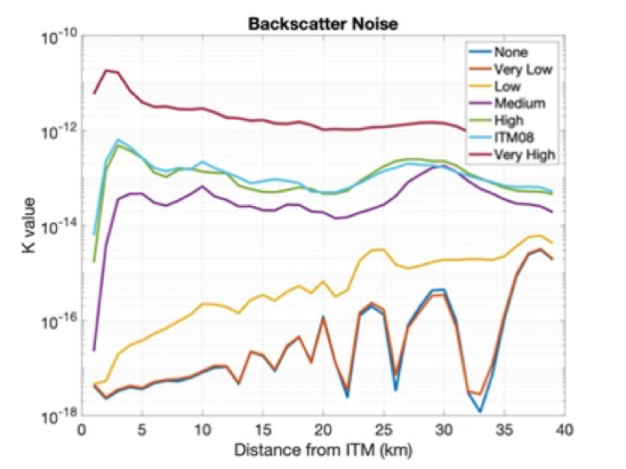
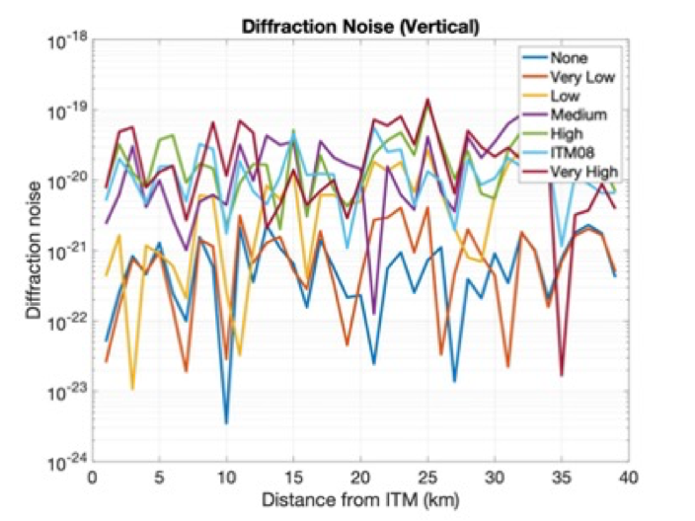
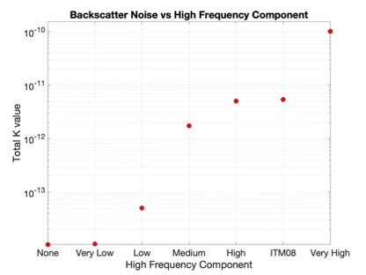
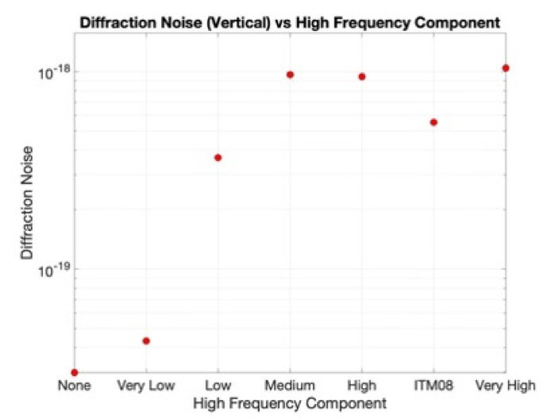
Mirror Surface Roughness Effect on Baffle Noise
For this study, we used SIS to calculate the diffraction and backscatter noise from the baffles.
Various ITM maps were used, while ETM was assumed perfect.
As expected, noise is higher for rougher surfaces.
Backscatter noise is much more dependent on roughness, than diffraction noise.

Slide 13
Thank You!

Slide 14
CE Stray Light General Approach for Beam-Tube Baffles
 | Simplest Baffle Configuration (Unsuspended) | Simple Baffles (With passive isolation) | Variable Size Baffles ( With active and passive isolation)
Optimistic Estimate
Pessimistic Estimate
?
?
?
?
?
?

